Slide 1
Metastability, or Stickman goes to the beach
ATM 210 – Fovell – Fall 2023

Slide 2
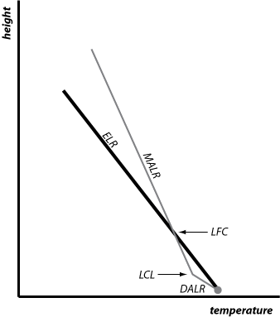
• Lift a moist but subsaturated parcel
• While subsaturated, parcel cools at DALR, faster than surrounding environment
• With enough forced lifting, parcel reaches saturation, though it’s still colder than environment
LCL = cloud base
• After saturation, parcel cools at slower MALR. MALR < ELR.
• Parcel may become warmer than environment. If so, it does so at LFC… after which it would rise on its own
LFC = level of free convection

Slide 3
Stickman kicks an air parcel. A little kick = no cloud

Slide 4
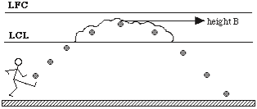
Stickman kicks harder, and makes a little shallow cloud

Slide 5
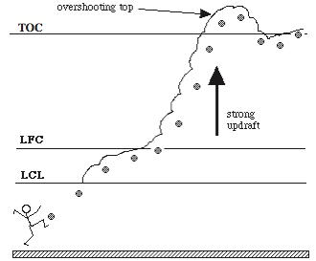
Big kick = reaches LFC = fireworks!
TOC = top of cloud

Slide 6
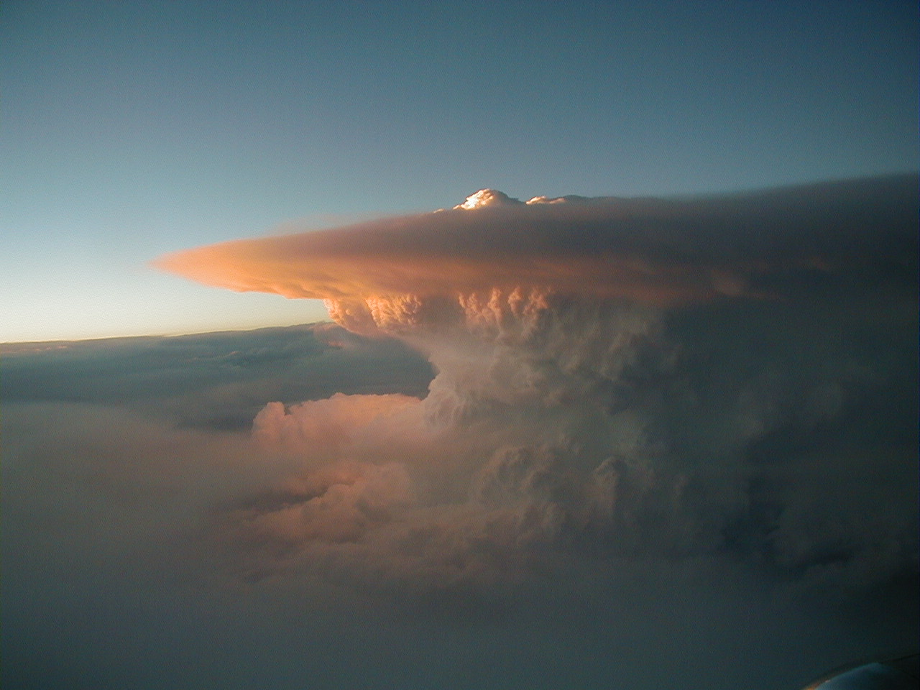
Toes to tropopause in less than 15 min

Slide 7
Three different outcomes from the same environment …
Three different kinds of weather…
depending on the amount of lifting available

Slide 8
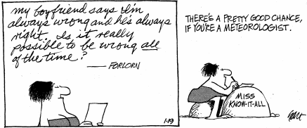

Slide 9
Arago’s admonition
“Never, no matter what may be the progress of science, will honest scientific men who have regards for their reputations venture to predict the weather.” -- Francois Arago (1786-1853)

