Slide 1
Class #1
ATM 240 ~ Fall 2022
Robert Fovell
rfovell@albany.edu

Slide 2
Course resources (also see syllabus)
Jupyter notebook (on reed.atmos.albany.edu or ash.atmos.albany.edu or lore.atmos.albany.edu)
Class web page (syllabus and class materials): http://www.atmos.albany.edu/facstaff/rfovell/ATM240
Zoom meetings: access & archive on Blackboard
Lin (2012) book “A Hands-On Introduction to Using Python in the Atmospheric and Oceanic Sciences” [“Lin-2012”]
  Link on class web page. Needed updating for modern Python 3. The copy I provide has alterations and notes added.

Slide 3
Packages used this term (subject to change)
numpy [arrays and operations]
math
matplotlib [plots]
cartopy [map making]
pyproj [map projections]
metpy [soundings, plots, cross-sections, units, more]
siphon [data ingestion]
scipy [smoothing, interpolation]
pandas [database]
xarray [database]
cfgrib [dealing with GRIB data]
shapley [cartographic objects]
datetime
os, sys, glob [operating system hooks]
mpl_toolkits [plot tricks]
random
netCDF4 [dealing with netCDF files]
sklearn [stats and machine learning]
bold = may not be part of a default python 3 install

Slide 4
For next class
Start reading Lin-2012 Chapter 3. Get as far as you can. Reading for understanding is best but reading for familiarity will help a lot.

Slide 5
Jupyter notebook server
In your web browser, type
https://reed.atmos.albany.edu:8000
Log in with your UAlbany NetID (lower case!!!!) and password
This should display your home directory, where you can create your Python notebooks. But…
The “atm240” link transports you to /spare11/atm240/yournetid.
Both your home directory and your spare directory are backed up
Backup Jupyter server: replace reed with ash or lore
Notes:
.snapshot does not appear w/ ls –a, but it is there in /spare11/atm240

Slide 6
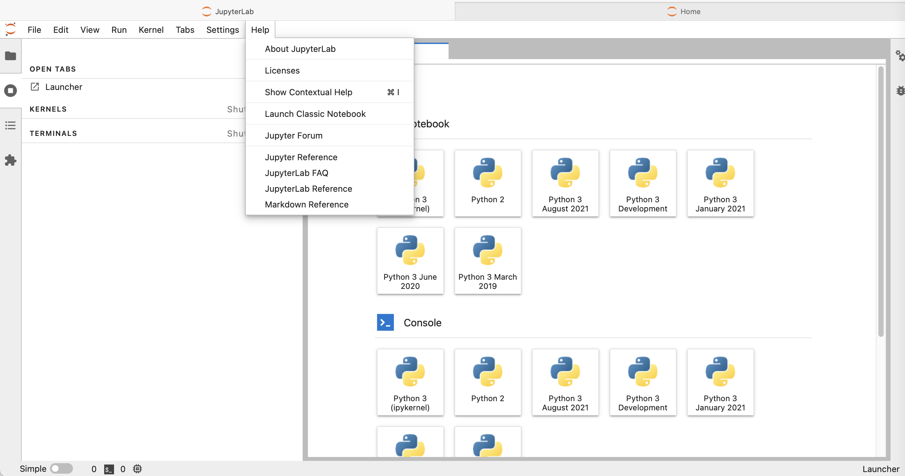
What my start page looks like.
I will move to “Classic Notebook”

Slide 7
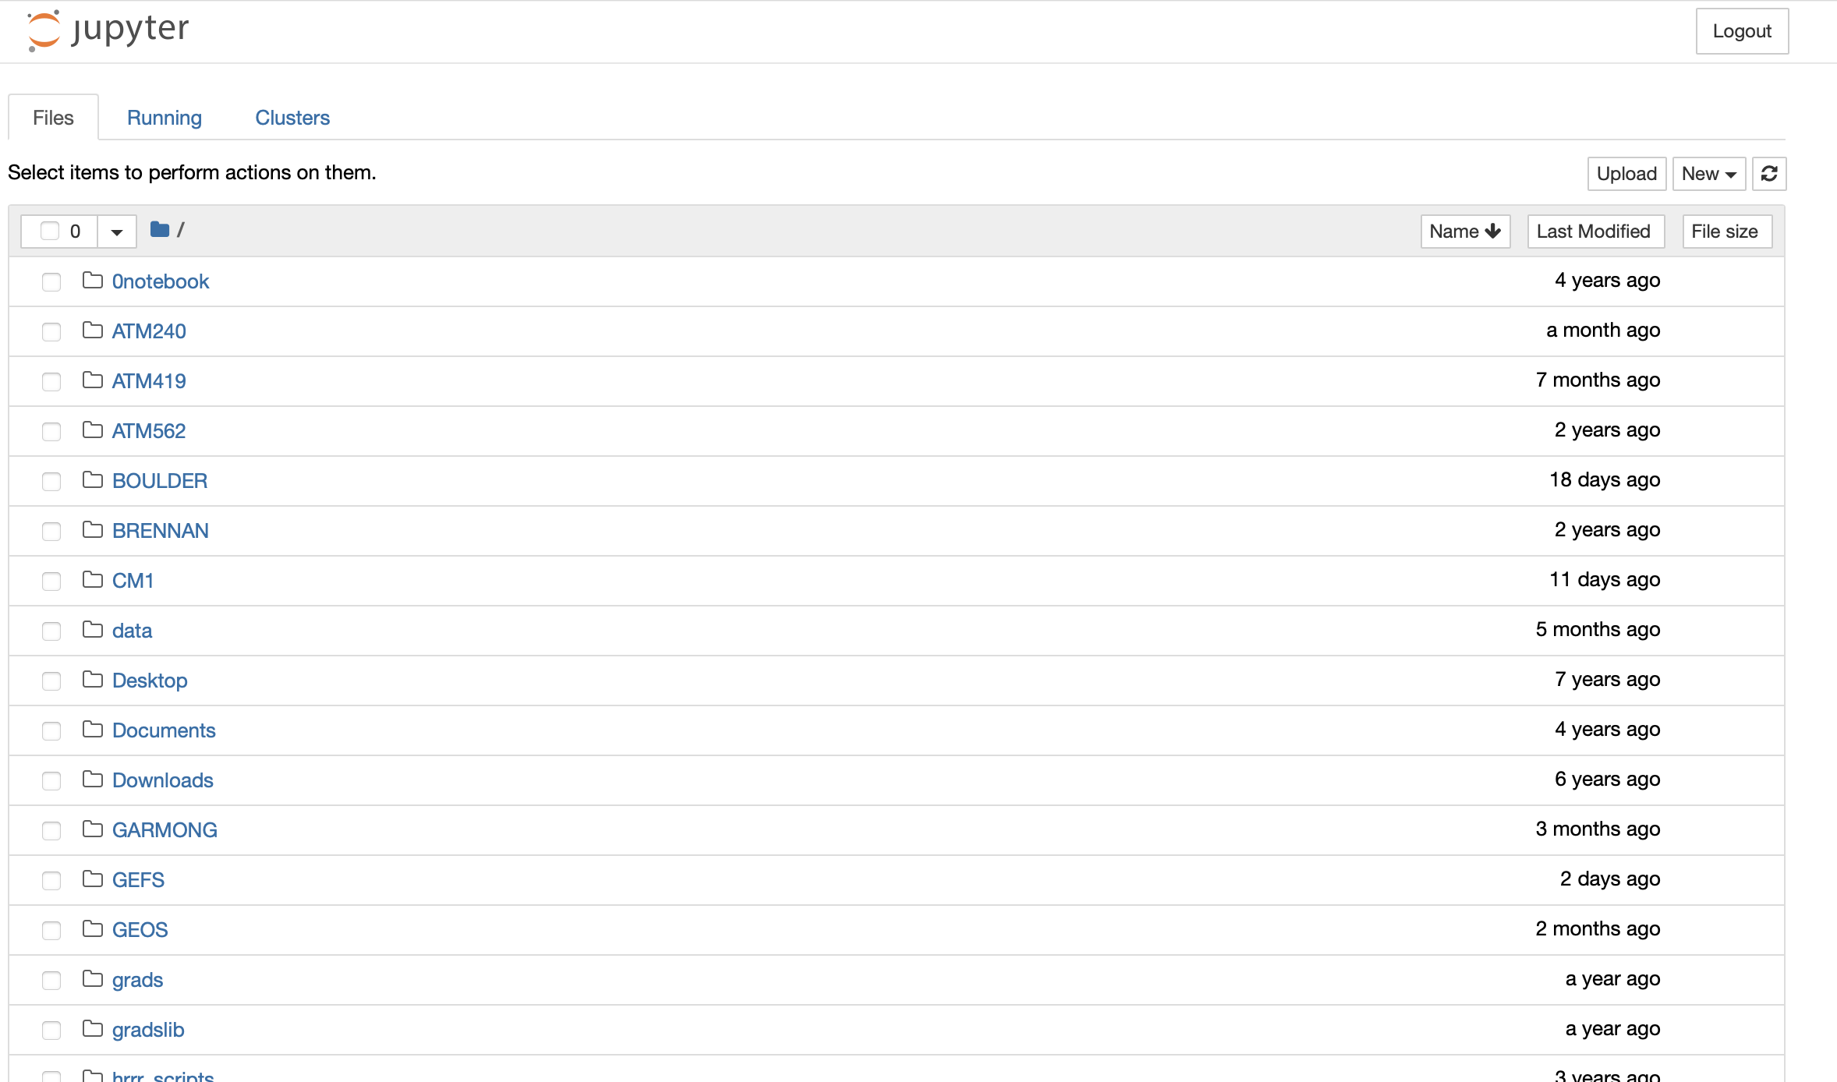
What my home directory looks like… (with Classic Notebook)

Slide 8
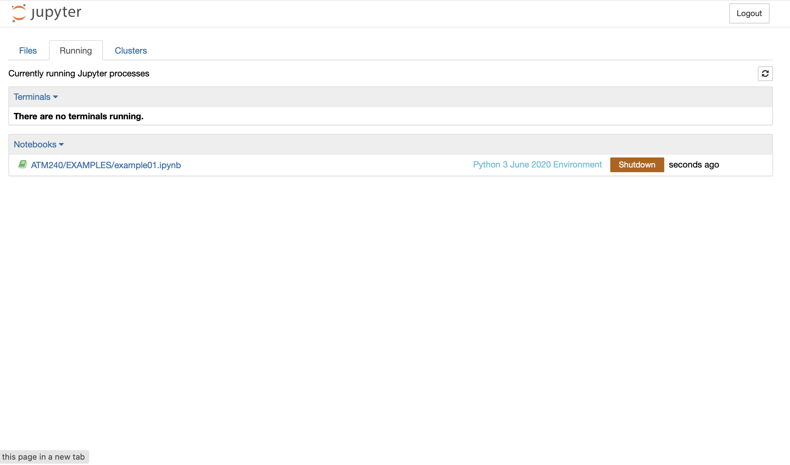
What processes I am running at the moment…
Keep an eye on this because resources are limited

Slide 9
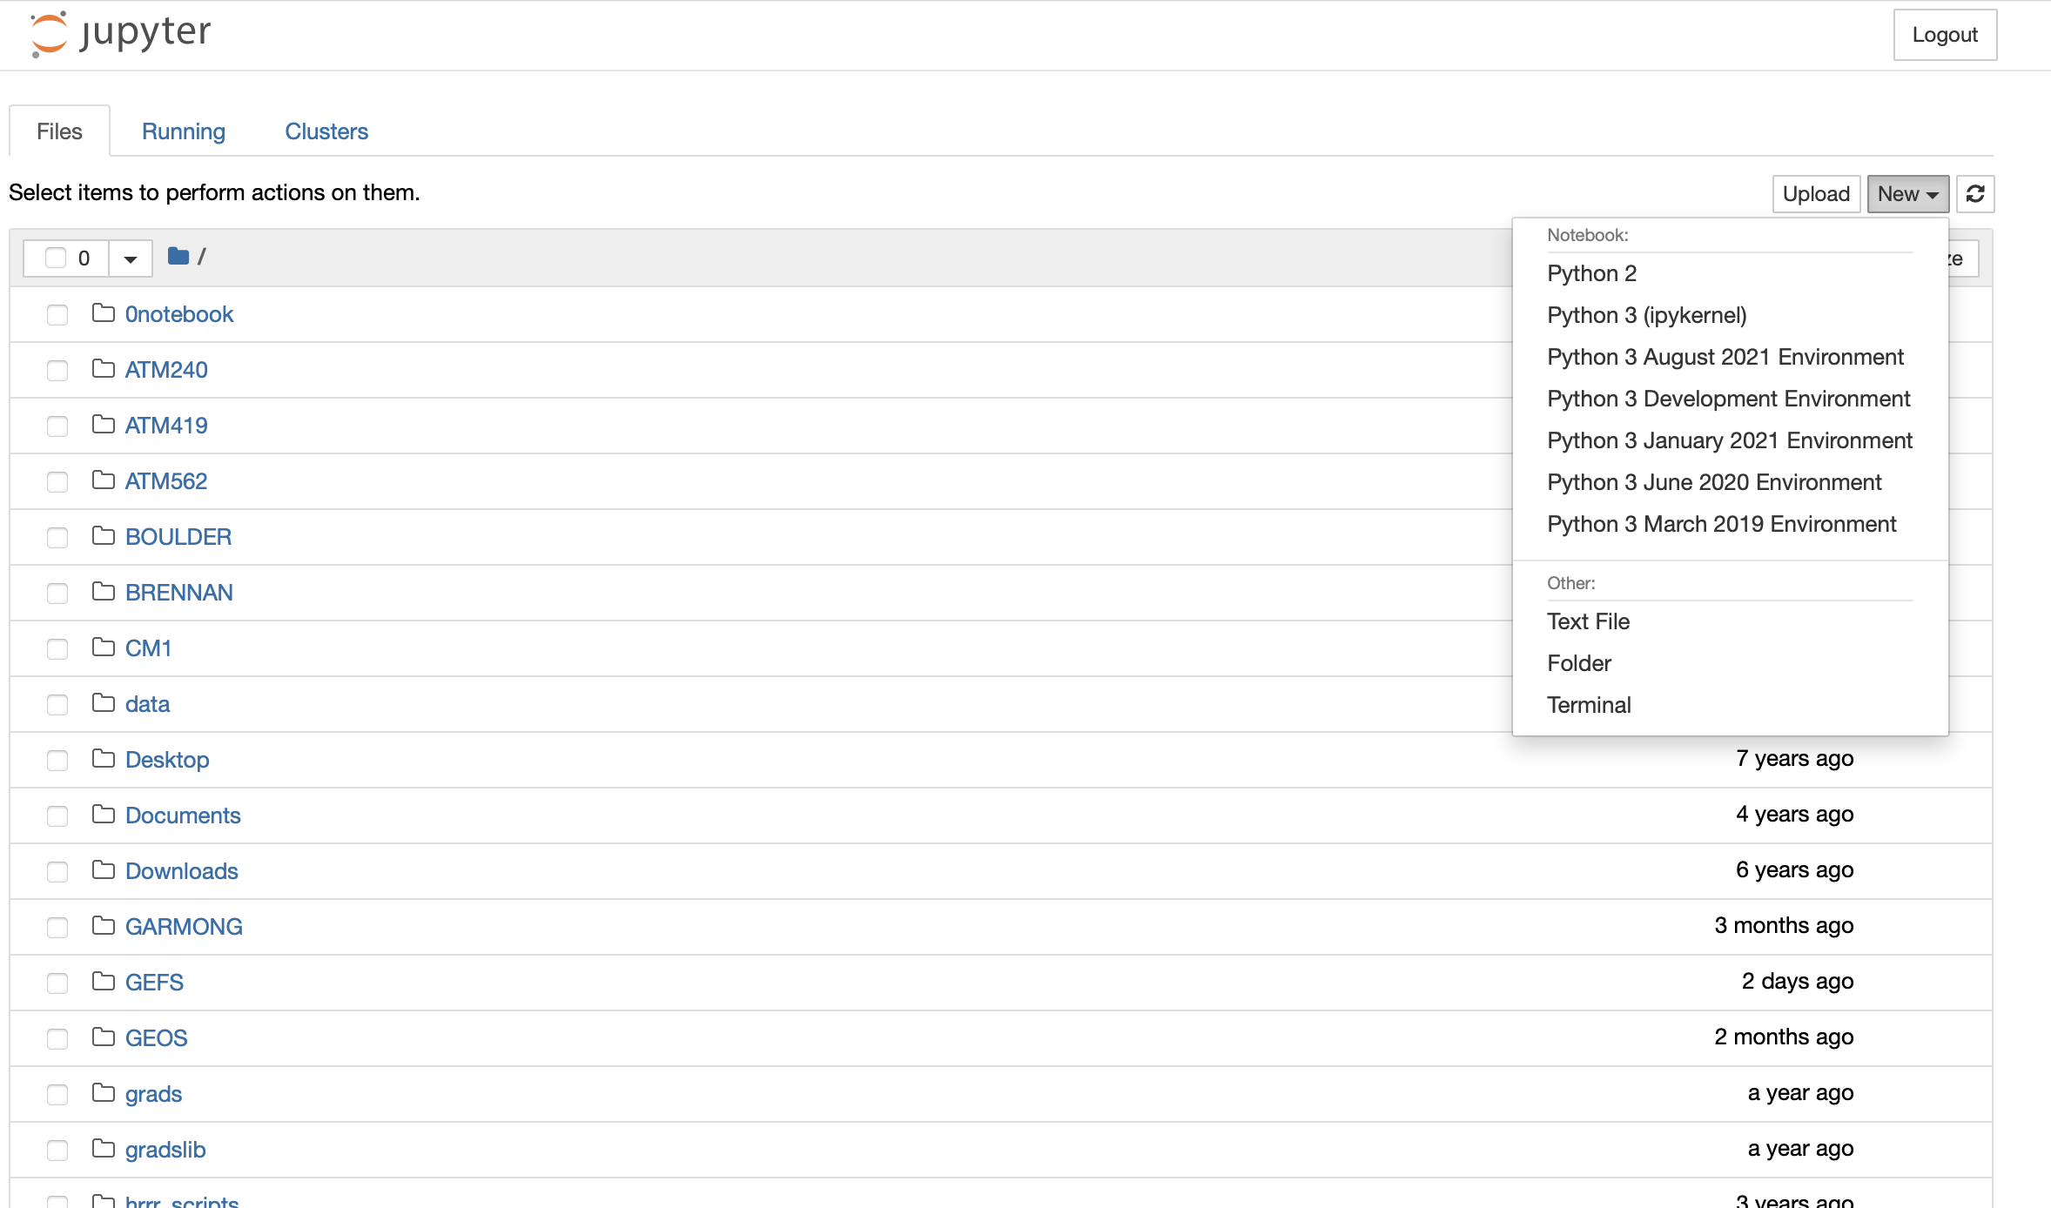
What processes I am running at the moment…
Keep an eye on this because resources are limited
Back in the Files view, select ”New” menu at right. Select Terminal.
This will open a terminal connection on reed in a new window
It will put you in your home directory

Slide 10
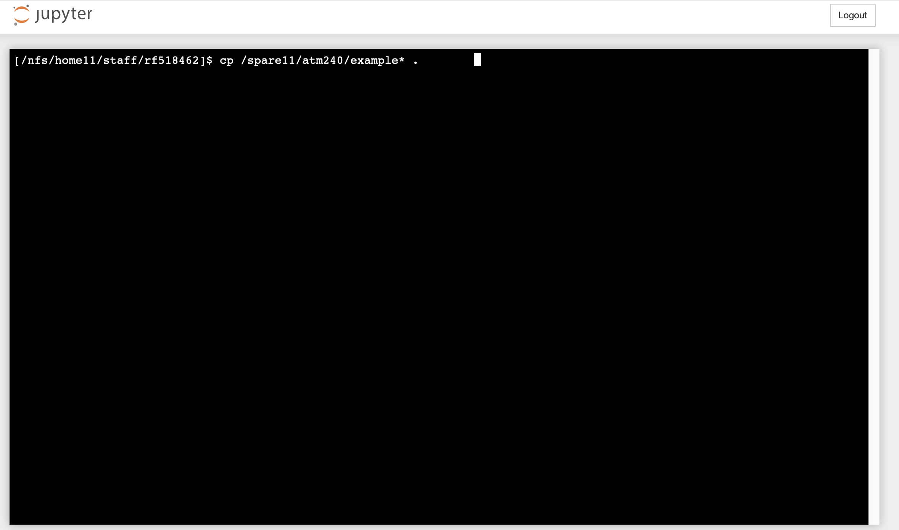
Type this exactly as shown.
Asterisk is wildcard.
Space before period is needed.
Unix/Linux is case sensitive.
“spare11” (the number 11)
cp /spare11/atm240/example* .

Slide 11
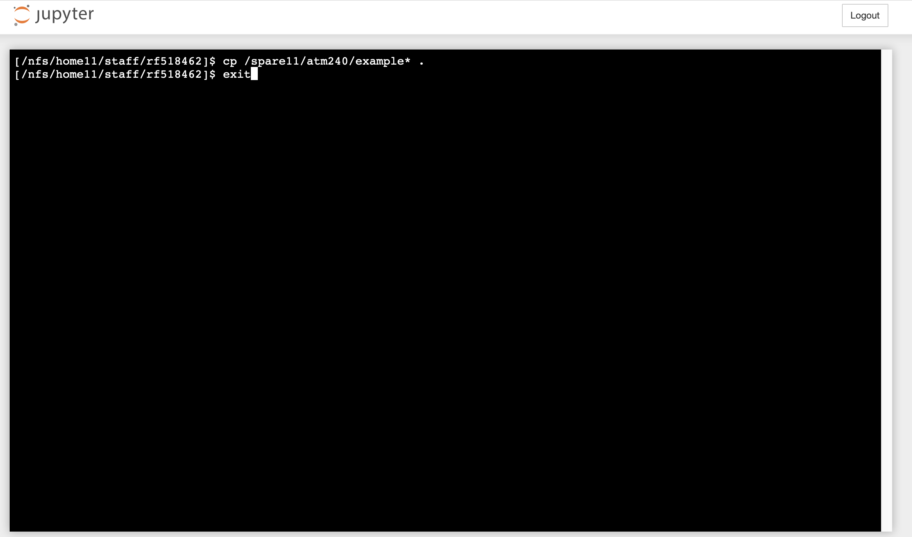
Type this exactly as shown.
Asterisk is wildcard.
Space before period is needed.
Unix/Linux is case sensitive.
Now type exit
When you see [CLOSED] you can close out the tab
Then…
Go back to the browser tab which lists your files (see slide 6)
You should find new files listed your home directory, with names like example*.ipynb
You may need to click the refresh button at upper right
Click on example00.ipynb filename to launch the notebook. It will open a new window
“spare11” (the number 11)
cp /spare11/atm240/example* .

Slide 12
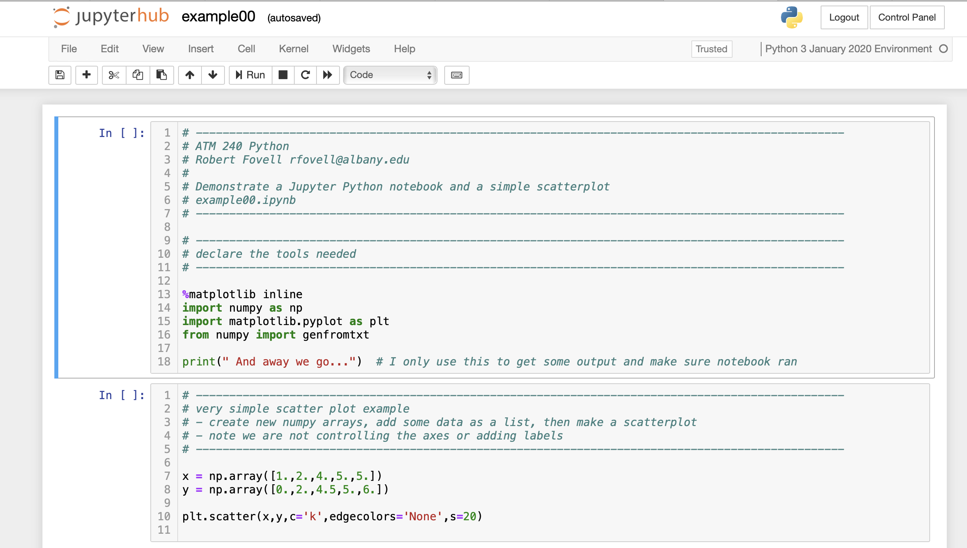
Comments follow # sign
The first cell is the active cell
Click the Run button once.
The first cell code will be executed
Cell #1
Cell #2

Slide 13
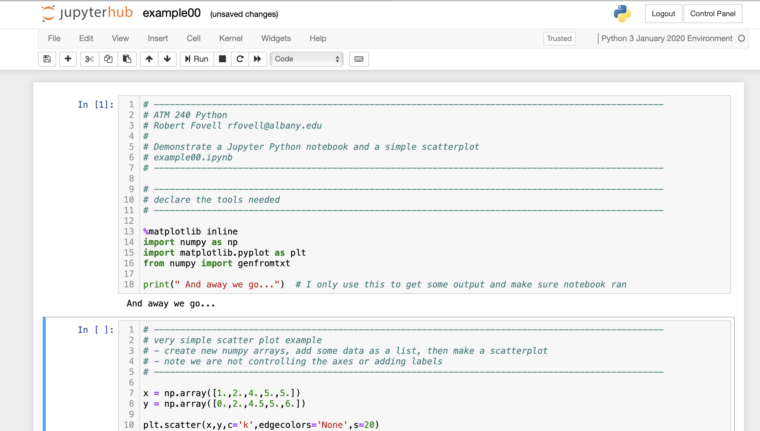
The first cell just does some setup stuff
The print statement helps to confirm the
cell code was executed
The next cell is now primed. Hit Run again.

Slide 14
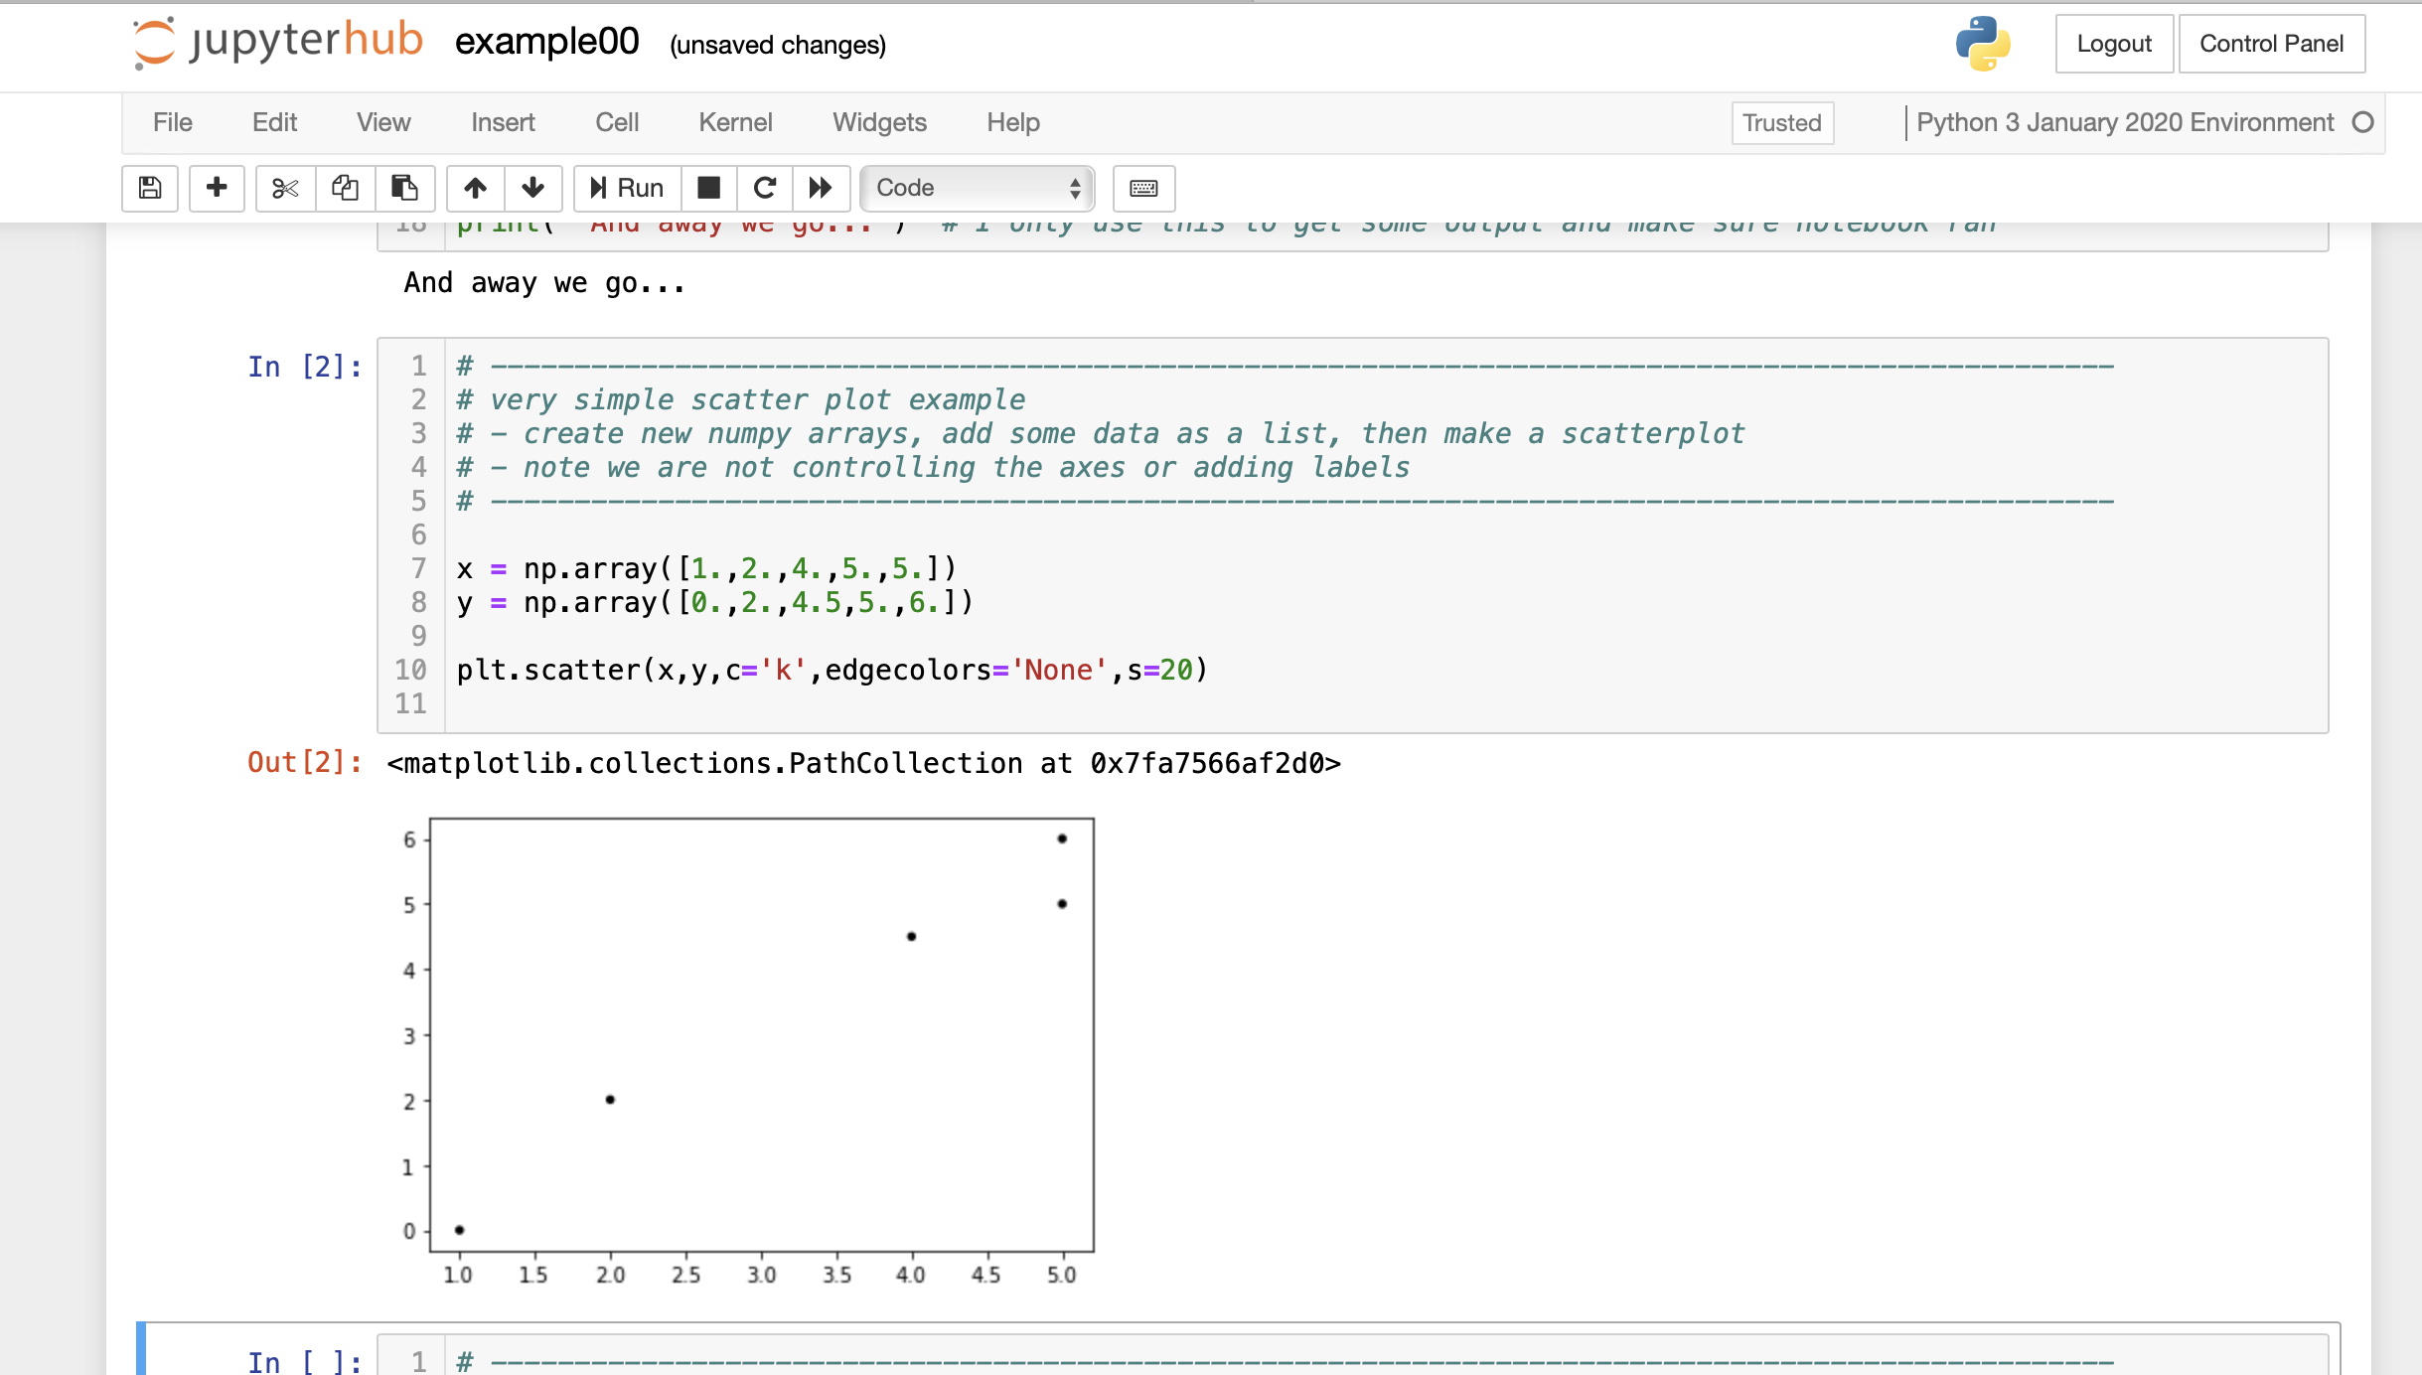
This cell creates two new variables, x and y
and requests and displays a scatterplot.
The scatterplot is displayed because you
hit Run.

Slide 15
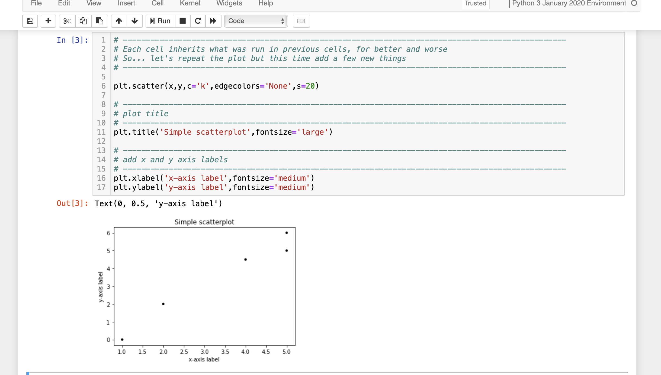
This cell makes the scatterplot of x vs. y again.
The x and y variables are still defined
and available from previous cells.
This time, we add a title and axis labels.
Hit Run again to execute this cell.

Slide 16
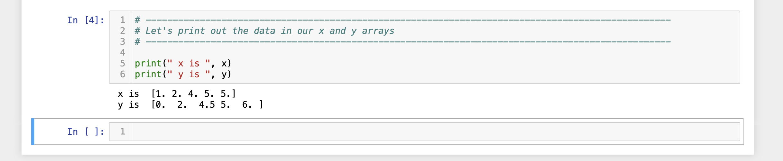
Here, we’re just asking for the contents
of the x and y arrays to be printed out.
The next cell is empty. In that cell enter the text below, and then hit Run
plt.plot(x,y)
# this plots a line plot instead of a scatterplot

Slide 17
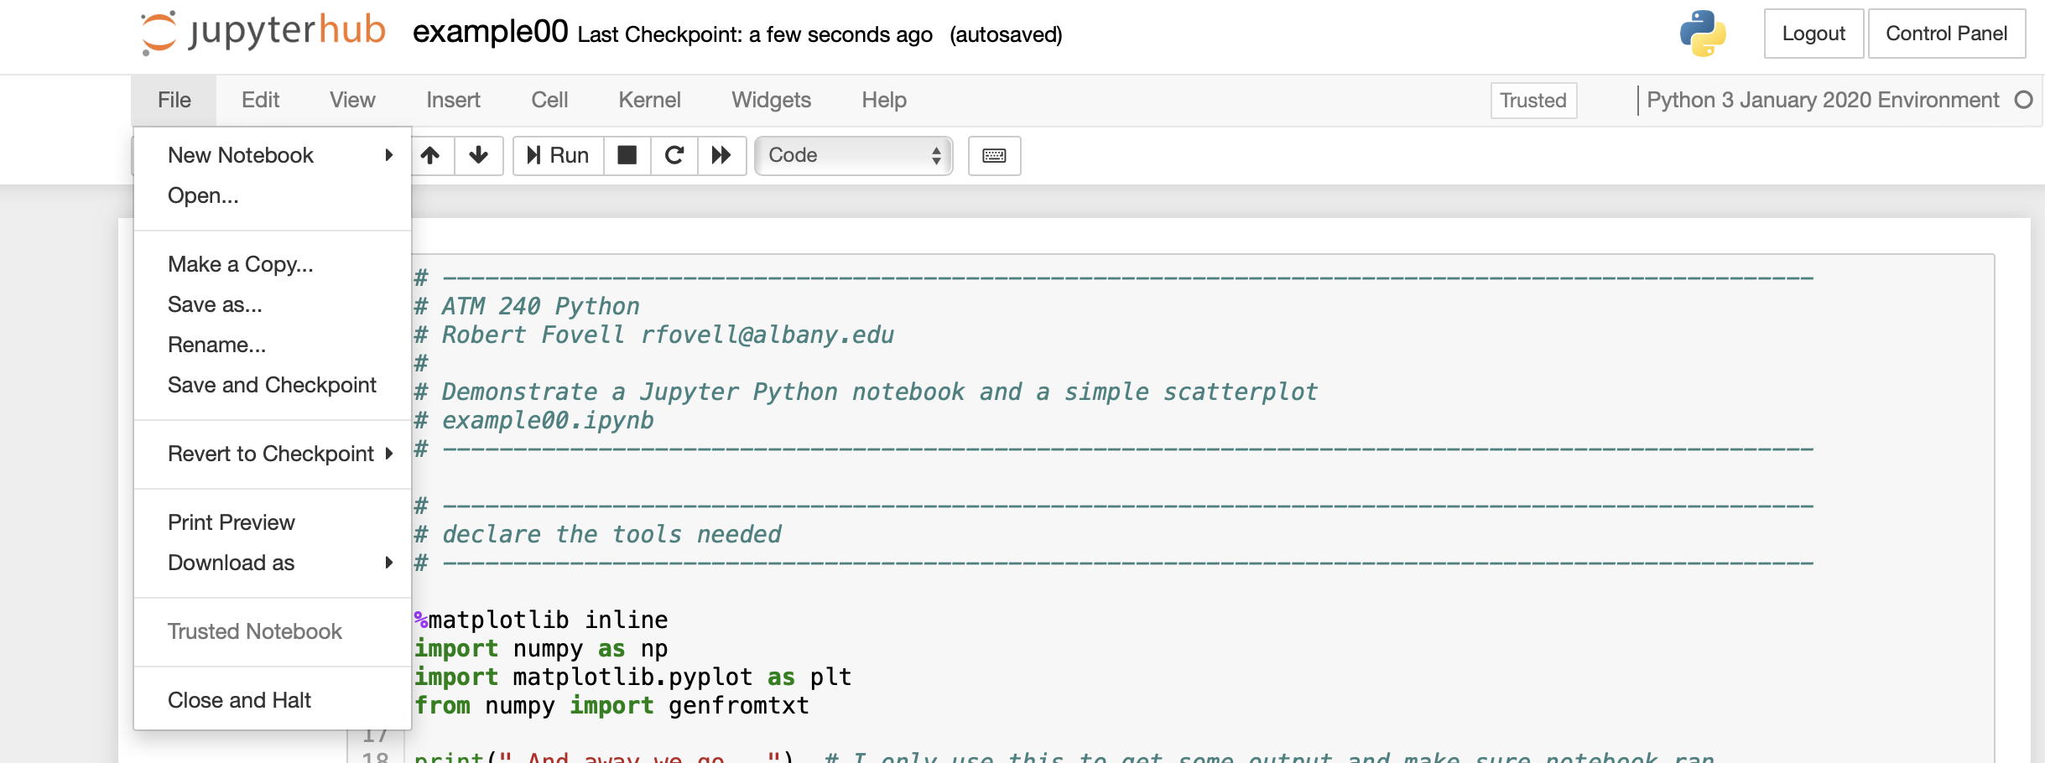
Important! Close and halt the notebook when you are done (to free up resources).

Slide 18
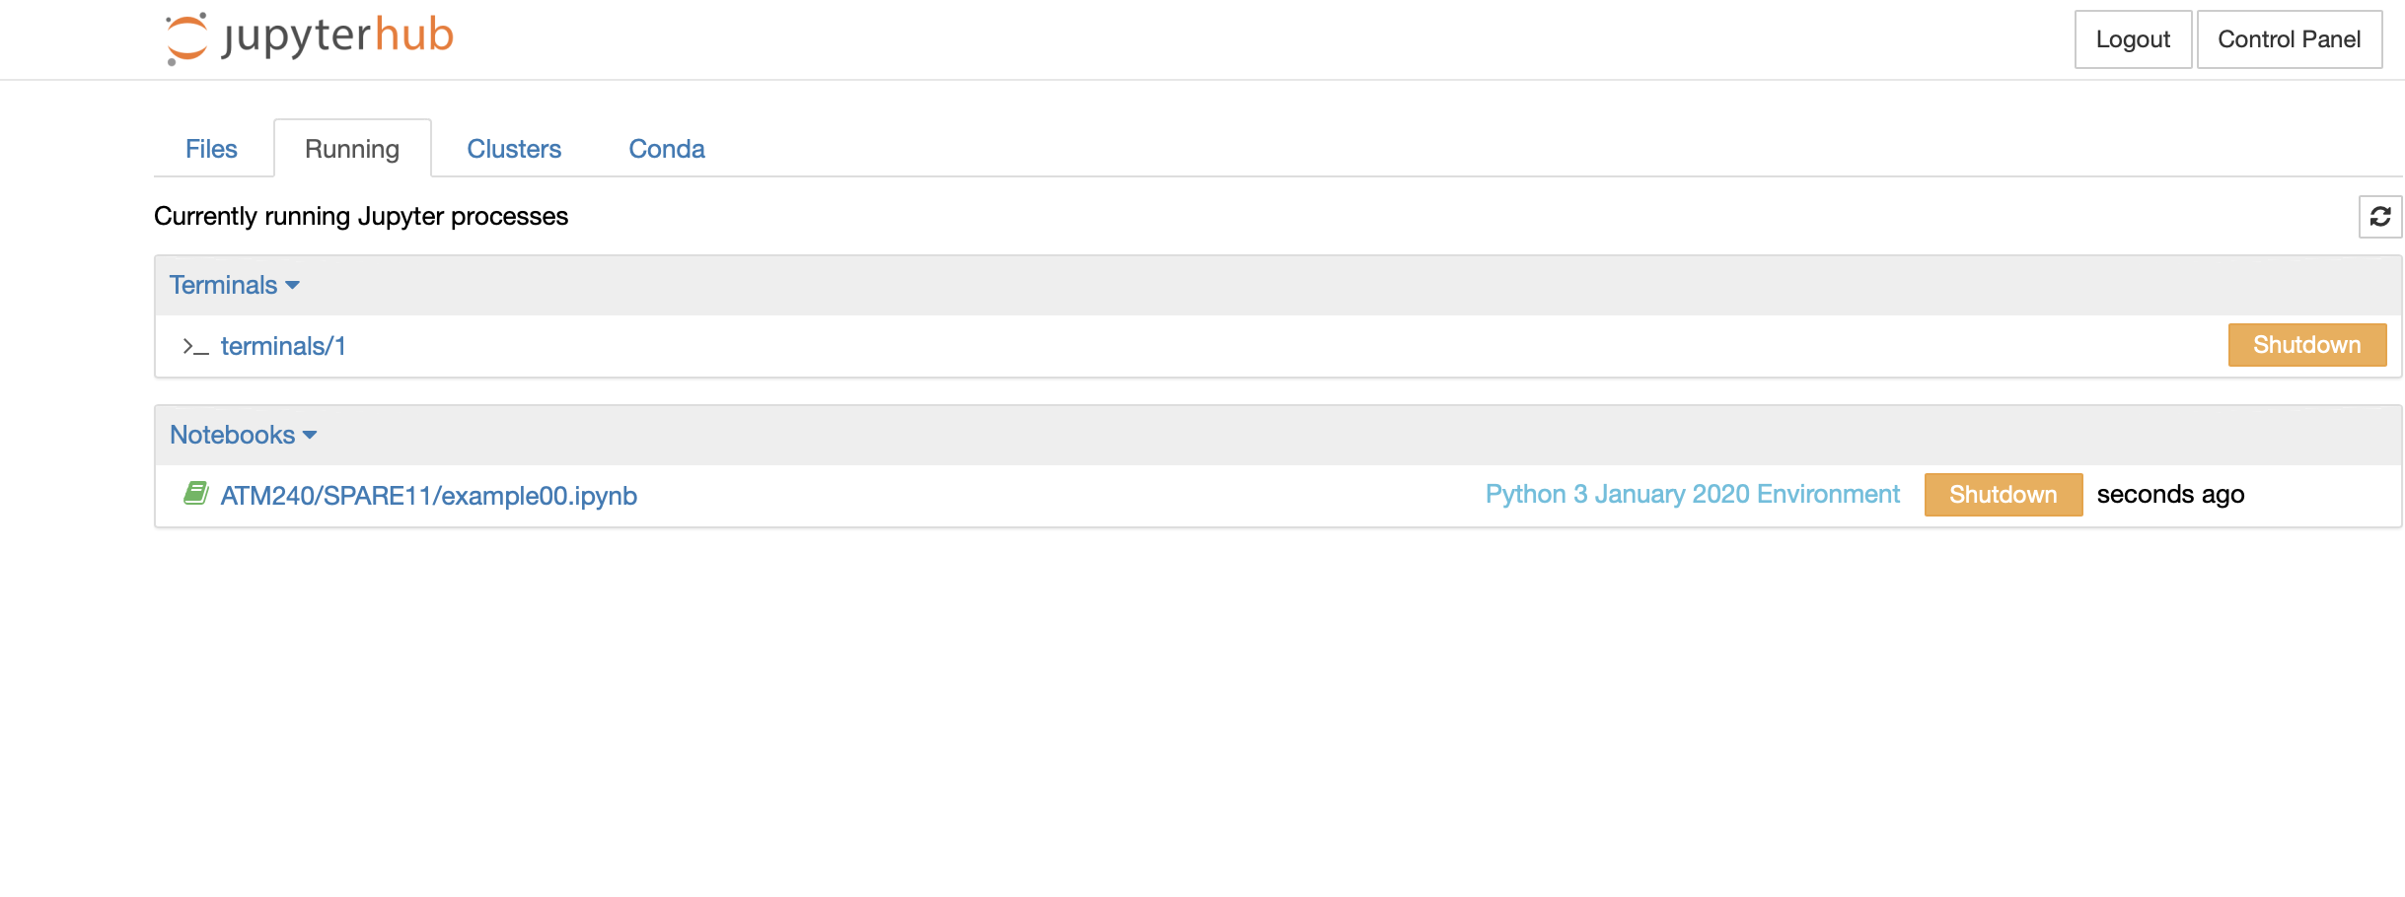
Close up that terminal process too, if it’s still running (it may not be, due to ‘exit’ command).
We don’t want to leave old processes running, since they use resources, which are finite.
There is sometimes a time lag of a few seconds before this page is updated.

Slide 19
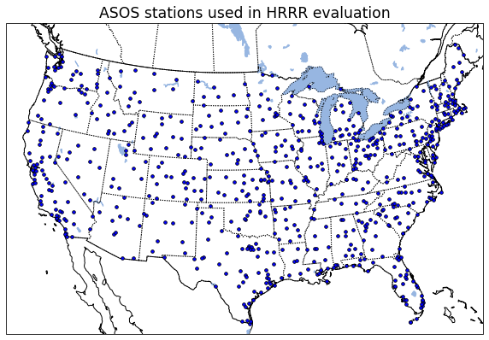
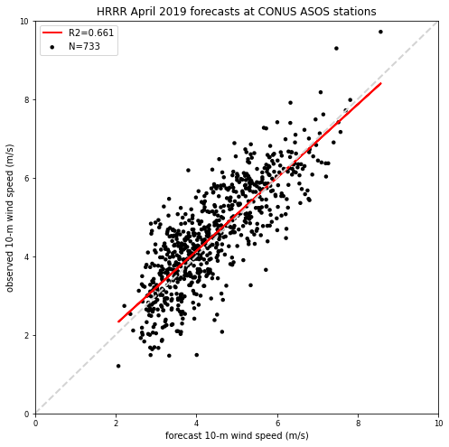
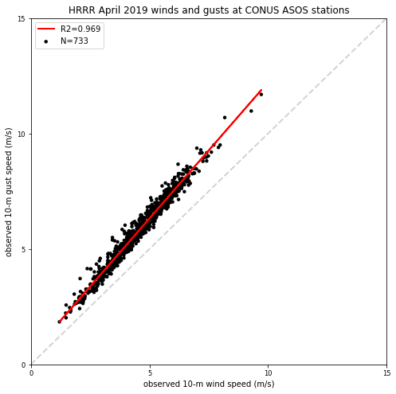
example01.ipynb
HRRR forecast winds, observed
winds, and observed gusts for
ASOS stations in CONUS for
April 2019
Forecast v. observed
winds
Observed winds v.
observed gusts

Slide 20
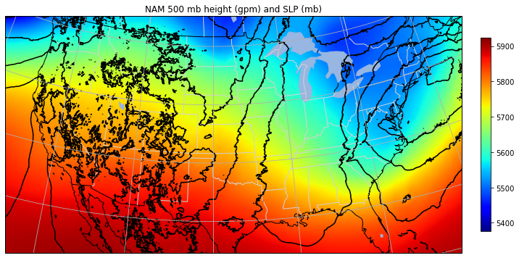
example02.ipynb #1
This notebook uses pygrib, which is no longer supported,
and requires an ‘old’ python environment… see next slide
• Reads in NAM model GRIB2 output, color shaded 500 mb height, contoured sea-level pressure (SLP)

Slide 21
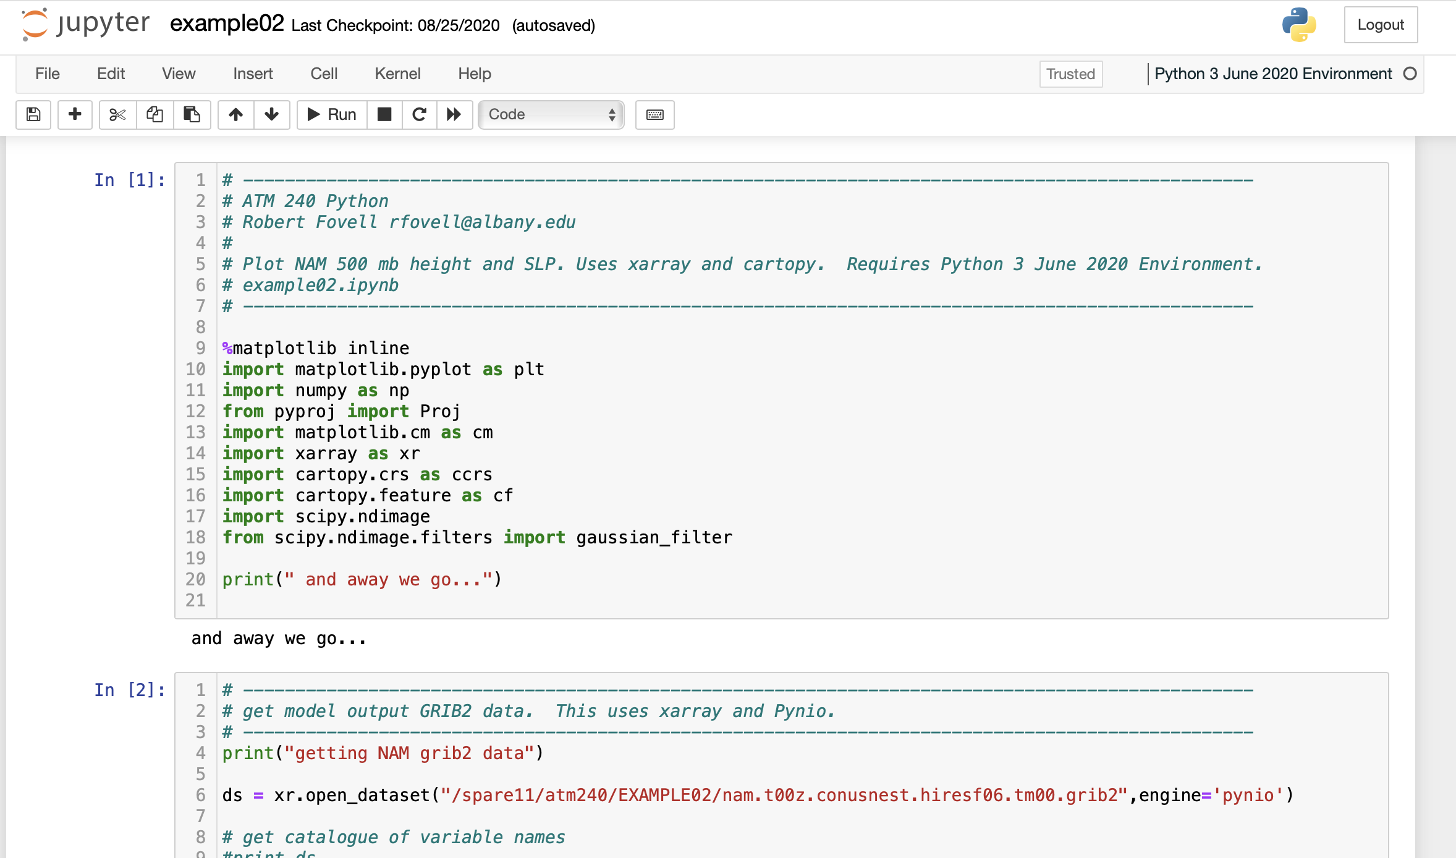
We’re using an obsolete environment to
make use of pygrib… but newer packages
will be missing or not work
Newer packages for reading GRIB files
have disadvantages and advantages
This notebook will eventually stop working

Slide 22
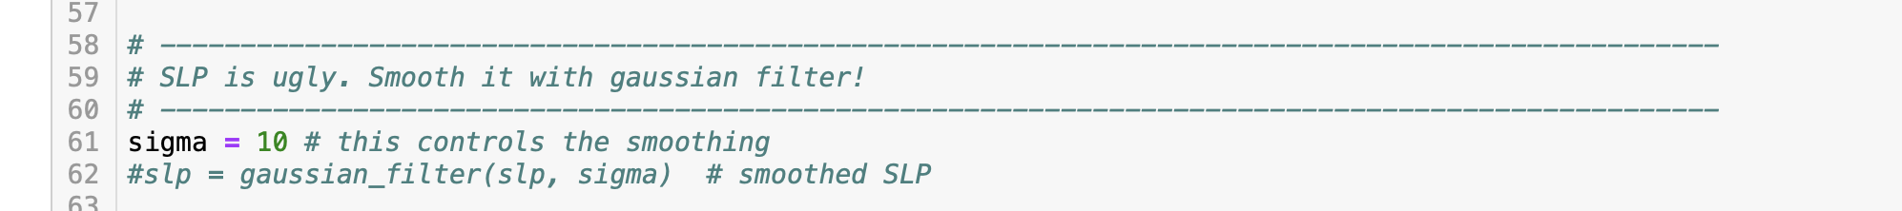
example02.ipynb #2
• SLP is very noisy. Uncomment line 62 in third cell to replace slp variable with smoothed version
(i.e., remove hash mark).
• sigma controls magnitude of the smoothing. Play with it.
• Click in this cell (to make sure it’s active) and hit Run to execute the cell again

Slide 23
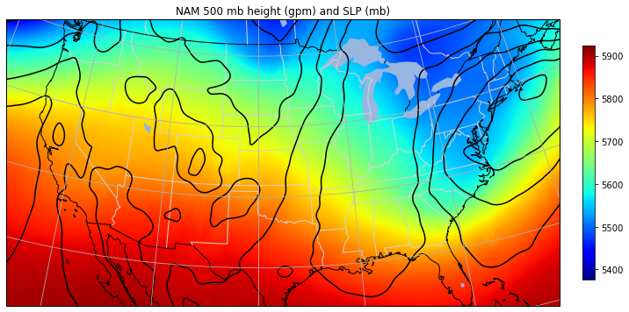
example02.ipynb #3
• SLP field is now much smoother, thanks to gaussian_filter. Play with sigma parameter to see its effect.

Slide 24
example02.ipynb #4
Try this:
  Comment out line 62 again (i.e., put the hash mark back)
  Run the cell again.
  You are wanting to see the unsmoothed version of SLP again
  What do you see?
  What happens if you re-enable the smoothing and run the cell repeatedly?
Rerunning or reinitializing a notebook
  Sometimes, you need to start from scratch (reboot). Do one of these:
  (1) Go back to the top cell, and Run again (or select Run all from Cell menu)
  (2) From Kernel menu, select one of the Restart options
  (3) From File menu, Close and Halt, and reopen notebook to start over
Notes:
SLP was already replaced w/ smoothed values, so you can’t retrieve original unsmoothed values w/o running notebook again from scratch

Slide 25
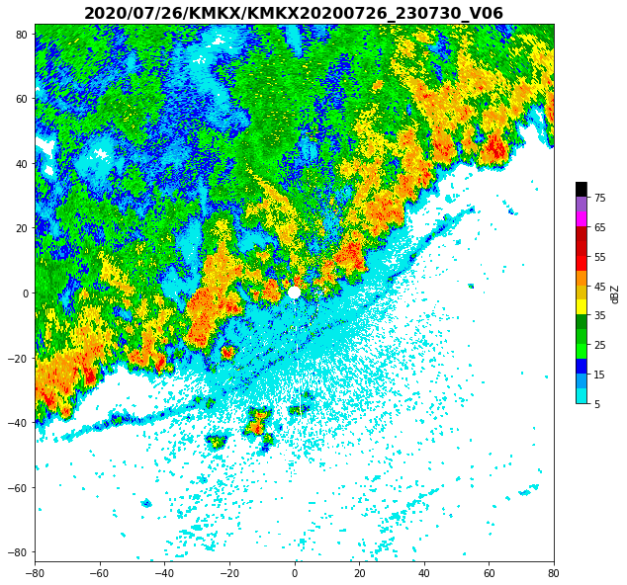
example03.ipynb
#1
• This notebook accesses archived Level 2
NEXRAD radar data from Amazon Web Services
for a specified station and plots base reflectivity
using the NWS reflectivity color scale
• This particular example is Milwaukee (KMKX)
radar for 26 July 2020 at 23:07Z

Slide 26
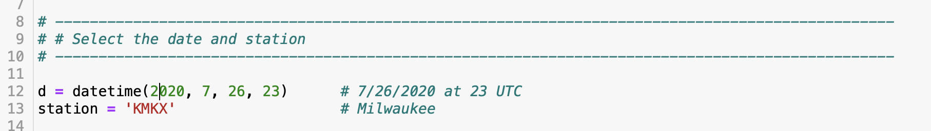
example03.ipynb #2
Repurposing this notebook is as easy as changing the station and the time
Radar selected is KMKX = Milwaukee

Slide 27
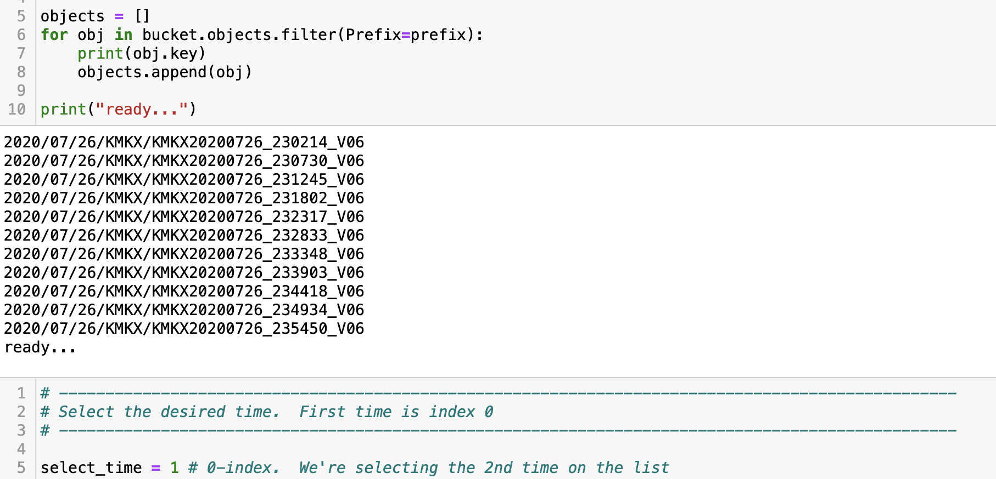
example03.ipynb #3
These are the times fetched from Amazon – they span an hour
Radar selected is KMKX = Milwaukee
We’re selecting the 2nd time listed (Python uses 0-based numbering)

Slide 28
Some plots we made in
2020 and 2021

Slide 29
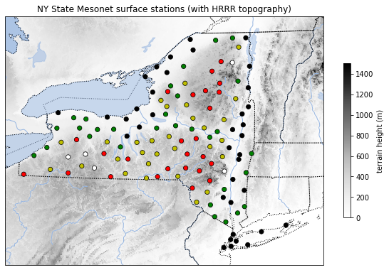
Basemap of NY State Mesonet stations superimposed on HRRR model topography

Slide 30
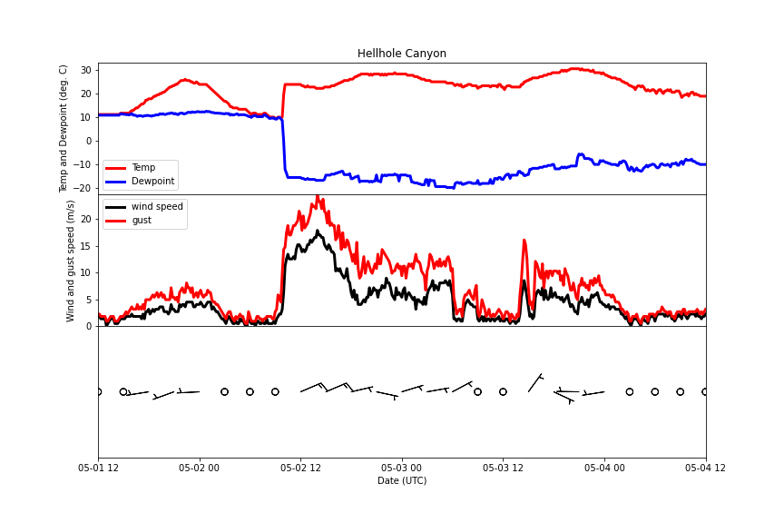
Weather data
from a San Diego
area station

Slide 31
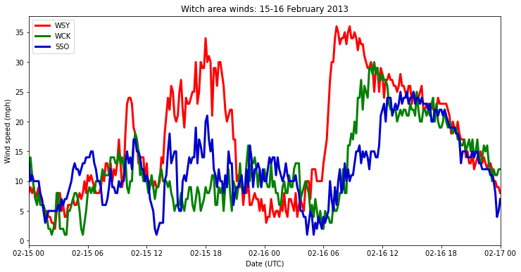
Winds at three lee slope surface stations

Slide 32
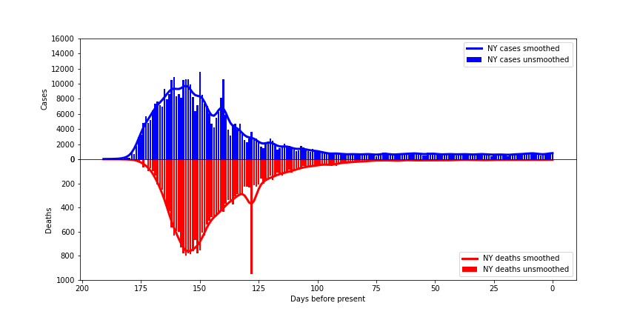
COVID cases v. deaths from 2020 (NY)
I’m now calling this an “iceberg plot”

Slide 33
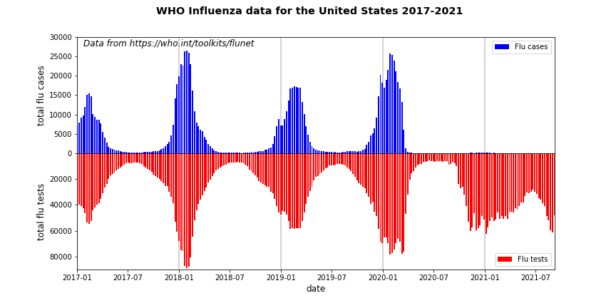
U.S. flu cases and tests: 2017-2021
Notes:
2021 even tested into the summer

Slide 34
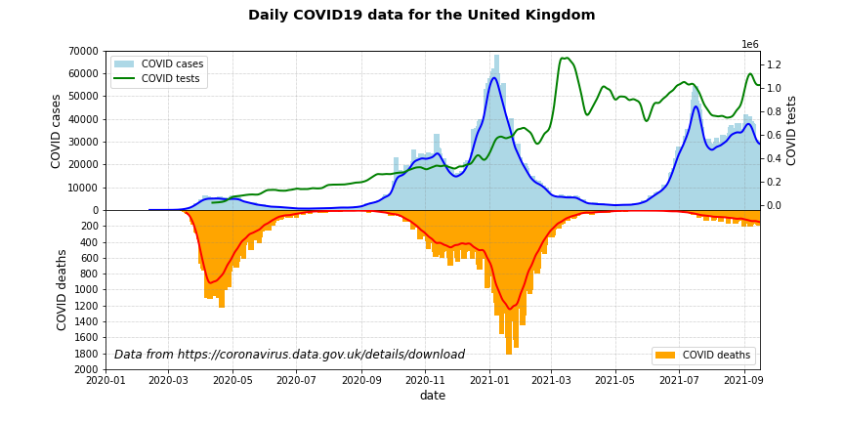
COVID case, tests, and deaths from the UK

Slide 35
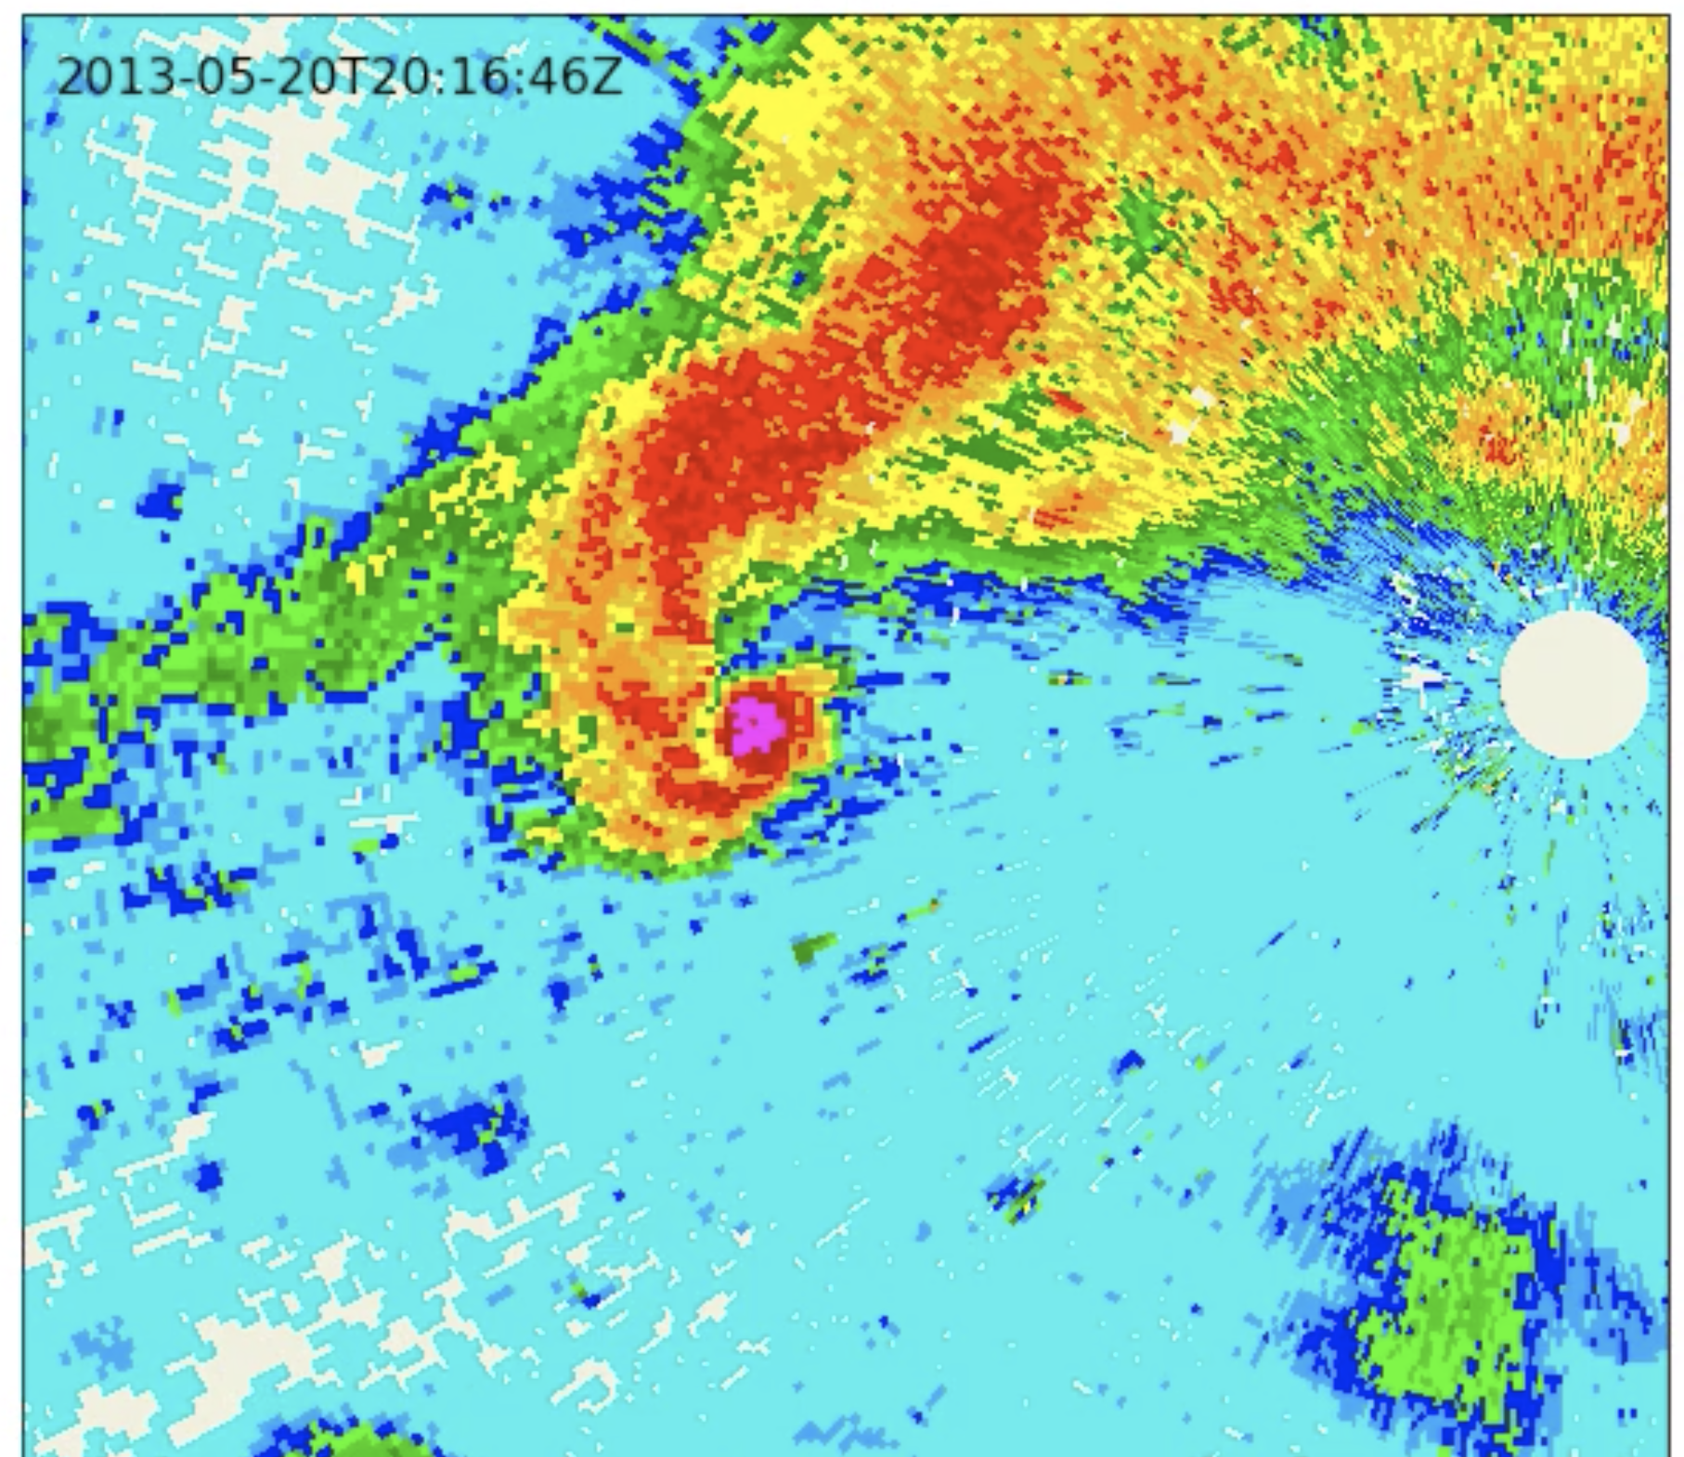
The infamous Moore, OK
EF-5 tornado, as seen on radar
May 20, 2013
radar

Slide 36
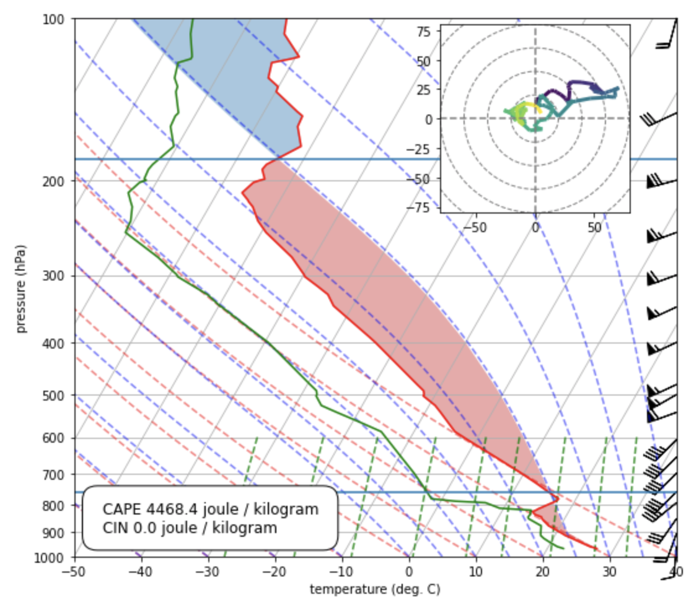
18Z sounding for
Norman, OK (OUN)
20 May 2013,
Day of the Moore EF-5

Slide 37
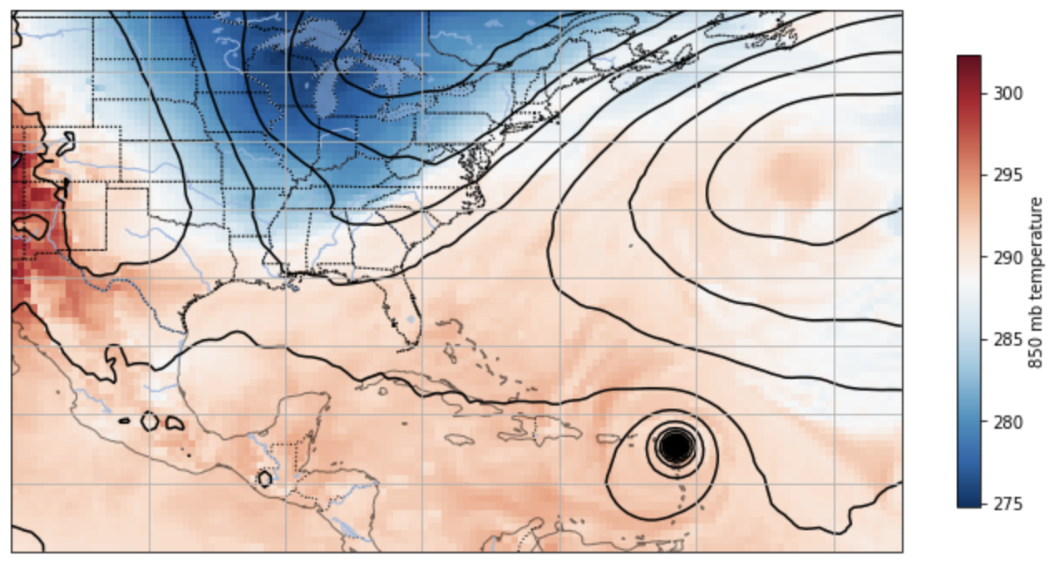
Hurricane Irma (2017) bearing down on the Caribbean
Notes:
2021 Class 8

Slide 38
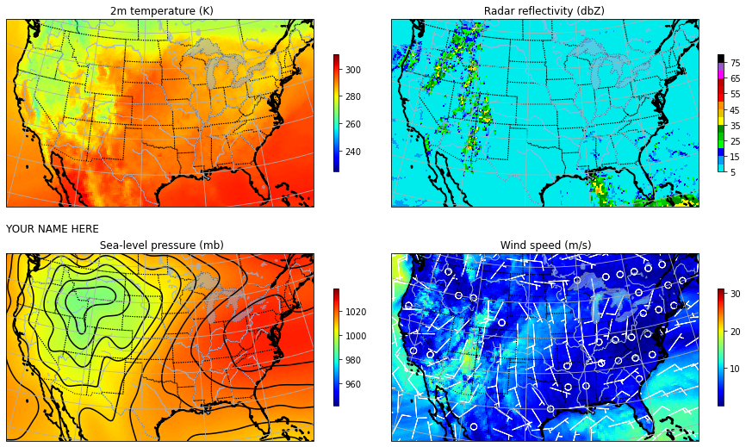
Forecast fields from the GFS model in 4-panel plot

Slide 39
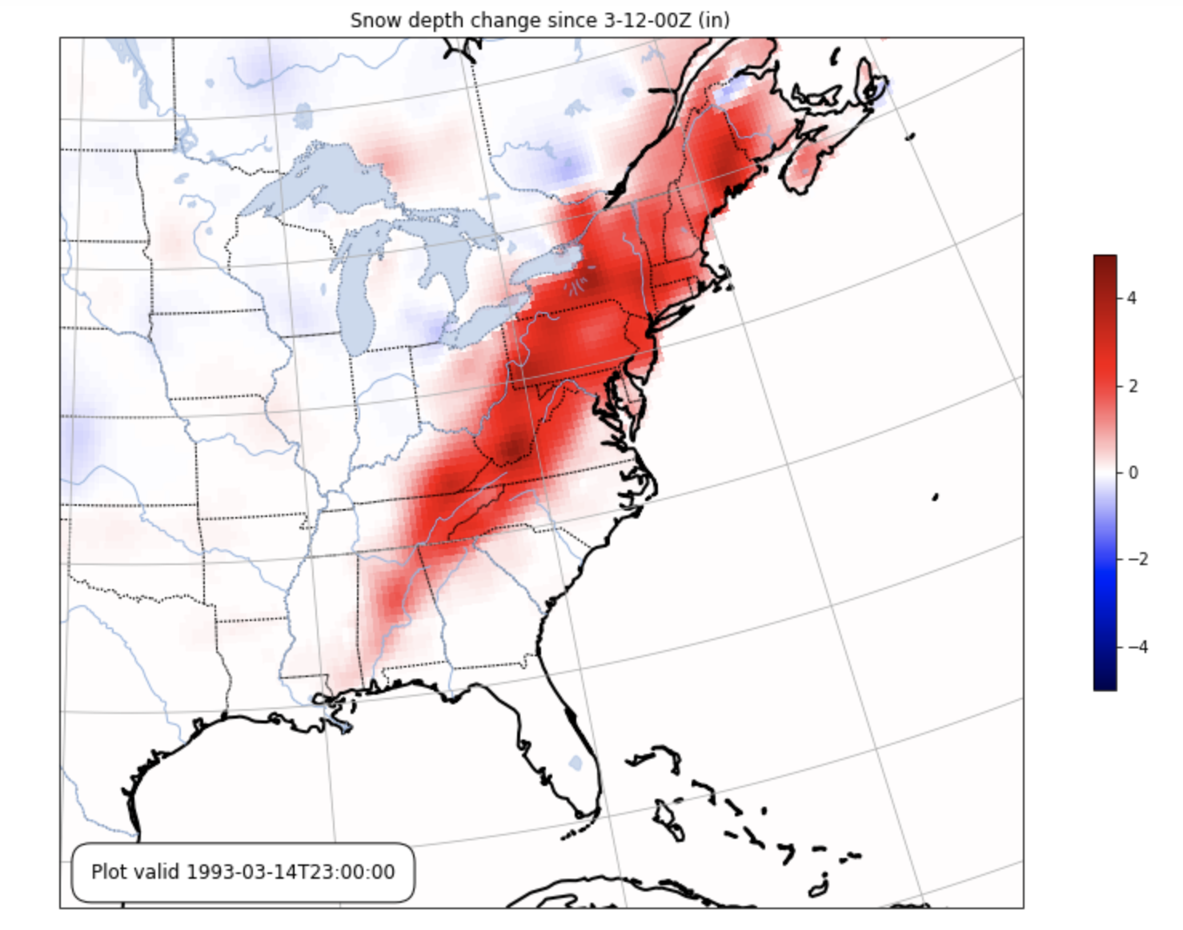
Snow footprint made by
the infamous “Superstorm 1993”
or the “Storm of the Century”

Slide 40
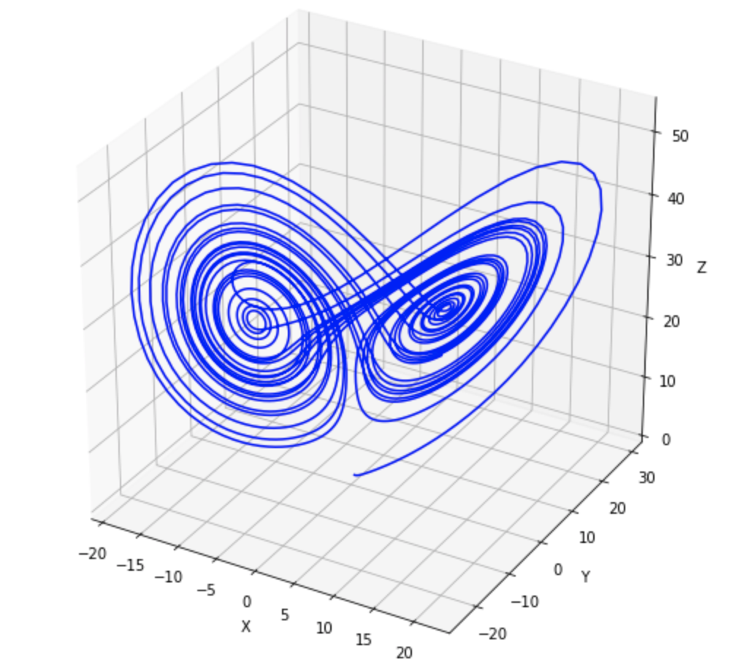
Lorenz’ “butterfly”

Slide 41
Reasons I now use Python…

Slide 42
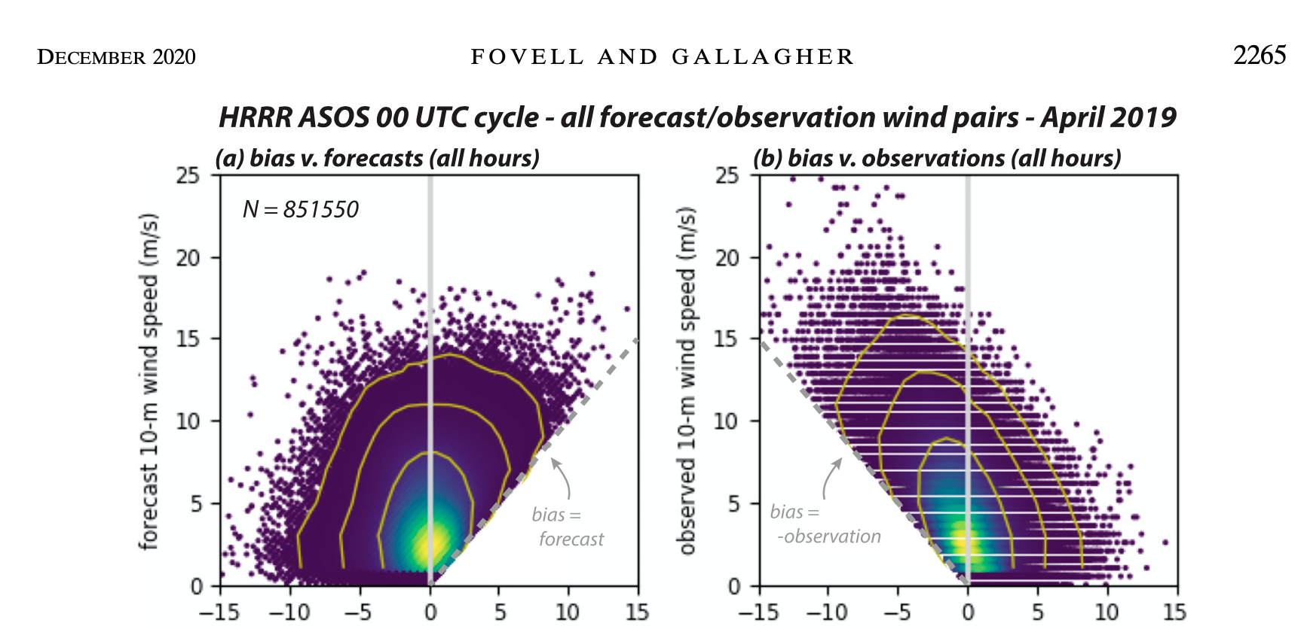
forecast wind bias forecast wind bias
Fovell and Gallagher (2020)

Slide 43
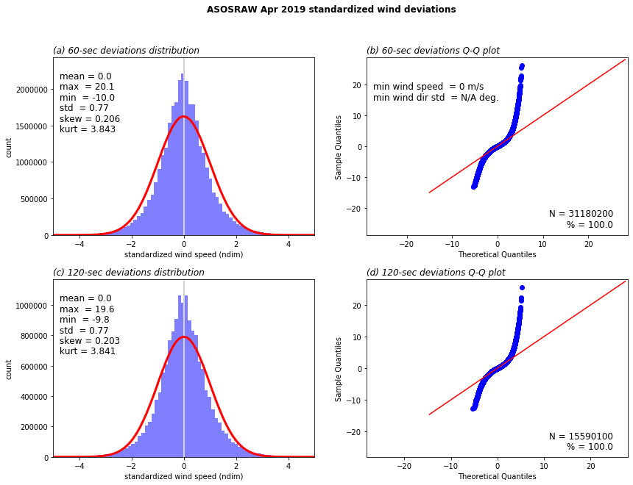

Slide 44
Fovell and Gallagher (2022)

Slide 45
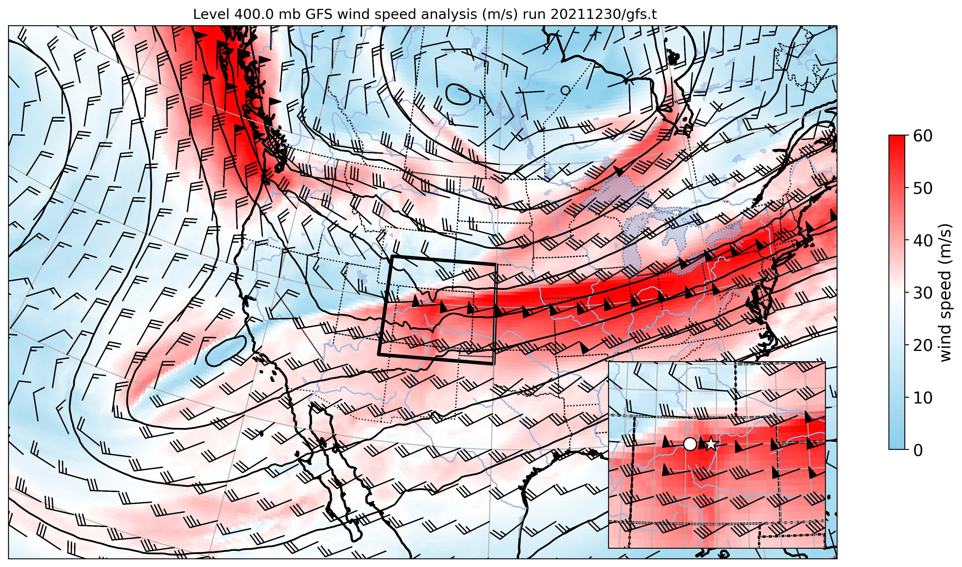
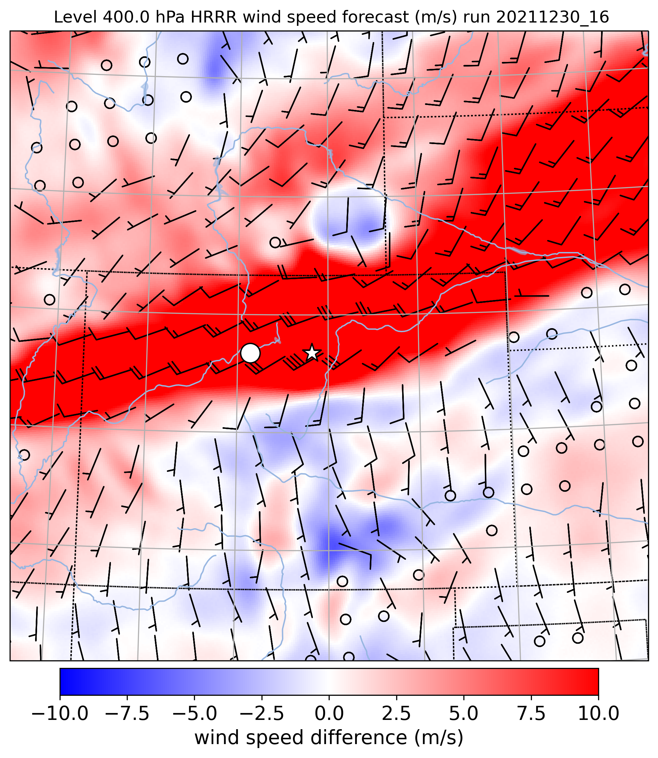
Fovell et al. (2022)

Slide 46
Fovell et al. (2022)

Slide 47
Other reasons
Plotting beautiful maps is very easy
Reading (and writing!) netCDF files is straightforward
Making cross-sections of observational and model data is pretty easy
Manipulating data as arrays & matrices, and computing means is very easy
Dealing with dates is so much easier than Excel
Dealing with enormous amounts of data is doable
Smoothing data is easy
The notebook environment facilitates step by step coding and seeing intermediate results

Slide 48
But Python is not perfect
Zero-based indexing takes time to master and provokes mistakes
Syntax is needlessly confusing and varies from method to method, even within the same package (I’m looking at you, matplotlib)
Python is a moving target… and stuff breaks far, far too often

Slide 49
Before you go…
Check the Running tab. Close and Halt your unneeded processes.

Slide 50
For next class
Again, read as much of Chapter 3 of Lin-2012 as possible!

