Slide 1
Class #10
ATM 240 ~ Fall 2022
Robert Fovell
rfovell@albany.edu

Slide 2
“Cheat sheet” reminder
Bookmark and visit this page for reminders regarding Python syntax and examples:
http://www.atmos.albany.edu/facstaff/rfovell/ATM240/csheet.html
This is a “living document”

Slide 3
Class roadmap
Read in GFS model forecast data in GRIB2 format and make some plots using Cartopy
At the end, you will be emailing (or showing) me a 4-panel plot of 2 m temperature, radar reflectivity, sea-level pressure, and 10 m wind speed
Create a Terminal window, move to your /spare11/atm240/yournetid space. Copy the notebook GFS_plot_exercise.ipynb from the directory above
cp ../GFS_plot_exercise.ipynb .

Slide 4
Resources
This powerpoint
Your Cartopy script from Class #7 cartopy.ipynb
The Irma Cartopy demo from Class #8 irma_xarray_cartopy.ipynb
Your Flu script from Class #9 plot_flu.ipynb

Slide 5
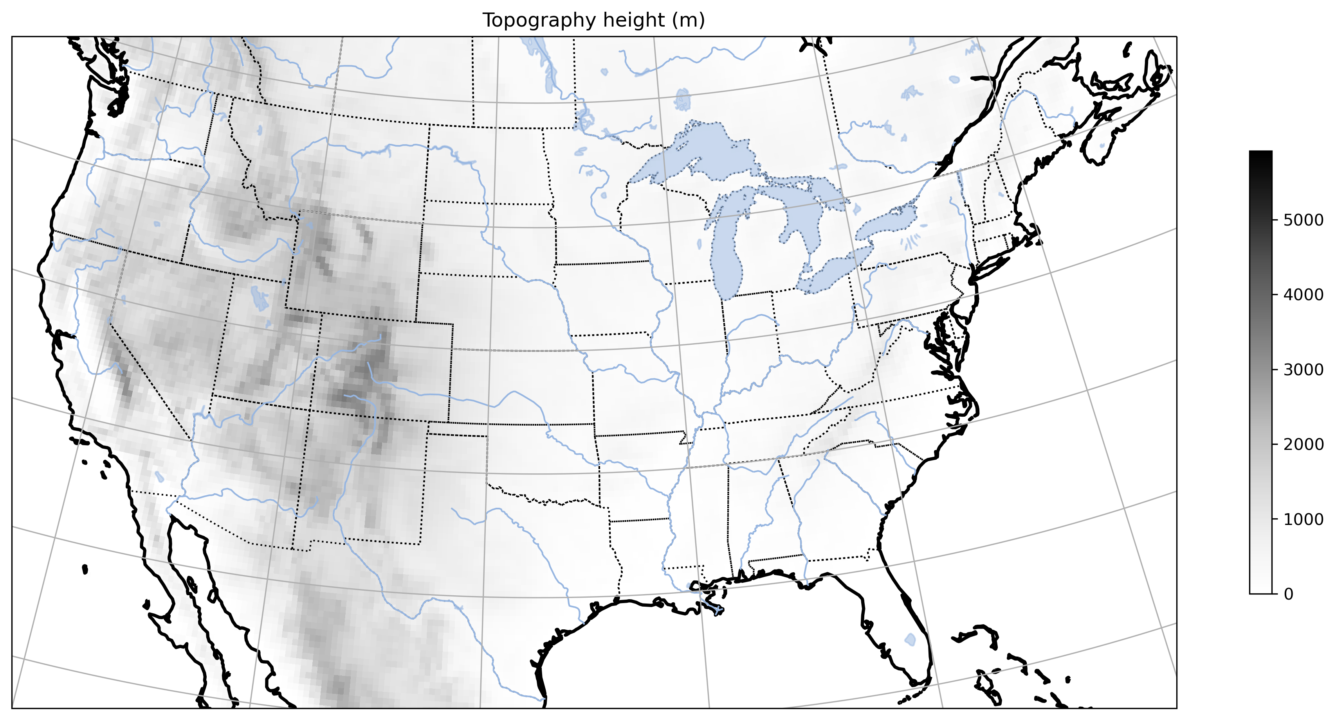
MAP #1

Slide 6
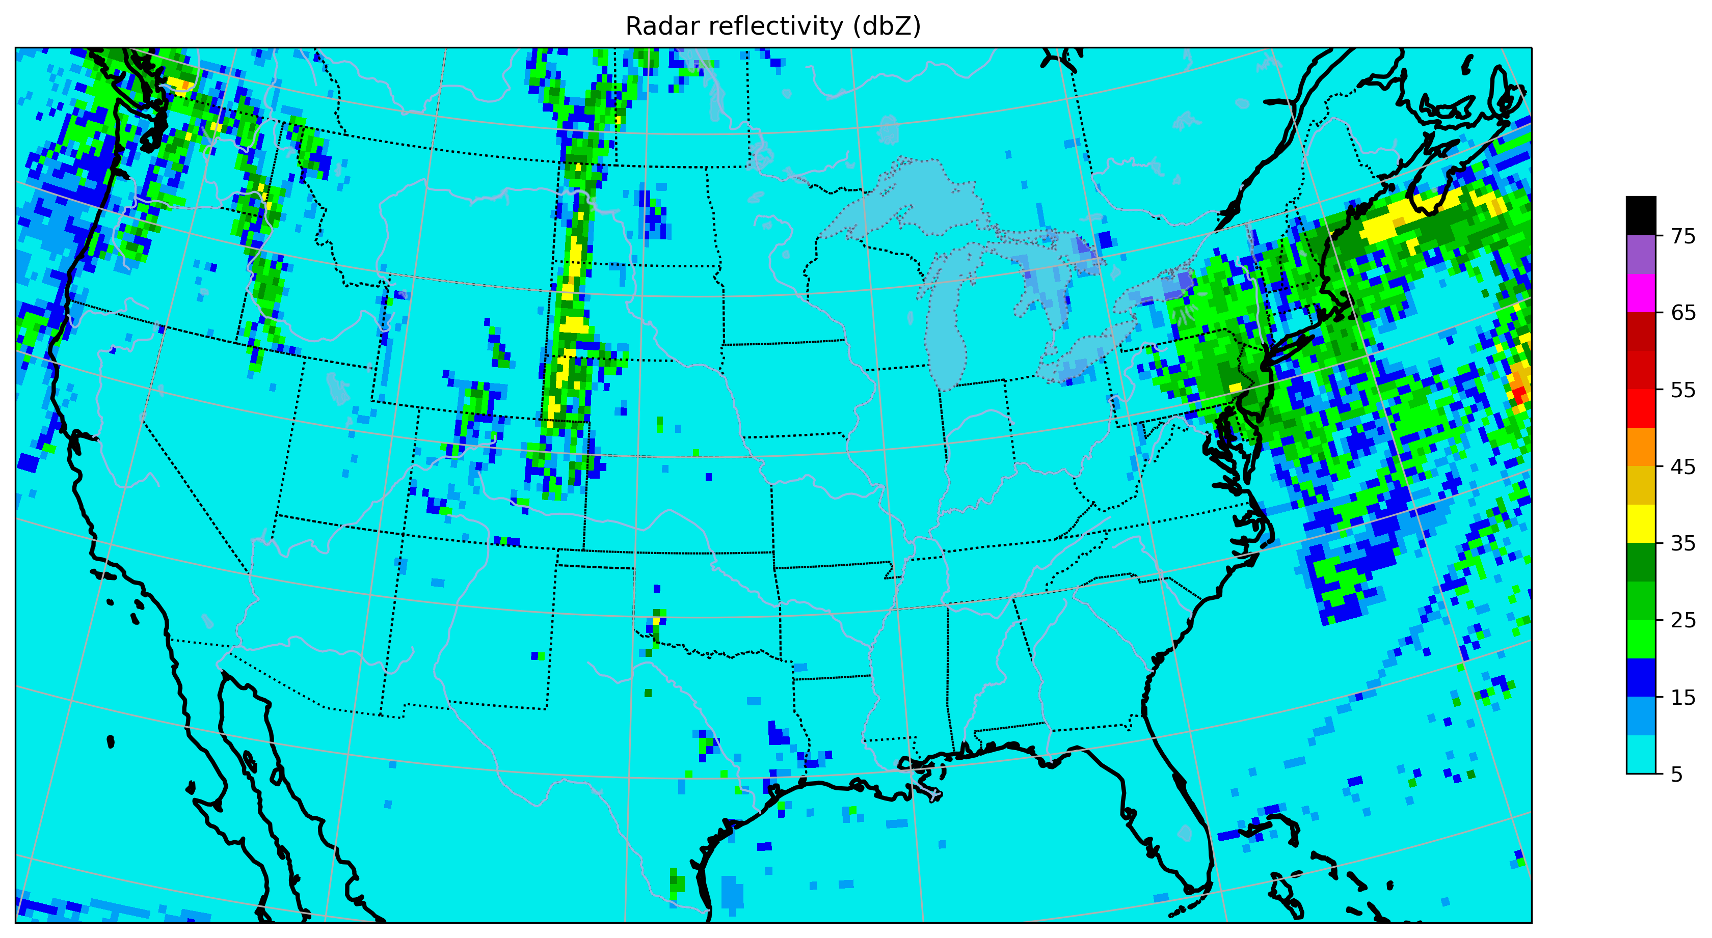
MAP #2

Slide 7
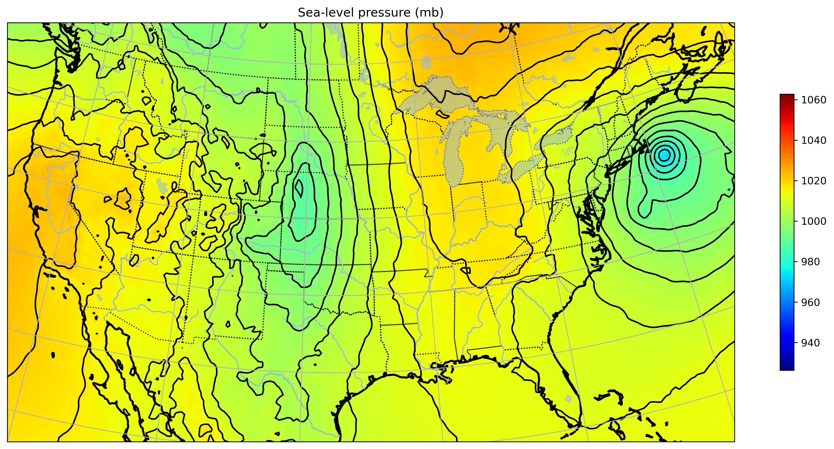
MAP #3

Slide 8
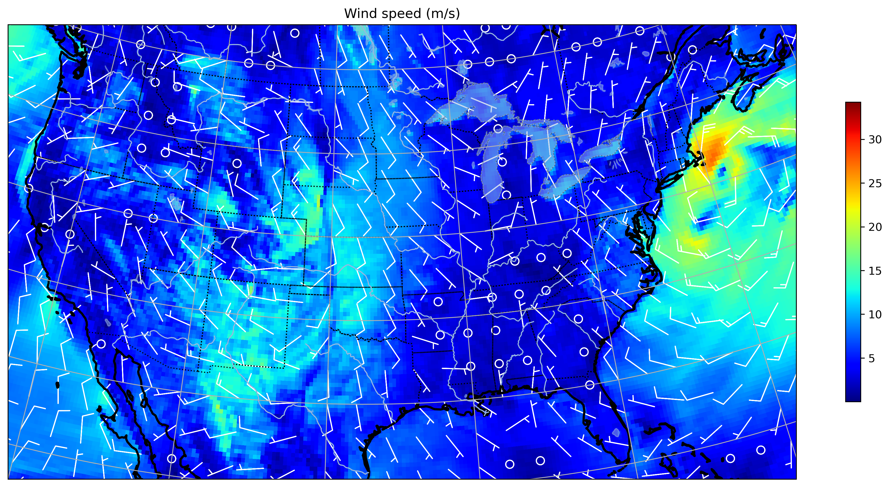
MAP #4

Slide 9
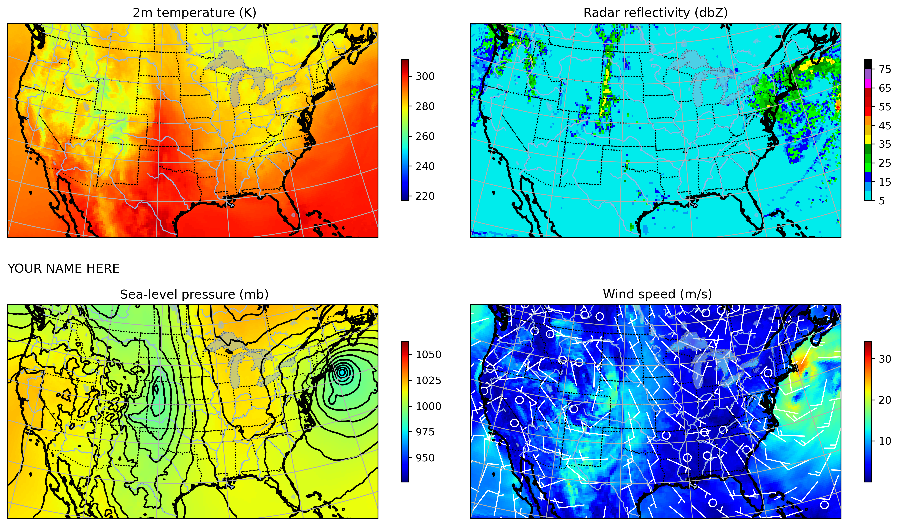
Our final product
Notes:
My final plot

Slide 10
Reading GRIB data in Python
GRIB == “gridded binary”, a WMO-sponsored format for disseminating and exchanging meteorological datasets for observations and model outputs
Original format GRIB (or GRIB1)
Current updated and improved format GRIB2 – files are more compact
GRIB files contain a collection of fields having different coordinate systems
Example: some fields are surface or single-level only: precip, 2-m temperature, 10-m wind; others also have a vertical dimension and different fields may have different number or type vertical levels (e.g., isobaric vs. height)
Need an ‘engine’ to read in the GRIB1/2 data. Two that currently exist are pynio and cfgrib. Both have advantages and disadvantages.
cfgrib attaches ‘nice’ names to variables but cannot simultaneously handle fields with different vertical coordinates and some fields apparently remain invisible to the engine
pynio can read all file contents, doesn’t get flustered about vertical coordinates, but variable names are ugly. It stopped working for awhile (became unsupported) but is currently working again

Slide 11
Tour of selected slides in notebook

Slide 12
Cell #1 - Openers
%matplotlib inline
import matplotlib.pyplot as plt
import numpy as np
import pandas as pd
from pyproj import Proj
import matplotlib.cm as cm
from datetime import datetime,timedelta
import os, sys
import xarray as xr
# metpy
import metpy.plots as mpplots
# cartopy
import cartopy.crs as ccrs # cartopy coordinate reference system
import cartopy.feature as cfeat # features like color-shading for land, ocean, coastlines, state boundaries
# cfgrib
# https://github.com/ecmwf/cfgrib
import cfgrib

Slide 13
Cell #3
# fetch GFS data for 2021102500 forecast hour 48 in GRIB2 format
# this uses xarray and the pynio engine to read GRIB2 data
# we saw xarray open_dataset in irma_xarray_metpy.ipynb
# IGNORE THE WARNING
# 'warning:["libsrc/NclFile.c":1601]:FileSetFileOption: FileStructure is not a recognized…'
ds = xr.open_dataset('/spare11/atm240/GFS/2021102500/gfs.t00z.pgrb2.0p25.f048',engine='pynio')

Slide 14
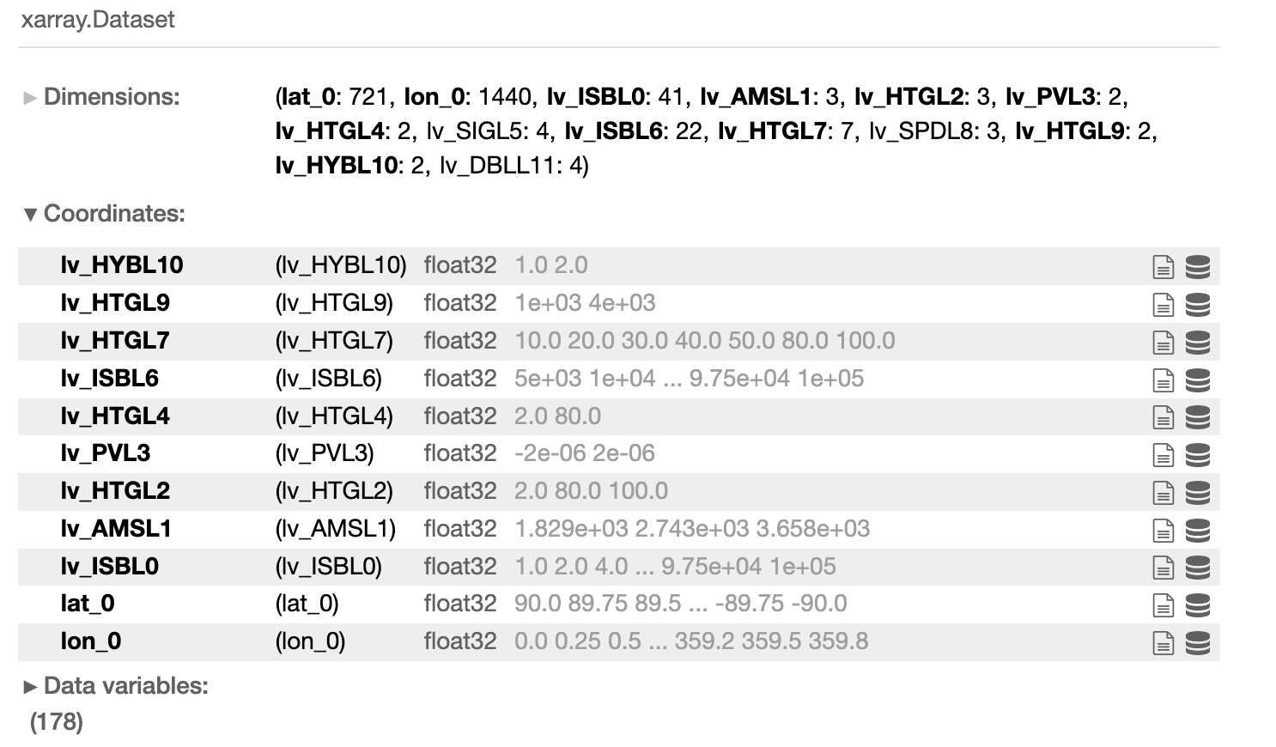
Look inside the GRIB2 → xarray dataset
Many different vertical coordinates
in this file --> a problem for cfgrib,
but we’re using pynio
With cfgrib, would need to open a
separate dataset for each different
vertical dimension…

Slide 15
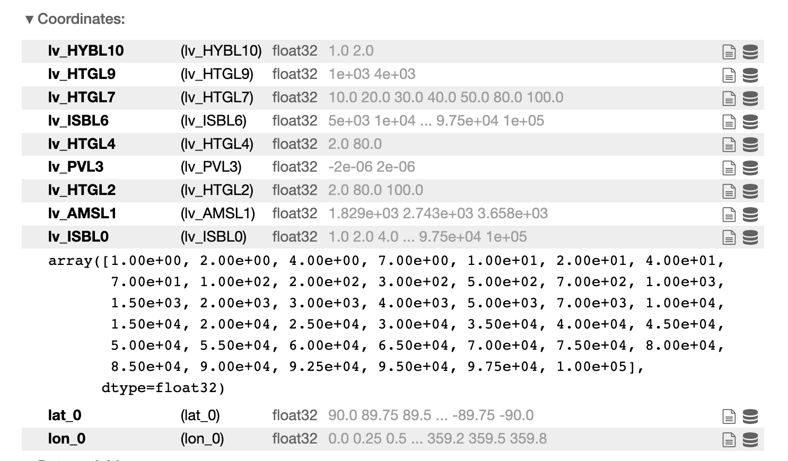
Look inside the GRIB2 → xarray dataset
Click on the ‘oreo’ to reveal the values
for this coordinate. This runs from
1 to 100000 Pa

Slide 16
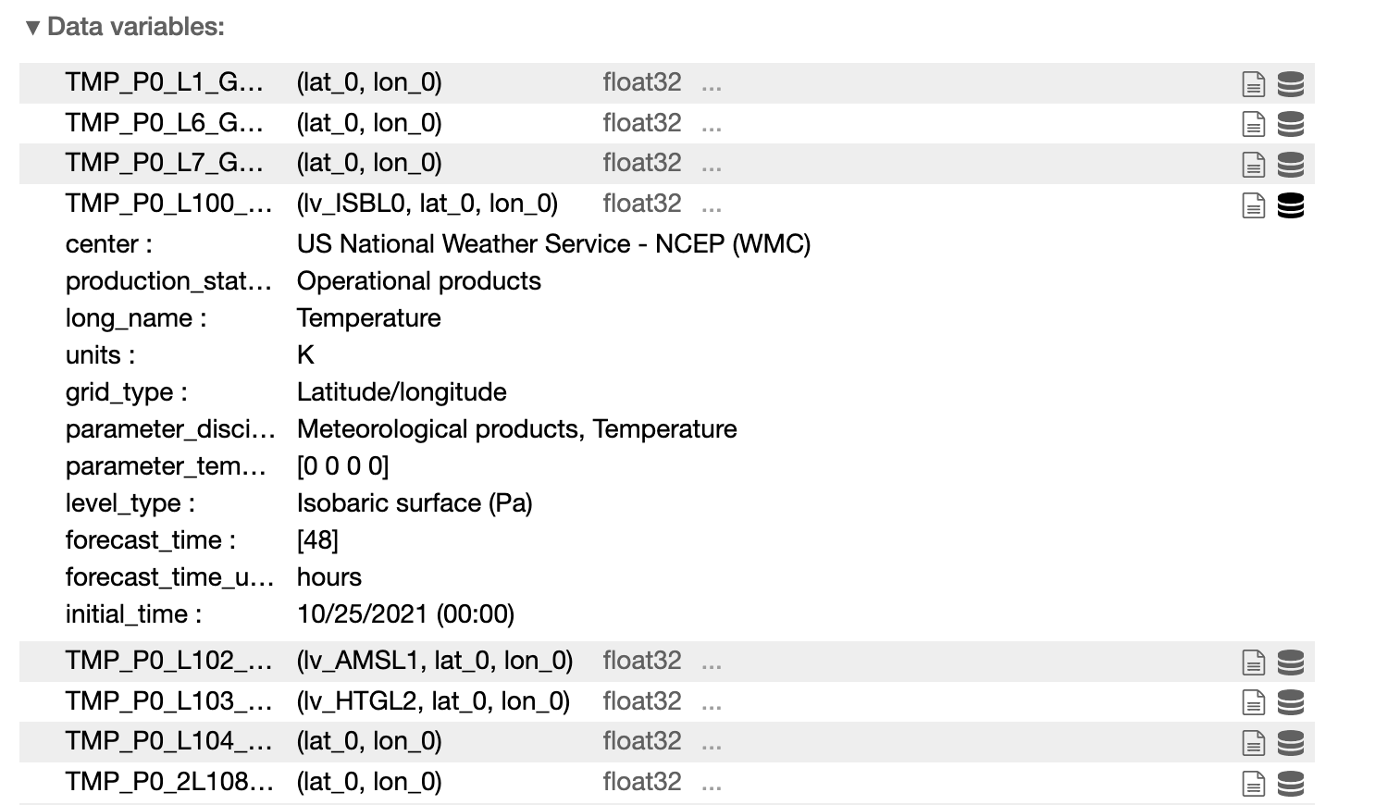
Look inside the GRIB2 → xarray dataset
Hover over the variable name to
reveal the full name like
TMP_P0_L100_GLL0. Its dimensions
are lv_ISBL0 by lat_0 by lon_0.
These are not universal names, at
least not the last four characters, and
vary depend on GRIB data source
(e.g., GFS vs. NAM vs. HRRR vs.
ECMWF etc.)

Slide 17
Cell #6 – Extract some variables
# We now ask for HGT_P0_L100_GLL0 to be pulled from ds
# AND we also select its lv_ISBL0 coordinate to be 50000.0 Pa
# Call this new variable hgt500
hgt500 = ds.HGT_P0_L100_GLL0.sel(lv_ISBL0 = 50000.0) # 500 mb height
# There is also a variable called HGT_P0_L1_GLL0 - notice the variable name is slightly
# different
# - This is geopotential height of ground or water surface == terrain height
# - its coordinates are (lat_0, lon_0) only, so there's nothing to select
# Save that variable as terr
hgt0 = ds.HGT_P0_L1_GLL0

Slide 18
Some notes
Specifying the dots per inch for the plot can improve its quality
plt.savefig("GFS_4panel.png", dpi=300, bbox_inches = ‘tight’)
Extra: find the location of that massive 1063 mb high sea-level pressure maximum, and plot a map identifying it with a star
See irma_xarray_cartopy.ipynb and cartopy.ipynb scripts
Suggest: plot the entire world (no set_extent) with projection PlateCarree

Slide 19
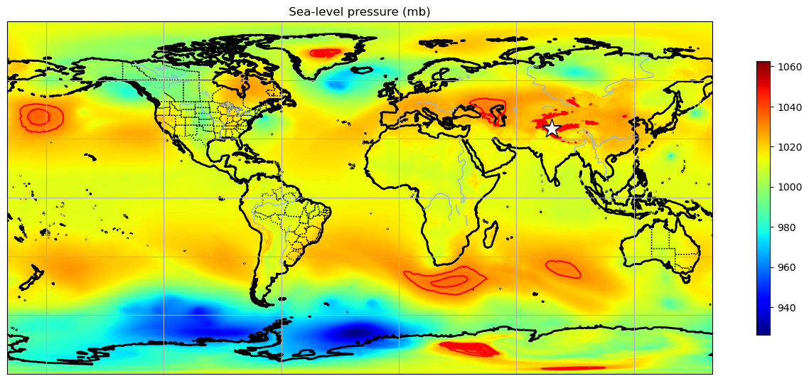
My map… [my SLP contours are in red to differentiate from coastlines]

Slide 20
[end]

