Slide 1
Class #13
ATM 240 ~ Fall 2022
Robert Fovell
rfovell@albany.edu

Slide 2
Class roadmap
Plot ERA5 data from the infamous “Storm of the Century” (SOC) or “Superstorm 1993” case
ERA5 is the 5th generation European Reanalysis dataset from the European Center for Medium-range Weather Forecasts (ECMWF)
A reanalysis is a retrospective analysis of past conditions employing as many available observations as possible assimilated into a numerical weather forecast model
By some measures, the SOC was the most impactful east coast snowstorm in US history
In your /spare11/atm240/yournetid space, create a new notebook, specifying “Python 3 August 2022 Environment”. Call your notebook “SOC”.

Slide 3
Some background

Slide 4
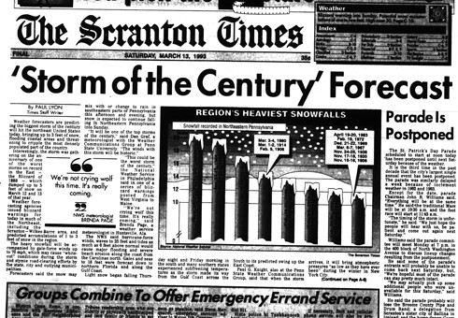
March 13, 1993

Slide 5
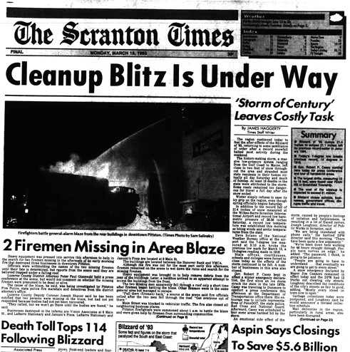
March 15, 1993

Slide 6
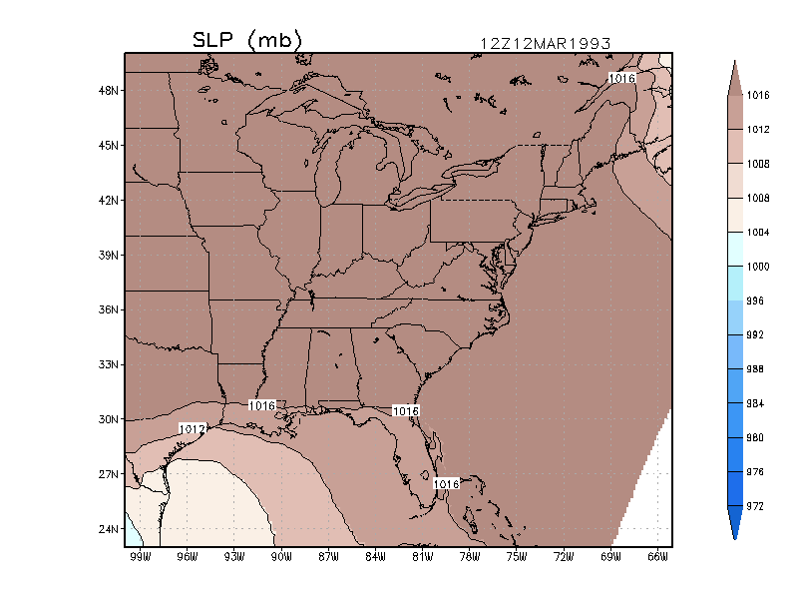
Animation of the SLP field
03/14/93 06Z
Storm Track
03/13/93 06Z
Notes:
Uses GrADS

Slide 7
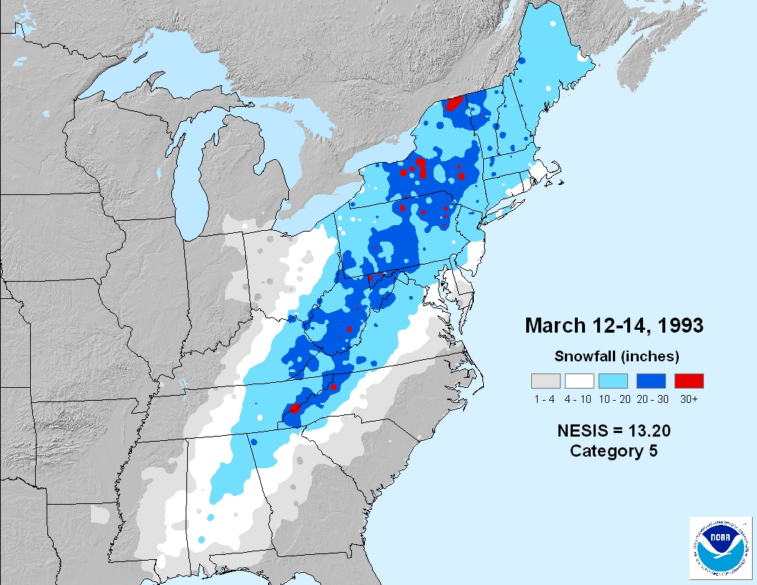
http://www.ncdc.noaa.gov/snow-and-ice/rsi/nesis
One of the costliest weather disasters in US history,
not directly because of the snow, but rather due to:
Economic loses from business closures
Damage from wind significant in many places
Snowfall footprint
Notes:
The newer RSI, intended to succeed NESIS, is much more complicated. For the NE sector, it places 22 Feb 1969 #1, and SOC #2. Altho formula looks the same, values are different owing to the way normalization was done – in RSI each category’s A and P denominators are calibrated separately, and separately for each region. Snowfall thresholds also diff for each region. But it remains that the new scheme, for NE, effectively weights snowfall bins differently, and that makes bvalues different, and lets 1969 “win”.

Slide 8
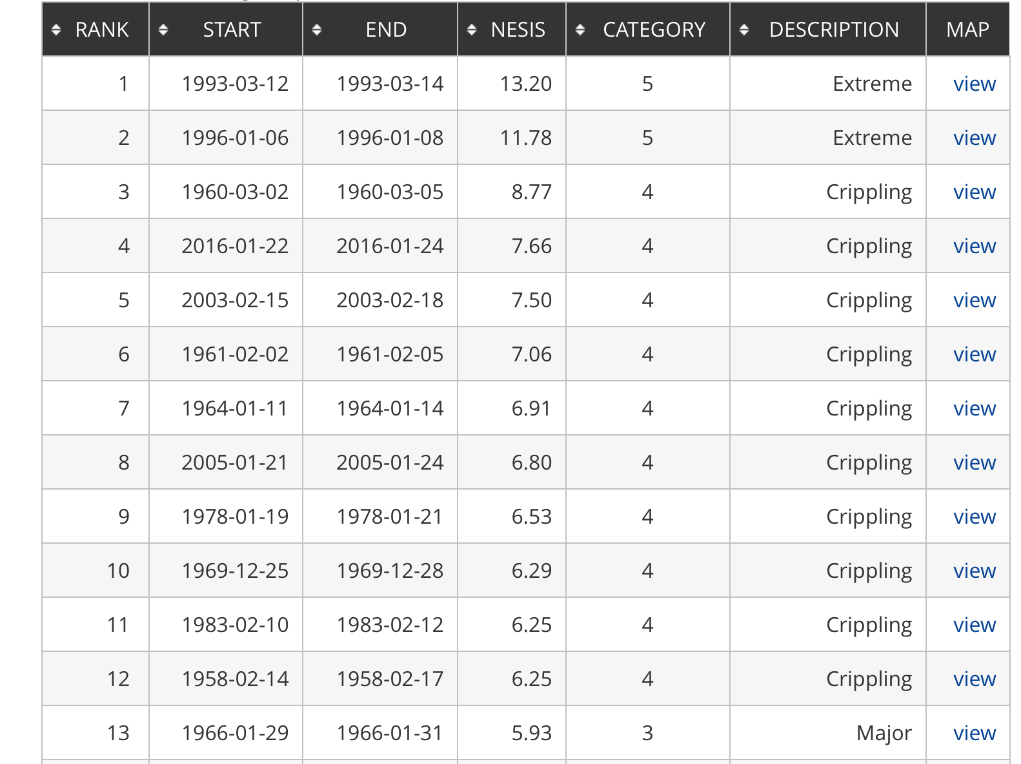
Most recent event on list
NorthEast Snow
Impact Scale
[NESIS]
• snow depth
weighted by
population and
area
More on the NESIS snow impact scale
http://www.ncdc.noaa.gov/snow-and-ice/rsi/nesis
Notes:
3/12-3/15/2017 storm: rank #23, NESIS = 5.03, Cat. 3
Largest in 2018: 3/5/18-3/8/18 NESIS = 3.45, rank 40. No 2019 storms.
Largest in 2020: 12/14-12/18 NESIS = 3.21, rank 44
2021 storm: 1/30-2/3 NESIS 4.93, rank 24

Slide 9
Resources
This Powerpoint
Powerpoint from Class #7 and cartopy.ipynb on Cartopy, projections, map features, intro to subplots
Powerpoint from Class #8 and irma_xarray_cartopy.ipynb for xarray and pcolormesh
Powerpoint from Class #10 and the GFS GRIB demo GFS_plot_exercise.ipynb for reading GRIB files

Slide 10
Plots we will make

Slide 11
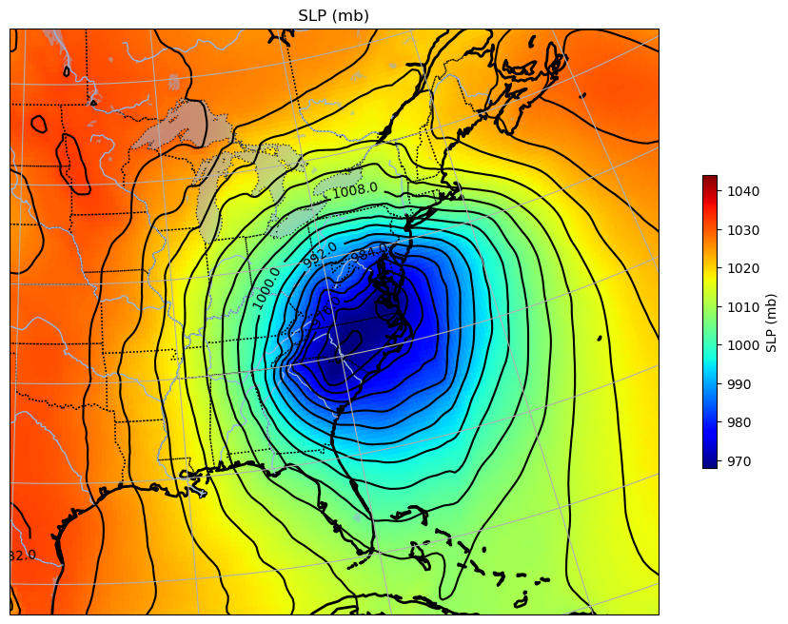
SLP contoured and
color-shaded

Slide 12
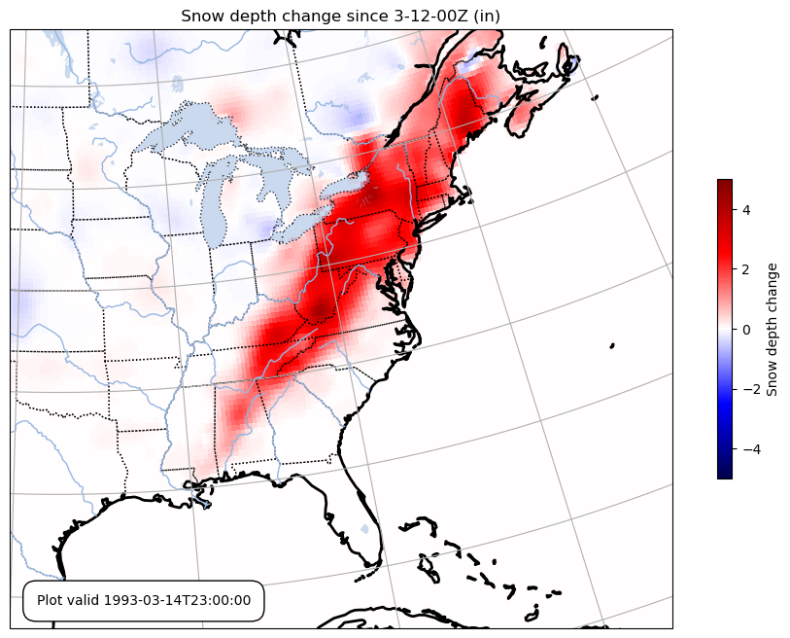
Observations
Reanalysis
Notes:
Snowed all the way down to the Gulf Coast!

Slide 13
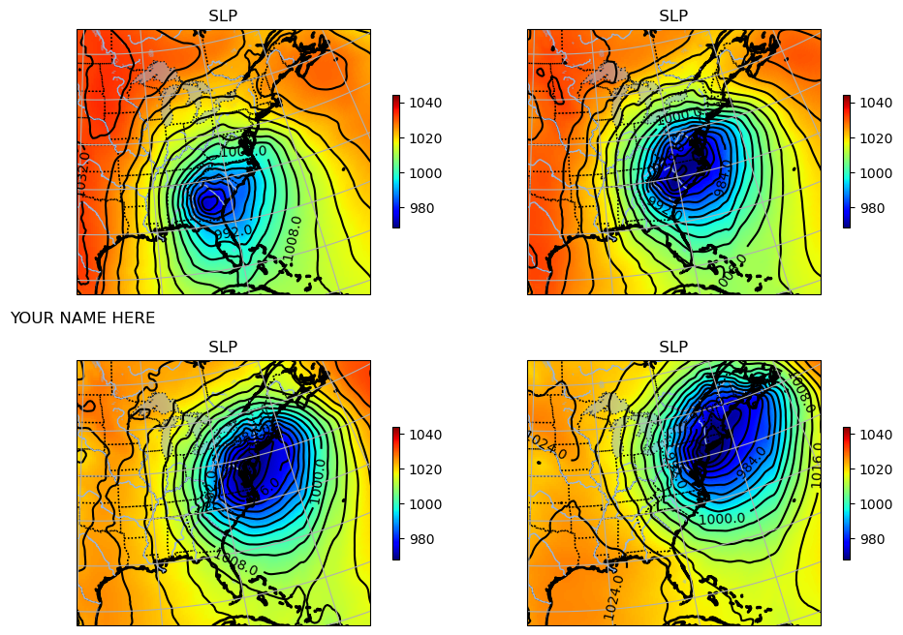

Slide 14
SOC script
Your new script SOC.ipynb in /spare11/atm240/yournetid

Slide 15
Cell #1 – Openers
%matplotlib inline
import matplotlib.pyplot as plt
import numpy as np
import pandas as pd
from pyproj import Proj
import matplotlib.cm as cm
import datetime
import os, sys
import xarray as xr
# cartopy
import cartopy.crs as ccrs # cartopy coordinate reference system
import cartopy.feature as cfeat # features like color-shading for land, ocean, coastlines, state boundaries

Slide 16
Cell #2 – For adding map features
# function for adding common cartopy features to plot. Augmented from GFS_plot_exercise.ipynb
def features(ax):
# Add coastlines and states, etc.
ax.add_feature(cfeat.COASTLINE.with_scale('50m'), linewidth=2)
ax.add_feature(cfeat.STATES.with_scale('50m'),linestyle='dotted')
ax.add_feature(cfeat.LAKES,alpha=0.5) # alpha sets transparency level
ax.add_feature(cfeat.RIVERS)
ax.add_feature(cfeat.OCEAN.with_scale('50m'))
ax.add_feature(cfeat.LAND.with_scale('50m'))
ax.gridlines()
# here is our SOC domain: the east coast
ax.set_extent([-100,-65,23.5,49]) # new addition
return ax
print(" ready to proceed ")

Slide 17
Cell #3 – Open the dataset
# in this cell, open the dataset using xarray. See information below
The dataset is at: /spare11/atm240/DATA/ERA5_SOC_surface.grib
Open as an xarray using the pynio engine
Refer to GFS_plot_exercise.ipynb for a very similar example

Slide 18
Cell #4 – Examine contents, identify variables [we’ll read in variables in next cell]
If you read in the dataset as object ‘ds’, type ‘ds’ in this cell and execute it.
Refer to GFS_plot_exercise.ipynb for inspiration and example.
Identify the variable for SLP {click the paper icon to confirm}
The snow depth variable we will use is SD_GDS0_SFC. (This is not the same as SD_GDS0_SFC_acc1h, also available)
• What units is the snow depth variable in?
Notice the available coordinate variables
What are the coordinates for the SLP and snow depth variables?
What are the latitude and longitude variables?
These lines yield a whole lot of information, in case of need:
names = ds.variables.keys()
print("Variable names:", names)

Slide 19
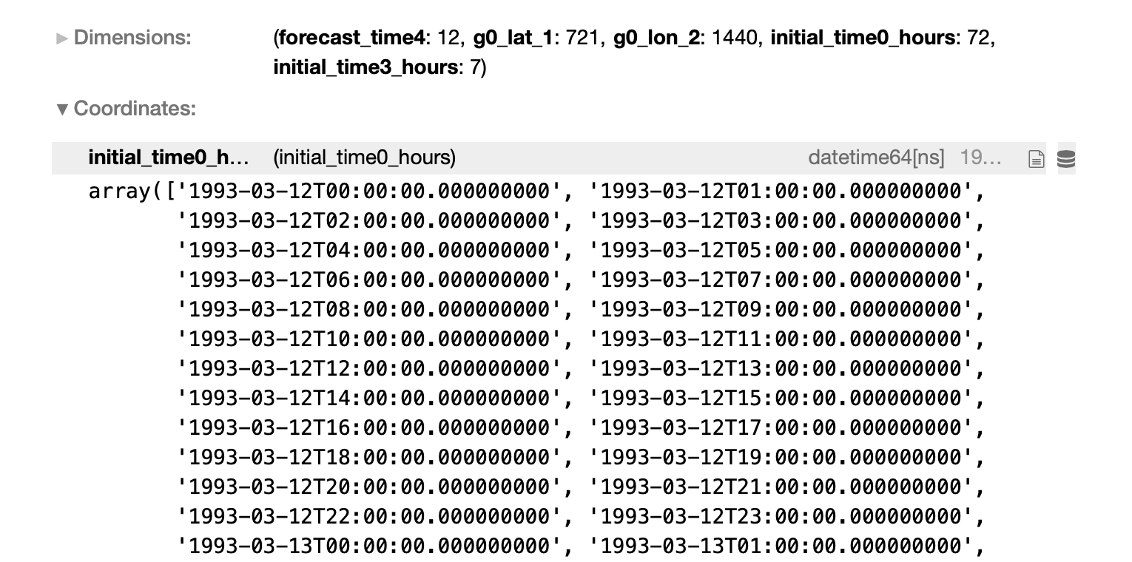
We have multiple times!
(Your screen may look somewhat different)
The SLP and snow depth variables have a
coordinate dimension called
initial_time0_hours
Notice we have multiple times in this dataset
and this coordinate is a datetime variable
We will need to extract specific times of interest
We also have 721 latitudes (g0_lat_1) and 1440
longitudes (g0_lon_2)

Slide 20
Cell #5 – Extract data for 3/13 at 18Z
# If we just grab the SLP variable, we also get all the available times. For now we only want one: 18Z 3/13
allslp = ds.MSL_GDS0_SFC
print(" shape of allslp ",allslp.shape) # or np.shape(allslp) works too
# From the initial_time0_hours coordinate find which is 18Z on 3/13 (remember we’re counting from zero)
forecast_hour = ds.initial_time0_hours[nn] # we’re pulling entry nn {replace with correct number}
slp = ds.MSL_GDS0_SFC[nn] # extracts SLP just for 18Z 3/13
print(forecast_hour.values) # verify we got the correct time. It’s an xarray!
We should see allslp has dimensions (72, 721, 1440): 72 times, 721 latitudes, 1440 longitudes
Our slp variable should have dimensions (721, 1440) since it represents only one single time

Slide 21
Cell #6 – SLP max/min and get lat and lon
# (1) In this cell, print out the max and min of SLP for 3/13 at 18Z. Note this is a global max and min!
# Check your result with the values printed below
# (2) Also create variables lat and lon from the coordinates g0_lat_1 and g0_lon_2. Note no time dimension.

Slide 22
Cell #7 – Plot SLP for 3/13 18Z
Refer to GFS_plot_exercise.ipynb for inspiration and example
Create a figure object, figsize = 12, 8
Set central longitude and latitude to -97.5 and 40.0
Select Lambert Conformal projection
Add a subplot. For this cell, only one plot
Add Cartopy features by calling the features function defined earlier. (This also sets the desired plot extent.)
Plot SLP in millibars as a color fill and contour plot
- color fill using pcolormesh and plt.cm.jet colormap, normalized to 968-1044 mb
- add a colorbar
- then contour at levels 968-1044 every 4 mb
[see slides 23-25]
Show me this plot.

Slide 24
The colormesh plot
A pcolormesh plot can be made like this:
I’ve created arrays lon, lat, and slp.
I normalize the plot between 968 and 1044 mb and specify the ‘jet’ colormap.
I capture the pcolormesh plot as an object (cm) so I can tack on a colorbar. The colorbar label is optional.
norm = plt.Normalize(968., 1044.)
cm = ax.pcolormesh(lon,lat,slp, shading='auto', norm=norm, cmap=plt.cm.jet,
transform=ccrs.PlateCarree())
plt.colorbar(cm, orientation="vertical", shrink=0.5, label='colorbar_label')

Slide 25
The contour plot
A contour plot can be made like this:
I’m reusing arrays lon, lat, and slp.
I specify contours between 968 and 1040 [not 1044!] mb and specify black ‘k’ as color.
I capture the contour plot as an object (cs) so I can manipulate contour labels (optional). The format (fmt) helps me prevent a useless number of digits being printed.
levels=np.arange(968.,1044.,4.)
cs = ax.contour(lon,lat,slp, colors='k', levels=levels, transform=ccrs.PlateCarree())
# I also added contour labels, on every other contour, formatted to suppress too many decimals
# I called my contour map object ‘cs’
fmt = '%r '
ax.clabel(cs, cs.levels[::2], inline=True, fmt=fmt, fontsize=10) # [::2] every other contour

Slide 26
Cell #8 – Make a snow depth change plot
# we need to compute the difference in the snow depth variable between the final and initial times
# converted to inches
# The snow depth variable is SD_GDS0_SFC
# How do we do that?
Make another new figure – again using subplots but just one plot, and this time showing
the difference in snow depth between the final and initial times (3/14 23Z and 3/12 00Z),
This plot should feature:
- snow depth change in inches (39.37 inches per meter)
- pcolormesh plot with colorbar, normalized to ±5 inches
- using colormap plt.cm.seismic
Add a title
Add an information box to the bottom, indicating final forecast time. See slides 28-29.
Also, print out the maximum and minimum values of snow depth difference in inches, checking with these values
MAX/MIN snowd: 4.3622627 -3.6779463
Show me this plot.
[see next slides]

Slide 27
See also
next 2 slides
In some places, snow depth change is
negative since some pre-existing snowpack
was lost. But most of this was new snow
from the Storm of the Century
Notes:
Snowed all the way down to the Gulf Coast!

Slide 28
plt.figtext(0.2,0.14,'Plot valid '+ str(timelast.values),size=10,
bbox=dict(facecolor='white', edgecolor='black', boxstyle='round,pad=1’))
# timelast is a variable I created that holds the final forecast time in datetime format
See also
next slide
Notes:
Snowed all the way down to the Gulf Coast!

Slide 29
Final version
By default, Python gives you a ridiculous number of digits, making
the information box ugly. My plt.figtext string uses the below,
knowing the standard length of the datetime value and pruning
the digits I don’t want. (Is the 19th character included?)
'Plot valid '+ str(timelast.values)[0:19]
Notes:
No.

Slide 30
Cell #9 – 4-panel SLP plot
# In this cell, create a new figure with a 2x2 pcolormesh/contour plot of SLP in millibars at
# 4 different times, representing forecast hours 36, 42, 48, and 54
# This will reveal the development of the Nor’easter cyclone and its movement up the east coast
# Use GFS_plot_exercise.ipynb and your cells above for inspiration and information
# Also see following slides…
# Don’t permit “too much” whitespace between plots
# In a publication-quality plot, we would not want to show the same colorbar four times, but
# this suffices for now
# Put your name on the plot, save it and send it to me, or show it to me
[see next slides for details]

Slide 32
4-panel details - 1
# You have already created a new figure object, and specified figsize
# You have already specified map’s centlon, centlat, and proj [projection]
# ------------------------------------------------------------------------------------------
# Let's make the upper left plot - a plot of 2 m temperature (t2m) as a colormesh
# ------------------------------------------------------------------------------------------
# For add_subplot, we now ask for 2 ROWS, 2 COLS, and start with plot number 1 (2,2,1)
ax = fig.add_subplot(2,2,1,projection=proj)
We are creating a new axis object (ax), and a set of subplots that are 2 rows x 2 columns, and we’re starting
with subplot number 1. We’ll then create 3 more subplots, varying this last number.
1 = upper left, 2 = upper right, 3 = lower left, 4 = lower right.
You can name them all ‘ax’ (reusing the object name), or give then names such as ax1, ax2, ax3, ax4…

Slide 33
4-panel details - 2
Near the end of the cell, you can use something like this to control whitespace between the frames. hspace = height, wspace = width
In savefig, using ’tight’ helps improve figure’s ‘bounding box’
For each frame, plt.title can provide a title. Consider putting the specific time shown into the title. In a multi-frame plot, the (optional) overall plot title is created with plt.suptitle.
plt.subplots_adjust(hspace=0.25) # these two lines squeeze out some whitespace
plt.subplots_adjust(wspace=0.0) # we used these in the COVID script
plt.savefig("SOC_4panel.png", bbox_inches = 'tight')

Slide 34
4-panel details - 3
If I wanted to spruce up my plot more, I would…
Only show the colorbar once, perhaps horizontally at the bottom of the plot
Remove even more whitespace, especially between columns
Put a custom title on each frame, left-justified, referenced as (a), (b), etc.
Have the frame title tell me what time is being displayed
Add an overall title
Change normalization for SLP so lowest pressures are not so deep blue

Slide 35
[end]

