Slide 1
“Fourier thinking”
[tool for visualizing and understanding dispersion error]
ATM 562 Fall 2021
Fovell

Slide 2
Fourier decomposition
A series of numbers, no matter how aperiodic in appearance, can be decomposed into a finite sum of sines and cosines of varying amplitudes and wavelengths
For N points, there will be N wave pairs
  The first pair has wavelength = length of series (N)
  Second pair has wavelength N/2 (so 2 waves in series)
  Third pair has wavelength N/3, and so on…
  Each sine and cosine has its own wave amplitude

Slide 3
“When Fourier presented his first paper to the Paris Academy in 1807, stating that an arbitrary function could be expressed [as a sum of sines and cosines], the mathematician Lagrange was so surprised that he denied the possibility in the most definite terms.”
    Boyce and DiPrima, “Elementary Differential Equations”

Slide 4
1D series in space
• This results from a sum of 10 waves: 5 sines and 5 cosines of 5 different
wavelengths, and 10 different amplitudes
• Could be thought of as time as well
Notes:
fourier_example_NEW.xlsx

Slide 5
First wave pair
• Red curve shows combination of sine and cosine of wavelength = domain width
(i.e., one sine and one cosine in domain)

Slide 6
Remove 1st wave pair

Slide 7
Identify 2nd wave pair
• Red curve now shows combination of sine and cosine wavelength = 1/2 domain width
(i.e., 2 sines and 2 cosines across domain)

Slide 8
Remove 2nd wave pair

Slide 9
Identify 3rd wave pair
• Red curve now shows combination of sine and cosine wavelength = 1/3 domain width
(i.e., 3 sines and 3 cosines across domain)

Slide 10
Remove 3rd wave pair

Slide 11
Identify 4th wave pair
• This wave pair represents 6 sines and cosines across domain

Slide 12
Remove 4th, identify final pair
• This wave pair represents 25 sines and cosines across domain (4∆x)
• I just used 10 waves. In reality, up to N (=100) could have been employed

Slide 13
…and they all sum to this
• All 10 waves combine to produce original series
• In the simplest case, all waves should be treated the same (same phase speed)
• In reality, advection error becomes worse as wavelengths become smaller

Slide 14
The original feature and its (paired) parts
Simple wave equation: feature is advected at speed c without change of amplitude or shape
Advection error: A wave’s amplitude not preserved and/or its speed is too fast or slow.
Dispersion error: Advection error varies with wavelength.
If error is dispersive, feature will unravel.

Slide 15
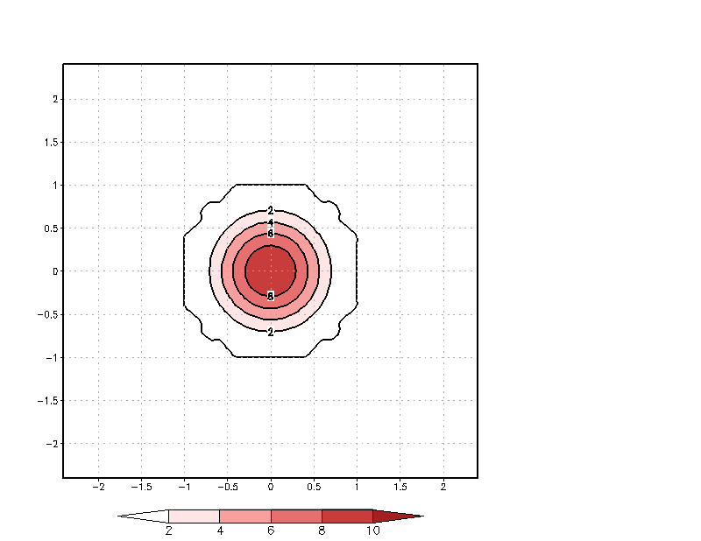
Model Task #4
Advection of a cone
at constant speed
in doubly periodic domain
Shaded: true solution
Contoured: numerical solution
• amplitude error: cone height
not perfectly preserved
• phase error: cone lags slightly
behind true solution
• dispersion error: phase error is
worse for smaller wavelengths
(2∆x, 2∆z waves actually
move in wrong direction)
Notes:
Smallest scale waves are moving in the wrong direction!

Slide 16
set black 0 0
would suppress the
zero contour, but
make us miss an
important point!!

