Slide 1
Adjoint models: Applications
ATM 562
Fovell
Fall 2021
(See course notes, Chapter 17)

Slide 2
Recap of theory

Slide 3
Background: integrate model
Initial condition is u₀. Integrate for N time steps.
We can relate the final forecast to the initial condition
through the transition matrix Q_{N}

Slide 4
Tangent linear model (TLM) - example
Example:
Model task 0B with
slightly different c
or slightly shifted
initial conditions
Keep in mind:
differences have to
be small

Slide 5
Tangent linear model (TLM) #6
Integrate the TLM. Initial condition is u’’₀
C_{n} based on control model run ONLY
- Run control simulation
- Archive C_{n} “every time step” (ideally)
[that’s for the adjoint]
- Initialize and run TLM

Slide 6
Forecast aspect J_{N} and its change ∆J_{N}
Change of J
at time N
Perturbation applied
to variable/location
x_{l} at time N
Sensitivity of J to x_{l}
at time N
p variables
M locations
Perturb a variable/location
It only changes J if J is sensitive to it!!!!

Slide 7
Making this less trivial
Renaming sensitivity for convenience
Rewrite as an inner product
Postulate the adjoint model, a prediction model for sensitivity x*
From control run
Take the TLM model and
Replace x’’ by x*
Transpose C_{n}
Operate it backwards
Note C_{n}^{T} ≠ C_{n}⁻¹, so we are NOT running the TLM backwards
TLM
Adjoint

Slide 8
The recipe
by definition
relate final to initial time
invoke adjoint property
relate final to initial time
trivial
Note therefore that
Jeopardy! = you know the answer,
you are trying to get the question

Slide 9
The recipe
KNOWN
TRIVIAL
KNOWN
NOT TRIVIAL!
x* identifies what perturbations x’’ have
to be at the initial time to get that
desired change to J at time N

Slide 10
Integrating the adjoint
(1) Run the control model to time N
and save C_{n} every time step
(2) Initialize adjoint at time N
(3) Integrate adjoint backwards,
reading in C_{n} from archive
You DON’T need to integrate the TLM
Sensitivities will tell us what to perturb at initial time
to get the desired changes at final time
(subject to applicability of assumptions)

Slide 11
Integrating the adjoint
Provided by you
KNOWN KNOWN
(1) Run the control model to time N
and save C_{n} every time step
(2) Initialize adjoint at time N
(3) Integrate adjoint backwards,
reading in C_{n} from archive
You DON’T need to integrate the TLM
KNOWN
Obtained by
integrating adjoint
(which fields at which locations
at this time impact forecast aspect J
at final time N)

Slide 12
Examples

Slide 13
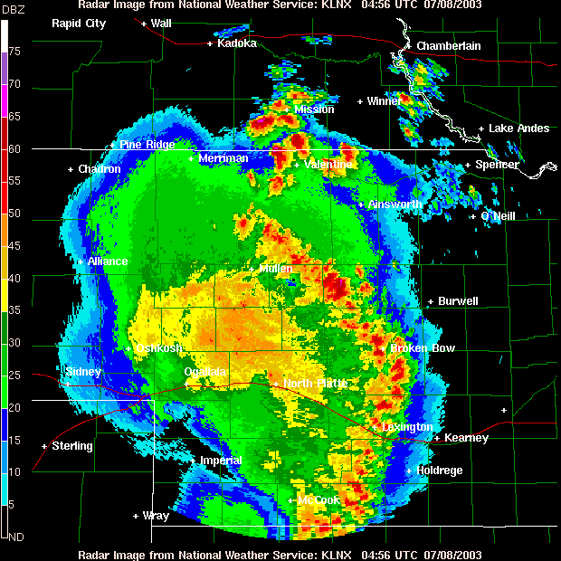
8 July 2003, Lincoln, NE
Notes:
08jul03-KLNX-multicell.GIF

Slide 14
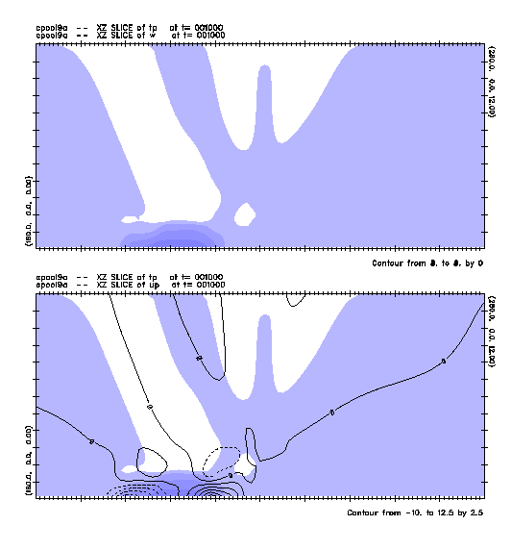
Multicellular unsteadiness
2D cloud model

Slide 15
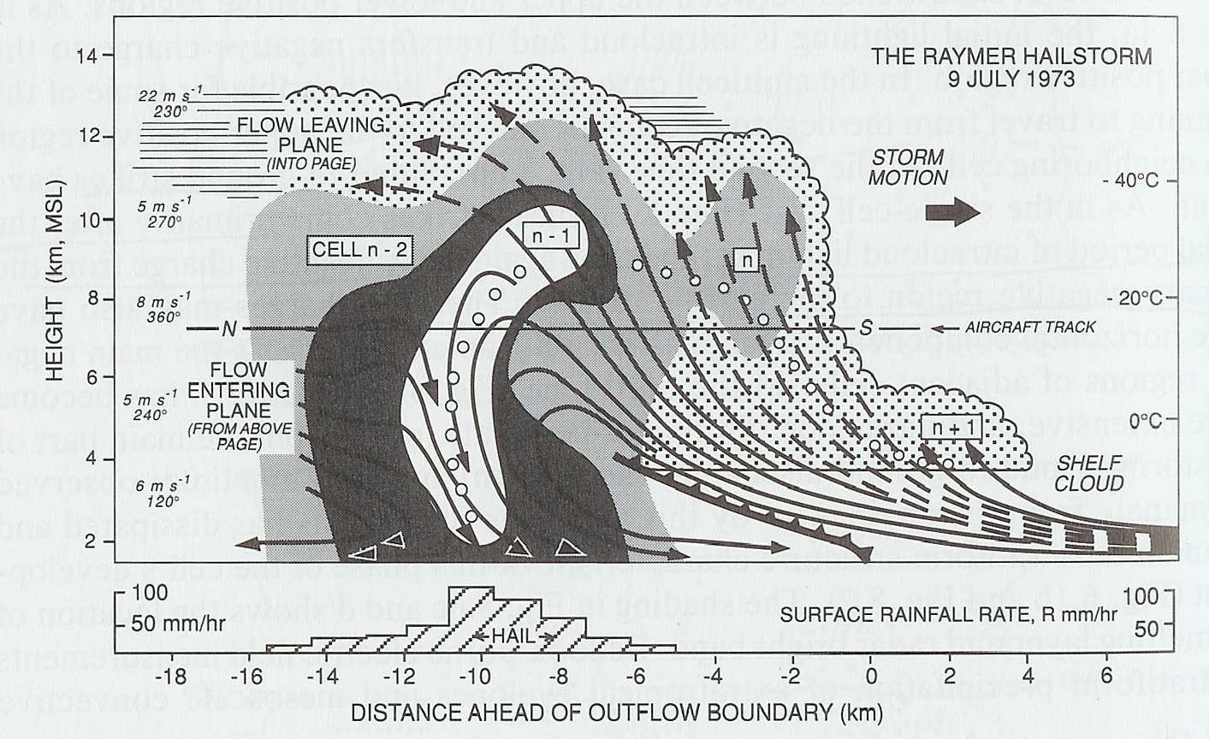
The multicell storm
Four cells at a single time
Or a single cell at four times
Browning et al. (1976)
Notes:
Also show multiple cells in conceptual model

Slide 16
Why are multicell storms unsteady?
Unsteady, long-lived storms consisting of short-lived elements (convective cells), sometimes organized into squall lines
1970s-1980s view
  The “ideal multicell” storm was steady – a “2D supercell”
    Why was this ever believed or desired?
  Unsteadiness was believed to be rooted in microphysical time scales
    This issued from 1D column models where downdraft development → demise
  ‘Science advances one funeral at a time’ – Max Planck (attributed)
Cloud models can be very complicated, especially due to moisture and microphysics → makes attribution studies difficult
Einstein (attributed): “Make things as simple as possible, but no simpler”
Notes:
Need to know the literature – to know what is known – but also run the risk of inheriting wrong ideas and assumptions. But fresh eyes can possibly see past that…
We see things through the lens of what we know. Sometimes that lens becomes warped or is distorted

Slide 17
The parameterized moisture model
Garner and Thorpe (1992) constructed a parameterized moisture (PM) model
  a cloudless cloud model with no microphysics, and even no moisture, in order to reveal the squall line’s underlying steady state, to elucidate the role of vertical wind shear in organizing the storm
  Exclusion of microphysics meant no rain-cooled downdrafts, “the main cause of cell decay”
Later… Fovell and Tan (1998) described multicellular unsteadiness as an episodic dry air entrainment process – no microphysics necessary
  Inspired by observing Malibu fire from a somewhat uncomfortable distance
Motivation for studying the PM model:
  The framework is attractively simple
  BUT, if Fovell and Tan (1988) was correct, why didn’t the PM model have unsteady solutions?
Executive summary of Fovell and Tan (2000):
  PM model does support unsteady cellular solutions
  But something else was odd about those results…

Slide 18
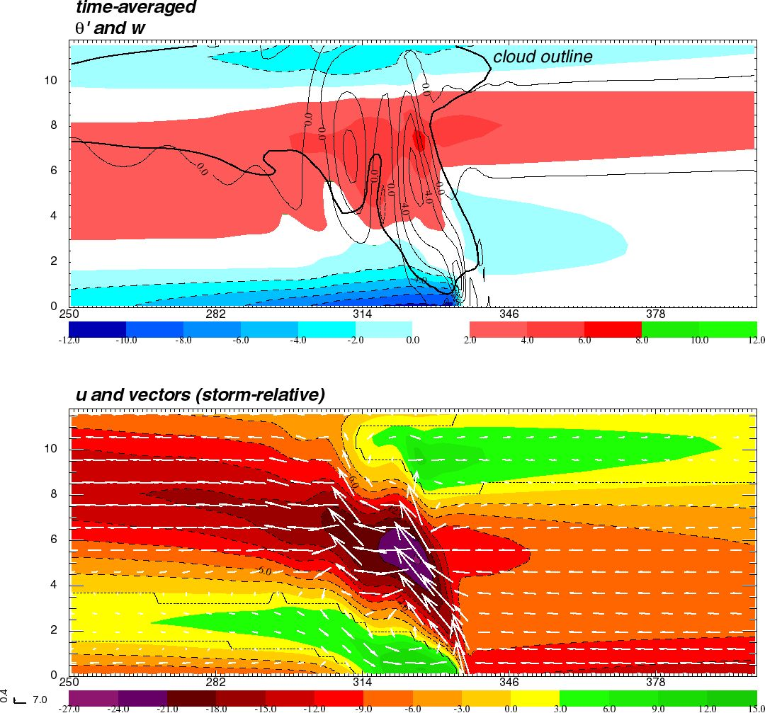
“Real” 2D cloud model output
Vertical cross-sections of a modeled squall line
D
Shaded: perturbation
potential temperature
(rel. to initial state)
Contoured: vert. velocity
Shaded: horiz. velocity
Vectors: u,w
A = warmed by latent
heat release
B = “warmed” by subsidence
(& mod by advection)
C = cooled by evaporation
D = “cooled” by adiabatic
expansion (overshooting)
E = “cooled” by forced ascent
B
A
B
E
C
Forward anvil outflow
Front-to-real flow
Rear inflow
Low-level inflow

Slide 19
Parameterized moisture (PM) framework
PM model removes explicit moisture
  See Garner and Thorpe (1992), Fovell and Tan (2000), Fovell (2002, 2004)
In a designated area (“unstable zone”) any and all ascent is presumed saturated, and generates heat proportional to updraft velocity
  Outside of unstable zone, updraft produces adiabatic cooling
Descent is presumed subsaturated (producing adiabatic warming) everywhere
Evaporation of rain is mimicked with a near-surface heat sink
PM physics is linear, with a simple adjoint representation
PM was producing unrealistic results… and its adjoint helped show what was wrong, and where (the user has to explain ‘why’)

Slide 20
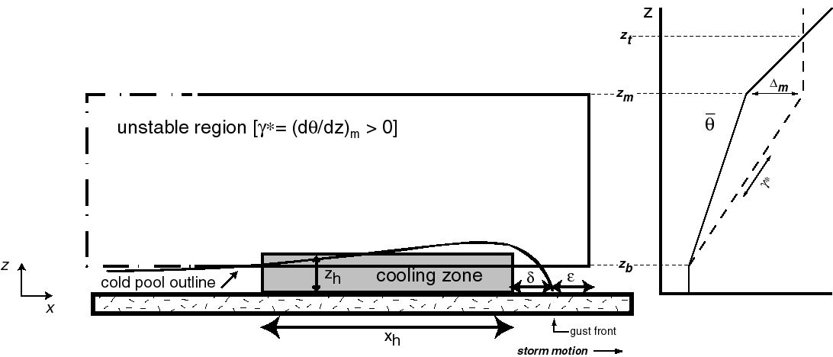
Parameterized Moisture model framework
In unstable region,
warm UP and warm DOWN
θ
“Real” 2D cloud model output
Fovell and Tan (2000) Fovell (2002, 2004)
Notes:
PM model setup

Slide 21
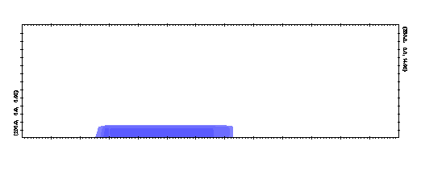
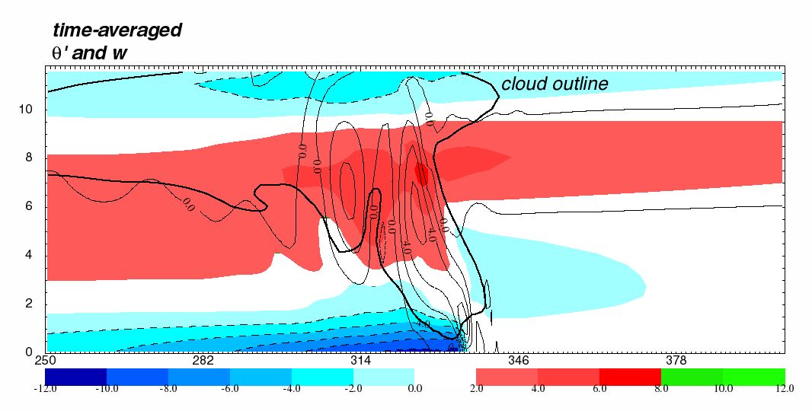
PM model
θ’ (shaded)
w (contoured)
Explicit moisture model
θ’ (shaded)
w (thin contoured)
Cloud outline (thick
contour)
[This is one of the steadier solutions, but
the model did produce realistic transience.]

Slide 22
Important points regarding the forward model and its adjoint
The forward model propagates temperature, pressure, velocities, etc., forward in time, from initial to final time
  Because the model is coupled, an initial disturbance in one field at one location at one time spreads to other fields at other locations at subsequent times
  The forward model’s control run forecasts are (ideally) archived every time step
The adjoint model propagates sensitivity to temperature, pressure, velocities, etc., backwards from final to initial time
  It is tied to the control run, which provides the “information” used to propagate the sensitivity in reverse
  Because the adjoint is also coupled, sensitivity originally confined to a single field and location at the final time will spread to other fields and locations at previous times
  Subject to the limitations of the model and method, this shows how the final forecast aspect could have been different, had certain fields and locations been altered at earlier times

Slide 23
Example #1
What would be needed to increase the upper tropospheric forward anvil outflow at a certain location and time?
Run first with adiabatic version of PM model
(i.e., sensitivity to diabatic heat sources ignored at first)

Slide 24
Sensitivity of forward anvil outflow
Forecast aspect J will be horizontal velocity at a certain place and time, located within the storm’s forward anvil outflow, where u > 0
∆J will be the change in this outflow
  So ∆J > 0 increases the outflow velocity
• Ran control PM model forwards to time N, archiving output
every time step → that creates C_{n}
• Initialized adjoint at time N with sensitivity confined to
u field in specific, confined area (x_{N}*)
• Run adjoint backwards, propagating sensitivity to other
fields and locations
• Don’t need to integrate adjoint all the way back to t = 0

Slide 25
Required perturbations at some time n
Perturbation required to accomplish desired change (inferred)
EXAMPLE: Want to increase J, so want ∆J > 0
- for fields and locations where sensitivity is positive,
the required perturbation is positive
[i.e., increase existing + or decrease – values]
- for fields and locations where sensitivity is negative,
the required perturbation is negative
- where sensitivity is zero, no perturbation will be effective
(according to the adjoint model, anyway)
Predicted by adjoint model

Slide 26
Required perturbations at some time n
Perturbation required to accomplish desired change (inferred)
Predicted by adjoint model
In this experiment, we are not predicting perturbations x” at all. No TLM involved.
We are predicting sensitivities x* backwards, and inferring the perturbations that
would be needed to accomplish the ∆J we want.

Slide 27
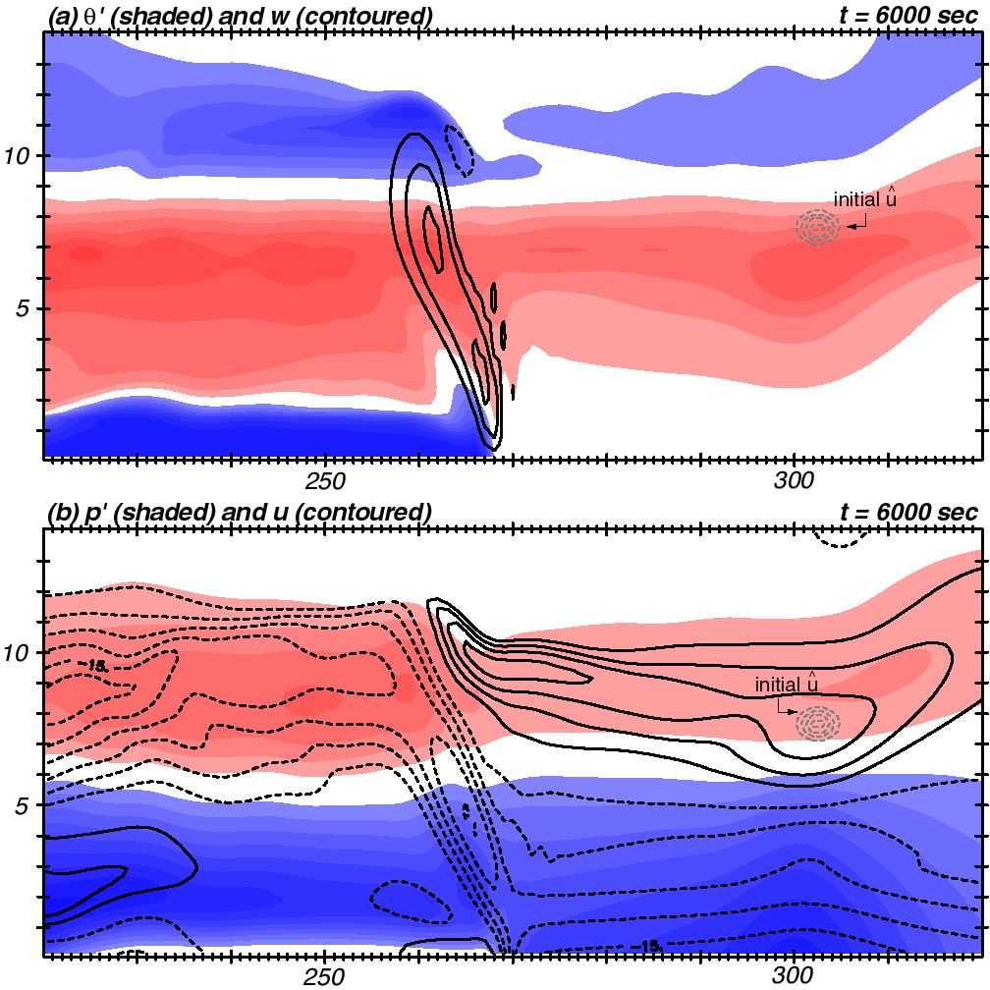
Final control run fields and forecast aspect
^
x* (x) at final time is ONLY a function
of horiz. vel. u, and ONLY in area shown
θ’ (shaded)
w (contoured)
from control run
p’ (shaded)
storm-rel u (contoured)
from control run
sensitivity
initialization
(at final time)
J is outflow velocity
∆J > 0 enhances outflow

Slide 28
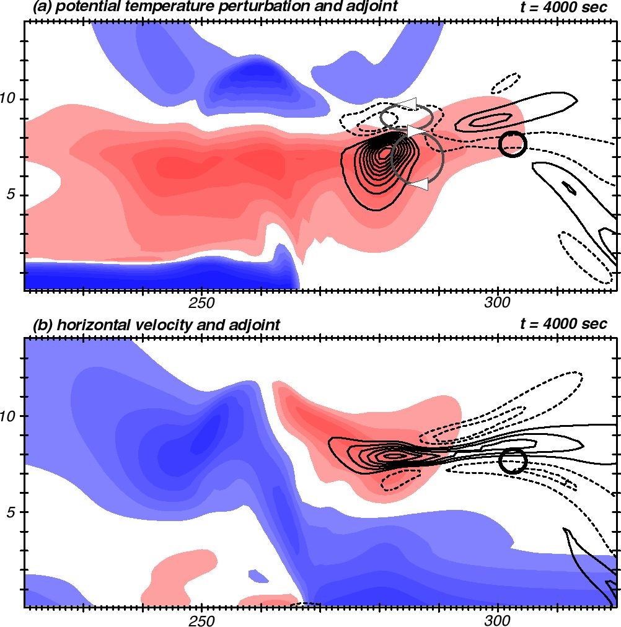
Adjoint run with adiabatic adjoint model
J is outflow velocity
∆J > 0 enhances outflow
Adjoint model run backwards 2000 sec
Shaded field: u from forward control run
Contoured: sensitivity to u from adjoint run
Adiabatic adjoint ignores
how ∆w -> ∆θ’ in moisture
parameterization
To increase outflow velocity there later (i.e., ∆J > 0),
Increase outflow velocity HERE NOW
Sensitivity is +
So, for ∆J > 0, need + perturbation
Flow is already +
Therefore, + pert makes it more +
(speeds flow up more)
Original J location

Slide 29
Adjoint run with adiabatic adjoint model
Adjoint model run backwards 2000 sec
Shaded field: u from forward control run
Contoured: sensitivity to u from adjoint run
… and/or slow down outflow here
Sensitivity is -
So, for ∆J > 0, need - perturbation
Flow is already +
Therefore, - pert slows it down
And perturbations here do not matter
as there is no sensitivity (at this time)
and here
Notes:
Confining anvil outflow into a shallower layer at 4000 s leads to stronger outflow at the selected location at 6000 s (end time)

Slide 30
Adjoint run with adiabatic adjoint model
Sensitivity is -
So, for ∆J > 0, need - perturbation
θ’ is already +
Therefore, - pert cools it down
…and/or by decreasing it HERE
Increase outflow there later
..by increasing temperature HERE NOW
Sensitivity is +
So, for ∆J > 0, need + perturbation
θ’ is already +
Therefore, + pert makes even warmer
w
Notes:
Model is providing the sensitivity – WE are providing the interpretation

Slide 31
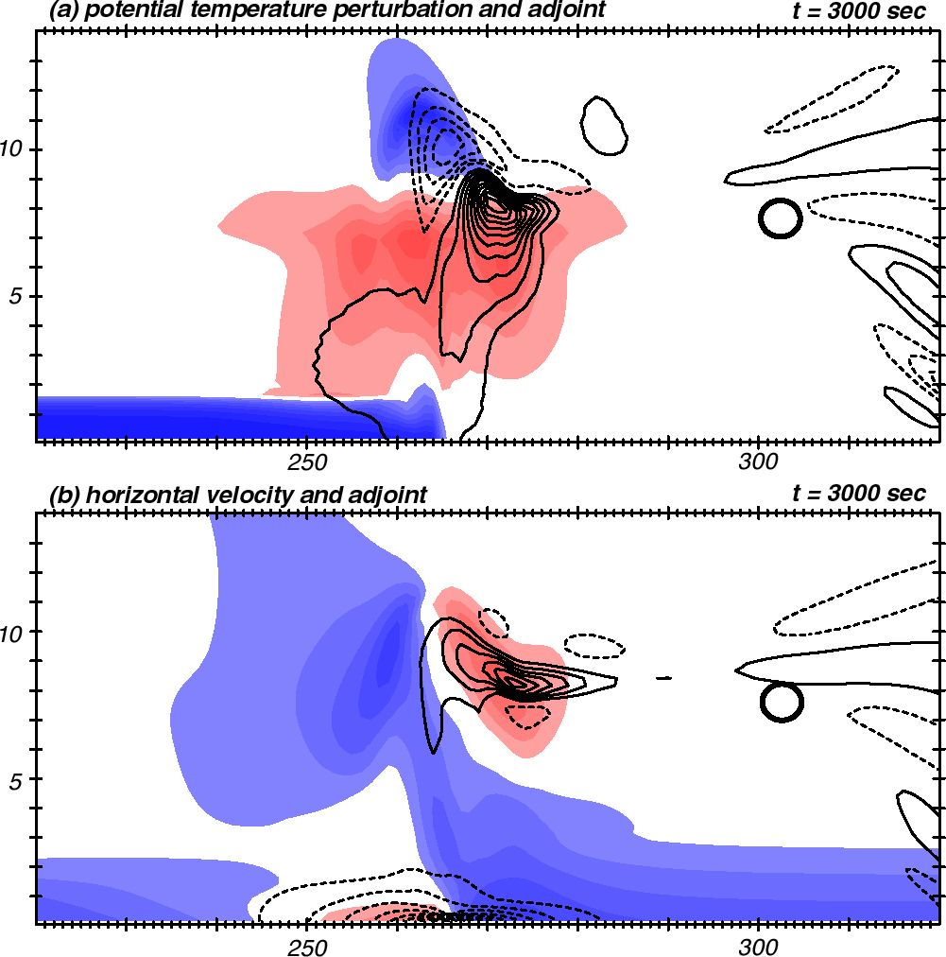
Adjoint run with adiabatic adjoint model
Go back another 1000 sec
Decreasing the westerly
flow here now enhances
the upper trop outflow later?
(Hard to explain)
Increasing inflow here
enhances upper trop outflow later…

Slide 32
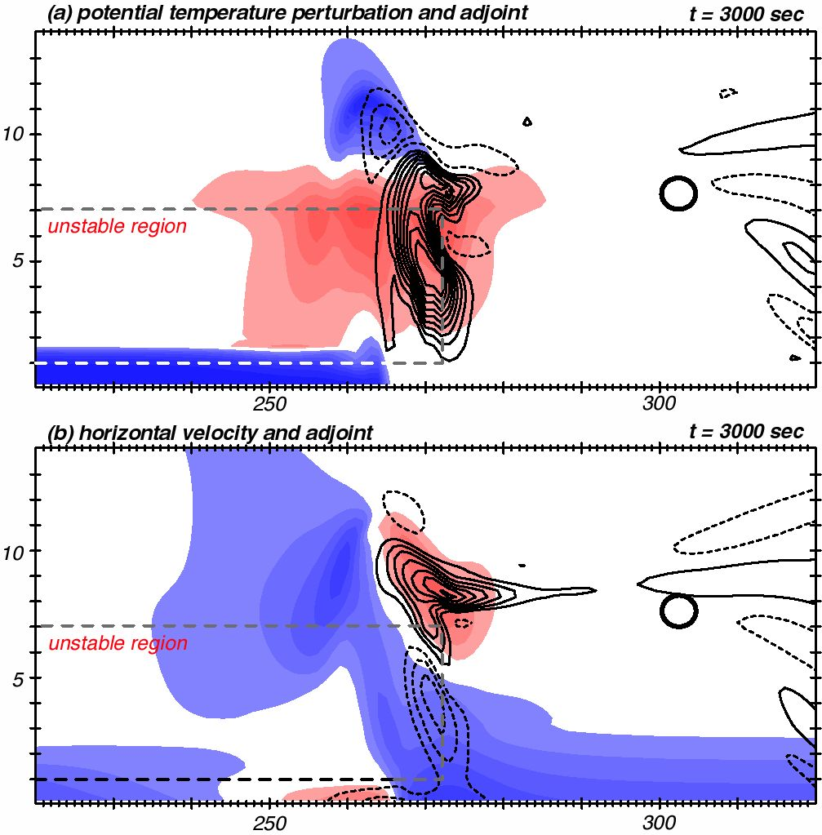
Adjoint run with DIABATIC adjoint model
The adjoint provides the
sensitivity fields
You provide the interpretation,
subject to adjoint’s
assumptions & limitations
The diabatic adjoint model
includes PM physics, so
changing flow in unstable
region changes heating from
control run values
(If the physics is not
incorporated into adjoint
correctly, the conclusions
will be wrong/different)
Sensitivity a lot smaller
now that diabatic response
is permitted...

Slide 33
Example #2
Diagnose unrealistic results from PM model

Slide 34
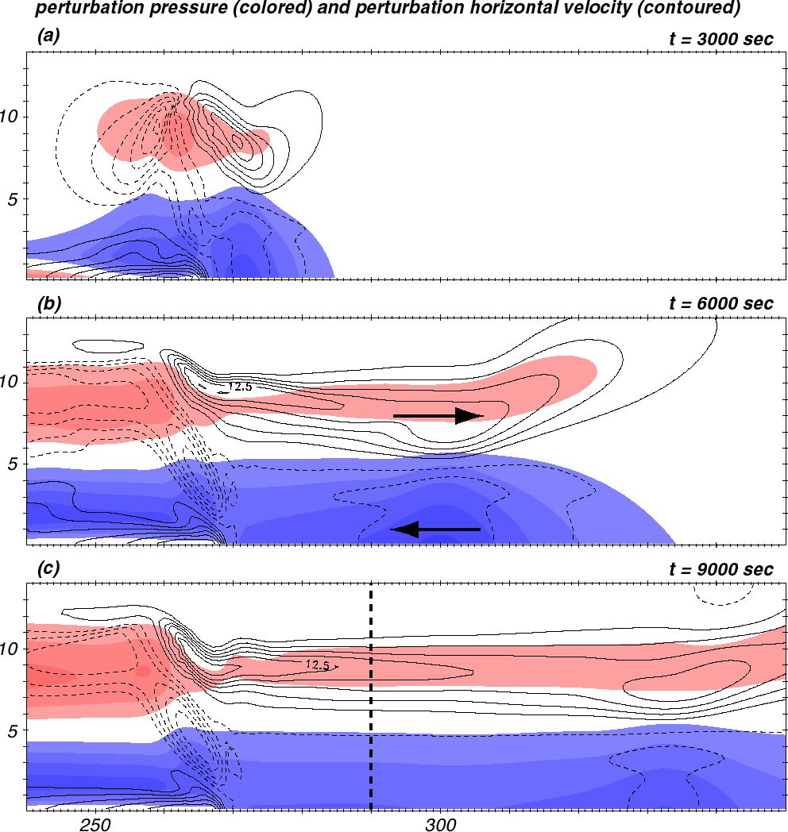
PM forward model fields
at 3 times
Flow away from storm
in upper troposphere,
flow towards storm
in lower troposphere

Slide 35
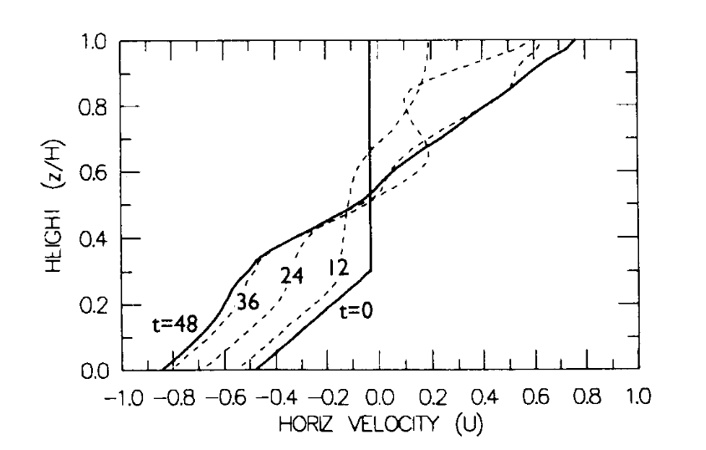
Garner and Thorpe (1992)
(nondimensionalized)
PM forward model fields
at 3 times
Flow away from storm
in upper troposphere,
flow towards storm
in lower troposphere
PM model causes substantial
acceleration of low-level
inflow and upper level
outflow (relative to initial
state) ahead of storm

Slide 36
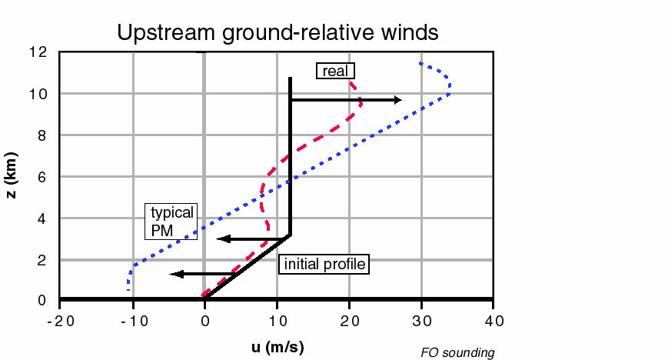
Garner and Thorpe (1992)
Induced inflow and outflow too strong
Induced inflow max at wrong level
(compared with “real” cloud model)
PM forward model fields
at 3 times
Flow away from storm
in upper troposphere,
flow towards storm
in lower tropsphere
Fovell and Tan (2000)

Slide 37
Anelastic constraint - 1
Start with traditional anelastic continuity equation & integrate around a box
Taking the upper and lower boundaries to be rigid (w = 0) removes the
vertical term, leaving

Slide 38
Anelastic constraint - 2
Integration with respect to x from left (L) to right (R) yields
This implies that the vertical sum of mean density x horizontal flow
in a column is preserved.
Therefore, enhancing westerly flow at some level (relative to
the initial state) has to be balanced by increased easterly flow elsewhere,
and vice-versa.
(My model is compressible, but deviation from anelasticity is small.)

Slide 39
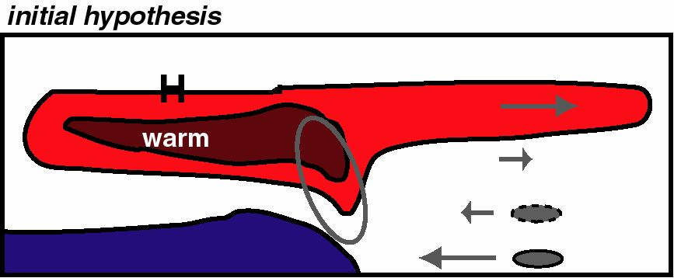
• Anelastic constraint means upper and lower tropospheric
problems are related
• HYPOTHESIS:
(1) PM model is warm UP and warm DOWN
(2) Rear side of storm too HOT
(3) Pressure in upper tropo at rear too HIGH
(4) Horizontal PGF in upper trop across storm too LARGE
(5) Forward anvil outflow too STRONG
(6) So lower level inflow also too strong, due to anelastic
constraint
• PROPOSED SOLUTION: Implemented a sponge to prevent rear side of storm from getting so hot

Slide 40
“For every problem, there is one solution which is simple, neat and wrong.”
- H. L. Mencken
(In other words, I couldn’t get the rear sponge to fix the problem.)

Slide 41
• Forecast aspect J is horizontal velocity ahead of storm
- want to increase inflow in middle troposphere
- want to decrease inflow in lower troposphere
(these are two separate experiments)
Want to decrease u (strengthen the inflow)
Define J = -u and want ∆J > 0
Want to increase u (decrease the inflow)
Define J = u and want ∆J > 0
Inflow is u < 0

Slide 42
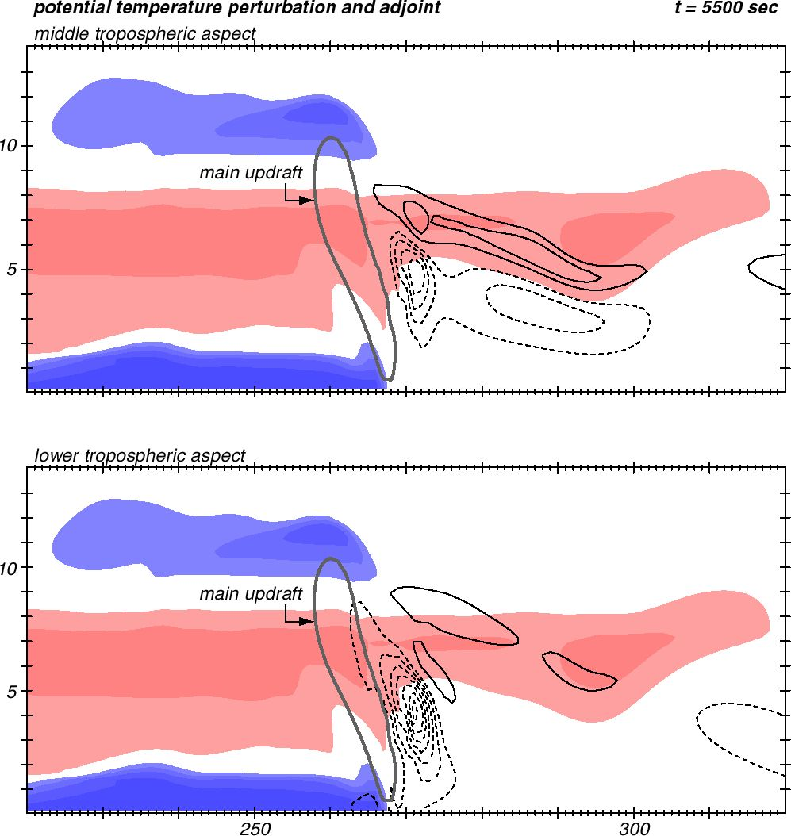
“Want” ∆J > 0
Focus on temperature field
and sensitivity
Integrated adjoint model
backwards 500 sec
Both experiments identified
the same answer
Increase midlevel inflow (there later)
by making it cooler (here now)
Middle tropo J
Lower tropo J
Reversed sign of J from notes
Decrease low-level inflow (there later)
by making it cooler (here now)
Color shaded: control run
Contoured: adjoint sensitivity
Notes:
Lower aspect: want ∆J > 0. Since sens neg, want to apply neg perts. Theta’ already neg so make cold air COLDER.

Slide 43
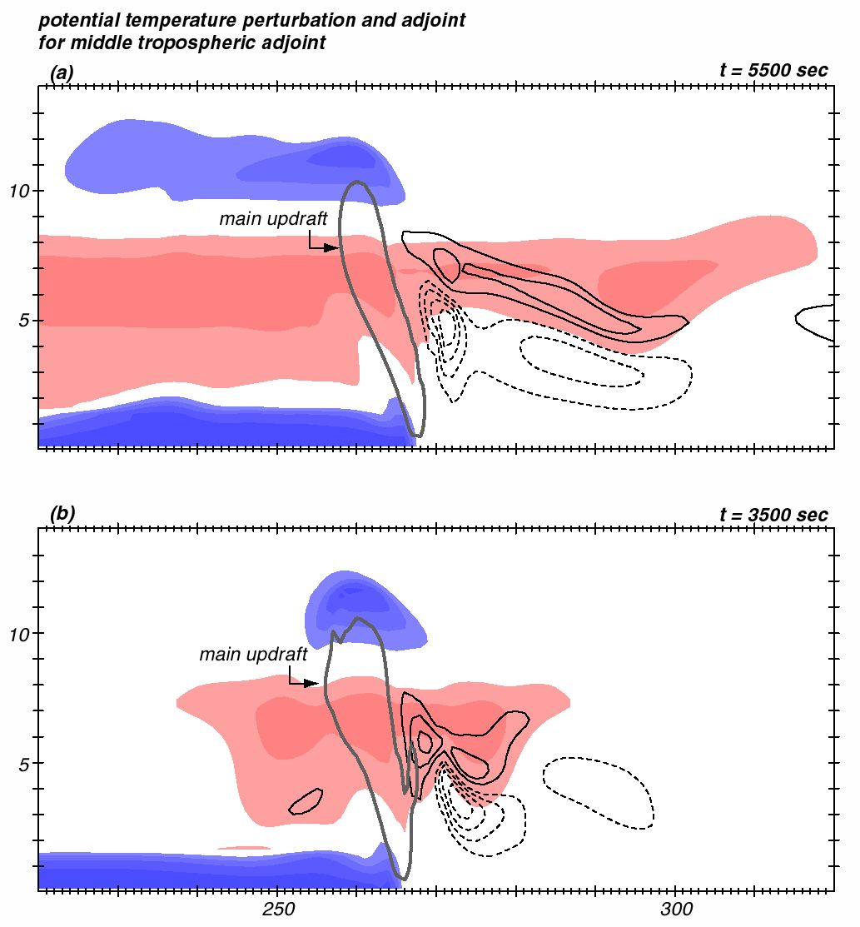
Sensitivity never “reaches”
any field at the rear of the
storm…
… which is why my hypothesis
didn’t work
The hypothesis was physically
plausible, but it wasn’t how
the model got it wrong
Run middle tropo aspect
back another 2000 sec
Notes:
BOTH plots are middle tropo aspect, at diff times

Slide 44
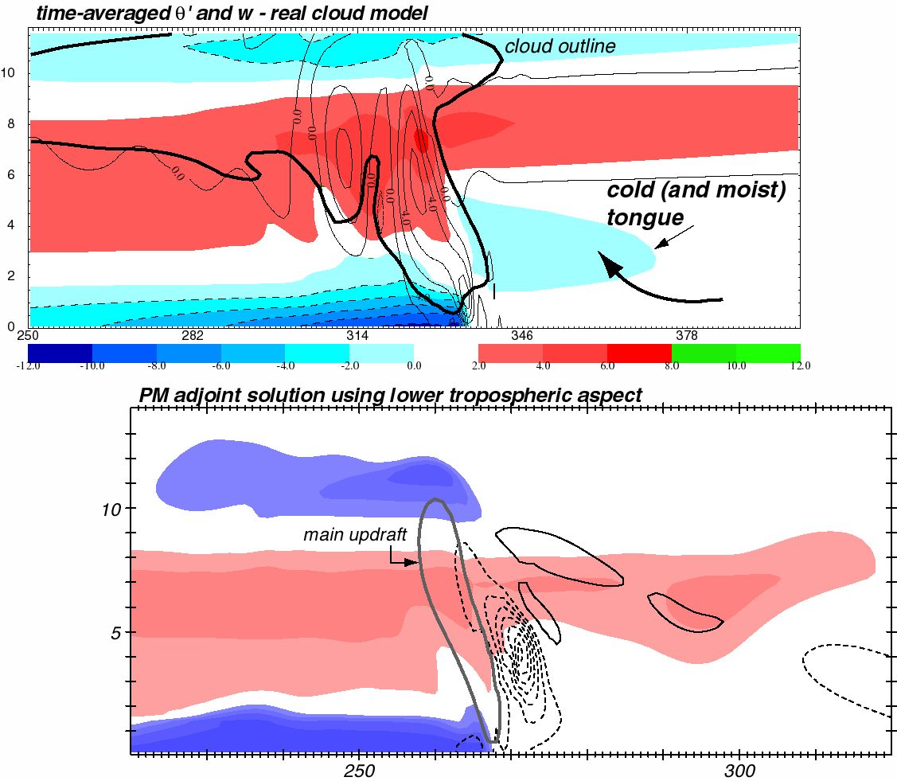
Real cloud model
Adjoint PM model
X

Slide 45
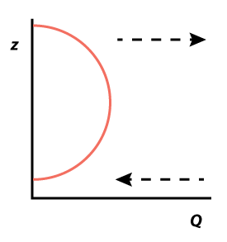
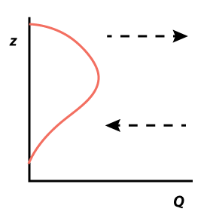
PM model design
presumed this heating profile
which induces low-level inflow
... but the real cloud model
produces a different profile
which induces mid-level inflow
Notes:
PM model setup

Slide 46
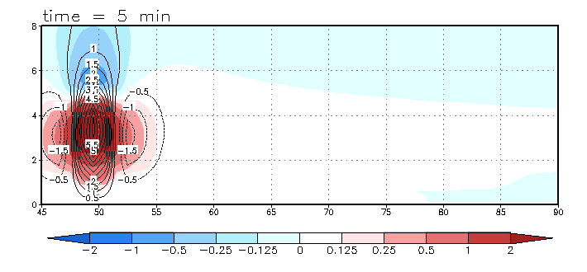
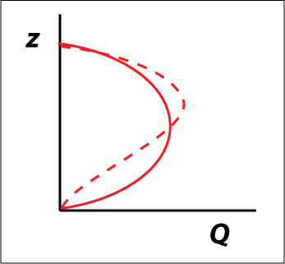
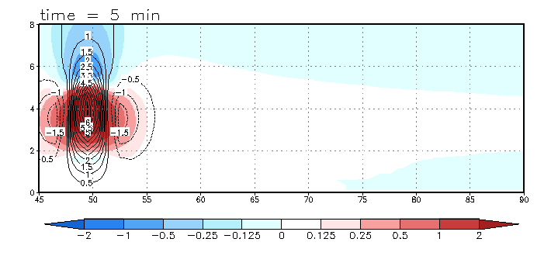
Imposed heat source
[see Chapter 15.6]
Origin of “cool tongue”
Half-sine heating
profile (solid)
“Top-heavy”
heating profile
(dashed)

Slide 47
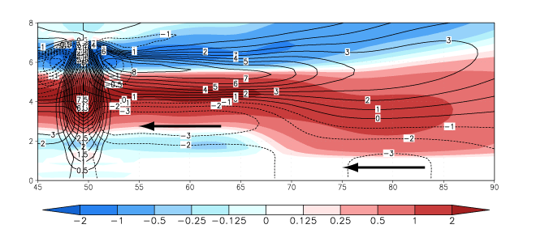
θ’ and U for top-heavy profile

Slide 48
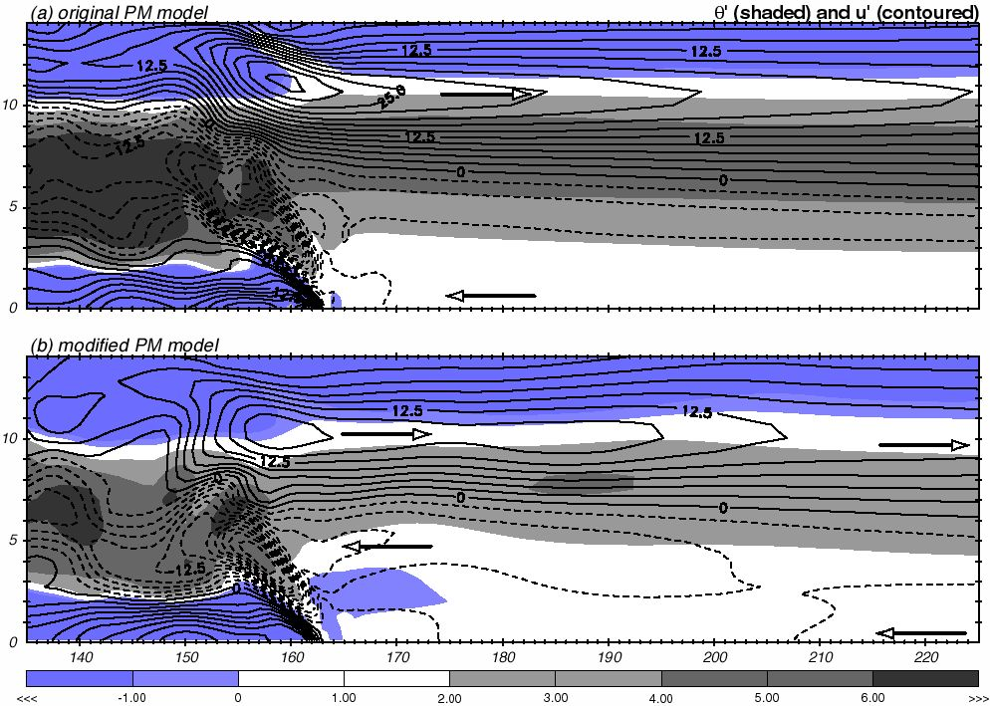
Fixing the PM model
Fovell (2002, 2004)

Slide 49
A simple explicit-moisture model and its adjoint
J
Contoured: temperature sensitivity
at t = 5500 sec
This model has water vapor and
condensation, but no microphysics.
All cloud water is removed
(pseudoadiabatic).
Physics still easy to make adjoint of.

Slide 50
Concluding comments
Adjoint model advantage: can dynamically trace model output features (especially errors) back to their sources
  How did the model get to a particular state?
Adjoint model disadvantages:
  Difficult to construct
  Inherent assumptions cannot be ignored
  Massive storage may be required to ”do it right”
Course notes Chapter 16 discusses how to construct an adjoint model from the model discretized equations
  Automatic software tools are also available
  Real challenge is crafting adjoints to complicated model physics (PBL, microphysics, diffusion, radiation, etc.) and linearity of the model assumptions
  Viable alternative: ensemble sensitivity analysis (e.g., Torn and Hakim 2008)

Slide 51
[end]

