Slide 1
Adjoint models: Examples
ATM 562
Fovell
Fall 2018
(See course notes, Chapter 17)

Slide 2
Recap of theory

Slide 3
Background: integrate model
Initial condition is u₀. Integrate for N time steps.
We can relate the final forecast to the initial condition
through the transition matrix P_{N}

Slide 4
Tangent linear model (TLM) - example
Example:
Model task 0B with
slightly different c
or slightly shifted
initial conditions
Keep in mind:
differences have to
be small

Slide 5
Tangent linear model (TLM) #6
Integrate the TLM. Initial condition is u’’₀
C_{n} based on control model run
- Run control simulation
- Archive C_{n} “every time step” (ideally)
- Initialize and run TLM

Slide 6
Change of forecast aspect ∆J_{N}
Change of J
at time N
Perturbation applied
to variable/location
x_{l} at time N
Sensitivity of J to x_{l}
at time N
p variables
M locations
Perturb a variable/location
It only changes J if J is sensitive to it!!!!

Slide 7
Making this less trivial
Renaming sensitivity for convenience
Rewrite as an inner product
Postulate the adjoint model, a prediction model for sensitivity x*
From control run
Take the TLM model and
Replace x’’ by x*
Transpose C_{n}
Operate it backwards
Note C_{n}^{T} ≠ C_{n}⁻¹, so we are NOT running the TLM backwards
TLM
Adjoint

Slide 8
The recipe
by definition
relate final to initial time
invoke adjoint property
relate final to initial time
trivial
Note therefore that

Slide 9
The recipe
KNOWN
TRIVIAL
KNOWN
NOT TRIVIAL!
x* identifies what perturbations x’’ have
to be at the initial time to get that
desired change to J at time N

Slide 10
Integrating the adjoint
(1) Run the control model to time N
and save C_{n} every time step
(2) Initialize adjoint at time N
(3) Integrate adjoint backwards,
reading in C_{n} from archive
You DON’T need to integrate the TLM
Sensitivities will tell us what to perturb at initial time
to get the desired changes at final time
(subject to applicability of assumptions)

Slide 11
Integrating the adjoint
Provided by you
KNOWN KNOWN
(1) Run the control model to time N
and save C_{n} every time step
(2) Initialize adjoint at time N
(3) Integrate adjoint backwards,
reading in C_{n} from archive
You DON’T need to integrate the TLM
KNOWN
Obtained by
integrating adjoint
(which fields at which locations
at this time impact forecast aspect J
at final time N)

Slide 12
Examples

Slide 13
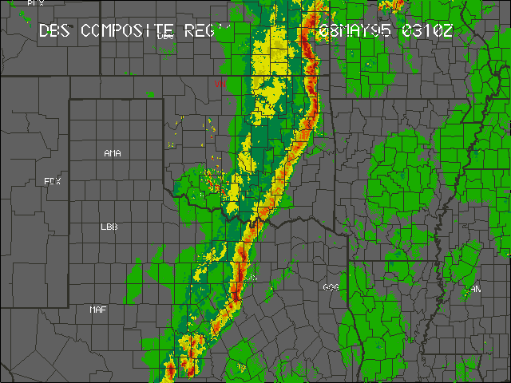
A midlatitude squall line

Slide 14
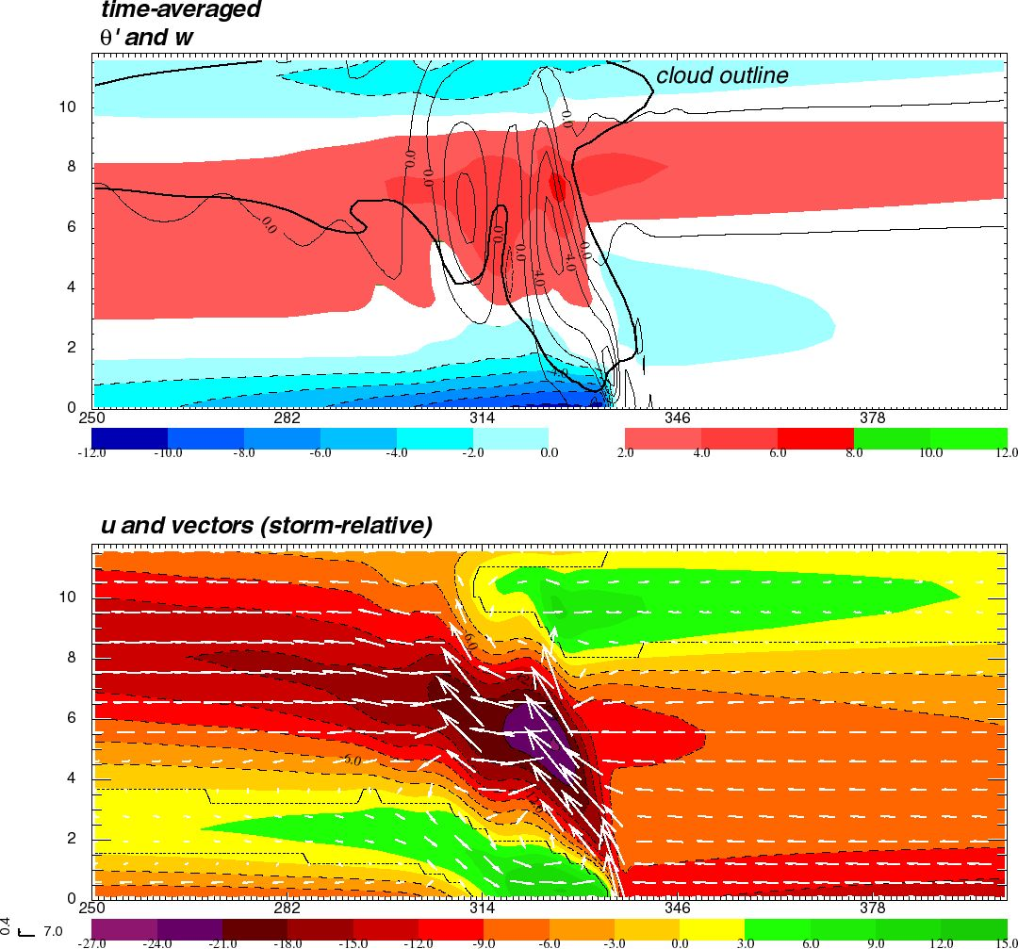
Vertical cross-sections of a modeled squall line
D
Shaded: perturbation
potential temperature
(rel. to initial state)
Contoured: vert. velocity
Shaded: horiz. velocity
Vectors: u,w
A = warmed by latent
heat release
B = warmed by subsidence
(& mod by advection)
C = cooled by evaporation
D = cooled by adiabatic
expansion (overshooting)
E = cooled by forced ascent
B
A
B
E
C

Slide 15
Parameterized moisture (PM) framework
PM model removes explicit moisture
  See Garner and Thorpe (1992), Fovell and Tan (2000), Fovell (2002, 2004)
In a designated area (“unstable zone”) any and all ascent is presumed saturated, and generates heat proportional to updraft velocity
  Outside of unstable zone, updraft produces adiabatic cooling
Descent is presumed subsaturated (producing adiabatic warming) everywhere
Evaporation of rain is mimicked with a near-surface heat sink
PM physics is linear, with a simple adjoint representation
PM was producing unrealistic results… and its adjoint helped show what was wrong, and where (the user has to explain ‘why’)

Slide 16
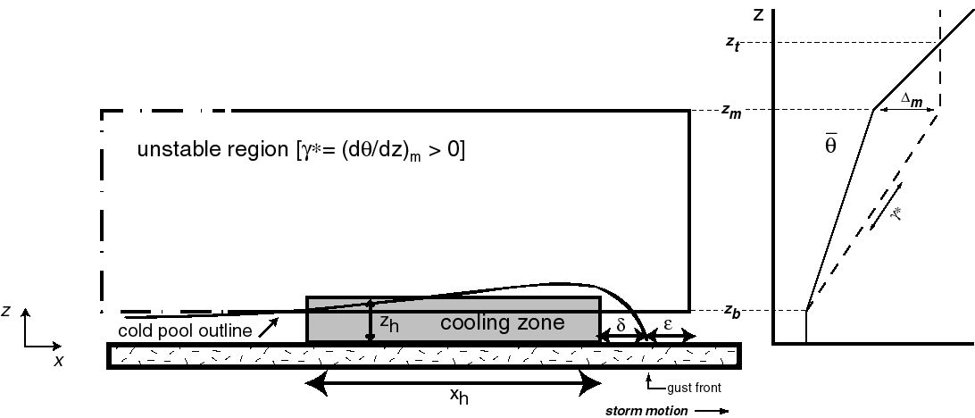
PM model framework
In unstable region,
warm UP and warm DOWN
Fovell and Tan (2000) Fovell (2002, 2004)
Notes:
PM model setup

Slide 17
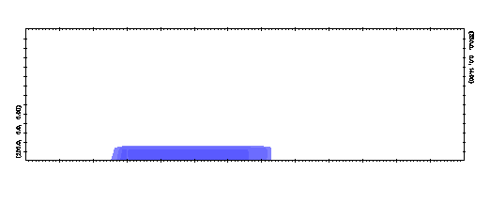
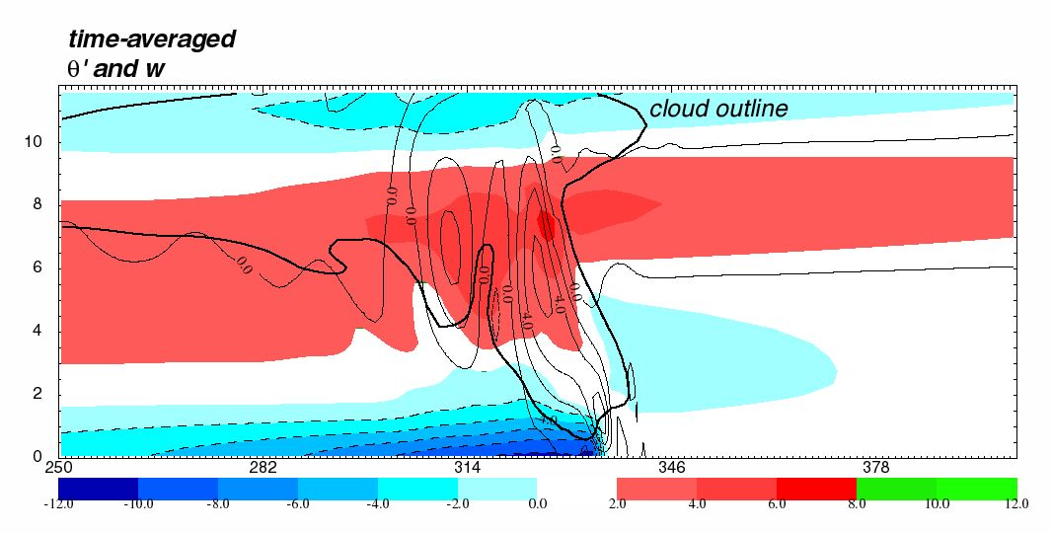
PM model
θ’ (shaded)
w (contoured)
Explicit moisture model
θ’ (shaded)
w (thin contoured)
Cloud outline (thick
contour)

Slide 18
Important points regarding the forward model and its adjoint
The forward model propagates temperature, pressure, velocities, etc., forward in time, from initial to final time
  Because the model is coupled, an initial disturbance in one field at one location at one time spreads to other fields at other locations at subsequent times
  The forward model’s control run forecasts are (ideally) archived every time step
The adjoint model propagates sensitivity to temperature, pressure, velocities, etc., backwards from final to initial time
  It is tied to the control run, which provides the “information” used to propagate the sensitivity in reverse
  Because the adjoint is also coupled, sensitivity originally confined to a single field and location at the final time will spread to other fields and locations at previous times
  Subject to the limitations of the model and method, this shows how the final forecast aspect could have been different, had certain fields and locations been altered at earlier times

Slide 19
Example #1
What would be needed to increase the upper tropospheric forward anvil outflow at a certain location and time?
Run first with adiabatic version of PM model
(i.e., sensitivity to diabatic heat sources ignored)

Slide 20
Sensitivity of forward anvil outflow
Forecast aspect J will be horizontal velocity at a certain place and time, located within the storm’s forward anvil outflow, where u > 0
∆J will be the change in this outflow
  So ∆J > 0 increases the outflow velocity
• Ran control PM model forwards to time N, archiving output
every time step - that creates C_{n}
• Initialized adjoint at time N with sensitivity confined to
u field in specific, confined area (x_{N}*)
• Run adjoint backwards, propagating sensitivity to other
fields and locations

Slide 21
Required perturbations at some time n
Perturbation required to accomplish desired change (inferred)
EXAMPLE: Want to increase J, so want ∆J > 0
- for fields and locations where sensitivity is positive,
the required perturbation is positive
[i.e., increase existing + or decrease – values]
- for fields and locations where sensitivity is negative,
the required perturbation is negative
- where sensitivity is zero, no perturbation will be effective
(according to the adjoint model, anyway)
Predicted by adjoint model

Slide 22
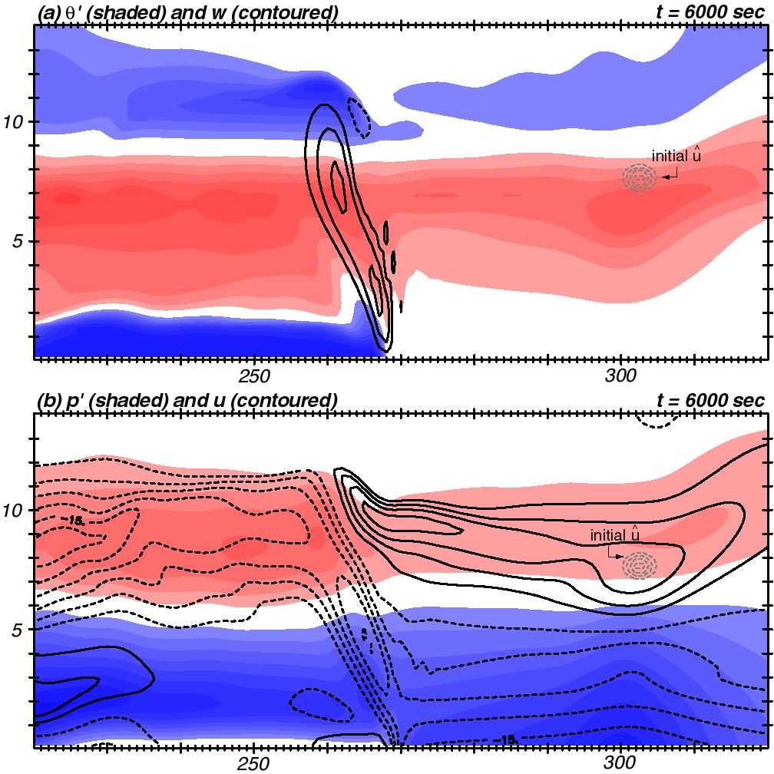
Final control run fields and forecast aspect
^
x* (x) at final time is ONLY a function
of horiz. vel. u, and ONLY in area shown
θ’ (shaded)
w (contoured)
from control run
p’ (shaded)
storm-rel u (contoured)
from control run
sensitivity
initialization
(at final time)
J is outflow velocity
∆J > 0 enhances outflow

Slide 23
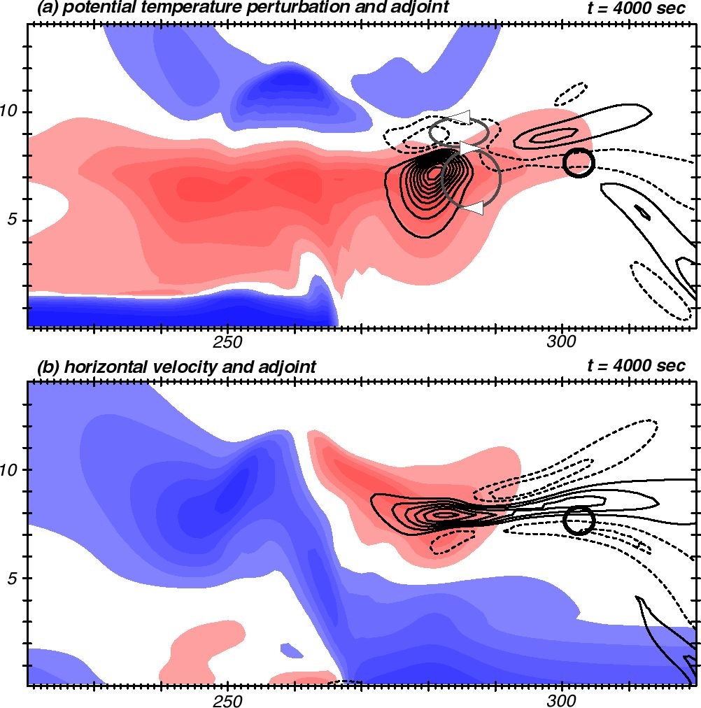
Adjoint run with adiabatic adjoint model
J is outflow velocity
∆J > 0 enhances outflow
Adjoint model run backwards 2000 sec
Shaded field: u from forward control run
Contoured: sensitivity to u from adjoint run
Adiabatic adjoint ignores
how ∆w -> ∆θ’ in moisture
parameterization
To increase outflow velocity there later (i.e., ∆J > 0),
Increase outflow velocity HERE NOW
Sensitivity is +
So, for ∆J > 0, need + perturbation
Flow is already +
Therefore, + pert makes it more +
(speeds flow up more)
Original J location

Slide 24
Adjoint run with adiabatic adjoint model
Adjoint model run backwards 2000 sec
Shaded field: u from forward control run
Contoured: sensitivity to u from adjoint run
… and/or slow down outflow here
Sensitivity is -
So, for ∆J > 0, need - perturbation
Flow is already +
Therefore, - pert slows it down
And perturbations here don’t matter
as there is no sensitivity (at this time)
and here
Notes:
Confining anvil outflow into a shallower layer at 4000 s leads to stronger outflow at the selected location at 6000 s (end time)

Slide 25
Adjoint run with adiabatic adjoint model
Sensitivity is -
So, for ∆J > 0, need - perturbation
θ’ is already +
Therefore, - pert cools it down
…and/or by decreasing it HERE
Increase outflow there later
..by increasing temperature HERE NOW
w
Sensitivity is +
So, for ∆J > 0, need + perturbation
θ’ is already +
Therefore, + pert makes even warmer

Slide 26
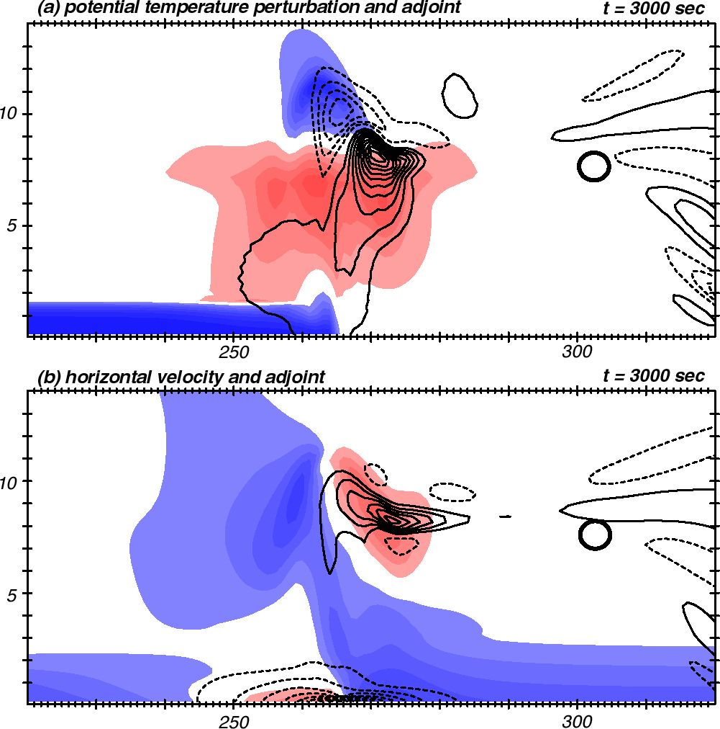
Adjoint run with adiabatic adjoint model
Go back another 1000 sec
Decreasing the westerly
flow here now enhances
the upper trop outflow later?
(Hard to explain)
Increasing inflow here
enhances upper trop outflow later…

Slide 27
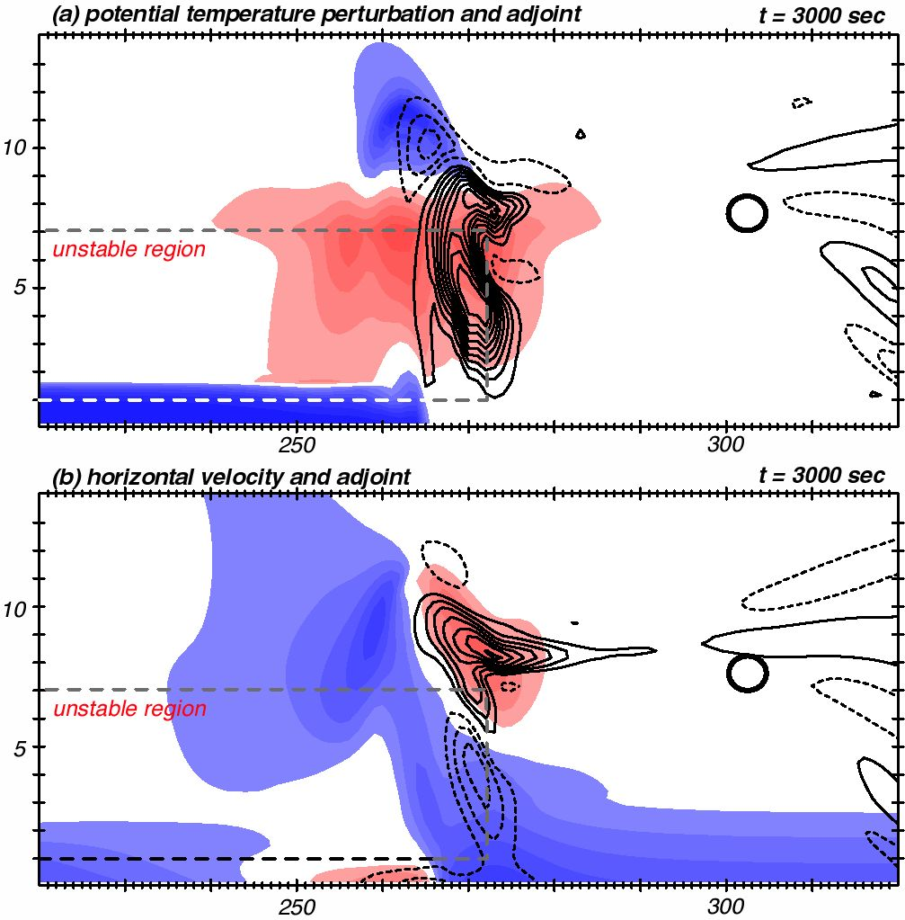
Adjoint run with DIABATIC adjoint model
The adjoint provides the
sensitivity fields
You provide the interpretation,
subject to adjoint’s
assumptions & limitations
The diabatic adjoint model
includes PM physics, so
changing flow in unstable
region changes heating from
control run values
(If the physics is not
incorporated into adjoint
correctly, the conclusions
will be wrong/different)
Sensitivity a lot smaller
now that diabatic response
is permitted...

Slide 28
Example #2
Diagnose unrealistic results from PM model

Slide 29
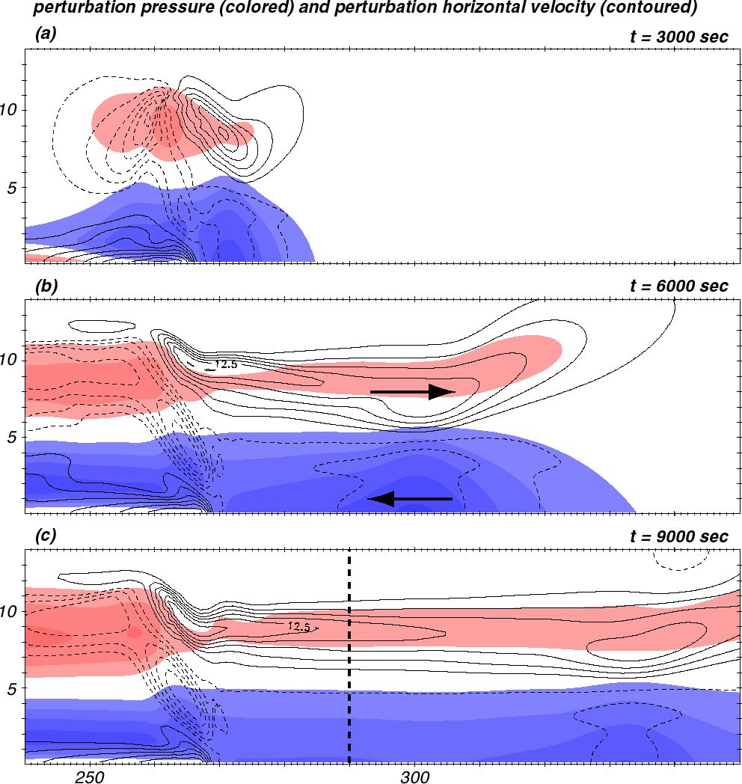
PM forward model fields
at 3 times
Flow away from storm
in upper troposphere,
flow towards storm
in lower tropsphere

Slide 30
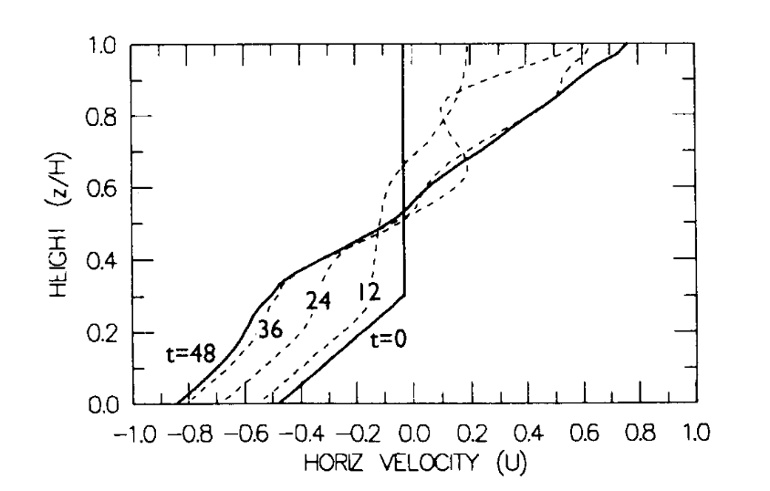
Garner and Thorpe (1992)
(nondimensionalized)
PM forward model fields
at 3 times
Flow away from storm
in upper troposphere,
flow towards storm
in lower tropsphere
PM model causes substantial
acceleration of low-level
inflow and upper level
outflow (relative to initial
state) ahead of storm

Slide 31
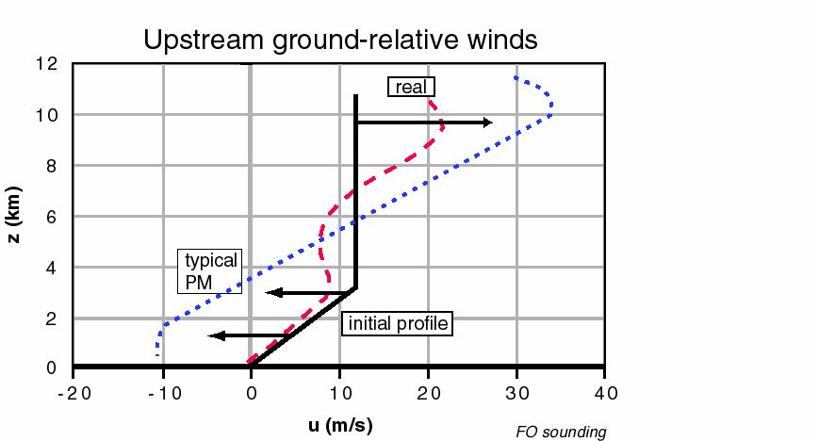
Garner and Thorpe (1992)
Induced inflow and outflow too strong
Induced inflow max at wrong level
(compared with “real” cloud model)
PM forward model fields
at 3 times
Flow away from storm
in upper troposphere,
flow towards storm
in lower tropsphere
Fovell and Tan (2000)

Slide 32
Anelastic constraint - 1
Start with traditional anelastic continuity equation & integrate around a box
Taking the upper and lower boundaries to be rigid (w = 0) removes the
vertical term, leaving

Slide 33
Anelastic constraint - 2
Integration with respect to x from left (L) to right (R) yields
This implies that the vertical sum of mean density x horizontal flow
in a column is preserved.
Therefore, enhancing westerly flow at some level (relative to
the initial state) has to be balanced by increased easterly flow elsewhere,
and vice-versa.
(My model is compressible, but deviation from anelasticity is small.)

Slide 34
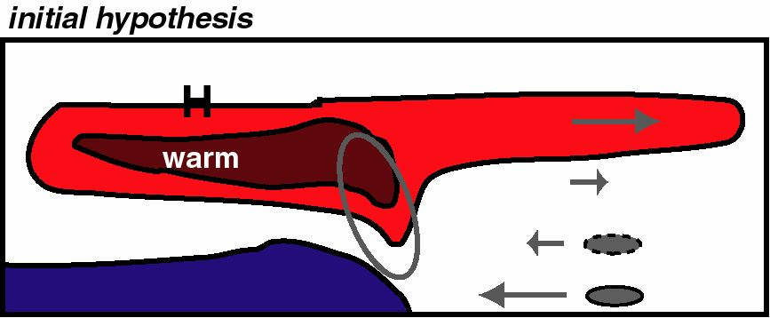
• Anelastic constraint means upper and lower tropospheric
problems are related
• HYPOTHESIS:
(1) PM model is warm UP and warm DOWN
(2) Rear side of storm too hot
(3) Pressure in upper tropo at rear too HIGH
(4) Horizontal PGF in upper trop across storm too large
(5) Forward anvil outflow too strong
(6) So lower level inflow too strong, due to anelastic
constraint
• PROPOSED SOLUTION: Implemented a sponge to prevent rear side of storm from getting too hot

Slide 35
“For every problem, there is one solution which is simple, neat and wrong.”
- H. L. Mencken

Slide 36
• Forecast aspect J is horizontal velocity ahead of storm
- want to increase inflow in middle troposphere
- want to decrease inflow in lower troposphere
(these are two separate experiments)
Want to decrease u (strengthen the inflow)
Define J = -u and want ∆J > 0
Want to increase u (decrease the inflow)
Define J = u and want ∆J > 0
Inflow is u < 0

Slide 37
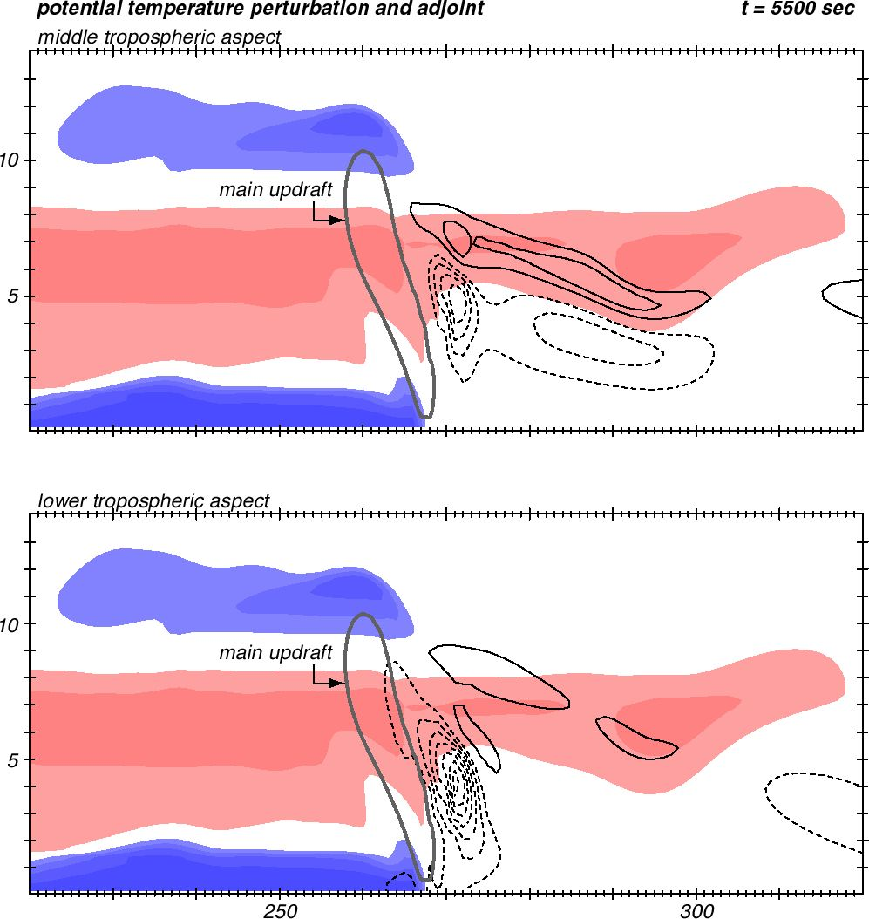
Focus on temperature field
and sensitivity
Integrated adjoint model
backwards 500 sec
Both experiments identified
the same answer
Increase midlevel inflow (there later)
by making it cooler (here now)
Middle tropo J
Lower tropo J
Reversed sign of J from notes
Decrease low-level inflow (there later)
by making it cooler (here now)
Notes:
Lower aspect: want ∆J > 0. Since sens neg, want to apply neg perts. Theta’ already neg so make cold air COLDER.

Slide 38
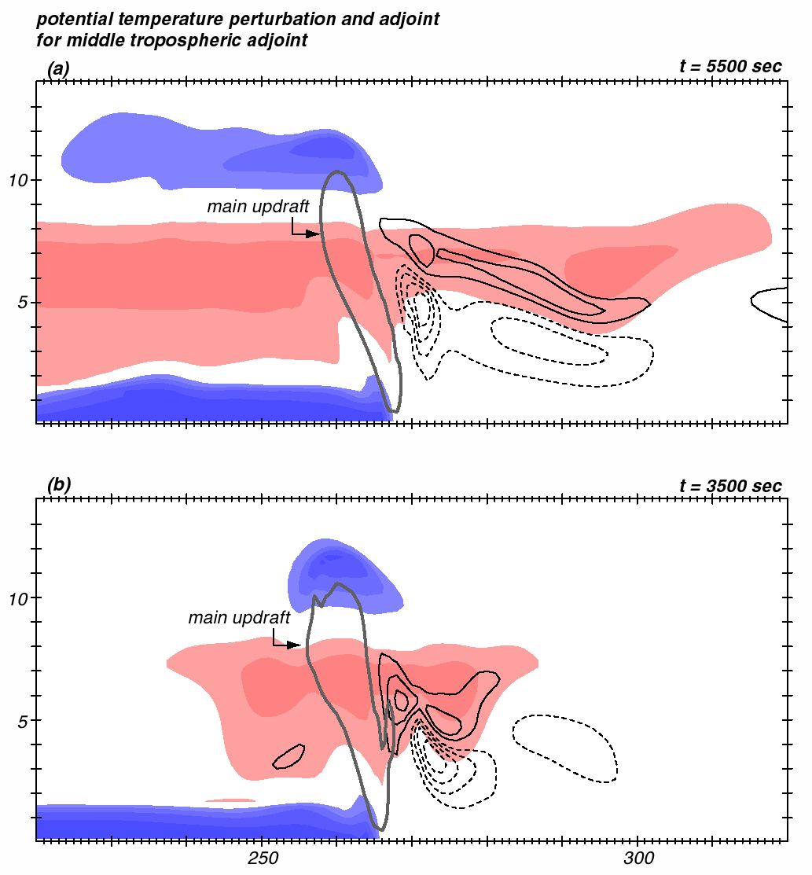
Sensitivity never “reaches”
any field at the rear of the
storm…
… which is why my hypothesis
didn’t work
The hypothesis was physically
plausible, but it wasn’t how
the model got it wrong
Run middle tropo aspect
back another 2000 sec

Slide 39
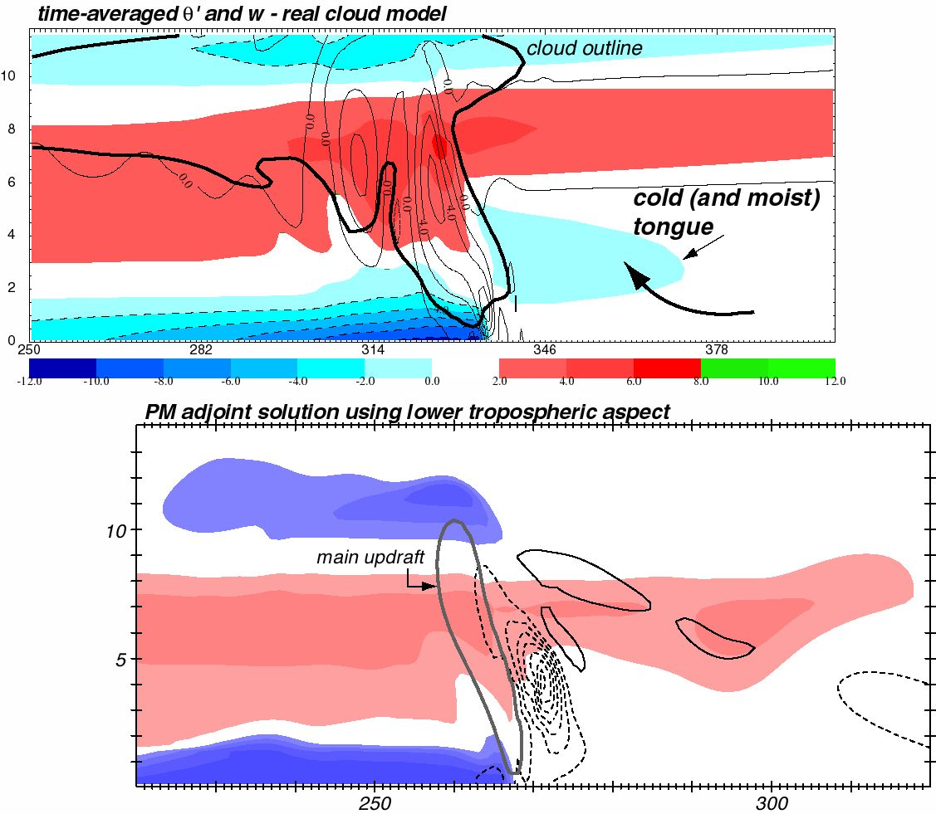
Real cloud model
Adjoint PM model
X

Slide 40
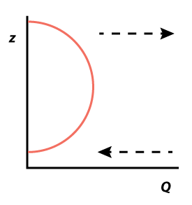
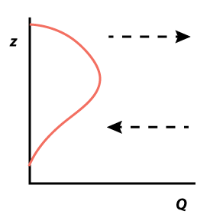
PM model design
presumed this heating profile...
... but the real cloud model
produces a different profile
Notes:
PM model setup

Slide 41
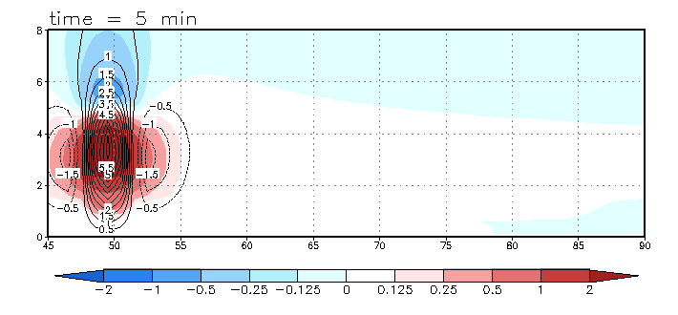
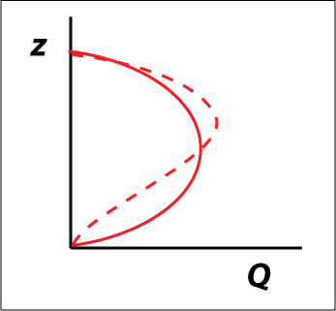
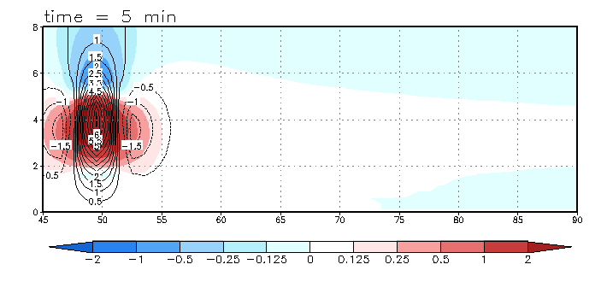
Origin of “cool tongue”
Half-sine heating
profile (solid)
“Top-heavy”
heating profile
(dashed)

Slide 42
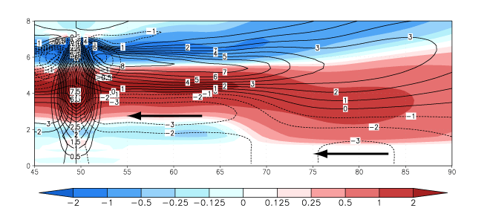
θ’ and U for top-heavy profile

Slide 43
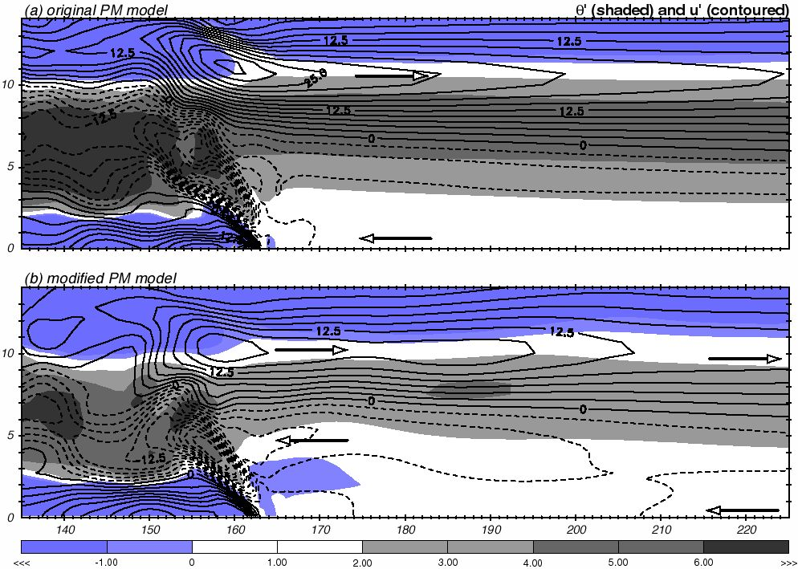
Fixing the PM model
Fovell (2002, 2004)

Slide 44
A simple explicit-moisture model and its adjoint

Slide 45
Concluding comments
Adjoint model advantage: can dynamically trace model output features (especially errors) back to their sources
  How did the model get to a particular state?
Adjoint model disadvantages:
  Difficult to construct
  Inherent assumptions cannot be ignored
  Massive storage may be required
Course notes chapter 16 discusses how to construct an adjoint model from the model discretized equations
  Automatic software tools are also available
  Real challenge is crafting adjoints to complicated model physics (PBL, microphysics, diffusion, radiation, etc.) and linearity of the model assumptions
  Viable alternative: ensemble sensitivity analysis (e.g., Torn and Hakim 2008)

