Slide 1
ATM 562 overview and example final projects
Robert Fovell
ATM 562
Fall 2018

Slide 2
{ History of this class }

Slide 3
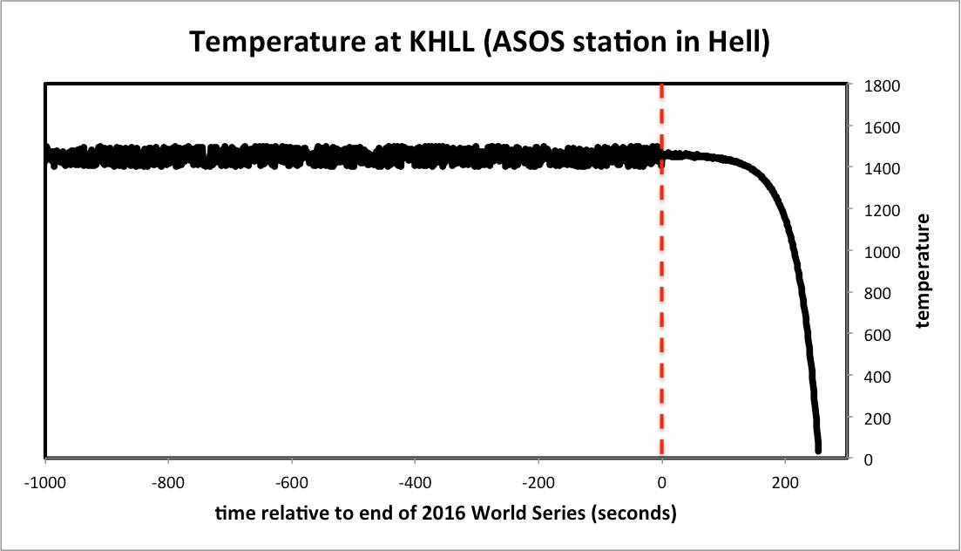
(This will take some explanation)

Slide 4
Goal
Create a 2D compressible “cloud model” capable of simulating many phenomena, such as
  Buoyant thermals or bubbles
  Density currents
  Kelvin-Helmholtz billows
  Sea-breeze and heat island circulations
  Boundary layer rolls
  Internal gravity waves and mountain waves
  Hydraulic jumps
  Clouds (if you incorporate moisture)

Slide 5
Learning objectives
To show how numerical models work, from the “inside”
To learn strengths and weaknesses of models, their approximations, assumptions, inaccuracies, and sensitivities
How to identify and mitigate model errors
How to utilize numerical models in experiments
To provide scientific programming experience

Slide 6
Tools
Fortran, C, Python or language of your choice
  2015 projects:
    Fortran 46%, Python 29%, NCL 14%, Matlab/IDL 11%
Visualization tools: GrADS, Python, NCL, etc.
Course home page
  http://www.atmos.albany.edu/facstaff/rfovell/ATM562/
Course notes (on course home page)
  A “living document”
Other tools, examples, scripts provided on course home page

Slide 7
Slack
ATM562 Slack channel
  Subchannels for lectures and model tasks

Slide 8
7 model tasks
(0) 1D wave equation
(1) Construct model vertical grid and sounding
(2) Compute CAPE from sounding
(3) Create a buoyant thermal initial condition
(4) Demonstrate advection errors in 2D
(5) Simulate a buoyant thermal
(6) Final project of your design
Notes:
(0) does not directly lead to the class model

Slide 9
Model Task 0: Solving the simple 1D wave equation

Slide 10
Model Task 1:
Set up the vertical grid and
solve for the basic state

Slide 11
Model Task 2: Assess CAPE & CIN

Slide 12
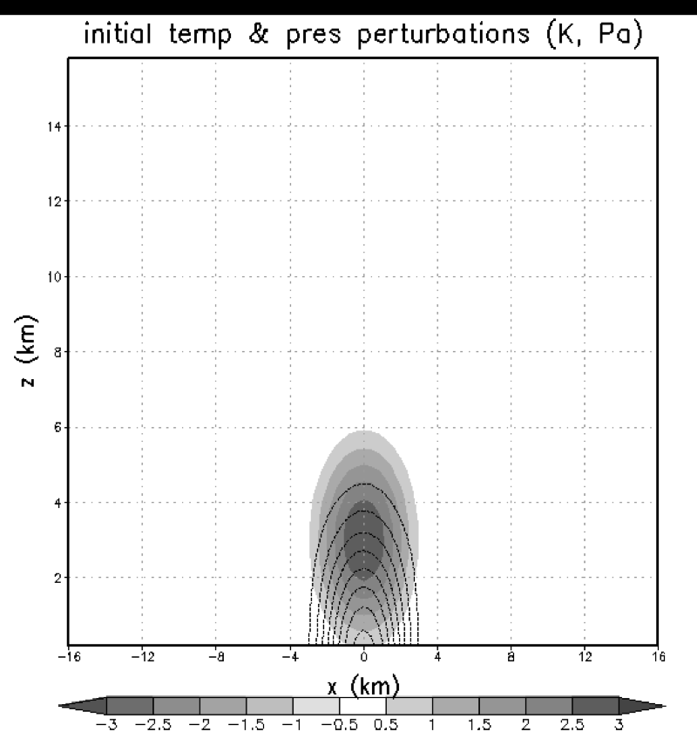
Model Task 3:
Set up the model 2D grid and
initial condition

Slide 13
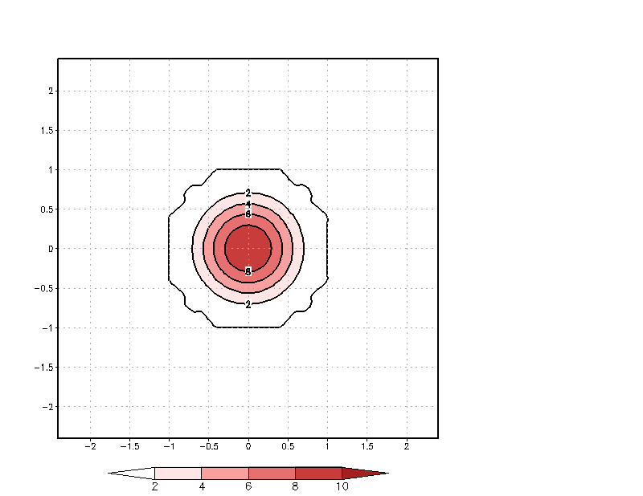
Model Task 4: Dispersion error

Slide 14
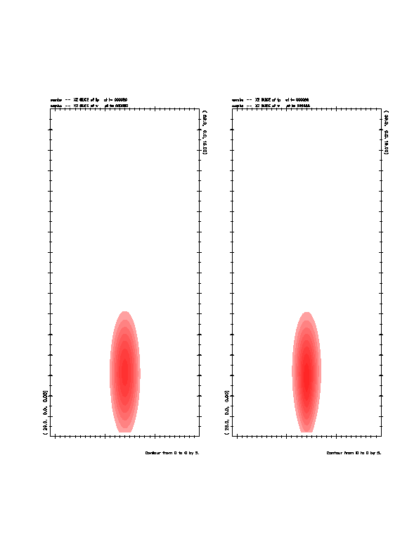
Model Task 5: buoyant thermal in neutral atmosphere
Sensitivity to speed of sound:
potential temperature (shaded)
vertical velocity (contoured)

Slide 15
Some examples of
Model Task 6 (final project)

Slide 16
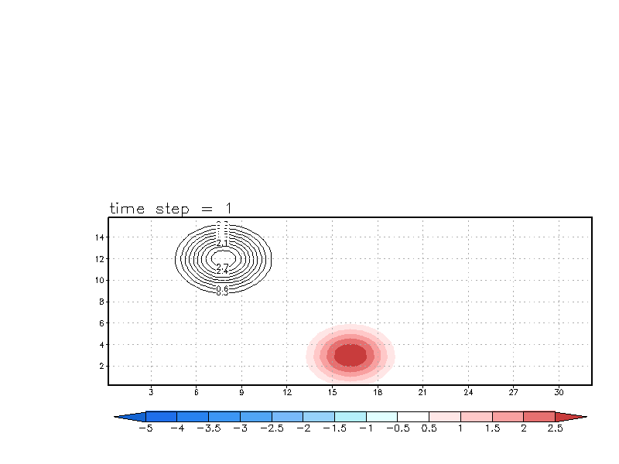
Adding a passive tracer

Slide 17
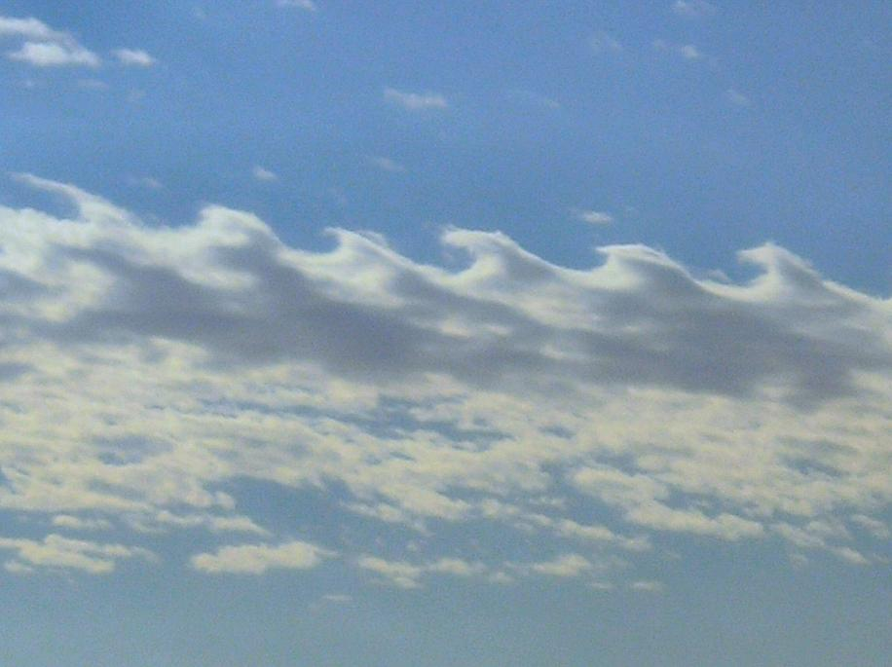
Kelvin-Helmholtz instability
Prof. Brian Tang

Slide 18
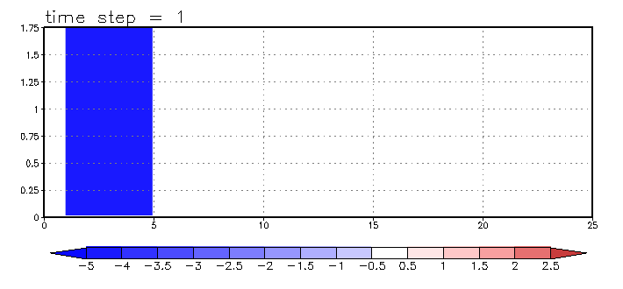
Kelvin-Helmholtz billows shaded: perturbation potential temperature

Slide 19
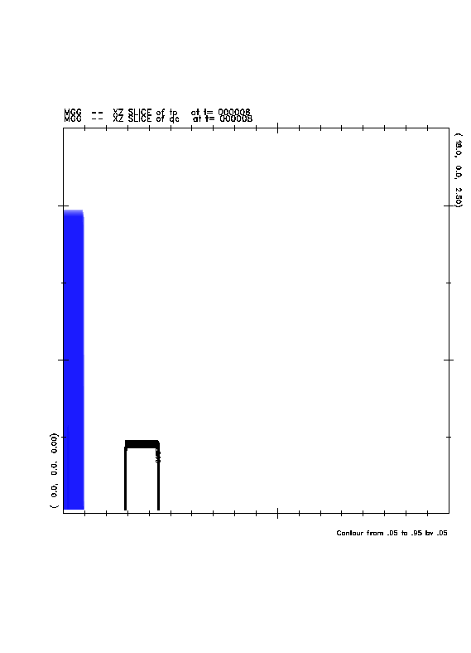
Adding a passive tracer

Slide 20
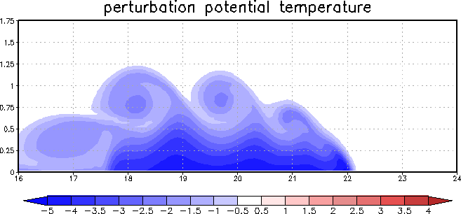
Perturbation potential temperature at a single time

Slide 21
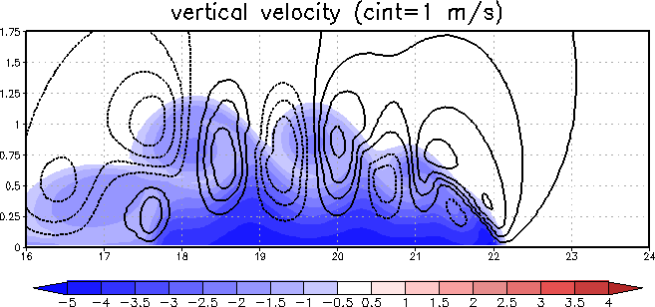
Add vertical velocity

Slide 22
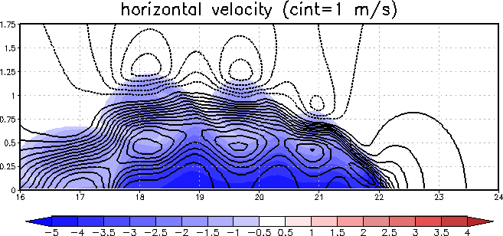
Add horizontal velocity

Slide 23
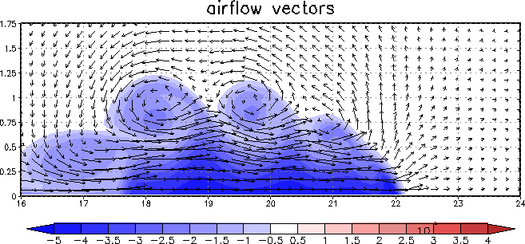
Add airflow vectors

Slide 24
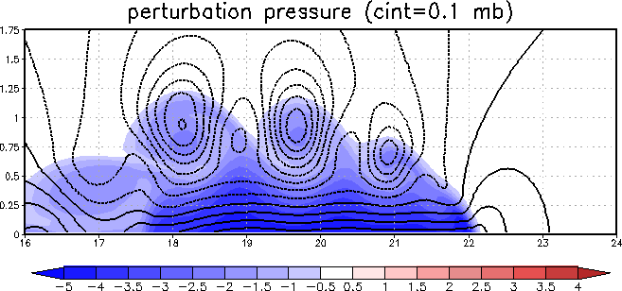
Add pressure perturbations
Why?
Why?
Why?
Notes:
This isn't just about reproducing Nature, but understanding it as well.

Slide 25
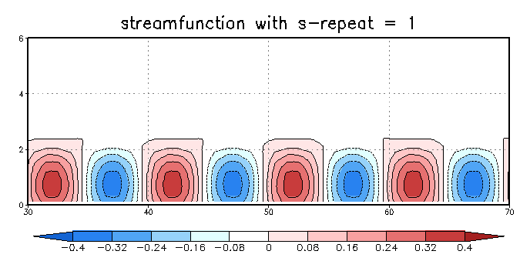
Adding an artificial momentum source (streamfunction) to mimic mountain ridges or rolls
wind

Slide 26
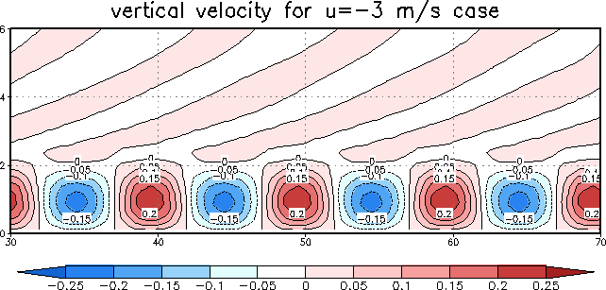
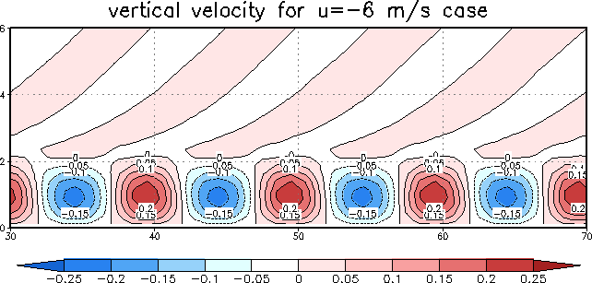
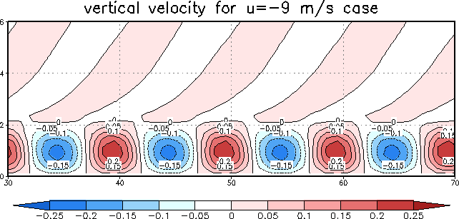
Effect of varying wind speed on
mountain waves
Shaded: vertical velocity

Slide 27
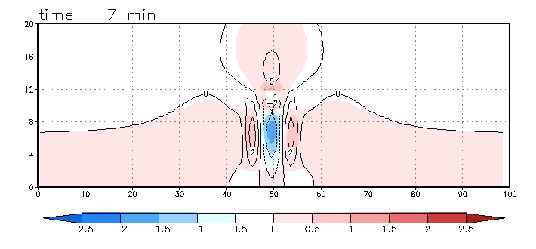
Gravity waves provoked by an isolated, oscillating streamfunction
Shaded: temperature perturbation
Contoured: vertical velocity

Slide 28
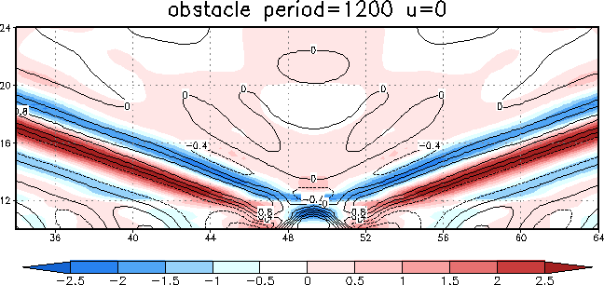
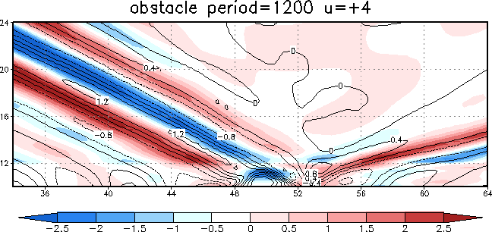
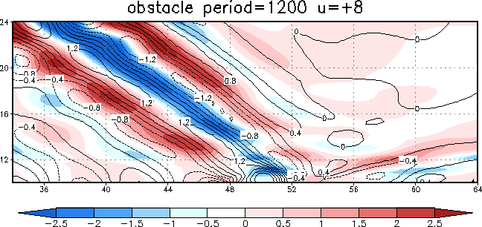
Effect of varying wind speed on
gravity waves
Shaded: temperature perturbation
Contoured: vertical velocity
What happens if you change the
oscillation period instead?

Slide 29
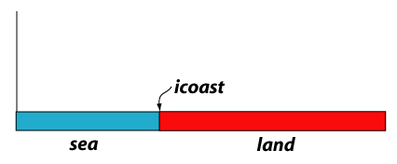
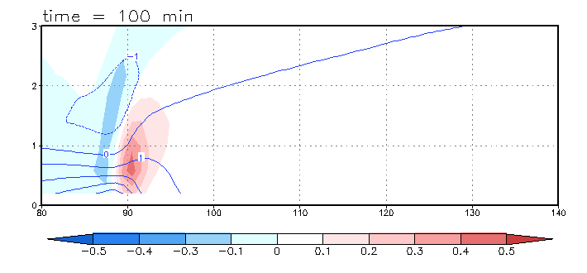
Sea-breeze circulation shaded: vertical velocity; contoured: horizontal velocity

Slide 30
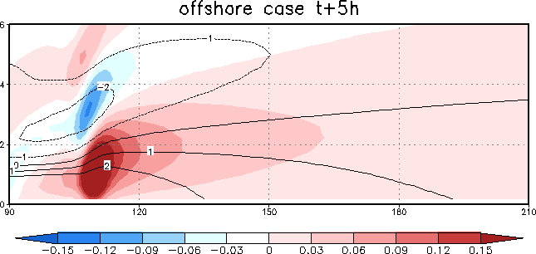
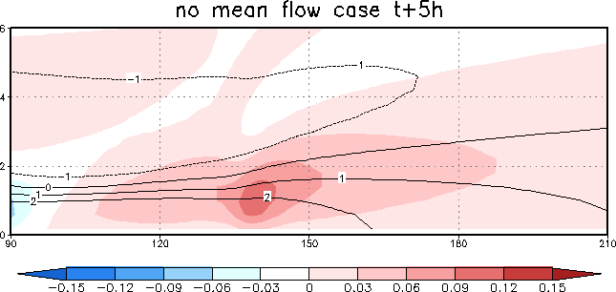
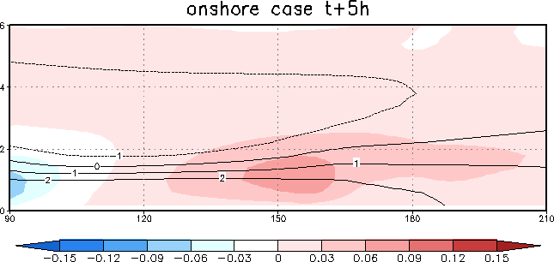
Effect of varying wind speed and
direction on sea-breeze propagation
Contoured: horizontal velocity perturbation
Shaded: vertical velocity

Slide 31
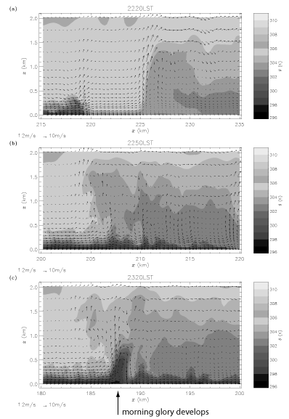
Storms initiated by morning glory
morning glory
Collision of 2 sea-breezes

Slide 32
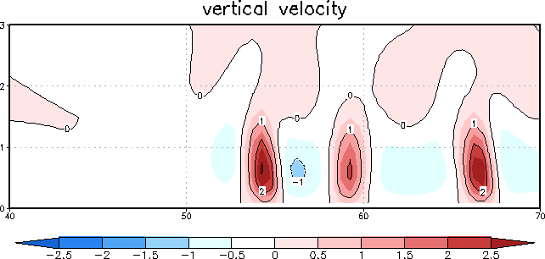
Making rolls with random surface heat fluxes
sea-breeze front
rolls

Slide 33
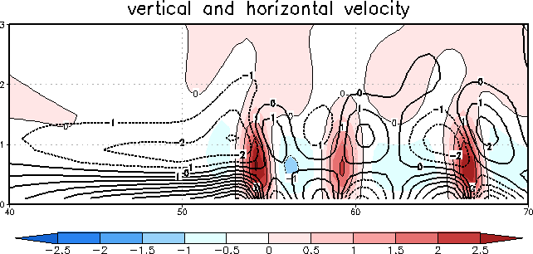
Making rolls with random surface heat fluxes

Slide 34
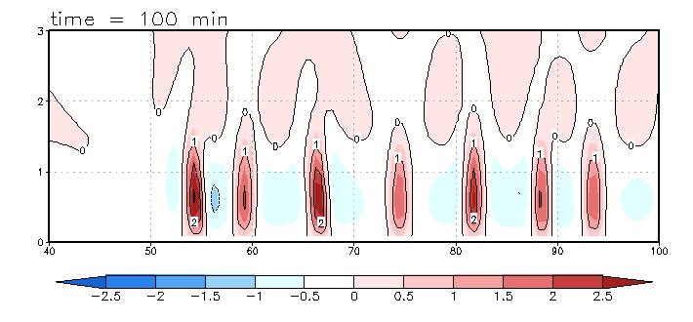
Making rolls with random surface heat fluxes

Slide 35

Fire-induced plumes made with intense surface heat fluxes
Shaded: temperature perturbation
Contoured: vertical velocity

Slide 36
Thermal 2D vs. 3D
Notes:
Attard 2015

Slide 37
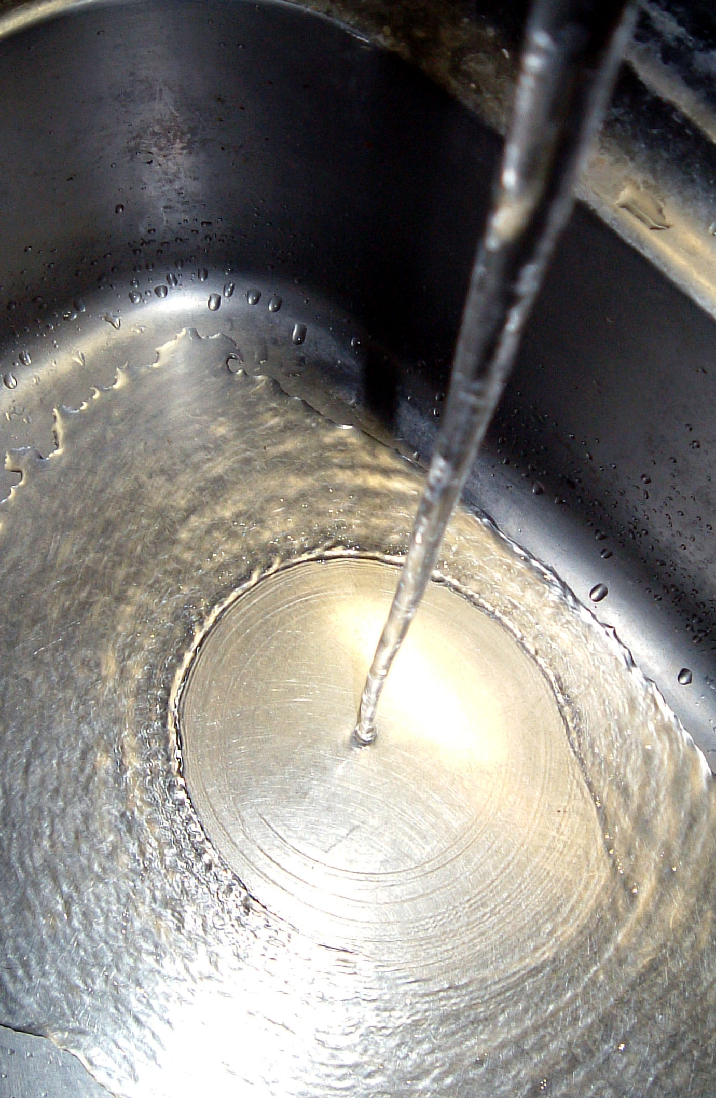
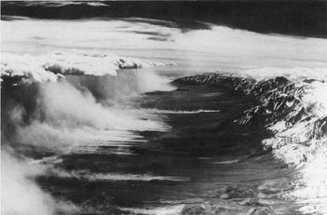
Examples of hydraulic jumps
Wind -→

Slide 38
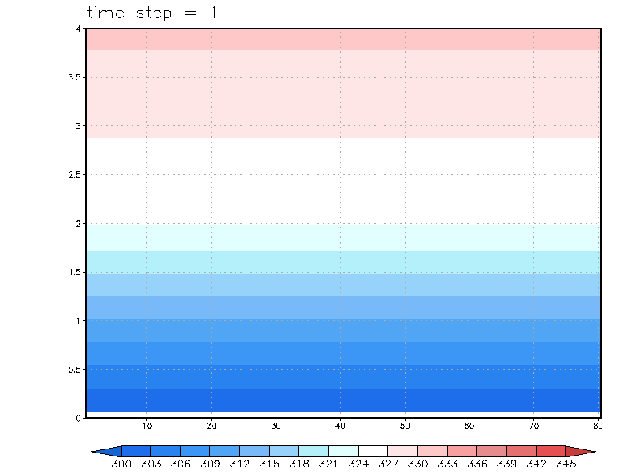
Animation of hydraulic jump
Shaded: potential temperature
mountain made with streamfunction ^

Slide 39
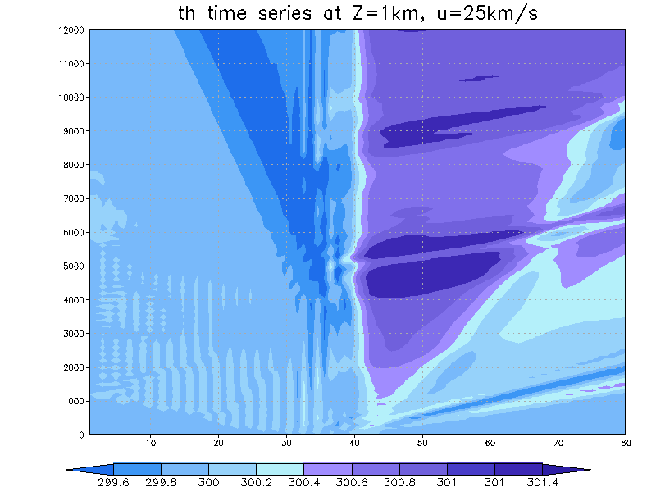
Hovmoller (time-space) diagram
Time >>>

Slide 40
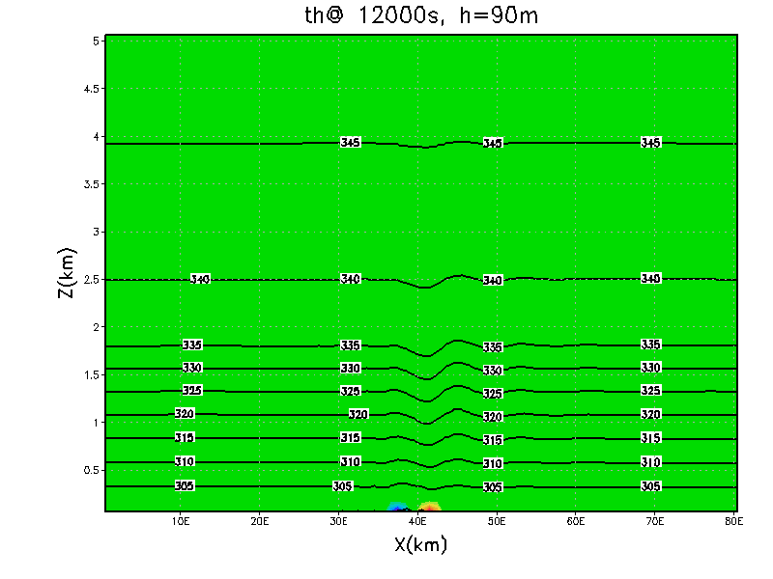
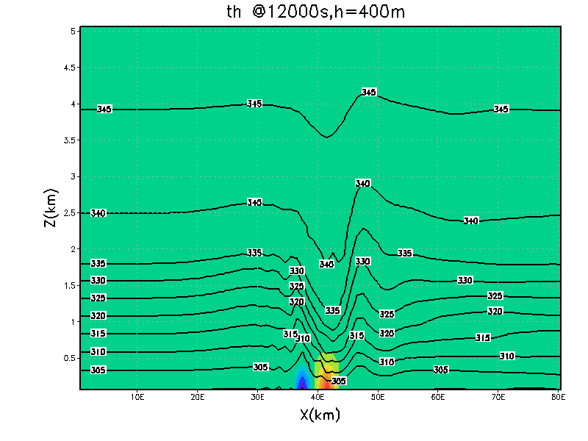
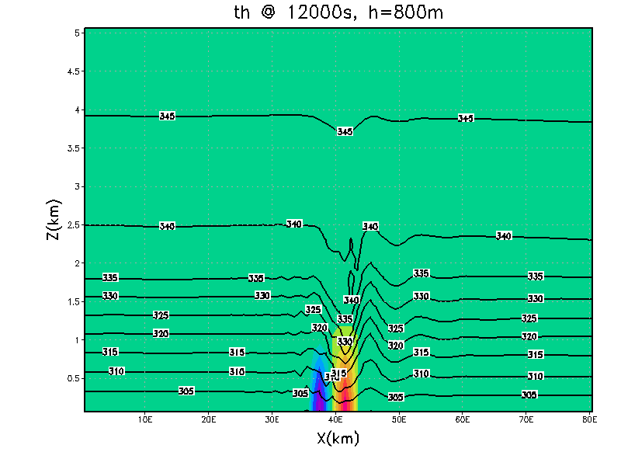
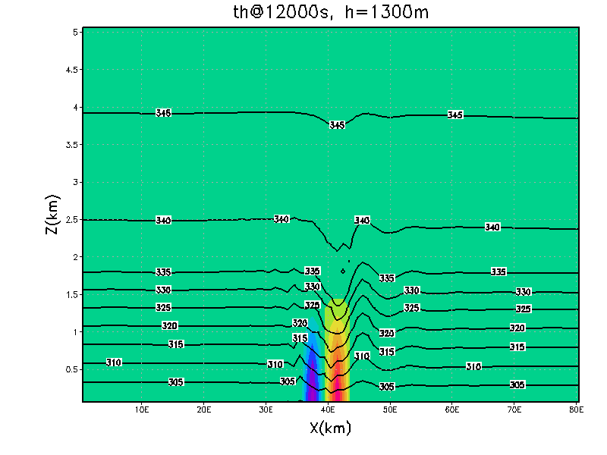
Vary “mountain” height
Contoured: potential temperature

Slide 41
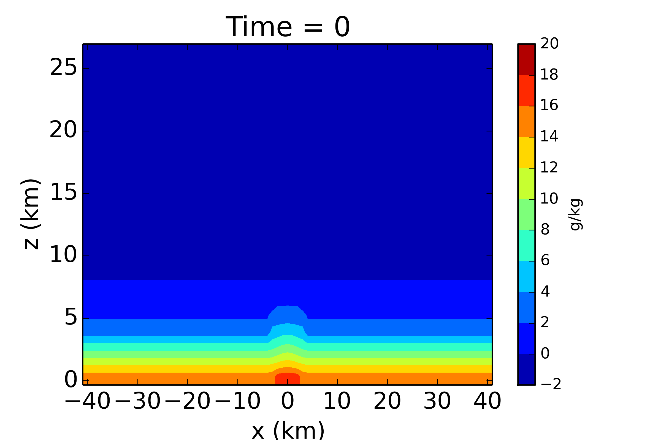
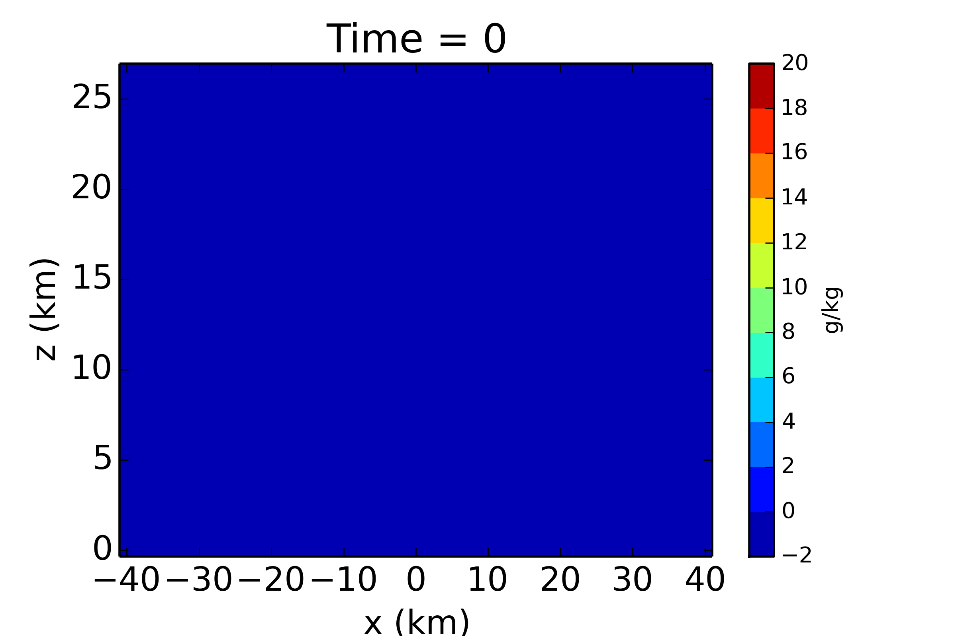
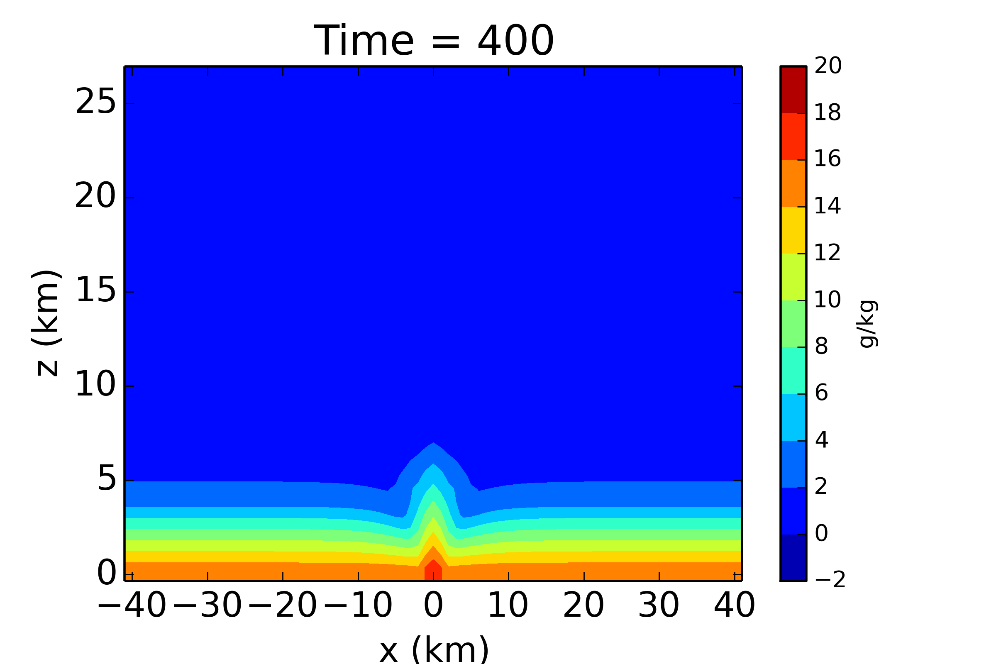
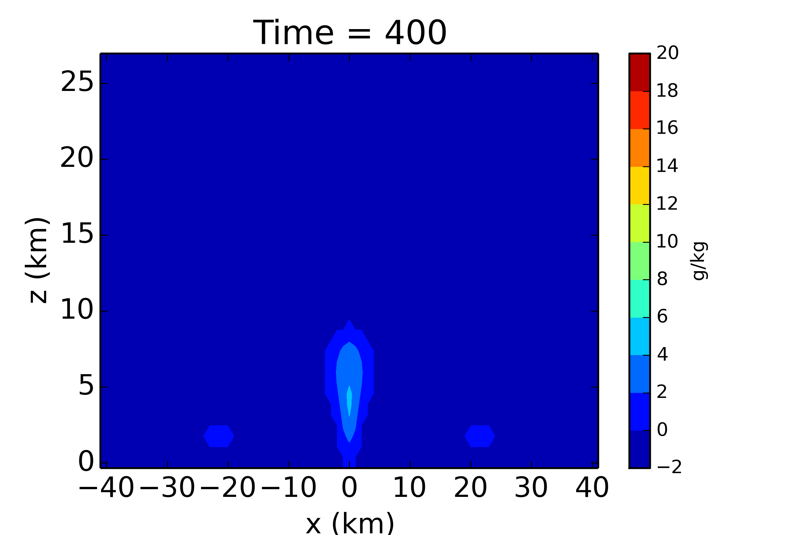
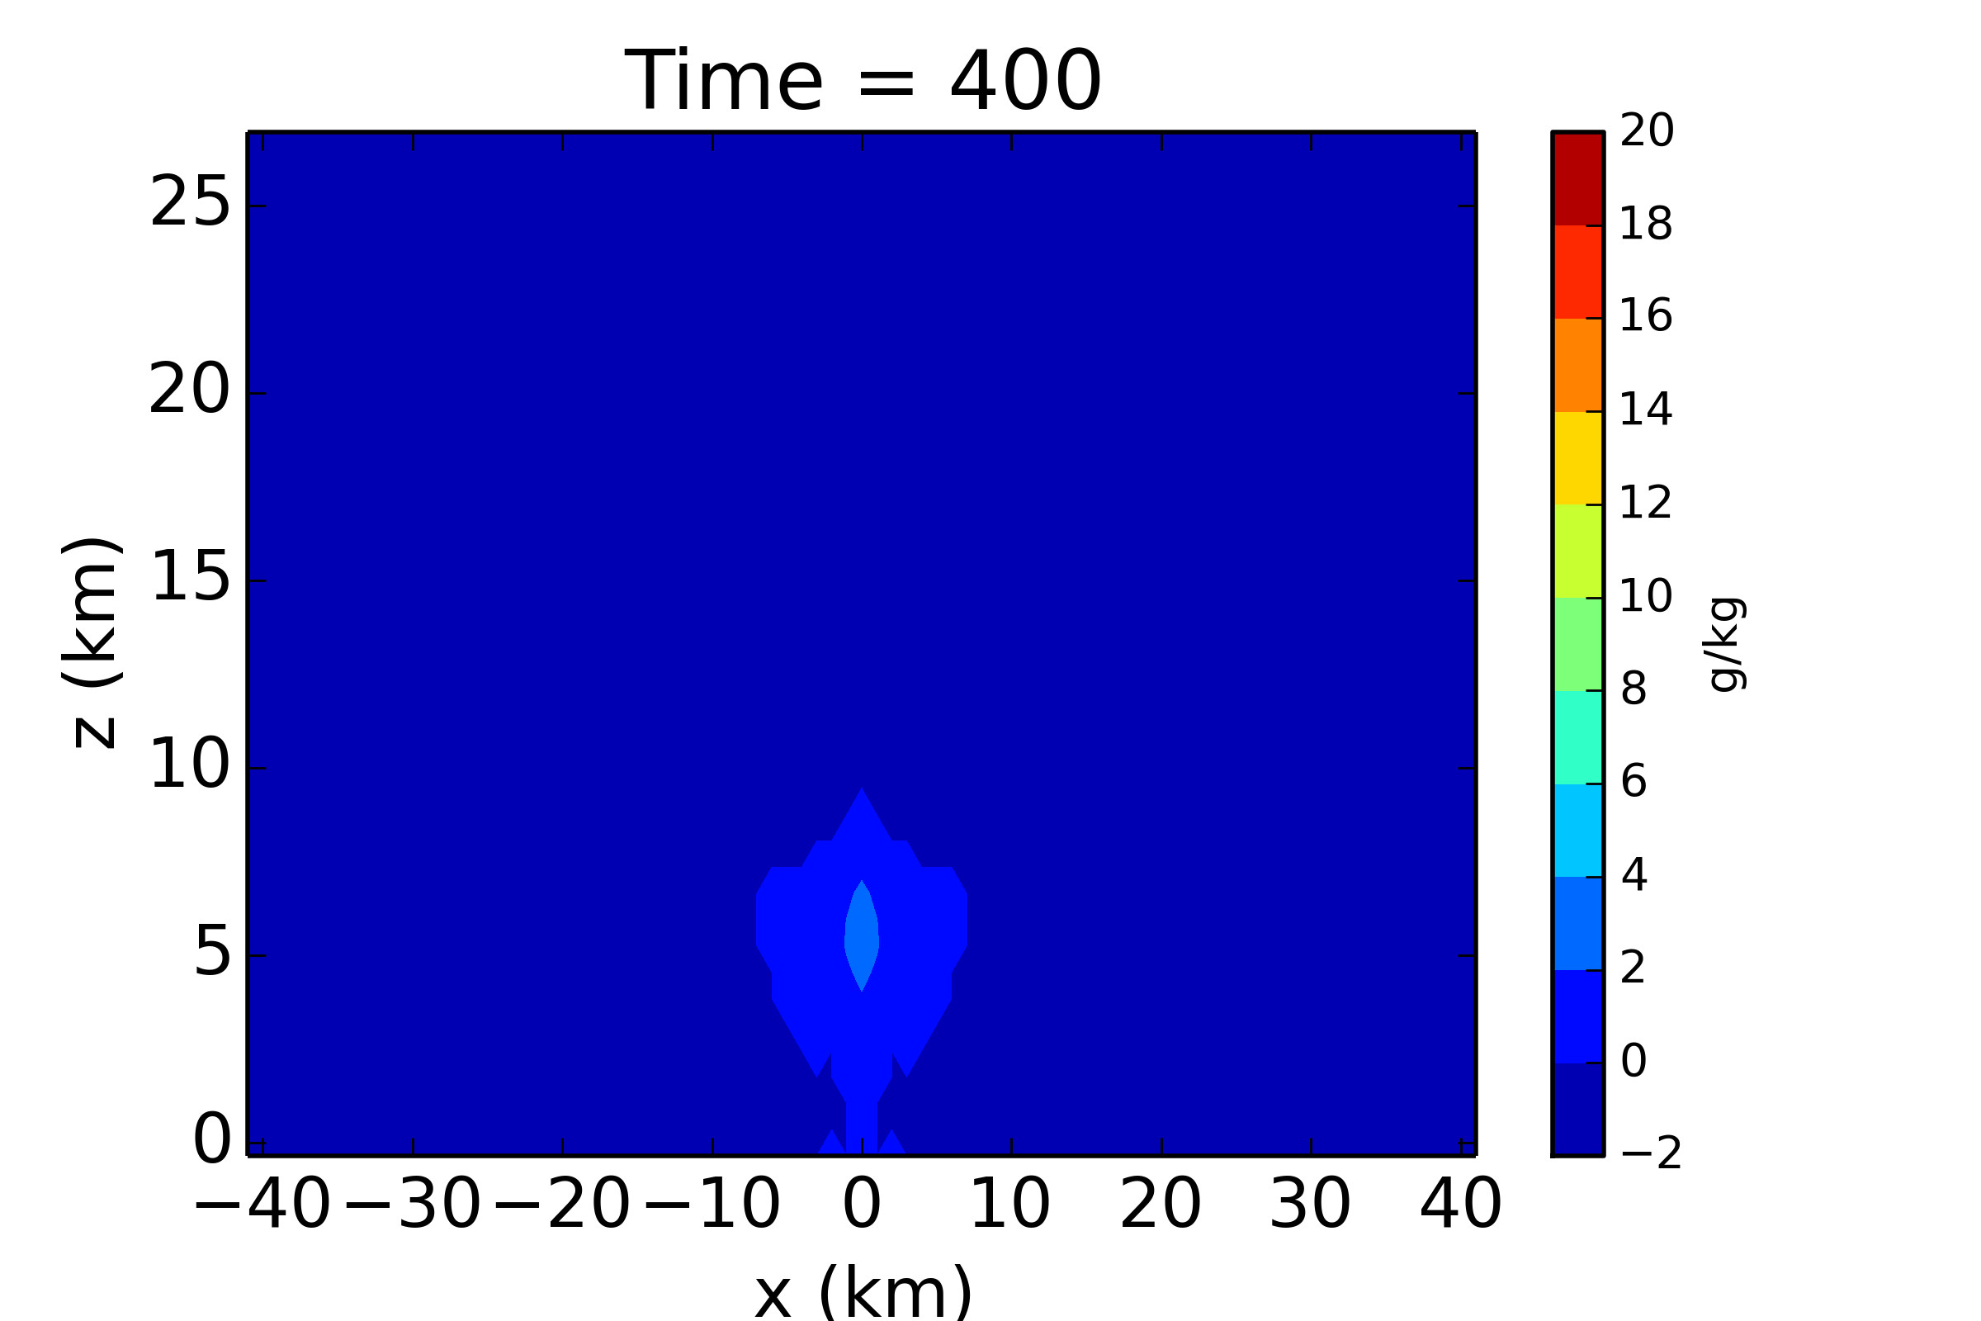
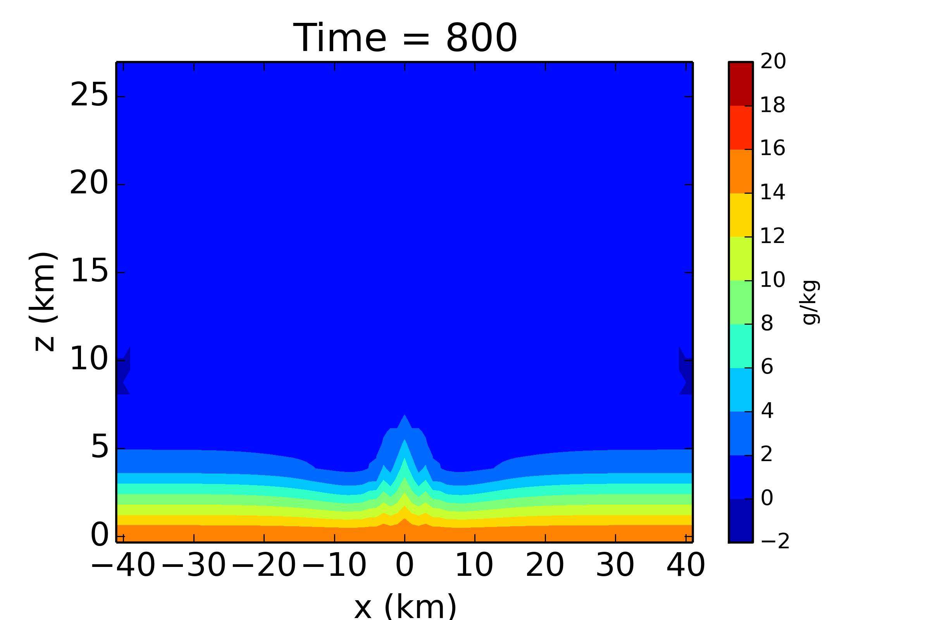
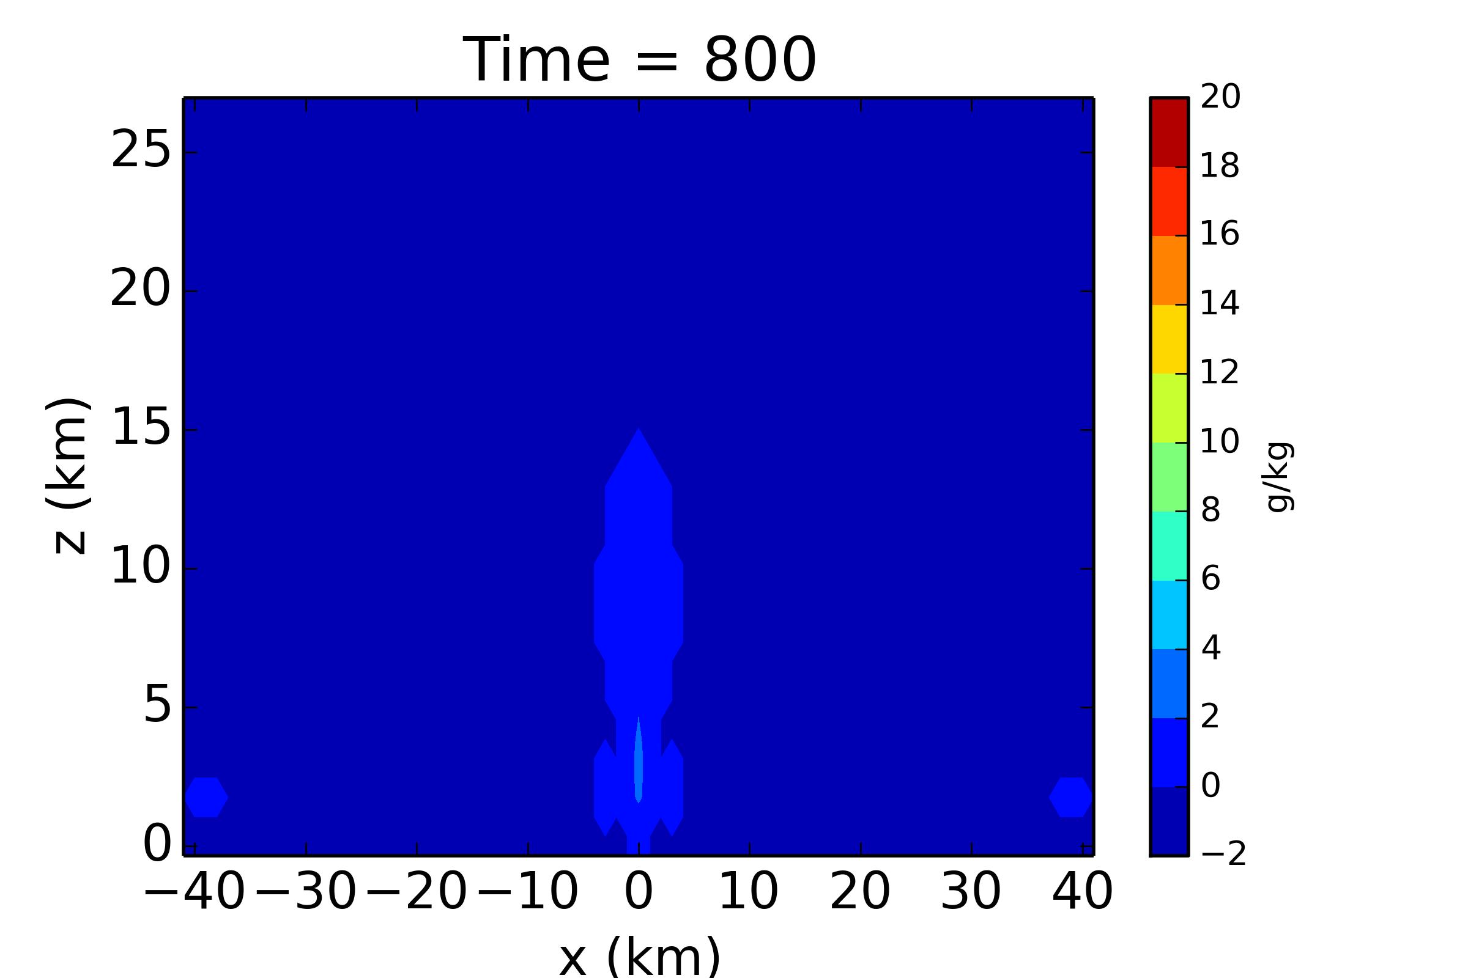
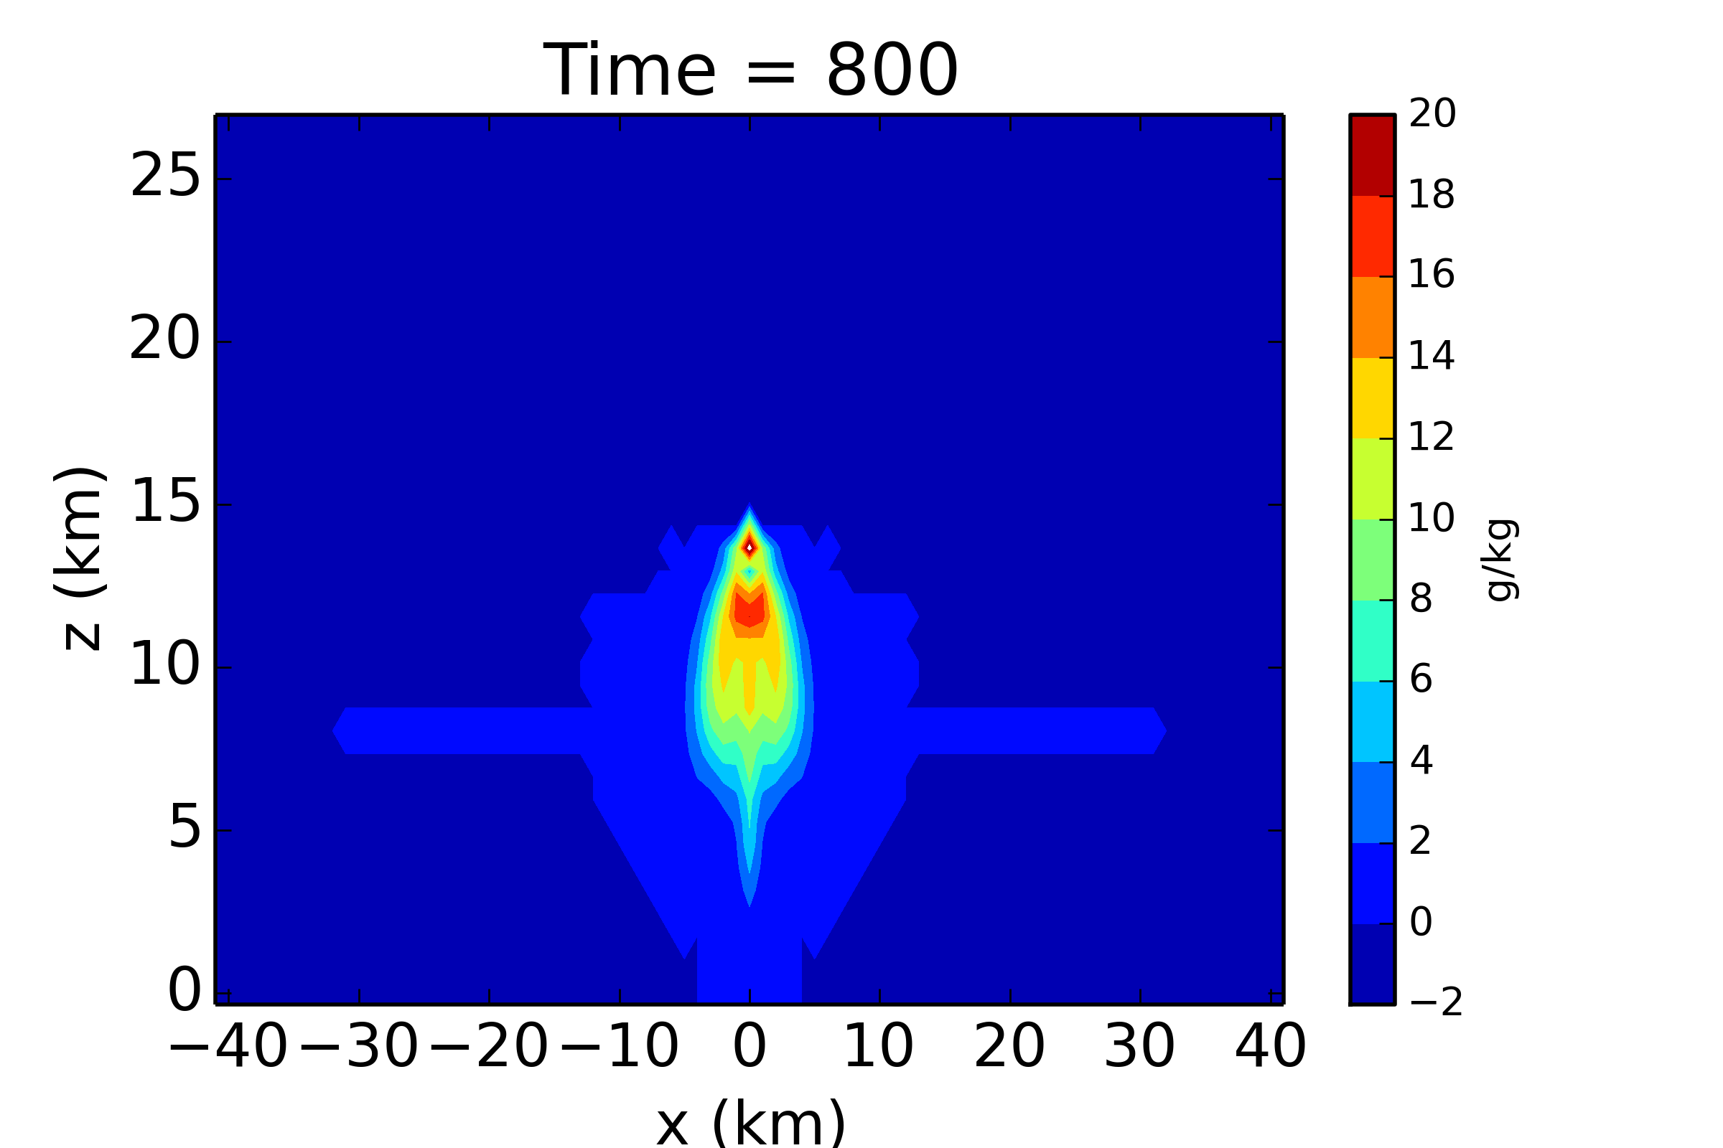
vapor
cloud water
rain
Cloud simulation with
Kessler scheme
Notes:
Alland 2015

Slide 42
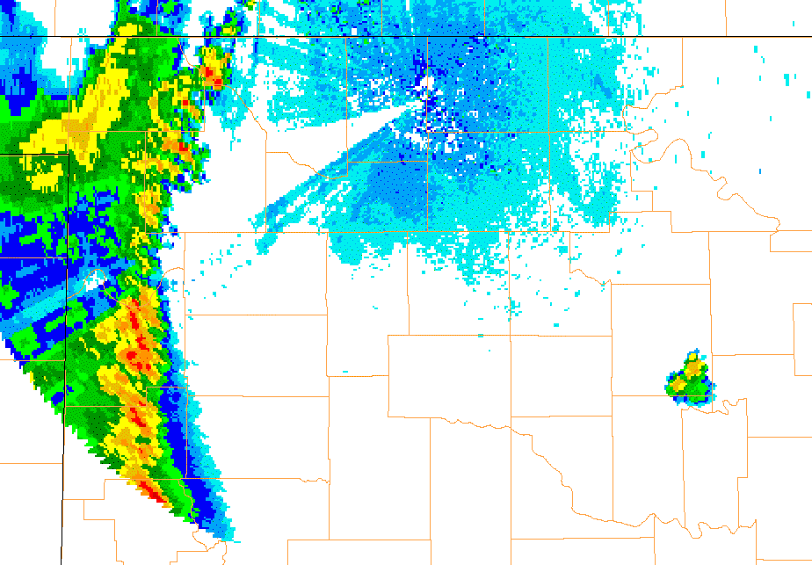
Squall-line moves across Oklahoma

Slide 43
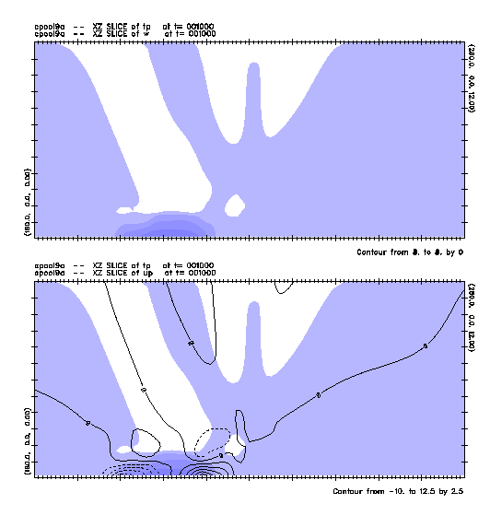
Shaded: temperature perturbation
Contoured: vertical velocity
A very simple 2D model of a squall-line thunderstorm
Shaded: temperature perturbation
Contoured: horizontal velocity

Slide 44
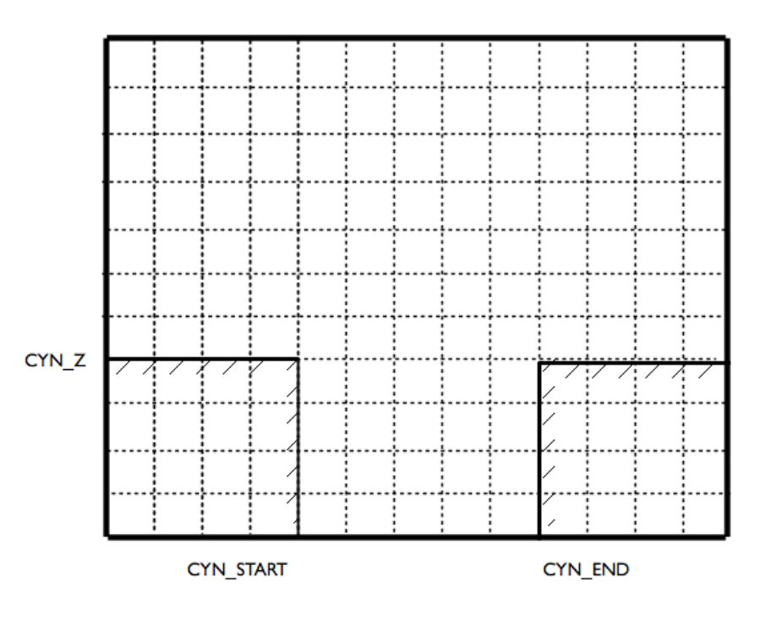
Flow into a canyon

Slide 45
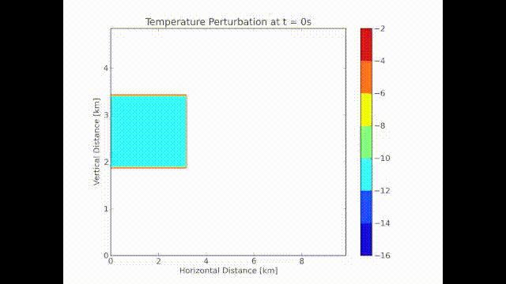
Flow into a canyon

Slide 46

A dry hurricane (axisymmetric model)
Notes:
Fischer 2015, heat source in axisymmetric model

Slide 47

Testing “open” lateral boundary conditions
Notes:
Di Chen 2015

Slide 48


Sea-breeze with and without mountain
Mean flow, surface
flux, no mountain
Add 800 m tall, 140 km
wide mountain
(island)
Vertical velocity and
horizontal wind
Notes:
Rios 2015.
Sometimes adding complexity does not change things much

Slide 49
Mac resources
Terminal.app (in /Applications/Utilities)
  Alternatives: https://en.softonic.com/solutions/what-are-the-best-alternatives-to-terminal-for-mac-os-x
Xcode (App Store)
X11
  http://www.xquartz.org
Homebrew (for gcc/gfortran, etc.)
  http://brew.sh
Text editors:
  TextWrangler (free*, very good editor; App Store)
  BBEdit
  Atom
GrADS (Grid Analysis and Display System)
  http://cola.gmu.edu/grads/grads.php
  http://opengrads.org
NCL (NCAR Command Language)
  http://www.ncl.ucar.edu

