Slide 1
Some MT#0A results
ATM 562 Fall 2021
Fovell

Slide 2
Experiment #3
Change the wavelength of the initial condition to, say, 5∆x (wavelength = 5) and c’ = 0.5 (∆t = 0.5). From Fig. 4.3 from the notes, expect to lose 20% amplitude per time step. Plot maximum wave value vs. time. Do you?
Warning: because of the periodic BCs, your initial condition has to have an integer number of waves in the domain, or the BC will mishandle the wave. To explore some wavelengths, it may be necessary to change NX.
Notes:
Yes, very close, until roundoff becomes an issue.

Slide 3
Upstream: amplitude errors are wavelength-dependent (c’ ≠ 1)
c’ = c∆t/∆x
1.0
L = 5∆x
k = 2π/L k∆x/π = 2∆x/(5∆x) = 0.4
Expect about 20% amplitude loss per time step when c’ = 0.5

Slide 4
Experiment #3
5∆x wave amplitude per time step when
c’ = 0.5. Amplitude loss is 19.7%/step.
That is exponential decay, so plotting
ln(amplitude) vs. step yields straight line.
Eventually, as amplitude gets very small,
precision differences appear (single vs.
double precision).

Slide 5
Experiment #4
Compare solutions for the 50∆x wave with c’ = 0.5 and 0.25. Run each simulation for 50 time units. According to Fig. 4.3 (left), the amplitude error is supposed to be worse for c’ = 0.5. Is it? If not, why not?
Note 50 seconds requires 100 time steps with dt = 0.5 second, and 200 time steps for dt = 0.25 second.

Slide 6
Experiment #4
Integrate a 50∆x wave for 50 sec
for c’ = 0.5 and 0.25.
The plot at left indicates c’ = 0.5 has
the worst amplitude error per time step.
Which solution is worse after 50 sec?

Slide 7
Experiment #4
The c’ = 0.25 wave has lost amplitude
faster than the c’ = 0.5 wave. Why?

Slide 8
Experiment #4
The c’ = 0.25 wave has lost amplitude
faster than the c’ = 0.5 wave. Why?
The c’ = 0.5 loss per step IS larger
(20% vs. 15% per time step),
but c’ = 0.25 requires more steps.
It would seem from Fig. 4.3 that the
amplitude loss would be negligible,
but it’s every time step so it really
accumulates.

Slide 9
Experiment #5
According to Fig. 4.3 (right), the 2∆x wave isn’t supposed to move with time for any value of c’. Does it move? If it does, why does it?
Note that because a 2∆x wave is easily “lost” on the grid, you have to modify the code a little…
xi=float(i-2)
if(wavelength.eq.2) xi=xi+0.5
u(i) = amp*sin(2*xi*trigpi/wavelength)
Result: 2∆x wave DOES move, despite what Fig. 4.3 claims.
Notes:
Mine does advect, w/o error, for c’=1 and c’ =0.5

Slide 10
Experiment #6
Combine a 50∆x wave and 10∆x wave
with c’ = 0.5 for one revolution.
Anticipate what this will look like.
We expect to see the 10∆x component
decay much faster than the 50∆x part,
so the shape should change as
the wave propagates to the right.

Slide 11
Initial condition and exact solution

Slide 12
After 1 revolution (100 steps)…

Slide 13
Wave component amplitudes over 100 time steps
50∆x and 10∆x waves with c’=0.5
run separately for 100 time steps
(50 sec, or 1 revolution)
50∆x amplitude loss 0.2%/step
10∆x amplitude loss 5%/step
As expected from exponential decay
ln(amplitude) vs. time step is straight
Notes:
Obtained by running the model separately for 50dx and 10dx waves

Slide 14
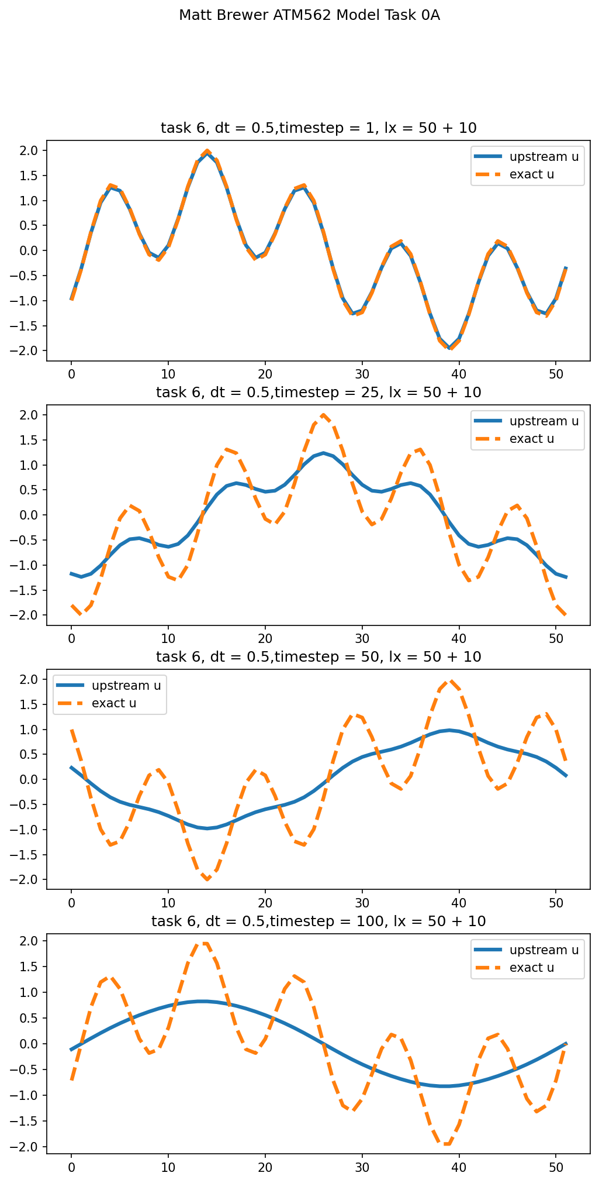

Slide 15
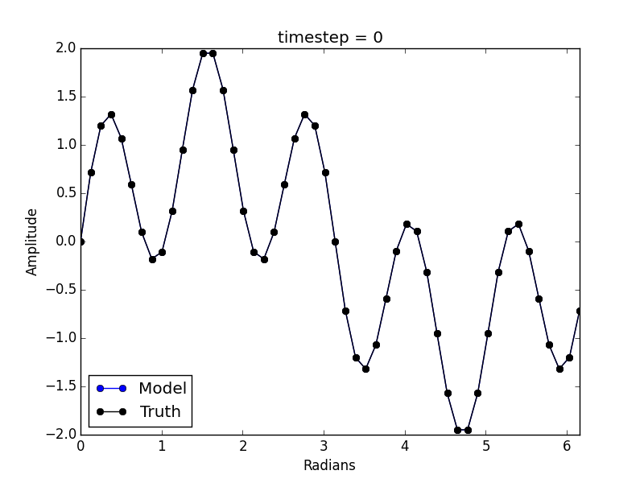
Experiment #6: 50 and 10∆x waves; c’ = 0.5
(Adam Massman)

