Slide 1
MT#0B recap: leapfrog vs. RK3
ATM 562 Fall 2021
Fovell

Slide 2
Recap
The upstream scheme had little phase error but had horrible amplitude error when c’ < 1.
  We will see the reason is the scheme has truncation error that has the form of a diffusion term
The leapfrog (LF) and RK3 schemes have advantages and disadvantages
  LF preserves amplitude very well but we will see it has a convolved “computational mode” that can cause 2∆t instability and needs to be suppressed. This is a consequence of its using 3 time levels (n-1, n, n+1). LF also has some phase error.
  “Our” RK3 has more problems than LF with amplitude, can have more phase error, and is also more expensive computationally. Its amplitude and phase error are dependent on c’ and wavelength. But, it has no computational mode and permits longer time steps than LF.
These behaviors are being seen in very simple models & situations
TANSTAAFL: There ain’t no such thing as a free lunch

Slide 3
Comparison of LF with
2 RK3 schemes
RK3.2: second-order spatial differencing
(“our” RK3 scheme, easy to program, not recommended)
RK3.4: fourth-order spatial differencing
(a more competitive version;
see Wicker and Skamarock 2002, eqn. 4b)

Slide 4
50∆x wave: c’ = 1, 500 sec
(10 revolutions)
RK3.2 (with 2nd order spatial differencing):
a little phase error
RK3.4 is competitive
Experiments #2 and #5

Slide 5
25∆x wave: c’ = 1, 500 sec
(10 revolutions)
Difference between LF and RK3.2
is the time differencing
RK3.2 (with 2nd order spatial differencing):
serious phase error
Both RK3 versions:
a little amplitude error
Experiments #4 and #5
Notes:
Diff between LF and RK3.2 is the time differencing

Slide 6
10∆x wave: c’ = 1, 500 sec
(10 revolutions)
Both RK3 versions:
serious amplitude error for
“short” waves
Experiments #4 and #5

Slide 7
RK3.2 and RK3.4 stability
Experiments #3, #5, and more
To get gfortran to promote all single precision reals to double precision:
gfortran -fdefault-real-8 your_code.f

Slide 8
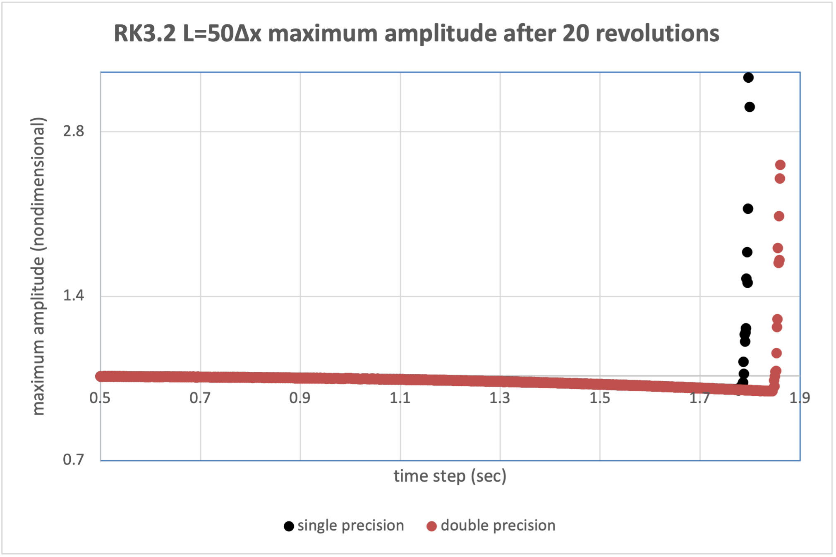
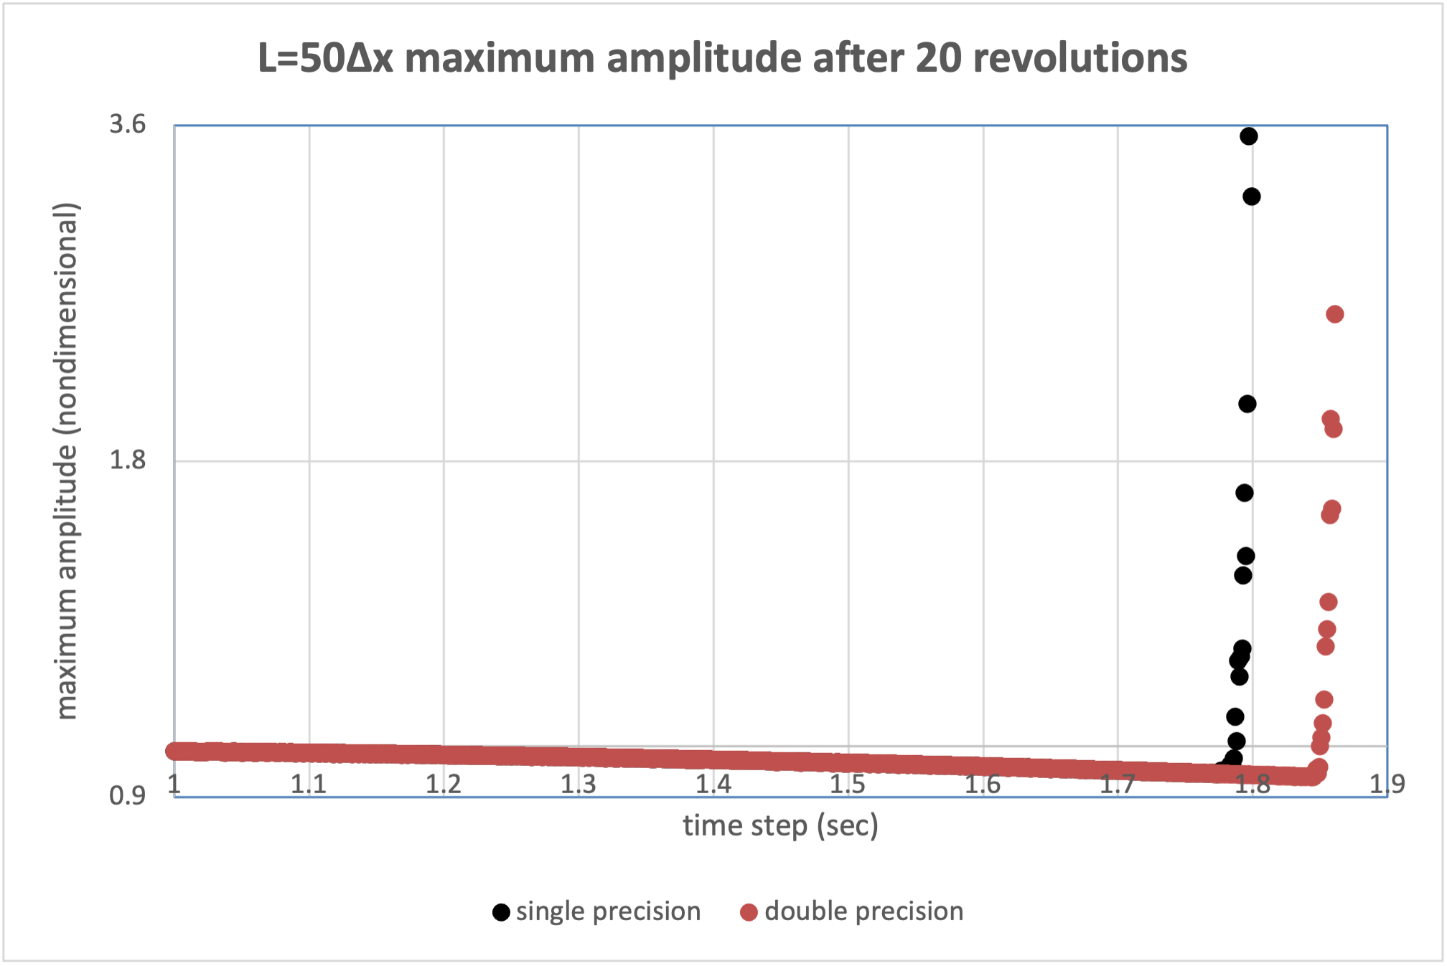
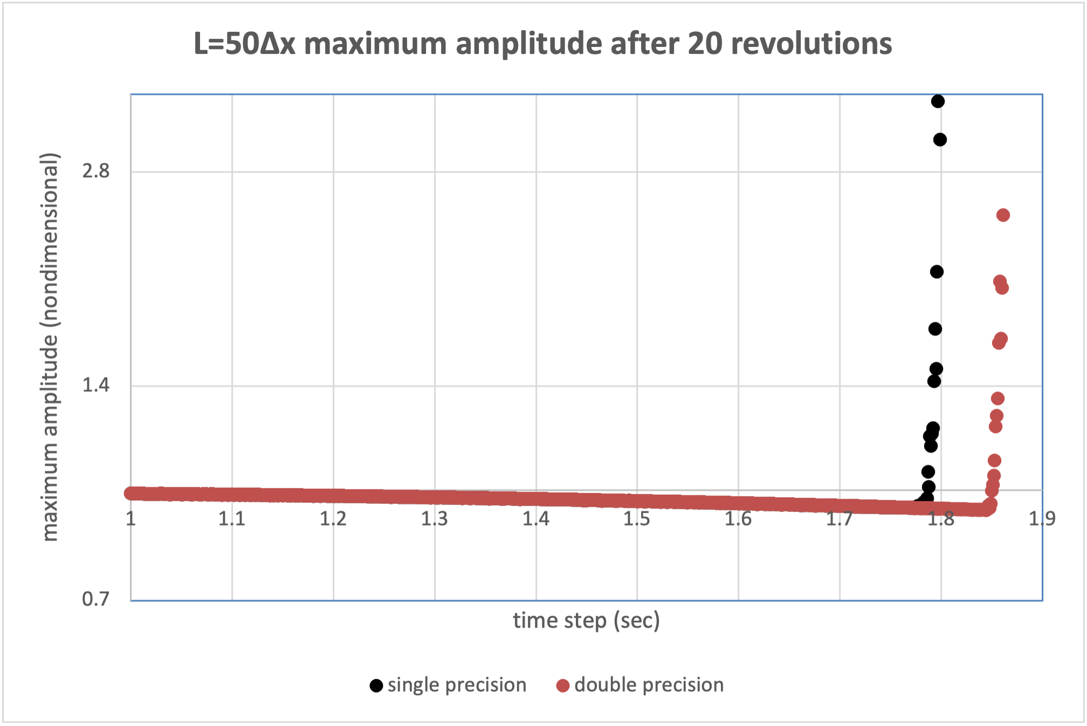
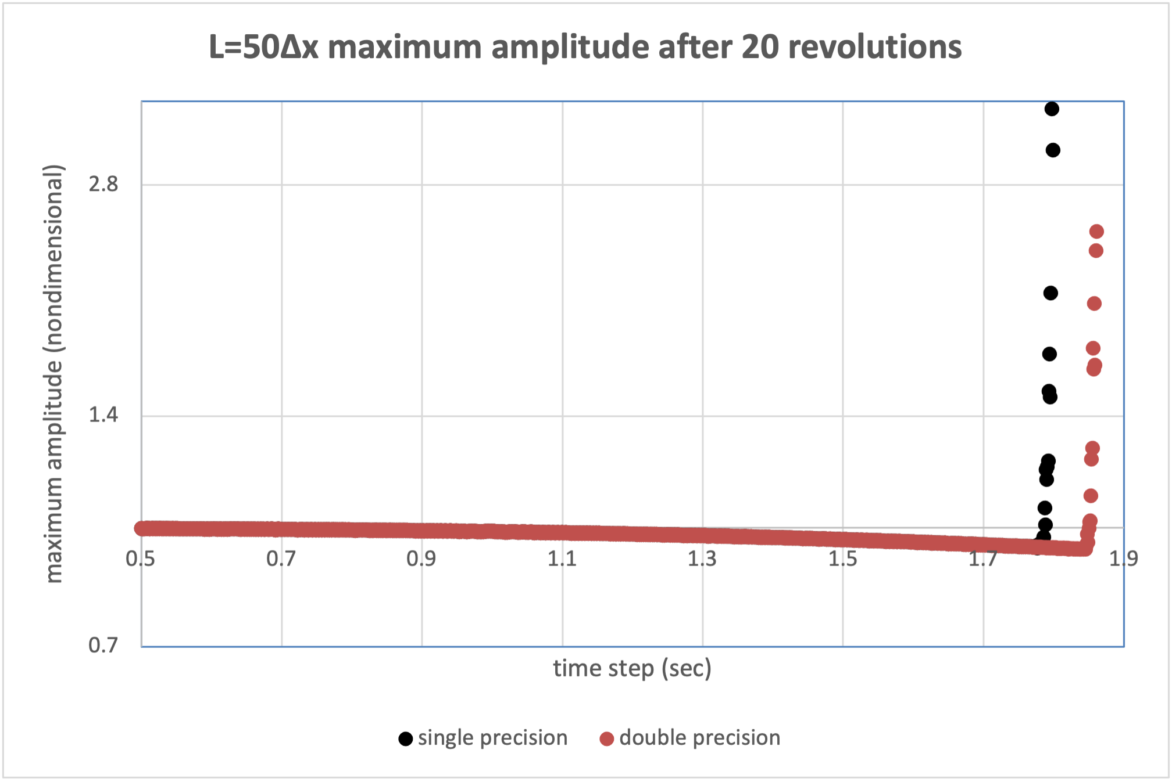
RK3.2 max amplitude for L=50∆x after
20 revolutions
“Our” RK3.2 can handle longer time steps
but precision and length of integration matter
Experiments #3 and #5
Notes:
Students will get different threshold time steps depending on precision of calculations. This is a LONG wave.

Slide 9
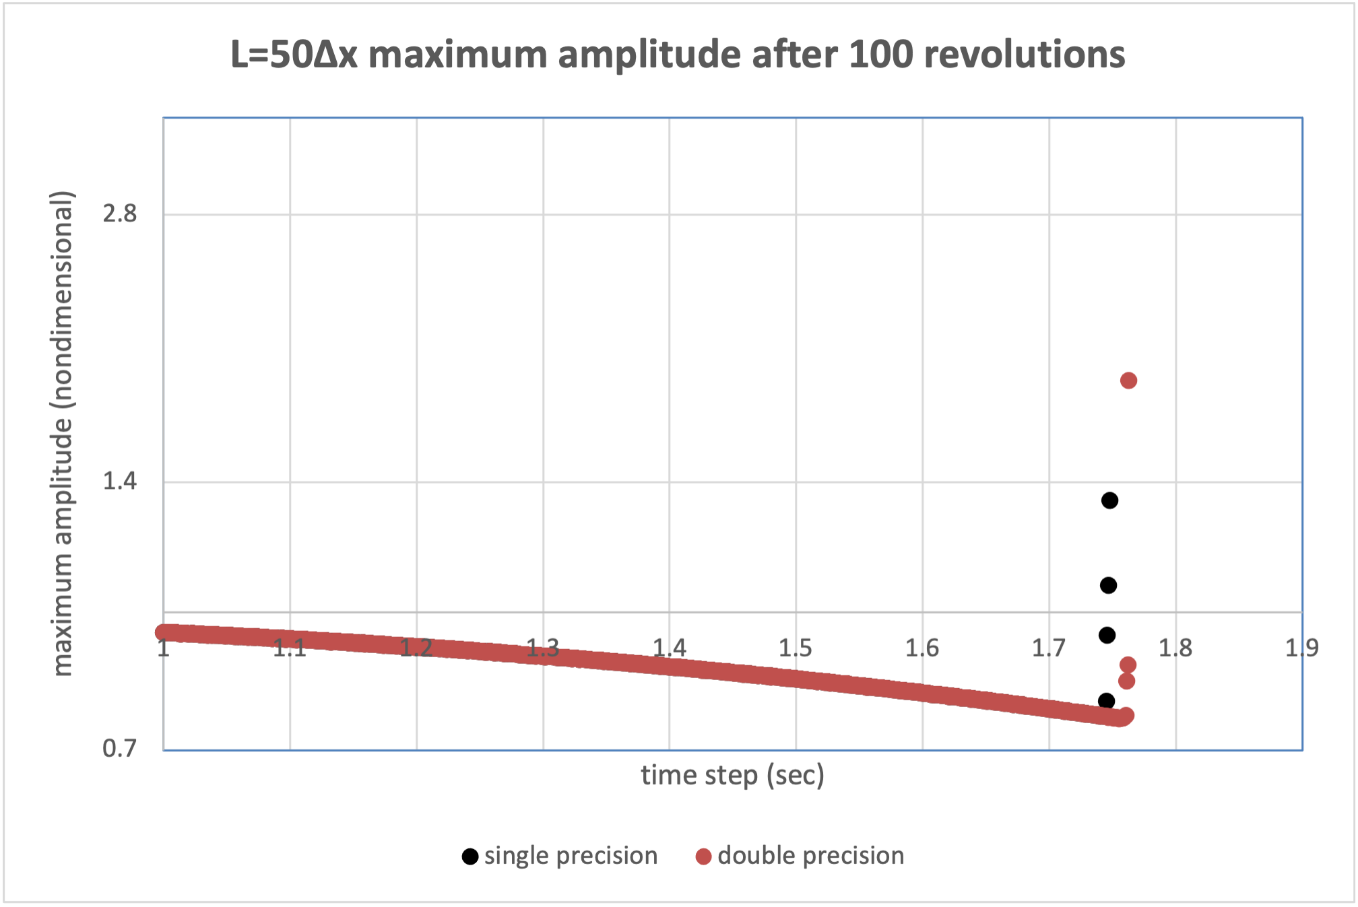
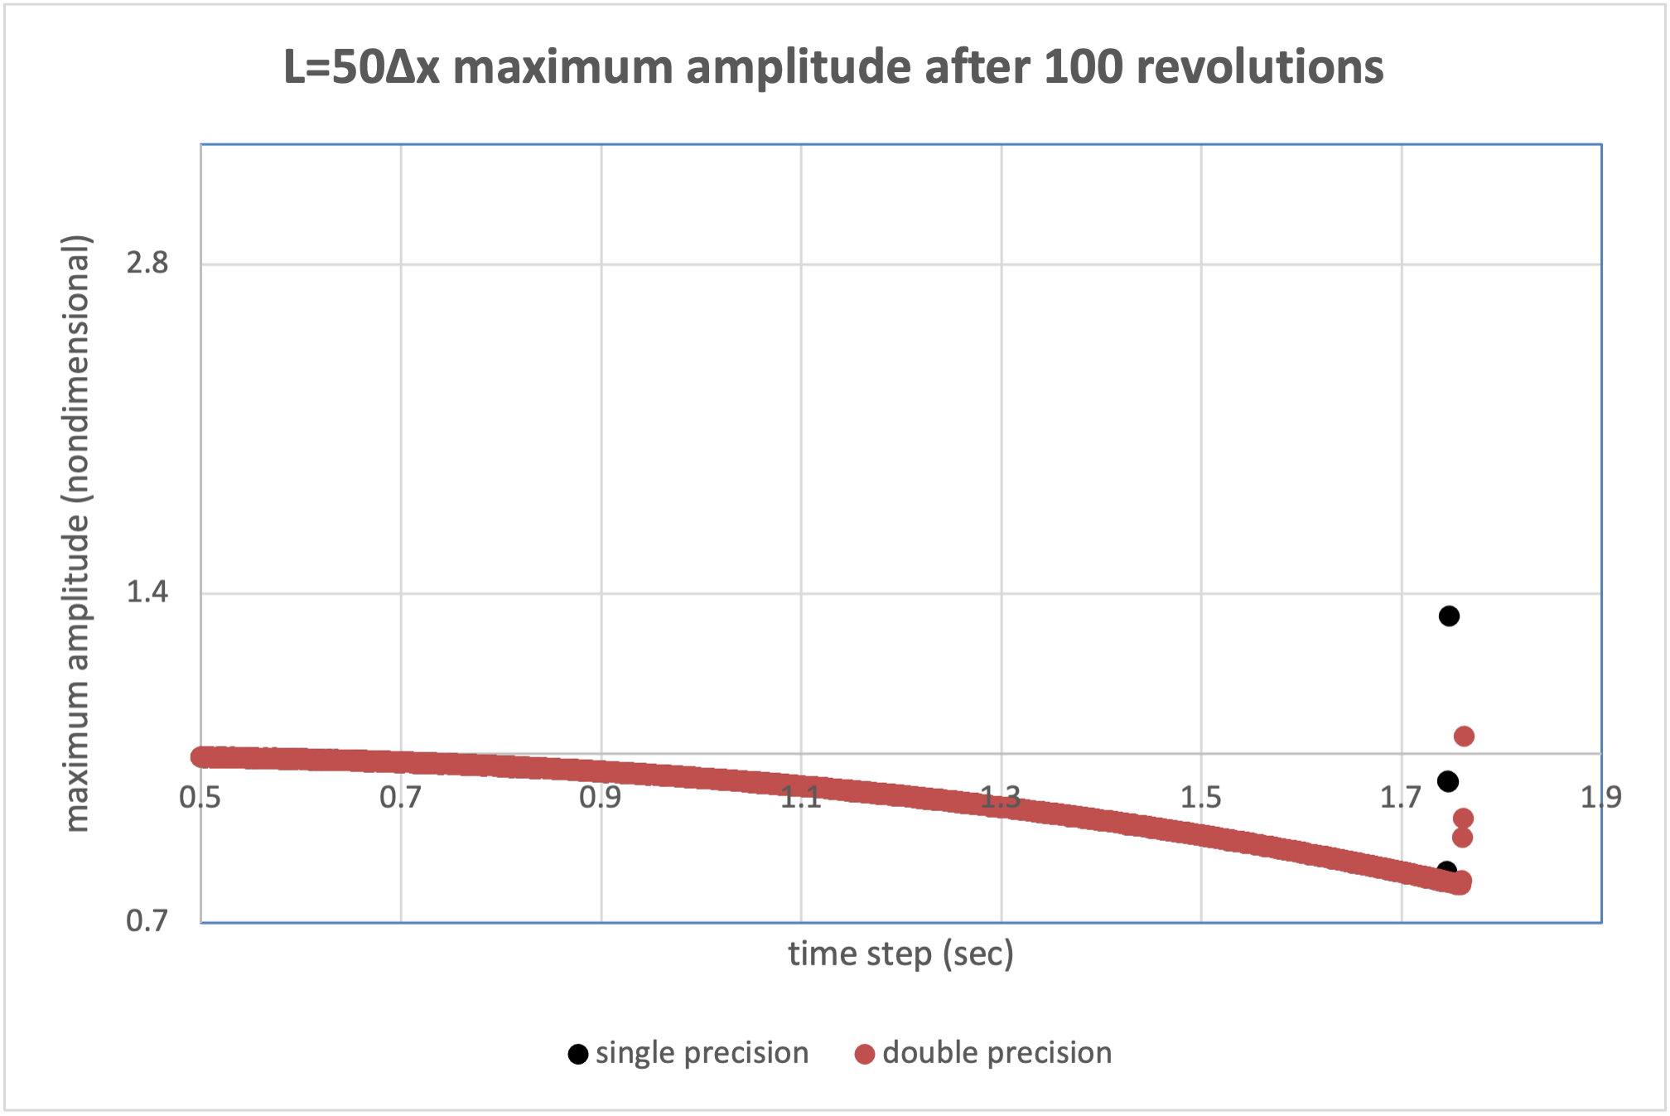
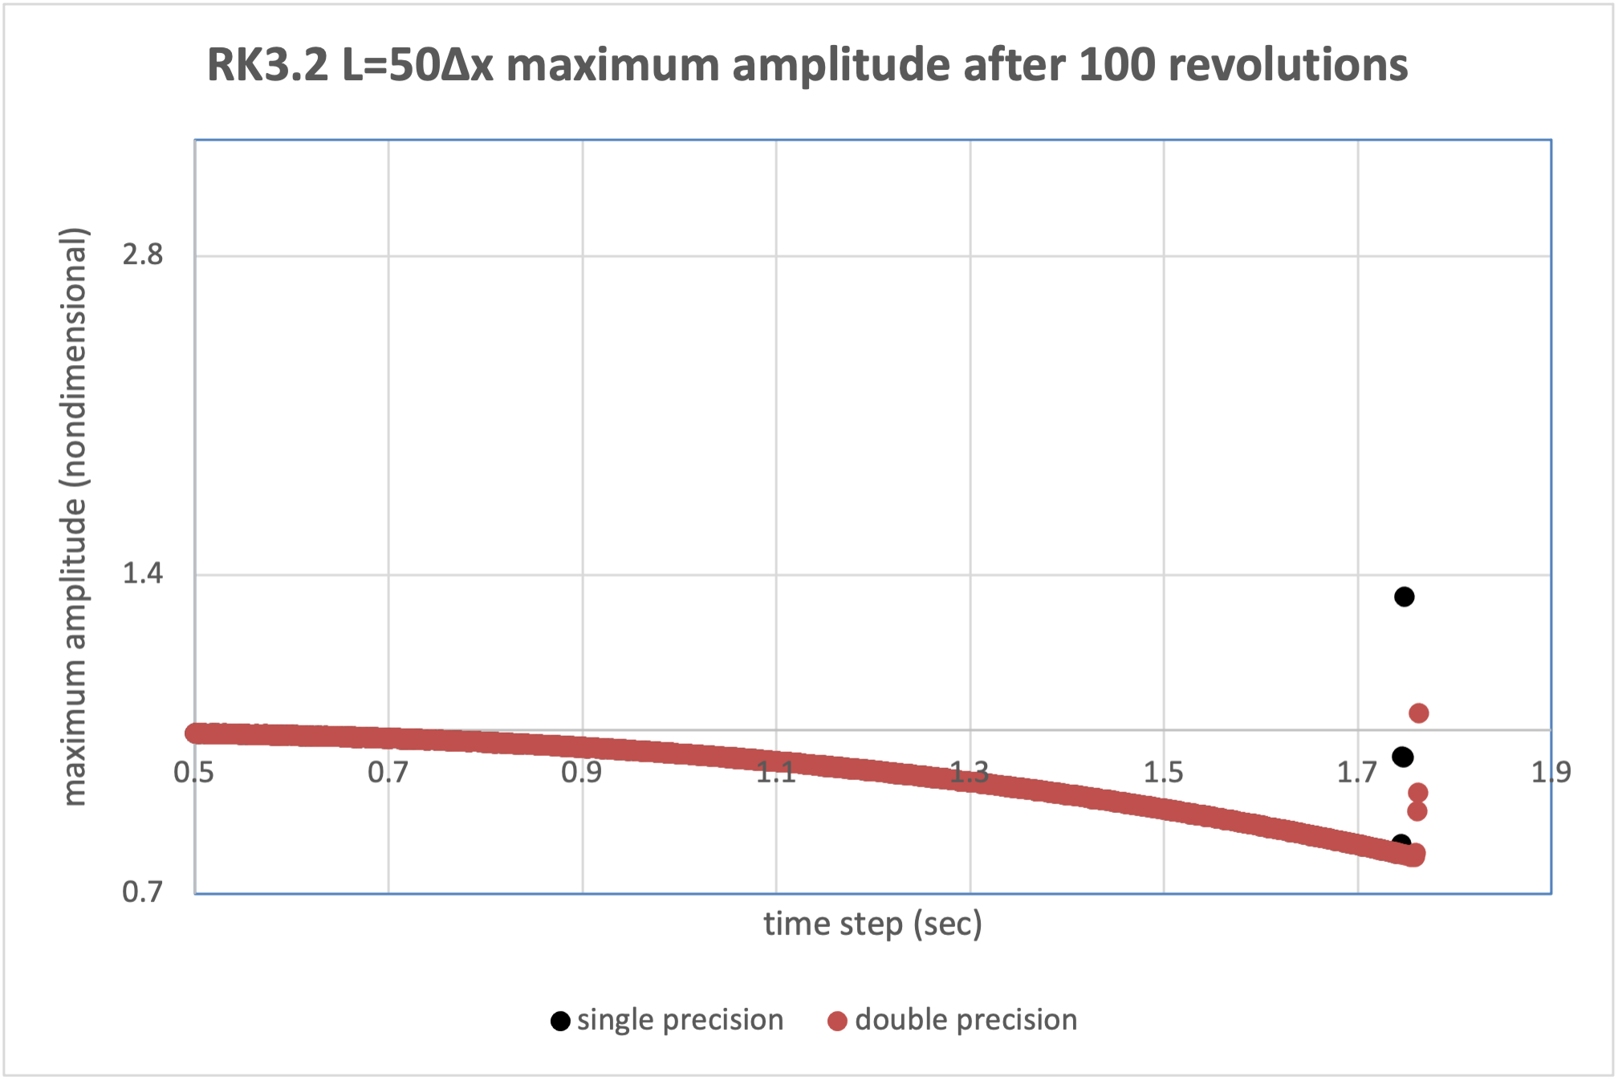
RK3.2 max amplitude for L=50∆x after
100 revolutions
As integrations lengthen, critical ∆t shortens to 1.73 s
and sensitivity to precision disappears
Stable ∆t values suffer from substantial amplitude decay
Even “small” ∆t values, like 0.5, will eventually damp long waves
Notes:
Students will get different threshold time steps depending on precision of calculations

Slide 10
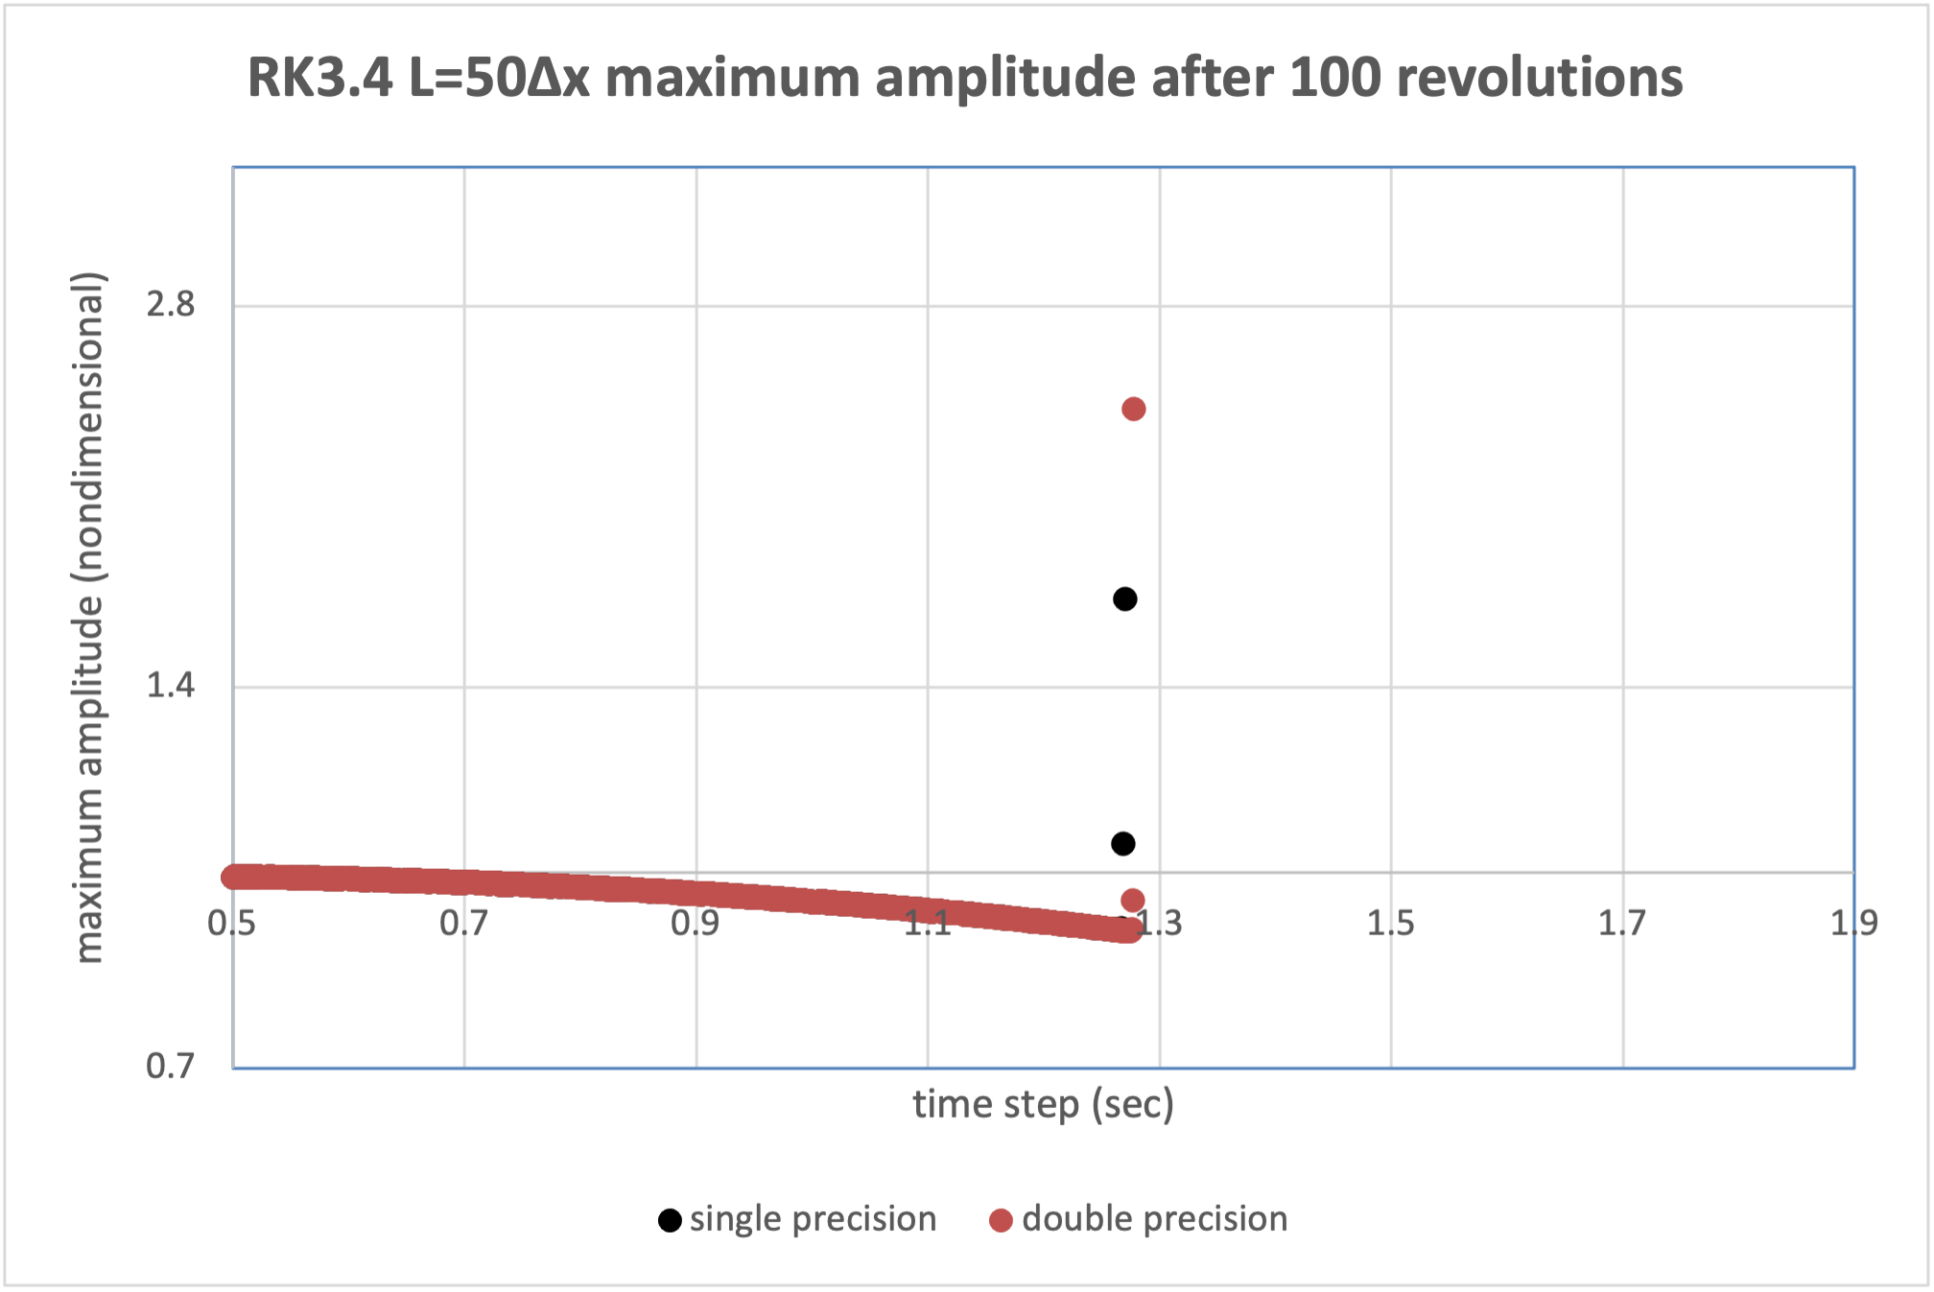
RK3.4 max amplitude for L=50∆x after
100 revolutions
RK3.4 cannot handle time steps as long
Amplitude error is still present for stable ∆t
(Major benefit is better phase speed)
Notes:
Students will get different threshold time steps depending on precision of calculations

Slide 11
Leapfrog computational mode
(See Chapter 5)

Slide 12
LF computational mode
The LF computational mode…
  Is a consequence of crafting a centered-in-time scheme from three time levels (n-1, n, n+1, or um, u, up)
  Is manifested by high-frequency (especially 2∆t) oscillations
  Is excited at the very start by setting um = u
  Can be excited at any time in a more realistic setting by high frequency forcing (e.g., latent heating in a cloud simulation)
In this simple case…
  The computational mode remains restrained (lack of nonlinearity and subsequent impulsive forcing) and no filtering or suppression is needed
  Can be eradicated by crafting a more accurate initialization, in which um ≠ u, and both um and u = exact solution for their respective times
Bottom line:
  Computational mode cannot be avoided in more realistic situations
  Robert-Asselin filter can control it, at the cost of some damping

Slide 13
LF dependence on initialization: max amplitude vs. time
Standard initialization: um = u; initial d2t = dt
Modified initialization: um ≠ u, both set to exact solution
[Note difference in this case is very small]
1st 80 time steps shown
Notes:
Mod has a little error. Should be maxamp = 1 for all time steps.
There is a spectral peak near (but not precisely on) 2∆t and a set of subharmonics

