Slide 1
Model Task #0B: Leapfrog (LF) and Runge-Kutta (RK) schemes
ATM 562
Fall 2021
Fovell

Slide 2
Overview
The upstream scheme suffers from substantial amplitude error. This task modifies the 1D linear wave equation model developed for Task #0A to employ the leapfrog and a version of the 3rd order Runge-Kutta (RK) schemes instead¹.
Advantages and disadvantages of the schemes relative to the upstream method, and each other, are explored.
¹ Note the terms “leapfrog” and “RK” actually refer to how they accomplish the time integration. You still have to
select how the spatial derivative is to be handled.

Slide 3
The leapfrog scheme
(2nd order accurate in time and space version)

Slide 4
The leapfrog (LF) scheme
The leapfrog approximation is centered in both time and space. Note this means that three time levels (n-1, n, n+1) and three grid points (i-1, i, i+1) are involved.
Note an odd feature of this scheme. The forecast for here does NOT depend on the present value here ! Can you imagine that might cause some interesting behavior?

Slide 5
Leapfrog time stepping

Slide 6
Explicit form and code
This approximation can be written explicitly as
Let the forecast, present, and past values be called up, u and um. The Fortran code version of this might be
up(i) = um(i) – c*(d2t/d2x)*(u(i+1)-u(i-1))
…where handling of d2t will be discussed presently.
As before, the space index runs from i = 1 to NX, with NX-2 real points (for Fortran) and 2 fake points that facilitate boundary condition handling.
Notes:
Didn’t cancel out the common 2 factor. Will see why.

Slide 7
Initialization
The initial time = 0 seconds. The time index n starts at 0. First forecast is n = 1.
Since this is a three time level scheme, we ostensibly need two values, for time 0 and time -1, at the start.
Where does u at time n = -1 come from? Usually, we fudge it.
The easiest (and usually, the only practical) way to start the scheme is to leap by ∆t instead of 2∆t for the first time step (only). We can code this efficiently via equating the time 0 and -1 values, as will be seen.
Thus, the first time step will be handled differently from all remaining steps, using a forward-time, center-space scheme that is unstable. However, it is only used once.

Slide 8
Strategy
Provide initial condition for u for all grid points, real and fake, as before.
Now, assign these values to um also.
Define d2x = dx + dx.
Initialize d2t = dt.
Step ahead with leapfrog, making first forecast up. In theory, you jumped d2t from um, but in practice, you only jumped dt from u.
At conclusion of first time step, redefine d2t = dt + dt.

Slide 9
Recap: the first leapfrog time step
The standard leapfrog step jumps from time n-1 to n+1, over 2∆t. For the first step, however, we actually jump only ∆t, from time n = 0 to n = 1. The second time step does jump 2∆t, from n = 0 to n = 2.
First time step
d2t = dt
Every subsequent step
d2t = dt + dt

Slide 10
! Initialize constants
d2x = dx + dx
d2t = dt
! Initialize u(i,k) over all real and fake points
[code here]
! Fudge um
do i=1,nx
um(i,k) = u(i,k)
enddo
! In the time stepping loop… Since um = u and d2t = dt to start, this
! is really a forward-time step, not a leapfrog step first time through.
do i=2,nx-1
up(i) = um(i)-(c*d2t/d2x)*(u(i+1)-u(i-1))
enddo
! Take care of boundary points
[code here]
! Set for new time step
do i=1,nx
um(i) = u(i) ! Present time becomes past
u(i) = up(i) ! Future time becomes present
up(i) = 0. ! Start with a clean slate
enddo
! Update d2t at end of time step. Can do every time step; does not hurt
d2t = dt + dt

Slide 11
Test problem
Let c’ = c∆t/∆x (by definition)
Test: c = 1.0, dt = 1.0, dx = 1.0, so c’ = 1.0
NX = 52 (50 real points)
NT = 50 (timend = 50 since dt = 1.0)
Wavelength L = 50∆x (one sine wave in domain), with amplitude 1.0
Execute for one revolution
As with the upstream scheme, there should be no significant error for c’ = 1.0 after 1 revolution. This is your code test.

Slide 12
Phase error
As long as the scheme is stable (i.e., c’ ≤ 1 for this simple problem), the leapfrog scheme has no amplitude error (apart from roundoff).
However, the scheme has phase error. Generally, the combination of centered time and space differencing pushes waves a little too slowly.
Also, this error is wavelength-dependent. The scheme is progressively worse for shorter waves. Thus, the scheme is also dispersive.
Next slide shows phase error vs. wavenumber (wavelength decreases to right) and c’, for c’ ≤ 1 for the 1D leapfrog scheme.

Slide 13
Phase error for 1D leapfrog
0.96
Much less sensitivity
to time step (via c’)
than upstream scheme’s
amplitude error
c’ = c∆t/∆x
0.48
2∆x wave does not move
Caveat: multidimensional leapfrog behavior will be
somewhat quantitatively different (although qualitatively similar)
Notes:
Fact that contours are nearly vertical is a good thing – not very sensitive to time step

Slide 14
Leapfrog vs. upstream
Odd order schemes generally do better with phase than amplitude, while even order schemes do better with amplitude than phase. (We’ll see why.)
That said, the leapfrog phase error is not too bad for long waves. You may have to execute a number of revolutions to detect it.
The next slide shows upstream and leapfrog solutions for a 50∆x wave at c’=0.5 after 10 revolutions. The upstream wave is in the correct position, but its amplitude has been seriously diminished. The leapfrog wave is a little slow but its amplitude is nearly perfect.

Slide 15
Leapfrog vs. upstream

Slide 16
Leapfrog computational mode
We will see in class that the leapfrog scheme, as a 2nd-order scheme, actually supports two solutions that are convolved. One solution may not be right, but the other (called the computational mode in time) is certainly wrong.
This mode is 2∆t in time (“2∆t noise”)
In more complex problems than this one, some kind of time smoothing may be needed to suppress the computational mode.
The Robert-Asselin time filter is a crude but relatively effective means of accomplishing this.

Slide 17
Robert-Asselin filter
Recall you are predicting from
At each time, readjust based on the new forecast. In the code below, asterisks indicate unadjusted values.
ε is the filter coefficient, usually set to a small value (0.1 or 0.05, nondimensional)

Slide 18
An RK3 scheme
(3nd order accurate in time
and 2nd order in space)

Slide 19
Runge-Kutta (RK) schemes
RK is a family of predictor-corrector schemes, including RK2, RK3, and RK4 (2nd through 4th order accurate, respectively). Additionally, there are several versions of an “RK2” or “RK3” scheme, for example.
As with leapfrog, the method refers to how it integrates in time. You also need to select a form of spatial differencing.
Leapfrog attained 2nd order accuracy in time by centering the tendency about time n (leaping from n-1 to n+1), over an interval of 2∆t – at the cost of creating an artificial computational mode.
An RK2 scheme attains 2nd order accuracy in time by re-computing the tendency halfway between times n and n+1. It’s still centered in time, but not around time n.
We’ll look at the RK3, which is used in WRF. It re-computes the tendency between n and n+1 twice, for a total of 3 estimates.
Notes:
MPAS has reverted to an RK2. Less accurate but time stepping was not seen as a major source of error, plus RK2 allows longer time steps than RK3

Slide 20
RK3
Wicker and Skamarock (2002, MWR, p. 2089; “W&S”) describe an RK3 scheme that is 3rd order in time and either 3rd, 4th, 5th or 6th order accurate in space.
I will describe an RK3 joined with a simple centered spatial difference that is only 2nd order accurate (easy to code but uncompetitive) like our leapfrog’s term .
Once your scheme is implemented and tested, feel free to add an RK3 with better spatial accuracy (see W&S)
Keep in mind there are many potential legitimate RK3 schemes; this is just one of them (and the one employed by WRF-ARW).
Aside: MPAS has “downgraded” to an RK2. Not much more error but permits longer stable time steps.

Slide 21
An RK3 (#1)
Define the 2nd order advection term at i for time n as
For the first estimate, , we compute advection at time n and add it to the present time, but only jump ahead ∆t/3 instead, creating
If we had jumped the full ∆t, we’d be using a forward-time, centered-space method, which is absolutely unstable.
Note minus sign

Slide 22
An RK3 (#2)
Instead, we’re going to re-compute advection using our new temporary estimate , and use that to compute our second estimate
Note advection was recomputed, using
But, note that we are again starting with but now jumping farther, by ∆t/2.
Using , we will re-compute advection a third time, and use it to jump one full ∆t from the present to our forecast:
This is centered… ultimately, advection was estimated halfway between times n and n+1.

Slide 23
W&S RK3 time stepping concept

Slide 24
Experiments

Slide 25
MT#0B experiments (see notes p. 119) (bold = turn in to me)
I said the forward in time, centered in space scheme is absolutely unstable. You can prove this by coding and running it.
Do an experiment using upstream, LF, and our RK3 with c’= 1 and L = 50∆x, executed for 10 revolutions. You should find the upstream and LF solutions are nearly exact, but our RK3 has phase lag even at c’=1. Send me this plot.
Our RK3 is more costly to compute compared to the leapfrog, but it also permits longer time steps, and can stay stable for some c’ > 1. Try runs with larger ∆t. When does the RK3 scheme become unstable? Make a plot of maximum wave amplitude after 20 revolutions vs. ∆t, for time steps between 1 and 2 seconds. Send me this plot.
Compare our RK3 to the leapfrog scheme for various other wavelengths, such as 25∆x and 10∆x. How does it perform as a function of c’?
Our RK3 isn’t optimal. What would happen if you adopted a higher order spatial differencing? (See Wicker and Skamarock, 2002, MWR, p. 2089).
There are many, many different RK3 schemes. Durran’s (2010) text presents two, more complex alternatives (p. 53; see next slide). Do they do better?
Please label your plots fully, include your name, and send me your code

Slide 26
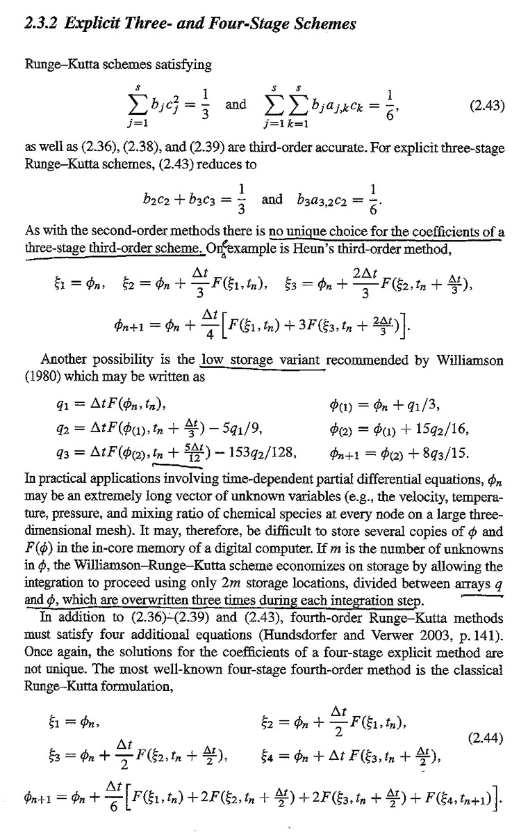
Durran text, p. 53

Slide 27
Notes
Higher order accuracy in space (especially in the horizontal) is achievable and often adopted in modern NWP models. For example, the leapfrog can be implemented as a 2nd order in time and 4th order in space scheme.
In multi-dimensional problems, different orders are used in different dimensions (usually, lower accuracy in vertical)
Keep in mind terms like “RK” and “leapfrog” actually refer to how the time differencing is done, and there is no single “RK3” scheme.
Also keep in mind you can use different spatial differencing with RK3. WRF uses RK3 in time, usually with 5th order in horizontal space and 3rd order in vertical space.

