Slide 1
Model Task #1:
Setting up the base state
ATM 562 Fall 2021
Fovell
(see course notes, Chapter 9)

Slide 2
Overview
Construct the base state (function of z alone) for a subset of our five prognostic variables (u, w, θ, q_{v}, and π) and also ρ.
The Weisman and Klemp (1982) sounding will be adopted. θ and q_{v} functions of z will be provided, and π and ρ will be computed.
The grid will be staggered, using Arakawa’s “C” grid arrangement.
Fake points above and below the model will facilitate handling of the boundary conditions.

Slide 3
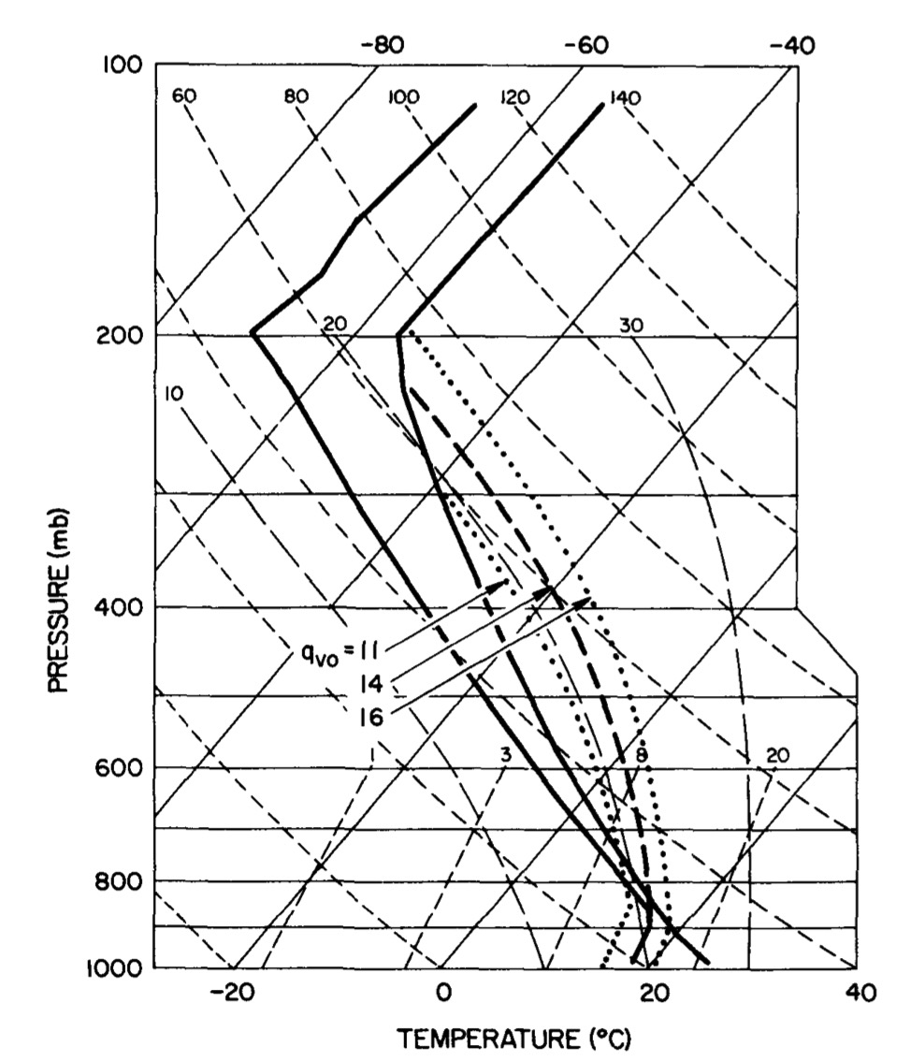
Weisman and Klemp (1982)

Slide 4
“C” grid arrangement
(s = scalar)
∆x
k+1
k+1/2
k
k-1/2
k-1
∆z
NOTE:
u(i,k), w(i,k) and
s(i,k) not colocated!

Slide 5
Model surface
and top are
W locations
and rigid plates
so w = 0

Slide 6
Vertical grid
Fortran
  The surface resides at the k = 2 level for w.
  k = 2 is also first real scalar level, so height of this level is z_{T} = (k-1.5)∆z, or 0.5∆z above ground
C++ and other zero-indexed languages
  The surface resides at the k = 1 level for w.
  k = 1 is also first real scalar level, so height of this level is z_{T} = (k-0.5)∆z, or (still) 0.5∆z above ground
For this example problem, we take NZ = 40 and ∆z = 700 m. Code so these are easily changed.

Slide 7
W-K sounding
Base state potential temperature (z_{T} = scalar height [temperature] above ground; z_{TR} = tropopause height above ground [12 km]; q_{TR} = tropopause pot. temp. [343 K]; T_{TR} = tropopause temp. [213 K]; g = 9.81 m/s² ; c_{pd} = 1004 J/kg/K). Note this is not θ_{v}.
Base state water vapor mixing ratio can be specified as:

Slide 8
Real and fake points
For Fortran, the real points in the vertical for a scalar are k = 2, nz-1, with the k = 2 scalar level being 0.5∆z above surface.
Once we define mean potential temperature and mixing ratio (which I will call tb and qb) for the real points, we need to also fill in the fake points.
  Note the k=1 fake point is below the ground!
  We will presume the values 0.5∆z below the ground = those 0.5∆z above ground. That is, we assume zero vertical gradient.
With tb and qb, we can compute tbv, or mean virtual potential temperature, for all real and fake points.
_
_
_

Slide 9
Derived quantities
_
_
Given mean θ, q_{v}, we will compute the base state nondimensional pressure (π) presuming it is hydrostatic
Recall given p₀ = 100000 Pa, R_{d} = 287 J/kg/K:
_
_
_
_
_
_

Slide 10
Computing mean π
psurf = 96500 Pa is the provided surface pressure. We need to compute pressures starting at 0.5∆z above the surface, and then every ∆z above that
! tbv = virtual potential temperature, already computed
p0 = 100000.
xk = rd/cpd
pisfc = (psurf/p0)**xk
pib(2) = pisfc-grav*0.5*dz/(cpd*tbv(2))
do k = 3, nz-1
tbvavg = 0.5*(tbv(k)+tbv(k-1))
pib(k) = pib(k-1) - grav*dz/(cpd*tbvavg)
enddo
[see also next slide]

Slide 11
Concept
pib(k) = pib(k-1) - grav*dz/(cp*tbvavg)
pib(2) = pisfc
-grav*0.5*dz/(cpd*tbv(2))
Fortran indexing

Slide 12
Base state density
As a scalar, density is logically defined at the scalar/u height, but is useful also to define density at w heights. I will call these RHOU and RHOW.
RHOU will be computed using and averaged to form RHOW
  rhow(k) = 0.5*(rhou(k) + rhou(k-1))

Slide 13
Saturation mixing ratio (q_{vs})
One form of Tetens’ equation for q_{vs}
You can substitute using and
Ref: Soong and Ogura (1973)

Slide 14
Some results (see notes)
z(km) tb(K) qb(g/kg) rhou(kg/m^3) rel. hum (%)
0.35 300.52 14.92 1.09E+00 88.78
1.05 302.05 12.56 1.02E+00 96.08
1.75 303.88 10.19 9.60E-01 99.96
2.45 305.9 7.83 8.99E-01 98.72
3.15 308.08 5.47 8.41E-01 89.18
3.85 310.38 3.11 7.85E-01 66.11
4.55 312.79 2.24 7.31E-01 62.94
5.25 315.3 1.79 6.79E-01 66.96
[…]
19.95 493.94 0 8.72E-02 0
20.65 510.06 0 7.79E-02 0
21.35 526.71 0 6.97E-02 0
22.05 543.89 0 6.23E-02 0
22.75 561.64 0 5.57E-02 0
23.45 579.97 0 4.98E-02 0
24.15 598.89 0 4.45E-02 0
24.85 618.44 0 3.98E-02 0
25.55 638.62 0 3.56E-02 0
26.25 659.46 0 3.18E-02 0
Please hand in your code and
your version of this (full) table
These values require taking g = 9.81 m/s/s

