Slide 1
Model Task #2:
Calculating CAPE and CIN
ATM 562 Fall 2021
Fovell
(see course notes, Chapter 10)
Last modified 9/22/21

Slide 2
Overview
Given the Weisman-Klemp sounding on the model vertical grid constructed for MT1, compute CAPE and CIN.
MT1 yielded mean Θ, Θ_{v}, and Π as a function of height for the environment (denoted here with capitals instead of overbars as in the course notes).
We will define a parcel and lift it, grid level by grid level, using parcel assumptions (parcel pressure = environmental pressure), adjusting the parcel if/when it becomes saturated. This will yield θ_{p}, θ_{pv,} q_{vp} as a function of height, where subscript p indicates parcel.
CAPE and CIN are computed using Θ_{v,} θ_{pv}.

Slide 3
Procedure
Define parcel properties (θ_{p}, q_{vp}) at first real grid point above surface.
  Example problem: θ_{p} = 300.52 K, q_{vp}= 11.5 g/kg (parcel potential temperature about same value as environment, but parcel is a little drier, creating some negative buoyancy)
Lift the parcel up one level, conserving the dry adiabatic quantities θ_{p}, q_{vp}. Compute parcel saturation mixing ratio q_{vsp} valid for the new pressure and check relative humidity (RH). If saturated, perform isobaric saturation adjustment. Otherwise, parcel is unchanged.
Lift to next level, conserving the dry adiabatic quantities even if parcel is already saturated. Compute q_{vsp} and check RH. If saturated, perform saturation adjustment. Otherwise, parcel is unchanged.
Continue on to model top.

Slide 4
Grid and concept
On this figure, θ represents the parcel potential temperature, θ_{p}

Slide 5
Saturation adjustment
Parcel saturation mixing ratio is again a form of Tetens’ approximation over liquid
If q_{vp} > q_{vsp}, then the condensation produced is C
φ > 0 which means C < q_{vp} – q_{vsp}, which is logical because as vapor condenses, heat is released, increasing the saturation mixing ratio.

Slide 6
Adjusted properties and CAPE
The new adjusted parcel properties are
And then CAPE uses

Slide 7
Computing positive and negative areas
CAPE (and CIN) can be computed using the trapezoidal rule. For a given layer, we will have parcel buoyancy at the top and bottom of the layer, b_{k} and b_{k-1}.
If both buoyancy values are positive, the positive area is simply
Layers containing the LFC and EQL require special handling (see next slide).

Slide 8
CAPE/CIN area concept
Figure modified from Fig. 11.2 to match the specific example on next slide
Defining buoyancy b at scalar levels

Slide 9
Layer with LFC
Here, b_{k} is the first layer with positive buoyancy, so b_{k-1} is negatively buoyant
For the model layer encompassing the LFC (z_{LFC} is height where parcel buoyancy is zero and z_{k} is height of layer top), the positive area is nominally :
…but z_{LFC} can be linearly interpolated within the layer as
…so…
and
Notes:
Linear interp:
Ztop = zbot + (ztop-zbot)/(btop-bbot) * (btop-bbot), by definition. So zbot = ztop - dz/(btop-bbot) * (btop-bbot)
At z=zlfc, buoy is zero
Zlfc = ztop – dz/(btop-bbot) * (btop-blfc) = ztop – btop/(btop-bbot)*dz = ztop – beta*dz, where beta=btop/(btop-bbot)

Slide 10
Partial results
(g=9.81 m/s², Lv=2.5E6 J/kg/K)
θ_{p} = 300.52 K, q_{vp}= 11.5 g/kg initial parcel
initial parcel potential temperature: 300.52 K
initial parcel vapor mixing ratio: 11.50 g/kg
z p thv_env thv_prcl qv_prcl CAPE CIN buoybot buoytop
(km) (mb) (K) (K) (g/kg) (J/kg) (J/kg) (m/s^2) (m/s^2)
1.05 854.6 304.36 302.63 11.50 0.0 -26.6 -0.020 -0.056
1.75 786.5 305.76 306.00 10.15 0.3 -43.8 -0.056 0.008
2.45 722.7 307.36 309.51 8.78 27.0 -43.8 0.008 0.069
3.15 663.0 309.11 312.94 7.47 93.6 -43.8 0.069 0.122
3.85 607.2 310.97 316.29 6.23 194.9 -43.8 0.122 0.168
4.55 555.2 313.22 319.50 5.07 322.5 -43.8 0.168 0.197
5.25 506.8 315.64 322.51 4.01 466.0 -43.8 0.197 0.214
5.95 461.8 318.15 325.28 3.06 617.7 -43.8 0.214 0.220
6.65 420.1 320.73 327.73 2.24 769.5 -43.8 0.220 0.214
7.35 381.5 323.38 329.81 1.56 912.7 -43.8 0.214 0.195
8.05 345.7 326.11 331.50 1.03 1037.8 -43.8 0.195 0.162
8.75 312.7 328.97 332.77 0.64 1134.2 -43.8 0.162 0.113
9.45 282.2 331.90 333.67 0.38 1192.2 -43.8 0.113 0.052
10.15 254.2 334.88 334.26 0.21 1205.8 -43.8 0.052 -0.018
[…]
Vertically integrated CAPE 1205.8 J/kg CIN is -43.8 J/kg
LFC detected at 1.67 km
EQL detected at 9.97 km

Slide 11
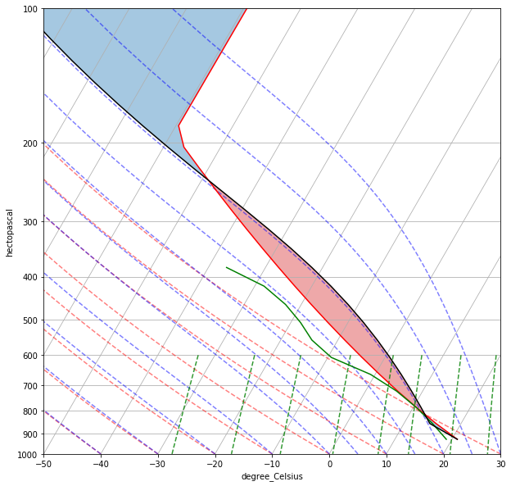
Not CIN
Plotted using metpy
EQL
CAPE
LFC
LCL
CIN
Notes:
plot_wk_sounding.ipynb

Slide 12
MT2 assignment:
Please turn in your code and output showing accumulated CAPE and CIN for each model level for the NZ=40, DZ=700 m setup from MT1.
[see slide 10]
[asking for a complete table of values, not a plot]

Slide 13
Notes and thought questions
The example parcel starts with less vapor than the environment at the first scalar level, so the parcel buoyancy there is negative (not zero). This affects CIN calculation.
CIN is only computed between the initial parcel level and the LFC, so don’t include the negative buoyancy above the EQL.
This result should be sensitive to resolution. What happens if you increase NZ and decrease ∆z?
This result is also sensitive to how the initial parcel is defined. What happens if you change the initial parcel properties?
Do you think the CAPE and CIN would change a lot if you used a more accurate technique than the trapezoidal rule?
For subfreezing conditions, a form of Tetens’ formula valid for ice might be used instead. How would this change CAPE?
Soong and Ogura (1973, JAS) also try to account for how pressure changes along a moist adiabat, so their saturation adjustment is not strictly isobaric. Do you think that would make much of a difference?
Comparison issues: (1) Some CAPE calculations do not include virtual temperature, which affects the results. (2) Alternatives to Tetens’ exist and affect calculations.

Slide 14
Partial results (g=9.8 m/s²)
Use g=9.81 m/s/s instead
initial parcel potential temperature: 300.52 K
initial parcel vapor mixing ratio: 11.50 g/kg
z p thv_env thv_prcl qv_prcl CAPE CIN buoybot buoytop
(km) (mb) (K) (K) (g/kg) (J/kg) (J/kg) (m/s^2) (m/s^2)
1.05 854.7 304.36 302.63 11.50 0.0 -26.0 -0.020 -0.056
1.75 786.7 305.76 305.99 10.15 0.3 -43.0 -0.056 0.007
2.45 722.9 307.36 309.50 8.79 26.7 -43.0 0.007 0.068
3.15 663.3 309.11 312.93 7.48 92.9 -43.0 0.068 0.121
3.85 607.5 310.97 316.27 6.24 193.7 -43.0 0.121 0.167
4.55 555.5 313.22 319.48 5.08 320.7 -43.0 0.167 0.196
5.25 507.2 315.64 322.49 4.01 463.6 -43.0 0.196 0.213
5.95 462.2 318.15 325.25 3.07 614.6 -43.0 0.213 0.219
6.65 420.5 320.73 327.71 2.25 765.8 -43.0 0.219 0.213
7.35 381.9 323.38 329.79 1.57 908.4 -43.0 0.213 0.194
8.05 346.1 326.11 331.48 1.04 1032.9 -43.0 0.194 0.161
8.75 313.1 328.97 332.76 0.65 1128.8 -43.0 0.161 0.113
9.45 282.7 331.90 333.66 0.38 1186.5 -43.0 0.113 0.052
10.15 254.6 334.88 334.26 0.21 1200.0 -43.0 0.052 -0.018
[…]
Vertically integrated CAPE 1200.0 J/kg CIN is -43.0 J/kg
LFC detected at 1.67 km
EQL detected at 9.63 km

