Slide 1
Model Task #3:
Grid setup, initial condition and visualization
ATM 562 Fall 2021
Fovell
(see course notes, Chapter 11)
Last modified 10/9/21

Slide 2
Outline
Create the model grid and 2D arrays that will hold model prognostic variables
Make initial environment dry, calm, adiabatic
Introduce a thermal perturbation
Create an initial pressure perturbation field responding to the initial θ’
Visualization (GrADS example provided)

Slide 3
Model grid
To facilitate coding, we will employ a “frame” of fake points completely surrounding our physical domain
This is illustrated for 1-based (Fortran) and 0-based (C++, Python) languages on the following two slides
Note for horizontal direction (Fortran notation):
  First real U(i,k) point is for location i=2
  U(1,k) does exist but will never be referenced
  There is no U value at right edge of plot frame (no nx+1)
Note for vertical direction (Fortran notation):
  First real W(i,k) point is for level k=2
  W(i,1) does exist but will never be referenced
  There is no W at the top edge of plot frame (no nz+1)

Slide 4
Index starts at 1
Notes:
U(1) exists but will never be referenced
There is no U along right edge of false frame

Slide 5
Index starts at 0

Slide 6
Model variables - I
We will have four prognostic variables:
  u = zonal horizontal velocity
  w = vertical velocity
  th = perturbation potential temperature
  pi = perturbation nondimensional pressure
    Note that u is a “full field”, including a base state that could vary with height, but th and pi are the perturbation fields only.
Each prognostic variable requires three 2D arrays, dimensioned nx by nz
  The leapfrog scheme uses 3 time levels, n+1, n, and n-1
  I will use this naming convention: thp, th, thm
  The scheme can be coded more efficiently than I describe, but the code will not be as easily readable
I will add a fifth prognostic variable v, for meridional velocity. My example GrADS code requires this, and we will use vp, v, vm in MT4.

Slide 7
Model variables - II
We will also have, at a minimum, five 1D vectors to hold base state variables
  tb = mean potential temperature
  pib = mean nondimensional pressure
  rhou = mean density at u levels
  rhow = mean density at w levels
  ub = mean zonal velocity
    Initialize with zeroes: calm, shearless
  I also like to carry pb, for mean dimensional pressure
You can also add a base state virtual temperature, thvb, if you intend to incorporate moisture

Slide 8
Example Fortran code
! parameters
parameter(nx=83,nz=42)
! grid box lengths
parameter(dx=400.,dz=400.) ! real numbers
! base state vectors
dimension tb(nz),qb(nz),pb(nz),pib(nz),rhou(nz),rhow(nz),ub(nz)
! 2D prognostic arrays - 3 time levels
dimension thp(nx,nz),th(nx,nz),thm(nx,nz) ! pot. temp. pert.
dimension wp(nx,nz),w(nx,nz),wm(nx,nz) ! vert. vel.
dimension up(nx,nz),u(nx,nz),um(nx,nz) ! zonal horiz. vel.
dimension vp(nx,nz),v(nx,nz),vm(nx,nz) ! merid. horiz. vel.
dimension pip(nx,nz),pi(nx,nz),pim(nx,nz) ! ndim pert. pres.
You can also add a base state virtual temperature, thvb, if you intend to incorporate moisture

Slide 9
Modified base state
Revise your MT1/MT2 tb and qb to create a calm, dry, neutral base state. (Don’t throw your MT2 code away.)
  tb = 300.
  qb = 0.
  ub = 0.
Enforce zero-gradient boundary conditions on tb, qb and ub.
  E.g., ensure that tb(1) = tb(2) and tb(nz) = tb(nz-1) [Fortran indexing example]
Your MT1/MT2 code will compute the appropriate mean nondimensional pressures and densities, given new sounding.
NB: your first real rhow should be computed with psurf.
Do this after WK sounding
but before calc of pib, rhou

Slide 10
Initial thermal perturbation
where
z_{T} = height of theta level above model surface = (k – 1.5)∆z for Fortran, (k-0.5)∆z for Python
IMID = center of domain = (nx+1)/2 for Fortran, (nx-1)/2 for Python, if nx is odd
RADX and RADZ are horizontal and vertical thermal radii
ZCNT = height of thermal center above model surface
∂ = amplitude = 3 K [etc., see Chap. 11]
In the above, π is trigonometric π, not nondimensional pressure. tripgi = 4.0*atan(1.0)

Slide 11
Coding
I’ll put the thermal perturbation in a double DO loop over all real k and i
imid=(nx+1)/2
do k=2,nz-1
do i=2,nx-1
argz=((dz*(float(k)-1.5)-zcnt)/radz)**2
argx=(dx*(i-imid)/radx)**2
rad=sqrt(argz+argx)
if(rad.le.1.)then
th(i,k)=0.5*delt*(cos(trigpi*rad)+1)
else
th(i,k)=0.
endif
thm(i,k)=th(i,k) ! Initialize thm too
enddo
enddo
! Then enforce boundary conditions on th, thm

Slide 12
Column-major vs. row-major order
In Fortran, memory access is more efficient if arrays are handled (in DO loops) win “column-major” order. For an array th(nx,nz), that means nesting the loop over NX inside the loop over NZ. (This was done in code on previous slide.)
In contrast, “row-major” order is used in C++ and Python, so it is theoretically more efficient put the loop over NZ in the inner loop.
Does this make a difference in practice? Maybe code your final project both ways and compare.

Slide 13
Theory vs. practice in Fortran
Since Fortran is column-major, theoretically the leftmost index should vary fastest for greatest efficiency
However, in practice, nz < nx, so it still may be more efficient to put make k the inner loop, if loops are “short”
do k = 2, nz-1
do i = 2, nx-1
th(i,k) = …
enddo
enddo
do i = 2, nx-1
do k = 2, nz-1
th(i,k) = …
enddo
enddo
An alternative is to dimension arrays (nz,nx) instead
Notes:
https://jblevins.org/log/efficient-code

Slide 14
Initial pressure perturbation
Placing a temperature perturbation impulsively into the model will cause an immediate environmental reaction. In a neutral state as we are adopting here, gravity waves will not be excited, but sound waves will be.
We can attempt to address this imbalance by also providing an initial pressure perturbation π’, hydrostatically balanced with θ’.
In theory, the atmosphere responds to this temperature perturbation very quickly, making its influence detectable over an enormous area, because sound waves are so fast.
In practice, the magnitude of the environmental disturbance decreases rapidly away from the thermal.
As a compromise, and an initial attempt, we will modify only grid points residing within and below the thermal.
  We’ll see later if that actually does any good!
Notes:
1 km in 3 sec!

Slide 15
Perturbation hydrostatic equation
(dry atmosphere)
We will assume that far above the thermal, the environment is undisturbed; i.e., π’ = 0.
Discretize the equation above and integrate downward, towards the model surface.
Since θ’ and π’ are defined at the same levels, vertical averaging of the temperatures is needed (see text).
Seen from (3.34)
with dw/dt = 0

Slide 16
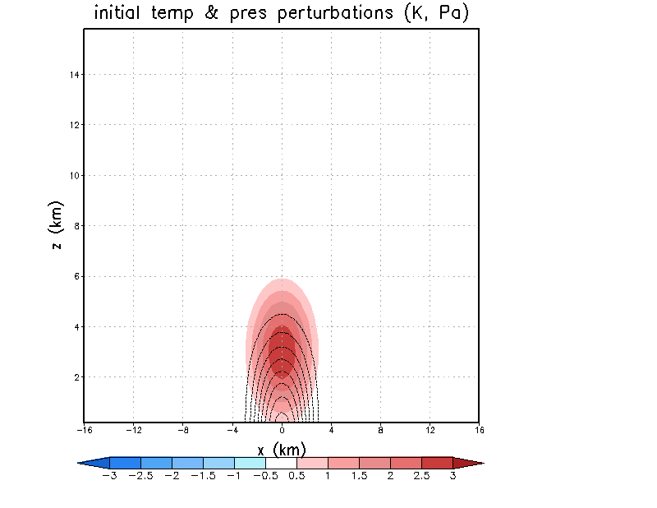
Turn in a copy of this plot
and your code
Temp. pert. (shaded)
Dimensional pres. pert.
(contoured)

Slide 17
Initializing the leapfrog scheme
The leapfrog scheme uses three time levels, so it actually requires two initial conditions for each prognostic variable, at times n and n-1.
Typically, we don’t have knowledge of the fields at time -∆t prior to the model start, so we fudge it by presuming the field is not changing with time (e.g., thm = th, and pim = pi).
  That is obviously false, and this can cause problems. It is one way the scheme’s “computational mode” (see Chapter 5) can be excited.
  Note the code snippets I provided also initialized the time n-1 fields.

Slide 18
Visualization
One option (especially for Fortran users) is GrADS
Sample Fortran code for generating GrADS files is detailed in Chap. 11 and posted on the course website
Links
  GrADS home page
  Users guide and scripting basics
  GrADS control file
  Controlling colors
  GrADS script library

Slide 19
Programming concept
(including information applicable to subsequent model tasks)
grads_example_code_augmented.f
grads_routines_augmented.f
(see notes and website)

Slide 20
program task3
! parameters
parameter(nx=83,nz=42)
! grid box lengths
parameter(dx=400.,dz=400.)
! base state vectors
dimension tb(nz),qb(nz),pb(nz),pib(nz),rhou(nz),rhow(nz),ub(nz)
! 2D prognostic arrays - 3 time levels
dimension thp(nx,nz),th(nx,nz),thm(nx,nz) ! pot. temp. pert.
dimension wp(nx,nz),w(nx,nz),wm(nx,nz) ! vert. vel.
dimension up(nx,nz),u(nx,nz),um(nx,nz) ! zonal horiz. vel.
dimension vp(nx,nz),v(nx,nz),vm(nx,nz) ! merid. horiz. vel.
dimension pip(nx,nz),pi(nx,nz),pim(nx,nz) ! ndim pert. pres.
[more…]
! ----------------------------------------------------------------
! model setup code
• specify dt, define d2x = dx + dx, initialize d2t = dt
• sounding: tb, qb, ub
• derived quantities: pib, rhou, rhow
• do boundary conditions on base state arrays
! then do your initial conditions, apply boundary conditions on them
[…]

Slide 21
! define plot interval
nplt=60 ! plot every 60 time steps, or 300 sec
! ----------------------------------------------------------------
! GrADS initialization is here
! ----------------------------------------------------------------
! * set your casename (will create 'casename'.ctl, 'casename'.dat)
! * create a temporary control (*.ctl) file
! * write initial condition to data (*.dat) file
! examples... you need to change these
casename='test' ! declare 'character*80 casename' above
iplt = 0 ! counter for plotting calls
byteswap = 0 ! if byteswapping not needed, set = 0
igradscnt =999 ! grads counter - dummy value to start
call write_to_grads_ctl(casename,nx,nz,dt,dx,dz, &
igradscnt,nplt,byteswap) ! create the temporary control file
igradscnt =0 ! reset grads counter
call dumpgrads(igradscnt,u,v,w,th,pi,rhou,tb,pib,ub,qb,nx,nz,cpd)

Slide 22
! ----------------------------------------------------------------
! model integration loop STARTS here (added in MT4)
! ----------------------------------------------------------------
! * update plot counters
! * integrate your equations, take care of boundary conditions
! * set for next time step
! example...
iplt = iplt + 1 ! plot counter
! ----------------------------------------------------------------
! decide if it's time to plot...
! ----------------------------------------------------------------
! * if it's time to plot, call dumpgrads and reset plot counter
! example...
if(iplt.eq.nplt)then
call dumpgrads(igradscnt,u,v,w,th,pi,rhou,tb,pib,ub,qb,nx,nz,cpd)
iplt=0
endif
! ----------------------------------------------------------------
! At the end of the model integration… (needed for MT3)
! ----------------------------------------------------------------
print *,' writing final control file’
call write_to_grads_ctl(casename,nx,nz,dt,dx,dz,
1 igradscnt,nplt,byteswap) ! final ctl file

Slide 23
The GrADS strategy summary
GrADS data sets consist of two individual files: a control (.ctl) file and a binary data (.dat) file
After creating the base state and initial condition and their boundary conditions:
  Define casename (name for .ctl and .dat files)
  Call write_to_grads_ctl to create a new, but temporary, .ctl file
  Call dumpgrads to write out the initial condition
During your model integration
  Call dumpgrads when it’s time to write history data
After the integration ends
  Call write_to_grads_ctl to create the final, complete .ctl file

Slide 24
DSET ^test.dat
OPTIONS sequential
UNDEF -9.99E33
XDEF 81 LINEAR -16.00000 0.40000
YDEF 1 LINEAR 1.0 1.0
ZDEF 40 levels
0.200
0.600
[…]
15.800
TDEF 999 LINEAR 00:00Z01JAN2000 1mn
VARS 11
u 40 00 horizontal velocity
upr 40 00 pert horizontal velocity
v 40 00 north-south velocity
w 40 00 vertical velocity
th 40 00 potential temperature
thpr 40 00 pert potential temperature
qv 40 00 vapor mixing ratio
qvpr 40 00 pert vapor mixing ratio
pi 40 00 ndim pressure
pipr 40 00 pert ndim pressure
pprmb 40 00 pert pressure in millibars
ENDVARS
GrADS control file
test.ctl

Slide 25
GrADS scripts
Some scripts available on
class web page

Slide 26
* plot_init_cond.gs [Copy on class web page]
* define some nice colors via the rgbset script. Also available on class web page
'run rgbset.gs'
* set background color white and clear screen
'set display color white'
'clear'
* set map projection off
'set mproj off'
* this formats the virtual page
'set vpage 0 8.5 0.5 8.5'
* smooth contours. enabled until switched off.
'set csmooth on'
* ----------- make temperature perturbation plot -----------------
* set contour label, make thp plot, draw title and axes
* declare a color-shaded plot
'set gxout shaded'
* define colors and contour levels
* colors are as defined in rgbset.gs
'set clevs -3 -2.5 -2 -1.5 -1 -0.5 0 0.5 1.0 1.5 2.0 2.5 3'
'set ccols 49 47 45 44 43 42 0 0 62 63 64 65 67 69’
* this next line turns off the grads logo
'set grads off’

Slide 27
* override default GrADS axis labels (GrADS doesn’t stop you from making mistakes)
'set xaxis -16 16 4'
'd thpr'
* draw the colorbar. requires script cbarn.gs
'run cbarn 1 0 5 0.18'
* reset graphics output to contour
'set gxout contour'
* ----------- make pressure perturbation plot -----------------
* set contour color and contour interval
'set ccolor 1'
'set cint 50'
* suppress contour labels
'set clab off'
* this next line tries to suppress the zero contour
'set black 0 0'
* plot pprmb but convert to Pascals
'd pprmb*100'
* draw titles and labels
'draw title initial temp & pres perturbations (K, Pa)'
'draw xlab x (km)'
'draw ylab z (km)’
* ----------- make a PNG plot ---------------------------------
’gxprint init_tp_pp.png’

