Slide 1
Model Task #4:
Time stepping and the leapfrog scheme
ATM 562 Fall 2021
Fovell
(see course notes, Chapter 12)
Version of 10/13/21

Slide 2
Outline
The 2D model framework was established in MT3
MT4 accomplishes two things:
  Implements a time stepping loop for one simple, 2D linear advection equation, with doubly periodic boundary conditions
  Illustrates phase and dispersion errors inherent in the leapfrog (LF) scheme
The MT3 initial conditions on θ’, π’ are not used for this task (but don’t remove them)
  …those will be used in MT5
  A similar initial condition is implemented for a variable I’ll call “v”. This variable is defined at the scalar point (grid center)
For MT5, the contents of the MT4 time stepping loop will be replaced with our four nonlinear model prognostic equations

Slide 3
Openers and declarations
BCs = boundary conditions
Base state (+BCs & definitions)
MT1
Initial conditions (+BCs)
MT3 + MT4
Initialize GrADS
if applicable
Time stepping loop
& periodic plotting/
writing to GrADS
[one simple 2D linear equation and its exact solution]
Time stepping loop
& periodic plotting/
writing to GrADS
[Our four 2D nonlinear model equations]
MT4
MT5
Close up shop

Slide 4
Synopsis
MT4 model domain will be square and doubly periodic
Initial condition will be a cone-shaped object
Cone will be advected at constant speed
You do not need to touch your MT3 code, except to change the domain configuration (nx, nz) and grid spacing (dx, dz).

Slide 5
Equation and code
Advection equation
Code (Fortran) for 2nd order LF over the real points
Specifics:
  nx = nz = 51
  cx = cz = 1 m/s
  dx = dz = 100 m
  dt = 50 sec
  rd2x = 1./(2.*dx) and rd2z = 1./(2.*dz)
  d2t = dt + dt (after 1st time step). d2t = dt to start
  timend = 4900 sec
vp(i,k)=vm(i,k)-cx*d2t*rd2x*(v(i+1, k )-v(i-1, k )) &
-cz*d2t*rd2z*(v( i ,k+1)-v( i ,k-1))

Slide 6
Initial condition
Initial condition: very similar to MT3 for θ’, but for v with radx = radz = 1000 m, delt = 10, and placed at the domain center
For Fortran, imid = (nx+1)/2, kmid = (nz+1)/2.
For 0-based index languages, imid = (nx-1)/2, kmid = (nz-1)/2
Don’t forget to set vm(i,k) = v(i,k) to start
π is trigonometric pi
Leave your MT3 θ’, π’ initialization code alone, we’ll use it in MT5

Slide 7
Boundary conditions
Doubly periodic, with a frame of fake points, so for Fortran the real points are 2,nx-1 and 2,nz-1
Boundary conditions for fake points
do k=2,nz-1 ! Over real points in vertical
v( 1,k)=v(nx-1,k)
v(nx,k)=v( 2,k)
enddo
do i=1,nx ! Over ALL points in horizontal
v(i, 1)=v(i,nz-1)
v(i,nz)=v(i, 2)
enddo
At the end of this sequence, ALL grid points have been updated

Slide 8
Programming concept
From MT3 and earlier, you have set up your 1D and 2D arrays, base state, and an initial condition for θ’ and π’. Keep all this.
For MT4, create an additional initial condition for v, vm. Start with d2t = dt. (Note nx, nz, dx, dz also change from MT3, and will change again for MT5.)
Implement time stepping loop:
  Predict vp using v, vm for all real points
  Take care of boundary conditions on vp
  Calculate exact solution (see later)
  Set for new time step: vm = v; v = vp; vp = 0, and d2t = dt + dt
  Time to plot?
  Time to end run? If not, go to top of time stepping loop.

Slide 9
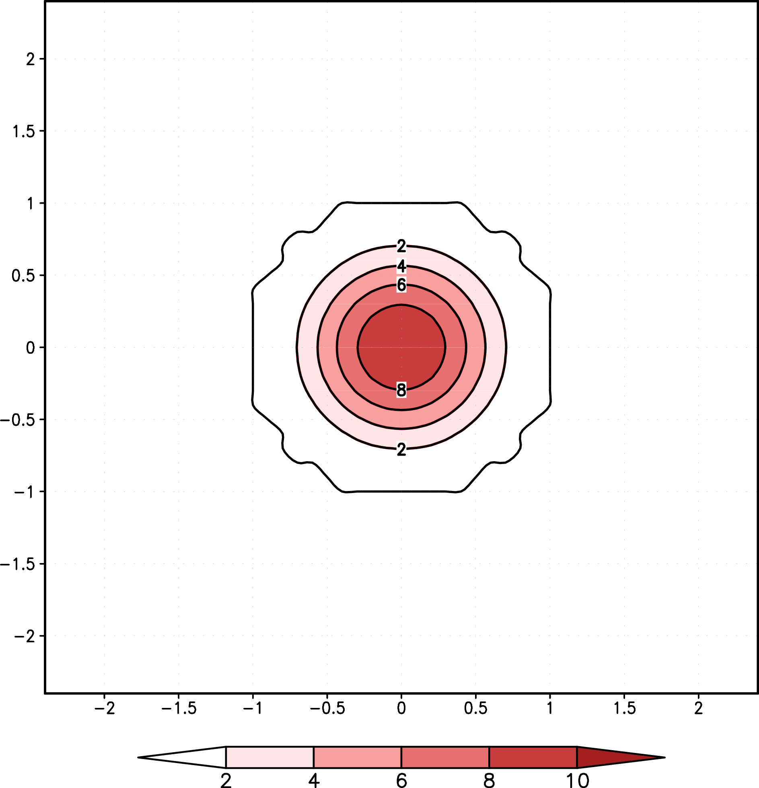
t = 0 sec
Zero contours
can be a little
wonky, and
dependent
on precision…
Black contours: LF solution. Shading and red contours: true solution

Slide 10
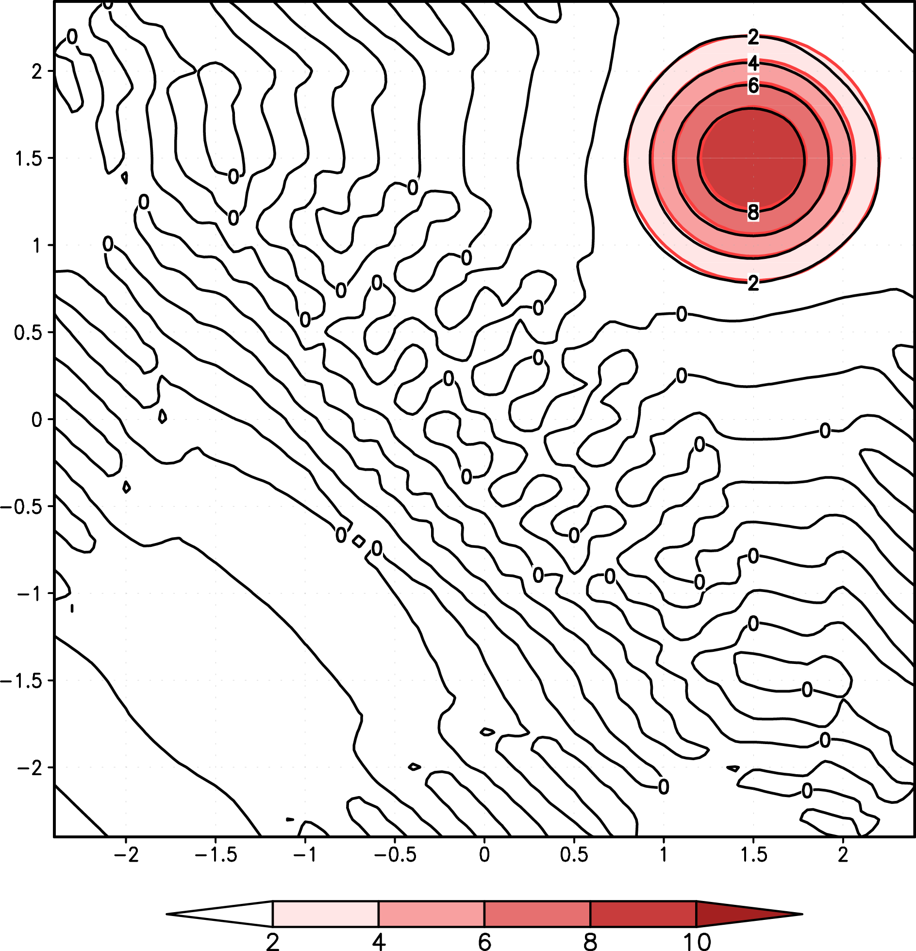
t = 1500 sec
Note short wavelength
components are moving in
the wrong direction!
Black contours: LF solution. Shading and red contours: true solution

Slide 11
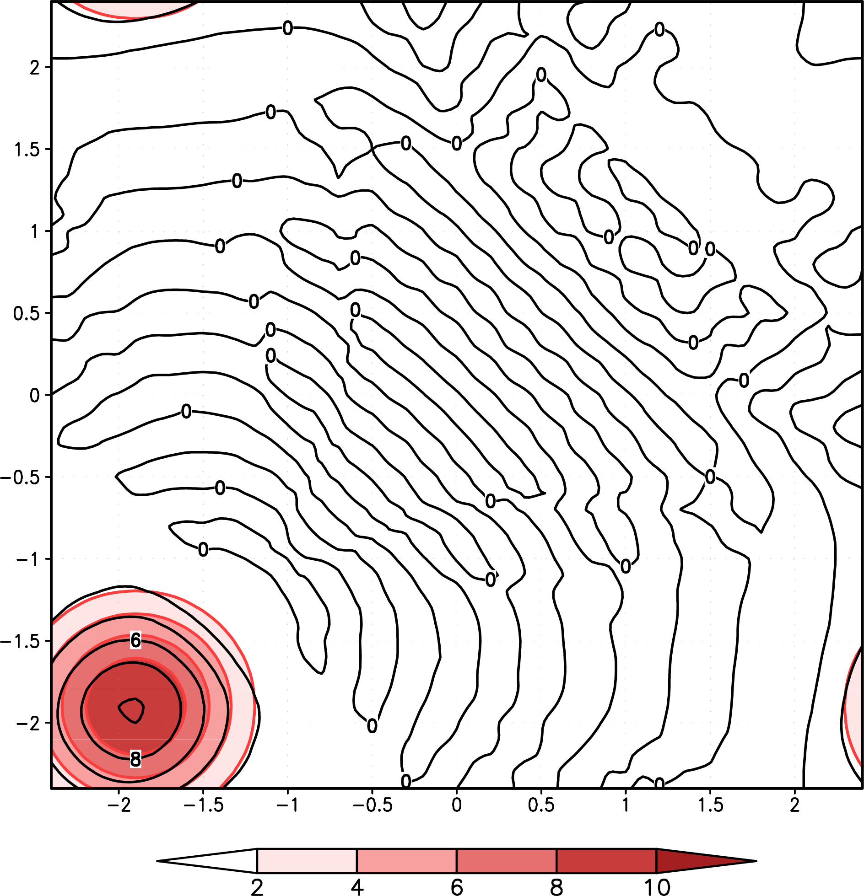
t = 3000 sec
Black contours: LF solution. Shading and red contours: true solution

Slide 12
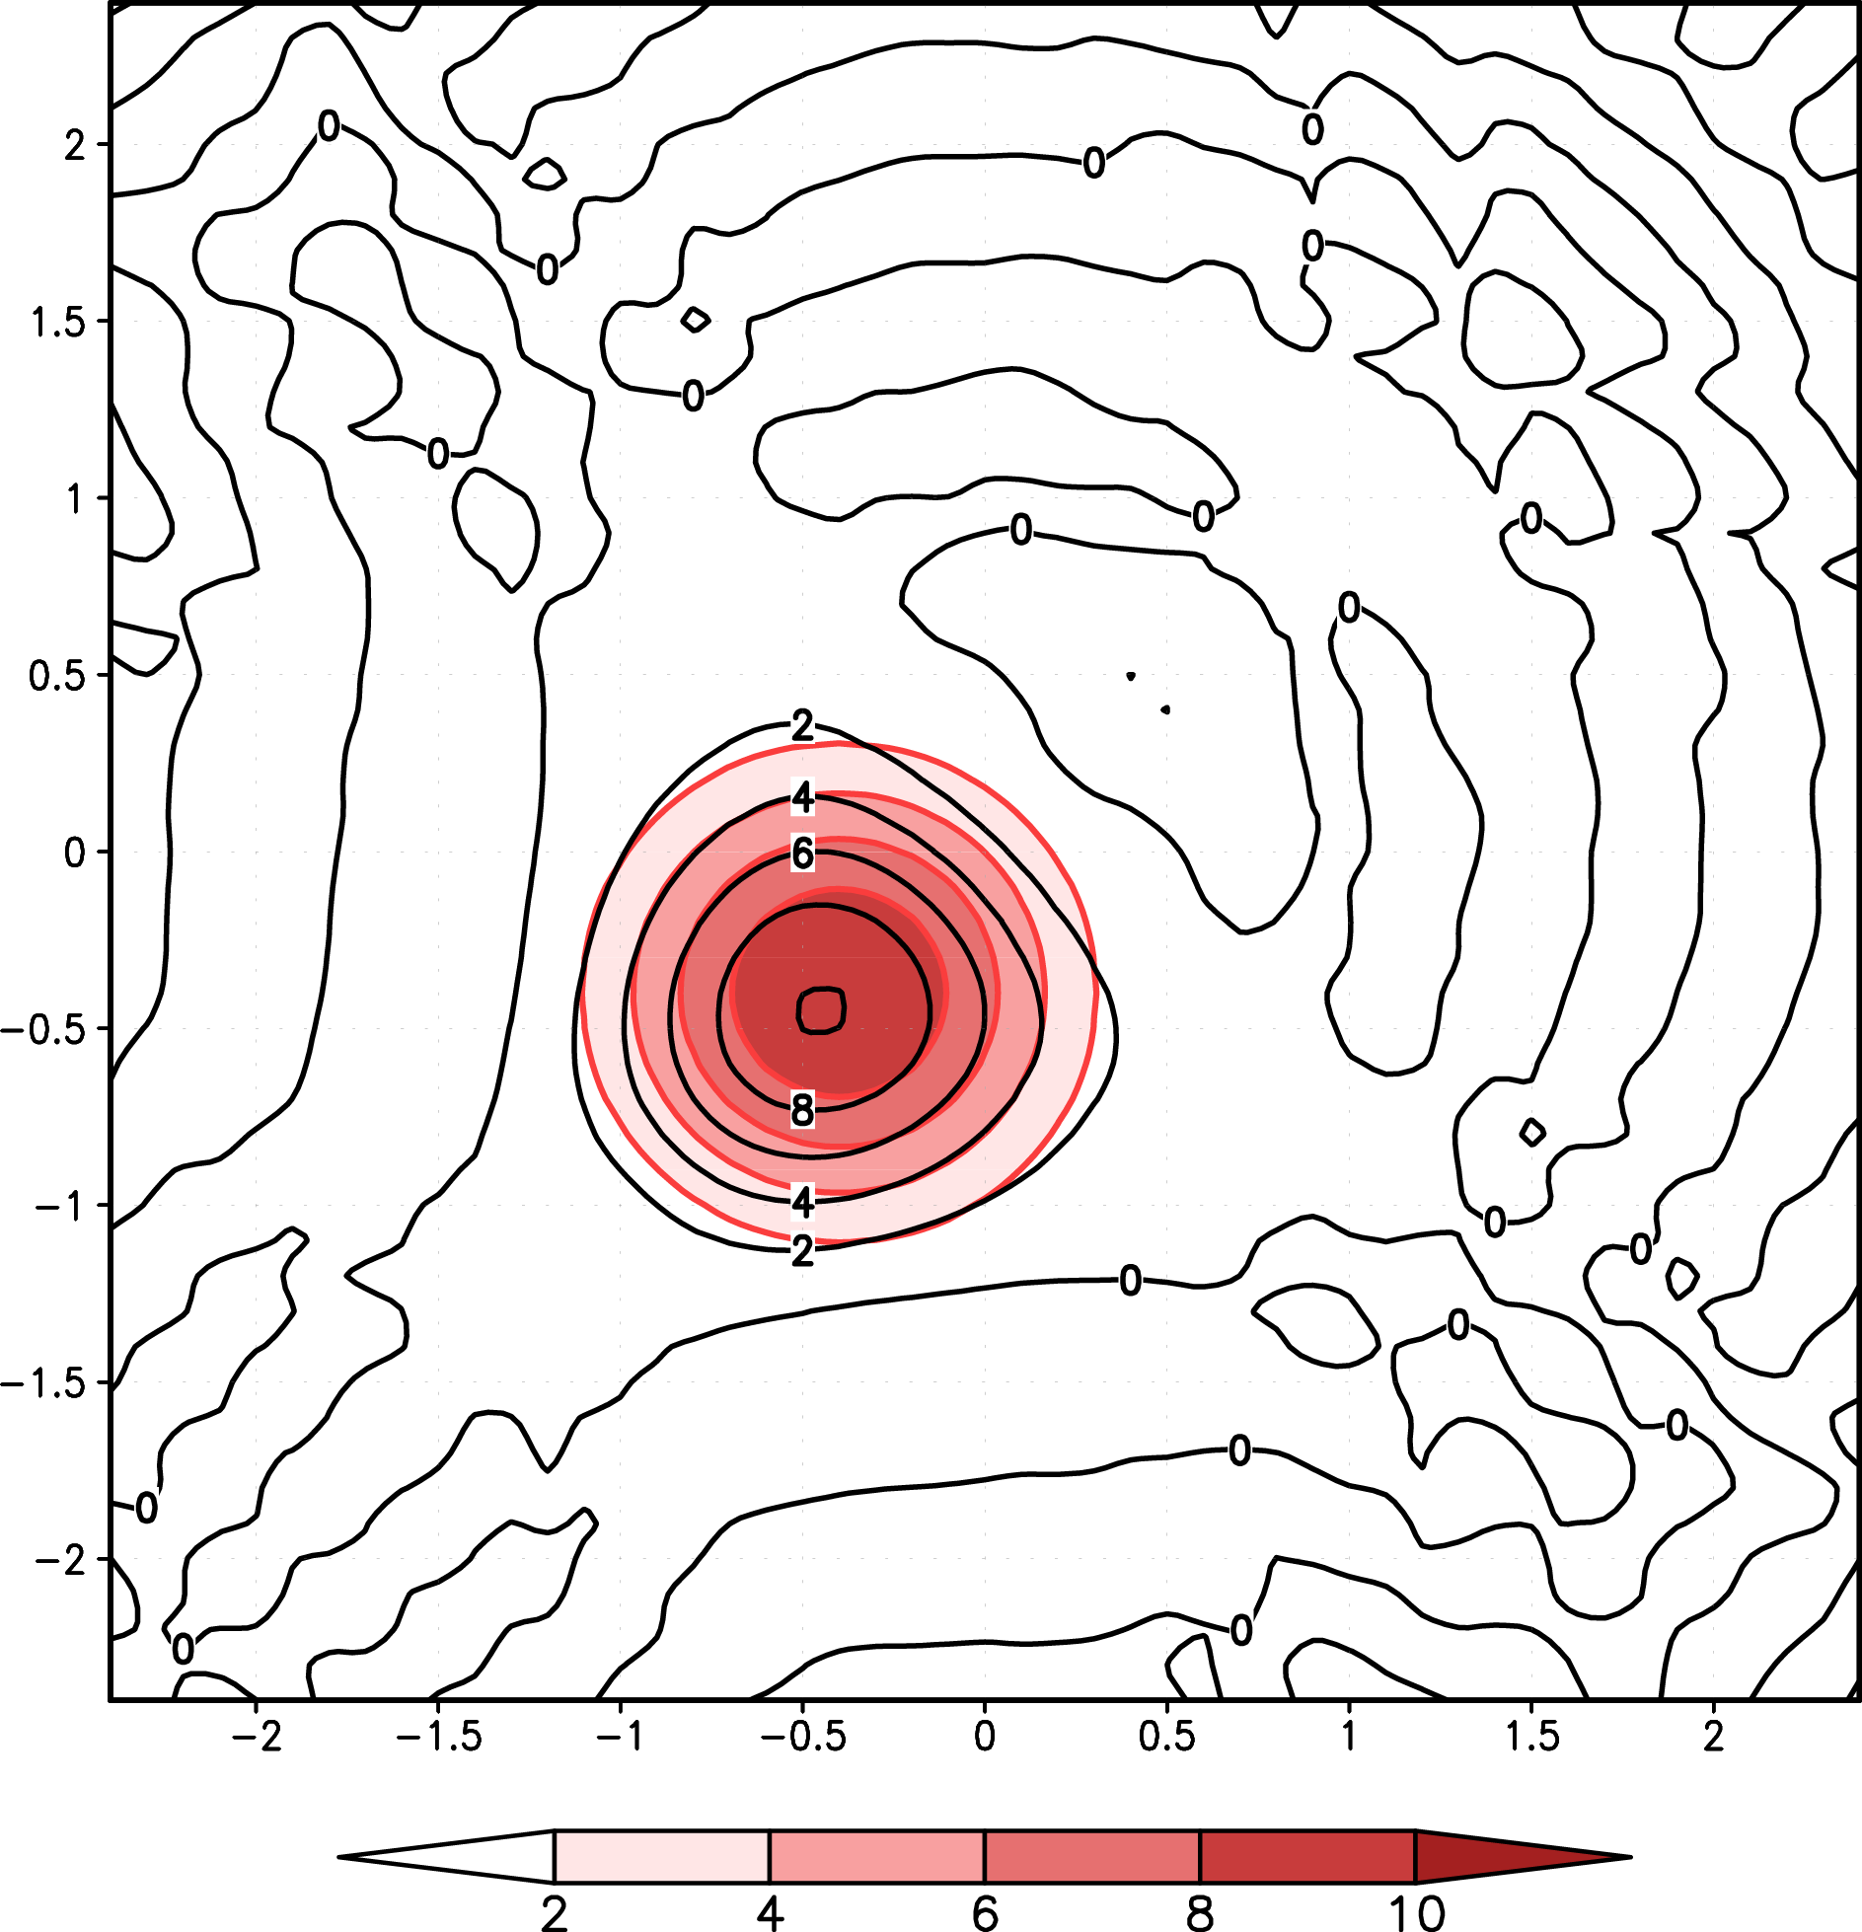
t = 4500 sec
Maybe a bit of amplitude error
Some phase error (lag)
More dispersion error
Black contours: LF solution. Shading and red contours: true solution

Slide 13
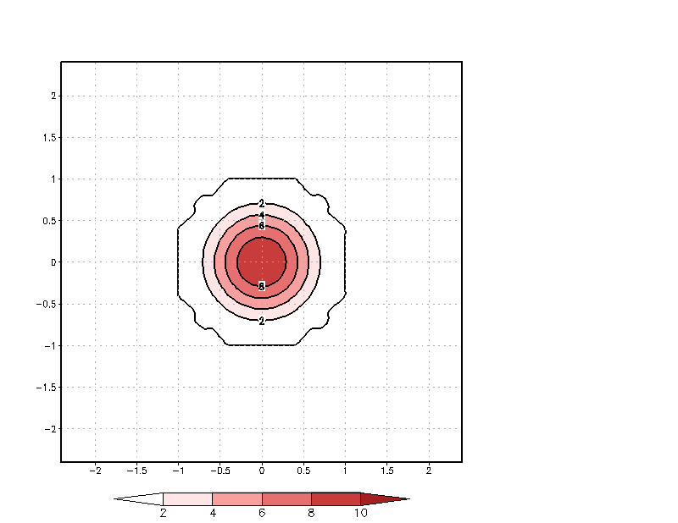
Animation (frames every 100 sec)

Slide 14
Tracking the exact solution
Saved in qv array in this example

Slide 15
Problem geometry
xi = a grid point in
the domain
xloc = distance to
cone centroid (xmid)
xlocmirror = distance to
cone’s mirror image (xmidmirror)
Take minimum of xloc, xlocmirror

Slide 16
c ----------------------------------------------------------------------
c exact solution
c ----------------------------------------------------------------------
xmid=dx*(nx+1)/2+cx*n*dt ! Departure of cone centroid
zmid=dz*(nz+1)/2+cz*n*dt ! from initial position
if(xmid.ge.nx*dx) xmid=xmid-(nx-2)*dx ! Passing the periodic
if(zmid.ge.nz*dz) zmid=zmid-(nz-2)*dz ! boundary
if(xmid.gt.dx*(nx+1)/2) then ! The cone’s “mirror” location
xmidmirror=xmid-(nx-2)*dx ! on other side of periodic
else ! boundary
xmidmirror=xmid+(nx-2)*dx
endif
if(zmid.gt.dz*(nz+1)/2) then
zmidmirror=zmid-(nz-2)*dz
else
zmidmirror=zmid+(nz-2)*dz
endif
qv=0. ! start with a clean slate

Slide 17
c ----------------------------------------------------------------------
c exact solution (continued)
c ----------------------------------------------------------------------
do i=2,nx-1
do k=2,nz-1
xi=float(i)*dx ! Current location
zk=float(k)*dz
xloc=((xi-xmid)/radx)**2 ! Location relative to
zloc=((zk-zmid)/radz)**2 ! domain midpoint
xlocmirror=((xmidmirror-xi)/radx)**2 ! Mirror beyond the
zlocmirror=((zmidmirror-zk)/radz)**2 ! periodic boundary
xloc=amin1(xloc,xlocmirror) ! Make sure location is
zloc=amin1(zloc,zlocmirror) ! in the domain
rad=sqrt(xloc+zloc)
if(rad.lt.1.) qv(i,k)=.5*delt*(cos(trigpi*rad)+1.) ! Exact soln.
enddo
enddo

Slide 18
Example GrADS script for making animations

Slide 19
* example GrADS plot script for model task 4
* this version can save individual frames as png images
* ATM562
* http://www.atmos.albany.edu/facstaff/rfovell/ATM562/plot_cone_movie.gs
* version of 10/9/2018
'set display color white'
'clear'
'run rgbset.gs'
* display parameters
'set mproj off'
'set vpage 0. 8.5 0. 8.5'
'set parea 1 7.5 1 7.5'
* save individual plots as png images?
say 'Create png images? (1=yes ; 0=no)'
pull ans
* find final time in grads file
frame = 1
'q file'
rec=sublin(result,5)
_endtime=subwrd(rec,12)
say " endtime is " _endtime
* looping flag
runscript = 1
* start at time 1
dis_t = 1

Slide 20
* =======================================================================
* MOVIE LOOP
* =======================================================================
while(runscript)
'set t ' dis_t
'clear'
'set grads off'
'set ccolor 15'
'set cint 2.0'
'set black 0 0'
'set cthick 7'
'set gxout shaded'
'set clevs 0 2 4 6 8 10'
'set ccols 0 0 61 63 65 67 69'
'd qv'
'run cbarn.gs'
'set clab off'
'set gxout contour'
'set ccolor 2'
'set clevs 2 4 6 8 10'
'd qv'
'set clab on'
'set cthick 5'
'set ccolor 1'
'set cthick 6'
'set cint 2.0'
'd v’

Slide 21
* =======================================================================
* FINISH
* =======================================================================
if(ans)
if( frame < 10 )
’gxprint movie00'frame'.png'
else
if ( frame < 100 )
’gxprint movie0'frame'.png'
else
’gxprint movie'frame'.png'
endif
endif
frame=frame+1
endif
* this next line makes you hit return key to advance
pull dummy
if ( dis_t=_endtime )
runscript=0
endif
dis_t = dis_t + 1
endwhile
Results in sequence of individual PNG files named movie*.png,
which can be combined into a GIF animation

Slide 22
GIF animations
Gifsicle http://www.lcdf.org/gifsicle/
  Command-line tool, multiple platforms
Graphic Converter (Mac)
  https://www.lemkesoft.de/en/image-editing-slideshow-browser-batch-conversion-metadata-and-more-on-your-mac/ [and app store]
  Online converters exist
Many, many others

Slide 23
MT4 Summary
Turn in your model code and a plot showing your LF solution at 4900 sec
Chapter 5 will reveal that the stability condition for the 2D leapfrog is a lot more restrictive: c’=0.5. Our experiment is using c’ = 0.5 exactly. Prove you cannot use a larger ∆t than 50 sec. Which wavelengths are blowing up fastest?
What happens if you code the upstream or an RK3 scheme instead?

