Slide 1
Model Task #5:
Implementing the 2D model
ATM 562 Fall 2021
Fovell
(see course notes, Chapter 13)
Version of 10/25/21

Slide 2
Outline
The 2D model framework was established in MT3, along with initial conditions for θ’, π’
MT4 added a time stepping loop for a single, simple equation
For MT5, we remove that simple advection equation and:
  Code in equations for our four prognostic variables
  Periodic boundary conditions in x direction
  Apply rigid boundaries in the z direction
  Simulate a thermal rising in a neutral environment
  (Modifying NX, NZ, dx, dz, dt)

Slide 3
Openers and declarations
BCs = boundary conditions
Base state (+BCs & definitions)
MT1
Initial conditions (+BCs)
MT3 + MT4
Initialize GrADS
if applicable
Time stepping loop
& periodic plotting/
writing to GrADS
[one simple 2D linear equation and its exact solution]
Time stepping loop
& periodic plotting/
writing to GrADS
[Our four 2D nonlinear model equations]
MT4
MT5
Close up shop

Slide 4
Model equations
At this point, the model has no moisture, but I have retained mean virtual potential temperature where it appears.

Slide 5
Writing advection in flux form
Flux form entails rewriting advection and forcing the traditional anelastic continuity equation to be valid
Example: take u equation, multiply by mean density:
Use chain rule to form
The bracketed term is zero if the traditional anelastic continuity equation is valid. Presume this is so. That is flux form.

Slide 6
Model equations in flux form
Flux form not applied to base state potential temperature, as there’s no term to cancel out ∂w/∂z
Divergence term in pressure equation also expanded.

Slide 7
The 2D staggered grid
Circled variables
represent point i,k

Slide 8
The u equation, term by term
We will solve for u_{i,k}^{n+1}, so the
remainder moves to the RHS

Slide 9
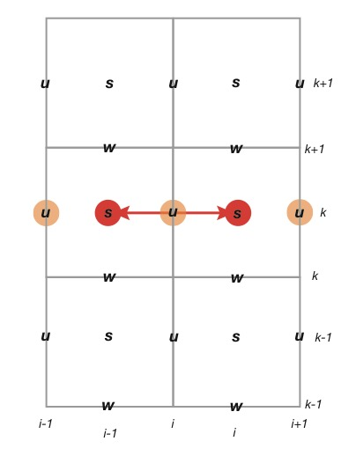
Derivative NOT performed over 2∆x,
but is still second-order accurate,
owing to grid staggering
u is averaged to scalar points before
being subtracted

Slide 10
Lining up your code in some fashion
facilitates catching bugs…
First two terms, in code (more to come)
up(i,k)=um(i,k)-.25*dtx*((u(i+1,k)+u(i,k))**2 &
-(u(i-1,k)+u(i,k))**2)
where dtx = d2t/dx

Slide 11
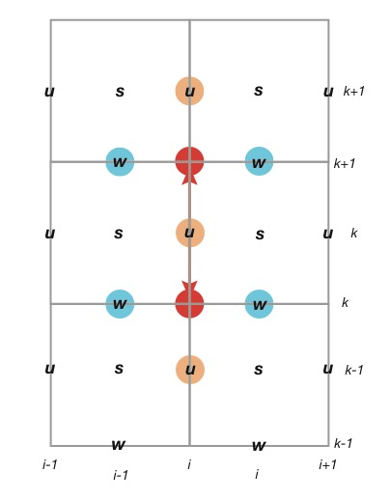
This term requires averaging w and u to points
∆dz/2 above and below u_{i,k}^{n}
This term also demonstrates why it is useful
to carry mean density at both u and w levels

Slide 12
This term requires averaging w and u to points
∆dz/2 above and below u_{i,k}^{n}
This term also demonstrates why it is useful
to carry mean density at both u and w levels
-.25*dtz*(rhow(k+1)*(w(i,k+1)+w(i-1,k+1)) &
*(u(i,k+1)+u(i ,k)) &
-rhow( k )*(w(i,k )+w(i-1,k )) &
*(u(i,k )+u(i ,k-1)))/rhou(k)
where dtz = d2t/dz

Slide 13
The PGA term works out very neatly
for this grid stagger
-dtx*cpd*tbv(k)*(pi(i,k)-pi(i-1,k))

Slide 14
Put the u equation together
c loop over unique points: i=2,nx-1 and k=2,nz-1
do k=2,nz-1
do i=2,nx-1
up(i,k)=um(i,k)-.25*dtx*((u(i+1,k)+u(i,k))**2 &
-(u(i-1,k)+u(i,k))**2) &
-.25*dtz*(rhow(k+1)*(w(i,k+1)+w(i-1,k+1)) &
*(u(i,k+1)+u(i ,k)) &
-rhow( k )*(w(i,k )+w(i-1,k )) &
*(u(i,k )+u(i ,k-1)))/rhou(k) &
-dtx*cp*tbv(k)*(pi(i,k)-pi(i-1,k))
enddo
enddo
c zero gradient top and bottom over the unique points
do i=2,nx-1
up(i,1)=up(i,2)
up(i,nz)=up(i,nz-1)
enddo
c now k=1,nz has been done for the unique points
c now apply periodic lateral boundaries for all k
do k=1,nz
up(1,k)=up(nx-1,k)
up(nx,k)=up(2,k)
enddo
Order of these 2
DO loops does not
matter…
Don’t set for new time step on UP before
computing the three other prognostic variables!
Notes:
You may wonder which to do first: do lower and upper BCs, then enforce periodicity, or to do periodicity first and then the upper and lower BCs.
It should not matter. The points u(1,1), u(nx,nz), u(1,nz) and u(nx,1) will never be used.

Slide 15
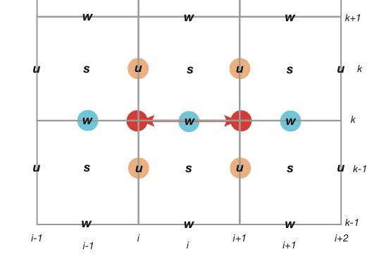
Parts of the w equation

Slide 16
Parts of the w equation, continued
When moisture is implemented
will need to rewrite RHS so
it uses virtual temperature
When you put it all together, don’t forget to multiply through by d2t.

Slide 17
θ’ in flux form
• Note horizontal and vertical derivatives of θ’ are in flux form, but the
vertical derivative of mean potential temperature is in advective form.
• See that flux form is the difference of averages,
while advective form is the average of differences.
Notes:
There is no reason to multiply and divide d(\bar\theta)/dz by \bar\rho, but it gets done sometimes.

Slide 18
π’ equation
Coefficient applied to terms on RHS.
Sound speed should vary with height, but we will
take it to be a fixed, externally supplied parameter.

Slide 19
Integration setup
Base state and initial conditions as constructed for MT3
Sound speed = 50 m/s (too slow!!!)
∆t = 2 sec
Integrate for 1200 sec
Notes:
  Upper boundary is a rigid plate. This is very artificial.
  Initial condition is symmetric and centered in domain. Since initial u = 0, the bubble should retain horizontal symmetry axis at domain midpoint [sanity check!]

Slide 20
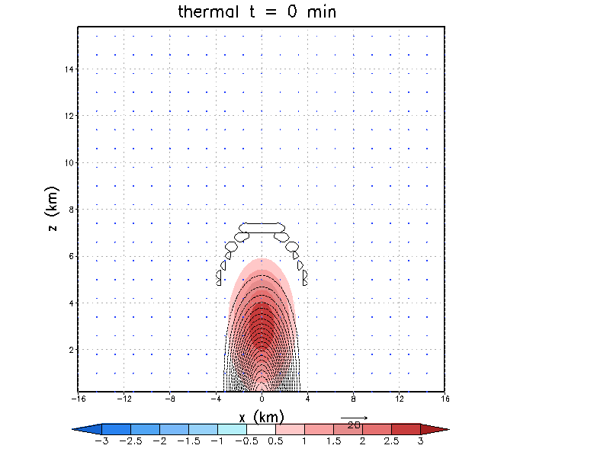
Animation
x10 sec
Color: θ’
Contoured: p’
(dimensional)
Airflow vectors
skip 4 pts in x,
2 in z
Note the 2 waves
that move horizontally
away from the thermal;
and note they
reflect off the lateral
boundaries…

Slide 21
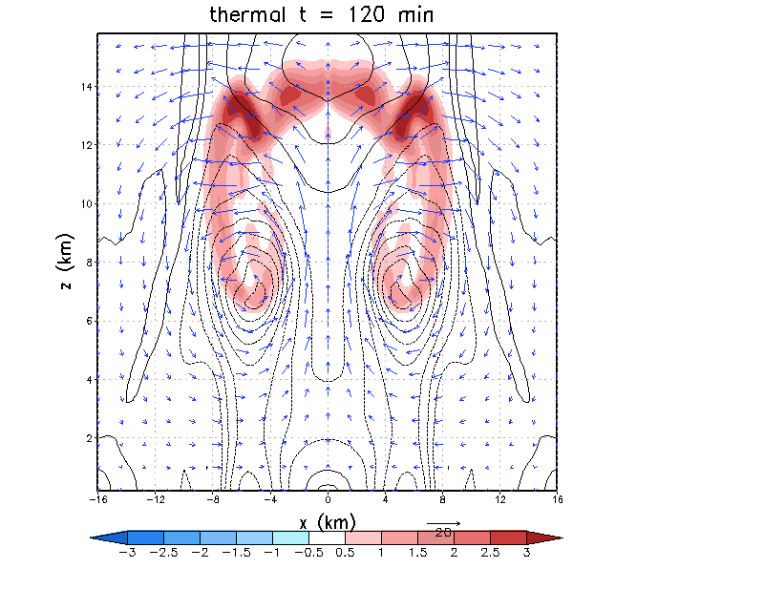
x10 sec
H
What does this
resemble to you?
L
L
H
Notes:
What does this look like to you?

Slide 22

http://www.startrek.com/uploads/assets/db_articles/0379b23e9845c9c652488c13f7bb557fc62a3642.jpg
Notes:
http://www.startrek.com/uploads/assets/db_articles/0379b23e9845c9c652488c13f7bb557fc62a3642.jpg

Slide 23
Initial condition
from MT3
Note “large”
magnitude of
pressure pert
immediately below
thermal

Slide 24
Hovmoller diagram of surface dimensional pressure
Change c_{s} to alter this…
but keep model stable!
c_{s}
Look how quickly the magnitude
of the initial p’ changed

Slide 25
MT5
Turn in your code and a plot of θ’ and p’ (or π’) at 1200 sec
Experiments to consider:
  Does that reflection cause significant problems? Try expanding the domain (increasing nx)
  Did the initially supplied π’ cause more harm than good? Run the model without it, and compare the results
  For the given ∆x, ∆z, and c_{s} how sensitive are the results to the time step?
  What happens if you improve time and space resolution?
  How sensitive is the result to the specified c_{s}?
  Does coding θ’ in flux form make any difference?
  What if you made the base state stable instead of neutral?

