Slide 1
Compressible vs. anelastic pressure and pressure decomposition
(based on MT5 thermal)
ATM 562 Fall 2021
Fovell

Slide 2
Caveat
We will examine a compressible simulation of a thermal with c_{s} = 50 m/s and
  Compare predicted compressible pressure perturbation with diagnosed anelastic pressure perturbation
  Then, divide anelastic perturbation into dynamic and buoyancy pressure components
We are comparing a prognosed pressure field with an anelastic version of it. We are NOT, in this example, comparing a compressible simulation with an anelastic simulation.
  The anelastic pressure field is not being used in the prediction model, so we’re not testing how “good” the very slow sound speed approximation is

Slide 3
Anelastic pressure decomposition
(see Chap. 6 and MT6)
Dimensional pressure perturbation can be written as (this form largely ignores variation of mean density and potential temperature with height):
dynamic pressure forcing buoyancy pressure
forcing
Convergence and divergence
create H dynamic pressure
CCW and CW rotation
create L dynamic pressure

Slide 4
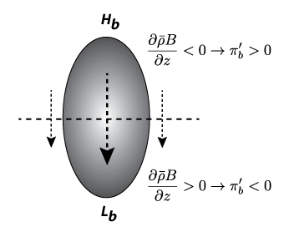
Buoyancy pressure gradient

Slide 5
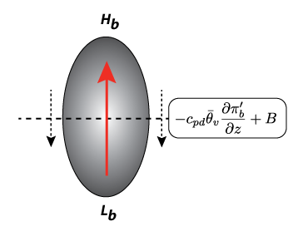
Buoyancy pressure gradient + buoyancy

Slide 6
Combining buoyancy pressure and buoyancy terms
Our equations with dynamic and buoyancy pressure separated
“TAX”
driving force

Slide 7
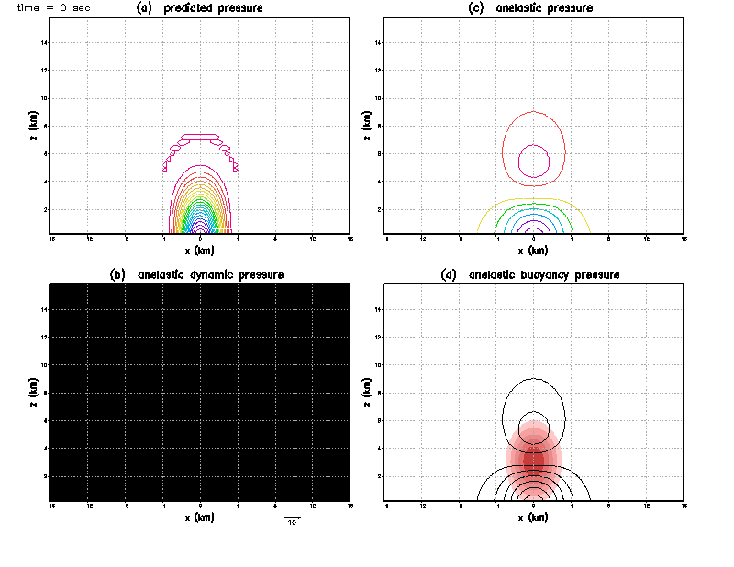
MT3 initial condition
H
Zero field
Contour interval = 0.2 mb
Shaded: pot. temp. pert. ~ buoyancy
Notes:
High buoyancy pressure appears above thermal because vertical buoyancy gradient is negative.
Similarly, low buoyancy pressure appears below thermal where buoyancy increases with height.
Thus there is a vertical gradient in buoyancy pressure. It is downward both INSIDE and OUTSIDE of thermal.
Note also the response of the anelastic pressure field is wider than the thermal itself. Also MAGNITUDE DIFF… Airplane example! Anelastic eq has already SPREAD IT OUT

Slide 8
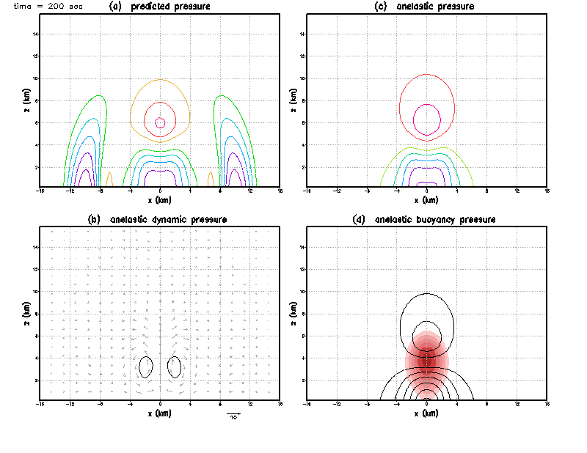
What are these?
Notes:
Buoyancy points UP. Buoyancy pressure gradient points DOWN. Buoyancy prevails. Thermal rises. Slower than expected from buoyancy alone. The TAX.
As thermal rises, downward motion develops on thermal flanks. Initially, that is buoyancy pressure gradient being unopposed by buoyancy (as it is outside thermal).
The rising motion IN thermal and sinking OUTSIDE induces rotation, which makes low dynamic pressure.

Slide 9
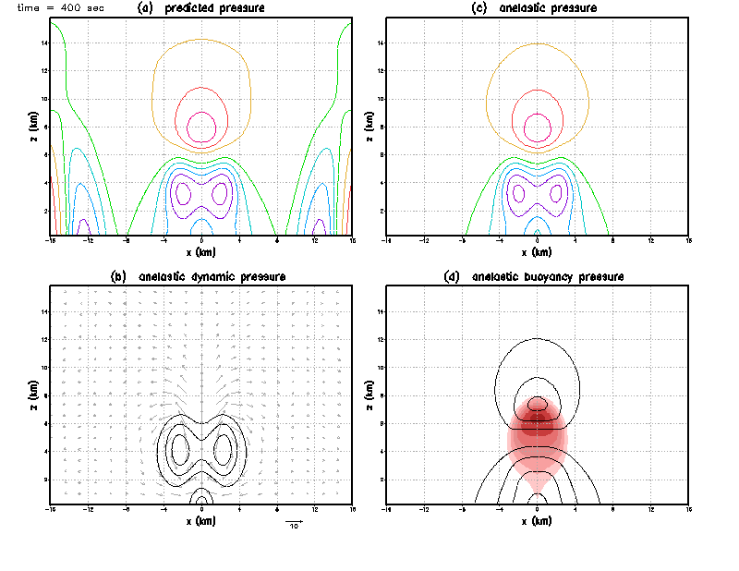
L
L
H
Notes:
Convergence appears beneath thermal as part of its circulation. Convergence and divergence BOTH make high dynamic pressure.
Now, beneath thermal, dynamic and buoyancy pressures are in opposition.
Sound waves reaching lateral bdries, will reflect

Slide 10
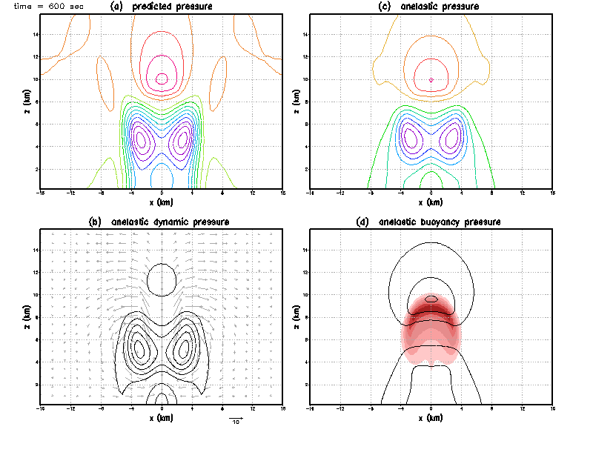
H
H
Notes:
Contour intervals same for all plots. So, dynamic pressure is coming to dominate the pressure perturbation field almost everywhere.
High dynamic pressure above thermal where there is divergence has now also appeared.
Sound waves heading back, reaching domain middle again, explains diff w/r/t anelastic there now

Slide 11
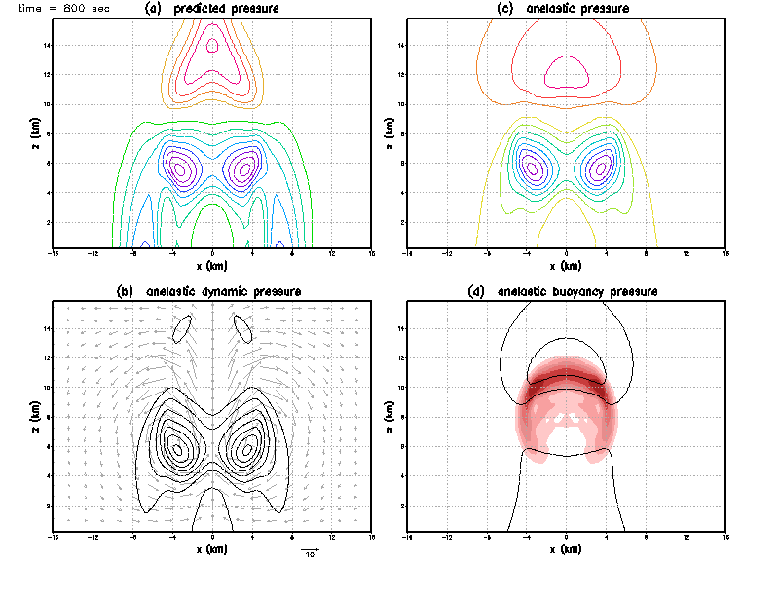

Slide 12
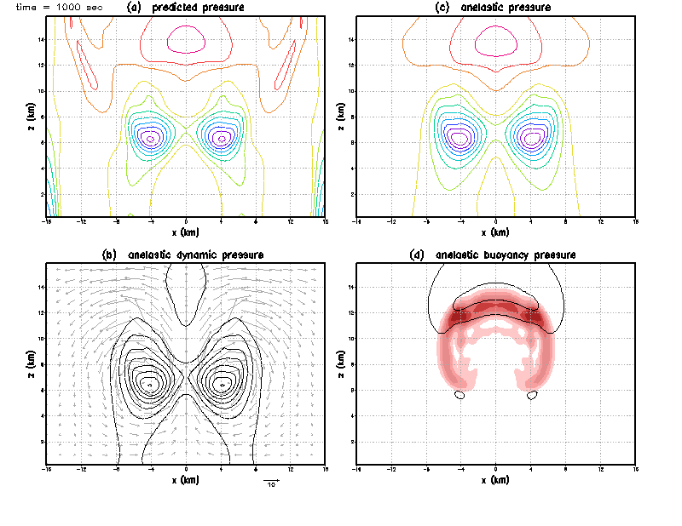

Slide 13
Look again at initial time…

Slide 14
Contour interval = 0.2 mb

Slide 15
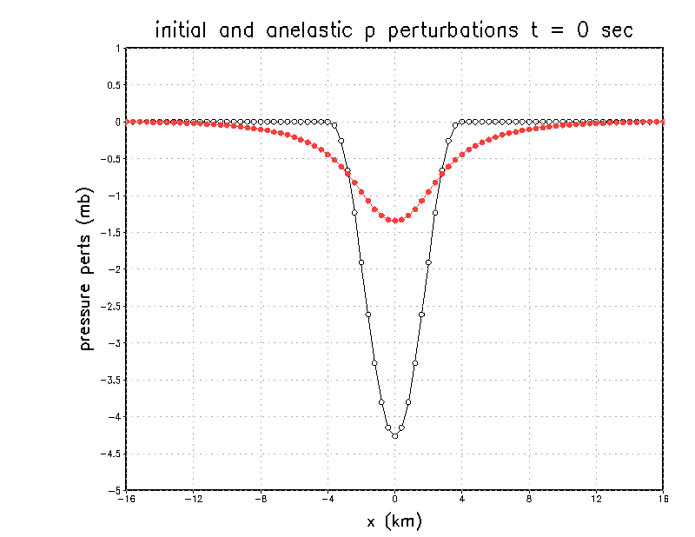
anelastic
Hydrostatic
(3x larger magnitude at max)
plot shows lowest scalar level
Notes:
Airplane example!
And if we moved the thermal far above the ground, the hydrostatic response does not change (you are integrating downward) but the anelastic response is MUCH smaller,
as the response has much more room vertically to spread horizontally

Slide 16
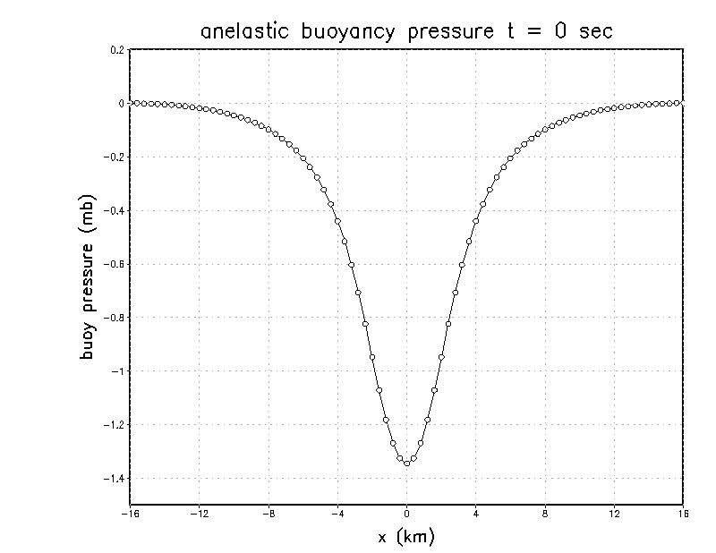
Every grid point actually has
a nonzero buoyancy pressure perturbation,
immediately, at time 0. Spiderweb.
Since pressure not uniquely determined
I subtracted value from first real point (2,2)
from the field, forcing it to be zero there

Slide 17
Look again at t = 200 s

Slide 18
Subtract (a)-(c) … see next slide

Slide 19
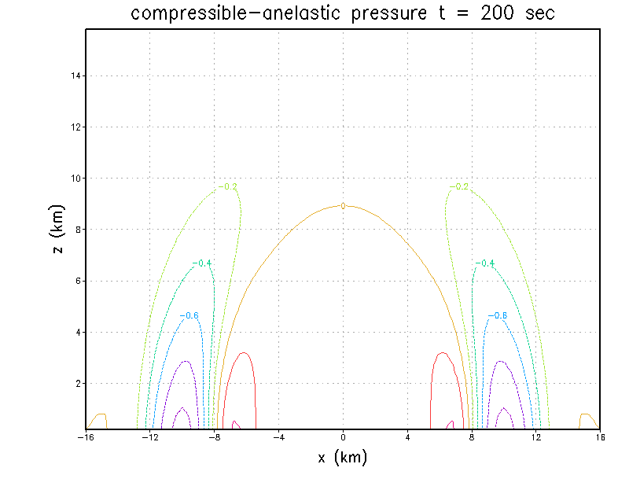
The difference between the (very) compressible
p’ field and its anelastic version is largely the sound wave
excited by the not-fully-balanced initial condition and
fails to escape the domain due to periodic (closed) boundaries
If I had open boundary conditions, sound waves would escape
and model p’ would strongly resemble anelastic version. Model reaches same state as anelastic but took time due to slack.
Notes:
If I used a larger Cs, at the cost of a smaller ∆t, the difference field (sound wave) should be smaller amplitude because sound wave smaller magnitude when less slack is permitted

