Slide 1
Experiment #6 cumulus ensemble summary
ATM 419/563
Spring 2021
Fovell
© Copyright 2021 Robert Fovell, Univ. at Albany, SUNY, rfovell@albany.edu

Slide 2
Cumulus ensemble
Please move to $LAB/EXP06, launch GrADS, and open cu_ensemble.ctl
This ensemble control file addresses 18 members for a 36 km domain:
14 different cumulus schemes
Two additional options involving scheme #1 (KF)
1 simulation without cumulus active
“TRUTH” run made with higher resolution, microphysics only, interpolated to the 36 km domain

Slide 3
ensemble member | last name | cu_physics | scheme name | mp_physics | kfeta_trigger | filename | notes
1 | Anderson | 1 | KF | 4 | 1 | cu01 | kfeta_trigger=1 is default, only works with cu=1
2 | Heeren | 2 | BMJ | 4 |  | cu02
3 | Komarc | 3 | GF | 4 |  | cu03
4 | Maura | 5 | G3 | 4 |  | cu05
5 | Moore | 6 | Tiedtke | 4 |  | cu06
6 | Odstrchel | 10 | KF-CuP | 4 |  | cu10
7 | Smith | 11 | MS-KF | 4 |  | cu11
8 | Watts | 14 | KSAS | 4 |  | cu14
9 | Werner | 16 | New Tiedtke | 4 |  | cu16
10 | Wheeler | 93 | GD | 4 |  | cu93
11 | Fandrich | 94 | HWRF SAS | 4 |  | cu94
12 | Garmong | 95 | Old SAS | 4 |  | cu95
13 | Gyawali | 96 | NSAS | 4 |  | cu96
14 | Johnson | 99 | Old KF | 4 |  | cu99
15 | Naple | 1 | KF | 4 | 2 | cu01X | does trigger setting matter?
16 | Piersante | 1 | KF | 4 | 3 | cu01Y | does trigger setting matter?
17 | Fovell | 0 | NONE | 4 |  | cu00 | 1-domain no cumulus
18 | Fovell | 0 | 2-domain | 4 |  | cuXX | 2-domain no cumulus ("TRUTH")
Pat and Jeremiah: note you have TWO settings to change.

Slide 4
GrADS ensemble dimension
Contents of cu_ensemble.ctl
dset ^cu%e.dat
undef 1.e35
options template
edef 18 NAMES 01 02 03 05 06 10 11 14 16 93 94 95 96 99 01X 01Y 00 XX
pdef 71 47 lcc 29.789 -107.971 1.000 1.000 38. 38. -95.000 36000. 36000.
xdef 207 linear -111.9 0.16216215
ydef 102 linear 28.8 0.16216215
zdef 56 levels
0.03100
0.08587
0.15834
0.25018[etc.]
• Reads in files cu01.dat, cu02.dat, cu03.dat, cu05.dat, etc..
• Ensemble dimension selected via “e”
“set e 4” selects 4th member (cu05.dat)
• Ensemble ctl file and each member file has to have consistent file structures
(domain size, number of times, number of variables and levels, etc..

Slide 5
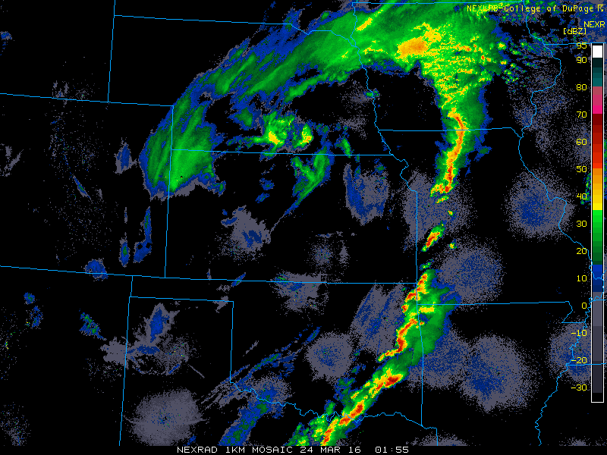
02Z
Broader precip to N can
be at least partially resolved
at this coarse grid spacing
[microphysics]
About 8∆x
At 36 km resolution, our
squall line is essentially subgrid.
Cumulus scheme attempts to
account for this activity
Notes:
8 grid points to resolve things well. 8*36 = 288 km. Squall line is very very subgrid.

Slide 6
RAINC and RAINNC
GrADS commands
set e 1
set t last
set mpdset hires
d rainnc [precip from microphysics]
d rainc [precip from cumulus scheme]
Note:
Contour intervals are different. Lot more RAINNC.
Microphysics and cumulus precip are fairly well separated spatially.
Microphysics captures the larger scale precipitation N of the cyclone, while cumulus is attempting to produce rain associated with the cold front and pre-frontal squall line
Cumulus rainfall seems smeared spatially. Keep in mind RAINC (and RAINNC) is an accumulation. The precipitating area is shifting.
step.gs rainc 33 43 1

Slide 7
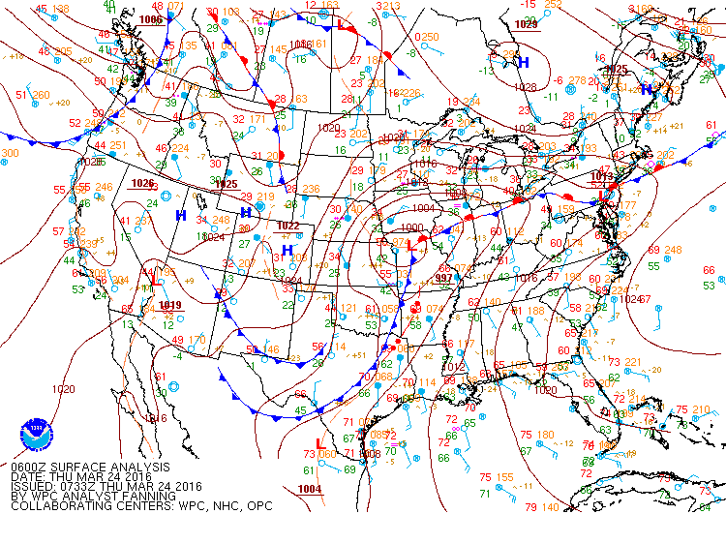
06Z
t + 42 h
Squall line

Slide 8
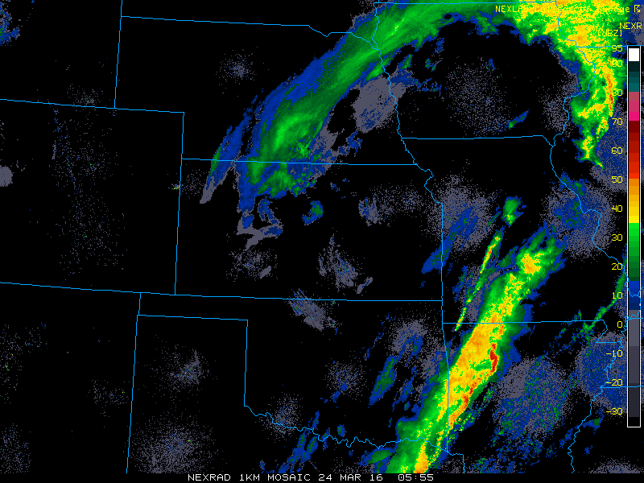
06Z
L

Slide 9
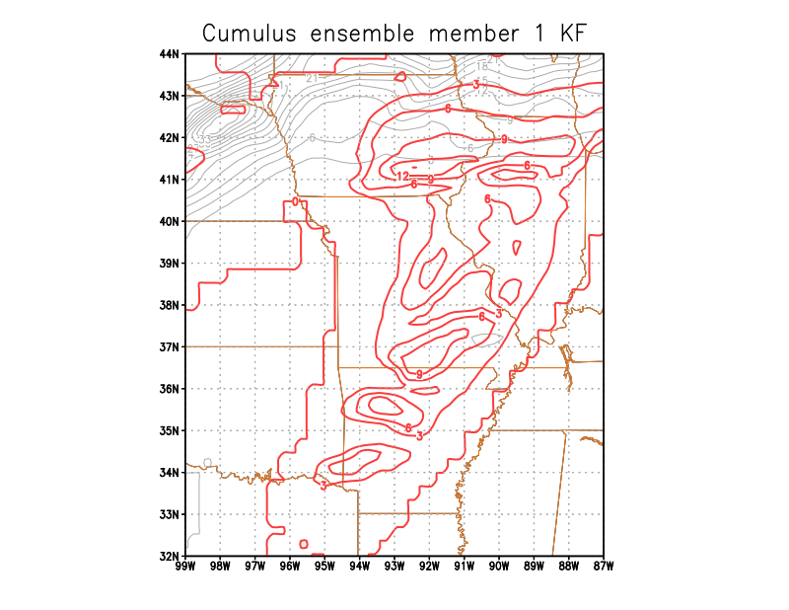
ga-> set e 1
ga-> contours.gs
Keep in mind: there is
an eastward movement
of both RAINC & RAINNC
Still, this member seems to
have produced too much
rain too far east too early
Grey = RAINNC
Red = RAINC
Accumulated precip at final time
Notes:
2021.
Remember, we’re partly seeing the eastward progression of both parameterized and resolved precip.
Keeping in mind precip is being smeared, still seems too much rain too early AHEAD of line, in E MO, IL, E AR

Slide 10
contours.gs
Use contours.gs script to compare simulation total RAINC + RAINNC among ensemble members
Pay particular attention to how well captured the squall line rainfall is
Also note some cumulus precip NW of the cyclone
To do this, just
set e 1
contours.gs
[then select another ensemble member, etc.]
Notes:
We didn’t systematically vary the MP, and MP and CU are pretty well separated (an advantage of this case study), so we don’t really expect to see much variation in RAINNC among members.

Slide 11
Look through ensemble #1
Explore the cumulus ensemble, focusing primarily on the cumulus precip (red contours) in the Missouri-Arkansas area
Which scheme “looks” best?
Some groupings* [see slide 3]
Members 1, 6, 7, 14 – Different Kain-Fritsch (K-F) versions
Members 1, 15, 16 – Basic K-F with different trigger functions
Members 3, 4, 8, 10, 11, 12, 13 – Arakawa-Schubert type schemes
Members 5 and 9 – Old and new Tiedtke schemes
* Ensemble member numbers, not cumulus scheme numbers in WRF

Slide 12
Look through ensemble #2
Then look at NO CUMULUS and EXPLICIT runs
set e 17 → 36 km run without cumulus scheme
Microphysics was “on its own” at 36 km spacing…
set e 18 → 12 km run without cumulus, interpolated to 36 km for comparison (“TRUTH”)
Keeping in mind 12 km really isn’t ‘good enough’ spacing

Slide 13
Time series of area-averaged precip from convective scheme for designated area
set e 1
set x 1
set y 1
set z 1
set t 19 43
d tloop(aave(rainc(e=1),lon=-99,lon=-87,lat=32,lat=44))
d tloop(aave(rainc(e=2),lon=-99,lon=-87,lat=32,lat=44))
d tloop(aave(rainc(e=3),lon=-99,lon=-87,lat=32,lat=44))
[…]
The script plot_precip.gs will plot time series of area-averaged RAINC, RAINNC,
and finally total precipitation for a subset of ensemble members, for part of the
simulation period, using commands like the above.

Slide 14
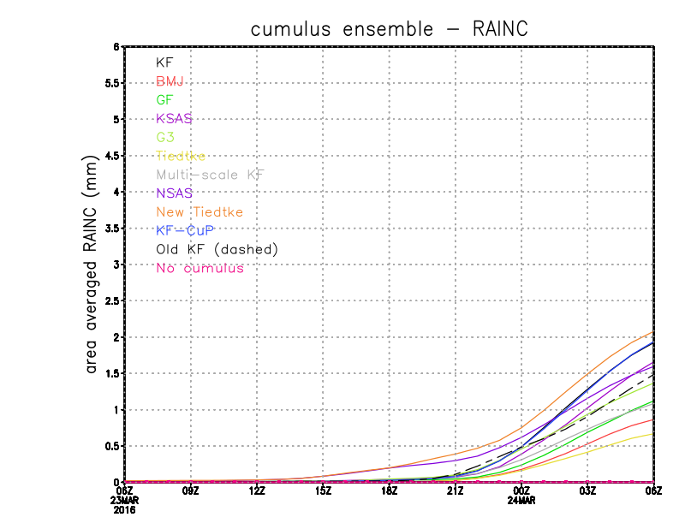
plot_precip.gs
Not entire simulation period depicted
(set t 19 43)
New Tiedtke
KF, KF-CuP
KSAS, NSAS
Old KF (dashed)
G3
MS-KF, GF
BMJ
Tiedtke
New Tiedtke
NSAS
Notes:
2021
Two schemes activate earlier than the others: NSAS, NT
Factor of 4 difference among runs

Slide 15
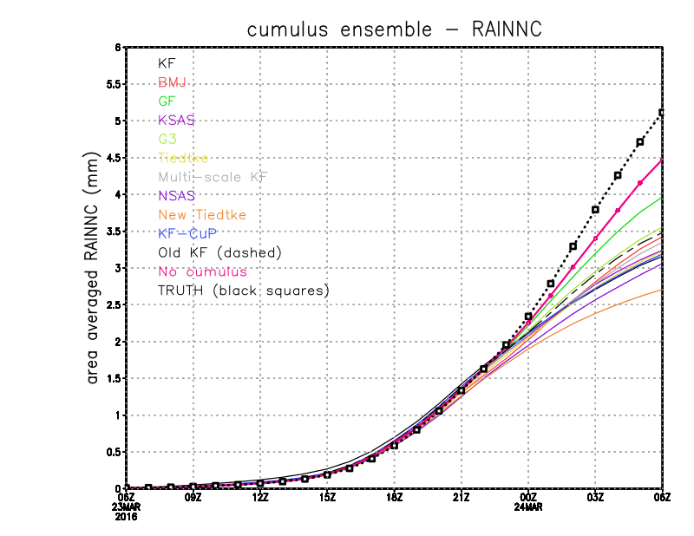
“TRUTH”
NOCUMULUS
GF
G3, Old KF, KSAS,
MS-KF, BMJ
Tiedtke, KF-CuP,
NSAS
New Tiedtke
Notes:
See CU affects MP! NT brings up the rear – it produced much more cumulus precip, but well away from squall line area

Slide 16
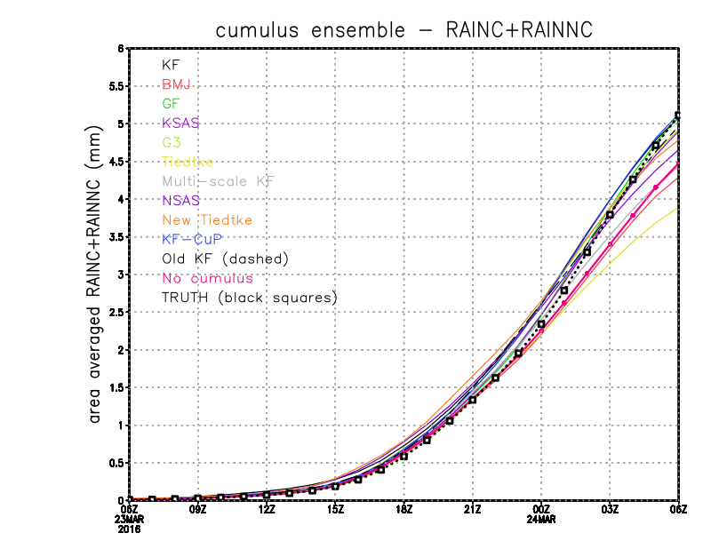
KF-CuP, “TRUTH”, KF
GF, Old KF, G3,, KSAS,
New Tiedtke
NSAS,
NOCUMULUS, MS-KF,
BMJ
Tiedtke
Notes:
Tiedtke total precip 25% less than “truth”
Tiedtke 33% less than combo w/ highest total precip

Slide 17
[end]

