Slide 1
Experiment #4
SOC NNRP-based SKEBS runs
Spring 2021
Unperturbed:
NESIS = 11.48
RMSE SLP vs. NNRP = 2.01 mb/gridpoint
© Copyright 2021 Robert Fovell, Univ. at Albany, SUNY, rfovell@albany.edu

Slide 2
Hypotheses
Each storm has its own distribution with respect to NESIS, which may or may not be normally distributed (bell curve)
  Some NESIS values are more likely than others
An event is but one sample from the storm’s distribution… so it could fall anywhere in the range
  Again, it’s most likely the sample will fall near the distribution peak… but it could occur in either tail
We elect to employ SKEBS as a means of applying perturbations
Hypothesis 1: the closer to the (high) tail the unperturbed run falls, the more likely that any perturbation of it would result with a smaller NESIS
  We surmise that the SOC was #1 among snowstorms because it falls in the high tail of its own distribution
  Therefore: perturbed runs should tend to have smaller NESIS values than the unperturbed run, if the unperturbed run is “accurate”
Hypothesis 2: the more accurate the model physics, the more likely that perturbations will increase, rather than decrease, SLP error
Notes:
Therefore, if by perturbing we get smaller NESIS, that means unpert run was in high tail

Slide 3
NESIS (or SLP error) distribution hypothesis
unperturbed
Scenario #1: unperturbed run falls near peak of
its own distribution
Expected outcome from perturbations:
Equal chances of generating larger and
smaller NESIS or SLP error values
unperturbed
Scenario #2: unperturbed run falls near tail of
its own distribution [e.g., 1927 Yankees?]
Expected outcome from perturbations:
Higher chances of generating smaller
NESIS or larger SLP error values
This hypothesis presumes that SKEBS provides a reasonable, and perhaps the most reasonable,
way of perturbing these simulations, and could be used to reveal the storm distribution.
It also assumes the NNRP is a reasonable initialization and verification source, despite coarse
resolution.
Notes:
1927 Yankees: Babe Ruth, Lou Gehrig. What if perturbed that team? Mod batting order, schedule, pitch selection, baserunning strategy?
How does the real (control) roster compare to its perturbed members? Could the GOAT have been GOATier?

Slide 4
2020+2021 SKEBS ensemble results
116 perturbed simulations available

Slide 5
Control + 116 members: NESIS ranking
unperturbed
MAX: 14.6
MIN: 8.2
Ctrl: 11.5
Of 116 perturbed members:
67 had larger NESIS than control (unperturbed)
0 were tied
49 had smaller NESIS than control
What does this imply for Hypothesis 1? What does it imply for predictability? For NESIS?
Notes:
The first 8 runs seem different… and last 2 also

Slide 6
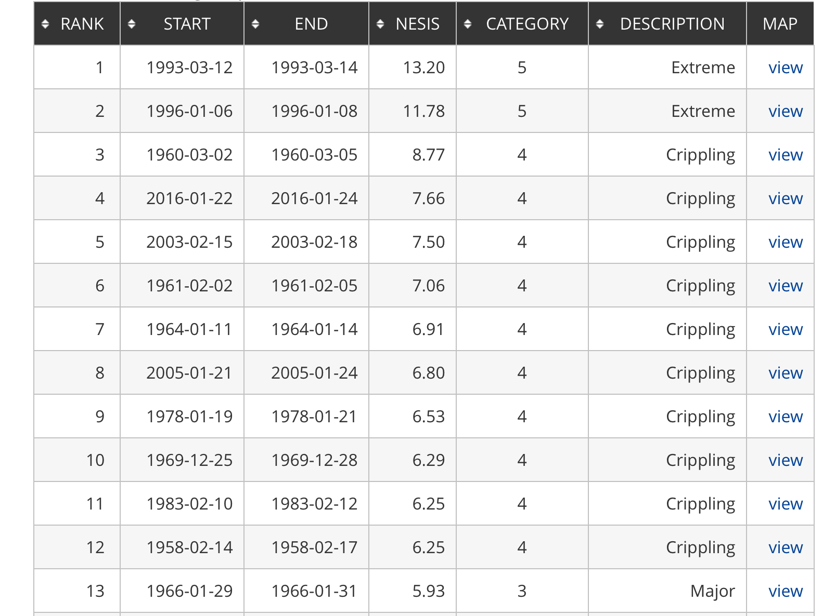
Even lowest NESIS value
would rank #4
Notes:
3/12-3/15/2017 storm: rank #23, NESIS = 5.03, Cat. 3
Other 2018 storms came in #43 and #51

Slide 7
2018-2021 ensembles combined
control
Total 251 perturbed runs
Notes:
Same init. Although physics choices same, alterations may have been made to one or more physics schemes. Also, vert coord changed to hybrid

Slide 8
Control + 116 members: SLP error ranking
unperturbed
MAX: 2.81
MIN: 1.74
Of 116 perturbed members:
16 had smaller SLP error than control (unperturbed) [max reduction 13.4%]
2 were tied
98 had larger SLP error than control [max increase 40%]
What does this imply for Hypothesis 2? What does it imply for skill, certainty, physics?

Slide 9
Control + 116 members: SLP error ranking
unperturbed
alternate physics
MAX: 2.81
MIN: 1.74
Of 116 perturbed members:
16 had smaller SLP error than control (unperturbed) [max reduction 13.4%]
2 were tied
98 had larger SLP error than control [max increase 72%]
Alternative physics (unperturbed) was ALREADY at 1.6 mb/gridpoint – lowest of all
What does this imply for Hypothesis 2? What does it imply for the experiment?

Slide 10
Nudging vs. good model physics
Refine model physics first, THEN do SKEBS
KEEP IN MIND: this assumes NNRP fields are “truth”, but FDDA thinks so too!
SLP ERROR vs NNRP | Default setup | Alternate physics
No nudging (RUN01) | 2.01 mb/gridpt | 1.60 mb/gridpt
Regular nudging | 1.74 | 1.44
Spectral nudging | 1.72 | 1.43
…just nudging
first 6 h
So… how much of the difference above is due to random chance?
SLP ERROR vs NNRP | Default setup | Alternate physics
No SKEBS (RUN01) | 2.01 mb/gridpt | 1.60 mb/gridpt
SKEBS max error | 2.81 | ???
SKEBS min error | 1.74 | ???
SKEBS
experiment
(no nudging)
Because NNRP cyclone lacks frontal definition, nudging TO it may be moving you AWAY from a more realistic-appearing solution!!!
Notes:
Because NNRP cyclone lacks frontal definition, nudging to it may be moving you away from a more realistic-appearing solution

Slide 11
Is SLP error and NESIS correlated?
NNRP-based SKEBS ensemble
SLP error reflects differences in cyclone intensity, size, location, translation speed…

Slide 12
SLP error vs. NESIS for 2020 and 2021 SKEBS ensembles
R2 = 0.46 (variance explained)
r = 0.68 (correlation)
[R2 = (r)² for simple linear regression]
Notes:
Looks like two diff behaviors, below and above NESIS ~ 12. But higher error → larger NESIS. What made them different?

Slide 13
How do SLP errors vs. NNRP and NARR compare?

Slide 14
NNRP vs. NARR SLP error
There is a very high correlation between SLP error against NNRP and NARR.
BUT, note that SLP error vs. NARR is higher when initialized with NNRP,
while you will find SLP error vs. NNRP is higher when initialized with NARR.
Does this make sense?
Notes:
2 typos

Slide 15
Summary
Hypothesis 1: the closer to the (high) tail the unperturbed run falls, the more likely that any perturbation would result with a smaller NESIS
  Class SKEBS ensemble appears to refute Hypothesis 1
Hypothesis 2: the more accurate the model physics, the more likely that perturbations will increase, rather than decrease, SLP error
  Class SKEBS ensemble appears to support Hypothesis 2
BUT… we should revisit both hypotheses with a better initialization data source AND a better model physics configuration
Also, should we reconsider SKEBS perturbation defaults?
Finally:
  How do large and small NESIS storms compare?
  How do large and small SLP error simulations compare?
  Larger SLP errors → larger NESIS… why?
  [This could be an interesting final project, applied to SOC or another case.]

