Slide 1
“Storm of the Century”:
Grid nudging & stochastic perturbations (and Experiment #4)
ATM 419/563
Spring 2021
Fovell
© Copyright 2021 Robert Fovell, Univ. at Albany, SUNY, rfovell@albany.edu

Slide 2
New in this experiment
Simulation of the “Storm of the Century” (Superstorm 1993) snowstorm
Initialize with and verify against NNRP reanalysis (and NARR reanalysis)
We’ll look at parent model fields interpolated to the WRF grid at every available reanalysis time – so we can directly compare WRF runs to NNRP reanalysis fields on the same (WRF) grid
Perform analysis nudging (“FDDA”): regular and spectral versions
Explore using stochastic perturbations generated with SKEBS scheme and boundary condition perturbations
See SOC_EXP04_details.pdf

Slide 3
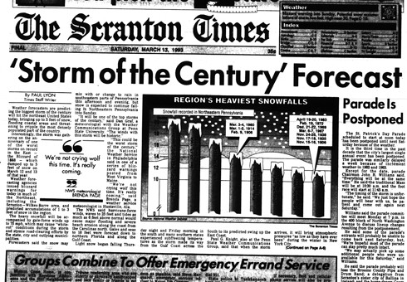

Slide 4
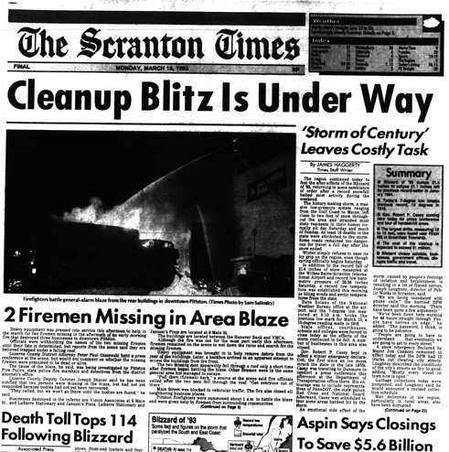

Slide 5
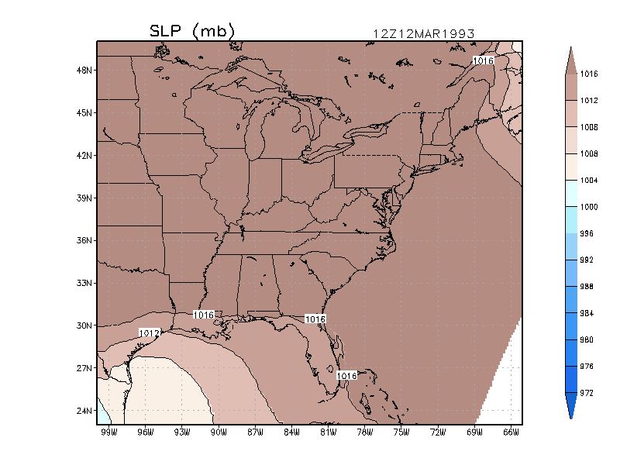
Animation of SLP field
(ECMWF reanalysis)
03/14/93 06Z
Storm Track
03/13/93 06Z
Notes:
ecmwf_movie.GIF

Slide 6
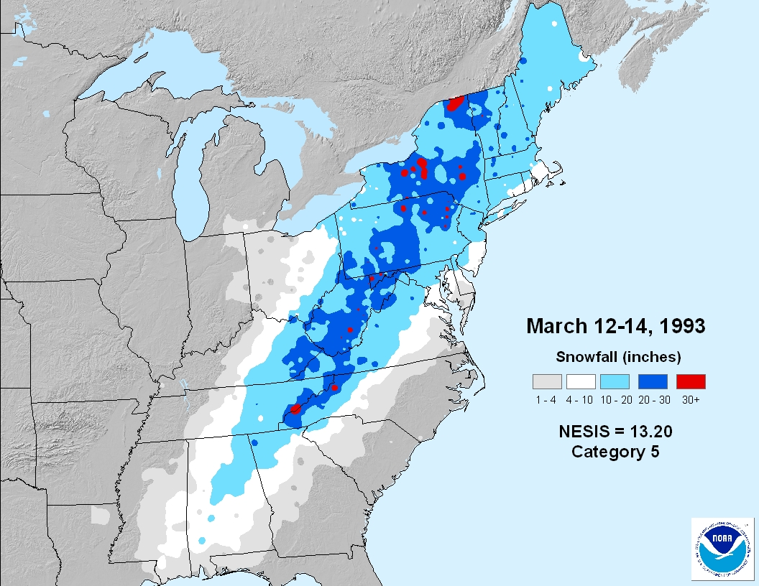
http://www.ncdc.noaa.gov/snow-and-ice/rsi/nesis
Notes:
The newer RSI, intended to succeed NESIS, is much more complicated. For the NE sector, it places 22 Feb 1969 #1, and SOC #2. Altho formula looks the same, values are different owing to the way normalization was done – in RSI each category’s A and P denominators are calibrated separately, and separately for each region. Snowfall thresholds also diff for each region. But it remains that the new scheme, for NE, effectively weights snowfall bins differently, and that makes bvalues different, and lets 1969 “win”.

Slide 7
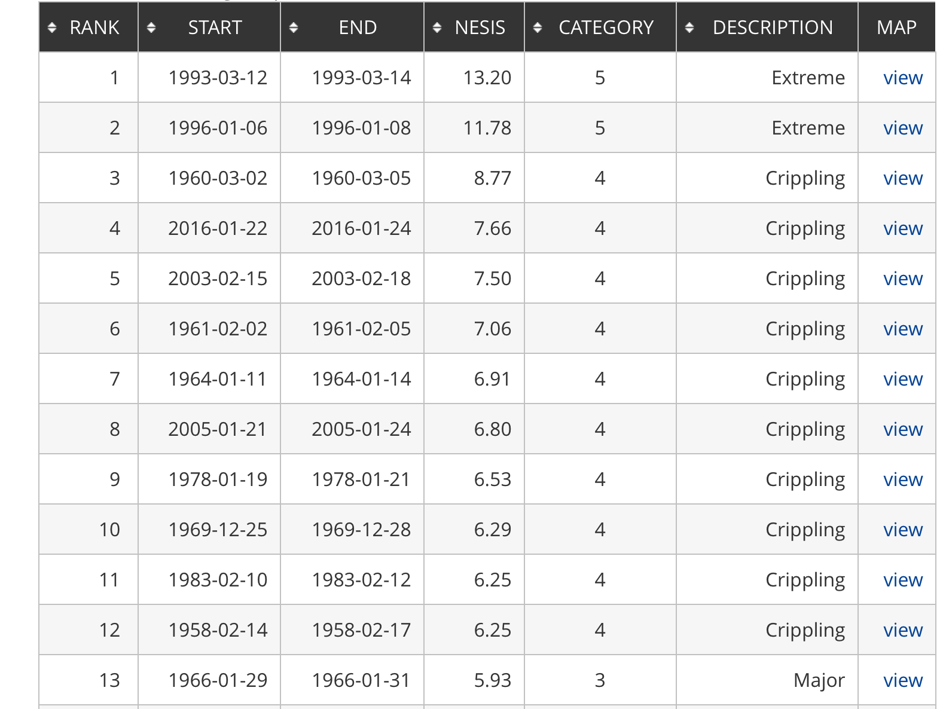
1/2016 storm
Notes:
3/12-3/15/2017 storm: rank #23, NESIS = 5.03, Cat. 3
Largest in 2018: 3/5/18-3/8/18 NESIS = 3.45, rank 41
Largest in 2020: 12/14/20 NESIS=3.21 rank 44

Slide 8
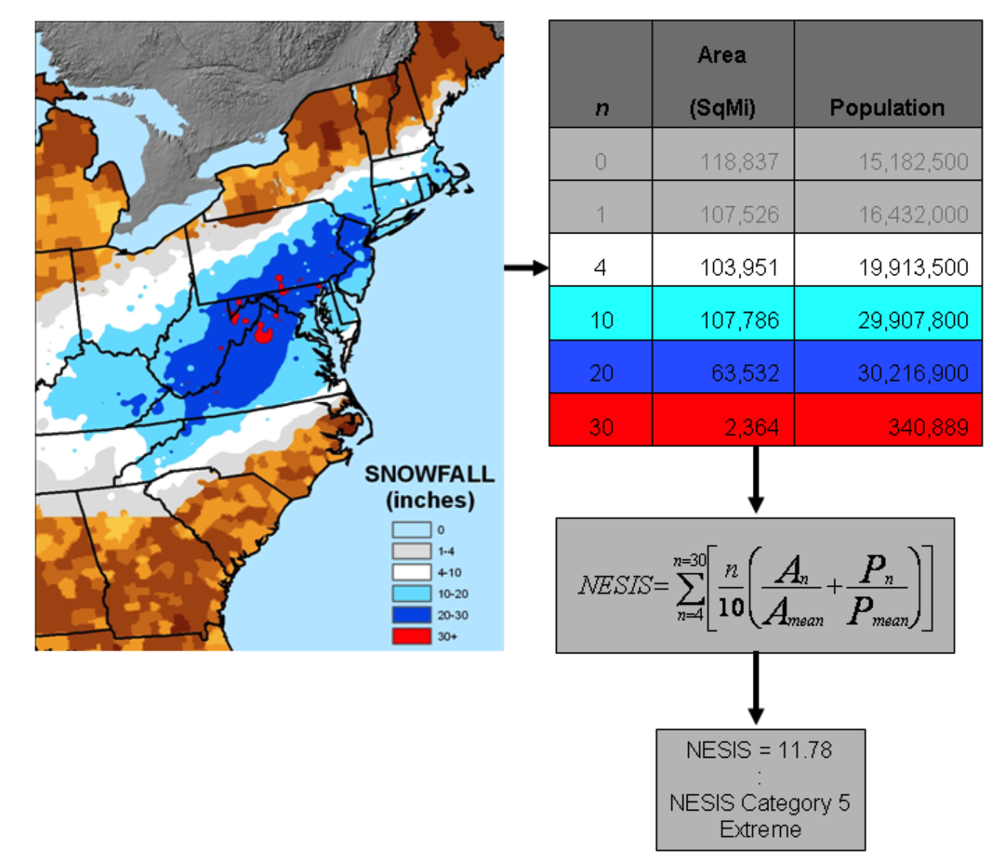
North East Storm Impact Scale (NESIS)
Snowfall totals
4”-9”
10”-19”
20”-29”
≥ 30”
• area-integrated AND
• population-weighted
http://www.ncdc.noaa.gov/snow-and-ice/rsi/nesis
Kocin and Uccellini (2004)
Notes:
NOTE: Example appears to suggest 10” area > 4” area, but formula would combine 10,20,30” areas into 4” category for NESIS computation. NESIS categories are “nested”.
“However, Equation (1) defines the area and population as “greater than” 4”, greater than 10”, etc. For example, the area for category 10 would include the areas for categories 10, 20, and 30. “ – Squires and Lawrimore (2006)

Slide 9
Initialization
NCEP/NCAR Reanalysis Project (NNRP)
  2.5˚ x 2.5˚ with 18 levels (but global and goes back to 1948), every 6 hours (21600 sec)
  Vtable.NNRP
Single 90 km domain
  See experiment script for details
Notes:
About 275 km grid spacing.

Slide 10
Domain configuration
Our 90 km domain
See script for details.
Do ungrib, geogrid
and metgrid as usual.
Check the map factors!
$LAB/SCRIPTS/max.csh MAPFAC_M geo_em.d01.nc
Notes:
Go to EXP04 script now. Map factors are going to start being a factor.
Dx_actual = dx_specified/m. Largest m = 1.13, so dx = 80 km (SW and SE corners), Smallest m = .966, so dx = 93 km.

Slide 11
namelist.input
&time_control
all_ic_times = .true.,
run_days = 2,
run_hours = 12,
run_minutes = 0,
run_seconds = 0,
start_year = 1993, 1993, 1993,
start_month = 03, 03, 03,
start_day = 12, 12, 12,
start_hour = 12, 12, 12,
start_minute = 00, 00, 00,
start_second = 00, 00, 00,
end_year = 1993, 1993, 1993,
end_month = 03, 03, 03,
end_day = 15, 15, 15,
end_hour = 00, 00, 00,
end_minute = 00, 00, 00,
end_second = 00, 00, 00,
interval_seconds = 21600,
Produces a wrfinput_d01 file at initial time AND each interval_seconds thereafter

Slide 12
all_ic_times = .true.
WRF input files created by real.exe
wrfinput_d01
wrfinput_d01.1993-03-12_18:00:00
wrfinput_d01.1993-03-13_00:00:00
wrfinput_d01.1993-03-13_06:00:00
wrfinput_d01.1993-03-13_12:00:00
wrfinput_d01.1993-03-13_18:00:00
wrfinput_d01.1993-03-14_00:00:00
wrfinput_d01.1993-03-14_06:00:00
wrfinput_d01.1993-03-14_12:00:00
wrfinput_d01.1993-03-14_18:00:00
wrfinput_d01.1993-03-15_00:00:00
You will concatenate these into a single file and run w2g on it, to create
a file called “nnrp_reanalysis”. (See script.)
This permits us to compare WRF runs with NNRP fields interpolated to the WRF grid
at each available time.

Slide 13
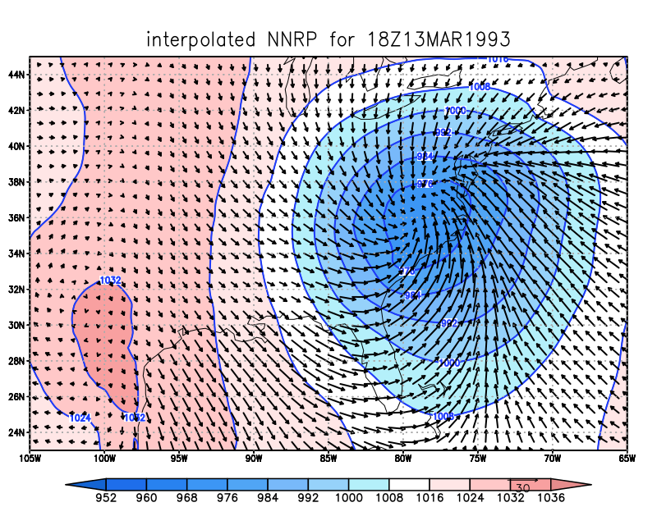
• opened nnrp_reanalysis (twice)
set t 6
cut_east.gs
compare.gs
set ccolor 1
d skip(u10,2);v10
Notes:
Too coarse resolution to capture the cold front

Slide 14
RUN01
Do ungrib, metgrid as usual. Check num_metgrid_levels
  Notice NNRP has only 2 soil levels!
RUN01 namelist.input is pre-configured for
  max_dom = 1
  mp_physics = 3 (WSM3)
  ra_lw and ra_sw = 1 (RRTM LW and Dudhia SW)
  MYJ PBL and surface scheme (sf_sfclay = bl_pbl = 2)
  Noah LSM (sf_surface_physics = 2)
  cu_physics = 3 (Grell-Freitas)
  cudt = 0 (as recommended for Grell schemes)
Create GrADS output file, call it “RUN01”
Notes:
Got here 2019

Slide 15
• opened nnrp_reanalysis (twice)
set t 6
cut_east.gs
compare.gs
set ccolor 1
d skip(u10,2);v10
Saw this before…
Notes:
Too coarse resolution to capture the cold front

Slide 16
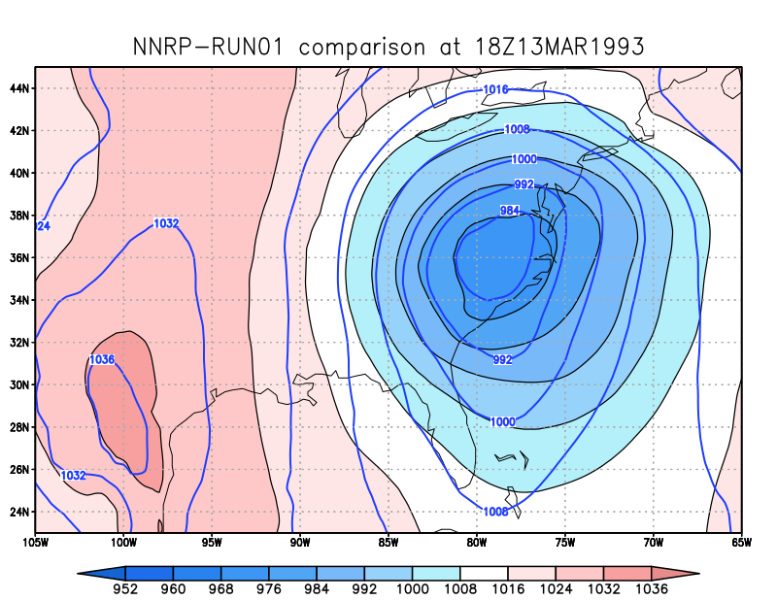
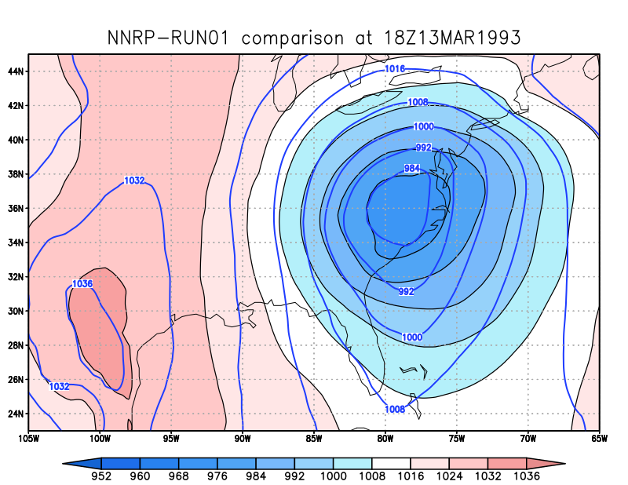
• opened RUN01 and nnrp_reanalysis [in that order]
set t 6
cut_east.gs
compare.gs
Colored/contoured field is NNRP
Thick contoured field is RUN01
Notes:
Looks like model is trying to establish a surface trough/cold front
Now blue contours are RUN01, black is NNRP

Slide 17
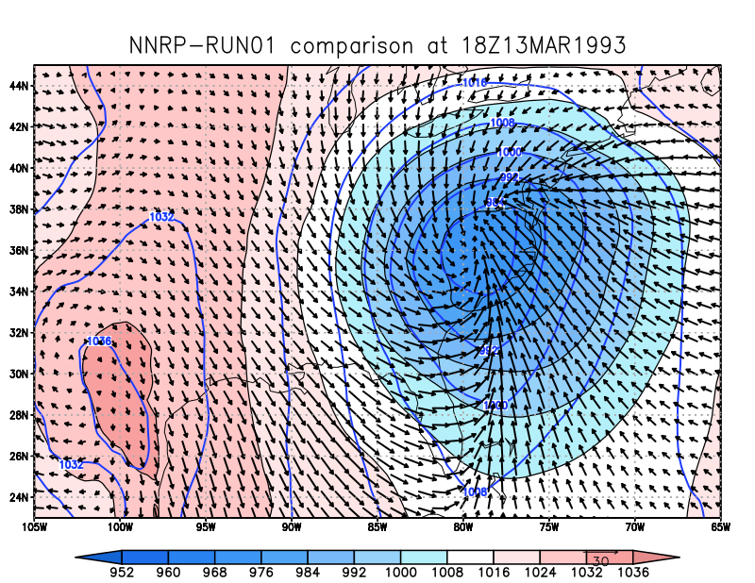
set arrscl 0.5 30
set ccolor 1
d skip(u10,2);v10
Notes:
Looks like model is trying to establish a surface trough/cold front

Slide 18
SLP root mean square error
(RMSE)
Computed relative to a reanalysis
(here, using NNRP)

Slide 19
Computing SLP RMSE
The provided script analyze.sh will use NCL scripts to compute RMSE SLP and NESIS. Record the values written to the screen.
  SLP is not a WRF output field. Previously, we used w2g to create it, and now we will use NCL
  SLP RMSE will be computed relative to the NNRP (and NARR) reanalysis fields, after interpolation to the WRF grid, every 6 hours, and summed over the simulation period.
    RMSE is computed w/r/t time at each grid point, then averaged across all grid points in domain 1
    Units: mb per gridpoint
  NESIS will be computed using SNOWNC and GRAUPELNC (snow and graupel precipitation received at the surface from microphysics scheme)
    More detail later

Slide 20
analyze.sh for RUN01
$ analyze.sh
(0) NESIS = 11.48 (pop component= 3.22796 area component= 8.24877)
(0) RMSE SLP = 2.38 mb per gridpoint (vs. NARR reanalysis)
(0) RMSE SLP = 2.01 mb per gridpoint (vs. NNRP reanalysis)
• If something goes wrong, check contents of the file named “OUT”
that is generated by this script
• NESIS calculation is very sensitive to small numerical details, and running
real.exe and/or wrf.exe on machines with different chipsets can change the #s
(Actual storm NESIS = 13.2)
Notes:
Actual 13.2. Big difference, but not concerned with that (yet).
2020

Slide 21
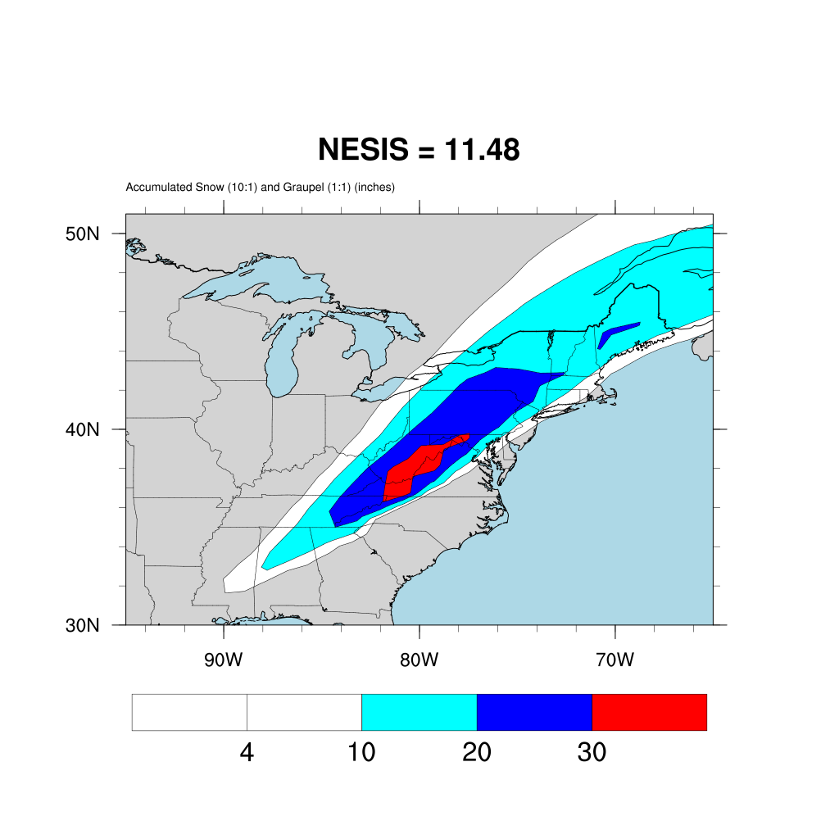
Actual NESIS =
13.2, but that
is also very
sensitive to
how we calculate
snow depth from
liquid water
equivalent
Notes:
Less snowfall on Long Island than in actual storm, which will make a big difference in the population component
Much too much snow in Appalachians, but that hardly affects population component

Slide 22
Analysis nudging “FDDA”
(four-dimensional data assimilation)
[WRF can also nudge to observations…]
Notes:
Lipstick on a pig

Slide 23
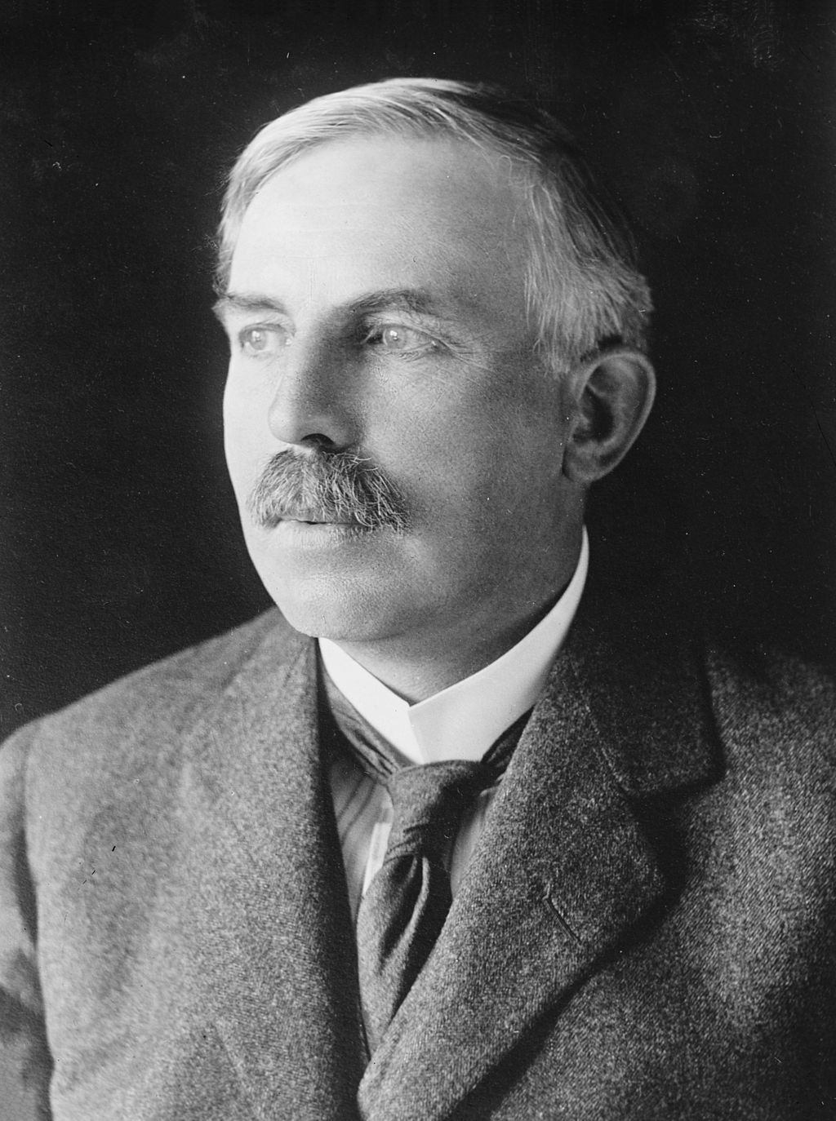
Ernest Rutherford (1871-1937)
Nobel Prize for Chemistry
“Father of nuclear physics”
Formulated concept of
radioactive “half-life”
[alleged to have said:]
“If your experiment needs statistics,
you ought to have done a
better experiment.”

Slide 24
Ernest Rutherford (1871-1937)
Nobel Prize for Chemistry
“Father of nuclear physics”
Formulated concept of
radioactive “half-life”
[if alive today he might say:]
“If your model needs nudging,
you ought to have done a
better model.”

Slide 25
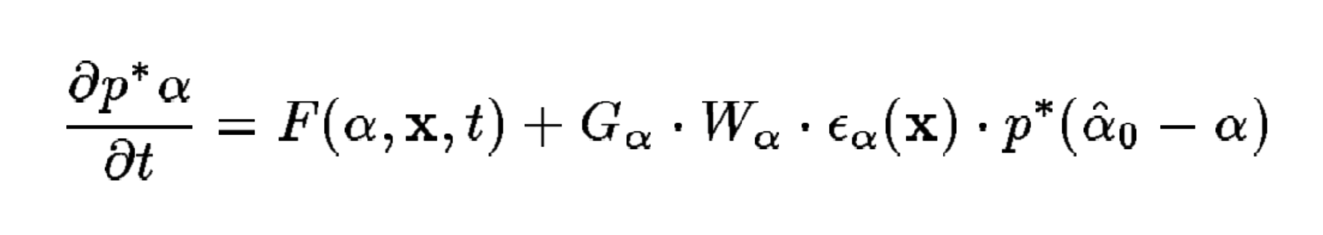
Nudging
Nudging adds terms like this to the model:
Tendency for Other RHS terms ------------------- Nudging term -------------------------
field α
Forcing α towards
analysis value
[zero-order diffuser]
Inverse time scale
Vertical weighting
function
We’ll use nudging
For 1st 6 hours ONLY…

Slide 26
grid_fdda = 1 turns on analysis
nudging (FDDA) in Domain 1.
Performed every 360 min
(= interval_seconds), or 6 h
Ceases after 6 h
Standard grid nudging
&fdda
grid_fdda = 1, 0,
gfdda_inname = "wrffdda_d<domain>",
gfdda_interval_m = 360, 360,
gfdda_end_h = 6, 6,
io_form_gfdda = 2
fgdt = 0, 0,
if_no_pbl_nudging_uv = 1, 1,
if_no_pbl_nudging_t = 1, 1,
if_no_pbl_nudging_q = 1, 1,
if_zfac_uv = 0, 0,
k_zfac_uv = 10, 10,
if_zfac_t = 0, 0,
k_zfac_t = 10, 10,
if_zfac_q = 0, 0,
k_zfac_q = 10, 10,
guv = 0.0003, 0.0003,
gt = 0.0003, 0.0003,
gq = 0.0003, 0.0003,
fgdtzero = 1, 0,
if_no_pbl_nudging_ph = 1, 1,
if_zfac_ph = 0, 0,
k_zfac_ph = 10, 10,
gph = 0.0003, 0.0003,
dk_zfac_uv = 1, 1,
dk_zfac_t = 1, 1,
dk_zfac_ph = 1, 1,
xwavenum = 7, 0,
ywavenum = 5, 0,
/
&fdda section of
namelist.input
Usually “nudge” only outer
domain, D1
Here, there is only one
domain anyway.
real.exe program creates file wrffdda_d01

Slide 27
Standard grid nudging
&fdda
grid_fdda = 1, 0,
gfdda_inname = "wrffdda_d<domain>",
gfdda_interval_m = 360, 360,
gfdda_end_h = 6, 6,
io_form_gfdda = 2
fgdt = 0, 0,
if_no_pbl_nudging_uv = 1, 1,
if_no_pbl_nudging_t = 1, 1,
if_no_pbl_nudging_q = 1, 1,
if_zfac_uv = 0, 0,
k_zfac_uv = 10, 10,
if_zfac_t = 0, 0,
k_zfac_t = 10, 10,
if_zfac_q = 0, 0,
k_zfac_q = 10, 10,
guv = 0.0003, 0.0003,
gt = 0.0003, 0.0003,
gq = 0.0003, 0.0003,
fgdtzero = 1, 0,
if_no_pbl_nudging_ph = 1, 1,
if_zfac_ph = 0, 0,
k_zfac_ph = 10, 10,
gph = 0.0003, 0.0003,
dk_zfac_uv = 1, 1,
dk_zfac_t = 1, 1,
dk_zfac_ph = 1, 1,
xwavenum = 7, 0,
ywavenum = 5, 0,
/
No nudging within PBL
(typical with coarse-resolution
analyses like NNRP)
Nudging coefficients
(default values, inverse seconds)
[about 1 hr]
&fdda section of
namelist.input
real.exe program creates file wrffdda_d01

Slide 28
FDDA procedure
Edit namelist.input to turn FDDA on
Run real again (to get wrffdda_d01 file)
Submit WRF batch job
With w2g, call output RUN02
Open RUN01 and then RUN02
  Look at t=6 (cut_east.gs; compare.gs)
  RUN02’s cyclone is a little deeper and larger
Execute script analyze.sh
  NESIS = 10.94 [was 11.48]
  RMSE SLP = 1.74 mb per gridpoint [was 2.01]
    13% improvement w/r/t NNRP reanalysis benchmark

Slide 29
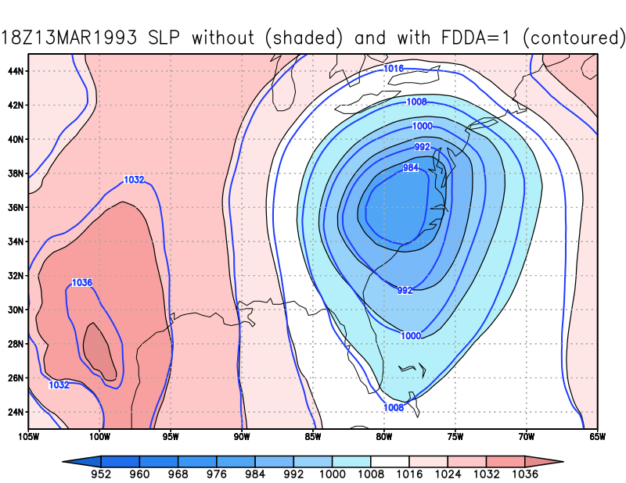
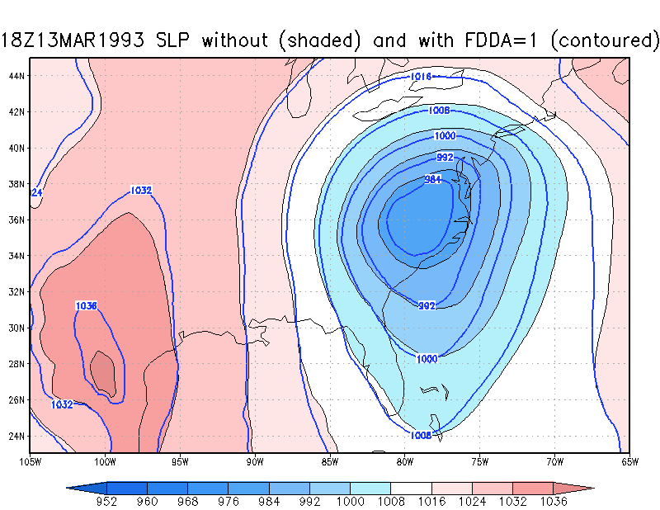
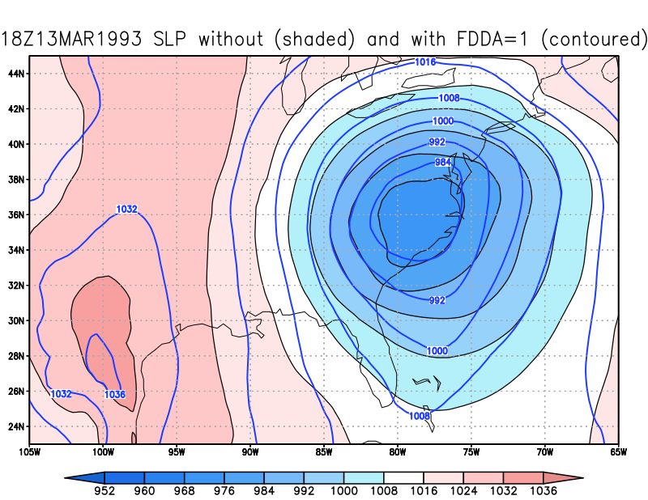
RUN01 vs RUN02
Colored/contoured field is RUN01
Thick contoured field is RUN02

Slide 30
OPTIONAL
grid_fdda = 2 turns on
spectral grid nudging in D1.
Spectral grid nudging
&fdda
grid_fdda = 2, 0,
gfdda_inname = "wrffdda_d<domain>",
gfdda_interval_m = 360, 360,
gfdda_end_h = 6, 6,
io_form_gfdda = 2
fgdt = 0, 0,
if_no_pbl_nudging_uv = 1, 1,
if_no_pbl_nudging_t = 1, 1,
if_no_pbl_nudging_q = 1, 1,
if_zfac_uv = 0, 0,
k_zfac_uv = 10, 10,
if_zfac_t = 0, 0,
k_zfac_t = 10, 10,
if_zfac_q = 0, 0,
k_zfac_q = 10, 10,
guv = 0.0003, 0.0003,
gt = 0.0003, 0.0003,
gq = 0.0003, 0.0003,
fgdtzero = 1, 0,
if_no_pbl_nudging_ph = 1, 1,
if_zfac_ph = 0, 0,
k_zfac_ph = 10, 10,
gph = 0.0003, 0.0003,
dk_zfac_uv = 1, 1,
dk_zfac_t = 1, 1,
dk_zfac_ph = 1, 1,
xwavenum = 7, 0,
ywavenum = 5, 0,
/
&fdda section of
namelist.input
Determines which
wavenumbers gets nudged
(see next slide)
real.exe program creates file wrffdda_d01

Slide 31
Spectral grid nudging
xwavenum and ywavenum determine which wavenumbers get nudged
Suggested target: select wavenumber such that domain extent/wavenumber ~ 1000 km in x and y directions separately
Here, D1 is 85 points x 90 km = 7650 km in x direction, so I chose xwavenum = 7, and 56 points x 90 km = 5040 km in y direction, so I chose ywavenum = 5.
Thus, we’re nudging wavenumbers 1-7 in x, and 1-5 in y directions, leaving smaller scale waves alone
If you do this, make sure to run real.exe AGAIN
My RUN03 using spectral nudging:
  NESIS = 11.18
  RMSE SLP = 1.72 mb per gridpoint (w/r/t NNRP) (14% improvement) [better improvement found in older WRF versions]

Slide 32
Nudging vs. good model physics
KEEP IN MIND: this assumes NNRP fields are “truth”, but FDDA thinks so too!
SLP ERROR vs NNRP | Default setup | Alternate physics
No nudging (RUN01) | 2.01 mb/gridpt | 1.60 mb/gridpt
Regular nudging | 1.74 | 1.44
Spectral nudging | 1.72 | 1.43
…just nudging
first 6 h
So… how much of the difference above is due to random chance?
SLP ERROR vs NNRP | Default setup | Alternate physics
No SKEBS (RUN01) | 2.01 mb/gridpt | 1.60 mb/gridpt
nens = 1 | 2.33 | 2.10
nens = 2 | 2.23 | 1.79
nens = 3 | 2.04 | 1.71
SKEBS
experiment
(no nudging)
Because NNRP cyclone lacks frontal definition, nudging TO it may be moving you AWAY from a more realistic-appearing solution!!!
Notes:
Got to here 2021
Because NNRP cyclone lacks frontal definition, nudging to it may be moving you away from a more realistic-appearing solution

Slide 33
SKEBS perturbations
(stochastic kinetic energy backscatter scheme)
Berner et al. (2010)

Slide 34
SKEBS
SKEBS is an attempt to simulate the uncertainty associated with unresolvable turbulence by infusing some model fields with random noise where/when turbulence is anticipated
  Small perturbations are added to the potential temperature and rotational components of the horizontal wind
Activated by inserting &stoch namelist section and setting switch skebs = 1 for each domain you desire to use it in.
Lateral boundaries are also perturbed if perturb_bdy = 1.
WARNING: SKEBS is still switched ON, even if skebs = 0, as long as the perturb_bdy switch is set to 1.
  So, if you don’t want SKEBS on AT ALL, you need to make sure to switch BOTH options off (i.e., set them to 0).
Make sure grid_fdda = 0!

Slide 35
&stoch
Activates scheme (set BOTH to 0 to deactivate)
&stoch
skebs = 1, 0,
perturb_bdy = 1
nens = 1
tot_backscat_psi = 1.0E-05
tot_backscat_t = 1.0E-06
ztau_psi = 10800.0
ztau_t = 10800.0
rand_perturb = 1, 1,
gridpt_stddev_rand_pert = 0.03
stddev_cutoff_rand_pert = 3.0
lengthscale_rand_pert = 500000.0
timescale_rand_pert = 21600.0
/
IMPORTANT!
Set nens to a different
integer value for each run,
to generate different
perturbations!

Slide 36
EXP04: assigned nens values
Google Docs spreadsheet for Experiment 4 (click here)
79, 80, 81 – Anderson 118, 119, 120 – Johnson
82, 83, 84 – Heeren 121, 122, 123 – Naple
85, 86, 87 – Komarc 124, 125, 126 – Piersante
88, 89, 90 – Maura
91, 92, 93 – Moore
94, 95, 96 – Odstrchel
97, 98, 99 – Smith
100, 101, 102 – Watts
103, 104, 105 – Werner
106, 107, 108 – Wheeler
109, 110, 111 – Fandrich
112, 113, 114 – Garmong
115, 116, 117 – Gyawali
If you don’t have permission to add
your info to spreadsheet, let me know…
Redo RUN01 w/ NO FDDA (fdda = 0) but SKEBS ON (skebs = 1 and perturb_bdy = 1).
This experiment asks you to run three separate runs, each with a different value of nens.
Report SLP error metric values (w/r/t NNRP and NARR) and NESIS obtained using analyze.sh
for each of your runs via email.

Slide 37
Example: my analyze.sh output for nens = 1
(0) NESIS = 9.2 (pop component= 2.23591 area component= 6.9689)
(0) RMSE SLP = 2.67 mb per gridpoint (vs. NARR reanalysis)
(0) RMSE SLP = 2.33 mb per gridpoint (vs. NNRP reanalysis)
• Copy and paste this information, AND the nens values, for your runs to
us via email, and also enter it on the Google spreadsheet

Slide 38
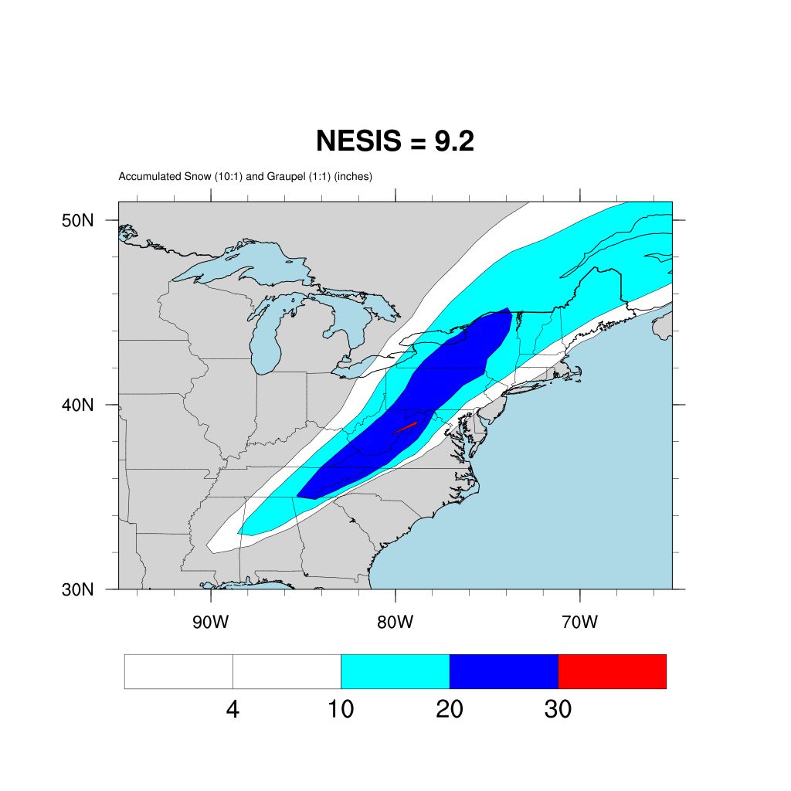
Default setup
nens = 01

Slide 39
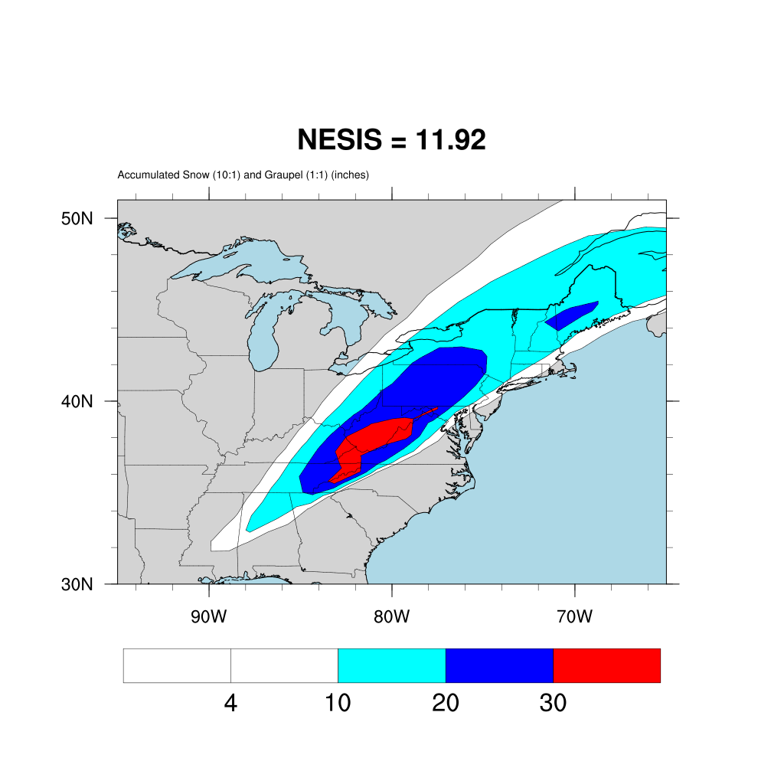
Default setup
nens = 02

Slide 40
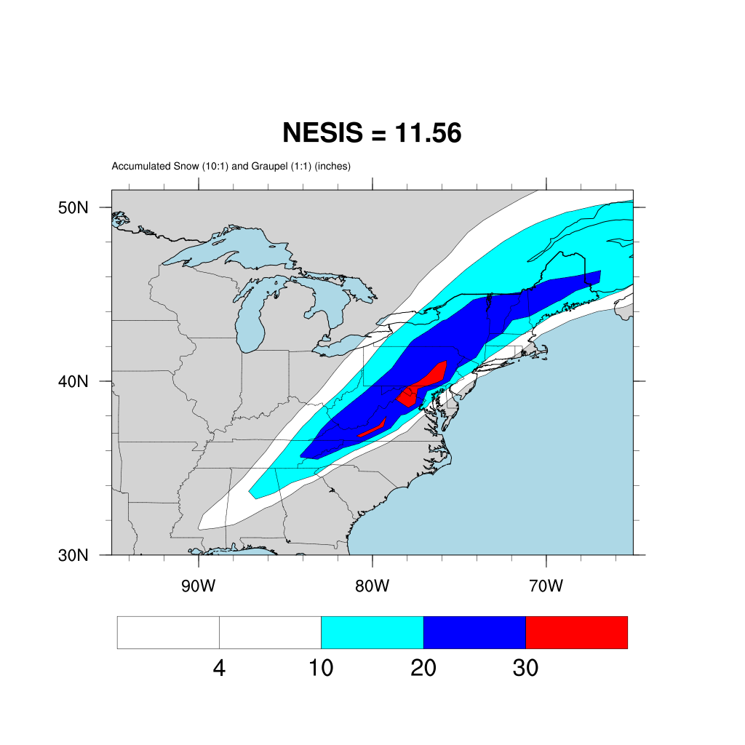
Default setup
nens = 03

Slide 41
Notes
Nudging, especially to a low-resolution analysis, really has to be questioned
  The low-resolution reanalysis is not “truth”
  At least spectral nudging can be confined to the longest waves, however
  That said, we’re going to move to a higher-resolution reanalysis – the NARR
It does not appear to make sense to use nudging and SKEBS simultaneously

