Slide 1
More on NESIS, model levels, diffusers, advection, in-class demo using NARR, and Experiment #5
ATM 419/563
Spring 2021
Fovell
© Copyright 2021 Robert Fovell, Univ. at Albany, SUNY, rfovell@albany.edu

Slide 2
Outline
More information on NESIS
Methods of estimating snow depths from model outputs
Initializing WRF with the NARR reanalysis
Experiment #5 physics contest
How to modify vertical model levels in WRF
Some additional information on diffusers, dampers, and advection options

Slide 3
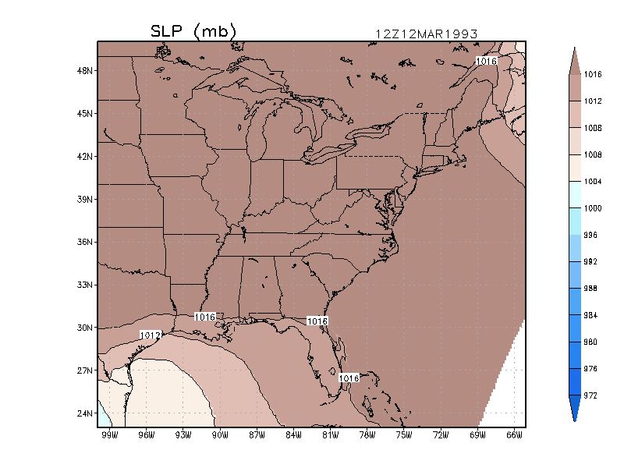
Animation of SLP field
(ECMWF reanalysis)
03/14/93 06Z
Storm Track
03/13/93 06Z
Notes:
ecmwf_movie.GIF

Slide 4
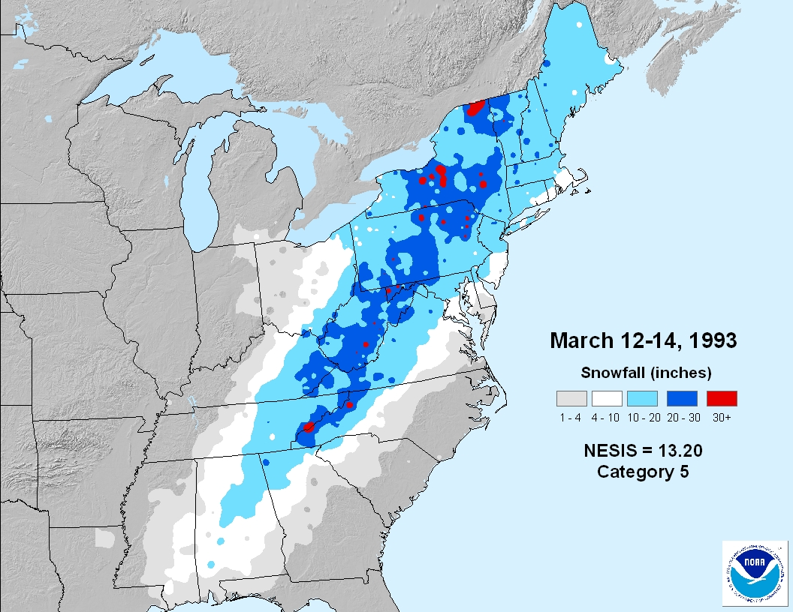

Slide 5
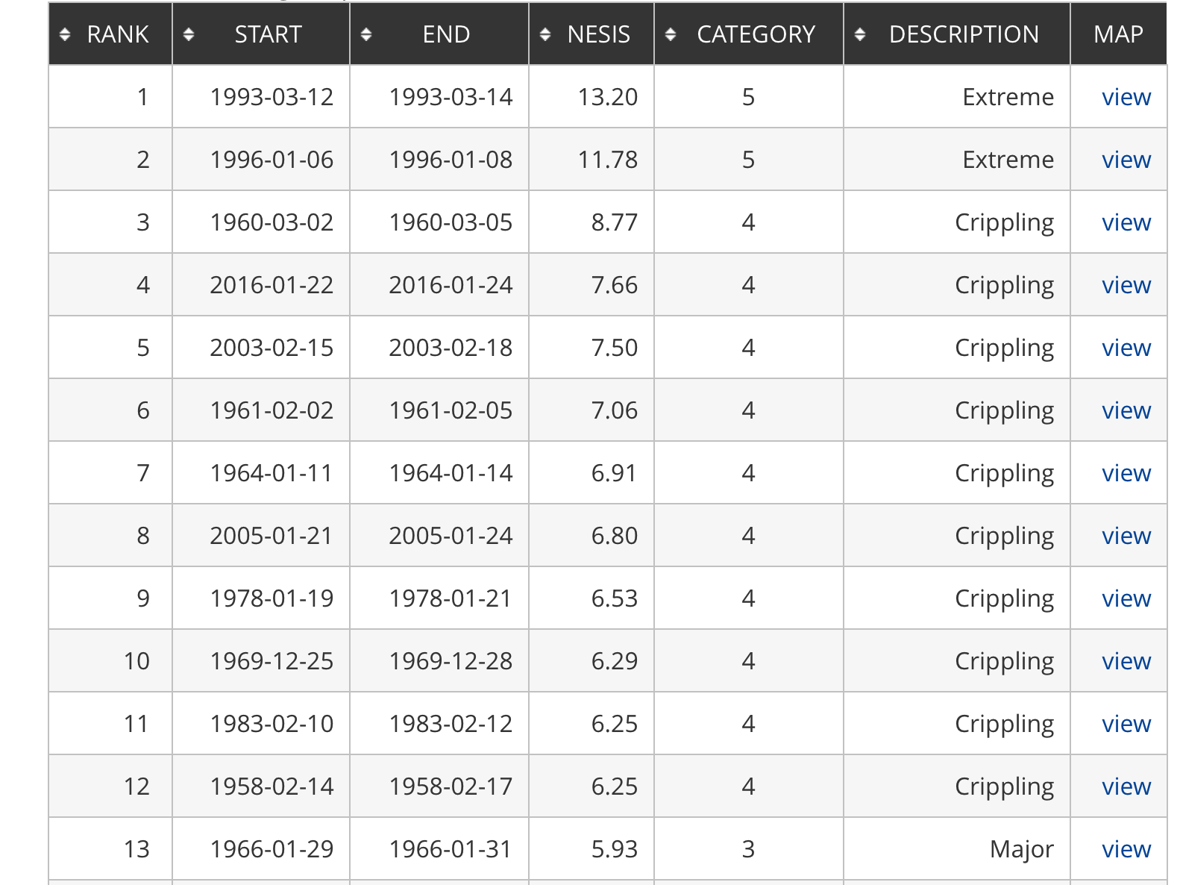
1/2016 storm
3/12-3/15/2017 storm:
NESIS = 5.03
rank #23 (Cat. 3)
1/30-2/3/2021 storm:
NESIS = 4.93
rank #24 (Cat. 3)
3/5-3/8/2018 storm:
NESIS = 3.45
rank #41 (Cat.2)
12/14/2020 storm:
NESIS = 3.21
rank #44 (Cat. 2)
5 2018 storms
0 2019 storms
Notes:
3/12-3/15/2017 storm: rank #23, NESIS = 5.03, Cat. 3
Largest in 2018: 3/5/18-3/8/18 NESIS = 3.45, rank 41
Largest in 2020: 12/14/20 NESIS=3.21 rank 44

Slide 6
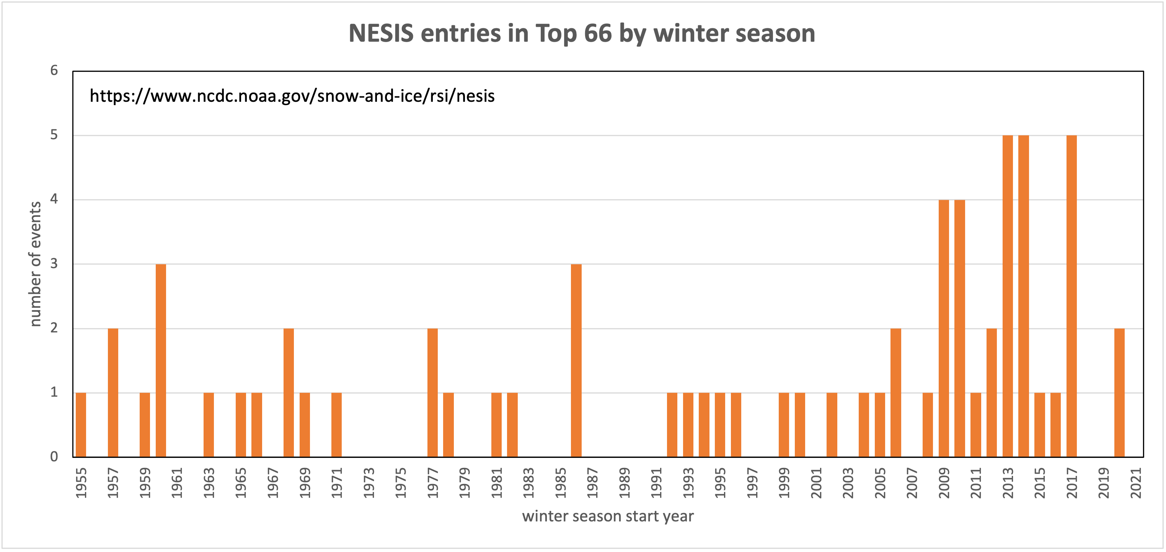
Winters with most top NESIS events
SOC
Is this an artifact of
better and more
complete snow obs?
Population growth?
Weather changes?

Slide 7
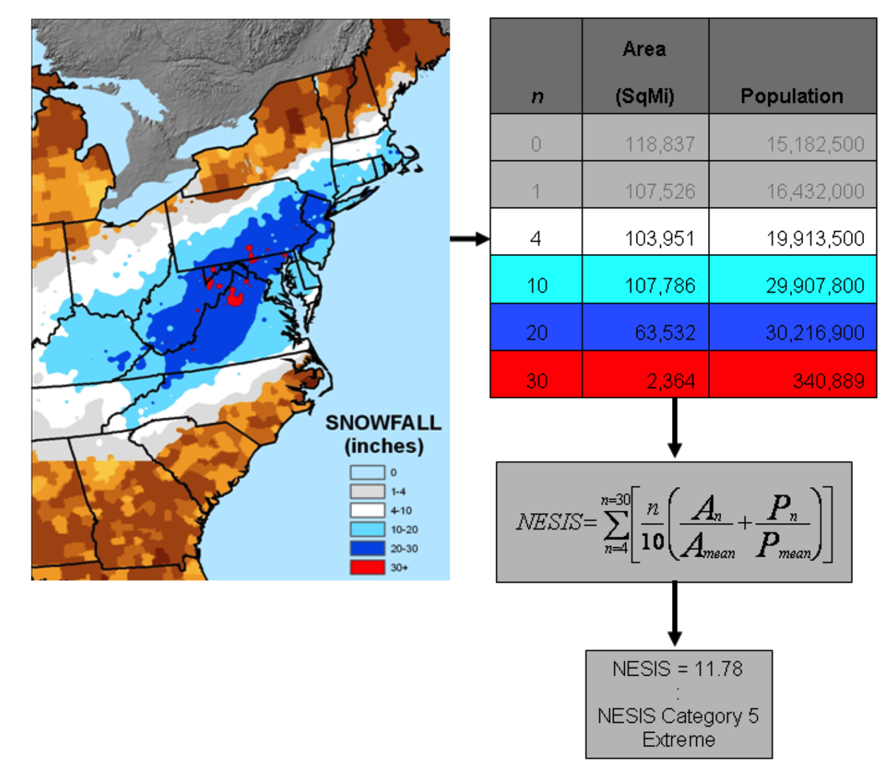
North East Storm Impact Scale (NESIS)
Snow depths of
4-9”
10-19”
20-29”
≥ 30”
[non-overlapping]
4 snowfall depth categories
(overlapping)
• area-integrated AND
• population-weighted
http://www.ncdc.noaa.gov/snow-and-ice/rsi/nesis
Kocin and Uccellini (2004)
Notes:
NOTE: Example appears to suggest 10” area > 4” area, but formula would combine 10,20,30” areas into 4” category for NESIS computation. NESIS categories are “nested”.
“However, Equation (1) defines the area and population as “greater than” 4”, greater than 10”, etc. For example, the area for category 10 would include the areas for categories 10, 20, and 30. “ – Squires and Lawrimore (2006)

Slide 8
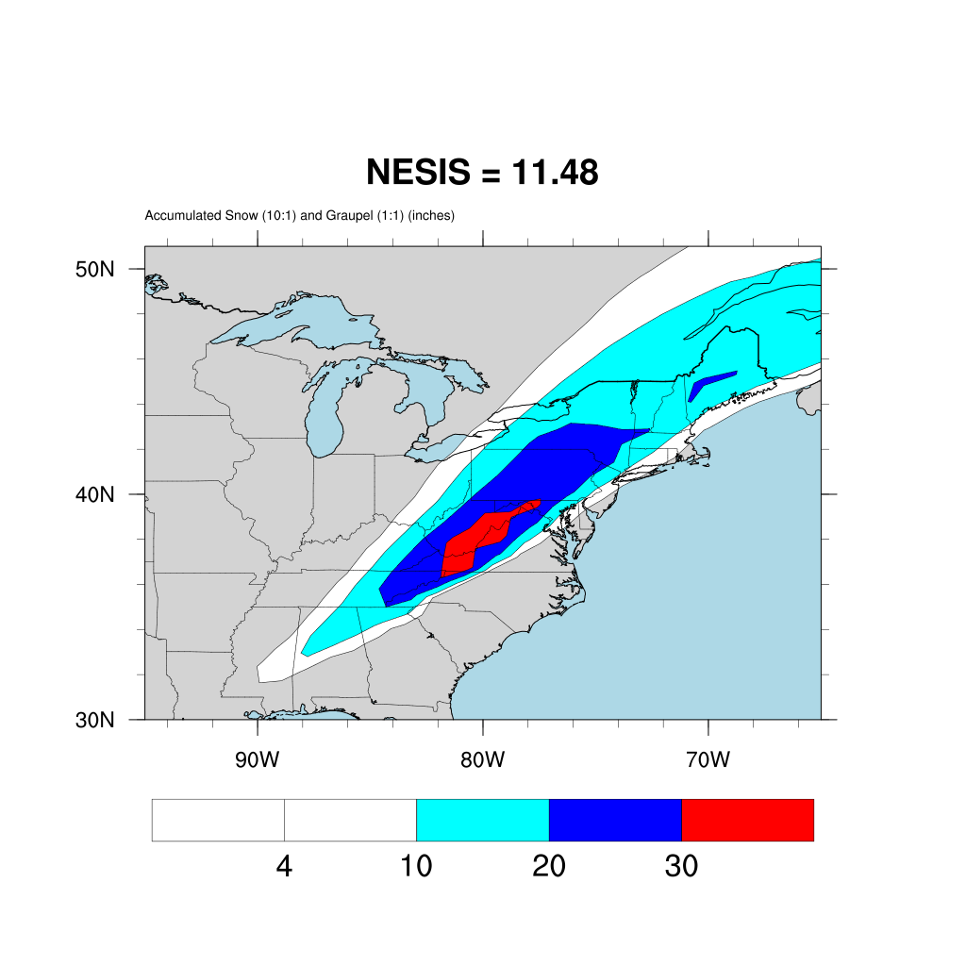
RUN01
(NNRP-
initialized)

Slide 9
RUN01’s NESIS
Output from analyze.sh:
NESIS = 11.48 (pop component= 3.22796 area component= 8.24877)
Where n₁ = 4”, n₂ = 10”, n₃ = 20”, and n₄ = 30”
P_{mean} = mean population affected by snowfall > 10” in 13-state Northeast
region (35.4 million)
A_{mean} = mean area of > 10” snowfall within 13-state Northeast region (91000 mi²)
Population based on 2000 census
Squires and Lawrimore (2006)

Slide 10
Computing snow depth #1
WRF computes RAINNC (total precipitation received at the surface from the microphysics scheme).
  Despite its name, it is total precipitation, and already includes precipitation in the form of snow (SNOWNC), graupel (GRAUPELNC), and hail (HAILNC), if they exist. Units are mm.
  It does NOT include precipitation from the cumulus scheme, if employed. That is RAINC.
SNOWNC and GRAUPELNC are actually liquid water equivalents.
  Snow mixing ratio q_{s} is kg_{snow}/kg_{air}
  Snow terminal velocity “through” model ground is V_{s} in m/s
  Flux of snow “through” model surface is ρV_{s}q_{s}, with units kg_{snow}/m²/s, where ρ = air density
  Multiply this by the time step (∆t) = units now kg_{snow}/m²
  Divide by density of liquid (1000; it’s liquid equivalent) and convert to mm (multiply by 1000) = yields SNOWNC
Notes:
RAINNC isn’t just rain, as its name would seem to imply. It’s total precip, including graupel, snow and hail (if they exist).
Some LSMs also prognose SNOWH – physical snow depth, in meters. This is not useful for gauging snowfall because it also includes snowpack compaction and loss, and is based on snow water equivalent anyway

Slide 11
Computing snow depth #2
How to compute snow depth?
Some different ways of converting SNOWNC liquid-equivalent to physical snow depth (not exhaustive):
  Just assume the classic 10:1 ratio
  Based on event observations of snow depth to water content (as in Lott 1993)
  Based on dew points recorded during snowfall (also from Lott 1993)
  Utilize climatological values in some fashion, such as those provided by Baxter et al. (2005)
  Based on 3-hourly snow precipitation rate and temperature (Byun et al. 2008 for Korean observations)
  Based on neutral network analysis of multiple meteorological factors [including solar radiation, temperature, relative humidity, wind speed, etc..] (Roebber et al. 2003)
  Employ the temperature-dependent Kuchera method (see forthcoming slide)
  If using Noah land surface model, use its snow depth variable SNOWH
What about GRAUPELNC? Some schemes produce a LOT of graupel. How to factor this into “snow”?

Slide 12
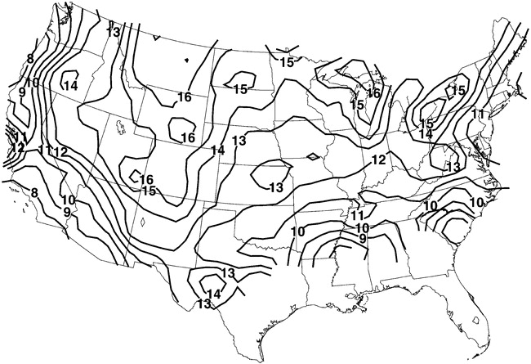
Climatological average snow-to-liquid ratio
Baxter et al. (2005)
Notes:
Suggests 10:1 is too small. But, a lot of snow cases involve lower temperatures.

Slide 13
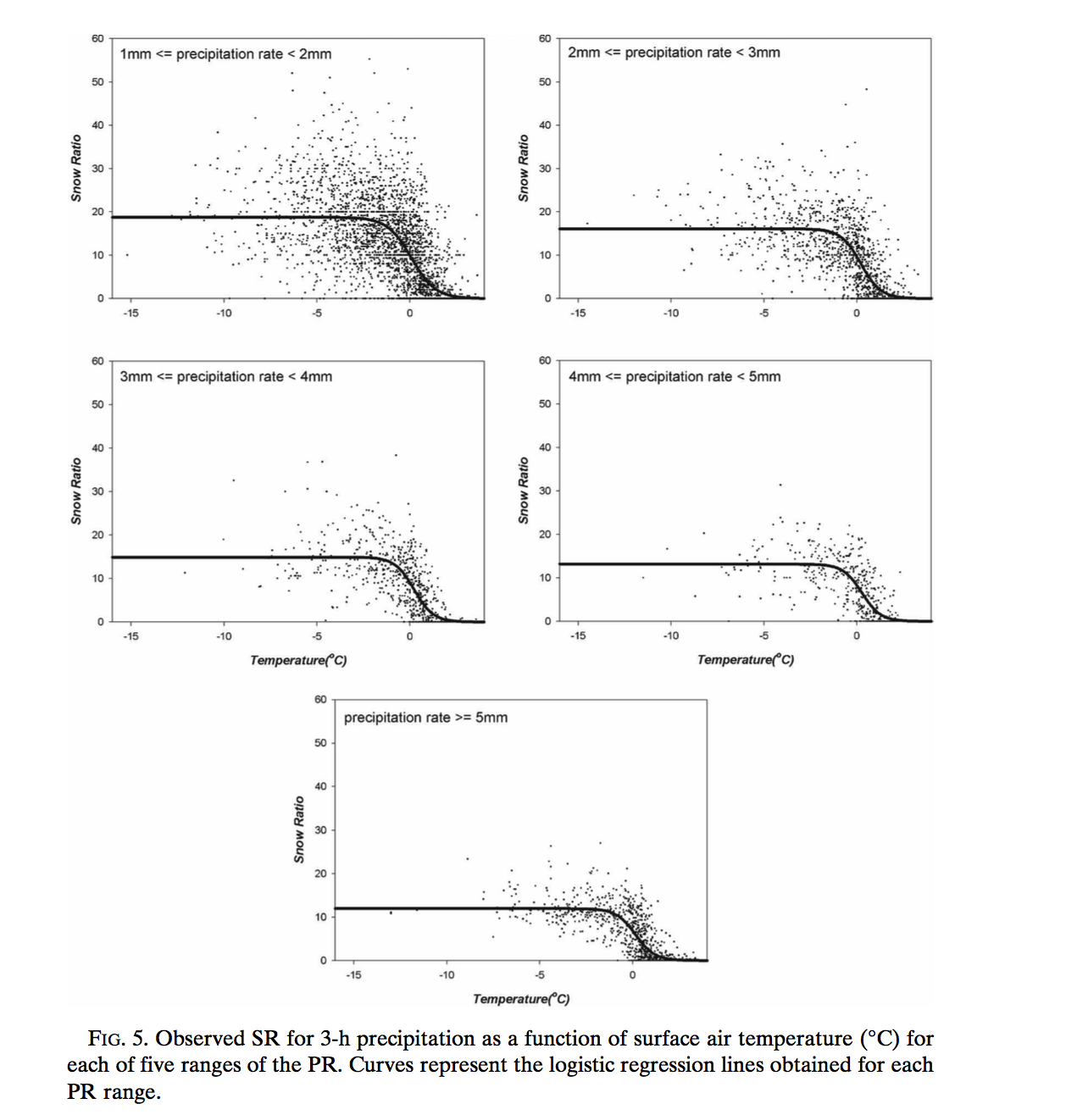
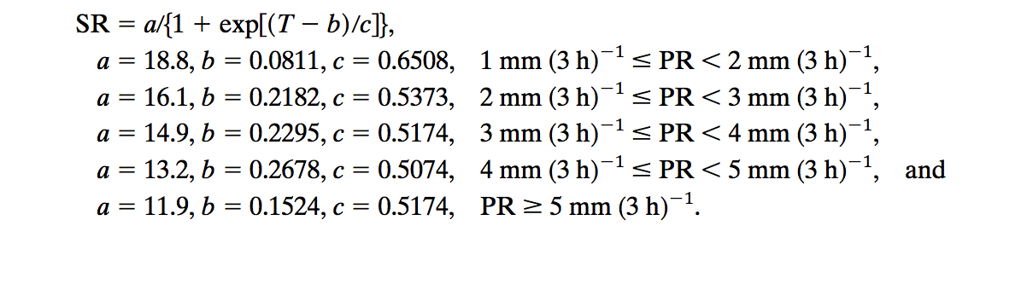
Byun et al. (2008)
Precip rate low, T cold
ratio approaches 20:1
Precip rate high, T close to 0˚C
ratio approaches 7:1
Notes:
When precip rate low and T is very cold, snow ratio approaches 20:1.
When precip rate large and T closer to 0, snow ratio more like 7:1

Slide 14
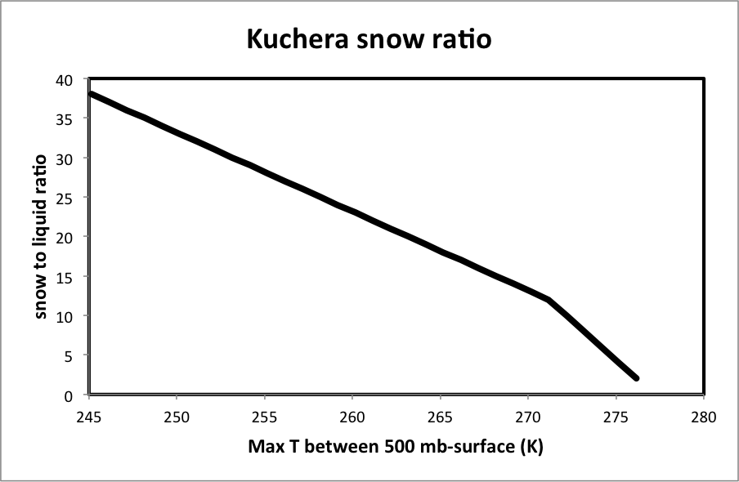
Kuchera snow depth algorithm
Determine maximum temperature between the surface and 500 mb (= Tmax), and then
  If Tmax > 271.16K, then snow ratio = 12.0 + 2.0*(271.16-Tmax)
  If Tmax ≤ 271.16K, then snow ratio = 12.0+ 1.0*(271.16-Tmax)
There is a snow depth option in the
AFWA package called ‘Kuchera’, but it’s
a different algorithm, based on surface T

Slide 15
analyze.sh script
The analyze.sh script calls three NCL scripts, with nesis.ncl being the one computing NESIS values
NESIS estimates will vary enormously among microphysics schemes, which is why we are not using them to verify the model
The current version of nesis.ncl uses a 10:1 snow:liquid ratio, which is simple but likely suboptimal, and a 1:1 ratio for graupel, which needs rethinking*
Only snow in continental US counts towards the NESIS estimate (this included file provides the CONUS mask: CONUS_grid_wrfout_d01_1993-03-12_12:00:00.nc )
* This presumes a microphysics scheme that produces graupel. WSM3 does not.
Some schemes also generate hail and HAILNC. This is currently ignored.

Slide 16
Initializing with the
NARR reanalysis
Notes:
Here 2020

Slide 17
NARR reanalysis
North American Regional Reanalysis, created using the ancient Eta model at 32 km horizontal resolution, with 29 pressure levels (and only to 100 mb - ouch)
Available after 1/1/1979
Can be obtained from the NCAR Research Data Archive (rda.ucar.edu) after creating free account
  Data set ds608.0

Slide 18
Using NARR reanalysis
NARR requires its own Vtable for ungrib and also a fixed-fields file to be provided for the metgrid step
NARR data are available every 3 hours (10800 sec)
NARR files (from NCAR) named like:
  merged_AWIP32.2005120715.3D merged_AWIP32.2005120715.RS.clm merged_AWIP32.2005120715.RS.flx merged_AWIP32.2005120715.RS.pbl merged_AWIP32.2005120715.RS.sfc
  actually need only the 3D, flx, and sfc files

Slide 19
Preparing for Experiment 5
Make a new directory in your lab space, called SOC2
Copy and unpack SETUP.TAR from directory: $LAB/SOC/
  Starting afresh is best way of avoiding complications
Do make_all_links.sh as usual
Run geogrid.exe to recreate the domain
  or copy geo_em.d01.nc from ../SOC/
Modifications to both namelist files will be needed to initialize WRF using NARR
SEE ALSO slides 25, 26

Slide 20
Prepare for WPS
SEE ALSO slides 25, 26
Make sure you are using Vtable.NARR as Vtable!!!
In namelist.wps, change &ungrib prefix and &metgrid fg_name to ‘NARR’
Also in namelist.wps:
  set interval_seconds = 10800
  make sure the “/” line is moved AFTER the constants_name line, like so:
&metgrid
fg_name = 'NARR',
io_form_metgrid = 2,
constants_name = '/network/rit/lab/atm419lab/DATA/FIXED_NARR',
/
NARR fixed-fields file
Notes:
Changing file name not necessary since using new directory

Slide 21
Next steps
Link to the NARR grids from one of two locations
srun ungrib.exe and metgrid.exe as usual
Check num_metgrid_levels and num_metgrid_soil_levels
Modify namelist.input as needed
  Make sure fdda is OFF (= 0)
  Make sure skebs, perturb_bdry are OFF (= 0)
  interval_seconds = 10800
  p_top_requested = 10000 (was 1000)
    NARR’s uppermost pressure level is only 10000 Pa = 100 mb (ugh!)
  link_grib.csh $LAB/DATA/NARR_199303/merged*
  link_grib.csh /rfovell/ATM419/NARR_199303/merged*
SEE ALSO slides 25, 26

Slide 22
Make first NARR run: NARR01
SEE ALSO slides 25, 26
Submit the submit_real script
  (or run at command line – it’s fast)
Check output
Submit WRF run
sh analyze.sh
real.exe
vs.
srun real.exe
vs.
srun –p snow real.exe
…run on 3 different machines
(0) NESIS = 15.09 (pop component= 4.79854 area component= 10.2872)
(0) RMSE SLP = 2.2 mb per gridpoint (vs. NARR reanalysis)
(0) RMSE SLP = 2.81 mb per gridpoint (vs. NNRP reanalysis)
If you are not able to reproduce my RMSE numbers, make sure the constants_name
section of namelist.wps is correct, and rerun metgrid.exe
(Unfortunately, the NESIS numbers are very sensitive to small and irrelevant variations in precision, such as that associated with different chipsets.)
Notes:
This has 22 files, not 11. Skip the concatenate

Slide 23
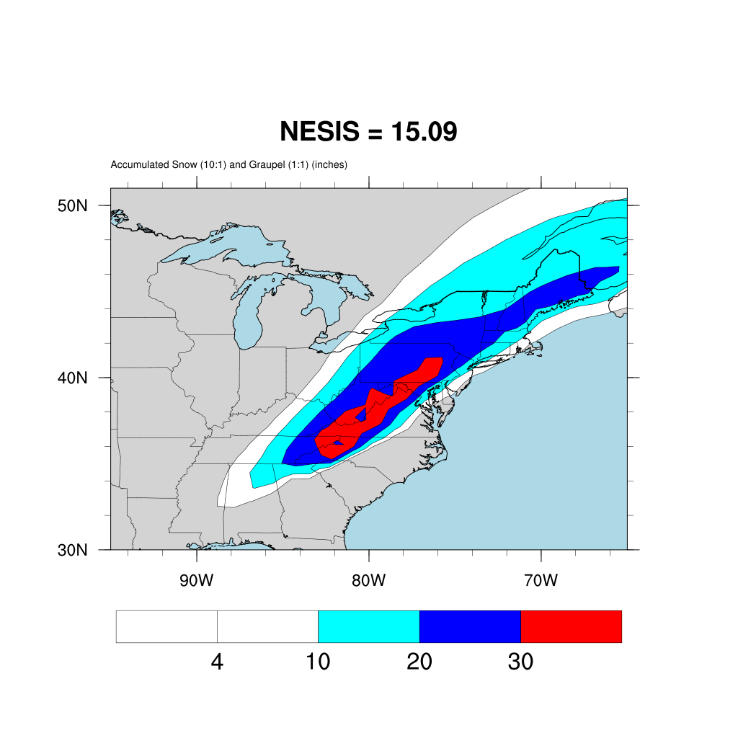
NARR01
(NARR-
initialized)
The NNRP control run’s NESIS was 11.48. “Official” NESIS for SOC is 13.20
Notes:
2020

Slide 24
Saving the snowmap figure
If you wish to save the snowmap figure to a file, edit the nesis.ncl script and look for these lines…
;---Make name of picture file
picture_name = ”NESIS"
picture_out_type = ”X11”
;picture_out_type = "png"
Change plot name if desired
Remove this semicolon
File will be called NESIS.png

Slide 25
mkdir SOC2
cd SOC2
cp $LAB/SOC/SETUP.TAR .
tar –xvf SETUP.TAR
sh make_all_links.sh
cp ../SOC/geo_em.d01.nc .
cp Vtable.NARR Vtable
EDIT namelist.wps for
  interval_seconds = 10800
  &ungrib: prefix = ‘NARR’
  &metgrid: fg_name = ‘NARR’
  Move “/” line AFTER “constants_name” line
link_grib.csh $LAB/DATA/NARR_199303/merged*
sbatch –p snow submit_ungrib
[CHECK tail ungrib.log for “Successful completion of program ungrib.exe”
sbatch –p snow submit_metgrid
[CHECK tail metgrid.srun.out for “Successful completion of program metgrid.exe”]
[CHECK for num_metgrid_levels and num_metgrid_soil_levels]
ncdump –h met_em.d01.1993-03-12_12:00:00.nc | more

Slide 26
EDIT namelist.input
  Make sure fdda = 0
  Make sure skebs = 0
  Make sure perturb_bdy = 0
  interval_seconds = 10800
  p_top_requested = 10000 [was 1000]
sbatch –p snow submit_real
[USE trsl TO CHECK. Make sure last line is SUCCESS COMPLETE]
sbatch –p snow submit_wrf
[USE trsl TO CHECK. Make sure last line is SUCCESS COMPLETE]
sh analyze.sh
If you are not able to reproduce my numbers, make sure the constants_name
section of namelist.wps is correct, and rerun metgrid.exe

Slide 27
Experiment 5
Find the best model physics configuration for simulating the Storm of the Century
See contest rules on slide after next
You are responsible for at least five submissions. However, the more the merrier!
Keep good notes (and copies of namelist.input, namelist.wps files) for each simulation you attempt
  I may need to reproduce your runs
Add your results to the class spreadsheet for Experiment 5 (next slide)

Slide 28
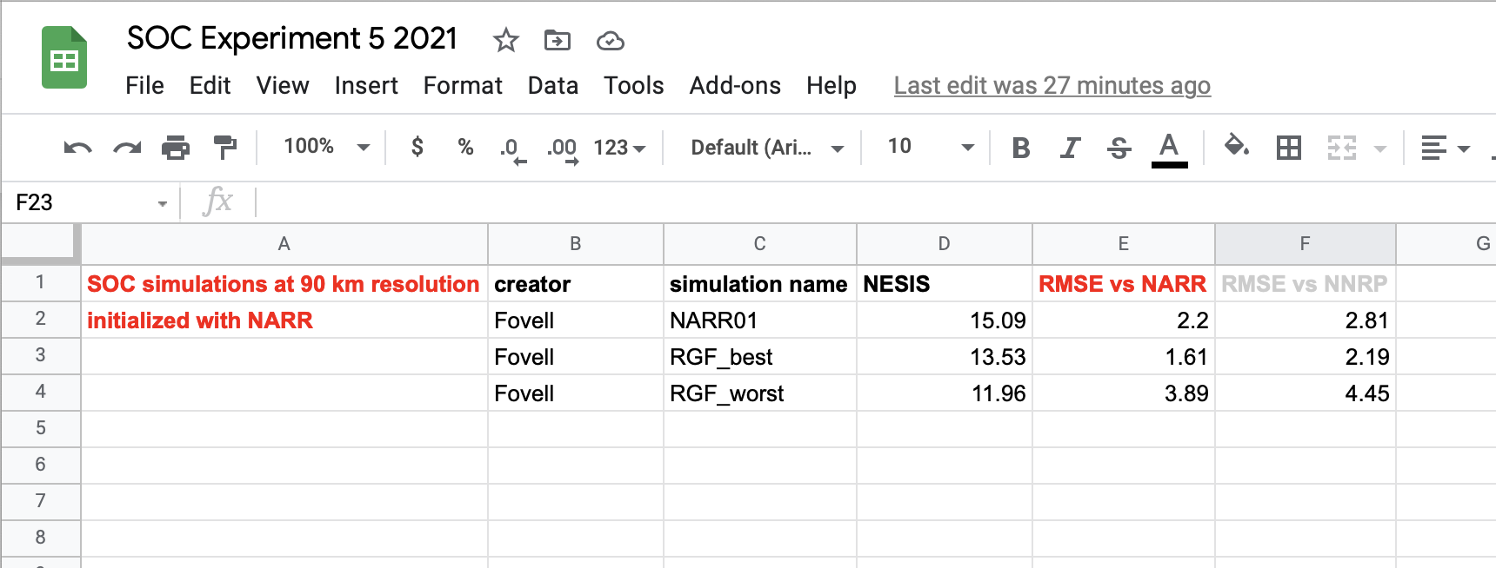
Class spreadsheet for Experiment 5
Google Docs spreadsheet for Experiment 5 (click here)
• Create a unique simulation name you will recognize and understand
• Report NESIS, RMSE vs. NARR, and RMSE vs. NNRP
• Record your results even if they weren’t very good (we also want to know what to avoid)

Slide 29
• The success metric will be RMSE SLP vs. NARR reanalysis, computed using analyze.sh.
The smallest total will "win".
Rules:
• You cannot change the time period being simulated. Your simulations must start on
03-12-1993, and run for 2.5 days.
• You must use the NARR reanalysis for initialization.
• NO data assimilation or nudging (fdda = 0)
• NO stochastic perturbations (skebs = 0, perturb_bdy = 0)
• You must use the domain I provided (one 90 km resolution domain), to facilitate statistics
• You must use a WRF model executable I provide
However:
• You CAN and SHOULD alter model physics options. See WRF namelist page for scads of
available options. (Do NOT use mp_physics = 1 [no ice], 30, or 32 – no NESIS no value)
• You CAN alter dampers, smoothers, diffusion options, advection order, if you wish.
• You CAN change the number of vertical levels (e_vert), and use the eta_levels namelist
option to manipulate them as you wish. (See following slides for additional information.)
• You CAN change the length of time steps, for the model and/or for the radiation and
cumulus schemes. Model time_step needs to divide into 3600. Please leave bldt = 0.
• You CAN ask me for specific alterations to physics schemes, if you have ideas along those lines
Keep in mind:
• WRF has many options, but not all “play nice” with each other.

Slide 30
My best and worst cases
Benchmarks to aim at (best) and avoid (worst):
  Best:
  (0) NESIS = 13.53 (pop component= 5.12017 area component= 8.4049)
  (0) RMSE SLP = 1.61 mb per gridpoint (vs. NARR reanalysis)
  (0) RMSE SLP = 2.19 mb per gridpoint (vs. NNRP reanalysis)
  Worst:
(0) NESIS = 11.96 (pop component= 4.4372 area component= 7.52274)
(0) RMSE SLP = 3.89 mb per gridpoint (vs. NARR reanalysis)
(0) RMSE SLP = 4.45 mb per gridpoint (vs. NNRP reanalysis)
Notes:
2021 for best

Slide 31
Altering model vertical levels used by WRF
Please also consult
https://www2.mmm.ucar.edu/wrf/users/docs/user_guide_v4/v4.2/users_guide_chap5.html#Namelist
[WRFV4 has changed this somewhat relative to earlier versions]

Slide 32
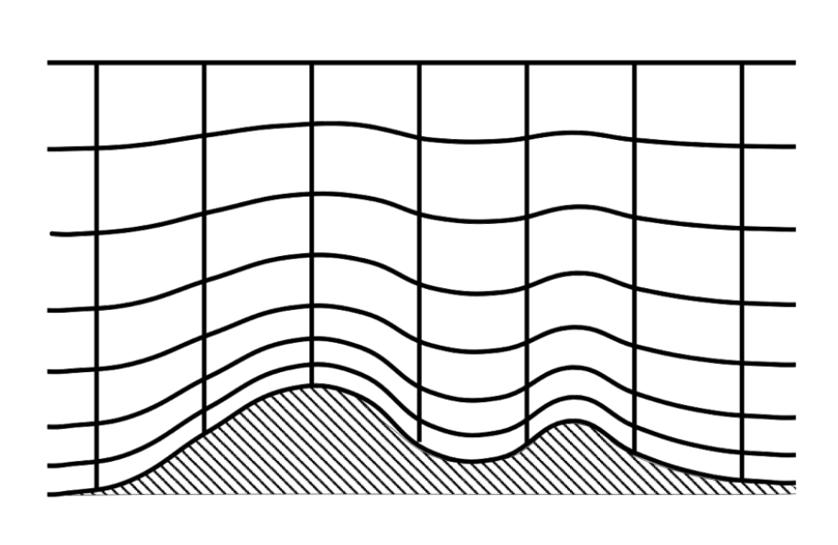
“Eta” or “sigma” coordinate
WRF Dynamics and numerics tutorial document
p^{h} = hydrostatic pressure
p^{h}_{s} = hydrostatic pressure at surface (varies w/ terrain)
p^{h}_{t} = hydrostatic pressure at model top = held constant
Notes:
http://www2.mmm.ucar.edu/wrf/users/tutorial/201901/skamarock_dynamics.pdf

Slide 33
Aside: python issues
It may be much easier to execute the read_wrfinput.py script on reed or ash
On reed & ash, your ATM419 lab space is accessible as
cd /atm419lab/yourlastname
- You may need to execute one of
source /linuxapps/bin/condalatest.bash (bash)
source /linuxapps/bin/condalatest.csh (tcsh)

Slide 34
Default model W and scalar (S) heights for e_vert = 51 levels
• Use read_wrfinput.py to convert model eta levels to physical heights (relative to ground level)
• python read_wrfinput.py wrfinput_d01
----------------------------------------------------------------
model level 01 W height 0.00 S height 26.30
model level 02 W height 52.60 S height 86.18
model level 03 W height 119.75 S height 162.40
model level 04 W height 205.06 S height 258.94
model level 05 W height 312.82 S height 380.36
model level 06 W height 447.90 S height 531.80
model level 07 W height 615.71 S height 718.82
model level 08 W height 821.93 S height 947.34
model level 09 W height 1072.74 S height 1222.91
model level 10 W height 1373.08 S height 1549.46
model level 11 W height 1725.85 S height 1929.26
model level 12 W height 2132.68 S height 2356.89
model level 13 W height 2581.10 S height 2803.52
model level 14 W height 3025.95 S height 3246.40
model level 15 W height 3466.85 S height 3685.31
model level 16 W height 3903.78 S height 4120.17
model level 17 W height 4336.56 S height 4550.83
model level 18 W height 4765.11 S height 4977.32
model level 19 W height 5189.53 S height 5399.81
model level 20 W height 5610.10 S height 5818.54
model level 21 W height 6026.99 S height 6233.60
model level 22 W height 6440.21 S height 6644.92
model level 23 W height 6849.63 S height 7052.25
model level 24 W height 7254.86 S height 7455.25
model level 25 W height 7655.63 S height 7853.60
model level 26 W height 8051.57 S height 8247.07
model level 27 W height 8442.57 S height 8635.61
model level 28 W height 8828.66 S height 9019.41
model level 29 W height 9210.16 S height 9398.67
model level 30 W height 9587.18 S height 9773.47
model level 31 W height 9959.76 S height 10143.85
model level 32 W height 10327.93 S height 10509.93
model level 33 W height 10691.94 S height 10871.83
model level 34 W height 11051.73 S height 11229.44
model level 35 W height 11407.15 S height 11582.66
model level 36 W height 11758.16 S height 11931.49
model level 37 W height 12104.82 S height 12276.00
model level 38 W height 12447.17 S height 12616.13
model level 39 W height 12785.10 S height 12951.86
model level 40 W height 13118.63 S height 13283.22
model level 41 W height 13447.82 S height 13610.34
model level 42 W height 13772.86 S height 13933.44
model level 43 W height 14094.02 S height 14252.80
model level 44 W height 14411.58 S height 14568.80
model level 45 W height 14726.01 S height 14881.86
model level 46 W height 15037.72 S height 15192.43
model level 47 W height 15347.15 S height 15500.97
model level 48 W height 15654.79 S height 15807.98
model level 49 W height 15961.17 S height 16113.95
model level 50 W height 16266.74 S height 16419.37
model level 51 W height 16572.00
----------------------------------------------------------------
These are the default levels for our WRF version, for 51 levels with p_top_requested=10000
Notes:
Heights AGL
height_levels_WRFV403.xlsx
Defaults have changed for WRFV4

Slide 35
Default vertical levels from real.exe
…results in
8 W levels within lowest 1 km AGL
First W level above ground at ~ 53 m
so first scalar level at about 26 m
[varies with time and space, owing to
temperature]
If you increase or decrease the number
of levels, these heights may not change…
… because real.exe tries to keep the lowest
levels at same heights (see next 3 slides)
Notes:
WRFV4 smoother curve near ground than previous versions

Slide 36
Model levels for e_vert = 51 and 71
Model level | W height (51 levels), in meters | W height (71 levels), in meters
1 | 0 | 0
2 | 52.6 | 52.6
3 | 119.75 | 119.75
4 | 205.06 | 205.06
5 | 312.82 | 312.82
6 | 447.9 | 447.9
7 | 615.71 | 615.71
8 | 821.93 | 821.93
9 | 1072.74 | 1072.74
10 | 1373.08 | 1373.08
11 | 1725.85 | 1676.03
12 | 2132.68 | 1977.34
13 | 2581.1 | 2277.29
Note both vertical grids
have same lowest 10
model levels. Even
farther aloft, heights
have changed little.
If you want to change
vertical resolution
near the surface,
this is NOT accomplished
by altering the number
of model levels!
Specify eta_levels instead.

Slide 37
Model levels for e_vert = 51 and 31
Model level | W height (51 levels), in meters | W height (31 levels), in meters
1 | 0 | 0
2 | 52.6 | 52.6
3 | 119.75 | 119.75
4 | 205.06 | 205.06
5 | 312.82 | 312.82
6 | 447.9 | 447.9
7 | 615.71 | 615.71
8 | 821.93 | 821.93
9 | 1072.74 | 1072.74
10 | 1373.08 | 1373.07
11 | 1725.85 | 1725.84
12 | 2132.68 | 2132.67
13 | 2581.1 | 2593.1
Note both vertical grids
are essentially identical
through model level 12
If you want to change
vertical resolution
near the surface,
this is NOT accomplished
by altering the number
of model levels!
Specify eta_levels instead.

Slide 38
31 vs. 51 vs. 71 model levels
Model top same (p_top_requested)
Number of vertical levels requested (e_vert) varies
But by default grid arrangement in lower troposphere is fixed
Notes:
Changes in heights now pushed even farther aloft w/ WRFV4’s hybrid coordinate

Slide 39
Altering vertical levels #1
• If you specify 51 vertical levels in the namelist.input, real.exe creates 51 “eta” or “sigma”
levels, representing a nondimensional vertical coordinate stored as ZNW in wrfinput_d01.
• Use ncdump to reveal the eta values. They always start at 1, and end with 0.
ncdump -v ZNW wrfinput_d01
ZNW =
1, 0.9934711, 0.9851701, 0.9746817, 0.961533, 0.9452094, 0.9251862,
0.9009796, 0.8722169, 0.8387195, 0.8005821, 0.758224, 0.7135561,
0.6711833, 0.6309878, 0.5928577, 0.5566865, 0.5223741, 0.4898246,
0.4589475, 0.429657, 0.4018715, 0.3755136, 0.3505101, 0.3267912,
0.3042911, 0.2829471, 0.2626998, 0.2434928, 0.2252726, 0.2079886,
0.1915928, 0.1760394, 0.1612852, 0.147289, 0.134012, 0.1214172,
0.1094695, 0.0981357, 0.08738429, 0.07718524, 0.06751028, 0.05833244,
0.04962616, 0.04136725, 0.03353267, 0.02610064, 0.01905055, 0.01236263,
0.00601837, 0 ;
These are the default levels
• You can manually declare these levels in namelist.input’s &domains section.
You should get the same result from real.exe, to within roundoff error.
eta_levels =
1, 0.9934711, 0.9851701, 0.9746817, 0.961533, 0.9452094, 0.9251862,
0.9009796, 0.8722169, 0.8387195, 0.8005821, 0.758224, 0.7135561,
0.6711833, 0.6309878, 0.5928577, 0.5566865, 0.5223741, 0.4898246,
0.4589475, 0.429657, 0.4018715, 0.3755136, 0.3505101, 0.3267912,
0.3042911, 0.2829471, 0.2626998, 0.2434928, 0.2252726, 0.2079886,
0.1915928, 0.1760394, 0.1612852, 0.147289, 0.134012, 0.1214172,
0.1094695, 0.0981357, 0.08738429, 0.07718524, 0.06751028, 0.05833244,
0.04962616, 0.04136725, 0.03353267, 0.02610064, 0.01905055, 0.01236263,
0.00601837, 0 ,
Notes:
Make sure to change semicolon to comma

Slide 40
Altering vertical levels #2
Altering the model levels is likely an iterative process.
  Suggestion: change eta_values in namelist.input, run real.exe, then execute read_wrfinput.py to see what the new levels look like in physical space
You may want to shift lowest model levels closer to the surface (perhaps to avoid assumptions regarding log wind profile). But keep in mind…
  You may need to reduce your model time step
  Some model physics do not work “well” when lowest level is too close to surface (e.g., ACM2, MRF, GFS PBL schemes)

Slide 41
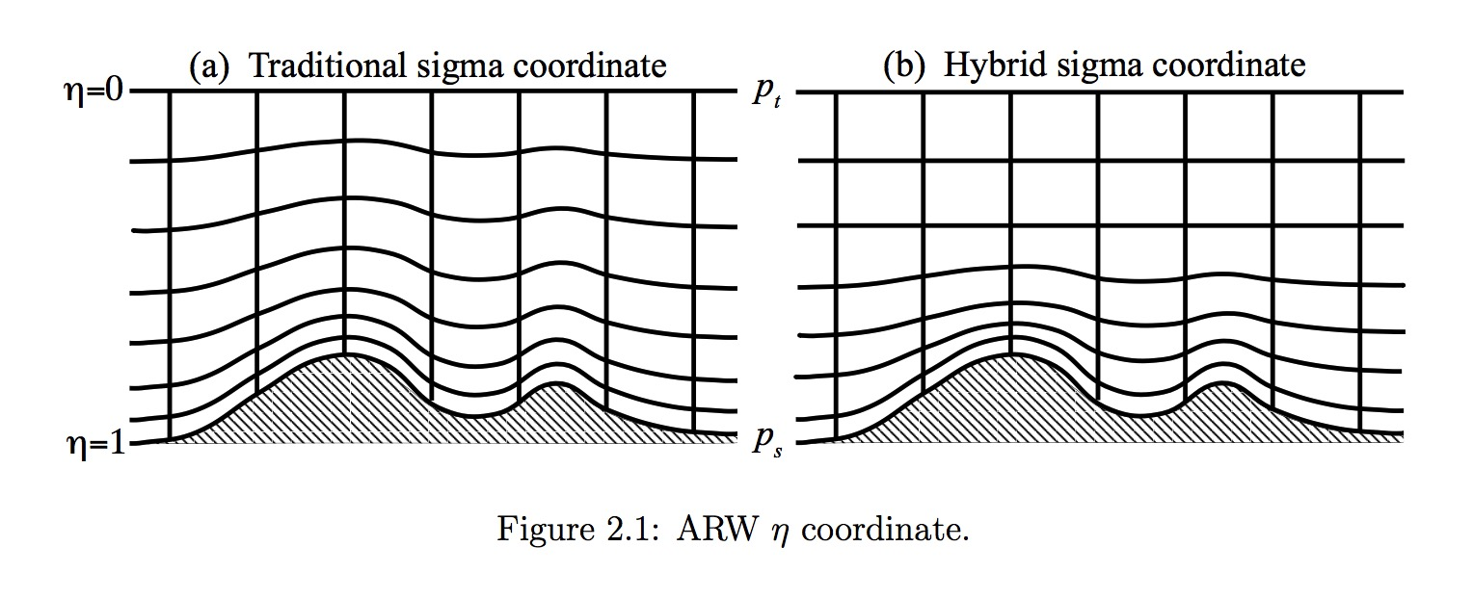
Hybrid vertical coordinate (new)
WRFV3
WRFV4
New hybrid vertical coordinate is terrain following near surface but shifts to
isobaric coordinates aloft, controlled by namelist.input variable etac (default value 0.2)
As of WRFV4, this is the default. To revert to older coordinate, select hybrid_opt = 0
Can specify stretching factors (dzstretch_s, dzstretch_u) for new coordinate
We have been using the defaults – they seem to work well.
Notes:
New coord helps model “lose” the terrain shape closer to surface. We are using the new coord.
Dzstretch_s used near surface; dzstretch_u used for upper levels

Slide 42
Diffusion, dampers, and advection order
(a quick look)

Slide 43
Dampers often used in real-data WRF
w_damping = 1,
diff_opt = 1,1,
km_opt = 4,4,
diff_6th_opt = 2, 2,
diff_6th_factor = 0.12, 0.12,
damp_opt = 3,
zdamp = 5000., 5000.,
dampcoef = 0.2, 0.2,
Horizontal diffusion to
compliment PBL scheme (see slide 45)
w_damping = 1 suppresses some “anomalously large” vertical motions.
Provides CFL warnings if wind speeds get too large.
Coefficients are hard-coded in
/network/rit/lab/atm419lab/SOFTWARE/WRFV422_H10/share/module_model_constants.F
diff_6th_opt = 1 or 2 provides 6th order smoothing (discussed earlier).
Here, option 2 is used, which is positive definite.
diff_6th_factor = 0.12 removes 2∆x waves in 8 applications
damp_opt = 3 provides upper-level Rayleigh damping.
Coefficient dampcoef is damping rate (1/s).
Applied over depth zdamp extending down below model top.
Typical values are up to 0.2 for real-data runs.
Notes:
I’m starting to think the default 6 order coefficient is kinda too big

Slide 44
Other dampers in WRF
epssm = damps vertically-propagating sound waves
emdiv = damps the “external mode”
If absent from namelist.input, default values are employed

Slide 45
Diffusion options
Please also consult
https://www2.mmm.ucar.edu/wrf/users/docs/user_guide_v4/v4.2/users_guide_chap5.html#Namelist
In a moderate resolution real-data WRF run, there are two kinds of “meteorological diffusion”: horizontal and vertical
  Vertical diffusion is handled by the PBL scheme, even for free atmosphere above the PBL
  Horizontal diffusion is handled by diff_opt, km_opt namelist options
km_opt = 4 computes strictly “horizontal” diffusion
  km_opt = 1 applies constant diffusion (probably undesirable)
  km_opt = 2 or 3 does 3D turbulent diffusion (inconsistent with PBL scheme)
  km_opt = 5 does 3D diffusion replacing PBL scheme (new; set bl_pbl_physics = 0)
diff_opt = 1 does diffusion along model surfaces, while diff_opt = 2 does diffusion in physical space (see next slide). diff_opt = 0 shuts it off. Because odd-order RK has implicit diffusion, diff_opt = 0 is a viable option.
  diff_opt = 2 used to blow up in complex terrain. Now it “shuts itself off”.
Standard setup for these runs: diff_opt = 1, km_opt = 4.

Slide 46
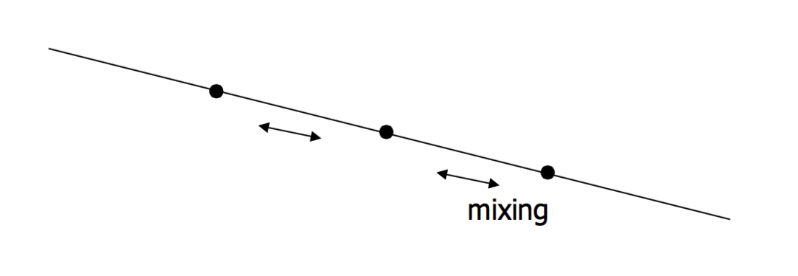
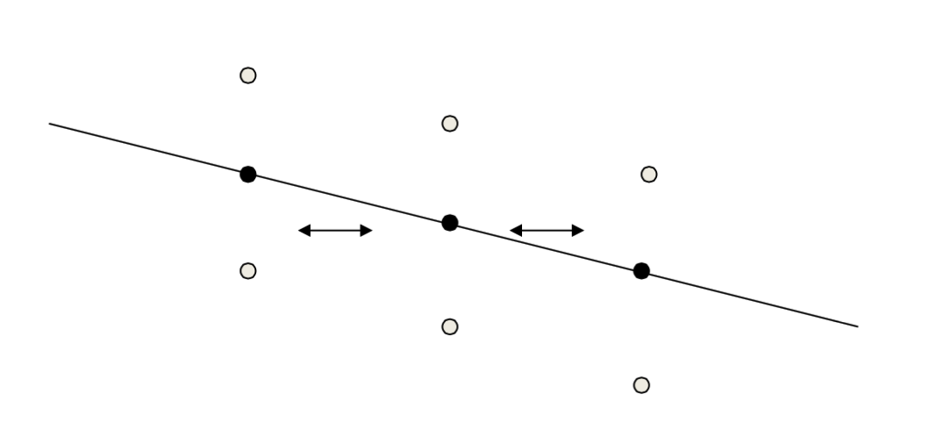
diff_opt = 1
diff_opt = 2
Horizontal diffusion is
along model surfaces
(if model levels sloped,
diffusion isn’t really
horizontal)
Diffusion is in physical
space (even if model
surfaces are sloped)

Slide 47
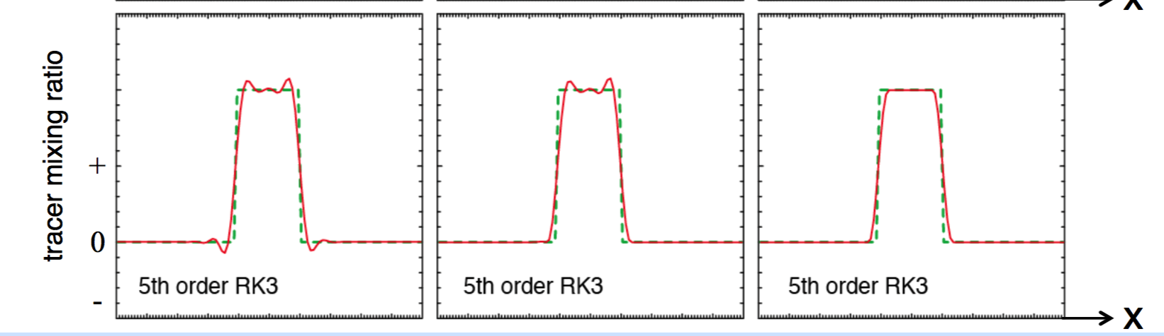
Advection options
moist_adv_opt = 2, 2,
scalar_adv_opt = 2, 2,
These can be used to make advection of moisture and other scalars
either positive definite (1), non-oscillatory (2) or both positive definite
and non-oscillatory (3). Default is (1).
Raw advection Positive definite Monotonic (pos. def. + no oscillations)
Notes:
Horiz diffusion was more important in practice back when advection schemes generated more small-scale noise…
Raw advection does not conserve positive mixing ratios. Pos definite removes the neg mixing ratios, but does not conserve mass.

