Slide 1
Real-data WRF:
Verification with MET package
ATM 419/563
Spring 2022
Fovell
© Copyright 2022 Robert Fovell, Univ. at Albany, SUNY, rfovell@albany.edu

Slide 2
Terms
AGL = above (local) ground level
MSL = above mean sea level
ASOS = Automated Surface Observing System
MET = Model Evaluation Tools package
MADIS = Meteorological Assimilation Data Ingest System
METAR = Meteorological Terminal Aviation Routine Weather Report (an obs data format)

Slide 3
References
MET website
UPP Users Guide (version 4) (PDF)
ASOS home page
MADIS data web portal
For your information,
we will not need to access these
MET has advanced to version 9.1 at this time, and UPP is at version 9.0.1.
We are not using the most recent versions.

Slide 4
Outline
Compare available ASOS observations to WRF simulation, including
  Temperature, dew point and humidity at 2 m AGL
  Wind speed, nominally at 10 m AGL
    (some ASOS wind towers not at 10 m or 33’)
ASOS observations acquired from MADIS in METAR format
  ASOS METAR forces light winds (<1.5 m/s, 2.9 kt, 3.36 mph, 5.4 kmh) to zero and only intermittently reports gusts (cf. Fovell and Gallagher 2018). True for AWOS METARs as well.
Network-averaged analysis will show WRF model skill overall
Station-based analysis will help identify problems with the model (and the observations!)

Slide 5
Part 1: Network-averaged analysis
See script for required actions

Slide 6
Steps for Part 1
Unipost (Unified Post Processor or UPP)
  Unpacks WRF output files into GRIB1 format
  Operates on selected domains (if doing nesting)
PointStat tool (MET)
  Interpolates model fields to locations of observations derived from MADIS database for comparison
Principal subdirectories:
  wrfprd : where WRF model output resides
  postprd : where output from UPP/MET are stored

Slide 7
Scripts for Part 1
run_unipost_frames
  A bash shell script that calls UPP program unipost.exe
  Output: WRFPRS* and wrfprs* files in postprd/
MET6_run_ASCII2_ASOS.sh
  A bash shell script that invokes MET’s PointStat tool
  Output: point_stat* files in postprd/
network_plots.sh
  A bash shell script that extracts average forecast and observation values for several variables (via plot_met.sh) from the point_stat* files
read_output3.py
  Plots output generated by network_plots.sh

Slide 8
Unipost
See script for actions required
Execute run_unipost_frames
  These lines may/will need attention in future:
export startdate=2016031300
export fhr=00
export lastfhr=48
export incrementhr=01
for domain in d01
Start time/date of simulation
48h simulation (lastfhr), start at time 0 (fhr).
increment by 1 hour
[we have 20 min output, but
verifying against hourly output]
Process domain 1
[each domain, if exists, done separately]

Slide 9
Execute MET PointStat
See script for actions required
Execute MET6_run_ASCII2_ASOS.sh
  These lines may/will need attention in future:
Date_base=20160313
Date_hour=00
domain=1
OBS_base=$MYLAB/DATA/MADIS/MADIS_20160313_ASOS
Start time/date of simulation (expressed differently)
Process domain 1 [only one at a time]
where MADIS data reside
DO NOT alter $MYHOME and $MYLAB in script

Slide 10
Plot network-averaged time series
See script for actions required
network_plots.sh is a bash shell script that extracts information from postprd/*.cnt.txt files using another script called plot_met.sh, and writes to a text file called output.txt
read_output3.py is a Python program that reads in output.txt and makes a four-panel plot that is displayed to the screen and saved as a PNG file

Slide 11
Bias, MAE, MSE, and BCMSE
N = number of obs
Notes:
Large + or – bias means a bad forecast, but nearly zero bias doesn’t necessarily mean it’s a good forecast
MSE exaggerates impact of largest errors

Slide 12
Part of output.txt
Fhr Date_HHMMSS FCST OBS N MAE BCMSE MSE BIAS fcst std obs std level
0 20160313_000000 TMPf 288.00171 TMPo 288.99799 N 250 MAE 1.46435 BCMSE 3.35822 MSE 4.3508 BIAS -0.99628 STDf 4.10823 STDo 3.99308 LVL Z2f Z2o
1 20160313_010000 TMPf 285.69381 TMPo 287.48599 N 250 MAE 2.09225 BCMSE 4.26382 MSE 7.47574 BIAS -1.79218 STDf 3.93064 STDo 3.65356 LVL Z2f Z2o
2 20160313_020000 TMPf 284.91605 TMPo 286.2496 N 251 MAE 1.87927 BCMSE 4.47089 MSE 6.24923 BIAS -1.33354 STDf 4.06753 STDo 3.78339 LVL Z2f Z2o
3 20160313_030000 TMPf 284.32701 TMPo 285.51254 N 251 MAE 1.73464 BCMSE 4.14669 MSE 5.55219 BIAS -1.18554 STDf 4.09976 STDo 3.87092 LVL Z2f Z2o
4 20160313_040000 TMPf 283.88289 TMPo 285.03047 N 251 MAE 1.68696 BCMSE 4.2448 MSE 5.56176 BIAS -1.14759 STDf 4.17471 STDo 3.8701 LVL Z2f Z2o
5 20160313_050000 TMPf 283.54558 TMPo 284.56035 N 251 MAE 1.62574 BCMSE 4.21783 MSE 5.2476 BIAS -1.01477 STDf 4.33065 STDo 4.02827 LVL Z2f Z2o
6 20160313_060000 TMPf 283.28059 TMPo 284.14999 N 250 MAE 1.63312 BCMSE 4.19868 MSE 4.95455 BIAS -0.8694 STDf 4.3884 STDo 4.28034 LVL Z2f Z2o
NOTES:
• f = forecast, o = obs
• The forecast and observed field is TMP (2-m temperature) – averaged over N stations
• The forecast and observation level here is 2m (“Z2”).
Others: 10m (Z10), surface (Z0), model level 1 (L1)
• BIAS = bias or mean error
• MAE = mean absolute error
• MSE = mean squared error
• BCMSE = bias-corrected mean squared error
• std = standard deviation of the forecasts (STDf) and observations (STDo)

Slide 13
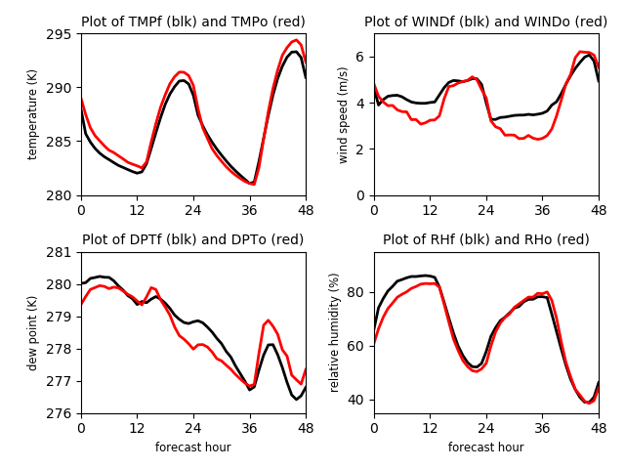
Created by read_output3.py
Some of this may be due to METAR filtering of low wind observations
four_panel.png
Ignore these errors…
libGL error: No matching fbConfigs or visuals found
libGL error: failed to load driver: swrast
Averaged over 254 ASOS stations

Slide 14
Notes for future applications
The run_unipost_frames script is set up for a WRF run with multiple output times written to a single wrfout file. A different version of the script will be used for experiments in which each output time is written to a unique, separate wrfout file.
The PointStat configuration file (PointStatConfig.ATM419.NEAREST.ASOS.NOGUSTS.SUBSET) called in the MET script controls which variables are selected for verification, how they are paired, and how data are interpolated. This file needs to be copied/altered if you wish to include other fields (like SLP, gusts) in your verification.
The Python plotting script requires modification if your analysis interval is not hourly or variables need to be added. Also, axis scales are specified and may need to be revised for other cases.

Slide 15
Part 2: Station-based analysis of 10m wind speed and
2m temperature
See script for required actions
Includes extra analyses not part of demo

Slide 16
Scripts for Part 2
run_stations_*.sh
  Bash shell scripts that call a Perl script that combs through point_stat* files in postprd/ for individual stations
  Output: Station by station files like member_WINDZ10F10M_KBMQ.dat in directory STATIONS/wind
sum_and_average_*.sh
  Bash shell scripts that call a Perl script that reads through files in directory STATIONS/wind or STATIONS/temp
  Output: input_for_grads file
grads_plot.sh
  A bash shell script that calls a Perl script to create a GrADS script for plotting from contents of input_for_grads
  Output: stations.gs

Slide 17
Execute run_stations_F10M.sh
See script for actions required
Contents of STATIONS/wind
member_WINDZ10F10M_K9V9.dat member_WINDZ10F10M_KFSD.dat member_WINDZ10F10M_KMSY.dat
member_WINDZ10F10M_KAAO.dat member_WINDZ10F10M_KFSM.dat member_WINDZ10F10M_KMTJ.dat
member_WINDZ10F10M_KABI.dat member_WINDZ10F10M_KFST.dat member_WINDZ10F10M_KMWL.dat
member_WINDZ10F10M_KABQ.dat member_WINDZ10F10M_KFTW.dat member_WINDZ10F10M_KMWT.dat
member_WINDZ10F10M_KABR.dat member_WINDZ10F10M_KFYV.dat member_WINDZ10F10M_KNFW.dat
member_WINDZ10F10M_KACT.dat member_WINDZ10F10M_KGAG.dat member_WINDZ10F10M_KODO.dat
member_WINDZ10F10M_KAEX.dat member_WINDZ10F10M_KGCC.dat member_WINDZ10F10M_KODX.dat
[and more]

Slide 18
Execute sum_and_average_F10M.sh
See script for actions required
more input_for_grads
Event-averaged statistics
member_WINDZ10F10M_K9V9.dat, Bias:, 0.904, MAE, Average:, 1.415, FBAR:, 4.55,
OBAR:, 3.64, STDEV_OBS:, 43.800, -99.320, 2.33, NUM_OBS, 49, MAXO:, 10.803,
member_WINDZ10F10M_KAAO.dat, Bias:, -0.486, MAE, Average:, 1.283, FBAR:, 2.65,
OBAR:, 3.14, STDEV_OBS:, 37.750, -97.220, 1.62, NUM_OBS, 49, MAXO:, 8.231,
member_WINDZ10F10M_KABI.dat, Bias:, -0.155, MAE, Average:, 1.206, FBAR:, 5.60,
OBAR:, 5.76, STDEV_OBS:, 32.420, -99.680, 2.32, NUM_OBS, 48, MAXO:, 10.289, [etc.]
station lat, lon
Files in STATIONS/wind
(one per station)
Station KABI’s average forecast wind bias
was -0.155 m/s over 48 forecasts
Event-averaged forecast (FBAR) 5.60 m/s
Event-averaged obs (OBAR) 5.76 m/s
Event MAE 1.206 m/s

Slide 19
Execute grads_plot.sh
See script for actions required (and also for the 2m temperature analysis…)
more stations.gs
'q w2xy -99.32 43.8'
xpos=subwrd(result,3)
ypos=subwrd(result,6)
'set line 0'
'draw mark 3 'xpos' 'ypos' 0.15'
'set line 1 1 5'
'draw mark 2 'xpos' 'ypos' 0.15’
[etc.]
Plots a circle for each station,
with circle fill indicating event-averaged bias
[scripts can be modified to plot other stats]

Slide 20
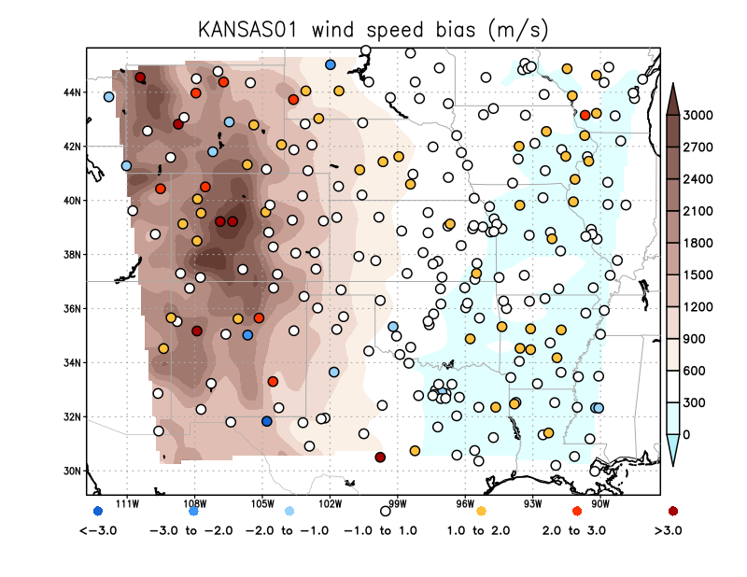
254 ASOS stations
KLXV (Leadville, CO)
KGDP (Guadalupe Pass, TX)
(We should prune stations close to lateral boundaries)

Slide 21
Wind speed bias ranked
Guadalupe Pass
Pasted content of input_for_grads from wind speed analysis into Excel
N = 254 stations. Mean bias = +0.39 m/s. Std. deviation 1.1 m/s.
This ranked distribution shape is essentially as expected if bias is normally distributed
(null hypothesis: distribution is normal. Probability > 99%)
Notes:
Normal means some deviant obs must be expected, but not too many of them.

Slide 22
Odd station subset needs to be explained.
Some of these less well-represented stations MAY:
- Have anemometers mounted below 10 m
- Are too close to domain boundary
- Have terrain misrepresented by coarse resolution
- Have inappropriate landuse or z0 assignments
- Are inadvertently interpolated to an inland water site
- Are missing too many observations
- Are bad observations
Contents of input_for_grads copied into Excel,
plotting event-average forecast wind speed (FBAR) vs. observed (OBAR)
- each point is a station, averaged over up to 48 hourly forecasts (plus analysis)
Notes:
Group of stations well below, but parallel to, 1:1 line. Those may be improver assignments, due to landuse changes, or insufficient resolution, or overly smoothed topography.

Slide 23
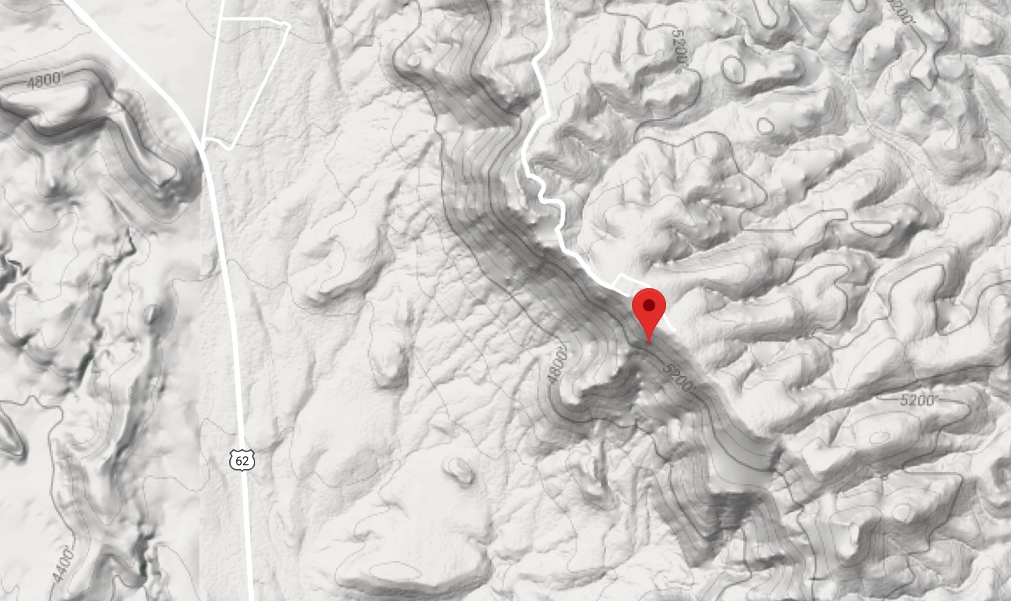
Guadalupe Pass, TX
KDGP is not an airport site
And appears to be at top of a steep cliff
(Not all ASOS are at airports. Two other
exceptions are Downtown Los Angeles
and NYC Central Park!)
Notes:
Not so shocking that the wind is substantially underpredicted

Slide 24
Forecast wind bias vs. observed wind speed
Guadalupe Pass
Small but significant tendency to overpredict slower wind sites
and underpredict faster wind sites
(See Cao and Fovell 2016, 2018; Fovell and Gallagher 2018, 2020)
Odd station subset is also detectable (higher than expected bias given their wind obs)

Slide 25
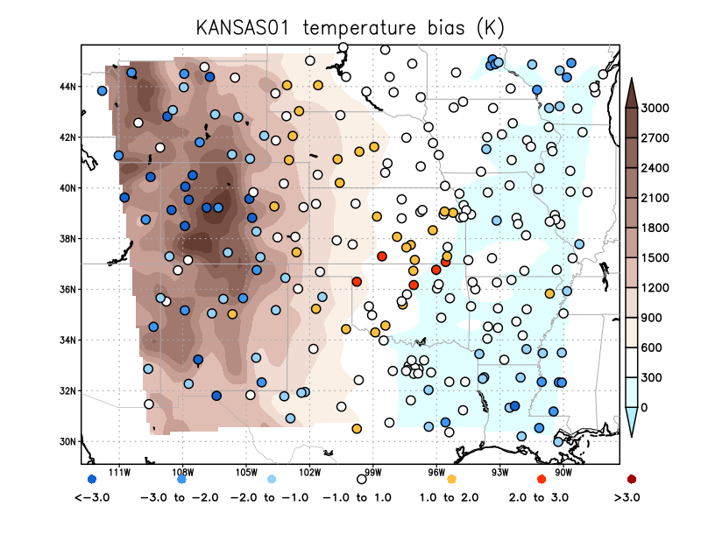
254 ASOS stations

Slide 26
Temperature bias ranked
Pasted content of input_for_grads from temperature analysis into Excel
N = 254 stations. Mean bias = -0.52 K. Std. deviation 1.6 K.
This ranked distribution shape is still approximately normally distributed.

Slide 27
Temperature comparison
A particular challenge is getting
station elevation correct in complex
terrain when the grid spacing is
fairly coarse. This impacts
temperature most of all.
Could this be exacerbated by the
western boundary being placed
through the Rockies?
Could snow or land cover be mishandled?
Systematic radiation and/or cloudiness issues?
Notes:
Airports could be snow free, and get warmer, even if surrounding area has snow

Slide 28
Forecast T bias vs. observed T
Unlike for wind speed, we do not see a systematic bias with respect to observed temperature
Notes:
Relationship not significant

Slide 29
[end]

