Slide 1
Real-data WRF: Advanced (Experiment #3: due 8 April 2020)
ATM 419/563
Spring 2021
Fovell
© Copyright 2021 Robert Fovell, Univ. at Albany, SUNY, rfovell@albany.edu
Notes:
Changed time_step 2021

Slide 2
Outline
Create and position outer domain + nest
D1 = Domain 1
D2 = Domain 2 (nest)
Use model grids obtained from NOMADS archive
Utilize different initialization data sources
GFS
NAM
RAP
Combine two different data sources
NAM and RAP since RAP incomplete (soil information missing on NOMADS for some RAP outputs)

Slide 3
Objective
By completion of Experiment #3, we will have covered:
how and why some parameterizations work and fail,
how to create a parent domain with nests,
what to check when creating a domain,
how to initialize WRF using different data sets and how to combine them when necessary,
how to visualize model output using GrADS
Soon, we will also cover:
how to verify forecasts against observations,
how to recognize, diagnose, and mitigate numerical difficulties,
how the model is integrated in time and discretized in space,
how to perturb forecasts and modify model default levels
Notes:
As a result of the course to date…

Slide 4
Roadmap: next topics
Model verification with the Model Evaluation Tools (MET)
Modeling fundamentals, error sources, and troubleshooting
Tools and techniques: nudging, stochastic perturbations, diffusion and damping, modifying model levels
Model instability and diffusion
Cumulus parameterizations

Slide 5
Case study: 27 March 2016 severe storms

Slide 6
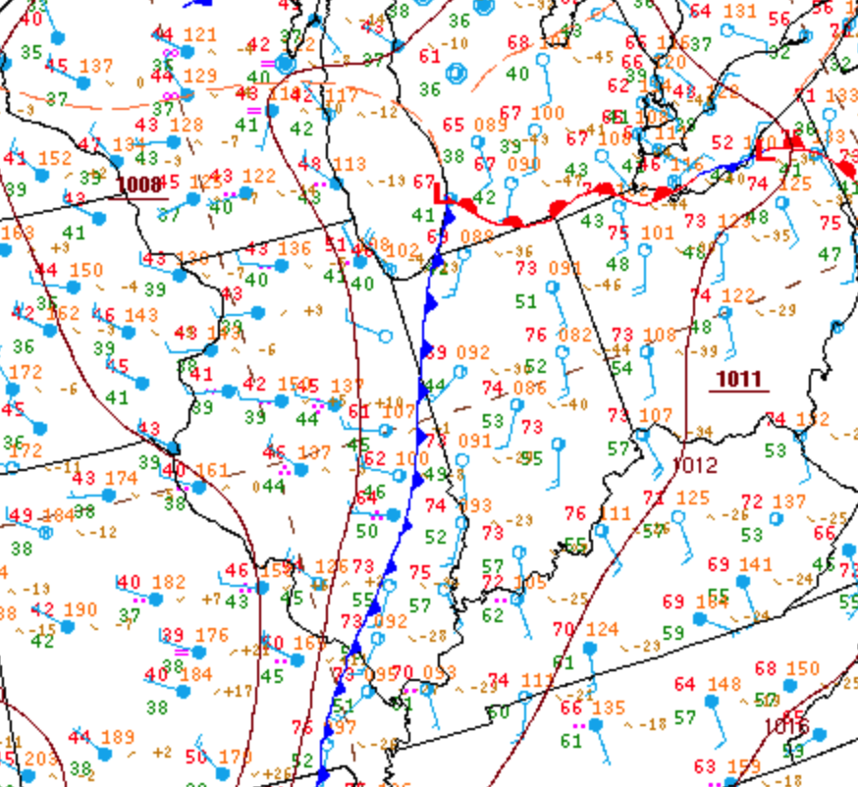
3-27-2016
2100Z surface chart
Notes:
Cold front analyzed along temperature boundary, west of primary surface trough which is in convergence zone ahead of front (where storms appear)

Slide 7
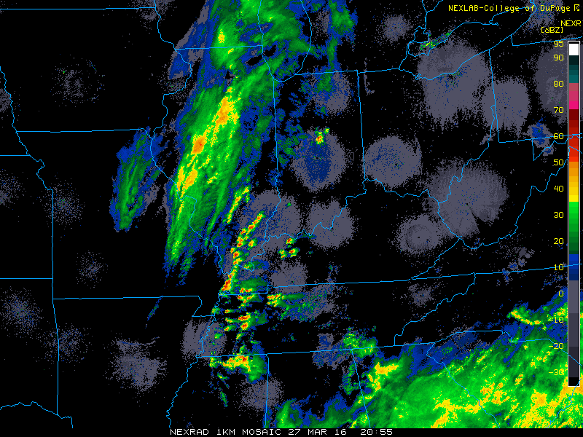
3-27-2016
2055Z
Notes:
Storms develop well ahead of cold front, including around IND

Slide 8
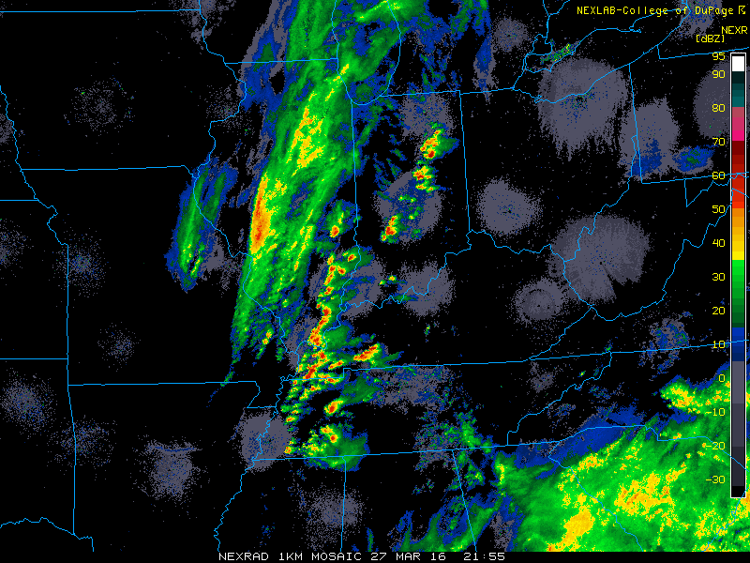
3-27-2016
2155Z

Slide 9
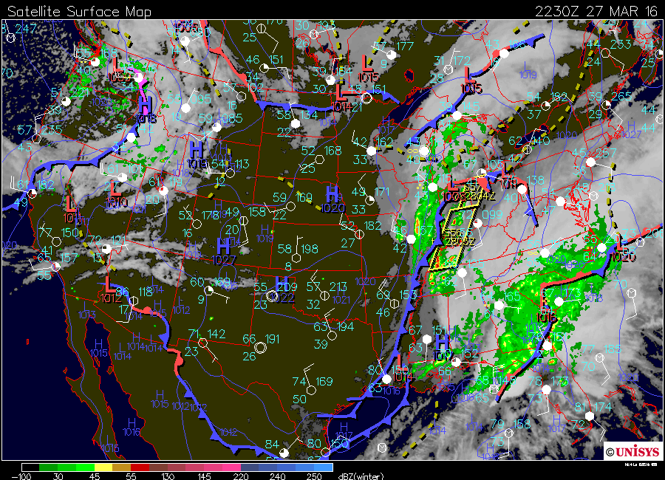
3-27-2016
2230Z

Slide 10
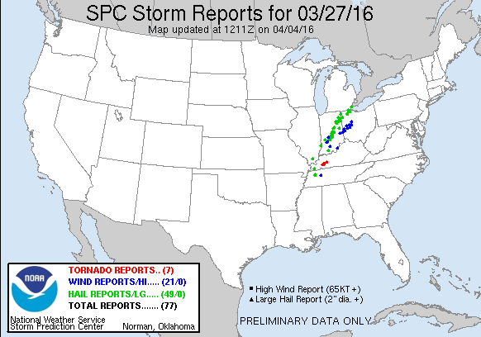
Notes:
Mainly hail reports in Indiana

Slide 11
Setup

Slide 12
Setup
Create a directory called INDIANA
Copy into it $LAB/INDIANA/SETUP.TAR and unpack
The tar archive contains these files:
make_all_links.sh
namelist.input and namelist.wps
control_file.D1 and control_file.D2
submit_real, submit_wrf, submit_ungrib, submit_metgrid
submit_geogrid
refl.gs, max.csh
Execute sh make_all_links.sh
Note these Vtables now appear in your directory: Vtable.GFS, Vtable.NAM, Vtable.RAP.hybrid.ncep, Vtable.RAP.pressure.ncep
Namelists will require editing
tar –xvf SETUP.TAR
Notes:
Vtable.RAP.hybrid.ncep so you know it exists in case you get hybrid-level RAP data in future

Slide 13
Simulation period
Start 3/27/2016 at 12Z
End 3/28/2016 at 00Z
Simulation length: 12 hours
Different initialization data sets have different temporal availabilities
GFS: every 3 hours (interval_seconds = 10800)
NAM: every 1 hour (interval_seconds = 3600)
RAP: every 1 hour (interval_seconds = 3600)
num_metgrid_levels will vary as well
Remember to use the correct Vtable!

Slide 14
Links and locations
NOMADS archived NCEP model grids (for future reference)
https://www.ncdc.noaa.gov/data-access/model-data
http://nomads.ncep.noaa.gov/
GFS input data
$LAB/DATA/GFS_2016032712_NOMADS
NAM input data
$LAB/DATA/NAM_2016032712_NOMADS
RAP input data
$LAB/DATA/RAP_2016032712_NOMADS
Copies of parent model data also available in /rfovell/ATM419/

Slide 15
Geogrid step
2 domains maximum
D1: 201 x 201 points, 12 km resolution
D2: 214 x 196 points, 4 km resolution
D2 lower left corner positioned at (58, 68) within D1 [slide 18]
D2:D1 grid ratio will be 3:1 (standard)
Lambert projection
Reference latitude: +40˚
Lambert true latitudes: both +40˚
Reference and standard longitudes: -86˚
Edit namelist.wps as needed
Inspect domain using plotgrids.ncl (don’t skip this)
Execute geogrid.exe somehow [see slide 17]
Use ncview or max.csh on geo_em.d01.nc to check out max and min map factors (MAPFAC_M)
Notes:
Max map factor 1.02, min 1.00

Slide 16
NOW the second column matters
namelist.wps
&share
wrf_core = 'ARW',
max_dom = 2,
start_date ='2018-01-01_00:00:00', '2018-01-01_00:00:00'
end_date = '2018-01-04_00:00:00', '2018-01-04_00:00:00'
interval_seconds = 21600,
Same start/end times for both domains
Controls nest grid spacing
(D2 = D1/3)
[3:1 ratio is standard]
&geogrid
parent_id = 1, 1,
parent_grid_ratio = 1, 3,
i_parent_start = 1, 58,
j_parent_start = 1, 68,
s_we = 1, 1,
e_we = 201, 214,
s_sn = 1, 1,
e_sn = 201, 196,
geog_data_res =’default',’default',
dx = 12000.,
dy = 12000.,
Controls location
(lower left corner) in parent
D1’s grid spacing
grey: never altered
Notes:
SOME of these mods have already been made, but not ALL of them.
Grey = these are never altered.
Our WRF core is ARW

Slide 17
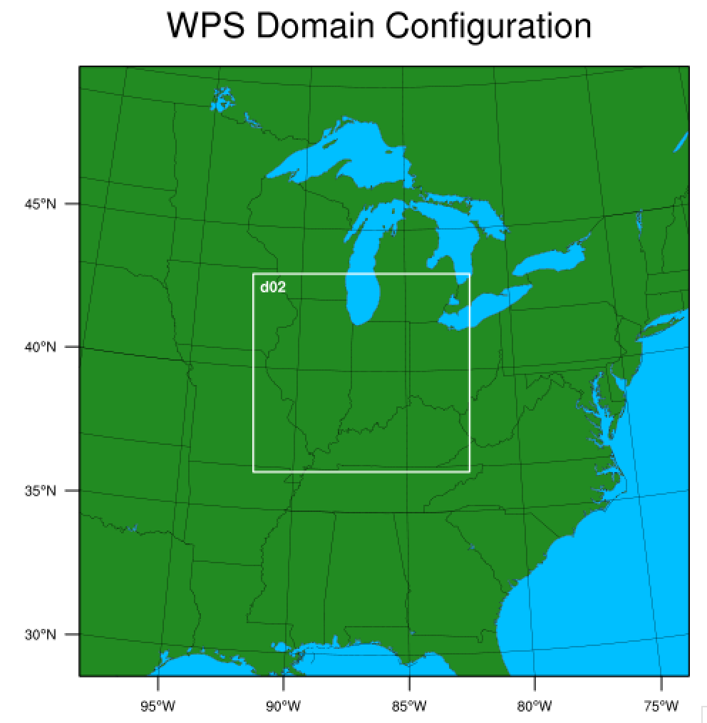
D1: 201x201 @ 12 km
D2: 214x196 @ 4 km
REMINDER: execute
ncl plotgrids.ncl script
BEFORE running geogrid.exe
to inspect your domain
Make sure your domain looks
like this before moving on!
(58,68)

Slide 18
Running geogrid.exe
The geogrid program can take some time, especially when generating large nests. However, geogrid is also MPI-aware (all WPS/WRF programs are, except ungrib.exe and tc.exe)
Options:
Ask for multiple cpus with srun. Example:
srun –p snow –n 4 geogrid.exe
Submit a batch job (submit_geogrid provided)
sbatch –p snow submit_geogrid

Slide 19
GFS-based simulation
Setup for 2 domains,
but run single-domain simulation first

Slide 20
namelist.wps
&ungrib
out_format = 'WPS',
prefix = ’GFS',
/
&metgrid
fg_name = ’GFS’,
io_form_metgrid = 2,
/
Make sure you are identifying the
ungrib.exe output and metgrid.exe
input as GFS, as we will be unpacking
other data sources as well

Slide 21
WPS Tasks
Complete editing of namelist.wps as needed
Make sure you have Vtable.GFS copied as “Vtable”
Link to GFS data at ONE of these locations
$LAB/DATA/GFS_2016032712_NOMADS/gfs*
/rfovell/ATM419/GFS_2016032712_NOMADS/gfs*
COPY ungrib output from $LAB/INDIANA/
cp $LAB/INDIANA/GFS* .
Execute ungrib.exe and metgrid.exe
Or use submit_ungrib and submit_metgrid scripts
Or copy $LAB/INDIANA/GFS* to your INDIANA directory
Check num_metgrid_levels
ncdump –h met_em.d01.2016-03-27_12:00:00.nc | more

Slide 22
NOW the second column matters
namelist.input
&time_control
run_days = 0,
run_hours = 12,
run_minutes = 0,
run_seconds = 0,
start_year = 2016, 2016,
start_month = 03, 03,
start_day = 27, 27,
start_hour = 12, 12,
start_minute = 00, 00,
start_second = 00, 00,
end_year = 2016, 2016,
end_month = 03, 03,
end_day = 28, 28,
end_hour = 00, 00,
end_minute = 00, 00,
end_second = 00, 00,
interval_seconds = 10800,
input_from_file = .true., .true.,
history_interval = 60, 20,
frames_per_outfile = 1, 1,
Notes:
Check the stuff in red. All will need to change.

Slide 23
MAKE SURE INFO MATCHES namelist.wps!
namelist.input
&domains
time_step = 48,
time_step_fract_num = 0,
time_step_fract_den = 1,
max_dom = 1,
e_we = 201, 214,
e_sn = 201, 196,
e_vert = 57, 57,
p_top_requested = 5000,
num_metgrid_levels = 27,
num_metgrid_soil_levels = 4,
dx = 12000., 4000.,
dy = 12000., 4000.,
grid_id = 1, 2,
parent_id = 0, 1,
i_parent_start = 1, 58,
j_parent_start = 1, 68,
parent_grid_ratio = 1, 3,
parent_time_step_ratio = 1, 3,
For D1
1 domain (for now)
D2 has 1/3 the grid spacing of D1, and will use 1/3 the time step
Notes:
Need to directly specify D2 grid spacing (4000 m) and indirectly (through parent_grid_ratio = 3)

Slide 24
Edit namelist.input
Configure start and end times, and run time is 12 hours
Make sure domain configuration (size, nest location, grid spacing) either matches exactly or is consistent with namelist.wps
max_dom = 1 for this first run
Model physics
Microphysics 8 (Thompson)
LW and SW radiation 4 (RRTMG) w/ 20 min call interval (radt)
Surface physics 2 (Noah) and 4 soil layers
PBL and surface layer physics 1 (YSU + Monin-Obukhov)
Cumulus scheme 1 (Kain-Fritsch) IN DOMAIN1 ONLY
cu_physics = 1, 0,
cudt = 5, 5,
After editing namelist.input, submit submit_real, check output
sbatch –p snow submit_real
Then do submit_wrf [takes about 15 min]
Use control_file.D1 and call your output GFSRUN1DOM
Use refl.gs to plot composite reflectivity at 22Z (set t 11 for D1’s hourly output)
control_file.D1 set up for hourly outputs
control_file.D2 set up for 20-min outputs

Slide 25
3-27-2016
2155Z

Slide 26
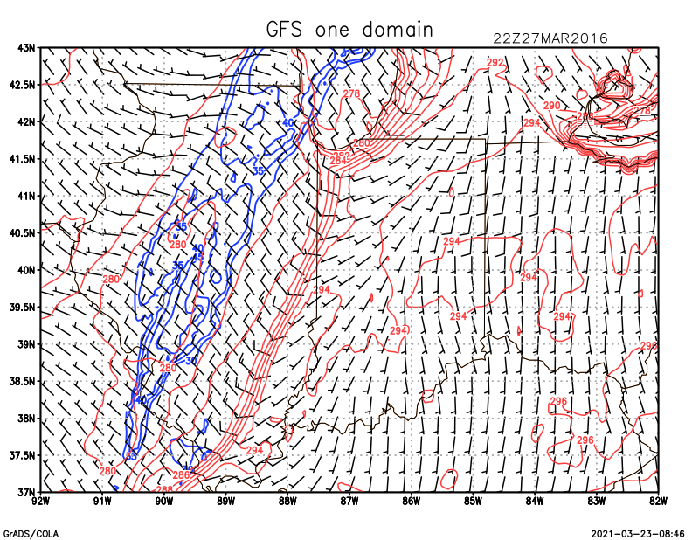
refl.gs plot for 22Z
Reflectivity (blue contours)
2-m T (red contours)
10-m wind barbs
set t 11 from hourly output
Notes:
Updated 2021

Slide 27
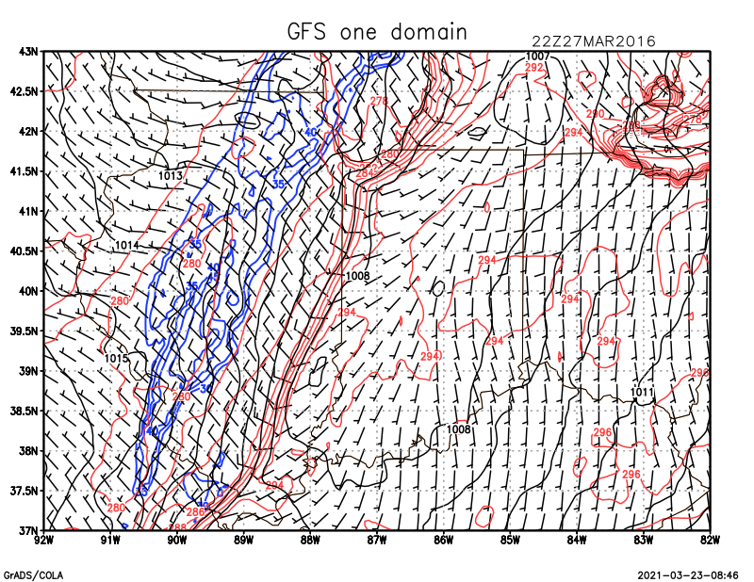
Added slvl
Sea-level pressure (1 mb
contours) added
Pre-frontal troughs are common
in Midwest (Schultz 2005)

Slide 28
'clear'
'set mpdset hires'
* cut to roughly D2
'set lon -92 -82'
'set lat 37 43'
* composite reflectivity
'set cmin 30'
'set cint 5'
'set ccolor 4'
'set cthick 7'
* max reflectivity over lowest 35 model levels. Cut out small values.
'd max(maskout(refl_10cm,refl_10cm-20),z=1,z=35)'
* 10-m wind and 2-m T
'set cthick 5'
'set gxout barb'
'd skip(u10,5);v10'
'set gxout contour'
'set ccolor 2'
'd t2'
* plot current time
'q dims'
rec=sublin(result,5)
_analysis=subwrd(rec,6)
'set strsiz .15'
'set string 1 l 3'
'draw string 7.75 7.9 ' _analysis
* draw map (again)
'draw map'
refl.gs
Not displaying entire D1 domain
Modify this later, when you run/analyze D2

Slide 29
Moving forward…
This simulation was not very good, if your goal was to capture the convective activity along and ahead of the cold front
Possible deficiencies/solutions
Better or different initialization?
Higher resolution?
Different model physics?
The 12 km simulation had two ways of capturing precipitation processes, which cooperate and compete
A microphysics scheme: can resolve clouds but can’t follow every hydrometeor
A cumulus scheme: attempts to account for impact of subgrid clouds
Microphysics schemes are always used. Cumulus parameterizations are typically used for horizontal grid spacings > 10 km or so
Some newer cumulus schemes are “scale aware” and reduce their effects based on grid spacing
For the most part, strive to avoid innermost nests with resolution between ~5-11 km

Slide 30
For Experiment #3 (Due date 8 April 2020)
Run 2-domain version of GFS-initialized simulation (call it GFSRUN)
Run two more 2-domain simulations, initialized with NAM and RAP+NAM
These are described in the following slides
3 new simulations total, each with 2 DOMAINS
Use w2g to make GrADS output for D2 (control_file.D2)
Use refl.gs script to make a plot of simulated composite reflectivity at 22Z for each 2-domain simulation (3 plots)
That’s set t 31 for D2 runs w/ 20 min outputs
Edit the refl.gs script to make it nicer looking (not too many wind barbs)
Put appropriate titles on each plot (e.g., GFSRUN, NAMRUN, RAPNAMRUN; see subsequent slides), including your last name
Output as PNG files and email to me. Name your plots with your surname.
You are sending Brennan and I three plots
Think about your results. How are they different? Which might be most realistic?

Slide 31
Non-GFS runs: NAM and RAP+NAM
At the end, we will have:
GFSRUN = 2-domain initialized w/ GFS
NAMRUN = 2-domain initialized w/ NAM
RAPNAMRUN – 2-domain initialized w/ RAP atmosphere and NAM soil

Slide 32
Warning about switching among parent model data sources
Some sources (like GFS) are 3-hourly while others (like NAM) may be available hourly.
This can cause problems if you switch among sources, since met_em.d* files from different sources can become improperly combined.
When metgrid is run, it will overwrite any files it encounters for the times it is processing
BUT if metgrid is run on a less frequent data source after one available more frequently, it will not overwrite some files created from the higher frequency source, resulting in inconsistencies
Example: If you run metgrid.exe on NAM with hourly inputs (interval_seconds = 3600), you create met_em.d* files for each hour. If you then run metgrid.exe on GFS (interval_seconds=10800), only some of the NAM-generated met_em.d* files are overwritten. This leaves a mix of met_em.d* files created by NAM and GFS (with different num_metgrid_levels), which can cause problems.
The solution is to remove any and all existing met_em.d* files prior to running metgrid.exe
\rm met_em.d0* [always be very careful with \rm !!!!!!]
Notes:
Prob not a problem if you set interval_seconds correctly, but even then it could be an issue.

Slide 33
NAM-based run - WPS
Edit namelist.wps
interval_seconds = 3600 (since we have hourly data)
In &ungrib, prefix = ‘NAM’
In &metgrid, fg_name= ‘NAM’
Copy Vtable.NAM as Vtable
Link to NAM grids in one of these two locations
$LAB/DATA/NAM_2016032712_NOMADS/nam*
/rfovell/ATM419/NAM_2016032712_NOMADS/nam*
ungrib.exe and metgrid.exe
Check for num_metgrid_levels

Slide 34
NAM-based run - WRF
Edit namelist.input
interval_seconds = 3600 (matching namelist.wps)
Set correct num_metgrid_levels
Submit real batch job and check result
Submit wrf batch job and check result
Use wrf_to_grads to make GrADS output for D2 (control_file.D2)
Call your GrADS file NAMRUN

Slide 35
RAP+NAM-based run - WPS
Edit namelist.wps
interval_seconds = 3600 (still, as RAP also provides hourly data)
In &ungrib, prefix = ‘RAP’
In &metgrid, fg_name= ‘NAM’,’RAP’
Copy Vtable.RAP.pressure.ncep as Vtable
Link to RAP grids at one of these two locations
$LAB/DATA/RAP_2016032712_NOMADS/rap*
/rfovell/ATM419/RAP_2016032712_NOMADS/rap*
ungrib.exe and metgrid.exe
Check for num_metgrid_levels
in that order!!!
Notes:
Num_metgrid_levels should not change

Slide 36
namelist.wps
This tells metgrid.exe to combine two data sources.
The source listed LAST takes FIRST priority!!!!!!
&metgrid
fg_name = 'NAM','RAP',
io_form_metgrid = 2,
Processing domain 1 of 2
Processing 2016-03-27_12
NAM
RAP
Processing 2016-03-27_13
NAM
RAP
Processing 2016-03-27_14
NAM
RAP
Processing 2016-03-27_15
When you execute metgrid.exe,
make sure the order reported is
NAM followed by RAP

Slide 37
RAP+NAM-based run - WRF
Edit namelist.input
interval_seconds = 3600 (matching namelist.wps)
Set correct num_metgrid_levels
Submit real batch job and check result
Submit wrf batch job and check result
Use w2g to make GrADS output for D2 (control_file.D2)
Call your GrADS file RAPNAMRUN

Slide 38
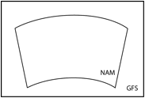
Reasons for combining parent model datasets
To provide required fields that are missing from one of the two parent datasets while keeping its advantages
Example: we used NAM soils to make up for missing data in RAP parent grids
To replace fields in one dataset with better information in another
Example: you could provide a better or different SST analysis
To combine complementary but incomplete datasets
Example: NARR reanalysis data are split into different file types
To provide extended spatial coverage
Example: we can use global GFS grids to extend the limited spatial extent of the NAM domain
your domain
Notes:
For NARR, have to run ungrib more than once, on different sets of files.

Slide 39
Final project
Identify something you wish to do for your final project
Can be a real-data case or an idealized experiment
Formulate a hypothesis you wish to test
Use tools provided in this course
Consult with me for help and advice
Discuss your idea with me
Examples:
Effect of (lead time, model physics, parent model, resolution, etc.) on forecasts of (February 2017 snowstorm, Hurricane Katrina, etc.) with respect to (intensity, position, snowfall totals)
Verification of (wind, temperature, humidity) forecasts at ASOS, RAWS and CWOP (citizen) stations for (case study, runs over month, etc.)
Verification of above-surface temperature and winds against radiosondes for (case study, runs over month, etc.)
Experiment with various wind shear magnitudes and shear layer depths with 2D or 3D idealized (squall line, supercell, sea-breeze, downslope windstorm)

