Slide 1
Cumulus parameterizations
(and Experiment #6)
ATM 419/563
Spring 2021
Fovell
© Copyright 2021 Robert Fovell, Univ. at Albany, SUNY, rfovell@albany.edu

Slide 2
Goals
Introduce cumulus parameterizations and the role they play in mesoscale and synoptic-scale simulations
Create a cumulus ensemble for a case with relatively well (spatially) separated larger-scale and convective-scale precipitation features
Explore sensitivity to cumulus scheme with respect to precipitation production
Observe cooperation and competition between microphysics and cumulus schemes with respect to precipitation production

Slide 3
Microphysics vs. cumulus schemes
Microphysics schemes
  Clouds can be resolved but hydrometeors are subgrid. The creation, growth, and settling of hydrometeors have to be parameterized. This is accomplished with particle size distributions (or bins).
  Condensation occurs explicitly on the grid, (generally) when grid-scale saturation is reached. Precipitation occurs as hydrometeors reach the model surface. Microphysics is applied grid volume by grid volume.
  Also called “explicit” or “stratiform” (no longer appropriate term).
Cumulus (convective) schemes
  Clouds cannot be resolved: they are subgrid. Their influence on the grid column they are embedded in must be parameterized. This is accomplished by adjusting the column sounding, column by column.
  Condensation and precipitation occur implicitly, as the column sounding is adjusted. Convection can occur when RH < 100% (grid-scale saturation is not necessary) if CAPE exists and trigger conditions are met… (that’s both advantageous and disadvantageous).
Notes:
Stratiform is no longer appropriate because we can resolve convective precip w/ microphysics alone, using sufficiently high resolution.
Advantageous: my hurricane example. Disadvantageous: our precip area in MO and AR and IL will be too wide, precip triggered over too wide an area

Slide 4
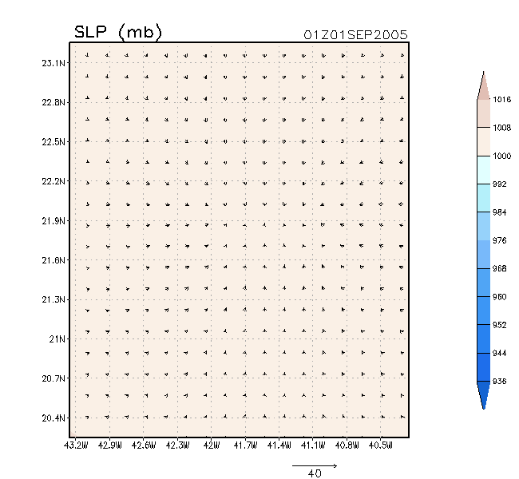
Aside: hurricane “bubble” initialization
Spin up of TC from
bubble, using
Kain-Fritsch cumulus
scheme
30 km
Fovell and Su (2007) and subsequent papers
Only part of domain shown
Notes:
Faced with problem of creating a hurricane from scratch w/o predetermining its structure (as in bogussing). Tried using a bubble.
But w/ only MP, which needs grid scale saturation, initial TC was very very small. With CP, which does not need grid scale sat, TC larger.

Slide 5
Aside: hurricane “bubble” initialization
z
CP = cumulus parameterization
Fovell and Su (2007) and subsequent papers

Slide 6
Convective activity in a grid column
Deep convection occurs when conditions are favorable
  CAPE exists (i.e., instability and moisture)
  A source of lifting is available
Convection clearly modifies the air within the cloud(s)…
What specifically does convective activity do to its environment?
  That is, its environment in the SAME GRID COLUMN
  We can imagine it makes it warmer (latent heat release, compensating subsidence) overall and drier (moisture loss via precipitation)
So what does a post-convective environment look like?
  Within the deep convective cloud itself, you might guess the vertical lapse rate is moist adiabatic (constant θ_{e}) – but we cannot “see” that cloud
  We’re concerned with how the clouds modify their surrounding environment
  In a coarse-resolution model, a grid column may contain narrow deep clouds of various depths and widths… but most of the grid volume is expected to be cloud-free (between the clouds)
  What does this cloud-free environment look like (temperature, moisture, lapse rate, etc.)?
Notes:
Warmer overall – could be cooler near sfc owing to rain evaporation, say.

Slide 7
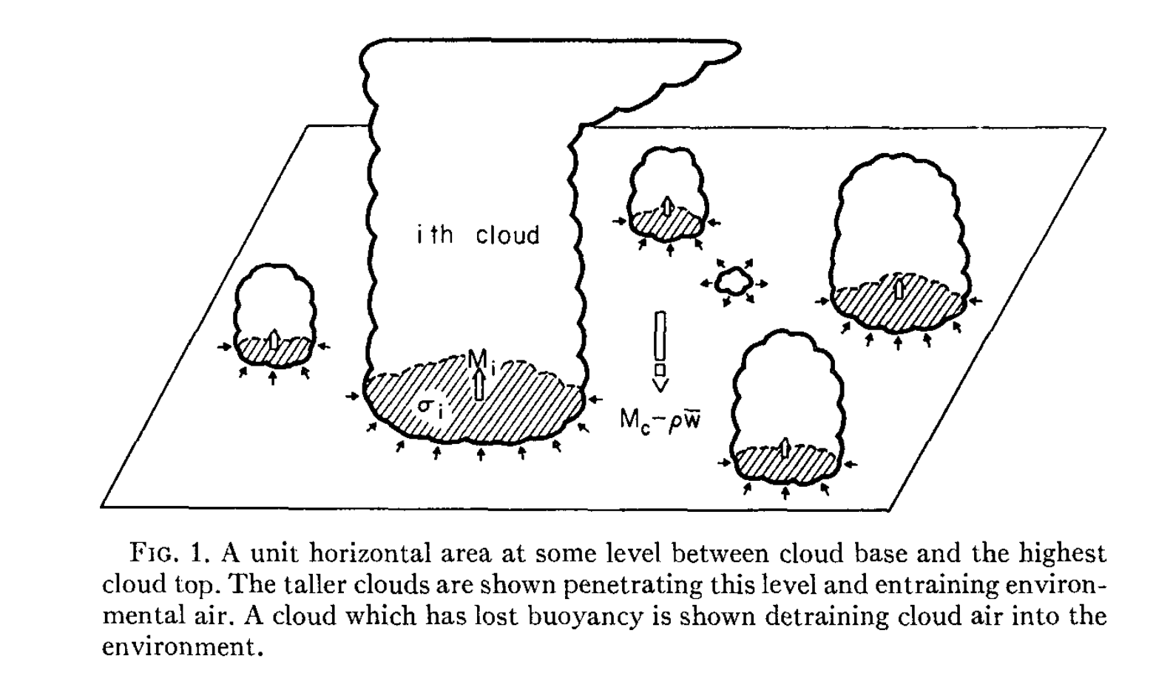
Start with a grid box.
Depicted is one level in a model column.
There are unresolvable clouds/updrafts of various depths within the grid box.
Note most of the grid box area is not occupied by updrafts.
grid box
Arakawa and Schubert (1974)

Slide 8
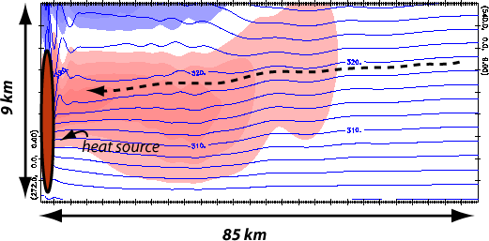
Convective cloud is influencing its own grid column
Consider this as one grid column within a coarser scale model
Which is more important: “direct” ∆T by condensation & advection, or “indirect” via compensating subsidence?
Blue contours: isentropes
Colored field: potential temperature change (red = increase)
Notes:
Heat source is an active cumulus cloud within the grid box. Entire domain can be thought of as one (coarse resolution) grid box, so everything you see is subgrid
Not a glide path. Parcels are not moving westward there

Slide 9
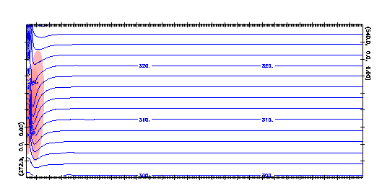
How a deep convective cloud modifies its surrounding environment
Consider this as one grid column within a coarser scale model
subgrid
convective cloud
response to subgrid cloud activity
Adjustment to convective heating is spread by gravity waves.
All of this is taking place within one grid column.
Net result: entire column is net warmer and drier than before.
Notes:
Parcel represents air w/ 320 K theta original elevation

Slide 10
Say each cloud entrains environmental (cloud-free) air at every level,
except at its top, where it detrains.
In this example, five clouds are entraining at this level,
while one (red arrow) is detraining.
grid box
Arakawa and Schubert (1974)
Notes:
Somehow the bulk consequence of all of this unresolvable, complex activity has to be parameterized

Slide 11
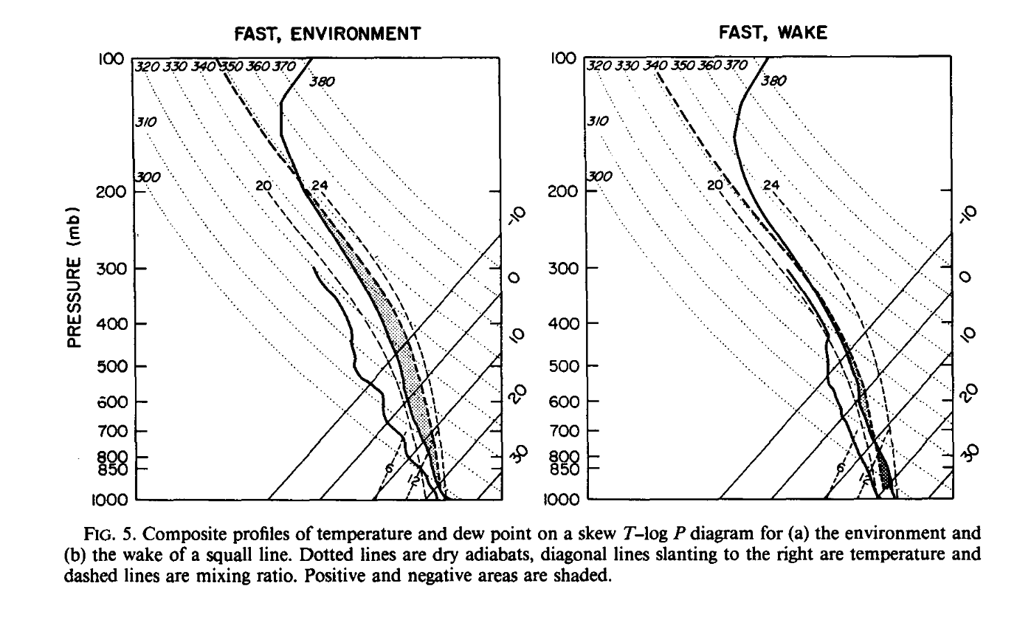
Environment ahead of squall line (at left) has a fair amount of CAPE (1000 J/kg).
Sounding in squall line wake has somewhat different structure, and much less CAPE (150 J/kg)
Convective activity
Convective activity converts one sounding into the other. How can you accomplish
this when you cannot resolve the clouds?
Barnes and Sieckman (1984)
Notes:
Convective activity turns one environment into the other. How to do this when you cannot resolve the clouds?
Barnes and Sieckman (1984) examined fast-moving and slow-moving tropical squall lines. These soundings are for the fast-moving cases.
Hmm… superimposing the two yields smaller warming in wake sounding than I expected.

Slide 12
Apparent heat source and moisture sink
We cannot resolve the subgrid clouds
But… these clouds are mixing and modifying the environment
Diagnose the net effect of convective activity in an area (such as a grid column) via two quantities: Q₁ and Q₂
  Q₁ is the “apparent heat source”
  Q₂ is the “apparent moisture sink”
  Both have units J/kg/s
  Dividing by c_{pd} yields units of K/s – sensible and latent heating rates
Notes:
Energy rates

Slide 13
Deriving Q₁ and Q₂ #1
• s = dry static energy
(conserved for subsaturated
adiabatic processes)
• Change s following the motion
with net radiative forcing (Q_{R})
and water phase changes
(i.e., non-adiabatic processes)
• Continuity equation in isobaric
coordinates
c = condensation
e = evaporation
Notes:
S conserved for subsaturated adiabatic. But we can change it w/ diabatic forcings such as radiation, and phase changes

Slide 14
Deriving Q₁ and Q₂ #2
cancels due to continuity
Large scale quantities
(radiation and microphysics)
subgrid effects of
convection
= Q₁
• LHS is Q₁, representing the grid-averaged quantities (overbars) – what we need in model
• blue box represents effects of subgrid eddies == convective activity
Notes:
Define LHS as Q1. It’s grid-scale averaged ds/dt in grid volume.
First part of RHS is diabatic forcings. Remainder is subgrid effects --- the subgrid convection! QR is radiation scheme. Lv(c-e) is microphysics. Rest is cumulus scheme

Slide 15
Deriving Q₁ and Q₂ #3
• Similarly for water vapor q_{v}:
= -Q₂ / L_{v}
subgrid effects of
convection
• LHS is –Q₂/L_{v}
• Minus sign makes drying positive (“moisture sink”)
• Both Q₁ and Q₂ have units of J/kg/s. Divide by c_{pd} to get K/s.

Slide 16
Diagnosis of subgrid convection
• Combine Q₁ and Q₂ equations, utilizing definition of moist static energy h. Then,
neglect the horizontal eddy transport term, yielding second equation below
subgrid effects of
convection
• If Q₁ – Q₂ – Q_{R} = 0 for a grid column,
there’s no subgrid convection in the column
• If there’s subgrid convection in a column,
then Q₁ – Q₂ – Q_{R} ≠ 0
• From observations, we can estimate Q₁, Q₂, Q_{R}… so
combination reveals what subgrid convection is doing
• In the model, we can’t get Q₁ and Q₂ w/o estimating
the subgrid convection contribution
Notes:
Combining the Q1 and Q2 equations: the Lv term cancels out
If Q1 and Q2 = QR, there’s nothing for subgrid stuff to do
In the model, we need to forecast Q1 and Q2 – that’s how T and q are changing – and cant do that w/o estimating what subgrid convec is doing

Slide 17
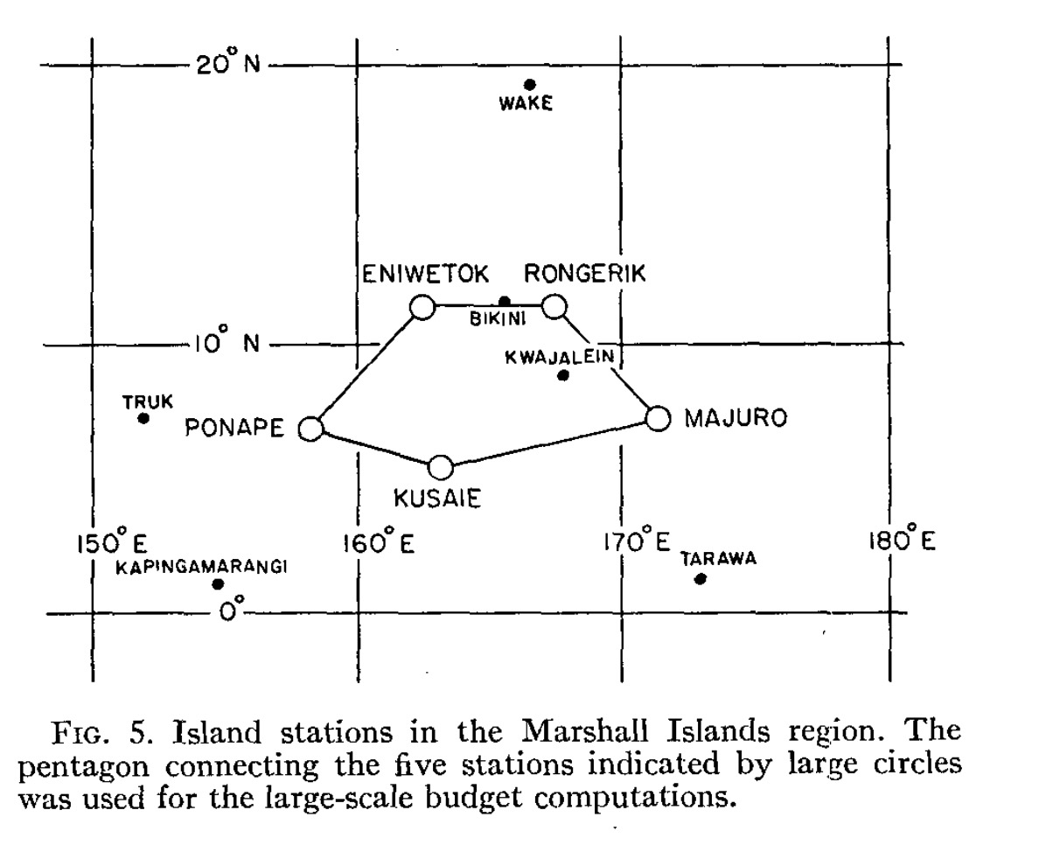
Q₁ and Q₂ from observations
• You can estimate Q₁ and Q₂ from
observations by using an array
of soundings.
• You are estimating the mean
quantities (overbars), which are
a consequence of convective
activity within the array.
• [Q_{R} is obtained by other means.]
Yanai et al. (1973)
Notes:
Est Q1 and Q2 from obs, to demonstrate what the model should be producing w/ its cumulus scheme

Slide 18
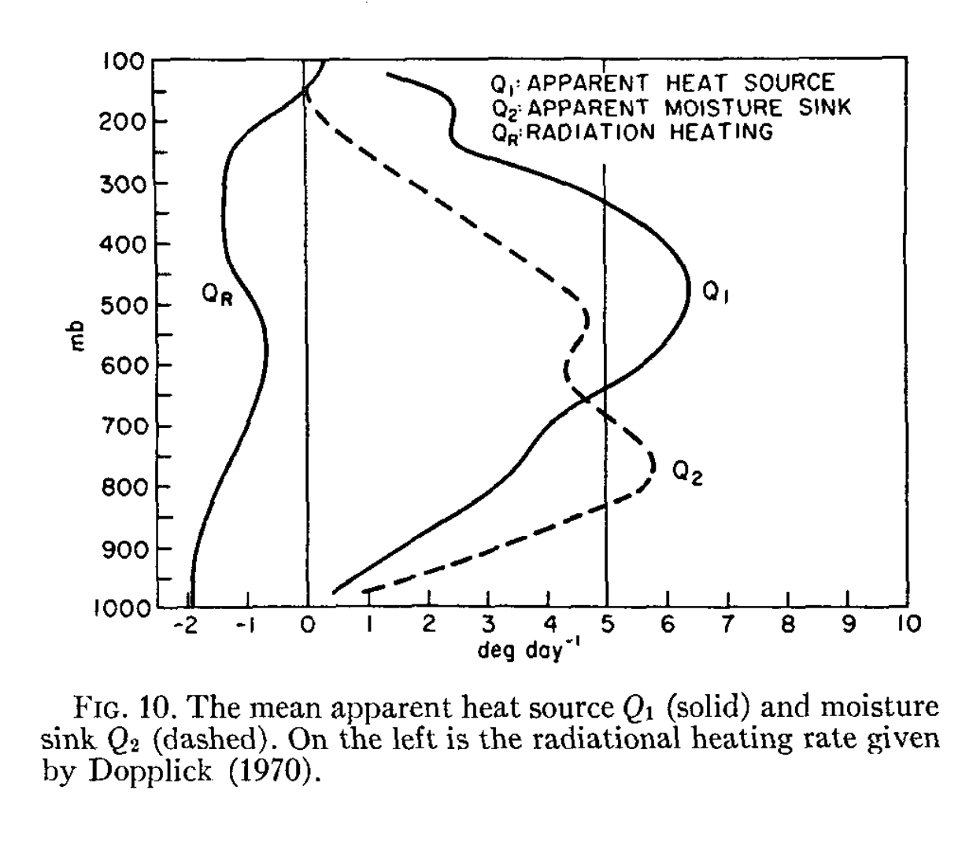
Q₁ and Q₂ as estimated from observations
• Net radiation (Q_{R}) cools the
troposphere
• Q₁: convection warms the
troposphere everywhere,
with maximum around 500 mb,
making lower trop more stable
• Q₂: convection dries the
troposphere everywhere,
more pronounced in lower
troposphere
• Both have been divided by c_{pd}
Q₁ and Q₂ are what we need our model physics to accomplish
so our forecasts are correct. In the model, need to estimate
the contribution of subgrid convection (h’ω’). That’s the job
of the cumulus parameterization.
Yanai et al. (1973)
Notes:
You can’t get these profiles w/o convection, much of which is subgrid in coarser models. Convective schemes attempt to produce these.

Slide 19
Some cumulus parameterizations
Kuo (1965) [not available in WRF]
  Relates convective activity to horizontal moisture convergence
  Criticism: moisture convergence itself does not cause convection (‘Planes need runways but runways don’t cause planes.’)
Arakawa and Schubert (1974)
  Convection rapidly consumes creation of CAPE by large-scale environment (“quasi-equilibrium” hypothesis)
  Original, very complex scheme simplified somewhat (Simplified Arakawa Schubert, or SAS, in WRF as OSAS, NSAS, and KSAS)
    Similar or related: Grell-Devenyi (2002), Grell-Freitas (2014)
  Criticism: The evidence that relates convective activity with CAPE generation is questionable at best (Mapes 1997)
Kain-Fritsch (Kain 2004)
  Convection activated by trigger function, governed by a time scale
Betts-Miller-Janjic (Janjic 1994)
  Creates post-convective environment motivated by observations
Notes:
Corr ≠ causation Chicken vs egg
Trenberth – move heating up a level, mult this other by 13 “worked better than 12” → lots of engineering. NWP class in those days was very very different.
“Cargo cult science”: WW2 pilots landed on runways on tropical islands. After the war, natives built runways to lure the pilots back. Planes need runways but runways don’t cause planes.

Slide 20
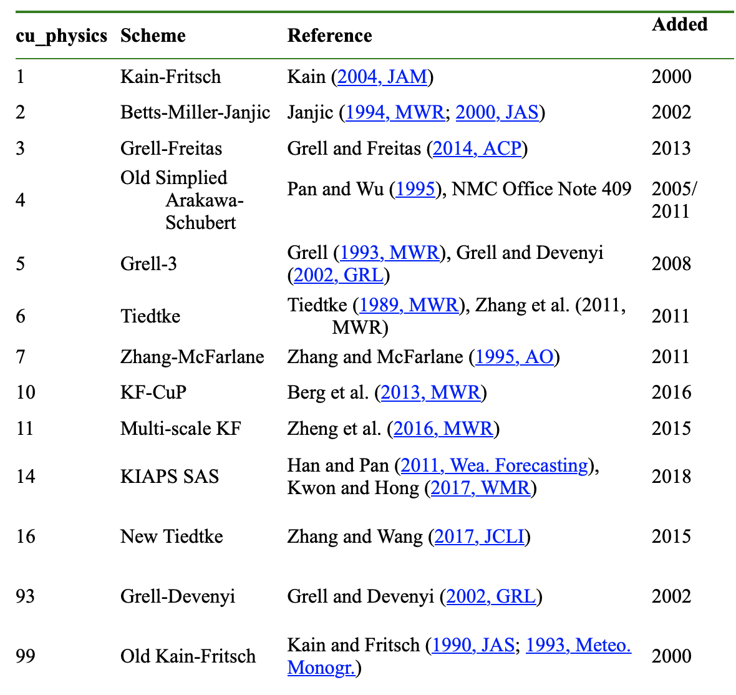
Cumulus schemes available
in WRF v4.2.2
Some of these schemes have
additional options
does not work
For this experiment,
with this version,
OSAS (cu=4) does not work
with WRF-ARW
Zhang-McFarlane (cu=7) requires
specific PBL schemes
#94 HWRF NSAS is missing from list
#95 Old SAS for ARW is missing
#96 Old NSAS is missing from list
Notes:
2021

Slide 21
Experiment #6: Cumulus ensemble & comparison to explicit precipitation simulation
[22-24 March 2016 event]

Slide 22
Outline
Task: 42 h simulation of a precipitation event in Great Plains, involving a pre-frontal squall line and a wider area of weaker precipitation, at 36 km resolution
  Use GFS model run from 3/22/2016 at 00Z but start with its 12 h forecast. So, we are using forecasts for initial and boundary conditions.
Contribute to a class ensemble involving variation of the cumulus schemes
  We are not varying the microphysics scheme in this ensemble
Compare to two “benchmark” cases
  36-km simulation with NO cumulus scheme used → what the cumulus scheme is contributing
  Higher resolution simulation with NO cumulus used → what the cumulus scheme is attempting to accomplish
Notes:
…at least as far as precip is concerned

Slide 23
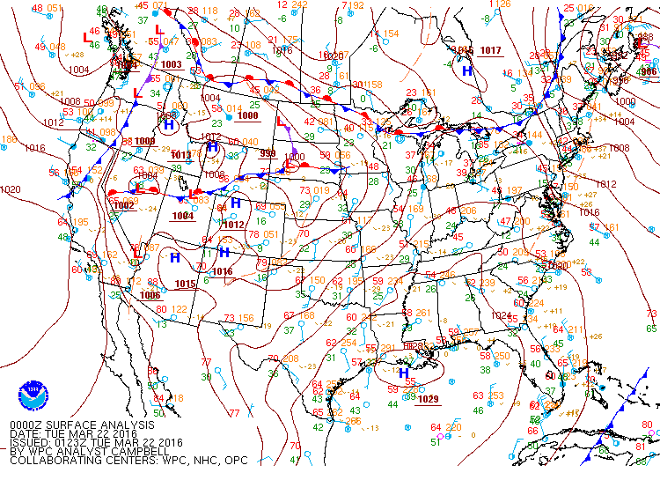
t – 12 h

Slide 24
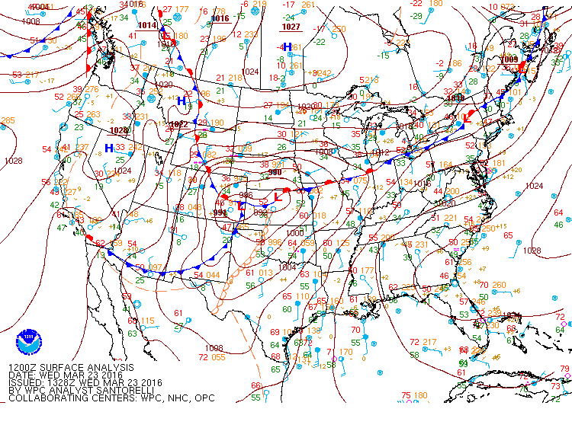
t + 24 h
Heavy snow in N Colorado
Dry line appears in W Texas

Slide 25
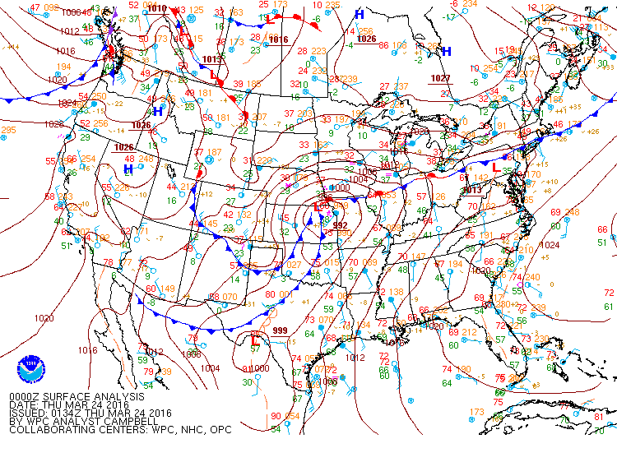
t + 36 h
Dryline overtaken by cold front.
Pre-frontal squall line appears soon.
Notes:
Dryline overtaken by cold front. Squall line forms ahead of this front (seen in satel pic, next slide)

Slide 26
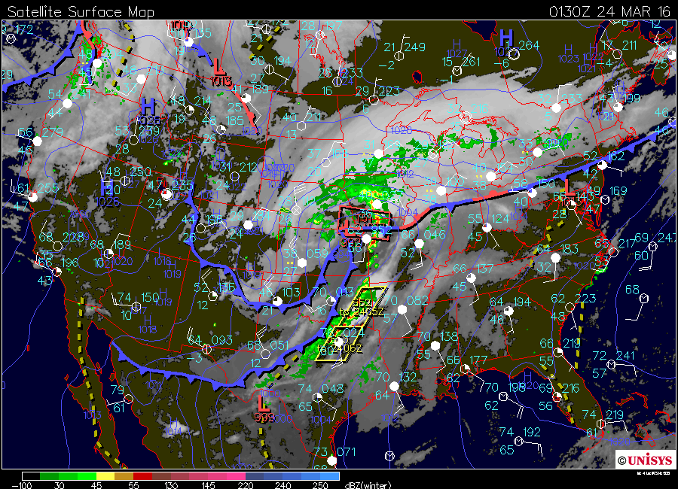
t + 37.5 h
Less intense frontal precip
Pre-frontal squall line appears

Slide 27
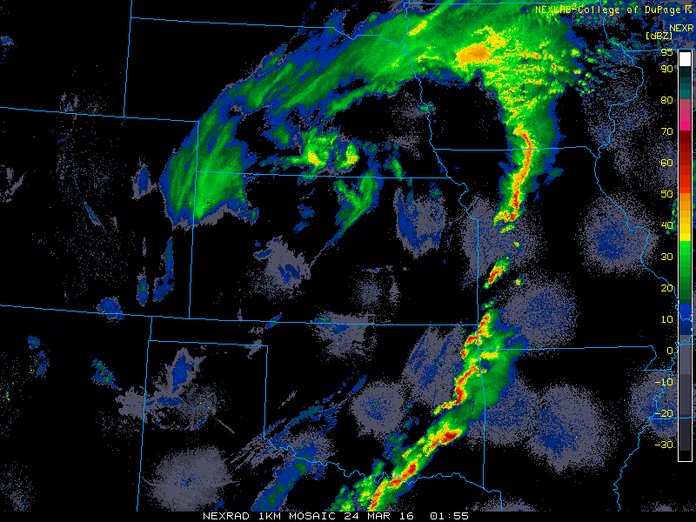
Broader precip to N can
be at least partially resolved
at this coarse grid spacing
[microphysics]
t + 38 h
About 8∆x
At 36 km resolution, our
squall line is essentially subgrid.
Cumulus scheme attempts to
account for this activity
Notes:
8 grid points to resolve things well. 8*36 = 288 km. Squall line is very very subgrid.

Slide 28
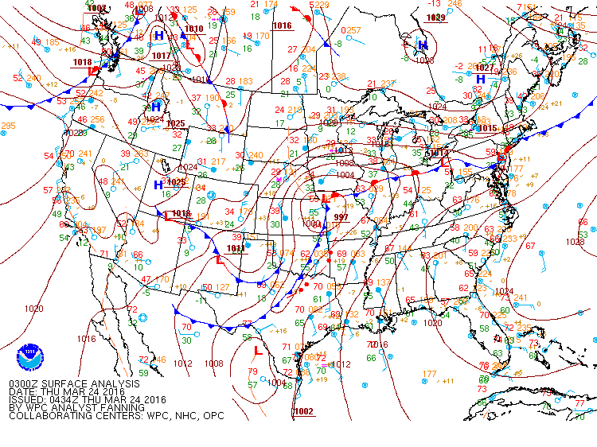
t + 39 h
Squall line

Slide 29
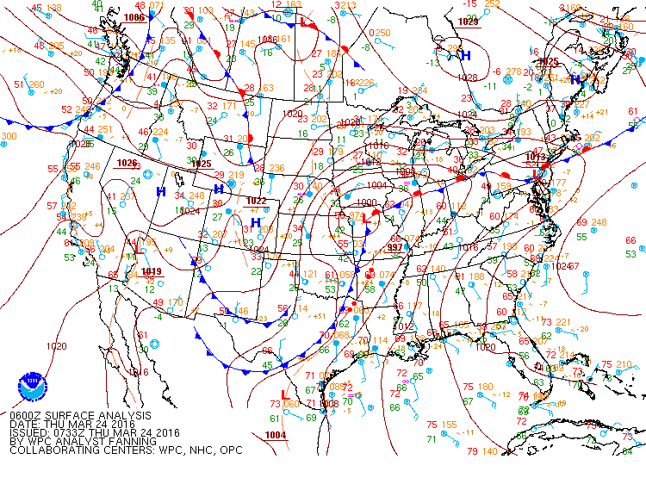
t + 42 h
Squall line

Slide 30
Experiment #6 setup
Create and enter into a new directory: CUMULUS
Copy into it entire contents of $LAB/CUMULUS directory
  cp $LAB/CUMULUS/* .
Then:
  namelist.input WILL REQUIRE SOME EDITING.
  Execute make_all_links.sh as usual
  Check out the Real-data WRF checklist
Geogrid output file (36 km domain) is already provided (geo_em.d01.nc)
We will use GFS from 00Z 22 March 2016 cycle but initialize with 12Z 22 March forecast [yes, we can do that…]. Ungrib outputs will be provided.
Make a 42 h simulation (1 days, 18 hours) for your assigned configuration (slides 34-35)
  Start 12Z 22 March, end 06Z 24 March
Common physics for our simulations: [already selected in namelist.input]
  mp_physics = 4 (WSM5), sf_surface_physics = 2 (Noah LSM), bl_pbl_physics = 1 (YSU PBL), sf_sfclay_physics = 1 (Monin-Obukhov surface layer), num_soil_layers = 4 (needed by Noah LSM)

Slide 31
When to use a cumulus scheme?
Most cumulus schemes employ the assumption that subgrid clouds are narrow and most of the grid box is cloud-free
  The larger the grid spacing, the better this assumption is
  Some newer schemes are “scale-aware” and try to “turn themselves off” as ∆x, ∆y become smaller
Rule of thumb (microphysics scheme always presumed ON):
  12 km grid spacing and larger = use a cumulus scheme
  6 km grid spacing and smaller = don’t use cumulus (except scale-aware)
  Between 6-12 km: try to avoid using these resolutions
Unlike most physics you can (and probably should) have the cumulus scheme active in some domains and switched off in others. Example:
  cu_physics = 1, 1, 0, 0, presuming ∆x = 36, 12, 4, 1.333 km
Our experiment: 36 km domain, with a simulation using a 12 km nest (and no cumulus) provided for comparison
  This is suboptimal but serves as an adequate demonstration

Slide 32
Vary cumulus schemes in this domain,
Including a no-cumulus member
No cumulus in this domain
Only microphysics
[you are not running this domain]
12 km
36 km
Our simulations will use only the outer 36 km domain
A simulation using both domains, with cumulus off in D2, will be provided for comparison
(You may consider something like this, but using even finer resolution, for final project.)

Slide 33
Tasks
Tasks
  Link to the pre-made ungrib outputs
    ln -s $LAB/CUMULUS/UNGRIB_GFS/FILE* .
  Do metgrid.exe – remember to srun, or use submit scripts
  Edit namelist.input for your configuration (next slide)
  Submit batch jobs for real.exe, wrf.exe
  Use control_file.2D to make your GrADS output, using naming convention provided (next slide)
  Copy your ctl and dat files to $LAB/EXP06
cu_physics = 3,
kfeta_trigger = 1,
Lines that might change
kfeta_trigger only used by KF scheme

Slide 34
ensemble member | last name | cu_physics | scheme name | mp_physics | kfeta_trigger | filename | notes
1 | Anderson | 1 | KF | 4 | 1 | cu01 | kfeta_trigger=1 is default, only works with cu=1
2 | Heeren | 2 | BMJ | 4 |  | cu02
3 | Komarc | 3 | GF | 4 |  | cu03
4 | Maura | 5 | G3 | 4 |  | cu05
5 | Moore | 6 | Tiedtke | 4 |  | cu06
6 | Odstrchel | 10 | KF-CuP | 4 |  | cu10
7 | Smith | 11 | MS-KF | 4 |  | cu11
8 | Watts | 14 | KSAS | 4 |  | cu14
9 | Werner | 16 | New Tiedtke | 4 |  | cu16
10 | Wheeler | 93 | GD | 4 |  | cu93
11 | Fandrich | 94 | HWRF SAS | 4 |  | cu94
12 | Garmong | 95 | Old SAS | 4 |  | cu95
13 | Gyawali | 96 | NSAS | 4 |  | cu96
14 | Johnson | 99 | Old KF | 4 |  | cu99
15 | Naple | 1 | KF | 4 | 2 | cu01X | does trigger setting matter?
16 | Piersante | 1 | KF | 4 | 3 | cu01Y | does trigger setting matter?
17 | Fovell | 0 | NONE | 4 |  | cu00 | 1-domain no cumulus
18 | Fovell | 0 | 2-domain | 4 |  | cuXX | 2-domain no cumulus ("TRUTH")
Pat and Jeremiah: note you have TWO settings to change.

Slide 35
Cumulus schemes available
in WRF v4.2.2
Some of these schemes have
additional options
does not work
For most schemes, cudt = 0 (call
cumulus scheme every time
step) is recommended
KF schemes can use cudt = 5 (calls
cumulus every 5 min)
Our experiment will use cudt = 0
for the KF schemes
Your results may be sensitive
to your choice
Notes:
2021

