Slide 1
HWRF instability example
Linear or nonlinear instability?

Slide 2
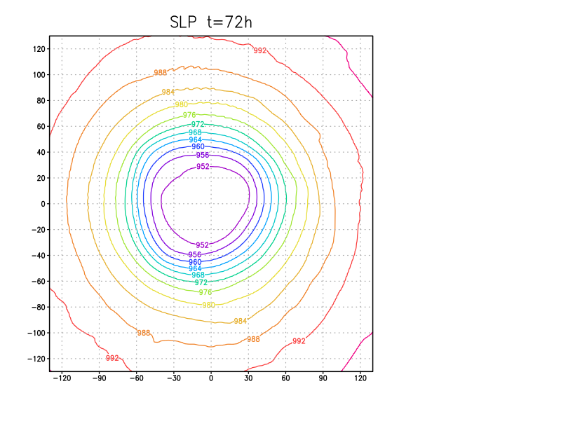
HWRF model
SLP field
y (km)
x (km)
Notes:
See a few wiggles. Nothing of concern – yet.

Slide 3
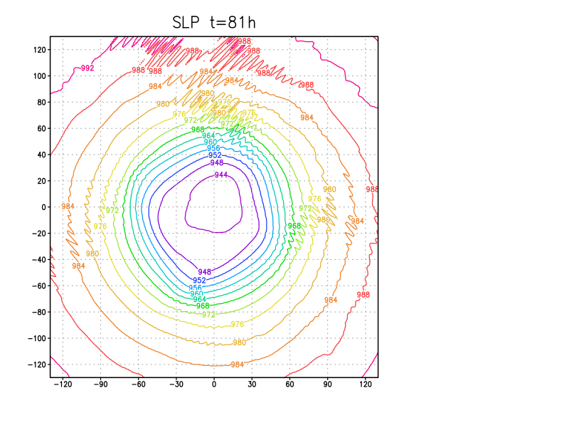
HWRF model
SLP field
y (km)
x (km)

Slide 4
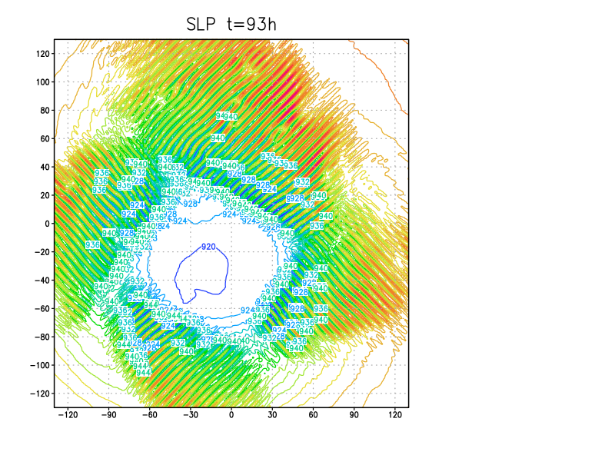
HWRF model
SLP field
y (km)
What went wrong?
How to fix it?
x (km)
Notes:
4 day simulation, ending at 96h. It didn’t blow up by that time, but it WOULD eventually do so if run longer.
What’s the cause? Linear or nonlinear instability? “Going to hell in a handbasket”

