Slide 1
Experiment #3 Review
ATM 419
Spring 2021
Fovell
© Copyright 2021 Robert Fovell, Univ. at Albany, SUNY, rfovell@albany.edu

Slide 2
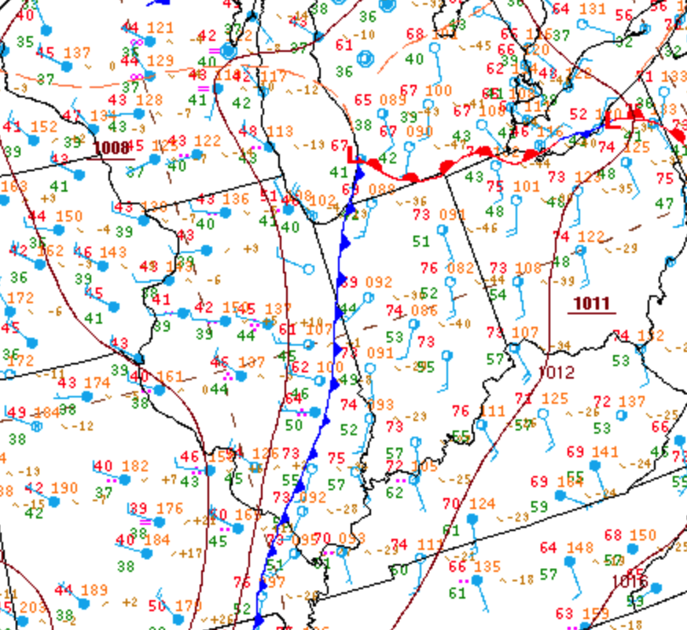
3-27-2016
2100Z surface chart
Notes:
Cold front analyzed along temperature boundary, west of primary surface trough which is in convergence zone ahead of front (where storms appear)

Slide 3
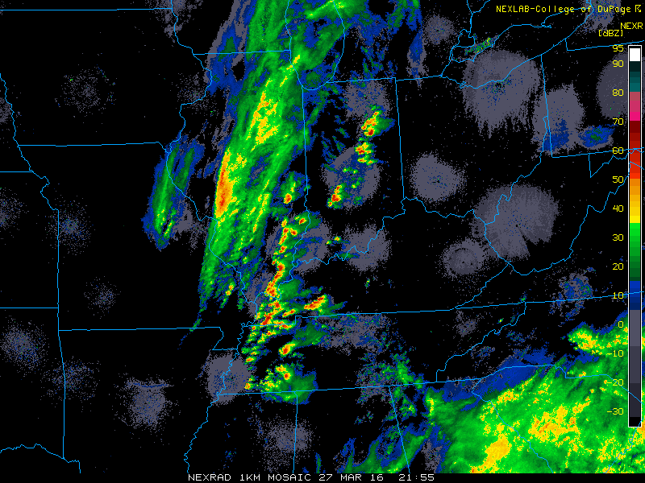

Slide 4
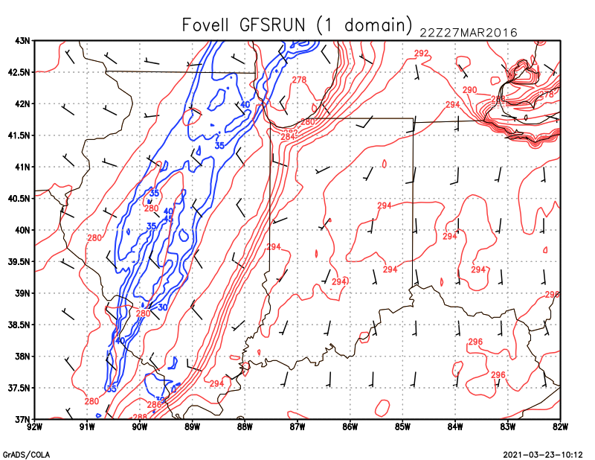
Winds every 15 gridpoints (D1)
Notes:
2021 – set t. 11

Slide 5
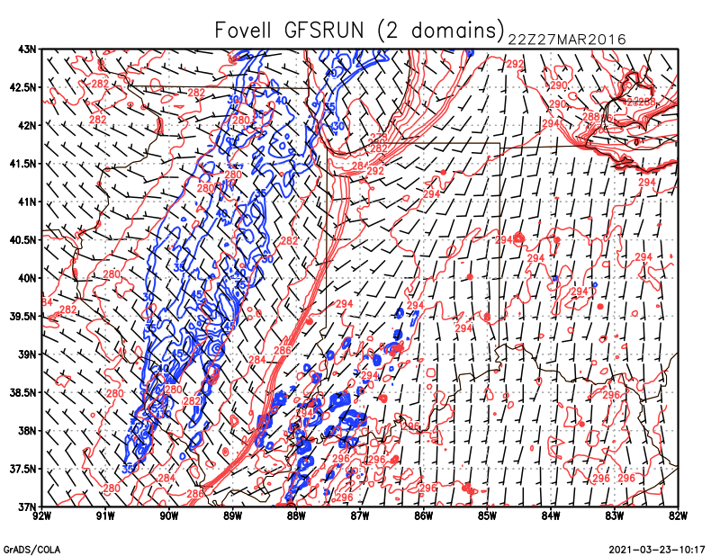
Winds every 15 gridpoints (D2)
Notes:
2021 – set t 31

Slide 6
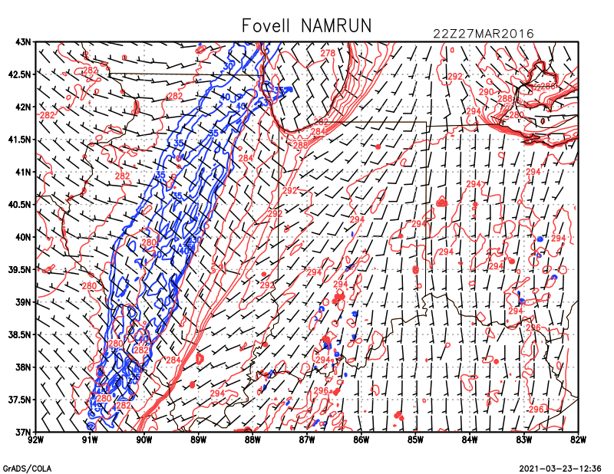
Notes:
Frontal gradient weak in central IL
Bit more of a sens to time_step

Slide 7
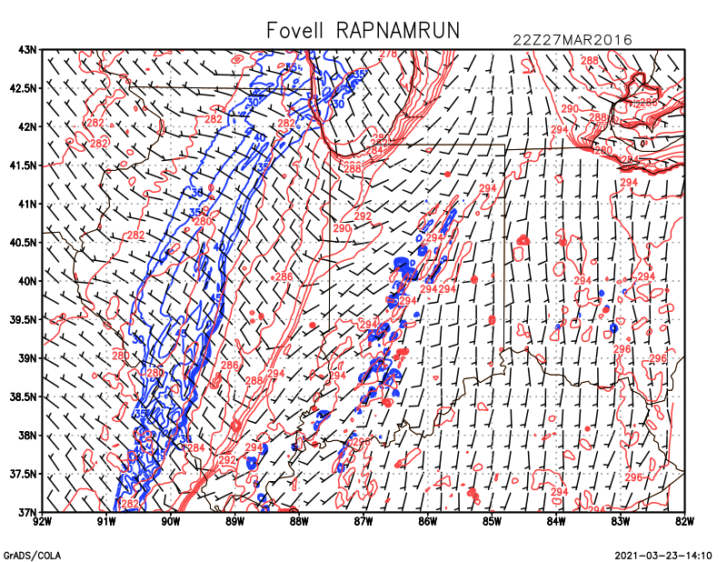

Slide 8
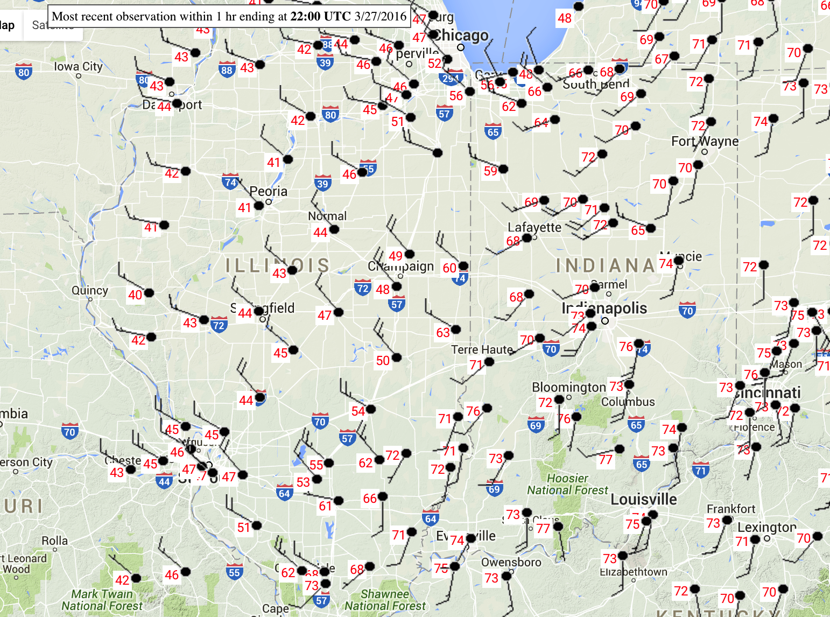

Slide 9
Exit questions
This experiment examined sensitivity to initialization fixing the model physics and setup, including resolution.
Would the sensitivity to physics/resolution for a single initialization be larger and/or different?
What if we used GFS soil for the RAP run?
This experiment revealed distinct differences in pre-frontal convective behavior based on initialization data source.
Which simulation was better quantitatively, with respect to forecast temperature, winds, humidity, precipitation rate, etc.?
What was it about the NAM atmospheric initialization that resulted in less convective activity? (Presumably not the soil inputs since those were also used in the RAP run.)
These runs used WRF as an “honest broker”. How did the GFS, NAM, and RAP models themselves do in forecasting this convection?

