Slide 1
Climate variability and change Introduction to the physical climate system
Oliver Elison Timm ATM 306 Fall 2016
Lecture 2
Notes:
Presentation slide for courses, classes, lectures et al.

Slide 2
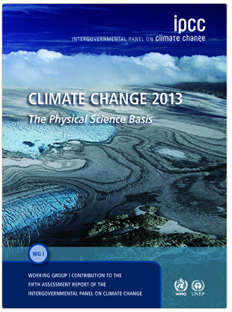
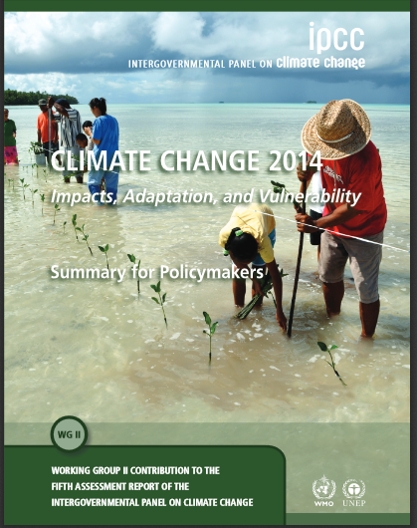
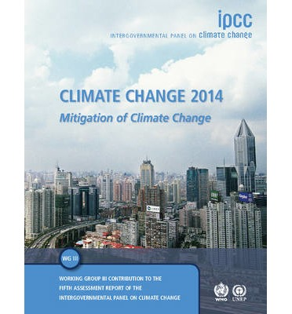
IPCC reports: Summary for Policymakers (SPM)
The Intergovernmental Panel on Climate Change has published
5 reports every 6-7 years since 1990.
Currently there are three working groups preparing reports:
WG on the Physical Science
WG on Impacts, Adaptation and Vulnerability
WG on Mitigation of Climate Change
Notes:
All reports, special reports, summary reports etc are available as PDF documents for free
http://www.ipcc.ch/publications_and_data/publications_and_data_reports.shtml

Slide 3
IPCC reports: Summary for Policymakers (SPM)
The full reports include a summary for policymakers:
A short narrative with the most important conclusions from the report’s chapters.
Important results are reported with a statement of confidence or uncertainty
Notes:
All reports, special reports, summary reports etc are available as PDF documents for free
http://www.ipcc.ch/publications_and_data/publications_and_data_reports.shtml

Slide 4
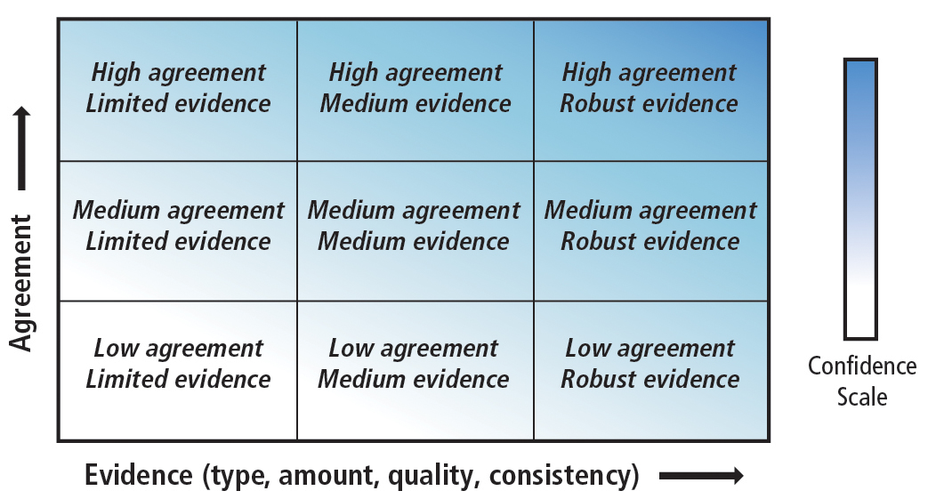
IPCC reports: Summary for Policymakers (SPM)
Terms used to describe confidence: ‘very low’ to ‘very high’
‘exceptionally unlikely’ to ‘virtually certain’
other terms are used to express uncertainty e.g. ‘as likely as not’
Notes:
This figure is in the technical report of AR5 WG1.

Slide 5
IPCC reports: Summary for Policymakers (SPM)
Major conclusions regarding
observed climate trends in atmosphere, ocean and snow/ice:
“Warming of the climate system is unequivocal, and since the 1950s, many of the observed changes are unprecedented over decades to millennial. The atmosphere and ocean have warmed, the amounts of snow and ice have diminished, sea level has risen, and the concentrations of greenhouse gases have increased.”
Notes:
See: AR5 WG1 SPM B

Slide 6
IPCC reports: Summary for Policymakers (SPM)
Major conclusions: observed climate trends in the atmosphere
Globally averaged surface temperature: linear trend 1880-2012 is 0.85K (confidence range [0.65-1.06K], units are kelvin)*
Virtually certain that the troposphere has warmed since mid-20th century, but highest confidence is limited to the well observed extratropical Northern Hemisphere
Precipitation over Northern Hemisphere mid-latitudes has increased:
since 1951with high confidence (since 1901with low confidence) (other regions low confidence in trends)
Likely that heat waves have increased in Europe, Asia, Australia since 1950
Many land regions see an increase in heavy precipitation events
*The report has this cautionary statement included: Interannual and decadal variability makes trend estimates on short records very sensitive to start and end dates.)
Notes:
See: AR5 WG1 SPM B

Slide 7
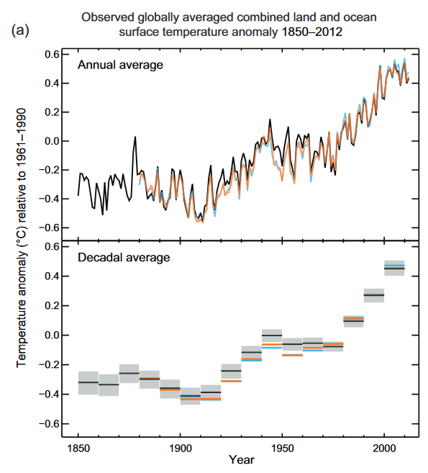
IPCC reports: Summary for Policymakers (SPM)
Notes:
See: AR5 WG1 SPM B

Slide 8
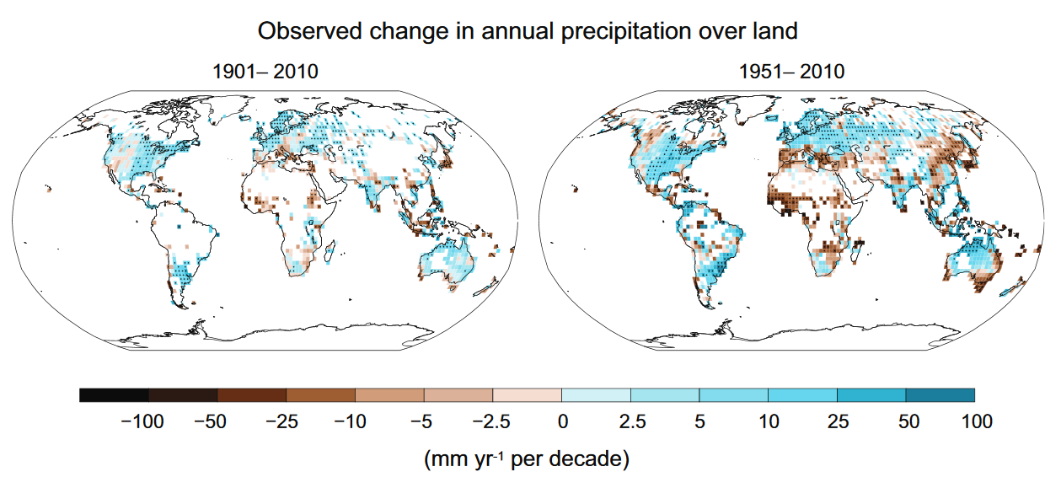
IPCC reports: Summary for Policymakers (SPM)
Notes:
See: AR5 WG1 SPM B

Slide 9
IPCC reports: Summary for Policymakers (SPM)
Major conclusions: observed climate trends in the ocean
It is likely that the ocean warmed also in the deeper layers 700-2000m (between years 1957-2009)
Regions with high salinity (subtropical gyres) have become more saline, while the regions with low salinity have become less saline.
Notes:
See: AR5 WG1 SPM B
Question: What controls surface salinity in the open ocean
Precipitation – evaopartion
So the trend pattern we see is what is described as “the wet gets wetter, the dry gets drier”

Slide 10
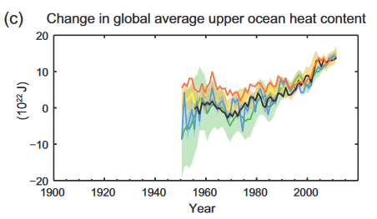
IPCC reports: Summary for Policymakers (SPM)
Major conclusions: observed climate trends in the ocean
Notes:
See: AR5 WG1 SPM B

Slide 11
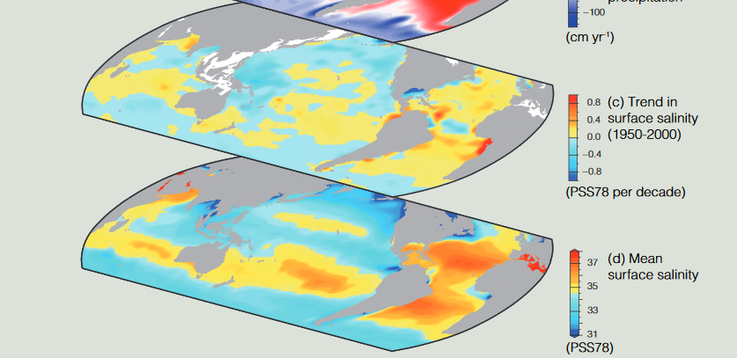
IPCC reports: Summary for Policymakers (SPM)
Major conclusions: observed climate trends in the ocean
Top: trend in surface salinity 1950-2000
Bottom: long-term average surface salinity 1950- 2000
Notes:
See: AR5 WG1 SPM B

Slide 12
IPCC reports: Summary for Policymakers (SPM)
Major conclusions: observed climate trends in the cryosphere
Average ice loss from glaciers (not counting Greenland, Antarctica): 275 Gt/yr between 1971-2009
Greenland ice sheet melting has accelerated in the recent years: 154-275 Gt/yr (2002-2011)
West Antarctica ice melt has increased over past decades: 72-221 Gt/yr
Arctic sea ice extend decreased between 1979-2012, especially during summer months
Northern Hemisphere snow cover has decreased since mid 20th cent. (very high confidence)
Notes:
See: AR5 WG1 SPM B
Note: (Gt: 10^9 tons water, that is 10^12kg water, and one gallon is 3.75 kg, so of the order of 10^12kg / 3.75kg/gallon = 2.7*10^11 gallons water per year)

Slide 13
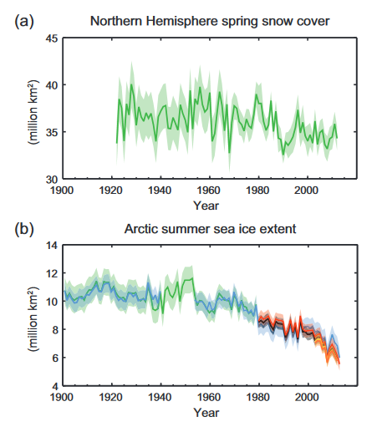
IPCC reports: Summary for Policymakers (SPM)
Major conclusions: observed climate trends in the cryosphere
Notes:
See: AR5 WG1 SPM B
Note: (Gt: 10^9 tons water, that is 10^12kg water, and one gallon is 3.75 kg, so of the order of 10^12kg / 3.75kg/gallon = 2.7*10^11 gallons water per year)

Slide 14
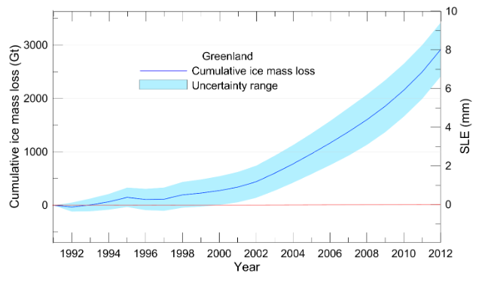
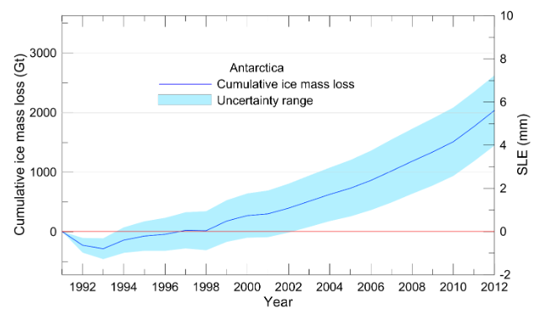
IPCC reports: Summary for Policymakers (SPM)
Major conclusions: observed climate trends in the cryosphere
Greenland accumulated ice loss
Antarctica accumulated ice loss
Notes:
See: AR5 WG1 SPM B
Note: (Gt: 10^9 tons water, that is 10^12kg water, and one gallon is 3.75 kg, so of the order of 10^12kg / 3.75kg/gallon = 2.7*10^11 gallons water per year)

