Slide 1
Other modes of climate variability
Modes of climate Variability
Oliver Elison Timm ATM 306 Fall 2016
Lecture 6
Notes:
1

Slide 2
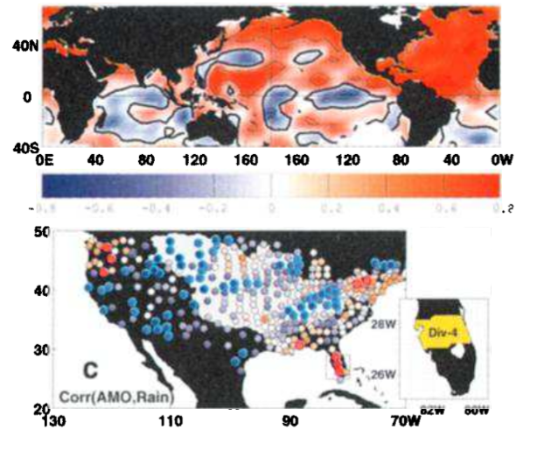
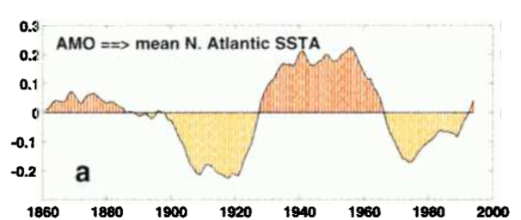
Atlantic Multidecadal Oscillation: Impacts on rainfall in the US
Correlation between AMO index and global SST(note by definition, the North Atlantic SST are highly correlated)
Correlation between AMO index and station rainfall data
SST index
-0.8
0
+0.8
Blue: less precipitation during warm phase
Red: more precipitation during warm phase
Notes:
From Enfield et al. 2001 GRL article:
Enfield, D. B.; Mestas-Nunez, A. M.; Trimble, P. J. (2001). "The Atlantic Multidecadal Oscillation and its relationship to rainfall and river flows in the continental U.S.". Geophys. Res. Lett. 28: 2077–2080. Bibcode:2001GeoRL..28.2077E. doi:10.1029/2000GL012745
NOTE: AMO index can be considered as a measure of the average SST anomalies in the North Atlantic Basin

Slide 3
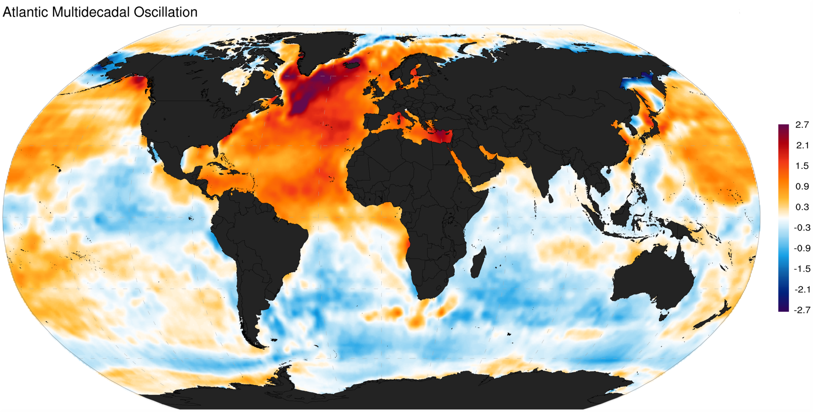
Altantic Multidecadal Oscillation (AMO)
North Atlantic Ocean SST index
Worldwide correlations with SST
Source: https://en.wikipedia.org/wiki/Atlantic_multidecadal_oscillation
Notes:
From wikipedia
Note:
Atlantic Interhemispheric Dipole with cooler SST
south of the Equator during positive AMO phase.
North Atlantic and North Pacific SSTs positive
correlation (both warmer than normal during
positive AMO phases)
Indian Ocean and Southern mostly negative anomalies during positive AMO phase

Slide 4
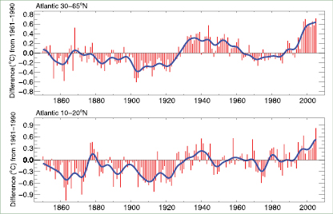
Atlantic Multidecadal Oscillation (AMO)
North Atlantic Ocean SST index
SST area average:
Usually the index
represents average
SST from 0N to 60N, 75W to 7.5W
(Note: various
definitions are used)
Extratropics 30-65N
Tropical/subtropical 10N-20N
Low-frequency variations
on 50-80 year time scales
Source: IPCC AR4 report (http://www.ipcc.ch/publications_and_data/ar4/wg1/en/ch3s3-6-6.html)
Notes:
The AMO is an ongoing series of long-duration changes in the sea surface temperature of the North Atlantic Ocean, with cool and warm phases that may last for 20-40 years at a time and a difference of about 1°F between extremes. These changes are natural and have been occurring for at least the last 1,000 years.
See:
http://www.aoml.noaa.gov/phod/amo_faq.php

Slide 5
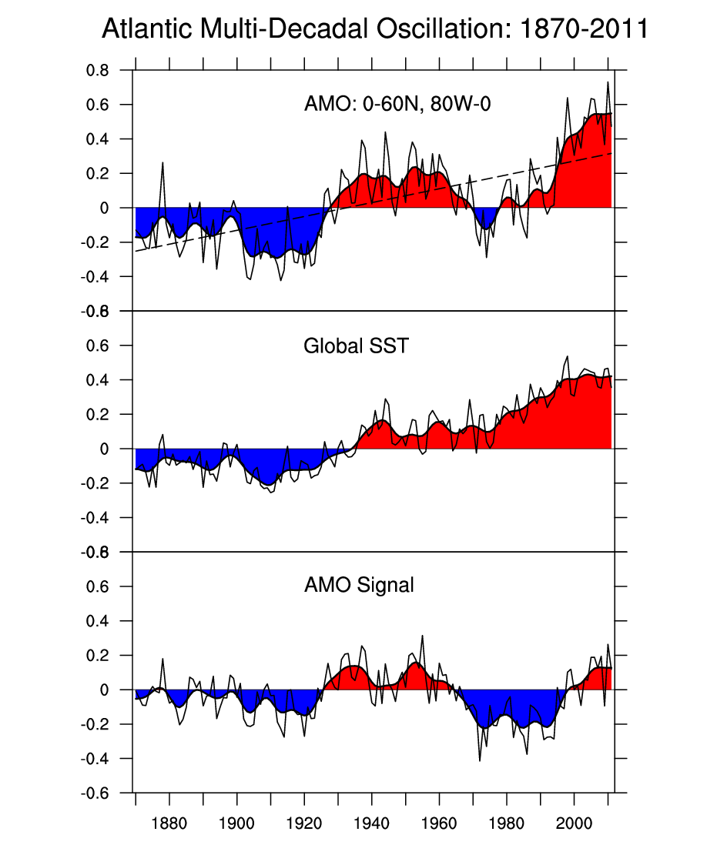
Atlantic Multidecadal Oscillation (AMO)
North Atlantic Basin SST index
This mode and the global warming trend
are difficult to distinguish from observations alone!
Physical climate models must be used to better understand origins of this low-frequency variability.

Slide 6
Impacts of the AMO
AMO variability coherent with rainfall anomalies in Sahel region in Africa:
Warm AMO phase more rain in Sahel region
Cold AMO phase less rain in Sahel region
Atlantic hurricane activity shows coherent variations with the AMO:
Warm phases more hurricanes
Cold phases fewer hurricanes

Slide 7
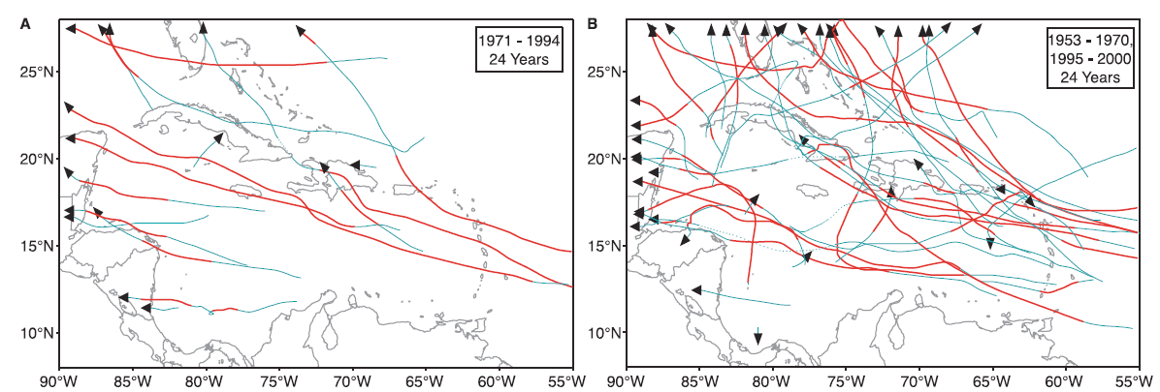
Modulation of Atlantic hurricane activity
Cold AMO phase
Warm AMO phase
Science article published in 2001, by Stanley B. Goldenberg, Christopher W. Landsea, Alberto M. Mestas-Nuñez, William M. Gray. They concluded:
“Because these changes exhibit a multidecadal time scale,
the present high level of hurricane activity is likely to persist for an additional ∼10 to 40 years. The shift in climate calls for a reevaluation of preparedness and mitigation strategies.“
Notes:
Contrast of Caribbean hurricanes between colder (A) and warmer
(B) values of the Atlantic multidecadal mode. The solid green (thin) and
red (thick) lines indicate where the hurricanes were at nonmajor and
major hurricanes intensities, respectively. Tropical storm intensity is
indicated by dotted lines in cases where a hurricane weakened to tropical
storm strength and then re-intensiÞed to hurricane status. The years are
similar to (34) except that the Þrst nine warmer years (1944Ð1952) are
not included to make the number of colder and warmer years equal. The
colder years (24 years) include 1971Ð1994. The warmer years (24 years)
include 1953Ð1970 and 1995Ð2000
This article was published in 2001 in Science by Stanley B. Goldenberg, Christopher W. Landsea
Alberto M. Mestas-Nuñez, William M. Gray
They conclude: “Because these changes exhibit a multidecadal time scale, the present high level of hurricane activity is likely to persist for an additional ∼10 to 40 years. The shift in climate calls for a reevaluation of preparedness and mitigation strategies. “

Slide 8
Modulation of Atlantic hurricane activity
The article was published in 2001 in Science by Stanley B. Goldenberg, Christopher W. Landsea, Alberto M. Mestas-Nuñez, William M. Gray
They conclude:
“Because these changes exhibit a multidecadal time scale, the present high level of hurricane activity is likely to persist for an additional ∼10 to 40 years. The shift in climate calls for a reevaluation of preparedness and mitigation strategies. “
Goldenberg et al, Science, 2001
Notes:
Discussion:
14 years later, what is your impression?
Is this statement supported by the past 14 years?
Yes, no, can't decide yet?
How many years should we wait?
If the AMO was predictable for that long? Why haven't we heard more about prediction of temperatures and rainfall in regions like SE US, Sahel region Africa
Data set homogeneous: counts of hurricanes?
Other factors?

Slide 9
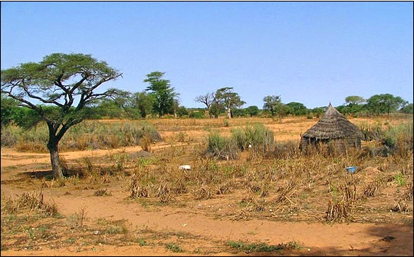
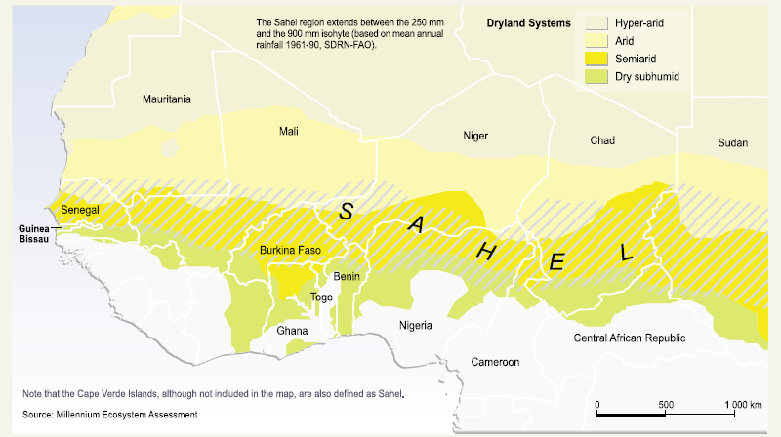
Sahel rainfall and oceanic forcing

Slide 10
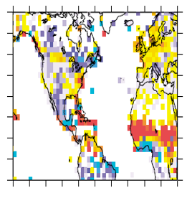
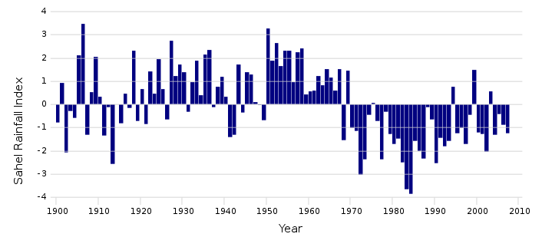
Impacts of the AMO during summer season (JJA): positive minus negative AMO phase
Differences between the mean JJA conditions from 1931 to 1960 (a warm phase of the AMO) and the mean JJA conditions from 1961 to 1990 (a cold phase of the AMO).
Station-based rainfall anomalies
(red: positive anomalies, blue negative)
Sahel rainfall index

Slide 11
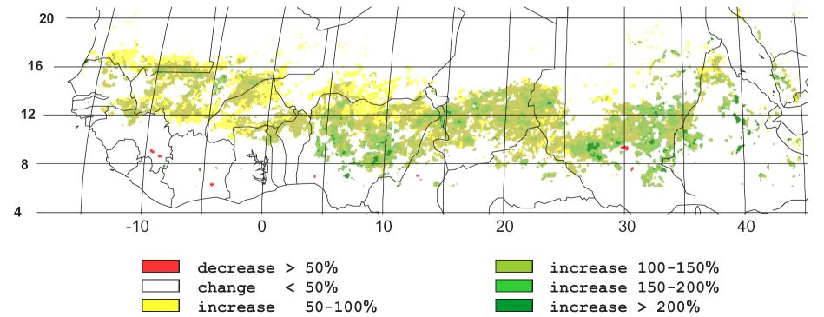
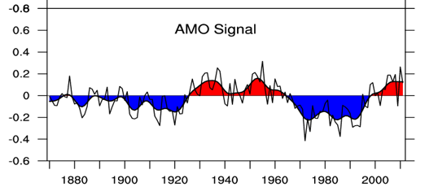
Impacts of the AMO on Sahel region:
Rainfall and vegetation response
Satellite’s measure the
vegetation cover.
A greening trend has been observed from 1982 to 1999
Sahel rainfall index
Notes:
Note: the Sahel rainfall and vegetation change maps are from Wikipedia
Retrieved 2016-11-01
https://en.wikipedia.org/wiki/Sahel_drought
The 1960-1980s had devastating impacts on the food production and food supplies
In the affected countries.

Slide 12
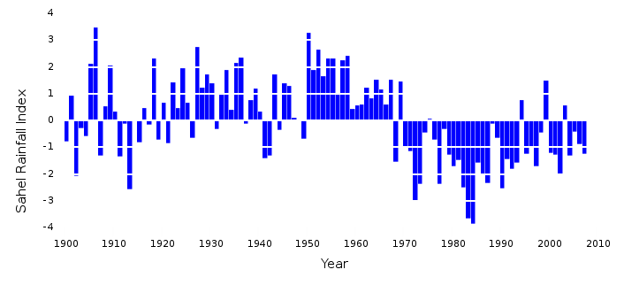
Impacts of the AMO on Sahel region:
Rainfall and vegetation response
Satellite’s measure the
vegetation cover.
A greening trend has been observed from 1982 to 1999
overlaid Sahel rainfall
Sahel rainfall index
Notes:
Note: the Sahel rainfall and vegetation change maps are from Wikipedia
Retrieved 2016-11-01
https://en.wikipedia.org/wiki/Sahel_drought
The 1960-1980s had devastating impacts on the food production and food supplies
In the affected countries.

Slide 13
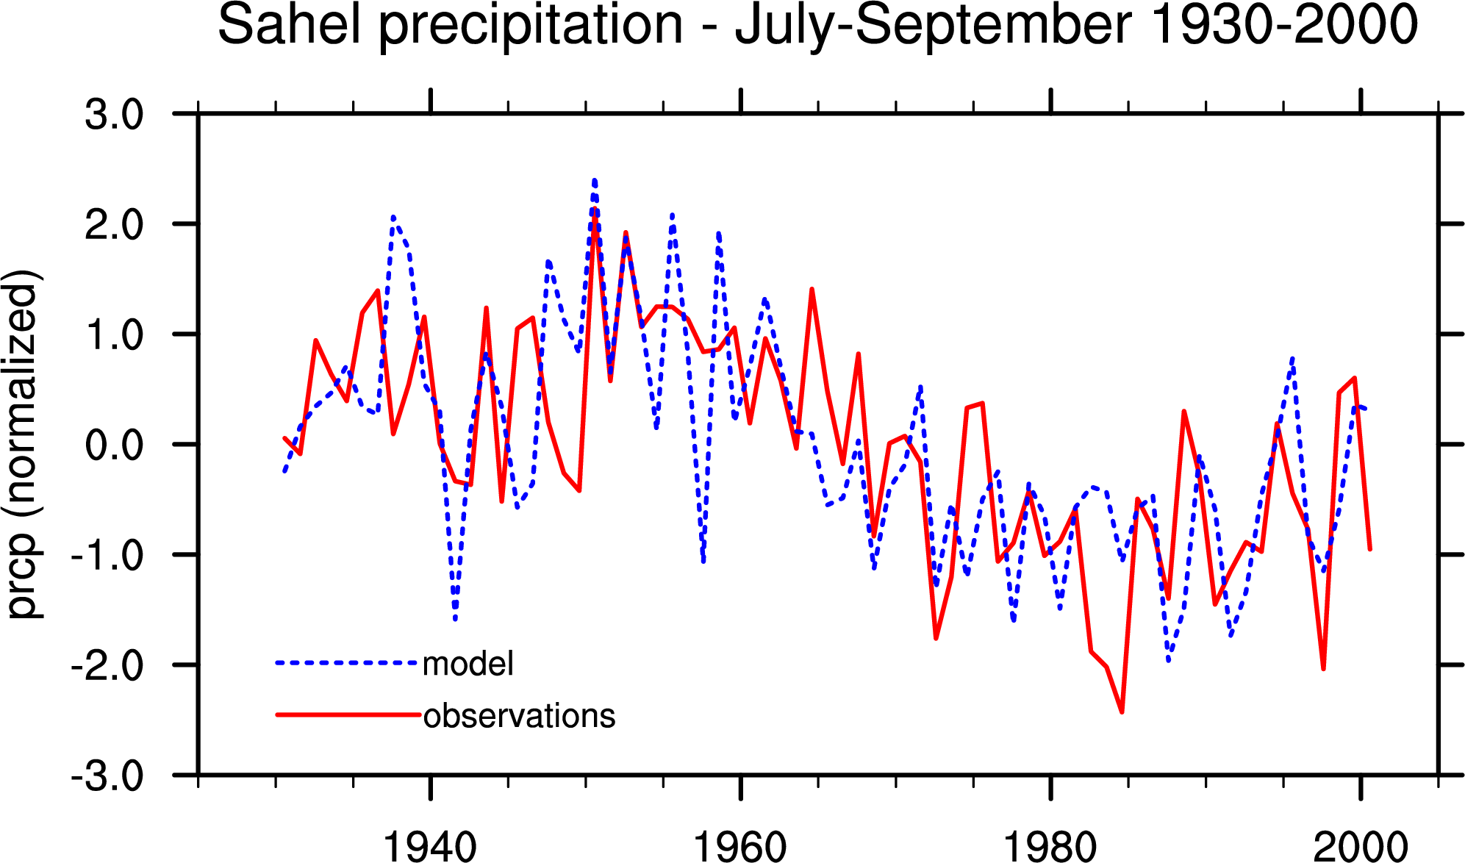
Climate simulation of Sahel rainfall
Climate simulations with prescribed ocean SSTs (taken from observations) reproduce the long-term variations
Correlation score r = 0.60
=> Prediction of the ocean SST developments would allow to predict the multi-decadal rainfall anomalies.
Notes:
Slide material from a PPT “Oceanic forcing of Sahel rainfall
on interannual to interdecadal time scales”
Author: A. Giannini (IRI)
R. Saravanan (NCAR) and P. Chang (Texas A&M)

Slide 14
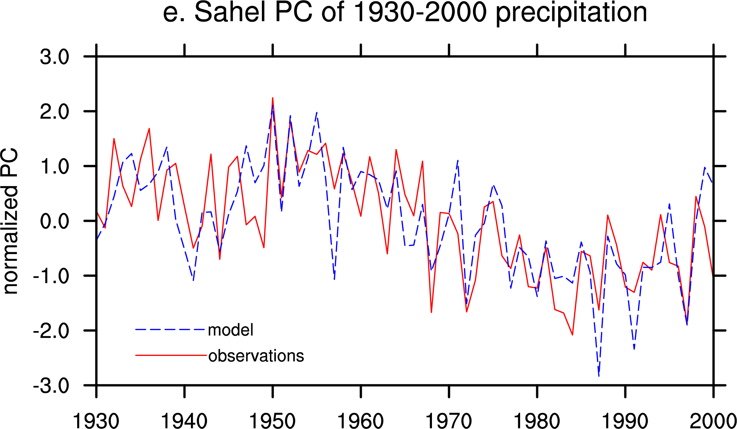
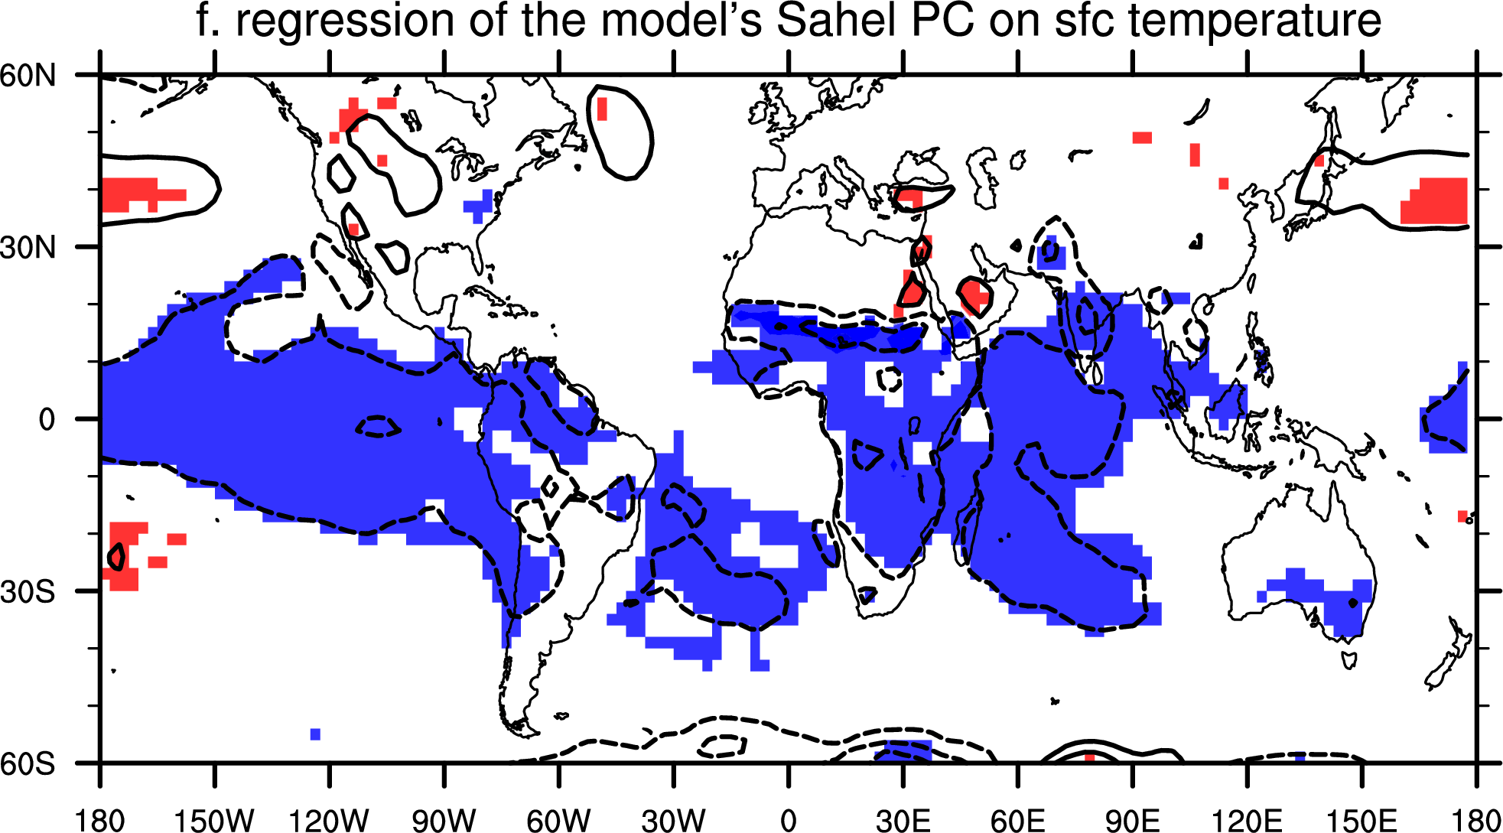
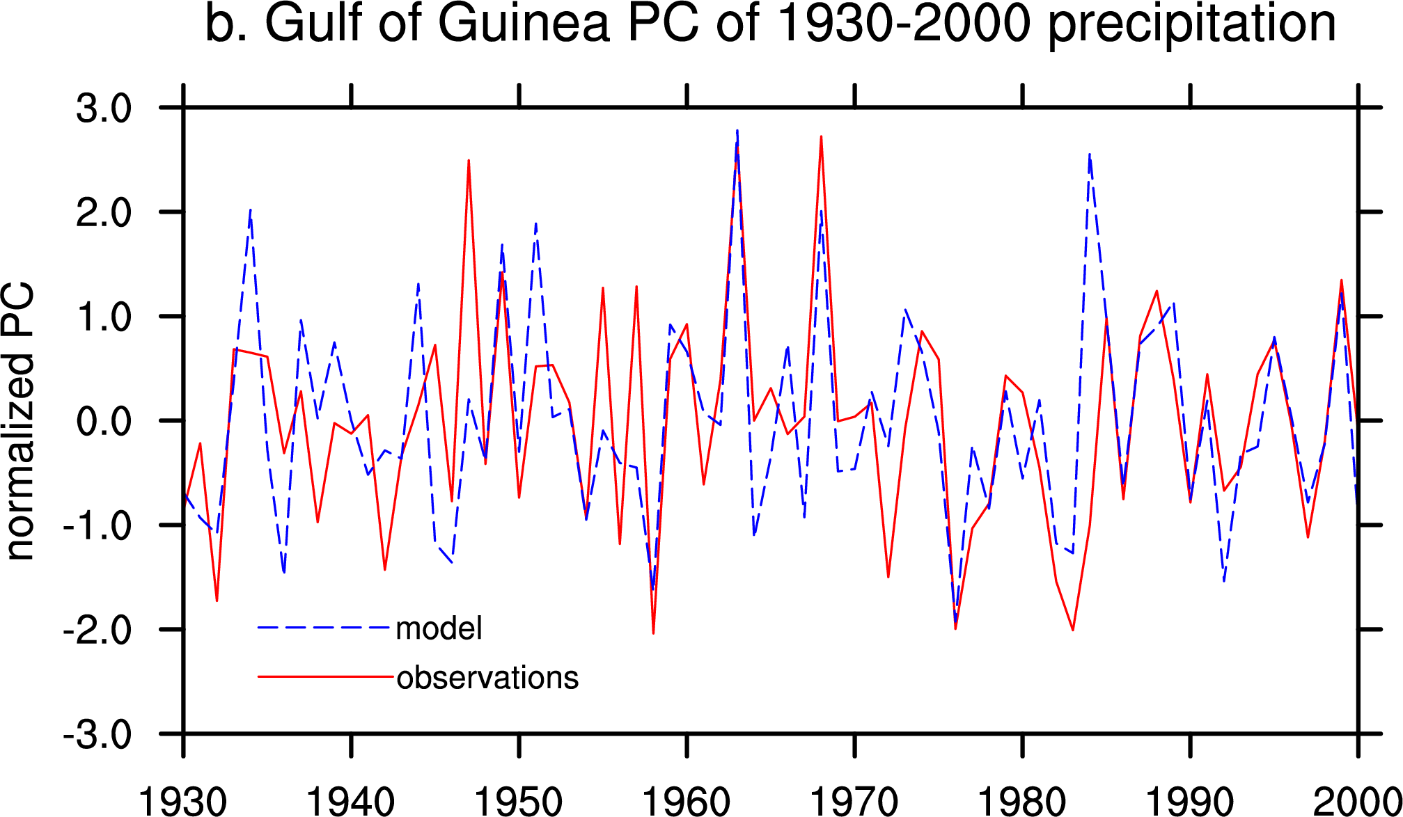
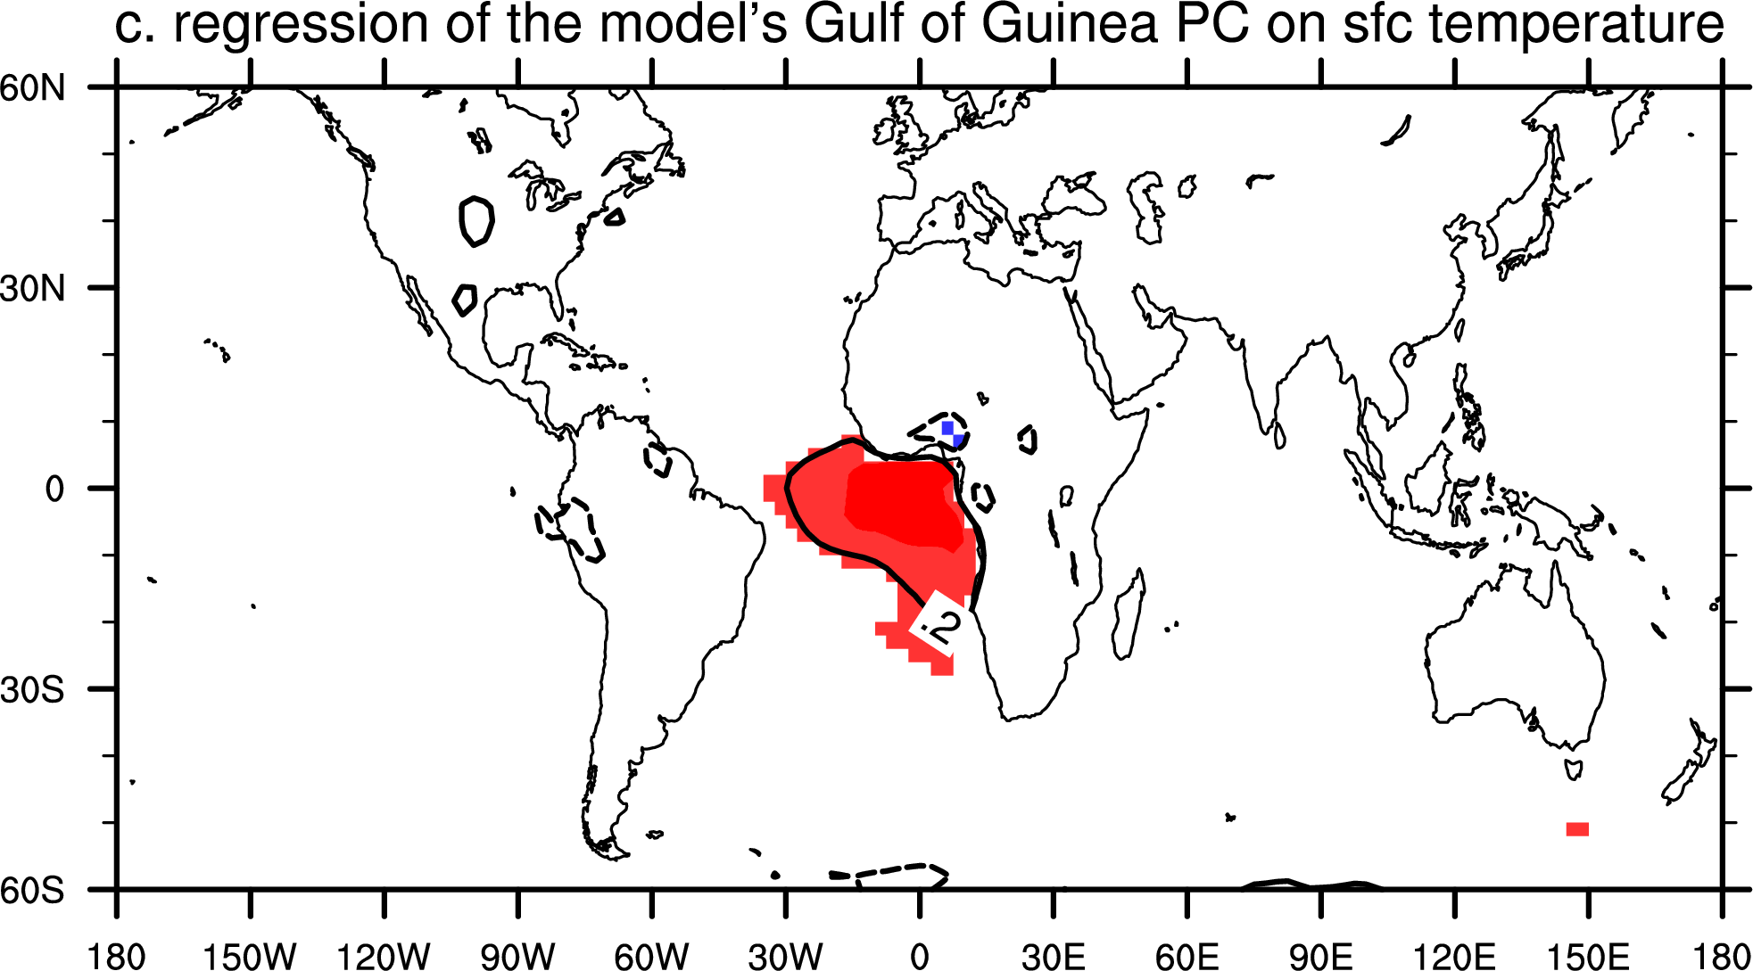
Sahel’s interannual is rainfall variability
is linked to the tropical ocean SST!
The blue-shaded areas indicate that year-to-year variations in Sahel rainfall actually are connected with the tropical Pacific and Indian Ocean! ENSO plays a crucial role for Sahel rainfall!
The low-frequency variations: the Atlantic SST becomes the important driver for Sahel rainfall variability!
Notes:
Slide material from a PPT “Oceanic forcing of Sahel rainfall
on interannual to interdecadal time scales”
Causality? AMO correlates well, but in the model simulation North Atlantic SST appears less important
Than tropical Pacific and Indain Ocean SST on driving the changes in Sahel rainfal. Other models show a much stronger connection between Atlantic SST and Sahel rainfall.l

Slide 15
Sahel rainfall and oceanic forcing
Summary AMO- Sahel Rainfall:
Interdecadal rainfall anomalies linked with AMO phases:
Negative AMO phase negative rainfall anomalies in Sahel
Positive AMO phase positive rainfall anomalies in Sahel
Variability in Sahel rainfall on interannual to interdecadal time scales is strongly influenced by SST variability (ENSO and warming trends)
Atmospheric model simulation can reproduce Sahel rainfall variability long-term changes when prescribing observed SSTs
These climate studies helped to better understand the causes of rainfall changes in this region (before land use practices and other human impacts on the environment were used to explain the Sahel droughts)
Notes:
The model experiments with prescribed SSTs are “hindcast experiments”: We know the SST anomalies from the past, but a true forecast would need to forecast SST anomalies and the atmospheric response.

Slide 16
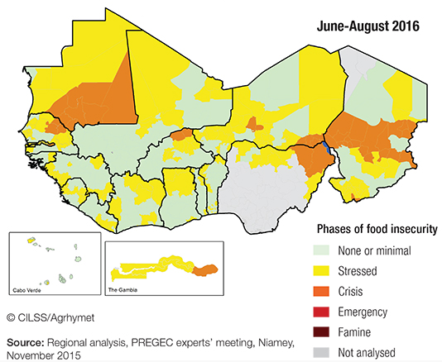
Extreme Sahel Droughts and food security
1970s/1980s:
Repeated and widespread drought conditions
Loss of crop and livestock
Famine, hunger and starvation in Sahel states
During/ in the aftermath of the crisis formation of the
Sahel and West Africa Club
International organization to foster regional governance, strengthen resilience against drought, improve food security (among other things)
Today’s monitoring of food and
nutrition standards

Slide 17
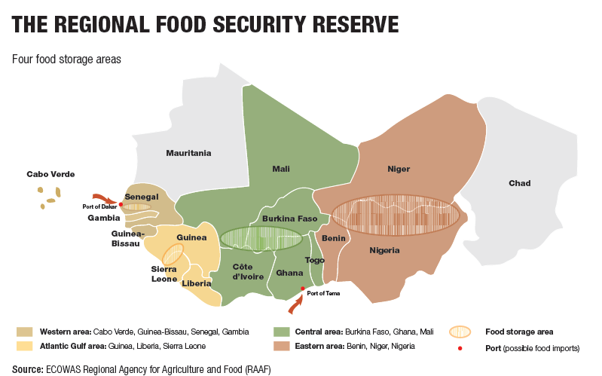
Class discussion (12 min)
How valuable could it be to the Sahel governments and organizations if they had an accurate climate prediction of the rainfall?
(a) A year ahead.
(b) some 10-20 years into future.
Which of the four objectives
(see handout article) would profit from climate predictions?

Slide 18
Indian Ocean Dipole
In the 1990s scientists examined the connection between Indian Ocean SST and rainfall in Africa, Indian, and the maritime region in the Indo-Pacific
Catastrophic rains of 1961 in tropical eastern Africa were part of an anomalous climate state over the tropical Indian Ocean:
warmer than usual SST over large parts of the western basin
SST off Sumatra were cooler than usual
Rainfall increased over tropical eastern Africa and western Indian Ocean
India experienced very high summer monsoon rainfall
Decreased rainfall over the Indonesian archipelago (resulting in severe drought)
Equatorial surface winds weakened and reversed direction (in a normal summer season blow towards the east)
There was no El Niño in the Pacific that year

Slide 19
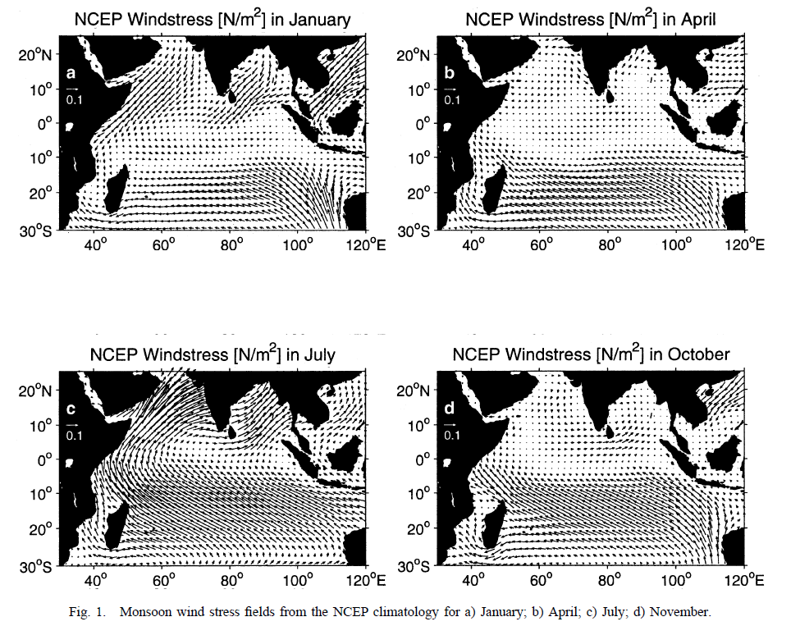
Windstress Climatology
Notes:
From Schott and McCreary:
Progress in Oceanography 51 (2001) 1–123
Wind stress shows strong seaonality due to the monsoon circulation.
April and October: Equatoral Indian ocean experiences winds that cause a weak westerly wind stress

Slide 20
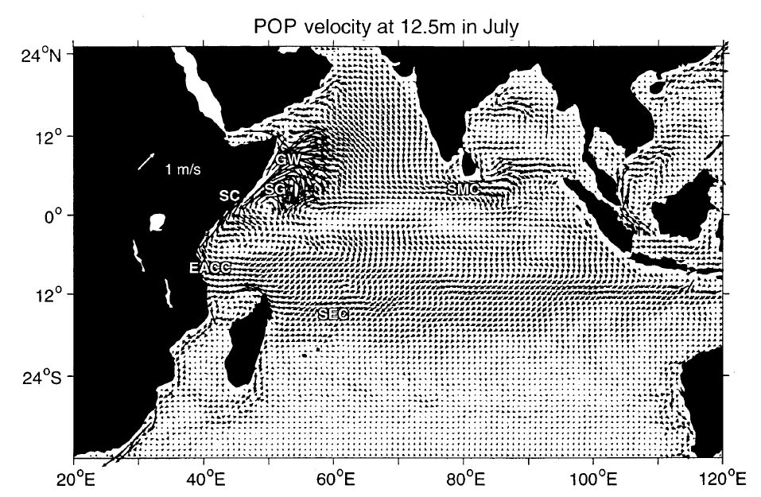
NH Summer
South Equatorial Current
Ocean Model near surface currents
Notes:
From Schott and McCreary:
Progress in Oceanography 51 (2001) 1–123
July model simulated surface currents.

Slide 21
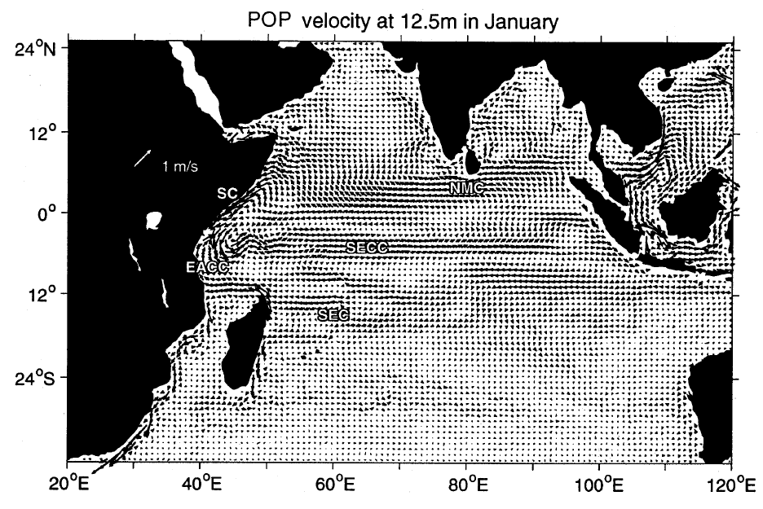
NH Winter
South Equatorial
Counter Current
Notes:
From Schott and McCreary:
Progress in Oceanography 51 (2001) 1–123
January model simulated surface currents.
Important for the Indian Ocean Dipole.
The SECC brings warm waters to the cold regions off Sumatra and helps to end an IOD
event.

Slide 22
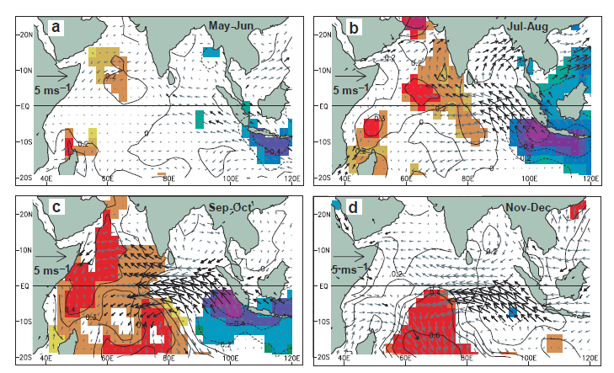
Indian Ocean Dipole
Seasonal evolution of a dipole event (Saji et al., Nature, 1999):
May-June
Jul-Aug
SST anomalies
(colors)
Windstress
Anomalies
(vectors)
Sep-Oct
Nov-Dec

Slide 23
Key mechanisms
Cold anomalies emerge in Lombok Strait south off Sumatra spread along the coast towards equator
Wind anomalies parallel to Sumatra's coast → upwelling
Easterly wind anomalies further cooling
In western Indian Ocean more convergence of warm waters, more convection
Similar to the Walker Circulation of the Pacific.
However the strong seasonal monsoon circulation interferes with the Bjerknes feedback, and equatorial ocean dynamics.
Peak SST anomalies during summer months (Jul-Sep)

Slide 24
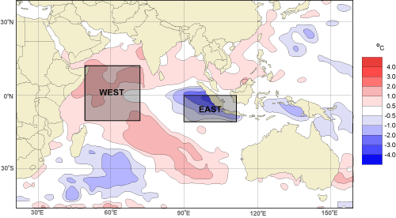
Indian Ocean Dipole
Dipole Mode Index (DMI):
difference in SST anomaly between the tropical western Indian Ocean (50E-70E, 10S-10N) and the tropical south-eastern Indian Ocean (90E-110E, 10S-0S).

Slide 25
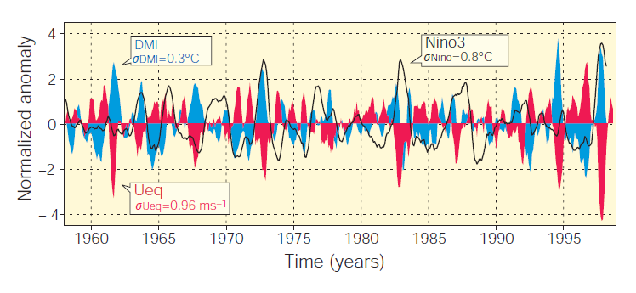
Indian Ocean Dipole impacts on rainfall
blue Dipole Mode Index
black, Nino-3 index
red equatorial wind anomalies (zonal wind area-averaged equatorial
zonal wind anomalies (Ueq) over this region (70E-90E, 5S-5 N)

Slide 26
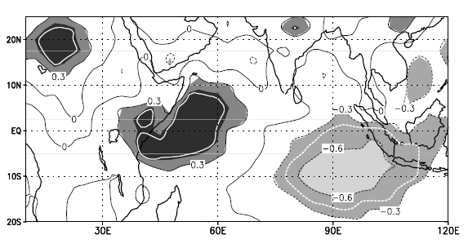
Indian Ocean Dipole impacts on rainfall
Correlation between Dipole Mode Index and rainfall 1979-1998
(summer season)

Slide 27
Further references for Indian Ocean Dipole
Saji N.H., Goswami B.N., Vinayachandran P.N., Yamagata T., 1999: A dipole mode in the tropical Indian Ocean, Nature, 401, 360-363
http://www.bom.gov.au/climate/IOD/about_IOD.shtml

Slide 28
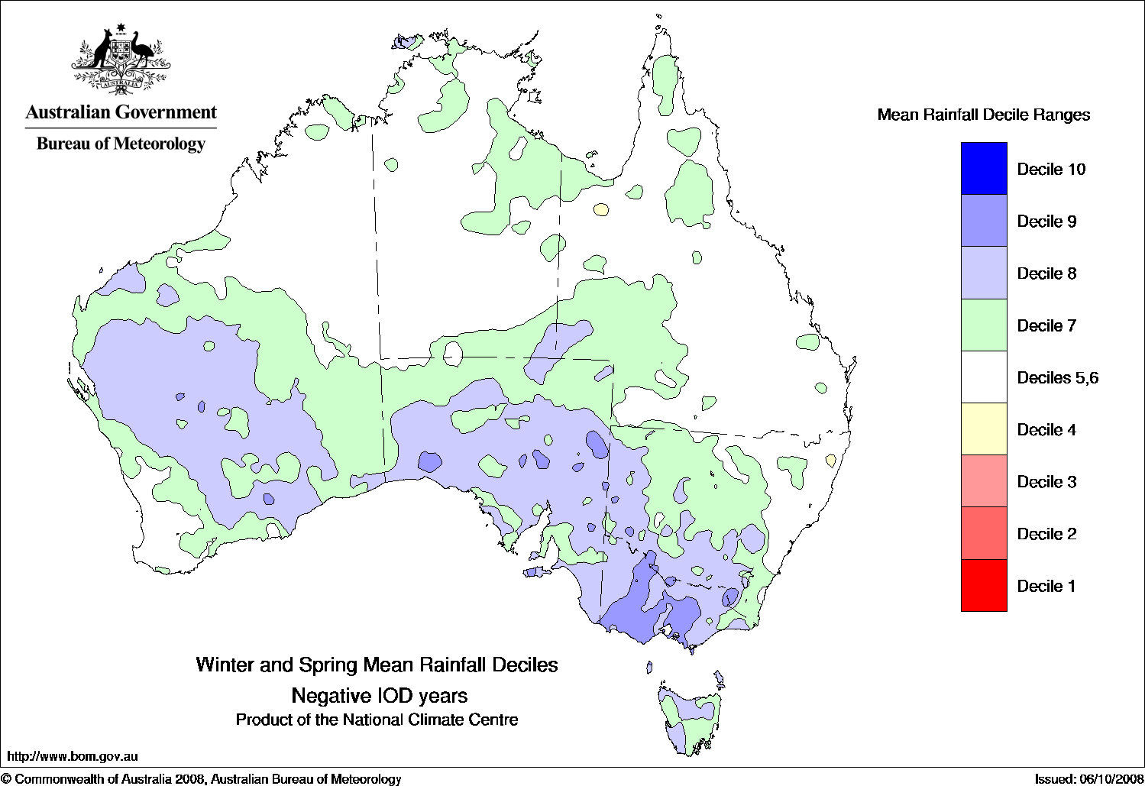
Impacts on Australian Rainfall
Austral winter and spring rainfall deciles during negative IOD years

Slide 29
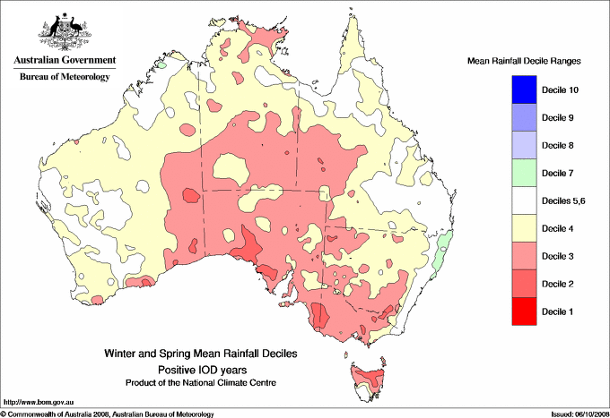
Impacts on Australian Rainfall
Austral winter and spring rainfall deciles during positive IOD years

Slide 30
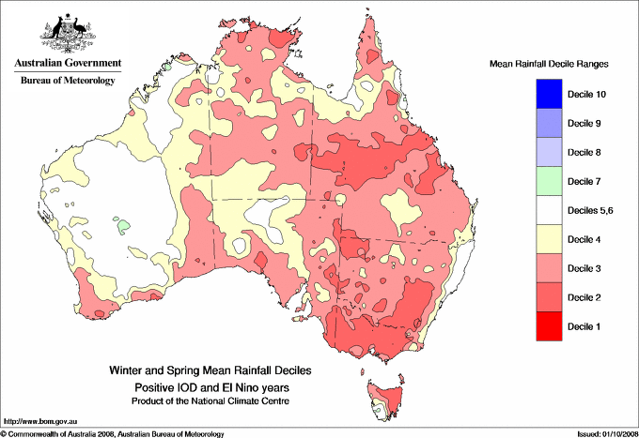
Impacts on Australian Rainfall
Austral winter and spring rainfall deciles during positive IOD
and El Niño years

Slide 31
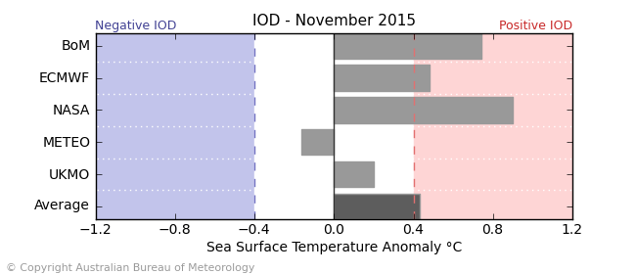
Seasonal prediction of IOD
Different models used for seasonal predictions (e.g. for ENSO) show neutral
conditions for the upcoming December, but the confidence is not as high as for ENSO
Forecasts.
http://www.bom.gov.au/climate/ahead/model-summary.shtml#tabs=Indian-Ocean

Slide 32
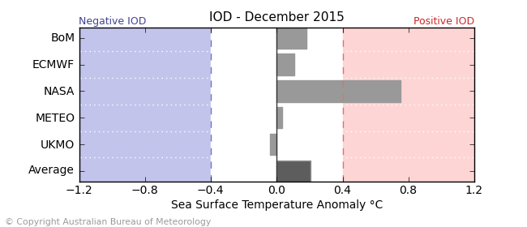
Seasonal prediction of IOD
Different models used for seasonal predictions (e.g. for ENSO) show neutral
conditions for the upcoming December, but the confidence is not as high as for ENSO
Forecasts.
Dec (Jan): peak months for ENSO, but IOD in decline
http://www.bom.gov.au/climate/ahead/model-summary.shtml#tabs=Indian-Ocean

Slide 33
Summary: Climate modes of variability
Tropical climate modes
Extratropical climate modes
Atmosphere
Atmosphere
Ocean
Ocean
Coupled Modes:
Atmospheric anomalies
force ocean anomalies
and ocean anomalies force
atmospheric anomalies
Atmosphere
Atmospheric anomalies
force ocean anomalies
ocean anomalies weak affect on atmosphere

Slide 34
Summary: Climate modes of variability
Tropical climate modes
Prediction of the system:
Seasonal forecast
Initial state of the ocean and atmosphere must be known (observations)
Non-linear (chaotic) systems:
Small errors grow with time
Ensemble predictions
(start from slightly different initial states)
Atmosphere
Ocean
Modeled variable (e.g. SST anomaly)
Forecast time

Slide 35
Summary: Climate modes of variability
Extratropical climate modes
Prediction of the system:
Seasonal forecasts to decadal
Initial state of the ocean (sea ice, land snow, soil moisture) must be known (observations)
Non-linear (chaotic) systems:
Small errors grow with time
Atmosphere internal random variability
Ensemble predictions
(start from slightly different initial states)
Atmosphere
Ocean
Modeled variable (e.g. SST anomaly)
Climate dynamics
(ongoing research?)
‘Memory effect’
Forecast time

