Slide 1
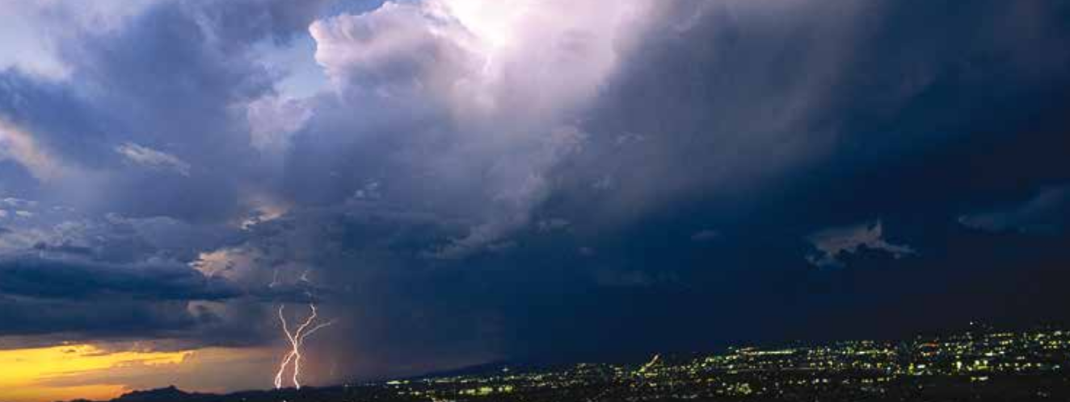
NLDN Data Processing
Dave Vollaro
March 7, 2017

Slide 2
History
Originated here at SUNY Albany in the late 1980’s under the direction of Dr. Richard Orville
Dr. Vince Idone conducted experiments using video and rocket-triggered lightning to validate flash detection accuracy.

Slide 3
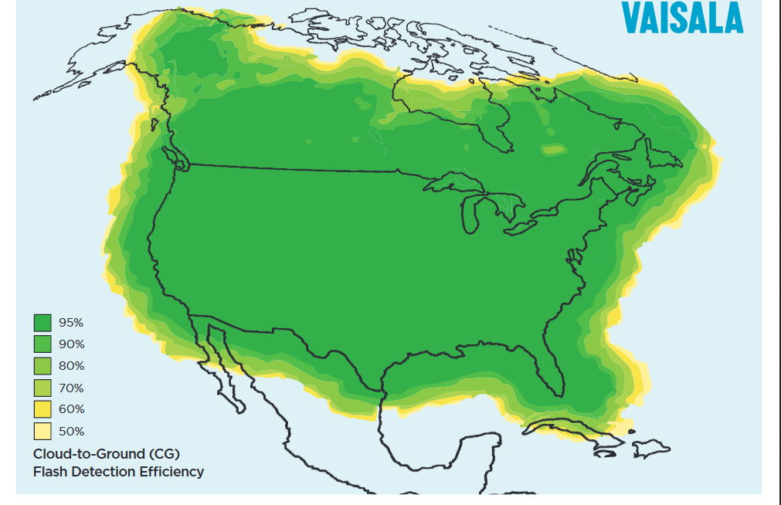
Network Description and Characteristics
Uses magnetic direction finders and time-of-arrival measurements to detect lightning strokes.
Strokes are detected by several sensors and their position is triangulated.
Stroke data can be converted to flashes using a time/distance algorithm.
Can detect nearly all thunderstorm activity
Cloud-to-ground(CG) detection efficiency > 95%
Cloud-to-ground(CG) location accuracy 500m
Intercloud(IC) flash detection efficiency <50%
Over 20million flashes detected annually
2016 Lightning Coverage Map

Slide 4
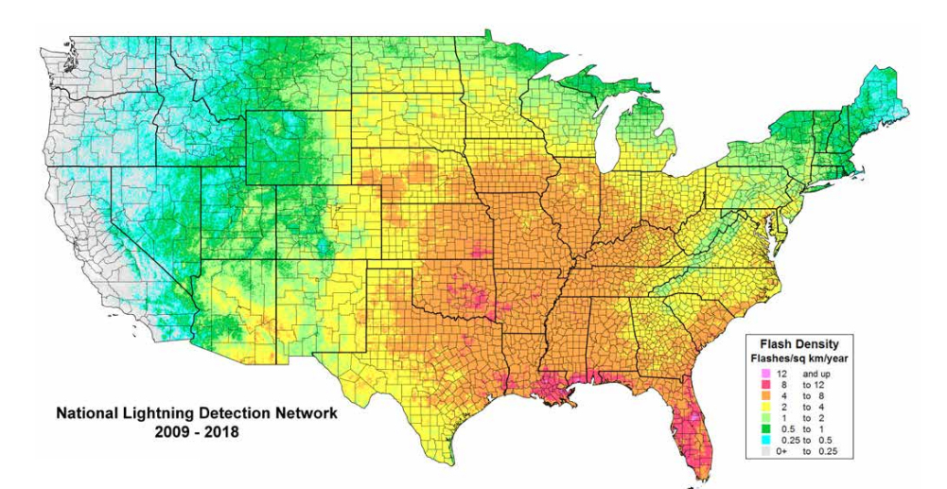
US Cloud-to-Ground Flash Density Map
2009-2017
Courtesy of Vaisala

Slide 5
Annual Distribution of Lightning Activity
Holle and Cummins, 2010

Slide 6
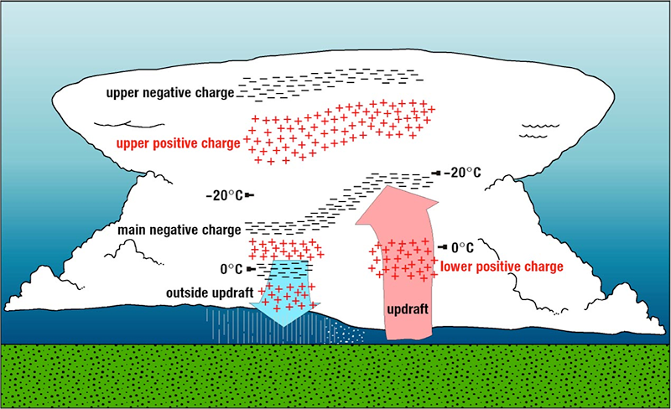
How do Flashes Occur?
Lightning flashes occur when the charge separation within the cloud or between the cloud and the ground below reaches a critical threshold.
Courtesy NSSL

Slide 7
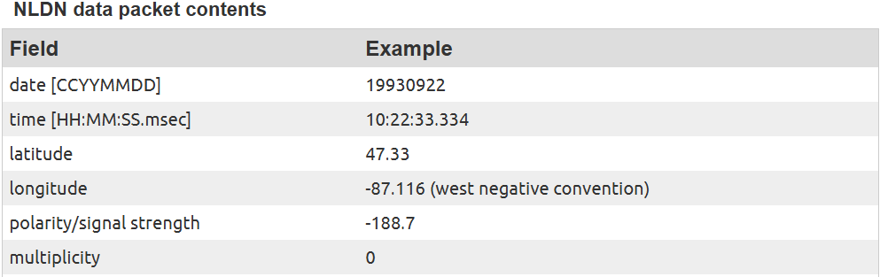
About the Data
We receive monthly data files from Vaisala which are archived locally.
These files must be preprocessed in order to be put into a usable form
Flash file final format: Each flash record contains 6 ASCII fields

Slide 8
Data Processing
**Data script must be run on Solaris Platform
Include the following lines in your .cshrc login file:
setenv NLDNBIN /apps/sparc/nldn/bin
setenv NLDNGAI /apps/sparc/nldn/gai
setenv DATEMSK /usr/local/etc/datemsk
set path=($path $NLDNBIN $NLDNGAI)
For this tutorial please copy files from /jm13/djv/jmdisks/jm1/students/sarah/flash into your work dir

Slide 9
Data Processing
Run UNIX script NLDN-flash_process.sc to convert a raw input file in DF format into ASCII flash records.
SAMPLE OUTPUT RECORD
05/31/13 20:07:37.247 36.8020 -96.2315 -78.1 01
date time lat lon RNSS multiplicity
This script can be edited where user changes input parameters or run in interactive mode where user in prompted for input.

Slide 10
Editing the Data Processing Script
########################################## *Blue text is user changeable input
# VARIABLE SETUP SECTION #
##########################################
echo "Enter raw flash input file"
set rawfile = “9707_2.dff” #NAME OF RAW INPUT TO PROCESS
echo "Enter output dir path"
set outpth = “/jm13/djv/nldn/data/” #DIRECTORY WHERE OUTPUT IS STORED
set ofile = $outpth$rawfile".asc“ #OUTPUT WILL HAVE SAME NAME AS INPUT
#BUT WITH “.asc” EXTENSION
set date1 = “07/16/97 00:00:00“ #INITIAL TIME TO PROCESS YY/MM/DD HH:MM:SS
set date2 = “07/22/97 23:59:59” #FINAL TIME TO PROCESS YY/MM/DD HH:MM:SS
set wlon = -150 #AREA TO RETRIEVE DATA( WEST/EAST LON
set elon = -40 #SOUTH/NORTH LAT)
set blat = 0
set ulat = 55

Slide 11
Running the Data Processing Script
To execute this script type:
csh NLDN-flash_process.sc
  Follow the interactive prompts
Once processed will get two ASCII output files:
9707_1.dff.asc Holds all flashes in desired time period
9707_1.dff-gt15kA.asc Removes positive flashes weaker than 15kA (IC)

Slide 12
Self Practice
Try editing this script and retrieving data for the period June 1 2013 at 12UTC through June 3 2013 at 6UTC over the area covering the state of Florida.

Slide 13
Practice Processing Script
########################################## *Blue text is user changeable input
# VARIABLE SETUP SECTION #
##########################################
echo "Enter raw flash input file"
set rawfile = “1306_1.dff” #NAME OF RAW INPUT TO PROCESS
echo "Enter output dir path"
set outpth = “/your path/” #YOUR OUTPUT DIRECTORY
set ofile = $outpth$rawfile".asc“
set date1 = “06/01/13 13:00:00“ #INITIAL TIME TO PROCESS YY/MM/DD HH:MM:SS
set date2 = “06/03/13 06:00:00” #FINAL TIME TO PROCESS YY/MM/DD HH:MM:SS
set wlon = -90 #AREA ENCOMPASSING FLORIDA
set elon = -79
set blat = 24
set ulat = 31

Slide 14
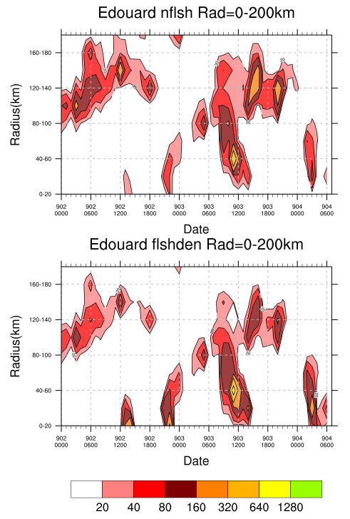
What can we do with this data?
I have developed several programs to display this data:
Radius time series of number of flashes and flash density on a storm centered cylindrical grid.
*NOTE: These programs are designed to run on a LINUX system

Slide 15
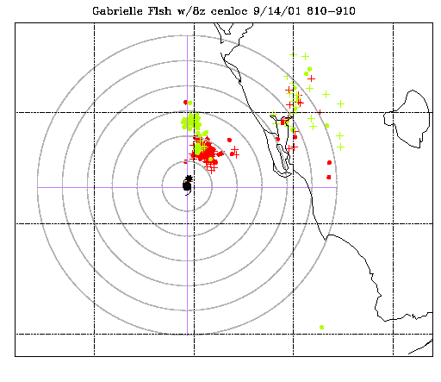
What can we do with this data?
I have developed several programs to display this data:
Radius time series of number of flashes and flash density on a storm centered cylindrical grid.
Plan plot of flash locations onto a map.

Slide 16
Command Line Parameters
The program to create a radius-time series is called with command line parameters
These are read in as input values by the program
Format: ncl name1=value name2=value program.ncl
Example: ncl color=‘”blue”’ radius=20 program.ncl
This command line imports variables color and radius into program:
String variables are enclosed by both single and double quotes (‘“string “‘)
Integer values need no quoting

Slide 17
Creating a Radius Time Series
Use program hov-2D-radtim-NLDN-pan-dum.ncl:
Command line:
ncl btime='“2002.0901.2330"' etime='“2002.0904.0630"' out_type='"png"' storm='“Edouard"' maxrad=200 dr=20 dt=60 flash_file=‘” 0209_1.dff-gt15kA.asc”’ hov-2D-radtim-NLDN-pan.ncl
  btime(string): beginning time to process. (year.mon+day.hr+min) *subtract dt/2 from time
  etime(string): ending time to process. (year.mon+day.hr+min) *add dt/2 to time
  out_type(string): type of output plot. Options=png,ps
  storm(string): Name of storm
  maxrad(integer): maximum radius from center to plot(km)
  dr(integer): Radial bin increment(km)
  dt: Time bin increment(minutes)
  flash_file(string): Name of input flash file processed by NLDN-flash_process.sc

Slide 18
Creating a Radius Time Series
The program hov-2D-radtim-NLDN-pan-dum.ncl has several default parameters which can be altered by editing lines in the “User Parameters” section. For now use the default values….
Using the command line in the previous slide will yield the following output:

Slide 19
Self Practice
Try running this program to create a radius-timeseries plot for Hurricane Danny (1997).
Group flashes into hourly 20km bins for the time range July 16 13UTC to July 19 01UTC.
Use flash file: /jm13/djv/nldn/9707_1.dff-gt15kA.asc

Slide 20
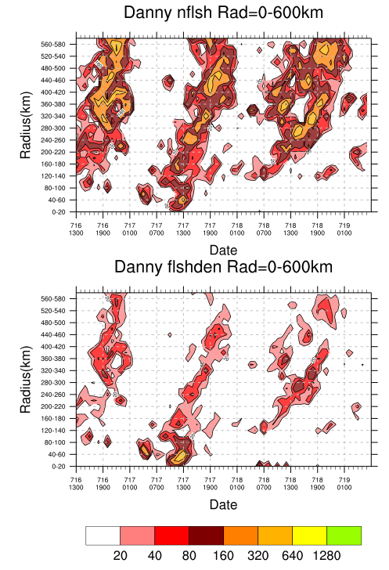
Timeseries Result
Command line:
ncl btime='"1997.0716.1130"' etime='"1997.0719.0130"' out_type='"png"' storm='"Danny"' maxrad=600 dr=20 dt=60 flash_file=‘” 9707_1.dff-gt15kA.asc”’ hov-2D-radtim-NLDN-pan.ncl

Slide 21
Plotting Flashes onto a Map
Program lgtplt-cfwnd-remap.exe will create a plot of flash locations onto an XY map color coding the flashes according to time.
Edit file lgtplt-cfwnd-remap.run with desired plot parameters
To run: lgtplt-cfwnd-remap.exe < lgtplt-cfwnd-remap.run

Slide 22
lgtplt-cfwnd-remap.run file (part 1)
1,1 !# tiles in idir,jdir *Things need to change for desired storm
1,1 !worksta type/id(def=1,1)
t !DEBUG FLAG
./lgtplt.namlst
./color-lgt.dat
f !latlon labelling flag
.012,.015,.02,.015,.01 !TITLE,LALOLAB,HURRSYM +/- FLSH SIZE(PAUS/1000)
1000,3000,4000,3000,3000 !MAP,HSYM,RANGCIRC,TEXT thickness (def=1000)
f !USER DEFINED COLOR PALATTE Flag
0,0,2,0,0 !MAP,HSYM,RANGCRC,TXT colors(0BLK,1WHT,2-15)
2,2000 !pos flsh sym typ+thickness(-,+,*,x,o,filled circ)
6,1000 !neg flsh sym typ+thickness(-,+,*,x,o,filled circ)
1 !# signal stratification bins
-9999.,9999.,11 !min/mx signal strength +coll -9999,9999 plts all
1 !PROJ CHC(1=MERC,2=LC)
-84.8,-80.6,24.8,27.8 !MAP BOUNDS (wlon,elon,blat,ulat)
26.34,-83.07 !storm center latlon
Gabrielle Flsh w/8z cenloc 9/14/01 810-910@ !Plot Title

Slide 23
lgtplt-cfwnd-remap.run file (part 2)
*Things need to change for desired storm
6 !# of range circles from center, if >0 followed by values(km)
25.
50.
75.
100.
125.
150.
2 !# of axes to plot if >0, list next
0,3000,3 !axis angle (deg ccw from north) thickness+COLOR
90,3000,3 !axis angle (deg ccw from north) thickness+COLOR
90,0,3000,2 !ticinc(deg ccw from N),+type(0=no,1=in,2=out,3=bth),thickness+COLOR
/jm13/djv/jmdisks/jm7/john/gabrielle01/light/gt10kA/gabrielle01-gt10kA.asc !datafile
0 !file source type 0=nldn,1=vaisala longrange
2 !NUMBER OF SUBDIVISIONS IN DESIRED TIME RANGE
010914/081000,010914/084059,15,15 !1ST,LAST TIME IN SUBRNGE and pos/neg FLSH COLS
010914/084100,010914/090959,10,10 !1ST,LAST TIME IN SUBRNGE and pos/neg FLSH COLS

Slide 24
lgtplt-cfwnd-remap.run file (part-3)
*Things need to change for desired storm
0 !wind flag (0=none;1=shear vector;2=overlay all winds)
/home11/staff/djv/flash/pltxy/data/shear.dat !wind file
990921/1800 !time to plot winds
t !Convert to kts (data in m/s)
0.5 !staff len in deg
999,999 !additional storm locs(999,999=omit
t !plot additional symbols(IF TRUE NEXTLINE=DATASET)
/home11/staff/djv/flash/pltxy/data/lgt-addtxt-rel08.dat
3 !PLOT RECON DATA PLT FLG(1=WND+VAL;2=COLCOD WND;3=NONE
rec01g-2min-9140810_0910-cmp-bt8z.fil
.007,1500 !size/thick of recon data
F !convert from m/s to kt(t/f)
0.09 !min staff len in deg
t !label move flag
f !plot flash sym key

Slide 25
Plotting Flashes onto a Map
To run: lgtplt-cfwnd-remap.exe < lgtplt-cfwnd-remap.run
Output file will be called gmeta
To convert this file to postscript:
  ctrans -d $ncdir/graphc/ps.portmax.color gmeta > file.ps
To convert this postscript file to png:
  convert file.ps file.png

Slide 26

Adding a wind vector onto plot
To run: Alter following lines in lgtplt-cfwnd-remap.run
1 !wind flag (0=none;1=shear vector;2=overlay all winds)
/home11/staff/djv/flash/pltxy/data/shear.dat0 !wind file
010914/1200 !time to plot winds
t !Convert to kts
0.5 !staff len in deg

Slide 27
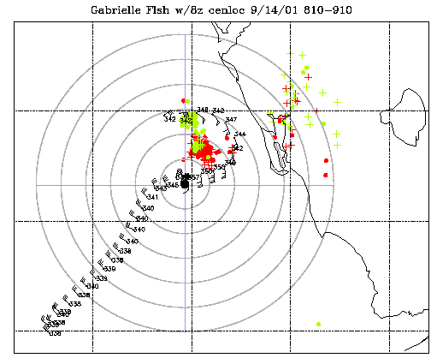
Adding recon winds onto plot
To run: Alter following lines in lgtplt-cfwnd-remap.run
1 !PLOT RECON DATA PLT
rec01g-2min-9140810_0910-cmp-bt8z.fil
.007,1500 !size/thick of recon data
F !convert from m/s to kt
0.09 !min staff len in deg
t !label move flag

Slide 28
Self Practice
Alter lgtplt-cfwnd-remap.run to create a plot with the following parameters:
Plot flashes in hourly bins from 17-20UTC on July 12 2003.
Make each hour of flash data a different color
Storm center =24.51N 90.88W
Plot range rings every 50km out to 150km
Plot shear data at 18UTC using file shear-03c.dat
Plot recon wind data from file recon-03c.dat
Use flash file: 0307_1.dff-gt15kA.asc
EXTRA:
increase size of hurricane symbol
increase size of recon winds
Change +/- flash symbols
Plot map lat/lon labels

Slide 29
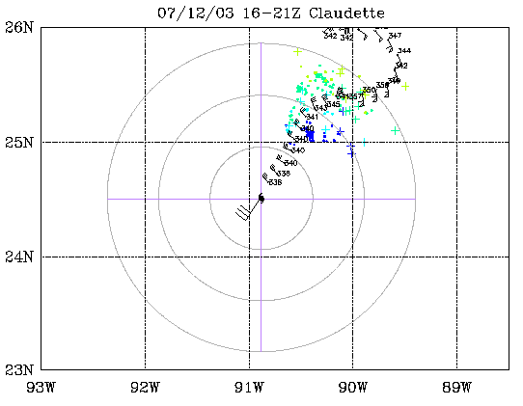
Result

Slide 30
Result
*Things need to change
*Extra
1,1 !# tiles in idir,jdir
1,1 !worksta type/id(def=1,1)
t !DEBUG FLAG
./lgtplt.namlst
./color-lgt.dat
t !latlon labelling flag
.012,.015,.02,.015,.01 !TITLE,LALOLAB,HURRSYM
1000,3000,4000,3000,3000 !MAP,HSYM,RANGCIRC,TEXT
f !USER DEFINED COLOR PA
0,0,2,0,0 !MAP,HSYM,RANGCRC,TXT color
2,2000 !pos flsh sym typ+thick(-,+,*,x,o,filled circ)
6,1000 !neg flsh sym typ+thick(-,+,*,x,o,filled circ)
1 !# signal stratification bins
-9999.,9999.,11 !min/mx signal strength +coll -9999
1 !PROJ CHC(1=MERC,2=LC)
-93.0,-88.5,23.,26. !MAP BOUNDS (wlon,elon,blat,ulat)
24.51-90.88 !storm center latlon
07/12/03 16-21z Claudette@ !Plot Title
3 !# of range circles from center,
50.
100.
150.
2 !# of axes to plot if >0, list next

Slide 31
0,3000,3 !axis angle (deg ccw from north) thickness+COLOR
90,3000,3 !axis angle (deg ccw from north) thickness+COLOR
90,0,3000,2 !ticinc(deg ccw from N),+type(0=no,1=in,2=out,3=bth)
./0307_1.dff-gt15kA.asc
0 !file source type 0=nldn,1=vaisala longrange
4 !NUMBER OF SUBDIVISIONS IN DESIRED TIME RANGE
030712/163000,030712/172959,05,05 !1ST,LAST TIME IN SUBRNGE + +/- FLSH COLS
030712/173000,030712/182959,07,07 !1ST,LAST TIME IN SUBRNGE + +/- FLSH COLS
030712/183000,030712/192959,08,08 !1ST,LAST TIME IN SUBRNGE + +/- FLSH COLS
030712/193000,030712/202959,10,10 !1ST,LAST TIME IN SUBRNGE + +/- FLSH COLS
0 !wind flag (0=none;1=shear vector;2=overlay all winds)
shear-03c.dat
030712/1800 !time to plot winds
t !Convert to kts (data in m/s)
0.5 !staff len in deg
999,999 !additional storm locs(999,999=omit
t !plot additional symbols()
/home11/staff/djv/flash/pltxy/data/lgt-addtxt-rel08.dat
1 !PLOT RECON DATA PLT FLG(1=WND
recon-03c.dat
.007,1500 !size/thick of recon data
F !convert from m/s to kt(t/f)
0.19 !min staff len in deg
t !label move flag
f !plot flash sym key

