Slide 1
Confessions of an Accidental Meteorologist: Meteorology Then, Now, and ???
Lance F. Bosart
97th American Meteorological Society Annual Meeting
Bosart Symposium
Thursday 26 January 2017
Seattle, Washington
Grateful for Decades of Support from NSF, NOAA, NASA, ONR, COMET, and UAlbany
Grateful for my seniors who looked out for me when I was younger and dumber

Slide 2
Research Opportunities Going Forward (I)
Large-scale Predictability:
  Subseasonal and regime-dependent (how to shade the climo PDF?)
  ENSO, MJO, Stratosphere (what drives what?)
Arctic Synoptic Meteorology:
  Storm tracks (how will they change going forward?)
  Arctic-midlatitude interactions (how are the governing synoptics changing?)
Mid-latitude Synoptic Meteorology:
  Clustered cyclones (what are the dynamics of cyclone clustering?)
  Dynamically linked, geographically separate extreme weather (governing dynamics?)
Tropical Synoptic Meteorology:
  “Cool” season rainstorms in the subtropics (role of antecedent mid-latitude circulations?)
  Synoptics of the MJO (what processes govern MJO onset and mid-latitude connectivity?)
Weather-Climate Intersection:
  Internal variability vs. external forcing (where is the boundary and how does it vary?)
  Extreme weather events (how to better determine subseasonal and seasonal forecast impact?)

Slide 3
Research Opportunities Going Forward (II)
Baroclinic Cyclones:
  Baroclinic cyclones in convective environments (how to connect the dynamical dots?)
  Dynamics and thermodynamics of the rain-snow line (is it mostly thermodynamics?)
Tropical Cyclones (TCs):
  TC-trough and TC-TC interactions (how to better understanding forecast sensitivity?)
  Recurving TCs that reintensify as midlatitude cyclones (dynamics vs. thermodynamics?)
Severe Weather and Mesoscale Heavy Rain Events:
  Mesoscale boundary evolution (dynamics, thermodynamics, and bottom boundary forcing?)
  Multiple convective life cycles (what governs convective mode, transition, and life cycles?)
Orographically Influenced Mesoscale Processes:
  Changing mountain “shape” (stability vs. wind shear, vs. cold-air damming?)
  Weather beyond the Froude number (how to link mesoscale and synoptic scale processes?)
Heat Waves and Droughts:
  Subtropical continental anticyclones (action at a distance vs. regional/local forcing?)
  Elevated mixed layers (dynamics vs. surface soil moisture anomalies and evapotranspiration?)

Slide 4
The California Deluge of 8–9 January 2017
Lance Bosart, Tomer Burg, and Alicia Bentley

Slide 5
Total Precipitation (mm): 1–23 January 2017
Source: NOAA Advanced Hydrologic Prediction Service

Slide 6
Percent of Normal Precipitation: 1–23 January 2017
Source: NOAA Advanced Hydrologic Prediction Service

Slide 7
California-Nevada River Forecast Center
Water Year Precipitation (inches) for North Sierras (left) and San Joaquin Sierras (right)

Slide 8
CFSv(2) and CPC Outlooks for Jan 2017 and Jan-Feb-Mar 2017

Slide 9
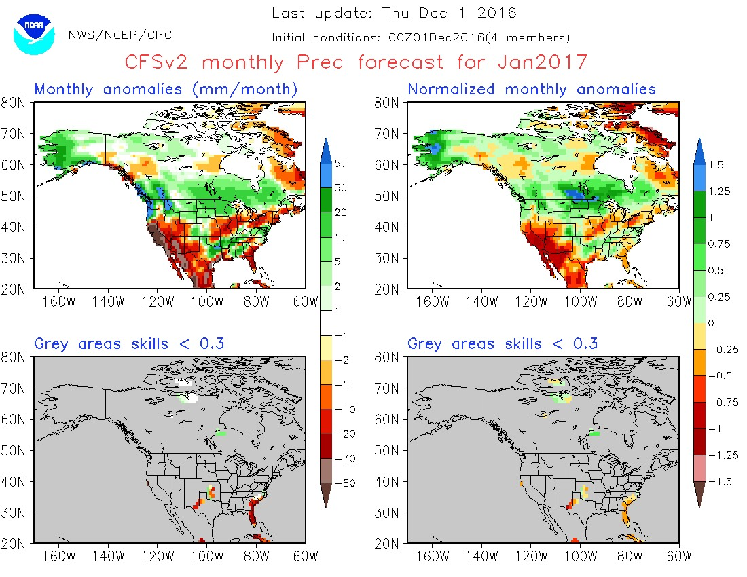

Slide 10
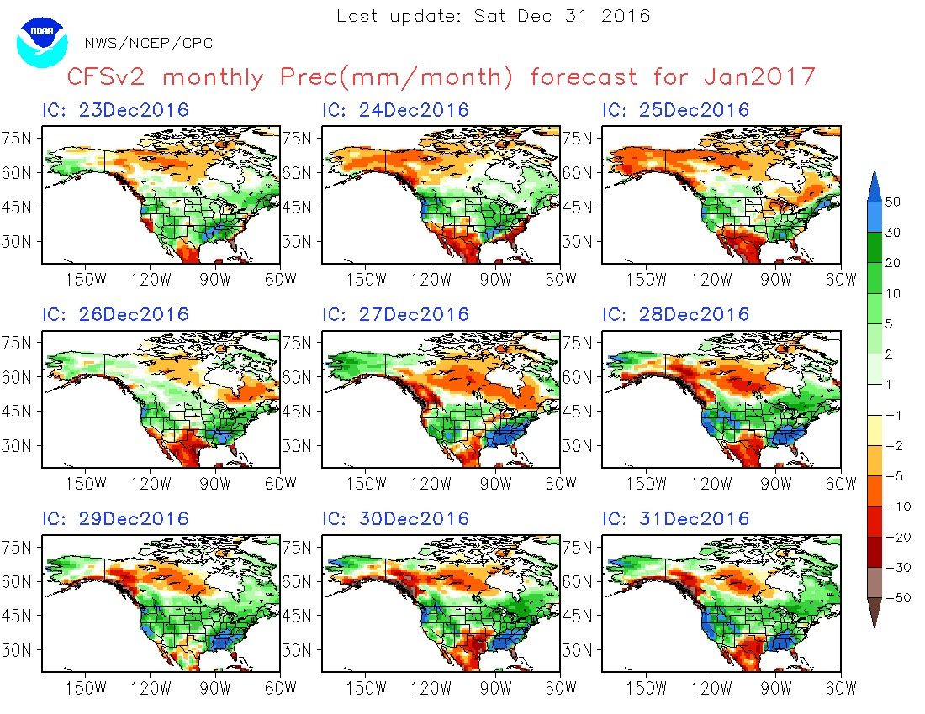

Slide 11
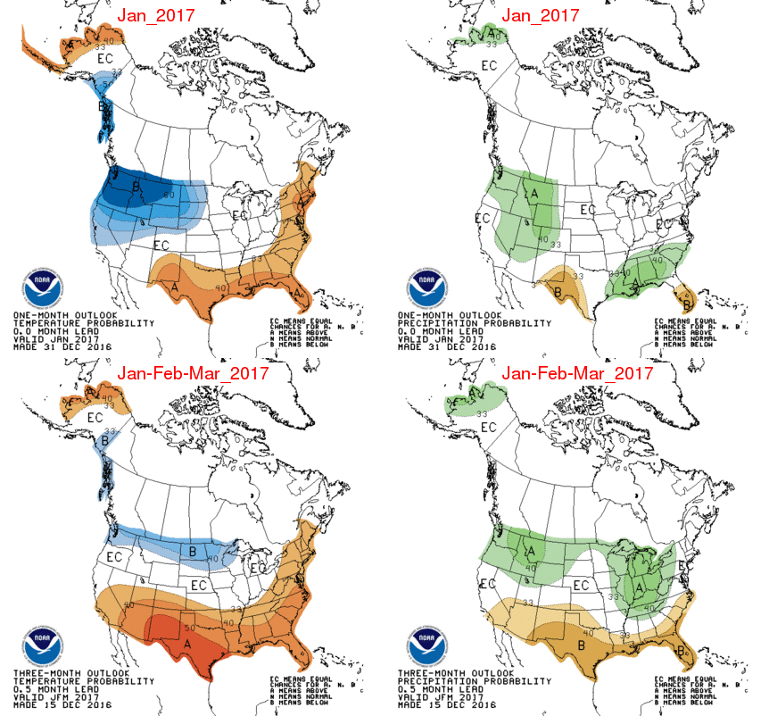
CPC Outlook
Top: 31 Dec 2016
Bot: 15 Dec 2016

Slide 12
North Pacific Loops for 31 Dec–15 Jan 2017
Dynamic tropopause (DT) potential temperature and winds, and 925–850-hPa layer-mean relative vorticity
500-hPa geopotential heights, relative vorticity, winds, and vertical motion (ascent only)
Mean sea level pressure, 1000–500-hPa thickness, and 250-hPa wind speeds (shaded above 50 m s⁻¹)

Slide 13
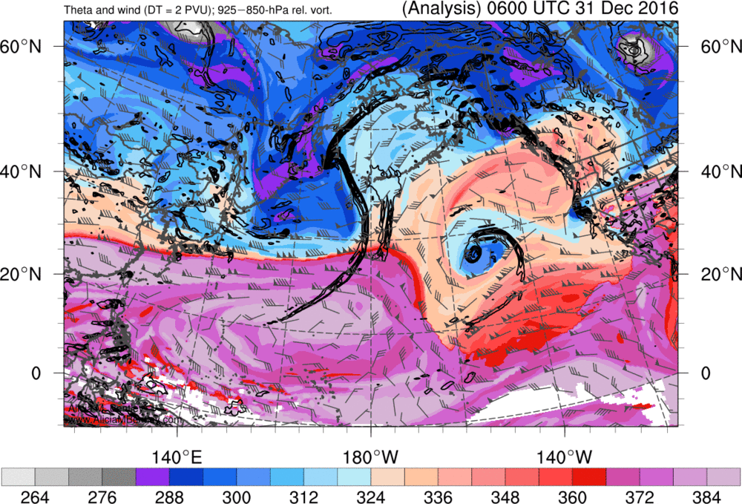
Source: Alicia Bentley

Slide 14
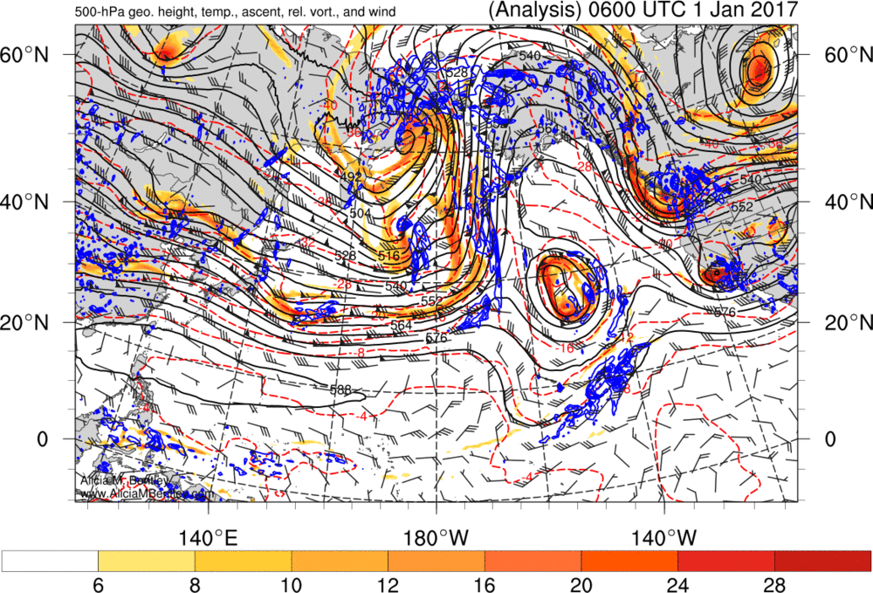
Source: Alicia Bentley

Slide 15
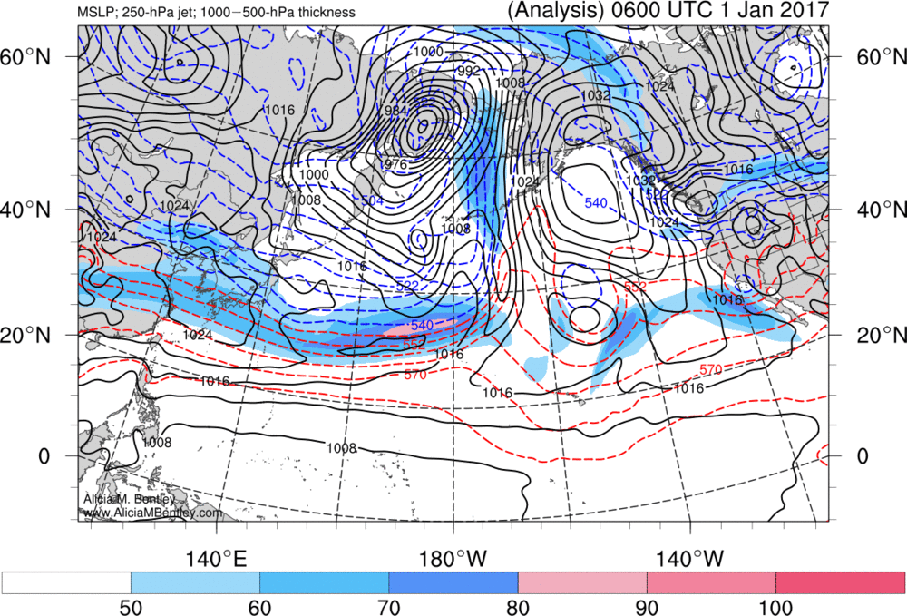
Source: Alicia Bentley

Slide 16
Loop Takeaways:
Blocking and cyclonic wave breaking (CWB) dominate higher latitudes
Anticyclonic wave breaking (AWB) occurs in westerlies below block
Alaskan block retrogrades to northeastern Russia in response to CWB
Trans-Pacific southern stream westerlies prevail south of the block
High-latitude, high-amplitude CWB occurs west of the Dateline
Low-amplitude AWB in the low-latitude westerlies east of Dateline
AWB induces southward trough extension (~5°N) west of Baja California
Aforementioned trough interacts with cutoff cyclone from the north
Result is a California deluge (and Portland snowstorm)

Slide 17
A d(prog)/dt Overview of the California Deluge of 8–9 January 2017 Based on GFS Deterministic Forecasts Verifying at 1200 UTC 8 January 2017
Lance Bosart and Tomer Burg

Slide 18
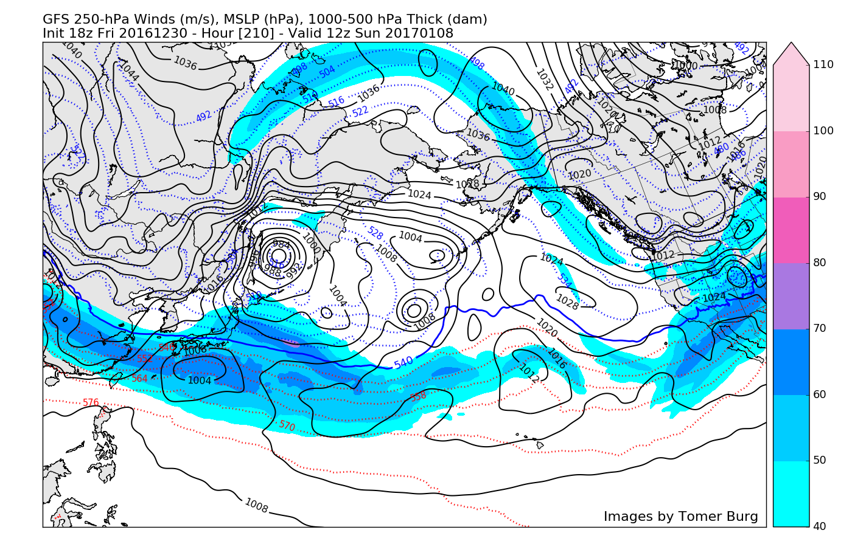
210 h GFS Forecast: Weak Pacific Flow and Absence of Westerly Flow toward California

Slide 19
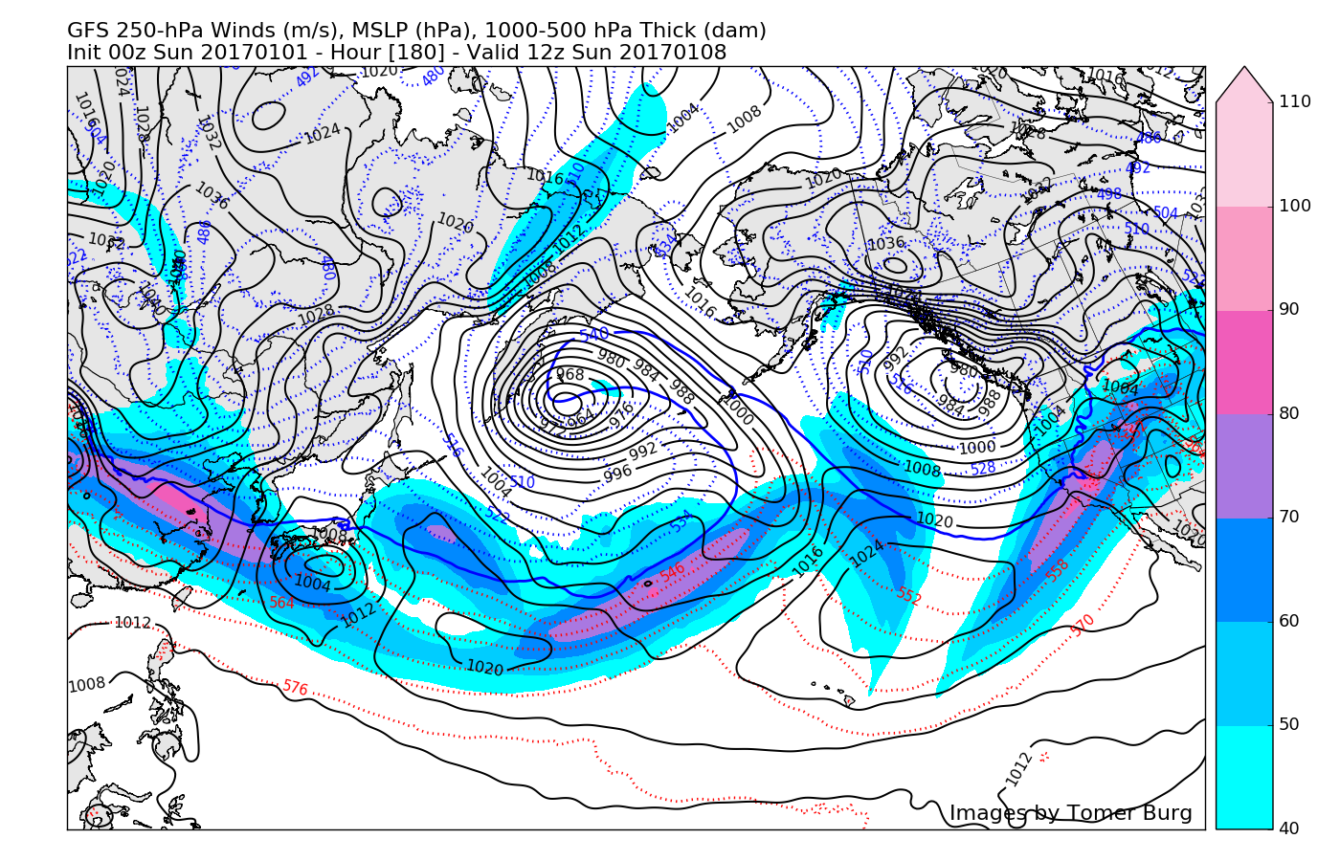
180 h GFS Forecast: Cyclones; California Jet Forms; Anticyclonic Flow over most of California

Slide 20
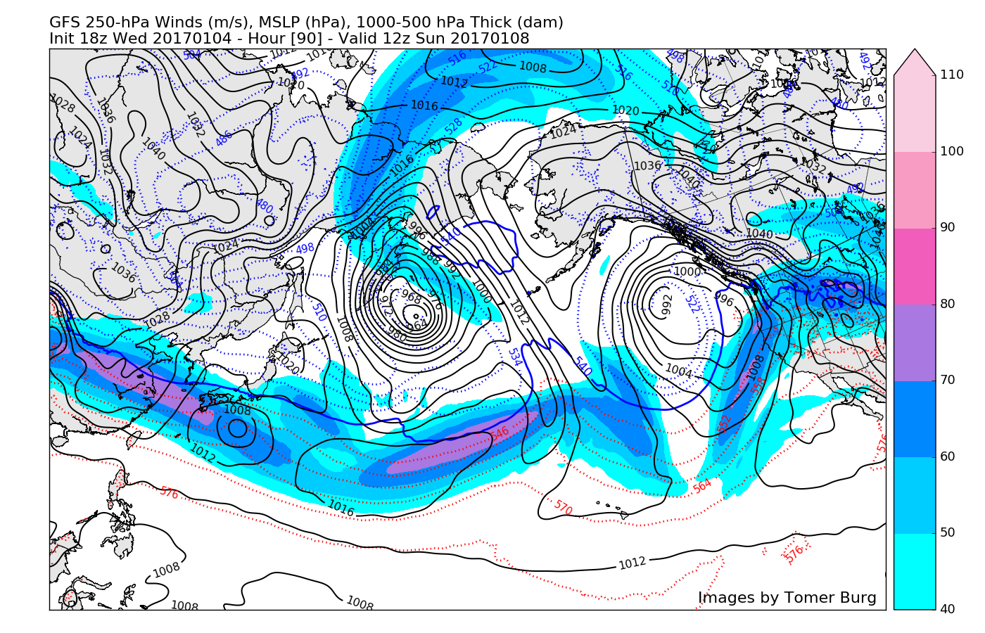
90 h GFS Forecast: EPAC Trough, Frontal System and Jet Axis Extend to Lower Latitudes

Slide 21
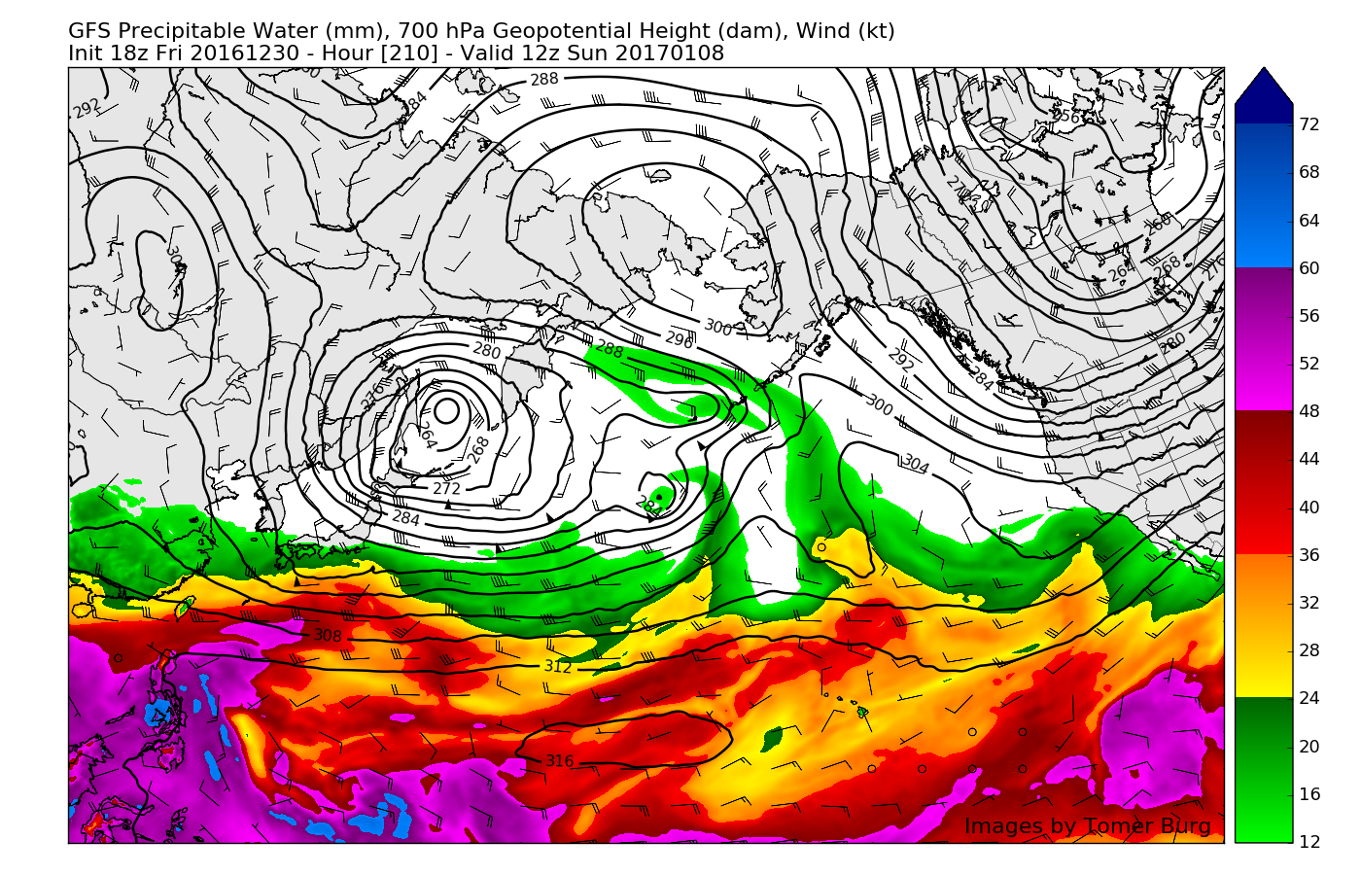
210 h GFS Forecast: Precipitable Water Remains Mostly Confined to the Tropics

Slide 22
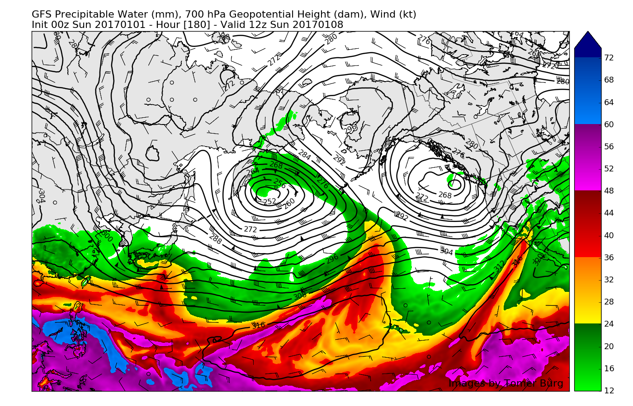
180 h GFS Forecast: Atmospheric Rivers are Evident in Central/Eastern Pacific

Slide 23
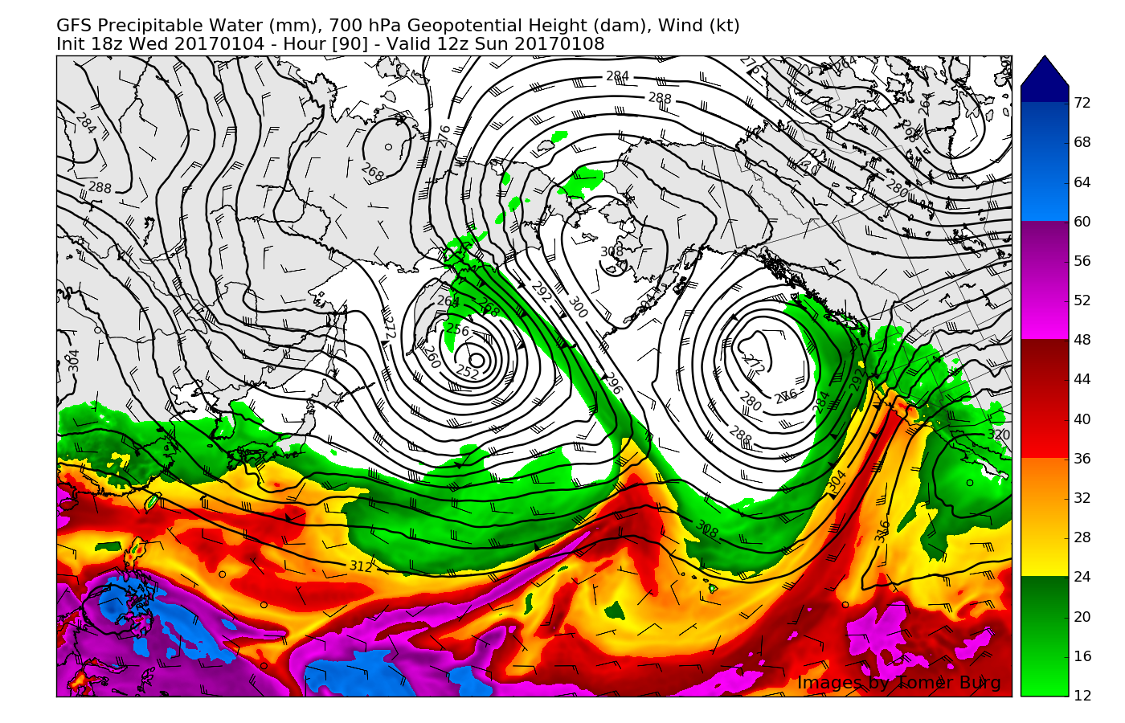
90 h GFS Forecast: Strong Easternmost Atmospheric River Targets Northern California

Slide 24
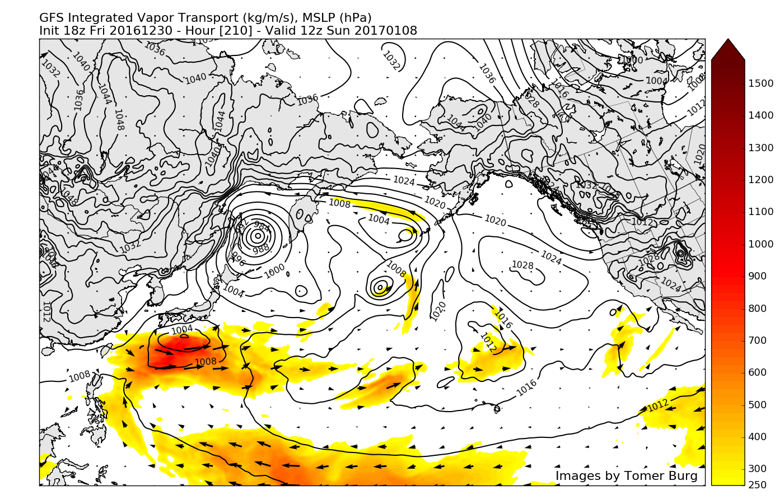
210 h GFS Forecast: Little Evidence for IVT Directed Toward West Coast

Slide 25
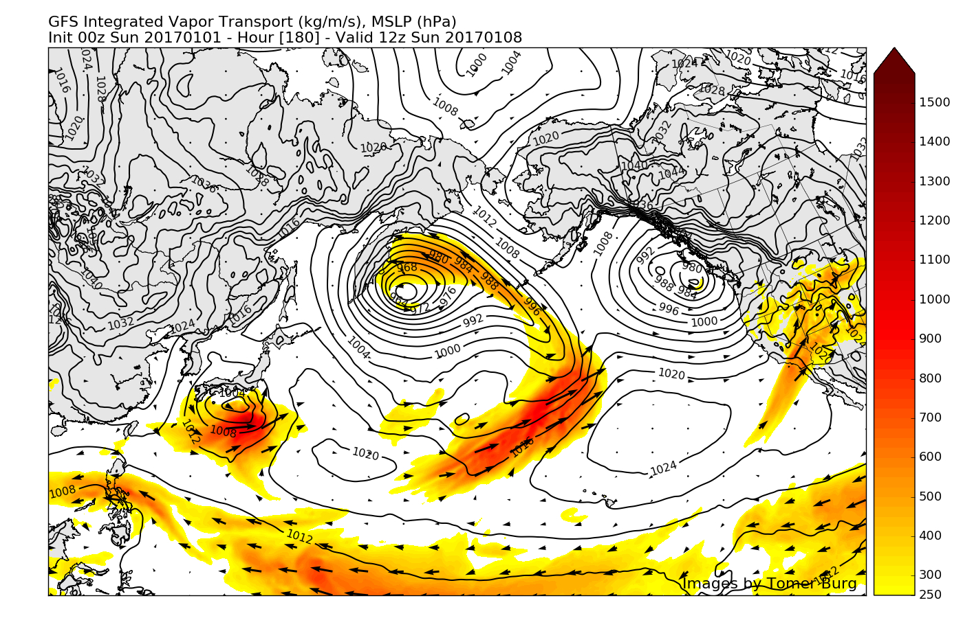
180 h GFS Forecast: Weak IVT is Directed Toward Southern California

Slide 26
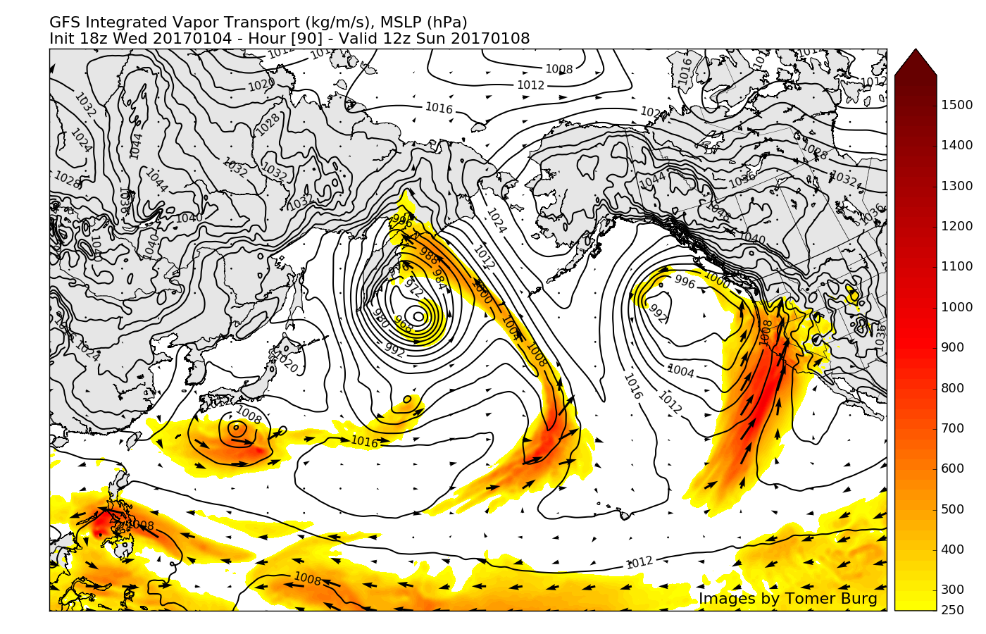
90 h GFS Forecast: Significant IVT shift toward northern California and Oregon

Slide 27
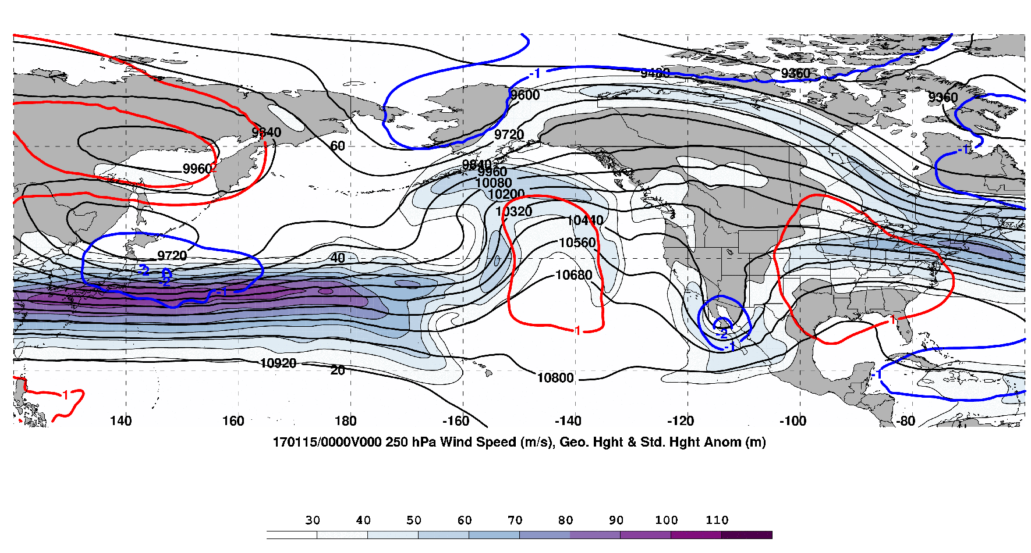
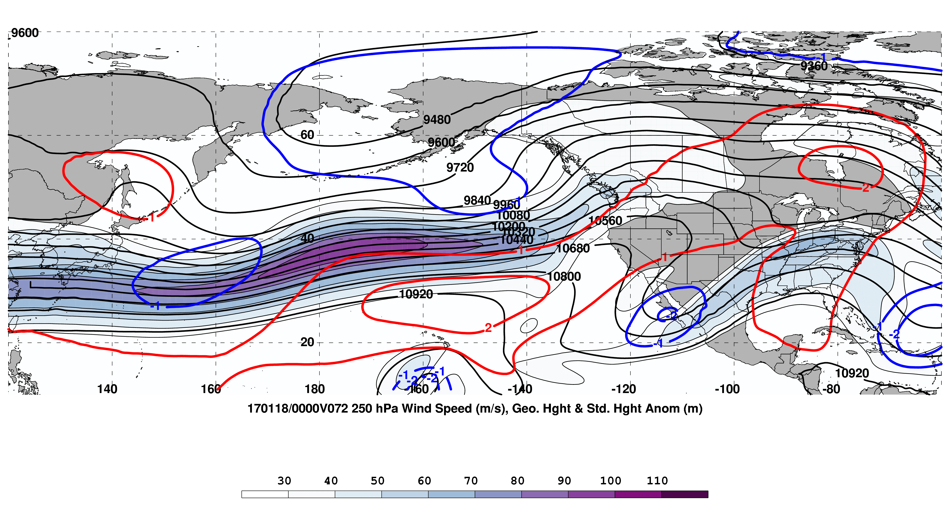
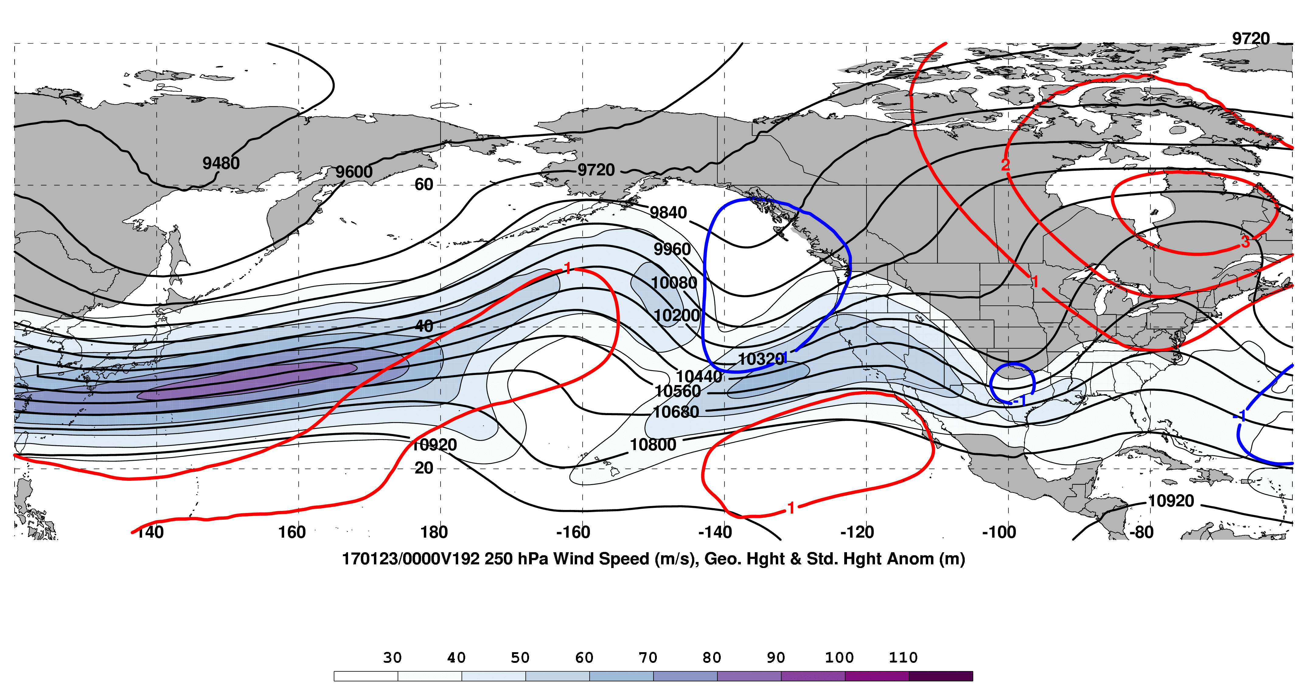
00-h Forecast valid 0000 UTC 15 Jan.
North Pacific Jet Phase Diagram
(Dr. Andrew Winters)
Left Column:
North Pacific Jet phase diagram probabilistic 9-day forecast
Right Column:
250-hPa wind speed (m s^{–1}; shading)
250-hPa heights (m; black)
250-hPa std. height anomalies (red; positive / blue; negative)
72-h Forecast valid 0000 UTC 18 Jan.
192-h Forecast valid 0000 UTC 23 Jan.
Link: http://www.atmos.
albany.edu/facstaff/awinters/realtime/About_EOFs.php

Slide 28
California Deluge Model Takeaway
Good early “heads-up” from the global models
Forecast of Gulf of Alaska omega block on 3–4 Jan was key
WSW flow prevailed across the Pacific south of the block
Multiple troughs moved around and under the block
Troughs interacted and deepened between HI and CA
Lower latitude AWB facilitated trough deepening
Tropical IVT transport shifted north with time toward CA/OR
Biggest snowstorm (30 cm) in Portland, Oregon since 1995
Subseasonal/seasonal forecasting is still a work in progress

Slide 29
Northwest Pacific TC Lionrock’s Extratropical Transition, “Sandy-like Left Hook” and Associated Strong Predecessor Rain Event: A Legacy of
Multiple TC-TC and TC-Gyre Interactions and an Early Season East Asian Cold Surge in Late August 2016
Starring TC players: Kompasu, Mindulle, Lionrock, and TD-14W
Lance Bosart, Alicia Bentley, and Philippe Papin

Slide 30
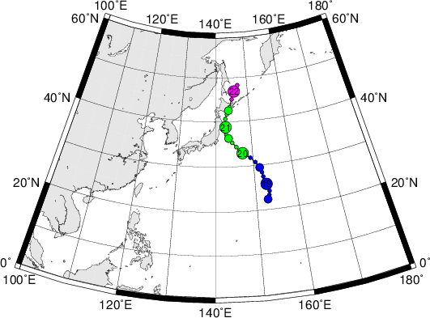
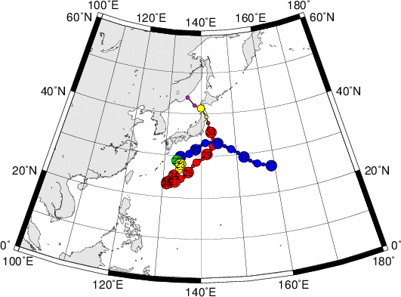
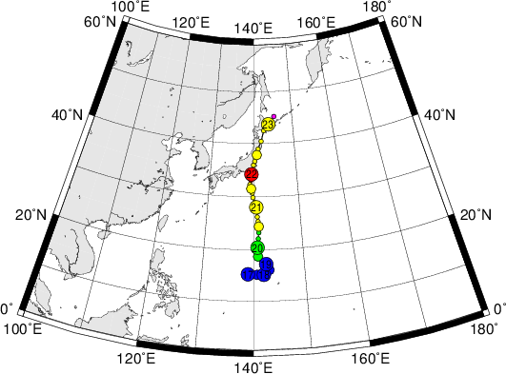
Western Pacific Typhoon Tracks: 20–30 August 2016
Kompasu
20–21 Aug
Lionrock
21–30 Aug
Kompasu: 994 hPa; N/A
Lionrock: 940 hPa; 90 kt
Mindulle: 975 hPa; 65 kt
Mindulle
19–23 Aug
Not Shown
TD-14W

Slide 31
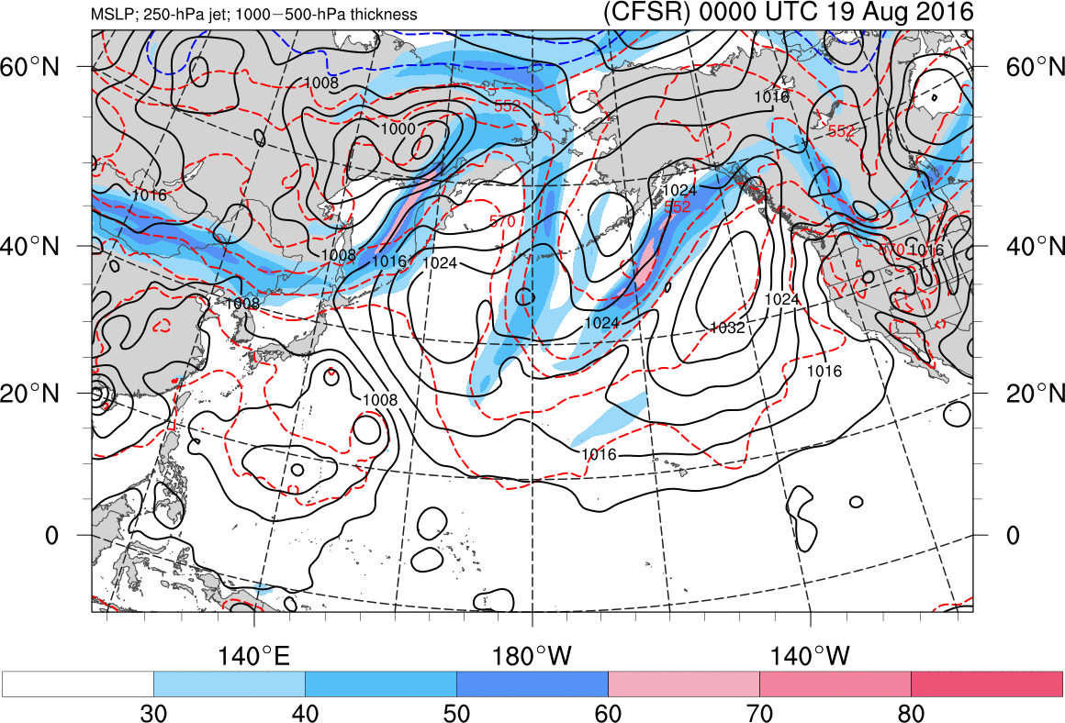
Kompasu
Lionrock
Mindulle
Source: Alicia Bentley

Slide 32
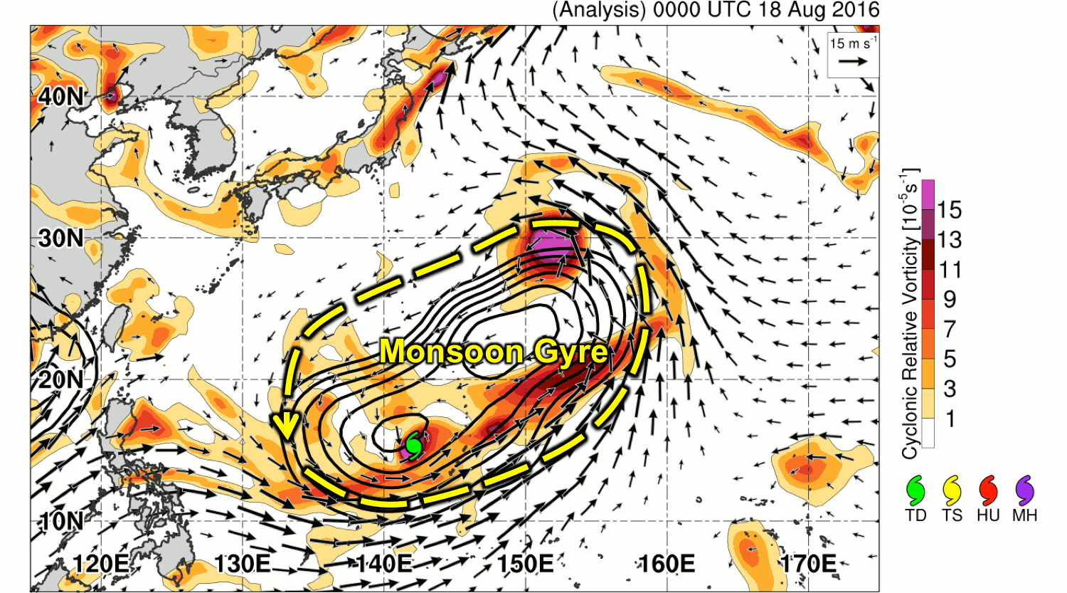
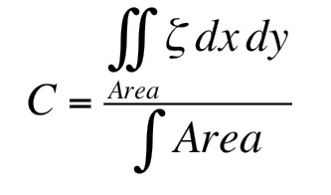
Evolution of Lionrock Within Larger Flow
1200 km
900 km
Animation by Philippe Papin
850-hPa cyclonic relative vorticity (shaded, 10⁻⁵ s⁻¹), 900–1200-km area-average vorticity (black contours, starting 1x10⁻⁵ s⁻¹), wind vectors (> 5 m s⁻¹)
.gif Version
An extension of research conducted over similar-scale systems in Central America
Papin, P., L. F. Bosart, R. D. Torn, 2016: A Climatology of Central American Gyres. Mon. Wea. Rev. (In Review)

Slide 33
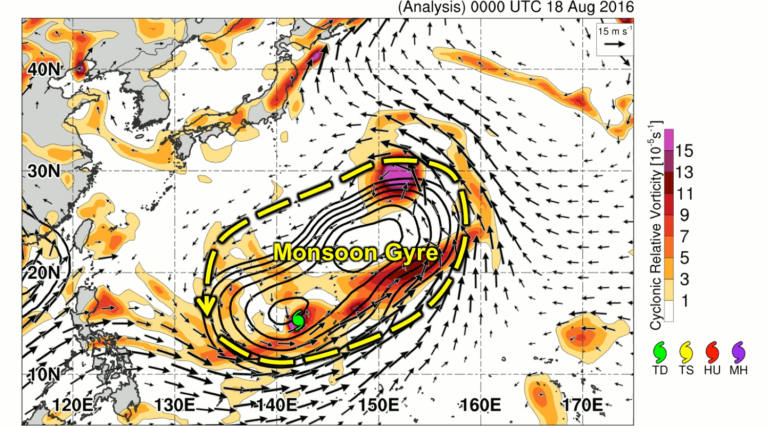
Evolution of Lionrock Within Larger Flow
1200 km
900 km
Animation by Philippe Papin
850-hPa cyclonic relative vorticity (shaded, 10⁻⁵ s⁻¹), 900–1200-km area-average vorticity (black contours, starting 1x10⁻⁵ s⁻¹), wind vectors (> 5 m s⁻¹)
.mp4 Version
An extension of research conducted over similar-scale systems in Central America
Papin, P., L. F. Bosart, R. D. Torn, 2016: A Climatology of Central American Gyres. Mon. Wea. Rev. (In Review)

Slide 34
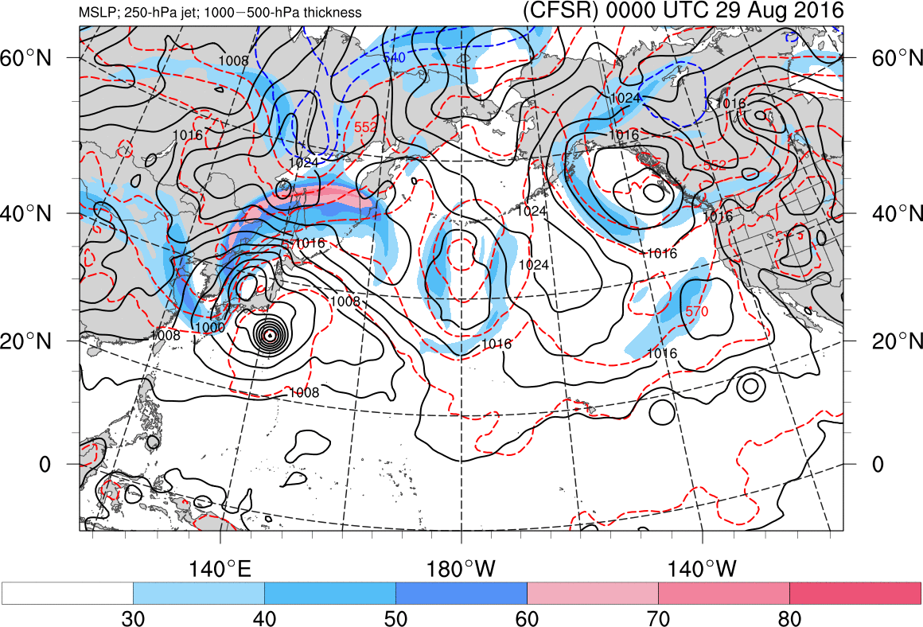
Lionrock
Source: Alicia Bentley

Slide 35
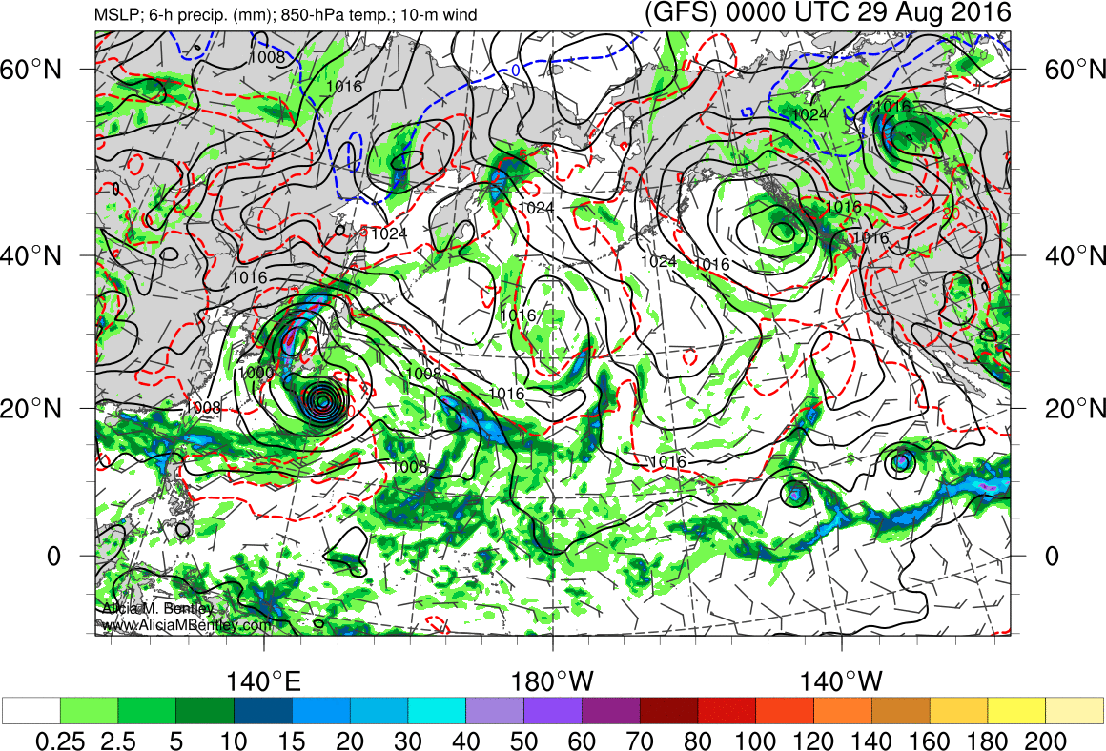
Lionrock
Source: Alicia Bentley

Slide 36
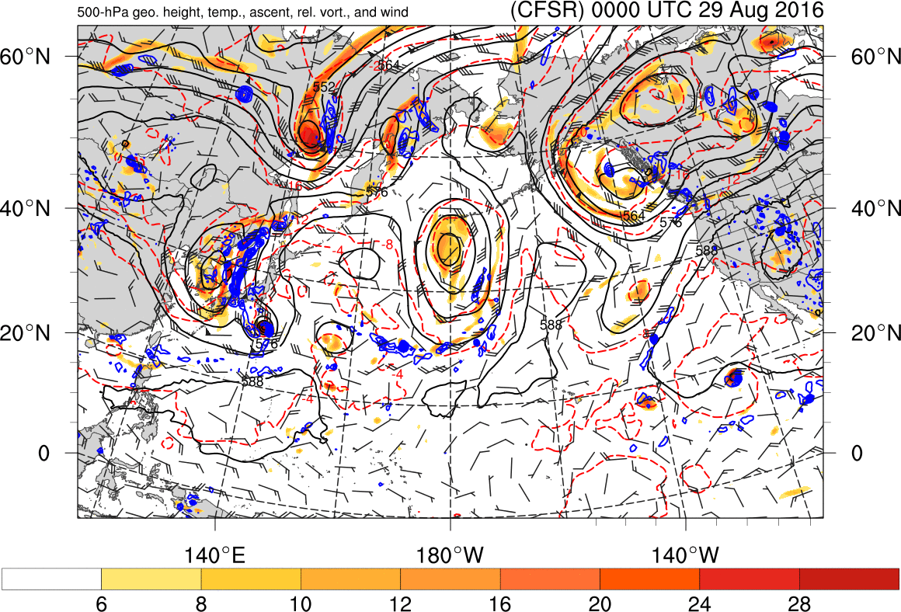
Lionrock
Source: Alicia Bentley

Slide 37
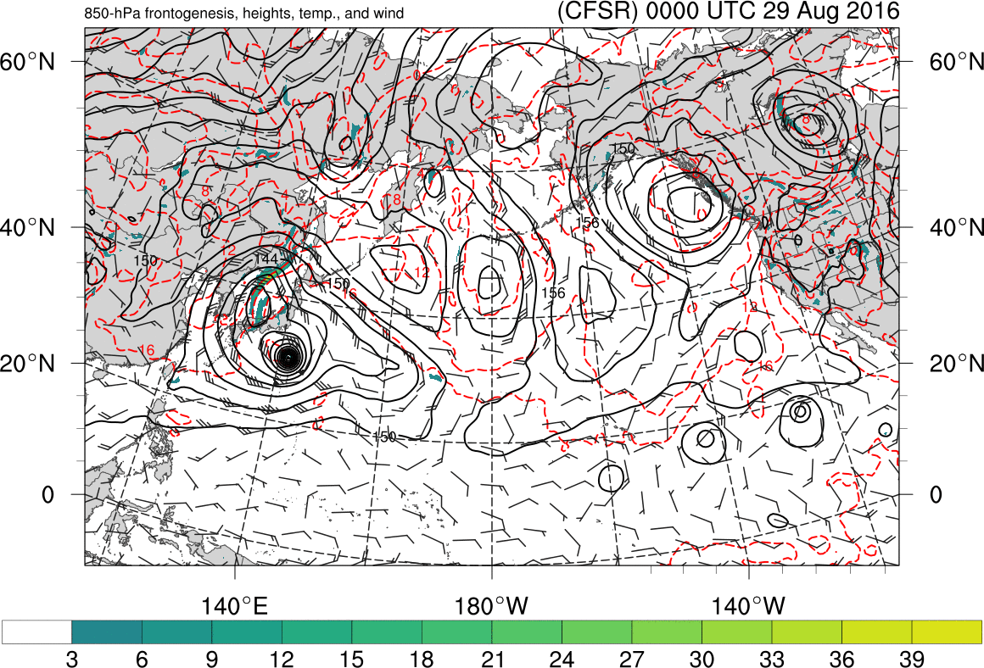
Lionrock
Source: Alicia Bentley

Slide 38
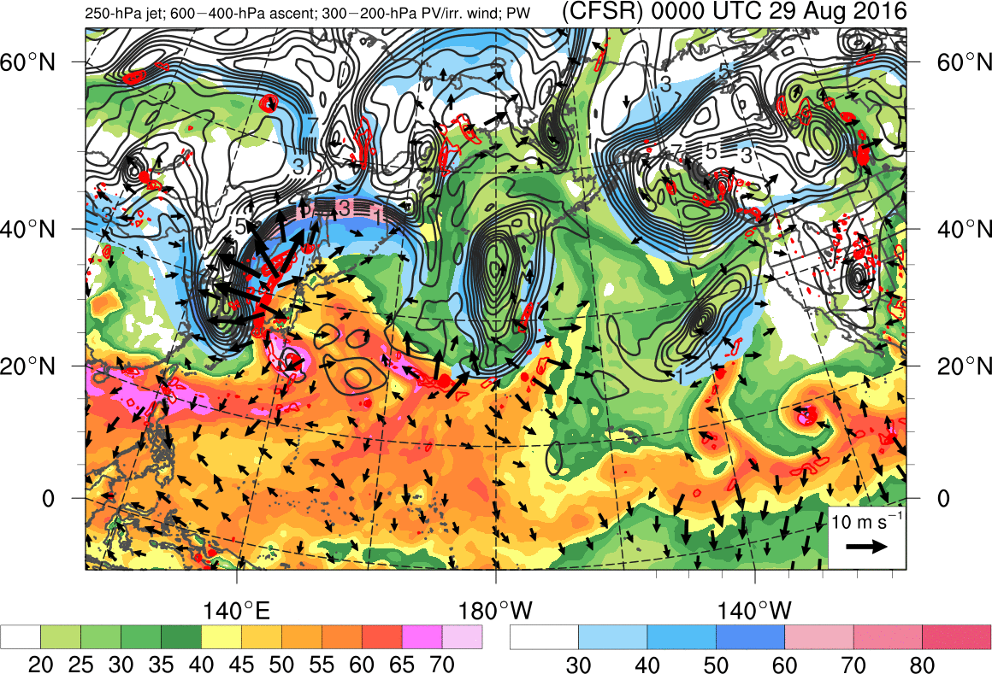
Lionrock
Source: Alicia Bentley

Slide 39
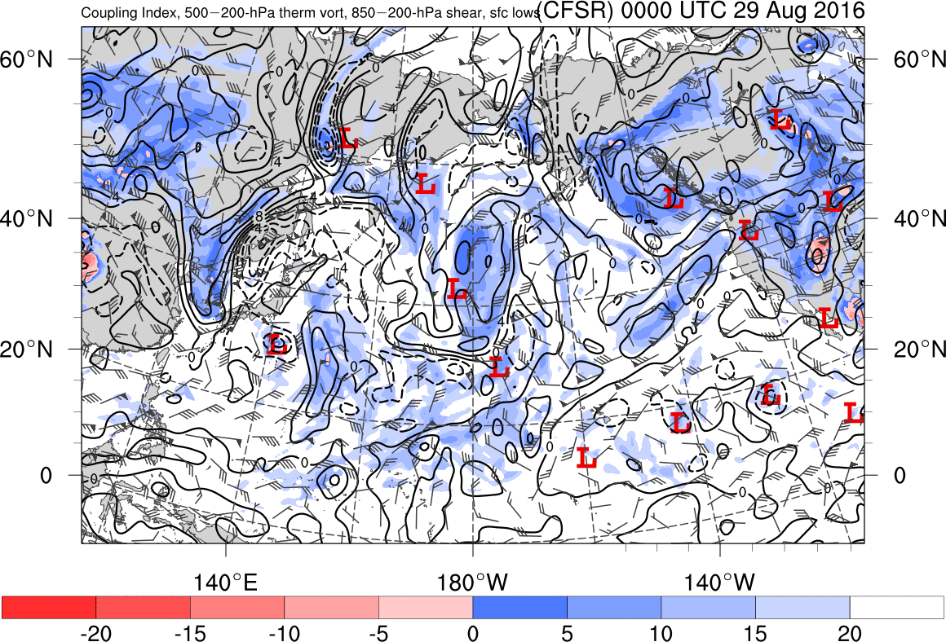
Lionrock
Source: Alicia Bentley

Slide 40
NW Pacific TC-related Science Opportunities
Quantify TC Lionrock’s interactions with TCs Kompasu and Mindulle within a western Pacific monsoon gyre circulation and subsequent TC-midlatitude trough interactions
Determine how an unusually deep early season East Asian upper-level trough facilitated TC-TC, TC-trough, and TC-gyre interactions
Investigate whether the ET of Mindulle contributed to Lionrock’s subsequent ET, downstream PRE formation, and Lionrock’s subsequent TC Sandy-like “left hook”
Ascertain whether diabatically driven downstream ridge building resulting from the Lionrock ET contributed to trough reestablishment near the Dateline
Establish whether the Dateline trough, an eastern Pacific ridge, and a western North American trough contributed to “endless summer” in the eastern CONUS
Evaluate whether the observed multiple TC-TC and TC-trough interactions over the western Pacific impacted the downstream ensemble predictability horizon

Slide 41
Arctic Synoptic-Dynamic Meteorology

Slide 42
NH 850-hPa Temperatures and 250-hPa Geopotential Heights for Dec–Feb: (2007–2016) – (1957–1966)

Slide 43
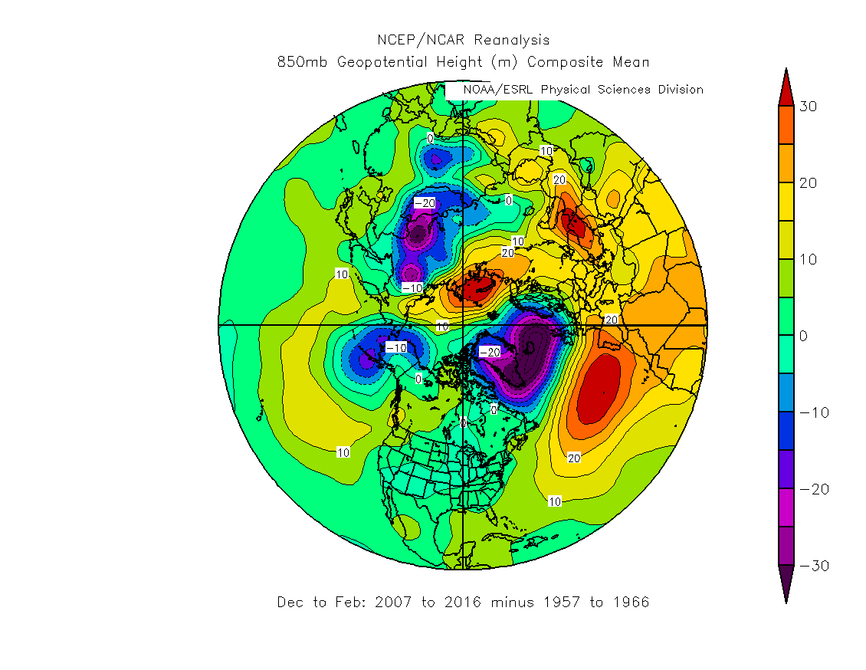
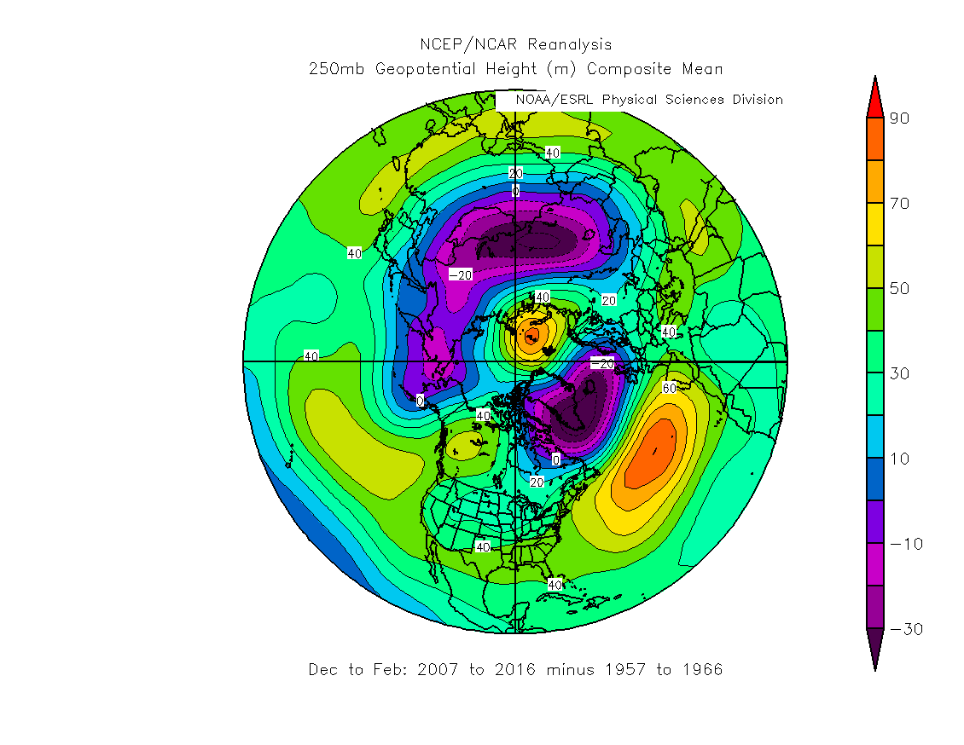
NH Geopotential Heights (m): DJF 850 hPa (left) vs. 250 hPa (right) for (2007–2016)-(1957–1966)

Slide 44
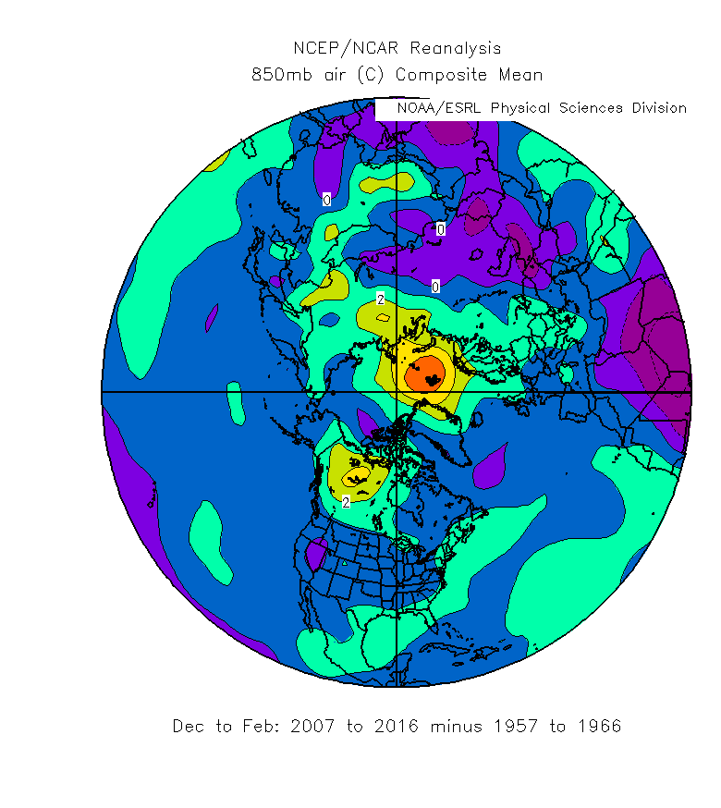
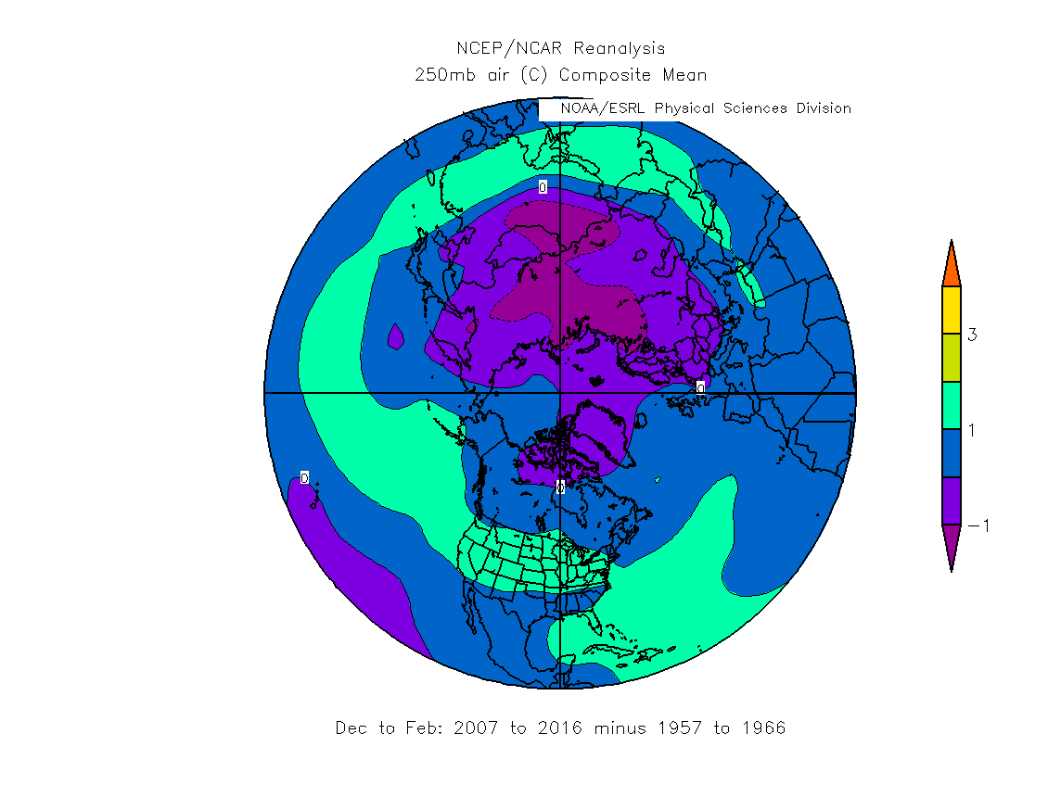
Dec-Jan-Feb NH Air Temperature (°C): 850 hPa (left) vs. 250 hPa (right) for (2007–2016)-(1957–1966)

Slide 45
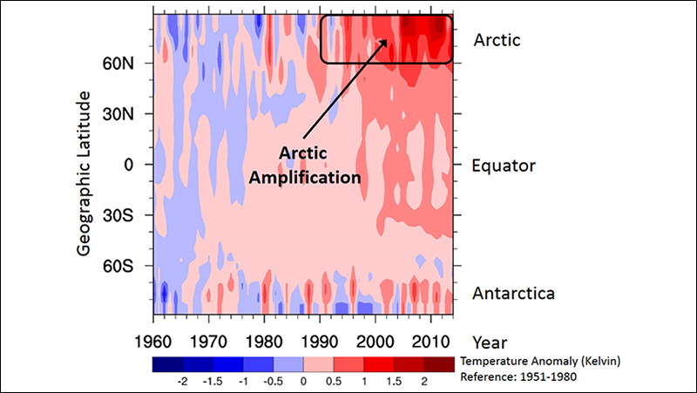
Arctic Amplification
Source: Wendisch, M., et al. (2017), Understanding causes and effects of rapid warming in the Arctic, Eos, 98, doi:10.1029/2017EO064803
Fig. 1. Mean temperatures (by location and year, measured in kelvins), shown as variations from 1951–1980 mean temperatures. The increase in red areas in more recent years indicates global warming. The area inside the black box shows how this warming is amplified in the Arctic, particularly within the past 25 years. The data are provided by the NASA Goddard Institute for Space Studies.

Slide 46
Arctic Sea Ice Time Series (1979–2017)
Source: Arctic Sea Ice News and Analysis http://nsidc.org/arcticseaicenews/charctic-interactive-sea-ice-graph/

Slide 47
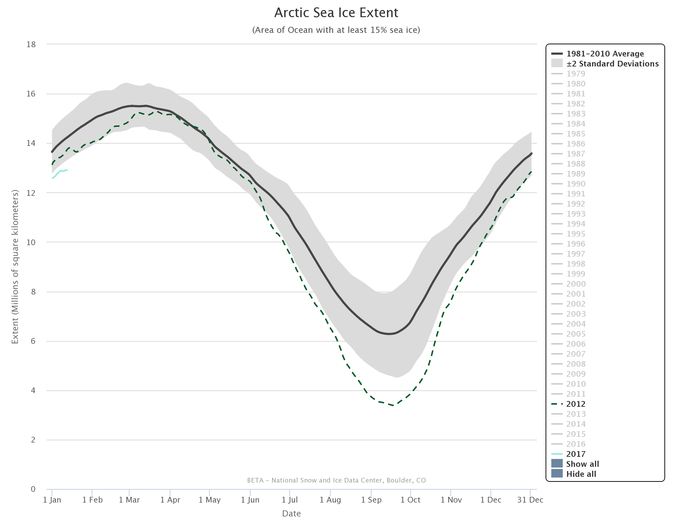

Slide 48
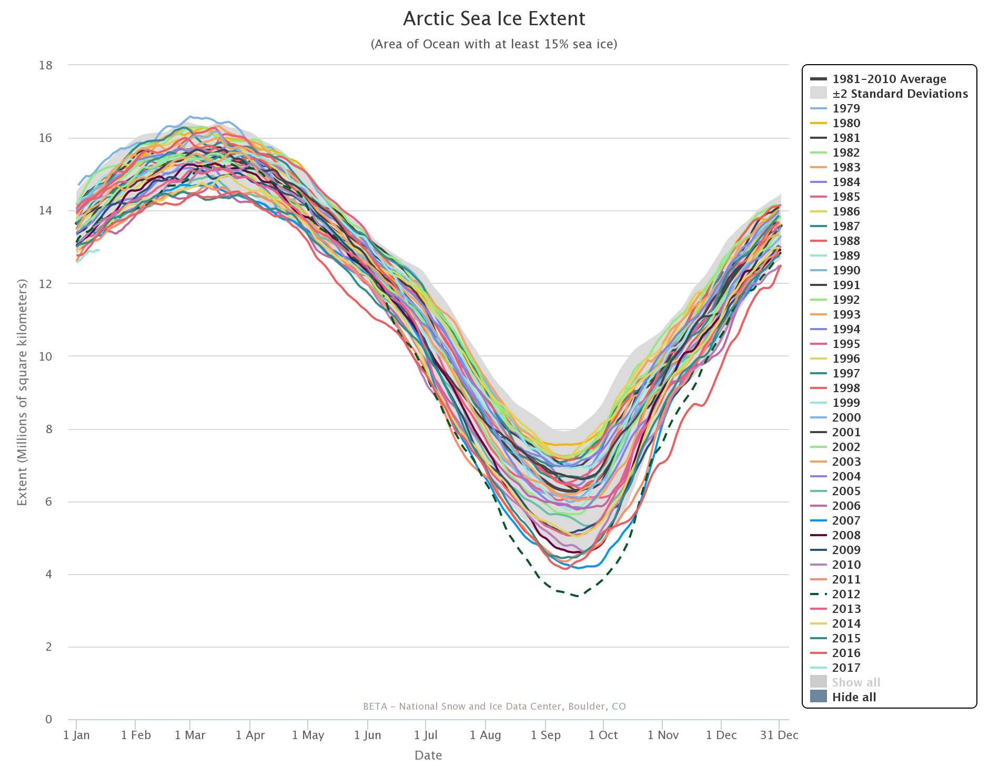

Slide 49
A Trans-Arctic Surge of Warm, Moist Air: 17–23 December 2016

Slide 50
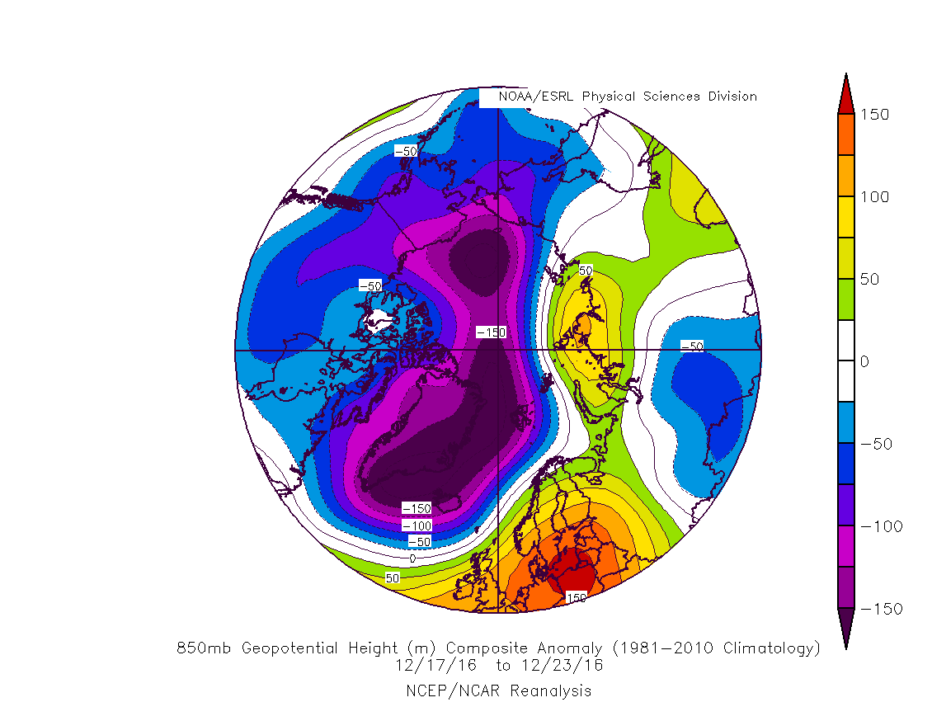

Slide 51
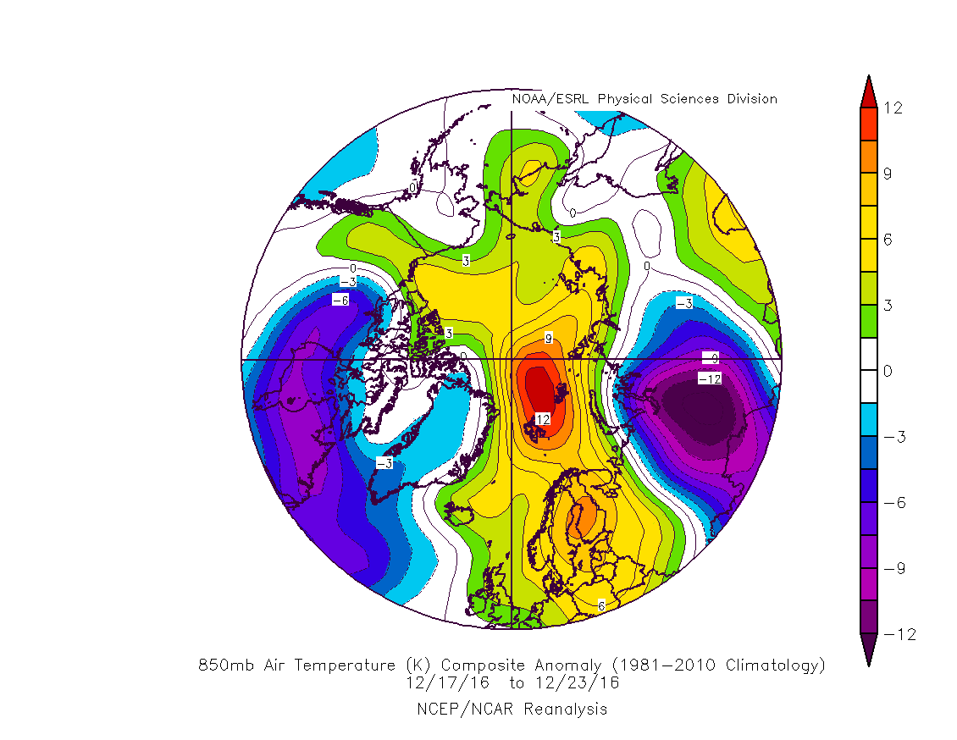

Slide 52
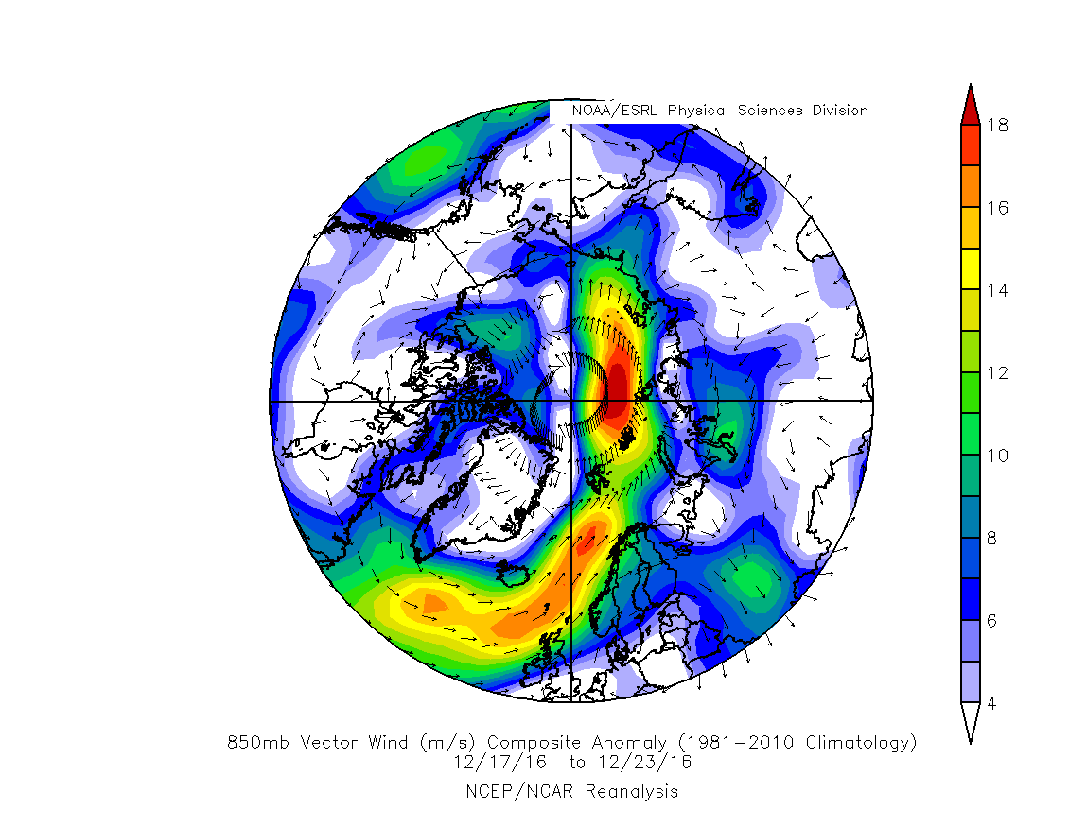

Slide 53
Research Opportunities
(aka Opportunity Knocks for Synoptic Meteorologists)
Determine intraseasonal and interannual variability of Arctic weather regimes
Establish the preferred longitudinal pathways for midlatitude-arctic air exchanges
Document changes in the structure, evolution, and behavior of arctic cyclones
Ascertain ways that arctic tropopause polar vortices interact with midlatitude weather systems
Discern how tropospheric-stratospheric interactions in polar regions impact midlatitude circulation regimes

Slide 54
Animal Farm Meteorology
All Forecast Errors are Equal, but some Forecast Errors are more Equal than Others
I-5 and I-95 corridors vs. I-80 and I-70 corridors on the Plains
Grand Junction vs. Denver, Colorado
Washington, DC and Atlanta when it snows
Los Angeles when it rains
Bad weather at a major outdoor sporting event
Storm track errors in complex terrain areas (e.g., SEA, PDX)

