Slide 1
Hurricane Sandy (2012): A Multiscale Analysis and Perspective
Lance F. Bosart
Department of Atmospheric and Environmental Sciences
University at Albany, SUNY
Albany, NY 12222
16th Cyclone Workshop
Sainte-Adèle, Quebec
Monday 23 September 2013
Support provided by NSF Grant AGS-1240502

Slide 2
Sandy Participants
Students
  Hannah Attard, Alicia Bentley, Patrick Duran
  Larry Gloeckler, Chip Helms, Bill Lamberson
  Adrian Mitchell, Philippe Papin, Rosimar Rios-Berrios
  Nicholas Schiraldi, and Stephanie Stevenson
Faculty
  Lance Bosart, Kristen Corbosiero, John Gyakum,
  Daniel Keyser, Andrea Lang, Justin Minder
  Brian Tang, and Ryan Torn

Slide 3
Motivation:
Hurricane Sandy, a storm of historical (and hysterical) proportions, provided a serendipitous research opportunity to examine a well-sampled and well-documented storm from pre-genesis to post-landfall (soup-to-nuts).
Noteworthy aspects of Hurricane Sandy's lifecycle included multiple trough interactions, an unusual "Hazel (1954)-like" track, and an unprecedented post-landfall Appalachian snowstorm.

Slide 4
Outline:
Pre-genesis environment
First trough interaction
Second trough interaction
Third trough interaction
Sandy vs. Hazel (1954) and 38’ Hurricane
Post-landfall snowstorm
Conclusions

Slide 6
Pre-Genesis Environment

Slide 7
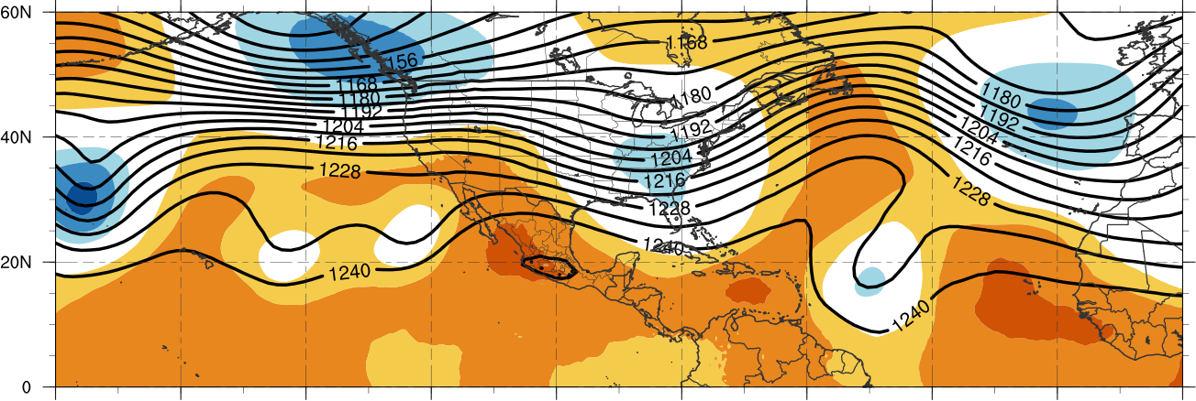
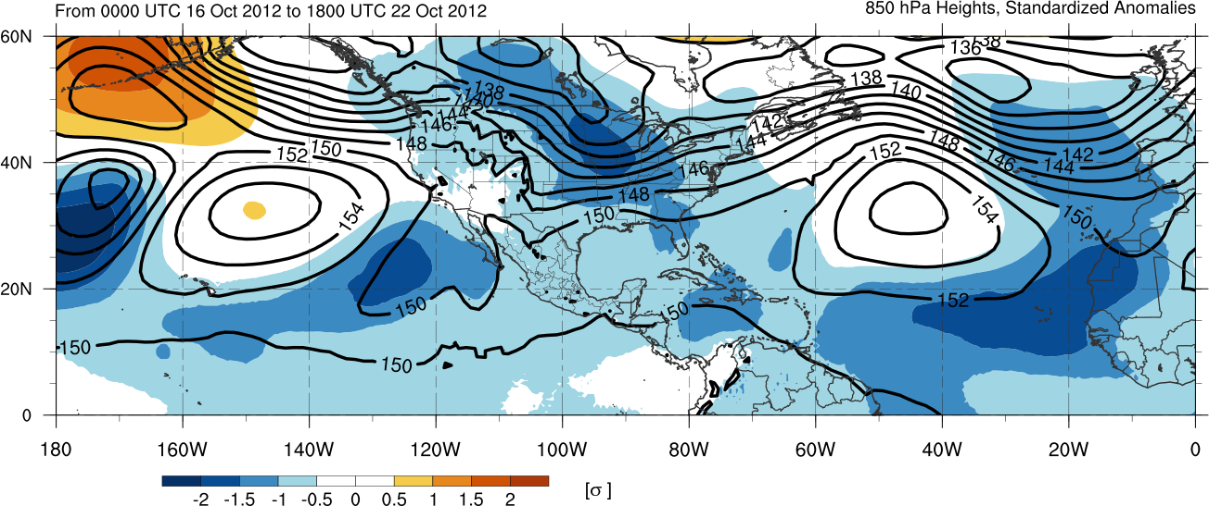
200-hPa Geopotential Height
850-hPa Geopotential Height
Mean and Standardized Anomalies 16 - 22 Oct 2012

Slide 8
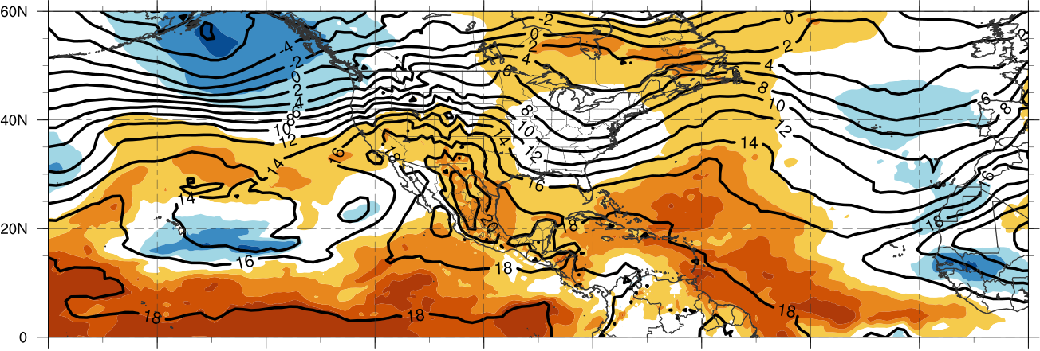
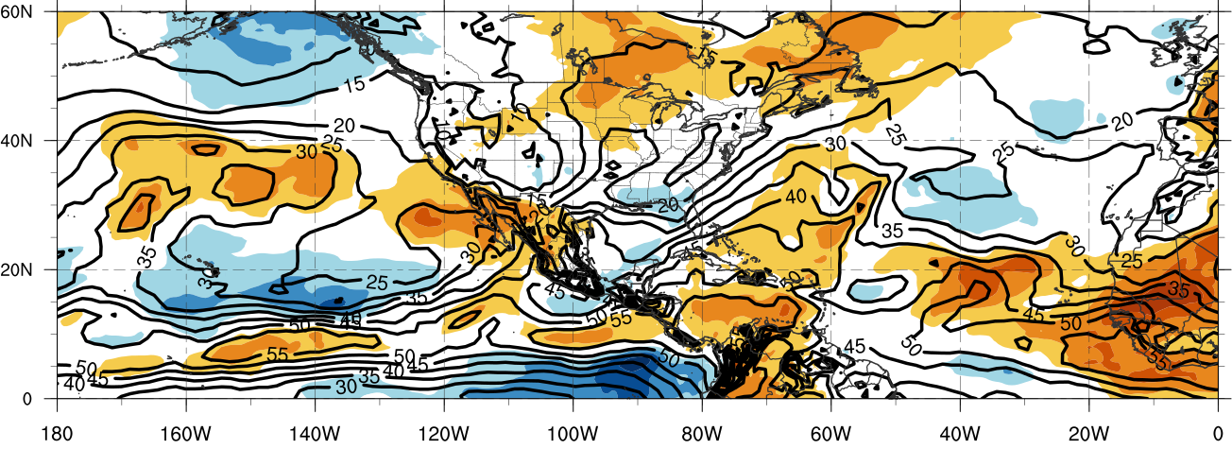
850-hPa Temperature
Precipitable Water
Mean and Standardized Anomalies 16 - 22 Oct 2012

Slide 9
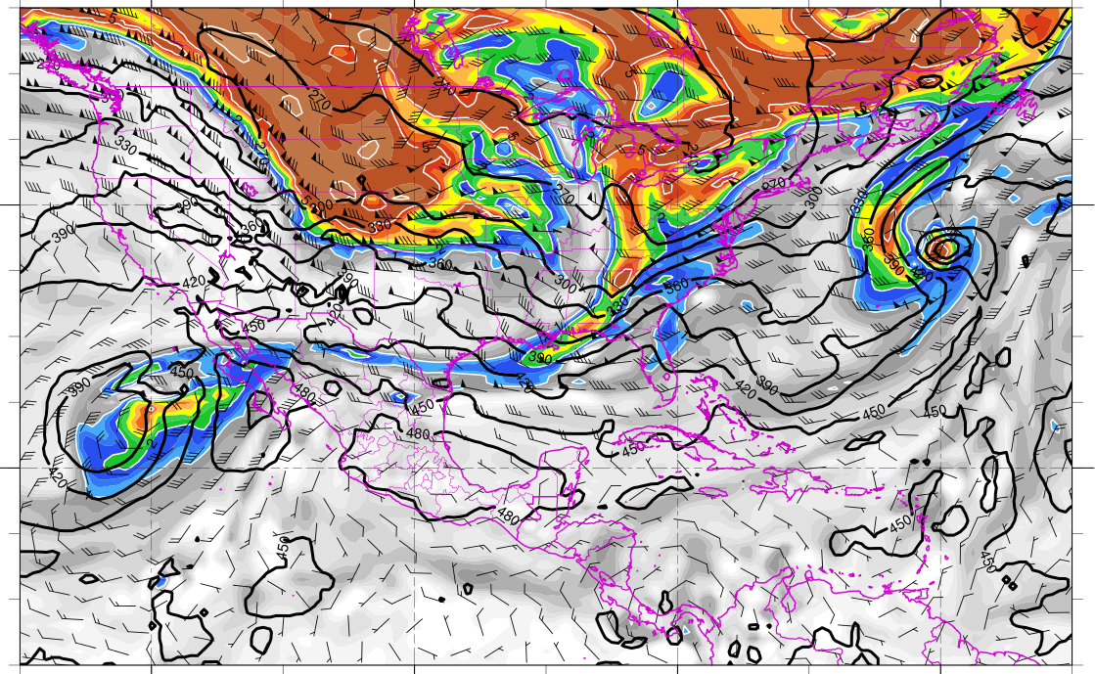
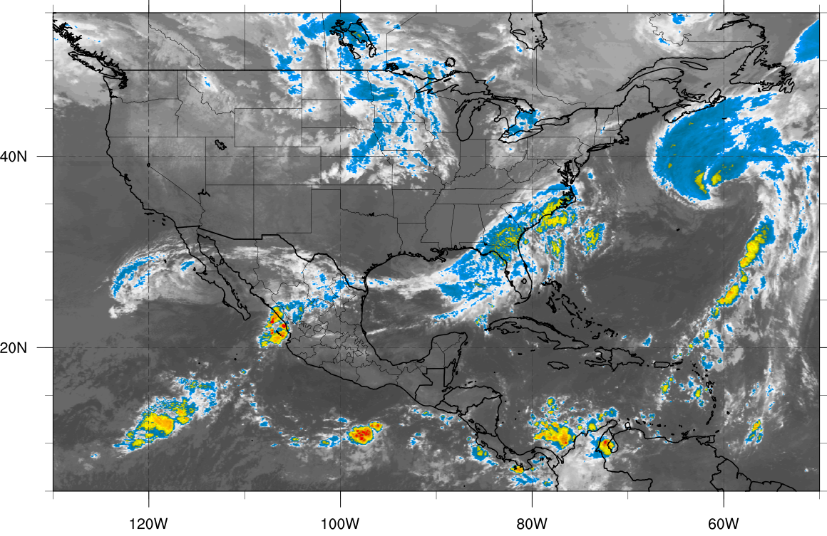
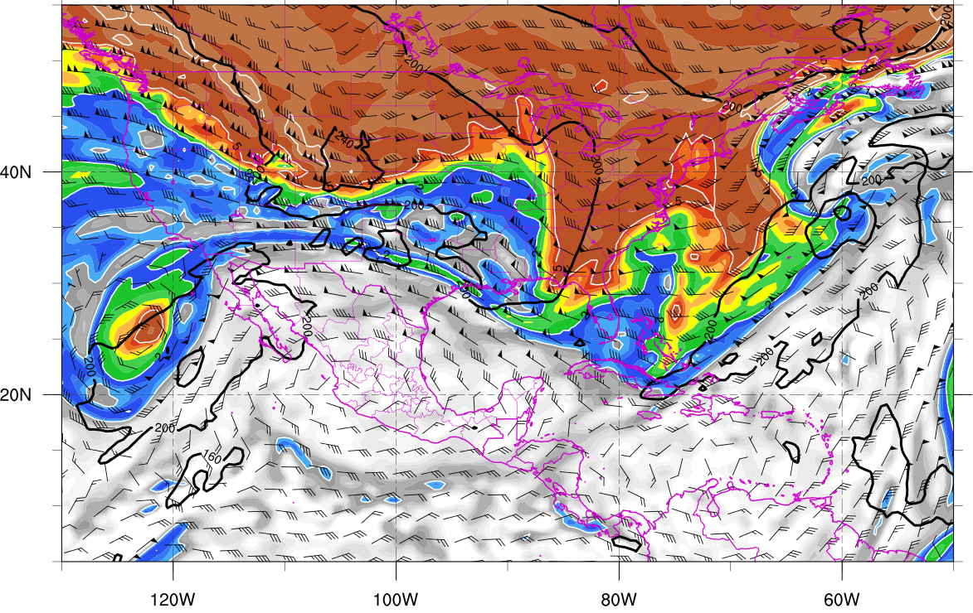
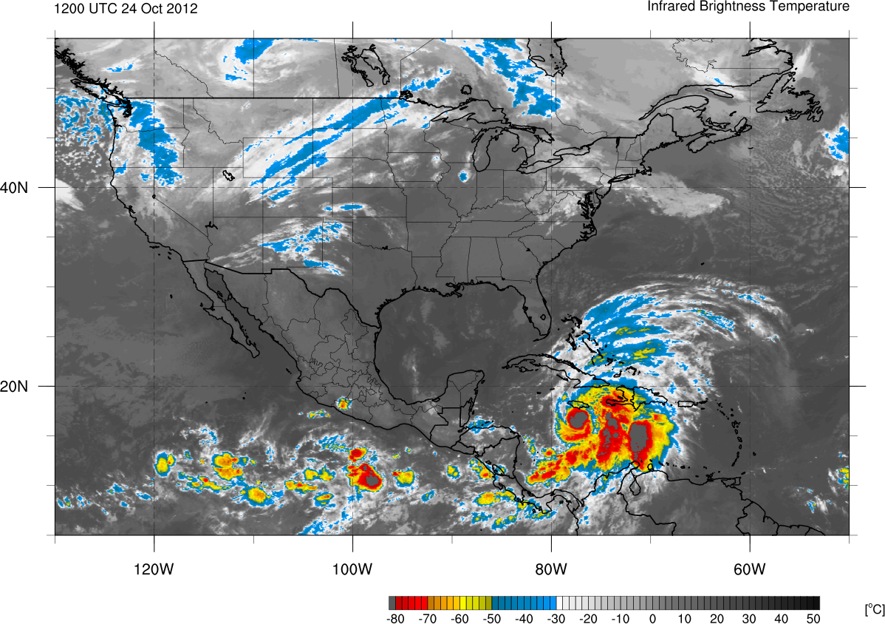
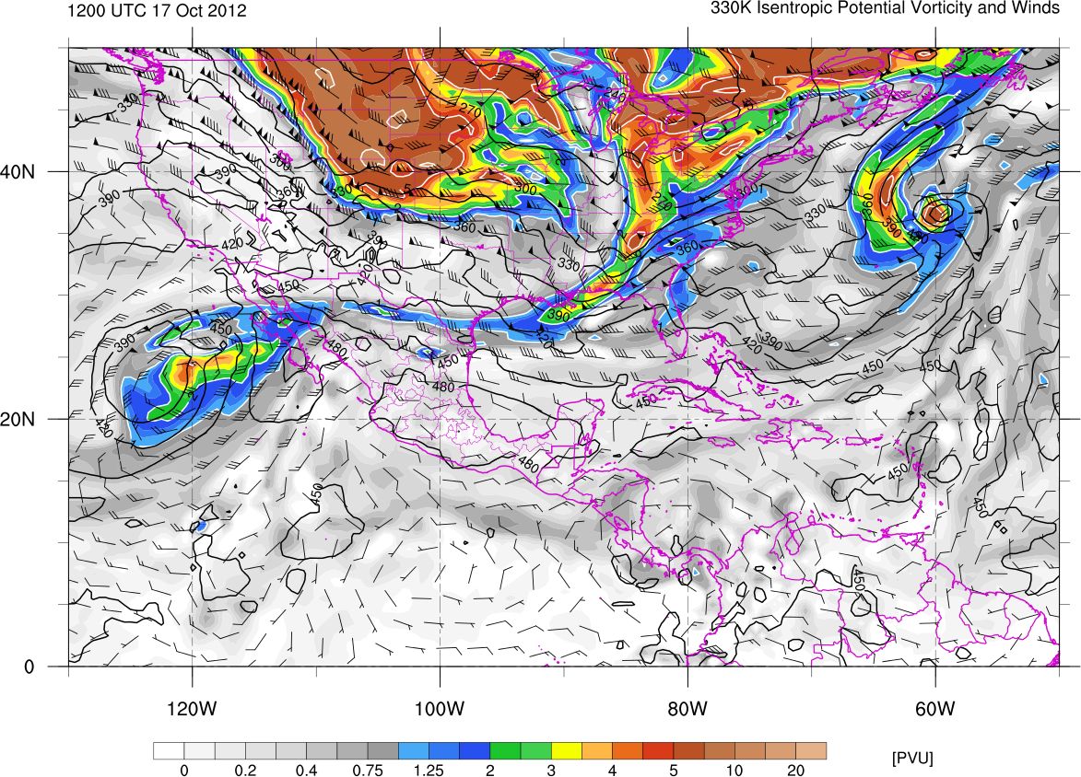
1200 UTC 17 Oct 2012
330K Surface
IR Satellite
350K Surface
Potential vorticity (shaded, PVU), pressure (contours, hPa),
winds (barbs, m s⁻¹)

Slide 10
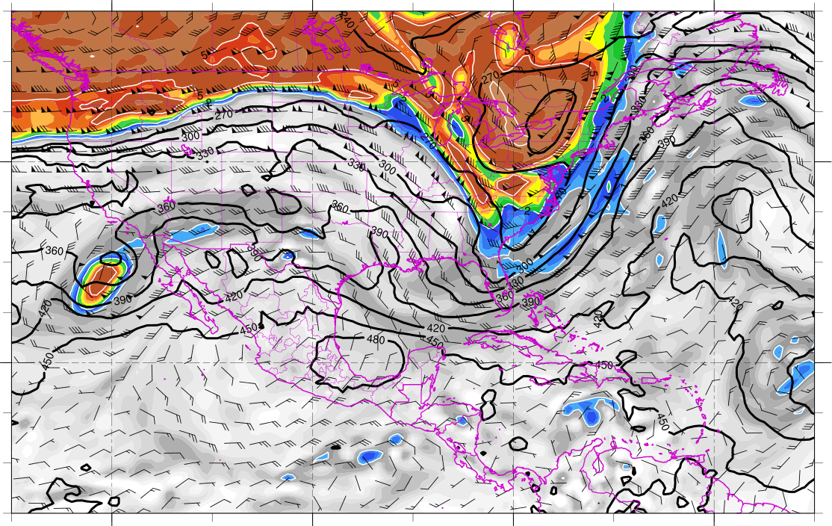
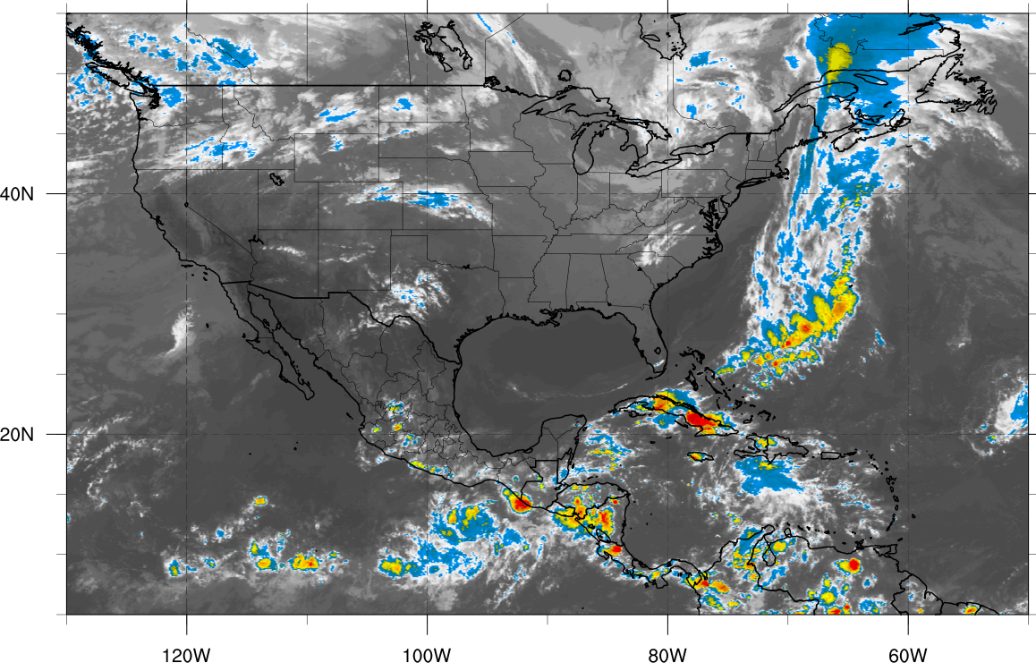
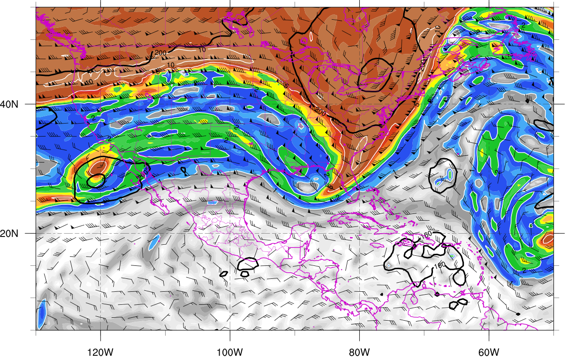
0000 UTC 21 Oct 2012
330K Surface
IR Satellite
350K Surface
Potential vorticity (shaded, PVU), pressure (contours, hPa),
winds (barbs, m s⁻¹)

Slide 11
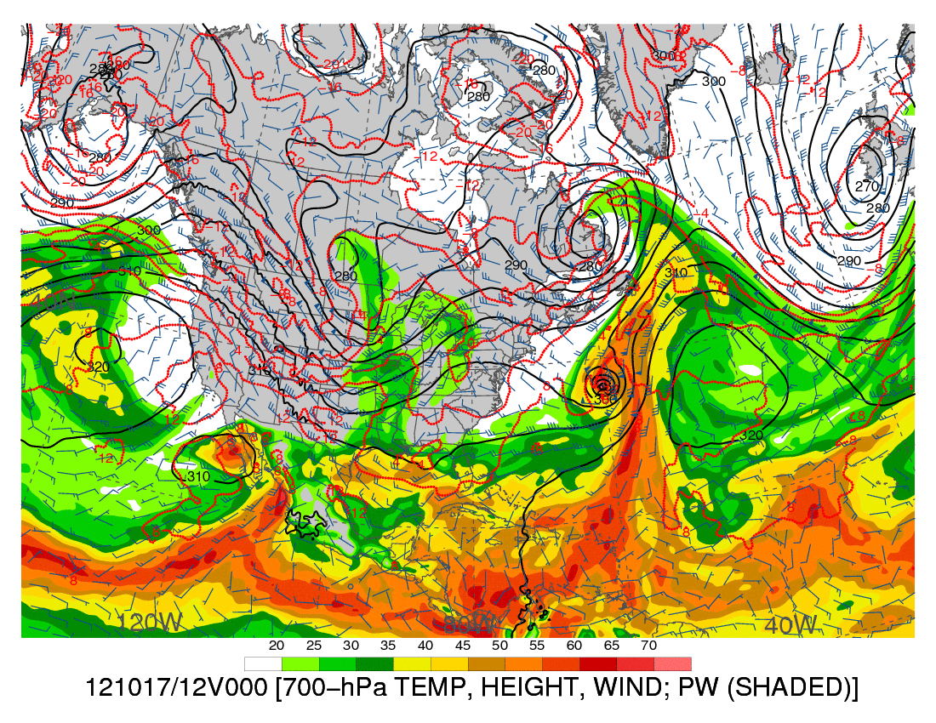
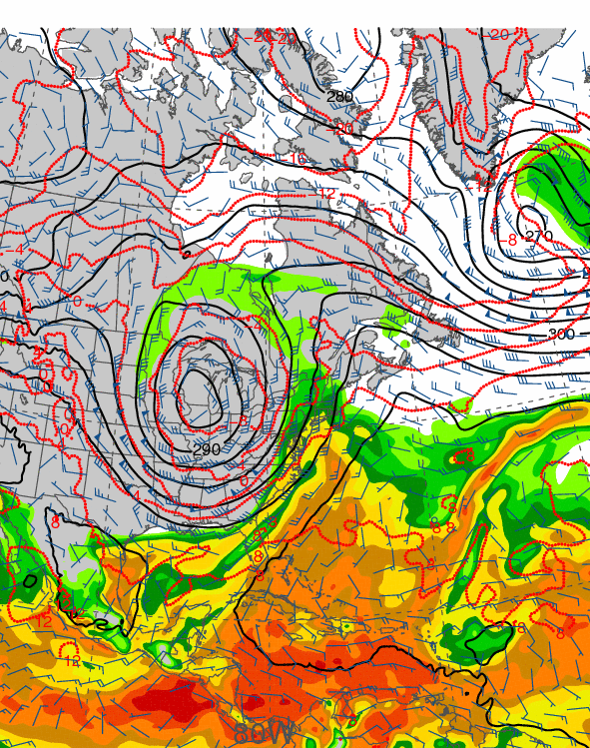
1200 UTC 17 October 2012
1200 UTC 19 October 2012
Precipitable water (shaded, mm); 700-hPa wind speed (barbs, kts), temperature
(dashed red contours, °C), and geopotential height (black solid contours, dam)

Slide 12
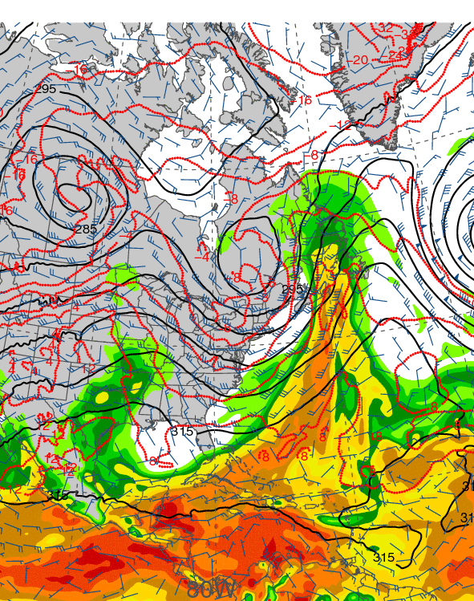
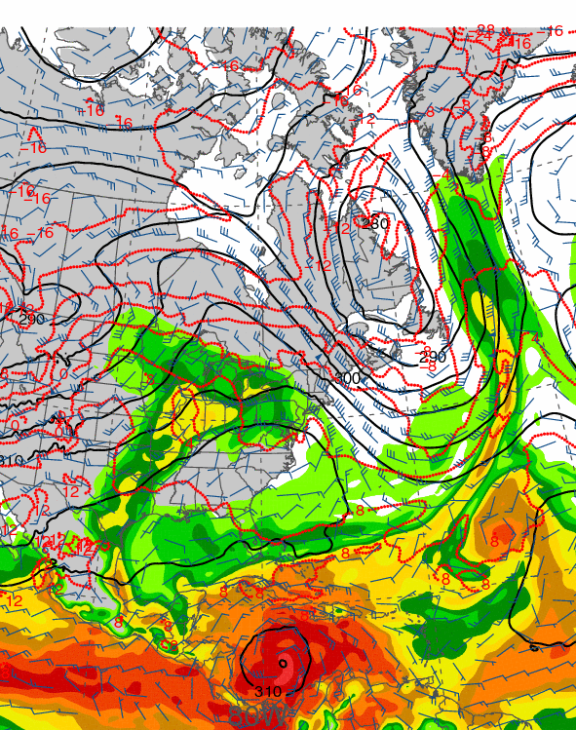
1200 UTC 21 October 2012
1200 UTC 23 October 2012
Precipitable water (shaded, mm); 700-hPa wind speed (barbs, kts), temperature
(dashed red contours, °C), and geopotential height (black solid contours, dam)

Slide 13
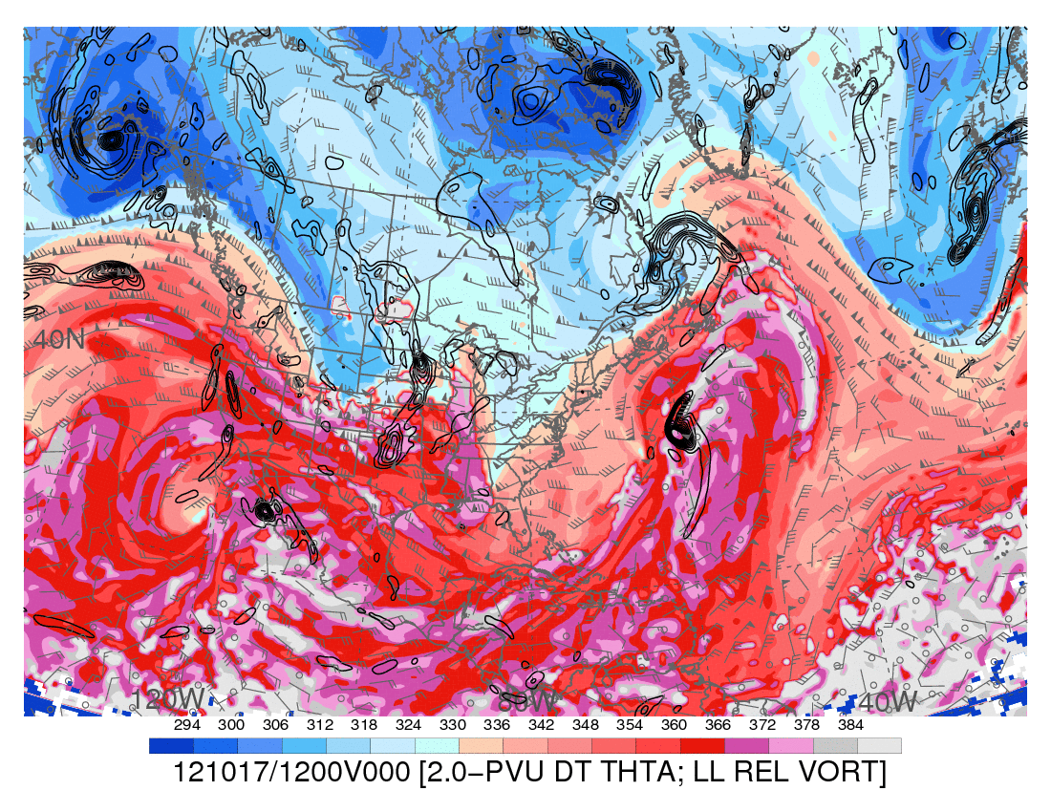
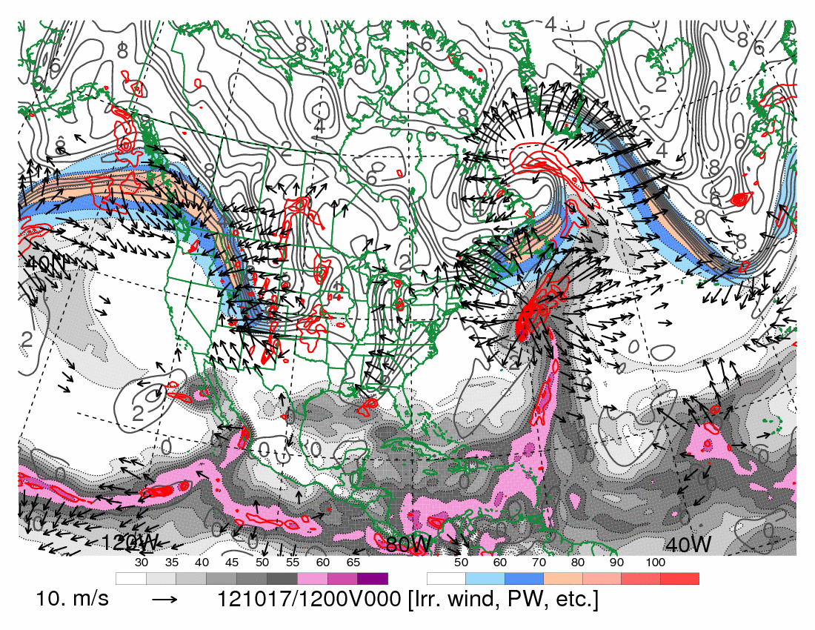
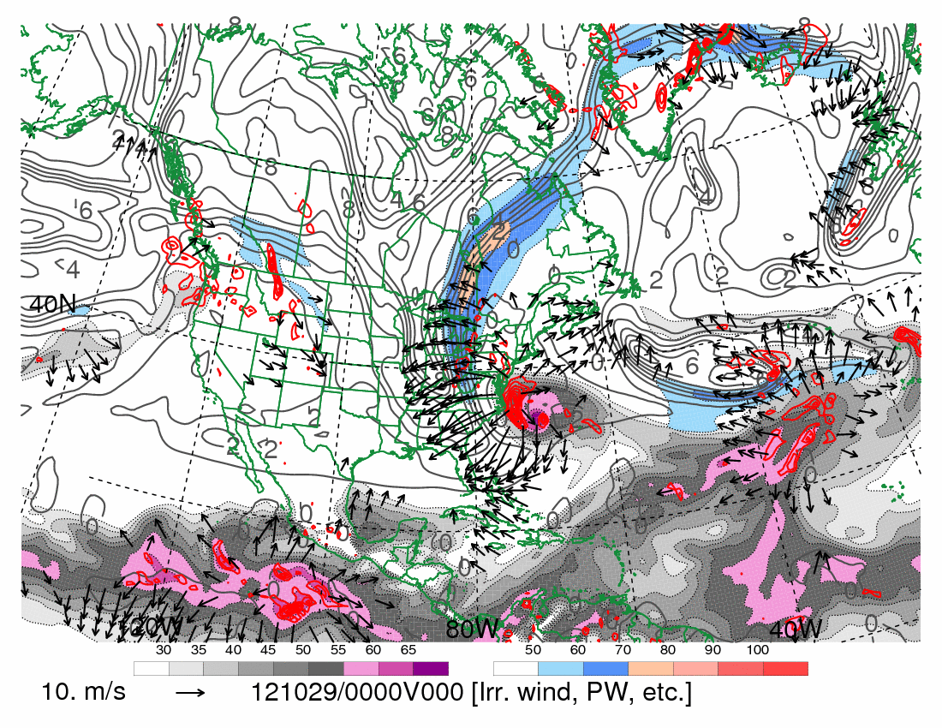
1200 UTC 17 October 2012
10.0 m s⁻¹
Dynamic tropopause (DT, 1.5-PVU surface) potential
temperature (shaded, K) and wind (barbs, kts),
925–850-hPa layer-averaged cyclonic relative vorticity
(black contours every 0.5 × 10⁻⁴ s⁻¹)
250-hPa wind speed (shaded, m s⁻¹), 300–200-hPa layer-averaged PV (gray contours, PVU), PW (gray scale, mm),
600–400-hPa layer-averaged ascent (red contours every
5.0 × 10⁻³ hPa s⁻¹), 250-hPa irrotational wind (vectors, m s⁻¹)

Slide 14
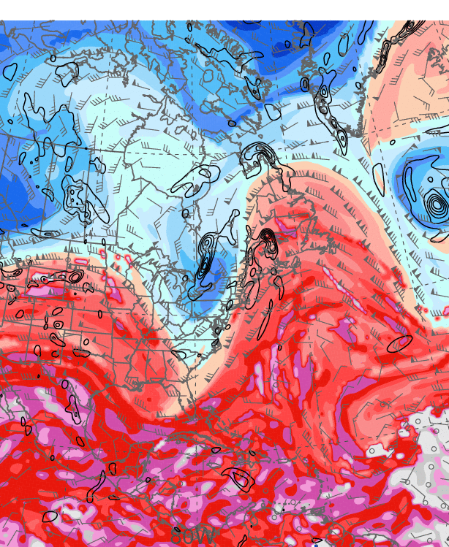
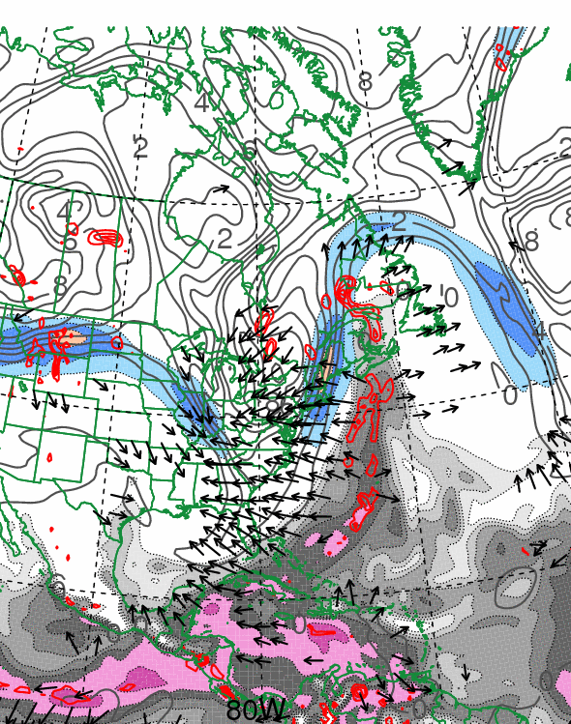
0000 UTC 21 October 2012
10.0 m s⁻¹
Dynamic tropopause (DT, 1.5-PVU surface) potential
temperature (shaded, K) and wind (barbs, kts),
925–850-hPa layer-averaged cyclonic relative vorticity
(black contours every 0.5 × 10⁻⁴ s⁻¹)
250-hPa wind speed (shaded, m s⁻¹), 300–200-hPa layer-averaged PV (gray contours, PVU), PW (gray scale, mm),
600–400-hPa layer-averaged ascent (red contours every
5.0 × 10⁻³ hPa s⁻¹), 250-hPa irrotational wind (vectors, m s⁻¹)

Slide 15
First Trough Interaction: Poleward Convective Cloud Expansion

Slide 16
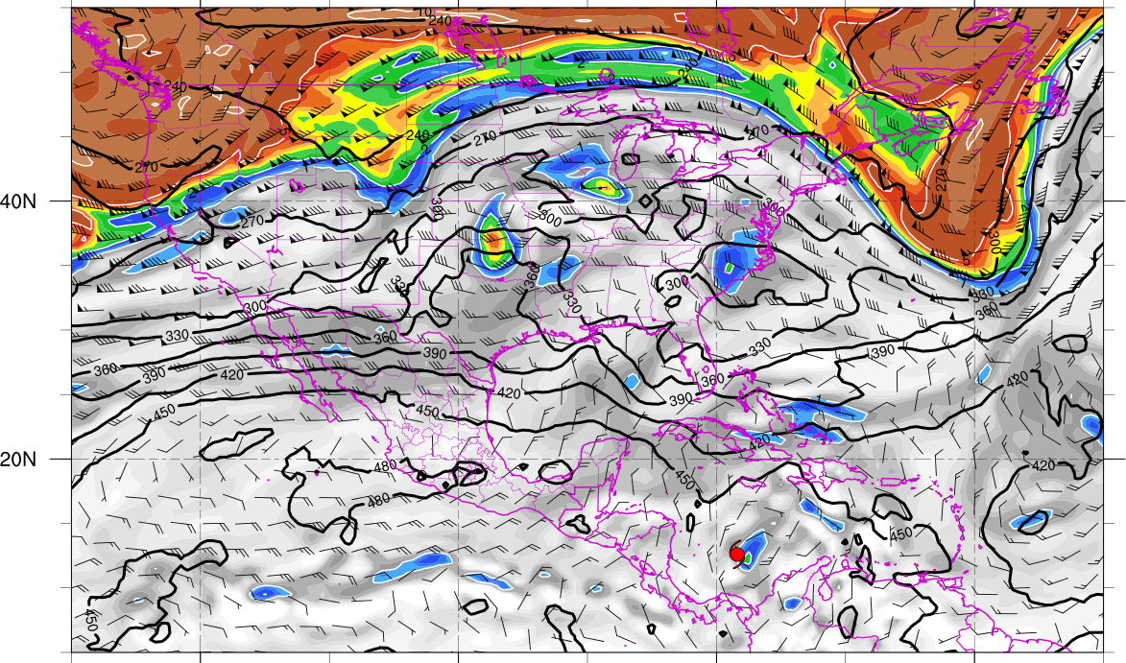
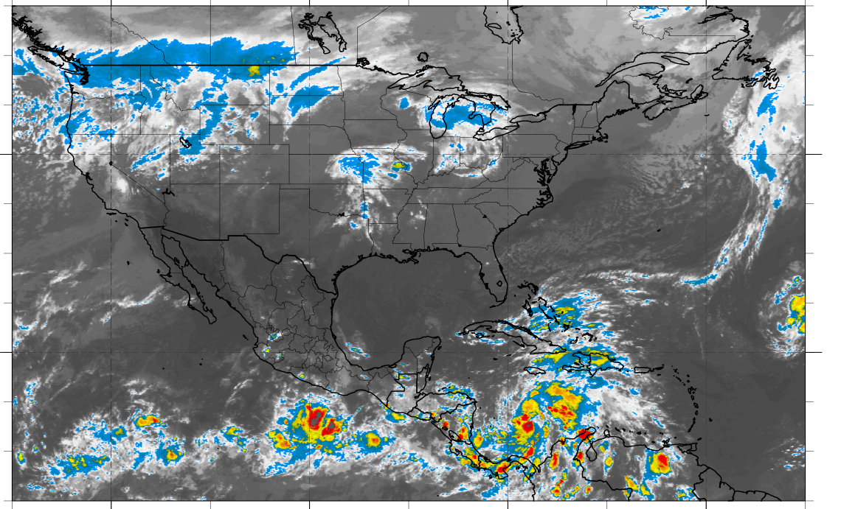
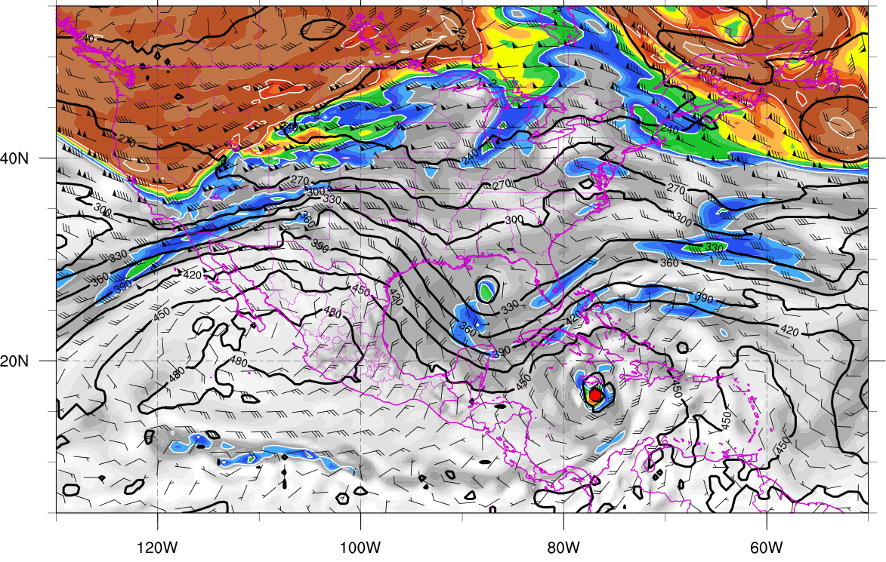
330K Surface and IR 0000 UTC 23 Oct
330K Surface and IR 1200 UTC 24 Oct
Potential vorticity (shaded, PVU), pressure (contours, hPa), winds (barbs, m s⁻¹)

Slide 17
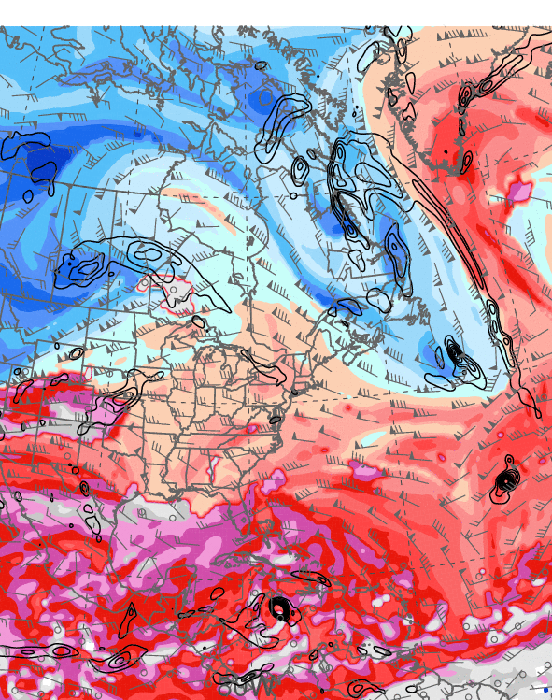
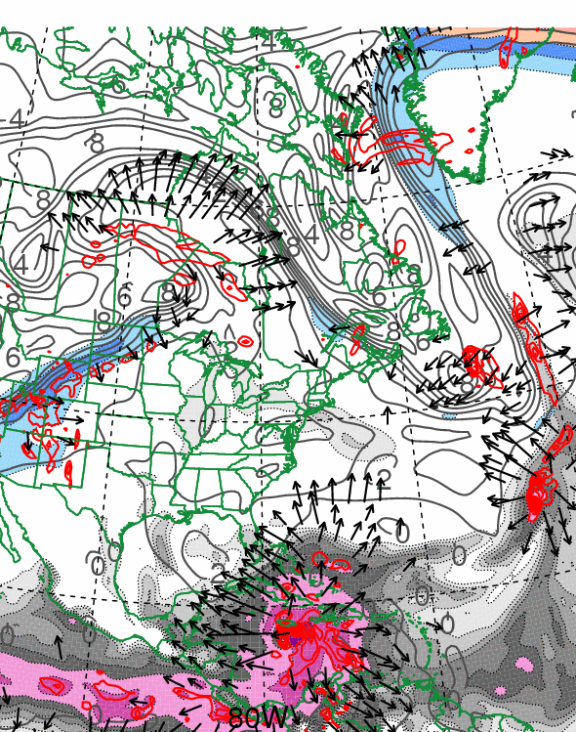
1200 UTC 24 October 2012
10.0 m s⁻¹
Dynamic tropopause (DT, 1.5-PVU surface) potential
temperature (shaded, K) and wind (barbs, kts),
925–850-hPa layer-averaged cyclonic relative vorticity
(black contours every 0.5 × 10⁻⁴ s⁻¹)
250-hPa wind speed (shaded, m s⁻¹), 300–200-hPa layer-averaged PV (gray contours, PVU), PW (gray scale, mm),
600–400-hPa layer-averaged ascent (red contours every
5.0 × 10⁻³ hPa s⁻¹), 250-hPa irrotational wind (vectors, m s⁻¹)

Slide 18
Second Trough Interaction:
First Westward Turn

Slide 19
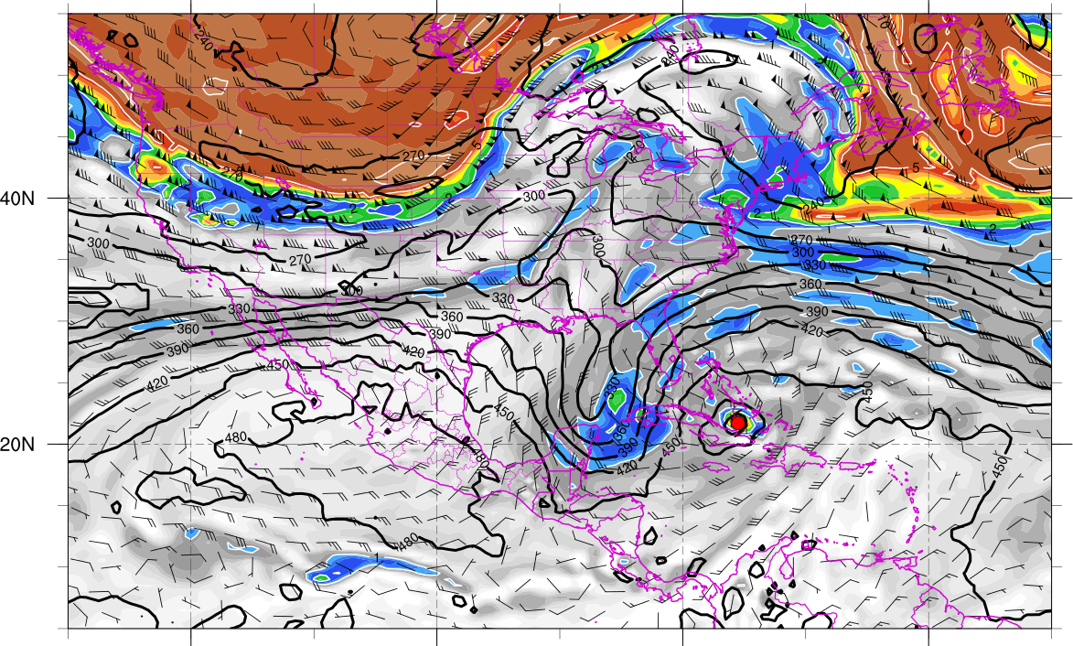
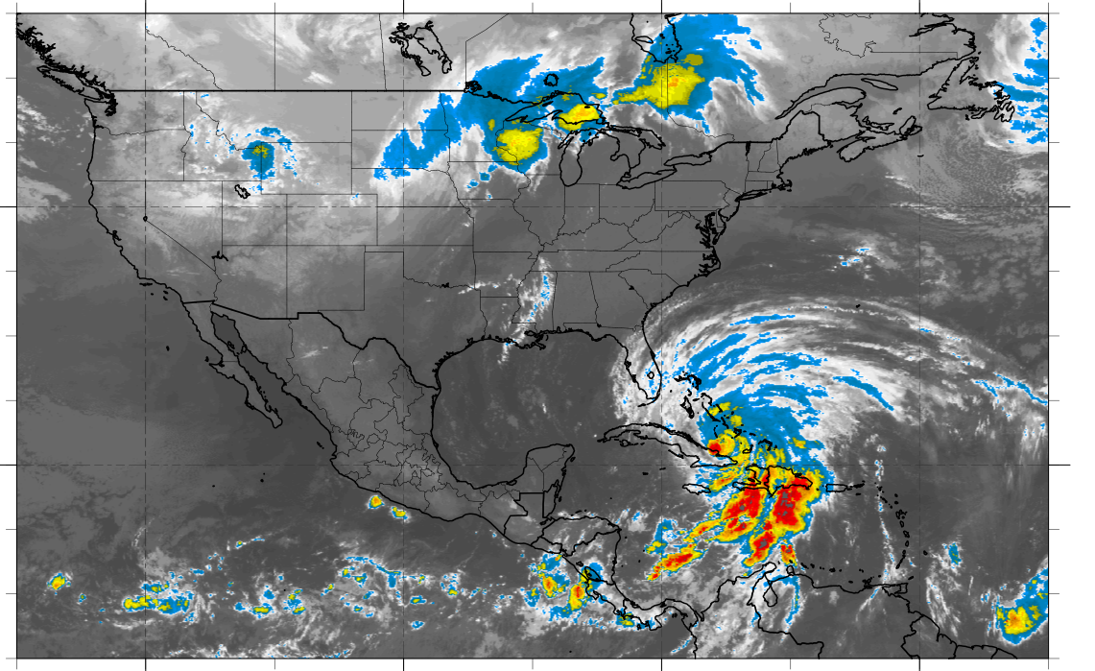
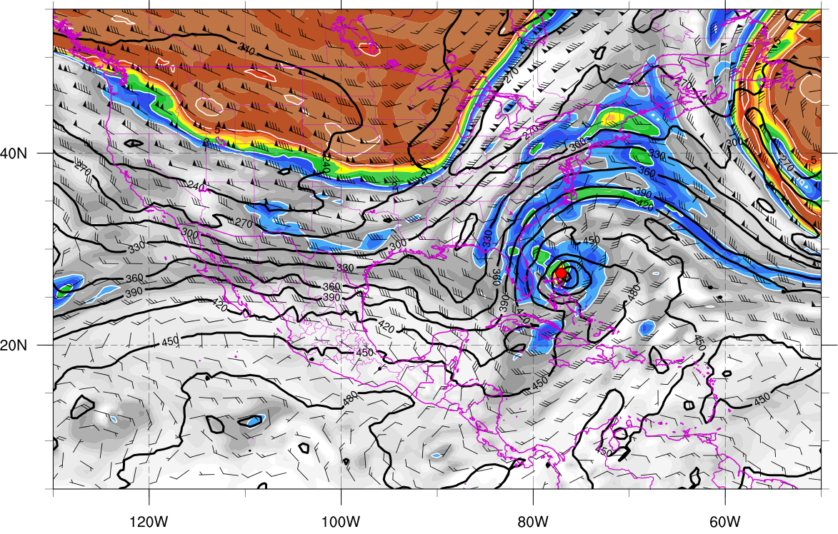
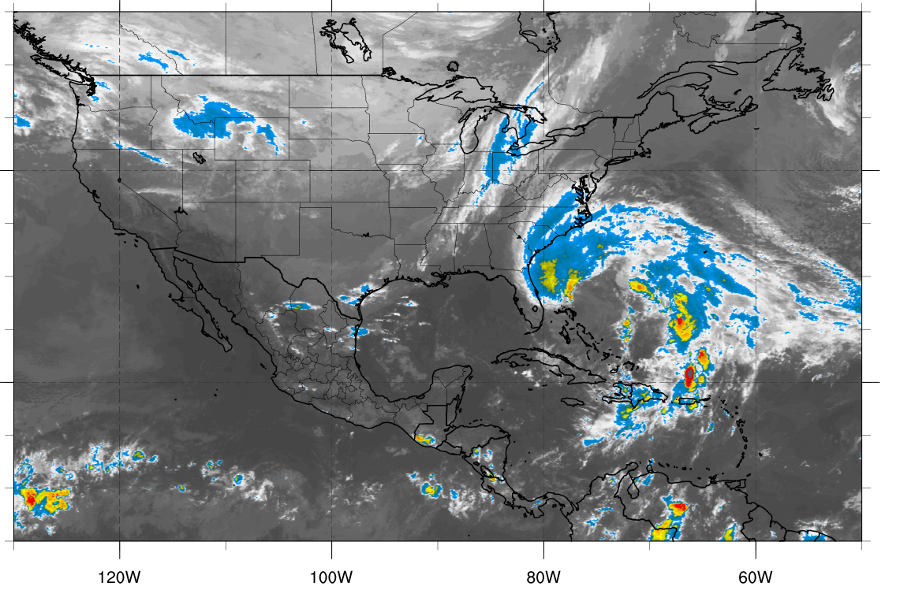
330K Surface and IR 1200 UTC 25 Oct
330K Surface and IR 0000 UTC 27 Oct
Potential vorticity (shaded, PVU), pressure (contours, hPa), winds (barbs, m s⁻¹)

Slide 20
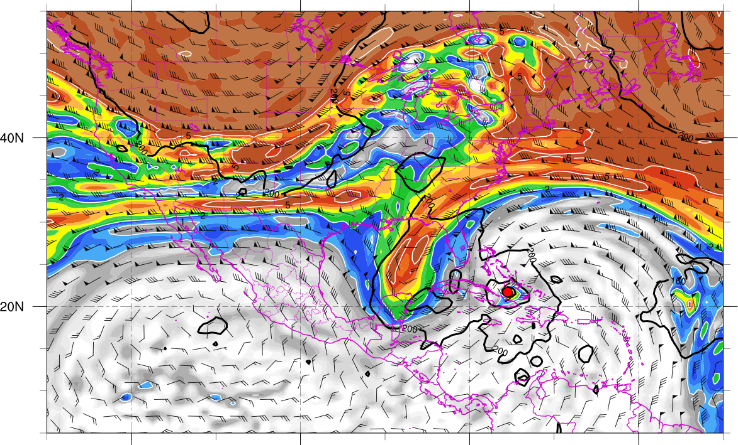
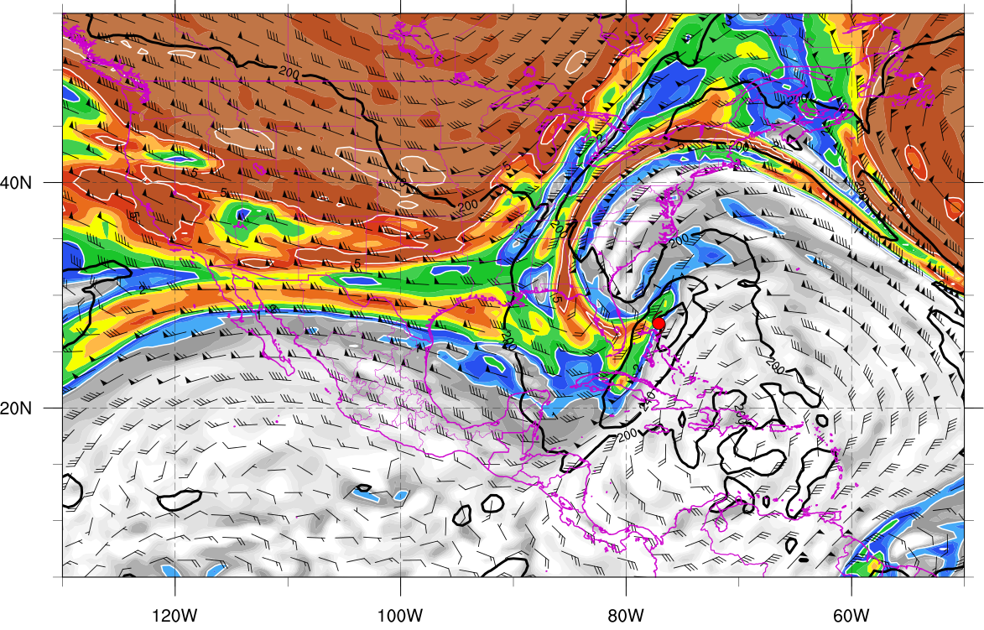
350K Surface and IR 1200 UTC 25 Oct
350K Surface and IR 0000 UTC 27 Oct
Potential vorticity (shaded, PVU), pressure (contours, hPa), winds (barbs, m s⁻¹)

Slide 21
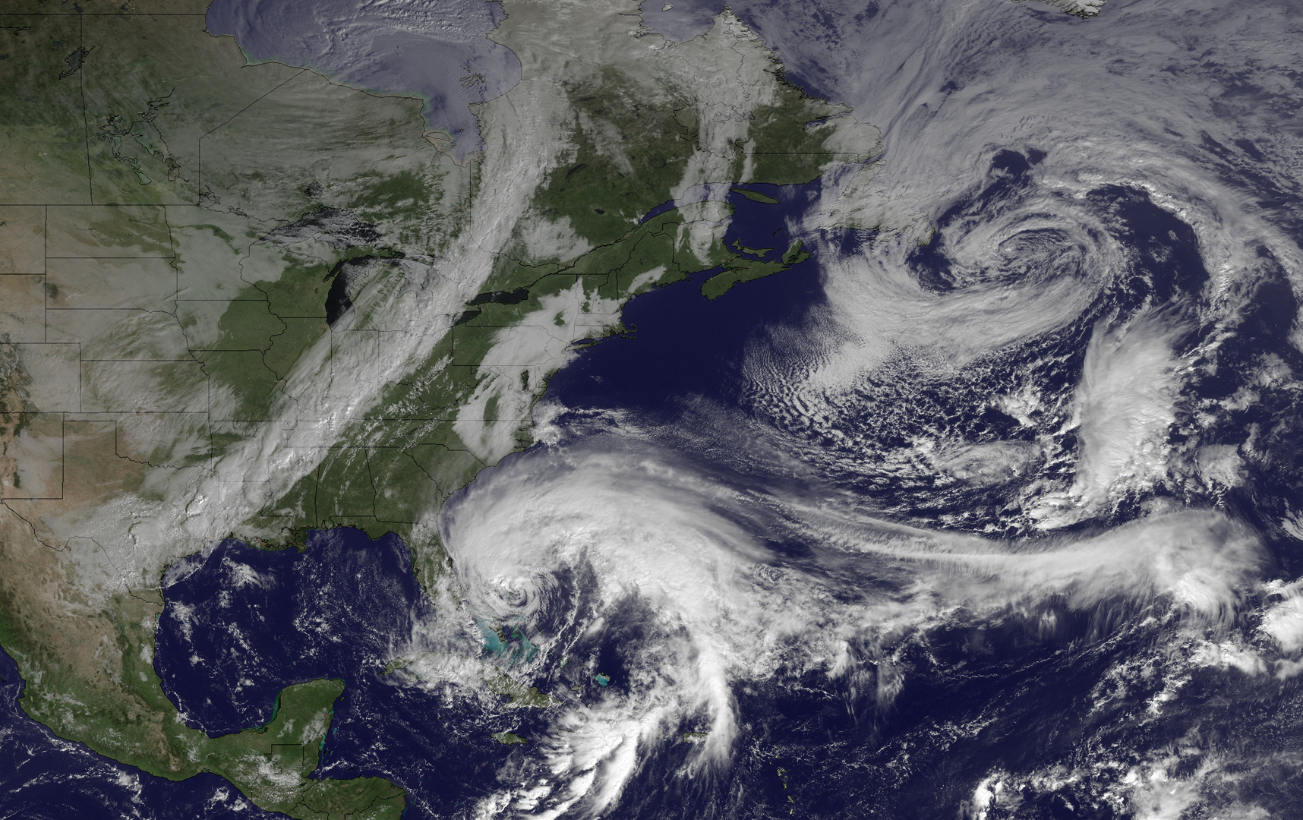
1445 UTC 26 October 2012
Image courtesy of the
NOAA’s Environmental
Visualization Laboratory

Slide 22
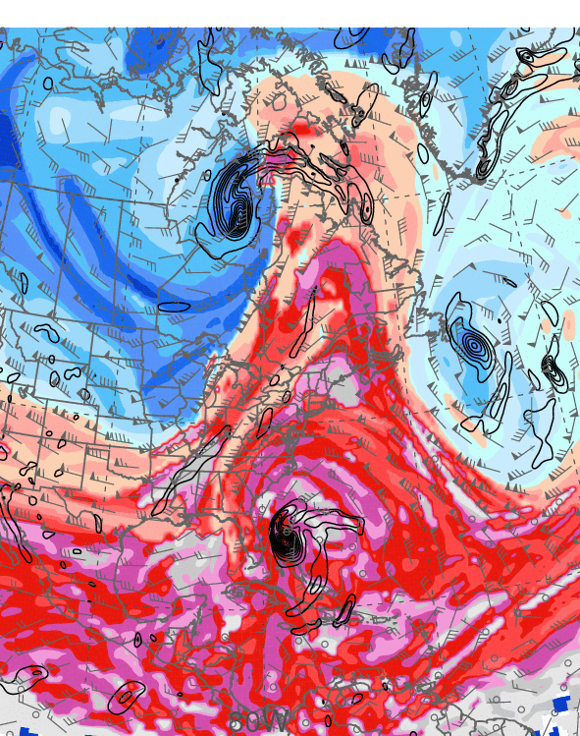
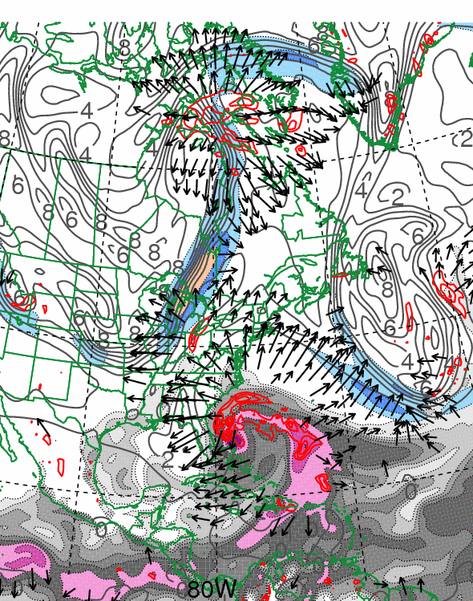
0000 UTC 27 October 2012
10.0 m s⁻¹
Dynamic tropopause (DT, 1.5-PVU surface) potential
temperature (shaded, K) and wind (barbs, kts),
925–850-hPa layer-averaged cyclonic relative vorticity
(black contours every 0.5 × 10⁻⁴ s⁻¹)
250-hPa wind speed (shaded, m s⁻¹), 300–200-hPa layer-averaged PV (gray contours, PVU), PW (gray scale, mm),
600–400-hPa layer-averaged ascent (red contours every
5.0 × 10⁻³ hPa s⁻¹), 250-hPa irrotational wind (vectors, m s⁻¹)

Slide 23
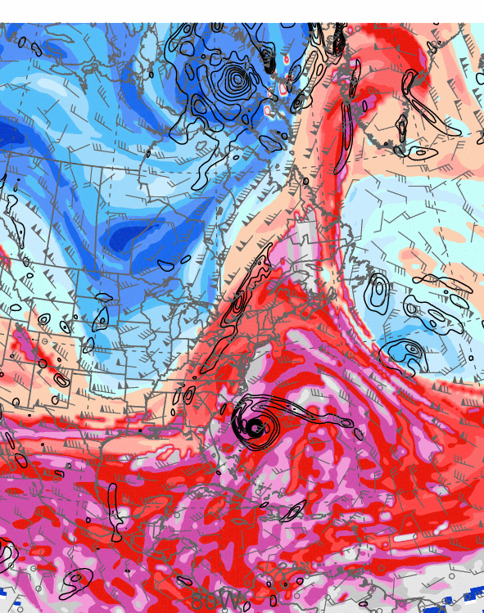
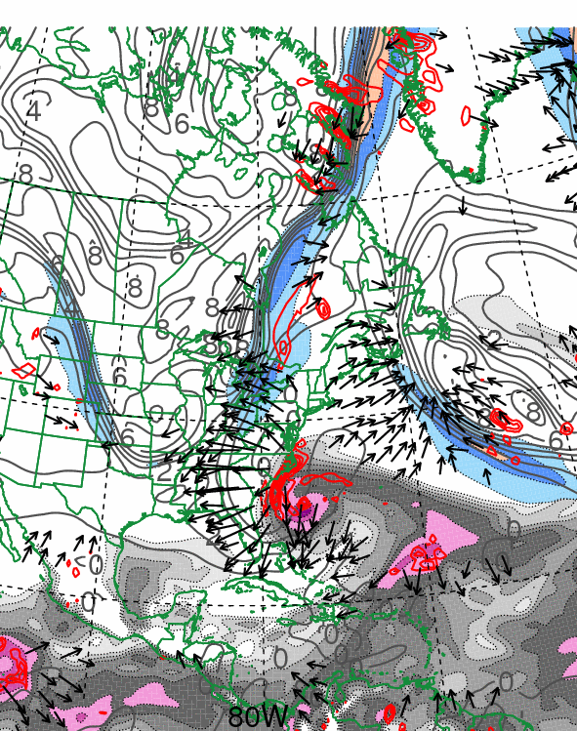
0000 UTC 28 October 2012
10.0 m s⁻¹
Dynamic tropopause (DT, 1.5-PVU surface) potential
temperature (shaded, K) and wind (barbs, kts),
925–850-hPa layer-averaged cyclonic relative vorticity
(black contours every 0.5 × 10⁻⁴ s⁻¹)
250-hPa wind speed (shaded, m s⁻¹), 300–200-hPa layer-averaged PV (gray contours, PVU), PW (gray scale, mm),
600–400-hPa layer-averaged ascent (red contours every
5.0 × 10⁻³ hPa s⁻¹), 250-hPa irrotational wind (vectors, m s⁻¹)

Slide 24
Third Trough Interaction:
Second Westward Turn and Landfall

Slide 25
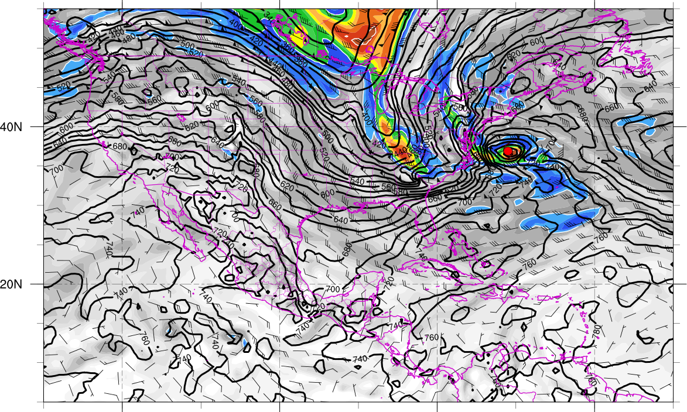
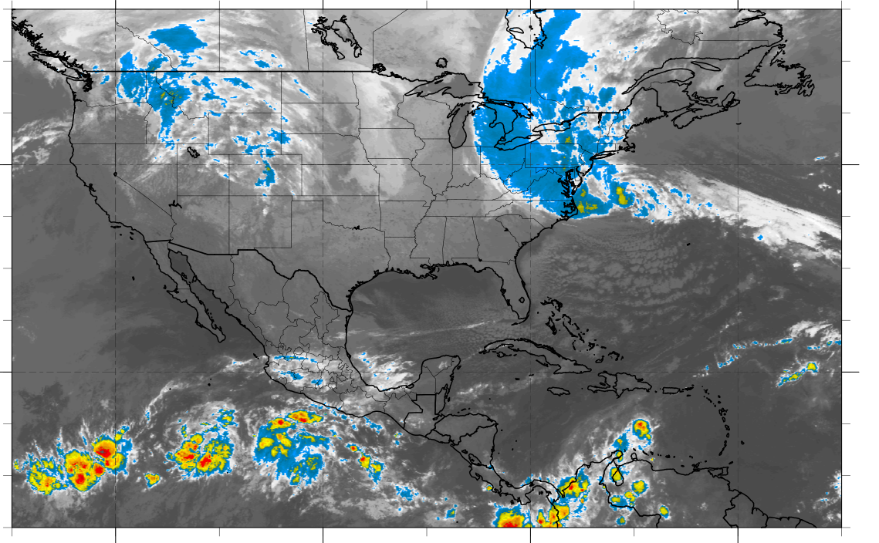
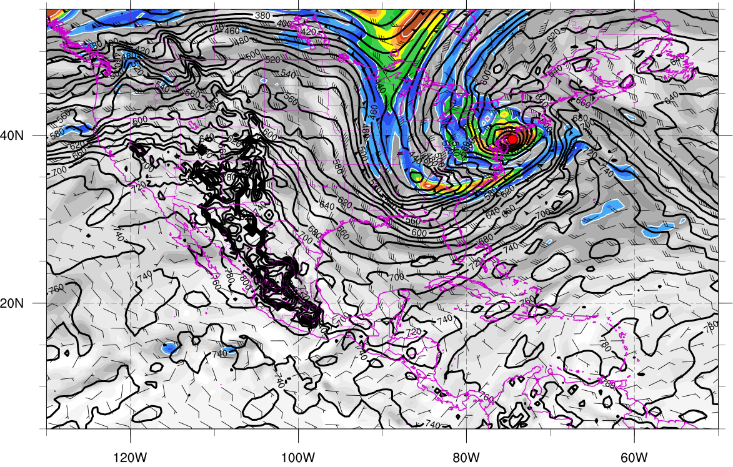
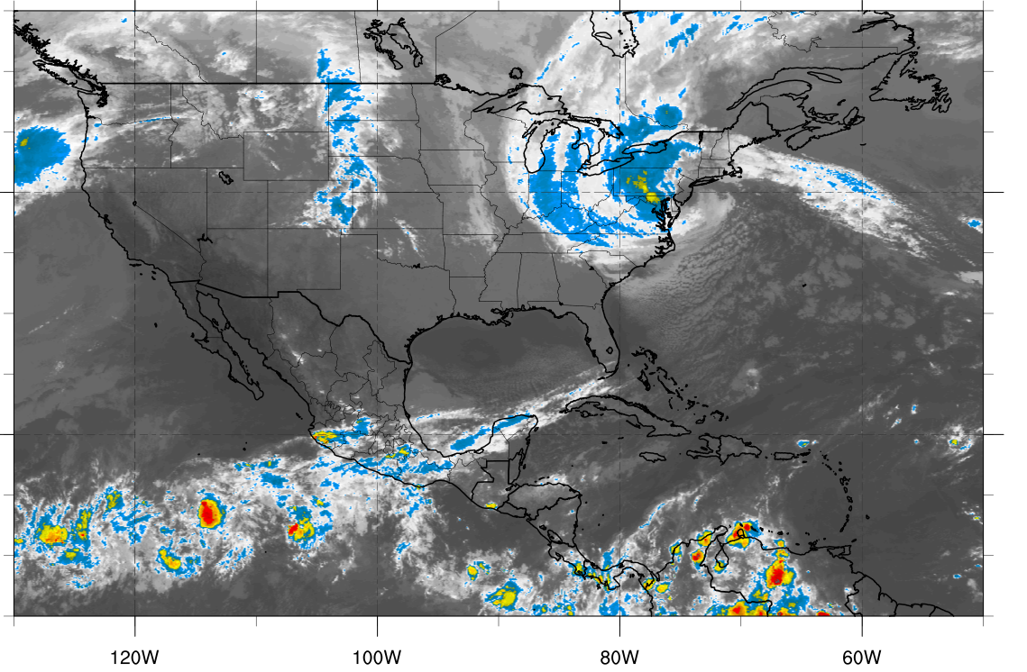
310K Surface and IR 1200 UTC 29 Oct
310K Surface and IR 0000 UTC 30 Oct
Potential vorticity (shaded, PVU), pressure (contours, hPa), winds (barbs, m s⁻¹)

Slide 26
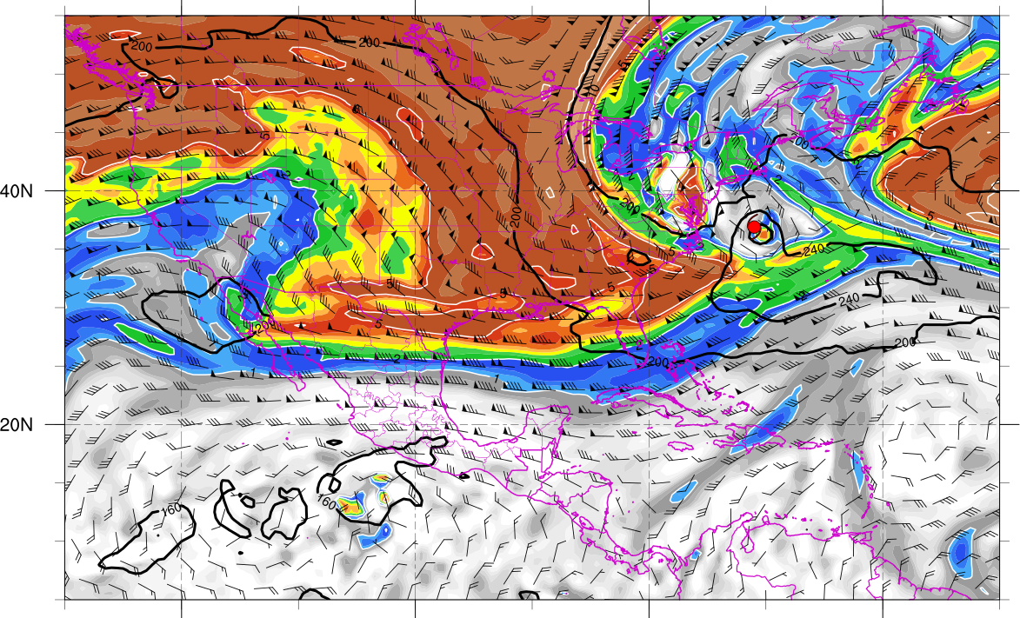
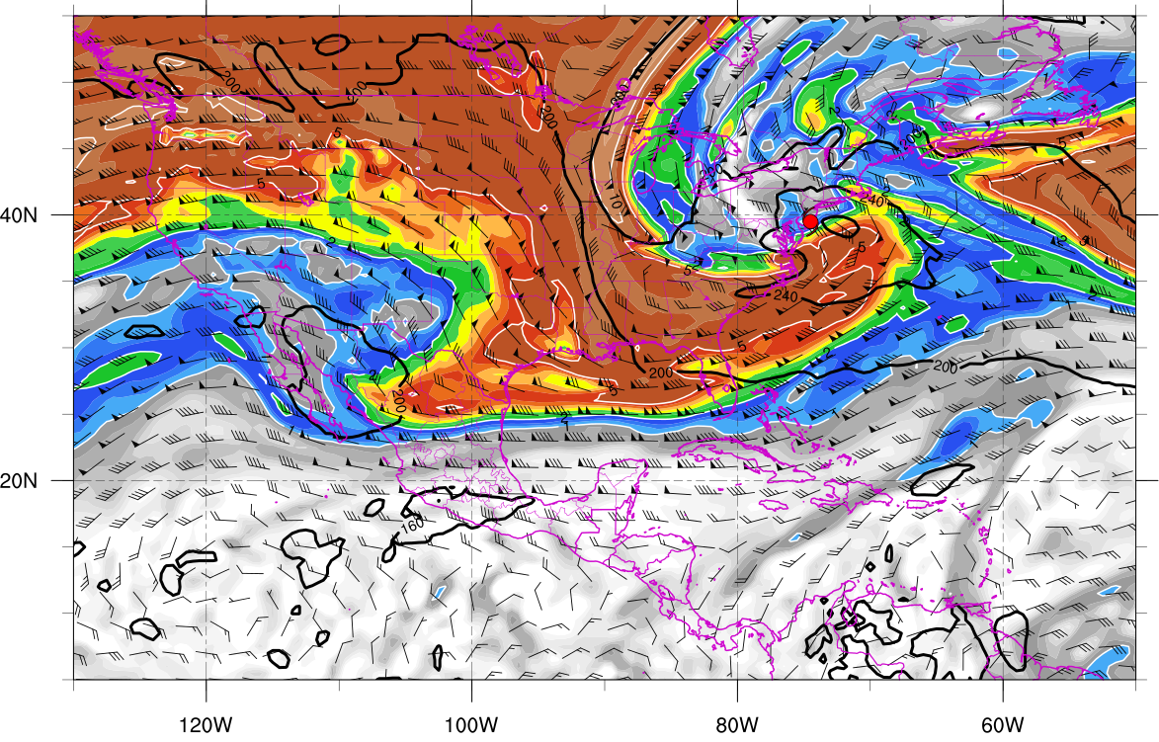
350K Surface and IR 1200 UTC 29 Oct
350K Surface and IR 0000 UTC 30 Oct
Potential vorticity (shaded, PVU), pressure (contours, hPa), winds (barbs, m s⁻¹)

Slide 27
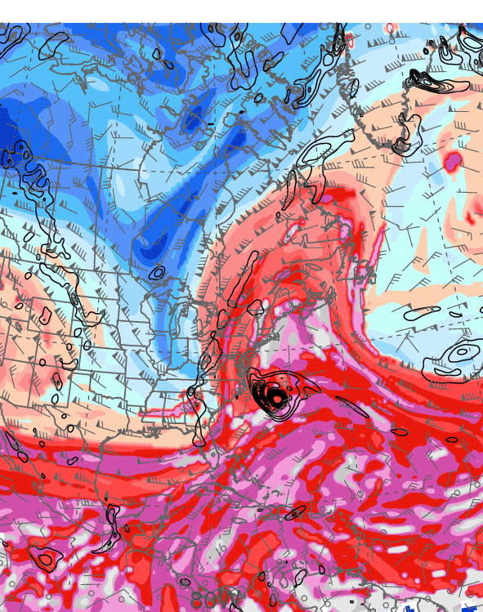
0000 UTC 29 October 2012
10.0 m s⁻¹
Dynamic tropopause (DT, 1.5-PVU surface) potential
temperature (shaded, K) and wind (barbs, kts),
925–850-hPa layer-averaged cyclonic relative vorticity
(black contours every 0.5 × 10⁻⁴ s⁻¹)
250-hPa wind speed (shaded, m s⁻¹), 300–200-hPa layer-averaged PV (gray contours, PVU), PW (gray scale, mm),
600–400-hPa layer-averaged ascent (red contours every
5.0 × 10⁻³ hPa s⁻¹), 250-hPa irrotational wind (vectors, m s⁻¹)

Slide 28
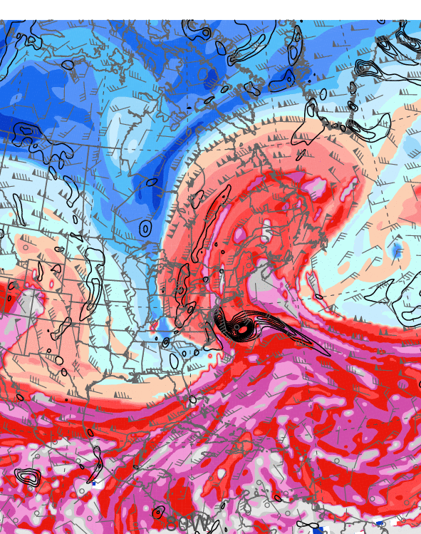
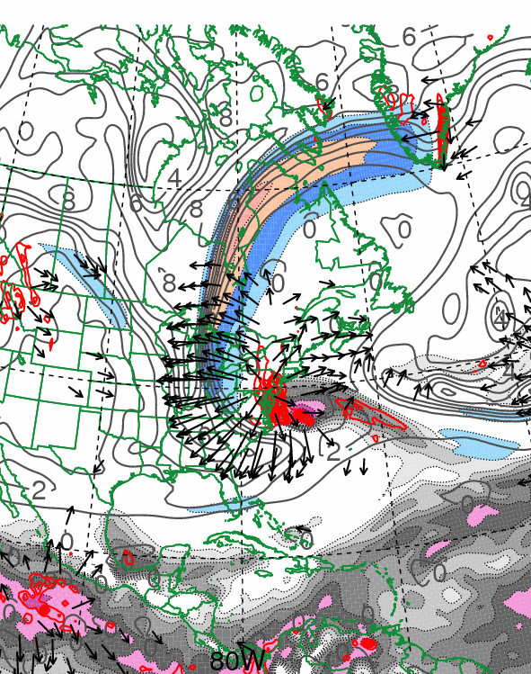
1200 UTC 29 October 2012
10.0 m s⁻¹
Dynamic tropopause (DT, 1.5-PVU surface) potential
temperature (shaded, K) and wind (barbs, kts),
925–850-hPa layer-averaged cyclonic relative vorticity
(black contours every 0.5 × 10⁻⁴ s⁻¹)
250-hPa wind speed (shaded, m s⁻¹), 300–200-hPa layer-averaged PV (gray contours, PVU), PW (gray scale, mm),
600–400-hPa layer-averaged ascent (red contours every
5.0 × 10⁻³ hPa s⁻¹), 250-hPa irrotational wind (vectors, m s⁻¹)

Slide 29
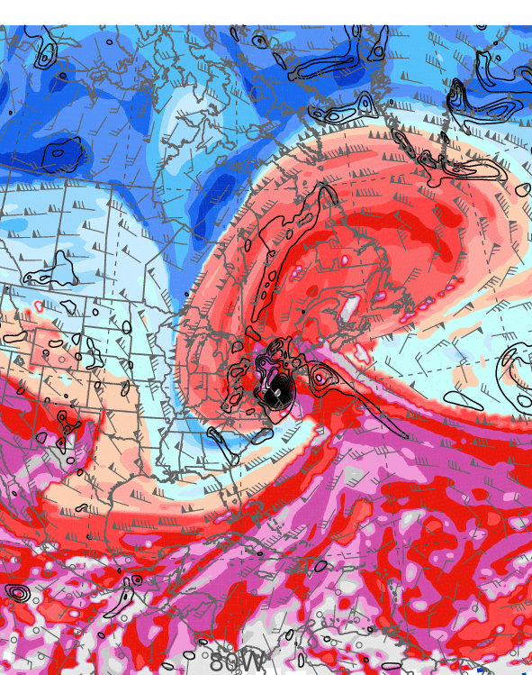
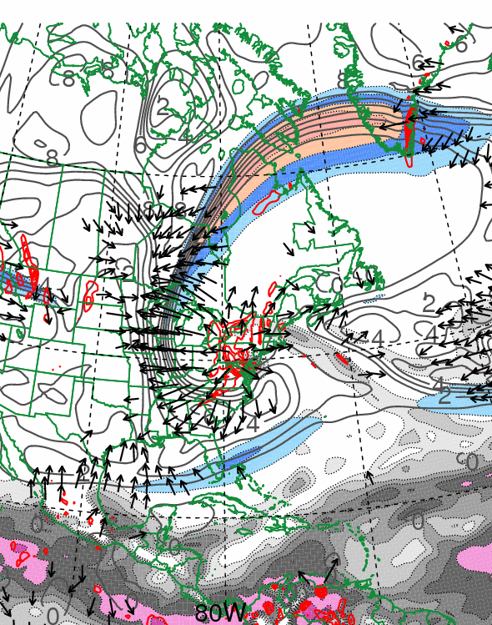
0000 UTC 30 October 2012
10.0 m s⁻¹
Dynamic tropopause (DT, 1.5-PVU surface) potential
temperature (shaded, K) and wind (barbs, kts),
925–850-hPa layer-averaged cyclonic relative vorticity
(black contours every 0.5 × 10⁻⁴ s⁻¹)
250-hPa wind speed (shaded, m s⁻¹), 300–200-hPa layer-averaged PV (gray contours, PVU), PW (gray scale, mm),
600–400-hPa layer-averaged ascent (red contours every
5.0 × 10⁻³ hPa s⁻¹), 250-hPa irrotational wind (vectors, m s⁻¹)

Slide 30
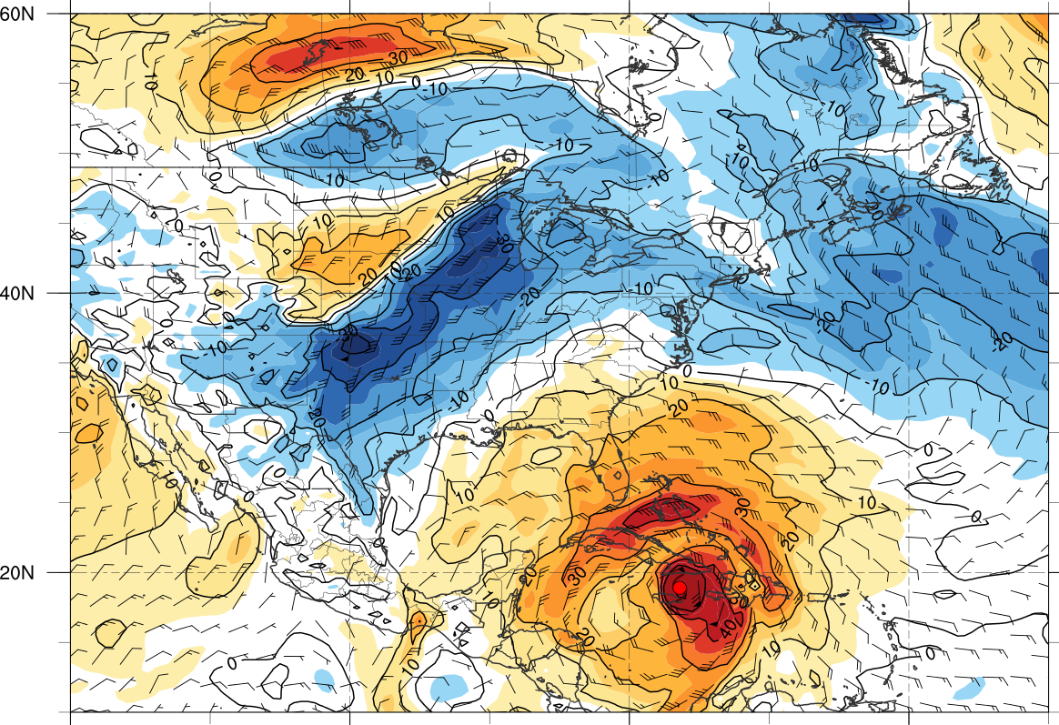
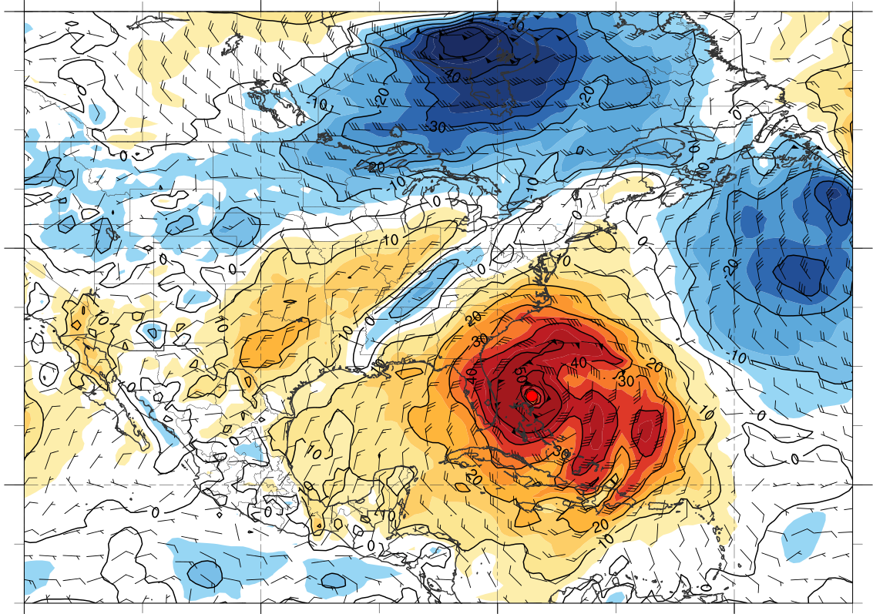



850-hPa tangential wind (color shaded) and total wind (barbs) centered on TC Sandy
0000 UTC 25 Oct
0000 UTC 27 Oct
0000 UTC 28 Oct
0000 UTC 30 Oct

Slide 31
Sandy (2012), Hazel (1954) and the 1938 New England Hurricane: A Perspective

Slide 32







Low pressure
Tropical depression
Tropical storm
Hurricane (Sandy)
Hurricane (Hazel)
Hurricane (38-Hurr)
Extratropical (Sandy)
Extratropical (Hazel)
Extratropical (38-Hurr)
Sandy: 1800 UTC 21 October – 1200 UTC 31 October 2012
Hazel: 0600 UTC 5 October – 1200 UTC 18 October 1954
1938 New England Hurricane: 1200 UTC 9 September – 0000 UTC 23 September 1938

Slide 33



0000 UTC 15 October 1954
0000 UTC 16 October 1954
250-hPa wind speed (shaded, m s⁻¹), temperature (dashed red contours, °C),
and geopotential height (black solid contours, dam)

Slide 34


0000 UTC 15 October 1954
0000 UTC 16 October 1954
250-hPa wind speed (shaded, m s⁻¹), 1000–500-hPa thickness (dashed red/blue contours, dam), and mean sea level pressure (black solid contours, hPa)

Slide 35


0000 UTC 15 October 1954
0000 UTC 16 October 1954
850-hPa frontogenesis [shaded, K (100 km) ⁻¹ (3 h) ⁻¹], temperature (dashed red contours, °C), and geopotential height (black solid contours, dam)

Slide 36


0000 UTC 21 September 1938
0000 UTC 22 September 1938
250-hPa wind speed (shaded, m s⁻¹), temperature (dashed red contours, °C),
and geopotential height (black solid contours, dam)

Slide 37


0000 UTC 21 September 1938
0000 UTC 22 September 1938
250-hPa wind speed (shaded, m s⁻¹), 1000–500-hPa thickness (dashed red/blue contours, dam), and mean sea level pressure (black solid contours, hPa)

Slide 38


0000 UTC 21 September 1938
0000 UTC 22 September 1938
850-hPa frontogenesis [shaded, K (100 km) ⁻¹ (3 h) ⁻¹], temperature (dashed red contours, °C), and geopotential height (black solid contours, dam)

Slide 39
Post Landfall:
The Snowy Side of Sandy

Slide 40


Total Precipitation
Observed snowfall (in, shaded)
Observed precipitation (in, shaded)
Downslope drying
Image Source: Weather Prediction Center

Slide 41

Quasi-Geostrophic Forcing
500-hPa heights (dam, solid), temperature (°K, dashed), Q-vectors (Pa m⁻¹ s⁻¹,
arrows), Q-vector forcing (Pa m⁻² s⁻¹, shaded)
1200 UTC 28 October 2012
Forcing for ascent in the snowfall region originated downstream of an upper-level trough at 1200 UTC 28 October

Slide 42

Quasi-Geostrophic Forcing
500-hPa heights (dam, solid), temperature (°K, dashed), Q-vectors (Pa m⁻¹ s⁻¹,
arrows), Q-vector forcing (Pa m⁻² s⁻¹, shaded)
0000 UTC 30 October 2012
500 hPa Q-vector convergence increased over West Virginia as forcing for ascent wrapped around the poleward and western side of the cyclone

Slide 43

Low-Level Warm-Air Advection
800-hPa temperature change (°C 6h⁻¹, shaded), temperature (solid > 0 °C, dashed < 0 °C), wind (kt, barbs)
0600 UTC 30 October
Northerly and northwesterly low-level warm-air advection upwind of the Appalachian Mountain spine increased the stability in this region
ILN

Slide 44


Wilmington, OH (ILN) Soundings
1200 UTC 29 October 2012
1200 UTC 30 October 2012
Inversion strengthens
12-km NAM forecast soundings for ILN match observed soundings

Slide 45



Blocked Flow
Along-barrier wind (kt, shaded), omega (Pa s⁻¹, dashed contours-upward, solid contours-downward)
Cross-barrier wind (kt, shaded), theta-e (K, solid)
Upstream lifting
Barrier jet
Decrease in cross-barrier wind speed
0600 UTC 30 October 2012
0600 UTC 30 October 2012
12-km NAM analyses

Slide 46


Upwind Precipitation Enhancement
NAM forecast precipitation (in, shaded) after inversion development

Slide 47
Schematic representation of three trough interactions that occurred during the life cycle of TC Sandy. Blue, purple, and red lines represent idealized 0.4 PVU, 0.8 PVU, and 2.0 PVU contours on the 330–335K layer-averaged potential temperature surface. Black contours depict 925–850-hPa layer-averaged cyclonic relative vorticity associated with TC Sandy (every 0.5 × 10⁻⁴ s⁻¹). Shading depicts the magnitude of the 250-hPa wind (m s⁻¹) at 1800 UTC 29 October 2012. Inset shows the total rainfall (green shading) and snowfall (blue shading) in inches associated with TC Sandy (adapted from NOAA/NWS WPC).

Slide 48
Conclusions
Antecedent baroclinic zone over Gulf of Mexico supports warm-air advection with first trough interaction and results in a poleward cloud expansion
Sandy expands in size, but remains warm core as it turns northwestward during second trough interaction
Sandy-induced westward-directed negative PV advection helps to establish a well-defined PV hook during third trough interaction
“Sandy-like” storm tracks have occurred previously (Hazel; ‘38 Hurricane)
Upwind increase (decrease) in stratification (cross-barrier flow) with warm advection from north creates flow blocking and westward snow expansion

Slide 49


