Slide 1
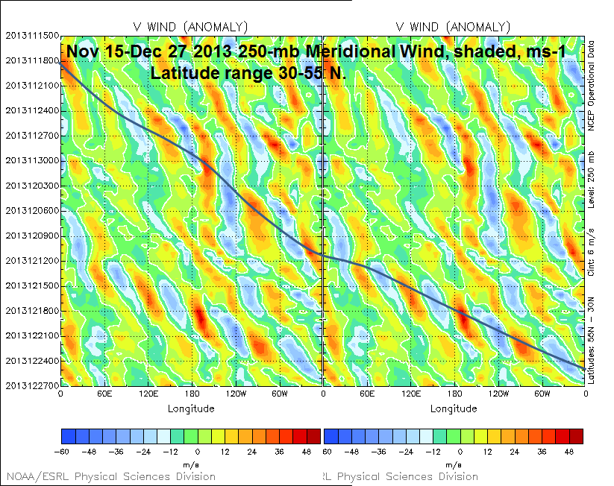
15 Nov
21 Nov
27 Nov
Time
3 Dec
9 Dec
c_{g} = ~18 m s⁻¹
15 Dec
21 Dec
27 Dec
−60 −48 −36 −24 −12 0 12 24 36 48
Source: Dr. Mel Shapiro
Notes:
When starting talk, define education–research interface and introduce Alicia and Kyle as current and previous TAs in upper-division thermodynamics and introductory graduate dynamics that I presently teach at UAlbany.

Slide 2
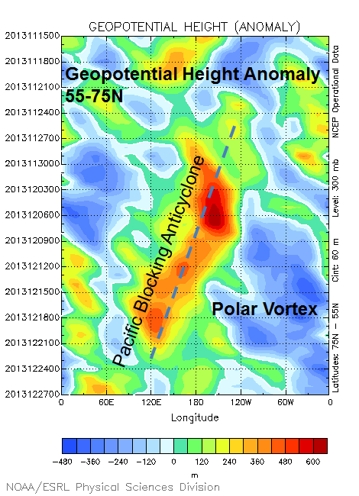
15 Nov
300-hPa
21 Nov
600
480
360
240
120
0
−120
−240
−360
−480
27 Nov
Time
3 Dec
9 Dec
15 Dec
c_{p} = ~−2 m s⁻¹
21 Dec
27 Dec
Source: Dr. Mel Shapiro
Notes:
When starting talk, define education–research interface and introduce Alicia and Kyle as current and previous TAs in upper-division thermodynamics and introductory graduate dynamics that I presently teach at UAlbany.

Slide 3
KDSV Dansville, NY
Elevation:
198 m
KDSV 221154Z AUTO 15007KT 10SM UP BKN095 OVC110 00/00 A2966 RMK AO2 PRESFR SLP057 P0001 60011 70105 T00000000 10011 20000 50020
KDSV 221254Z AUTO 14007KT 10SM -RA OVC095 02/02 A2967 RMK AO2 UPE23RAB23 SLP063 P0000 T00220017
KDSV 221354Z AUTO 16018G26KT 10SM BKN110 14/12 A2961 RMK AO2 PK WND 15026/1353 RAE48 SLP038 P0001 T01390117
KDSV 221454Z AUTO 33014G27KT 290V020 10SM CLR 17/12 A2963 RMK AO2 PK WND 16037/1439 WSHFT 1429 RAB16E25 PRESRR SLP044 P0000 60001 T01720117 55014 $
KDSV 221504Z AUTO 32028G42KT 10SM -RA SCT005 SCT019 02/01 A2967 RMK AO2 PK WND 33042/1500 RAB1456 PRESRR P0000 $
Notes:
When starting talk, define education–research interface and introduce Alicia and Kyle as current and previous TAs in upper-division thermodynamics and introductory graduate dynamics that I presently teach at UAlbany.

Slide 4
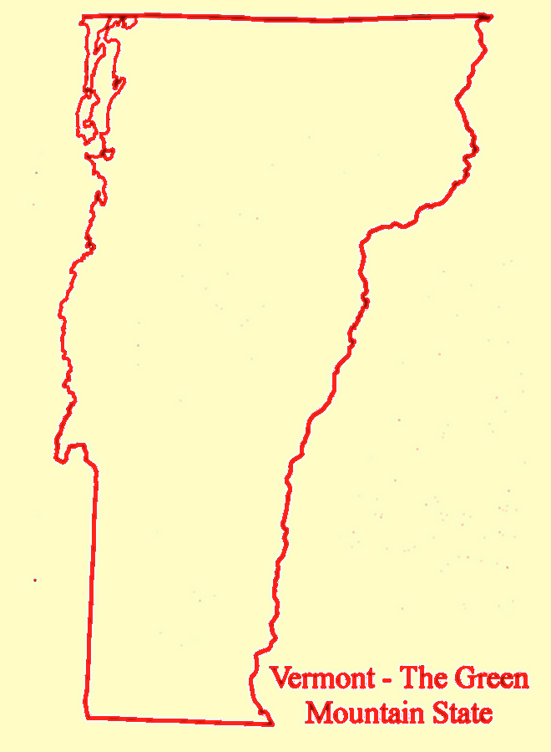
KDDH Bennington, VT
Elevation:
244 m
KDDH 221054Z AUTO 00000KT 4SM BR FEW002 OVC018 04/03 A2968 RMK AO2 SLP055 T00390028
KDDH 221226Z AUTO 21009G22KT 10SM BKN020 BKN060 OVC070 17/13 A2970 RMK AO2 P0000 $
KDDH 221240Z AUTO 20013G29KT 10SM SCT020 BKN055 OVC100 17/13 A2969 RMK AO2 PK WND 22029/1235 P0000 $
KDDH 221254Z AUTO 21014G23KT 10SM BKN022 BKN048 BKN100 17/13 A2970 RMK AO2 PK WND 22029/1235 SLP056 P0000 T01720133 $
KDDH 221344Z AUTO 01005KT 2 1/2SM BR BKN020 06/04 A2973 RMK AO2 $
Notes:
When starting talk, define education–research interface and introduce Alicia and Kyle as current and previous TAs in upper-division thermodynamics and introductory graduate dynamics that I presently teach at UAlbany.

Slide 5
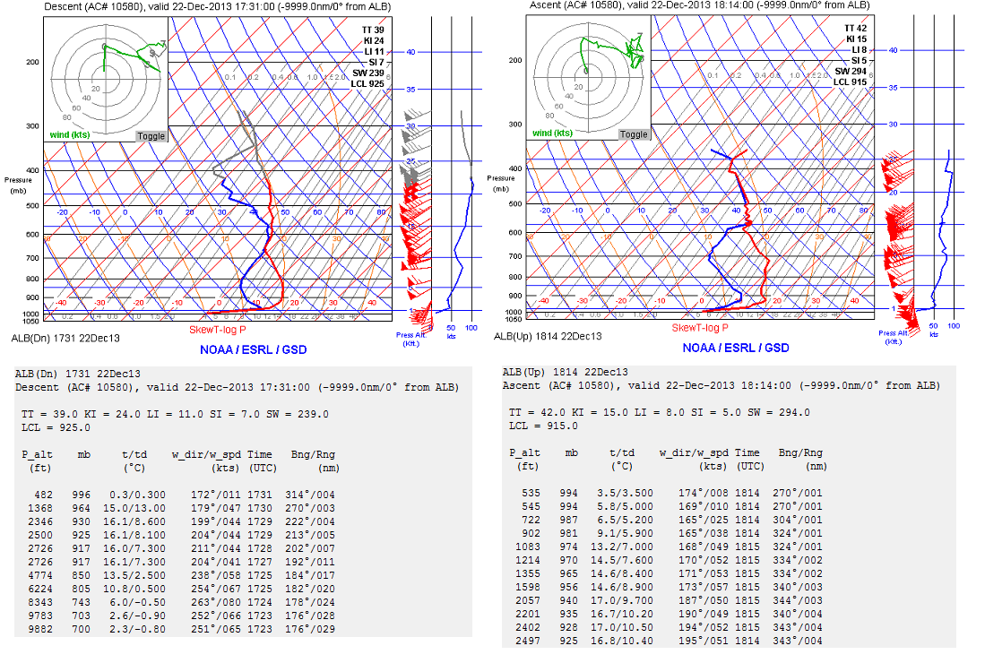
ALB (Albany, NY) Aircraft Soundings 1731 UTC 22 December 2013 1814 UTC 22 December 2013
Descent
Ascent
Source: Jonathan Blaes
Notes:
When starting talk, define education–research interface and introduce Alicia and Kyle as current and previous TAs in upper-division thermodynamics and introductory graduate dynamics that I presently teach at UAlbany.

