Slide 1
Tropical Moisture, Arctic Anticyclones, and Upper-Level Jets:
An Ice-Storm Recipe Par-Excellence
Lance F. Bosart, Alicia M. Bentley, and Philippe P. Papin
Department of Atmospheric and Environmental Sciences
University at Albany, State University of New York, Albany, NY 12222
95th American Meteorological Society Annual Meeting
Phoenix, Arizona
Tuesday 6 January 2015

Slide 2
Motivation
A raob wind speed of 248 kt (127.6 m s⁻¹) occurred over Goose Bay at 1200 UTC 22 December 2013
This 248 kt wind speed is the highest in the modern radiosonde data record (1979–2013)
The associated “uber jet” core was located to the east of the crest of a strong upper-tropospheric ridge
Juxtaposition of anomalously warm and cold air created deep baroclinicity beneath the uber jet
A widespread, disruptive ice storm occurred in the equatorward entrance region of this uber jet

Slide 3
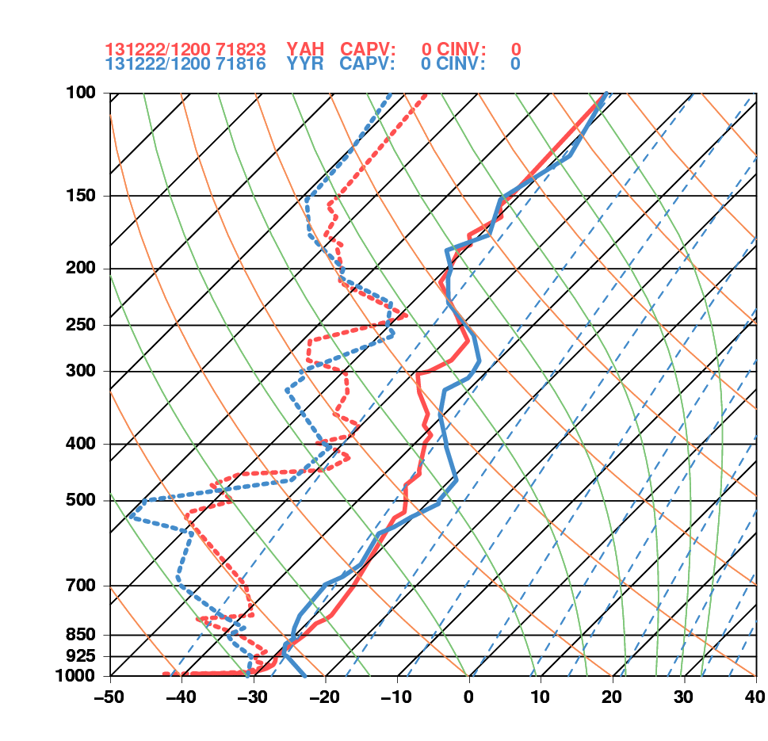
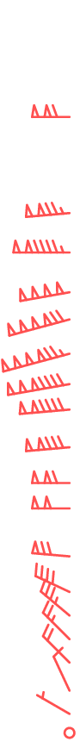
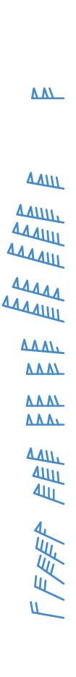
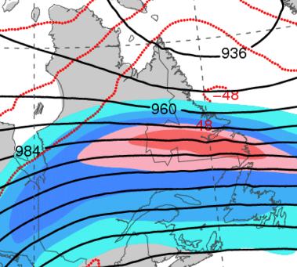
1200 UTC 22 December 2013
La Grande, QC Goose Bay, NL
Goose Bay, NL
La Grande, QC

Slide 4
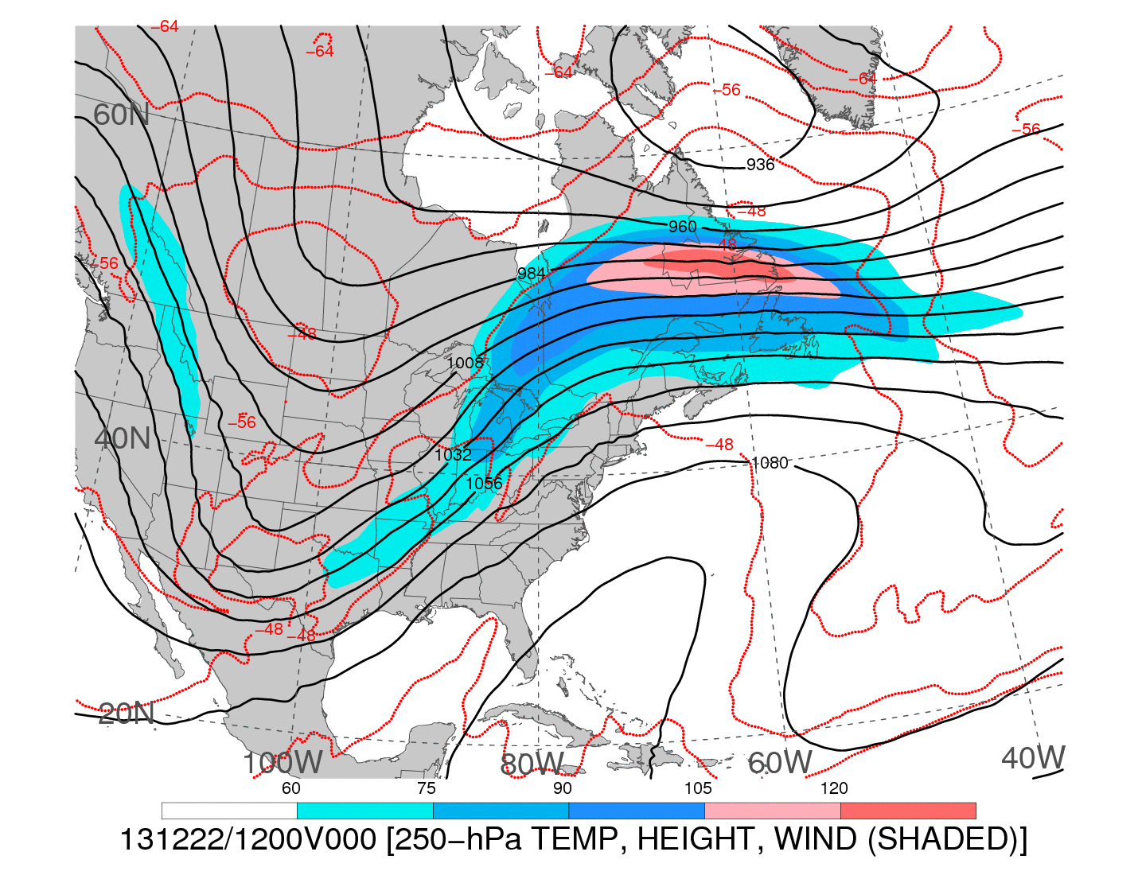
1200 UTC 22 December 2013
250-hPa wind speed (shaded, m s⁻¹; barbs, kts), geopotential height (black contours, dam),
and temperature (red dashed contours, °C)
Notes:
When starting talk, define education–research interface and introduce Alicia and Kyle as current and previous TAs in upper-division thermodynamics and introductory graduate dynamics that I presently teach at UAlbany.

Slide 5

1200 UTC 22 December 2013
−−
250-hPa wind speed (shaded, m s⁻¹; barbs, kts), geopotential height (black contours, dam),
and temperature (red dashed contours, °C)
Notes:
When starting talk, define education–research interface and introduce Alicia and Kyle as current and previous TAs in upper-division thermodynamics and introductory graduate dynamics that I presently teach at UAlbany.

Slide 6
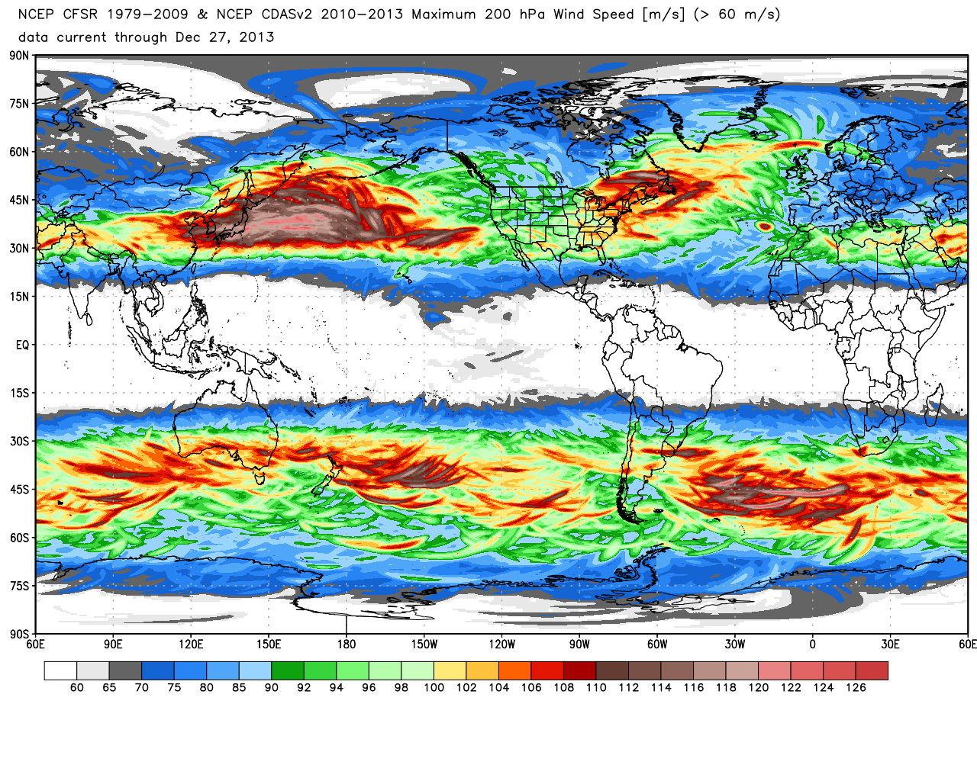
200-hPa maximum wind speed (m s⁻¹)
0.5° Climate Forecast System Reanalysis: 1979–2013
Source: Ryan Maue
Notes:
When starting talk, define education–research interface and introduce Alicia and Kyle as current and previous TAs in upper-division thermodynamics and introductory graduate dynamics that I presently teach at UAlbany.

Slide 7
200-hPa maximum wind speed (m s⁻¹)
0.5° Climate Forecast System Reanalysis: 1979–2013
Source: Ryan Maue
Notes:
When starting talk, define education–research interface and introduce Alicia and Kyle as current and previous TAs in upper-division thermodynamics and introductory graduate dynamics that I presently teach at UAlbany.

Slide 8
Outline
Jet statistics
Antecedent large-scale overview
Anticyclonic wave breaking and uber jet evolution
Regional synoptic analysis and ice storm setup
Sounding, surface and trajectory analysis
Cross section analysis
Conclusions

Slide 9
Data Sources
0.5º Global Forecast System (GFS) Analysis
0.5º Climate Forecast System (CFS) Reanalysis
Upper Air Radiosonde Network / Aircraft Observations
Surface METAR Observations

Slide 10
Large-Scale Overview
Notes:
When starting talk, define education–research interface and introduce Alicia and Kyle as current and previous TAs in upper-division thermodynamics and introductory graduate dynamics that I presently teach at UAlbany.

Slide 11
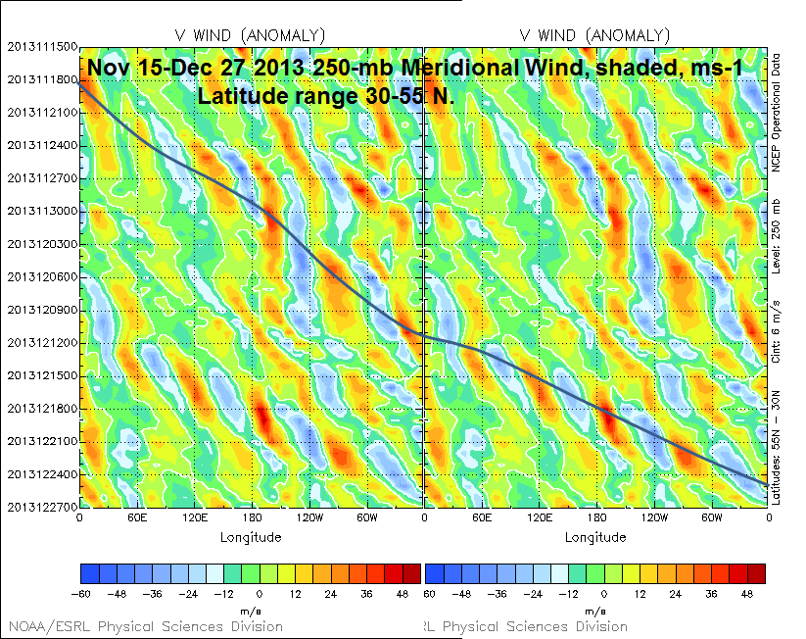
15 Nov
21 Nov
27 Nov
Time
3 Dec
9 Dec
c_{g} = ~18 m s⁻¹
15 Dec
21 Dec
27 Dec
−60 −48 −36 −24 −12 0 12 24 36 48
Source: Mel Shapiro
Notes:
When starting talk, define education–research interface and introduce Alicia and Kyle as current and previous TAs in upper-division thermodynamics and introductory graduate dynamics that I presently teach at UAlbany.

Slide 12
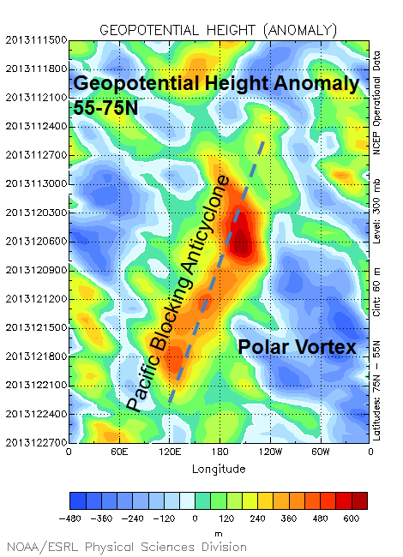
15 Nov
300-hPa
21 Nov
600
480
360
240
120
0
−120
−240
−360
−480
27 Nov
Time
3 Dec
9 Dec
15 Dec
c_{p} = ~−2 m s⁻¹
21 Dec
27 Dec
Source: Mel Shapiro
Notes:
When starting talk, define education–research interface and introduce Alicia and Kyle as current and previous TAs in upper-division thermodynamics and introductory graduate dynamics that I presently teach at UAlbany.

Slide 13
Anticyclonic Wave Breaking and Uber Jet Evolution
Notes:
When starting talk, define education–research interface and introduce Alicia and Kyle as current and previous TAs in upper-division thermodynamics and introductory graduate dynamics that I presently teach at UAlbany.

Slide 14
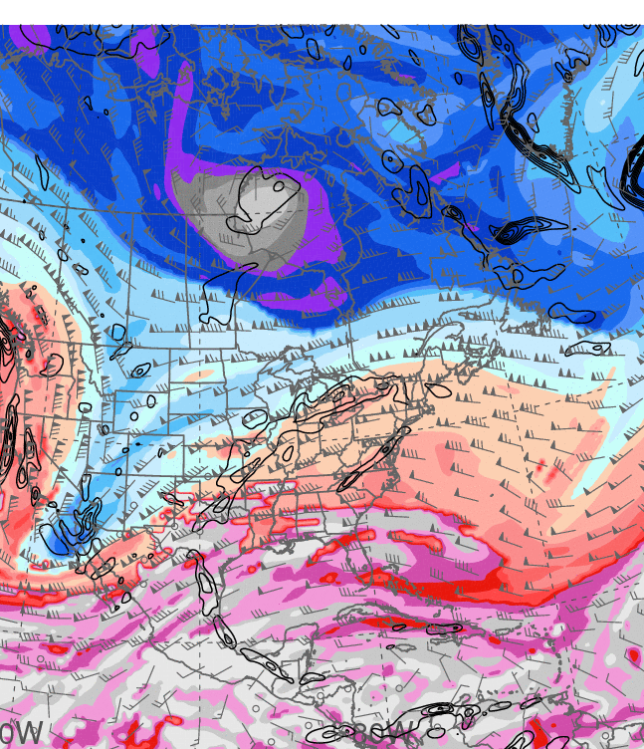
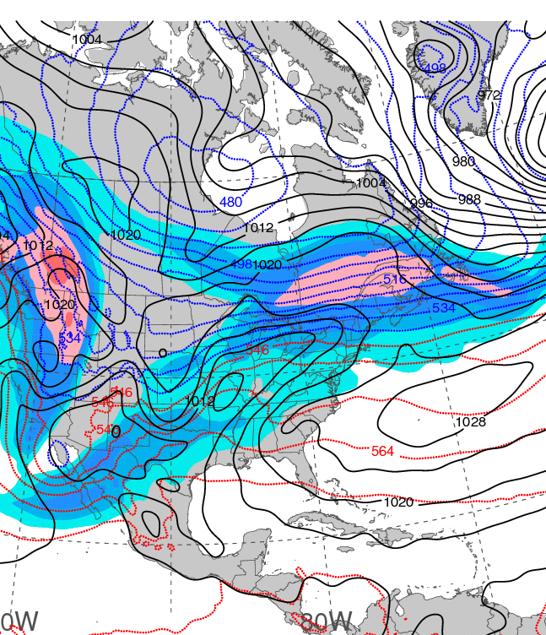
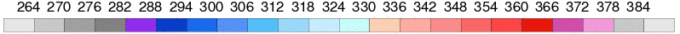
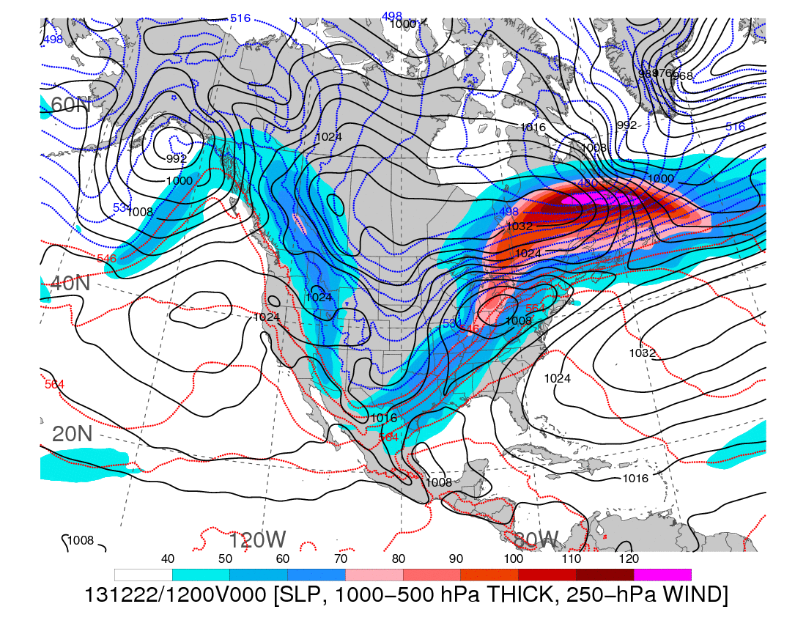
1200 UTC 20 December 2013
Dynamic tropopause (DT, 1.5-PVU surface) potential
temperature (shaded, K) and wind (barbs, kts),
925–850-hPa layer-averaged cyclonic relative vorticity
(black contours every 0.5 × 10⁻⁴ s⁻¹)
250-hPa wind speed (shaded, m s⁻¹), 1000–500-hPa thickness (blue contours ≤ 540 dam,
red contours > 540 dam), MSLP (black contours, hPa)

Slide 15
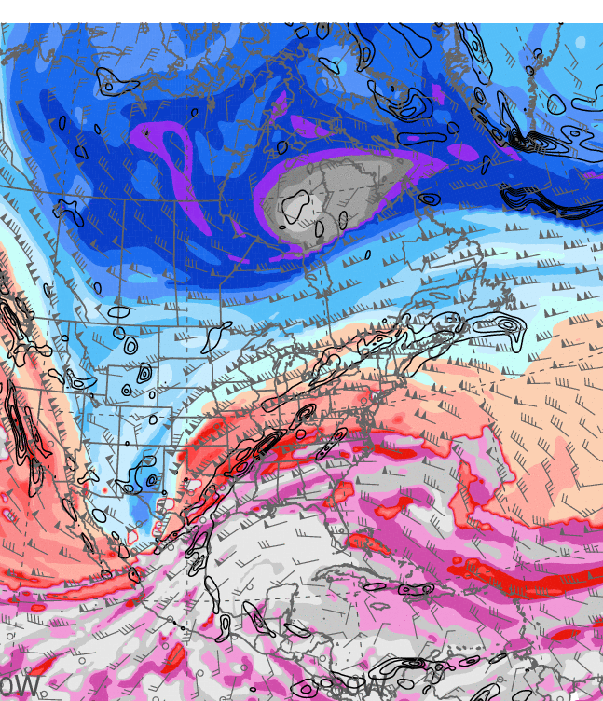
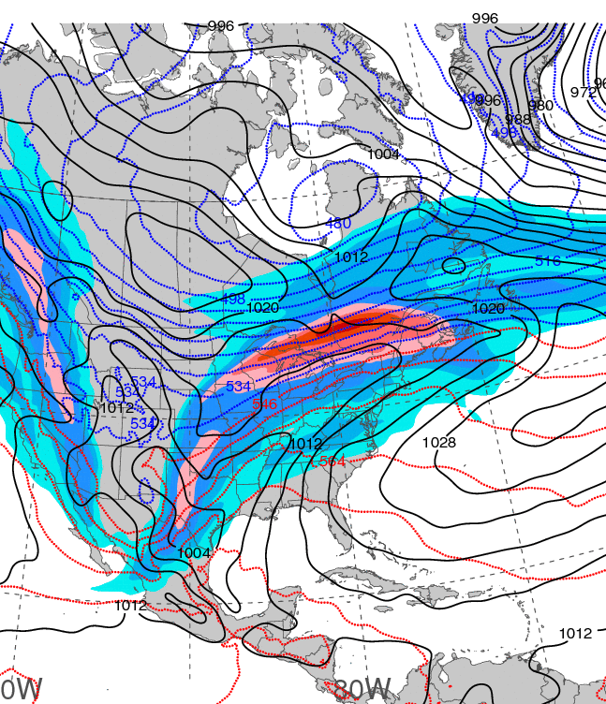
1200 UTC 21 December 2013
Dynamic tropopause (DT, 1.5-PVU surface) potential
temperature (shaded, K) and wind (barbs, kts),
925–850-hPa layer-averaged cyclonic relative vorticity
(black contours every 0.5 × 10⁻⁴ s⁻¹)
250-hPa wind speed (shaded, m s⁻¹), 1000–500-hPa thickness (blue contours ≤ 540 dam,
red contours > 540 dam), MSLP (black contours, hPa)

Slide 16
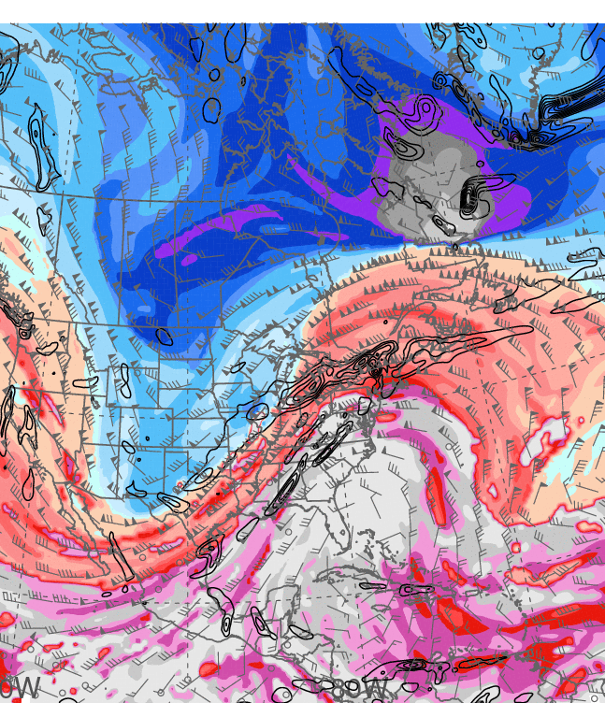
1200 UTC 22 December 2013
Dynamic tropopause (DT, 1.5-PVU surface) potential
temperature (shaded, K) and wind (barbs, kts),
925–850-hPa layer-averaged cyclonic relative vorticity
(black contours every 0.5 × 10⁻⁴ s⁻¹)
250-hPa wind speed (shaded, m s⁻¹), 1000–500-hPa thickness (blue contours ≤ 540 dam,
red contours > 540 dam), MSLP (black contours, hPa)

Slide 17
Regional Synoptic Analysis and Ice Storm Setup
Notes:
When starting talk, define education–research interface and introduce Alicia and Kyle as current and previous TAs in upper-division thermodynamics and introductory graduate dynamics that I presently teach at UAlbany.

Slide 18
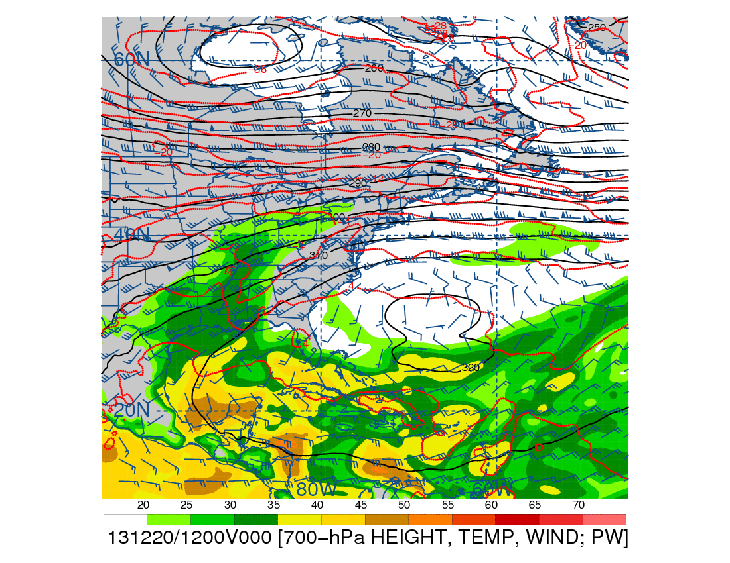
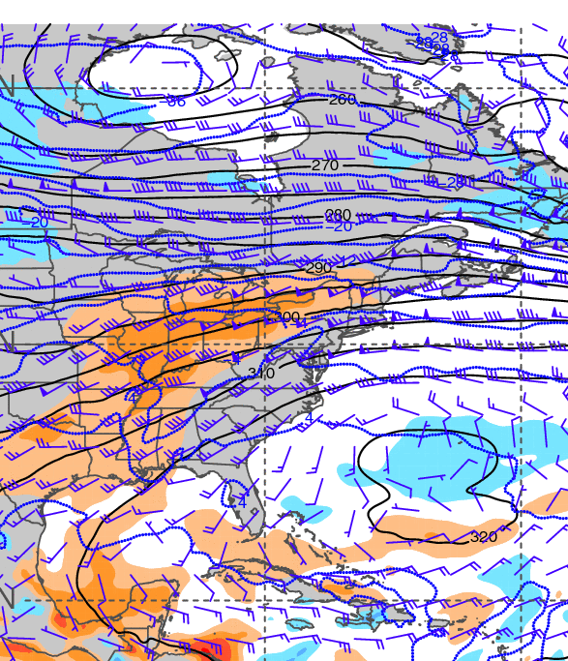
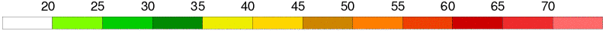
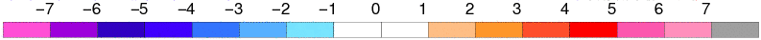
1200 UTC 20 December 2013
700-hPa geopotential height (black contours, dam),
temperature (red contours, °C), wind (barbs, kts),
and precipitable water (shaded, mm)
700-hPa geopotential height (black contours, dam),
temperature (blue contours, °C), wind (barbs, kts),
and precipitable water standardized anomalies (shaded, σ)

Slide 19
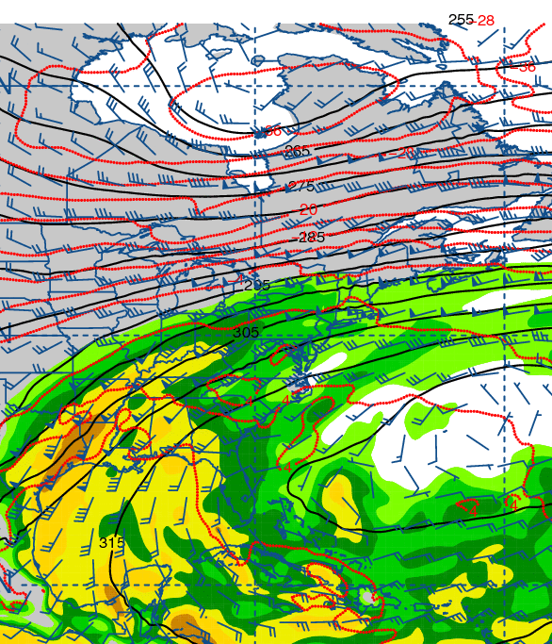
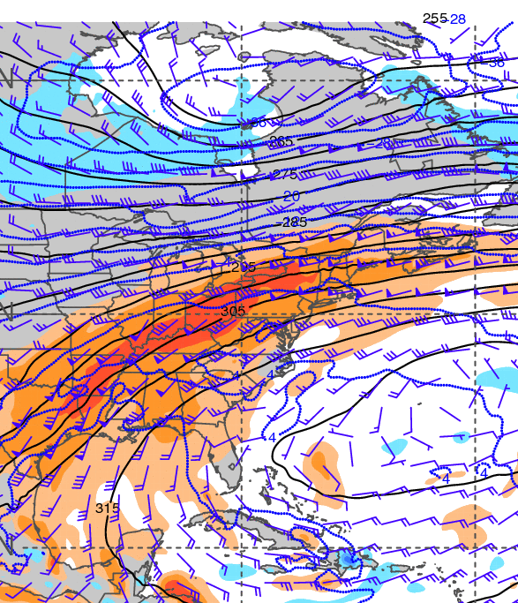
1200 UTC 21 December 2013
700-hPa geopotential height (black contours, dam),
temperature (red contours, °C), wind (barbs, kts),
and precipitable water (shaded, mm)
700-hPa geopotential height (black contours, dam),
temperature (blue contours, °C), wind (barbs, kts),
and precipitable water standardized anomalies (shaded, σ)

Slide 20
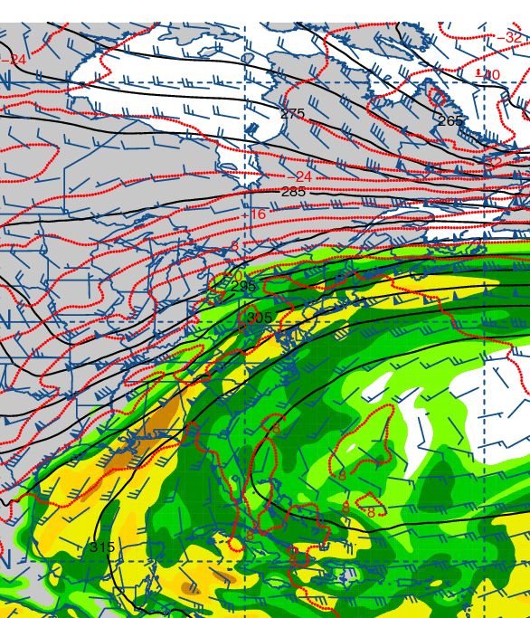
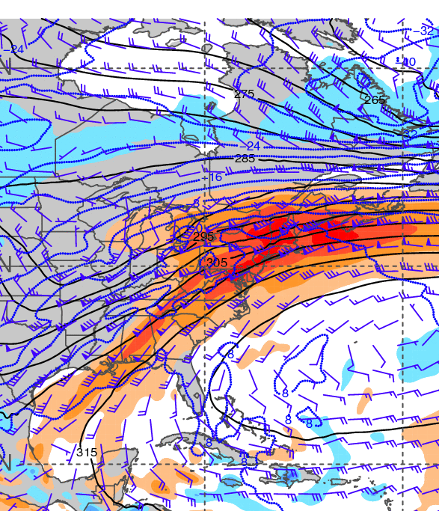
1200 UTC 22 December 2013
700-hPa geopotential height (black contours, dam),
temperature (red contours, °C), wind (barbs, kts),
and precipitable water (shaded, mm)
700-hPa geopotential height (black contours, dam),
temperature (blue contours, °C), wind (barbs, kts),
and precipitable water standardized anomalies (shaded, σ)

Slide 21
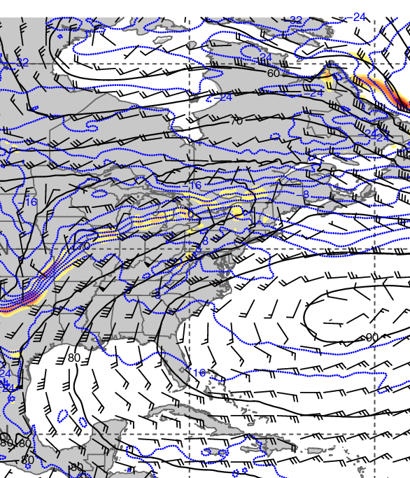
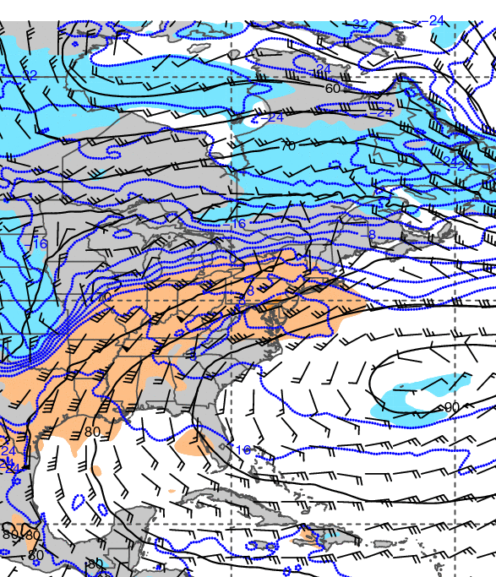
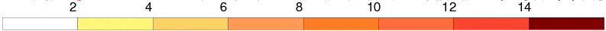
1200 UTC 20 December 2013
925-hPa geopotential height (black contours, dam),
temperature (blue contours, °C), wind (barbs, kts),
and frontogenesis (shaded, K [100 km]⁻¹ [3 h]⁻¹)
925-hPa geopotential height (black contours, dam),
temperature (blue contours, °C), wind (barbs, kts),
and temperature standardized anomalies (shaded, σ)

Slide 22
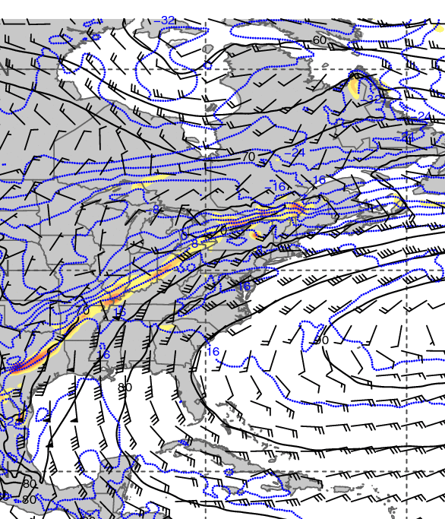
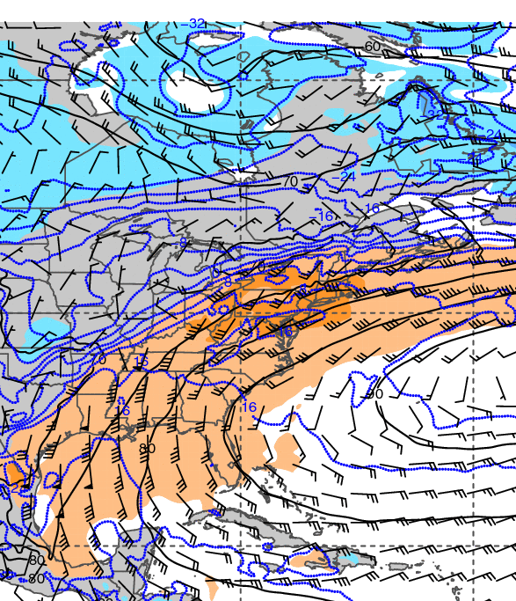
1200 UTC 21 December 2013
925-hPa geopotential height (black contours, dam),
temperature (blue contours, °C), wind (barbs, kts),
and frontogenesis (shaded, K [100 km]⁻¹ [3 h]⁻¹)
925-hPa geopotential height (black contours, dam),
temperature (blue contours, °C), wind (barbs, kts),
and temperature standardized anomalies (shaded, σ)

Slide 23
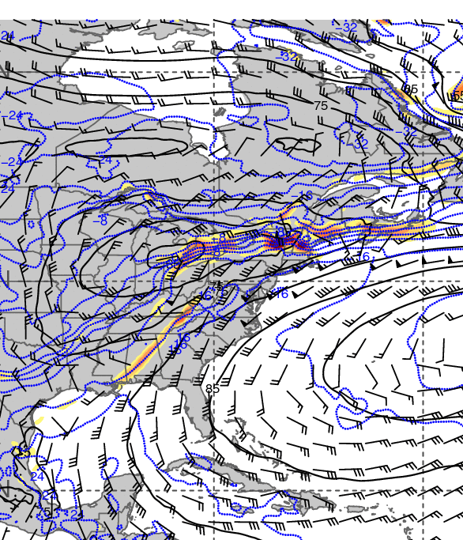
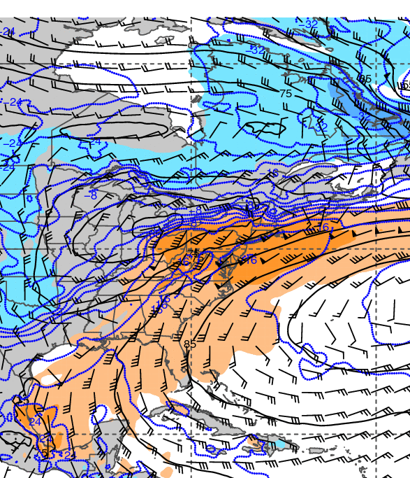
1200 UTC 22 December 2013
925-hPa geopotential height (black contours, dam),
temperature (blue contours, °C), wind (barbs, kts),
and frontogenesis (shaded, K [100 km]⁻¹ [3 h]⁻¹)
925-hPa geopotential height (black contours, dam),
temperature (blue contours, °C), wind (barbs, kts),
and temperature standardized anomalies (shaded, σ)

Slide 24
Sounding, Surface, and Trajectory Analysis
Notes:
When starting talk, define education–research interface and introduce Alicia and Kyle as current and previous TAs in upper-division thermodynamics and introductory graduate dynamics that I presently teach at UAlbany.

Slide 25
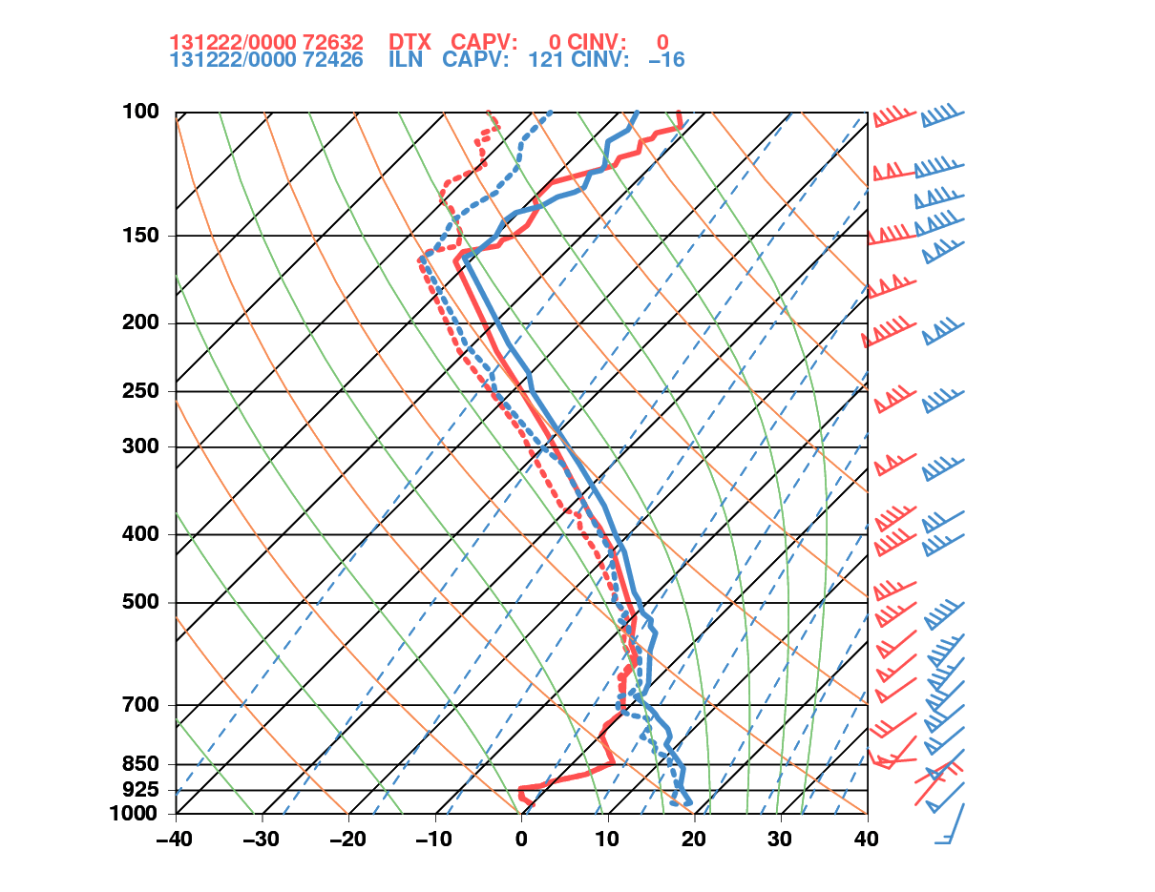
0000 UTC 22 December 2013
Detroit, MI Wilmington, OH
PW = 28.9 mm
CAPE = 0.0 J kg⁻¹
Thickness = 5546 m
PW = 37.4 mm*
CAPE = 99.3 J kg⁻¹
Thickness = 5645 m
*Record

Slide 26
CYYZ – Toronto, ON
CYYZ – Toronto, ON
120 h backward trajectories ending at:
0000 UTC 22 December 2013
72 h forward trajectories starting at:
0000 UTC 22 December 2013
Source: NOAA HYSPLIT MODEL
Notes:
When starting talk, define education–research interface and introduce Alicia and Kyle as current and previous TAs in upper-division thermodynamics and introductory graduate dynamics that I presently teach at UAlbany.

Slide 27
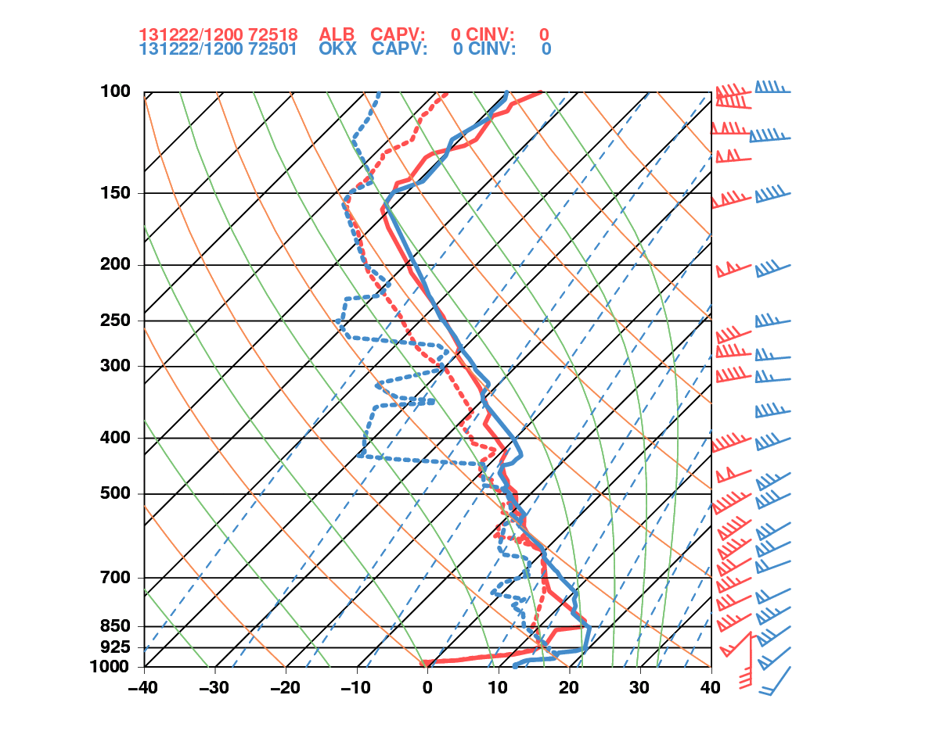
1200 UTC 22 December 2013
Albany, NY Upton, NY
PW = 36.8 mm*
CAPE = 0.0 J kg⁻¹
Thickness = 5629 m
PW = 36.2 mm
CAPE = 0.0 J kg⁻¹
Thickness = 5676 m
*2nd Highest

Slide 28
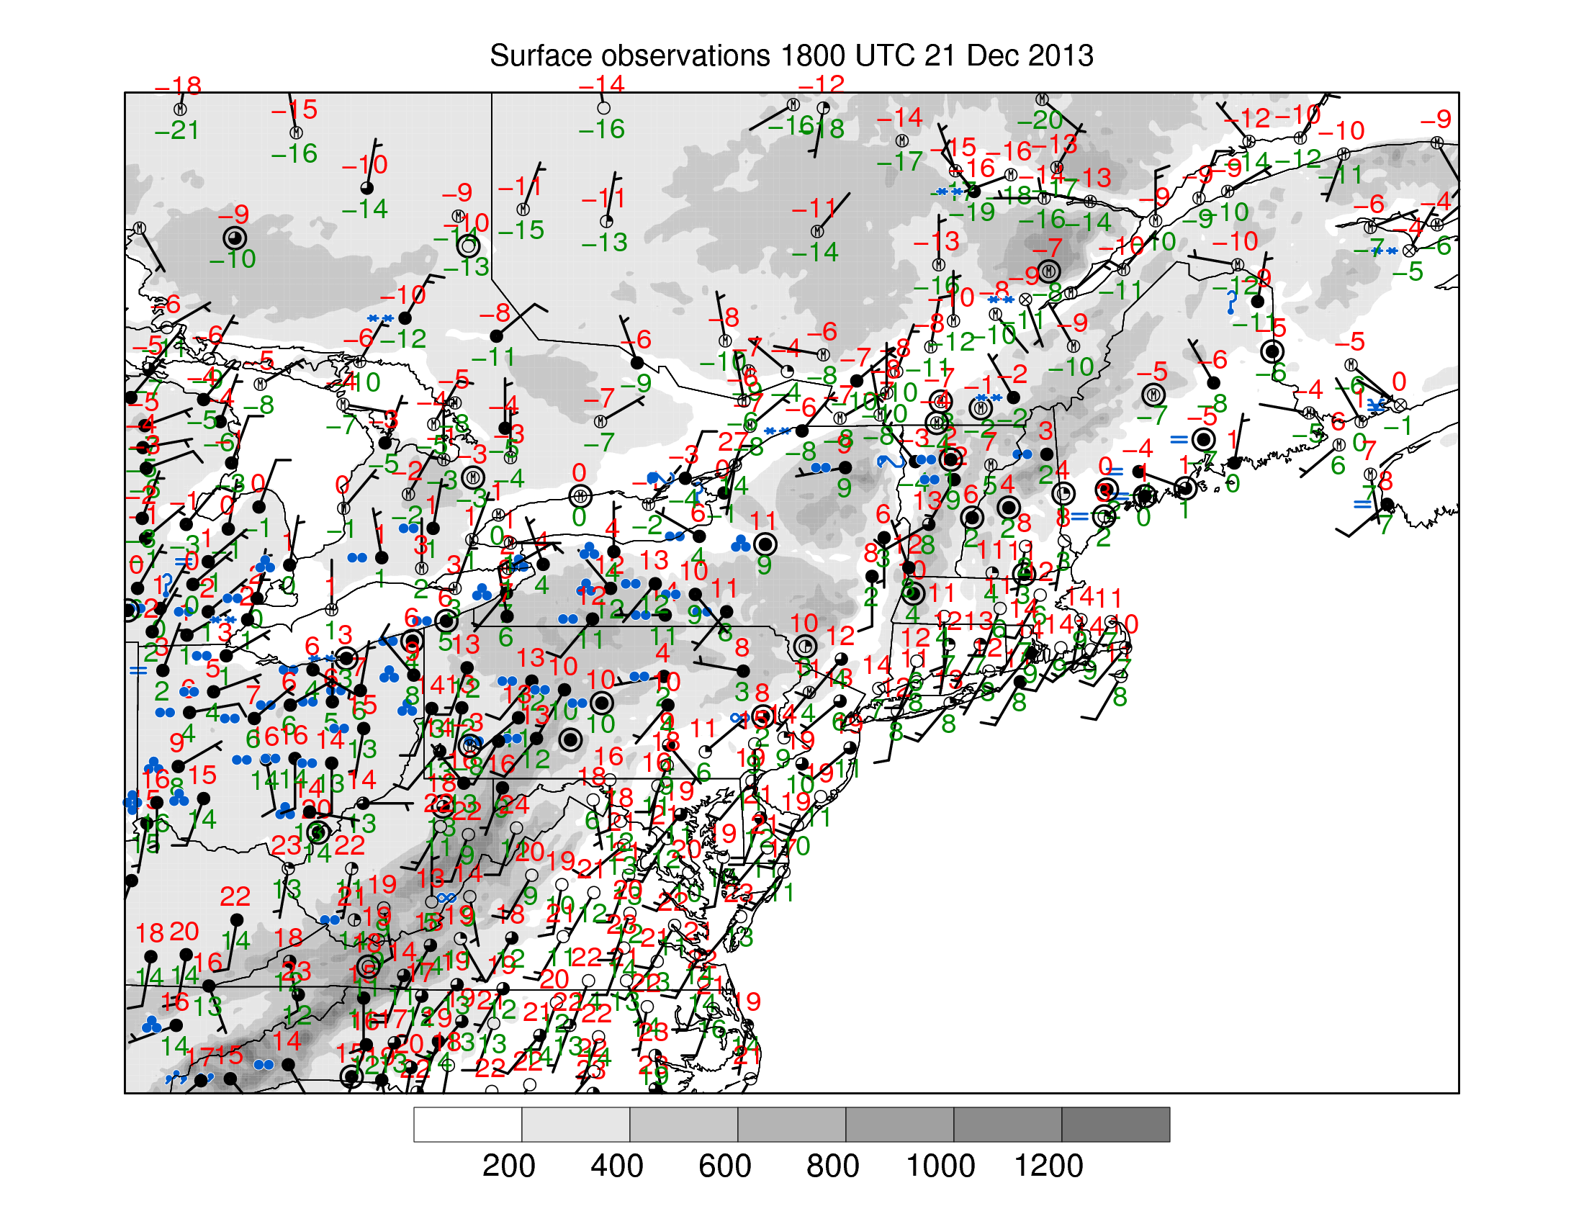
1800 UTC 21 December 2013
0ºC
KBTV (105 m): -3ºC
KSLK (498 m): 9ºC
KDDH (244 m): 12ºC
KALB (92 m): 8ºC
Surface METAR Observations and Elevation (shaded, m)

Slide 29
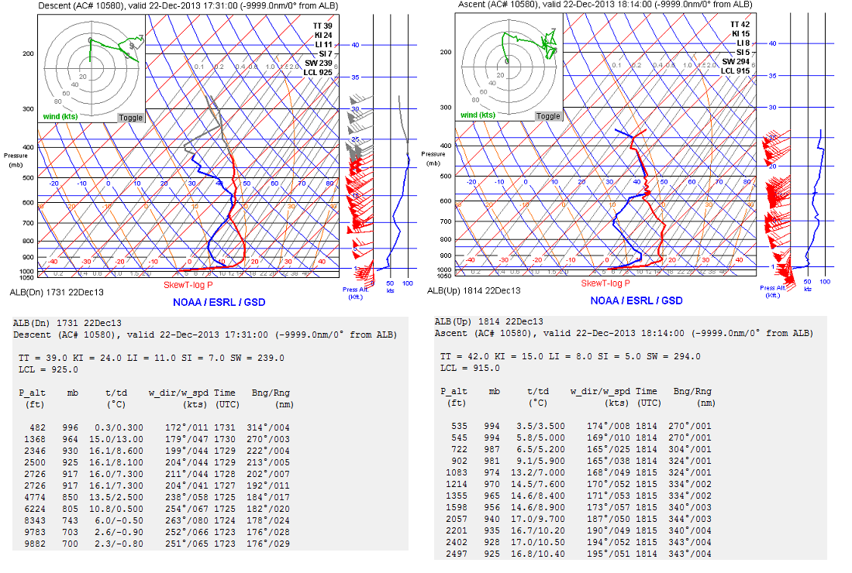
ALB (Albany, NY) Aircraft Soundings
1731 UTC 22 December 2013 1814 UTC 22 December 2013
Descent
Ascent
Source: Jonathan Blaes
Notes:
When starting talk, define education–research interface and introduce Alicia and Kyle as current and previous TAs in upper-division thermodynamics and introductory graduate dynamics that I presently teach at UAlbany.

Slide 30
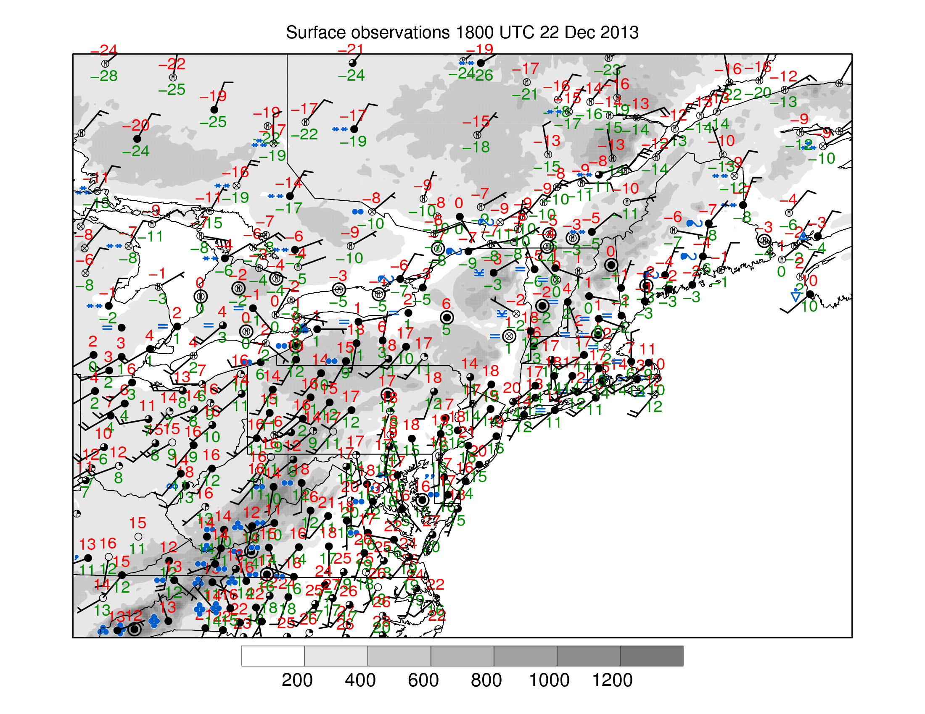
1800 UTC 22 December 2013
0ºC
KBTV (105 m): -5ºC
KSLK (498 m): -3ºC
KDDH (244 m): 18ºC
KALB (92 m): 1ºC
Surface METAR Observations and Elevation (shaded, m)

Slide 31
Cross Section Analysis

Slide 32
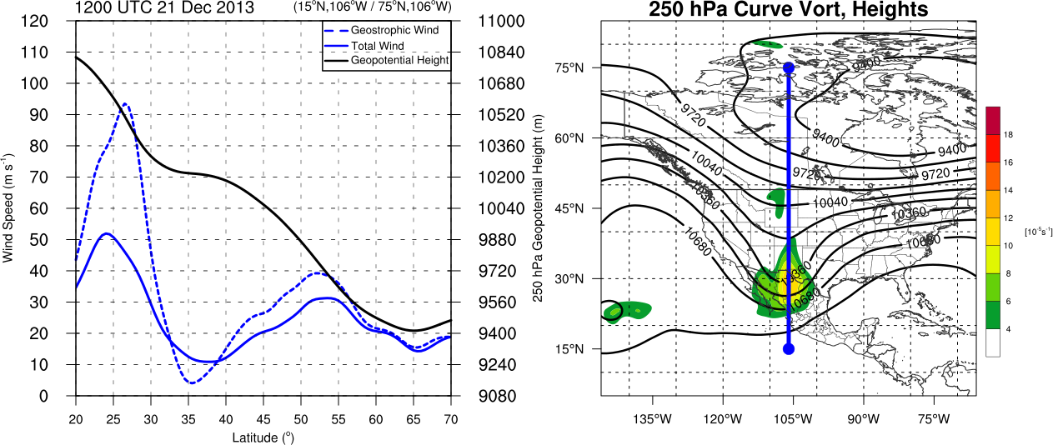
Trough Cross Section 1200 UTC 21 December 2013
Adapted From Newton and Palmen (1963)
250-hPa geopotential height (black contour, m)
geostrophic wind (blue dotted contour, m s⁻¹)
total wind (blue contour, m s⁻¹)
250-hPa geopotential heights (black contours, m)
Observed cyclonic curvature vorticity (shaded, 10⁻⁵ s⁻¹)

Slide 33
Trough Cross Section 1200 UTC 21 December 2013
Adapted From Newton and Palmen (1963)
250-hPa geopotential height (black contour, m)
geostrophic wind (blue dotted contour, m s⁻¹)
total wind (blue contour, m s⁻¹)
250-hPa geopotential heights (black contours, m)
Observed cyclonic curvature vorticity (shaded, 10⁻⁵ s⁻¹)
Maximum Cyclonic Curvature Vorticity at Base of Trough Along Jet

Slide 34
Trough Cross Section 1200 UTC 21 December 2013
Adapted From Newton and Palmen (1963)
250-hPa geopotential height (black contour, m)
geostrophic wind (blue dotted contour, m s⁻¹)
total wind (blue contour, m s⁻¹)
250-hPa geopotential heights (black contours, m)
Observed cyclonic curvature vorticity (shaded, 10⁻⁵ s⁻¹)
Maximum Cyclonic Curvature Vorticity at Base of Trough Along Jet
Subgeostrophic Flow at Trough Axis Along Subtropical and Polar Jets

Slide 35
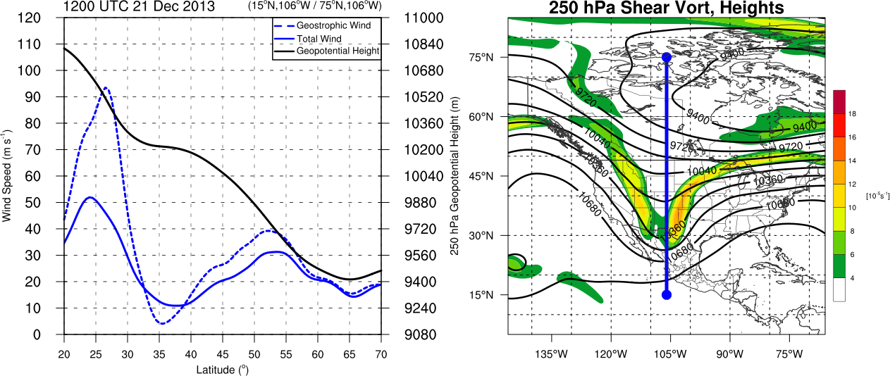
Trough Cross Section 1200 UTC 21 December 2013
Adapted From Newton and Palmen (1963)
250-hPa geopotential height (black contour, m)
geostrophic wind (blue dotted contour, m s⁻¹)
total wind (blue contour, m s⁻¹)
250-hPa geopotential heights (black contours, m)
Observed cyclonic shear vorticity (shaded, 10⁻⁵ s⁻¹)
Maximum Cyclonic Curvature Vorticity at Base of Trough Along Jet
Subgeostrophic Flow at Trough Axis Along Subtropical and Polar Jets
Maximum Shear Vorticity at Strongest Height Gradient Along Jets

Slide 36
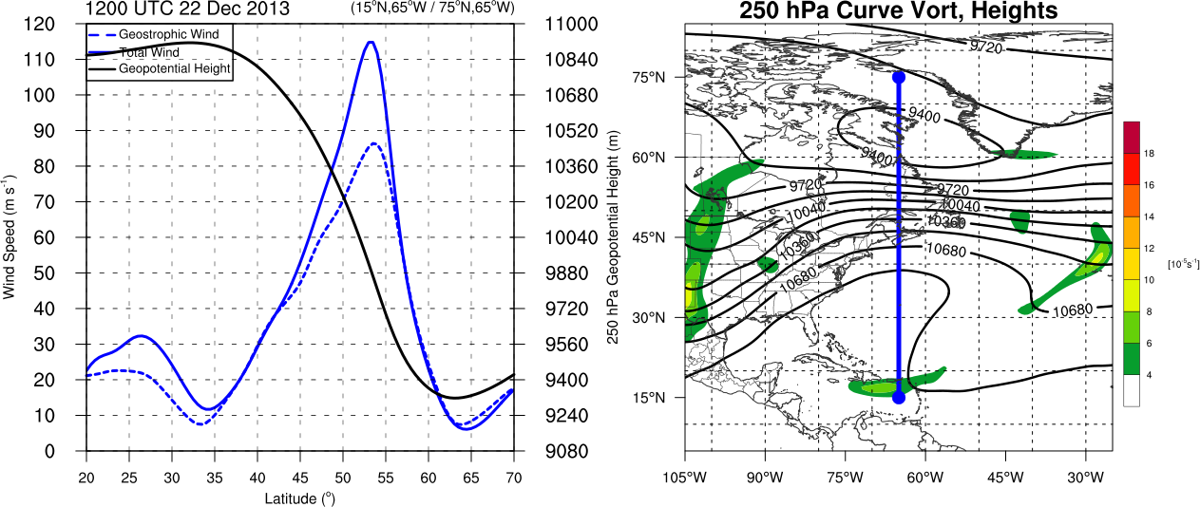
Ridge Cross Section 1200 UTC 22 December 2013
Adapted From Newton and Palmen (1963)
250-hPa geopotential height (black contour, m)
geostrophic wind (blue dotted contour, m s⁻¹)
total wind (blue contour, m s⁻¹)
250-hPa geopotential heights (black contours, m)
Observed cyclonic curvature vorticity (shaded, 10⁻⁵ s⁻¹)

Slide 37
Ridge Cross Section 1200 UTC 22 December 2013
Adapted From Newton and Palmen (1963)
250-hPa geopotential height (black contour, m)
geostrophic wind (blue dotted contour, m s⁻¹)
total wind (blue contour, m s⁻¹)
250-hPa geopotential heights (black contours, m)
Observed cyclonic curvature vorticity (shaded, 10⁻⁵ s⁻¹)
Little to No Cyclonic Curvature Vorticity at Base of Ridge Along Jet

Slide 38
Ridge Cross Section 1200 UTC 22 December 2013
Adapted From Newton and Palmen (1963)
250-hPa geopotential height (black contour, m)
geostrophic wind (blue dotted contour, m s⁻¹)
total wind (blue contour, m s⁻¹)
250-hPa geopotential heights (black contours, m)
Observed cyclonic curvature vorticity (shaded, 10⁻⁵ s⁻¹)
Little to No Cyclonic Curvature Vorticity at Base of Ridge Along Jet
Supergeostrophic Flow at Ridge Axis Along Merged Subtropical and Polar Jets

Slide 39
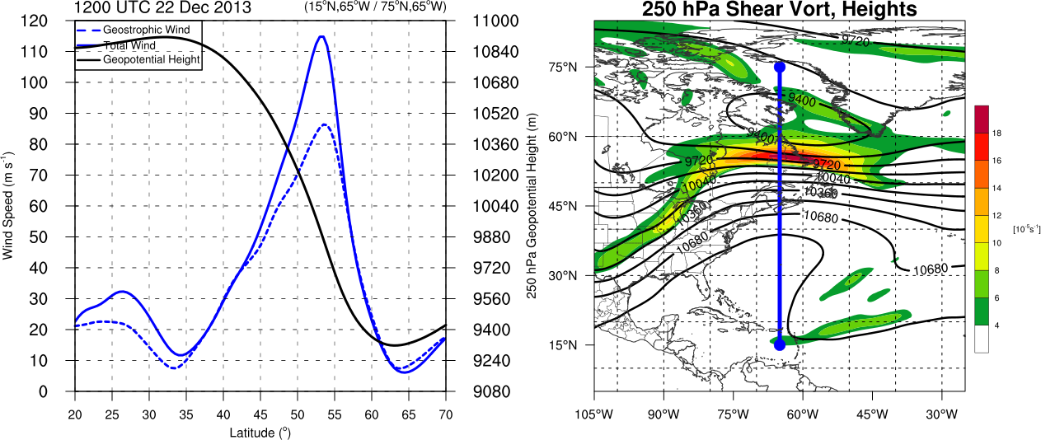
Ridge Cross Section 1200 UTC 22 December 2013
Adapted From Newton and Palmen (1963)
250-hPa geopotential height (black contour, m)
geostrophic wind (blue dotted contour, m s⁻¹)
total wind (blue contour, m s⁻¹)
250-hPa geopotential heights (black contours, m)
Observed cyclonic curvature vorticity (shaded, 10⁻⁵ s⁻¹)
Little to No Cyclonic Curvature Vorticity at Base of Ridge Along Jet
Supergeostrophic Flow at Ridge Axis Along Merged Subtropical and Polar Jets
Maximum Cycloinc Shear Vorticity Poleward of Jet Core (Along Broad Trough Axis)

Slide 40
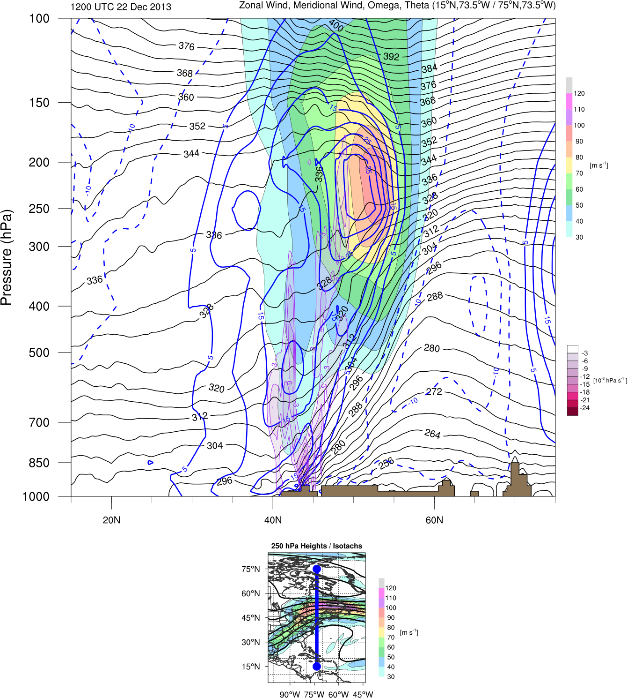
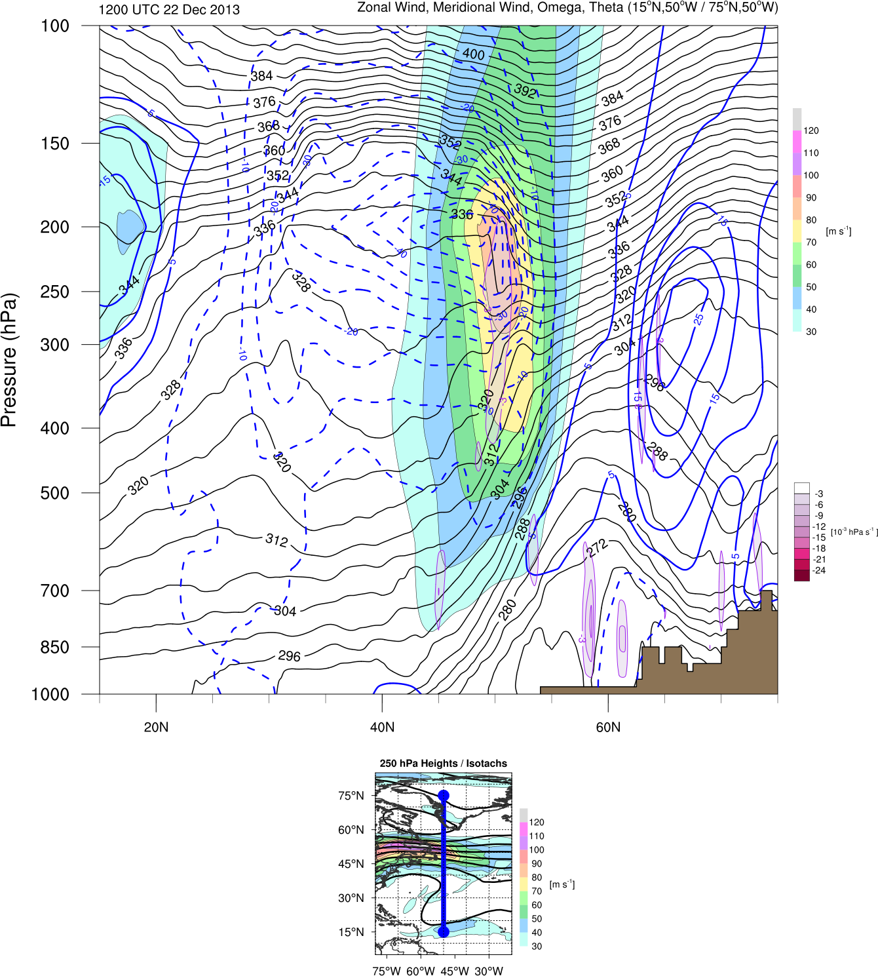
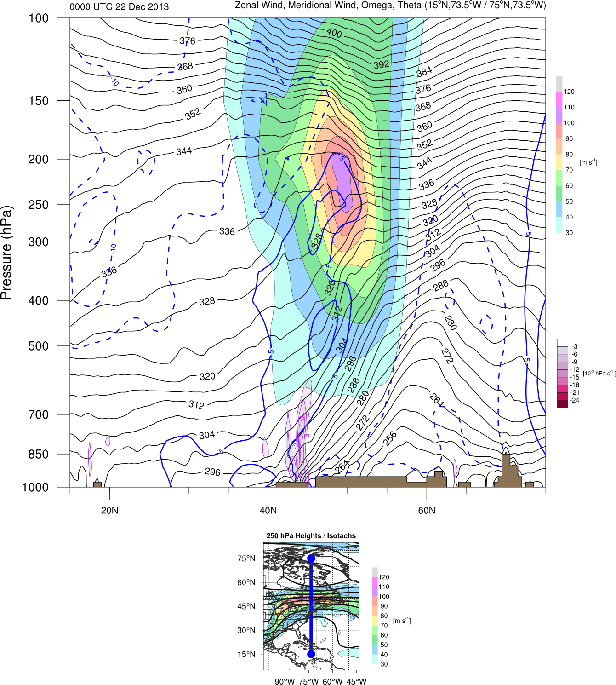
1200 UTC 22 December 2013
Jet Entrance
(15ºN,73.5ºW / 75ºN,73.5ºW)
Jet Exit
(15ºN,50ºW / 75ºN,50ºW)
CYUL
Zonal Wind (shaded, m s⁻¹), Meridional Wind (blue contours, m s⁻¹)
Omega (purple contours, 10⁻³ Pa s⁻¹), Theta (black contours, K)
Inset: 250-hPa Total Wind (shaded, m s⁻¹), 250-hPa Geopotential Height (black contours, m)

Slide 41
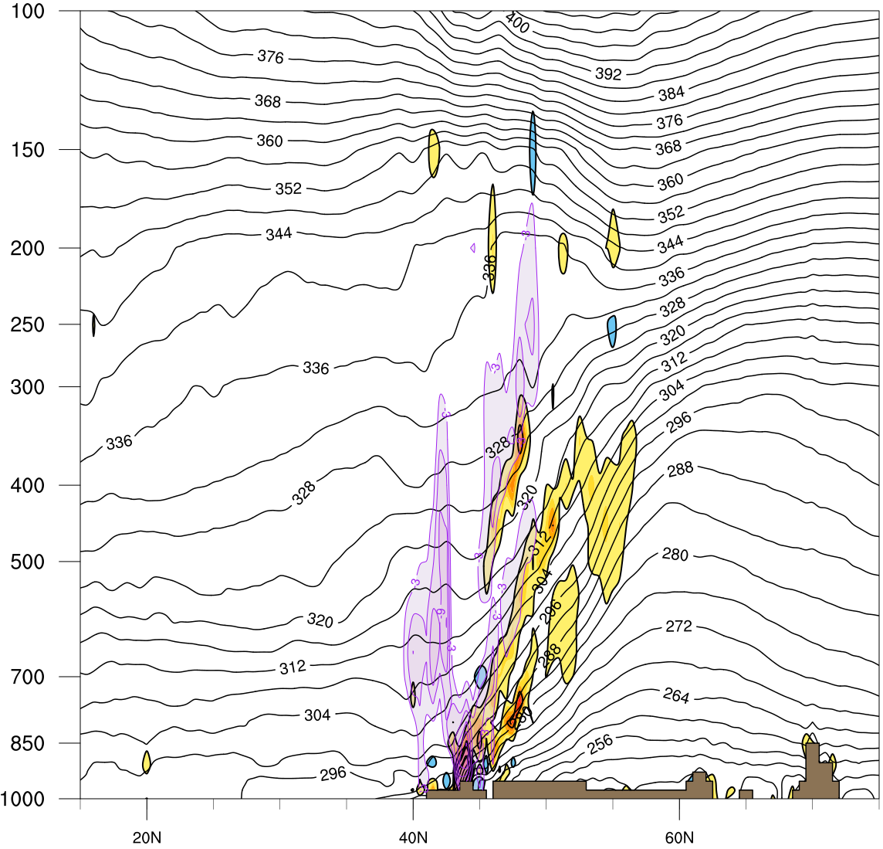
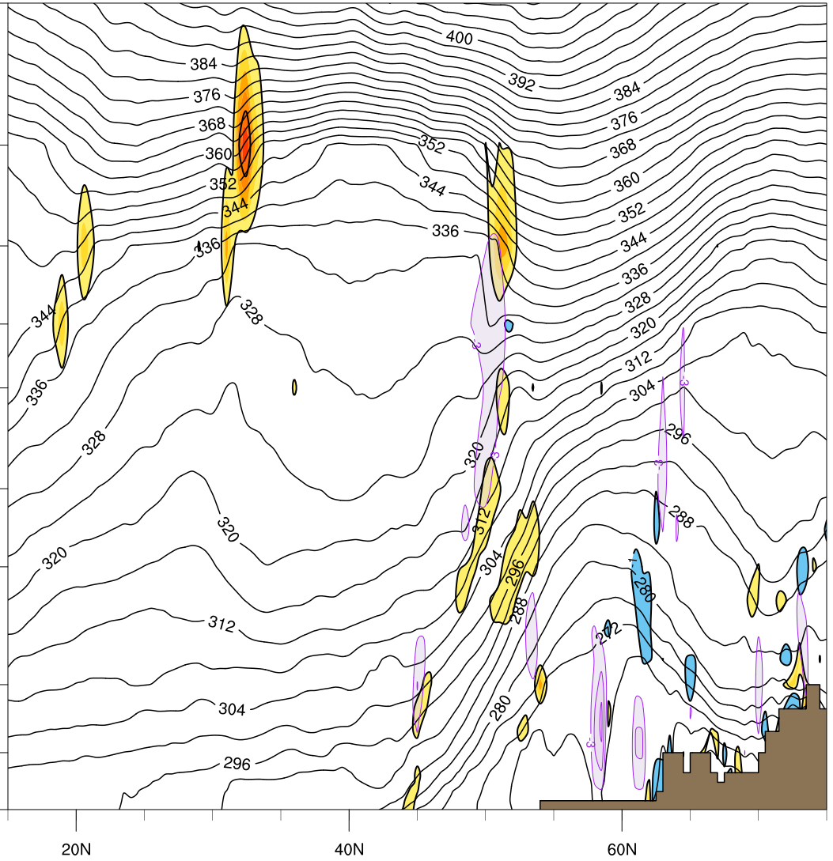
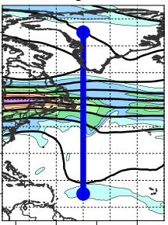
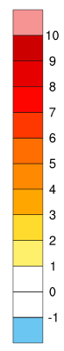
1200 UTC 22 December 2013
Jet Entrance
(15ºN,73.5ºW / 75ºN,73.5ºW)
Jet Exit
(15ºN,50ºW / 75ºN,50ºW)
CYUL
Frontogenesis (shaded, K [100 km]⁻¹ [3 h]⁻¹)
Omega (purple contours, 10⁻³ Pa s⁻¹), Theta (black contours, K)
Inset: 250-hPa Total Wind (shaded, m s⁻¹), 250-hPa Geopotential Height (black contours, m)

Slide 42
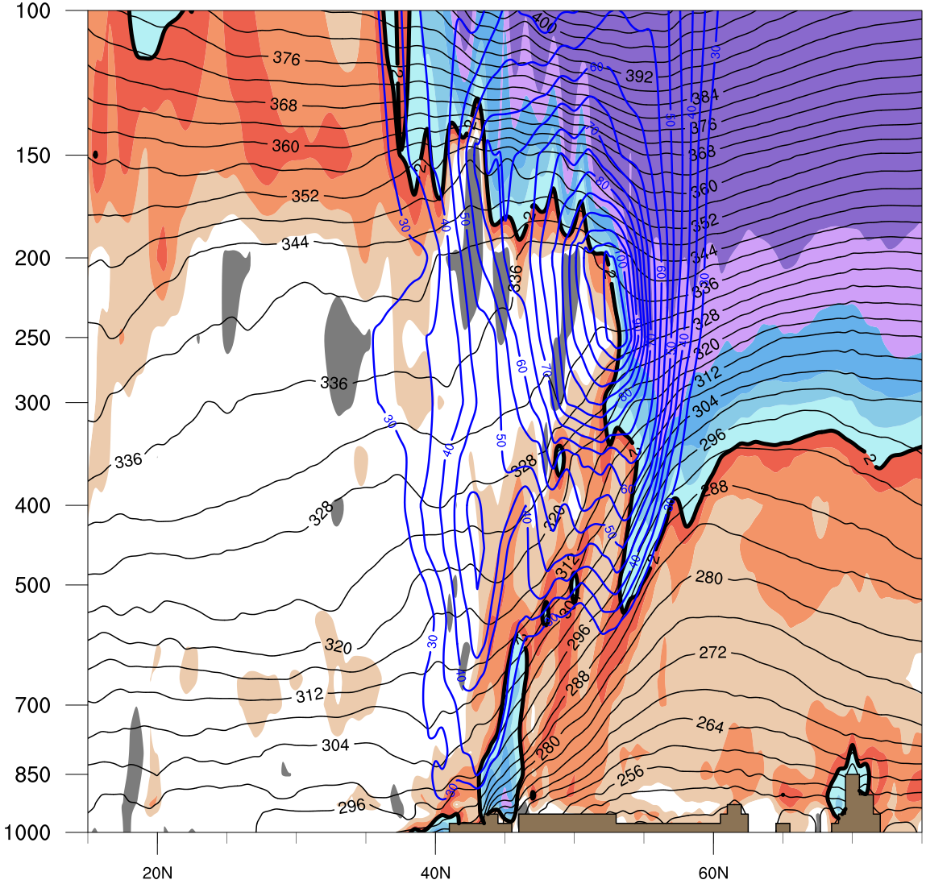
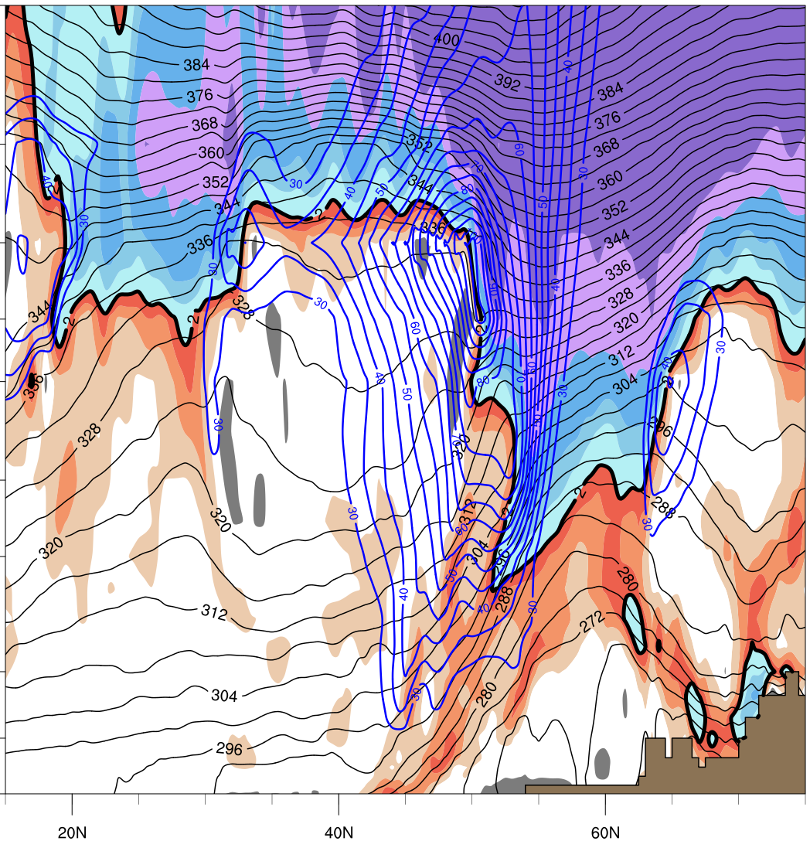
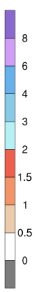
1200 UTC 22 December 2013
Jet Entrance
(15ºN,73.5ºW / 75ºN,73.5ºW)
Jet Exit
(15ºN,50ºW / 75ºN,50ºW)
CYUL
Potential Vorticity (shaded, PVU)
Total Wind (blue contours, m s⁻¹), Theta (black contours, K)
Inset: 250-hPa Total Wind (shaded, m s⁻¹), 250-hPa Geopotential Height (black contours, m)

Slide 43
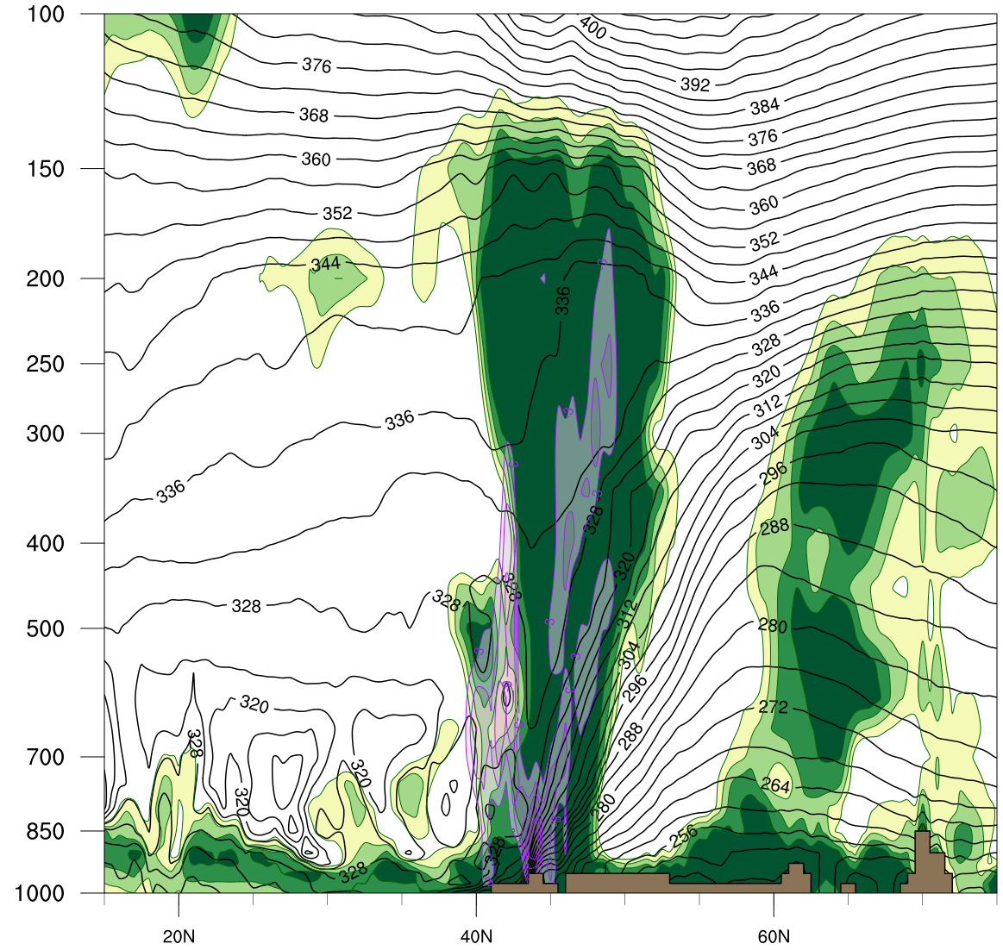

1200 UTC 22 December 2013
Jet Entrance
(15ºN,73.5ºW / 75ºN,73.5ºW)
Jet Exit
(15ºN,50ºW / 75ºN,50ºW)
CYUL
Relative Humidity (shaded, %)
Omega (purple contours, 10⁻³ Pa s⁻¹), Theta-e (black contours, K)
Inset: 250-hPa Total Wind (shaded, m s⁻¹), 250-hPa Geopotential Height (black contours, m)

Slide 44



Summary Schematic on 1200 UTC 22 Dec 2013
CAA
H
J
F_{gen}
L
V₈₅₀₋₇₀₀
>20 m s⁻¹
0ºC
WAA
0ºC
PW > 25mm
250-hPa geopotential height (solid black contours, every 12 dam) 250-hPa Wind Speed (color shading, m s⁻¹),
2 meter 0°C Isotherm (red dotted line), 850–700 hPa layer mean 0°C Isotherm (orange dotted line)
precipitable water (values > 25 mm shaded in green), concentrated 925-hPa frontogenesis (purple shading)
850–700 hPa wind vector (speed > 20 m s⁻¹ ), elevation (hatched, > 300 m)

Slide 45
Conclusions
High-latitude blocking and a progressive midlatitude flow teamed to
create a very strong jet where a deepening high-latitude trough phased with an amplifying midlatitude ridge
Anticyclonic wave breaking associated with a very moist tropical air mass for December contributed to the formation of an intense baroclinic zone/jet over eastern North America
Deep tropospheric confluence and frontogenesis intensified the meridional temperature gradient and forced an exceptionally strong uber jet
Cold-air advection and anticyclogenesis beneath the uber jet drove low-level arctic air southward and helped to set the stage for a major ice storm
Ice storm was sustained by deep warm-air advection in the equatorward entrance region of the uber jet in the presence of a very moist tropical air mass

