Slide 1
The Uber Jet and
the Widespread Disruptive Ice Storm
of 21–23 December 2013
Lance F. Bosart, Alicia M. Bentley, and Philippe P. Papin
Department of Atmospheric and Environmental Sciences
University at Albany, State University of New York, Albany, NY 12222
39th Annual Northeastern Storm Conference
Rutland, VT
Saturday 8 March 2014

Slide 2
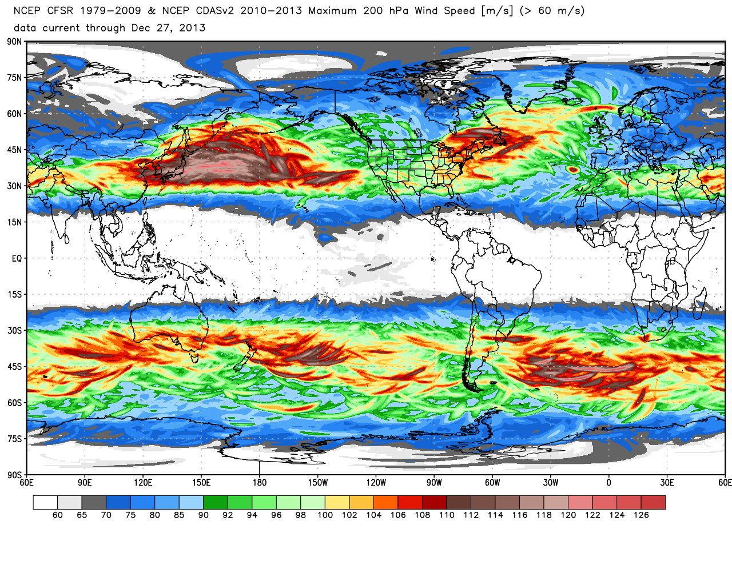
200-hPa maximum wind speed (m s⁻¹)
0.5° Climate Forecast System Reanalysis: 1979–2013
Source: Dr. Ryan Maue
Notes:
When starting talk, define education–research interface and introduce Alicia and Kyle as current and previous TAs in upper-division thermodynamics and introductory graduate dynamics that I presently teach at UAlbany.

Slide 3
200-hPa maximum wind speed (m s⁻¹)
0.5° Climate Forecast System Reanalysis: 1979–2013
Source: Dr. Ryan Maue
Notes:
When starting talk, define education–research interface and introduce Alicia and Kyle as current and previous TAs in upper-division thermodynamics and introductory graduate dynamics that I presently teach at UAlbany.

Slide 4
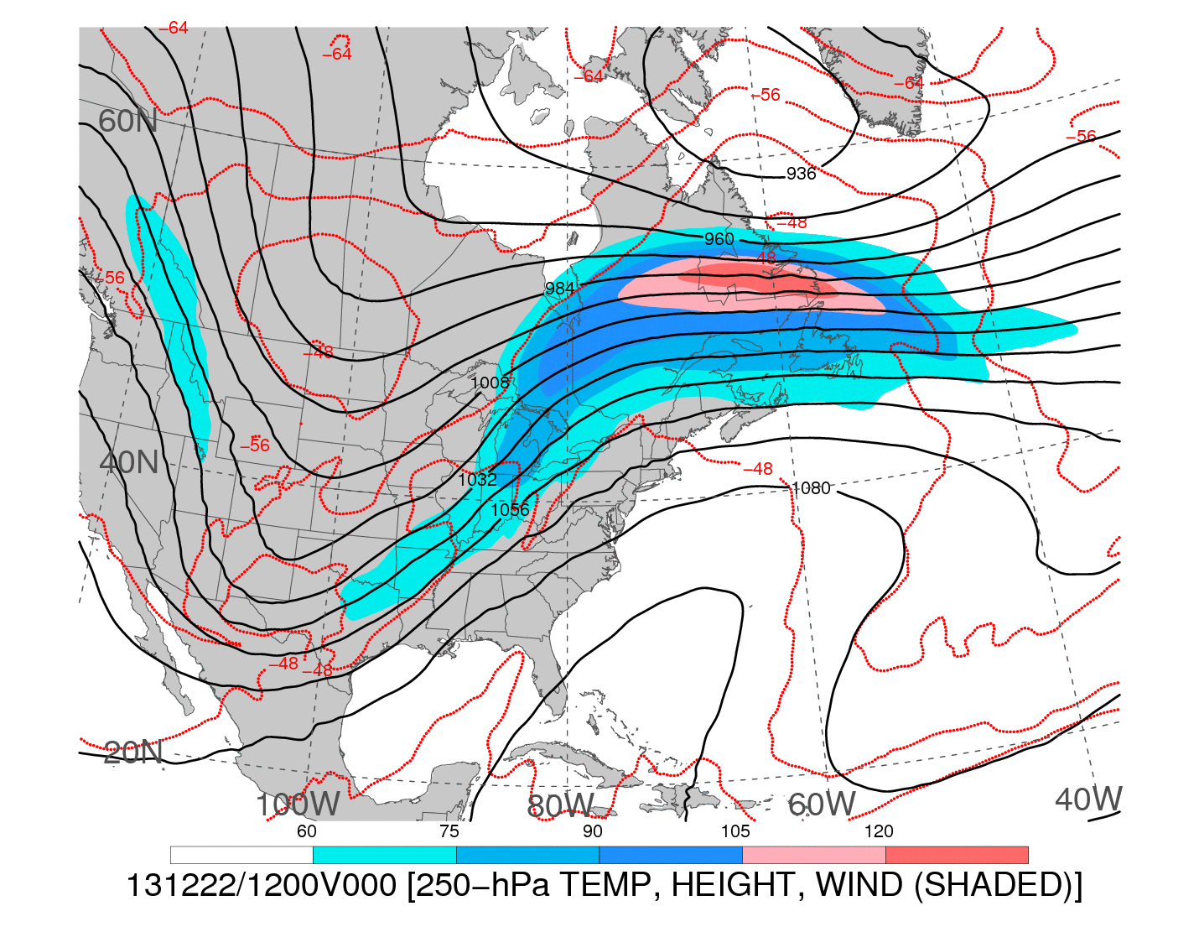
1200 UTC 22 December 2013
250-hPa wind speed (shaded, m s⁻¹; barbs, kts), geopotential height (black contours, dam),
and temperature (red dashed contours, °C)
Notes:
When starting talk, define education–research interface and introduce Alicia and Kyle as current and previous TAs in upper-division thermodynamics and introductory graduate dynamics that I presently teach at UAlbany.

Slide 5

1200 UTC 22 December 2013
−−
250-hPa wind speed (shaded, m s⁻¹; barbs, kts), geopotential height (black contours, dam),
and temperature (red dashed contours, °C)
Notes:
When starting talk, define education–research interface and introduce Alicia and Kyle as current and previous TAs in upper-division thermodynamics and introductory graduate dynamics that I presently teach at UAlbany.

Slide 6
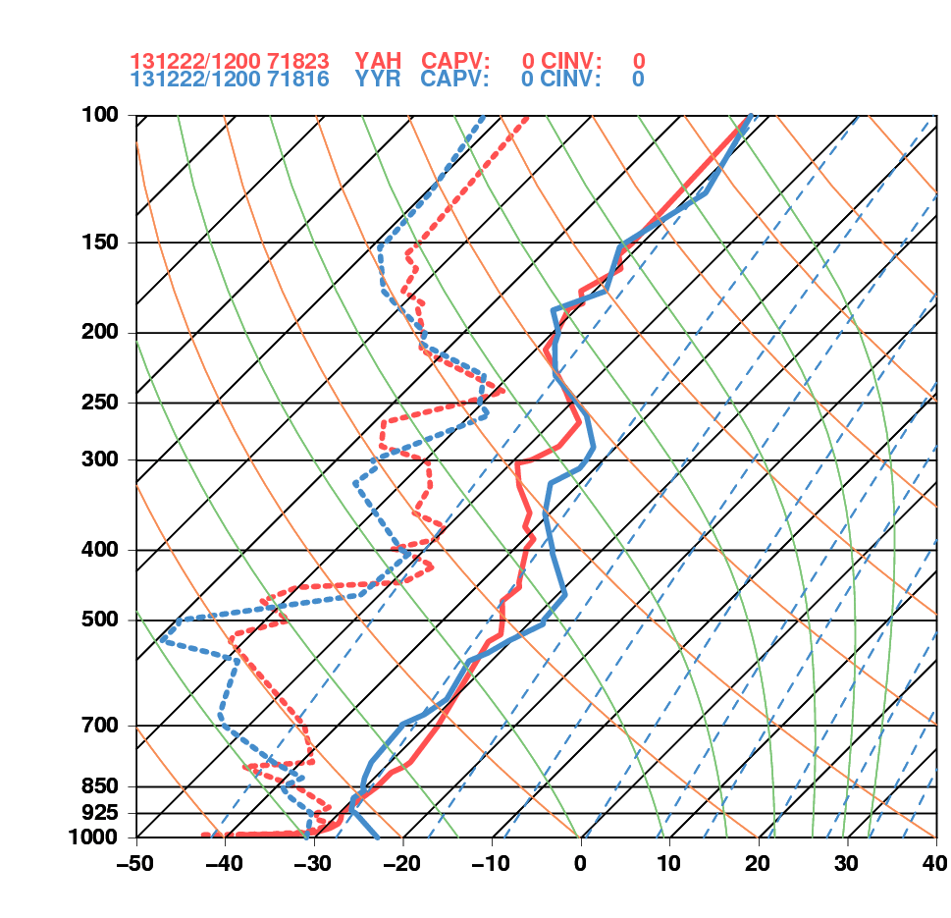
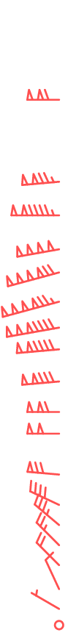
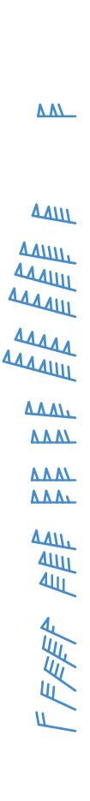
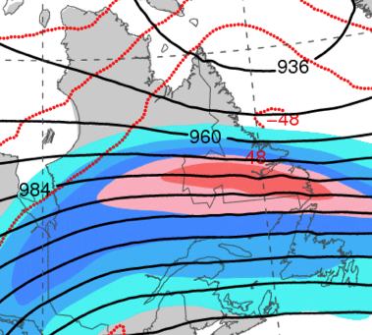
1200 UTC 22 December 2013
La Grande, QC Goose Bay, NL
Goose Bay, NL
La Grande, QC

Slide 7
DT & MSLP LOOPS
Notes:
When starting talk, define education–research interface and introduce Alicia and Kyle as current and previous TAs in upper-division thermodynamics and introductory graduate dynamics that I presently teach at UAlbany.

Slide 8
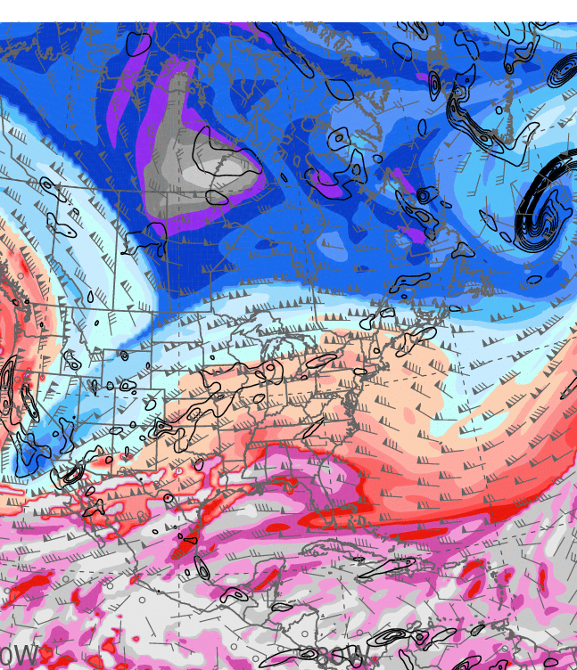
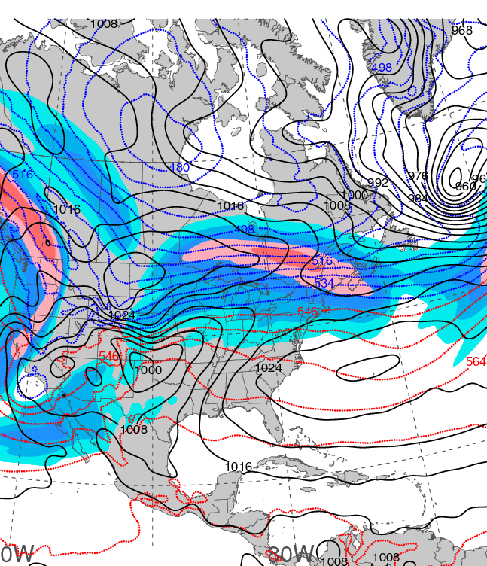
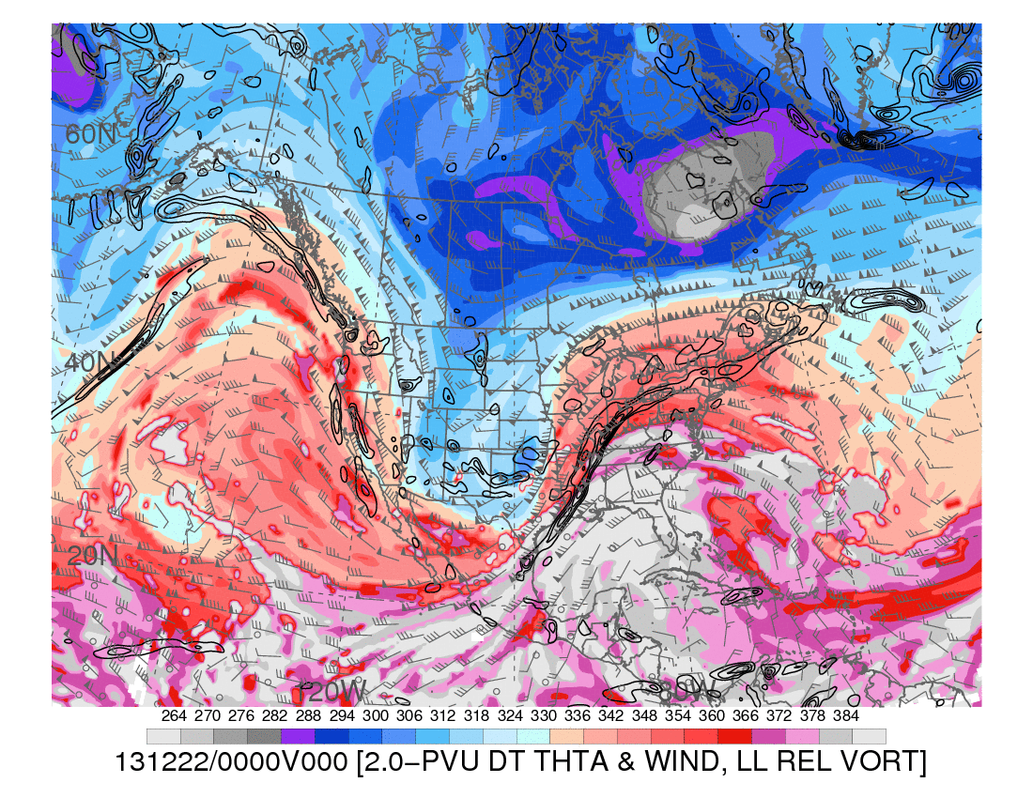
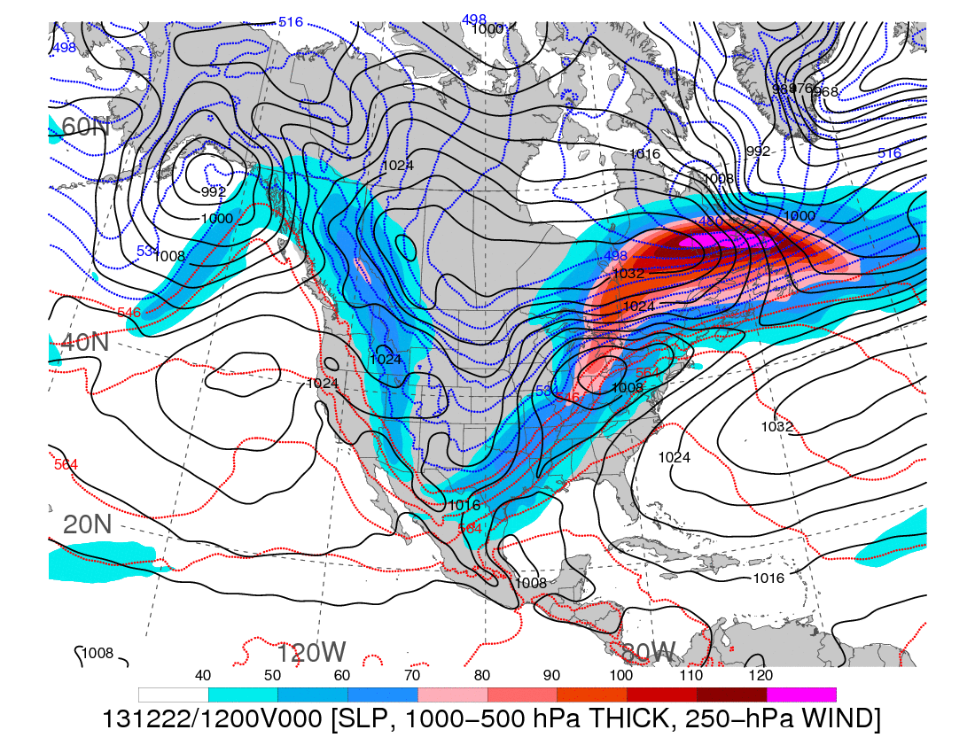
0000 UTC 20 December 2013
Dynamic tropopause (DT, 1.5-PVU surface) potential
temperature (shaded, K) and wind (barbs, kts),
925–850-hPa layer-averaged cyclonic relative vorticity
(black contours every 0.5 × 10⁻⁴ s⁻¹)
250-hPa wind speed (shaded, m s⁻¹), 1000–500-hPa thickness (blue contours ≤ 540 dam,
red contours > 540 dam), MSLP (black contours, hPa)

Slide 9
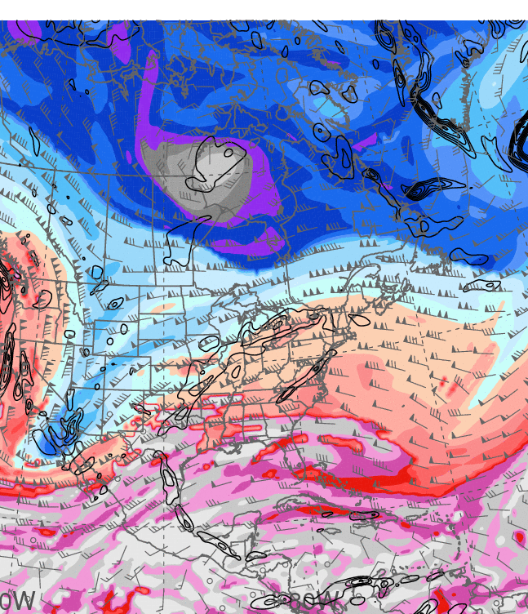
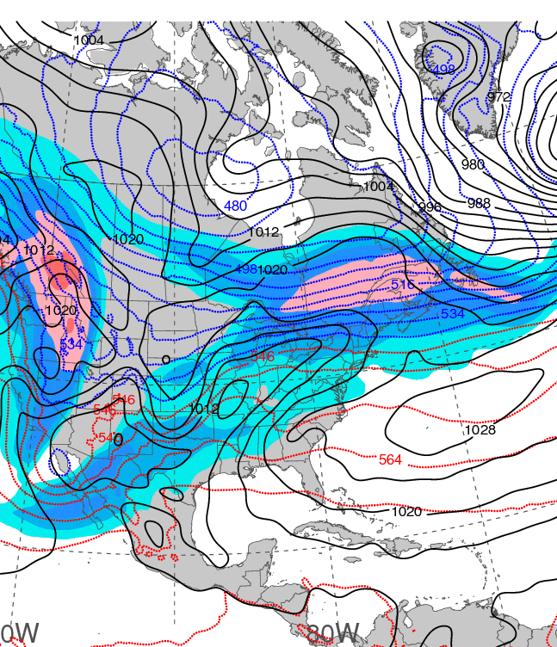
1200 UTC 20 December 2013
Dynamic tropopause (DT, 1.5-PVU surface) potential
temperature (shaded, K) and wind (barbs, kts),
925–850-hPa layer-averaged cyclonic relative vorticity
(black contours every 0.5 × 10⁻⁴ s⁻¹)
250-hPa wind speed (shaded, m s⁻¹), 1000–500-hPa thickness (blue contours ≤ 540 dam,
red contours > 540 dam), MSLP (black contours, hPa)

Slide 10
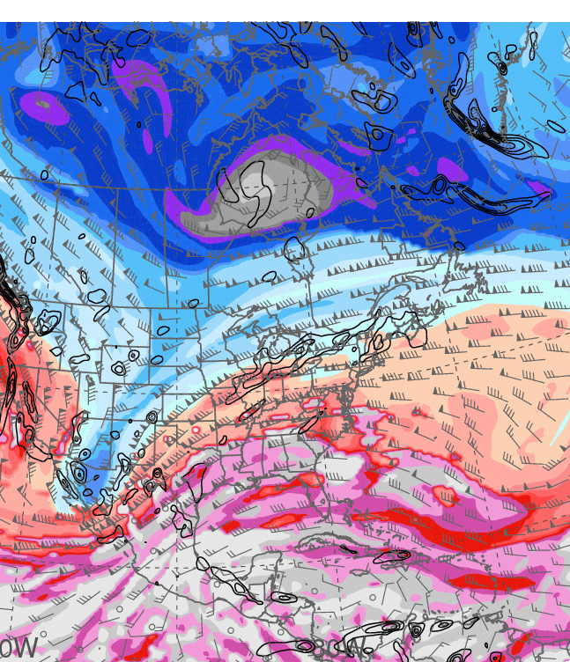
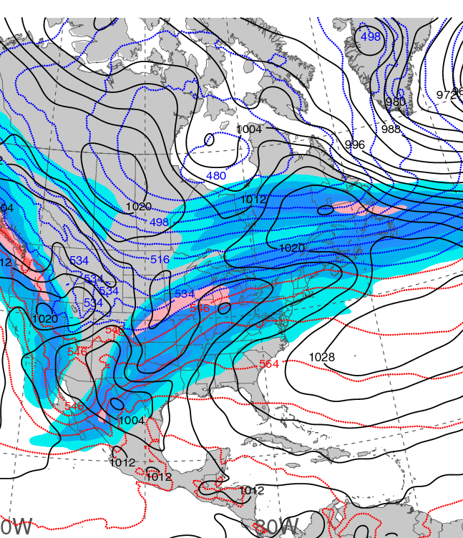
0000 UTC 21 December 2013
Dynamic tropopause (DT, 1.5-PVU surface) potential
temperature (shaded, K) and wind (barbs, kts),
925–850-hPa layer-averaged cyclonic relative vorticity
(black contours every 0.5 × 10⁻⁴ s⁻¹)
250-hPa wind speed (shaded, m s⁻¹), 1000–500-hPa thickness (blue contours ≤ 540 dam,
red contours > 540 dam), MSLP (black contours, hPa)

Slide 11
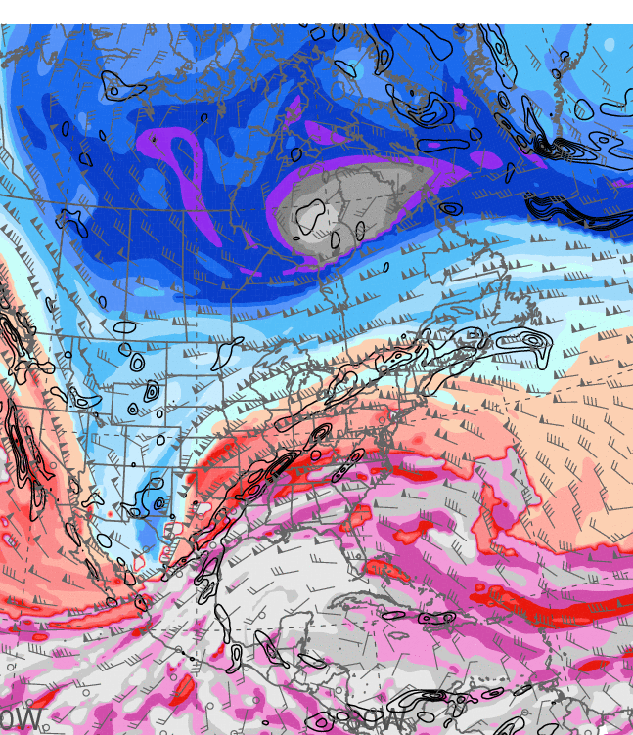
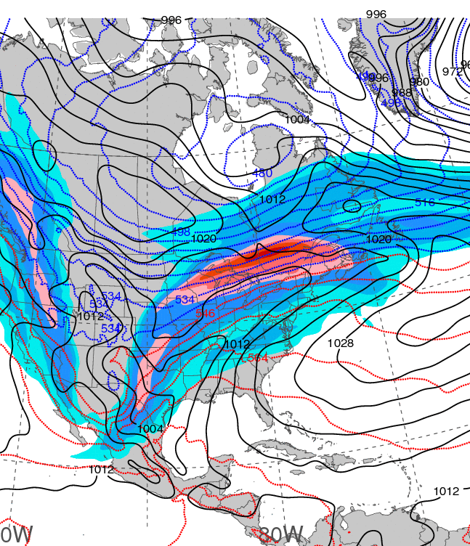
1200 UTC 21 December 2013
Dynamic tropopause (DT, 1.5-PVU surface) potential
temperature (shaded, K) and wind (barbs, kts),
925–850-hPa layer-averaged cyclonic relative vorticity
(black contours every 0.5 × 10⁻⁴ s⁻¹)
250-hPa wind speed (shaded, m s⁻¹), 1000–500-hPa thickness (blue contours ≤ 540 dam,
red contours > 540 dam), MSLP (black contours, hPa)

Slide 12
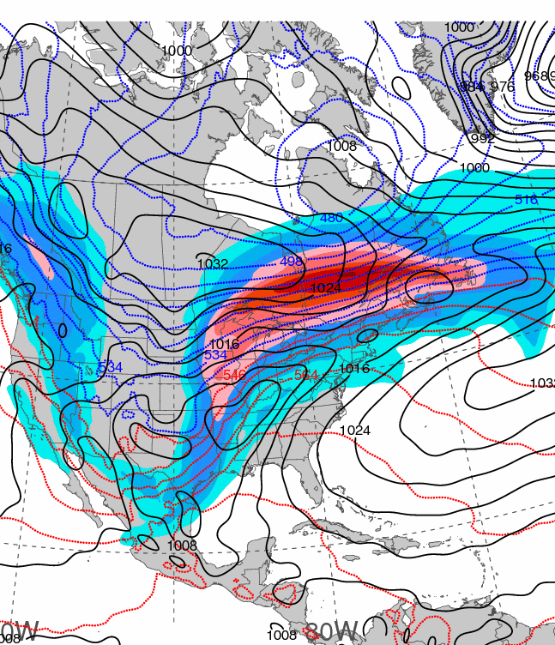
0000 UTC 22 December 2013
Dynamic tropopause (DT, 1.5-PVU surface) potential
temperature (shaded, K) and wind (barbs, kts),
925–850-hPa layer-averaged cyclonic relative vorticity
(black contours every 0.5 × 10⁻⁴ s⁻¹)
250-hPa wind speed (shaded, m s⁻¹), 1000–500-hPa thickness (blue contours ≤ 540 dam,
red contours > 540 dam), MSLP (black contours, hPa)

Slide 13
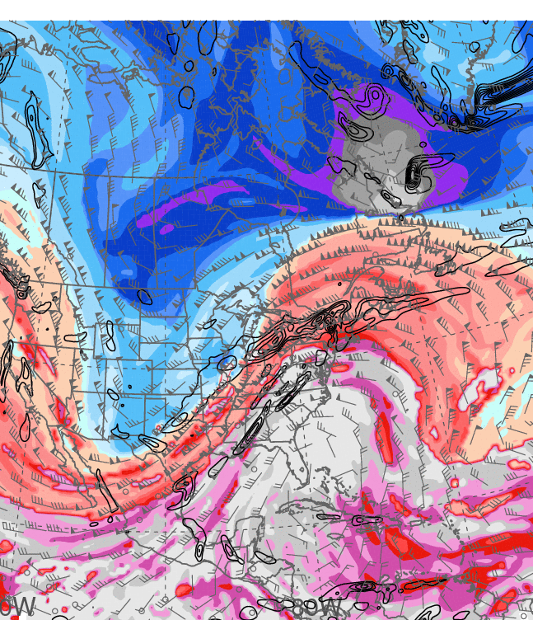
1200 UTC 22 December 2013
Dynamic tropopause (DT, 1.5-PVU surface) potential
temperature (shaded, K) and wind (barbs, kts),
925–850-hPa layer-averaged cyclonic relative vorticity
(black contours every 0.5 × 10⁻⁴ s⁻¹)
250-hPa wind speed (shaded, m s⁻¹), 1000–500-hPa thickness (blue contours ≤ 540 dam,
red contours > 540 dam), MSLP (black contours, hPa)

Slide 14
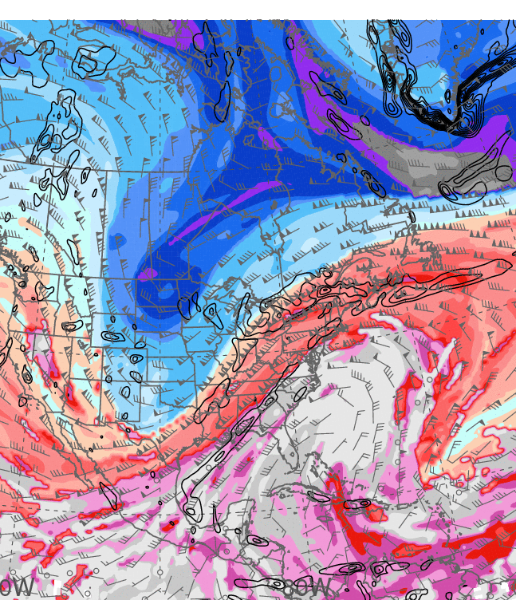
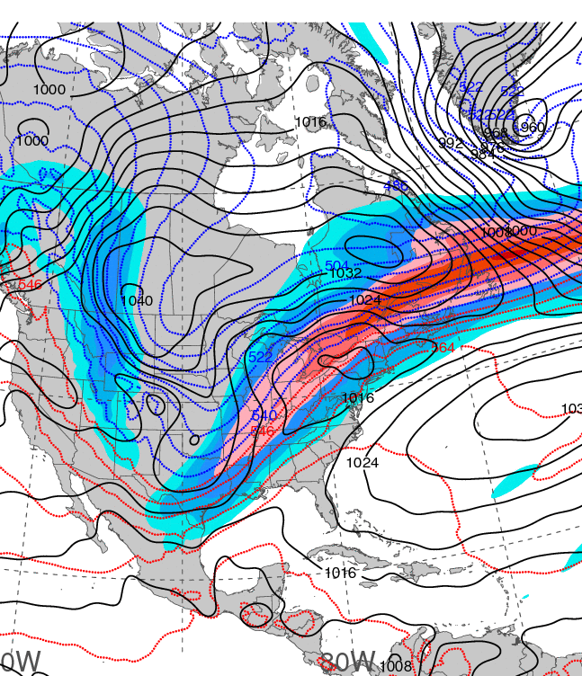
0000 UTC 23 December 2013
Dynamic tropopause (DT, 1.5-PVU surface) potential
temperature (shaded, K) and wind (barbs, kts),
925–850-hPa layer-averaged cyclonic relative vorticity
(black contours every 0.5 × 10⁻⁴ s⁻¹)
250-hPa wind speed (shaded, m s⁻¹), 1000–500-hPa thickness (blue contours ≤ 540 dam,
red contours > 540 dam), MSLP (black contours, hPa)

Slide 15
PW & ANOM. LOOPS
Notes:
When starting talk, define education–research interface and introduce Alicia and Kyle as current and previous TAs in upper-division thermodynamics and introductory graduate dynamics that I presently teach at UAlbany.

Slide 16
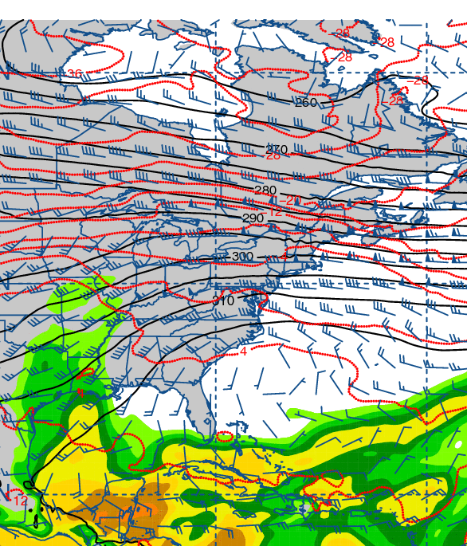
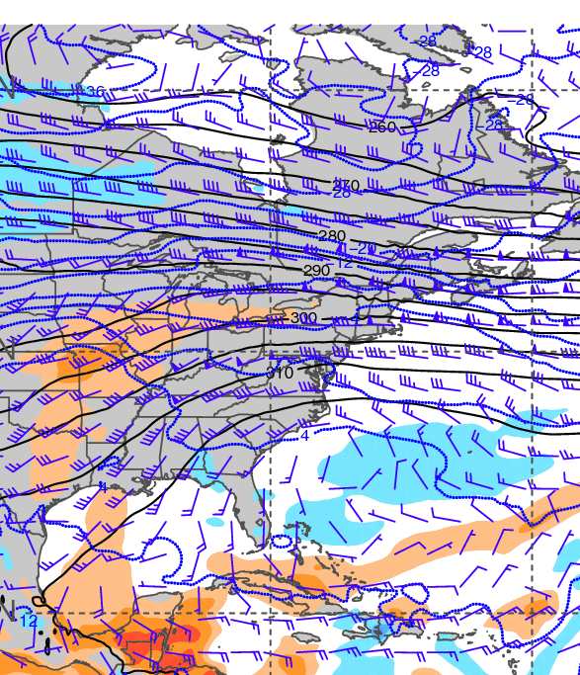
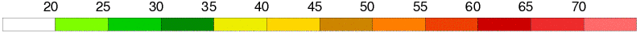
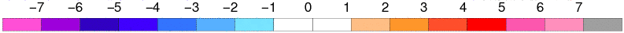
0000 UTC 20 December 2013
700-hPa geopotential height (black contours, dam),
temperature (red contours, °C), wind (barbs, kts),
and precipitable water (shaded, mm)
700-hPa geopotential height (black contours, dam),
temperature (blue contours, °C), wind (barbs, kts),
and precipitable water standardized anomalies (shaded, σ)

Slide 17
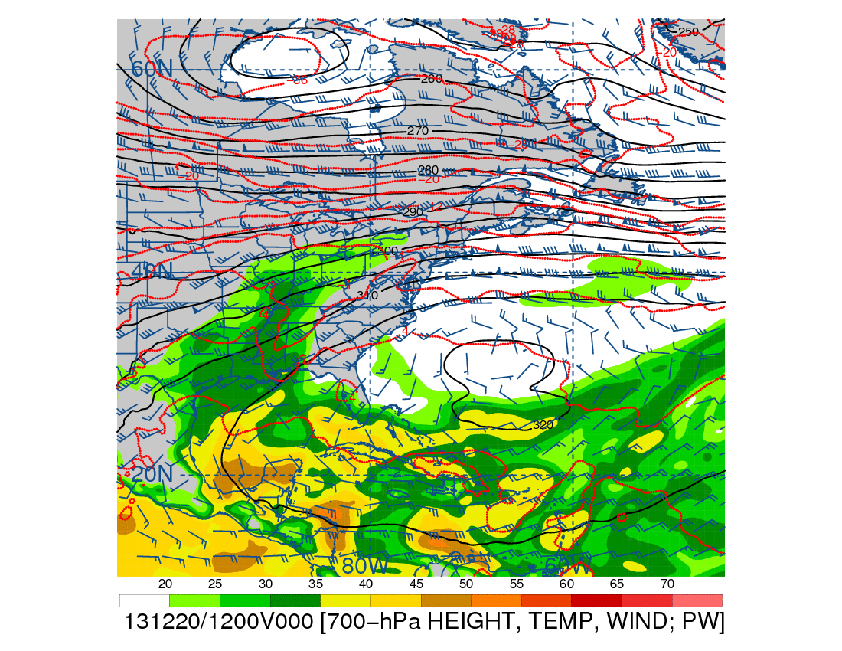
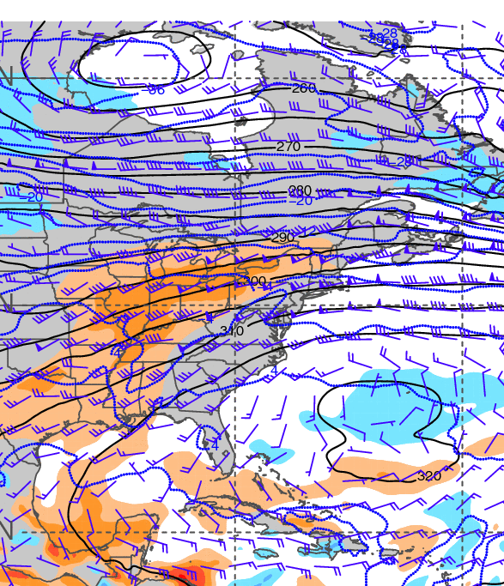
1200 UTC 20 December 2013
700-hPa geopotential height (black contours, dam),
temperature (red contours, °C), wind (barbs, kts),
and precipitable water (shaded, mm)
700-hPa geopotential height (black contours, dam),
temperature (blue contours, °C), wind (barbs, kts),
and precipitable water standardized anomalies (shaded, σ)

Slide 18
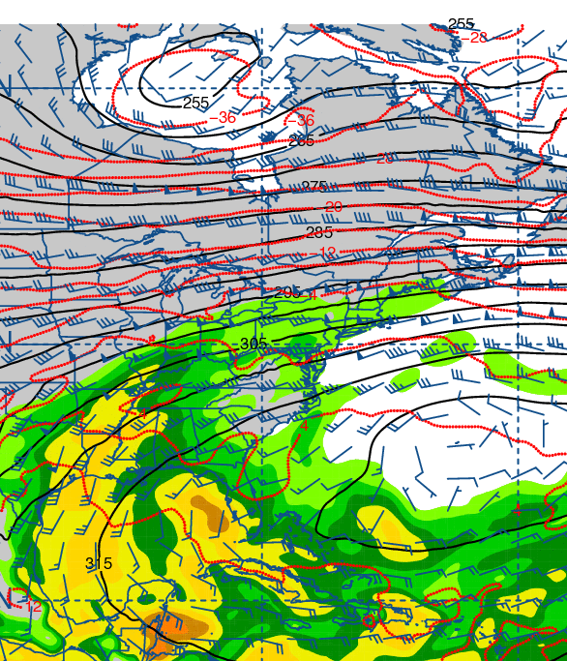
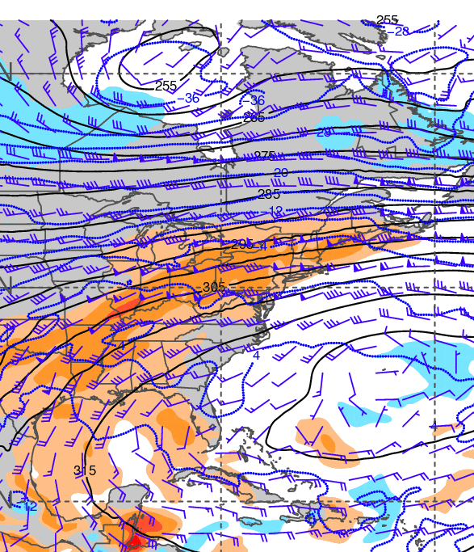
0000 UTC 21 December 2013
700-hPa geopotential height (black contours, dam),
temperature (red contours, °C), wind (barbs, kts),
and precipitable water (shaded, mm)
700-hPa geopotential height (black contours, dam),
temperature (blue contours, °C), wind (barbs, kts),
and precipitable water standardized anomalies (shaded, σ)

Slide 19
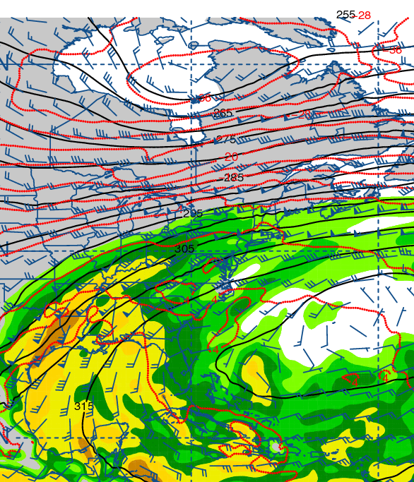
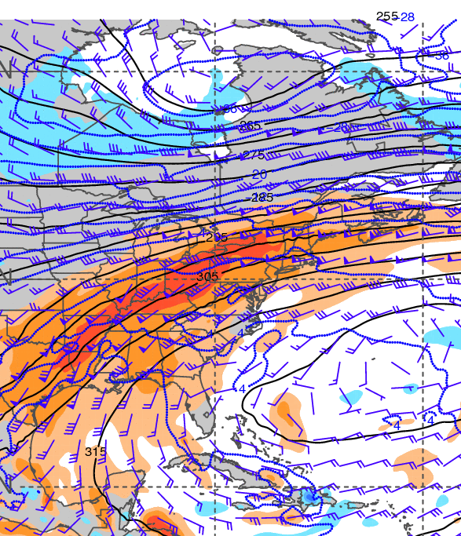
1200 UTC 21 December 2013
700-hPa geopotential height (black contours, dam),
temperature (red contours, °C), wind (barbs, kts),
and precipitable water (shaded, mm)
700-hPa geopotential height (black contours, dam),
temperature (blue contours, °C), wind (barbs, kts),
and precipitable water standardized anomalies (shaded, σ)

Slide 20
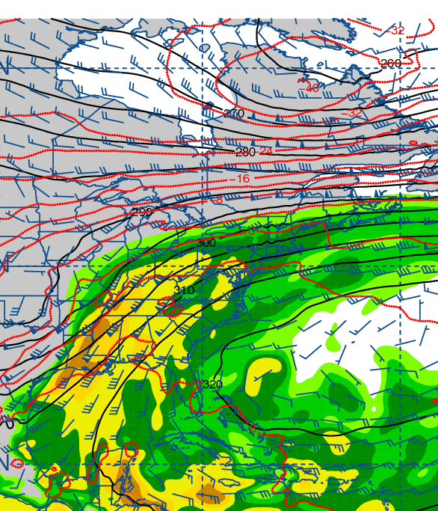
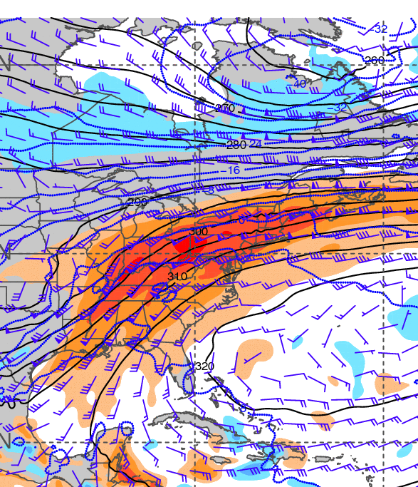
0000 UTC 22 December 2013
700-hPa geopotential height (black contours, dam),
temperature (red contours, °C), wind (barbs, kts),
and precipitable water (shaded, mm)
700-hPa geopotential height (black contours, dam),
temperature (blue contours, °C), wind (barbs, kts),
and precipitable water standardized anomalies (shaded, σ)

Slide 21
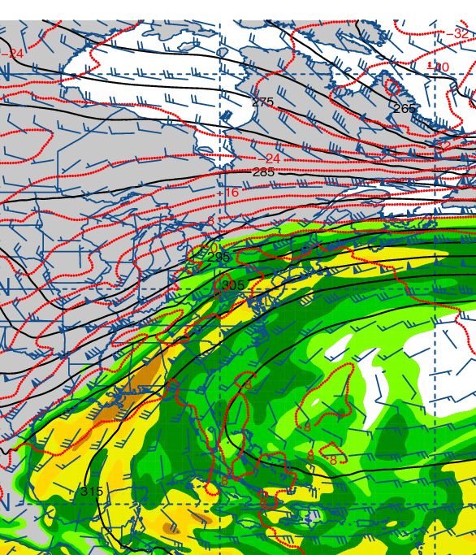
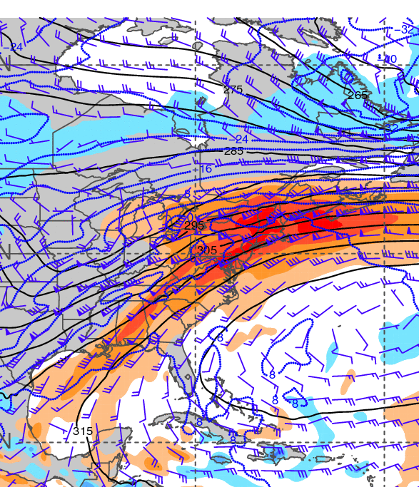
1200 UTC 22 December 2013
700-hPa geopotential height (black contours, dam),
temperature (red contours, °C), wind (barbs, kts),
and precipitable water (shaded, mm)
700-hPa geopotential height (black contours, dam),
temperature (blue contours, °C), wind (barbs, kts),
and precipitable water standardized anomalies (shaded, σ)

Slide 22
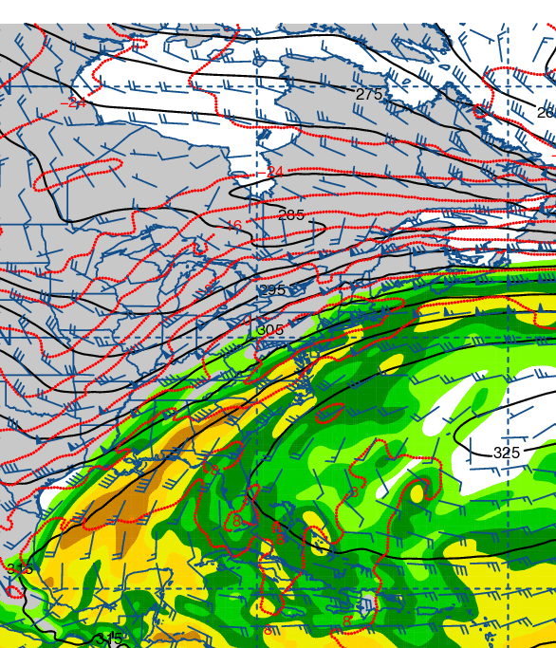
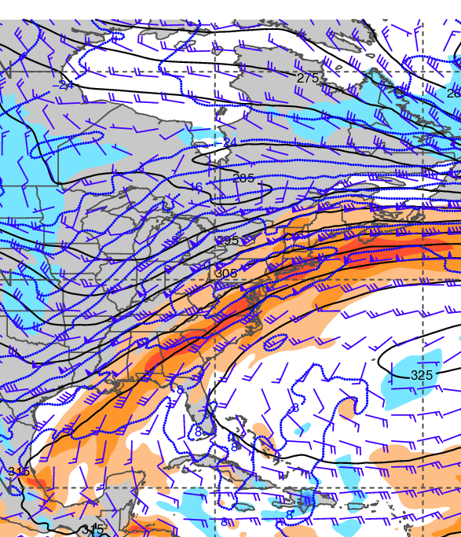
0000 UTC 23 December 2013
700-hPa geopotential height (black contours, dam),
temperature (red contours, °C), wind (barbs, kts),
and precipitable water (shaded, mm)
700-hPa geopotential height (black contours, dam),
temperature (blue contours, °C), wind (barbs, kts),
and precipitable water standardized anomalies (shaded, σ)

Slide 23
925-hPa temp. and anom.
Notes:
When starting talk, define education–research interface and introduce Alicia and Kyle as current and previous TAs in upper-division thermodynamics and introductory graduate dynamics that I presently teach at UAlbany.

Slide 24
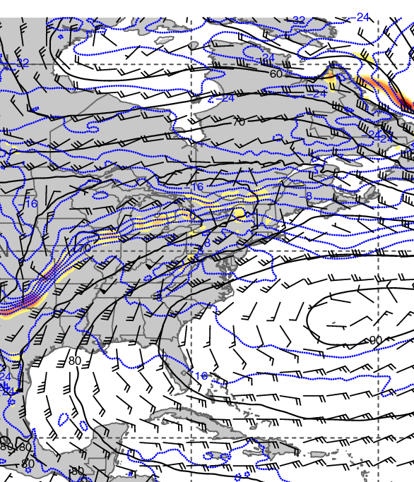
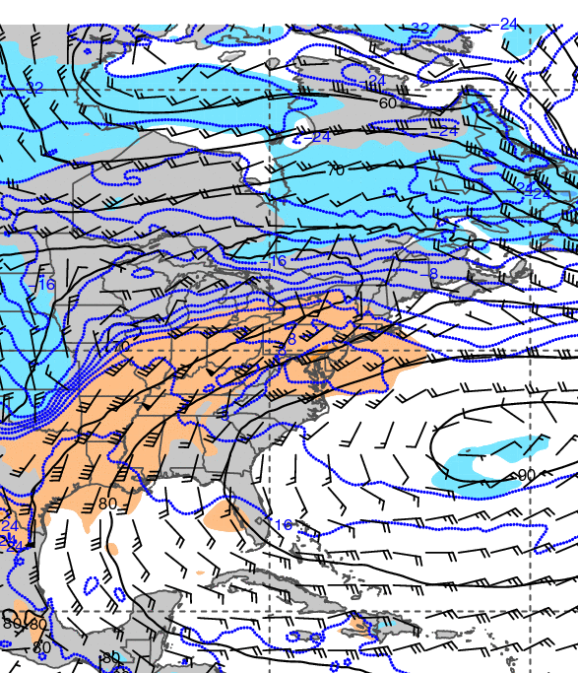
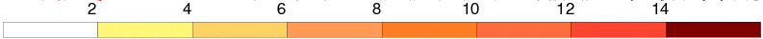
1200 UTC 20 December 2013
925-hPa geopotential height (black contours, dam),
temperature (blue contours, °C), wind (barbs, kts),
and frontogenesis (shaded, K [100 km]⁻¹ [3 h]⁻¹)
925-hPa geopotential height (black contours, dam),
temperature (blue contours, °C), wind (barbs, kts),
and temperature standardized anomalies (shaded, σ)

Slide 25
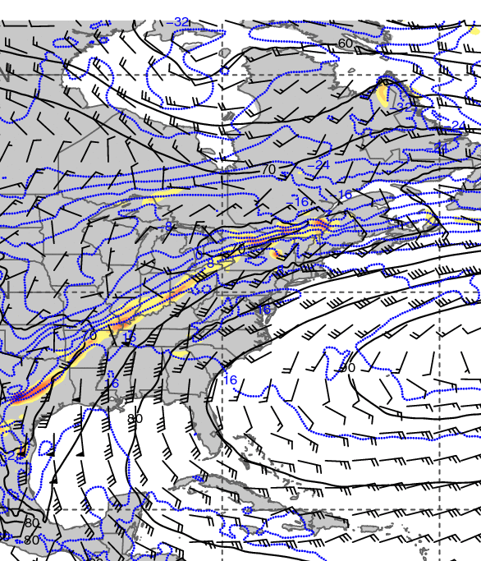
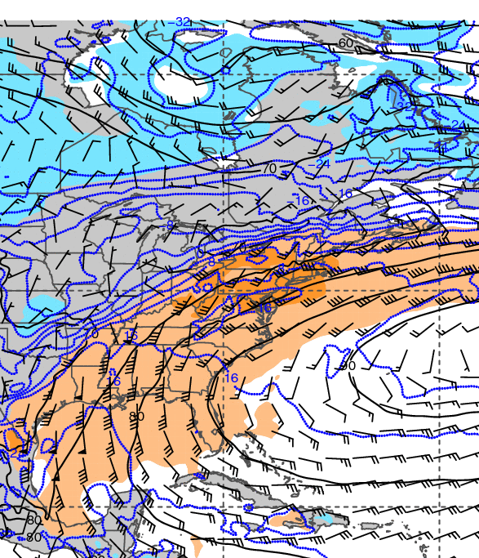
1200 UTC 21 December 2013
925-hPa geopotential height (black contours, dam),
temperature (blue contours, °C), wind (barbs, kts),
and frontogenesis (shaded, K [100 km]⁻¹ [3 h]⁻¹)
925-hPa geopotential height (black contours, dam),
temperature (blue contours, °C), wind (barbs, kts),
and temperature standardized anomalies (shaded, σ)

Slide 26
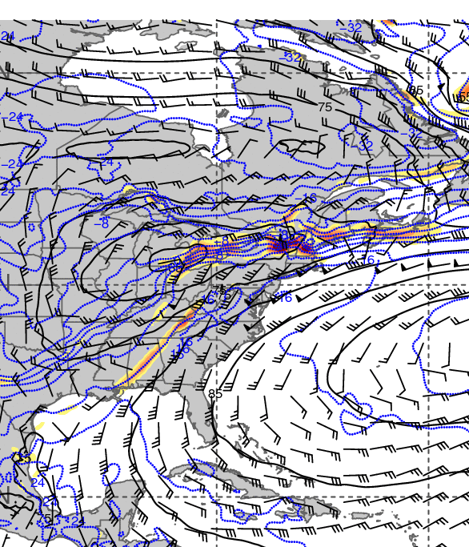
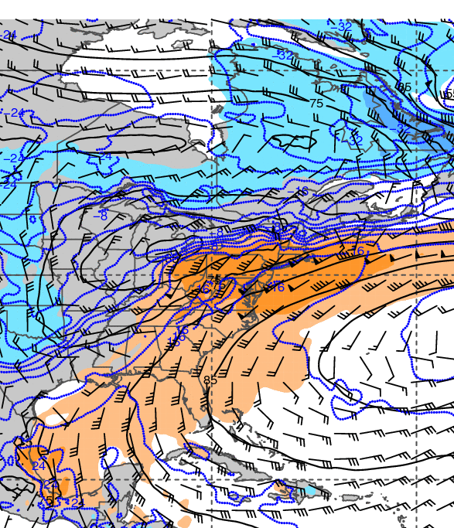
1200 UTC 22 December 2013
925-hPa geopotential height (black contours, dam),
temperature (blue contours, °C), wind (barbs, kts),
and frontogenesis (shaded, K [100 km]⁻¹ [3 h]⁻¹)
925-hPa geopotential height (black contours, dam),
temperature (blue contours, °C), wind (barbs, kts),
and temperature standardized anomalies (shaded, σ)

Slide 27
Maplist Images
Notes:
When starting talk, define education–research interface and introduce Alicia and Kyle as current and previous TAs in upper-division thermodynamics and introductory graduate dynamics that I presently teach at UAlbany.

Slide 28
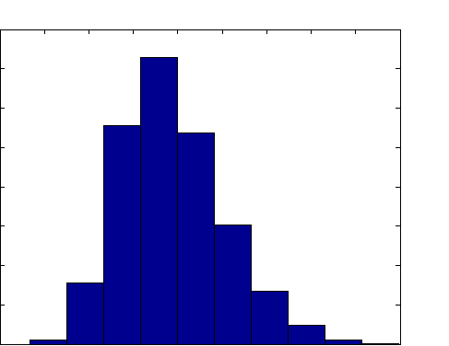
Histogram of 250-hPa maximum wind speed
NCEP–NCAR Reanalysis: 1979–2012
Domain: 40°–60°N and 90°–60°W
4000
3500
3000
2500
2000
1500
1000
500
0
Occurrences (1979–2012)
20 30 40 50 60 70 80 90 100 110
250-hPa Wind Speed (m s⁻¹)
Source: Dr. Jason Cordeira
Notes:
When starting talk, define education–research interface and introduce Alicia and Kyle as current and previous TAs in upper-division thermodynamics and introductory graduate dynamics that I presently teach at UAlbany.

Slide 29
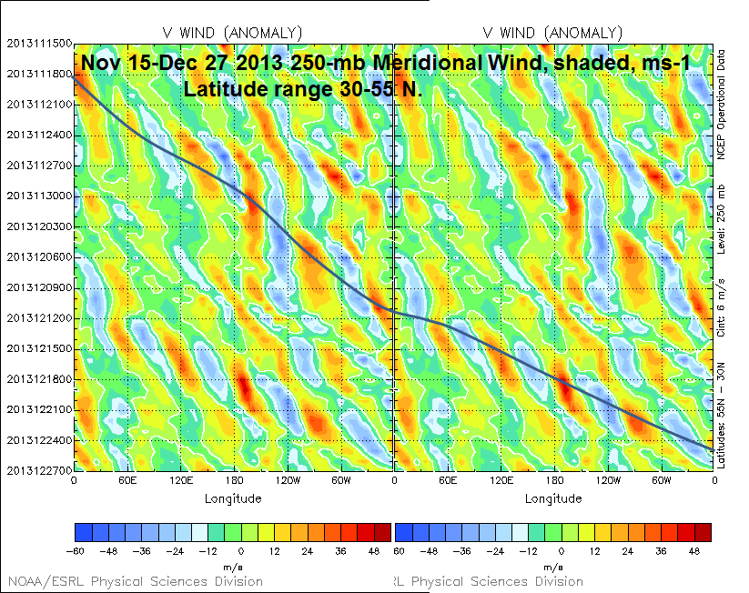
15 Nov
Time
27 Dec
−60 −48 −36 −24 −12 0 12 24 36 48
Source: Dr. Mel Shapiro
Notes:
When starting talk, define education–research interface and introduce Alicia and Kyle as current and previous TAs in upper-division thermodynamics and introductory graduate dynamics that I presently teach at UAlbany.

Slide 30
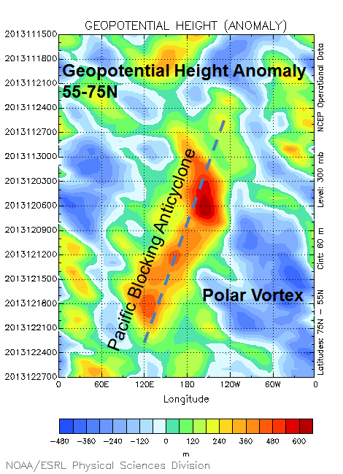
15 Nov
600
480
360
240
120
0
−120
−240
−360
−480
Time
27 Dec
Source: Dr. Mel Shapiro
Notes:
When starting talk, define education–research interface and introduce Alicia and Kyle as current and previous TAs in upper-division thermodynamics and introductory graduate dynamics that I presently teach at UAlbany.

Slide 31
CYYZ – Toronto, ON
CYYZ – Toronto, ON
120 h backward trajectories ending at:
0000 UTC 22 December 2013
72 h forward trajectories starting at:
0000 UTC 22 December 2013
Source: NOAA HYSPLIT MODEL
Notes:
When starting talk, define education–research interface and introduce Alicia and Kyle as current and previous TAs in upper-division thermodynamics and introductory graduate dynamics that I presently teach at UAlbany.

Slide 32
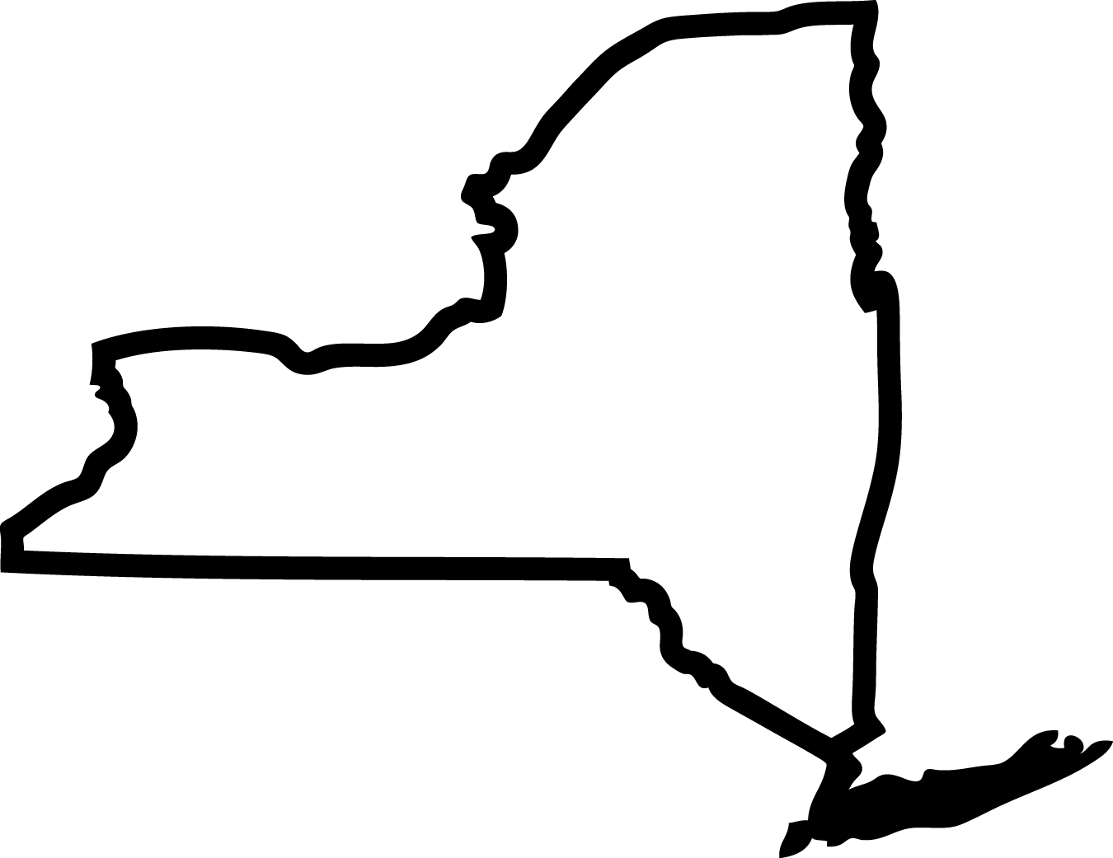
KDSV
Dansville, NY
KDSV 221154Z AUTO 15007KT 10SM UP BKN095 OVC110 00/00 A2966 RMK AO2 PRESFR SLP057 P0001 60011 70105 T00000000 10011 20000 50020
KDSV 221254Z AUTO 14007KT 10SM -RA OVC095 02/02 A2967 RMK AO2 UPE23RAB23 SLP063 P0000 T00220017
KDSV 221354Z AUTO 16018G26KT 10SM BKN110 14/12 A2961 RMK AO2 PK WND 15026/1353 RAE48 SLP038 P0001 T01390117
KDSV 221454Z AUTO 33014G27KT 290V020 10SM CLR 17/12 A2963 RMK
AO2 PK WND 16037/1439 WSHFT 1429 RAB16E25 PRESRR SLP044 P0000 60001 T01720117 55014 $
KDSV 221504Z AUTO 32028G42KT 10SM -RA SCT005 SCT019 02/01 A2967 RMK AO2 PK WND 33042/1500 RAB1456 PRESRR P0000 $
Notes:
When starting talk, define education–research interface and introduce Alicia and Kyle as current and previous TAs in upper-division thermodynamics and introductory graduate dynamics that I presently teach at UAlbany.

Slide 33
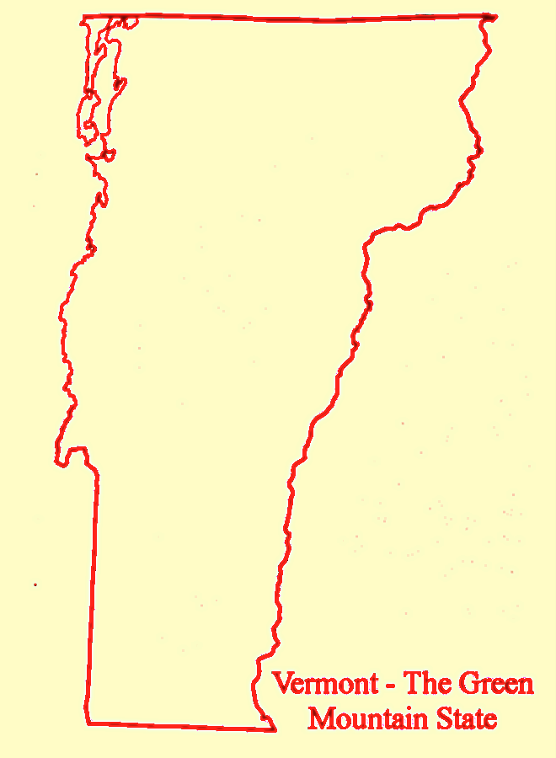
KDDH
Bennington, VT
KDDH 221344Z AUTO 01005KT 2 1/2SM BR
BKN020 06/04 A2973 RMK AO2 $
KDDH 221254Z AUTO 21014G23KT 10SM BKN022 BKN048 BKN100 17/13 A2970 RMK AO2 PK WND 22029/1235 SLP056 P0000 T01720133 $
KDDH 221240Z AUTO 20013G29KT 10SM SCT020 BKN055 OVC100 17/13 A2969 RMK AO2 PK WND 22029/1235 P0000 $
KDDH 221226Z AUTO 21009G22KT 10SM BKN020 BKN060 OVC070 17/13 A2970 RMK AO2 P0000 $
KDDH 221054Z AUTO 00000KT 4SM BR FEW002 OVC018 04/03 A2968 RMK AO2 SLP055 T00390028
Notes:
When starting talk, define education–research interface and introduce Alicia and Kyle as current and previous TAs in upper-division thermodynamics and introductory graduate dynamics that I presently teach at UAlbany.

Slide 34
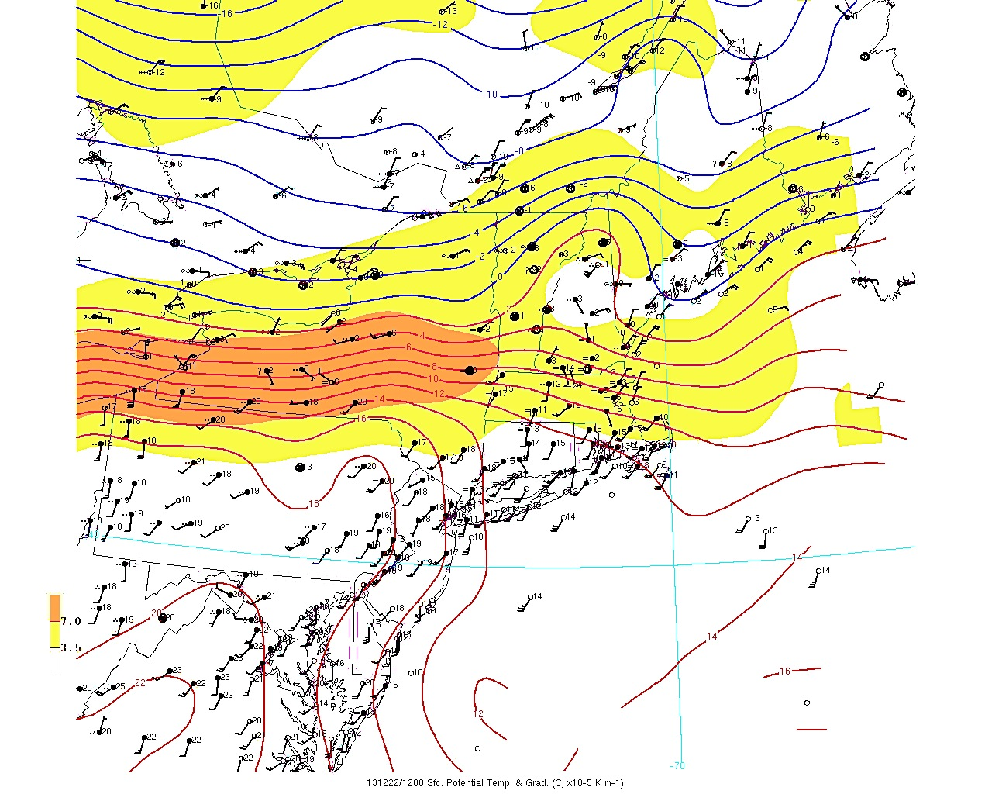
1200 UTC 22 December 2013
Potential Temperature and Gradient (C; ×10⁻⁵ K m⁻¹)
Notes:
When starting talk, define education–research interface and introduce Alicia and Kyle as current and previous TAs in upper-division thermodynamics and introductory graduate dynamics that I presently teach at UAlbany.

Slide 35
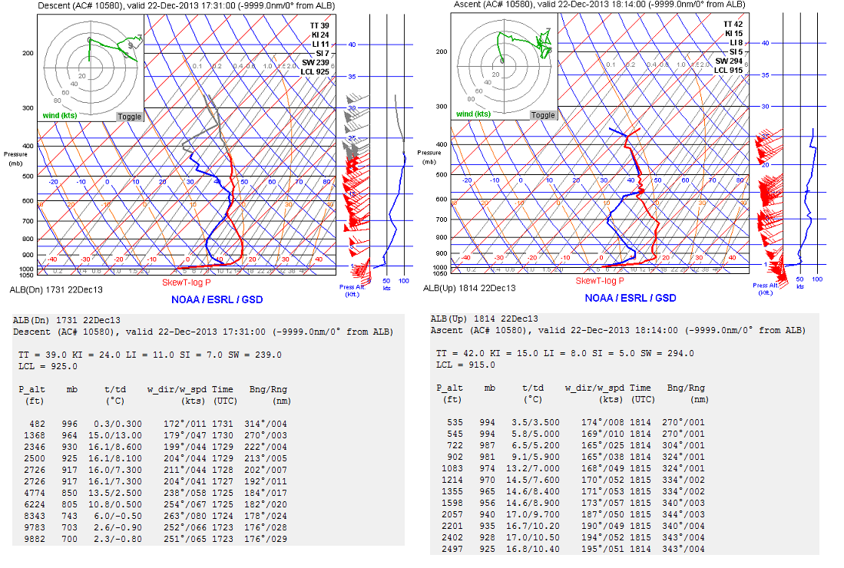
ALB (Albany, NY) Aircraft Soundings
1731 UTC 22 December 2013 1814 UTC 22 December 2013
Source: Jonathan Blaes
Notes:
When starting talk, define education–research interface and introduce Alicia and Kyle as current and previous TAs in upper-division thermodynamics and introductory graduate dynamics that I presently teach at UAlbany.

Slide 36
Additional Soundings
Notes:
When starting talk, define education–research interface and introduce Alicia and Kyle as current and previous TAs in upper-division thermodynamics and introductory graduate dynamics that I presently teach at UAlbany.

Slide 37

0000 UTC 22 December 2013
Detroit, MI Wilmington, OH
PW = 28.9 mm
CAPE = 0.0 J kg⁻¹
Thickness = 5546 m
PW = 37.4 mm*
CAPE = 99.3 J kg⁻¹
Thickness = 5645 m
*Record

Slide 38

0000 UTC 22 December 2013
Pittsburgh, PA Buffalo, NY
PW = 33.2 mm*
CAPE = 0.0 J kg⁻¹
Thickness = 5638 m
PW = 28.9 mm
CAPE = 0.0 J kg⁻¹
Thickness = 5546 m
*2nd Highest

Slide 39

1200 UTC 22 December 2013
Albany, NY Upton, NY
PW = 36.8 mm*
CAPE = 0.0 J kg⁻¹
Thickness = 5629 m
PW = 36.2 mm
CAPE = 0.0 J kg⁻¹
Thickness = 5676 m
*2nd Highest

Slide 40

0000 UTC 23 December 2013
Gray, ME Chatham, MA
PW = 23.2 mm
CAPE = 0.0 J kg⁻¹
Thickness = 5555 m
PW = 29.8 mm
CAPE = 0.0 J kg⁻¹
Thickness = 5663 m

Slide 41
Cross Sections
Adapted From Newton and Palmen (1963)

Slide 42

Trough Cross Section 1200 UTC 21 December 2013
Adapted From Newton and Palmen (1963)
250-hPa geopotential height (black contour, m)
geostrophic wind (blue dotted contour m s⁻¹)
total wind (blue contour, m s⁻¹)
250-hPa geopotential heights (black contours, m)
Cyclonic curvature vorticity (shaded, 10⁻⁵ s⁻¹)

Slide 43
Trough Cross Section 1200 UTC 21 December 2013
Adapted From Newton and Palmen (1963)
250-hPa geopotential height (black contour, m)
geostrophic wind (blue dotted contour m s⁻¹)
total wind (blue contour, m s⁻¹)
250-hPa geopotential heights (black contours, m)
Cyclonic curvature vorticity (shaded, 10⁻⁵ s⁻¹)
Maximum Cyclonic Curvature Vorticity at Base of Trough Along Jet

Slide 44
Trough Cross Section 1200 UTC 21 December 2013
Adapted From Newton and Palmen (1963)
250-hPa geopotential height (black contour, m)
geostrophic wind (blue dotted contour m s⁻¹)
total wind (blue contour, m s⁻¹)
250-hPa geopotential heights (black contours, m)
Cyclonic curvature vorticity (shaded, 10⁻⁵ s⁻¹)
Maximum Cyclonic Curvature Vorticity at Base of Trough Along Jet
Subgeostrophic Flow at Trough Axis Along Subtropical and Polar Jets

Slide 45

Trough Cross Section 1200 UTC 21 December 2013
Adapted From Newton and Palmen (1963)
250-hPa geopotential height (black contour, m)
geostrophic wind (blue dotted contour m s⁻¹)
total wind (blue contour, m s⁻¹)
250-hPa geopotential heights (black contours, m)
Cyclonic shear vorticity (shaded, 10⁻⁵ s⁻¹)
Maximum Cyclonic Curvature Vorticity at Base of Trough Along Jet
Subgeostrophic Flow at Trough Axis Along Subtropical and Polar Jets
Maximum Shear Vorticity at Strongest Height Gradient Along Jets

Slide 46

Ridge Cross Section 1200 UTC 22 December 2013
Adapted From Newton and Palmen (1963)
250-hPa geopotential height (black contour, m)
geostrophic wind (blue dotted contour m s⁻¹)
total wind (blue contour, m s⁻¹)
250-hPa geopotential heights (black contours, m)
Cyclonic curvature vorticity (shaded, 10⁻⁵ s⁻¹)

Slide 47
Ridge Cross Section 1200 UTC 22 December 2013
Adapted From Newton and Palmen (1963)
250-hPa geopotential height (black contour, m)
geostrophic wind (blue dotted contour m s⁻¹)
total wind (blue contour, m s⁻¹)
250-hPa geopotential heights (black contours, m)
Cyclonic curvature vorticity (shaded, 10⁻⁵ s⁻¹)
Little to No Cyclonic Curvature Vorticity at Base of Ridge Along Jet

Slide 48
Ridge Cross Section 1200 UTC 22 December 2013
Adapted From Newton and Palmen (1963)
250-hPa geopotential height (black contour, m)
geostrophic wind (blue dotted contour m s⁻¹)
total wind (blue contour, m s⁻¹)
250-hPa geopotential heights (black contours, m)
Cyclonic curvature vorticity (shaded, 10⁻⁵ s⁻¹)
Little to No Cyclonic Curvature Vorticity at Base of Ridge Along Jet
Supergeostrophic Flow at Ridge Axis Along Merged Subtropical and Polar Jets

Slide 49

Ridge Cross Section 1200 UTC 22 December 2013
Adapted From Newton and Palmen (1963)
250-hPa geopotential height (black contour, m)
geostrophic wind (blue dotted contour m s⁻¹)
total wind (blue contour, m s⁻¹)
250-hPa geopotential heights (black contours, m)
Cyclonic shear vorticity (shaded, 10⁻⁵ s⁻¹)
Little to No Cyclonic Curvature Vorticity at Base of Ridge Along Jet
Supergeostrophic Flow at Ridge Axis Along Merged Subtropical and Polar Jets
Maximum Cycloinc Shear Vorticity Poleward of Jet Core (Along Broad Trough Axis)

Slide 50
Cross Sections
Jet Entrance and Jet Exit

Slide 51



1200 UTC 22 December 2013
Jet Entrance
(15ºN,73.5ºW / 75ºN,73.5ºW)
Jet Exit
(15ºN,50ºW / 75ºN,50ºW)
CYUL
Zonal Wind (shaded, m s⁻¹), Meridional Wind (blue contours, m s⁻¹)
Omega (purple contours, 10⁻³ Pa s⁻¹), Theta (black contours, K)
Inset: 250 hPa Total Wind (shaded, m s⁻¹), 250 hPa Geopotential Height (black contours, m)

Slide 52




1200 UTC 22 December 2013
Jet Entrance
(15ºN,73.5ºW / 75ºN,73.5ºW)
Jet Exit
(15ºN,50ºW / 75ºN,50ºW)
CYUL
Frontogenesis (shaded, K [100 km]⁻¹ [3 h]⁻¹)
Omega (purple contours, 10⁻³ Pa s⁻¹), Theta (black contours, K)
Inset: 250 hPa Total Wind (shaded, m s⁻¹), 250 hPa Geopotential Height (black contours, m)

Slide 53



1200 UTC 22 December 2013
Jet Entrance
(15ºN,73.5ºW / 75ºN,73.5ºW)
Jet Exit
(15ºN,50ºW / 75ºN,50ºW)
CYUL
Potential Vorticity (shaded, PVU)
Total Wind (blue contours, m s⁻¹), Theta (black contours, K)
Inset: 250 hPa Total Wind (shaded, m s⁻¹), 250 hPa Geopotential Height (black contours, m)

Slide 54


1200 UTC 22 December 2013
Jet Entrance
(15ºN,73.5ºW / 75ºN,73.5ºW)
Jet Exit
(15ºN,50ºW / 75ºN,50ºW)
CYUL
Relative Humidity (shaded, %)
Omega (purple contours, 10⁻³ Pa s⁻¹), Theta-e (black contours, K)
Inset: 250 hPa Total Wind (shaded, m s⁻¹), 250 hPa Geopotential Height (black contours, m)

Slide 55
Paper Figures
Gyakum and Roebber (2001)

Slide 56

Figure 2 (from Gyakum and Robber 2001)

Slide 57

Figure 8 (from Gyakum and Robber 2001)

Slide 58
Summary Schematic

Slide 59


Summary Schematic on 1200 UTC 22 Dec
F_{gen}
L
0ºC
V₈₅₀₋₇₀₀
>20 m s⁻¹
0ºC
PW > 25mm
250 hPa geopotential height (solid black contours, every 12 dam) 250 hPa Wind Speed (color shading, m s⁻¹),
2 meter 0ºC Isotherm (red dotted line), 850-700 hPa Layer Mean 0ºC Isotherm (orange dotted line)
precipitable water (values > 25 mm shaded in green), concentrated 925 hPa frontogenesis (purple shading)
850-700 hPa wind vector (speed > 20 m s⁻¹ ), elevation (brown shading, > 300 m)

Slide 60
THE END
Notes:
When starting talk, define education–research interface and introduce Alicia and Kyle as current and previous TAs in upper-division thermodynamics and introductory graduate dynamics that I presently teach at UAlbany.

