Slide 1
The Uber Jet and
the Widespread Disruptive Ice Storm
of 21–23 December 2013
Lance F. Bosart, Alicia M. Bentley, and Philippe P. Papin
Department of Atmospheric and Environmental Sciences
University at Albany, State University of New York, Albany, NY 12222
39th Annual Northeastern Storm Conference
Rutland, VT
Saturday 8 March 2014
Notes:
When starting talk, define education–research interface and introduce Alicia and Kyle as current and previous TAs in upper-division thermodynamics and introductory graduate dynamics that I presently teach at UAlbany.

Slide 2
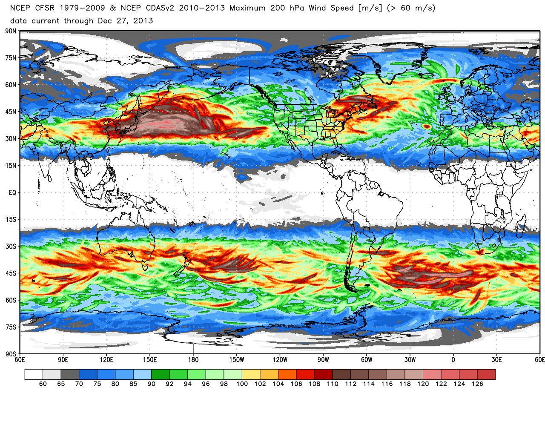
200-hPa maximum wind speed (m s⁻¹)
0.5° Climate Forecast System Reanalysis: 1979–2013
Source: Dr. Ryan Maue
Notes:
When starting talk, define education–research interface and introduce Alicia and Kyle as current and previous TAs in upper-division thermodynamics and introductory graduate dynamics that I presently teach at UAlbany.

Slide 3
200-hPa maximum wind speed (m s⁻¹)
0.5° Climate Forecast System Reanalysis: 1979–2013
Source: Dr. Ryan Maue
Notes:
When starting talk, define education–research interface and introduce Alicia and Kyle as current and previous TAs in upper-division thermodynamics and introductory graduate dynamics that I presently teach at UAlbany.

Slide 4
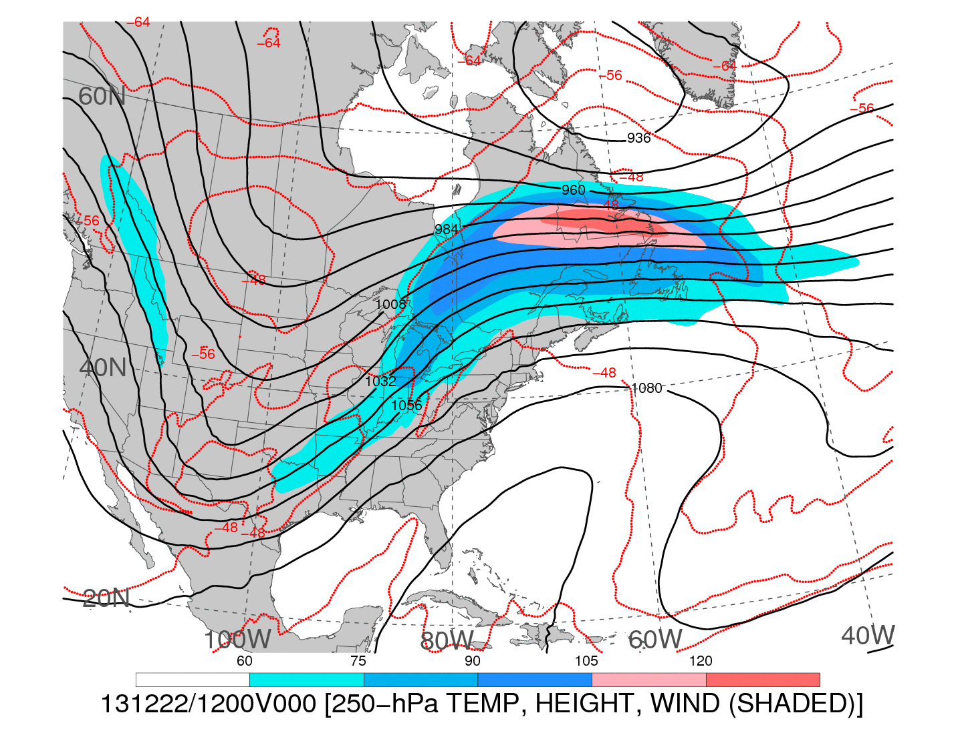
1200 UTC 22 December 2013
250-hPa wind speed (shaded, m s⁻¹; barbs, kts), geopotential height (black contours, dam),
and temperature (red dashed contours, °C)
Notes:
When starting talk, define education–research interface and introduce Alicia and Kyle as current and previous TAs in upper-division thermodynamics and introductory graduate dynamics that I presently teach at UAlbany.

Slide 5

1200 UTC 22 December 2013
−−
250-hPa wind speed (shaded, m s⁻¹; barbs, kts), geopotential height (black contours, dam),
and temperature (red dashed contours, °C)
Notes:
When starting talk, define education–research interface and introduce Alicia and Kyle as current and previous TAs in upper-division thermodynamics and introductory graduate dynamics that I presently teach at UAlbany.

Slide 6
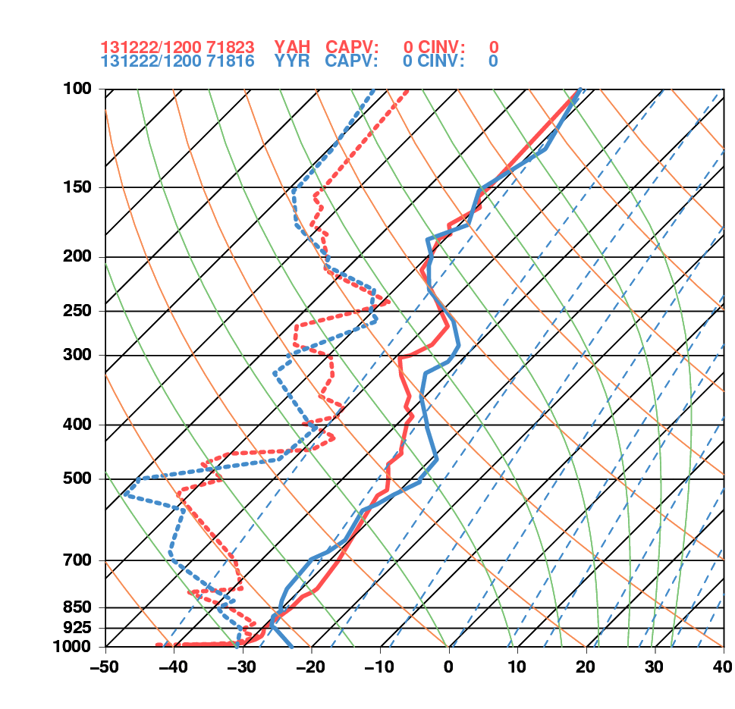
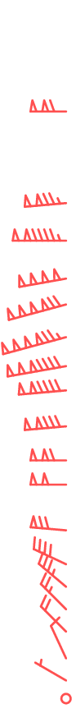
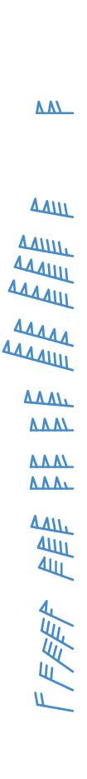
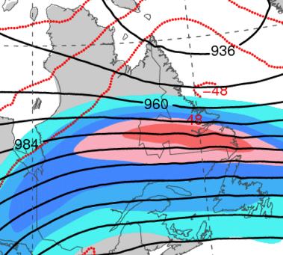
1200 UTC 22 December 2013
La Grande, QC Goose Bay, NL
Goose Bay, NL
La Grande, QC

Slide 7
DT & MSLP LOOPS
Notes:
When starting talk, define education–research interface and introduce Alicia and Kyle as current and previous TAs in upper-division thermodynamics and introductory graduate dynamics that I presently teach at UAlbany.

Slide 8
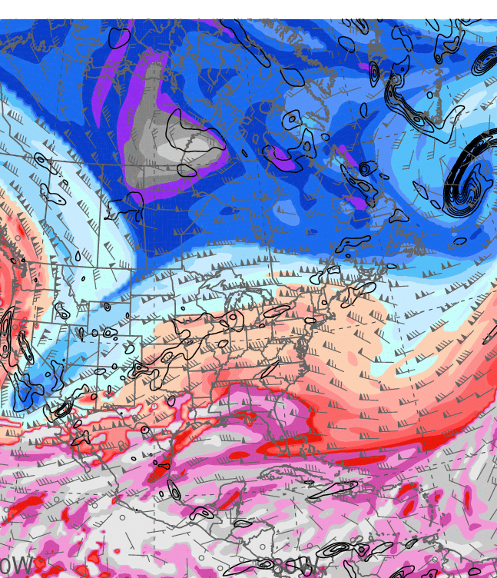
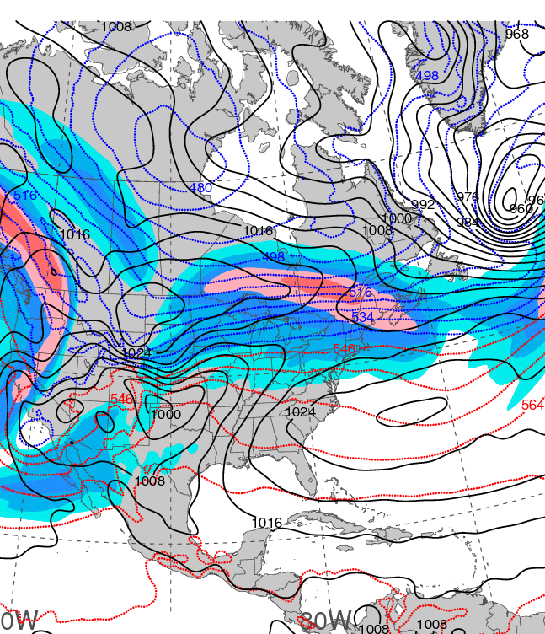
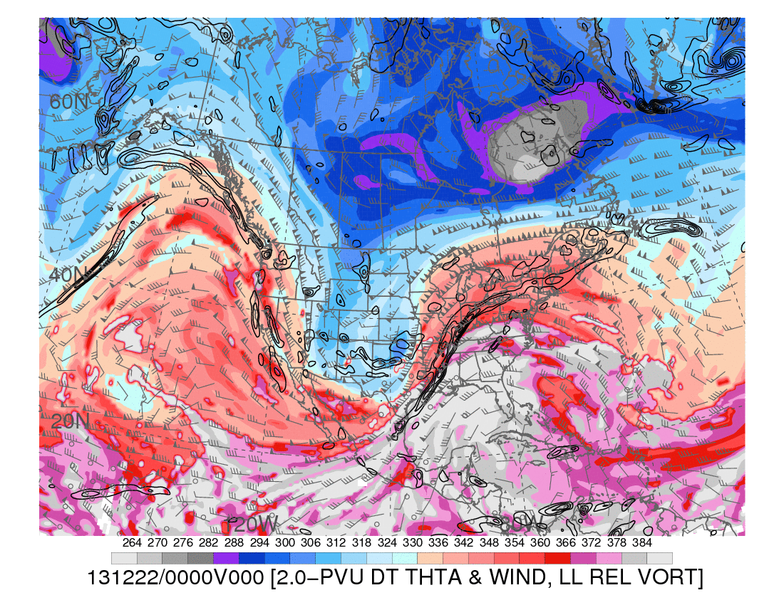
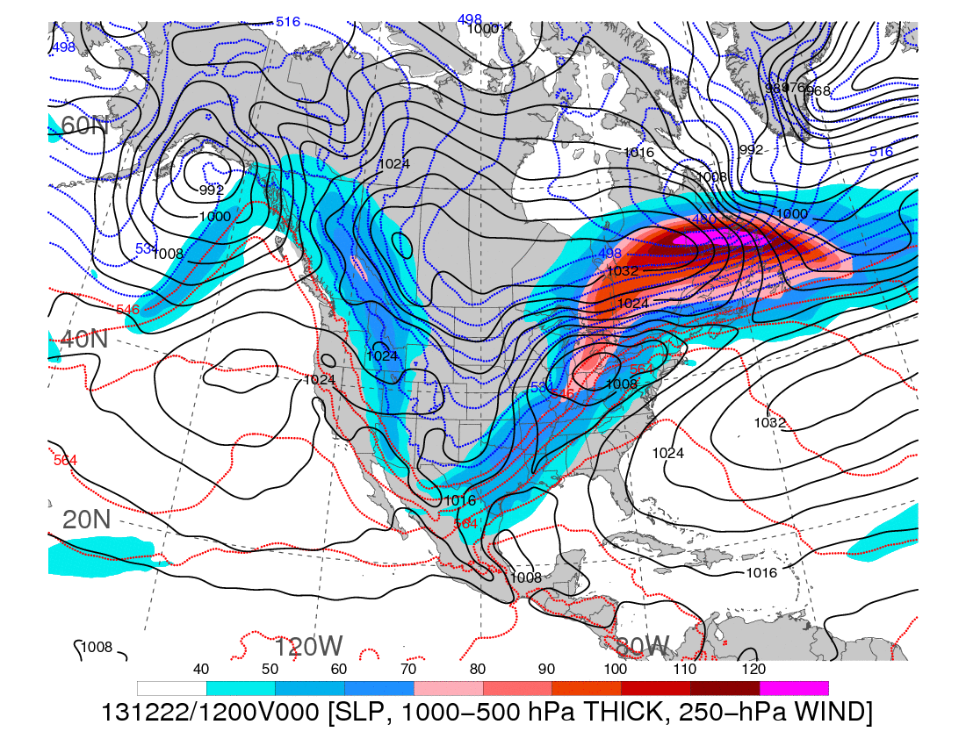
0000 UTC 20 December 2013
Dynamic tropopause (DT, 1.5-PVU surface) potential
temperature (shaded, K) and wind (barbs, kts),
925–850-hPa layer-averaged cyclonic relative vorticity
(black contours every 0.5 × 10⁻⁴ s⁻¹)
250-hPa wind speed (shaded, m s⁻¹), 1000–500-hPa thickness (blue contours ≤ 540 dam,
red contours > 540 dam), MSLP (black contours, hPa)

Slide 9
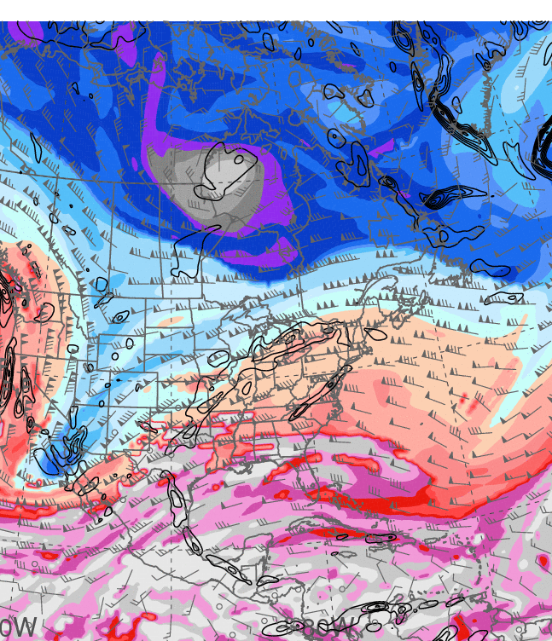
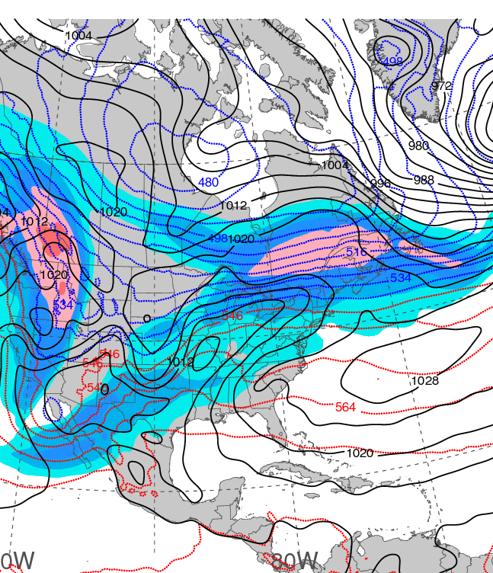
1200 UTC 20 December 2013
Dynamic tropopause (DT, 1.5-PVU surface) potential
temperature (shaded, K) and wind (barbs, kts),
925–850-hPa layer-averaged cyclonic relative vorticity
(black contours every 0.5 × 10⁻⁴ s⁻¹)
250-hPa wind speed (shaded, m s⁻¹), 1000–500-hPa thickness (blue contours ≤ 540 dam,
red contours > 540 dam), MSLP (black contours, hPa)

Slide 10
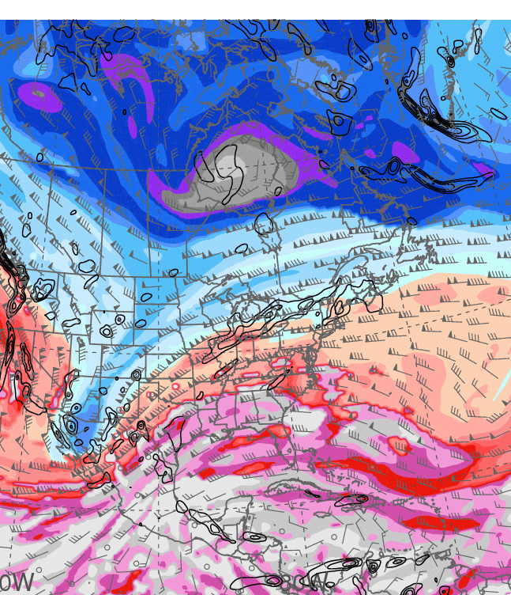
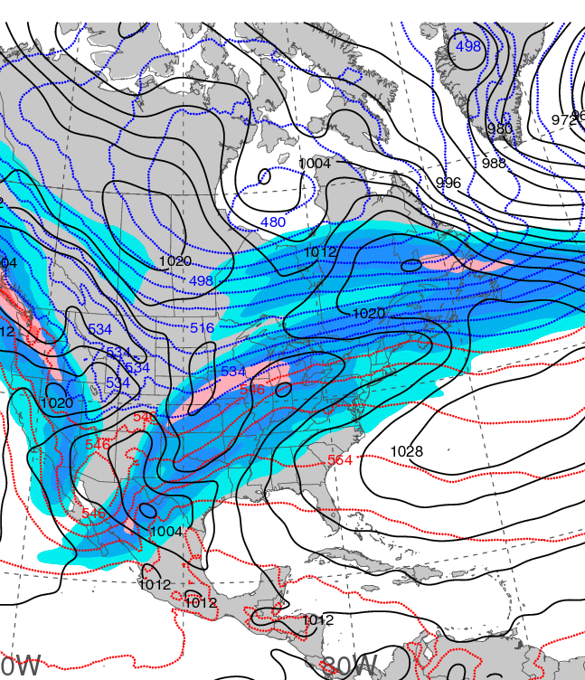
0000 UTC 21 December 2013
Dynamic tropopause (DT, 1.5-PVU surface) potential
temperature (shaded, K) and wind (barbs, kts),
925–850-hPa layer-averaged cyclonic relative vorticity
(black contours every 0.5 × 10⁻⁴ s⁻¹)
250-hPa wind speed (shaded, m s⁻¹), 1000–500-hPa thickness (blue contours ≤ 540 dam,
red contours > 540 dam), MSLP (black contours, hPa)

Slide 11
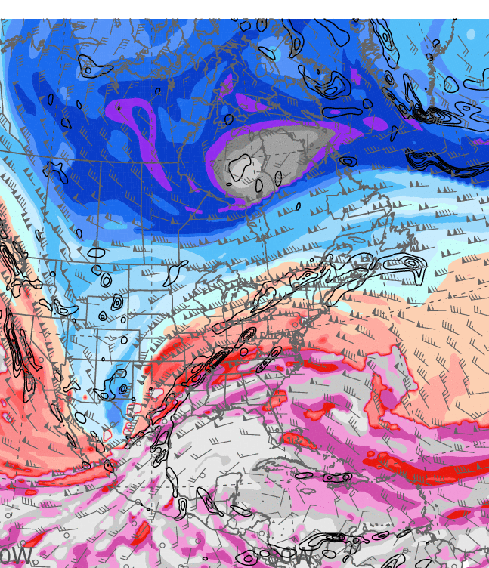
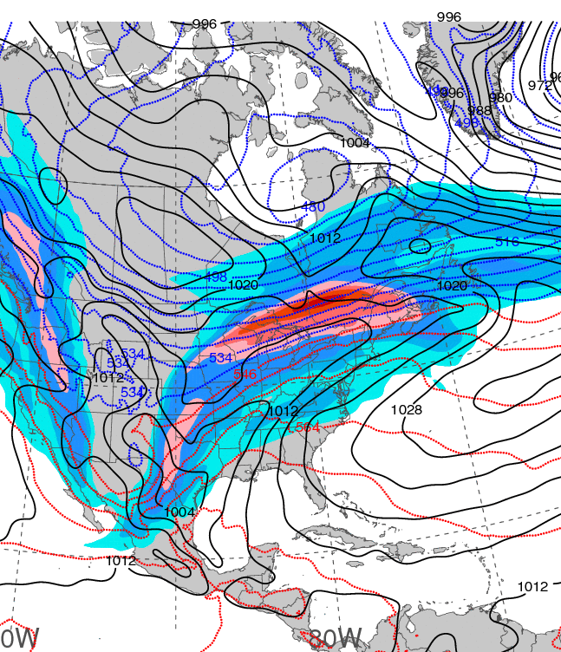
1200 UTC 21 December 2013
Dynamic tropopause (DT, 1.5-PVU surface) potential
temperature (shaded, K) and wind (barbs, kts),
925–850-hPa layer-averaged cyclonic relative vorticity
(black contours every 0.5 × 10⁻⁴ s⁻¹)
250-hPa wind speed (shaded, m s⁻¹), 1000–500-hPa thickness (blue contours ≤ 540 dam,
red contours > 540 dam), MSLP (black contours, hPa)

Slide 12
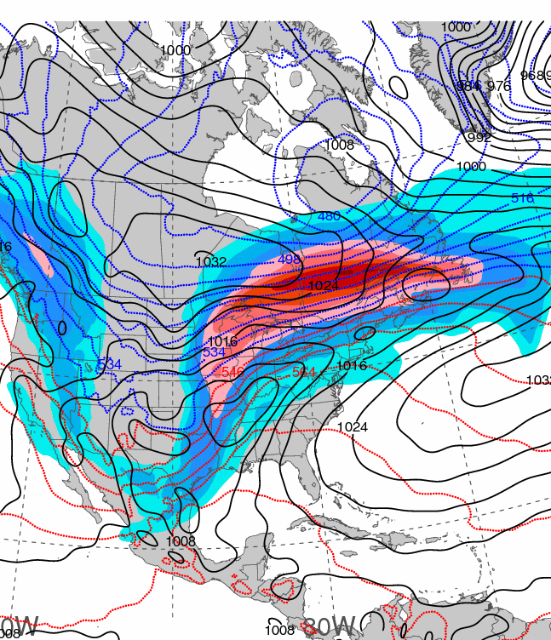
0000 UTC 22 December 2013
Dynamic tropopause (DT, 1.5-PVU surface) potential
temperature (shaded, K) and wind (barbs, kts),
925–850-hPa layer-averaged cyclonic relative vorticity
(black contours every 0.5 × 10⁻⁴ s⁻¹)
250-hPa wind speed (shaded, m s⁻¹), 1000–500-hPa thickness (blue contours ≤ 540 dam,
red contours > 540 dam), MSLP (black contours, hPa)

Slide 13
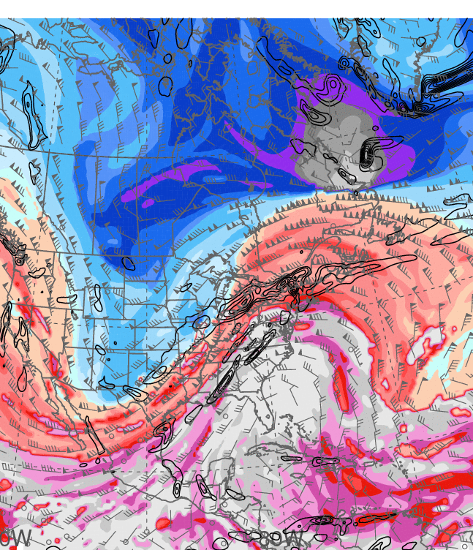
1200 UTC 22 December 2013
Dynamic tropopause (DT, 1.5-PVU surface) potential
temperature (shaded, K) and wind (barbs, kts),
925–850-hPa layer-averaged cyclonic relative vorticity
(black contours every 0.5 × 10⁻⁴ s⁻¹)
250-hPa wind speed (shaded, m s⁻¹), 1000–500-hPa thickness (blue contours ≤ 540 dam,
red contours > 540 dam), MSLP (black contours, hPa)

Slide 14
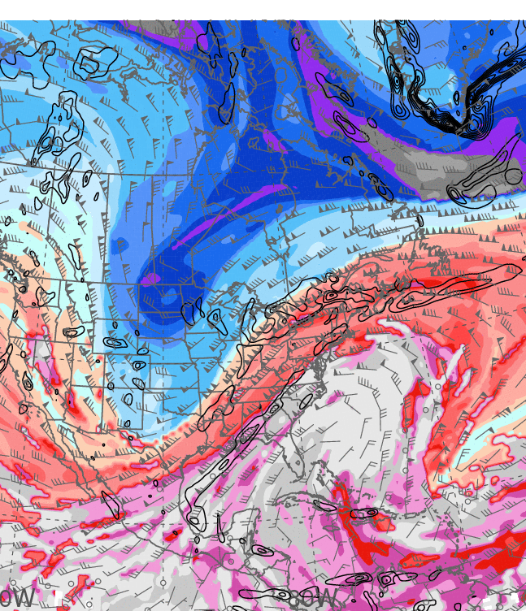
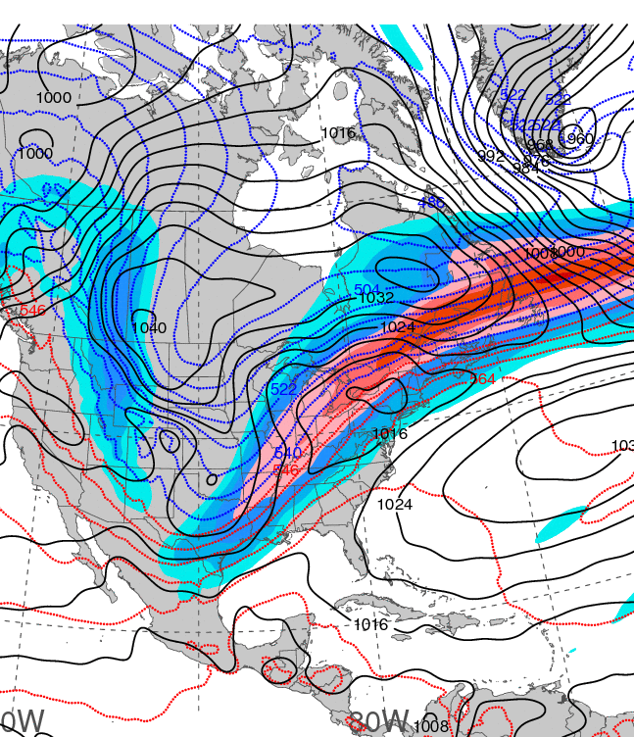
0000 UTC 23 December 2013
Dynamic tropopause (DT, 1.5-PVU surface) potential
temperature (shaded, K) and wind (barbs, kts),
925–850-hPa layer-averaged cyclonic relative vorticity
(black contours every 0.5 × 10⁻⁴ s⁻¹)
250-hPa wind speed (shaded, m s⁻¹), 1000–500-hPa thickness (blue contours ≤ 540 dam,
red contours > 540 dam), MSLP (black contours, hPa)

Slide 15
PW & ANOM. LOOPS
Notes:
When starting talk, define education–research interface and introduce Alicia and Kyle as current and previous TAs in upper-division thermodynamics and introductory graduate dynamics that I presently teach at UAlbany.

Slide 16
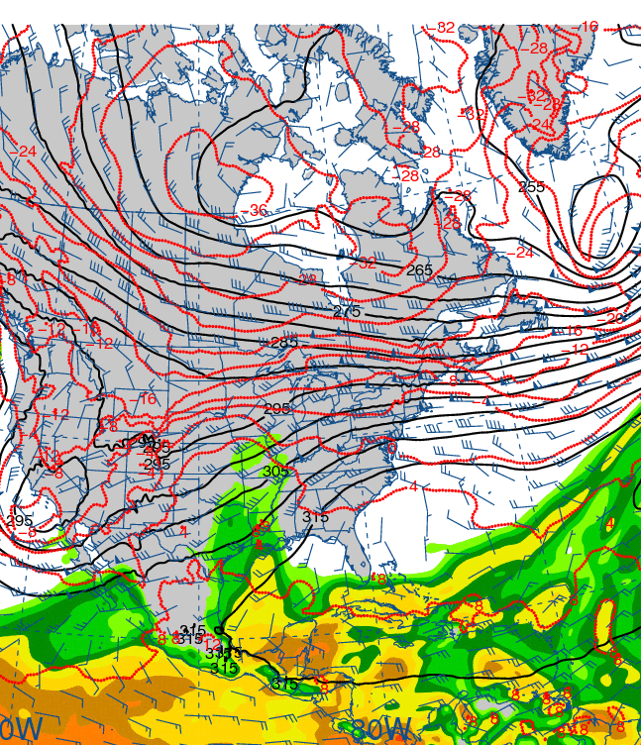
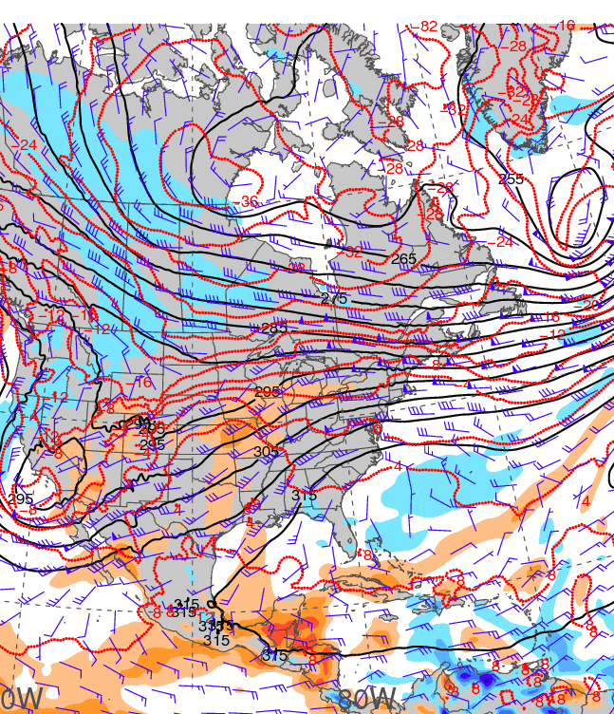
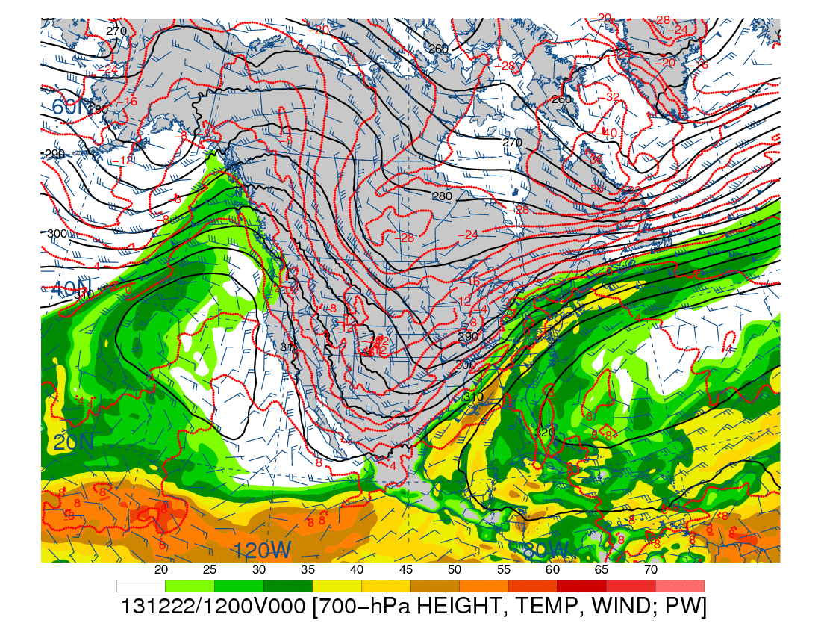
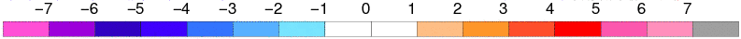
0000 UTC 20 December 2013
700-hPa geopotential height (black contours, dam),
temperature (red contours, °C), wind (barbs, kts),
and precipitable water (shaded, mm)
700-hPa geopotential height (black contours, dam),
temperature (red contours, °C), wind (barbs, kts),
and precipitable water std. anom. (shaded, σ)

Slide 17
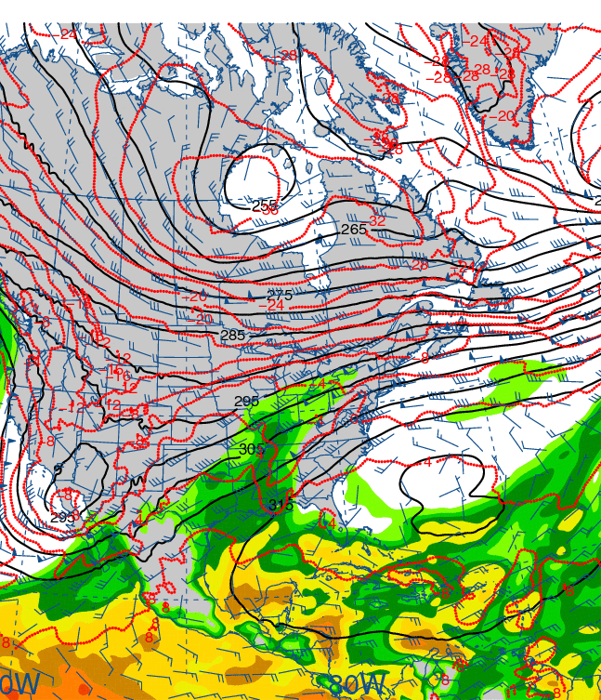
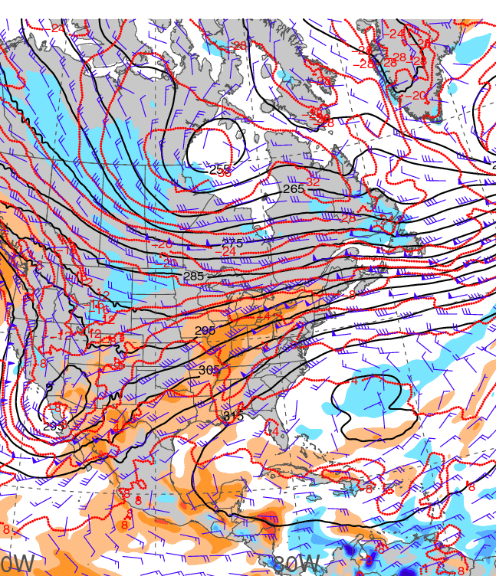
1200 UTC 20 December 2013
700-hPa geopotential height (black contours, dam),
temperature (red contours, °C), wind (barbs, kts),
and precipitable water (shaded, mm)
700-hPa geopotential height (black contours, dam),
temperature (red contours, °C), wind (barbs, kts),
and precipitable water std. anom. (shaded, σ)

Slide 18
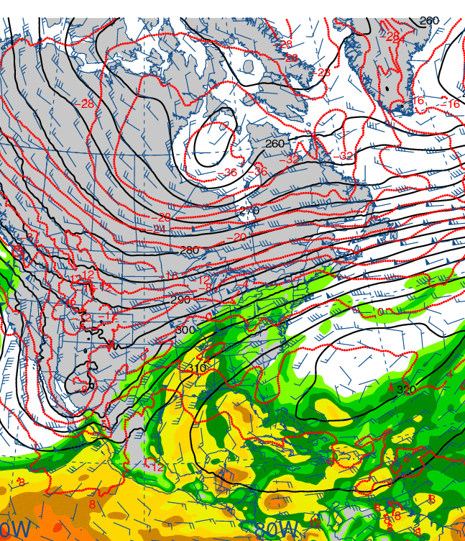
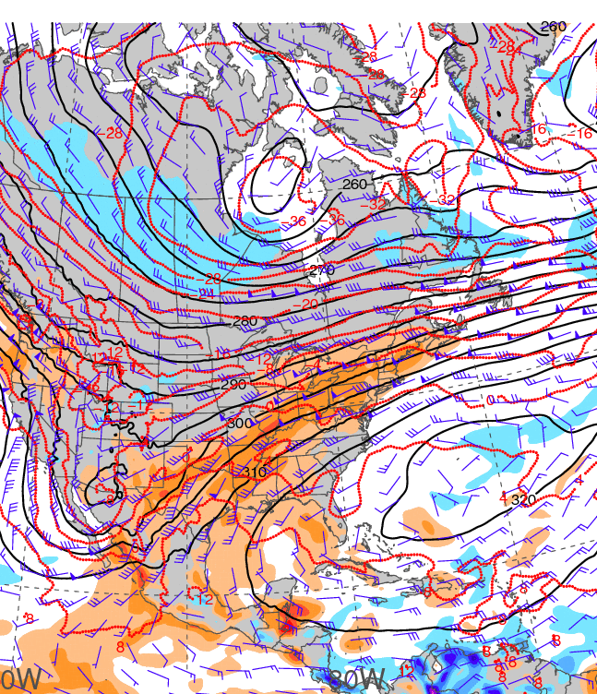
0000 UTC 21 December 2013
700-hPa geopotential height (black contours, dam),
temperature (red contours, °C), wind (barbs, kts),
and precipitable water (shaded, mm)
700-hPa geopotential height (black contours, dam),
temperature (red contours, °C), wind (barbs, kts),
and precipitable water std. anom. (shaded, σ)

Slide 19
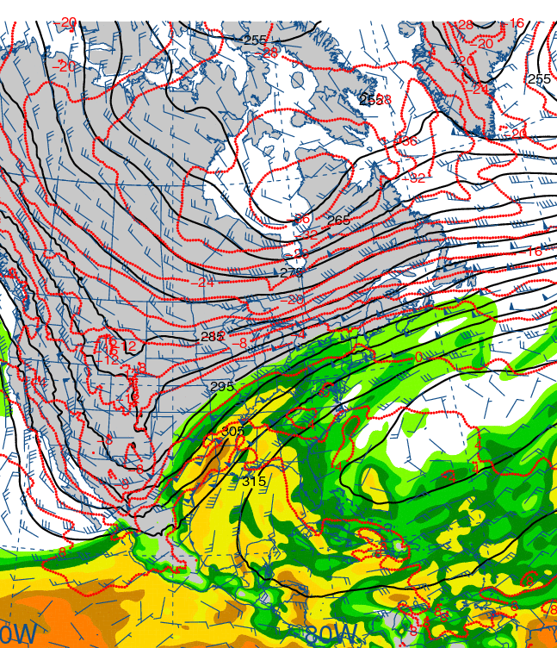
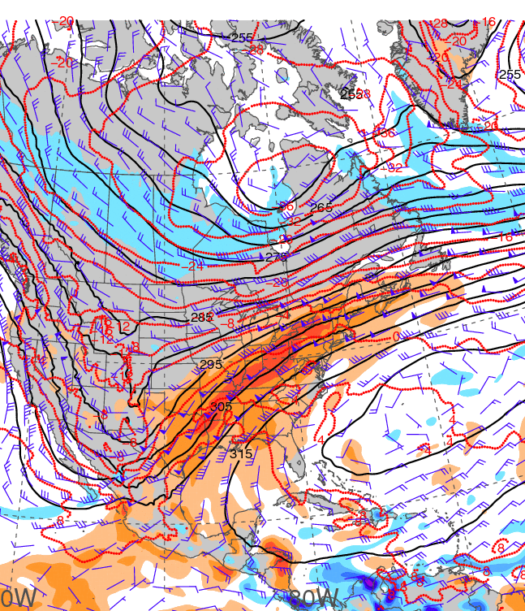
1200 UTC 21 December 2013
700-hPa geopotential height (black contours, dam),
temperature (red contours, °C), wind (barbs, kts),
and precipitable water (shaded, mm)
700-hPa geopotential height (black contours, dam),
temperature (red contours, °C), wind (barbs, kts),
and precipitable water std. anom. (shaded, σ)

Slide 20
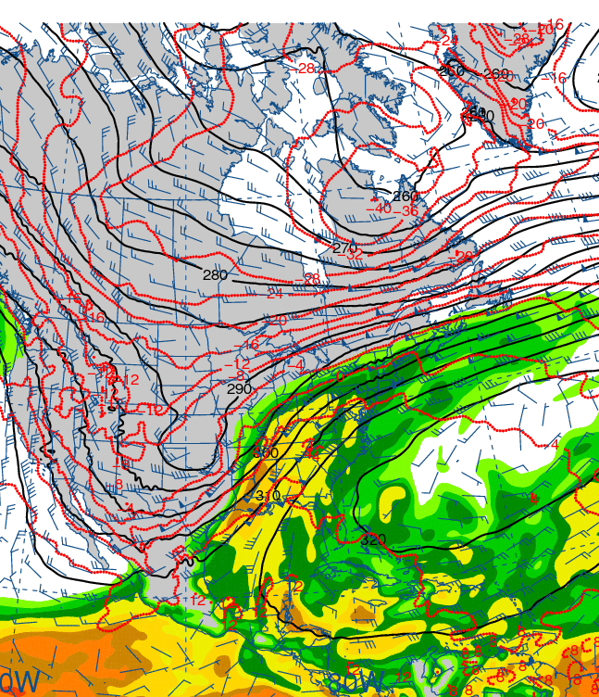
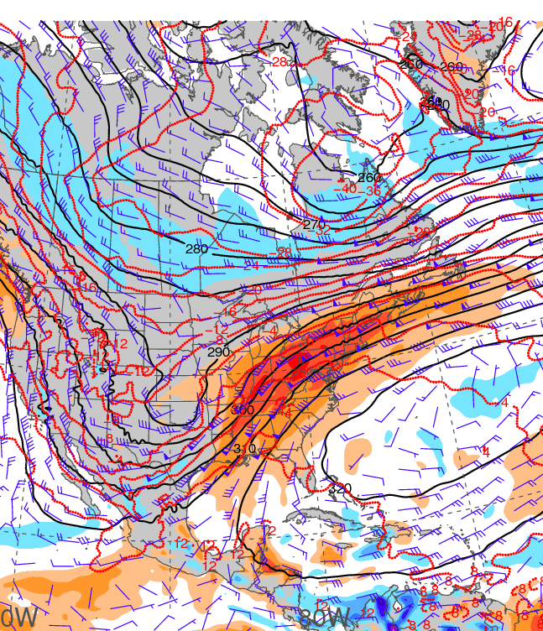
0000 UTC 22 December 2013
700-hPa geopotential height (black contours, dam),
temperature (red contours, °C), wind (barbs, kts),
and precipitable water (shaded, mm)
700-hPa geopotential height (black contours, dam),
temperature (red contours, °C), wind (barbs, kts),
and precipitable water std. anom. (shaded, σ)

Slide 21
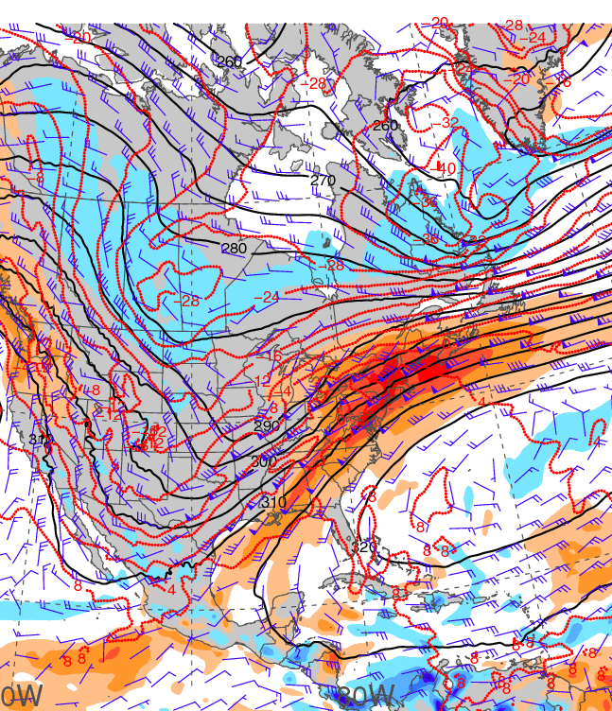
1200 UTC 22 December 2013
700-hPa geopotential height (black contours, dam),
temperature (red contours, °C), wind (barbs, kts),
and precipitable water (shaded, mm)
700-hPa geopotential height (black contours, dam),
temperature (red contours, °C), wind (barbs, kts),
and precipitable water std. anom. (shaded, σ)

Slide 22
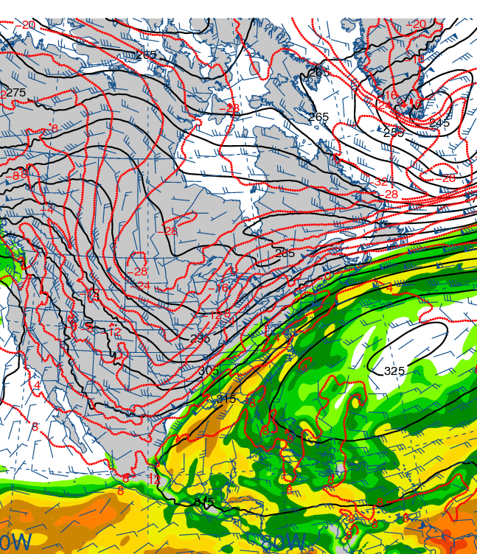
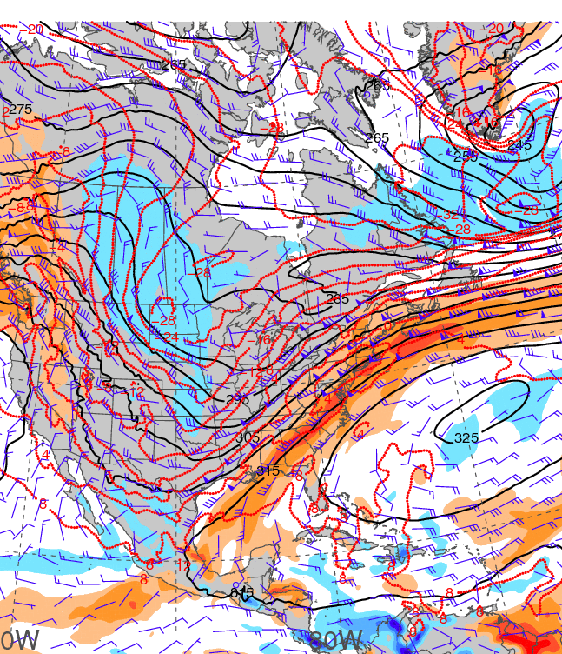
0000 UTC 23 December 2013
700-hPa geopotential height (black contours, dam),
temperature (red contours, °C), wind (barbs, kts),
and precipitable water (shaded, mm)
700-hPa geopotential height (black contours, dam),
temperature (red contours, °C), wind (barbs, kts),
and precipitable water std. anom. (shaded, σ)

Slide 23
850-hPa temp. and anom.
Notes:
When starting talk, define education–research interface and introduce Alicia and Kyle as current and previous TAs in upper-division thermodynamics and introductory graduate dynamics that I presently teach at UAlbany.

Slide 24
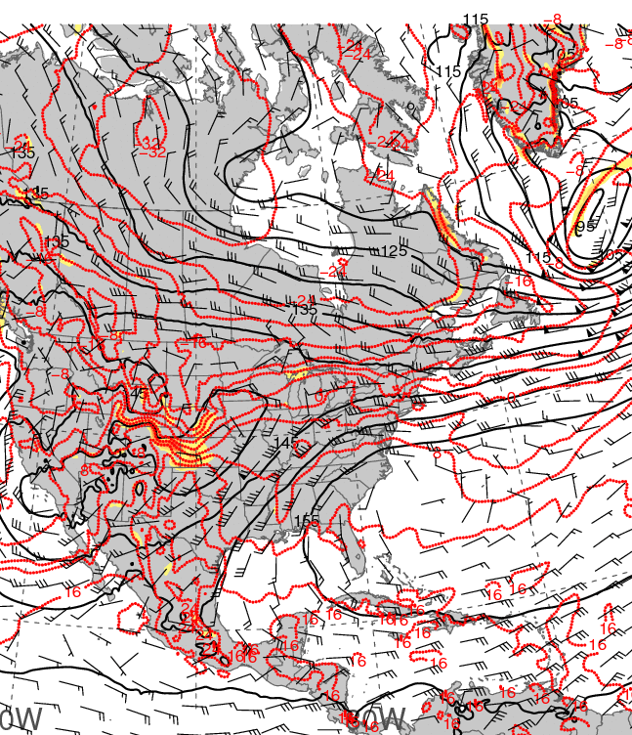
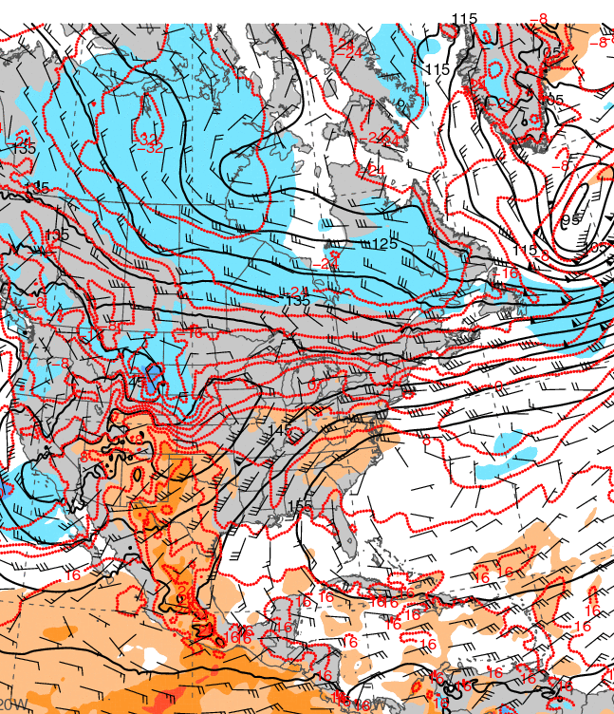
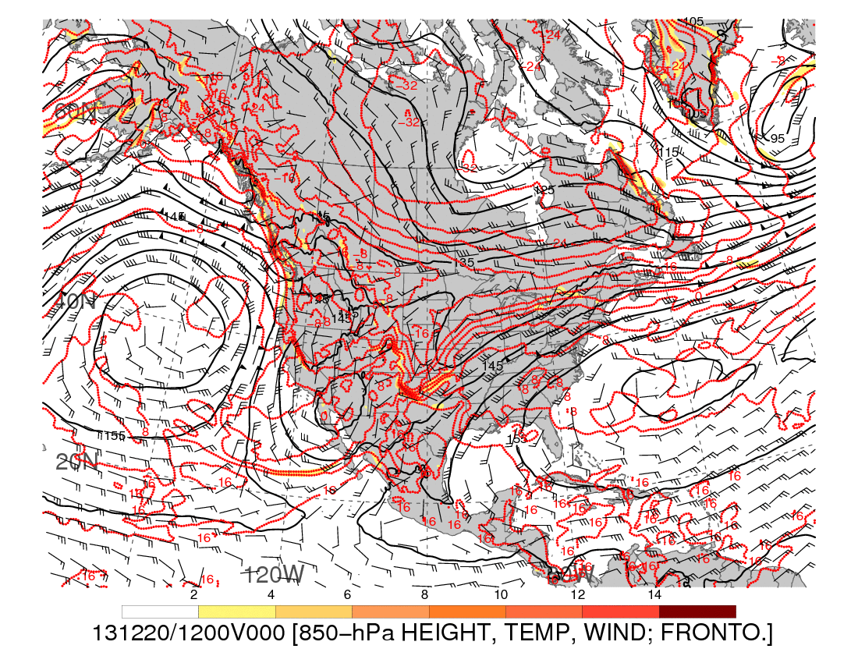
0000 UTC 20 December 2013
850-hPa geopotential height (black contours, dam),
temperature (red contours, °C), wind (barbs, kts),
and frontogenesis (shaded, K [100 km]⁻¹ [3 h]⁻¹)
850-hPa geopotential height (black contours, dam),
temperature (red contours, °C), wind (barbs, kts),
and temperature std. anom. (shaded, σ)

Slide 25
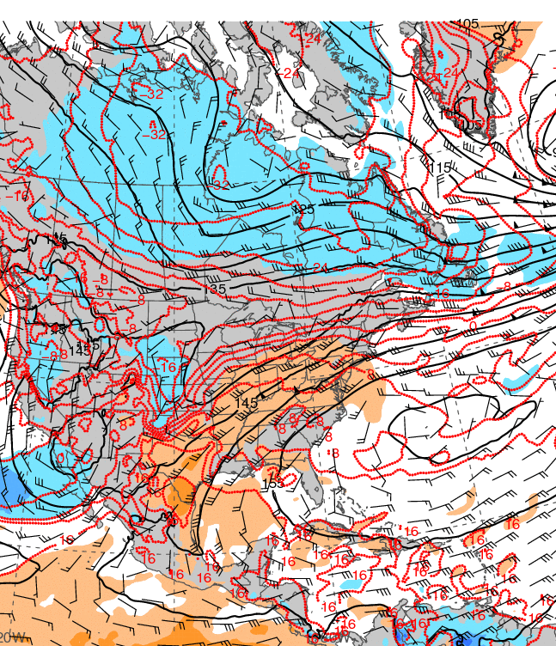
1200 UTC 20 December 2013
850-hPa geopotential height (black contours, dam),
temperature (red contours, °C), wind (barbs, kts),
and frontogenesis (shaded, K [100 km]⁻¹ [3 h]⁻¹)
850-hPa geopotential height (black contours, dam),
temperature (red contours, °C), wind (barbs, kts),
and temperature std. anom. (shaded, σ)

Slide 26
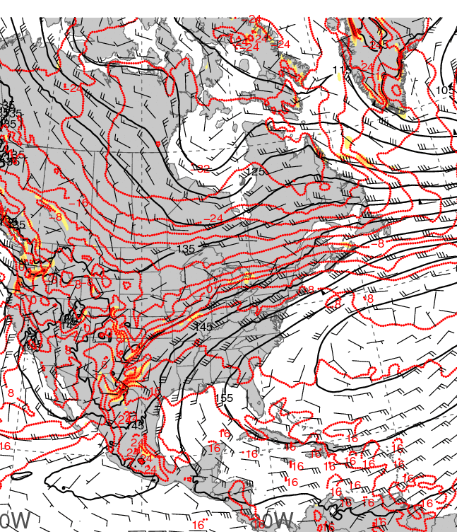
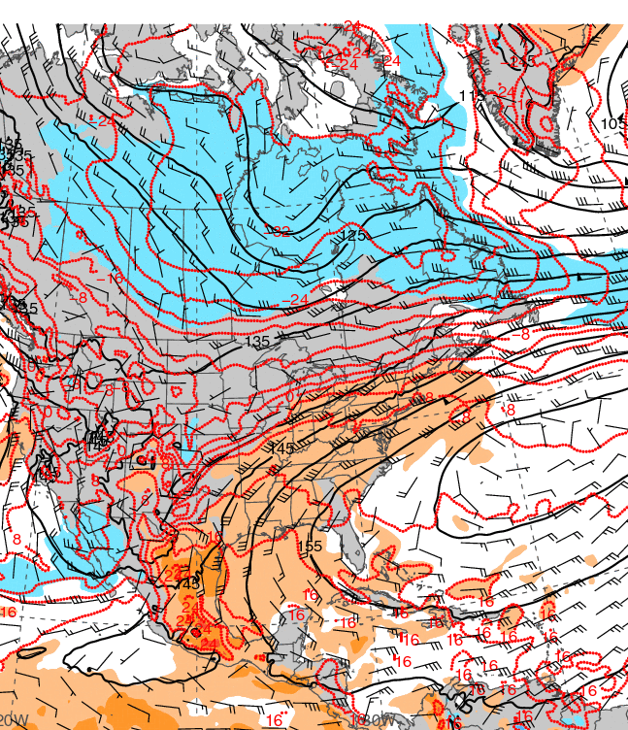
0000 UTC 21 December 2013
850-hPa geopotential height (black contours, dam),
temperature (red contours, °C), wind (barbs, kts),
and frontogenesis (shaded, K [100 km]⁻¹ [3 h]⁻¹)
850-hPa geopotential height (black contours, dam),
temperature (red contours, °C), wind (barbs, kts),
and temperature std. anom. (shaded, σ)

Slide 27
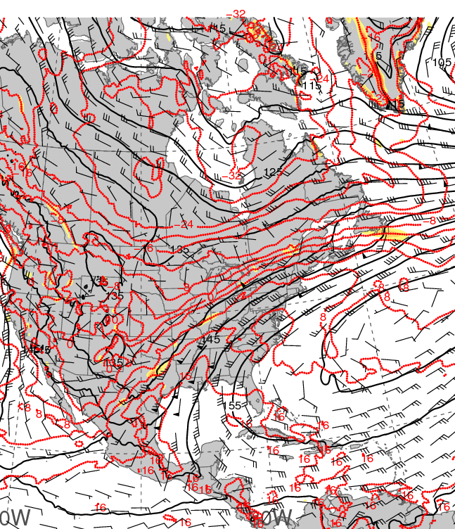
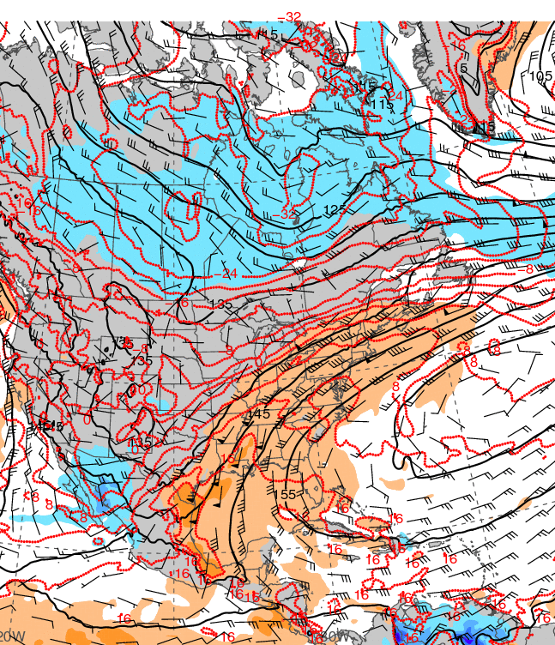
1200 UTC 21 December 2013
850-hPa geopotential height (black contours, dam),
temperature (red contours, °C), wind (barbs, kts),
and frontogenesis (shaded, K [100 km]⁻¹ [3 h]⁻¹)
850-hPa geopotential height (black contours, dam),
temperature (red contours, °C), wind (barbs, kts),
and temperature std. anom. (shaded, σ)

Slide 28
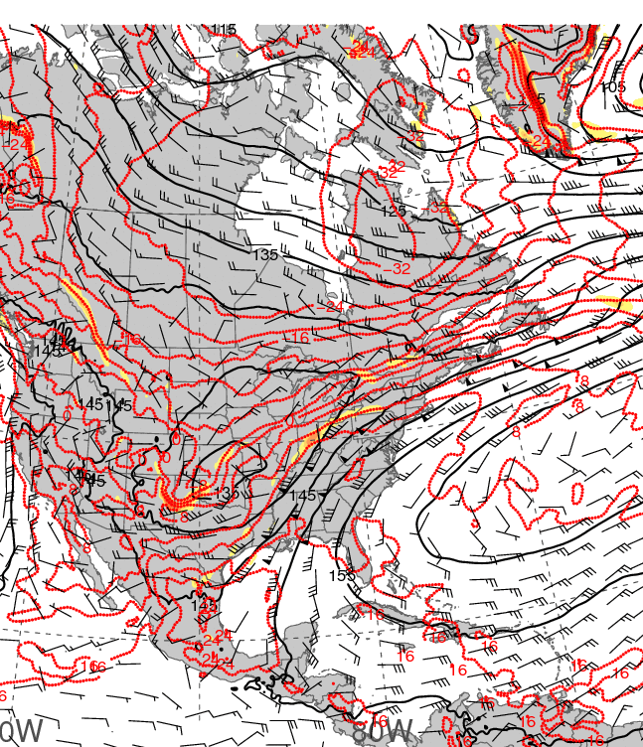
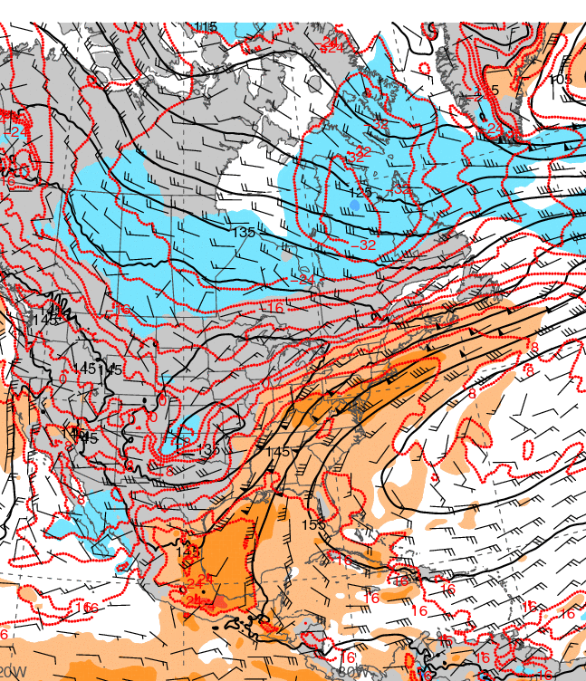
0000 UTC 22 December 2013
850-hPa geopotential height (black contours, dam),
temperature (red contours, °C), wind (barbs, kts),
and frontogenesis (shaded, K [100 km]⁻¹ [3 h]⁻¹)
850-hPa geopotential height (black contours, dam),
temperature (red contours, °C), wind (barbs, kts),
and temperature std. anom. (shaded, σ)

Slide 29
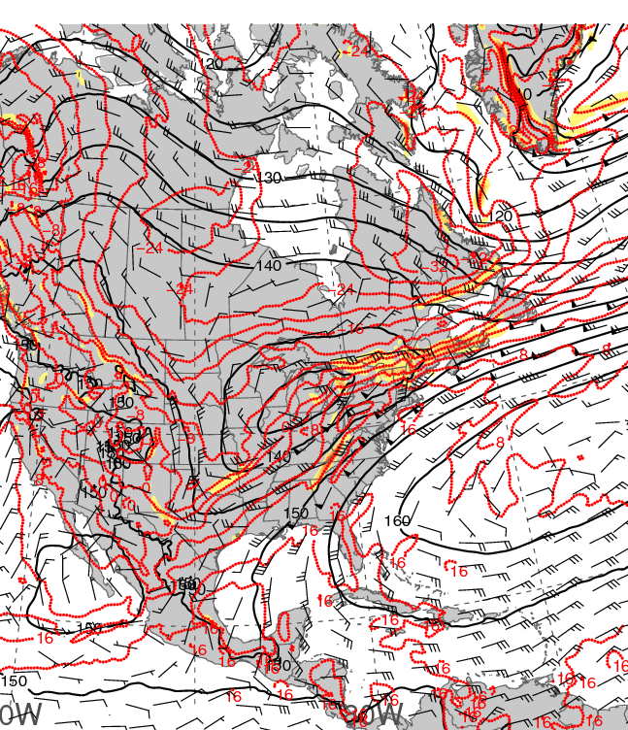
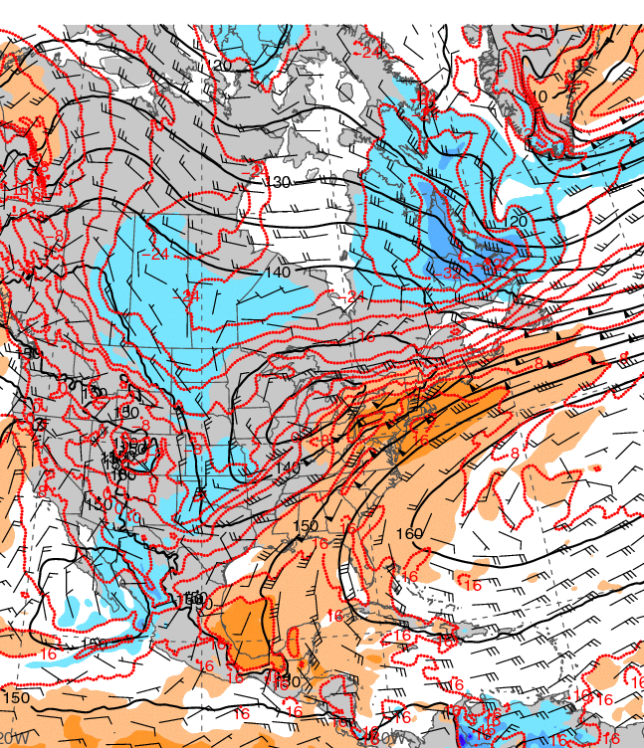
1200 UTC 22 December 2013
850-hPa geopotential height (black contours, dam),
temperature (red contours, °C), wind (barbs, kts),
and frontogenesis (shaded, K [100 km]⁻¹ [3 h]⁻¹)
850-hPa geopotential height (black contours, dam),
temperature (red contours, °C), wind (barbs, kts),
and temperature std. anom. (shaded, σ)

Slide 30
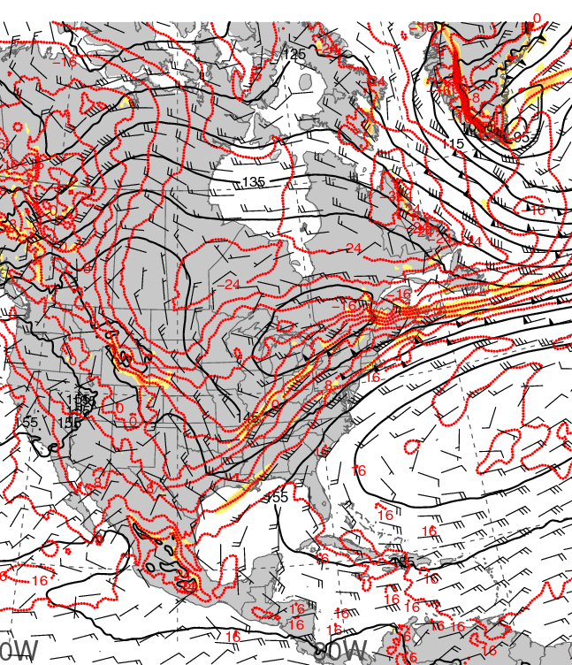
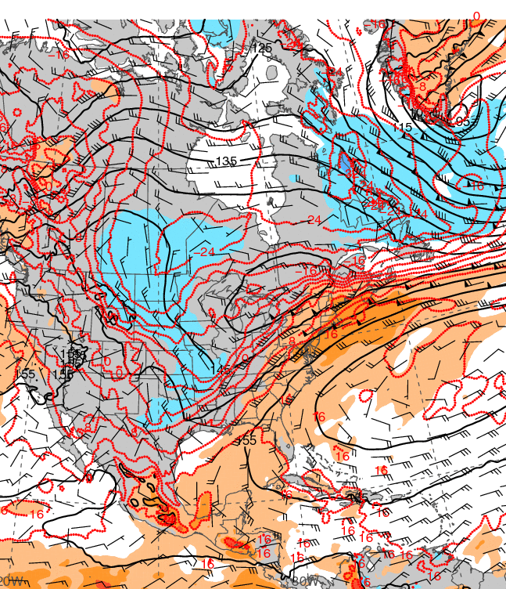
0000 UTC 23 December 2013
850-hPa geopotential height (black contours, dam),
temperature (red contours, °C), wind (barbs, kts),
and frontogenesis (shaded, K [100 km]⁻¹ [3 h]⁻¹)
850-hPa geopotential height (black contours, dam),
temperature (red contours, °C), wind (barbs, kts),
and temperature std. anom. (shaded, σ)

Slide 31
925-hPa temp. and anom.
Notes:
When starting talk, define education–research interface and introduce Alicia and Kyle as current and previous TAs in upper-division thermodynamics and introductory graduate dynamics that I presently teach at UAlbany.

Slide 32
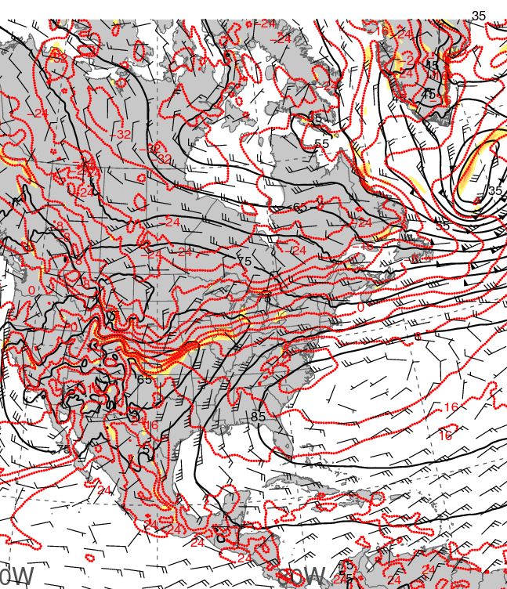

0000 UTC 20 December 2013
925-hPa geopotential height (black contours, dam),
temperature (red contours, °C), wind (barbs, kts),
and frontogenesis (shaded, K [100 km]⁻¹ [3 h]⁻¹)
925-hPa geopotential height (black contours, dam),
temperature (red contours, °C), wind (barbs, kts),
and temperature std. anom. (shaded, σ)

Slide 33


1200 UTC 20 December 2013
925-hPa geopotential height (black contours, dam),
temperature (red contours, °C), wind (barbs, kts),
and frontogenesis (shaded, K [100 km]⁻¹ [3 h]⁻¹)
925-hPa geopotential height (black contours, dam),
temperature (red contours, °C), wind (barbs, kts),
and temperature std. anom. (shaded, σ)

Slide 34


0000 UTC 21 December 2013
925-hPa geopotential height (black contours, dam),
temperature (red contours, °C), wind (barbs, kts),
and frontogenesis (shaded, K [100 km]⁻¹ [3 h]⁻¹)
925-hPa geopotential height (black contours, dam),
temperature (red contours, °C), wind (barbs, kts),
and temperature std. anom. (shaded, σ)

Slide 35


1200 UTC 21 December 2013
925-hPa geopotential height (black contours, dam),
temperature (red contours, °C), wind (barbs, kts),
and frontogenesis (shaded, K [100 km]⁻¹ [3 h]⁻¹)
925-hPa geopotential height (black contours, dam),
temperature (red contours, °C), wind (barbs, kts),
and temperature std. anom. (shaded, σ)

Slide 36


0000 UTC 22 December 2013
925-hPa geopotential height (black contours, dam),
temperature (red contours, °C), wind (barbs, kts),
and frontogenesis (shaded, K [100 km]⁻¹ [3 h]⁻¹)
925-hPa geopotential height (black contours, dam),
temperature (red contours, °C), wind (barbs, kts),
and temperature std. anom. (shaded, σ)

Slide 37


1200 UTC 22 December 2013
925-hPa geopotential height (black contours, dam),
temperature (red contours, °C), wind (barbs, kts),
and frontogenesis (shaded, K [100 km]⁻¹ [3 h]⁻¹)
925-hPa geopotential height (black contours, dam),
temperature (red contours, °C), wind (barbs, kts),
and temperature std. anom. (shaded, σ)

Slide 38


0000 UTC 23 December 2013
925-hPa geopotential height (black contours, dam),
temperature (red contours, °C), wind (barbs, kts),
and frontogenesis (shaded, K [100 km]⁻¹ [3 h]⁻¹)
925-hPa geopotential height (black contours, dam),
temperature (red contours, °C), wind (barbs, kts),
and temperature std. anom. (shaded, σ)

Slide 39
Maplist Images
Notes:
When starting talk, define education–research interface and introduce Alicia and Kyle as current and previous TAs in upper-division thermodynamics and introductory graduate dynamics that I presently teach at UAlbany.

Slide 40

Histogram of 250-hPa maximum wind speed
NCEP–NCAR Reanalysis: 1979–2012
Domain: 40°–60°N and 90°–60°W
4000
3500
3000
2500
2000
1500
1000
500
0
Occurrences (1979–2012)
20 30 40 50 60 70 80 90 100 110
250-hPa Wind Speed (m s⁻¹)
Source: Dr. Jason Cordeira
Notes:
When starting talk, define education–research interface and introduce Alicia and Kyle as current and previous TAs in upper-division thermodynamics and introductory graduate dynamics that I presently teach at UAlbany.

Slide 41

−60 −48 −36 −24 −12 0 12 24 36 48
Source: Dr. Mel Shapiro
Notes:
When starting talk, define education–research interface and introduce Alicia and Kyle as current and previous TAs in upper-division thermodynamics and introductory graduate dynamics that I presently teach at UAlbany.

Slide 42

600
480
360
240
120
0
−120
−240
−360
−480
Source: Dr. Mel Shapiro
Notes:
When starting talk, define education–research interface and introduce Alicia and Kyle as current and previous TAs in upper-division thermodynamics and introductory graduate dynamics that I presently teach at UAlbany.

Slide 43
CYYZ – Toronto, ON
CYYZ – Toronto, ON
120 h backward trajectories ending at:
0000 UTC 22 December 2013
72 h forward trajectories starting at:
0000 UTC 22 December 2013
Source: NOAA HYSPLIT MODEL
Notes:
When starting talk, define education–research interface and introduce Alicia and Kyle as current and previous TAs in upper-division thermodynamics and introductory graduate dynamics that I presently teach at UAlbany.

Slide 44

KDSV
Dansville, NY
KDSV 221154Z AUTO 15007KT 10SM UP BKN095 OVC110 00/00 A2966 RMK AO2 PRESFR SLP057 P0001 60011 70105 T00000000 10011 20000 50020
KDSV 221254Z AUTO 14007KT 10SM -RA OVC095 02/02 A2967 RMK AO2 UPE23RAB23 SLP063 P0000 T00220017
KDSV 221354Z AUTO 16018G26KT 10SM BKN110 14/12 A2961 RMK AO2 PK WND 15026/1353 RAE48 SLP038 P0001 T01390117
KDSV 221454Z AUTO 33014G27KT 290V020 10SM CLR 17/12 A2963 RMK
AO2 PK WND 16037/1439 WSHFT 1429 RAB16E25 PRESRR SLP044 P0000 60001 T01720117 55014 $
KDSV 221504Z AUTO 32028G42KT 10SM -RA SCT005 SCT019 02/01 A2967 RMK AO2 PK WND 33042/1500 RAB1456 PRESRR P0000 $
Notes:
When starting talk, define education–research interface and introduce Alicia and Kyle as current and previous TAs in upper-division thermodynamics and introductory graduate dynamics that I presently teach at UAlbany.

Slide 45

KDDH
Bennington, VT
KDDH 221344Z AUTO 01005KT 2 1/2SM BR
BKN020 06/04 A2973 RMK AO2 $
KDDH 221254Z AUTO 21014G23KT 10SM BKN022 BKN048 BKN100 17/13 A2970 RMK AO2 PK WND 22029/1235 SLP056 P0000 T01720133 $
KDDH 221240Z AUTO 20013G29KT 10SM SCT020 BKN055 OVC100 17/13 A2969 RMK AO2 PK WND 22029/1235 P0000 $
KDDH 221226Z AUTO 21009G22KT 10SM BKN020 BKN060 OVC070 17/13 A2970 RMK AO2 P0000 $
KDDH 221054Z AUTO 00000KT 4SM BR FEW002 OVC018 04/03 A2968 RMK AO2 SLP055 T00390028
Notes:
When starting talk, define education–research interface and introduce Alicia and Kyle as current and previous TAs in upper-division thermodynamics and introductory graduate dynamics that I presently teach at UAlbany.

Slide 46

1200 UTC 22 December 2013
Potential Temperature and Gradient (C; ×10⁻⁵ K m⁻¹)
Notes:
When starting talk, define education–research interface and introduce Alicia and Kyle as current and previous TAs in upper-division thermodynamics and introductory graduate dynamics that I presently teach at UAlbany.

Slide 47

ALB (Albany, NY) Aircraft Soundings
1731 UTC 22 December 2013 1814 UTC 22 December 2013
Source: Jonathan Blaes
Notes:
When starting talk, define education–research interface and introduce Alicia and Kyle as current and previous TAs in upper-division thermodynamics and introductory graduate dynamics that I presently teach at UAlbany.

Slide 48
Additional Soundings
Notes:
When starting talk, define education–research interface and introduce Alicia and Kyle as current and previous TAs in upper-division thermodynamics and introductory graduate dynamics that I presently teach at UAlbany.

Slide 49

0000 UTC 22 December 2013
Detroit, MI Wilmington, OH

Slide 50

0000 UTC 22 December 2013
Pittsburgh, PA Buffalo, NY

Slide 51

1200 UTC 22 December 2013
Albany, NY Upton, NY

Slide 52

0000 UTC 23 December 2013
Gray, ME Chatham, MA

Slide 53
THE END
Notes:
When starting talk, define education–research interface and introduce Alicia and Kyle as current and previous TAs in upper-division thermodynamics and introductory graduate dynamics that I presently teach at UAlbany.

