Slide 1
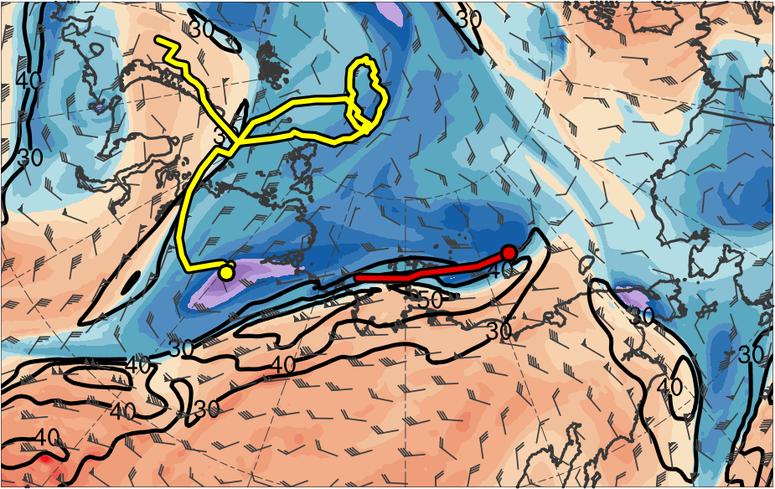
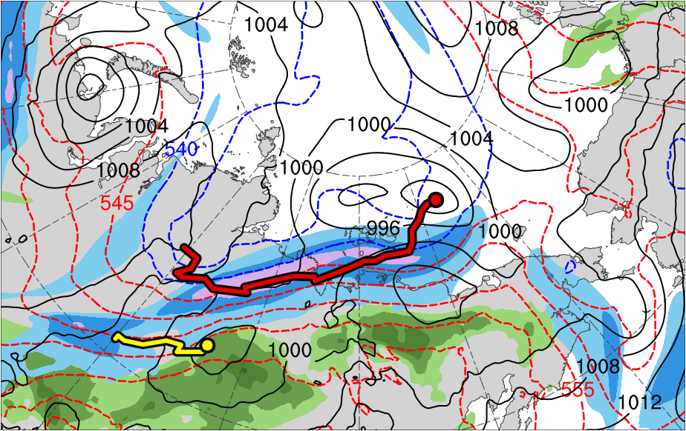
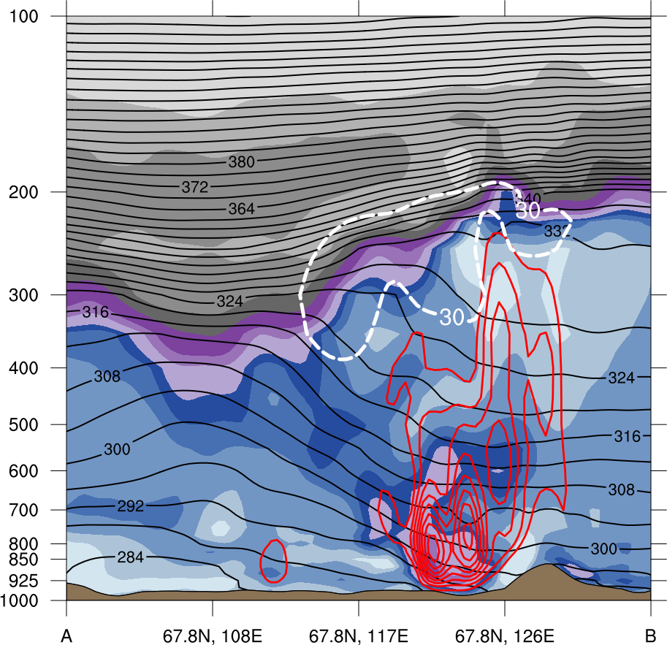
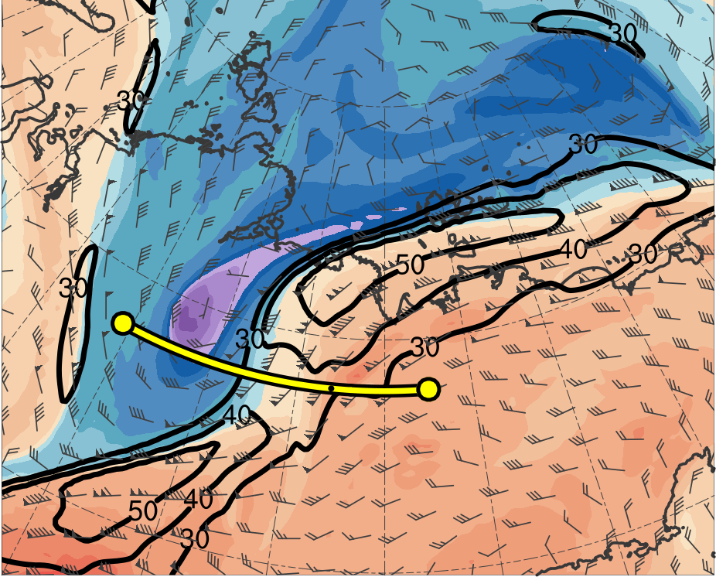
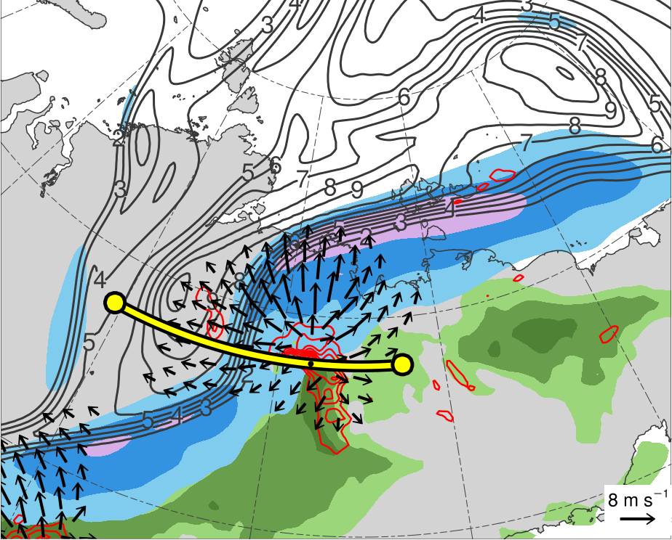
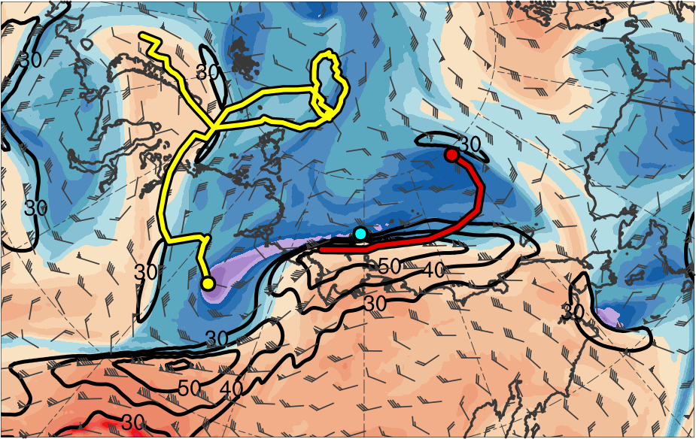
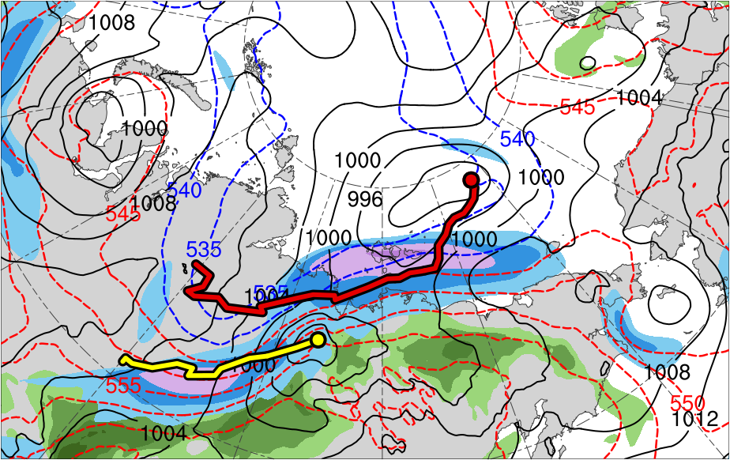
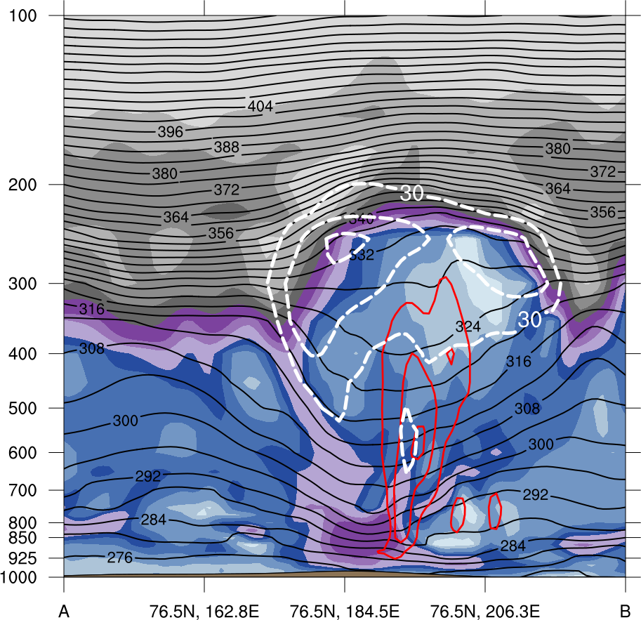
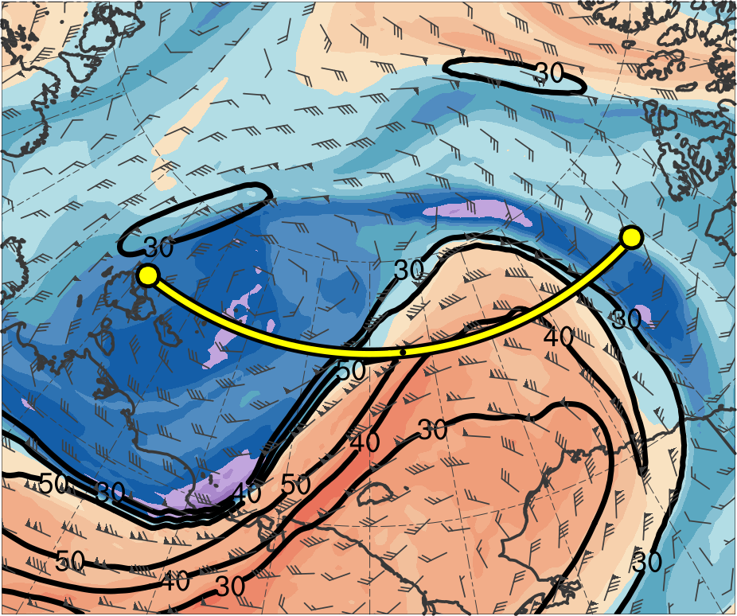
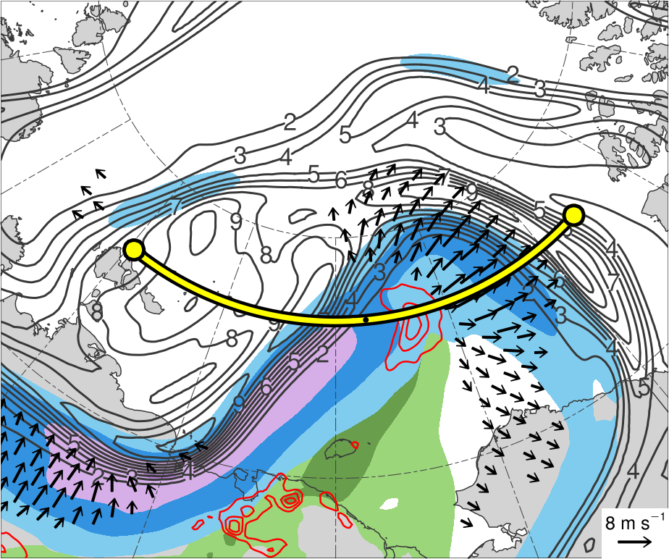
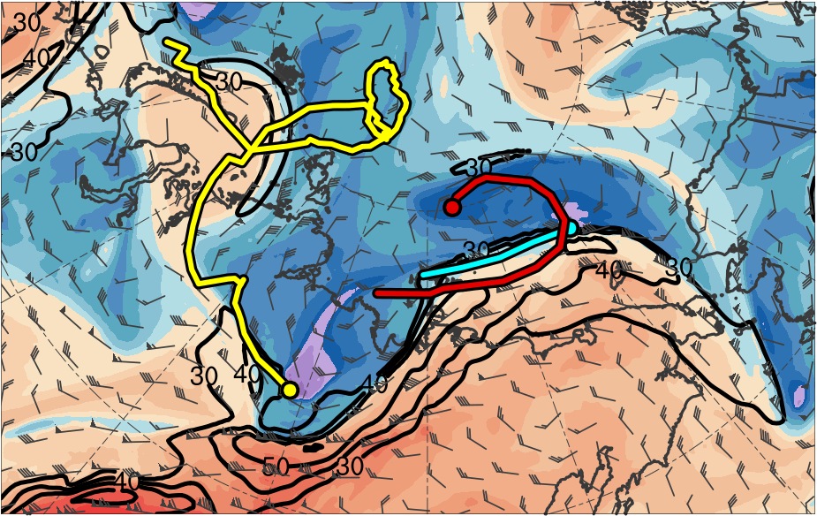
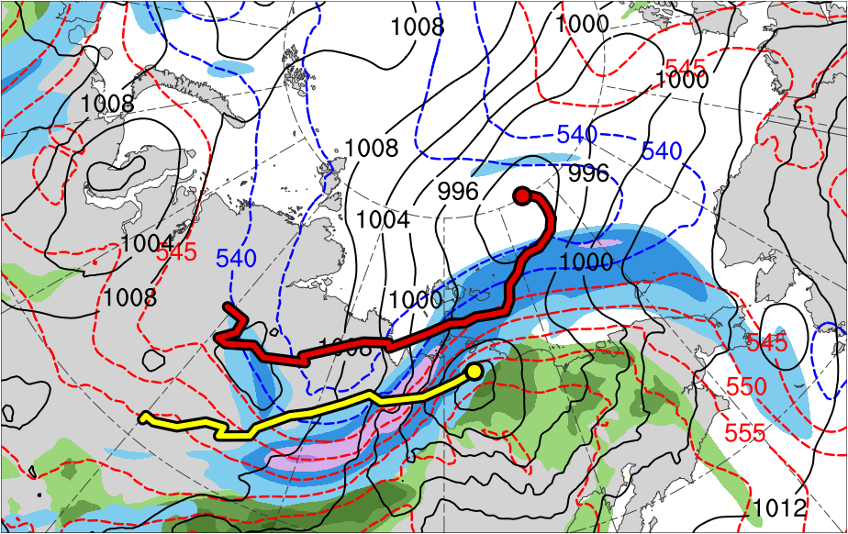
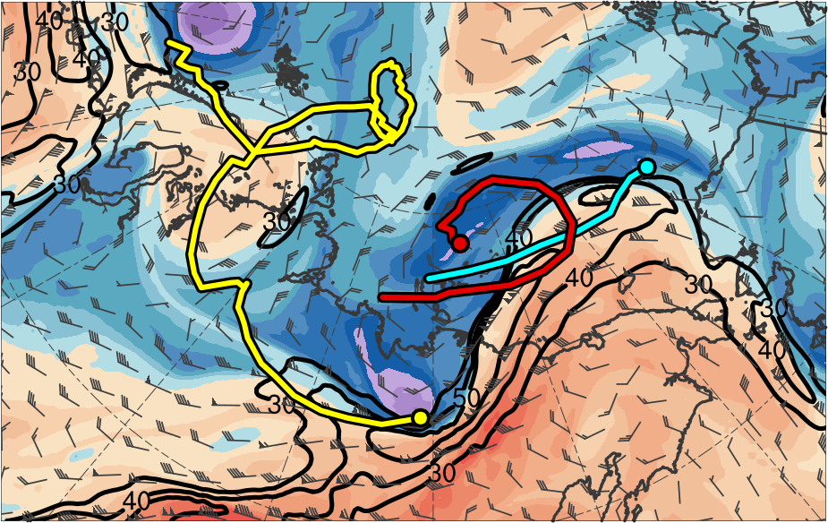
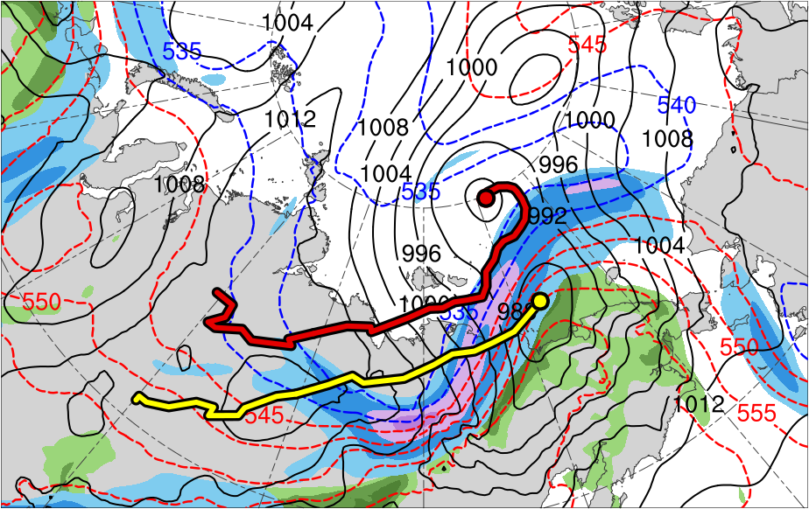
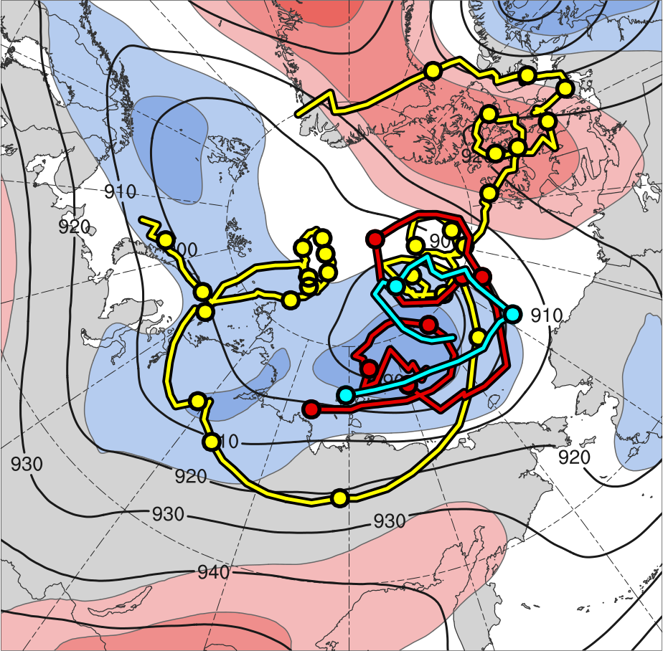
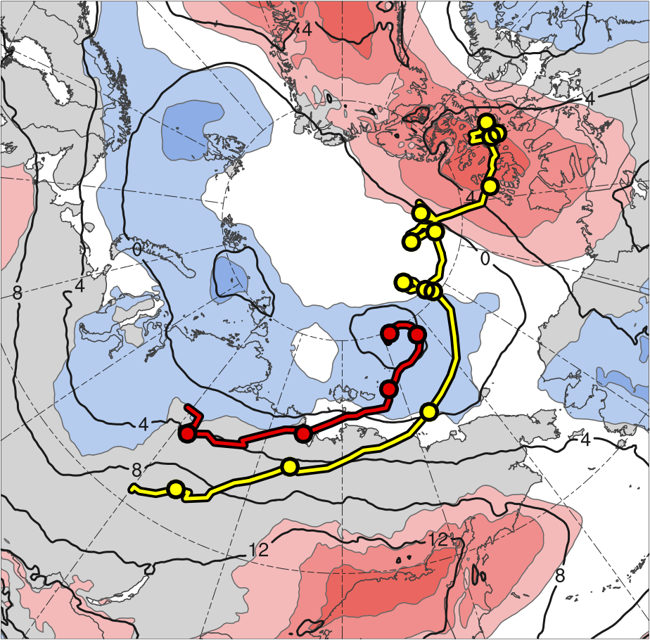
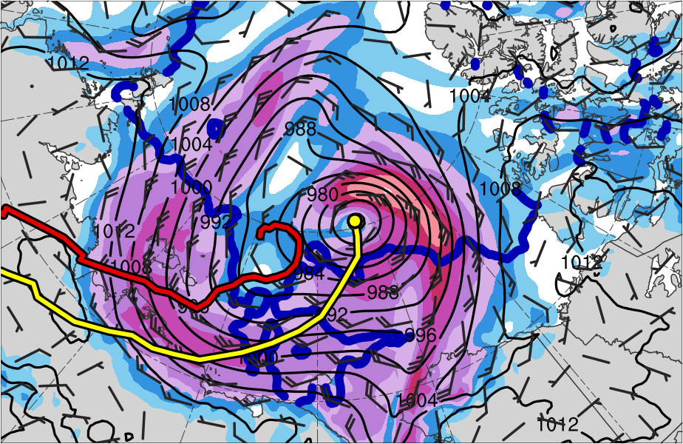
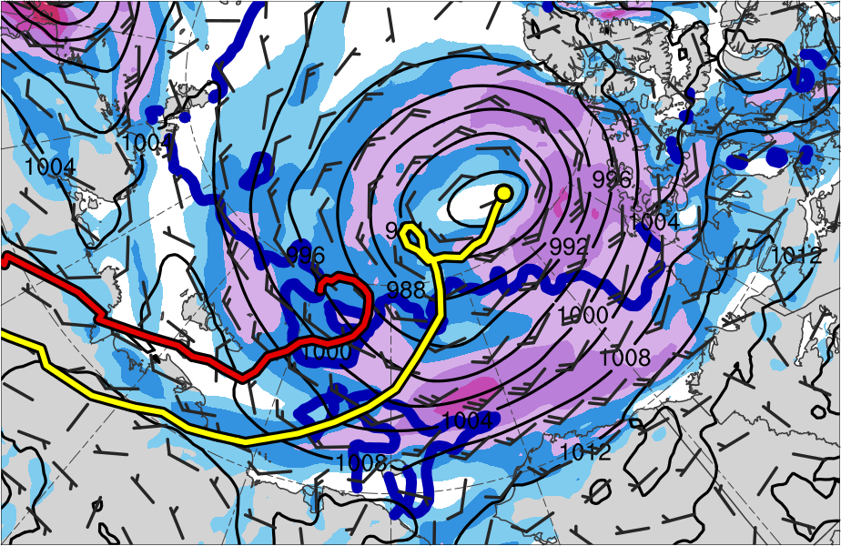
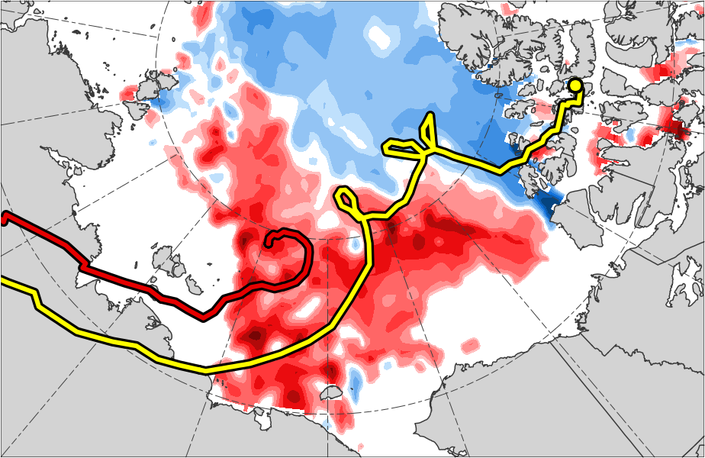
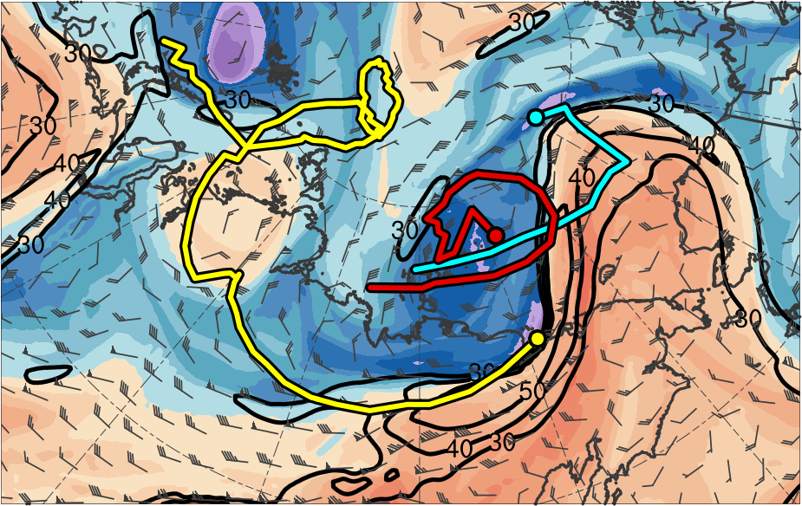
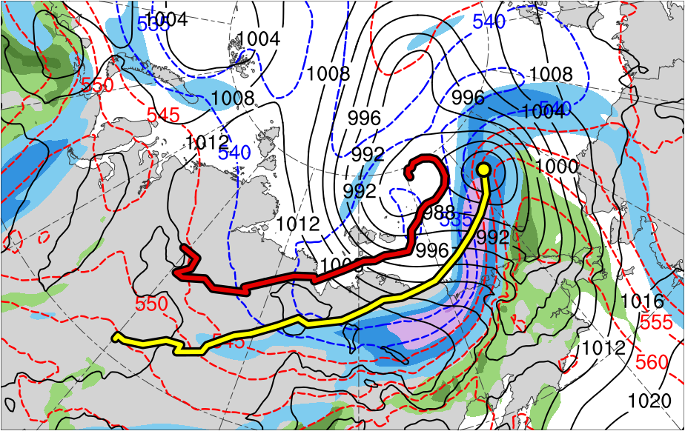
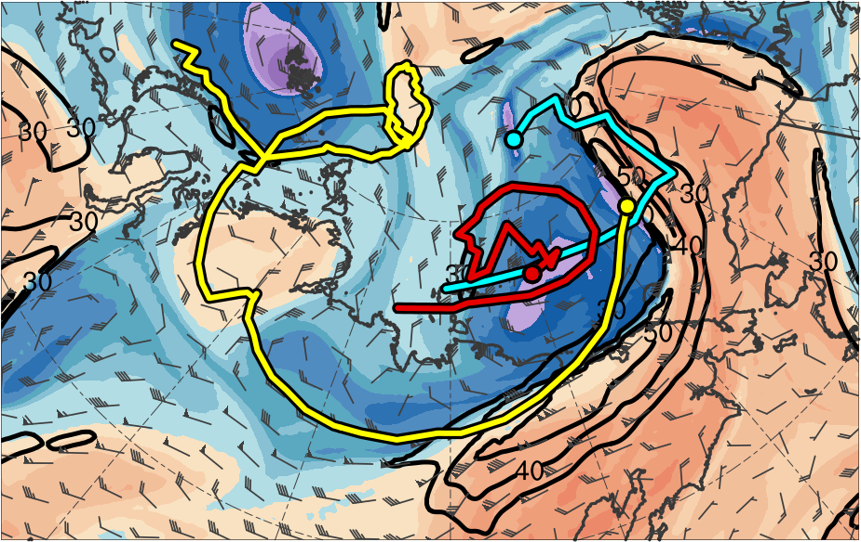
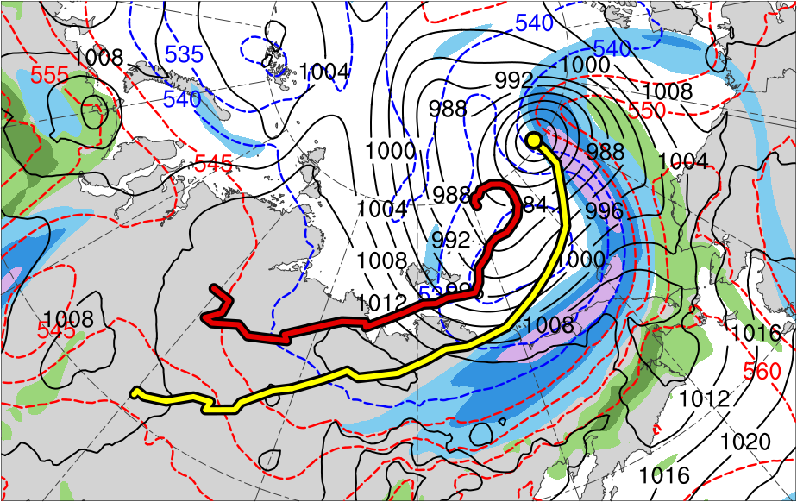
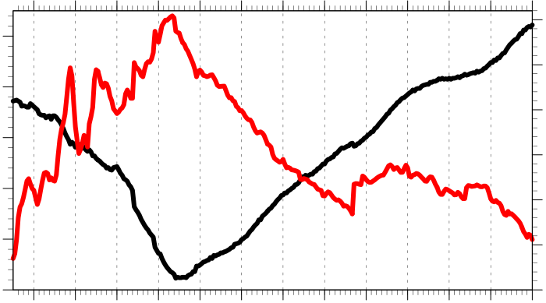
Linkages Between Tropopause Polar Vortices and
the Great Arctic Cyclone of August 2012
A51I-2273
Daniel Keyser¹, Kevin Biernat¹, Lance F. Bosart¹, and Steven M. Cavallo²
¹University at Albany, SUNY
²University of Oklahoma
This research was supported by Office of Naval Research Grant N00014-18-1-2200
.
Tropopause polar vortices (TPVs) are defined as tropopause-based vortices of high-latitude origin and are material features (Cavallo and Hakim 2010)
TPVs may interact with and strengthen jet streams, and act as precursors to the development of Arctic cyclones, including the Great Arctic Cyclone of August 2012 (hereafter AC12; e.g., Simmonds and Rudeva 2012; Tao et al. 2017)
Arctic cyclones may be associated with strong surface winds and poleward advection of warm, moist air, contributing to reductions in Arctic sea-ice extent (e.g., Zhang et al. 2013)
Heavy precipitation, strong surface winds, and large waves due to Arctic cyclones may pose hazards to ships moving through open passageways in the Arctic Ocean
AC12 formed over Siberia on 2 August 2012 and tracked northeastward into the Arctic, reaching a minimum central sea level pressure (SLP) of 966.4 hPa at 1800 UTC 6 August in the CFSR (Simmonds and Rudeva 2012)
Strong surface winds associated with AC12 helped to break up the thin Arctic sea ice (e.g., Parkinson and Comiso 2013), with sea-ice volume decreasing twice as fast as normal during AC12 due to melting of bottom and perimeter ice floes (e.g., Zhang et al. 2013)
This study will examine the linkages between TPVs and the evolution of AC12
4) Synoptic Evolution of TPVs and Cyclones
5) Cross Sections
1) Background
PV
(PVU)
(a) 1200 UTC 3 Aug 2012
(b) 1200 UTC 3 Aug 2012
(a) 2100 UTC 3 Aug 2012
(b) 2100 UTC 3 Aug 2012
(c) 2100 UTC 3 Aug 2012
12
TPV 1
TPV 2
TPV 1
TPV 2
10
8
A
A
6
A’
A’
4
3
2
Jet coupling phase
1.5
TPV 1
AC12
(c) 0000 UTC 4 Aug 2012
(d) 0000 UTC 4 Aug 2012
1
DT (2-PVU) θ (K)
0.5
252
258
264
270
276
282
288
294
300
306
312
318
324
330
336
342
348
354
360
366
372
378
0.25
AC12
300-hPa wind speed (m s⁻¹)
PW (mm)
A
67.8°N, 108°E
67.8°N, 117°E
67.8°N, 126°E
A’
30
40
50
60
70
80
90
100
25
30
35
40
45
50
55
Figure 4. Cross section along AA’ at 2100 UTC 3 Aug 2012. (a) θ (K, black), wind speed (30 m s⁻¹, white), and ascent (red, every 5 × 10⁻³ hPa s⁻¹); (b) DT (2-PVU) wind speed (m s⁻¹, black) and wind (m s⁻¹, flags and barbs); (c) 350–250-hPa layer-averaged PV (PVU, gray) and irrot. wind (m s⁻¹, vectors), and 800–600-hPa layer-averaged ascent (red, every 5 × 10⁻³ hPa s⁻¹).
PV
(PVU)
(a) 1200 UTC 5 Aug 2012
(b) 1200 UTC 5 Aug 2012
TPV 3
(c) 1200 UTC 5 Aug 2012
TPV 3
(e) 1200 UTC 4 Aug 2012
(f) 1200 UTC 4 Aug 2012
12
TPV 2
B’
TPV 2
B’
10
B
B
2) Data and Methods
8
Data: ERA5 at 0.3° horizontal resolution (Hersbach and Dee 2016)
Utilized TPV tracking algorithm to identify and track TPVs of interest for AC12 (Szapiro and Cavallo 2018)
Manually tracked a predecessor surface cyclone (L1) and AC12 by following the locations of minimum SLP
6
4
3
TPV 1
TPV 1
2
TPV 2
1.5
AC12
1
DT (2-PVU) θ (K)
0.5
252
258
264
270
276
282
288
294
300
306
312
318
324
330
336
342
348
354
360
366
372
378
(g) 0000 UTC 5 Aug 2012
(h) 0000 UTC 5 Aug 2012
0.25
B
AC12
B’
300-hPa wind speed (m s⁻¹)
PW (mm)
3) Track and Intensity
76.5°N, 162.8°E
76.5°N, 175.5°W
76.5°N, 153.7°W
30
40
50
60
70
80
90
100
25
30
35
40
45
50
55
(a) TPVs
(b) Surface Cyclones
Figure 5. As in Fig. 4, but for cross section along line BB’ at 1200 UTC 5 Aug 2012.
TPV 1
L1
6) Impacts of Cyclones on Arctic Sea Ice
TPV 2
AC12
(a) 0000 UTC 6 Aug 2012
(b) 0000 UTC 9 Aug 2012
(c) 2–14 Aug 2012
TPV 3
6
5
6
(i) 1200 UTC 5 Aug 2012
(j) 1200 UTC 5 Aug 2012
3
5
4
6
5
4
4
3
Jet crossing phase
10-m wind speed (m s⁻¹)
L1
Change in sea ice concentration (%)
4
3
6
5
4
6
8
10
12
14
16
18
AC12
-60
-50
-40
-30
-20
-10
-5
5
10
20
30
40
50
60
4
Figure 6. (a) SLP (hPa, black), 10-m wind (m s⁻¹, flags and barbs), and 20% contour of sea-ice concentration (thick blue) at (a) 0000 UTC 6 August 2012 and (b) 0000 UTC 9 August 2012; (c) Change in sea-ice concentration during 2–14 August 2012 (%, shaded).
5
3
TPV 1 approaches and interacts with AC12 in region of strong baroclinicity (Figs. 1a,b and Figs. 3a–l), likely supporting the development of AC12 via baroclinic processes and helping allow AC12 to attain a peak intensity of 962.3 hPa on 1000 UTC 6 Aug 2012 (Fig. 2)
TPV–jet interactions involving TPV 1, TPV 2, and TPV 3 likely contribute to the formation of a dual-jet configuration and jet coupling over AC12 (Figs. 3a–d)
Latent heating related to low-level ascent in the presence of warm, moist air in region of jet coupling likely contributes to the formation of the PV tower associated with AC12 (Figs. 4a–c) and concomitant relatively quick intensification of AC12 (Fig. 2)
Cold air advection in the wake of L1 may support strong baroclinicity in the vicinity of AC12 (Figs. 3b,d,f,h), which, along with the interaction between L1 and AC12 (Figs. 3h,j) may further support the intensification of AC12
Most rapid intensification of AC12 occurs on 5 August 2012 (Fig. 2), when AC12 crosses from the warm to the cold side of a strong upper-level jet streak (Figs. 4g–l)
– Latent heating contribution to intensification of AC12 during jet-crossing stages may be smaller
than that during jet–coupling phase (compare Figs. 5a–c to Figs. 4a–c)
Widespread, relatively strong surface winds associated with AC12 contribute to reduction in Arctic sea-ice extent (Figs. 6a–c), consistent with past studies (e.g., Zhang et al. 2013)
300 hPa
850 hPa
(k) 0000 UTC 6 Aug 2012
(l) 0000 UTC 6 Aug 2012
7) Discussion
-2
-1.5
-1
-0.5
0
0.5
1
1.5
2
σ
Genesis
Lysis
Table 1. Lifetimes of TPVs and surface cyclones
Figure 1. (a) TPV and (b) surface cyclone tracks, as well as 1–7 Aug 2012 time-mean (a) 300-hPa geopotential height (dam, gray) and standardized anomaly of 300-hPa geopotential height (σ, shaded), and (b) 850-hPa temperature (°C, gray) and standardized anomaly of 850-hPa temperature (σ, shaded). 0000 UTC positions of TPVs and surface cyclones shown by dots.
Feature | Date of Genesis | Date of Lysis | Lifetime (d)
TPV 1 | 23 Jul | 19 Aug | ~27
TPV 2 | 3 Aug | 9 Aug | 6
TPV 3 | 4 Aug | 6 Aug | ~3
L1 | 31 Jul | 5 Aug | ~5
AC12 | 2 Aug | 15 Aug | ~13
TPV 1
TPV 2
TPV 3
L1
AC12
DT (2-PVU) θ (K)
336
360
252
258
264
270
276
282
288
294
300
306
312
318
324
330
342
348
354
366
372
378
30
Figure 2. Intensity time series of AC12 during 2–15 Aug 2012 (every 3 h)
300-hPa wind speed (m s⁻¹)
90
PW (mm)
1010
30
40
50
60
70
80
100
25
30
35
40
45
50
55
1000
25
Figure 3. (left) DT (2-PVU surface) wind speed (m s⁻¹, black) and wind (m s⁻¹, flags and barbs); (right) 1000–500-hPa thickness (dam, dashed red and blue), and SLP (hPa, black)
20
Minimum SLP (hPa)
Cavallo, S. M., and G. J. Hakim, 2010: Composite structure of tropopause polar cyclones. Mon. Wea. Rev., 138, 3840–3857.
Hersbach, H., and D. Dee, 2016: ERA5 reanalysis is in production. ECMWF Newsletter, No. 147 ECMWF, Reading, United Kingdom, 7
[Available online at www.ecmwf.int/sites/ default/files/elibrary/2016/16299-newsletter-no147-spring-2016.pdf.]
Parkinson, C. L., and J. C. Comiso, 2013: On the 2012 record low Arctic sea ice cover: Combined impact of preconditioning and an August
storm. Geophys. Res. Lett., 40, 1356–1361.
Simmonds, I., and I. Rudeva, 2012: The great Arctic cyclone of August 2012. Geophys. Res. Lett., 39, L23709.
Szapiro, N., and S. Cavallo, 2018: TPVTrack v1.0: A watershed segmentation and overlap correspondence method for tracking tropopause
polar vortices. Geosci. Model Dev. Discuss., in review.
Tao, W., J. Zhang, Y. Fu, and X. Zhang, 2017b: Driving roles of tropospheric and stratospheric thermal anomalies in intensification and
persistence of the Arctic superstorm in 2012. Geophys. Res. Lett., 44, 10017–10025.
Zhang, J., R. Lindsay, A. Schweiger, and M. Steele, 2013: The impact of an intense summer cyclone on 2012 Arctic sea ice retreat.
Geophys. Res. Lett., 40, 720–726.
990
925-hPa relative vorticity (10⁻⁵ s⁻¹)
Maximum 925-hPa relative vorticity (averaged within 100-km of gridpoint)
References
SLP (hPa)
15
980
10
970
5
Jet coupling phase
960
3
4
5
6
7
8
9
10
11
12
13
14
15
0
Jet crossing phase

