Slide 1
Lower-Latitude Linkages to Two Intense Arctic Cyclones in Early June 2018
Lance F. Bosart¹, Kevin A. Biernat¹, Daniel Keyser¹, and Steven M. Cavallo²
¹Department of Atmospheric and Environmental Sciences
University at Albany, State University of New York
²University of Oklahoma
American Meteorological Society
32nd Conference on Climate Variability and Change
Tuesday 8 January 2019
Phoenix, Arizona
Research Supported by ONR Grant N00014-18-1-2200

Slide 2
Motivation
Rare occurrence of two sequential intense Arctic cyclones, AC1 and AC2, in early June 2018
AC1 formed over southern Europe in response to a deepening trough in northwesterly flow
AC2 formed east of Greenland and may have had antecedent vorticity “DNA” from TS Alberto
AC1 and AC2 underwent a cyclonic rotation over the Arctic Ocean during which AC2 absorbed AC1

Slide 3
Data and Methods
Gridded ERA-5 datasets (0.25°) were downloaded to depict all analysis fields
Gridded ERA-I datasets were used to compute mean and standardized anomalies
TS Alberto and surface cyclones were tracked from NHC positions and ERA5 datasets, respectively
Objective TPV tracking algorithm (Szapiro and Cavallo 2018) was used to identify and track TPVs
NOAA HYSPLIT Trajectory Model was used to compute backward trajectories

Slide 4
Big Picture
Depict AC1 and AC2 tracks and intensities
Establish relevant TPV tracks
Show mean/anomaly 300-hPa geopotential heights

Slide 5
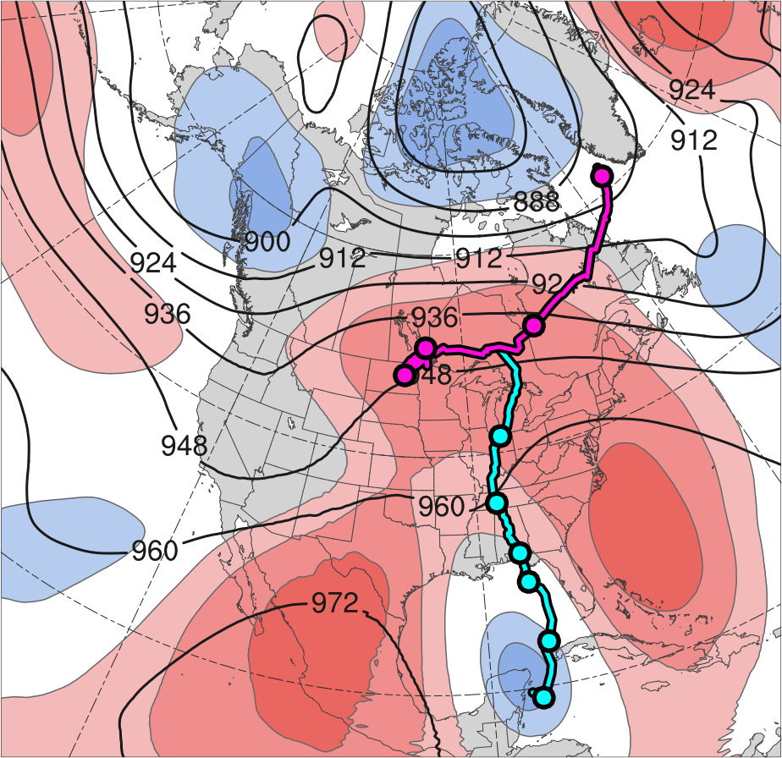
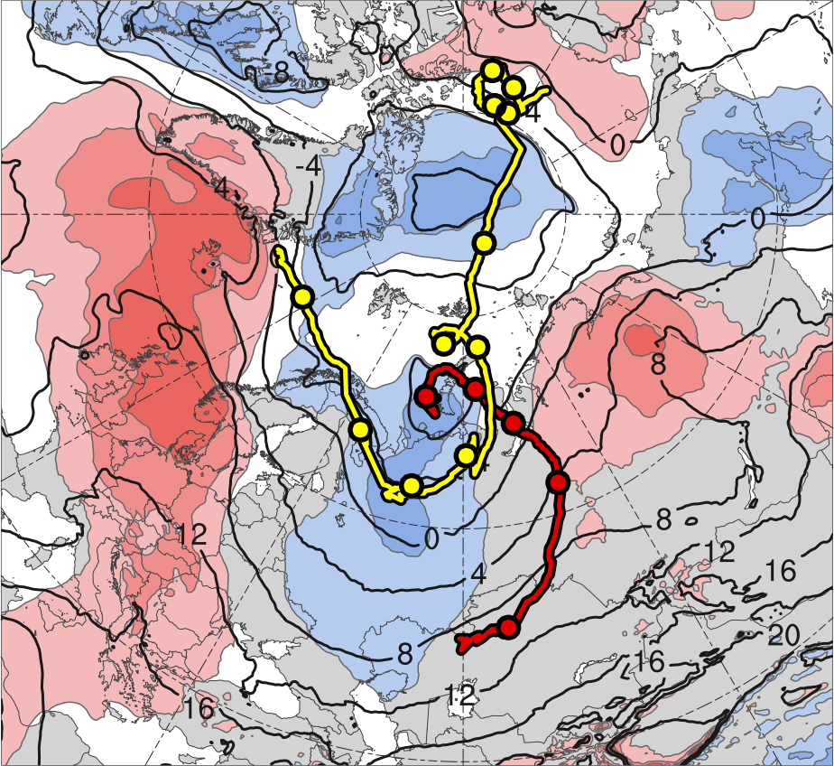
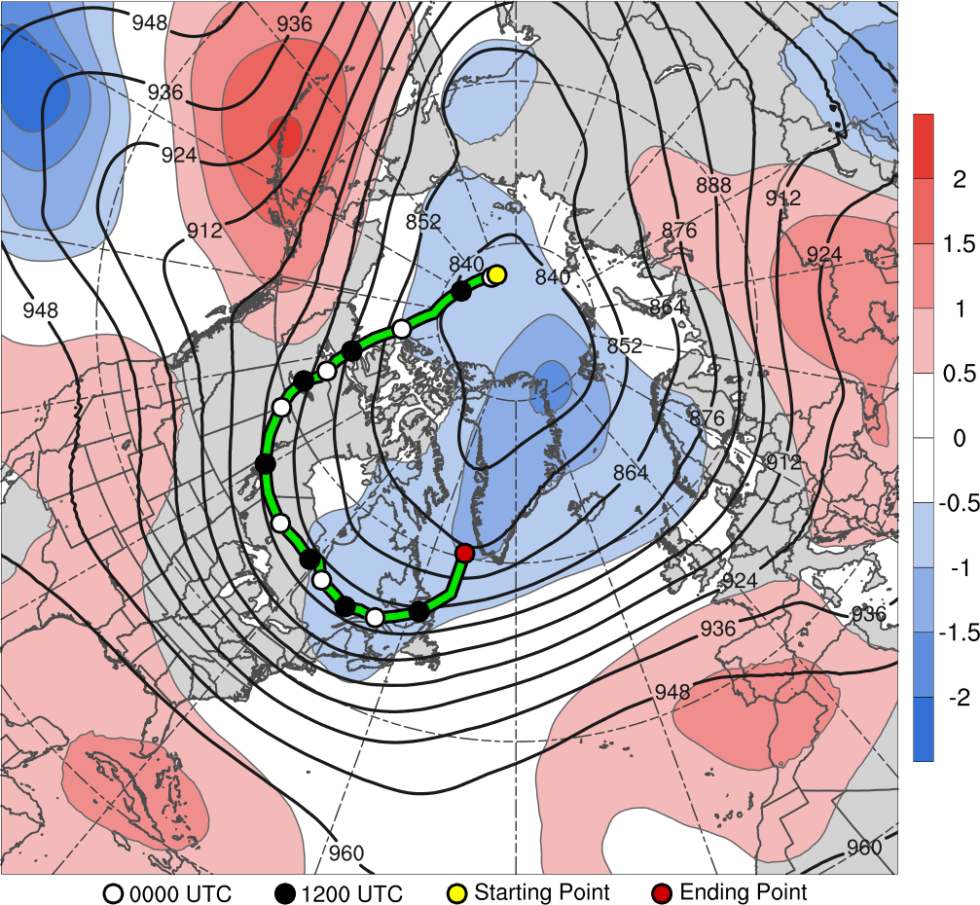
Track and Intensity of Cyclones
(a)
(b)
10
11
13
2
12
9
8
31
3
6
7
30
1
5
4
31
4
3
30
6
29
5
28
27
2
Alberto
26
AC1
CL
AC2
Genesis
Merger
-2
-1.5
-1
-0.5
0
0.5
1
1.5
2
σ
Lysis
0000 UTC positions
(a) 26 May–1 June 2018 time-mean 300-hPa geopotential height (dam, black) and standardized geopotential height anomalies (σ, shaded); (b) 1–7 June 2018 time-mean 850-hPa temperature (°C, black) and standardized temperature anomalies (σ, shaded).
Cyclone | Genesis | Lysis | Lifetime
AC1 | 1 June | 6 June | ~5 d
AC2 | 2 June | 13 June | ~11 d

Slide 6
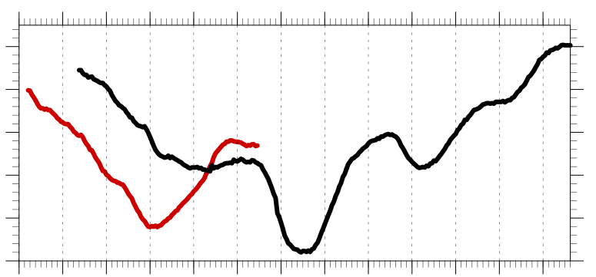
Track and Intensity of Cyclones
Hourly minimum SLP time series of AC1 and AC2
1010
1000
990
SLP (hPa)
980
970
960
1
2
3
4
5
6
7
8
9
10
11
12
13
Day in June 2018 labeled at 0000 UTC
AC1
AC2
Peak intensity of AC1 at 0400 UTC 4 June 2018 (967.9 hPa)
Peak intensity of AC2 at 1100 UTC 7 June 2018 (962.0 hPa)

Slide 7
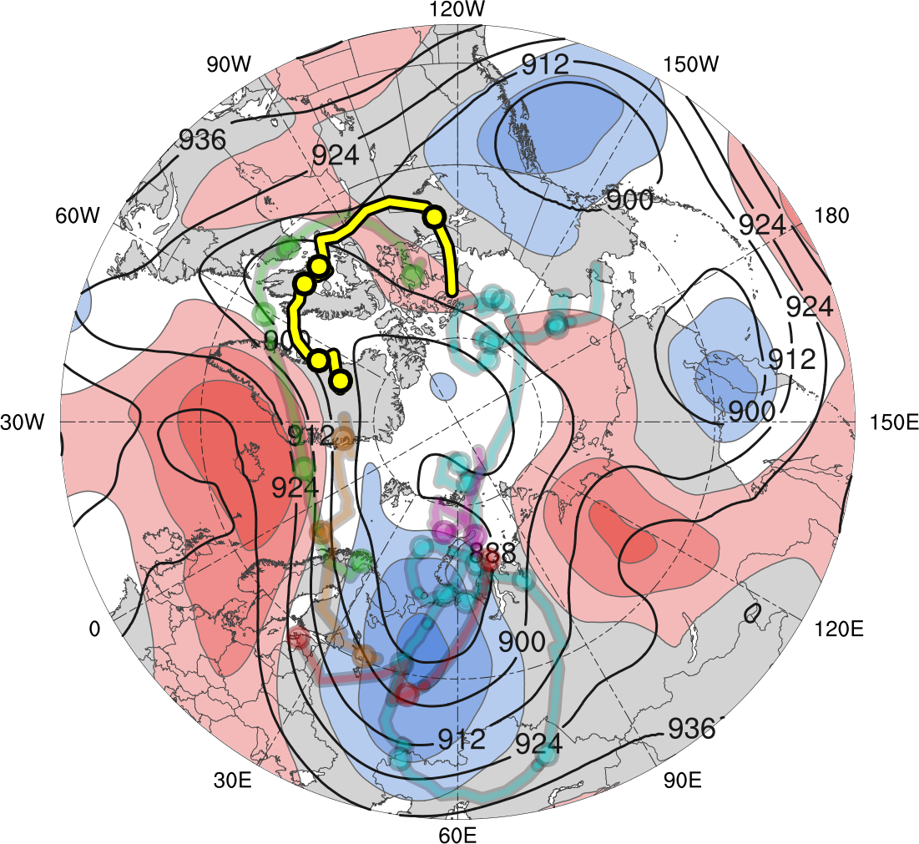
Tracks of TPVs
TPV | Genesis | Lysis | Lifetime
TPV 1a | 29 May | 3 June | ~5.4 d
TPV 1b | 2 June | 5 June | 2.5 d
TPV 1c | 5 June | 7 June | ~2.4 d
TPV 1d | 6 June | 8 June | 2 d
TPV 2 | 30 May | 15 June | 17 d
TPV 3 | 30 May | 4 June | ~4.4 d
31
30
1
2
3
TPV 1a
TPV 1d
TPV 1b
TPV 2
TPV 1c
TPV 3
Genesis
Lysis
0000 UTC positions
1–7 June 2018 time-mean 300-hPa geopotential height (dam, black) and standardized geopotential height anomalies (σ, shaded)
-2
-1.5
-1
-0.5
0
0.5
1
1.5
2
σ

Slide 8
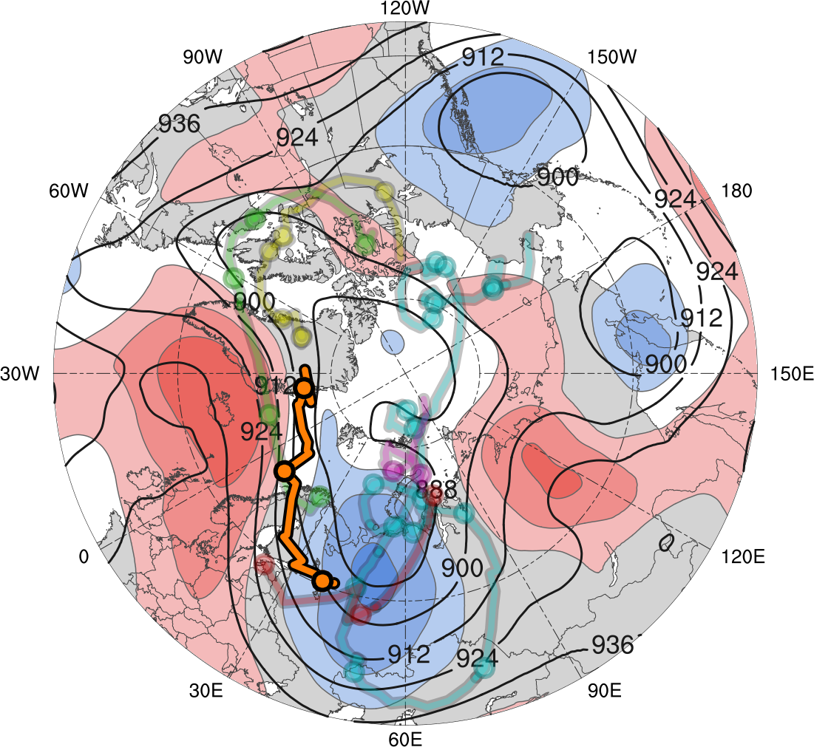
Tracks of TPVs
TPV | Genesis | Lysis | Lifetime
TPV 1a | 29 May | 3 June | ~5.4 d
TPV 1b | 2 June | 5 June | 2.5 d
TPV 1c | 5 June | 7 June | ~2.4 d
TPV 1d | 6 June | 8 June | 2 d
TPV 2 | 30 May | 15 June | 17 d
TPV 3 | 30 May | 4 June | ~4.4 d
3
TPV 1a
TPV 1d
TPV 1b
TPV 2
4
TPV 1c
TPV 3
Genesis
Lysis
5
0000 UTC positions
1–7 June 2018 time-mean 300-hPa geopotential height (dam, black) and standardized geopotential height anomalies (σ, shaded)
-2
-1.5
-1
-0.5
0
0.5
1
1.5
2
σ

Slide 9

Tracks of TPVs
TPV | Genesis | Lysis | Lifetime
TPV 1a | 29 May | 3 June | ~5.4 d
TPV 1b | 2 June | 5 June | 2.5 d
TPV 1c | 5 June | 7 June | ~2.4 d
TPV 1d | 6 June | 8 June | 2 d
TPV 2 | 30 May | 15 June | 17 d
TPV 3 | 30 May | 4 June | ~4.4 d
TPV 1a
TPV 1d
TPV 1b
TPV 2
7
TPV 1c
TPV 3
Genesis
Lysis
5
6
0000 UTC positions
1–7 June 2018 time-mean 300-hPa geopotential height (dam, black) and standardized geopotential height anomalies (σ, shaded)
-2
-1.5
-1
-0.5
0
0.5
1
1.5
2
σ

Slide 10
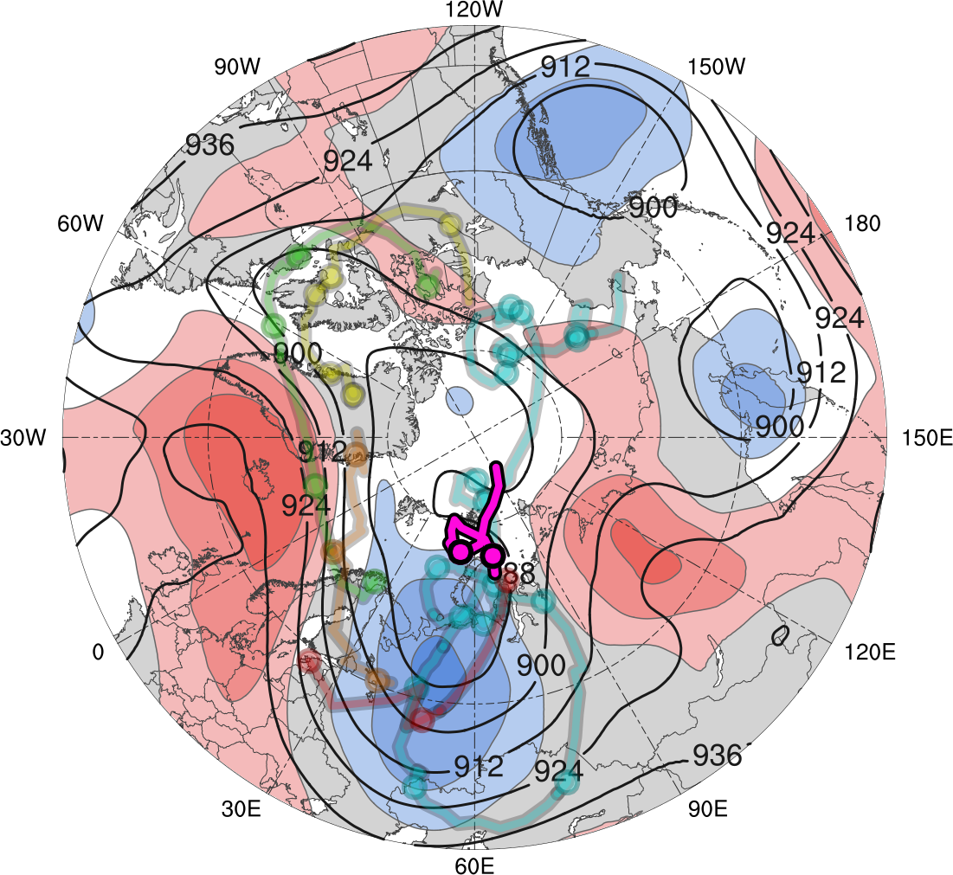
Tracks of TPVs
TPV | Genesis | Lysis | Lifetime
TPV 1a | 29 May | 3 June | ~5.4 d
TPV 1b | 2 June | 5 June | 2.5 d
TPV 1c | 5 June | 7 June | ~2.4 d
TPV 1d | 6 June | 8 June | 2 d
TPV 2 | 30 May | 15 June | 17 d
TPV 3 | 30 May | 4 June | ~4.4 d
TPV 1a
TPV 1d
8
7
TPV 1b
TPV 2
TPV 1c
TPV 3
Genesis
Lysis
0000 UTC positions
1–7 June 2018 time-mean 300-hPa geopotential height (dam, black) and standardized geopotential height anomalies (σ, shaded)
-2
-1.5
-1
-0.5
0
0.5
1
1.5
2
σ

Slide 11
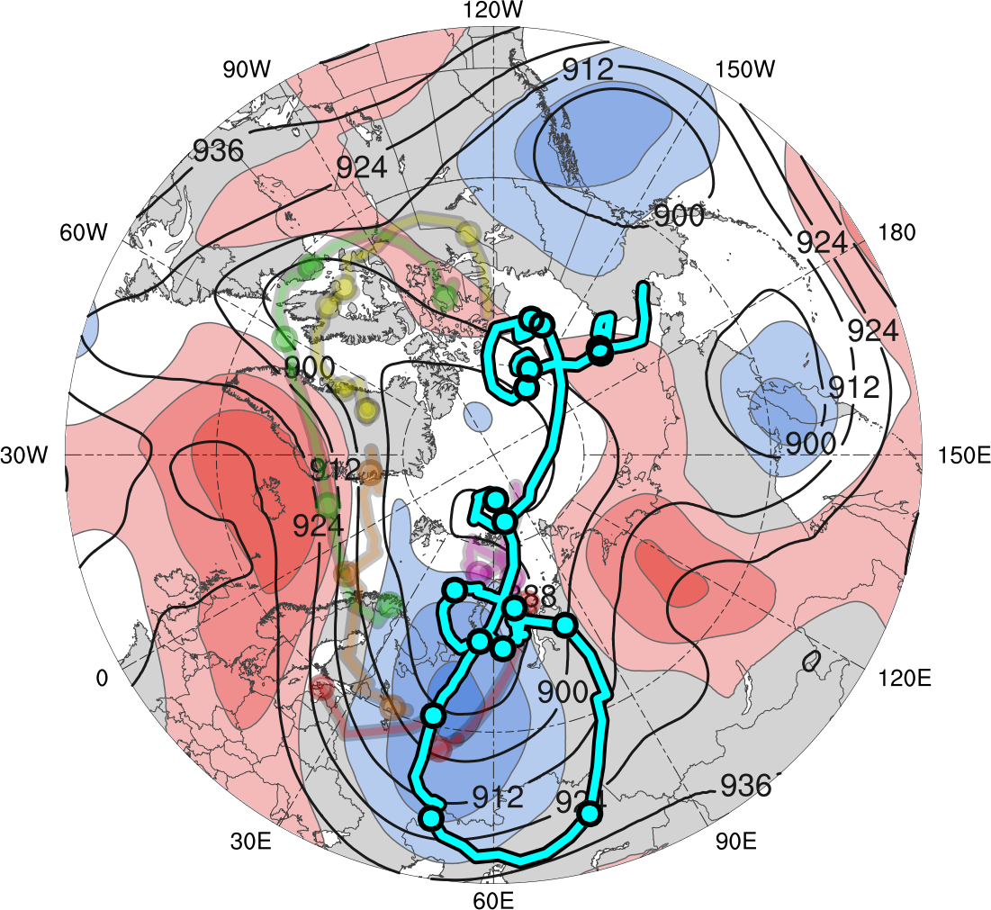
Tracks of TPVs
TPV | Genesis | Lysis | Lifetime
TPV 1a | 29 May | 3 June | ~5.4 d
TPV 1b | 2 June | 5 June | 2.5 d
TPV 1c | 5 June | 7 June | ~2.4 d
TPV 1d | 6 June | 8 June | 2 d
TPV 2 | 30 May | 15 June | 17 d
TPV 3 | 30 May | 4 June | ~4.4 d
11
10
14
15
13
8
12
9
TPV 1a
TPV 1d
TPV 1b
TPV 2
6
TPV 1c
TPV 3
4
7
5
Genesis
Lysis
1
31
0000 UTC positions
3
2
1–7 June 2018 time-mean 300-hPa geopotential height (dam, black) and standardized geopotential height anomalies (σ, shaded)
-2
-1.5
-1
-0.5
0
0.5
1
1.5
2
σ

Slide 12
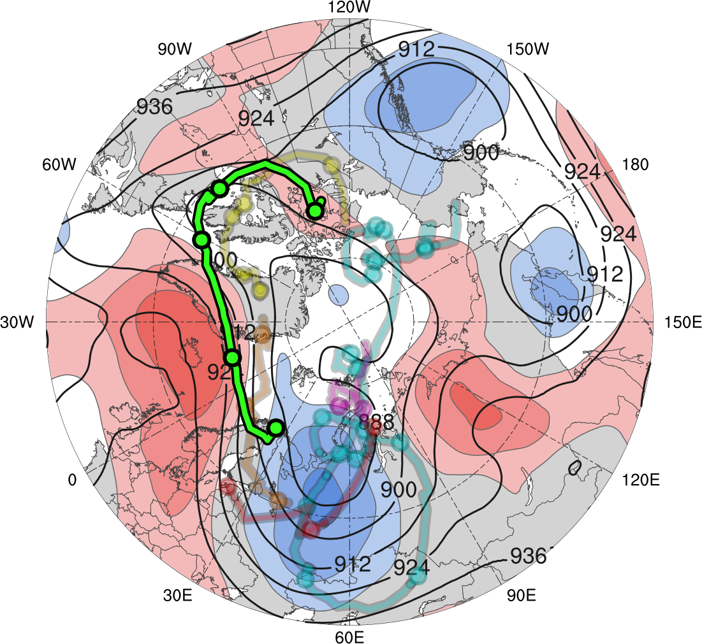
Tracks of TPVs
TPV | Genesis | Lysis | Lifetime
TPV 1a | 29 May | 3 June | ~5.4 d
TPV 1b | 2 June | 5 June | 2.5 d
TPV 1c | 5 June | 7 June | ~2.4 d
TPV 1d | 6 June | 8 June | 2 d
TPV 2 | 30 May | 15 June | 17 d
TPV 3 | 30 May | 4 June | ~4.4 d
1
2
31
TPV 1a
TPV 1d
3
TPV 1b
TPV 2
TPV 1c
TPV 3
4
Genesis
Lysis
0000 UTC positions
1–7 June 2018 time-mean 300-hPa geopotential height (dam, black) and standardized geopotential height anomalies (σ, shaded)
-2
-1.5
-1
-0.5
0
0.5
1
1.5
2
σ

Slide 13
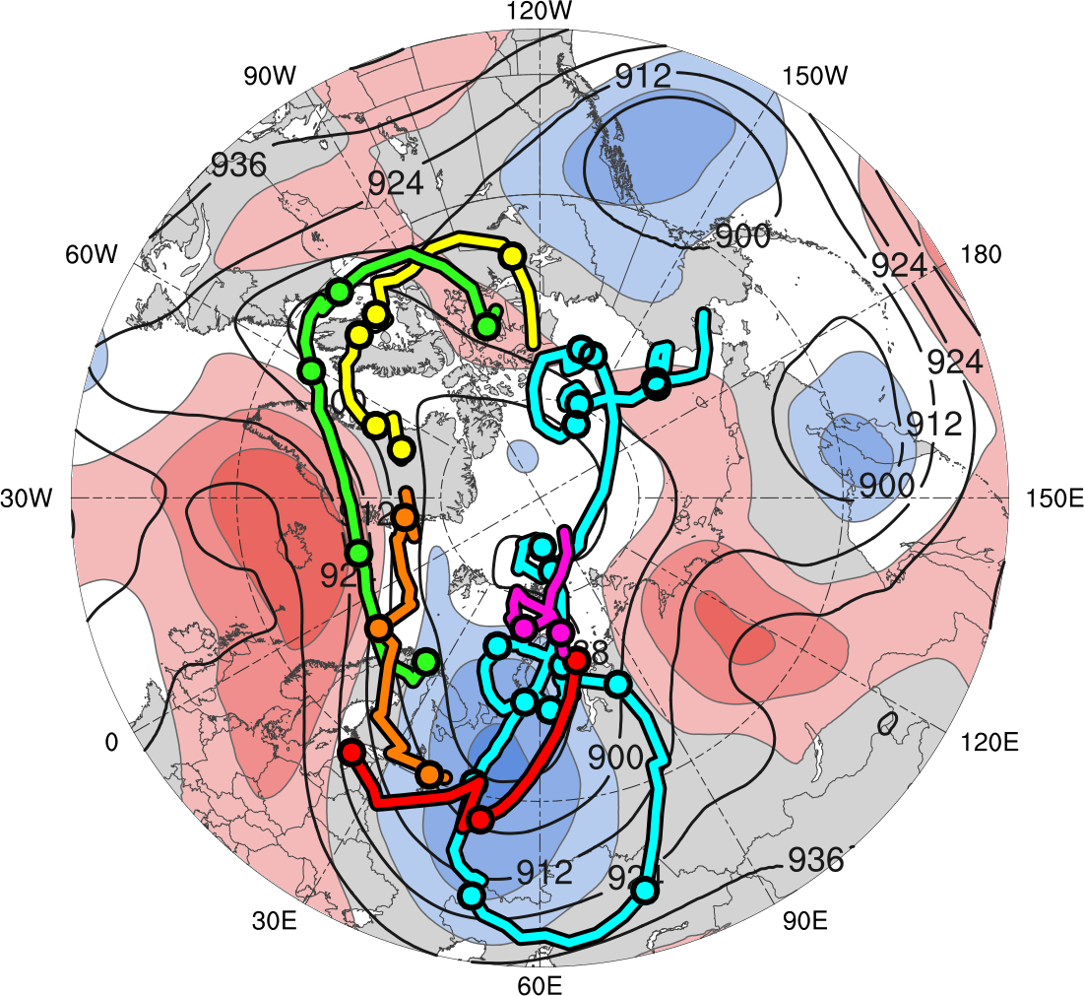
Tracks of TPVs
TPV | Genesis | Lysis | Lifetime
TPV 1a | 29 May | 3 June | ~5.4 d
TPV 1b | 2 June | 5 June | 2.5 d
TPV 1c | 5 June | 7 June | ~2.4 d
TPV 1d | 6 June | 8 June | 2 d
TPV 2 | 30 May | 15 June | 17 d
TPV 3 | 30 May | 4 June | ~4.4 d
TPV 1a
TPV 1d
TPV 1b
TPV 2
TPV 1c
TPV 3
Genesis
Lysis
0000 UTC positions
1–7 June 2018 time-mean 300-hPa geopotential height (dam, black) and standardized geopotential height anomalies (σ, shaded)
-2
-1.5
-1
-0.5
0
0.5
1
1.5
2
σ

Slide 14
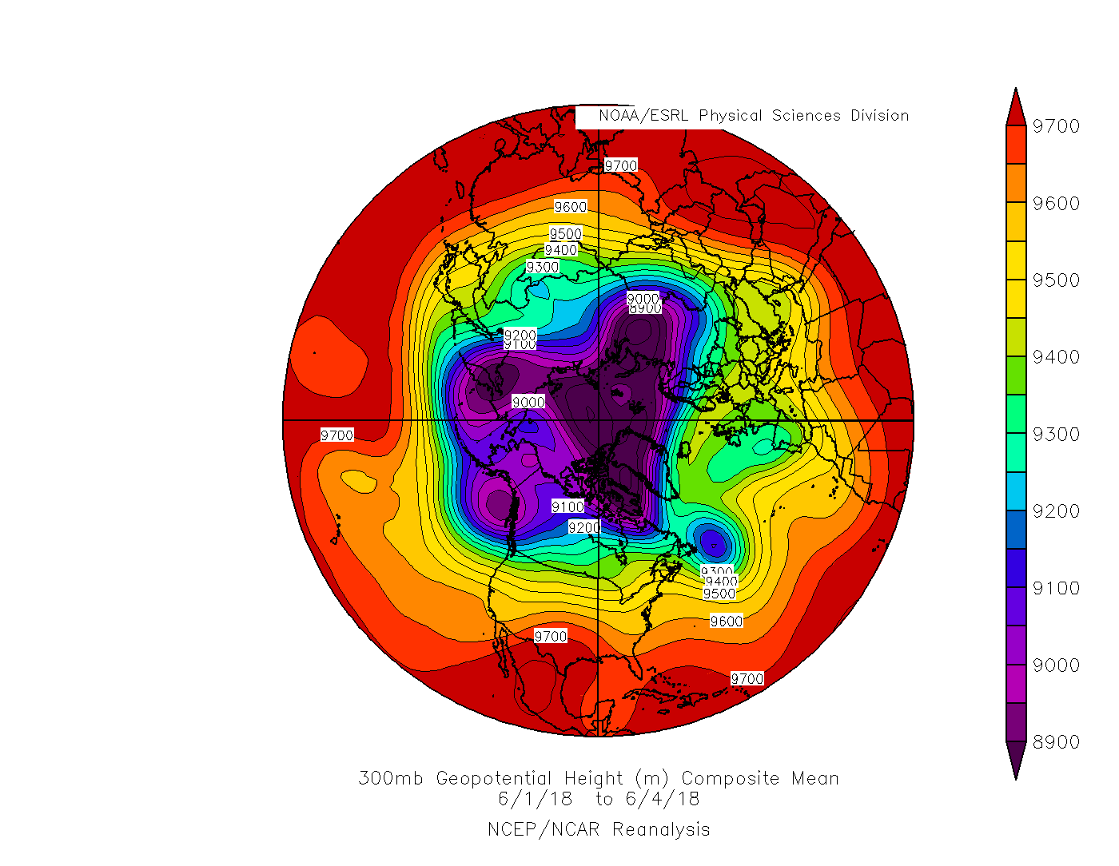
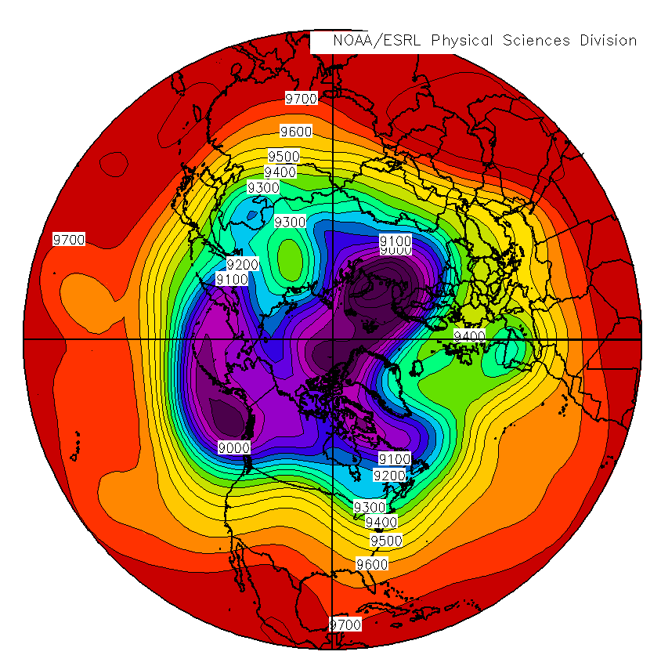
Mean 300-hPa Geopotential Heights (m) for 1–4 June 2018 (left) and 4–7 June 2018 (right)
8900
9000
9100
9200
9300
9400
9500
9600
9700

Slide 15
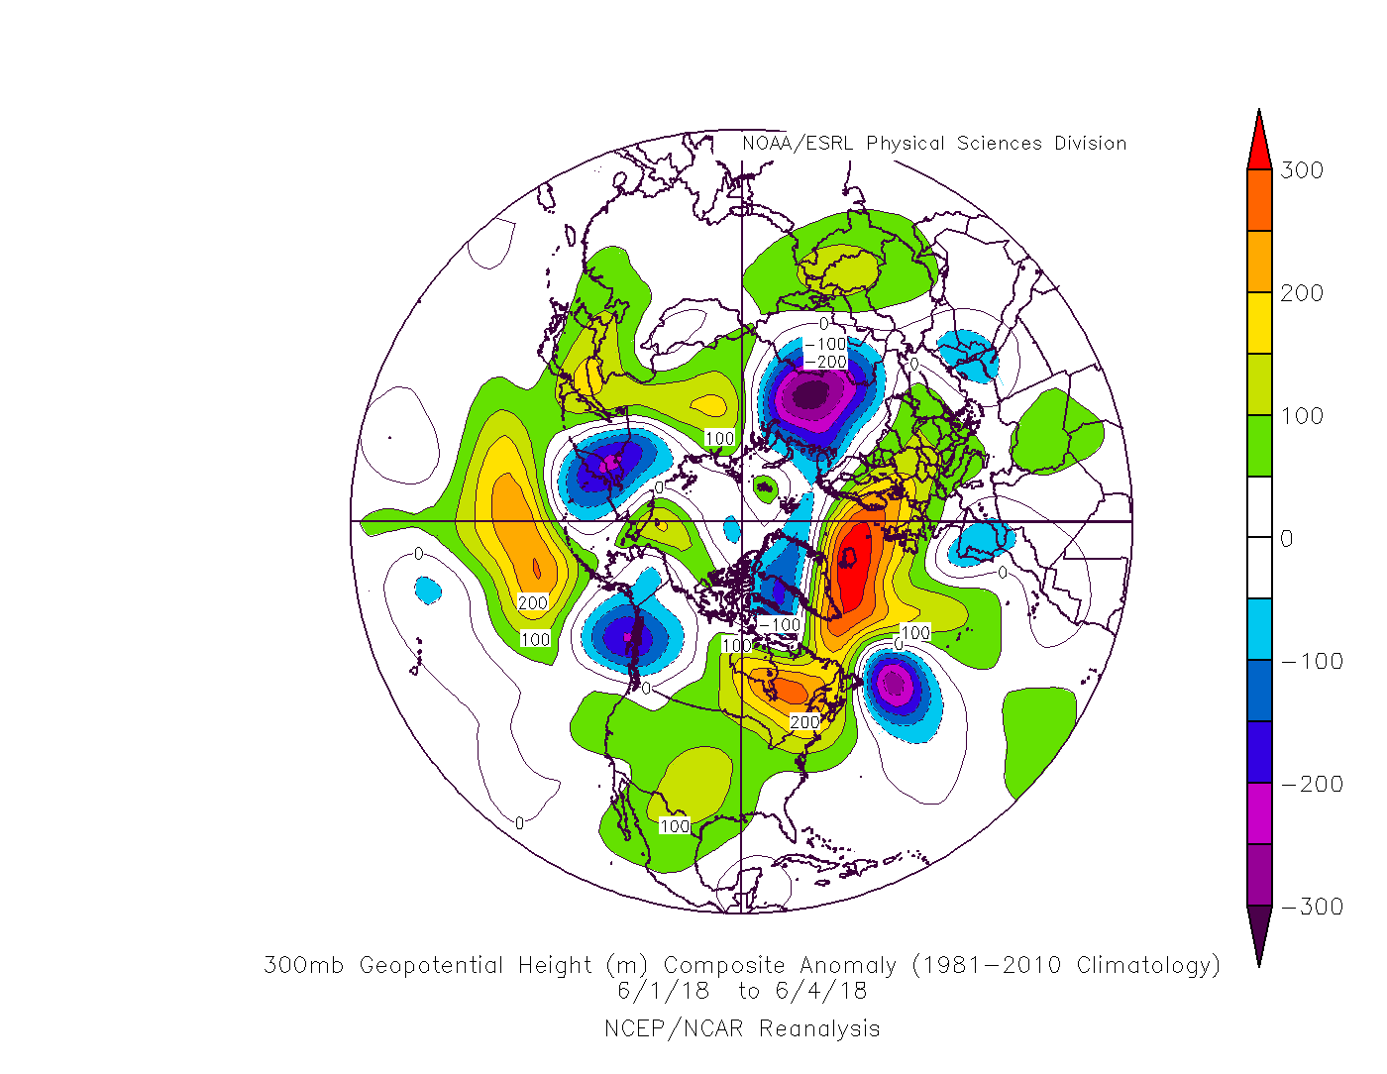
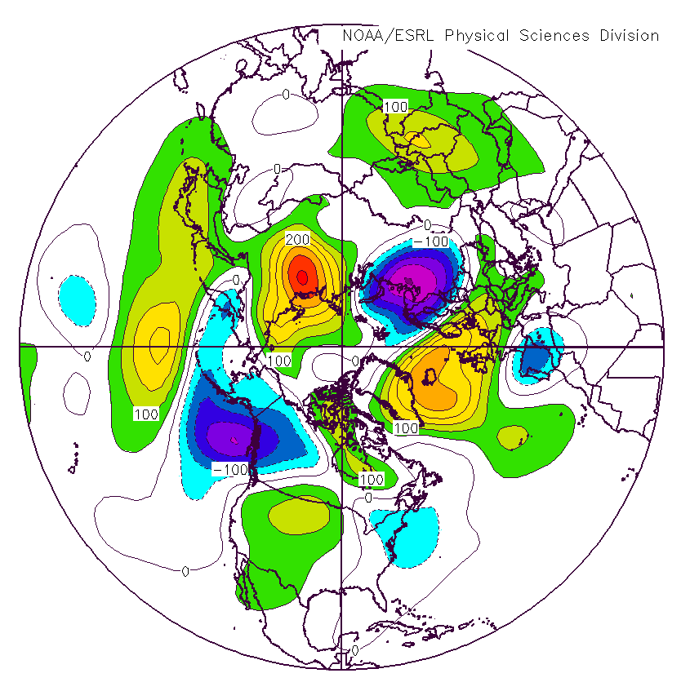
Anomaly 300-hPa Geopotential Heights (m) for 1–4 June 2018 (left) and 4–7 June 2018 (right)
-300
-200
-100
0
100
200
300

Slide 16
Synoptic-Scale Flow Evolution:
North America 30–31 May 2018

Slide 17
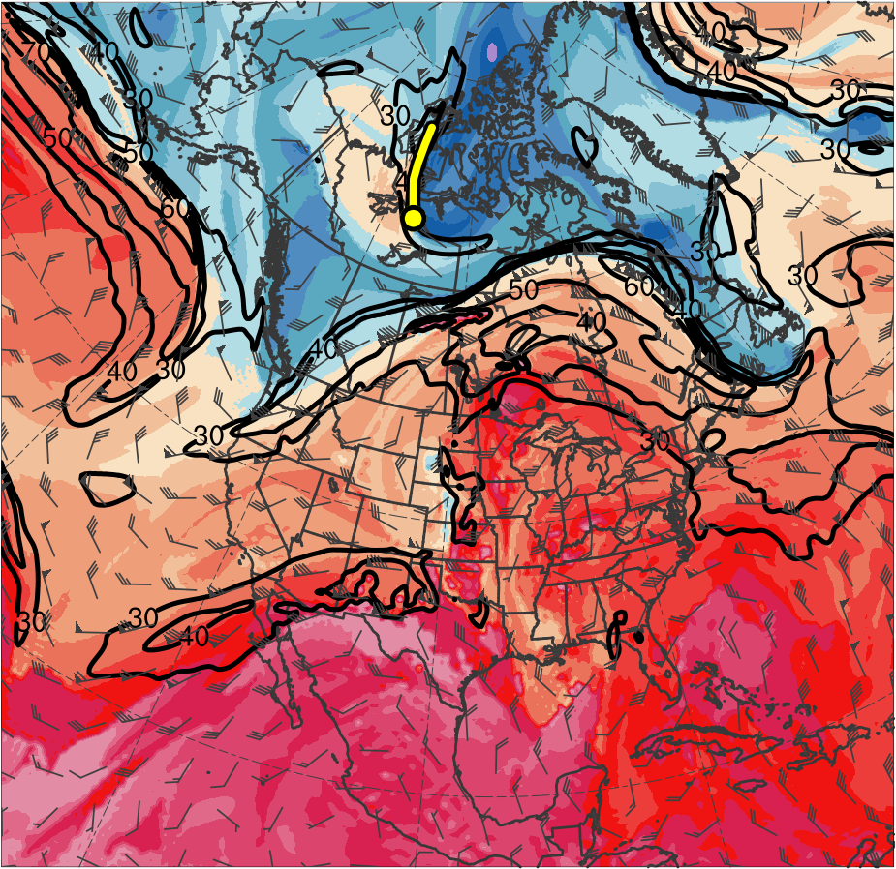
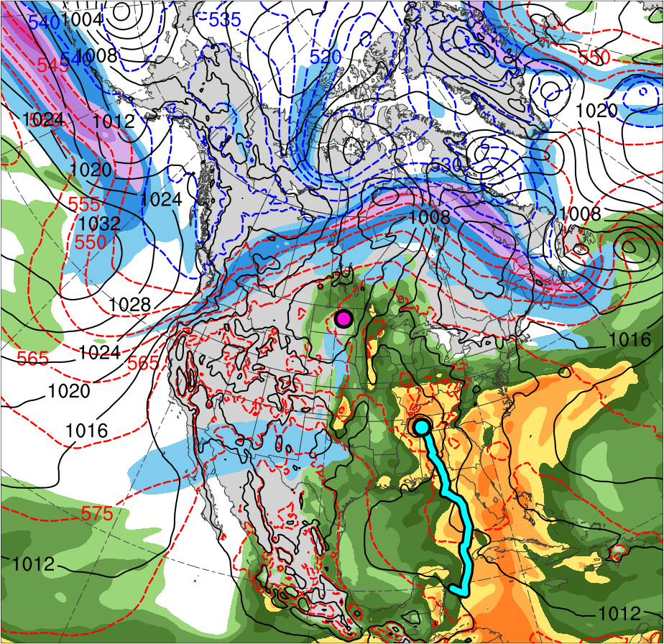
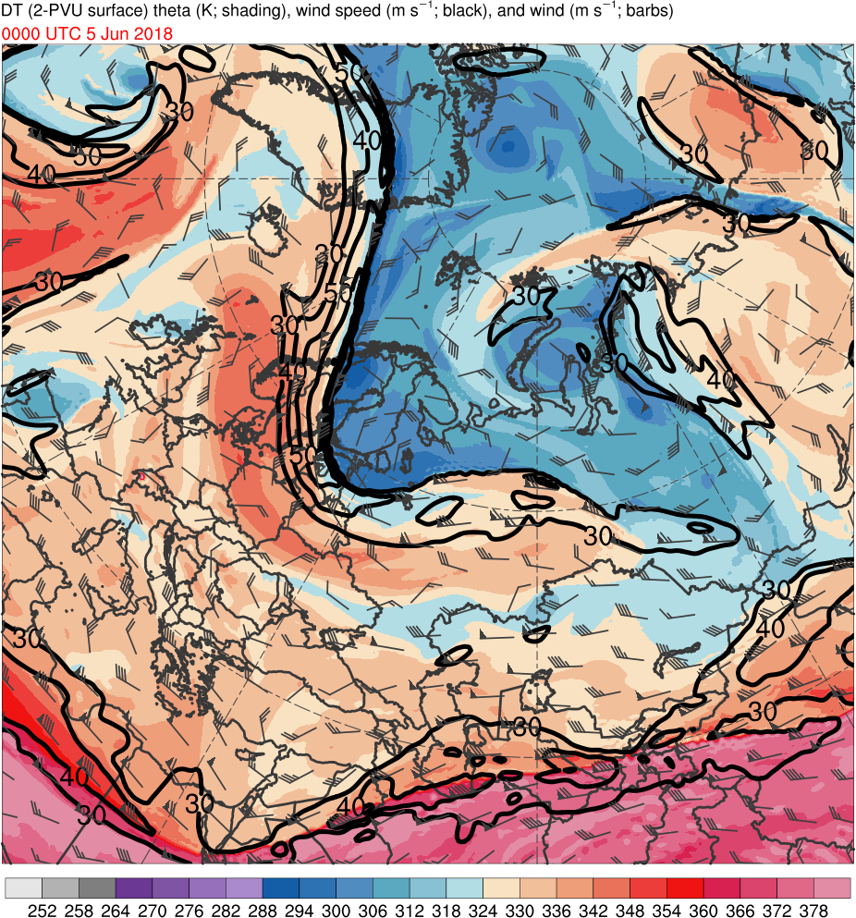
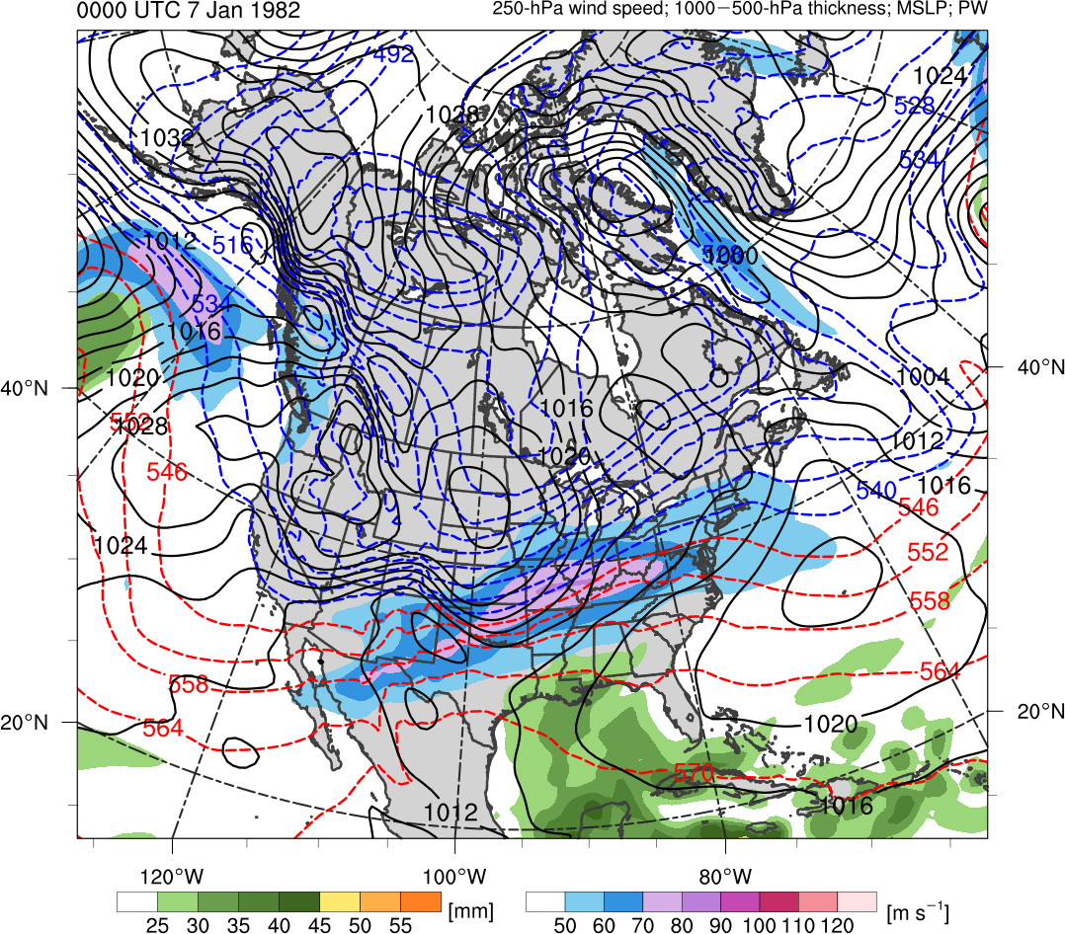
0000 UTC 30 May 2018
TPV 1a
Alberto
CL
(K)
252
258
264
270
276
282
288
294
300
306
312
318
324
330
336
342
348
354
360
366
372
378
(m s⁻¹ )
(mm)
30
40
50
60
70
80
90
100
25
30
35
40
45
50
55
Potential temperature (K, shaded), wind speed (black, every 10 m s⁻¹ starting at 30 m s⁻¹), and wind (m s⁻¹, flags and barbs) on 2-PVU surface
300-hPa wind speed (m s⁻¹, shaded),
1000–500-hPa thickness (dam, blue/red),
SLP (hPa, black), and PW (mm, shaded)

Slide 18
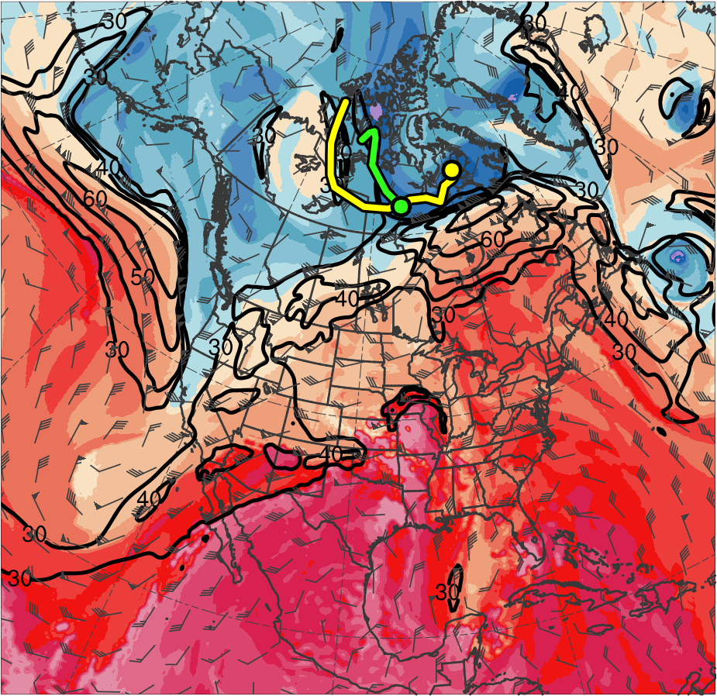
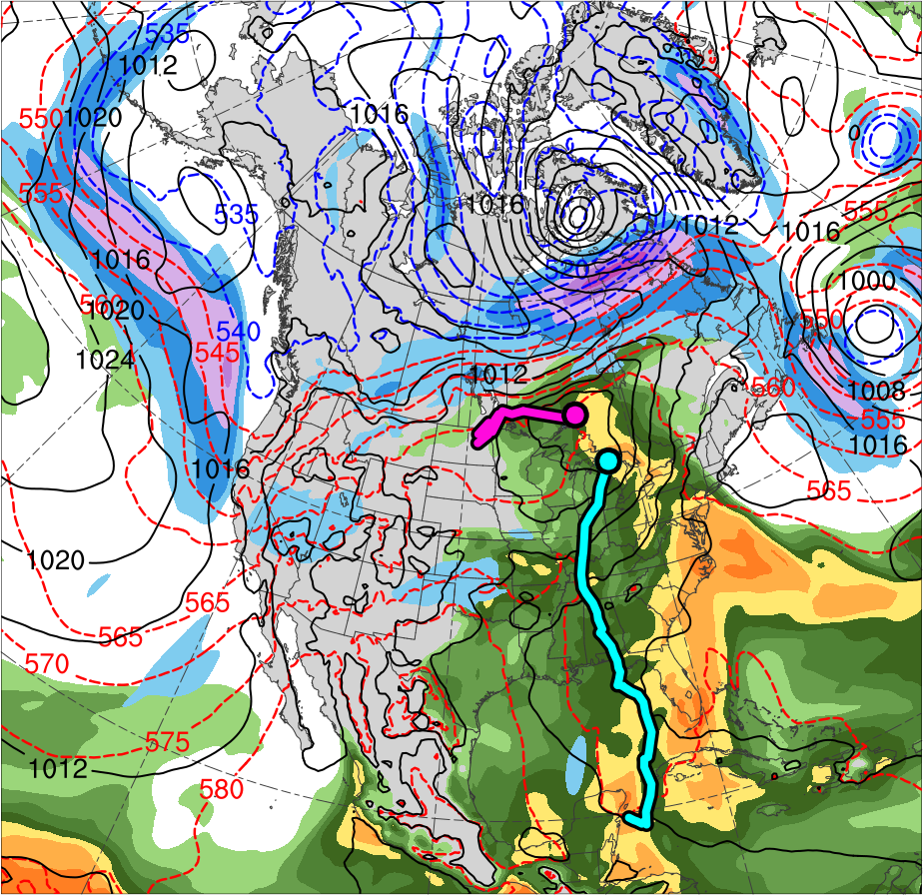
1200 UTC 31 May 2018
TPV 1a
Alberto
TPV 3
CL
(K)
252
258
264
270
276
282
288
294
300
306
312
318
324
330
336
342
348
354
360
366
372
378
(m s⁻¹ )
(mm)
30
40
50
60
70
80
90
100
25
30
35
40
45
50
55
Potential temperature (K, shaded), wind speed (black, every 10 m s⁻¹ starting at 30 m s⁻¹), and wind (m s⁻¹, flags and barbs) on 2-PVU surface
300-hPa wind speed (m s⁻¹, shaded),
1000–500-hPa thickness (dam, blue/red),
SLP (hPa, black), and PW (mm, shaded)

Slide 19
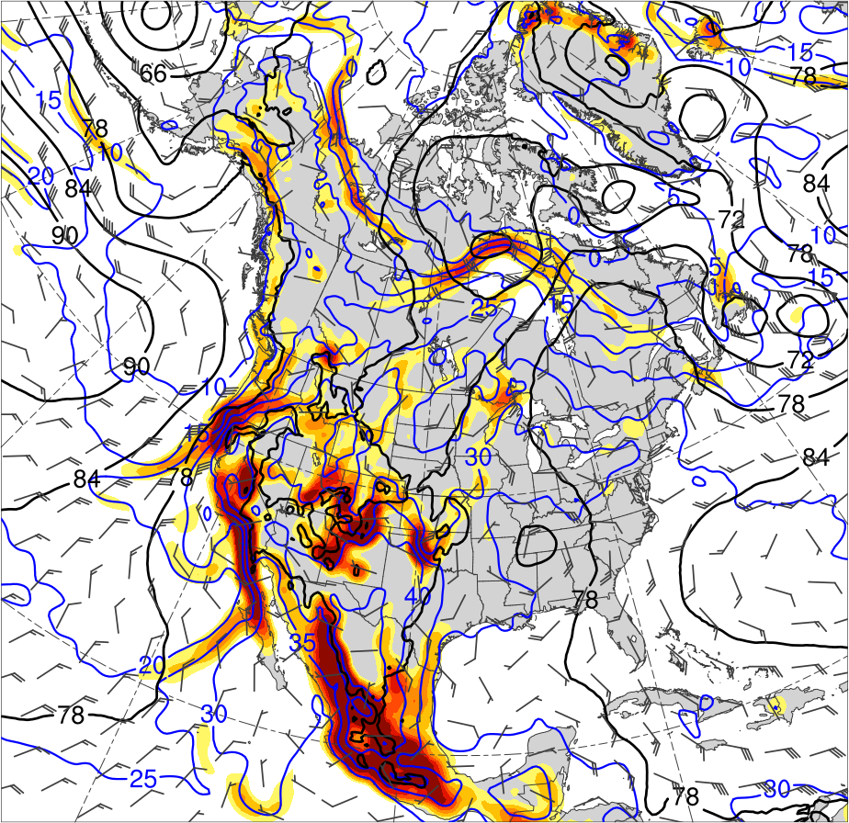
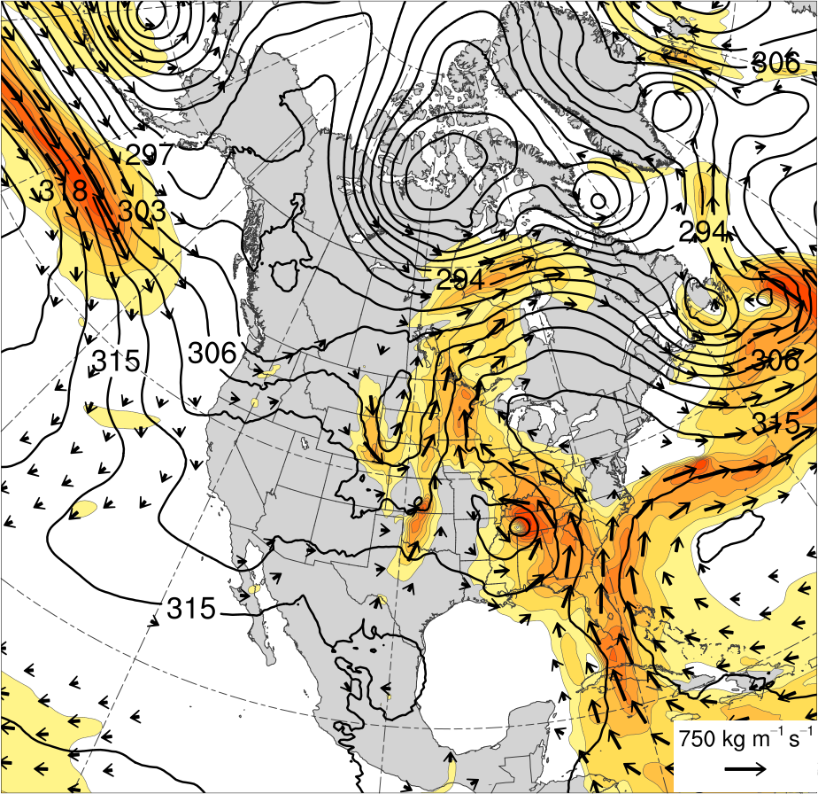
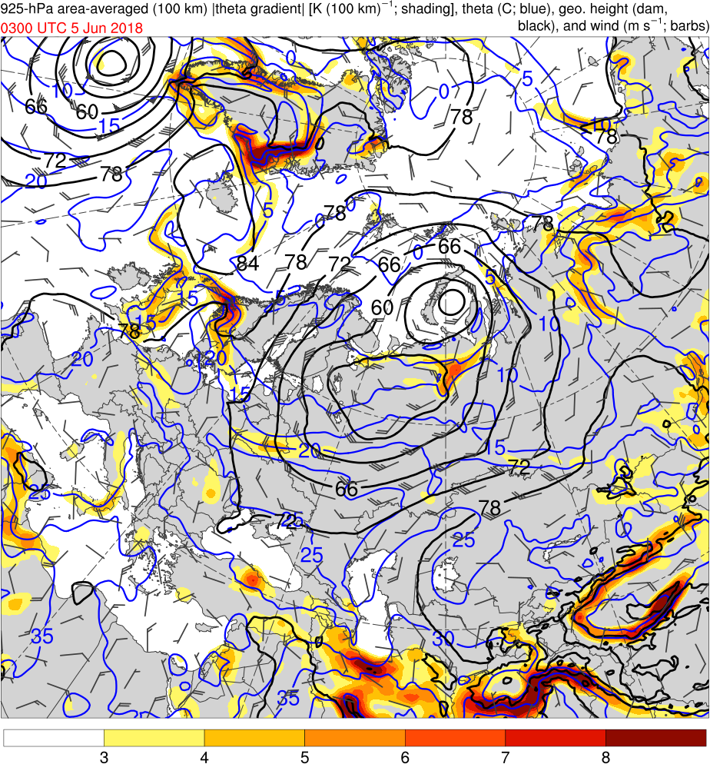
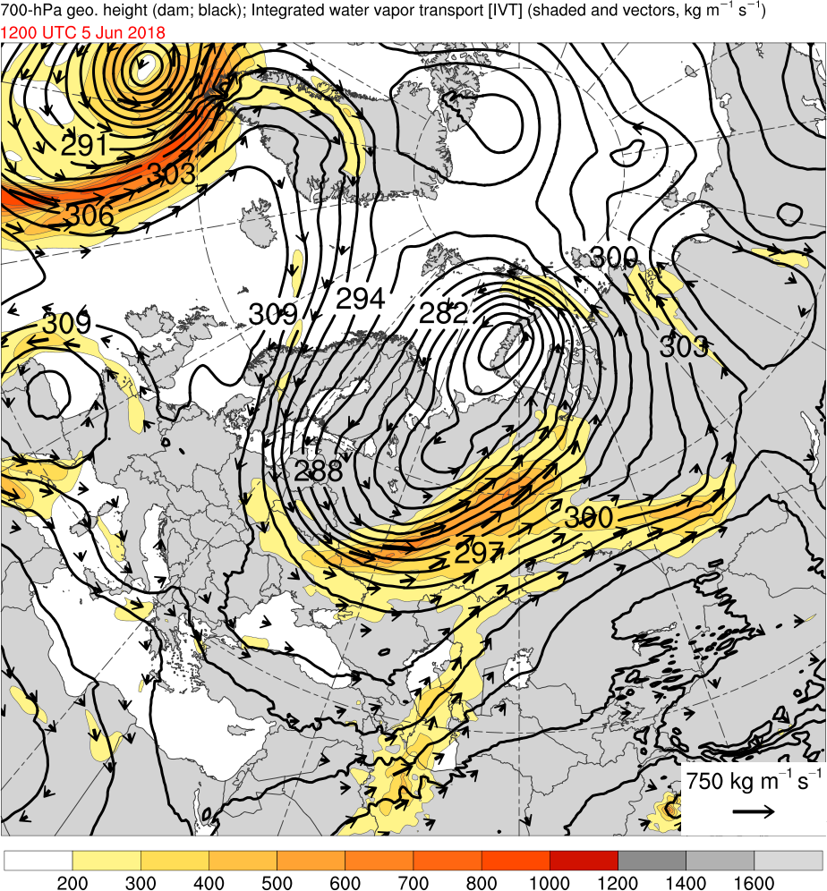
0000 UTC 30 May 2018
[K (100 km)⁻¹]
3
4
5
6
7
8
(kg m⁻¹ s⁻¹)
200
300
400
500
600
700
800
1000
1200
1400
1600
925-hPa area-averaged (100 km) θ gradient [K (100 km) ⁻¹, shaded ], θ (°C, blue), geopotential height (dam, black), and winds (m s⁻¹, flags and barbs)
IVT (kg m⁻¹ s⁻¹, shaded and vectors) and 700-hPa geopotential height (dam, black)

Slide 20
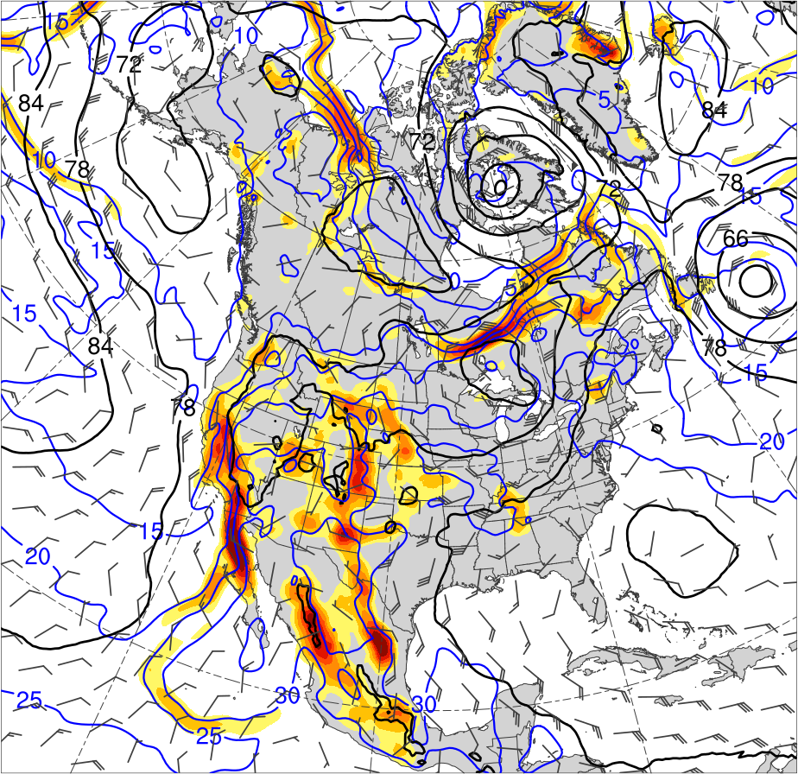
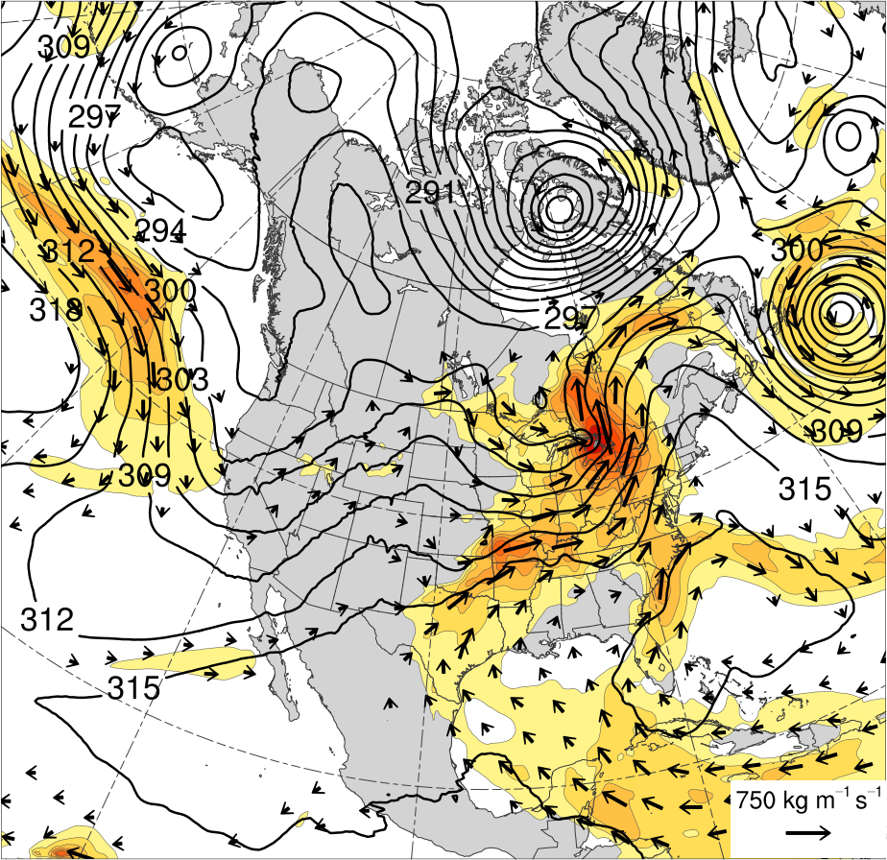
1200 UTC 31 May 2018
[K (100 km)⁻¹]
3
4
5
6
7
8
(kg m⁻¹ s⁻¹)
200
300
400
500
600
700
800
1000
1200
1400
1600
925-hPa area-averaged (100 km) θ gradient [K (100 km) ⁻¹, shaded ], θ (°C, blue), geopotential height (dam, black), and winds (m s⁻¹, flags and barbs)
IVT (kg m⁻¹ s⁻¹, shaded and vectors) and 700-hPa geopotential height (dam, black)

Slide 21
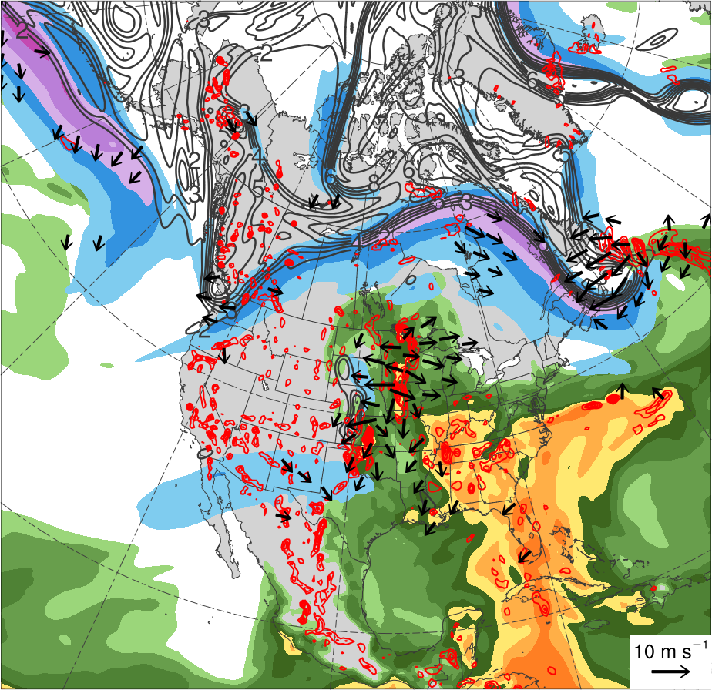
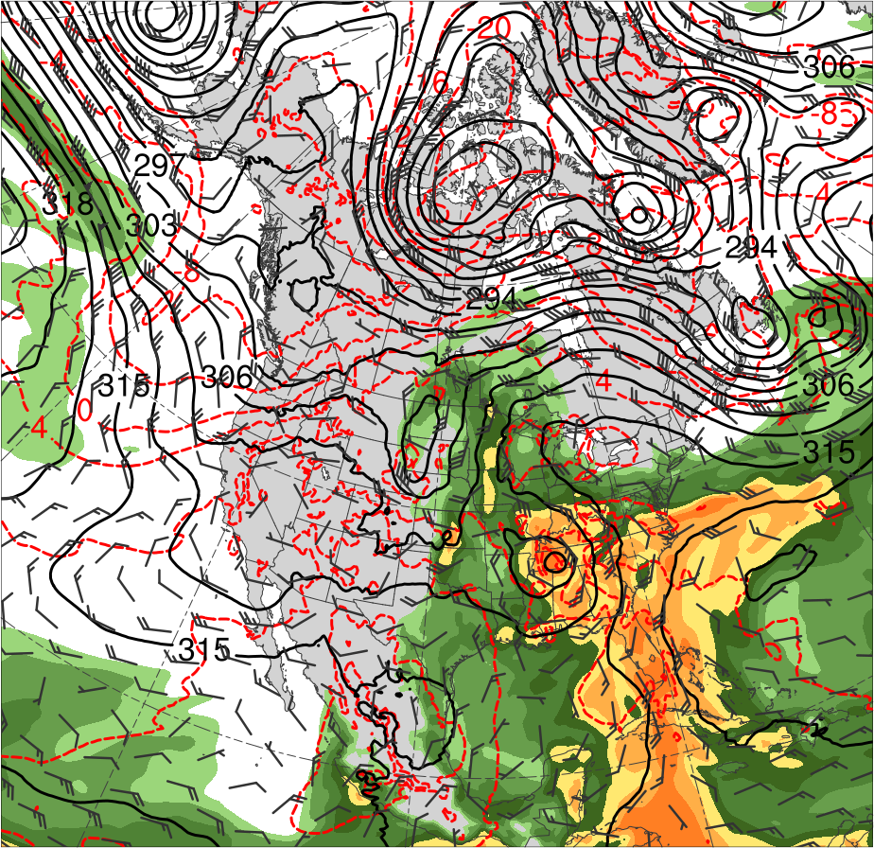
0000 UTC 30 May 2018
(m s⁻¹ )
(mm)
30
40
50
60
70
80
90
100
25
30
35
40
45
50
55
350–250-hPa PV (PVU, gray) and irrotational wind (m s⁻¹, vectors), 300-hPa wind speed (m s⁻¹, shading), 800–600-hPa ascent (every 3 × 10⁻³ hPa s⁻¹, red), and PW (mm, shading)
700-hPa geopotential height (dam, black), temperature (°C, red), and winds (m s⁻¹, flags and barbs), and PW (mm)

Slide 22
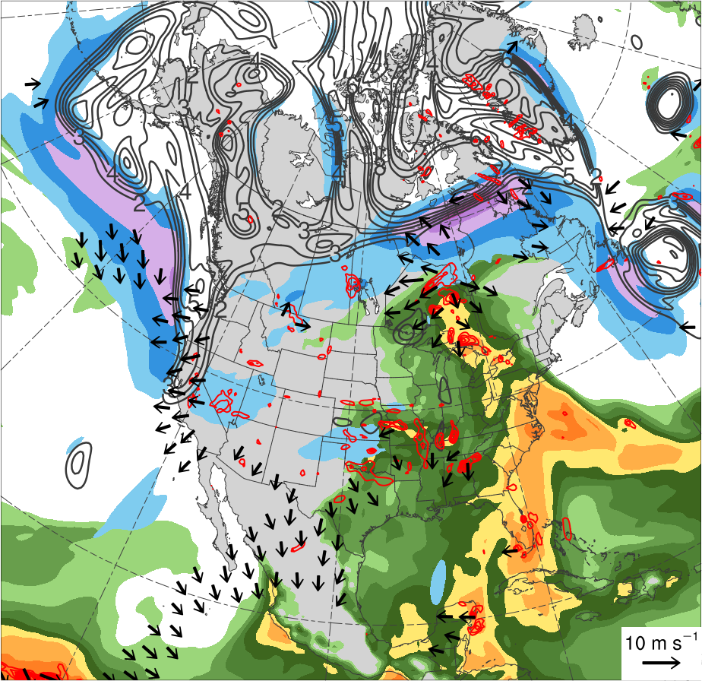
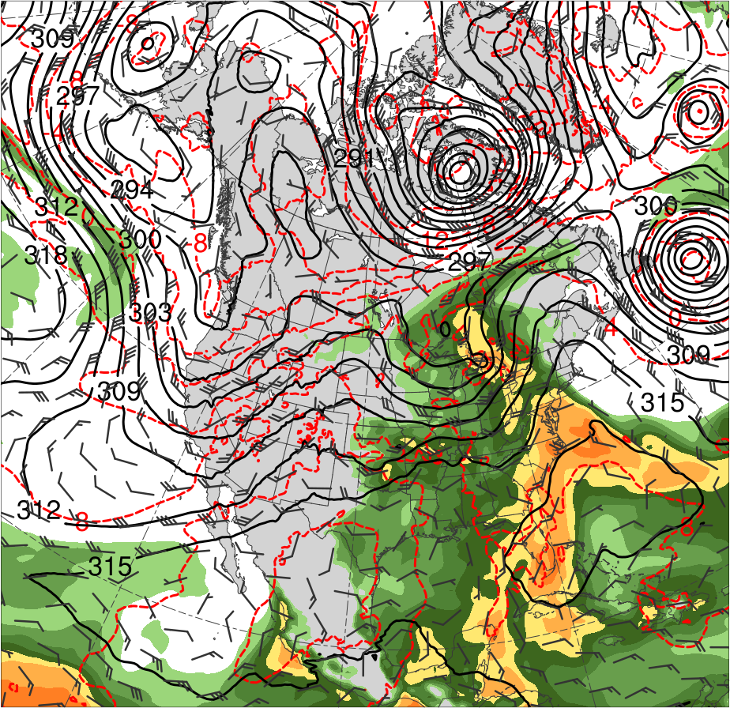
1200 UTC 31 May 2018
(m s⁻¹ )
(mm)
30
40
50
60
70
80
90
100
25
30
35
40
45
50
55
350–250-hPa PV (PVU, gray) and irrotational wind (m s⁻¹, vectors), 300-hPa wind speed (m s⁻¹, shading), 800–600-hPa ascent (every 3 × 10⁻³ hPa s⁻¹, red), and PW (mm, shading)
700-hPa geopotential height (dam, black), temperature (°C, red), and winds (m s⁻¹, flags and barbs), and PW (mm)

Slide 23
Flow Anomalies: North America

Slide 24
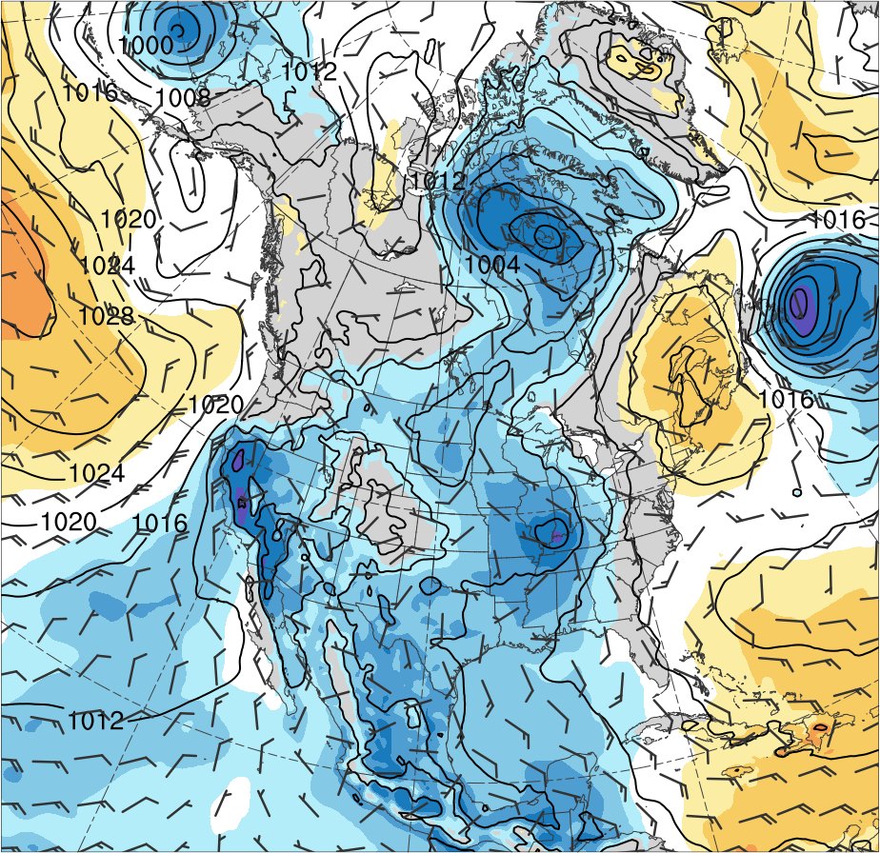
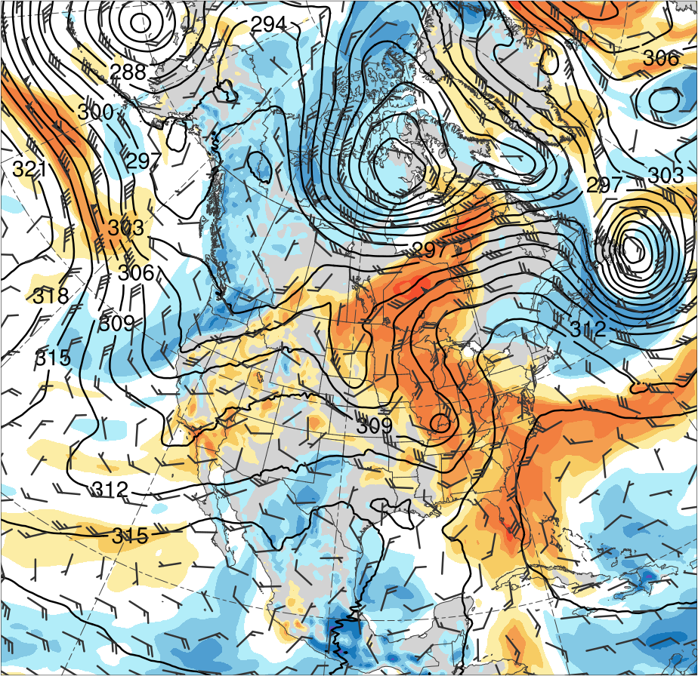
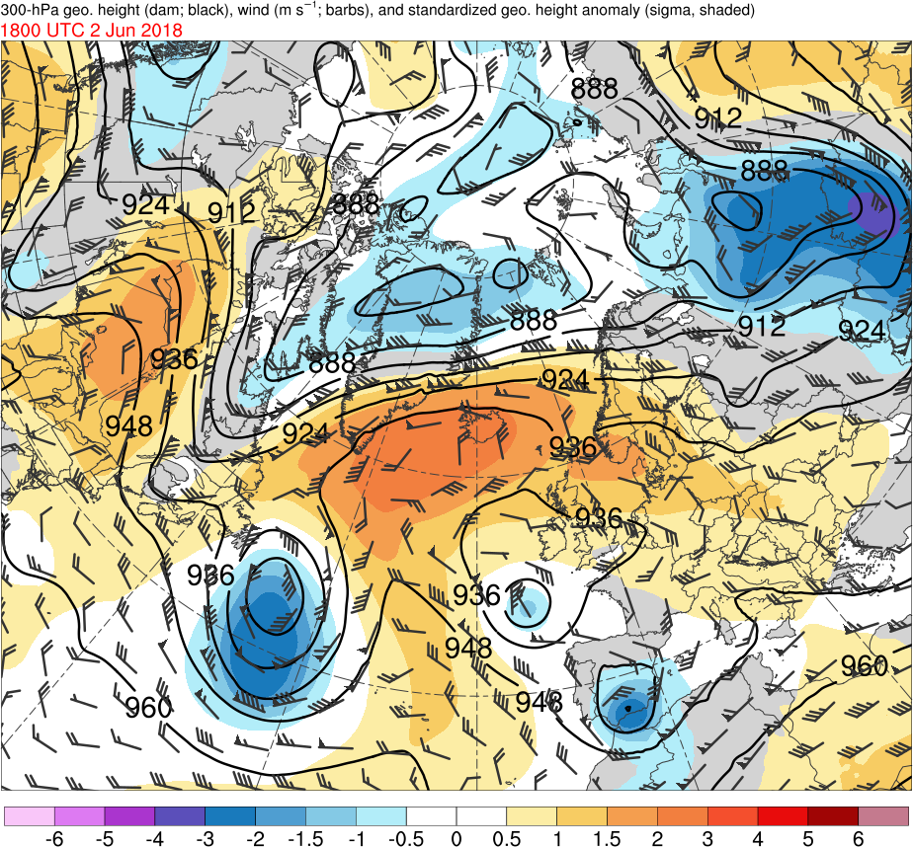
1200 UTC 30 May 2018
-6
-5
-4
-3
-2
-1.5
-1
-0.5
0
0.5
1
1.5
2
3
4
5
6
SLP (hPa, black), 10-m winds (m s⁻¹, flags and barbs), and standardized SLP anomalies (σ, shaded)
700-hPa geopotential height (dam, black) and winds (m s⁻¹, flags and barbs), and standardized PW anomalies (σ, shaded)

Slide 25
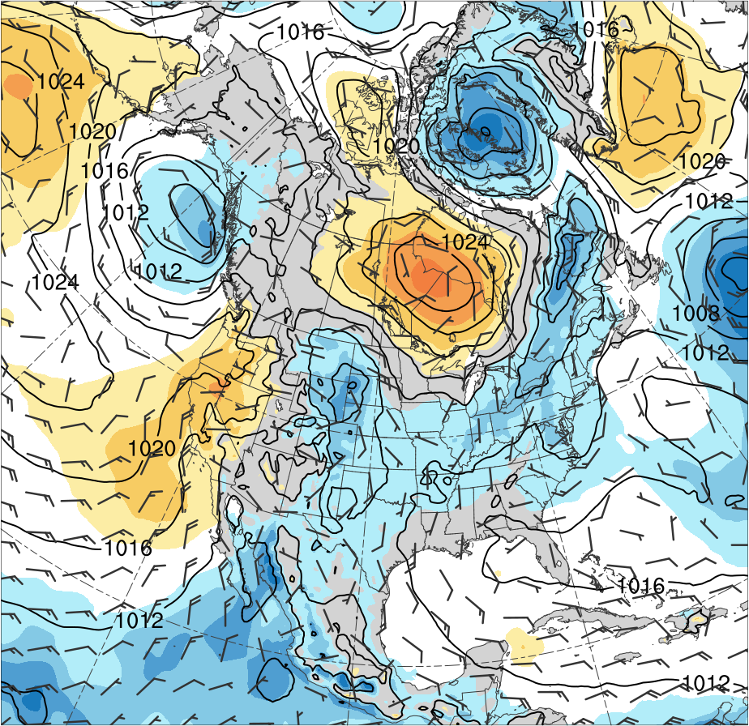
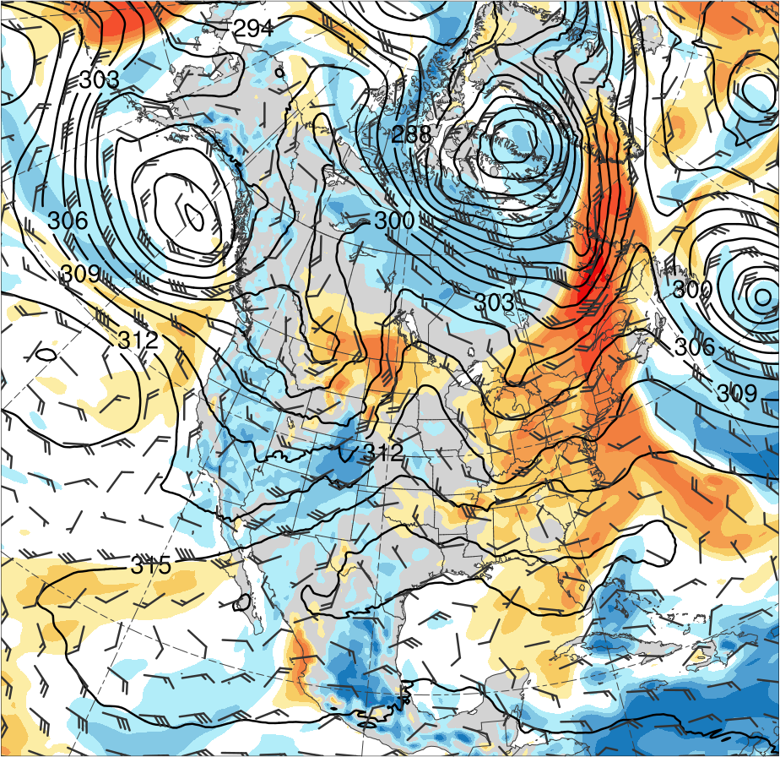
1200 UTC 1 Jun 2018
-6
-5
-4
-3
-2
-1.5
-1
-0.5
0
0.5
1
1.5
2
3
4
5
6
SLP (hPa, black), 10-m winds (m s⁻¹, flags and barbs), and standardized SLP anomalies (σ, shaded)
700-hPa geopotential height (dam, black) and winds (m s⁻¹, flags and barbs), and standardized PW anomalies (σ, shaded)

Slide 26
Synoptic-Scale Flow Evolution:
North Atlantic 1200 UTC 1 June 2018

Slide 27
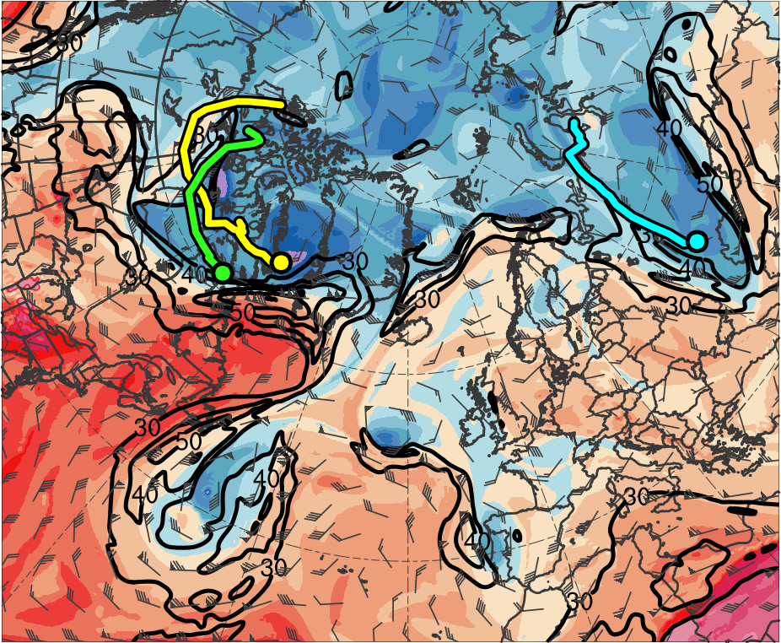
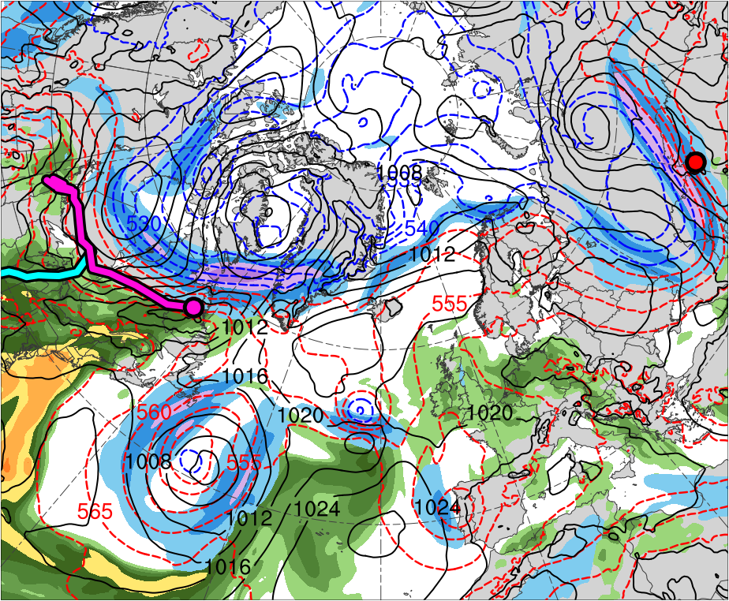
1200 UTC 1 Jun 2018
TPV 1a
Alberto
TPV 2
CL
TPV 3
AC1
(K)
252
258
264
270
276
282
288
294
300
306
312
318
324
330
336
342
348
354
360
366
372
378
(m s⁻¹ )
(mm)
30
40
50
60
70
80
90
100
25
30
35
40
45
50
55
Potential temperature (K, shaded), wind speed (black, every 10 m s⁻¹ starting at 30 m s⁻¹), and wind (m s⁻¹, flags and barbs) on 2-PVU surface
300-hPa wind speed (m s⁻¹, shaded),
1000–500-hPa thickness (dam, blue/red),
SLP (hPa, black), and PW (mm, shaded)

Slide 28
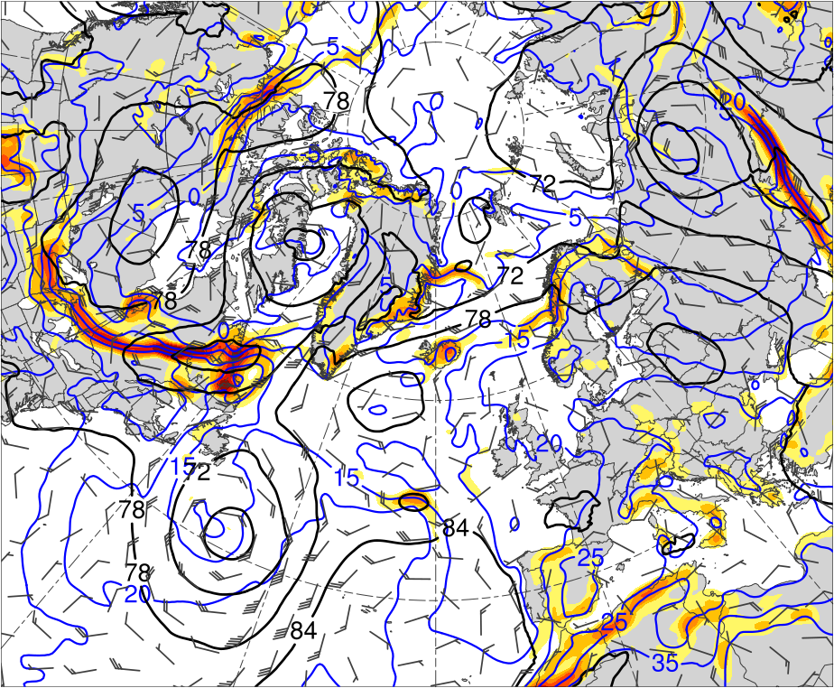
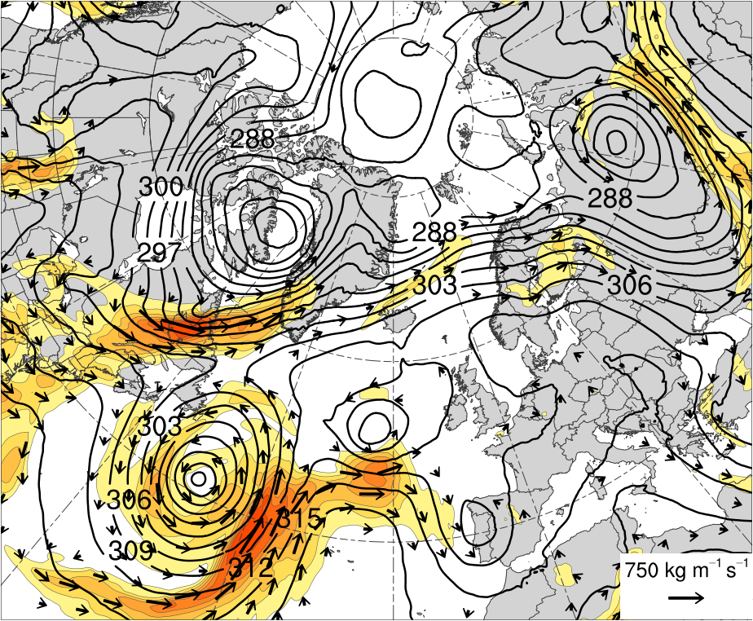
1200 UTC 1 Jun 2018
[K (100 km)⁻¹]
3
4
5
6
7
8
(kg m⁻¹ s⁻¹)
200
300
400
500
600
700
800
1000
1200
1400
1600
925-hPa area-averaged (100 km) θ gradient [K (100 km) ⁻¹, shaded ], θ (°C, blue), geopotential height (dam, black), and winds (m s⁻¹, flags and barbs)
IVT (kg m⁻¹ s⁻¹, shaded and vectors) and 700-hPa geopotential height (dam, black)

Slide 29
Lagrangian Perspective: Selected Trajectories

Slide 30
Synoptic-Scale Flow Evolution:
Eurasia 2–7 June 2018

Slide 31
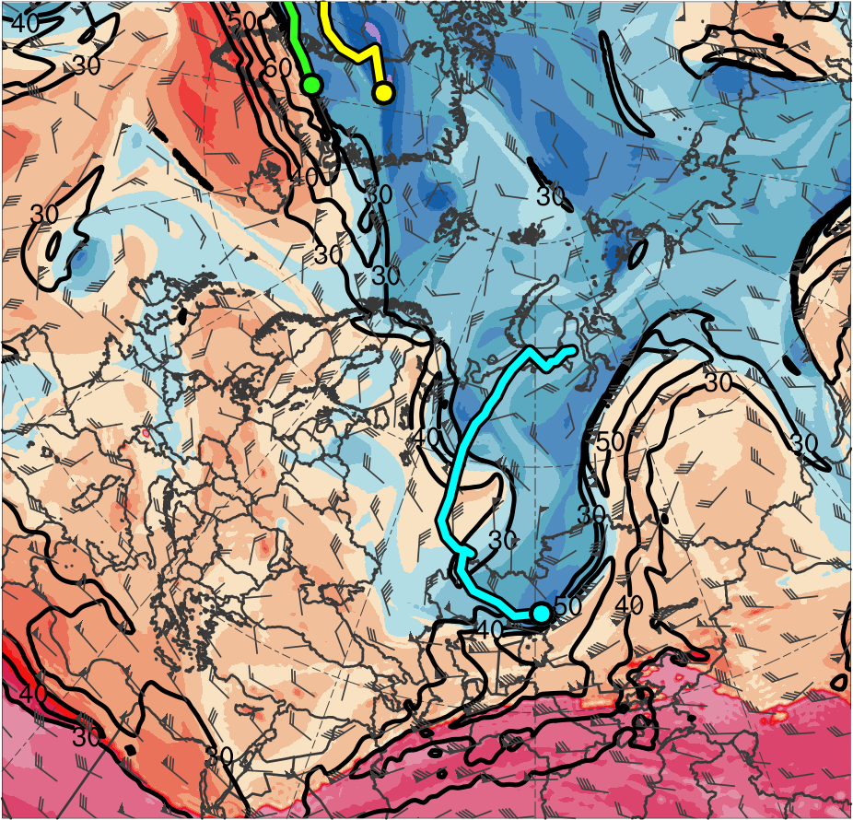
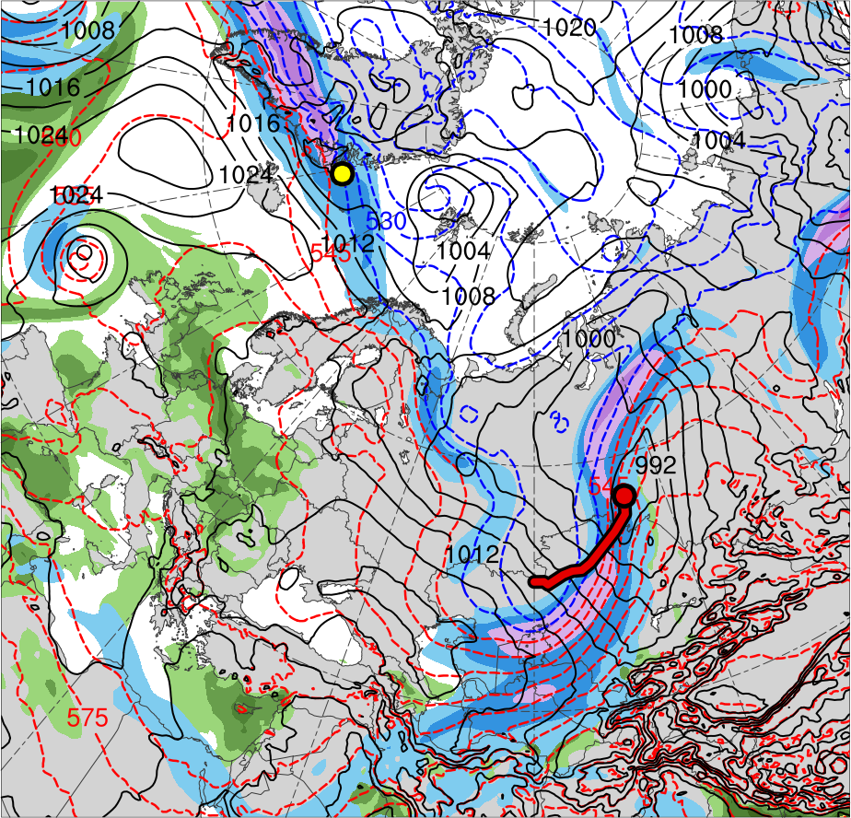
1200 UTC 2 Jun 2018
Lee cyclogenesis of AC2
TPV 1a
TPV 2
TPV 3
AC1
AC2
(K)
252
258
264
270
276
282
288
294
300
306
312
318
324
330
336
342
348
354
360
366
372
378
(m s⁻¹ )
(mm)
30
40
50
60
70
80
90
100
25
30
35
40
45
50
55
Potential temperature (K, shaded), wind speed (black, every 10 m s⁻¹ starting at 30 m s⁻¹), and wind (m s⁻¹, flags and barbs) on 2-PVU surface
300-hPa wind speed (m s⁻¹, shaded),
1000–500-hPa thickness (dam, blue/red),
SLP (hPa, black), and PW (mm, shaded)

Slide 32
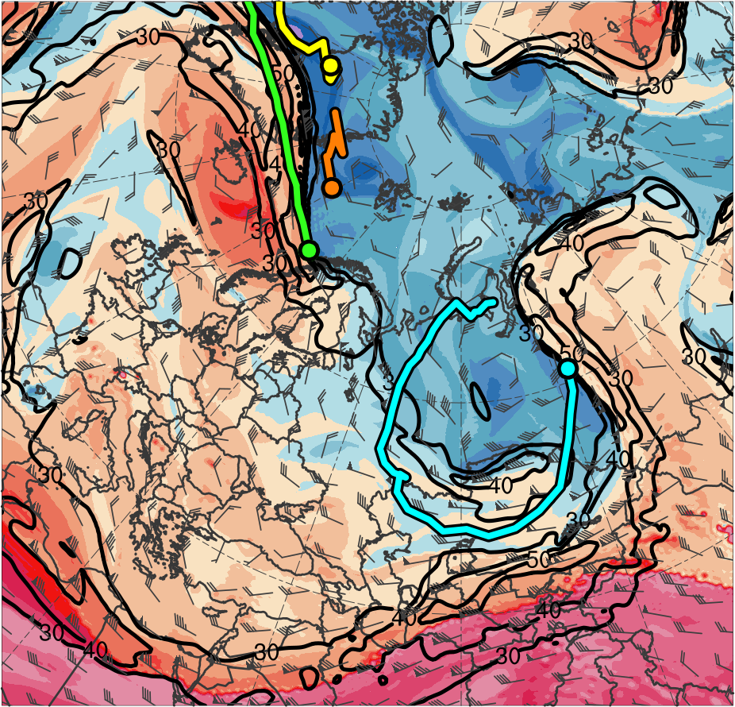
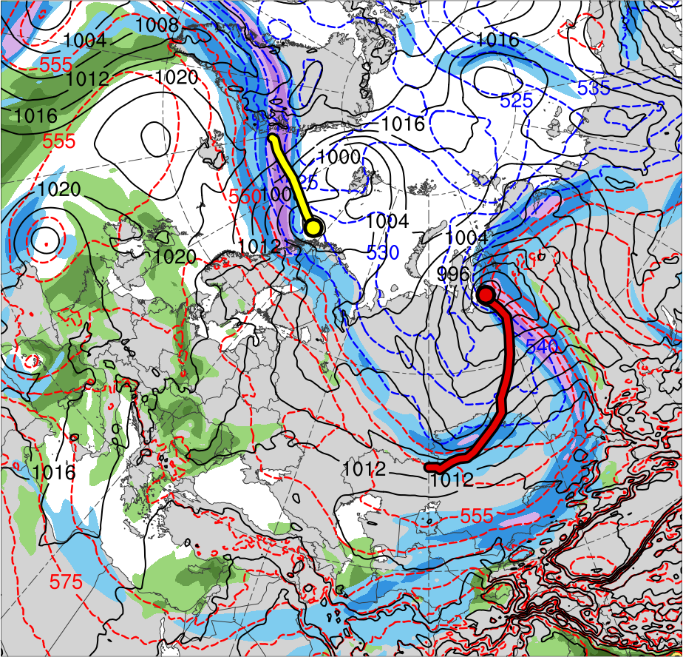
1200 UTC 3 Jun 2018
TPV 1a
TPV 2
TPV 3
TPV 1b
AC1
AC2
(K)
252
258
264
270
276
282
288
294
300
306
312
318
324
330
336
342
348
354
360
366
372
378
(m s⁻¹ )
(mm)
30
40
50
60
70
80
90
100
25
30
35
40
45
50
55
Potential temperature (K, shaded), wind speed (black, every 10 m s⁻¹ starting at 30 m s⁻¹), and wind (m s⁻¹, flags and barbs) on 2-PVU surface
300-hPa wind speed (m s⁻¹, shaded),
1000–500-hPa thickness (dam, blue/red),
SLP (hPa, black), and PW (mm, shaded)

Slide 33
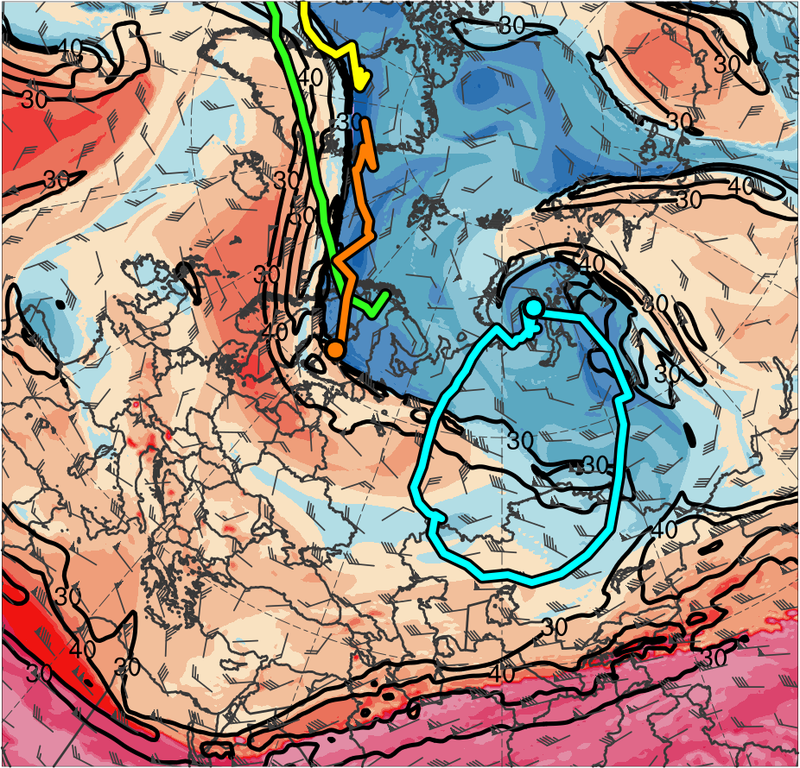
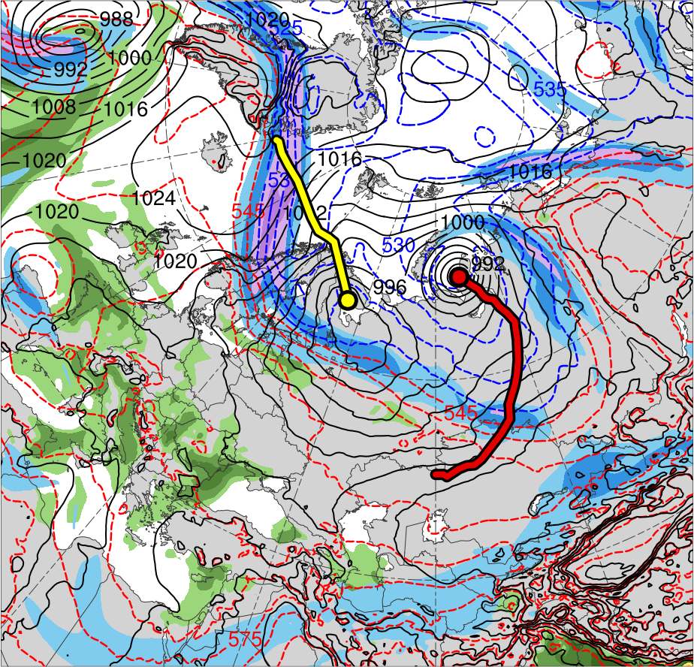
1200 UTC 4 Jun 2018
TPV 1a
TPV 2
TPV 3
TPV 1b
AC1
AC2
(K)
252
258
264
270
276
282
288
294
300
306
312
318
324
330
336
342
348
354
360
366
372
378
(m s⁻¹ )
(mm)
30
40
50
60
70
80
90
100
25
30
35
40
45
50
55
Potential temperature (K, shaded), wind speed (black, every 10 m s⁻¹ starting at 30 m s⁻¹), and wind (m s⁻¹, flags and barbs) on 2-PVU surface
300-hPa wind speed (m s⁻¹, shaded),
1000–500-hPa thickness (dam, blue/red),
SLP (hPa, black), and PW (mm, shaded)

Slide 34
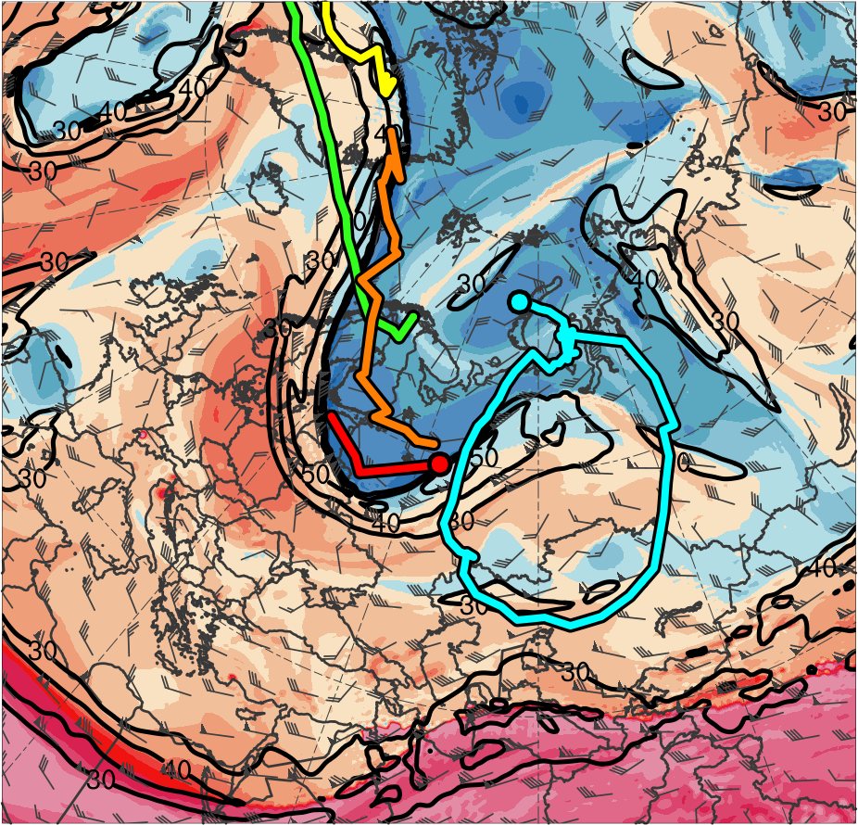
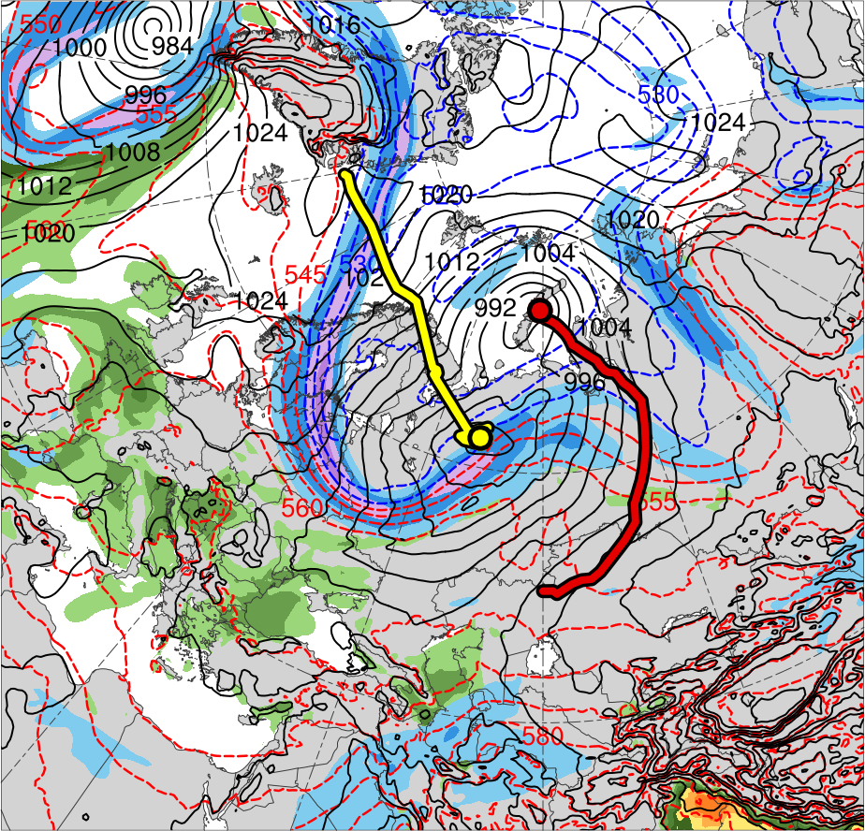
1200 UTC 5 Jun 2018
TPV 1a
TPV 2
TPV 3
TPV 1b
TPV 1c
AC1
AC2
(K)
252
258
264
270
276
282
288
294
300
306
312
318
324
330
336
342
348
354
360
366
372
378
(m s⁻¹ )
(mm)
30
40
50
60
70
80
90
100
25
30
35
40
45
50
55
Potential temperature (K, shaded), wind speed (black, every 10 m s⁻¹ starting at 30 m s⁻¹), and wind (m s⁻¹, flags and barbs) on 2-PVU surface
300-hPa wind speed (m s⁻¹, shaded),
1000–500-hPa thickness (dam, blue/red),
SLP (hPa, black), and PW (mm, shaded)

Slide 35
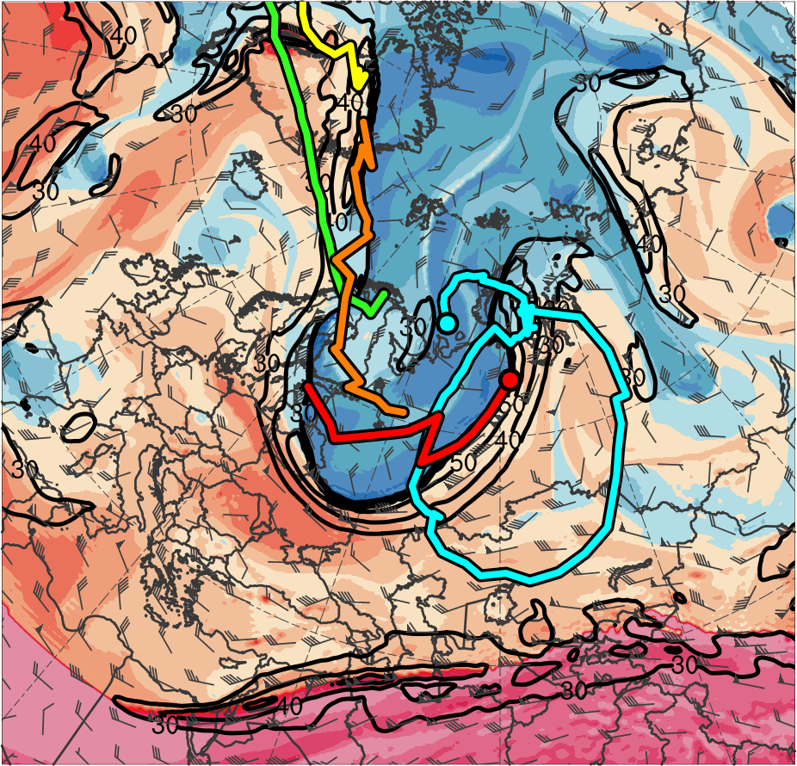
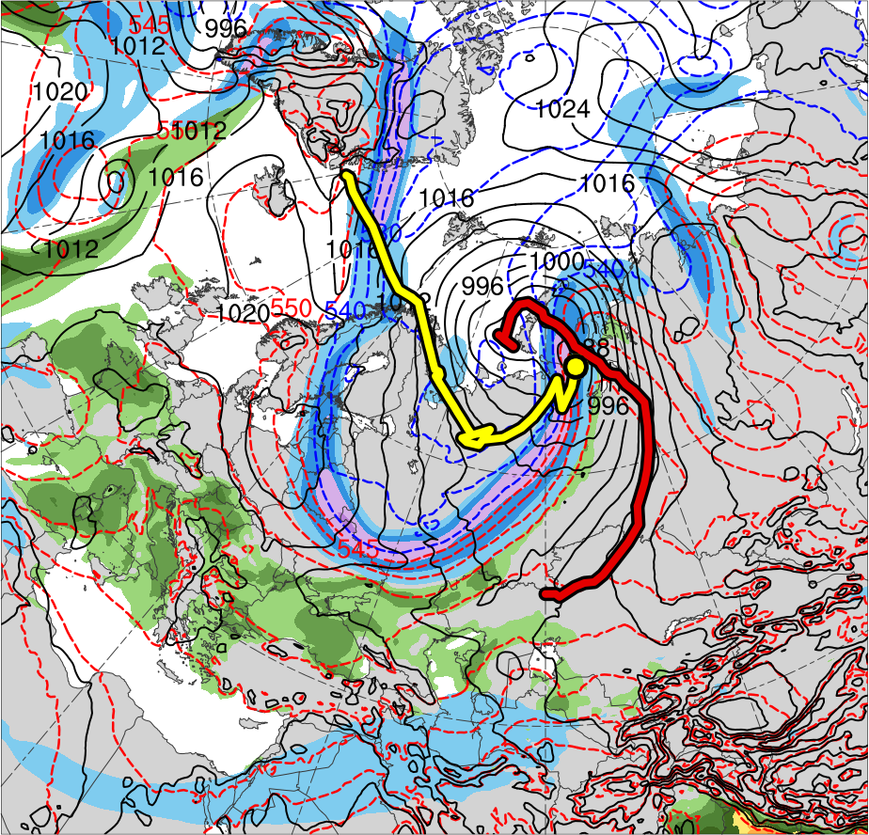
1200 UTC 6 Jun 2018
TPV 1a
TPV 2
TPV 3
TPV 1b
TPV 1c
AC1
AC2
(K)
252
258
264
270
276
282
288
294
300
306
312
318
324
330
336
342
348
354
360
366
372
378
(m s⁻¹ )
(mm)
30
40
50
60
70
80
90
100
25
30
35
40
45
50
55
Potential temperature (K, shaded), wind speed (black, every 10 m s⁻¹ starting at 30 m s⁻¹), and wind (m s⁻¹, flags and barbs) on 2-PVU surface
300-hPa wind speed (m s⁻¹, shaded),
1000–500-hPa thickness (dam, blue/red),
SLP (hPa, black), and PW (mm, shaded)

Slide 36
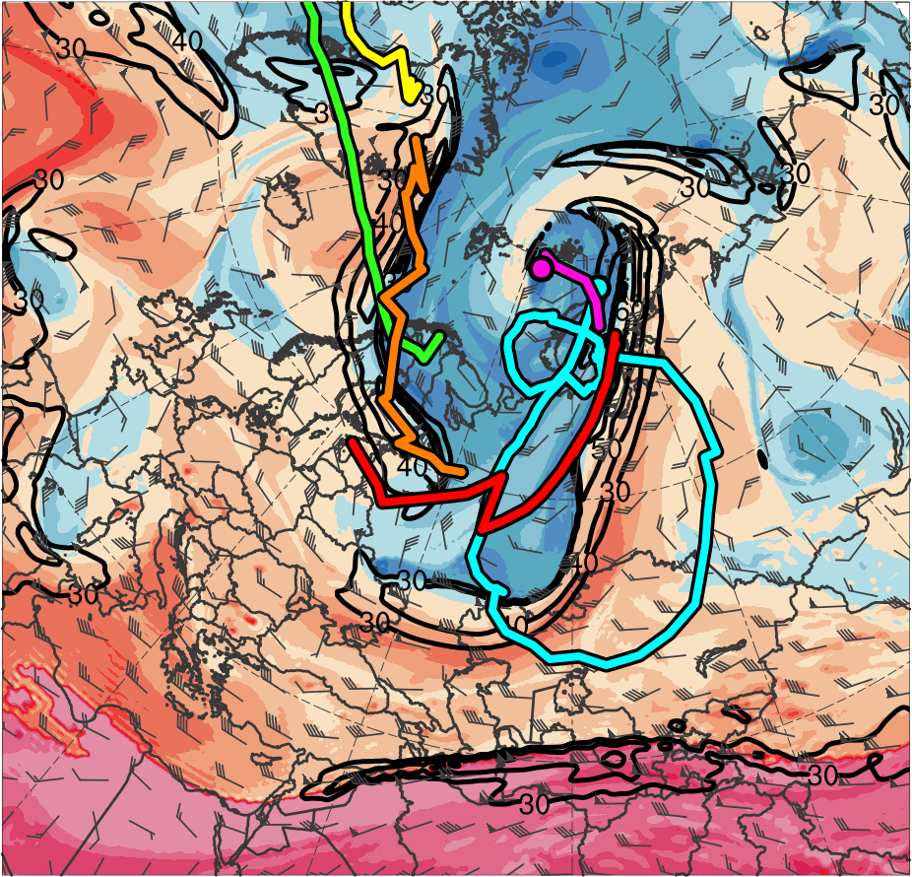

1200 UTC 7 Jun 2018
TPV 1a
TPV 2
TPV 3
TPV 1b
TPV 1c
AC1
TPV 1d
AC2
(K)
252
258
264
270
276
282
288
294
300
306
312
318
324
330
336
342
348
354
360
366
372
378
(m s⁻¹ )
(mm)
30
40
50
60
70
80
90
100
25
30
35
40
45
50
55
Potential temperature (K, shaded), wind speed (black, every 10 m s⁻¹ starting at 30 m s⁻¹), and wind (m s⁻¹, flags and barbs) on 2-PVU surface
300-hPa wind speed (m s⁻¹, shaded),
1000–500-hPa thickness (dam, blue/red),
SLP (hPa, black), and PW (mm, shaded)

Slide 37


1200 UTC 2 Jun 2018
[K (100 km)⁻¹]
3
4
5
6
7
8
(kg m⁻¹ s⁻¹)
200
300
400
500
600
700
800
1000
1200
1400
1600
925-hPa area-averaged (100 km) θ gradient [K (100 km) ⁻¹, shaded ], θ (°C, blue), geopotential height (dam, black), and winds (m s⁻¹, flags and barbs)
IVT (kg m⁻¹ s⁻¹, shaded and vectors) and 700-hPa geopotential height (dam, black)

Slide 38


1200 UTC 3 Jun 2018
[K (100 km)⁻¹]
3
4
5
6
7
8
(kg m⁻¹ s⁻¹)
200
300
400
500
600
700
800
1000
1200
1400
1600
925-hPa area-averaged (100 km) θ gradient [K (100 km) ⁻¹, shaded ], θ (°C, blue), geopotential height (dam, black), and winds (m s⁻¹, flags and barbs)
IVT (kg m⁻¹ s⁻¹, shaded and vectors) and 700-hPa geopotential height (dam, black)

Slide 39


1200 UTC 4 Jun 2018
[K (100 km)⁻¹]
3
4
5
6
7
8
(kg m⁻¹ s⁻¹)
200
300
400
500
600
700
800
1000
1200
1400
1600
925-hPa area-averaged (100 km) θ gradient [K (100 km) ⁻¹, shaded ], θ (°C, blue), geopotential height (dam, black), and winds (m s⁻¹, flags and barbs)
IVT (kg m⁻¹ s⁻¹, shaded and vectors) and 700-hPa geopotential height (dam, black)

Slide 40


1200 UTC 5 Jun 2018
[K (100 km)⁻¹]
3
4
5
6
7
8
(kg m⁻¹ s⁻¹)
200
300
400
500
600
700
800
1000
1200
1400
1600
925-hPa area-averaged (100 km) θ gradient [K (100 km) ⁻¹, shaded ], θ (°C, blue), geopotential height (dam, black), and winds (m s⁻¹, flags and barbs)
IVT (kg m⁻¹ s⁻¹, shaded and vectors) and 700-hPa geopotential height (dam, black)

Slide 41


1200 UTC 6 Jun 2018
[K (100 km)⁻¹]
3
4
5
6
7
8
(kg m⁻¹ s⁻¹)
200
300
400
500
600
700
800
1000
1200
1400
1600
925-hPa area-averaged (100 km) θ gradient [K (100 km) ⁻¹, shaded ], θ (°C, blue), geopotential height (dam, black), and winds (m s⁻¹, flags and barbs)
IVT (kg m⁻¹ s⁻¹, shaded and vectors) and 700-hPa geopotential height (dam, black)

Slide 42


1200 UTC 7 Jun 2018
[K (100 km)⁻¹]
3
4
5
6
7
8
(kg m⁻¹ s⁻¹)
200
300
400
500
600
700
800
1000
1200
1400
1600
925-hPa area-averaged (100 km) θ gradient [K (100 km) ⁻¹, shaded ], θ (°C, blue), geopotential height (dam, black), and winds (m s⁻¹, flags and barbs)
IVT (kg m⁻¹ s⁻¹, shaded and vectors) and 700-hPa geopotential height (dam, black)

Slide 43



1200 UTC 2 Jun 2018
(10⁻⁵ s⁻¹)
6
8
10
12
14
16
18
20
22
24
26
28
30
500-hPa relative vorticity (10⁻⁵ s⁻¹, shaded), geopotential height (dam, black), and winds (m s⁻¹, flags and barbs), and 800–600-hPa ascent (5 × 10⁻⁵ s⁻¹, blue)
925-hPa relative vorticity (10⁻⁵ s⁻¹, shaded), geopotential height (dam, black), and winds (m s⁻¹, flags and barbs)

Slide 44


1200 UTC 3 Jun 2018
(10⁻⁵ s⁻¹)
6
8
10
12
14
16
18
20
22
24
26
28
30
500-hPa relative vorticity (10⁻⁵ s⁻¹, shaded), geopotential height (dam, black), and winds (m s⁻¹, flags and barbs), and 800–600-hPa ascent (5 × 10⁻⁵ s⁻¹, blue)
925-hPa relative vorticity (10⁻⁵ s⁻¹, shaded), geopotential height (dam, black), and winds (m s⁻¹, flags and barbs)

Slide 45


1200 UTC 4 Jun 2018
(10⁻⁵ s⁻¹)
6
8
10
12
14
16
18
20
22
24
26
28
30
500-hPa relative vorticity (10⁻⁵ s⁻¹, shaded), geopotential height (dam, black), and winds (m s⁻¹, flags and barbs), and 800–600-hPa ascent (5 × 10⁻⁵ s⁻¹, blue)
925-hPa relative vorticity (10⁻⁵ s⁻¹, shaded), geopotential height (dam, black), and winds (m s⁻¹, flags and barbs)

Slide 46


1200 UTC 5 Jun 2018
(10⁻⁵ s⁻¹)
6
8
10
12
14
16
18
20
22
24
26
28
30
500-hPa relative vorticity (10⁻⁵ s⁻¹, shaded), geopotential height (dam, black), and winds (m s⁻¹, flags and barbs), and 800–600-hPa ascent (5 × 10⁻⁵ s⁻¹, blue)
925-hPa relative vorticity (10⁻⁵ s⁻¹, shaded), geopotential height (dam, black), and winds (m s⁻¹, flags and barbs)

Slide 47


1200 UTC 6 Jun 2018
(10⁻⁵ s⁻¹)
6
8
10
12
14
16
18
20
22
24
26
28
30
500-hPa relative vorticity (10⁻⁵ s⁻¹, shaded), geopotential height (dam, black), and winds (m s⁻¹, flags and barbs), and 800–600-hPa ascent (5 × 10⁻⁵ s⁻¹, blue)
925-hPa relative vorticity (10⁻⁵ s⁻¹, shaded), geopotential height (dam, black), and winds (m s⁻¹, flags and barbs)

Slide 48


1200 UTC 7 Jun 2018
(10⁻⁵ s⁻¹)
6
8
10
12
14
16
18
20
22
24
26
28
30
500-hPa relative vorticity (10⁻⁵ s⁻¹, shaded), geopotential height (dam, black), and winds (m s⁻¹, flags and barbs), and 800–600-hPa ascent (5 × 10⁻⁵ s⁻¹, blue)
925-hPa relative vorticity (10⁻⁵ s⁻¹, shaded), geopotential height (dam, black), and winds (m s⁻¹, flags and barbs)

Slide 49
Lagrangian Perspective: Selected Trajectories

Slide 50
Lagrangian Perspective: Selected Trajectories

Slide 51
Flow Anomalies: Eurasia

Slide 52


1200 UTC 1 Jun 2018
-6
-5
-4
-3
-2
-1.5
-1
-0.5
0
0.5
1
1.5
2
3
4
5
6
300-hPa geopotential height (dam, black), winds (m s⁻¹, flags and barbs), and standardized geopotential height anomalies (σ, shaded)
SLP (hPa, black), 10-m winds (m s⁻¹, flags and barbs), and standardized SLP anomalies (σ, shaded)

Slide 53


1200 UTC 2 Jun 2018
-6
-5
-4
-3
-2
-1.5
-1
-0.5
0
0.5
1
1.5
2
3
4
5
6
300-hPa geopotential height (dam, black), winds (m s⁻¹, flags and barbs), and standardized geopotential height anomalies (σ, shaded)
SLP (hPa, black), 10-m winds (m s⁻¹, flags and barbs), and standardized SLP anomalies (σ, shaded)

Slide 54


1200 UTC 3 Jun 2018
-6
-5
-4
-3
-2
-1.5
-1
-0.5
0
0.5
1
1.5
2
3
4
5
6
300-hPa geopotential height (dam, black), winds (m s⁻¹, flags and barbs), and standardized geopotential height anomalies (σ, shaded)
SLP (hPa, black), 10-m winds (m s⁻¹, flags and barbs), and standardized SLP anomalies (σ, shaded)

Slide 55


1200 UTC 4 Jun 2018
-6
-5
-4
-3
-2
-1.5
-1
-0.5
0
0.5
1
1.5
2
3
4
5
6
300-hPa geopotential height (dam, black), winds (m s⁻¹, flags and barbs), and standardized geopotential height anomalies (σ, shaded)
SLP (hPa, black), 10-m winds (m s⁻¹, flags and barbs), and standardized SLP anomalies (σ, shaded)

Slide 56


1200 UTC 5 Jun 2018
-6
-5
-4
-3
-2
-1.5
-1
-0.5
0
0.5
1
1.5
2
3
4
5
6
300-hPa geopotential height (dam, black), winds (m s⁻¹, flags and barbs), and standardized geopotential height anomalies (σ, shaded)
SLP (hPa, black), 10-m winds (m s⁻¹, flags and barbs), and standardized SLP anomalies (σ, shaded)

Slide 57


1200 UTC 6 Jun 2018
-6
-5
-4
-3
-2
-1.5
-1
-0.5
0
0.5
1
1.5
2
3
4
5
6
300-hPa geopotential height (dam, black), winds (m s⁻¹, flags and barbs), and standardized geopotential height anomalies (σ, shaded)
SLP (hPa, black), 10-m winds (m s⁻¹, flags and barbs), and standardized SLP anomalies (σ, shaded)

Slide 58


1200 UTC 7 Jun 2018
-6
-5
-4
-3
-2
-1.5
-1
-0.5
0
0.5
1
1.5
2
3
4
5
6
300-hPa geopotential height (dam, black), winds (m s⁻¹, flags and barbs), and standardized geopotential height anomalies (σ, shaded)
SLP (hPa, black), 10-m winds (m s⁻¹, flags and barbs), and standardized SLP anomalies (σ, shaded)

Slide 59


1200 UTC 1 Jun 2018
-6
-5
-4
-3
-2
-1.5
-1
-0.5
0
0.5
1
1.5
2
3
4
5
6
300-hPa geopotential height (dam, black), winds (m s⁻¹, flags and barbs), and standardized v-wind anomalies (σ, shaded)
925-hPa geopotential height (dam, black), winds (m s⁻¹, flags and barbs), and standardized v-wind anomalies (σ, shaded)

Slide 60


1200 UTC 2 Jun 2018
-6
-5
-4
-3
-2
-1.5
-1
-0.5
0
0.5
1
1.5
2
3
4
5
6
300-hPa geopotential height (dam, black), winds (m s⁻¹, flags and barbs), and standardized v-wind anomalies (σ, shaded)
925-hPa geopotential height (dam, black), winds (m s⁻¹, flags and barbs), and standardized v-wind anomalies (σ, shaded)

Slide 61


1200 UTC 3 Jun 2018
-6
-5
-4
-3
-2
-1.5
-1
-0.5
0
0.5
1
1.5
2
3
4
5
6
300-hPa geopotential height (dam, black), winds (m s⁻¹, flags and barbs), and standardized v-wind anomalies (σ, shaded)
925-hPa geopotential height (dam, black), winds (m s⁻¹, flags and barbs), and standardized v-wind anomalies (σ, shaded)

Slide 62


1200 UTC 4 Jun 2018
-6
-5
-4
-3
-2
-1.5
-1
-0.5
0
0.5
1
1.5
2
3
4
5
6
300-hPa geopotential height (dam, black), winds (m s⁻¹, flags and barbs), and standardized v-wind anomalies (σ, shaded)
925-hPa geopotential height (dam, black), winds (m s⁻¹, flags and barbs), and standardized v-wind anomalies (σ, shaded)

Slide 63


1200 UTC 5 Jun 2018
-6
-5
-4
-3
-2
-1.5
-1
-0.5
0
0.5
1
1.5
2
3
4
5
6
300-hPa geopotential height (dam, black), winds (m s⁻¹, flags and barbs), and standardized v-wind anomalies (σ, shaded)
925-hPa geopotential height (dam, black), winds (m s⁻¹, flags and barbs), and standardized v-wind anomalies (σ, shaded)

Slide 64


1200 UTC 6 Jun 2018
-6
-5
-4
-3
-2
-1.5
-1
-0.5
0
0.5
1
1.5
2
3
4
5
6
300-hPa geopotential height (dam, black), winds (m s⁻¹, flags and barbs), and standardized v-wind anomalies (σ, shaded)
925-hPa geopotential height (dam, black), winds (m s⁻¹, flags and barbs), and standardized v-wind anomalies (σ, shaded)

Slide 65


1200 UTC 7 Jun 2018
-6
-5
-4
-3
-2
-1.5
-1
-0.5
0
0.5
1
1.5
2
3
4
5
6
300-hPa geopotential height (dam, black), winds (m s⁻¹, flags and barbs), and standardized v-wind anomalies (σ, shaded)
925-hPa geopotential height (dam, black), winds (m s⁻¹, flags and barbs), and standardized v-wind anomalies (σ, shaded)

Slide 66






Interactions between Arctic Cyclones
(a) 1200 UTC 2 Jun 2018
(b) 1200 UTC 3 Jun 2018
(c) 1200 UTC 4 Jun 2018
AC1
AC1
6
5
AC1
4
AC2
3
AC2
2
1.5
AC2
1
0.5
(d) 1200 UTC 5 Jun 2018
(e) 1200 UTC 6 Jun 2018
(f) 1200 UTC 7 Jun 2018
0
AC1
-0.5
-1
-1.5
-2
AC2
-3
AC2
AC2
-4
-5
-6
SLP (hPa, black), 10-m winds (m s⁻¹, flags and barbs), and standardized SLP anomalies (σ, shaded)

Slide 67
Conclusions:
Anomalously amplified flow from eastern North America to Europe permits midlatitude disturbances to reach the Arctic
TS Alberto remnants merge with a Canadian cyclone, move northeastward and weaken over the Davis Strait windward of Greenland
AC2 forms in the lee (east) of Greenland near the nose of a strong upper-level jet and along a moisture axis linked back to TS Alberto
AC1 forms along a cold front near the Caspian Sea ahead of an amplified upper-level trough, deepens northeastward, and reaches the Kara Sea
Cyclonic wave breaking and amplifying flow over western and central Europe enables AC1 and AC2 to strengthen and move poleward
TPVs embedded within deep upper-level troughs foster rapid deepening of AC1 and AC2 in the left-exit regions of jet streaks
AC2 absorbs AC1 after a Fujiwara cyclonic rotation, becomes the dominant Arctic cyclone (962 hPa), and has a standardized SLP anomaly of < -6 σ

