Slide 1
Composite Analyses of Low-Skill Arctic Cyclones during Summer
Kevin A. Biernat, Lance F. Bosart, and Daniel Keyser
Department of Atmospheric and Environmental Sciences
University at Albany, State University of New York
16th AMS Conference on Polar Meteorology and Oceanography
Paper 5.1
Wednesday 2 June 2021
Research Supported by ONR Grant N00014-18-1-2200

Slide 2
Motivation and purpose
Arctic cyclones (ACs) are synoptic-scale low pressure systems that frequently form over the Arctic or move into the Arctic from lower latitudes during summer.
It is anticipated that forecast error growth associated with interactions between ACs and the synoptic-scale flow over the Arctic, baroclinic processes, and latent heating may contribute to relatively low forecast skill of ACs and the synoptic-scale flow over the Arctic.
Purpose: Examine features and processes governing the evolution of intense low-skill ACs occurring during periods of low forecast skill of the synoptic-scale flow over the Arctic during summer.

Slide 3
Arctic forecast skill evaluation
Utilize day-5 forecasts of 500-hPa geopotential height initialized at 0000 UTC during June–August of 2007–2017 from 11-member 1° GEFS reforecast dataset v2 (Hamill et al. 2013).
Calculate area-averaged root mean square error (RMSE) of 500-hPa geopotential height over the Arctic, using ERA-Interim as verification.
Calculate standardized anomaly of area-averaged RMSE (σ_{RMSE}).

Slide 4
Arctic forecast skill evaluation
Refer to forecast days valid at day 5 associated with the top 10% of σ_{RMSE} as low-skill days.
Refer to forecasts initialized 5 days prior to low-skill days as low-skill forecasts.
Refer to time periods through day 5 encompassed by low-skill forecasts as low-skill periods.

Slide 5
Identification of low-skill ACs
Create a climatology of ACs occurring during June–August of 2007–2017 by obtaining cyclone tracks from 1° ERA-Interim cyclone climatology prepared by Sprenger et al. (2017).
Deem cyclones that last ≥ 48 h and spend at least some portion of their lifetimes in the Arctic (> 70°N) as ACs.
Identify ACs that occur during low-skill periods.

Slide 6
Identification of low-skill ACs
Track ACs in forecasts from GEFS reforecast dataset v2 by utilizing an objective sea level pressure (SLP)-based tracking algorithm (Crawford et al. 2020).
Consider forecasts initialized 5 days prior to the time of lowest SLP of the ACs when located in the Arctic during low-skill periods.
Calculate day-5 intensity RMSE based on minimum SLP of the ACs at the aforementioned time of lowest SLP, using ERA-Interim as verification.
Refer to ACs associated with the top 25% of day-5 intensity RMSE as low-skill ACs.

Slide 7
AC-centered composites
Construct AC-centered composites of top 25% strongest low-skill ACs (N = 13) at various lag times relative to the time of lowest SLP of the ACs when located in the Arctic using ERA5 (0.25° × 0.25°).

Slide 8
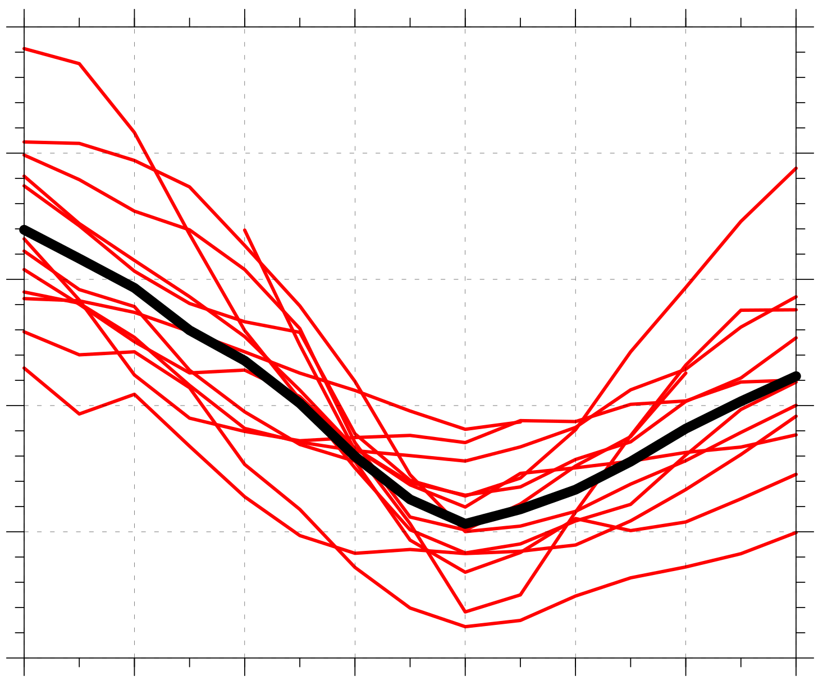
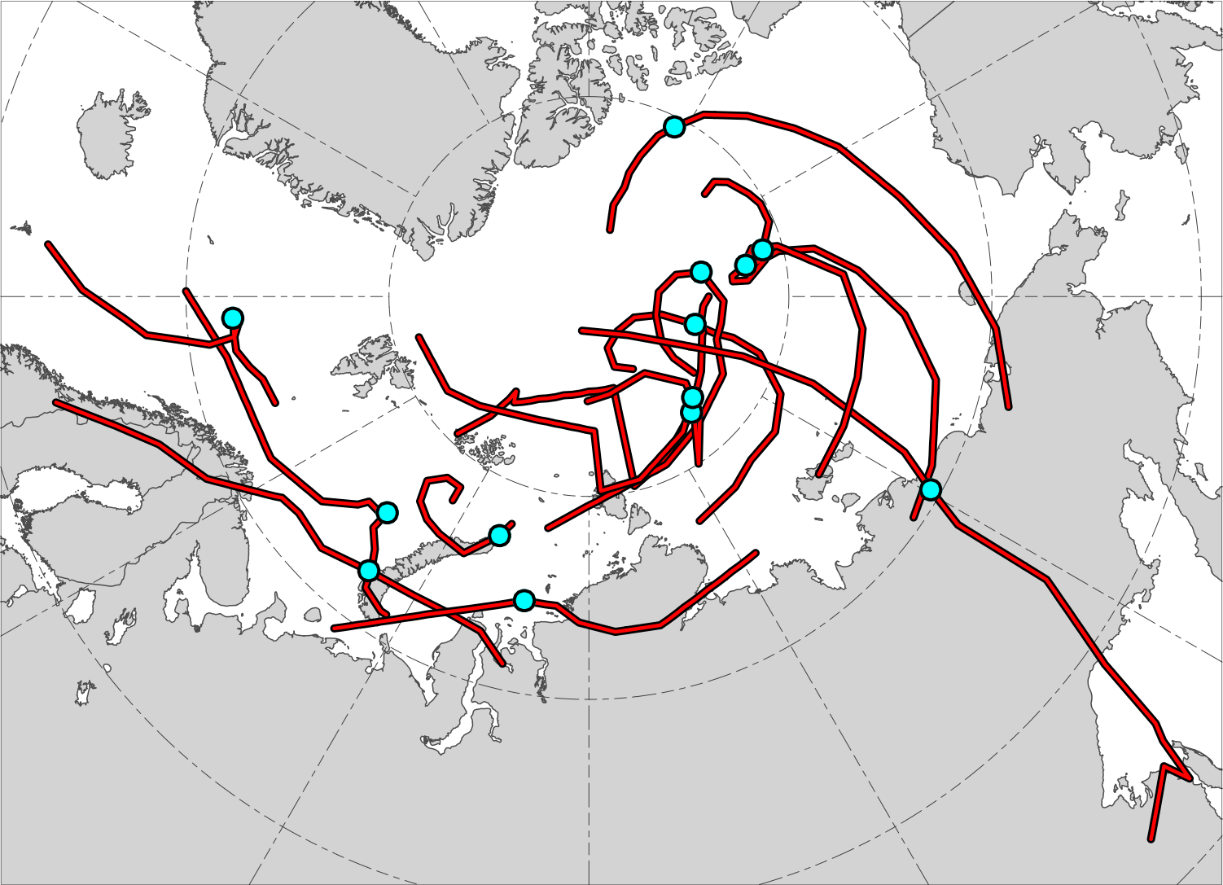
Track and intensity of composited ACs
N = 13
1010
N = 13
1000
990
Minimum SLP (hPa)
980
970
960
AC location at lag 0 h (time of lowest SLP of AC in Arctic)
−48
−36
−24
−12
0
12
24
36
Lag hour relative to time of lowest SLP of AC in Arctic
Red lines show tracks of ACs during lags –48 h to 36 h,
when valid.
Time series of minimum SLP (hPa) of ACs (red) and of mean minimum SLP (hPa) of ACs (black) during lags –48 h to 36 h, when valid.

Slide 9
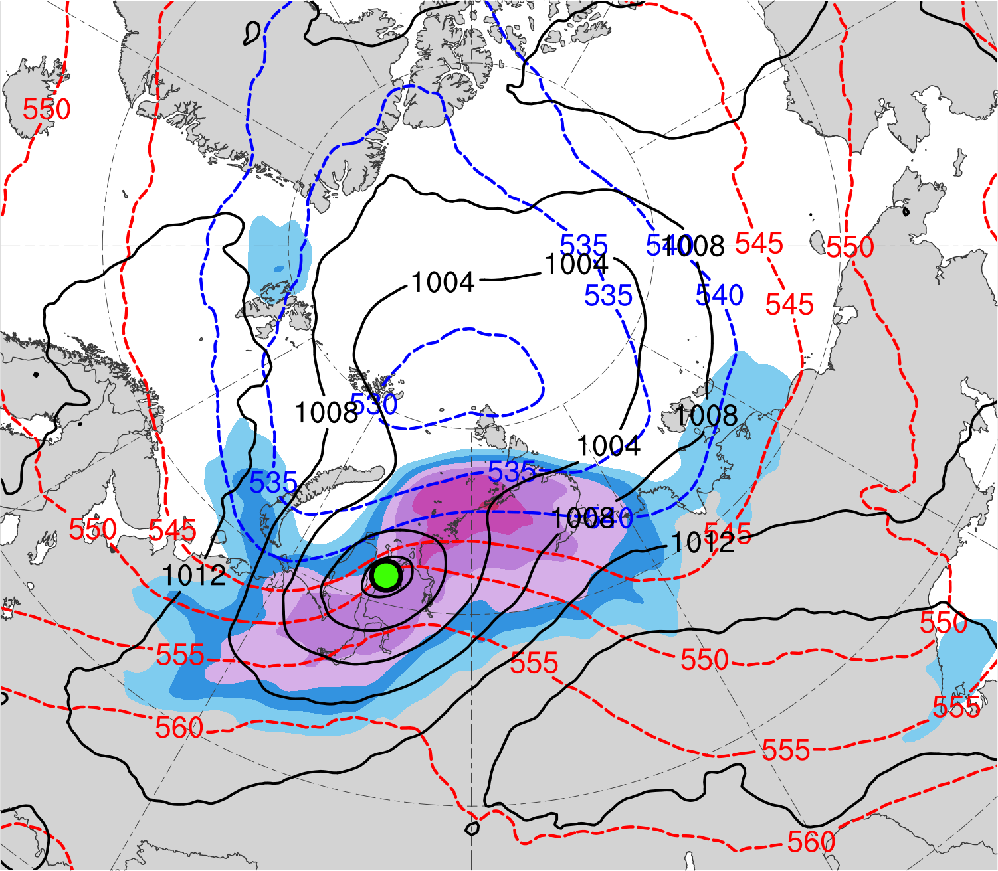
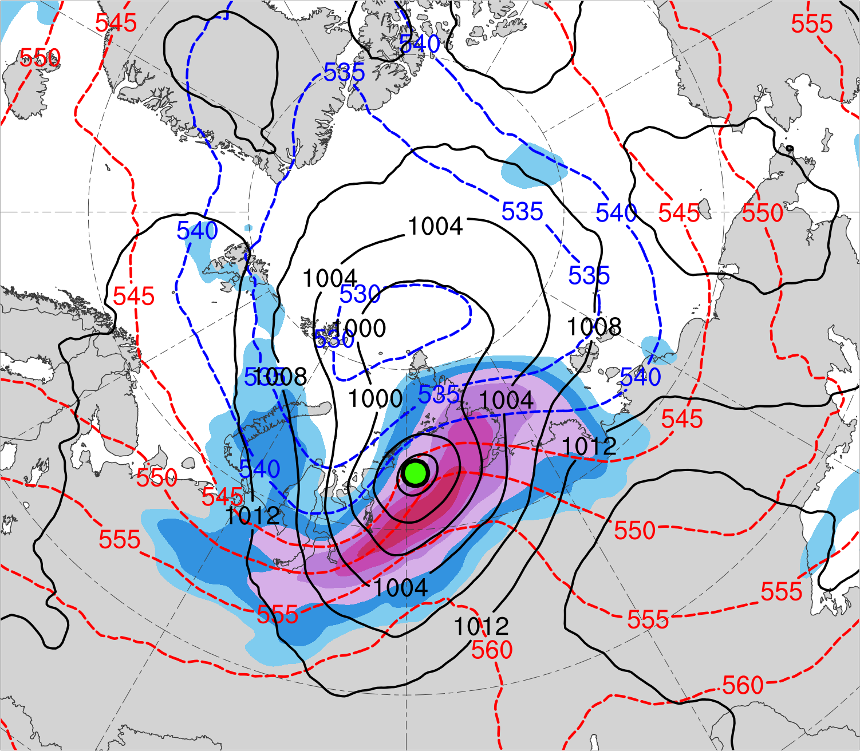
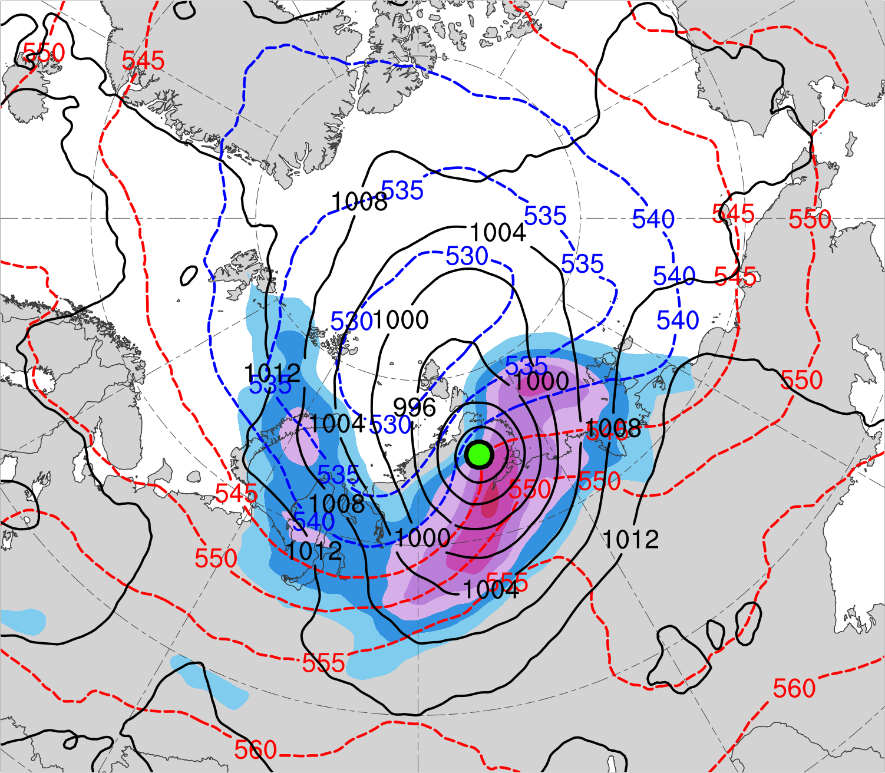
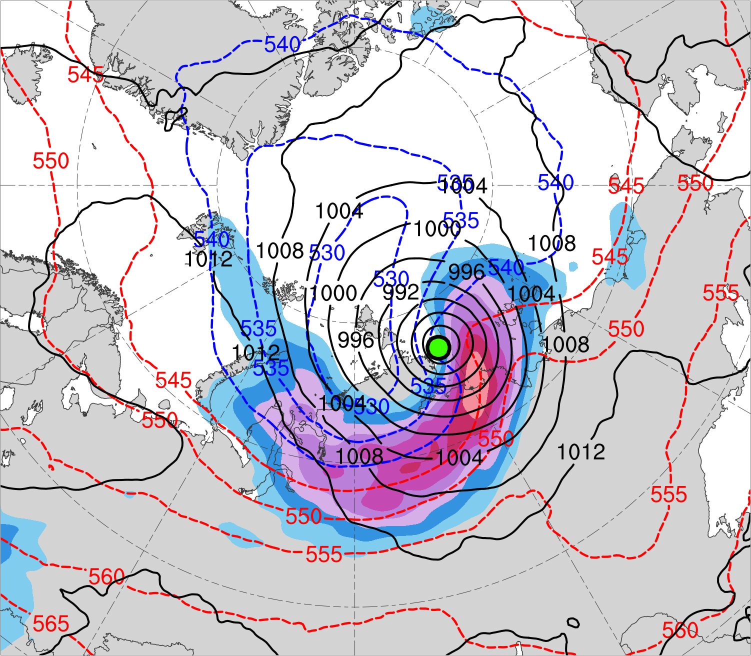
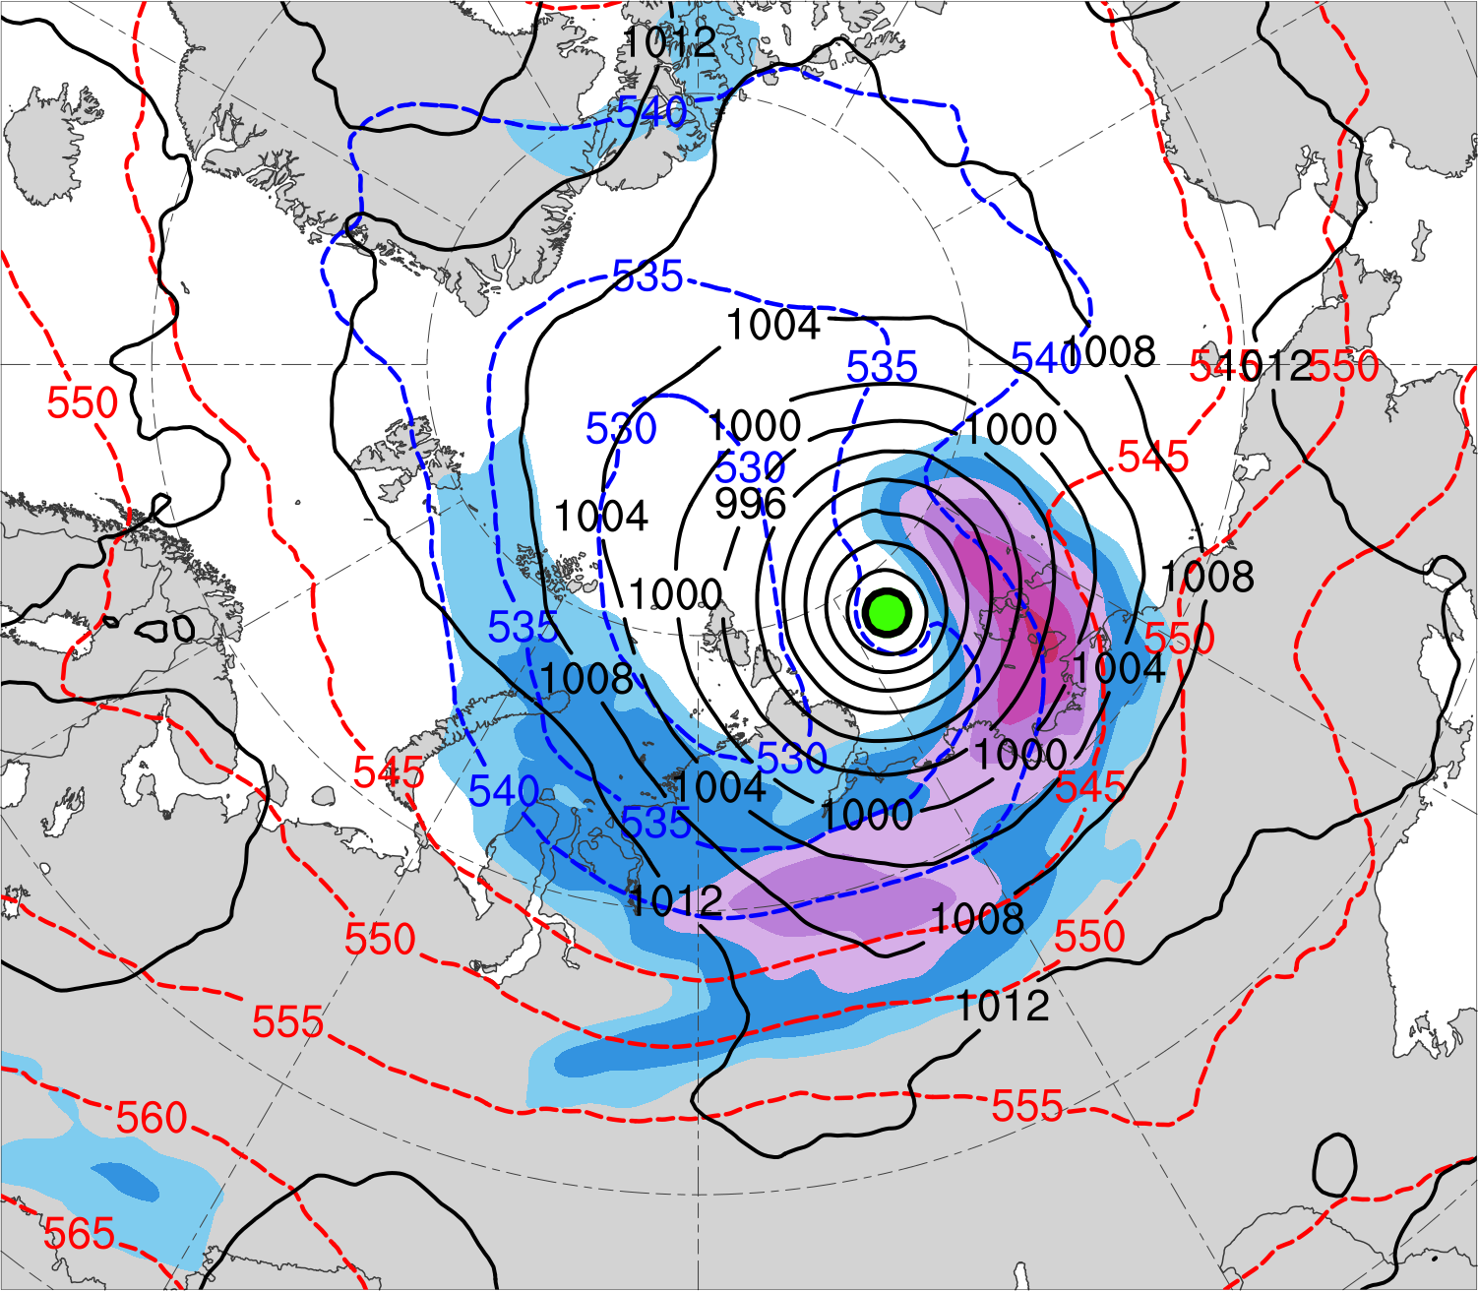
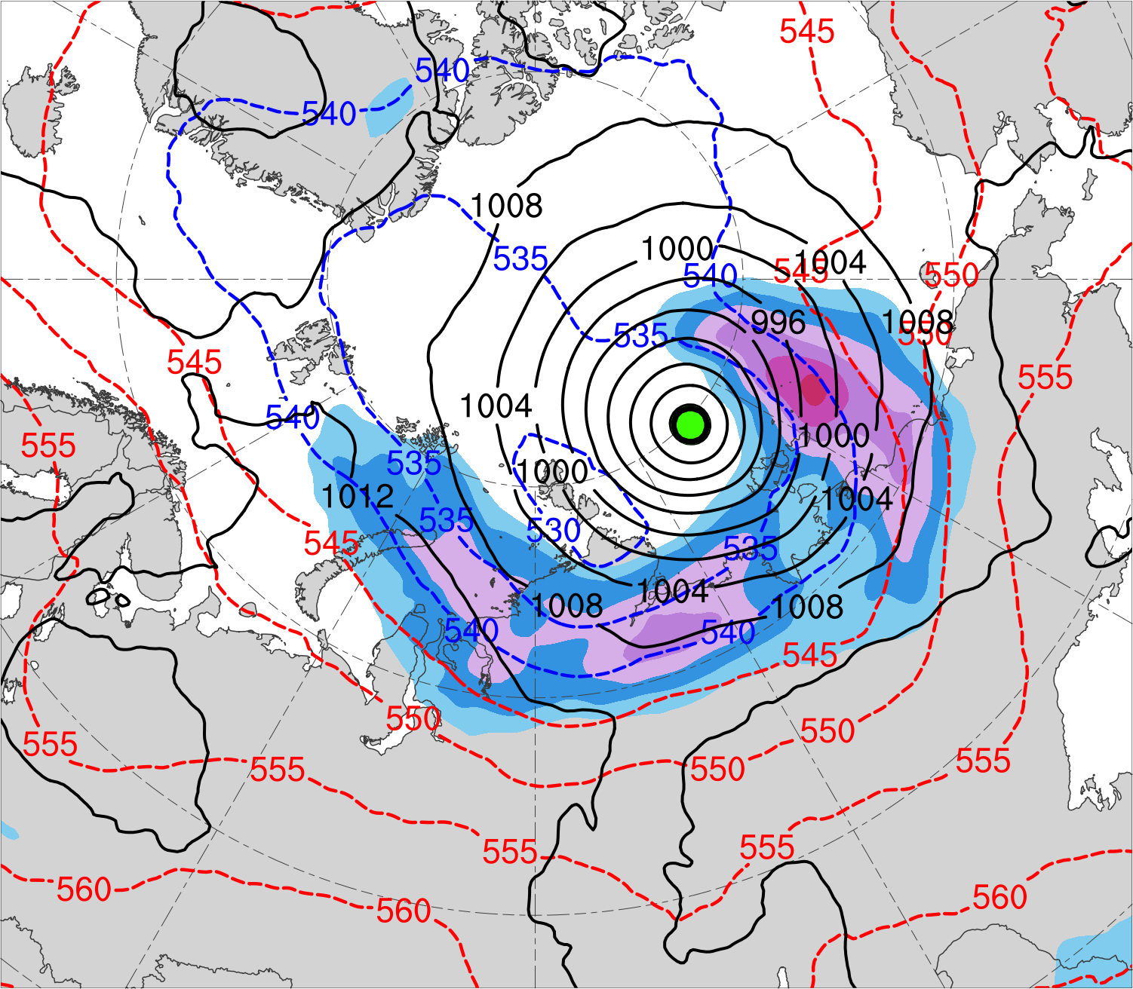
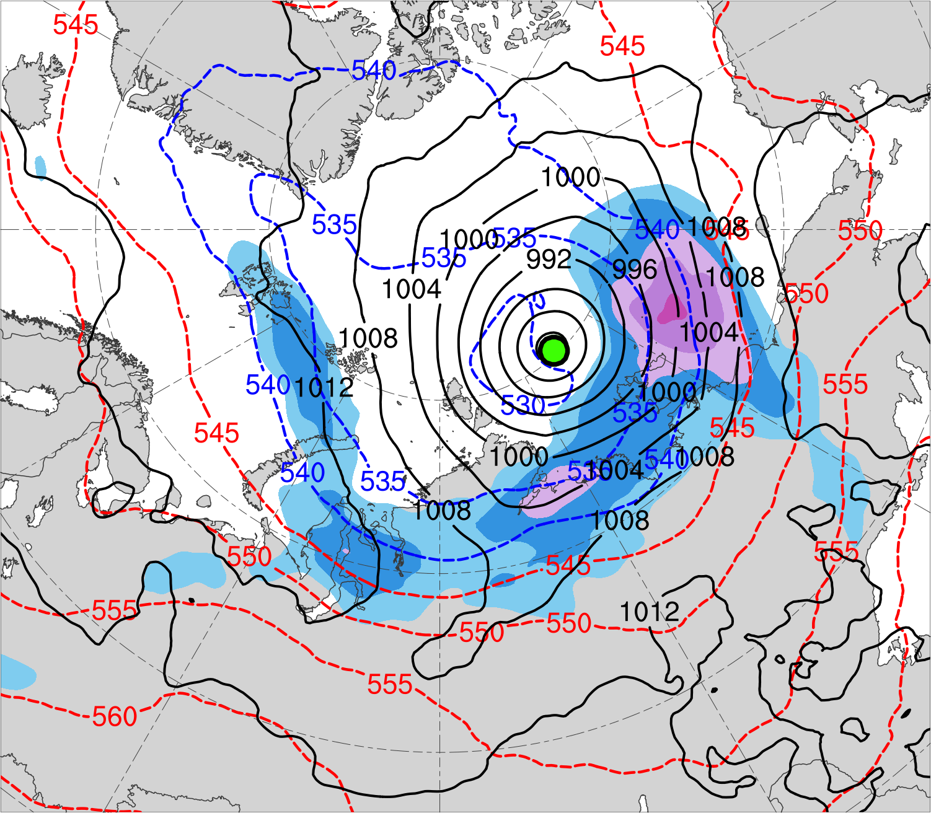
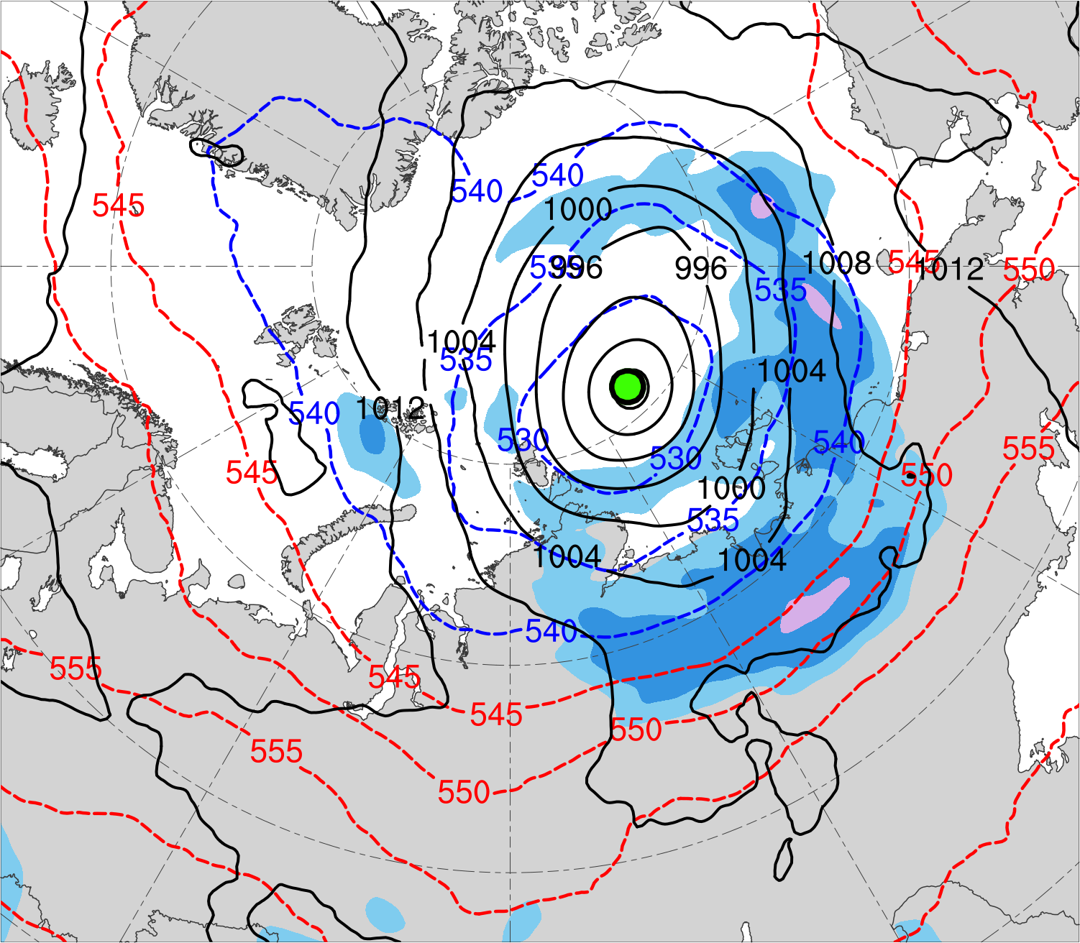
(a) Lag −48 h (N = 12)
(b) Lag −36 h (N = 12)
(c) Lag −24 h (N = 13)
(d) Lag −12 h (N = 13)
(e) Lag 0 h (N = 13)
(f) Lag 12 h (N = 12)
(g) Lag 24 h (N = 12)
(h) Lag 36 h (N = 11)
300-hPa wind speed (m s⁻¹)
Mean AC location
18
21
24
27
30
33
36
39
SLP (hPa)
1000–500-hPa thickness (dam)

Slide 10
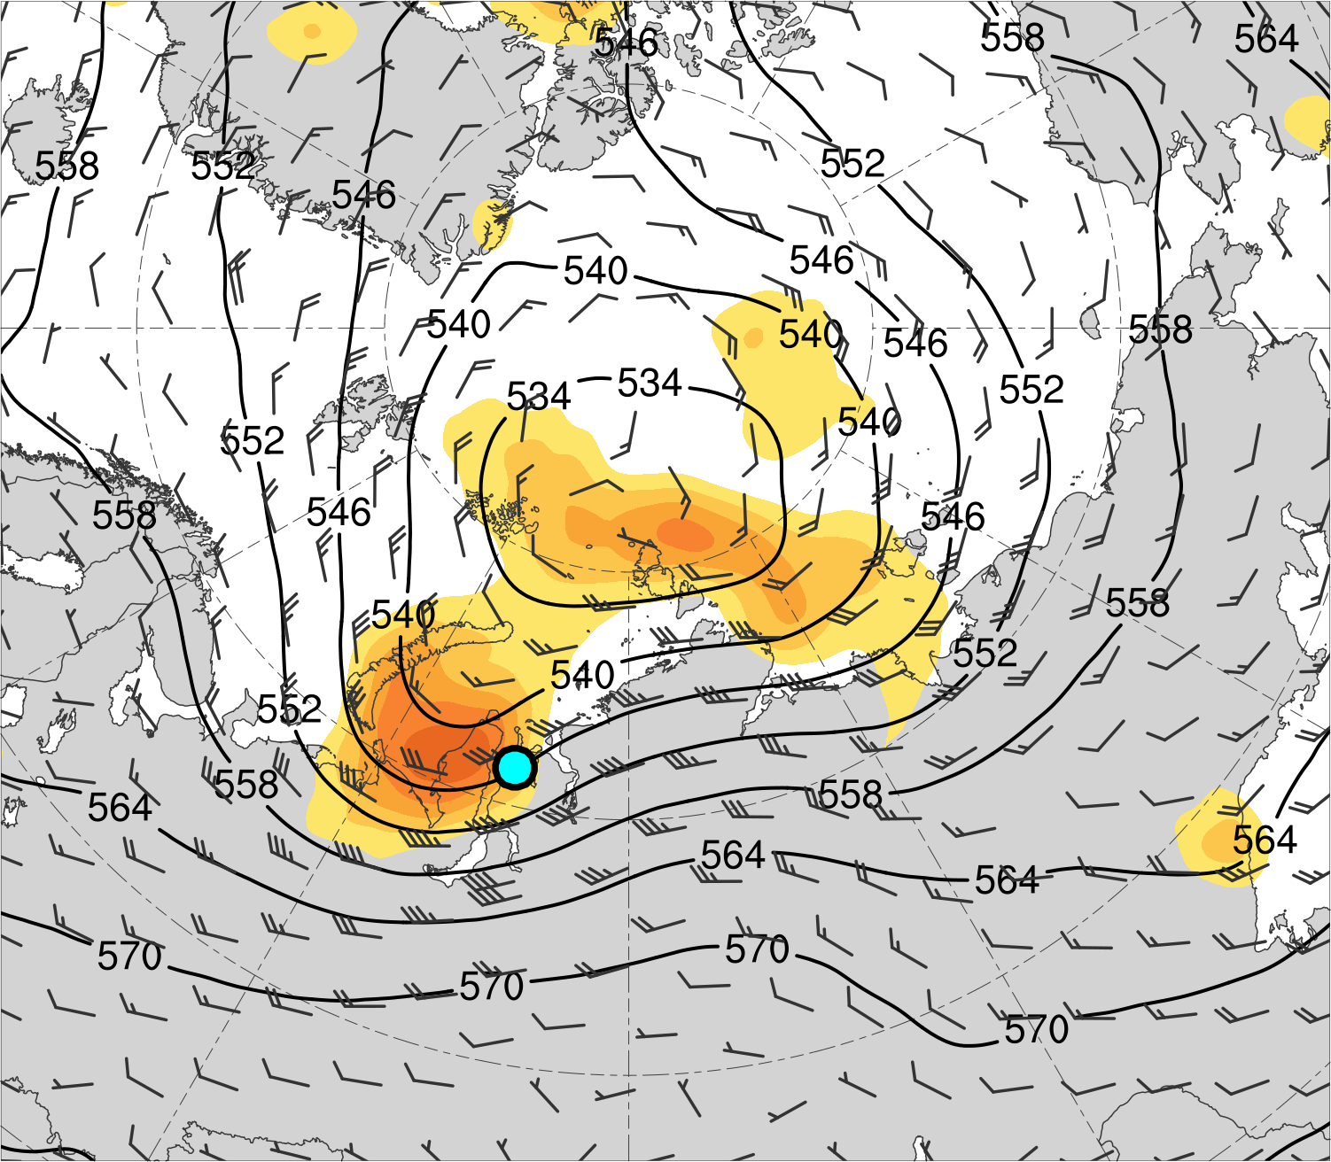
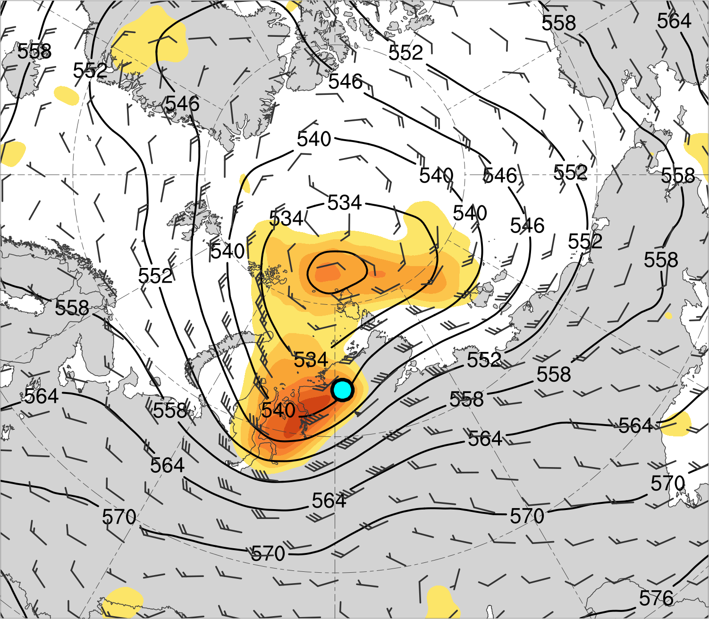
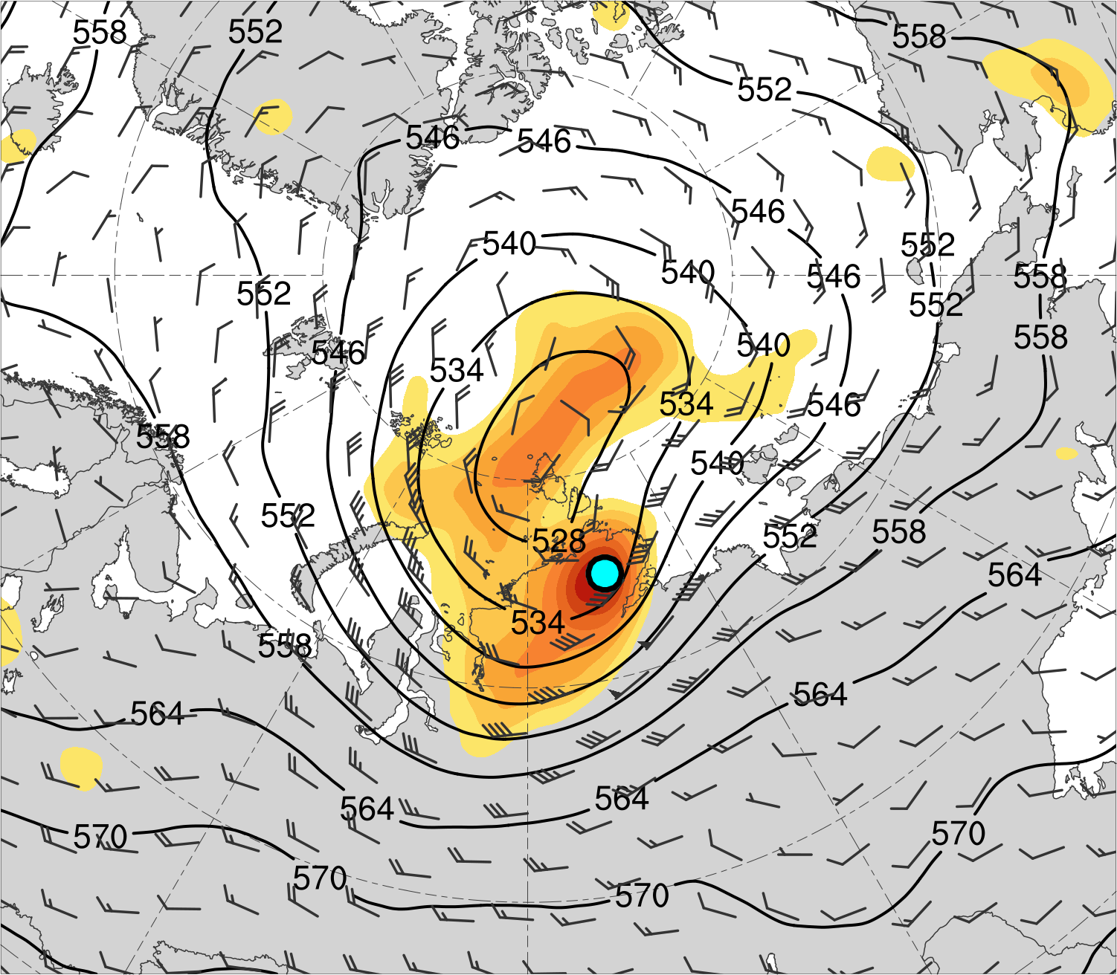
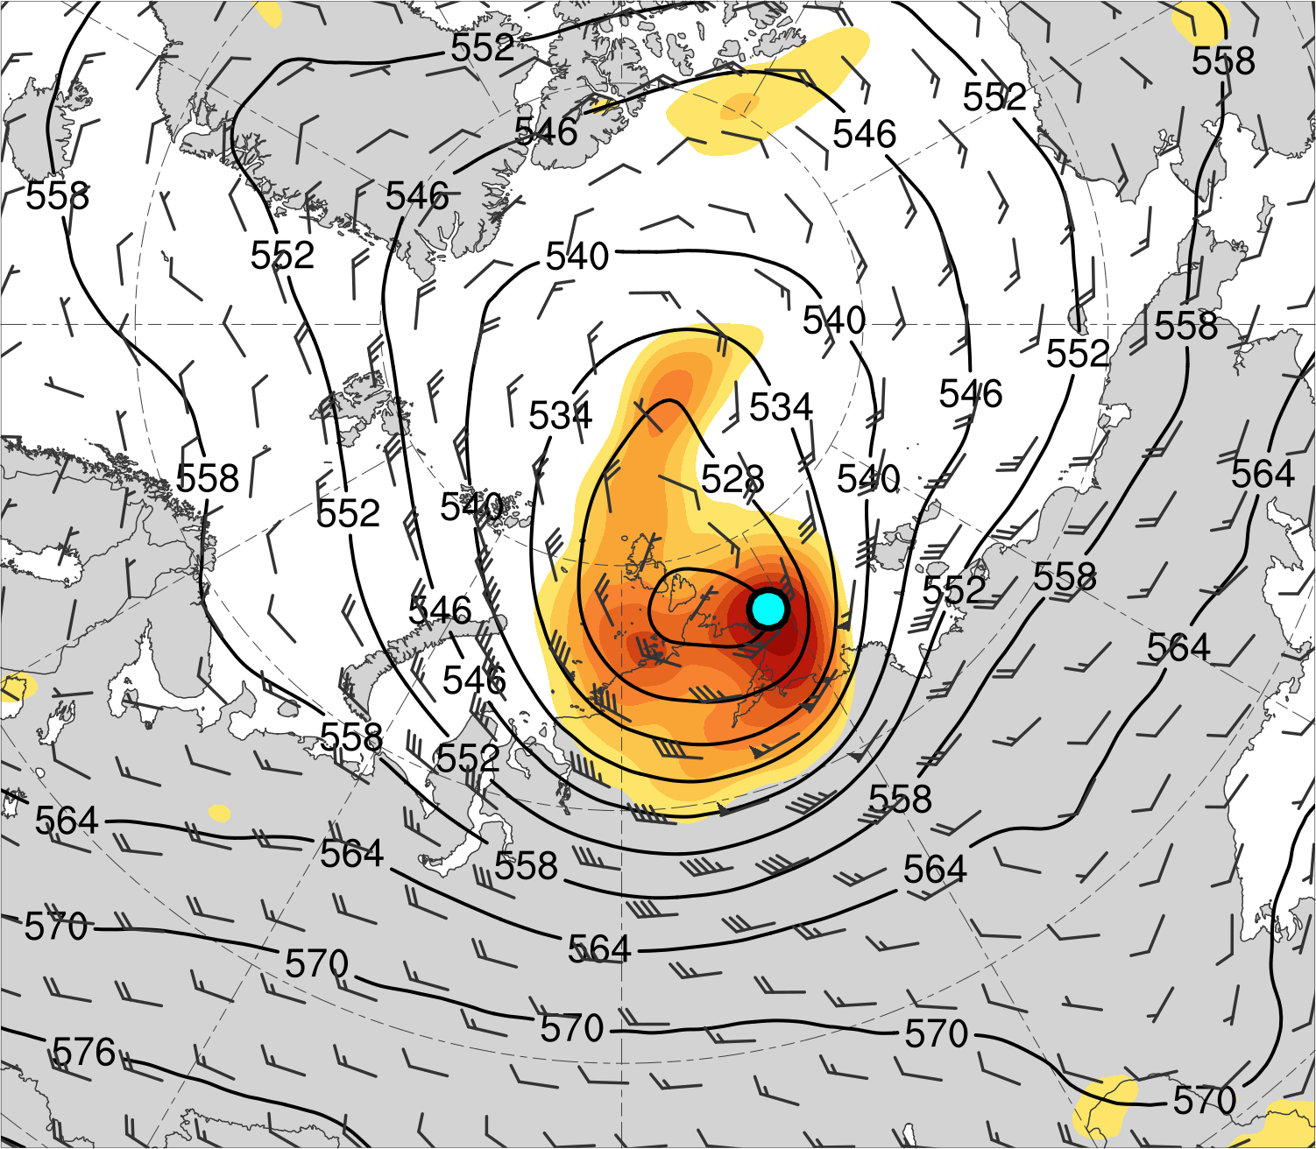
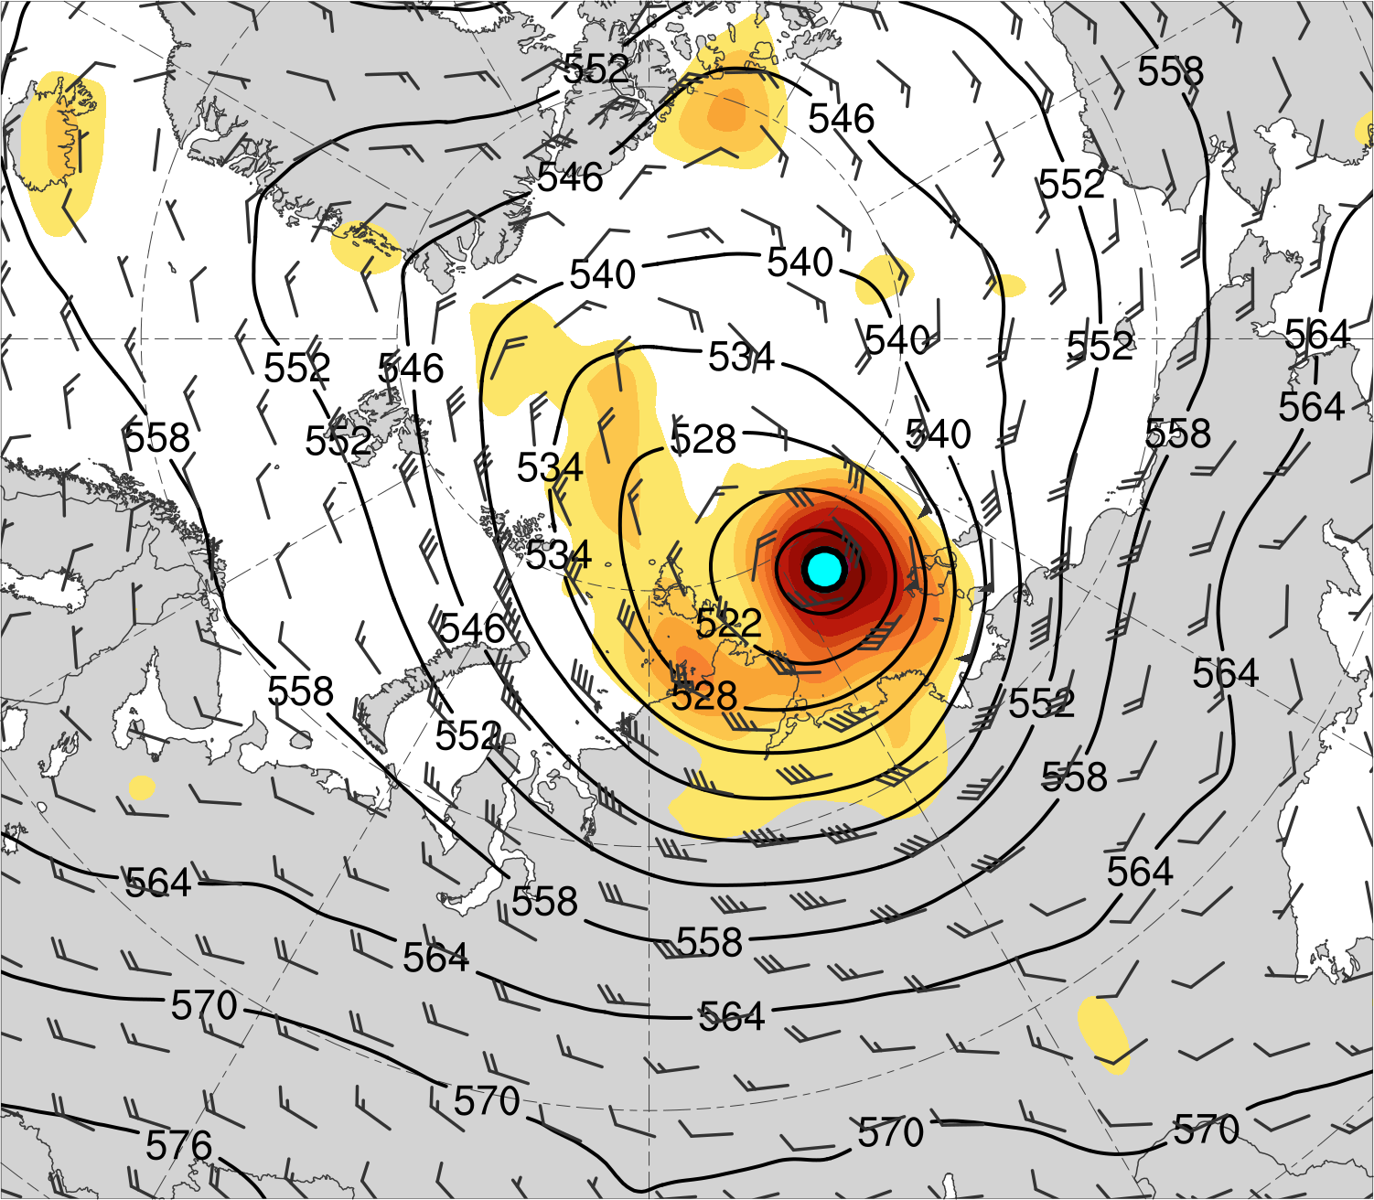
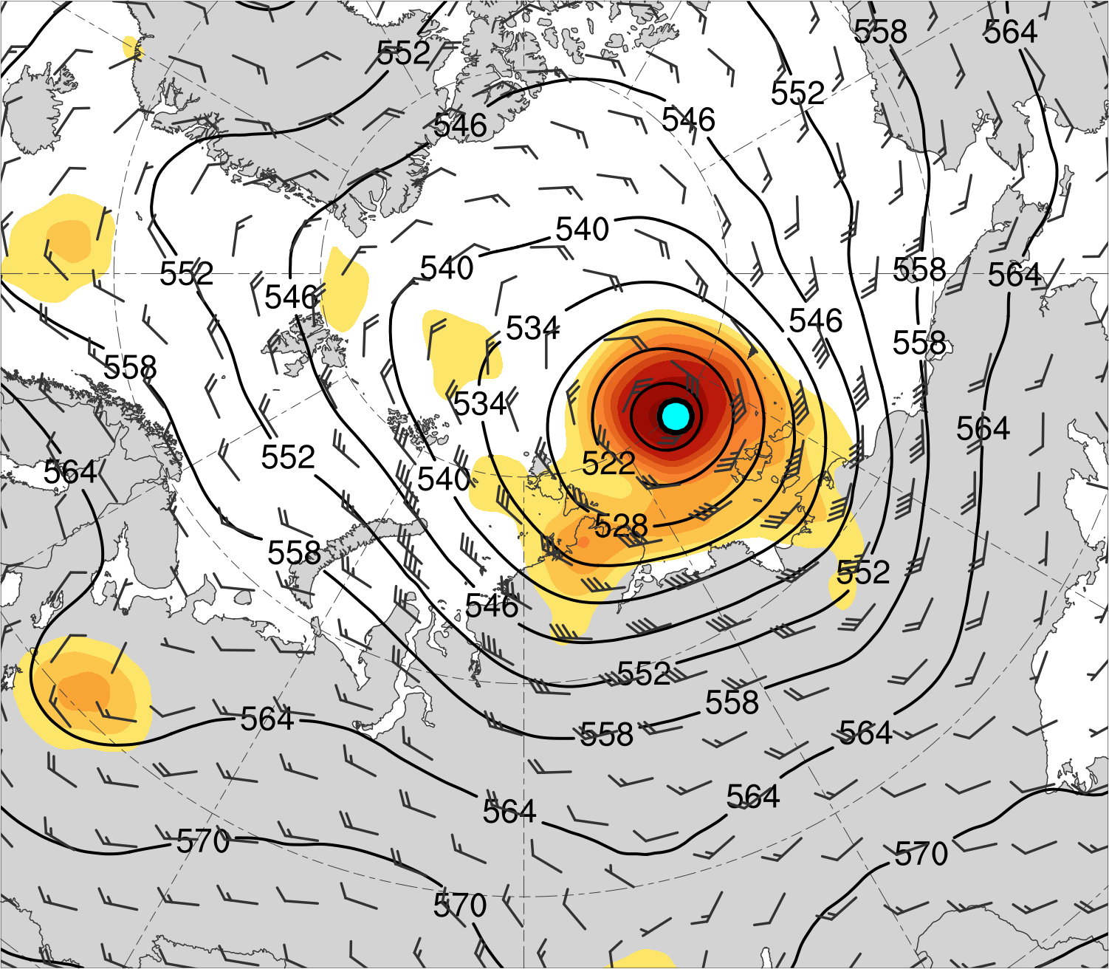
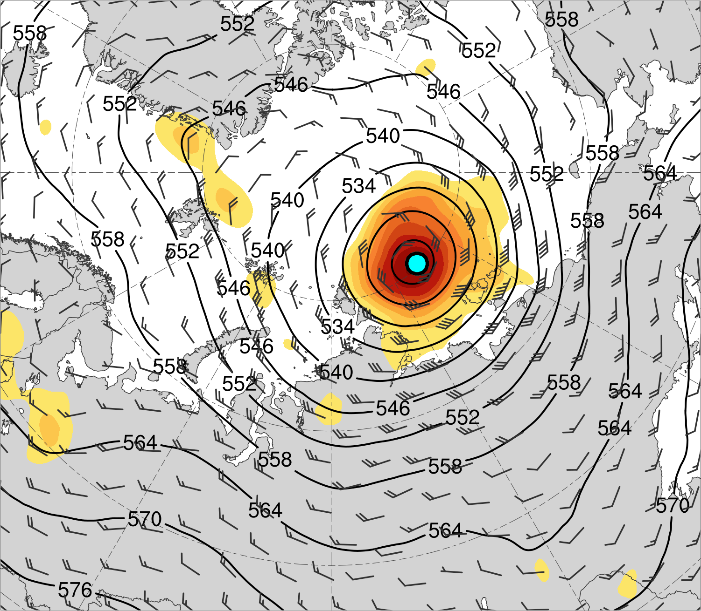
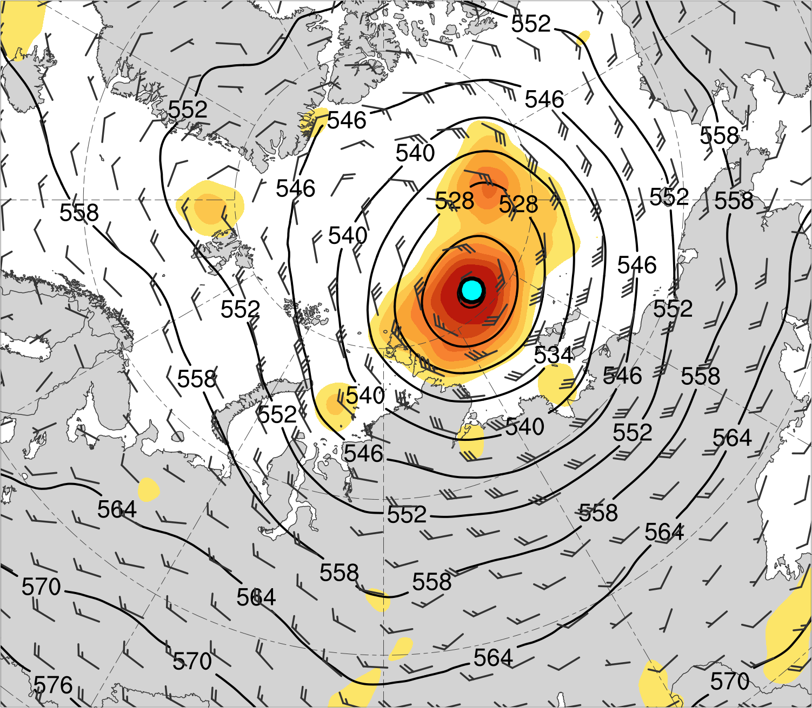
(a) Lag −48 h (N = 12)
(b) Lag −36 h (N = 12)
(c) Lag −24 h (N = 13)
(d) Lag −12 h (N = 13)
(e) Lag 0 h (N = 13)
(f) Lag 12 h (N = 12)
(g) Lag 24 h (N = 12)
(h) Lag 36 h (N = 11)
200-km area-averaged 500-hPa relative vorticity (10⁻⁵ s⁻¹)
Mean AC location
2
3
4
5
6
7
8
10
12
14
500-hPa geopotential
height (dam)
500-hPa wind (m s⁻¹)

Slide 11
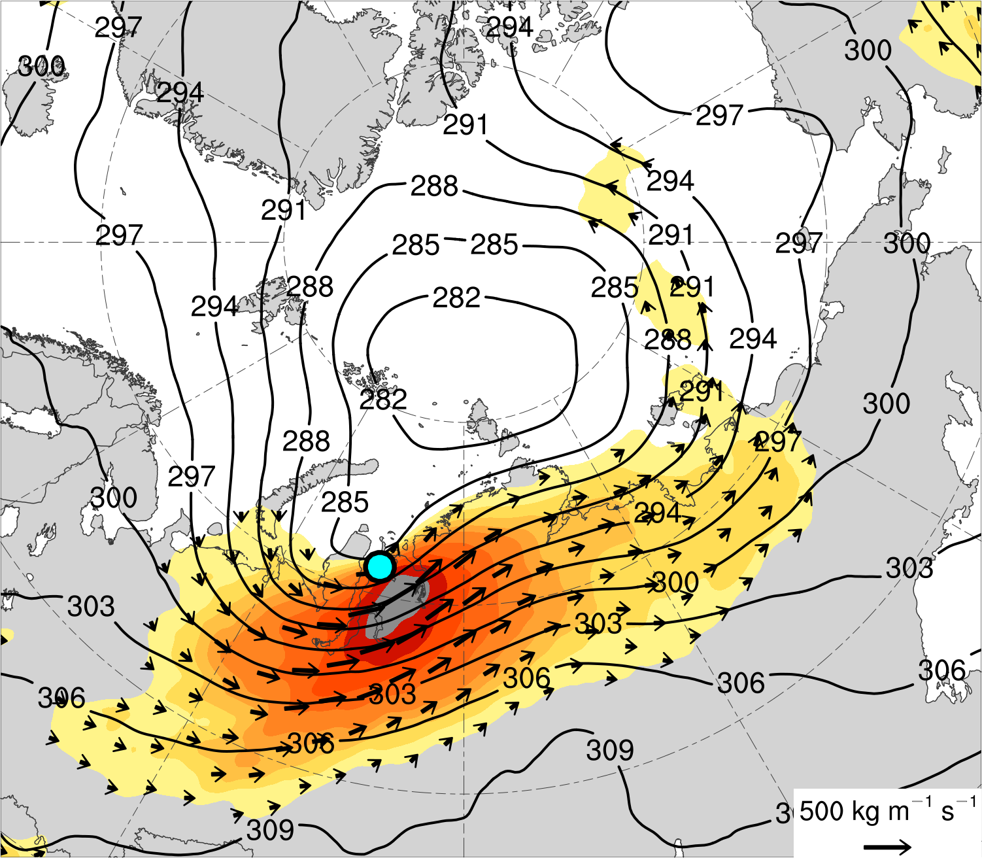
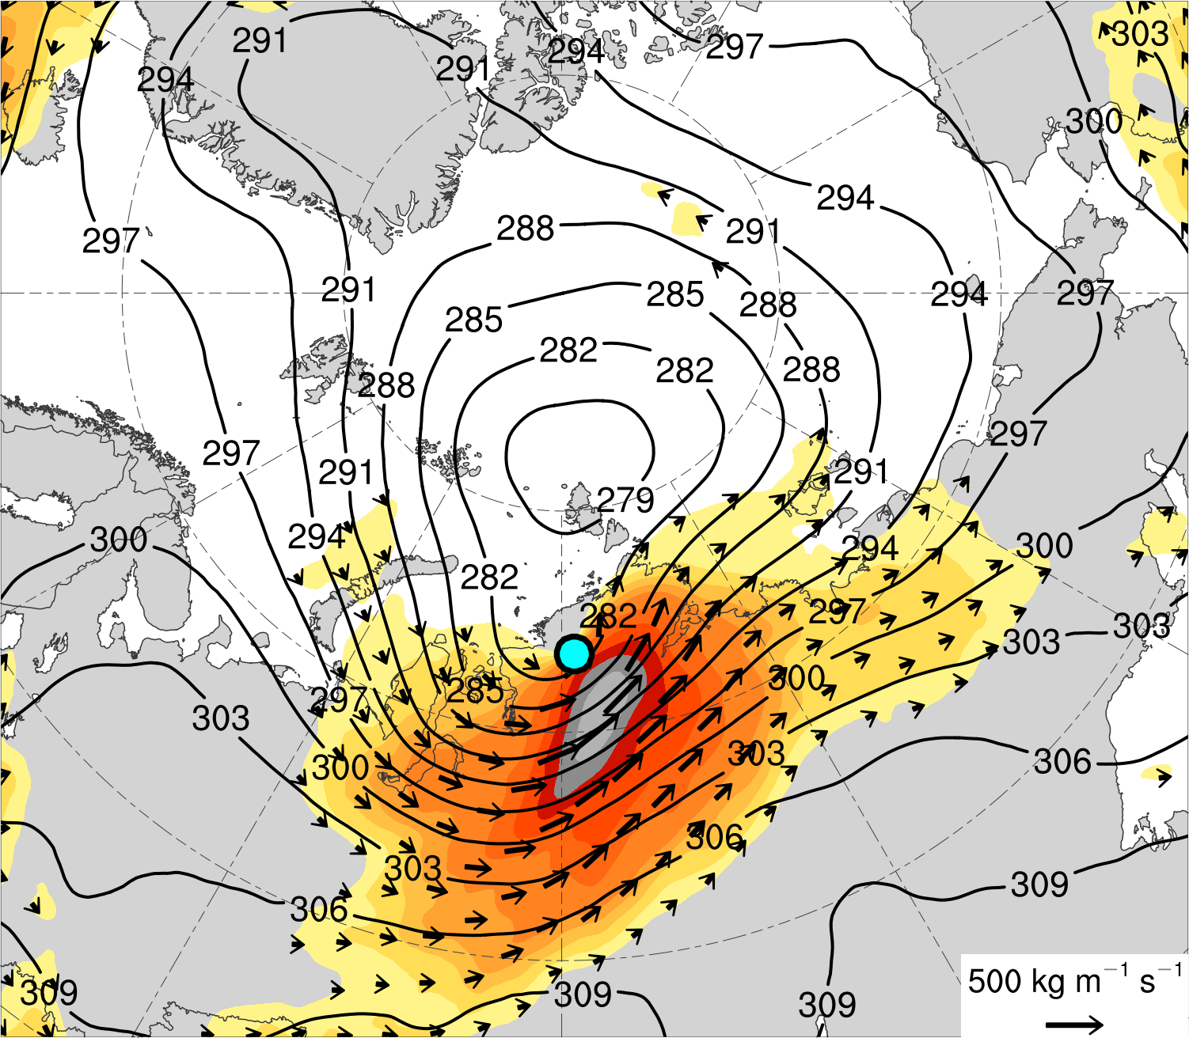
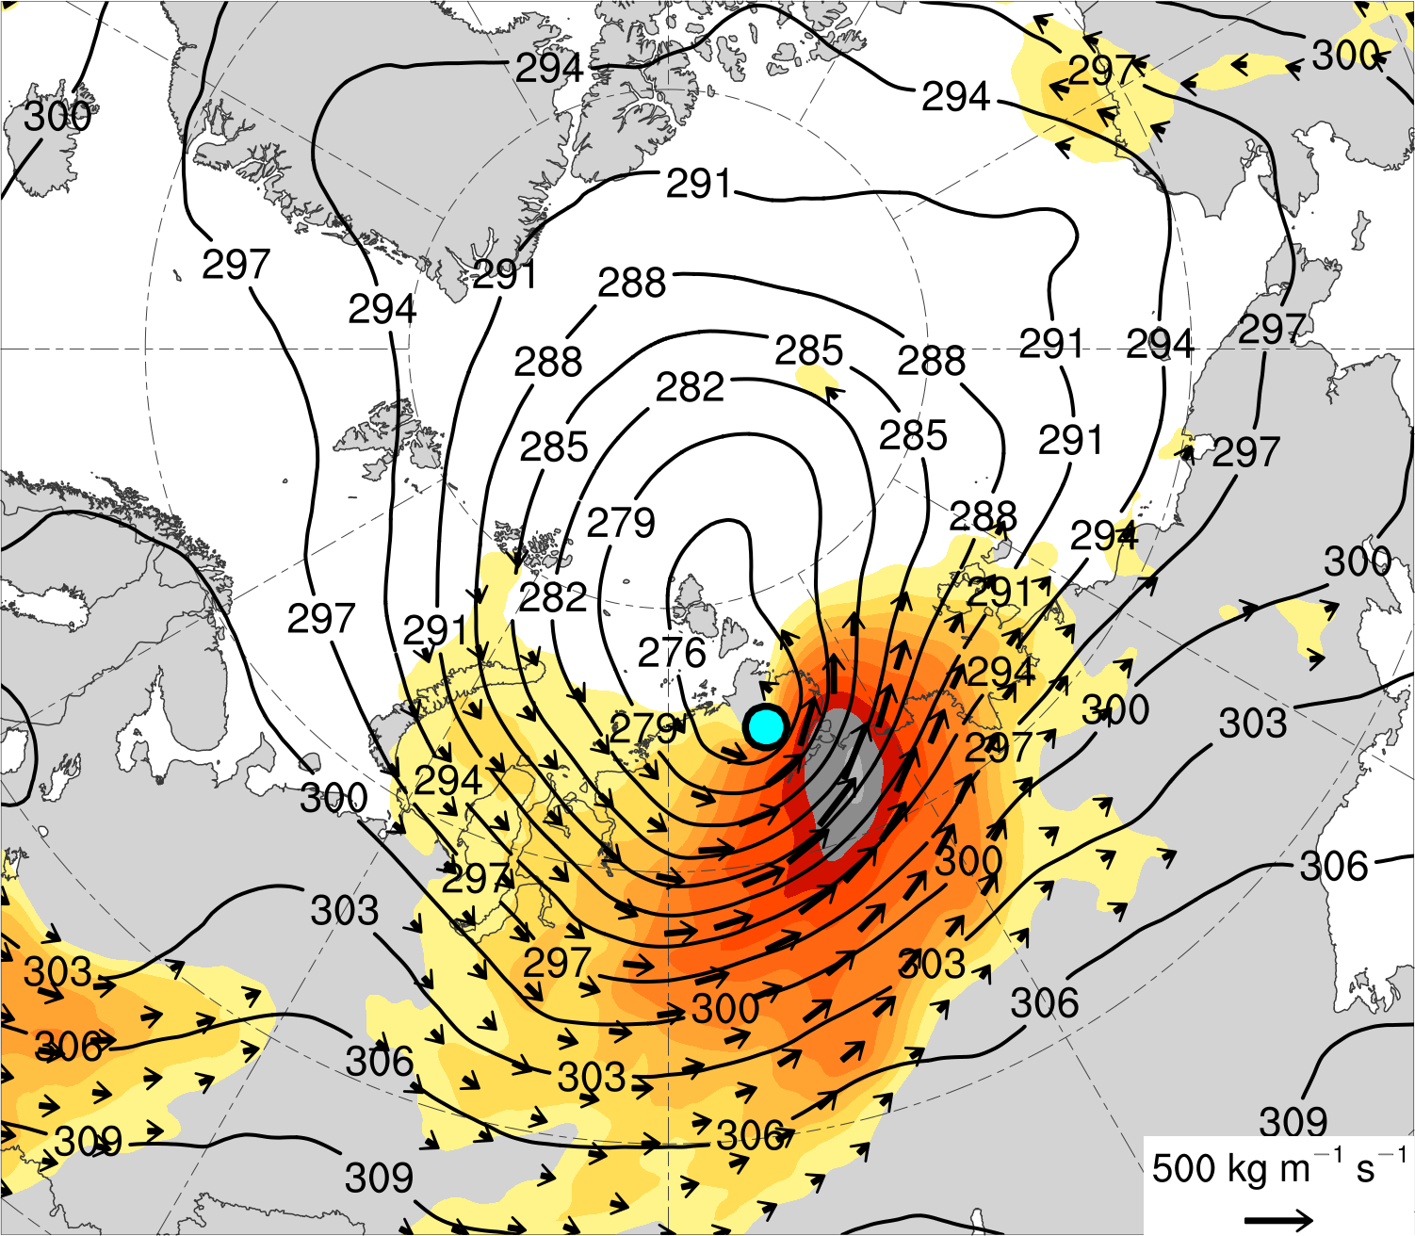
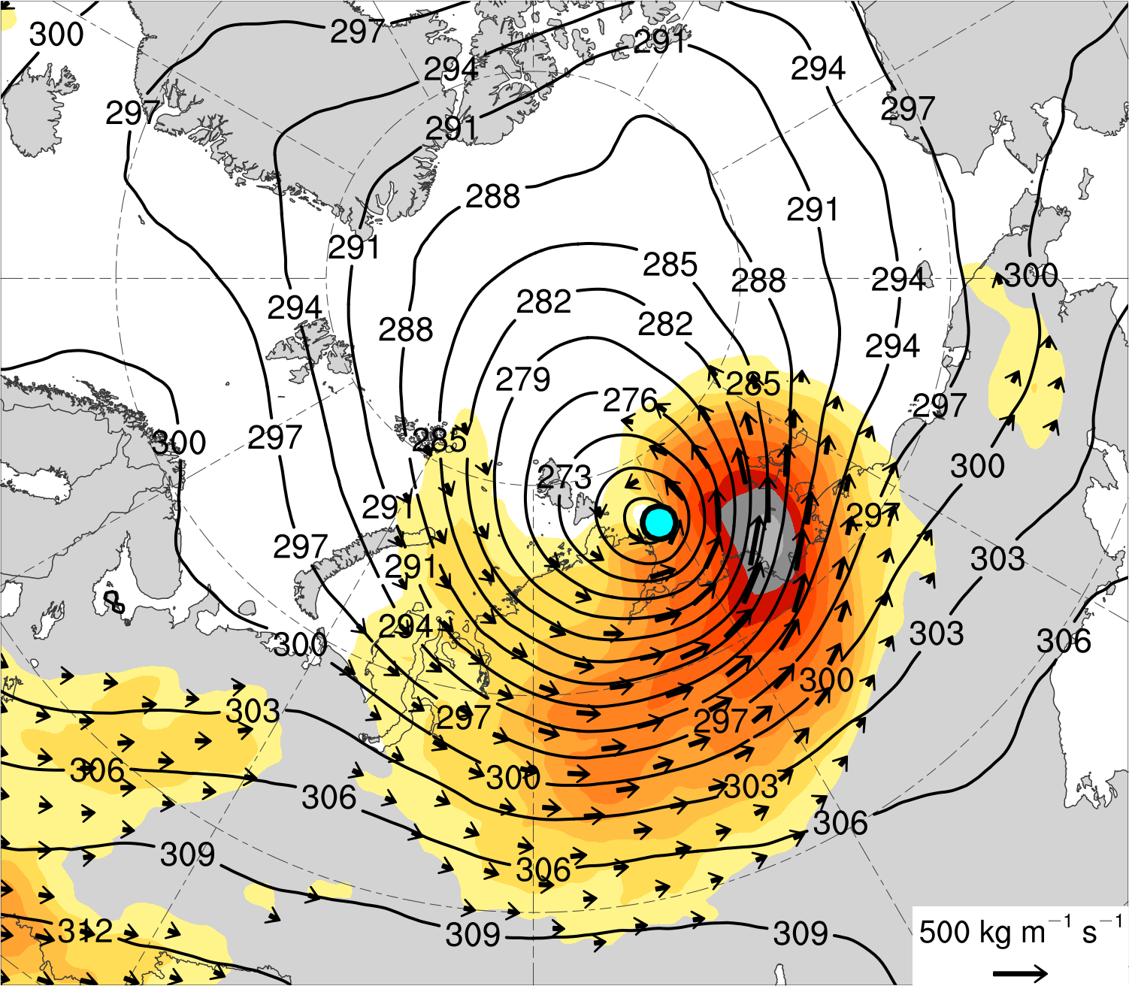
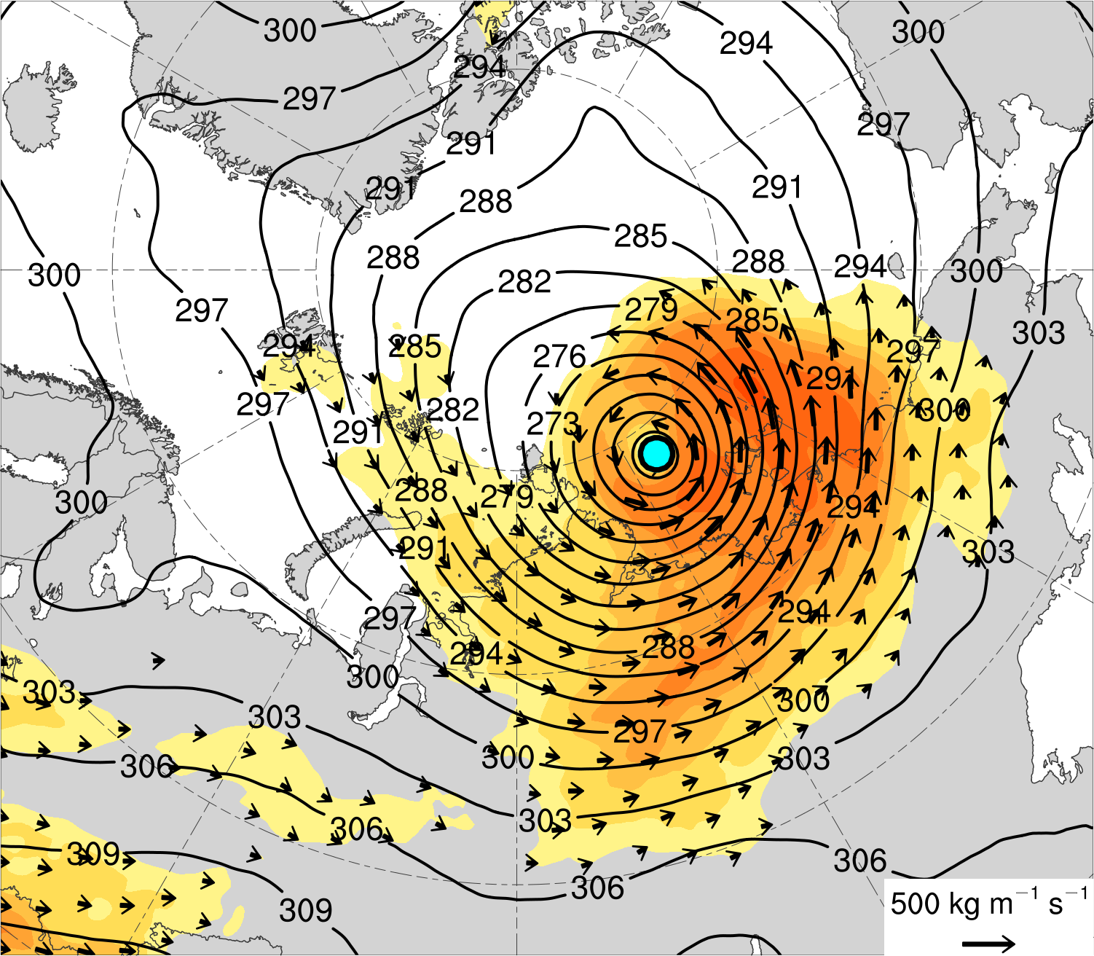
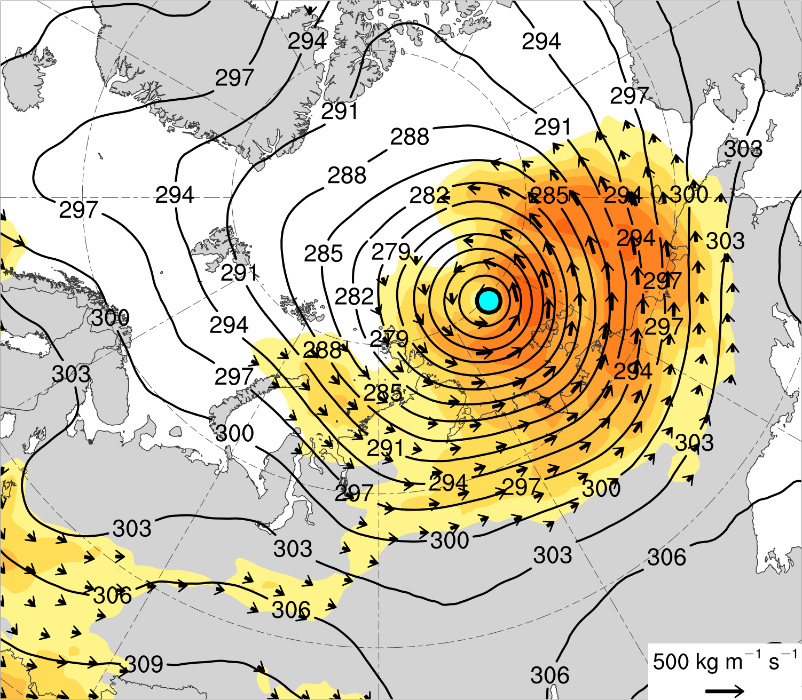
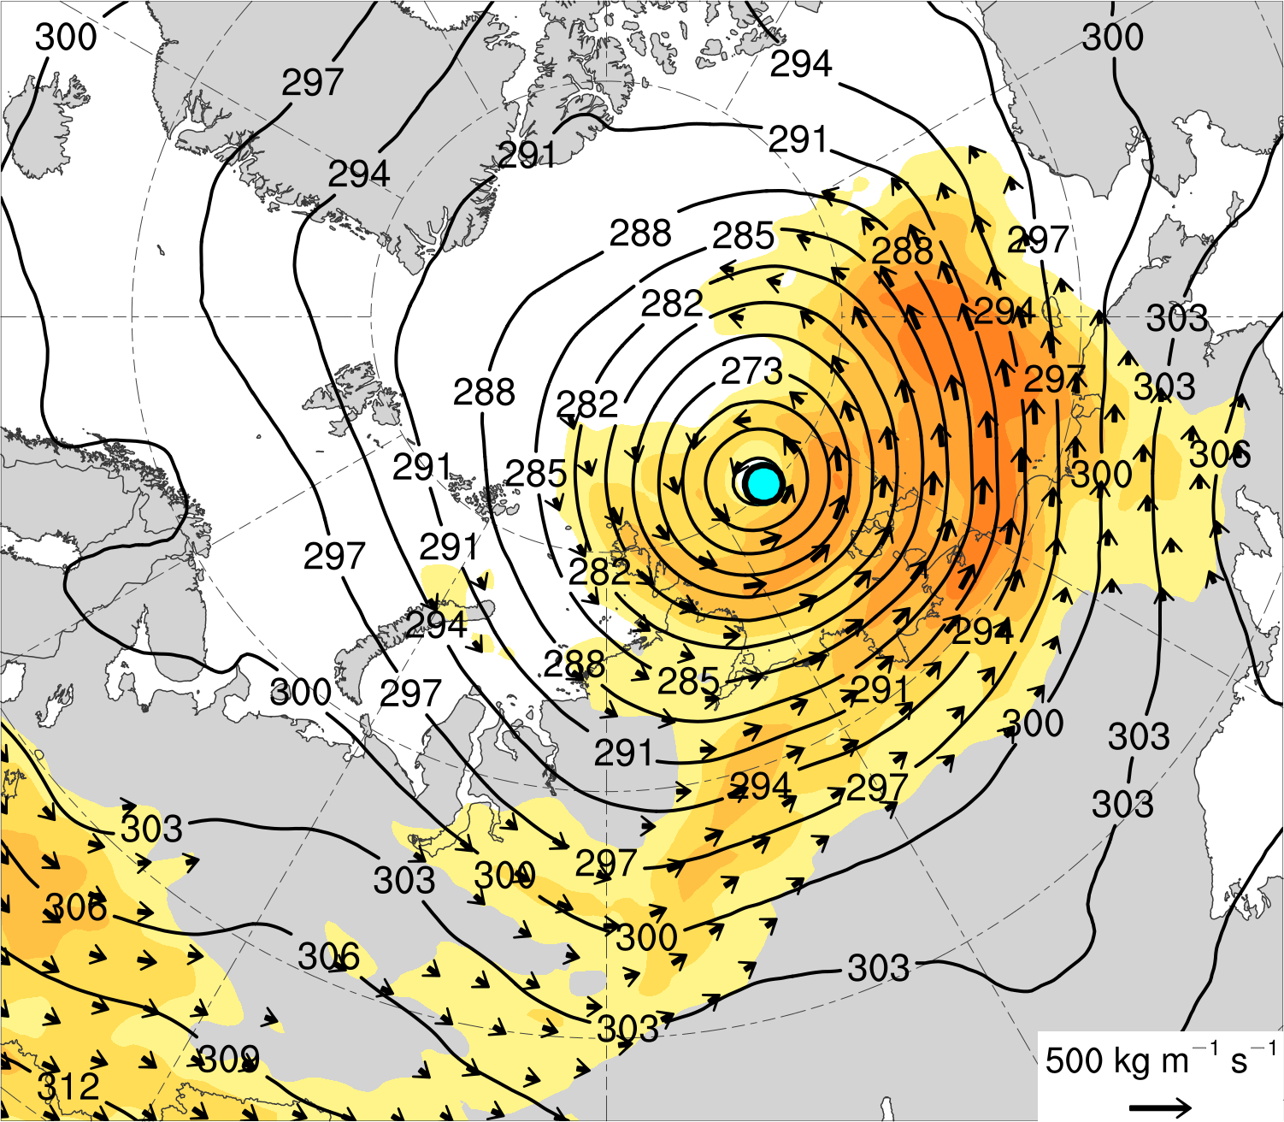
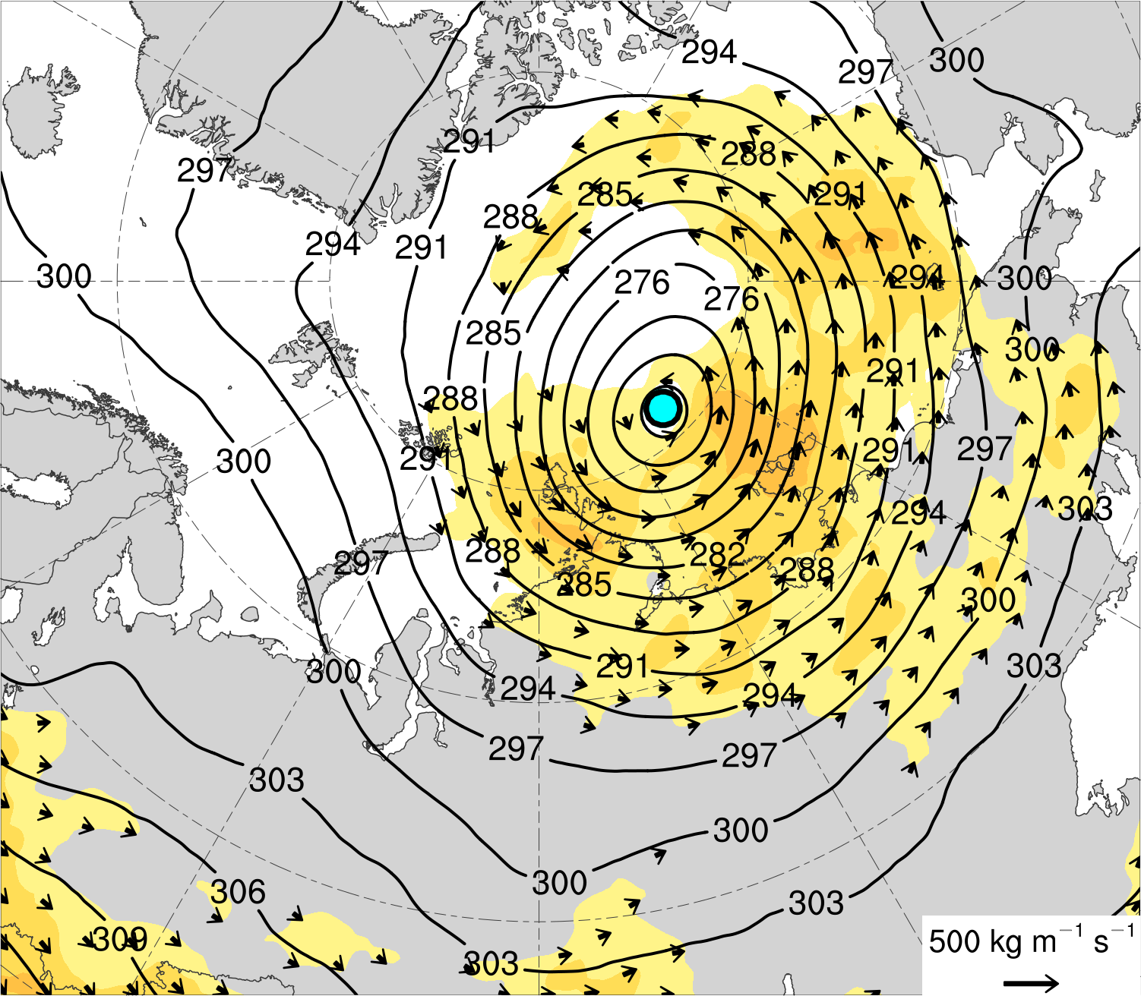
(a) Lag −48 h (N = 12)
(b) Lag −36 h (N = 12)
(c) Lag −24 h (N = 13)
(d) Lag −12 h (N = 13)
(e) Lag 0 h (N = 13)
(f) Lag 12 h (N = 12)
(g) Lag 24 h (N = 12)
(h) Lag 36 h (N = 11)
Integrated vapor transport (IVT) (kg m⁻¹ s⁻¹)
Mean AC location
100
125
150
175
200
250
300
350
400
450
500
IVT (kg m⁻¹ s⁻¹)
700-hPa geopotential
height (dam)

Slide 12
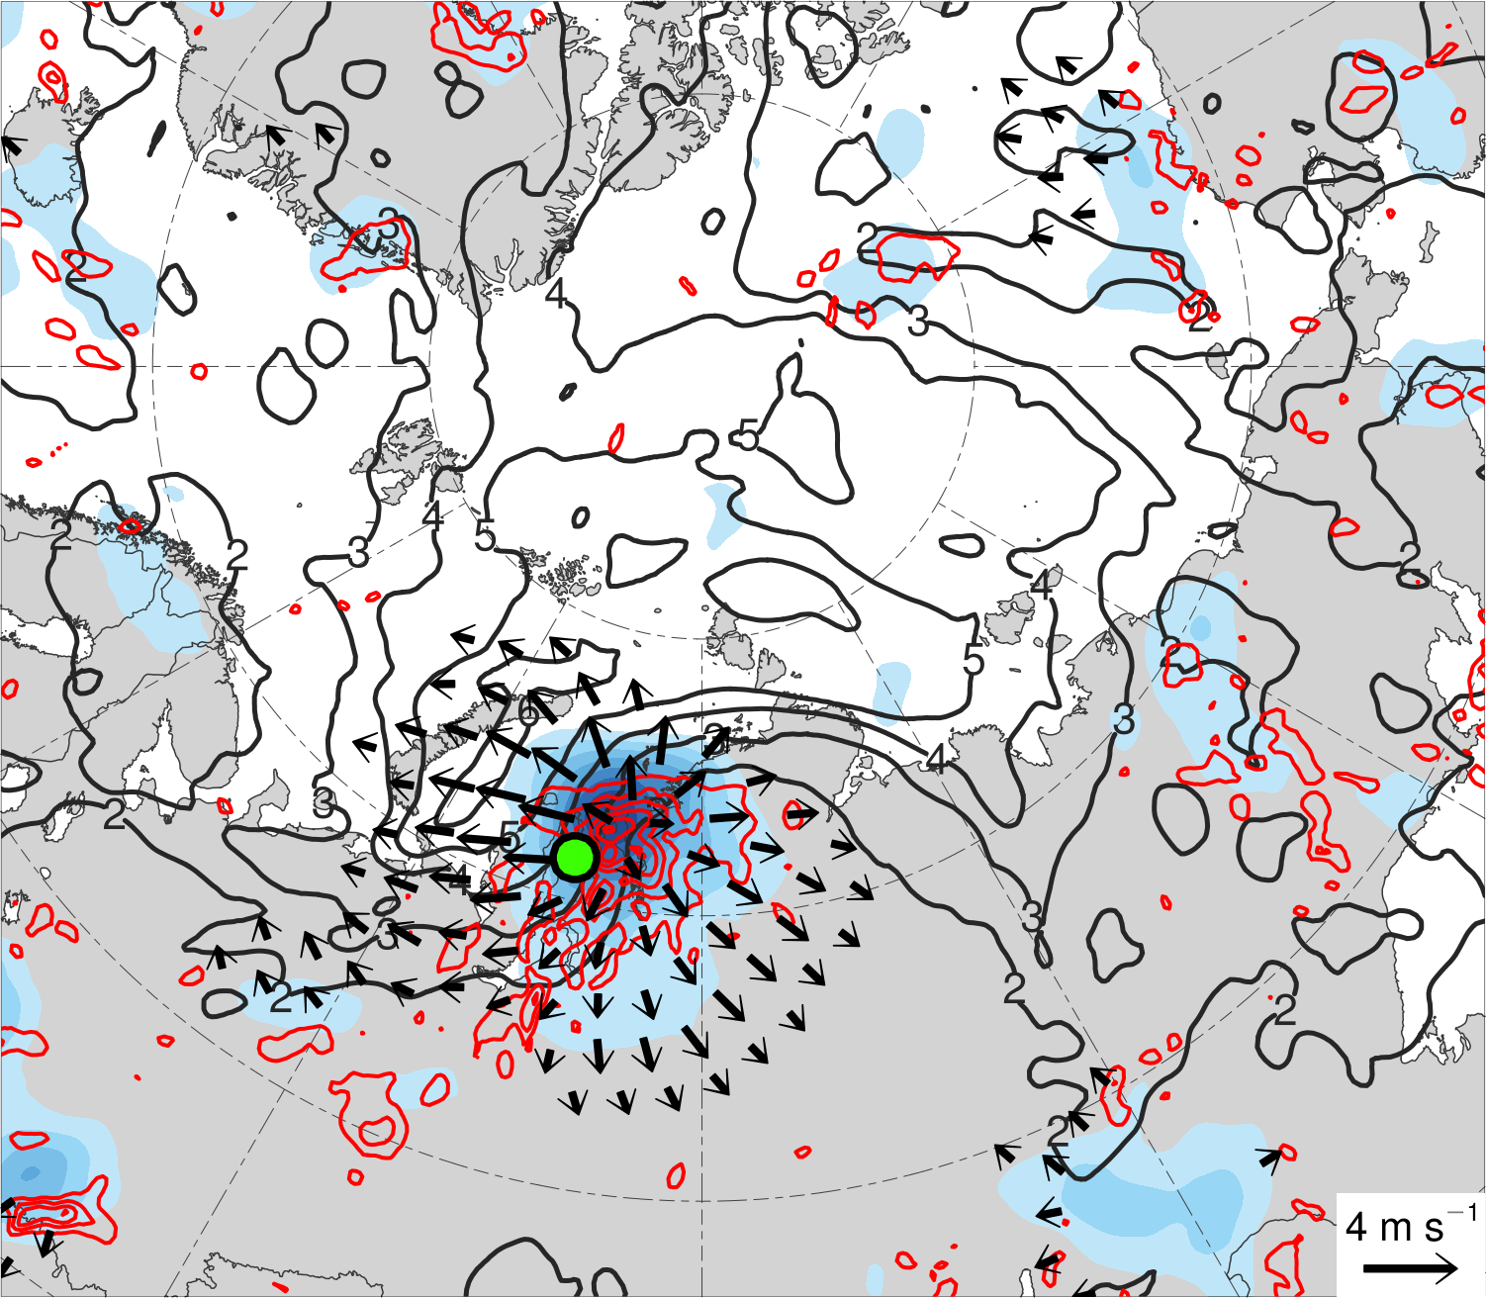
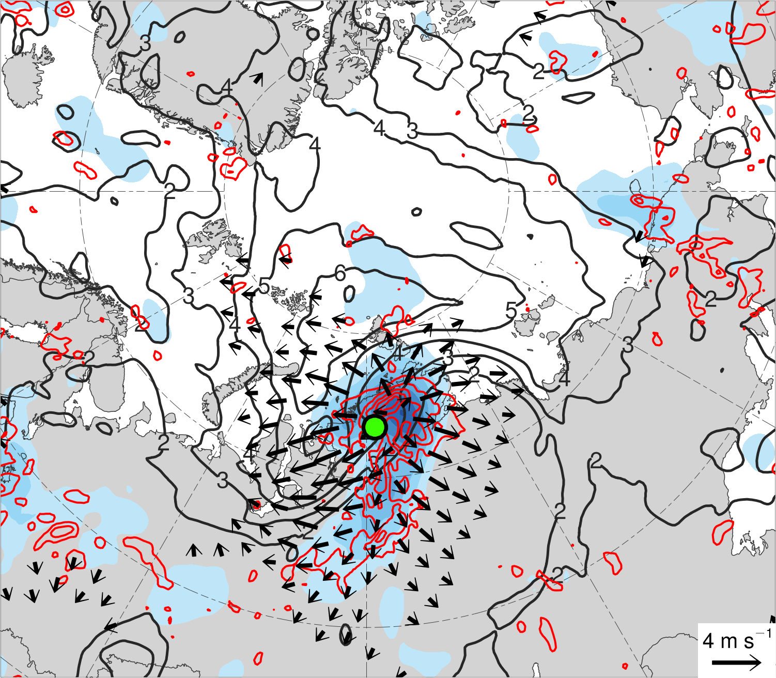
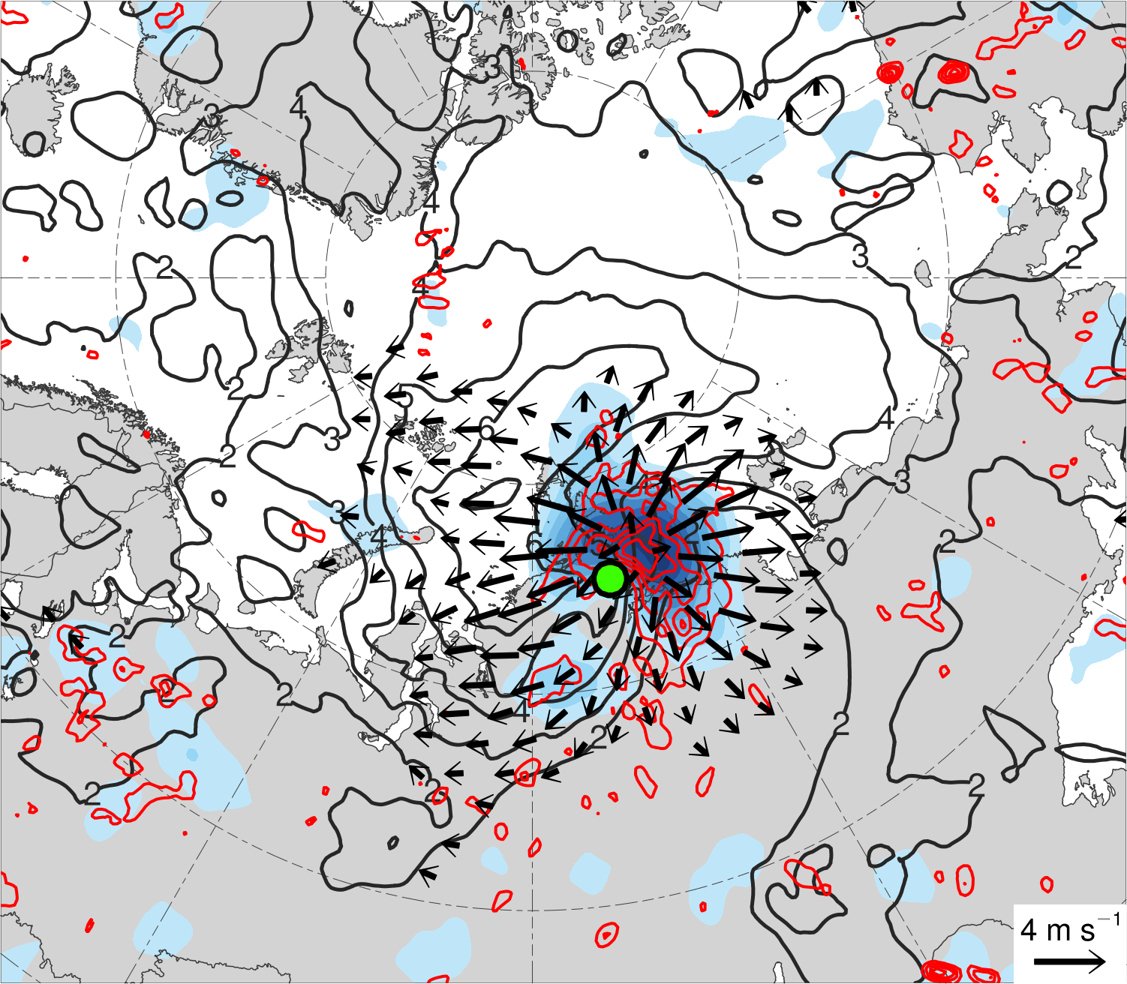
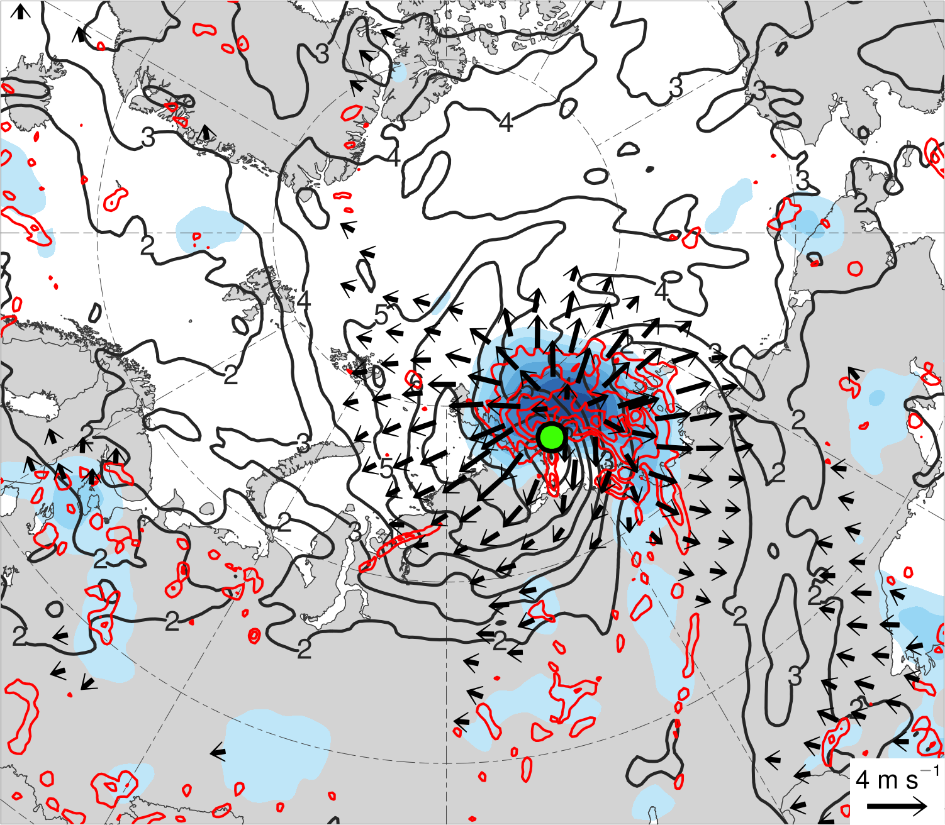
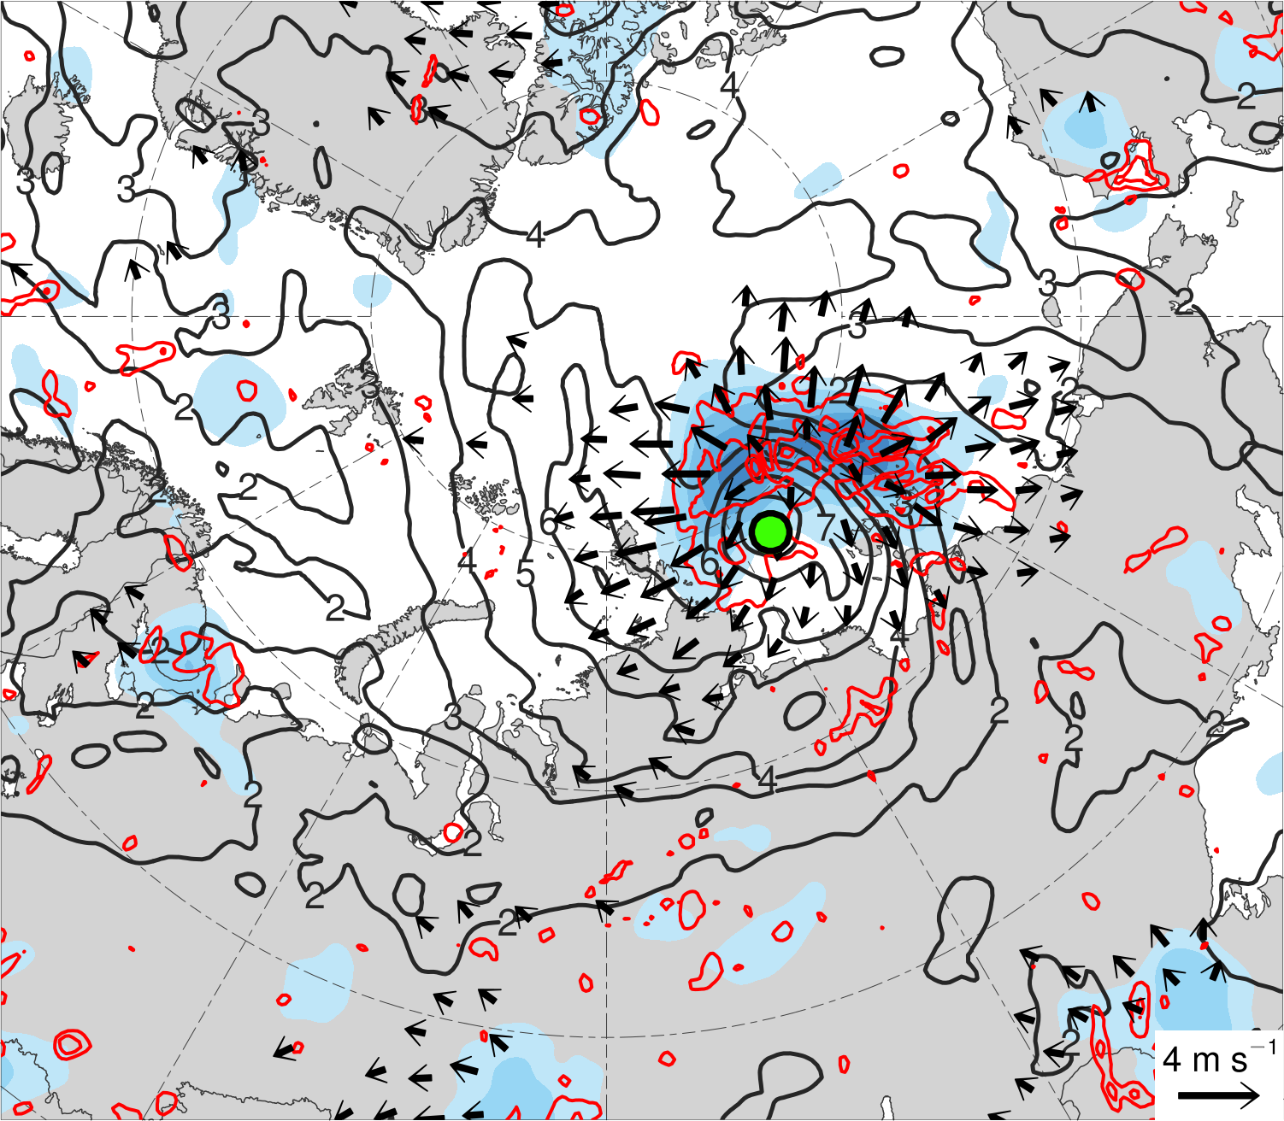
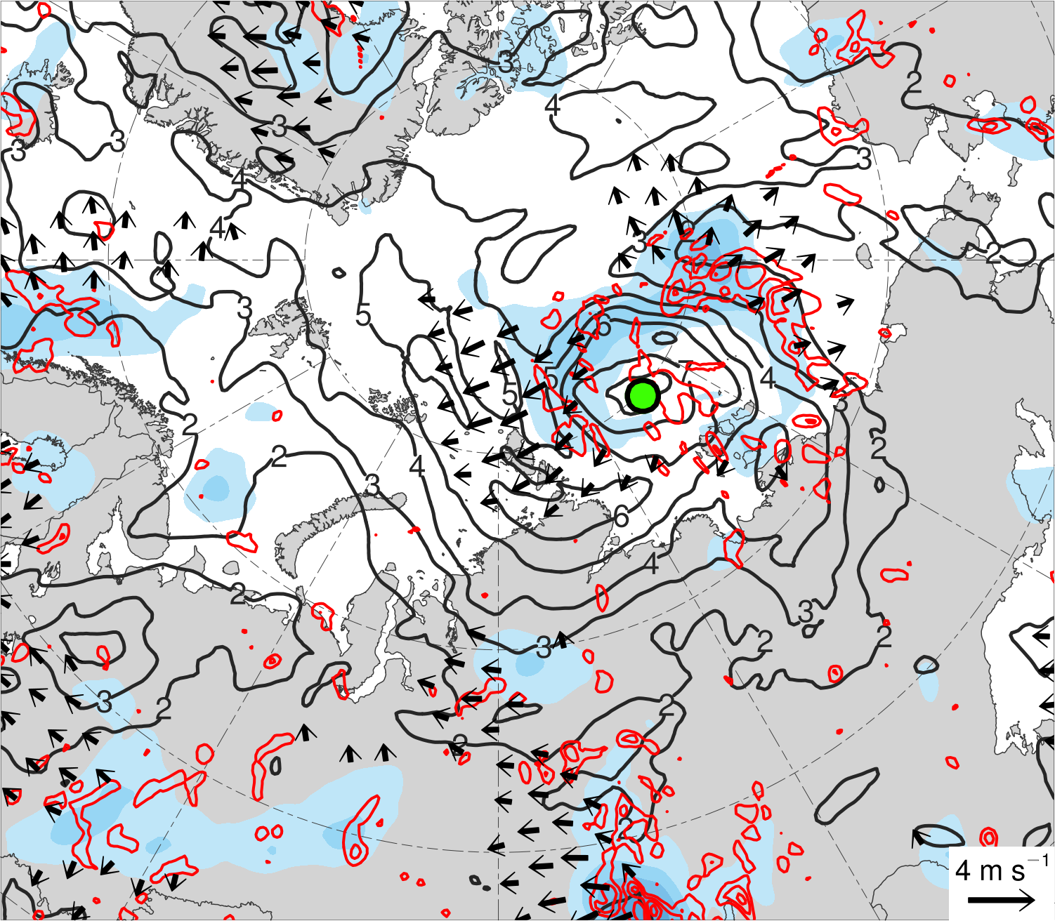
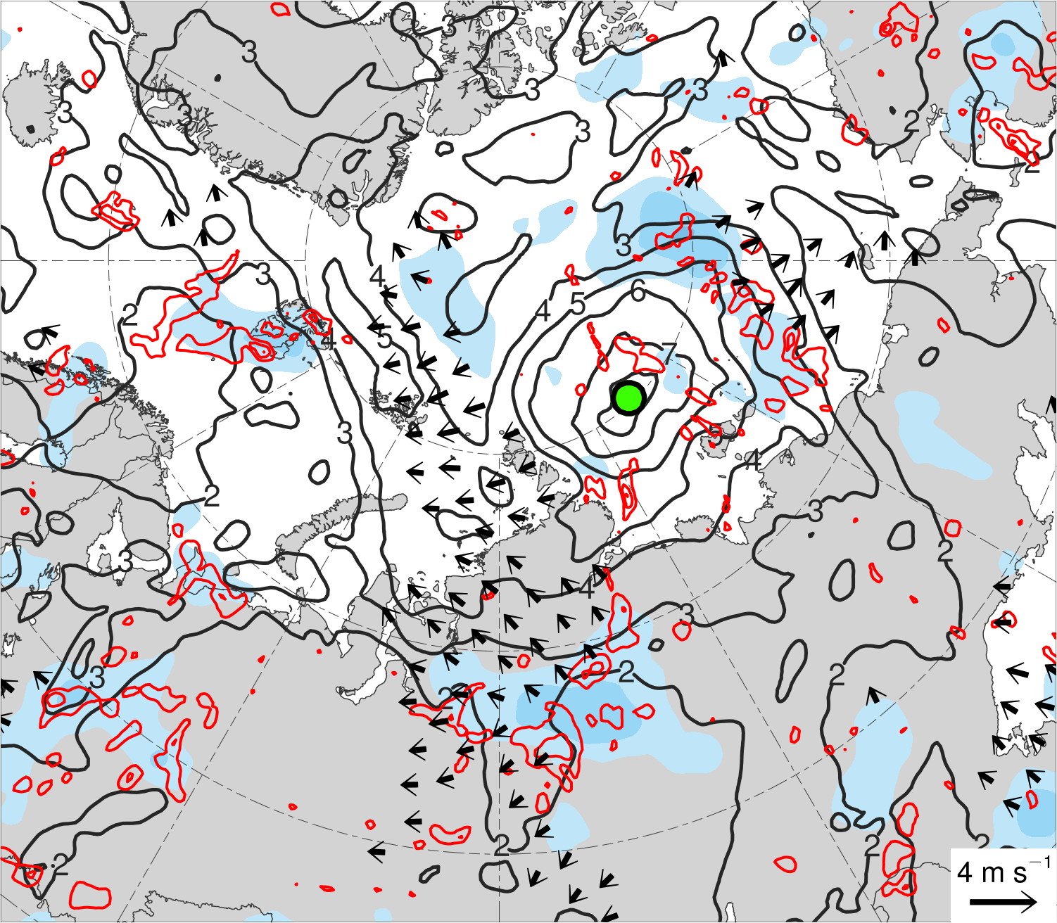
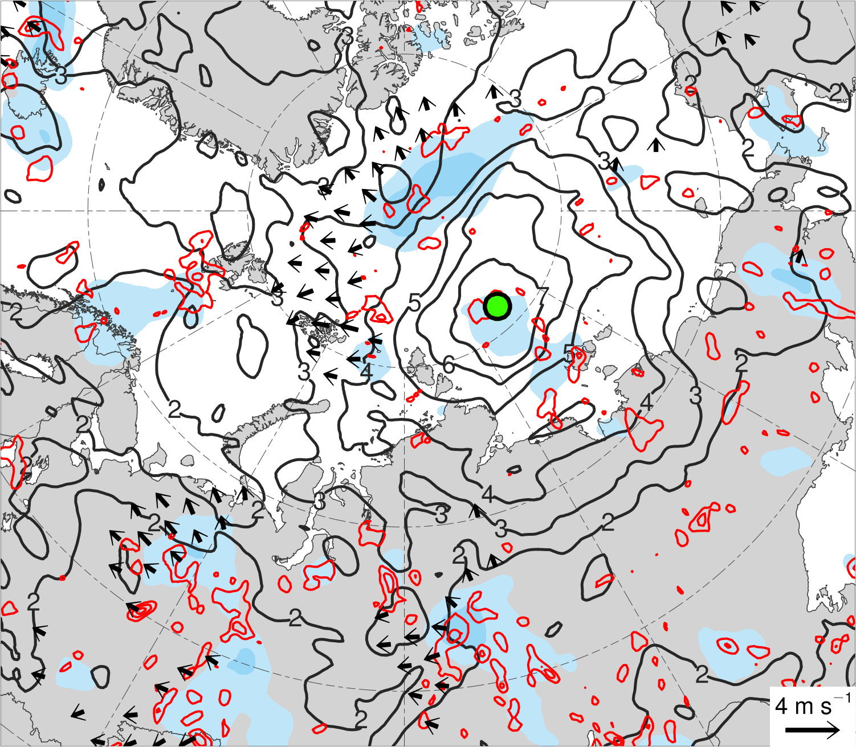
(a) Lag −48 h (N = 12)
(b) Lag −36 h (N = 12)
(c) Lag −24 h (N = 13)
(d) Lag −12 h (N = 13)
(e) Lag 0 h (N = 13)
(f) Lag 12 h (N = 12)
(g) Lag 24 h (N = 12)
(h) Lag 36 h (N = 11)
200-km area-averaged 350–250-hPa divergence (10⁻⁶ s⁻¹)
Mean AC location
2
4
6
8
10
12
14
16
350–250-hPa irrotational wind (m s⁻¹)
350–250-hPa PV (PVU)
Negative values of 800–600-hPa ω
(every 1 × 10⁻³ hPa s⁻¹)

Slide 13
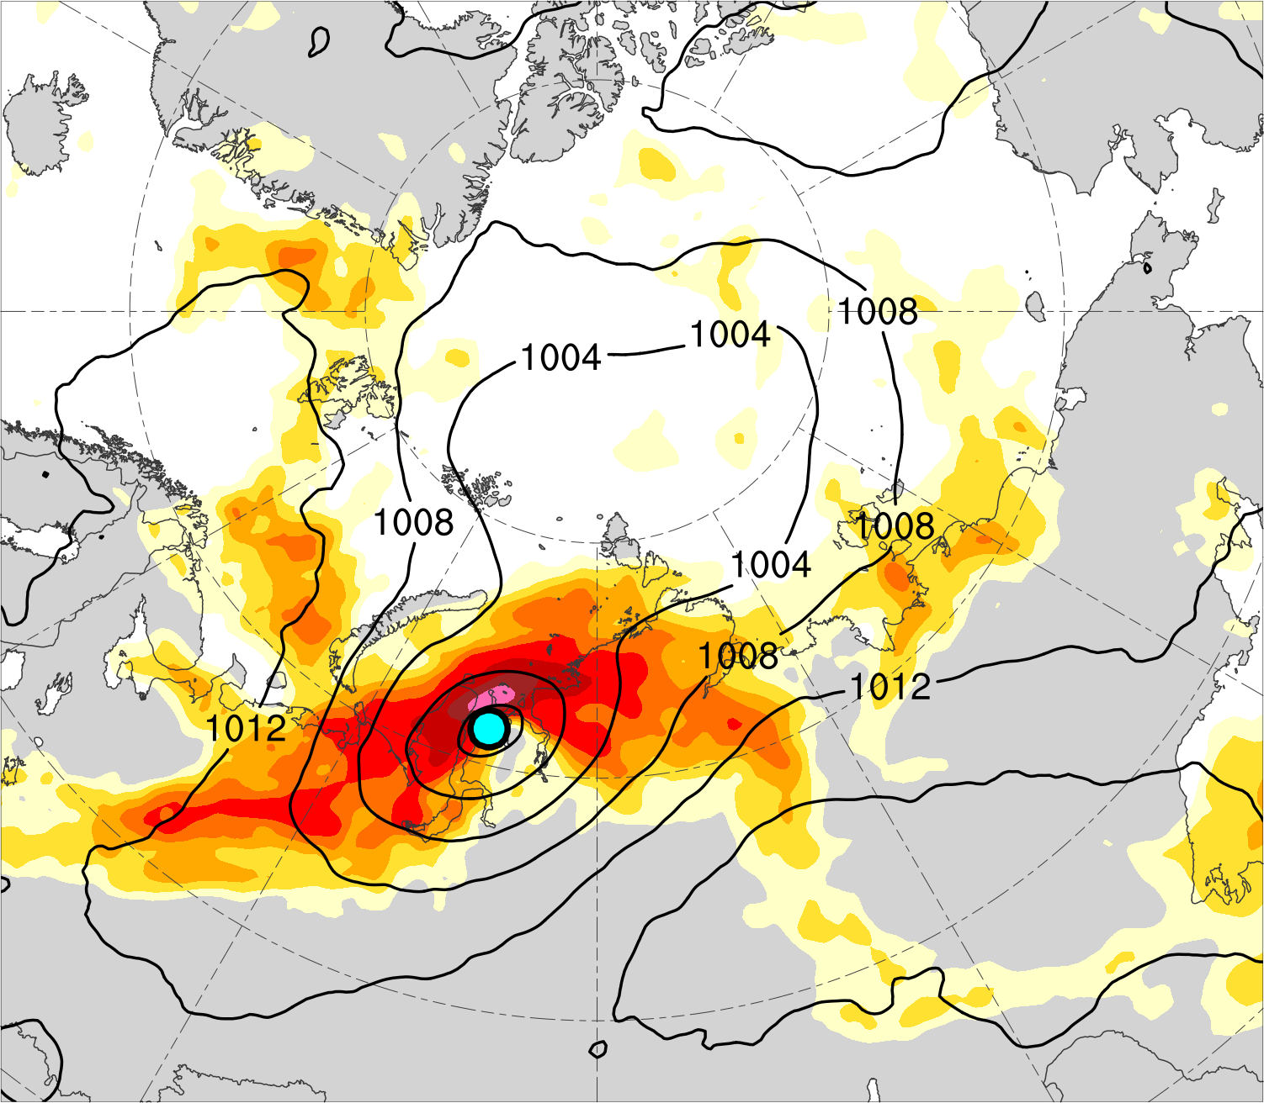
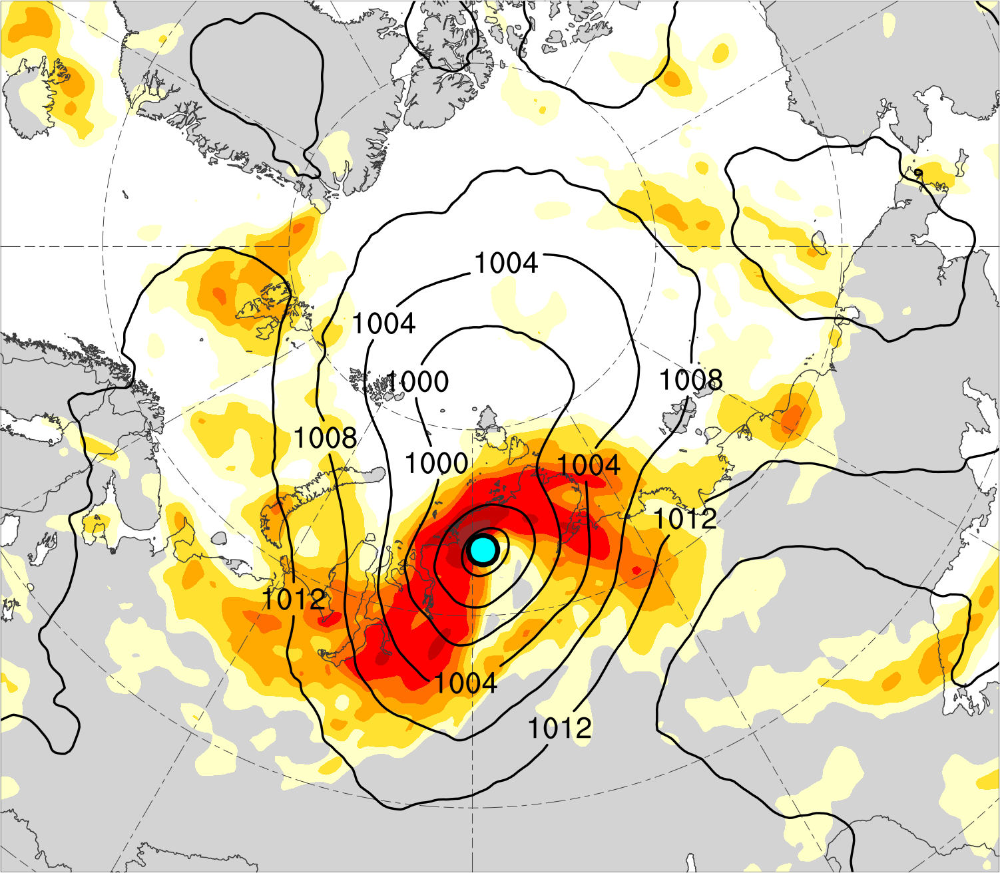
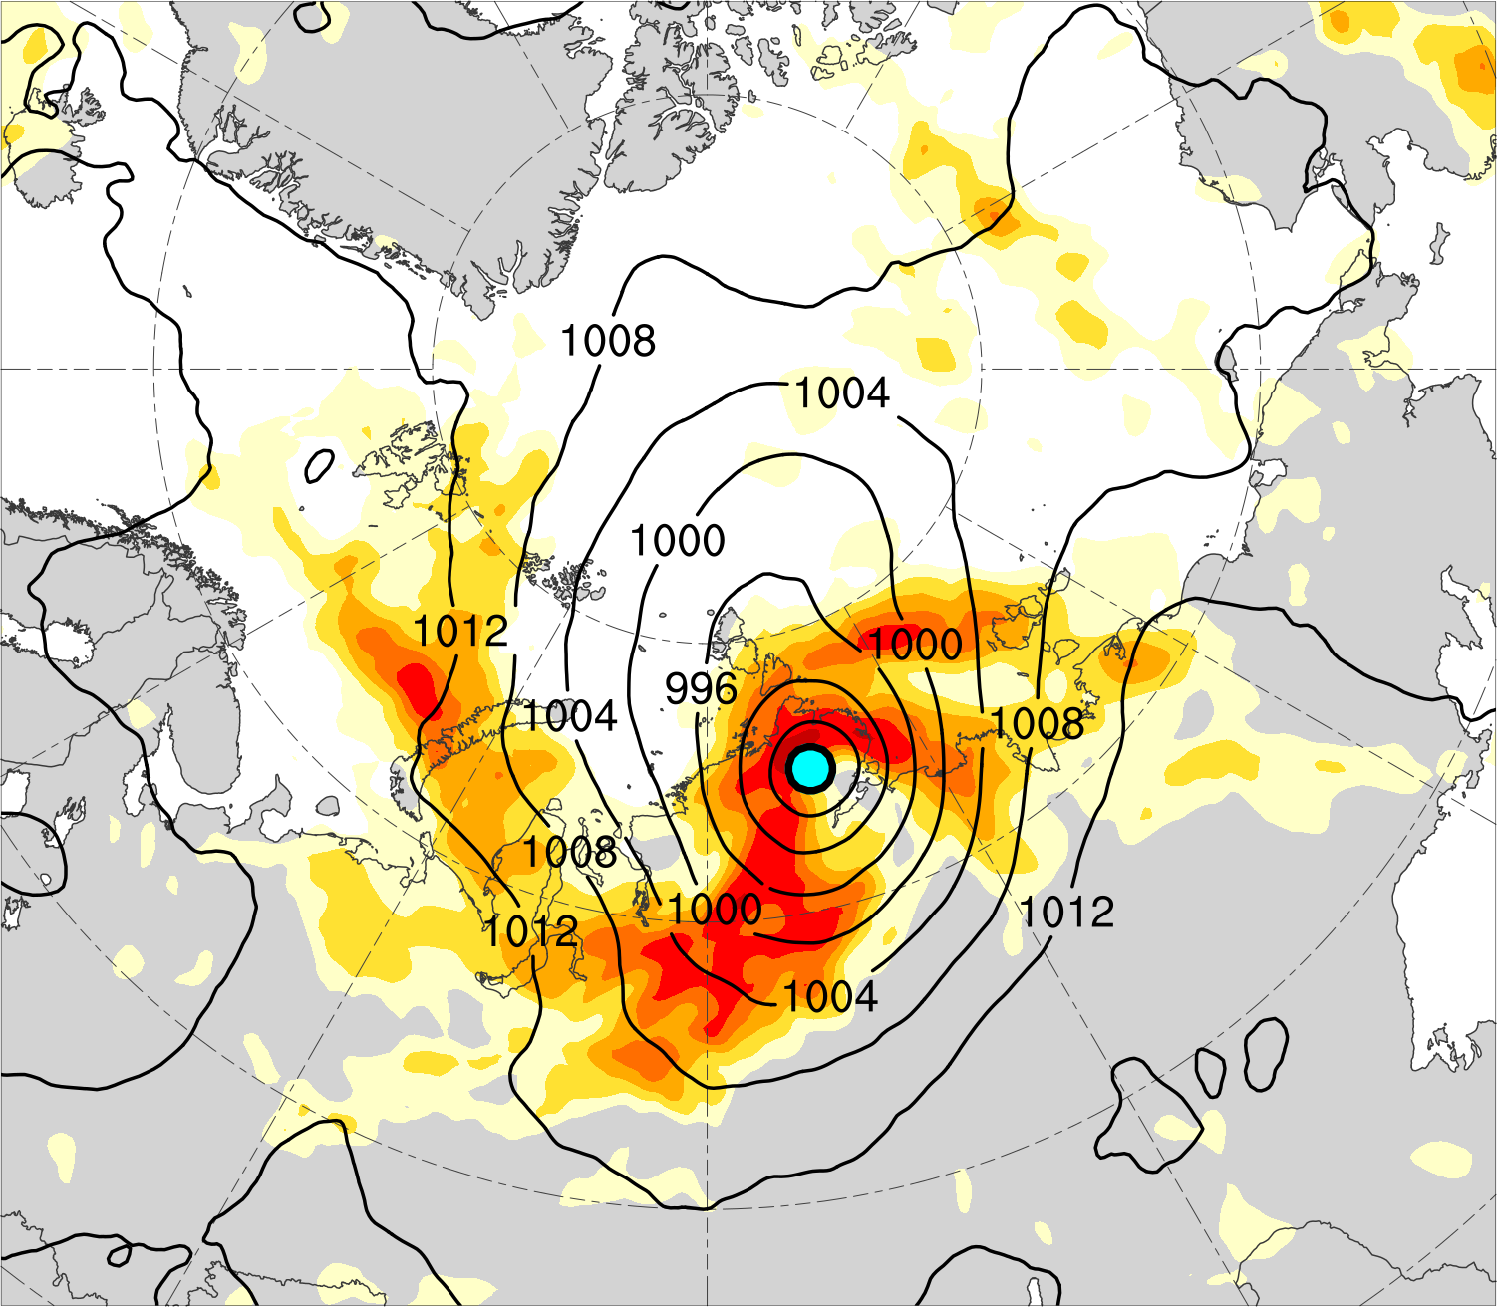
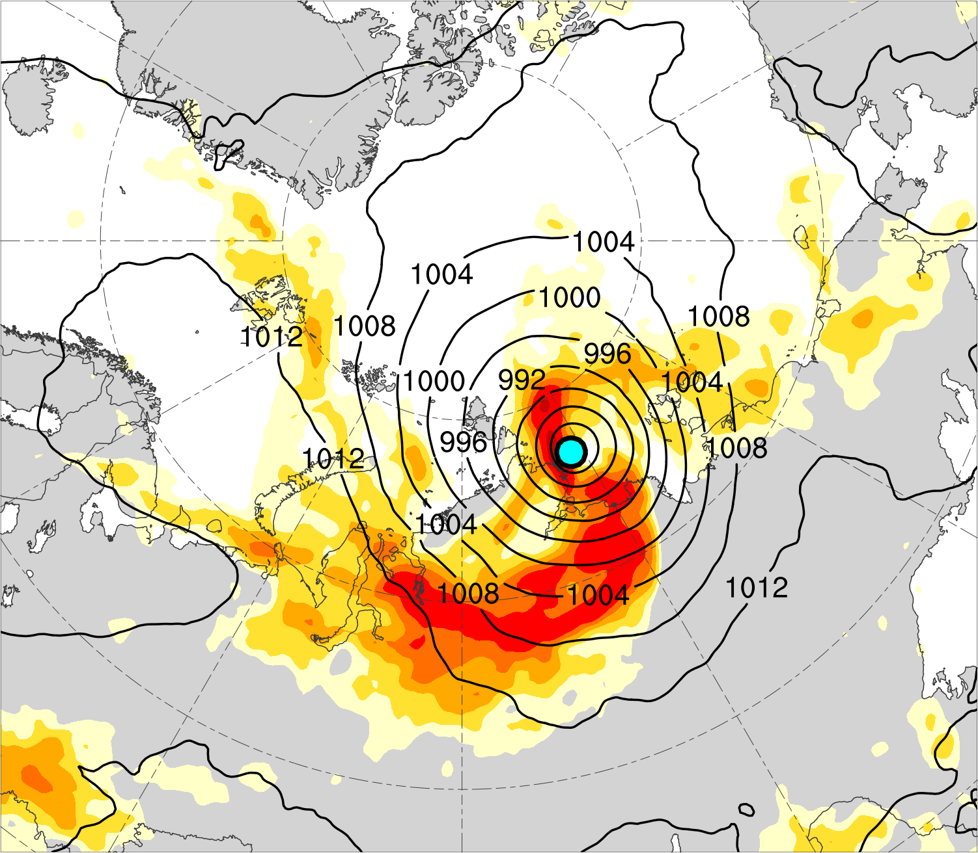
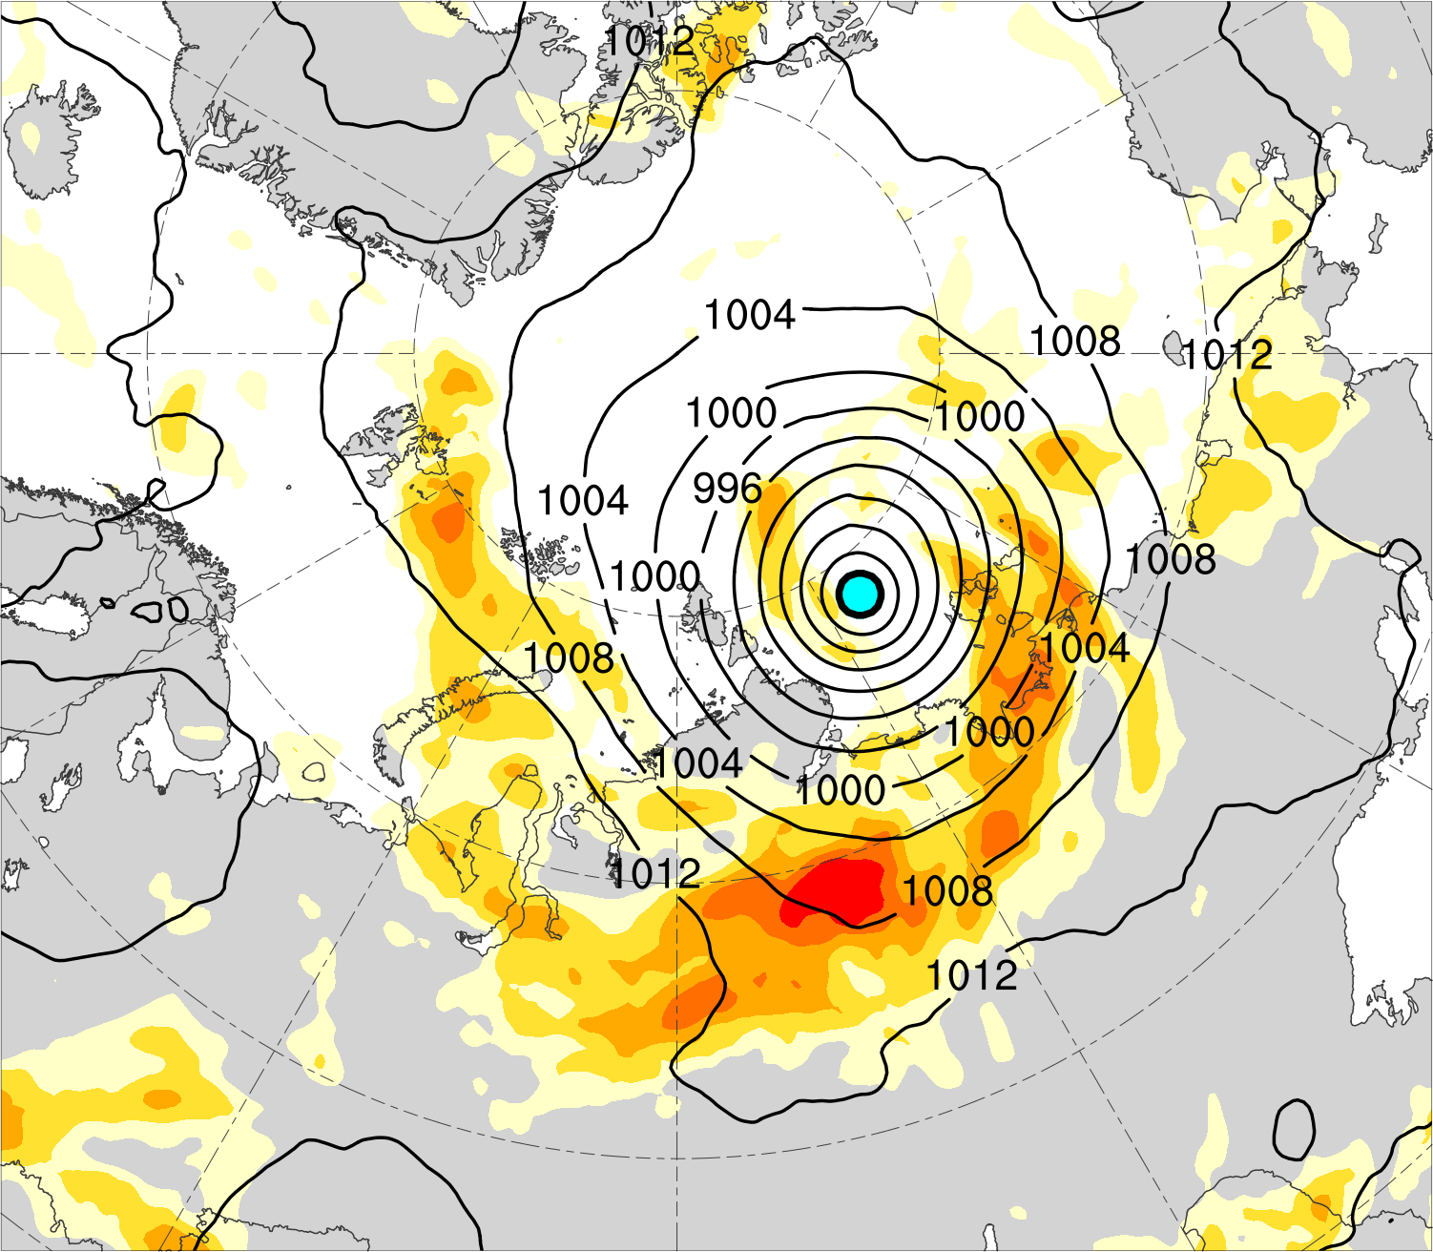
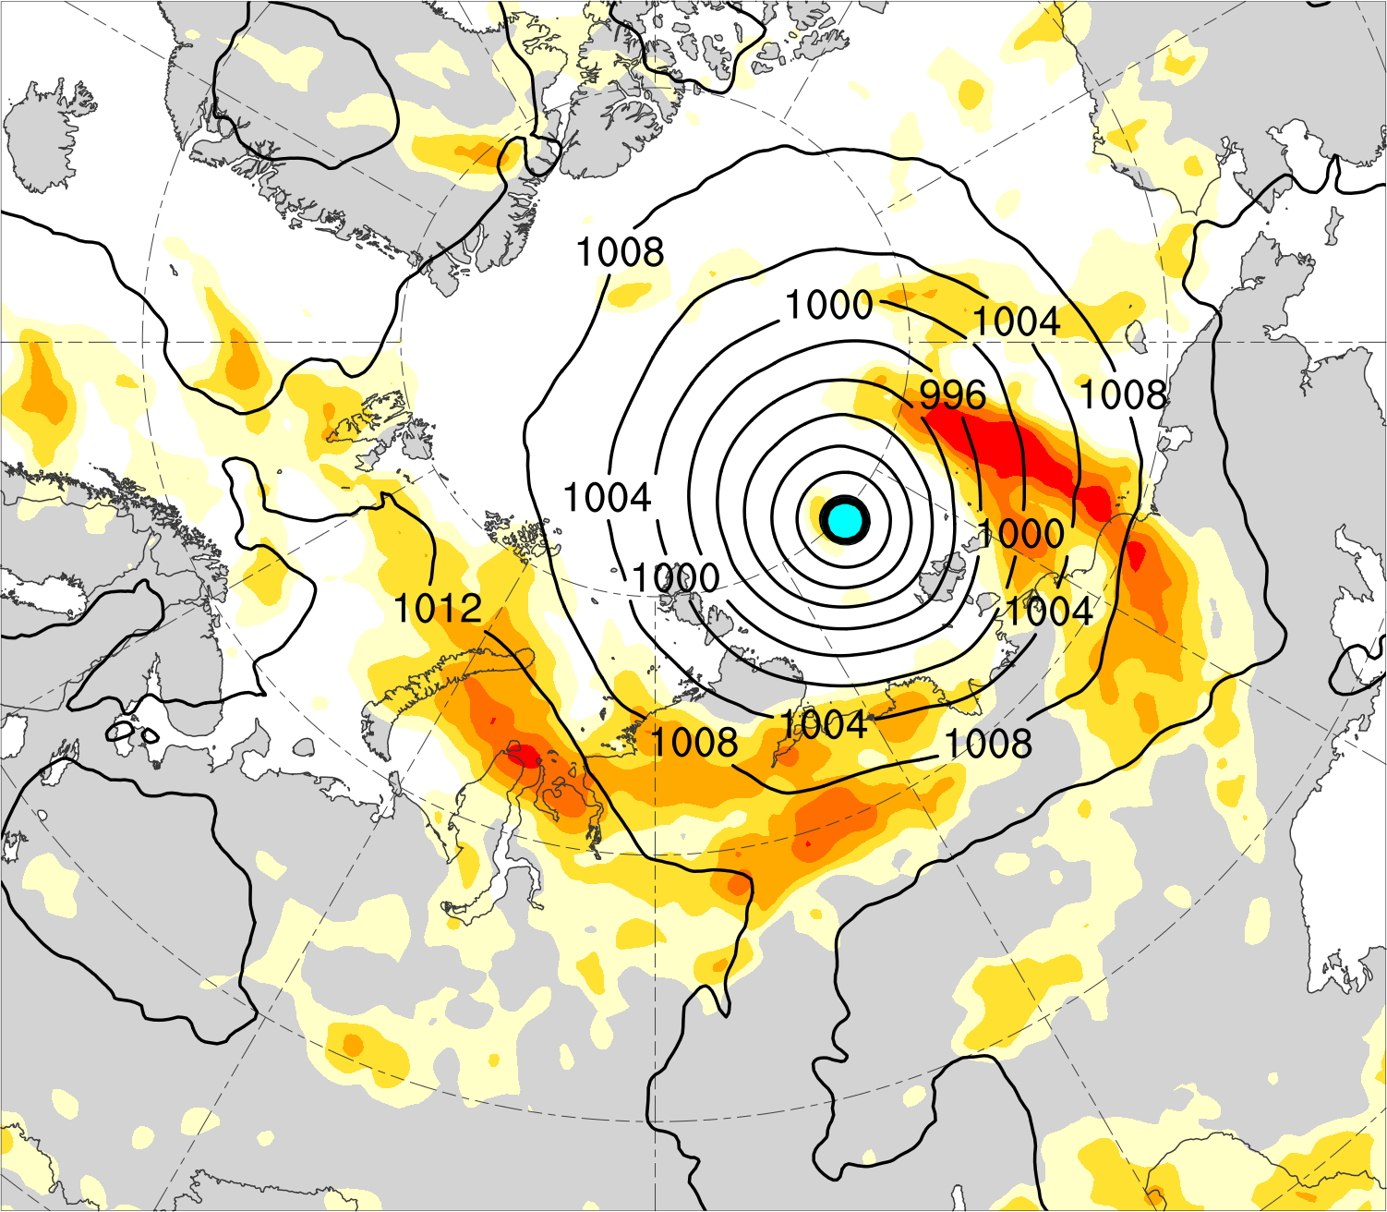
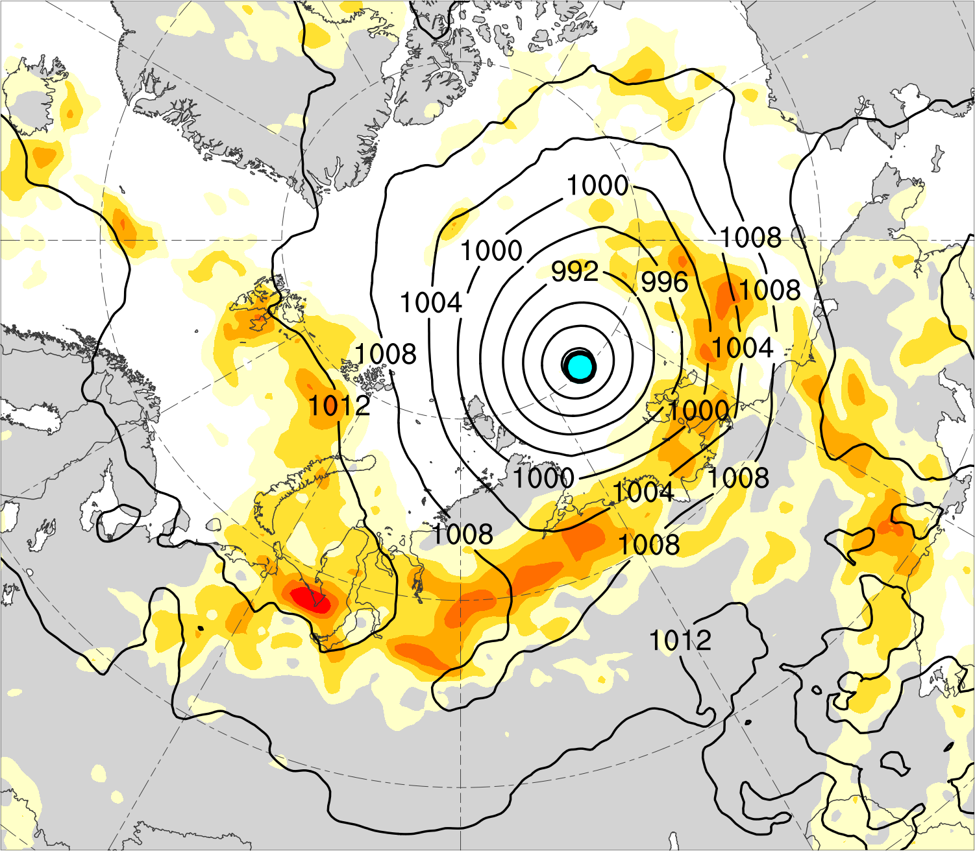
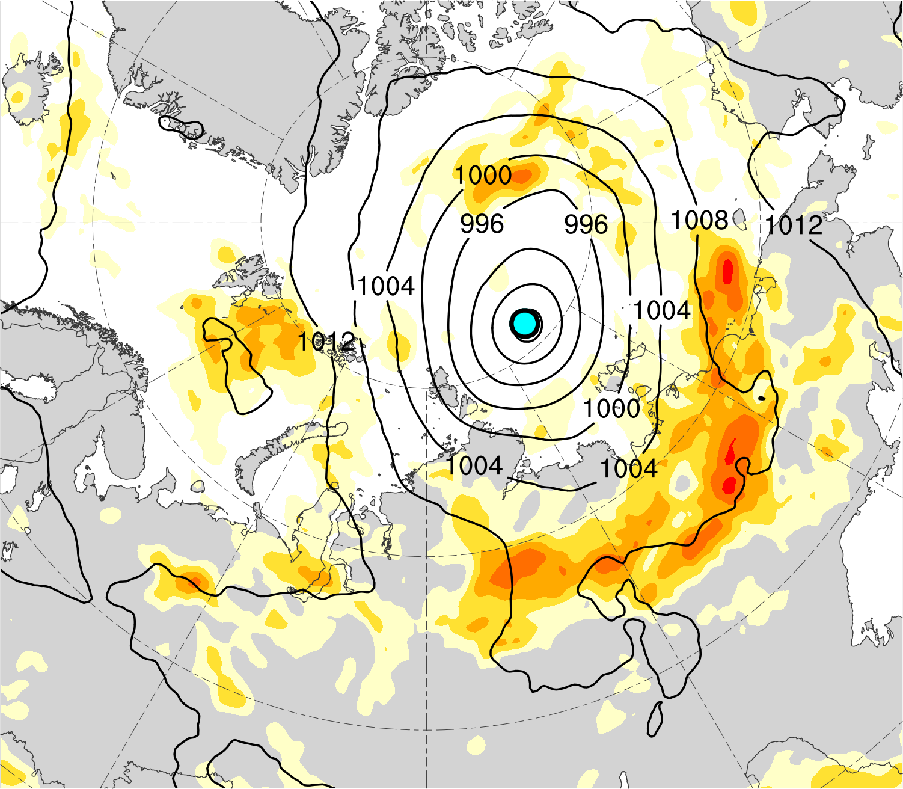
(a) Lag −48 h (N = 12)
(b) Lag −36 h (N = 12)
(c) Lag −24 h (N = 13)
(d) Lag −12 h (N = 13)
(e) Lag 0 h (N = 13)
(f) Lag 12 h (N = 12)
(g) Lag 24 h (N = 12)
(h) Lag 36 h (N = 11)
850–600-hPa Eady growth rate (day⁻¹)
Mean AC location
0.4
0.5
0.6
0.7
0.8
1.0
1.2
1.4
SLP (hPa)

Slide 14
Summary
The composite AC intensifies downstream of an upper-tropospheric potential vorticity maximum in a region of relatively strong lower-to-midtropospheric baroclinicity, lower-to-midtropospheric ascent, tropospheric-integrated vapor transport, and upper-tropospheric divergence.
A combination of baroclinic processes and latent heating play important roles in the intensification of intense low-skill ACs.

