Slide 1
A Comparison of Arctic Cyclones between Periods of Low and High Forecast Skill of the Synoptic-scale Flow over the Arctic
Kevin A. Biernat
Department of Atmospheric and Environmental Sciences
University at Albany, SUNY
Research Meeting
Wednesday 10 April 2019
Research Supported by ONR Grant N00014-18-1-2200

Slide 2
Motivation
Arctic cyclones are synoptic-scale cyclones that may originate within the Arctic or move into the Arctic from lower latitudes (e.g., Crawford and Serreze 2016)
Arctic cyclones may be associated with strong surface winds and poleward advection of warm, moist air, contributing to Arctic sea-ice loss (e.g., Zhang et al. 2013)

Slide 3
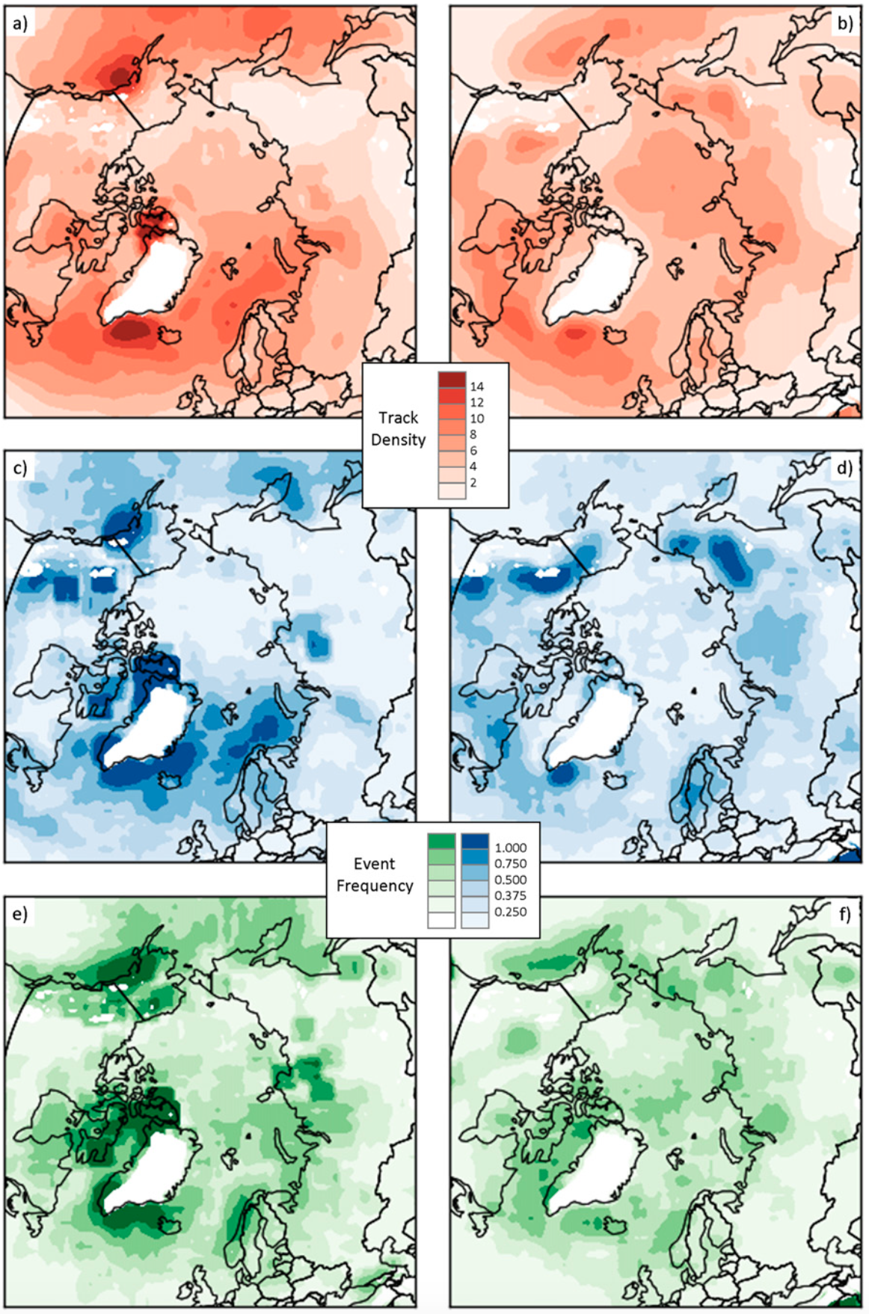
Background
Winter
Summer
Arctic cyclones may originate within and outside of Arctic
~30–40% of Arctic cyclones originate within Arctic during both winter and Summer
During winter, Arctic cyclones often originate from North Atlantic
During summer, Arctic cyclones often originate from Eurasia
Track Density
Genesis Frequency
Lysis Frequency
Figure 3 adapted from Crawford and Serreze (2016)

Slide 4
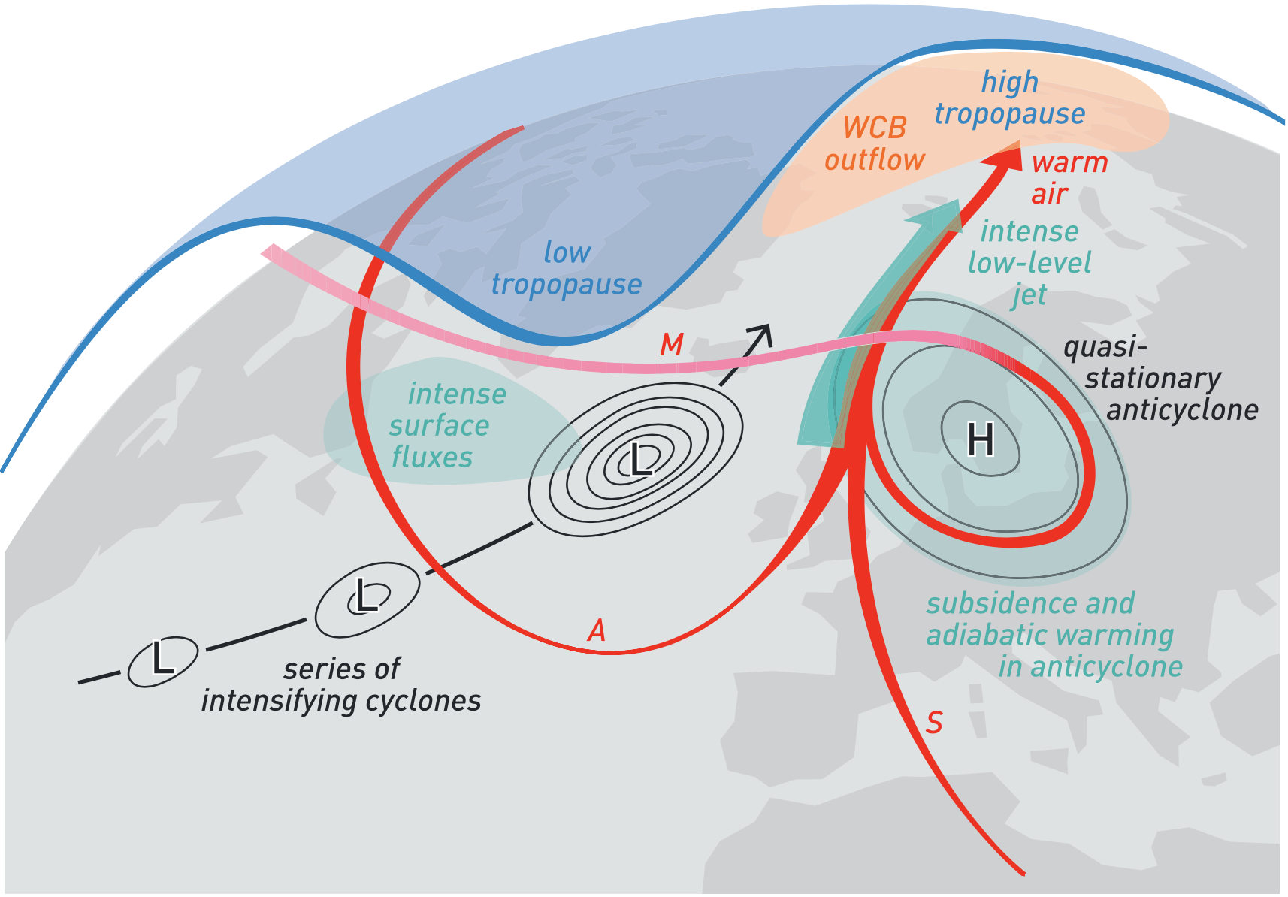
Background
Highly-amplified flow may enable cyclones and associated intrusions of warm, moist air to enter the Arctic
During late Dec 2015 and early Jan 2016, warm, moist air transported between series of cyclones and blocking anticyclone (Binder et al. 2017)
More than 30 cm of sea ice thinning in the Barents and Kara Seas occurred during this event
Kara
Sea
Barents Sea
L
H
L
L
Figure 4 adapted from Binder et al. (2017)

Slide 5
Background
Forecast skill over the Arctic may be lower than in middle latitudes (e.g., Sandu and Bauer 2018)
Yamagami et al. (2018) examine medium-range forecast skill for 10 strong Arctic cyclones occurring during the summers of 2008–2016 using five operational ensemble predictions systems (EPSs)
Forecast skill of these Arctic cyclones is lower than that of midlatitude cyclones in the Northern Hemisphere
Low Arctic forecast skill may be attributed in part to low forecast skill of Arctic cyclones

Slide 6
Purpose
Investigate whether there are differences in the frequency, intensity, location, seasonality, and associated synoptic-scale flow patterns of Arctic cyclones between periods of low and high forecast skill of the synoptic-scale flow over the Arctic

Slide 7
Data and Methods
Create a 2007–2017 Arctic cyclone climatology
Obtain cyclone tracks from 1° ERA-Interim cyclone climatology prepared by Sprenger et al. (2017)
Arctic cyclones are deemed cyclones that last at least 48 h and spend at least some portion of their lifetimes in the Arctic (>70°N), as done similarly by Simmonds and Rudeva (2014)

Slide 8
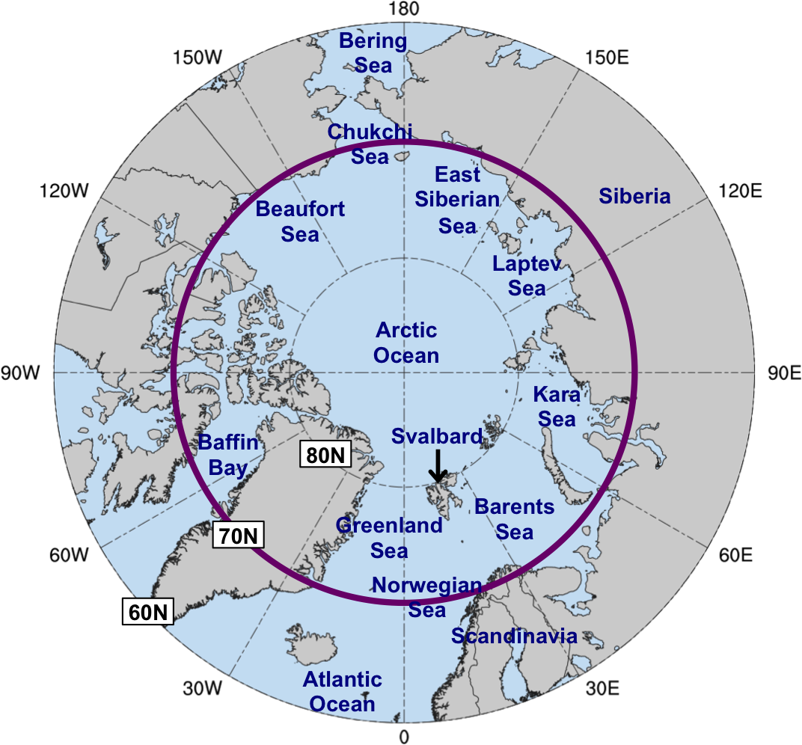
Data and Methods
Evaluate Arctic forecast skill in terms of an area-weighted average of standardized anomaly of ensemble spread (σ_{anom}) of 500-hPa geopotential height over the Arctic (≥70°N)
Forecasts initialized at 0000 UTC during 2007–2017 and valid at day 5 from:
11-member GEFS reforecast dataset v2 (Hamill et al. 2013)
51-member ECMWF EPS (Buizza et al. 2007)

Slide 9
Data and Methods
At each grid point (i), day of the year (d), and forecast lead time (f), σ_{anom} is calculated similarly following Torn (2017) as:
σ = raw ensemble spread
σ_{mean} = climatological mean ensemble spread
σ_{stdv} = climatological standard deviation of ensemble spread
σ_{mean} and σ_{stdv} calculated for 1985–2017 period from the GEFS reforecast dataset v2

Slide 10
Data and Methods
Forecast days valid at day 5 associated with the top and bottom 10% of the area-weighted average of σ_{anom} in both the GEFS and ECMWF EPS are referred to as low and high skill days, respectively
Time periods beginning five days prior to day 5 (i.e., day 0) through day 5 are referred to as low and high skill periods
Arctic cyclones that exist in the Arctic (>70°N) at any time within the low and high skill periods are determined

Slide 11
Data and Methods
Statistical significance testing done using bootstrap resampling tests

Slide 12
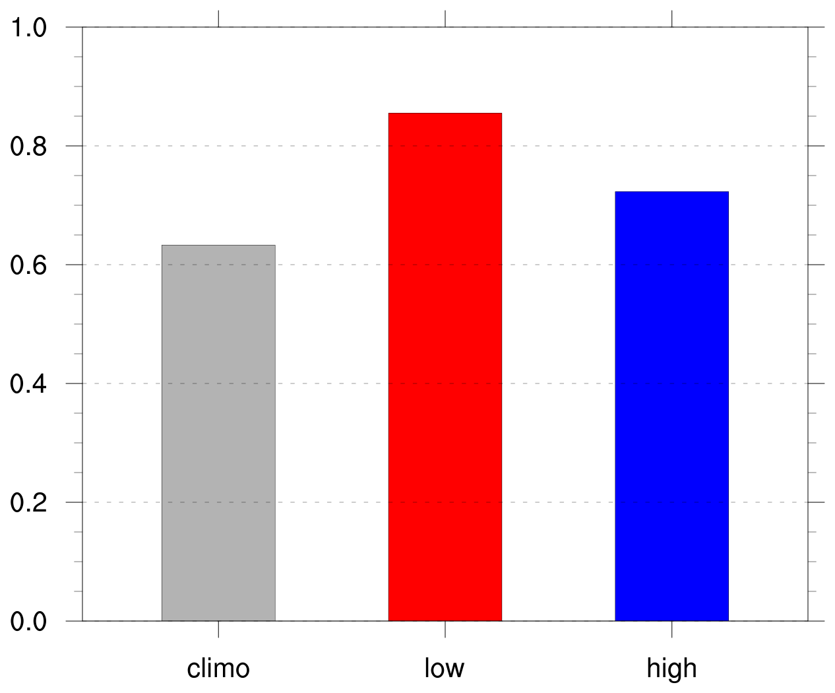
Number and Frequency of Arctic Cyclones
Frequency of Arctic cyclones (cyclones day⁻¹)
 | Number of days in period | Number of Arctic cyclones
Climo | 4018 | 2542
Low skill | 469 | 401
High skill | 477 | 345
Frequency = number of ACs within period / number of days within period

Slide 13
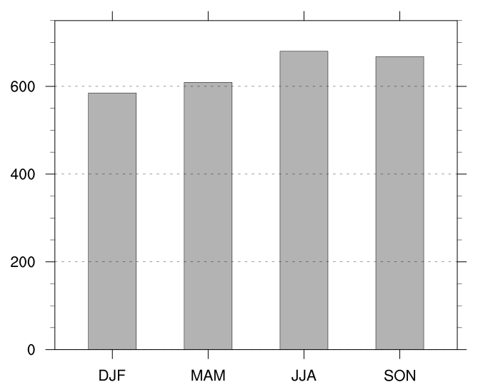
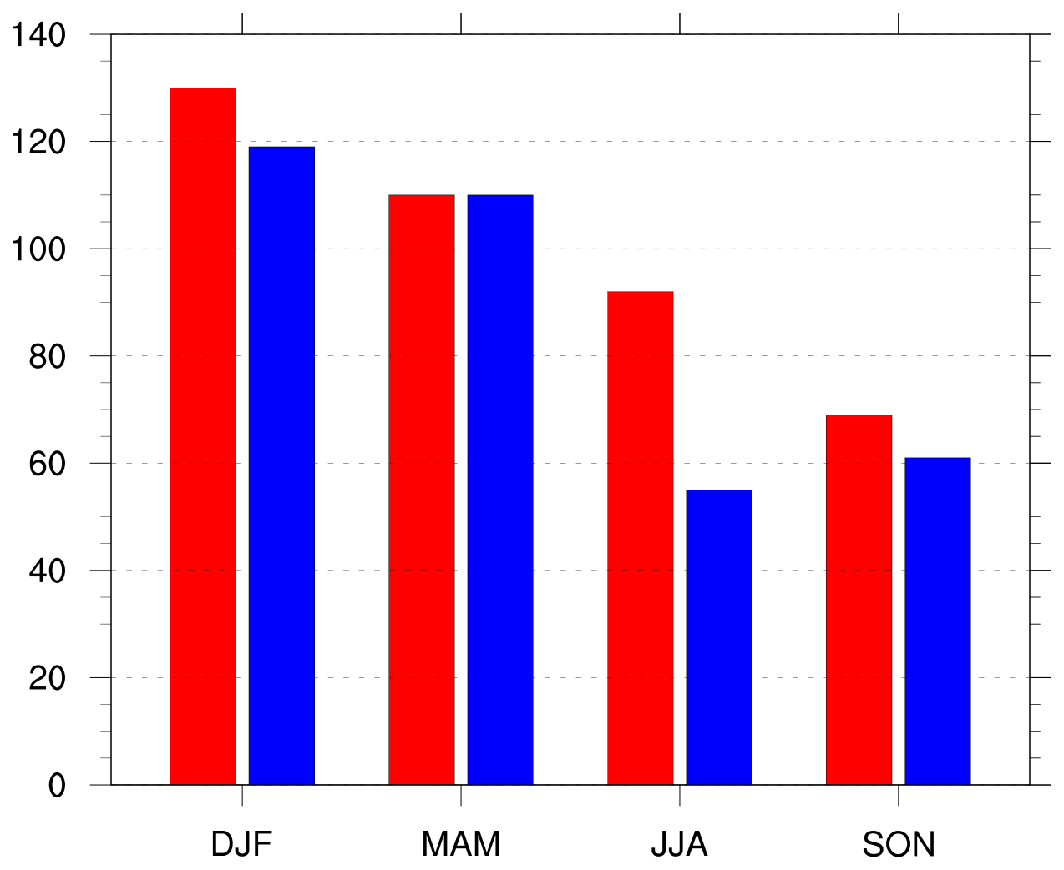
Number of Arctic Cyclones by Season
Number of Arctic cyclones in climatology by season
Number of Arctic cyclones in low and high skill periods by season
Low skill
High skill

Slide 14
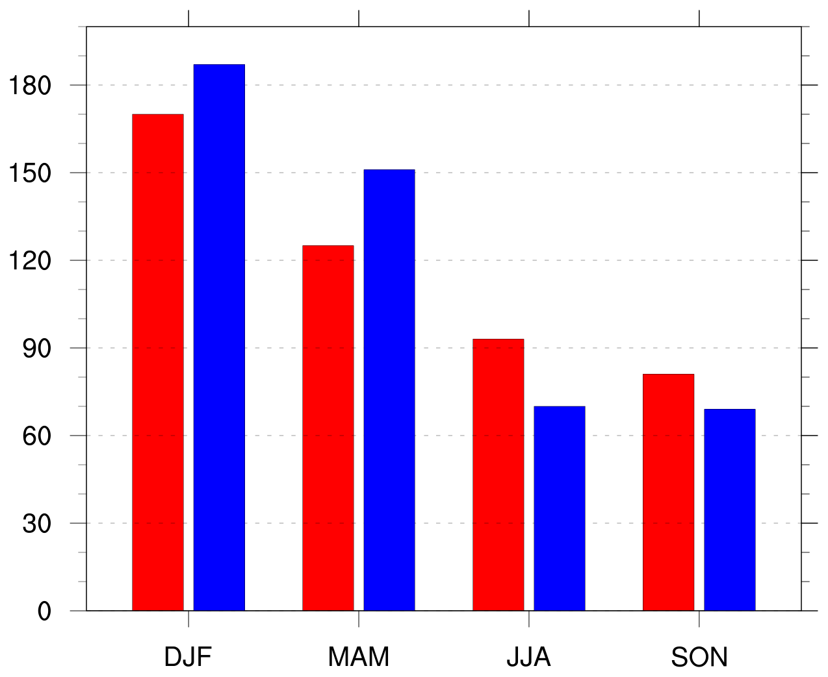
Number of Arctic Cyclones by Season
Number of days in low and high skill periods by season
Number of Arctic cyclones in low and high skill periods by season
Low skill
Low skill
High skill
High skill

Slide 15
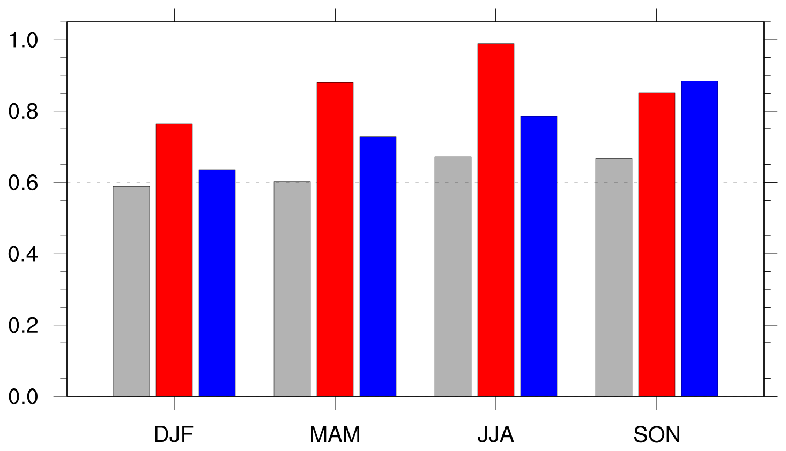
Frequency of Arctic Cyclones by Season
Frequency of Arctic cyclones (cyclones day⁻¹)
Climo
Low skill
High skill
Frequency = number of ACs within period / number of days within period

Slide 16
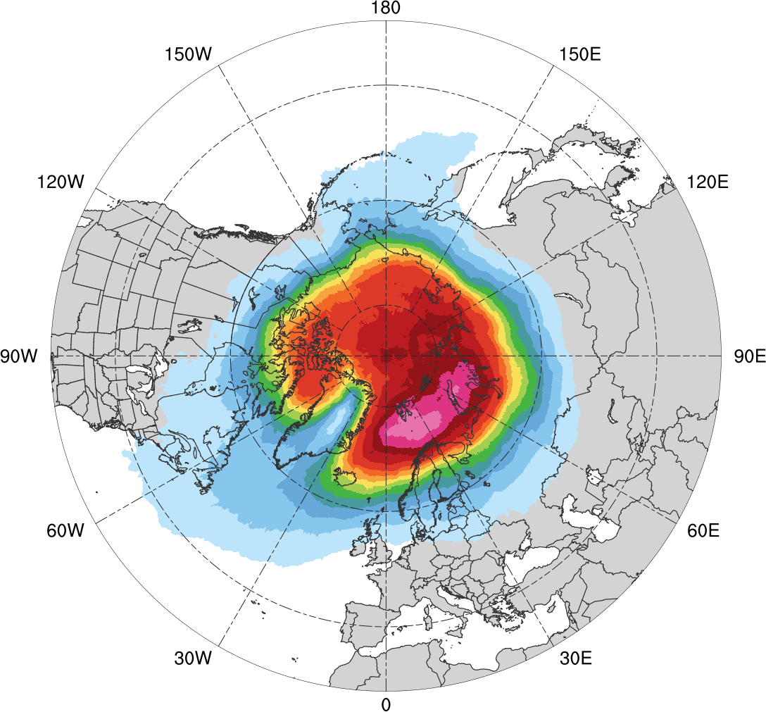
Normalized Track Density
Entire climatology (N = 2542)
0.05
0.1
0.15
0.2
0.25
0.3
0.35
0.4
0.45
0.5
0.6
0.7
0.8
0.9
Total number of Arctic cyclones within 500 km of a grid point, normalized by maximum value

Slide 17
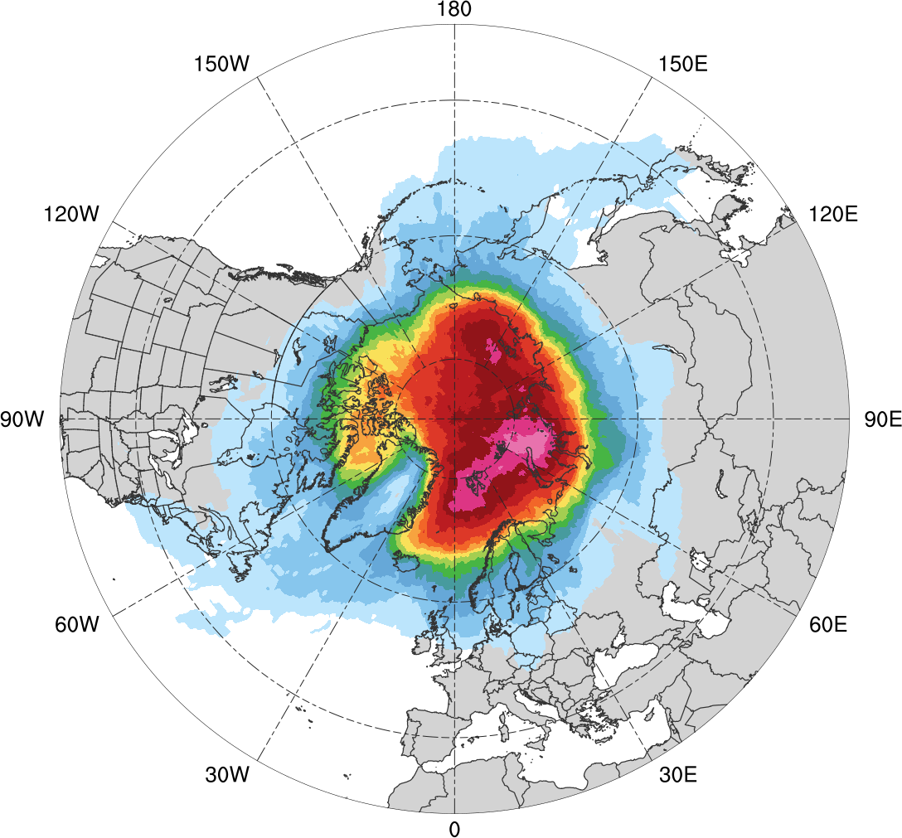
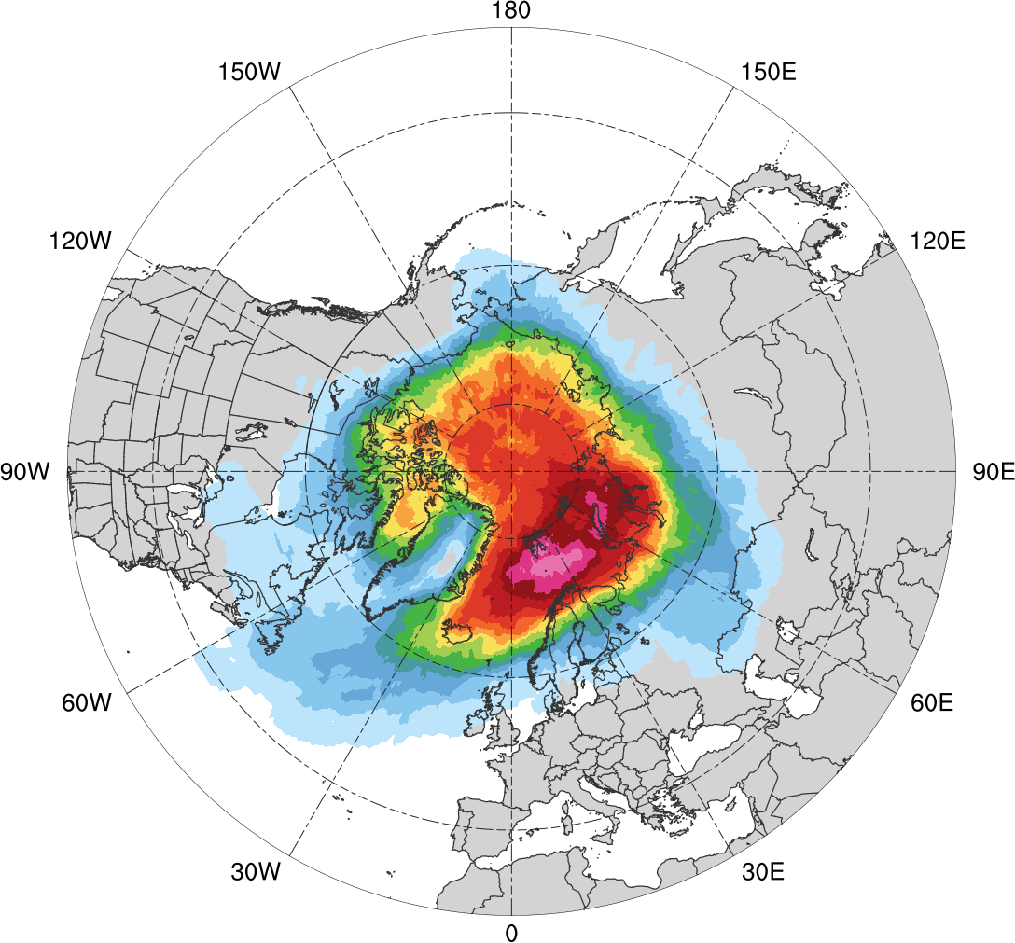
Normalized Track Density
Low skill (N = 401)
High skill (N = 345)
0.05
0.1
0.15
0.2
0.25
0.3
0.35
0.4
0.45
0.5
0.6
0.7
0.8
0.9
Total number of Arctic cyclones within 500 km of a grid point, normalized by maximum value, for each period

Slide 18
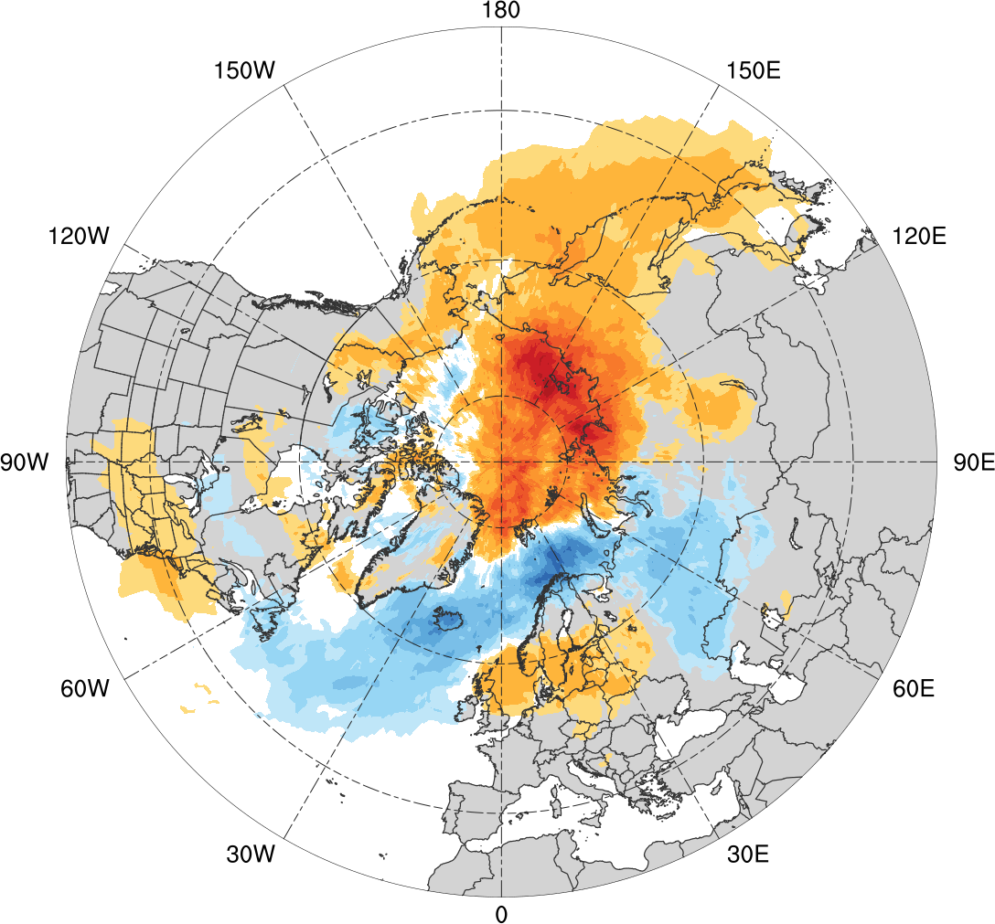
Normalized Track Density Differences
Low skill minus high skill
-0.35
-0.3
-0.25
-0.2
-0.15
-0.1
-0.05
-0.025
0
0.025
0.05
0.1
0.15
0.2
0.25
0.3
0.35
Difference in normalized Arctic cyclone track density

Slide 19
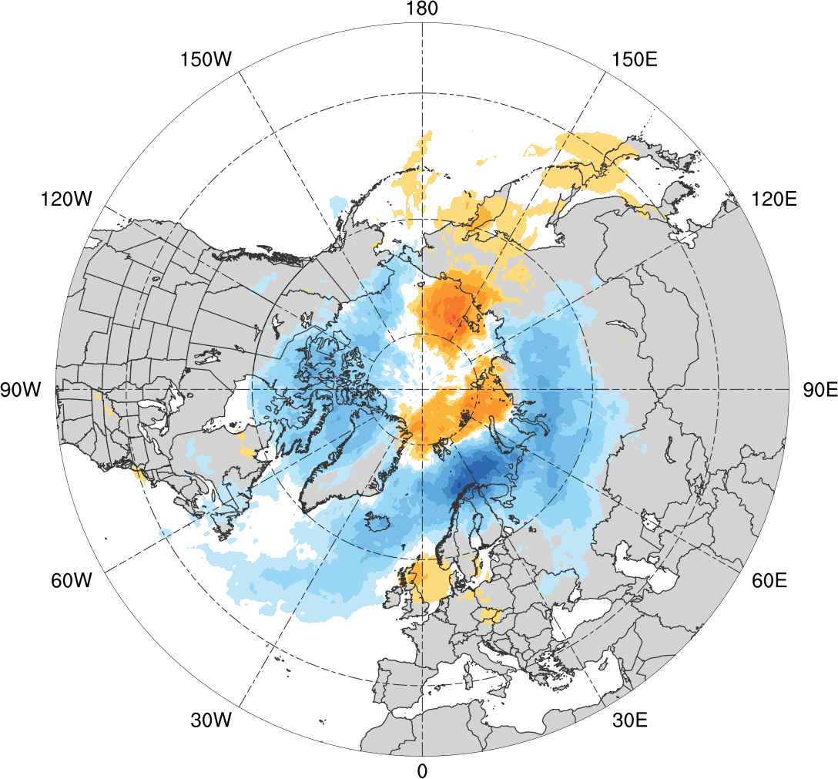
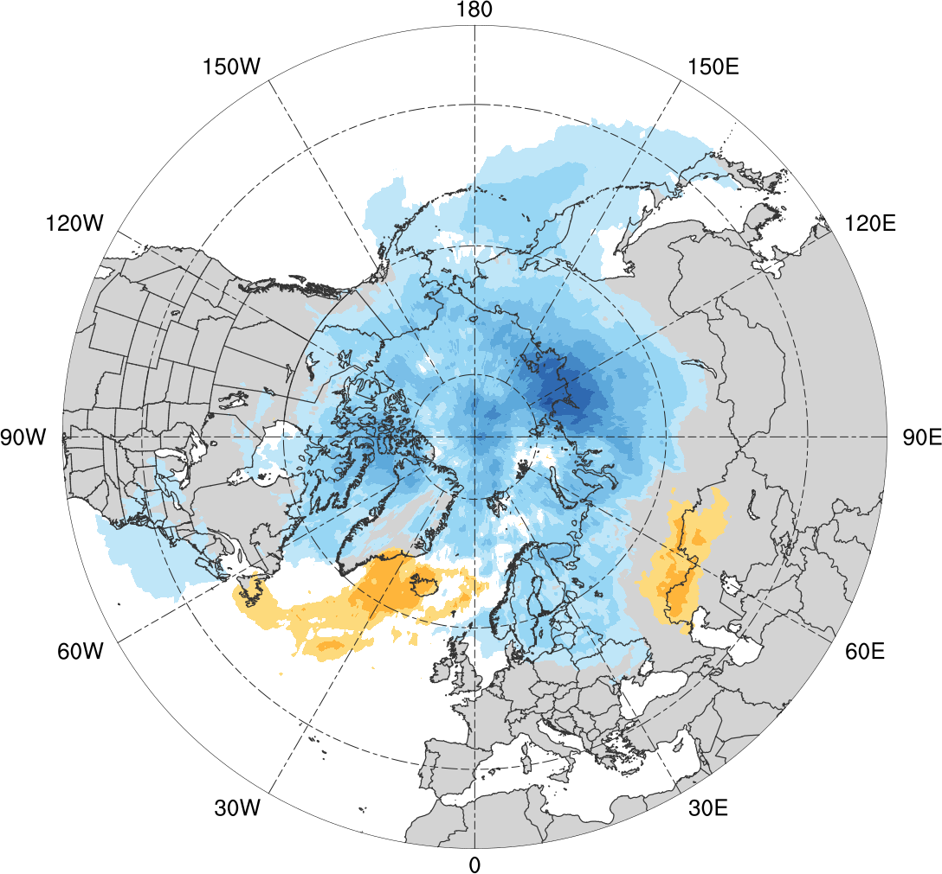
Normalized Track Density Differences
Low skill minus climatology
High skill minus climatology
-0.35
-0.3
-0.25
-0.2
-0.15
-0.1
-0.05
-0.025
0
0.025
0.05
0.1
0.15
0.2
0.25
0.3
0.35
Difference in normalized Arctic cyclone track density

Slide 20
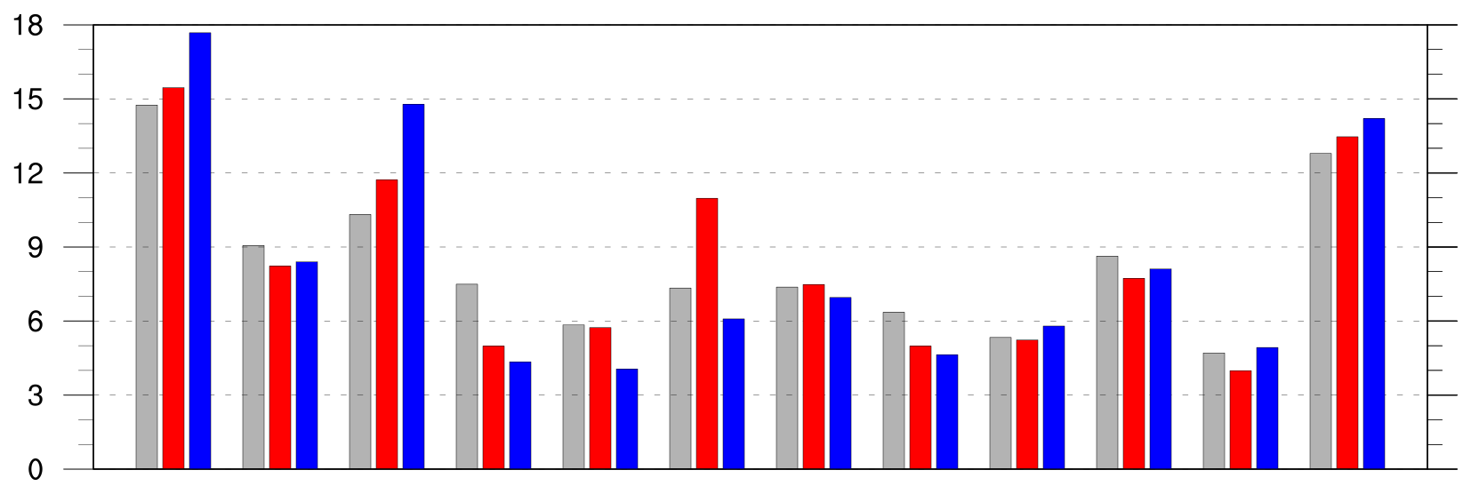
Preferred Longitudinal Corridors
Distribution of longitude of Arctic cyclones at first time in Arctic (>70°N; % per longitudinal bin)
90°N
70°N
50°N
30°N
0°
30°E
60°E
90°E
120°E
150°E
180°
150°W
120°W
90°W
60°W
30°W
0°
0°
30°E
60°E
90°E
120°E
150°E
180°
150°W
120°W
90°W
60°W
30°W
0°
climo (N=2542)
low (N=401)
high (N=345)

Slide 21
Preferred Longitudinal Corridors (DJF)
Distribution of longitude of Arctic cyclones at first time in Arctic (>70°N; % per longitudinal bin) during DJF
90°N
70°N
50°N
30°N
0°
30°E
60°E
90°E
120°E
150°E
180°
150°W
120°W
90°W
60°W
30°W
0°
0°
30°E
60°E
90°E
120°E
150°E
180°
150°W
120°W
90°W
60°W
30°W
0°
climo (N=585)
low (N=130)
high (N=119)

Slide 22
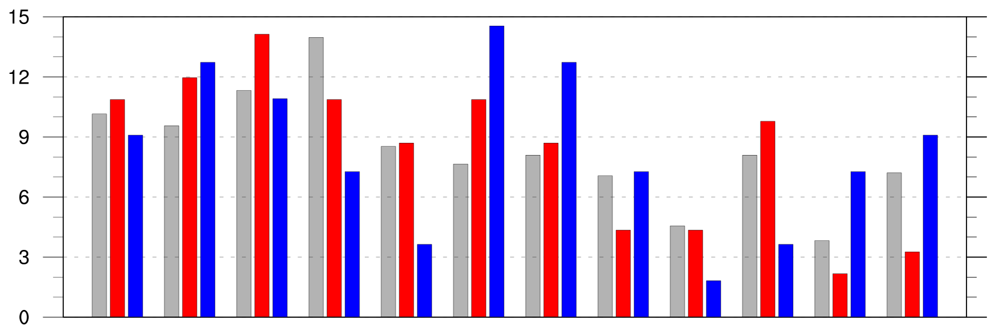
Preferred Longitudinal Corridors (JJA)
Distribution of longitude of Arctic cyclones at first time in Arctic (>70°N; % per longitudinal bin) during JJA
90°N
70°N
50°N
30°N
0°
30°E
60°E
90°E
120°E
150°E
180°
150°W
120°W
90°W
60°W
30°W
0°
0°
30°E
60°E
90°E
120°E
150°E
180°
150°W
120°W
90°W
60°W
30°W
0°
climo (N=680)
low (N=92)
high (N=55)

Slide 23
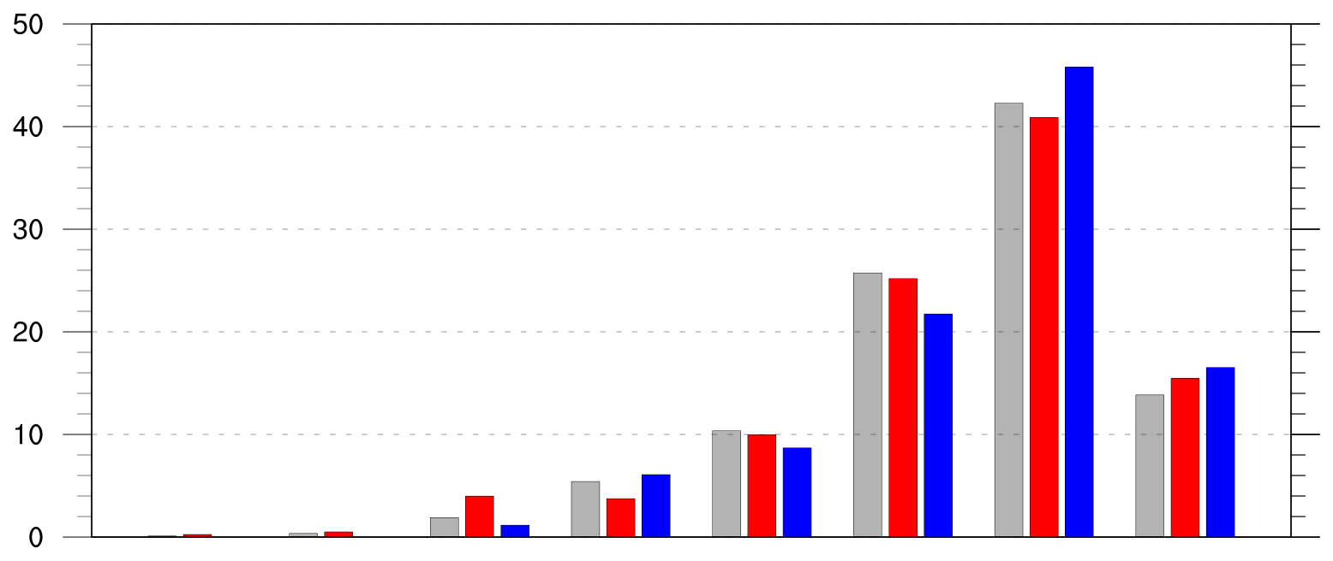
Genesis Latitude
Distribution of Arctic cyclone genesis latitude (% per latitude bin)
10°N
20°N
30°N
40°N
50°N
60°N
70°N
80°N
90°N
climo (N=2542)
low (N=401)
high (N=345)

Slide 24
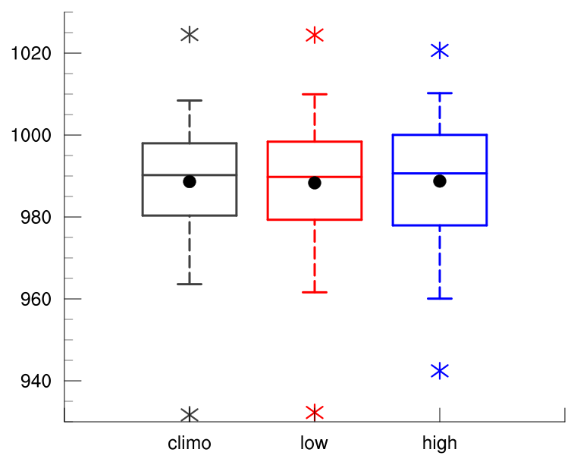
Intensity: Minimum SLP
Minimum SLP (hPa) of Arctic cyclones
min and max
mean
95%
75%
median
25%
5%
climo
(N=2542)
low
(N=401)
high
(N=345)

Slide 25
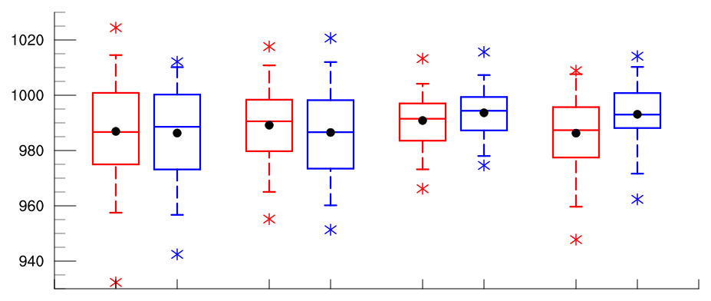
Intensity: Minimum SLP
Minimum SLP (hPa) of Arctic cyclones by season
low
(N =130)
high
(N=119)
low
(N=110)
high
(N=110)
low
(N=92)
high
(N=55)
low
(N=69)
high
(N=61)
DJF
MAM
JJA
SON
95%
75%
min and max
mean
median
Statistically significant differences in means
25%
5%

Slide 26
Intensity: Minimum Standardized Anomaly of SLP
Minimum standardized anomaly of SLP (σ) of Arctic cyclones
min and max
mean
95%
75%
median
25%
5%
Statistically significant differences in means
climo
(N=2542)
low
(N=401)
high
(N=345)

Slide 27
Intensity: Minimum Standardized Anomaly of SLP
Minimum standardized anomaly of SLP (σ) of Arctic cyclones
min and max
mean
95%
75%
median
25%
5%
Statistically significant differences in means
climo
(N=2542)
low
(N=401)
high
(N=345)

Slide 28
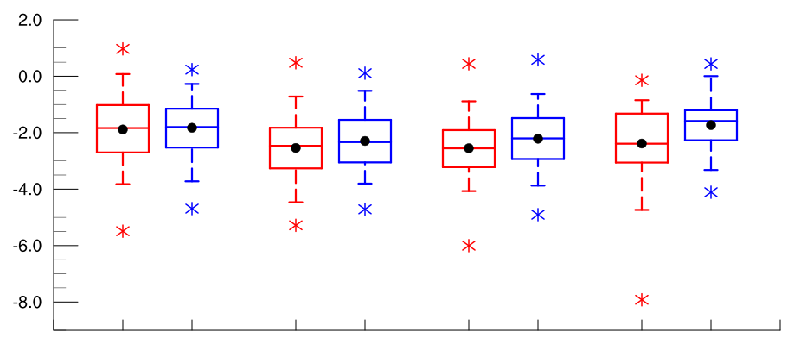
Intensity: Minimum Standardized Anomaly of SLP
Minimum standardized anomaly of SLP (σ) of Arctic cyclones by season
low
(N =130)
high
(N=119)
low
(N=110)
high
(N=110)
low
(N=92)
high
(N=55)
low
(N=69)
high
(N=61)
DJF
MAM
JJA
SON
95%
75%
min and max
mean
median
Statistically significant differences in means
25%
5%

Slide 29
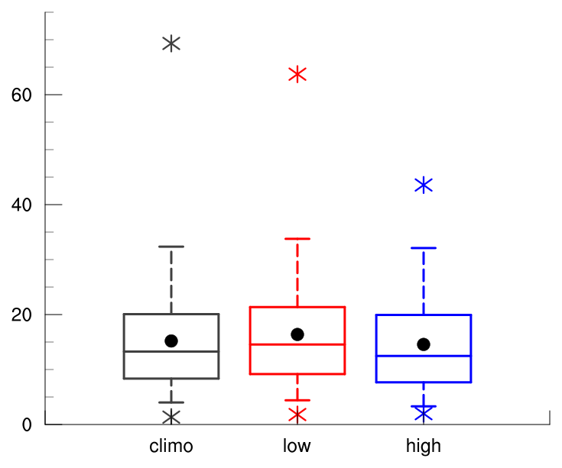
Intensity: Maximum SLP Depth
Maximum SLP depth (hPa) of Arctic cyclones
min and max
mean
95%
75%
median
25%
5%
Statistically significant differences in means
climo
(N=2542)
low
(N=401)
high
(N=345)

Slide 30
Intensity: Maximum SLP Depth
Maximum SLP depth (hPa) of Arctic cyclones
min and max
mean
95%
75%
median
25%
5%
Statistically significant differences in means
climo
(N=2542)
low
(N=401)
high
(N=345)

Slide 31
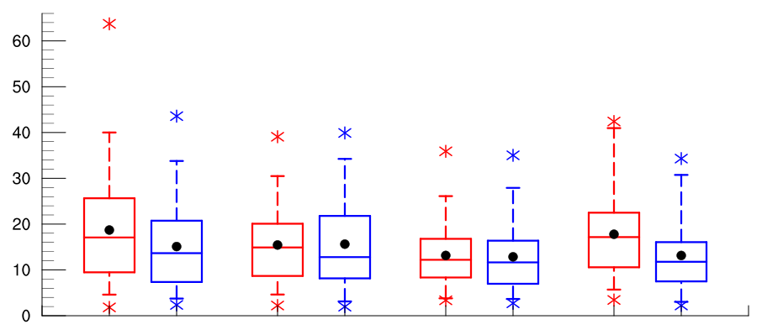
Intensity: Maximum SLP Depth
Maximum SLP depth (hPa) of Arctic cyclones by season
low
(N =130)
high
(N=119)
low
(N=110)
high
(N=110)
low
(N=92)
high
(N=55)
low
(N=69)
high
(N=61)
DJF
MAM
JJA
SON
95%
75%
min and max
mean
median
Statistically significant differences in means
25%
5%

Slide 32
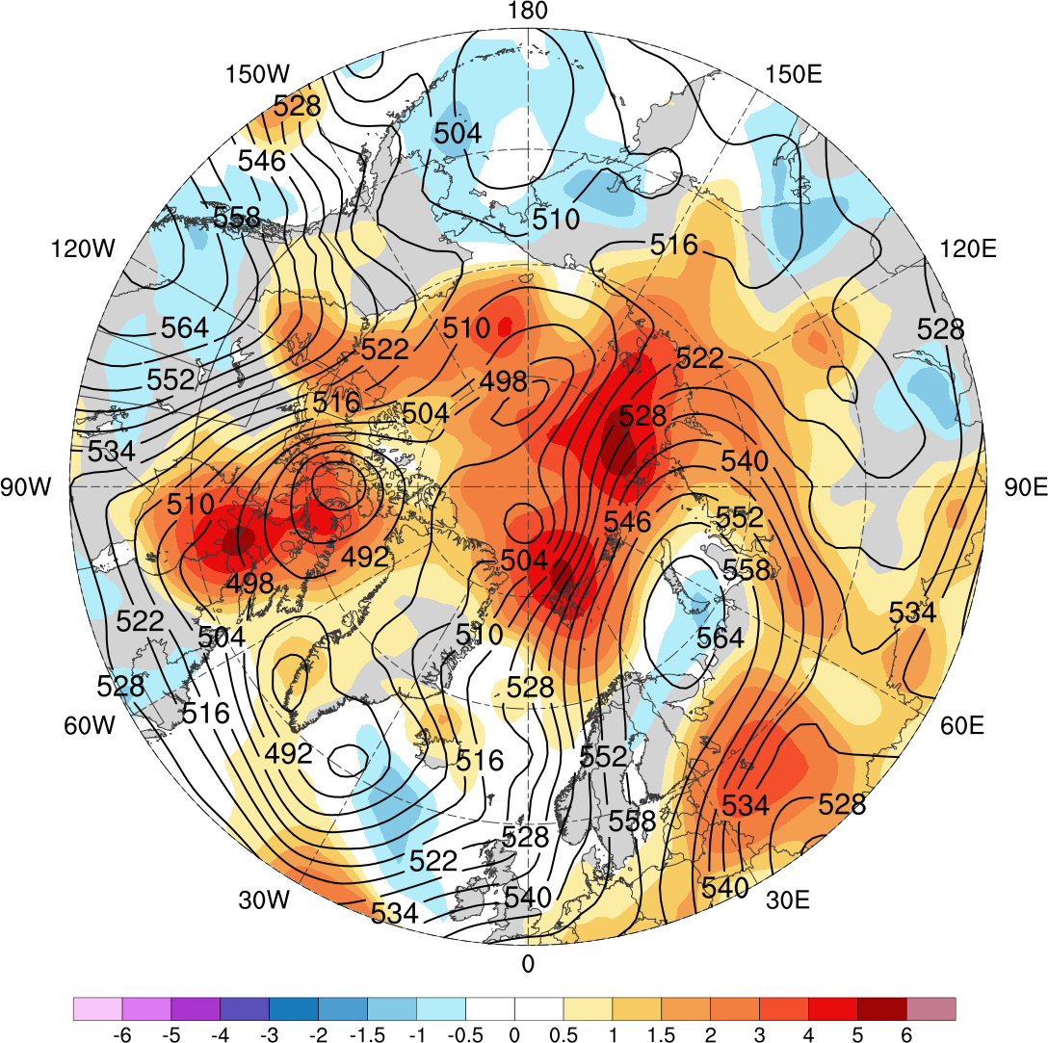
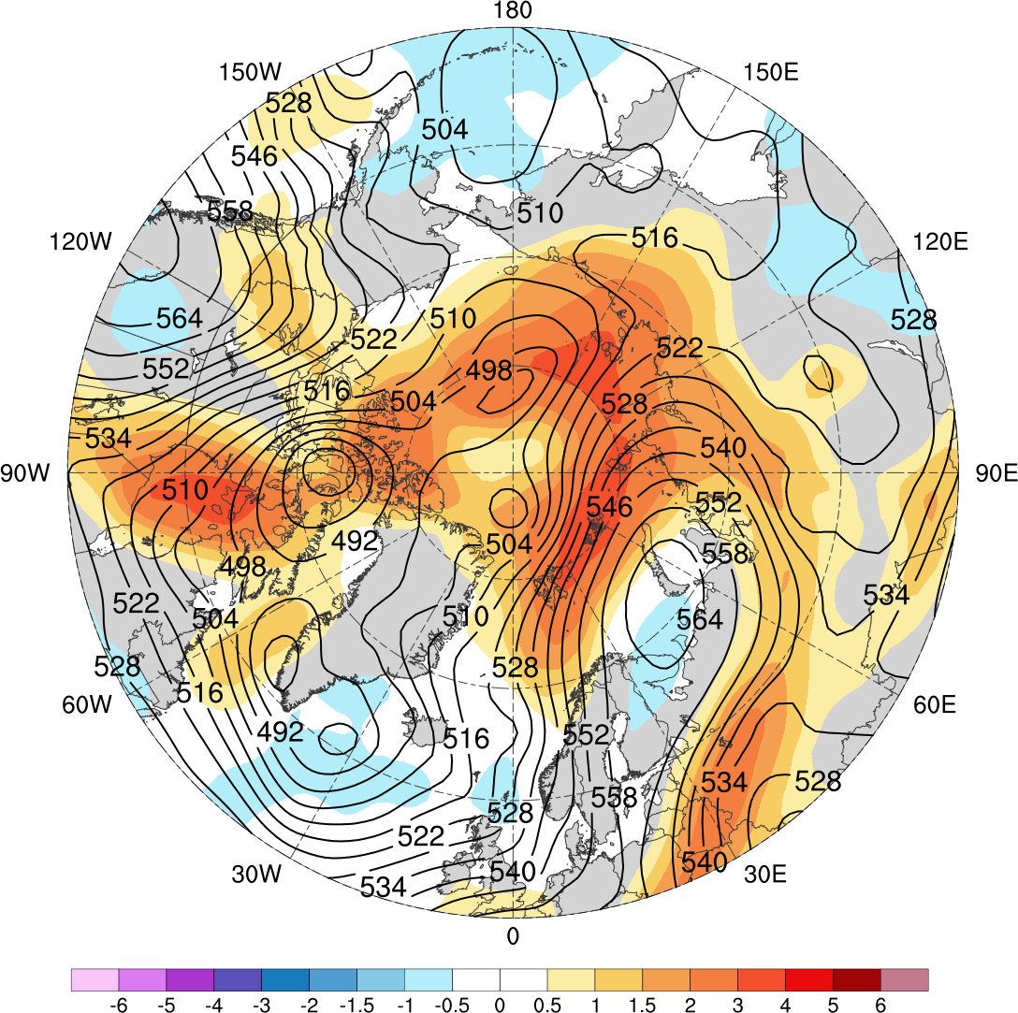
Low Skill Period Example
GEFS
0000 UTC 1 Jan 2016
ECMWF EPS
Standardized anomaly of ensemble spread of 500-hPa geopotential height (shading) valid at 0000 UTC 1 Jan 2016 (day-5 forecast) from GEFS (left) and ECMWF EPS (right); 500-hPa geopotential height (dam, black) from ERA-Interim

Slide 33
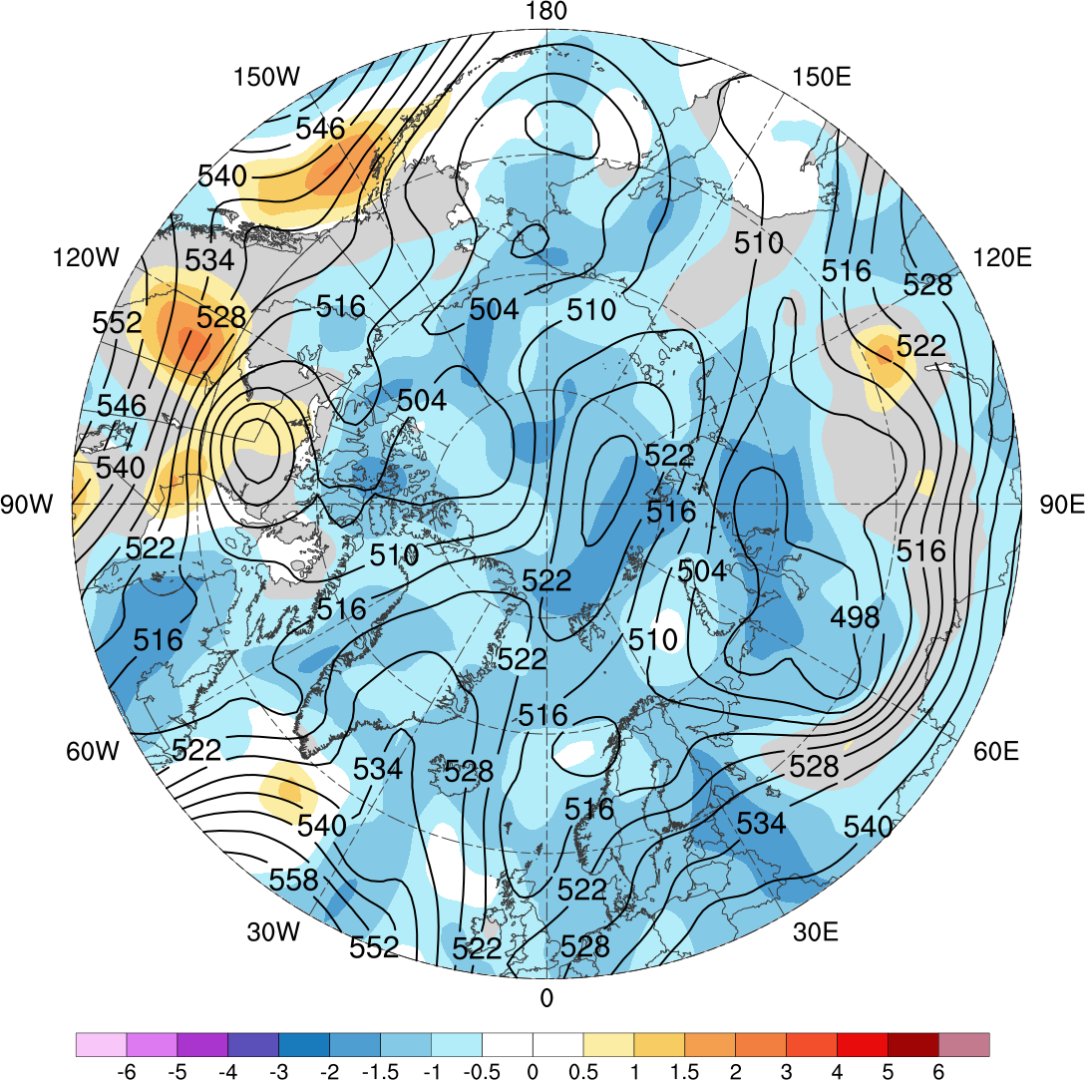
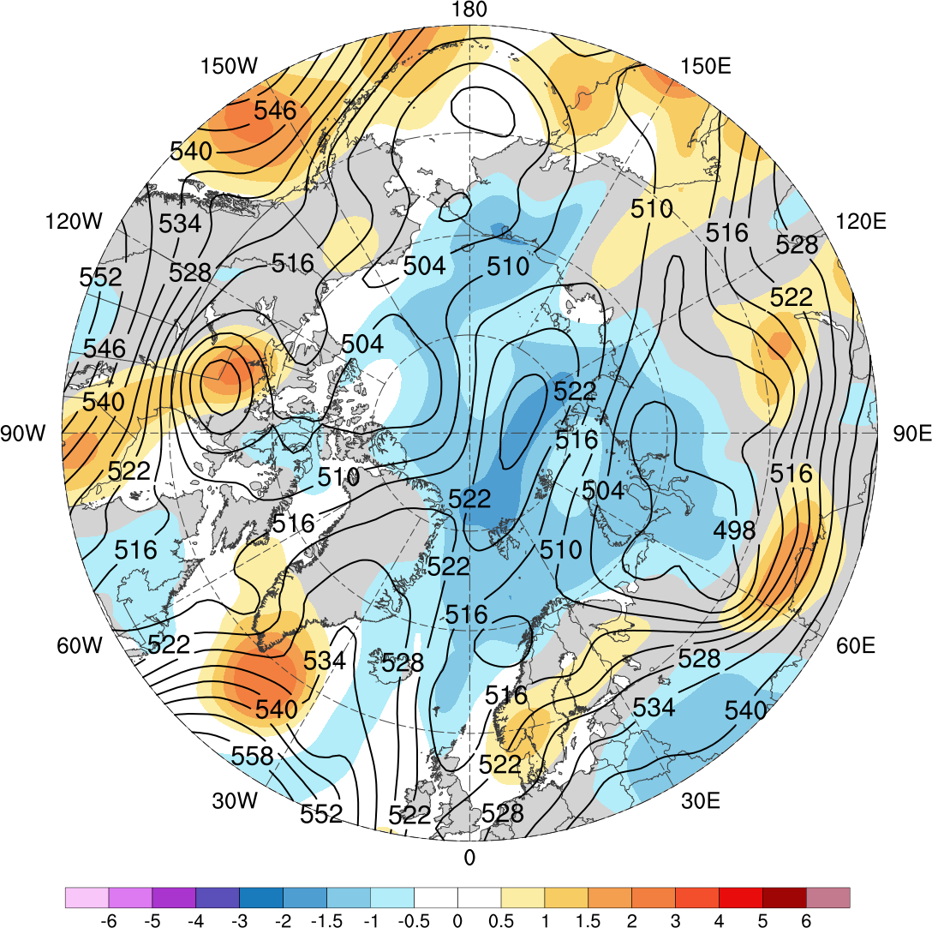
High Skill Period Example
GEFS
0000 UTC 6 Feb 2009
ECMWF EPS
Standardized anomaly of ensemble spread of 500-hPa geopotential height (shading) valid at 0000 UTC 6 Feb 2009 (day-5 forecast) from GEFS (left) and ECMWF EPS (right); 500-hPa geopotential height (dam, black) from ERA-Interim

Slide 34
Flow Amplitude
Calculate an area-weighted average of standardized anomaly of | 500-hPa v-wind | over the Arctic (≥70°N) using ERA-interim during low and high skill periods

Slide 35
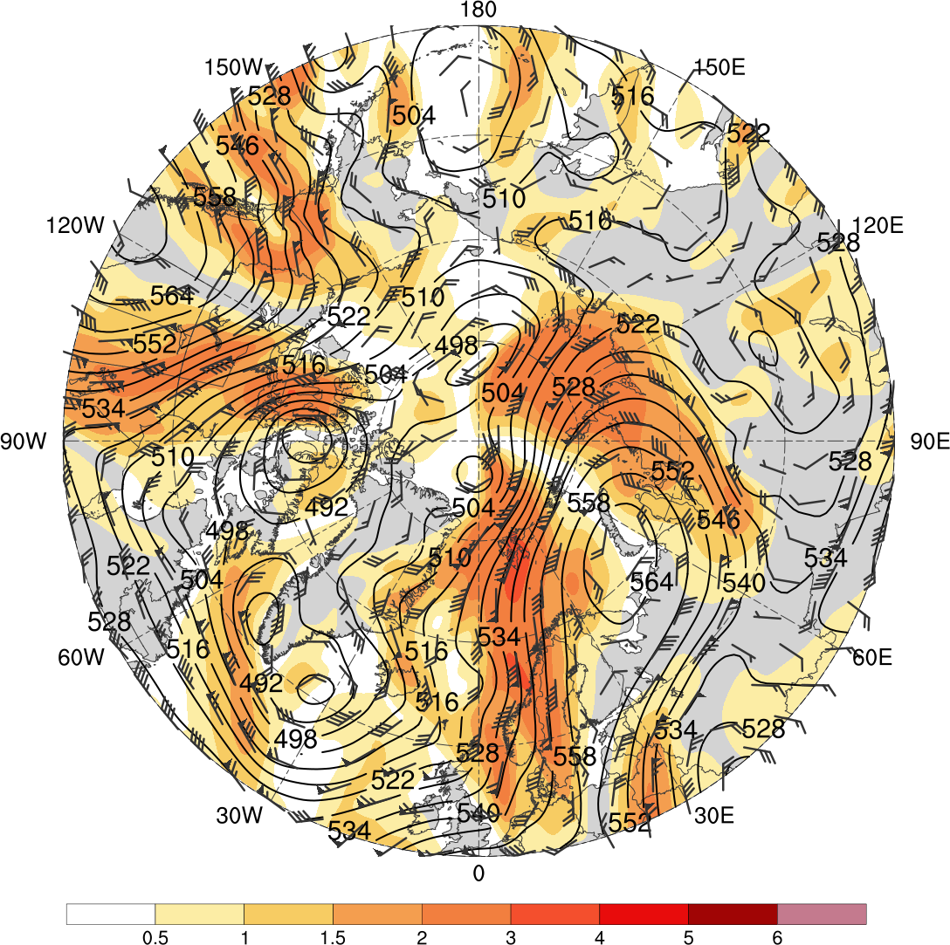
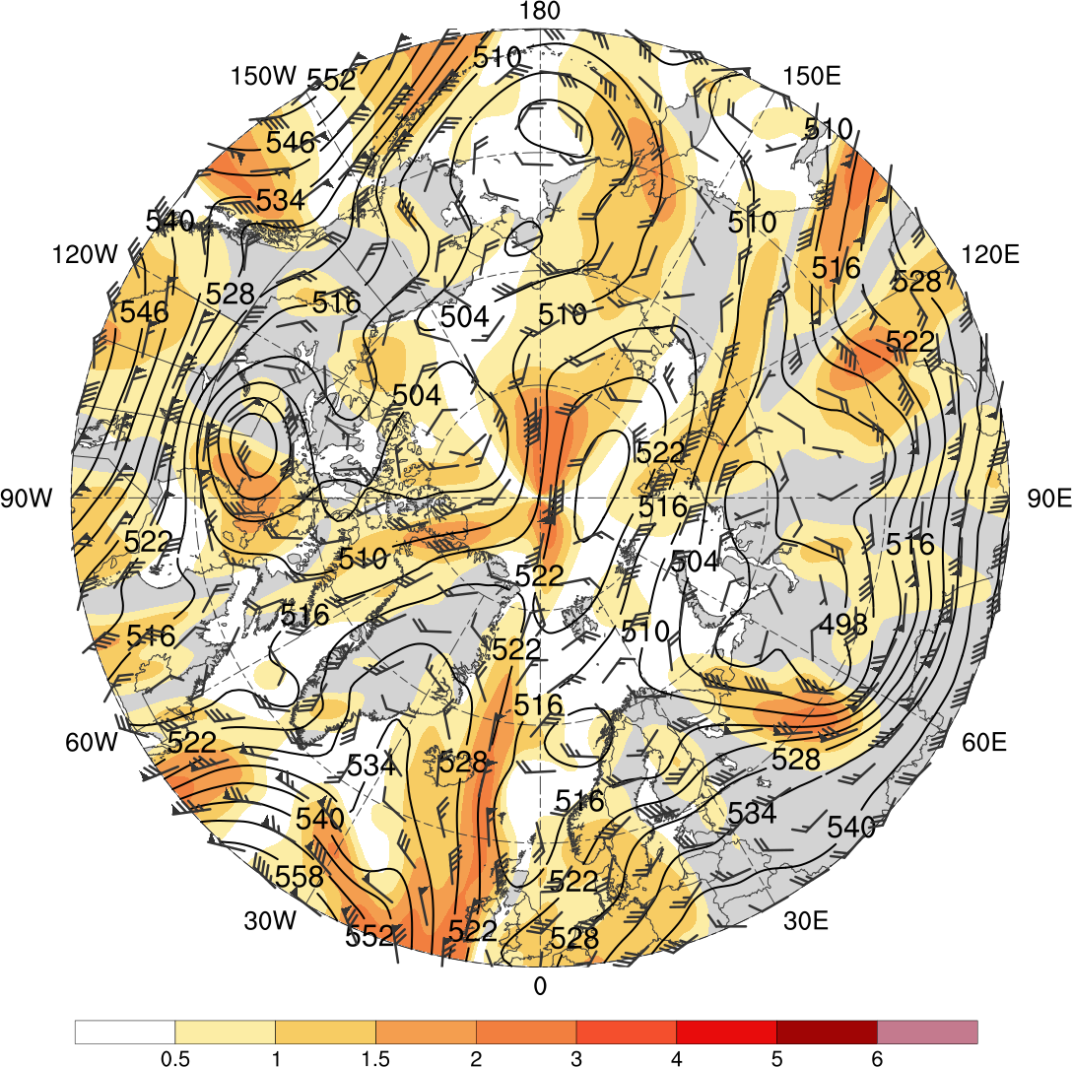
Flow Amplitude
Low skill case
0000 UTC 1 Jan 2016
High skill case
0000 UTC 6 Feb 2009
500-hPa geopotential height (dam), wind (flags and barbs, m s⁻¹), and standardized anomaly of | 500-hPa v-wind | (σ, shading) from ERA-Interim

Slide 36
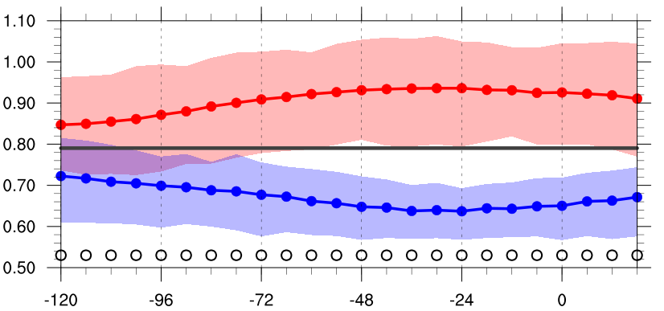
Flow Amplitude
Area-weighted average of standardized anomaly of | 500-hPa v-wind | over the Arctic (≥70°N)
σ
Hours relative to low and high skill days
1979–2017 climo mean
statistically significant difference between low/high skill mean and climo mean
statistically significant difference between low and high skill means
shading: interquartile range
low-skill mean
high-skill mean

Slide 37
Conclusions
Arctic cyclone frequency is higher for low skill periods compared to high skill periods
Arctic cyclones frequency is higher for both low and high skill periods compared to the entire climatology
Arctic cyclone frequency is highest during JJA for the entire climatology and low skill periods, and highest during SON for high skill periods
Arctic cyclone frequency is lowest during DJF for the entire climatology, and for low and high skill periods

Slide 38
Conclusions
Arctic cyclones during low skill periods more often occur over northern portions of central and eastern Eurasia and much of the adjacent Arctic Ocean compared to Arctic cyclones during high skill periods
Arctic cyclones during high skill periods more often occur over the northern North Atlantic and the adjacent Norwegian and Barents Seas compared to Arctic cyclones during low skill periods

Slide 39
Conclusions
Arctic cyclones tend to be stronger during low skill periods compared to high skill periods, especially during SON
The synoptic-scale flow over the Arctic tends to be significantly more amplified during low skill periods compared to high skill periods
The synoptic-scale flow over the Arctic tends to be significantly more and less amplified during low and high skill periods, respectively, compared to climatology

Slide 40
Extra Slides

Slide 41
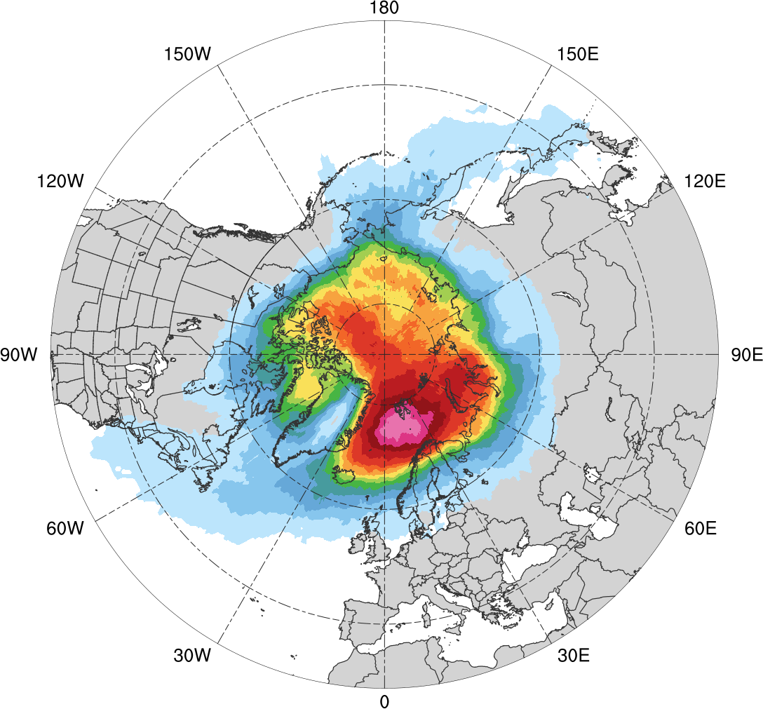
Normalized Track Density (DJF)
DJF climatology (N = 585)
0.05
0.1
0.15
0.2
0.25
0.3
0.35
0.4
0.45
0.5
0.6
0.7
0.8
0.9
Total number of Arctic cyclones during DJF within 500 km of a grid point, normalized by maximum value

Slide 42
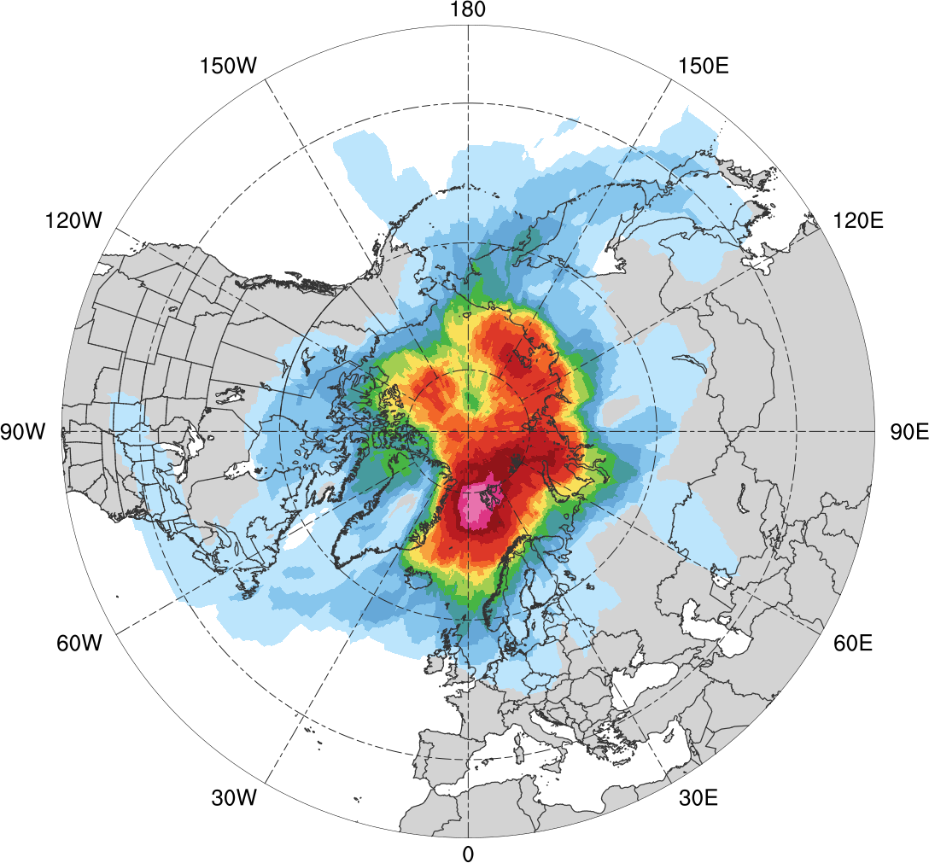
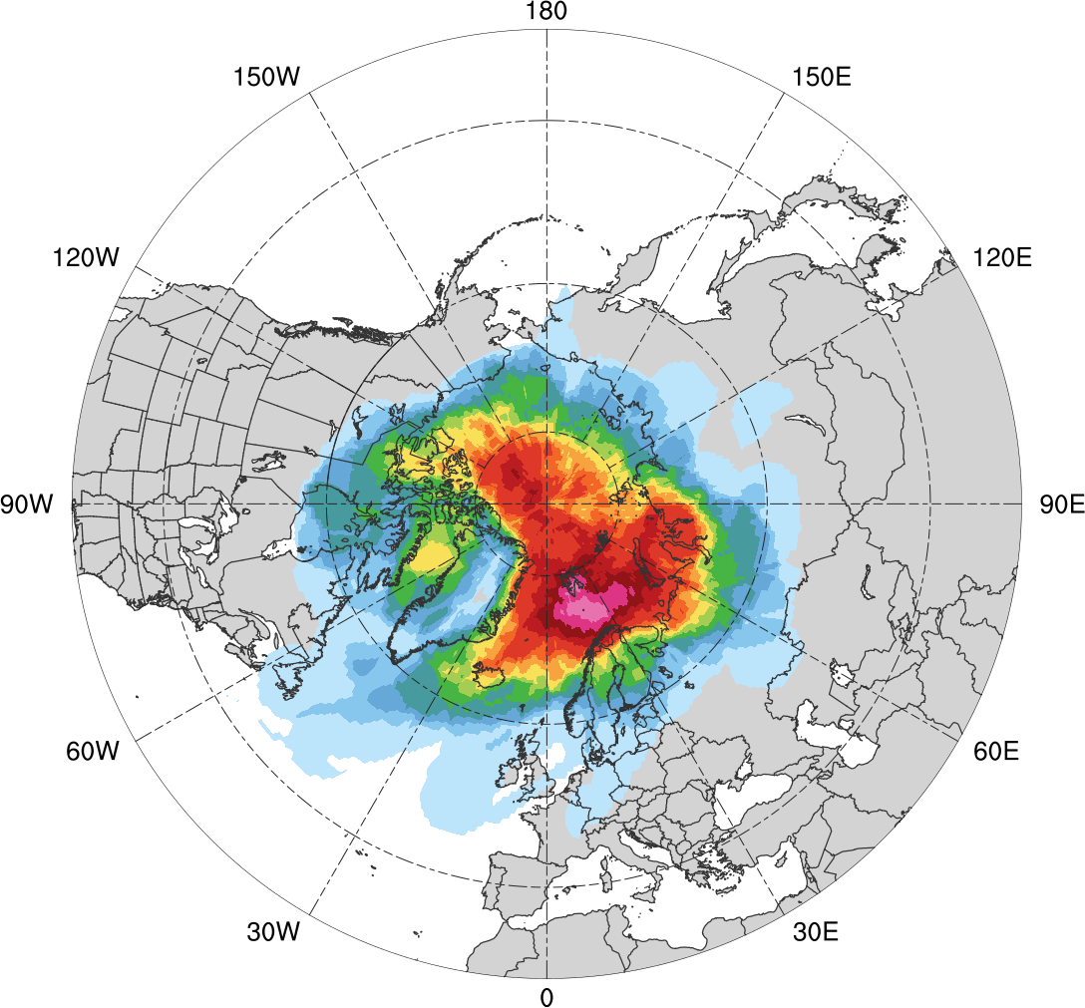
Normalized Track Density (DJF)
Low skill (N = 130)
High Skill (N = 119)
0.05
0.1
0.15
0.2
0.25
0.3
0.35
0.4
0.45
0.5
0.6
0.7
0.8
0.9
Total number of Arctic cyclones within 500 km of a grid point during DJF, normalized by maximum value, for each period

Slide 43
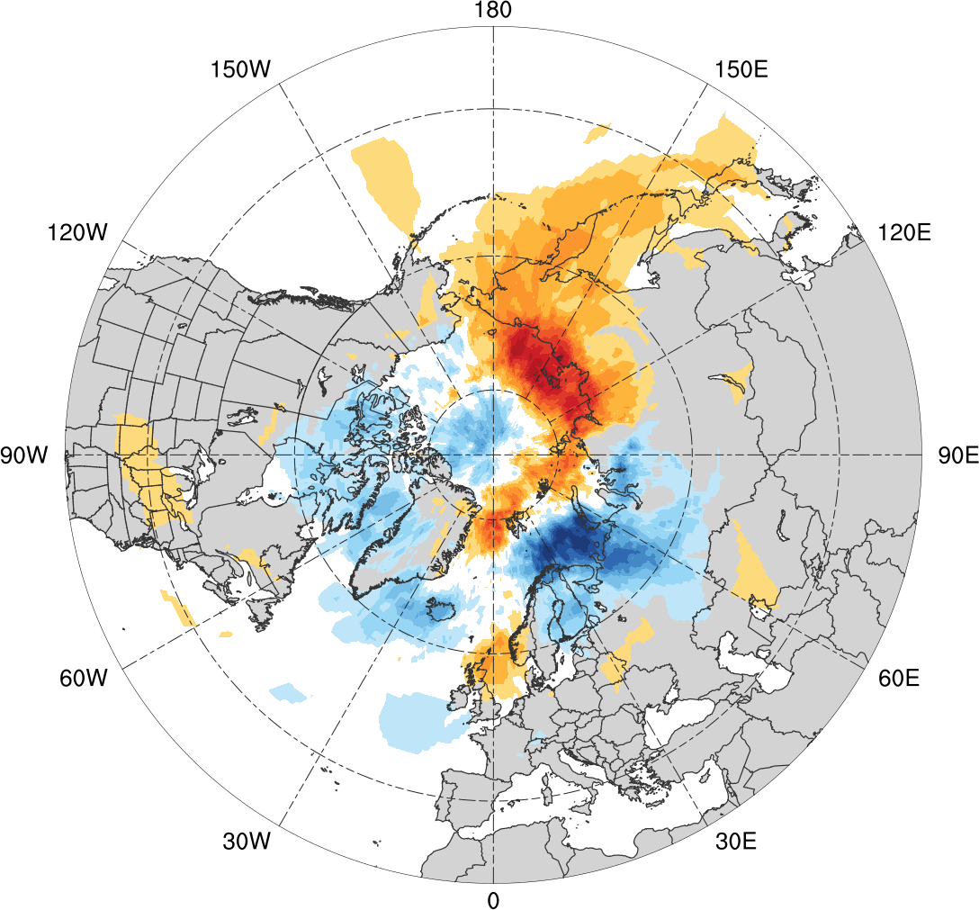
Normalized Track Density Differences (DJF)
Low skill minus high skill
-0.4
-0.35
-0.3
-0.25
-0.2
-0.15
-0.1
-0.05
0
0.05
0.1
0.15
0.2
0.25
0.3
0.35
0.4
Difference in normalized Arctic cyclone track density during DJF

Slide 44
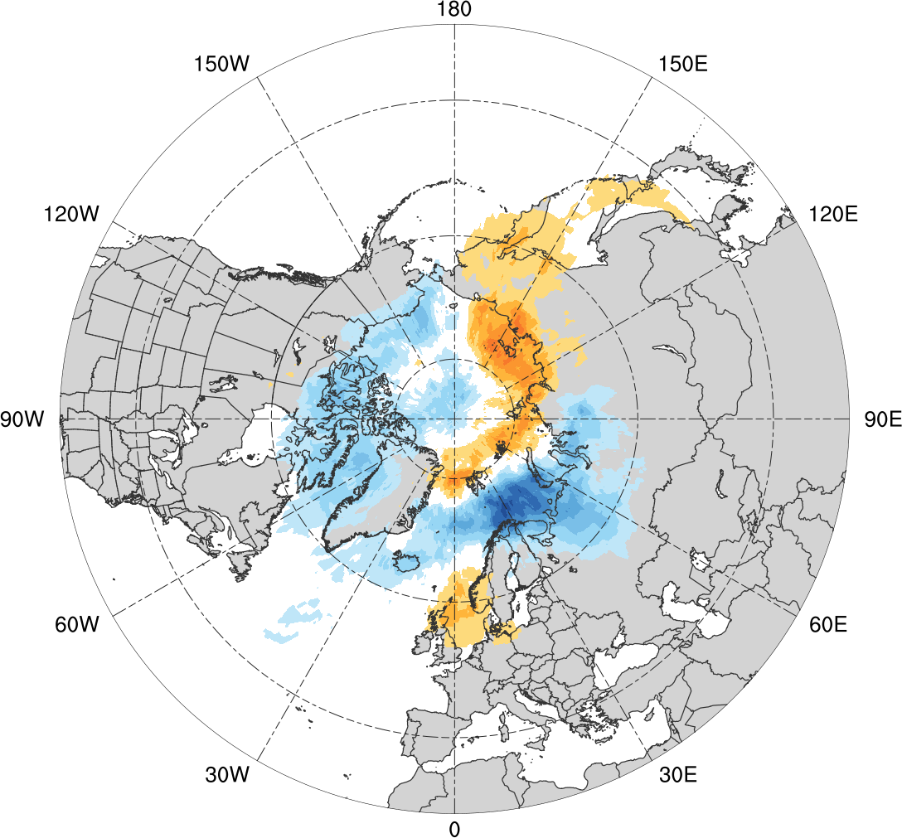
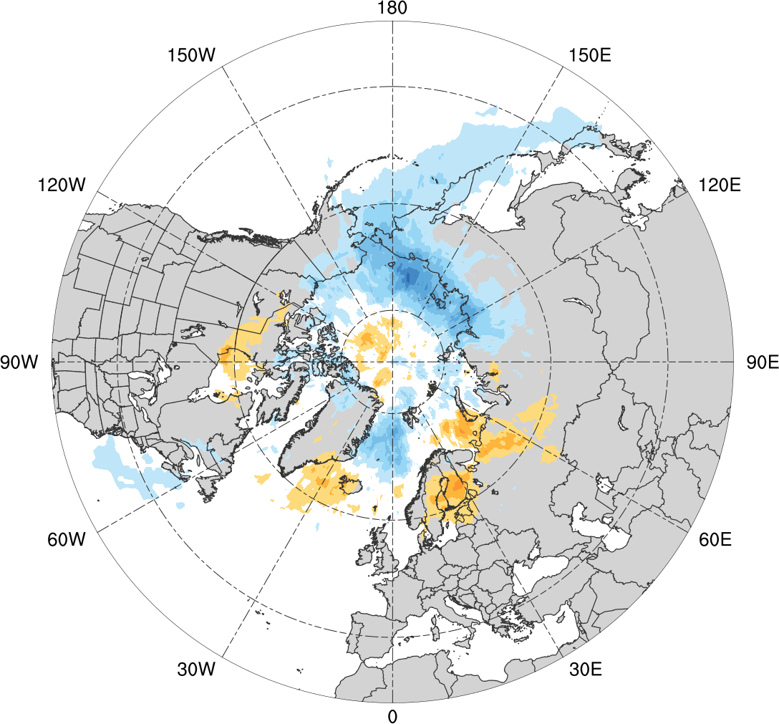
Normalized Track Density Differences (DJF)
Low skill minus climatology
High skill minus climatology
-0.4
-0.35
-0.3
-0.25
-0.2
-0.15
-0.1
-0.05
0
0.05
0.1
0.15
0.2
0.25
0.3
0.35
0.4
Difference in normalized Arctic cyclone track density during DJF

Slide 45
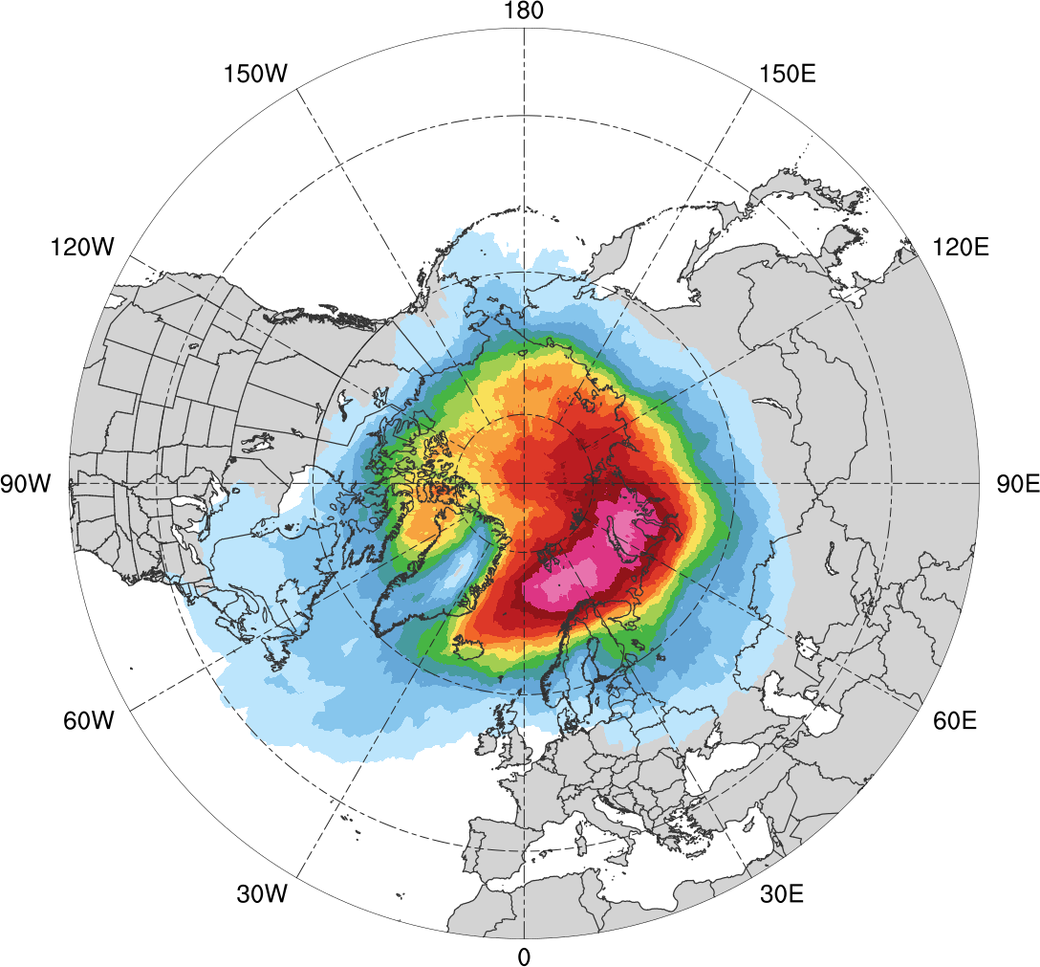
Normalized Track Density (MAM)
MAM climatology (N = 609)
0.05
0.1
0.15
0.2
0.25
0.3
0.35
0.4
0.45
0.5
0.6
0.7
0.8
0.9
Total number of Arctic cyclones during MAM within 500 km of a grid point, normalized by maximum value

Slide 46
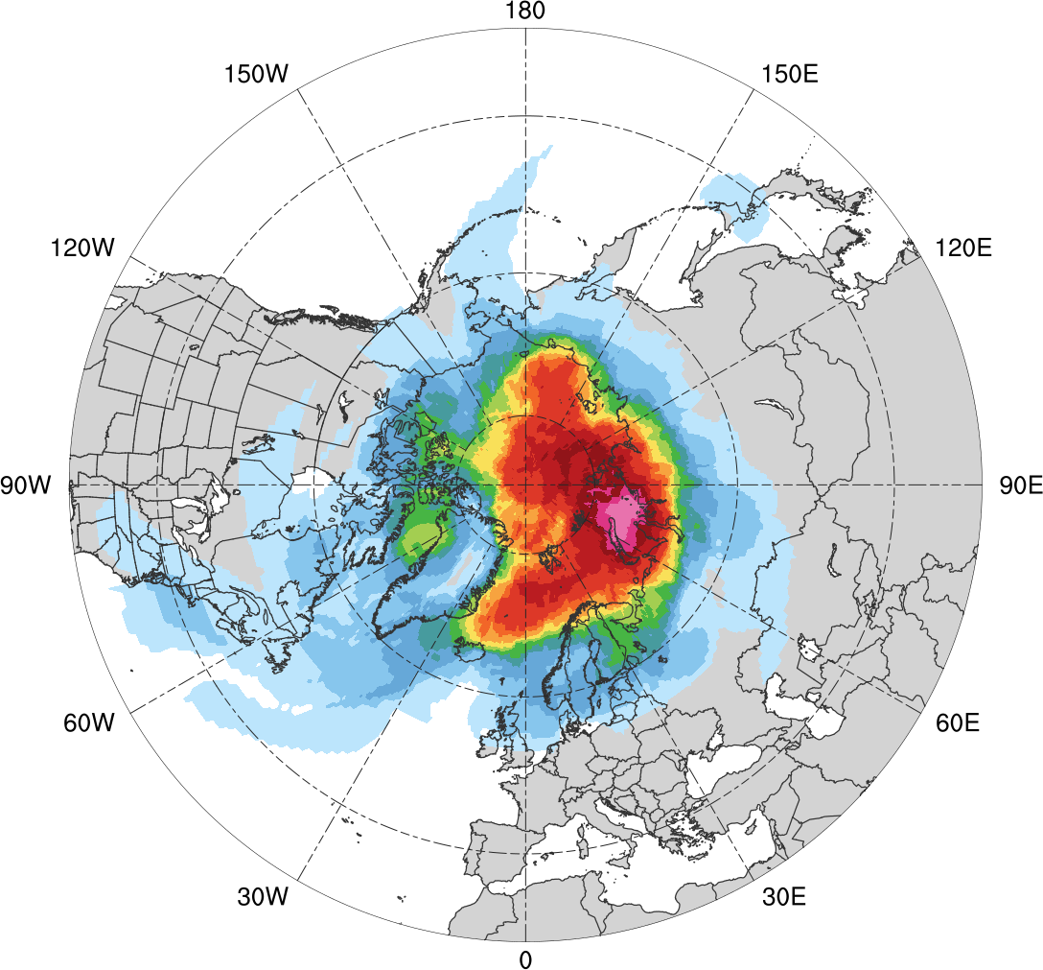
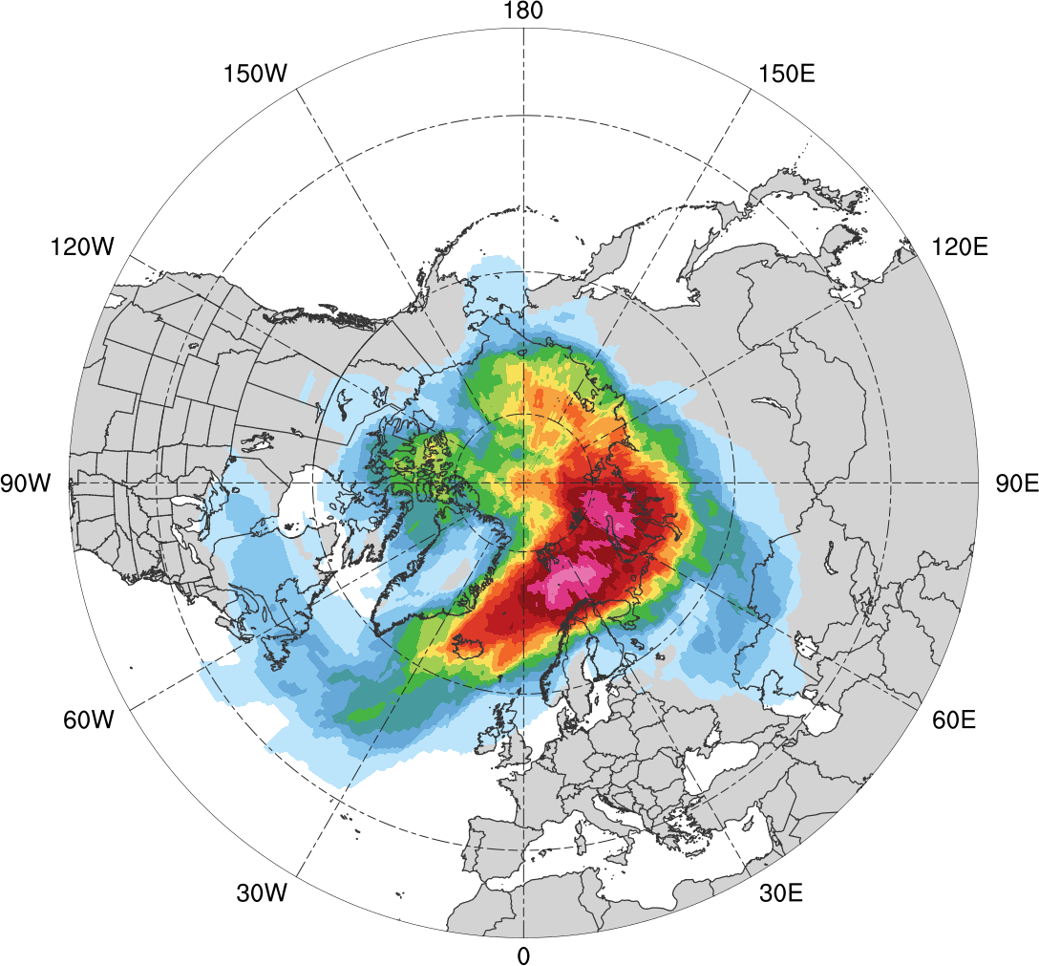
Normalized Track Density (MAM)
Low skill (N = 110)
High Skill (N = 110)
0.05
0.1
0.15
0.2
0.25
0.3
0.35
0.4
0.45
0.5
0.6
0.7
0.8
0.9
Total number of Arctic cyclones within 500 km of a grid point during MAM, normalized by maximum value, for each period

Slide 47
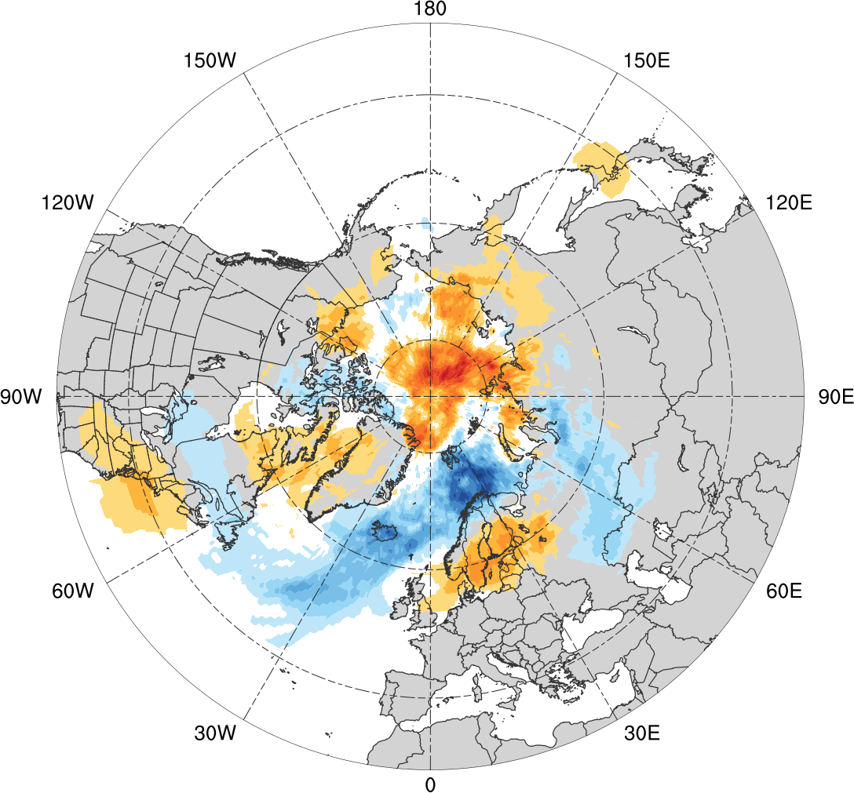
Normalized Track Density Differences (MAM)
Low skill minus high skill
-0.4
-0.35
-0.3
-0.25
-0.2
-0.15
-0.1
-0.05
0
0.05
0.1
0.15
0.2
0.25
0.3
0.35
0.4
Difference in normalized Arctic cyclone track density during MAM

Slide 48
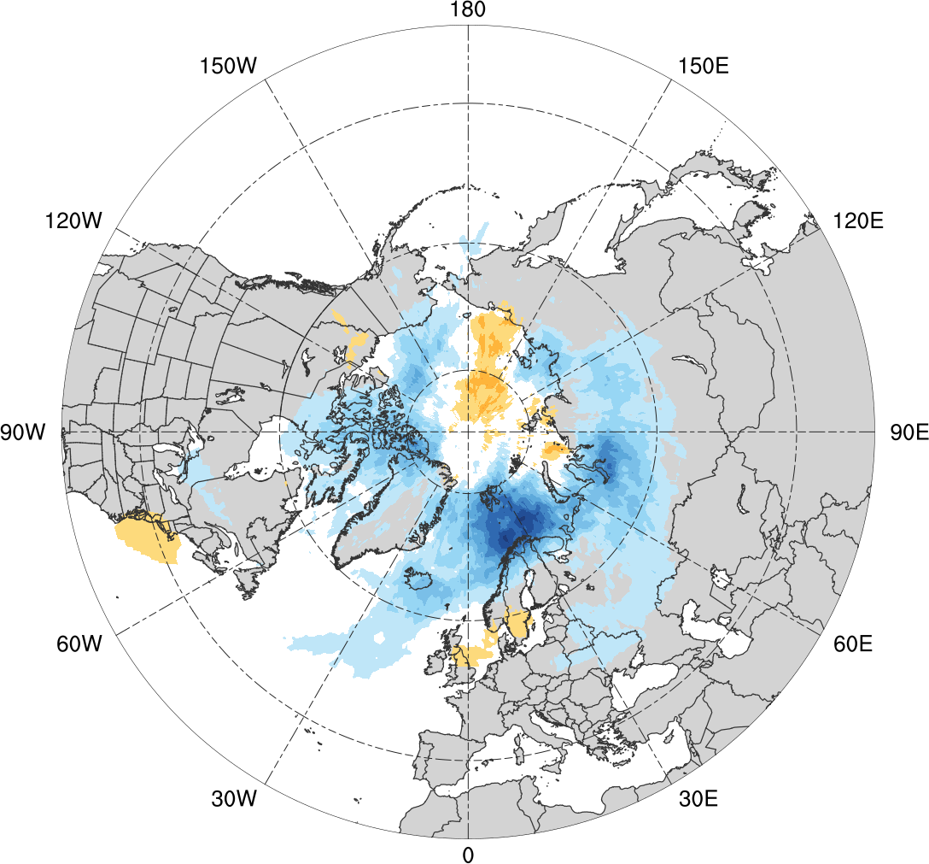
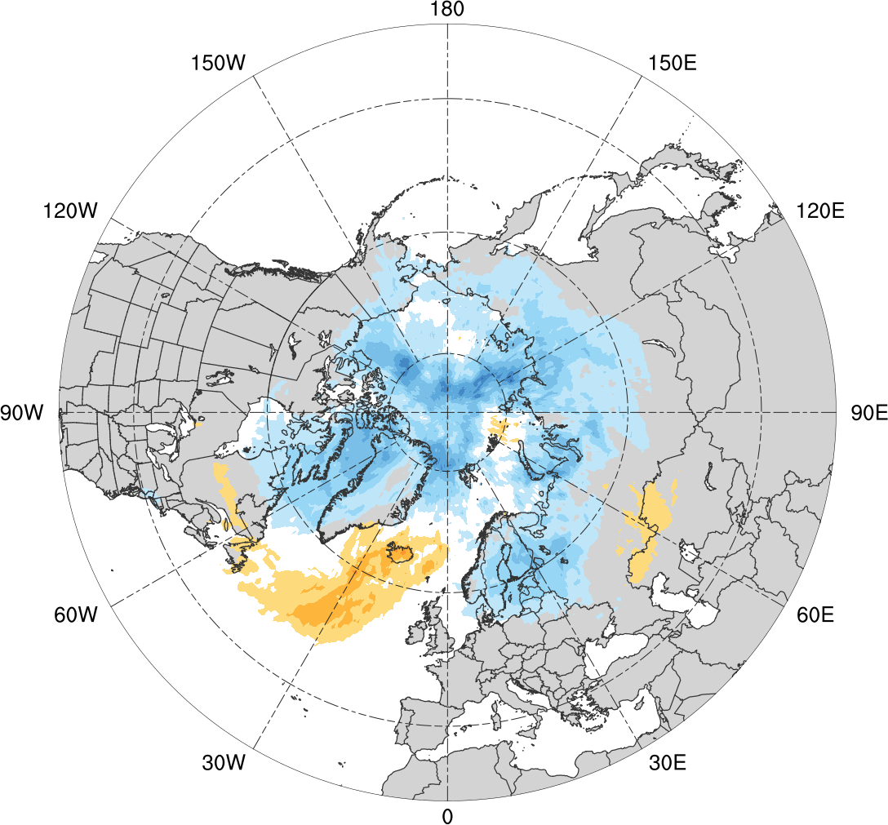
Normalized Track Density Differences (MAM)
Low skill minus climatology
High skill minus climatology
-0.4
-0.35
-0.3
-0.25
-0.2
-0.15
-0.1
-0.05
0
0.05
0.1
0.15
0.2
0.25
0.3
0.35
0.4
Difference in normalized Arctic cyclone track density during MAM

Slide 49
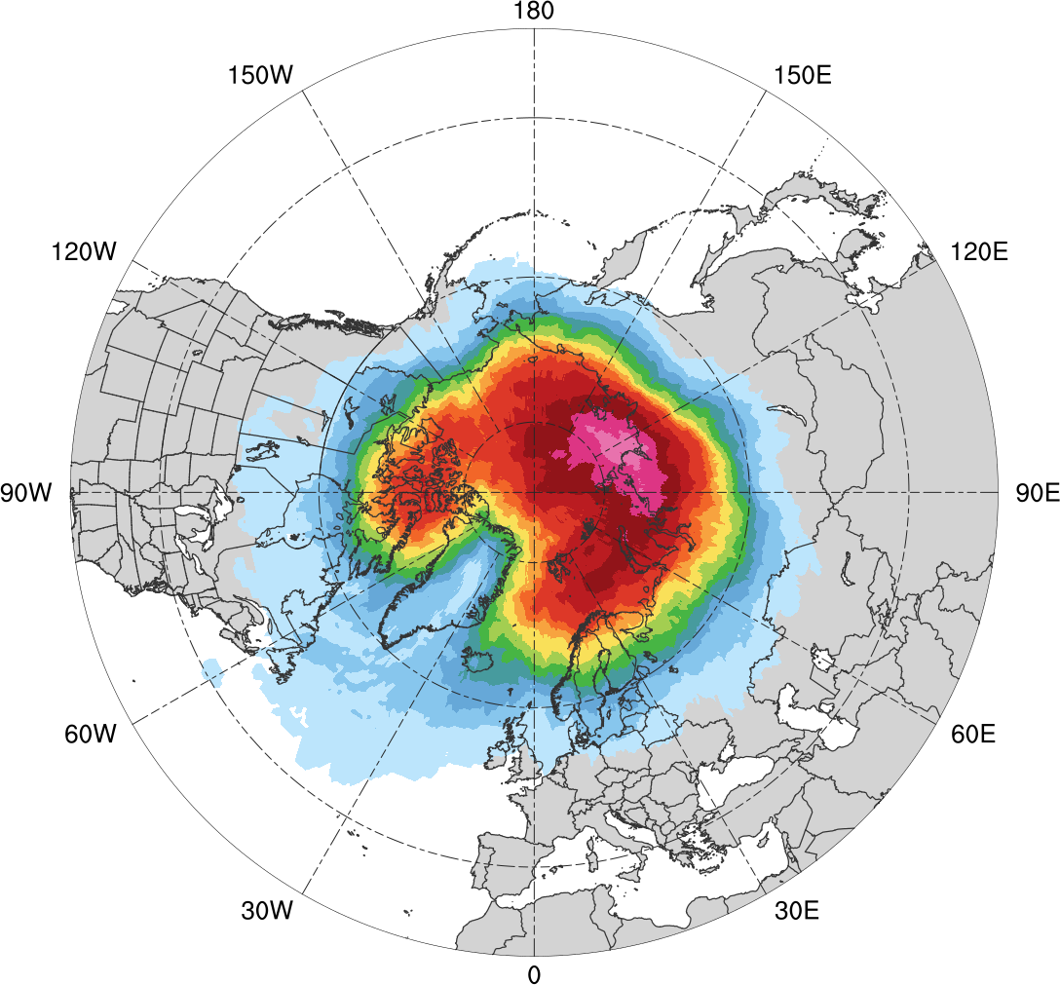
Normalized Track Density (JJA)
JJA climatology (N = 680)
0.05
0.1
0.15
0.2
0.25
0.3
0.35
0.4
0.45
0.5
0.6
0.7
0.8
0.9
Total number of Arctic cyclones during JJA within 500 km of a grid point, normalized by maximum value

Slide 50
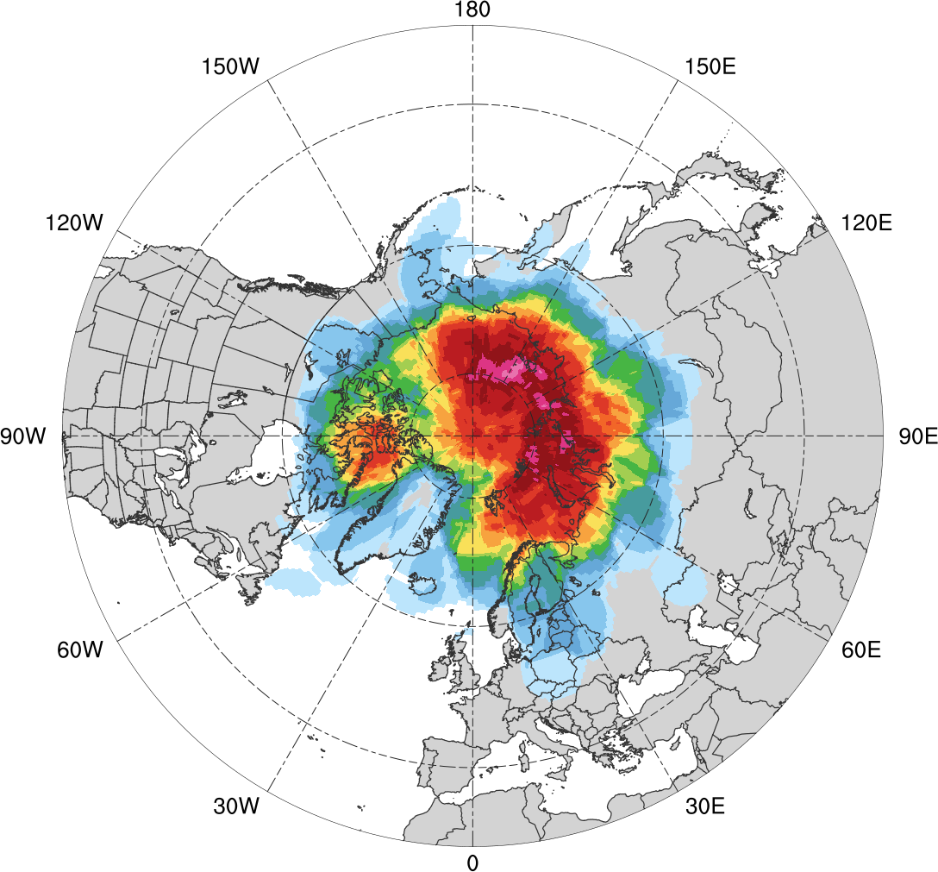
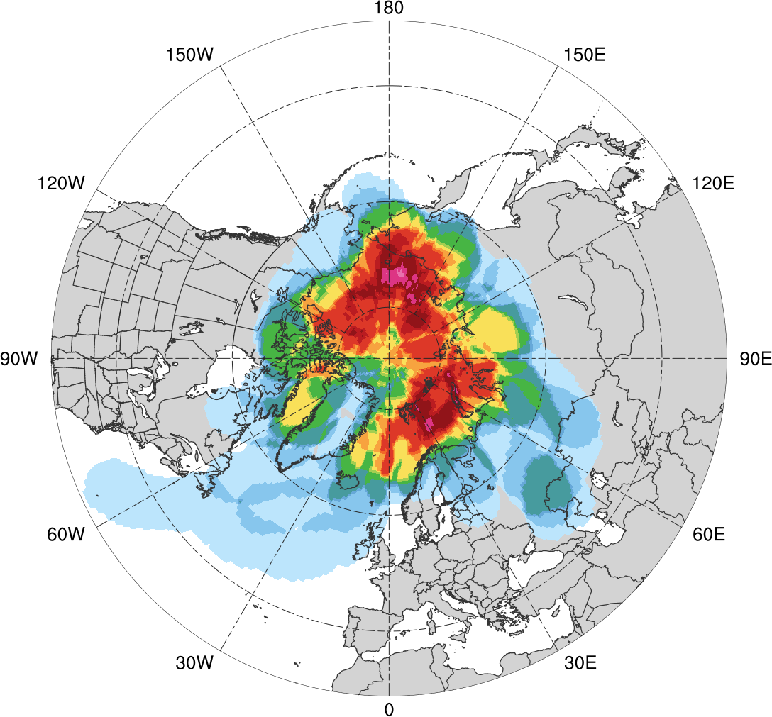
Normalized Track Density (JJA)
Low skill (N = 92)
High Skill (N = 52)
0.05
0.1
0.15
0.2
0.25
0.3
0.35
0.4
0.45
0.5
0.6
0.7
0.8
0.9
Total number of Arctic cyclones within 500 km of a grid point during JJA, normalized by maximum value, for each period

Slide 51
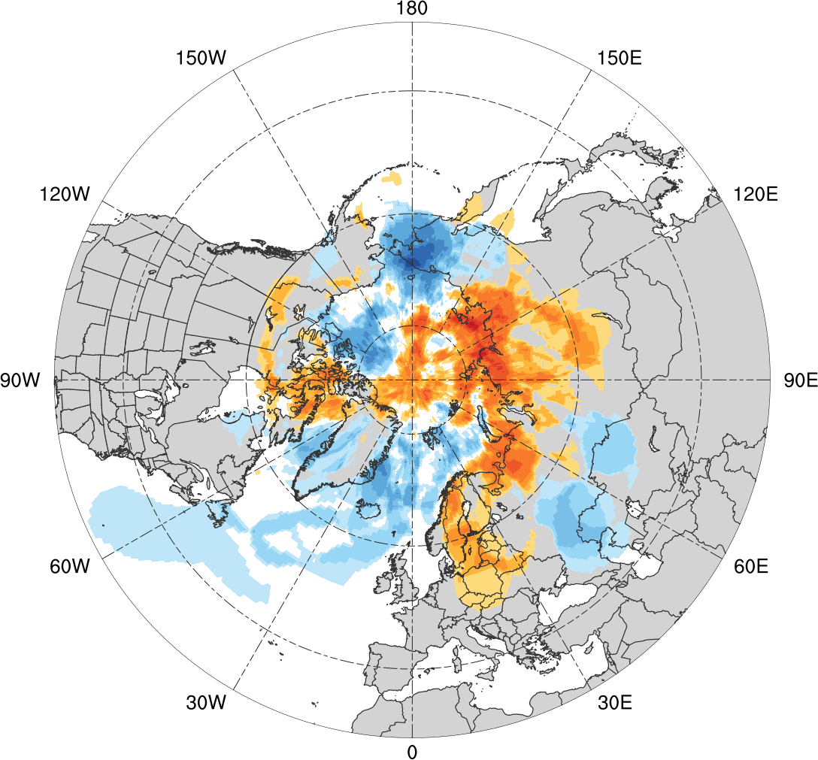
Normalized Track Density Differences (JJA)
Low skill minus high skill
-0.6
-0.5
-0.4
-0.3
-0.2
-0.15
-0.1
-0.05
0
0.05
0.1
0.15
0.2
0.3
0.4
0.5
0.6
Difference in normalized Arctic cyclone track density during JJA

Slide 52
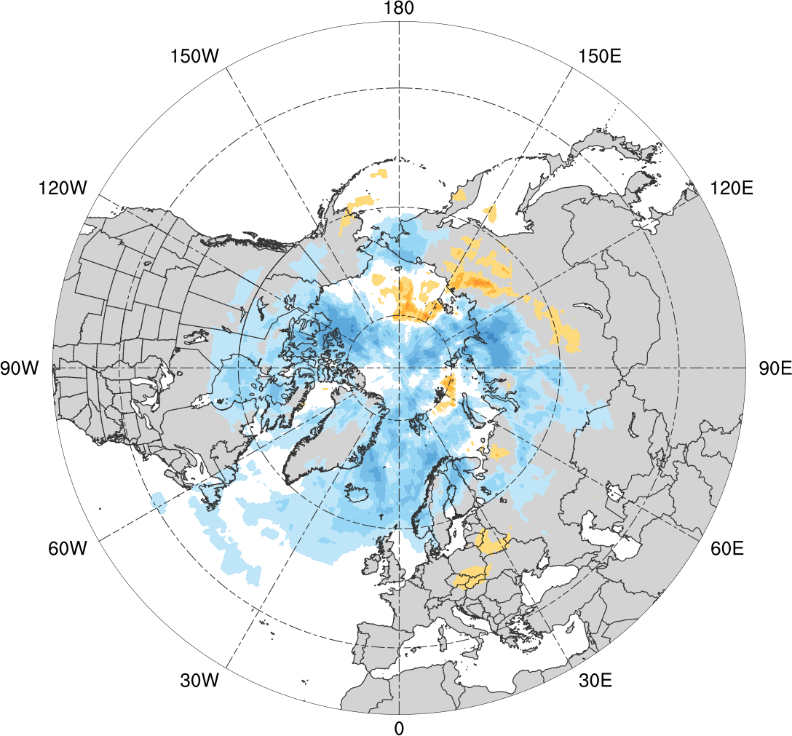
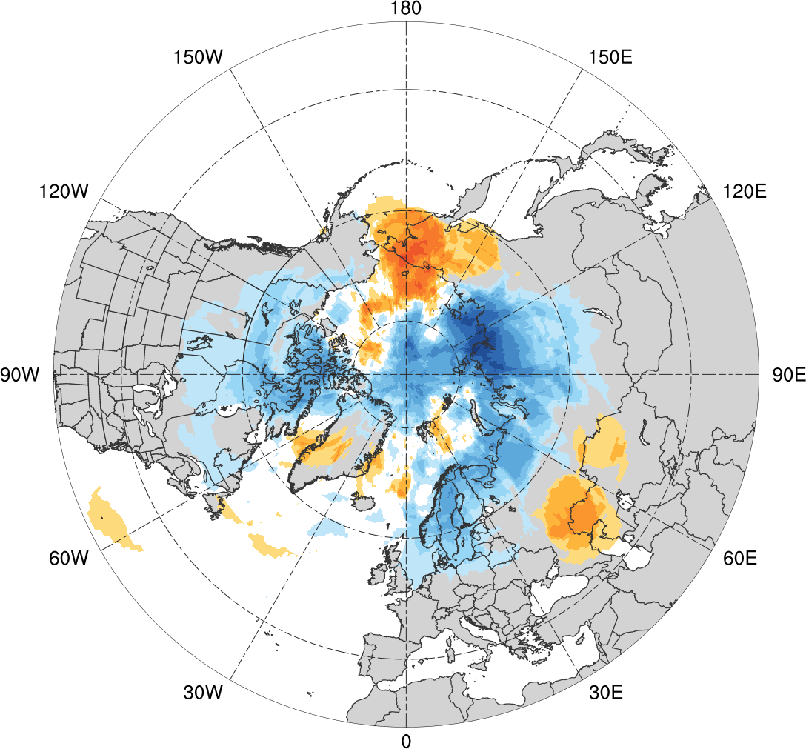
Normalized Track Density Differences (JJA)
Low skill minus climatology
High skill minus climatology
-0.6
-0.5
-0.4
-0.3
-0.2
-0.15
-0.1
-0.05
0
0.05
0.1
0.15
0.2
0.3
0.4
0.5
0.6
Difference in normalized Arctic cyclone track density during JJA

Slide 53
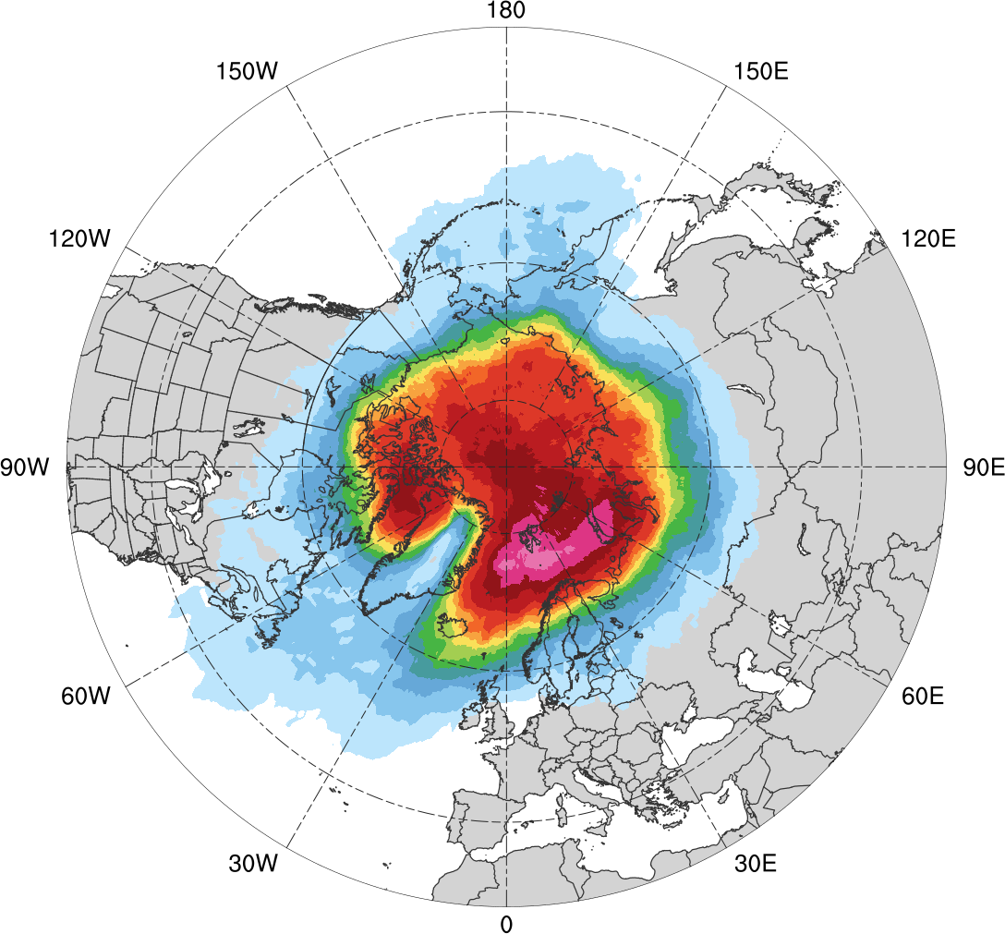
Normalized Track Density (SON)
SON climatology (N = 668)
0.05
0.1
0.15
0.2
0.25
0.3
0.35
0.4
0.45
0.5
0.6
0.7
0.8
0.9
Total number of Arctic cyclones during SON within 500 km of a grid point, normalized by maximum value

Slide 54
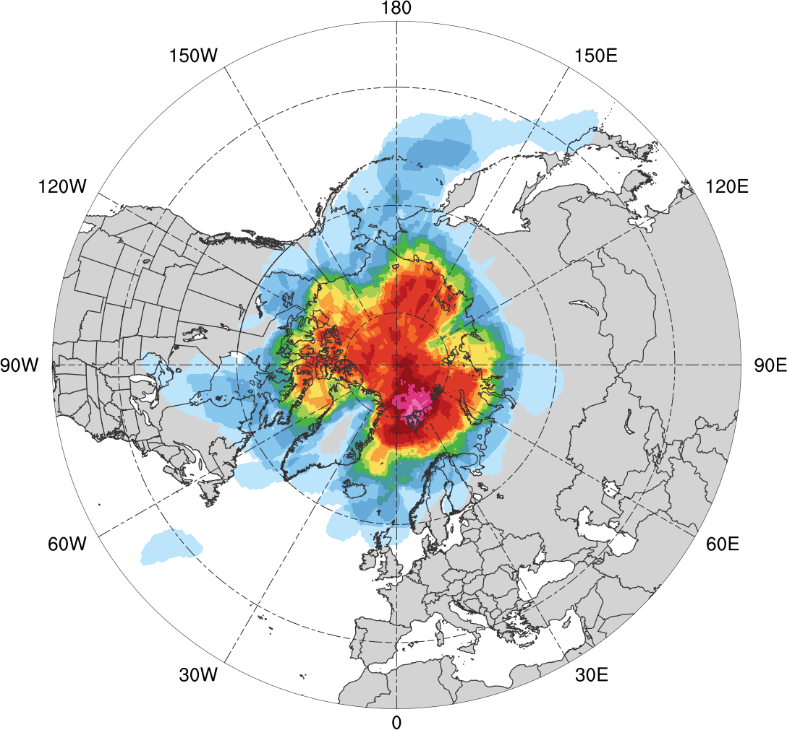
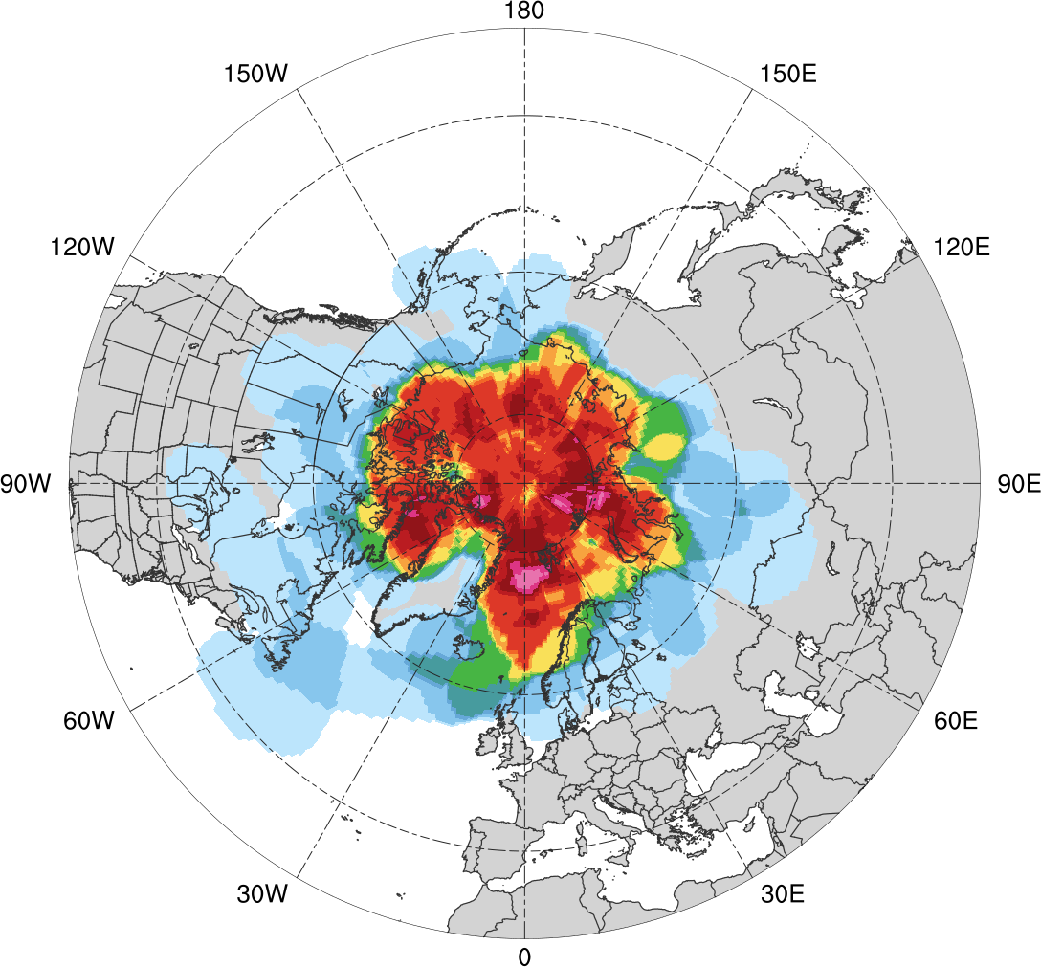
Normalized Track Density (SON)
Low skill (N = 69)
High Skill (N = 61)
0.05
0.1
0.15
0.2
0.25
0.3
0.35
0.4
0.45
0.5
0.6
0.7
0.8
0.9
Total number of Arctic cyclones within 500 km of a grid point during SON, normalized by maximum value, for each period

Slide 55
Normalized Track Density Differences (SON)
Low skill minus high skill
-0.5
-0.4
-0.3
-0.25
-0.2
-0.15
-0.1
-0.05
0
0.05
0.1
0.15
0.2
0.25
0.3
0.4
0.5
Difference in normalized Arctic cyclone track density during SON

Slide 56
Normalized Track Density Differences (SON)
Low skill minus climatology
High skill minus climatology
-0.5
-0.4
-0.3
-0.25
-0.2
-0.15
-0.1
-0.05
0
0.05
0.1
0.15
0.2
0.25
0.3
0.4
0.5
Difference in normalized Arctic cyclone track density during SON

Slide 57
Track Density
Entire climatology (N = 2542)
1
5
10
15
20
30
40
50
75
100
150
200
300
400
500
Total number of Arctic cyclones within 500 km of a grid point

Slide 58
Track Density
Low skill (N = 401)
High Skill (N = 345)
1
5
10
15
20
25
30
35
40
45
50
60
70
80
90
Total number of Arctic cyclones within 500 km of a grid point

Slide 59
Results: Preferred Longitudinal Corridors (MAM)
Percentage of Arctic cyclones per longitude bin according to longitude of Arctic cyclones at first time in Arctic (>70°N) during MAM
90°N
70°N
50°N
30°N
0°
30°E
60°E
90°E
120°E
150°E
180°
150°W
120°W
90°W
60°W
30°W
0°
0°
30°E
60°E
90°E
120°E
150°E
180°
150°W
120°W
90°W
60°W
30°W
0°
climo (N=609)
low (N=110)
high (N=110)

Slide 60
Results: Preferred Longitudinal Corridors (SON)
Percentage of Arctic cyclones per longitude bin according to longitude of Arctic cyclones at first time in Arctic (>70°N) during SON
90°N
70°N
50°N
30°N
0°
30°E
60°E
90°E
120°E
150°E
180°
150°W
120°W
90°W
60°W
30°W
0°
0°
30°E
60°E
90°E
120°E
150°E
180°
150°W
120°W
90°W
60°W
30°W
0°
climo (N=668)
low (N=69)
high (N=61)

Slide 61
Genesis Latitude (DJF)
Distribution of Arctic cyclone genesis latitude (% per latitude bin) during DJF
10°N
20°N
30°N
40°N
50°N
60°N
70°N
80°N
90°N
climo (N=585)
low (N=130)
high (N=119)

Slide 62
Genesis Latitude (MAM)
Genesis latitude of Arctic cyclones during MAM
10°N
20°N
30°N
40°N
50°N
60°N
70°N
80°N
90°N
climo (N=609)
low (N=110)
high (N=110)

Slide 63
Genesis Latitude (JJA)
Distribution of Arctic cyclone genesis latitude (% per latitude bin) during JJA
10°N
20°N
30°N
40°N
50°N
60°N
70°N
80°N
90°N
climo (N=680)
low (N=92)
high (N=55)

Slide 64
Genesis Latitude (SON)
Genesis latitude of Arctic cyclones during SON
10°N
20°N
30°N
40°N
50°N
60°N
70°N
80°N
90°N
climo (N=668)
low (N=69)
high (N=61)

Slide 65
Low Skill Period Example
GEFS
0000 UTC 1 Jan 2016
Genesis
Lysis
Standardized anomaly of ensemble spread of 500-hPa geopotential height (shading) valid at 0000 UTC 1 Jan 2016 (day-5 forecast) from GEFS; 500-hPa geopotential heights (dam, black) from ERA-Interim
Tracks of Arctic cyclones occurring during 27 Dec 2015–1 Jan 2016

Slide 66
High Skill Period Example
GEFS
0000 UTC 6 Feb 2009
Genesis
Lysis
Standardized anomaly of ensemble spread of 500-hPa geopotential height (shading) valid at 0000 UTC 6 Feb 2009 (day-5 forecast) from GEFS; 500-hPa geopotential heights (dam, black) from ERA-Interim
Tracks of Arctic cyclones occurring during 1–6 Feb 2009

