Slide 1
Two Intense Arctic Cyclones in June 2018
Background
Arctic cyclone 1 (AC1) formed along an old cold frontal boundary northeast of the Caspian Sea, moved poleward, performed a cyclonic loop with a subsequent Arctic cyclone (AC2) near the north coast of Russia, and eventually merged with AC2 over the Arctic Ocean
AC2 formed via lee cyclogenesis east of Greenland, and may have had some “DNA” (i.e., vorticity) from the remnants of Tropical Storm (TS) Alberto, which moved poleward across the central U.S. and northeastern Canada

Slide 2
Two Intense Arctic Cyclones in June 2018
Background
The comparative rarity of two sequential intense Arctic cyclones that interacted with one another, one of which (AC2) may have had antecedent DNA from TS Alberto, motivates this presentation

Slide 3
Two Intense Arctic Cyclones in June 2018
Data and Methods
Data: ERA5 gridded to 0.25° horizontal resolution for all fields, with ERA-Interim 1979–2010 mean and standard deviation of selected fields for calculation of standardized anomalies
Manually tracked AC1, AC2, and a Canadian low (CL) by following the locations of minimum SLP
Tracked TS Alberto using National Hurricane Center positions of TS Alberto during 1500 UTC 25 May–0600 UTC 29 May 2018 and remnants of TS Alberto using ERA5 afterward

Slide 4
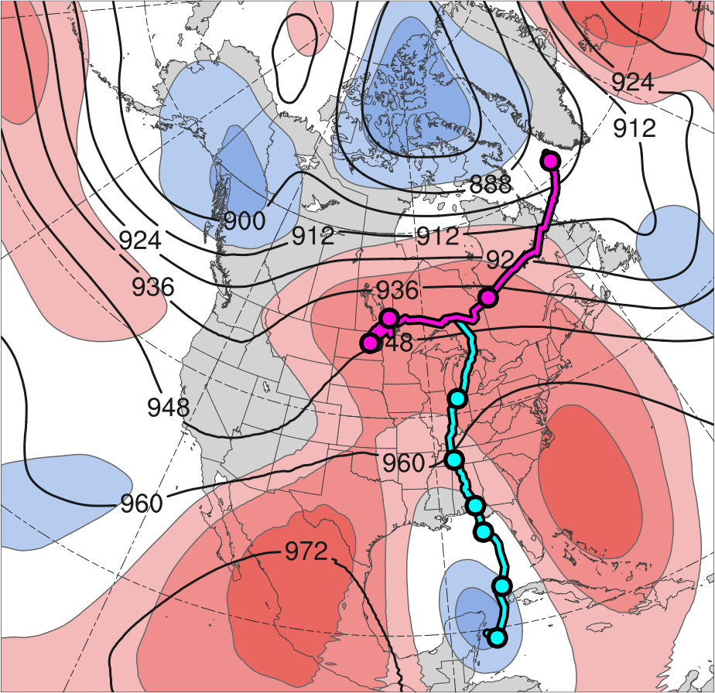
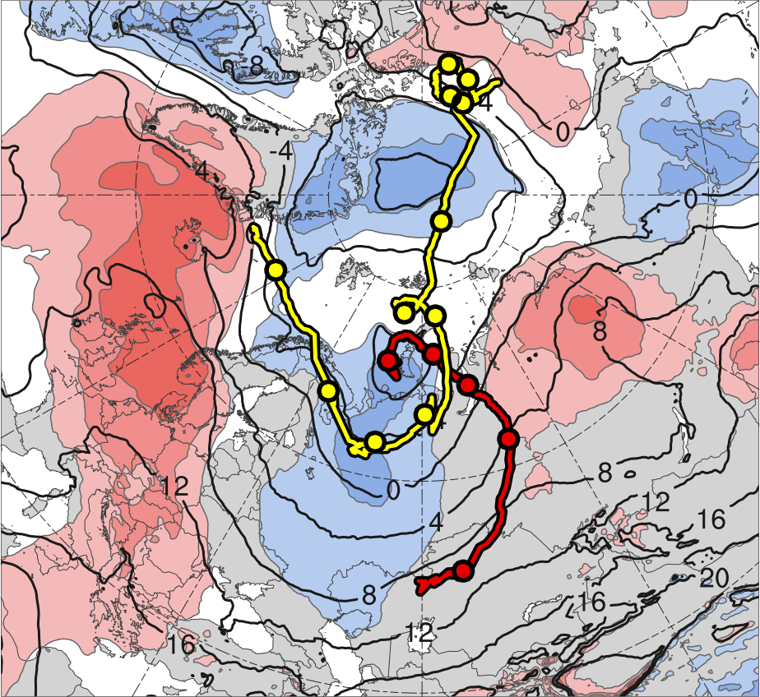
3) Track and Intensity
(a)
(b)
10
11
13
2
12
9
8
31
3
6
7
30
1
5
4
31
4
3
30
6
29
5
28
27
2
Alberto
26
AC1
CL
AC2
Genesis
Merger
-2
-1.5
-1
-0.5
0
0.5
1
1.5
2
σ
Lysis
0000 UTC positions
(a) 26 May–1 June 2018 time-mean 300-hPa geopotential height (dam, black) and standardized geopotential height anomalies (σ, shaded); (b) 1–7 June 2018 time-mean 850-hPa temperature (°C, black) and standardized temperature anomalies (σ, shaded).
Cyclone | Genesis | Lysis | Lifetime
AC1 | 1 June 2018 | 6 June 2018 | ~5 d
AC2 | 2 June 2018 | 13 June 2018 | ~11 d

Slide 5
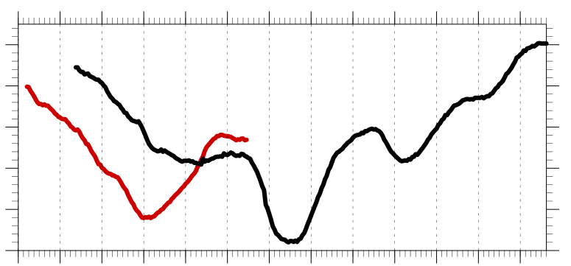
3) Track and Intensity
Hourly minimum SLP time series of AC1 and AC2
1010
1000
990
SLP (hPa)
980
970
960
1
2
3
4
5
6
7
8
9
10
11
12
13
Day in June 2018 labeled at 0000 UTC
AC1
AC2
Peak intensity of AC1 at 0400 UTC 4 June 2018 (967.9 hPa)
Peak intensity of AC2 at 1100 UTC 7 June 2018 (962.0 hPa)

Slide 6
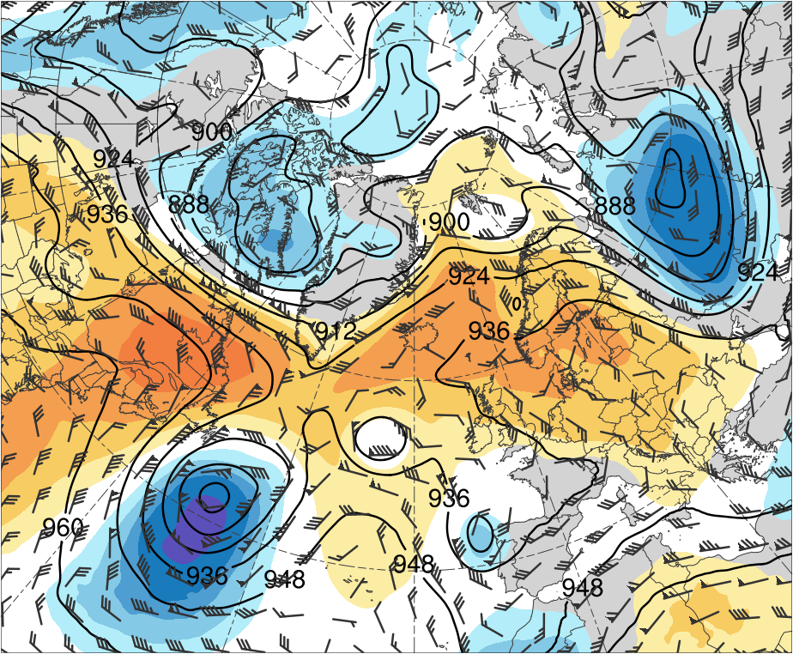
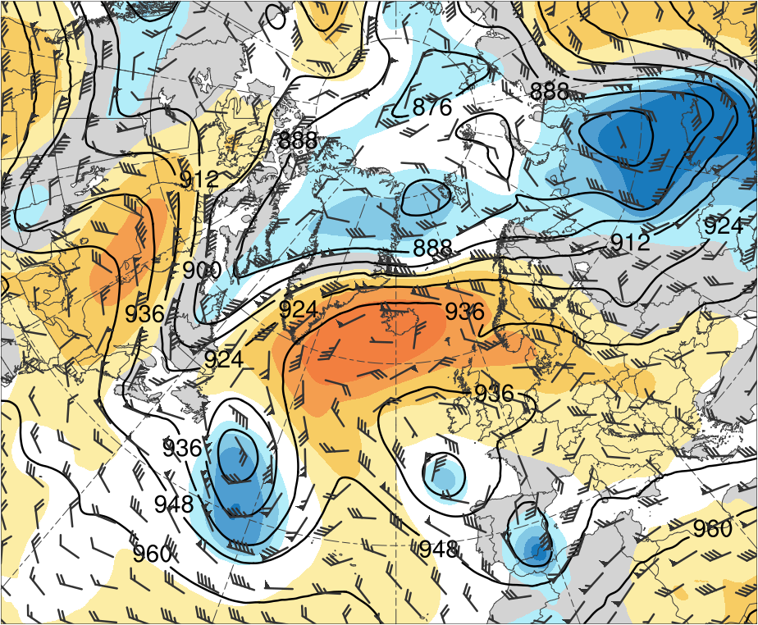
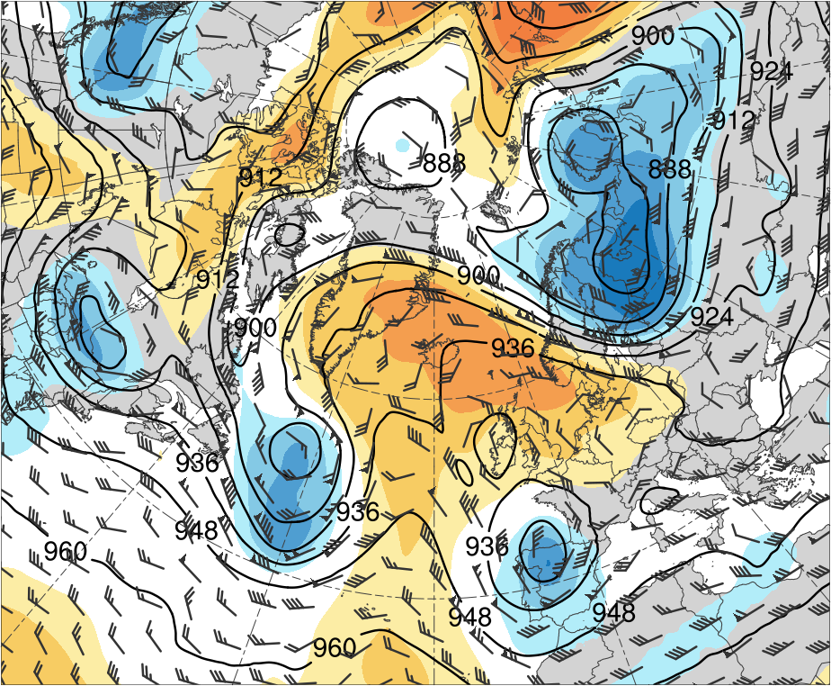
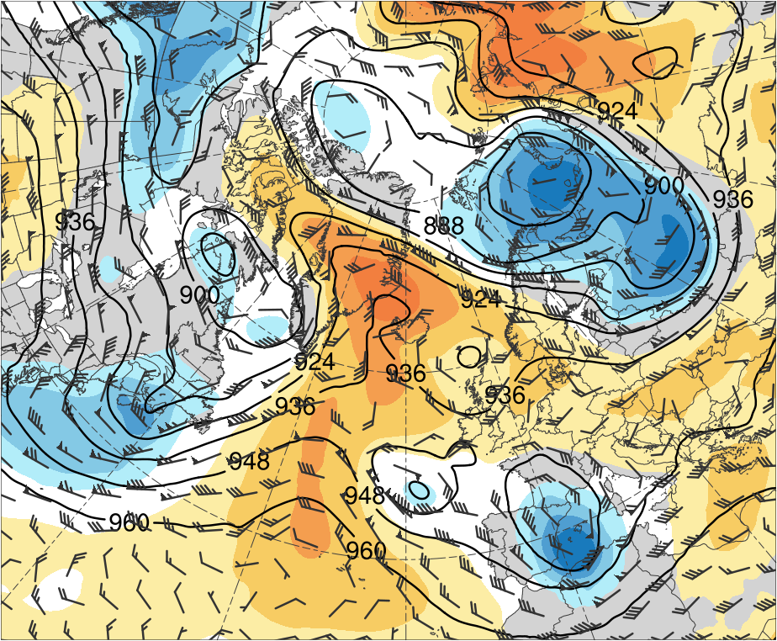
4) Large-Scale Flow Evolution
(a) 0000 UTC 1 Jun 2018
(b) 0000 UTC 3 Jun 2018
T1
6
T1
5
4
3
2
1.5
1
0.5
(c) 0000 UTC 5 Jun 2018
(d) 0000 UTC 7 Jun 2018
0
-0.5
T2
-1
T2
-1.5
-2
-3
-4
-5
-6
300-hPa geopotential height (dam, black), winds (m s⁻¹, flags and barbs), and standardized geopotential height anomalies (σ, shaded)

Slide 7
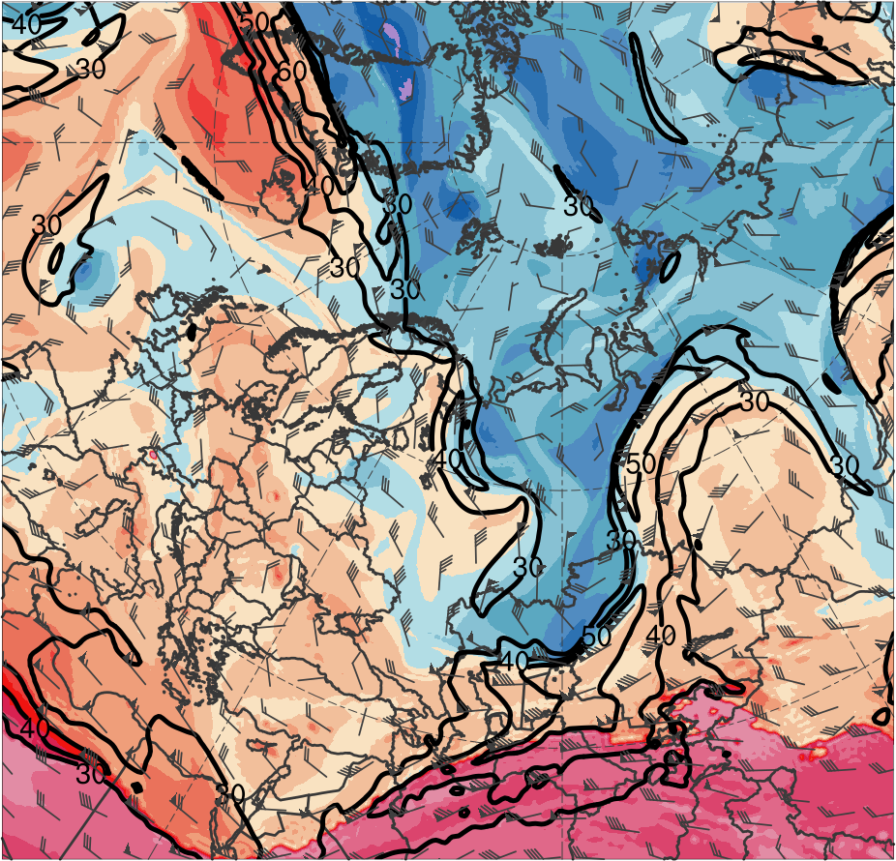
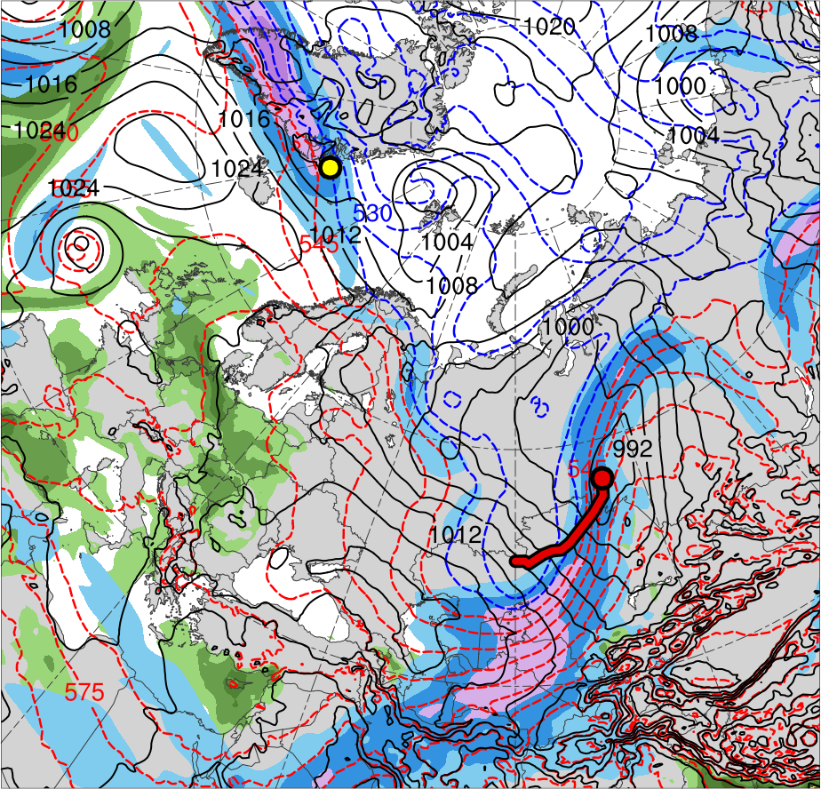
5) Synoptic Evolution
1200 UTC 2 June 2012
TPV 2
Lee cyclogenesis of AC2
TPV 1
AC1
AC2
(K)
252
258
264
270
276
282
288
294
300
306
312
318
324
330
336
342
348
354
360
366
372
378
(m s⁻¹ )
(mm)
30
40
50
60
70
80
90
100
25
30
35
40
45
50
55
Potential temperature (K, shaded), wind speed (black, every 10 m s⁻¹ starting at 30 m s⁻¹), and wind (m s⁻¹, flags and barbs) on 2-PVU surface
300-hPa wind speed (m s⁻¹, shaded),
1000–500-hPa thickness (dam, blue/red),
SLP (hPa, black), and PW (mm, shaded)

Slide 8
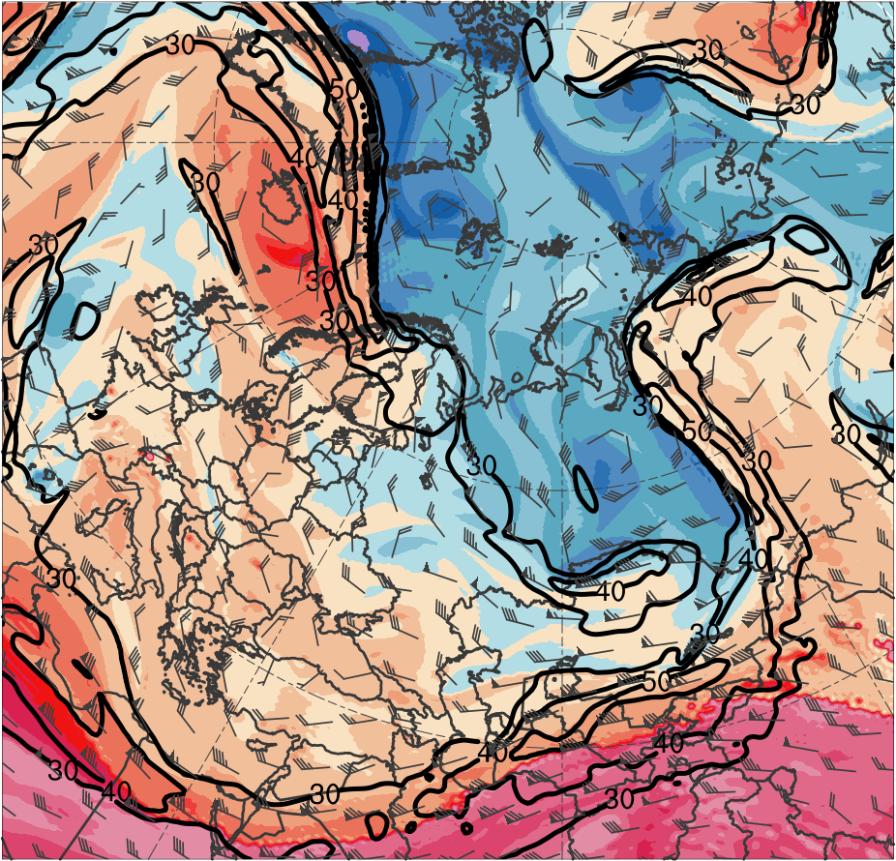
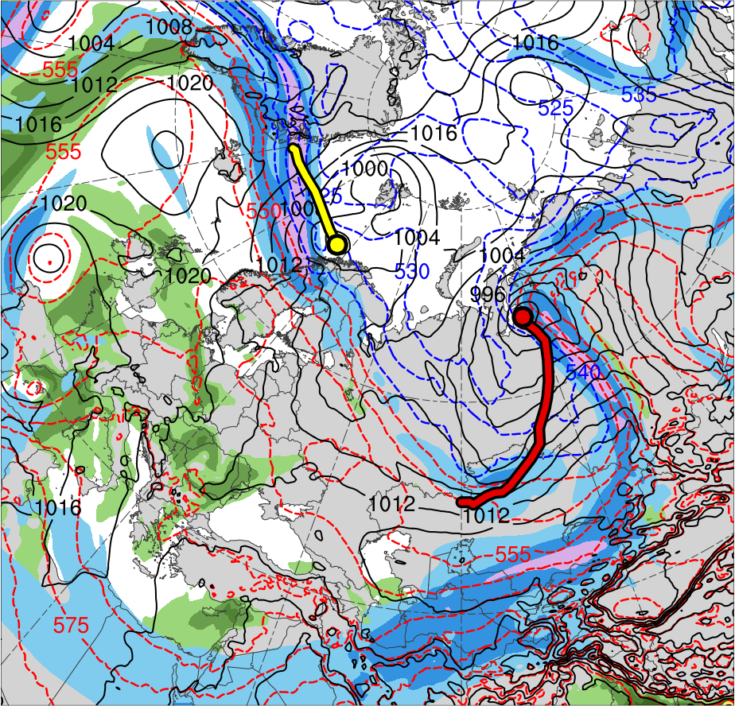
5) Synoptic Evolution
1200 UTC 3 June 2012
TPV 2
TPV 1
AC1
AC2
(K)
252
258
264
270
276
282
288
294
300
306
312
318
324
330
336
342
348
354
360
366
372
378
(m s⁻¹ )
(mm)
30
40
50
60
70
80
90
100
25
30
35
40
45
50
55
Potential temperature (K, shaded), wind speed (black, every 10 m s⁻¹ starting at 30 m s⁻¹), and wind (m s⁻¹, flags and barbs) on 2-PVU surface
300-hPa wind speed (m s⁻¹, shaded),
1000–500-hPa thickness (dam, blue/red),
SLP (hPa, black), and PW (mm, shaded)

Slide 9
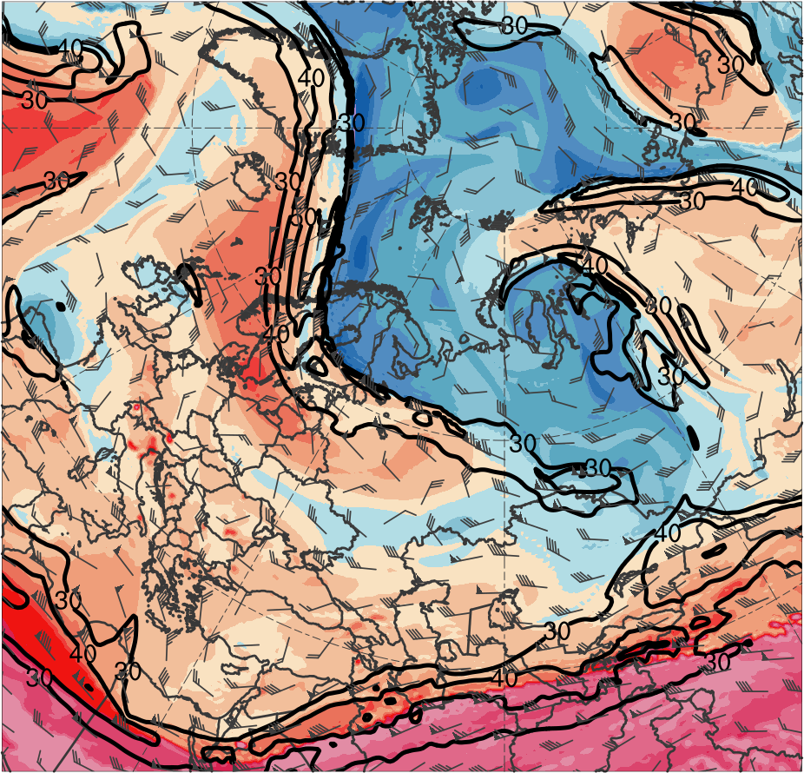
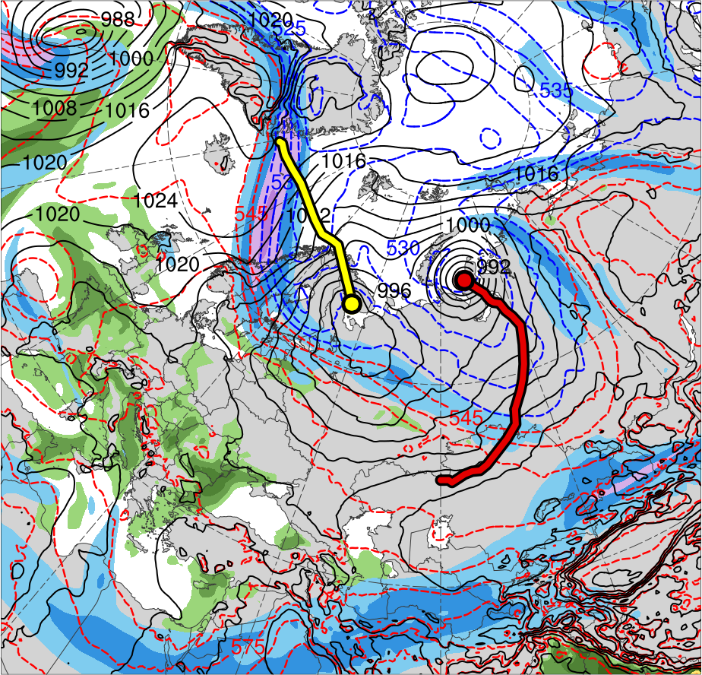
5) Synoptic Evolution
1200 UTC 4 June 2012
TPV 3
TPV 1
AC1
AC2
(K)
252
258
264
270
276
282
288
294
300
306
312
318
324
330
336
342
348
354
360
366
372
378
(m s⁻¹ )
(mm)
30
40
50
60
70
80
90
100
25
30
35
40
45
50
55
Potential temperature (K, shaded), wind speed (black, every 10 m s⁻¹ starting at 30 m s⁻¹), and wind (m s⁻¹, flags and barbs) on 2-PVU surface
300-hPa wind speed (m s⁻¹, shaded),
1000–500-hPa thickness (dam, blue/red),
SLP (hPa, black), and PW (mm, shaded)

Slide 10
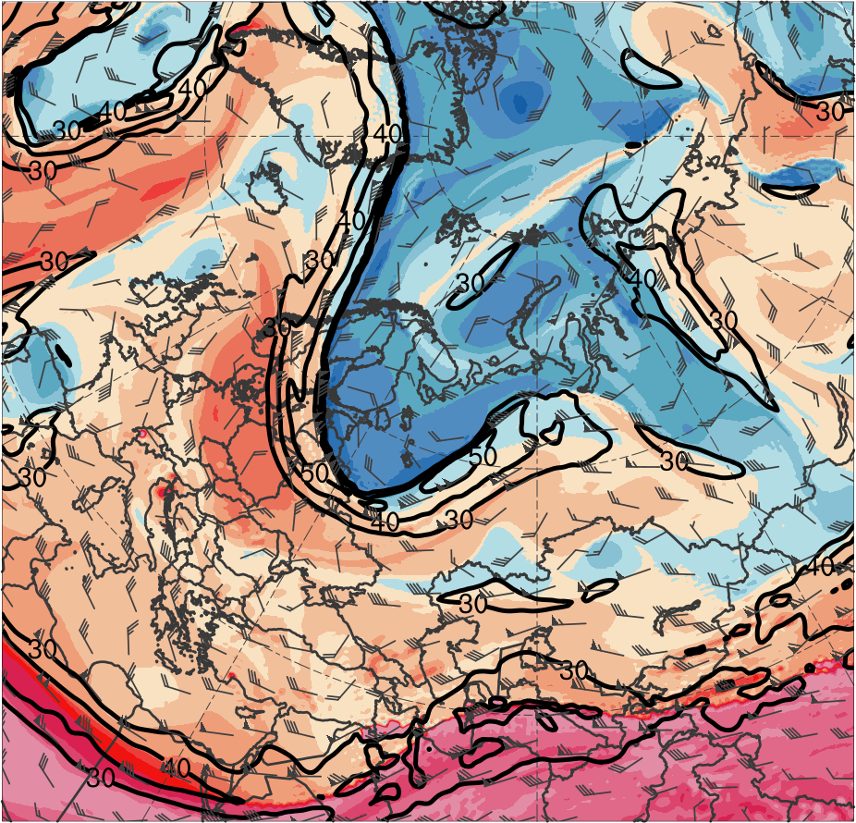
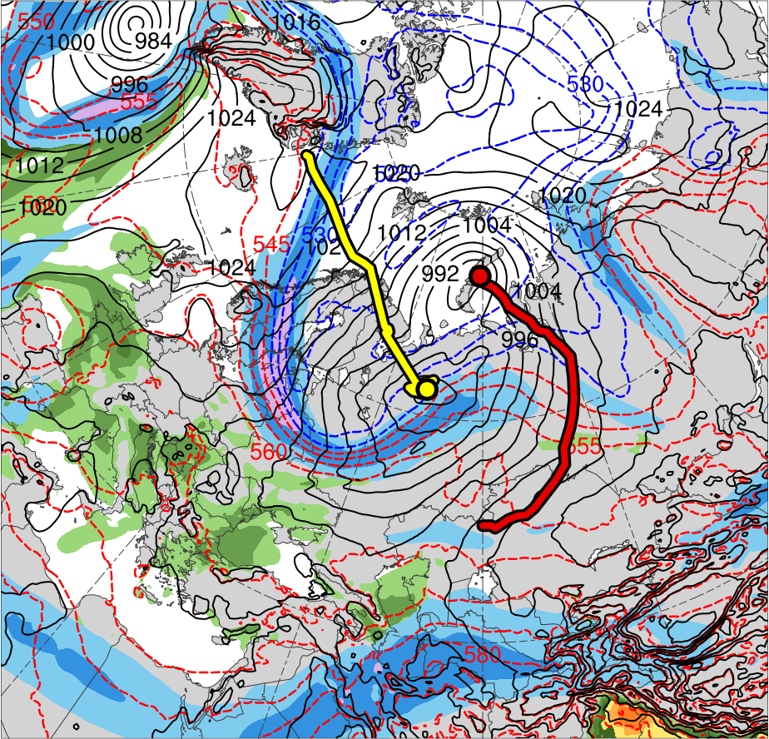
5) Synoptic Evolution
1200 UTC 5 June 2012
TPV 3
TPV 1
AC1
AC2
(K)
252
258
264
270
276
282
288
294
300
306
312
318
324
330
336
342
348
354
360
366
372
378
(m s⁻¹ )
(mm)
30
40
50
60
70
80
90
100
25
30
35
40
45
50
55
Potential temperature (K, shaded), wind speed (black, every 10 m s⁻¹ starting at 30 m s⁻¹), and wind (m s⁻¹, flags and barbs) on 2-PVU surface
300-hPa wind speed (m s⁻¹, shaded),
1000–500-hPa thickness (dam, blue/red),
SLP (hPa, black), and PW (mm, shaded)

Slide 11
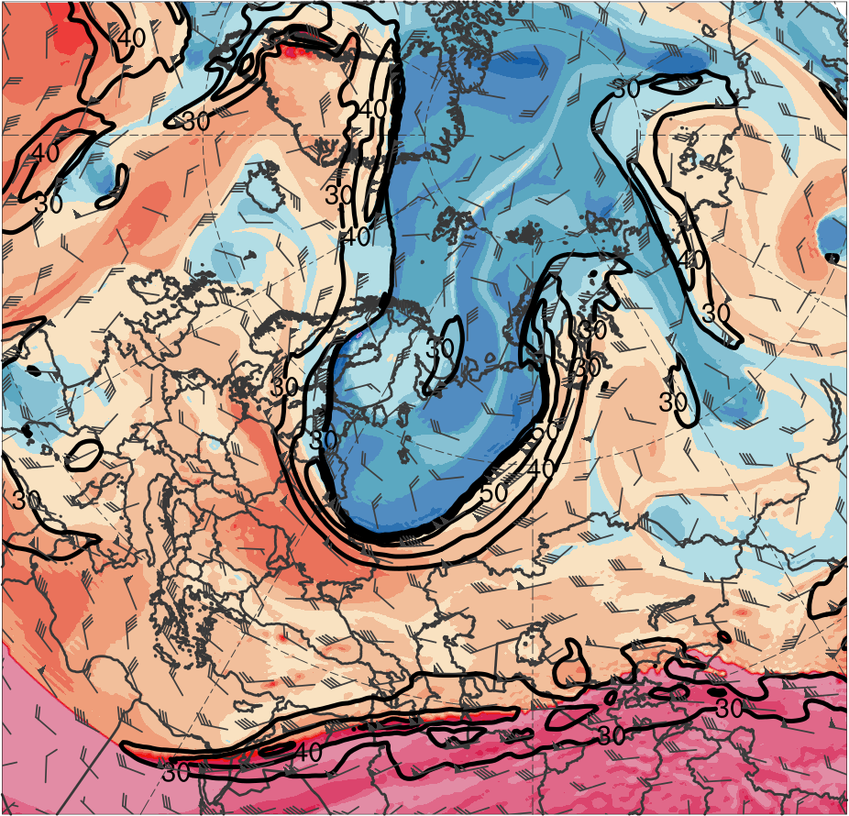
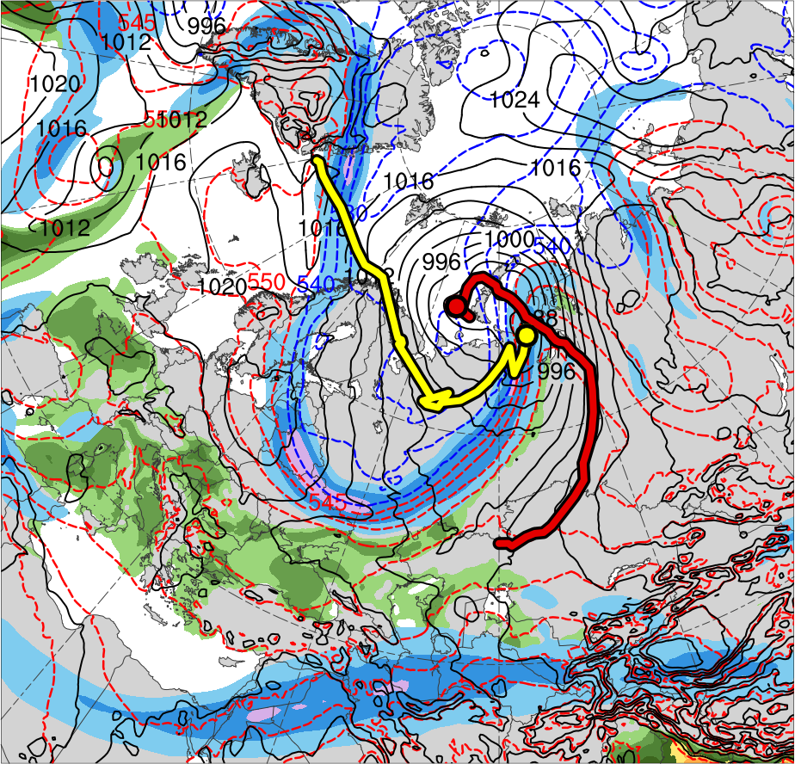
5) Synoptic Evolution
1200 UTC 6 June 2012
TPV 1
TPV 3
AC1
AC2
(K)
252
258
264
270
276
282
288
294
300
306
312
318
324
330
336
342
348
354
360
366
372
378
(m s⁻¹ )
(mm)
30
40
50
60
70
80
90
100
25
30
35
40
45
50
55
Potential temperature (K, shaded), wind speed (black, every 10 m s⁻¹ starting at 30 m s⁻¹), and wind (m s⁻¹, flags and barbs) on 2-PVU surface
300-hPa wind speed (m s⁻¹, shaded),
1000–500-hPa thickness (dam, blue/red),
SLP (hPa, black), and PW (mm, shaded)

Slide 12
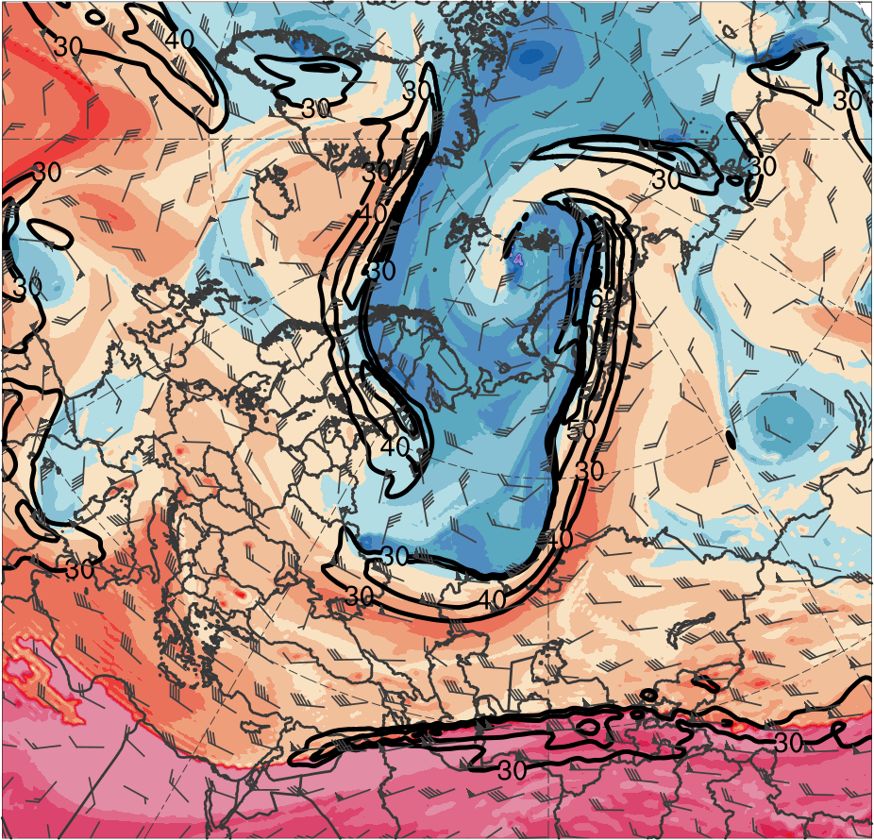
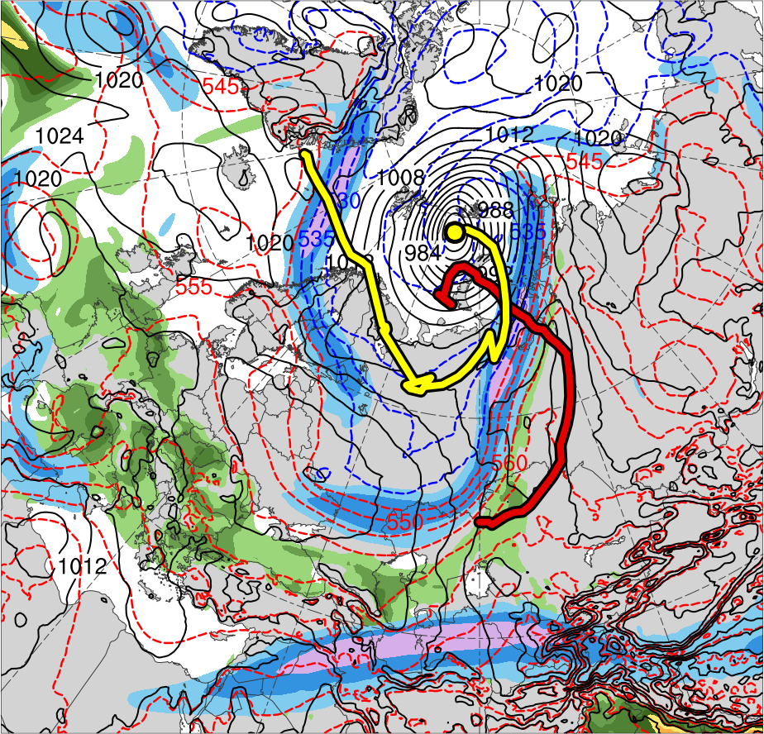
5) Synoptic Evolution
1200 UTC 7 June 2012
TPV 3
TPV 1
AC1
AC2
(K)
252
258
264
270
276
282
288
294
300
306
312
318
324
330
336
342
348
354
360
366
372
378
(m s⁻¹ )
(mm)
30
40
50
60
70
80
90
100
25
30
35
40
45
50
55
Potential temperature (K, shaded), wind speed (black, every 10 m s⁻¹ starting at 30 m s⁻¹), and wind (m s⁻¹, flags and barbs) on 2-PVU surface
300-hPa wind speed (m s⁻¹, shaded),
1000–500-hPa thickness (dam, blue/red),
SLP (hPa, black), and PW (mm, shaded)

Slide 13
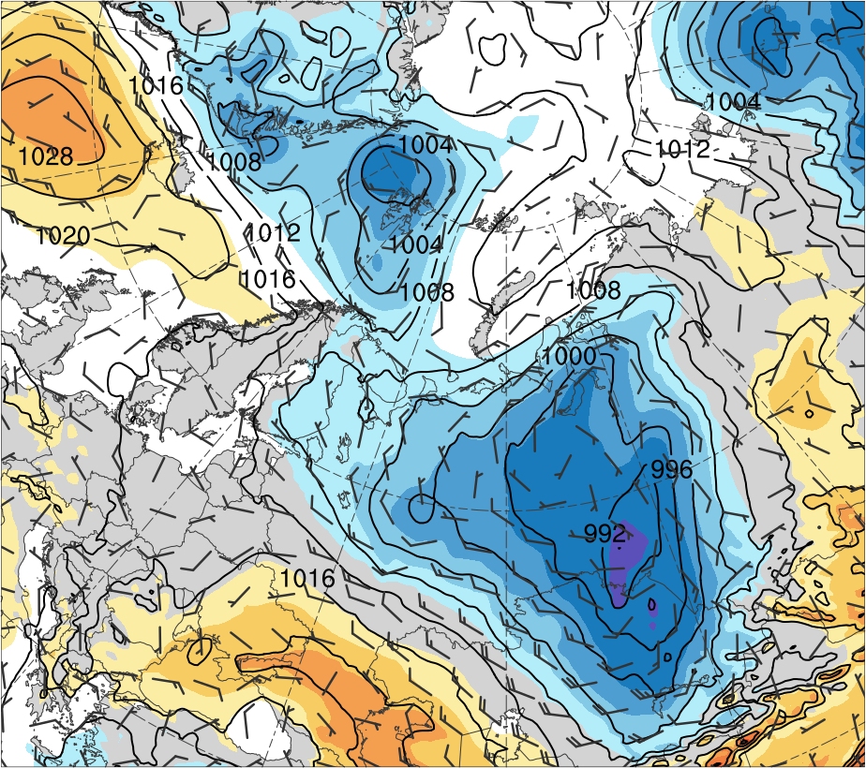
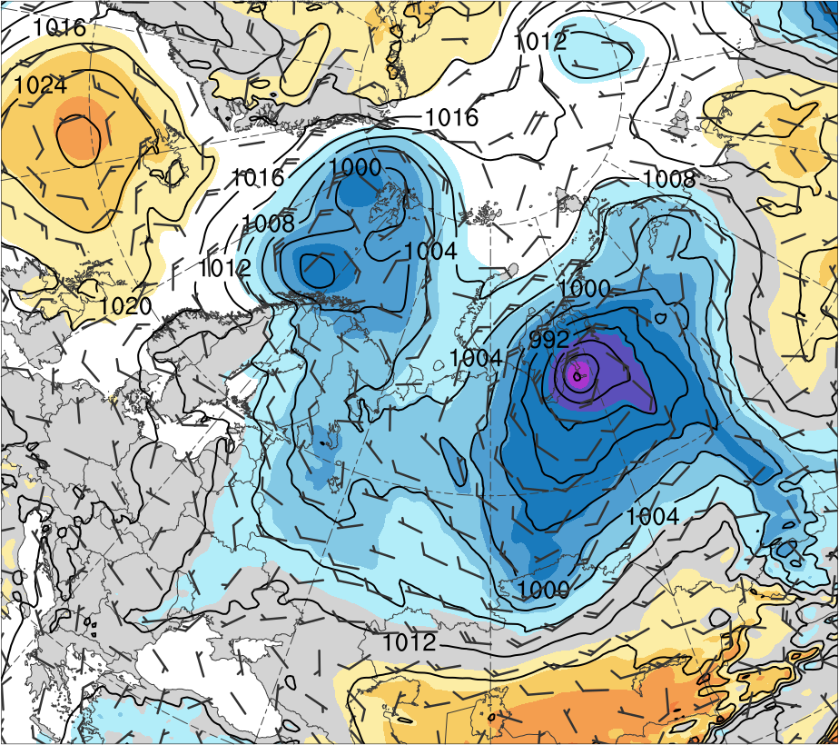
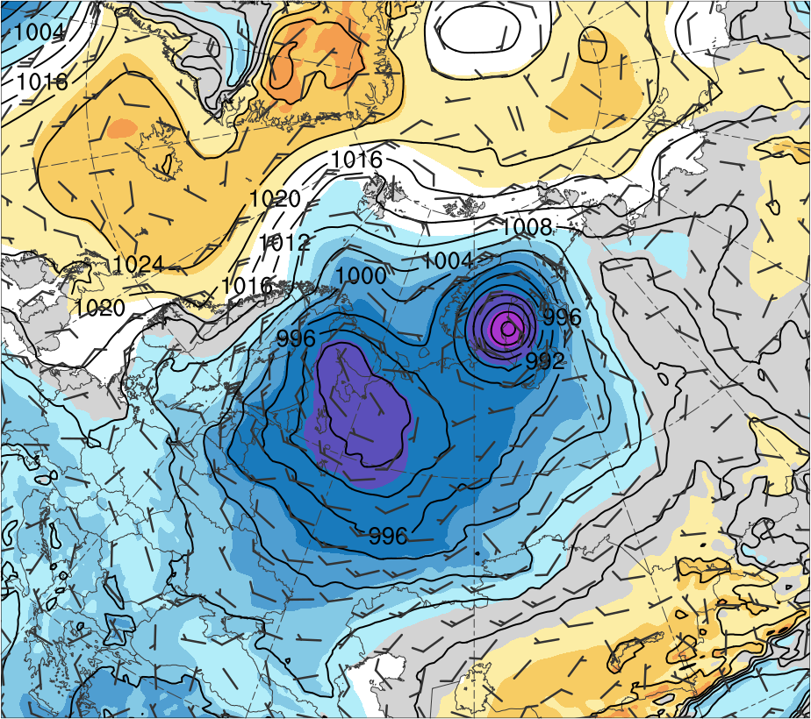
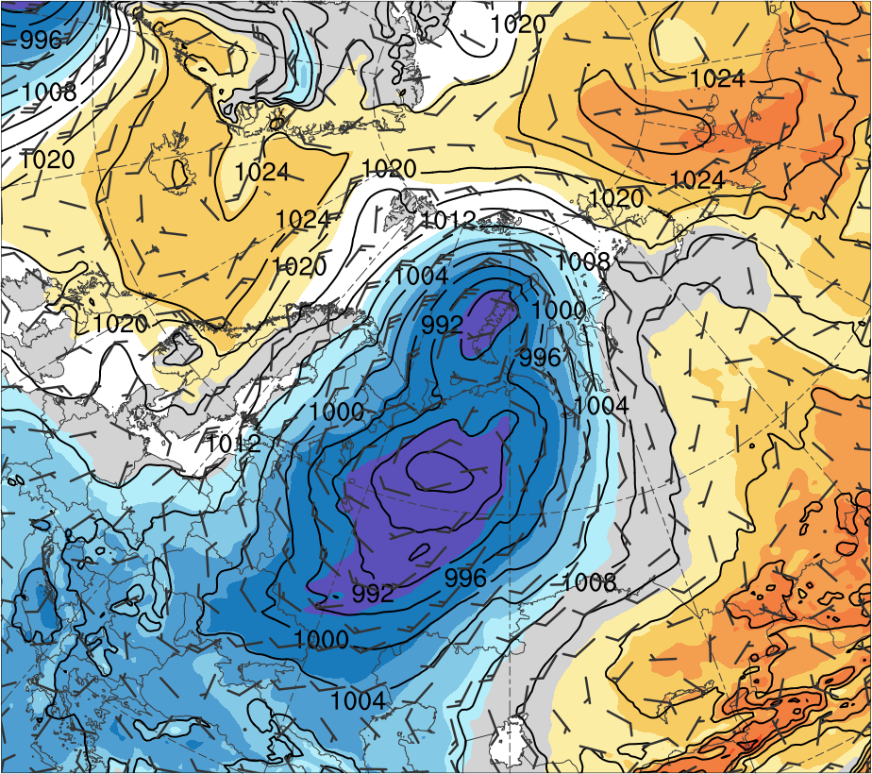
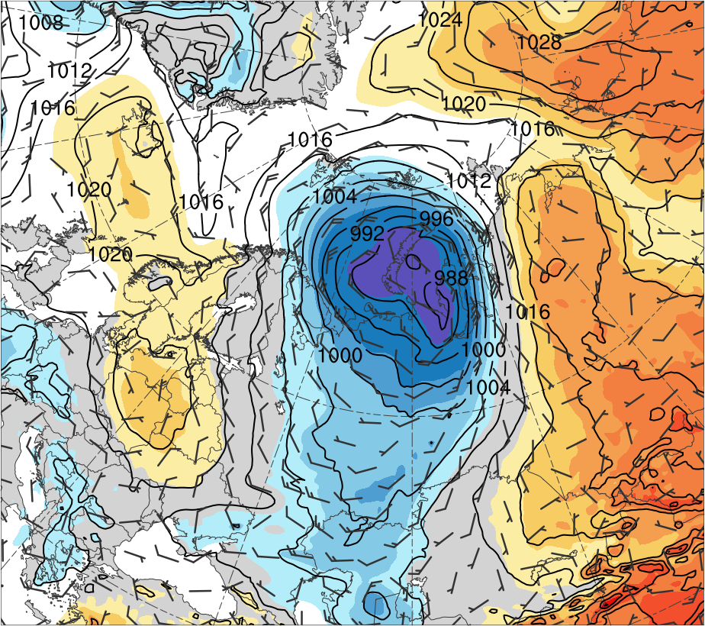
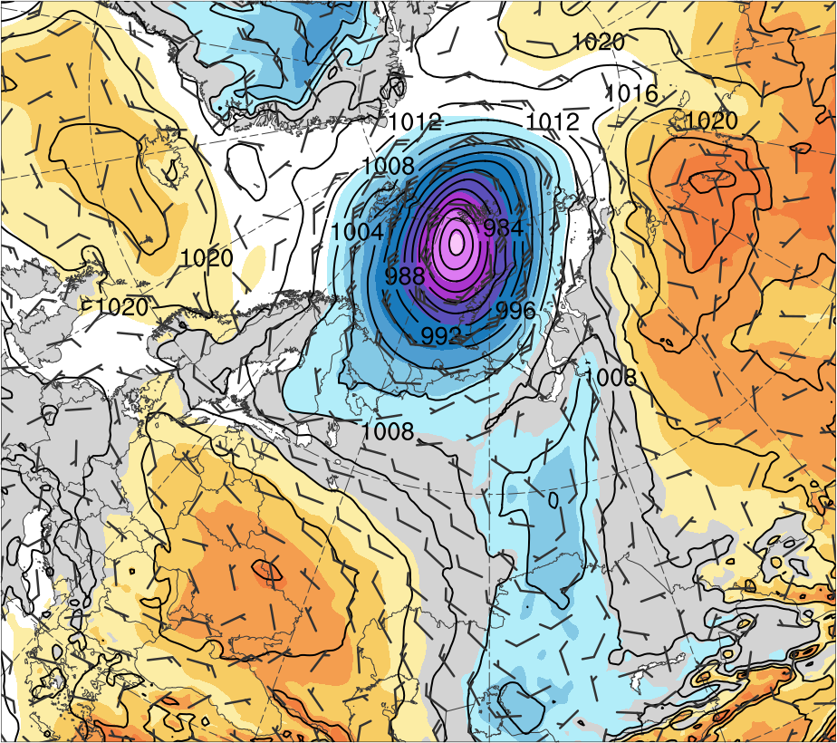
6) Interactions between Arctic Cyclones
(a) 1200 UTC 2 Jun 2018
(b) 1200 UTC 3 Jun 2018
(c) 1200 UTC 4 Jun 2018
AC1
AC1
6
5
AC1
4
AC2
3
AC2
2
1.5
AC2
1
0.5
(d) 1200 UTC 5 Jun 2018
(e) 1200 UTC 6 Jun 2018
(f) 1200 UTC 7 Jun 2018
0
AC1
-0.5
-1
-1.5
-2
AC2
-3
AC2
AC2
-4
-5
-6
SLP (hPa, black), 10-m winds (m s⁻¹, flags and barbs), and standardized SLP anomalies (σ, shaded)

Slide 14
Two Intense Arctic Cyclones in June 2018
Discussion
Remnants of TS Alberto are absorbed into the cyclonic/frontal region of CL over southern Canada
CL moves northeastward, weakens over the Davis Strait, and redevelops as a lee cyclone (AC2) east of Greenland
Successive deep troughs over Eurasia in early June that form in response to cyclonic wave breaking foster development of AC1 and AC2
AC1 forms near the Caspian Sea along a trailing cold front, moves northeastward, deepens, and reaches the Kara Sea

Slide 15
Two Intense Arctic Cyclones in June 2018
Discussion
AC2 intensifies as an ordinary baroclinic cyclone over northwestern Europe in conjunction with a strong jet stream
TPVs embedded within deep troughs likely contribute to rapid deepening of AC1 and AC2 in the left exit region of a jet streak
AC2 interacts and merges with AC1 and becomes the dominant cyclone, with a peak intensity of 962 hPa and a standardized SLP anomaly of < −6 σ

Slide 16
Extra Slide

Slide 17
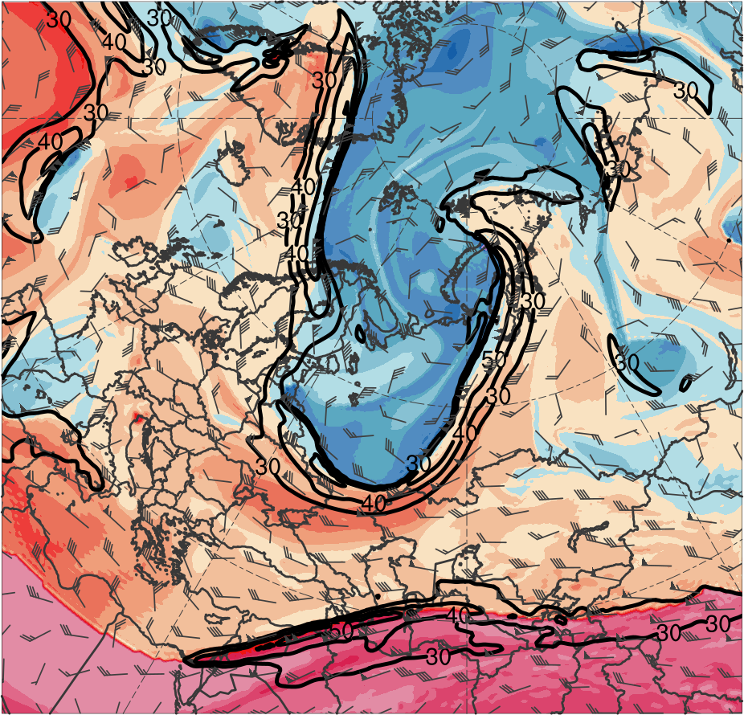
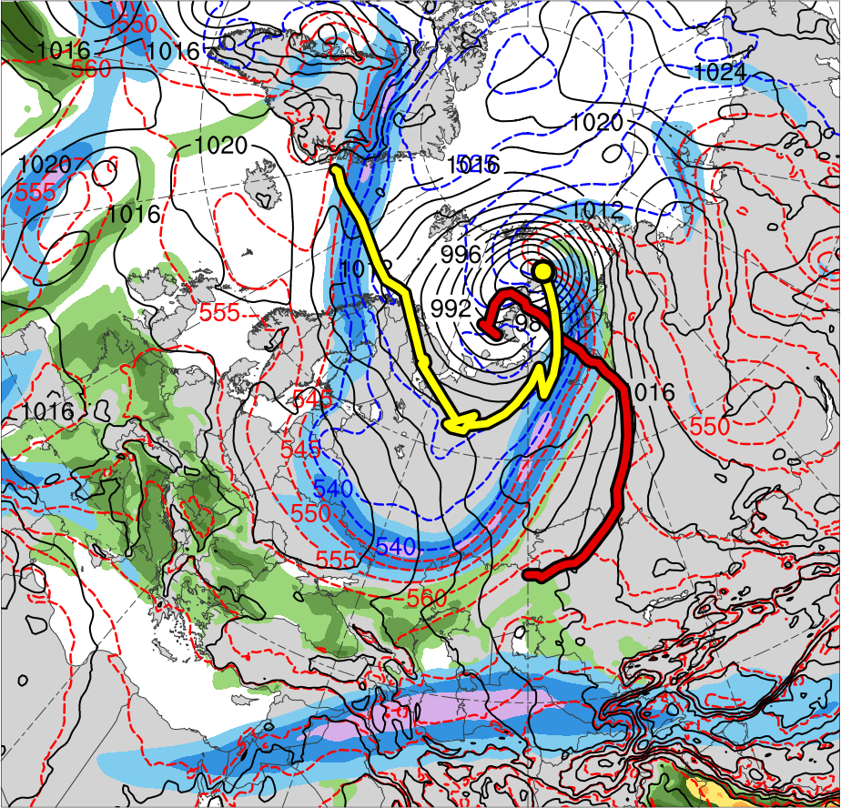
5) Synoptic Evolution
0000 UTC 7 June 2012
TPV 3
TPV 1
AC1
AC2
(K)
252
258
264
270
276
282
288
294
300
306
312
318
324
330
336
342
348
354
360
366
372
378
(m s⁻¹ )
(mm)
30
40
50
60
70
80
90
100
25
30
35
40
45
50
55
Potential temperature (K, shaded), wind speed (black, every 10 m s⁻¹ starting at 30 m s⁻¹), and wind (m s⁻¹, flags and barbs) on 2-PVU surface
300-hPa wind speed (m s⁻¹, shaded),
1000–500-hPa thickness (dam, blue/red),
SLP (hPa, black), and PW (mm, shaded)

