Slide 1
Linkages Between Tropopause Polar Vortices and the Great Arctic Cyclone of August 2012
Kevin A. Biernat, Lance F. Bosart, and Daniel Keyser
Department of Atmospheric and Environmental Sciences
University at Albany, SUNY
43rd Annual Northeastern Storm Conference
10 March 2018
Saratoga Springs, NY
Research support provided by NSF Grant AGS-1355960

Slide 2
What are Tropopause Polar Vortices (TPVs)
TPVs are defined as tropopause-based vortices of high-latitude origin and are material features (Pyle et al. 2004; Cavallo and Hakim 2009, 2010, 2012, 2013)
TPV
TPV
(left) Dynamic tropopause (DT) wind speed (every 15 m s⁻¹ starting at 50 m s⁻¹, thick contours) and DT potential temperature (K, thin contours and shading) on 1.5-PVU surface valid 0000 UTC 1 Dec 1991; (right) same as left except DT pressure (hPa, thin contours and shading). Adapted from Fig. 11 in Pyle et al. (2004).

Slide 3
Motivation
TPVs may interact with and strengthen jet streams, and act as precursors to the development of intense Arctic cyclones (e.g., Simmonds and Rudeva 2012, 2014)
Arctic cyclones may be associated with strong surface winds and poleward advection of warm, moist air, contributing to reductions in Arctic sea-ice extent (e.g., Zhang et al. 2013)
Heavy precipitation, strong surface winds, and large waves due to Arctic cyclones may pose hazards to ships moving through open passageways in the Arctic Ocean

Slide 4
The Great Arctic Cyclone of August 2012 (AC12)
AC12 formed over Siberia on 2 August 2012 and tracked northeastward into the Arctic, reaching a minimum central sea level pressure (SLP) of 966.4 hPa at 1800 UTC 6 August in the CFSR (Simmonds and Rudeva 2012)
AC12 led to reductions in Arctic sea-ice extent during a time in which sea ice was thin and sea-ice volume was well below normal (Zhang et al. 2013)
Strong surface winds associated with AC12 helped to break up the thin sea ice (e.g., Parkinson and Comiso 2013)

Slide 5
The Great Arctic Cyclone of August 2012 (AC12)
According to Zhang et al. (2013) sea-ice volume decreased twice as fast as normal during AC12 due to melting of the bottom and perimeter of ice floes
Simmonds and Rudeva (2012) and Yamazaki et al. (2015) found that a TPV played an important role in the lifecycle of AC12

Slide 6
Outline
Identification and synoptic examination of three TPVs, a predecessor surface cyclone, and AC12
Impact of AC12 on Arctic sea-ice extent

Slide 7
Data and Methods
Data:
0.3° ERA5 (Hersbach and Dee 2016)
Utilized TPV tracking algorithm developed by Nicholas Szapiro and Steven Cavallo to identify and track TPVs of interest for AC12
Input variables: potential temperature, relative vorticity, and wind on 2-PVU surface
Potential temperature minima on 2-PVU surface tracked spatially and temporally to create TPV tracks
Link for Tracking Algorithm: https://github.com/nickszap/tpvTrack

Slide 8
Data and Methods
Manually tracked the predecessor surface cyclone and AC12 by following the locations of minimum SLP

Slide 9
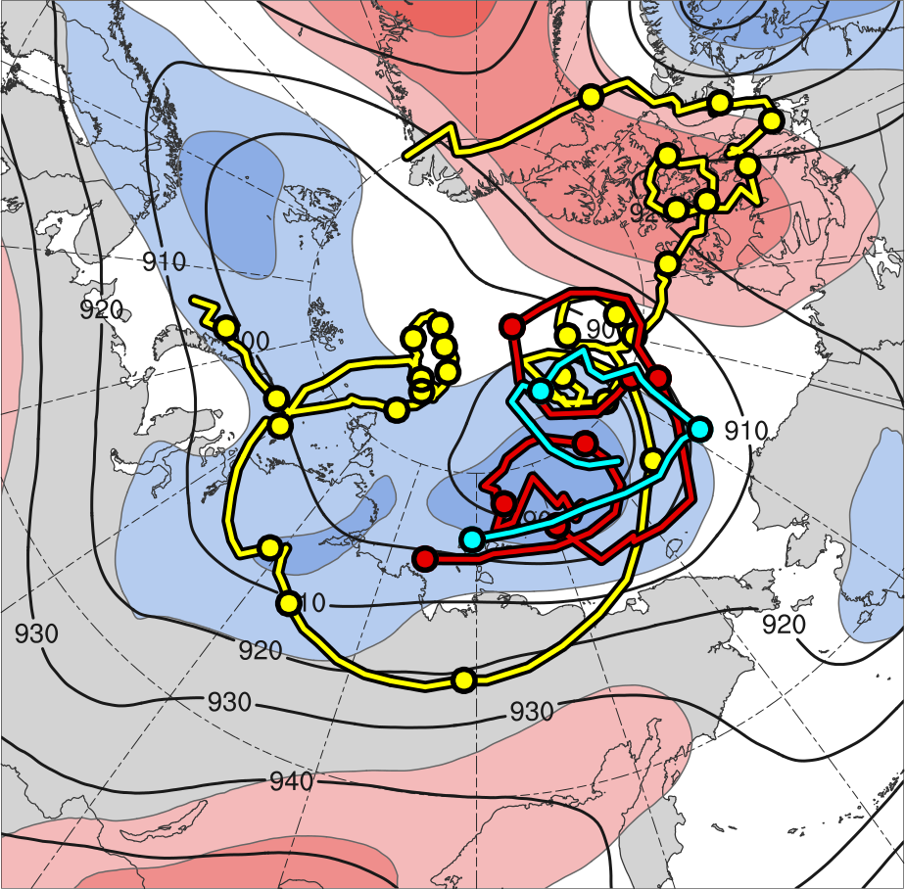
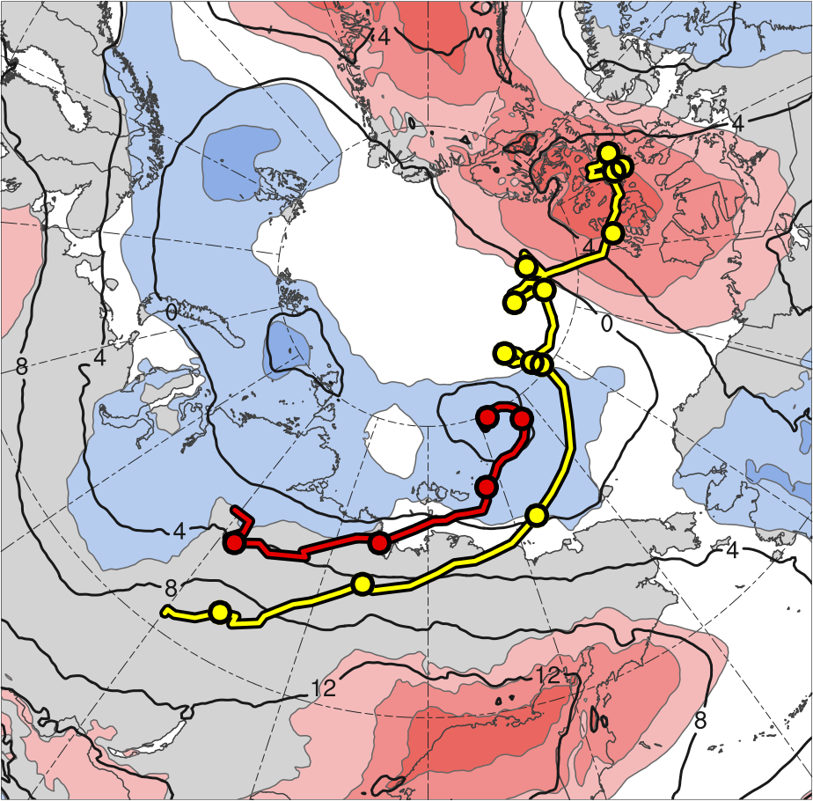
TPV and Surface Cyclone Tracks
TPV 1
L1
TPV 2
AC12
TPV 3
2
1.5
1
0.5
0
-0.5
-1
-1.5
-2
(σ)
Feature | Genesis | Lysis | Lifetime
TPV 1 | 23 July | 19 Aug | ~28 d
TPV 2 | 3 Aug | 9 Aug | ~6 d
TPV 3 | 4 Aug | 6 Aug | ~3 d
L1 | 31 July | 5 Aug | ~5 d
AC12 | 2 Aug | 15 Aug | ~13 d
Genesis
Lysis
0000 UTC positions
1–7 Aug 2012 time-mean (left) 300-hPa geopotential height (dam, black) and standardized anomaly of 300-hPa geopotential height (σ, shaded); (right) 850-hPa temperature (°C, black) and standardized anomaly of 850-hPa temperature (σ, shaded)

Slide 10
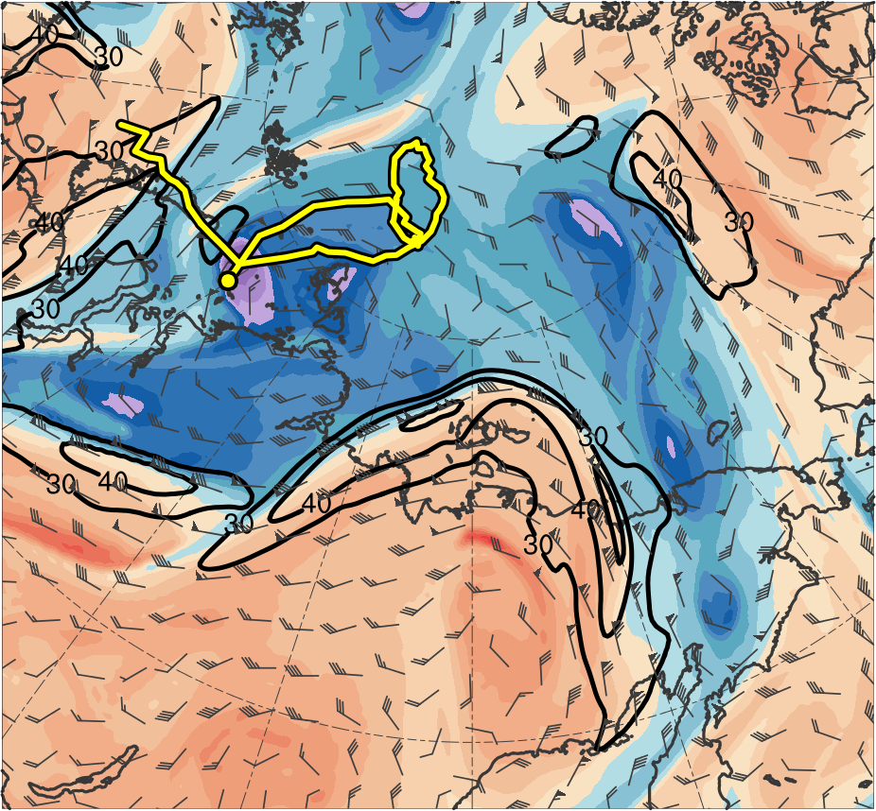
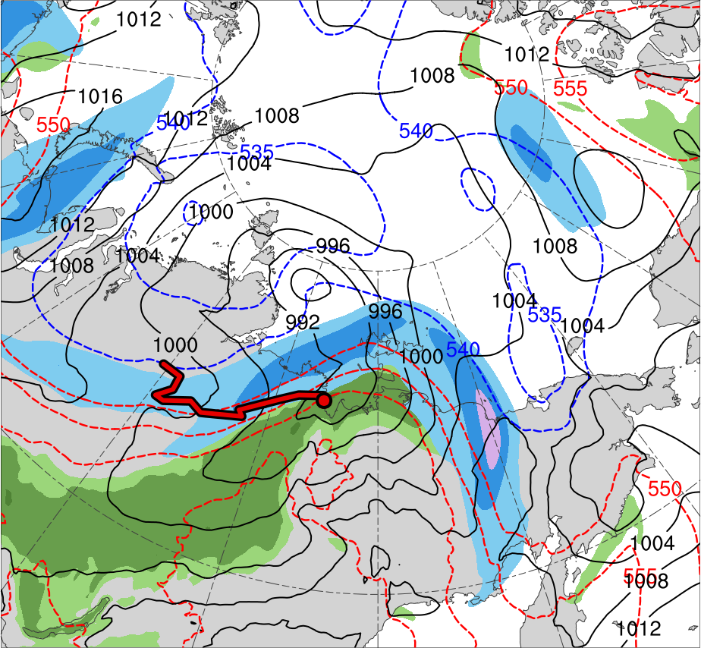
Synoptic Evolution
0000 UTC 2 Aug 2012
TPV 1
L1
(K)
252
258
264
270
276
282
288
294
300
306
312
318
324
330
336
342
348
354
360
366
372
378
(m s⁻¹ )
(mm)
30
40
50
60
70
80
90
100
25
30
35
40
45
50
55
Potential temperature (K, shaded), wind speed (black, every 10 m s⁻¹ starting at 30 m s⁻¹), and wind (m s⁻¹, flags and barbs) on 2-PVU surface
250-hPa wind speed (m s⁻¹, shaded),
1000–500-hPa thickness (dam, blue/red),
SLP (hPa, black), PW (mm, shaded)

Slide 11
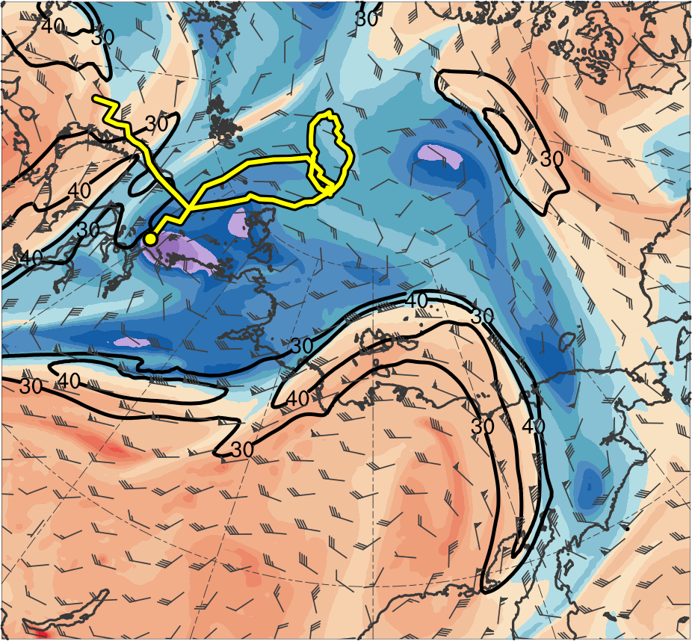
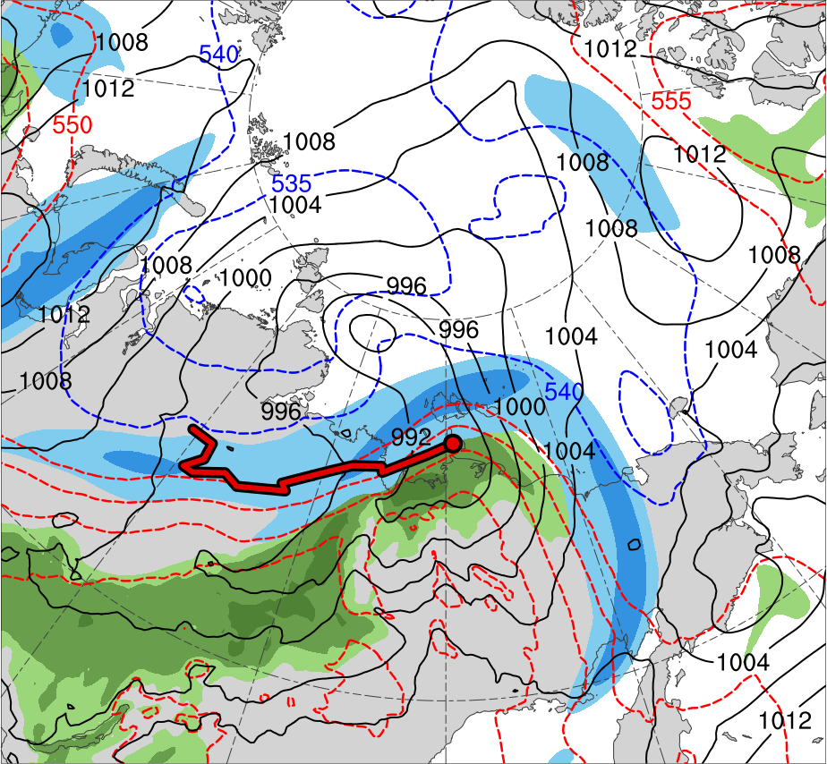
Synoptic Evolution
0600 UTC 2 Aug 2012
TPV 1
L1
(K)
252
258
264
270
276
282
288
294
300
306
312
318
324
330
336
342
348
354
360
366
372
378
(m s⁻¹ )
(mm)
30
40
50
60
70
80
90
100
25
30
35
40
45
50
55
Potential temperature (K, shaded), wind speed (black, every 10 m s⁻¹ starting at 30 m s⁻¹), and wind (m s⁻¹, flags and barbs) on 2-PVU surface
250-hPa wind speed (m s⁻¹, shaded),
1000–500-hPa thickness (dam, blue/red),
SLP (hPa, black), PW (mm, shaded)

Slide 12
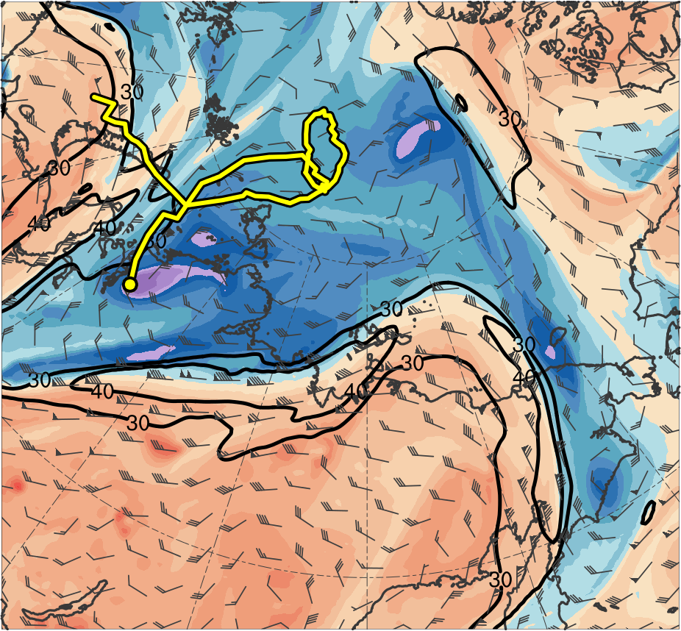
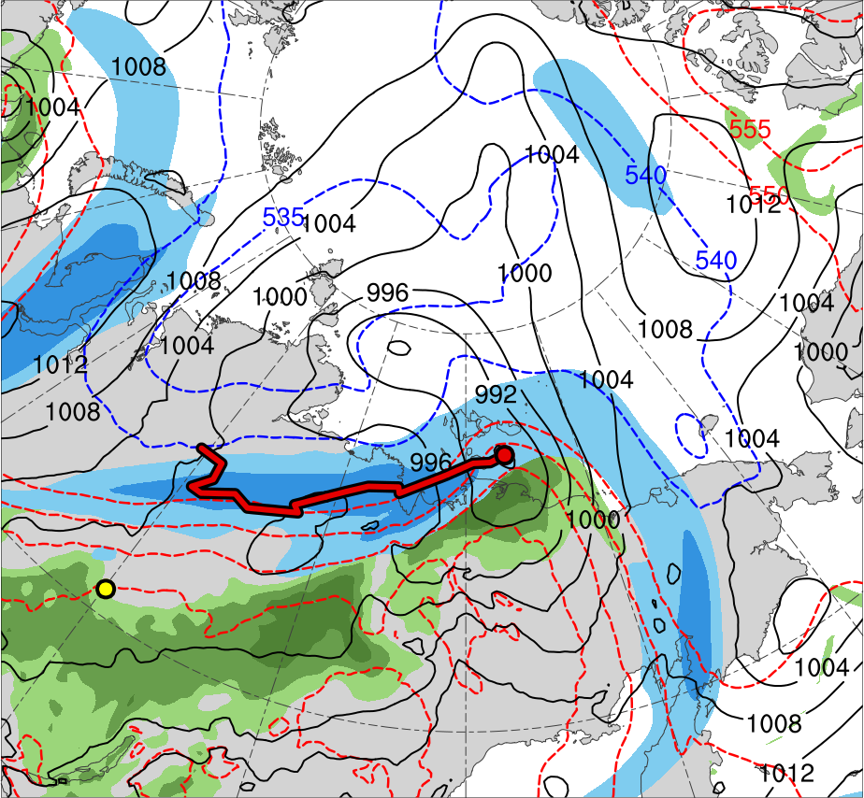
Synoptic Evolution
1200 UTC 2 Aug 2012
TPV 1
L1
AC12
(K)
252
258
264
270
276
282
288
294
300
306
312
318
324
330
336
342
348
354
360
366
372
378
(m s⁻¹ )
(mm)
30
40
50
60
70
80
90
100
25
30
35
40
45
50
55
Potential temperature (K, shaded), wind speed (black, every 10 m s⁻¹ starting at 30 m s⁻¹), and wind (m s⁻¹, flags and barbs) on 2-PVU surface
250-hPa wind speed (m s⁻¹, shaded),
1000–500-hPa thickness (dam, blue/red),
SLP (hPa, black), PW (mm, shaded)

Slide 13
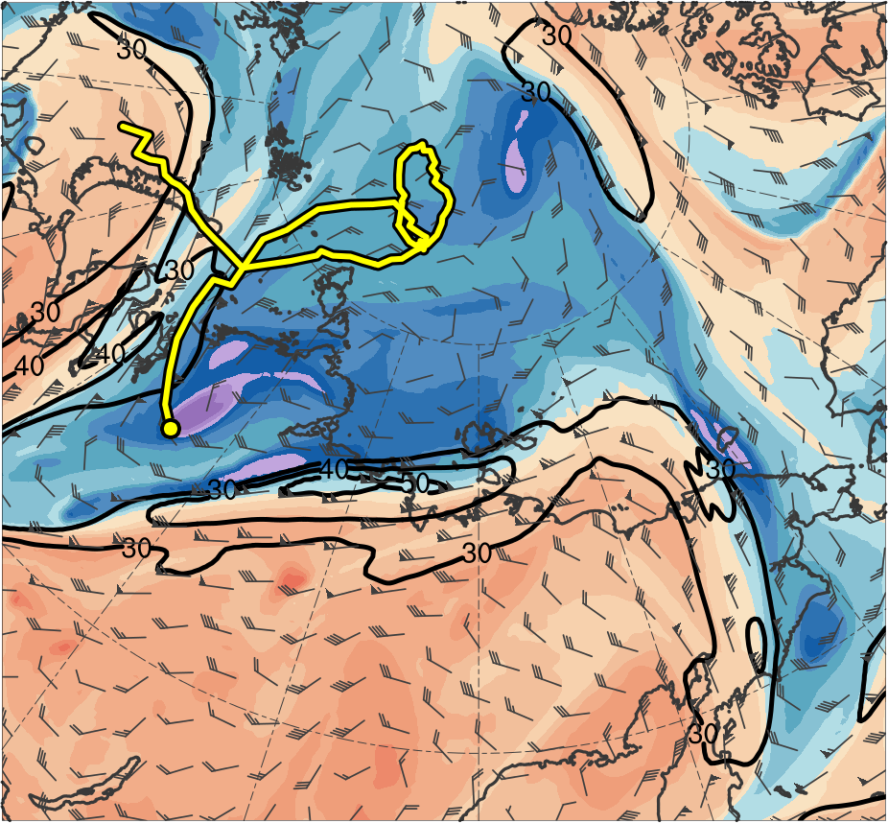
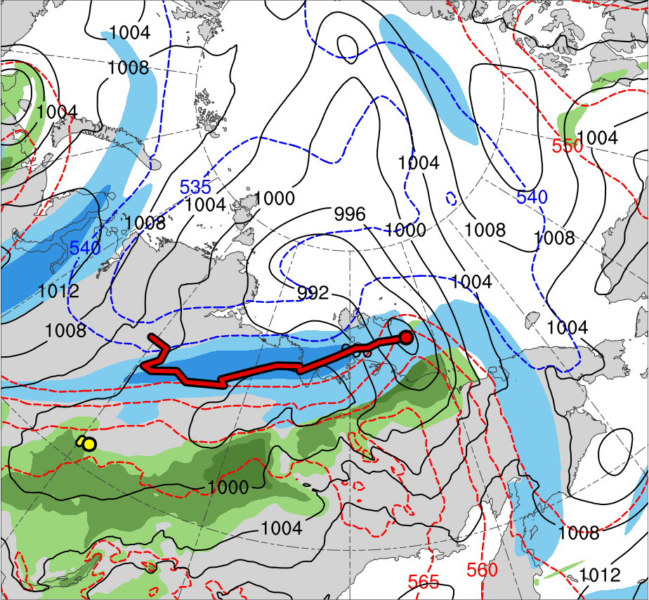
Synoptic Evolution
1800 UTC 2 Aug 2012
TPV 1
L1
AC12
(K)
252
258
264
270
276
282
288
294
300
306
312
318
324
330
336
342
348
354
360
366
372
378
(m s⁻¹ )
(mm)
30
40
50
60
70
80
90
100
25
30
35
40
45
50
55
Potential temperature (K, shaded), wind speed (black, every 10 m s⁻¹ starting at 30 m s⁻¹), and wind (m s⁻¹, flags and barbs) on 2-PVU surface
250-hPa wind speed (m s⁻¹, shaded),
1000–500-hPa thickness (dam, blue/red),
SLP (hPa, black), PW (mm, shaded)

Slide 14
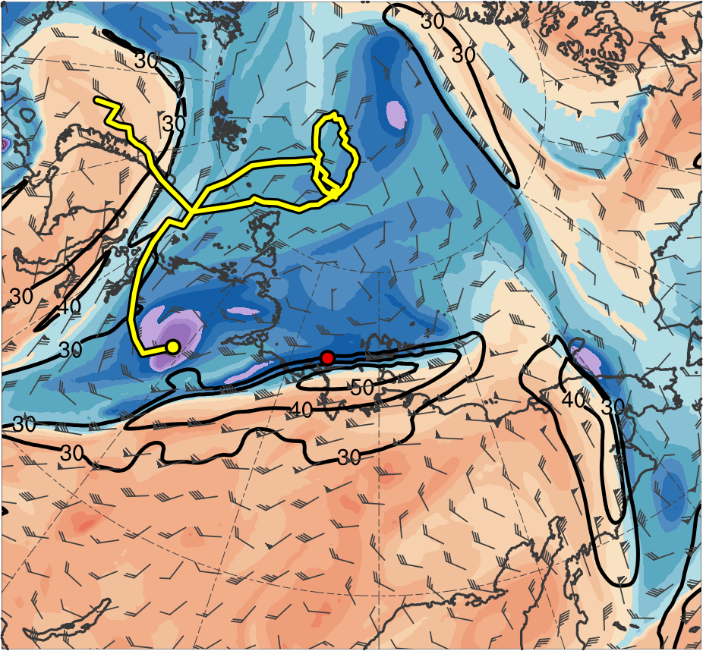
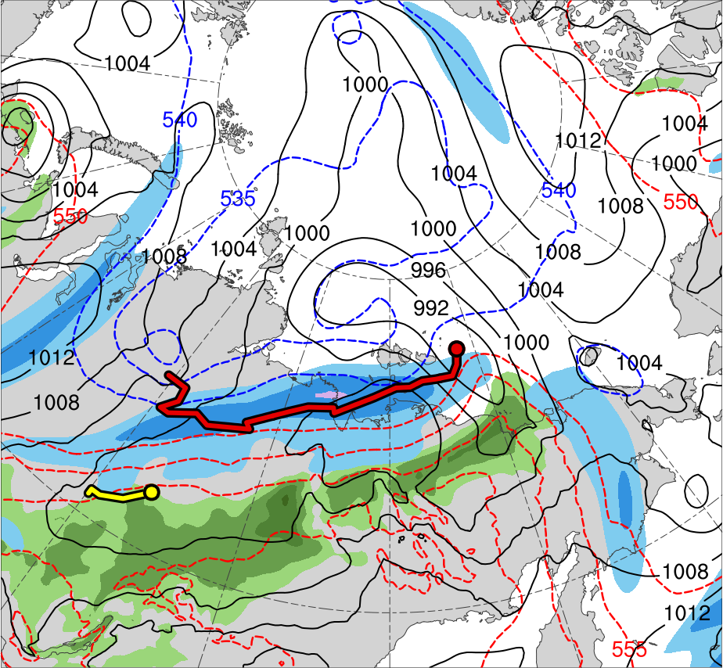
Synoptic Evolution
0000 UTC 3 Aug 2012
TPV 1
TPV 2
L1
AC12
(K)
252
258
264
270
276
282
288
294
300
306
312
318
324
330
336
342
348
354
360
366
372
378
(m s⁻¹ )
(mm)
30
40
50
60
70
80
90
100
25
30
35
40
45
50
55
Potential temperature (K, shaded), wind speed (black, every 10 m s⁻¹ starting at 30 m s⁻¹), and wind (m s⁻¹, flags and barbs) on 2-PVU surface
250-hPa wind speed (m s⁻¹, shaded),
1000–500-hPa thickness (dam, blue/red),
SLP (hPa, black), PW (mm, shaded)

Slide 15
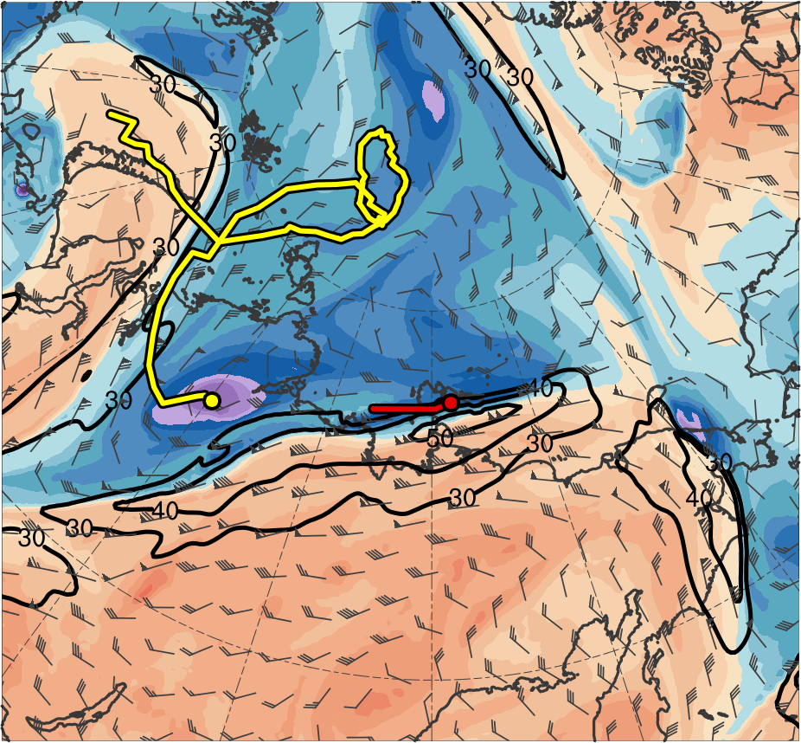
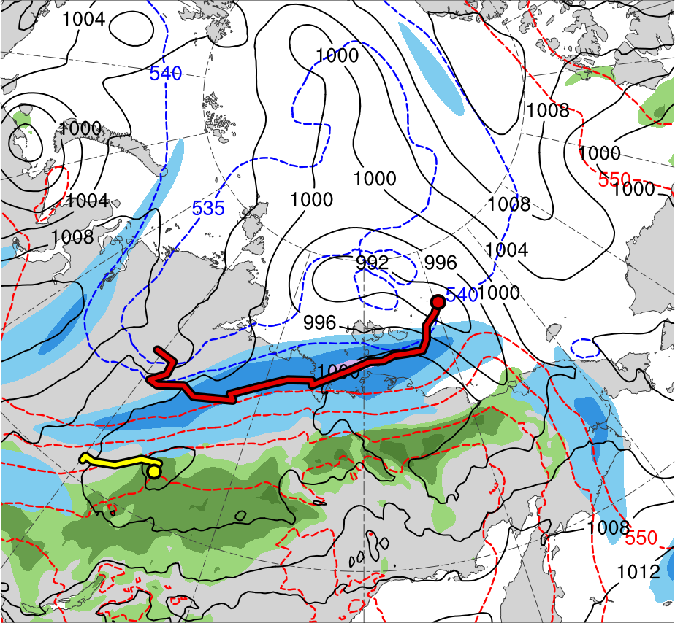
Synoptic Evolution
0600 UTC 3 Aug 2012
TPV 1
TPV 2
L1
AC12
(K)
252
258
264
270
276
282
288
294
300
306
312
318
324
330
336
342
348
354
360
366
372
378
(m s⁻¹ )
(mm)
30
40
50
60
70
80
90
100
25
30
35
40
45
50
55
Potential temperature (K, shaded), wind speed (black, every 10 m s⁻¹ starting at 30 m s⁻¹), and wind (m s⁻¹, flags and barbs) on 2-PVU surface
250-hPa wind speed (m s⁻¹, shaded),
1000–500-hPa thickness (dam, blue/red),
SLP (hPa, black), PW (mm, shaded)

Slide 16
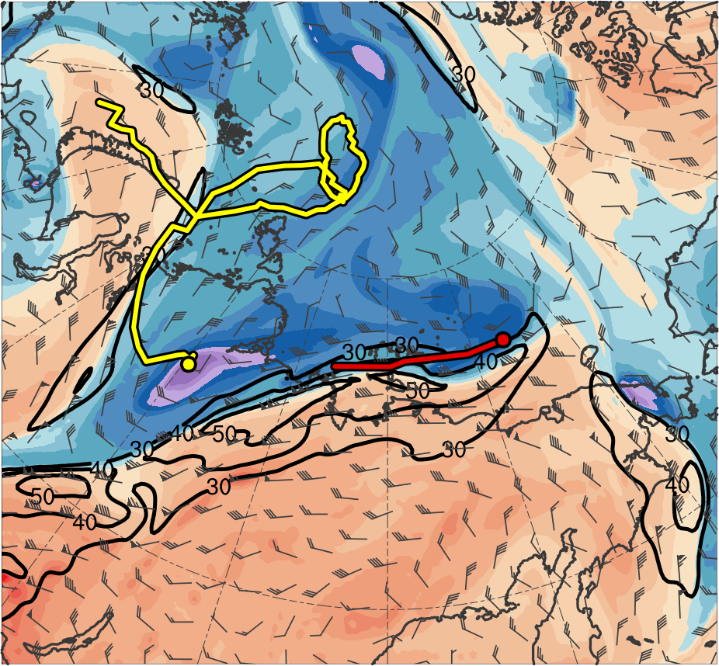
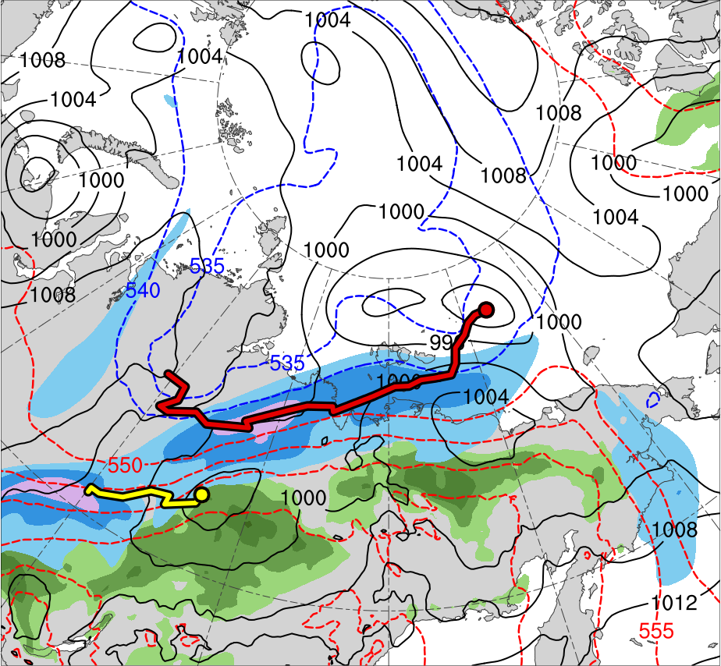
Synoptic Evolution
1200 UTC 3 Aug 2012
TPV 1
TPV 2
L1
AC12
(K)
252
258
264
270
276
282
288
294
300
306
312
318
324
330
336
342
348
354
360
366
372
378
(m s⁻¹ )
(mm)
30
40
50
60
70
80
90
100
25
30
35
40
45
50
55
Potential temperature (K, shaded), wind speed (black, every 10 m s⁻¹ starting at 30 m s⁻¹), and wind (m s⁻¹, flags and barbs) on 2-PVU surface
250-hPa wind speed (m s⁻¹, shaded),
1000–500-hPa thickness (dam, blue/red),
SLP (hPa, black), PW (mm, shaded)

Slide 17
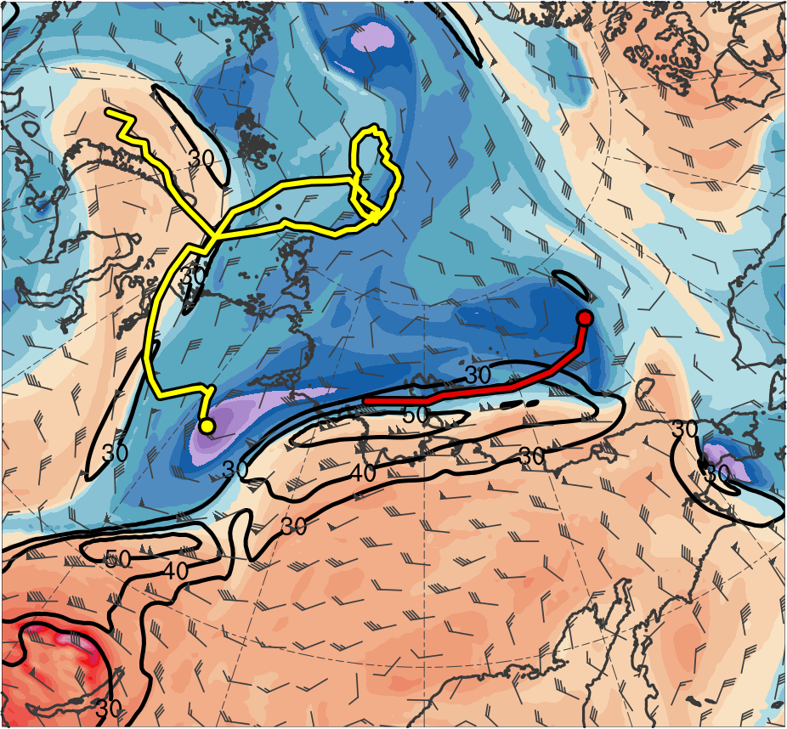
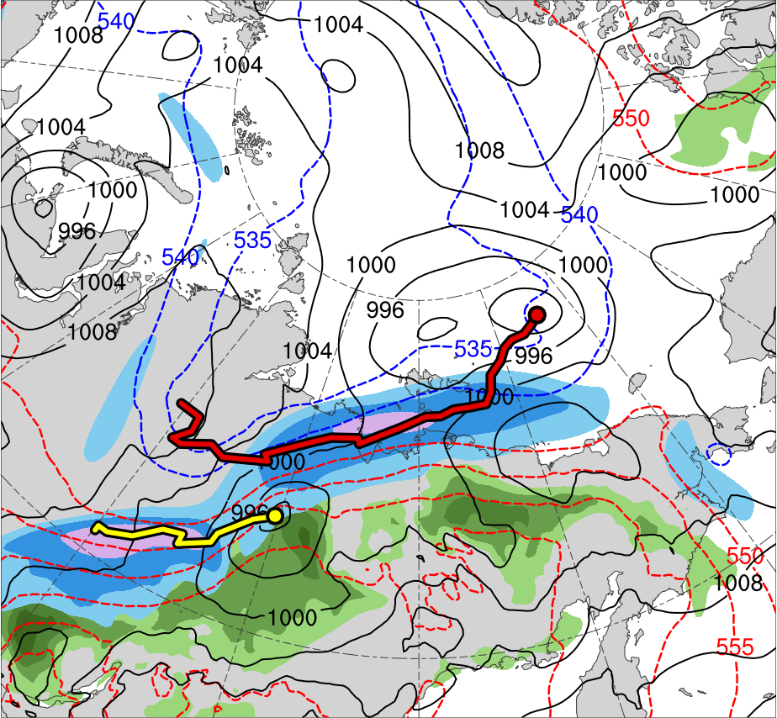
Synoptic Evolution
1800 UTC 3 Aug 2012
TPV 1
TPV 2
L1
AC12
(K)
252
258
264
270
276
282
288
294
300
306
312
318
324
330
336
342
348
354
360
366
372
378
(m s⁻¹ )
(mm)
30
40
50
60
70
80
90
100
25
30
35
40
45
50
55
Potential temperature (K, shaded), wind speed (black, every 10 m s⁻¹ starting at 30 m s⁻¹), and wind (m s⁻¹, flags and barbs) on 2-PVU surface
250-hPa wind speed (m s⁻¹, shaded),
1000–500-hPa thickness (dam, blue/red),
SLP (hPa, black), PW (mm, shaded)

Slide 18
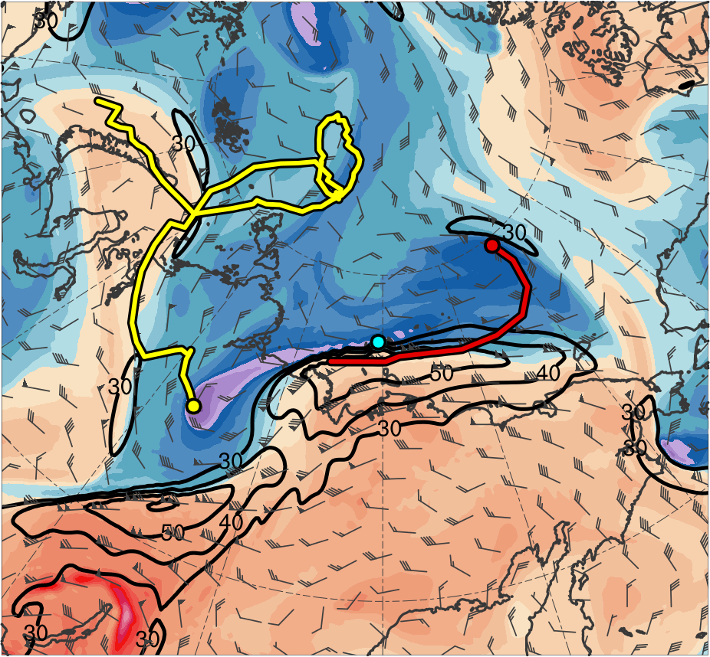
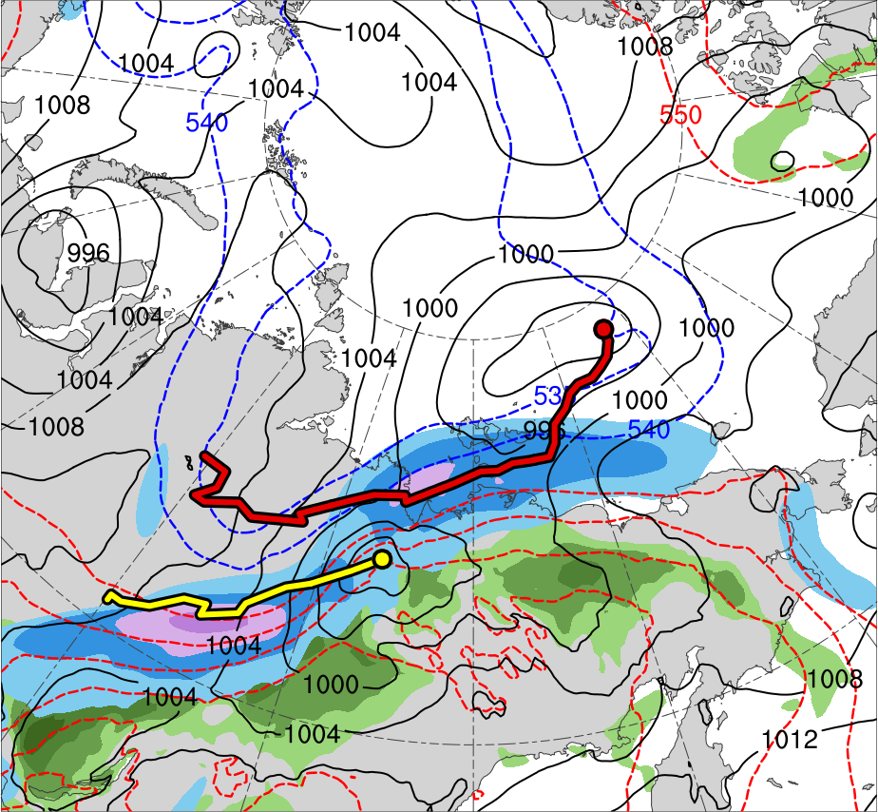
Synoptic Evolution
0000 UTC 4 Aug 2012
TPV 1
TPV 2
L1
TPV 3
AC12
(K)
252
258
264
270
276
282
288
294
300
306
312
318
324
330
336
342
348
354
360
366
372
378
(m s⁻¹ )
(mm)
30
40
50
60
70
80
90
100
25
30
35
40
45
50
55
Potential temperature (K, shaded), wind speed (black, every 10 m s⁻¹ starting at 30 m s⁻¹), and wind (m s⁻¹, flags and barbs) on 2-PVU surface
250-hPa wind speed (m s⁻¹, shaded),
1000–500-hPa thickness (dam, blue/red),
SLP (hPa, black), PW (mm, shaded)

Slide 19
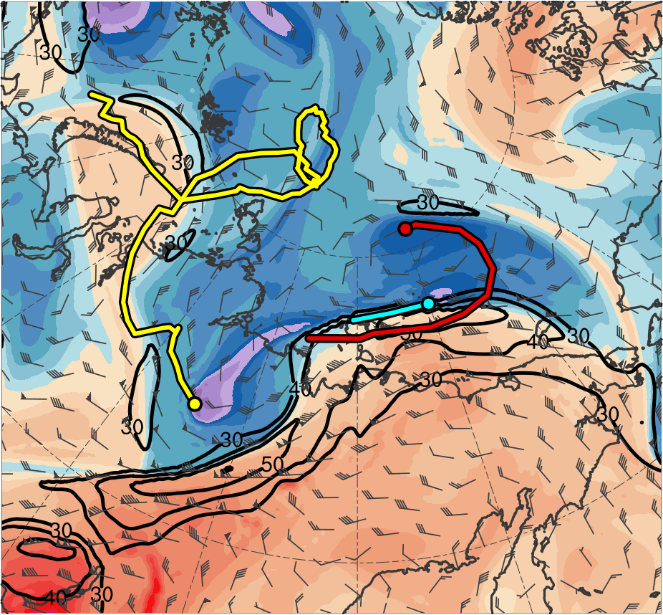
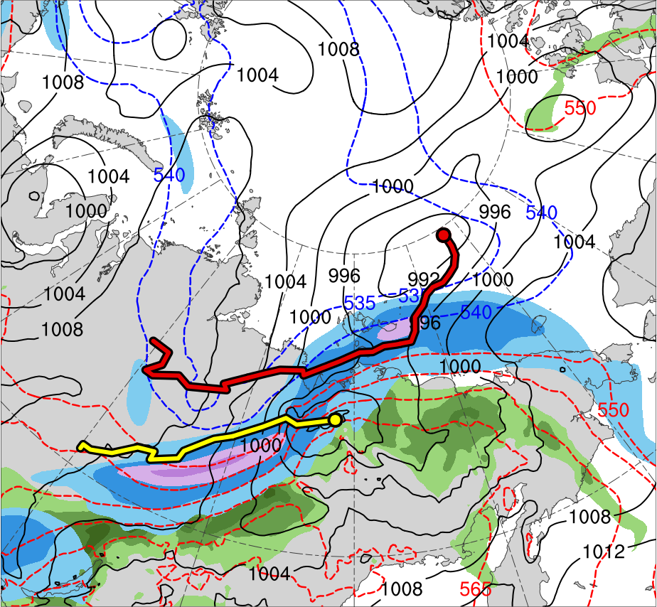
Synoptic Evolution
0600 UTC 4 Aug 2012
TPV 1
TPV 2
L1
TPV 3
AC12
(K)
252
258
264
270
276
282
288
294
300
306
312
318
324
330
336
342
348
354
360
366
372
378
(m s⁻¹ )
(mm)
30
40
50
60
70
80
90
100
25
30
35
40
45
50
55
Potential temperature (K, shaded), wind speed (black, every 10 m s⁻¹ starting at 30 m s⁻¹), and wind (m s⁻¹, flags and barbs) on 2-PVU surface
250-hPa wind speed (m s⁻¹, shaded),
1000–500-hPa thickness (dam, blue/red),
SLP (hPa, black), PW (mm, shaded)

Slide 20
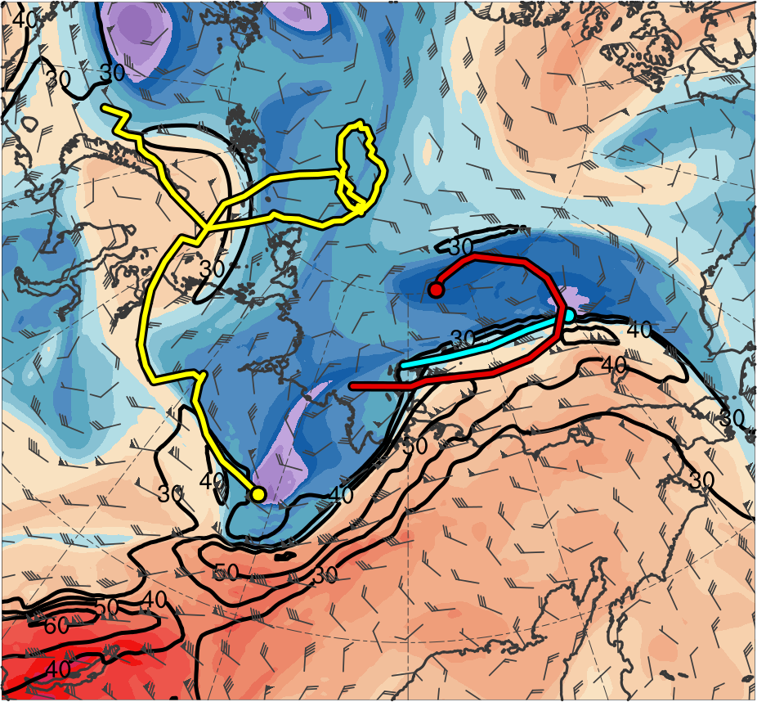
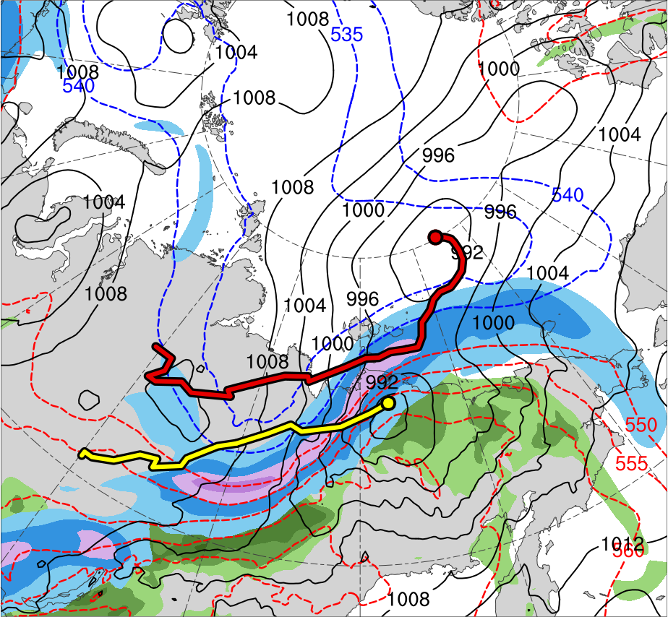
Synoptic Evolution
1200 UTC 4 Aug 2012
TPV 1
TPV 2
L1
TPV 3
AC12
(K)
252
258
264
270
276
282
288
294
300
306
312
318
324
330
336
342
348
354
360
366
372
378
(m s⁻¹ )
(mm)
30
40
50
60
70
80
90
100
25
30
35
40
45
50
55
Potential temperature (K, shaded), wind speed (black, every 10 m s⁻¹ starting at 30 m s⁻¹), and wind (m s⁻¹, flags and barbs) on 2-PVU surface
250-hPa wind speed (m s⁻¹, shaded),
1000–500-hPa thickness (dam, blue/red),
SLP (hPa, black), PW (mm, shaded)

Slide 21
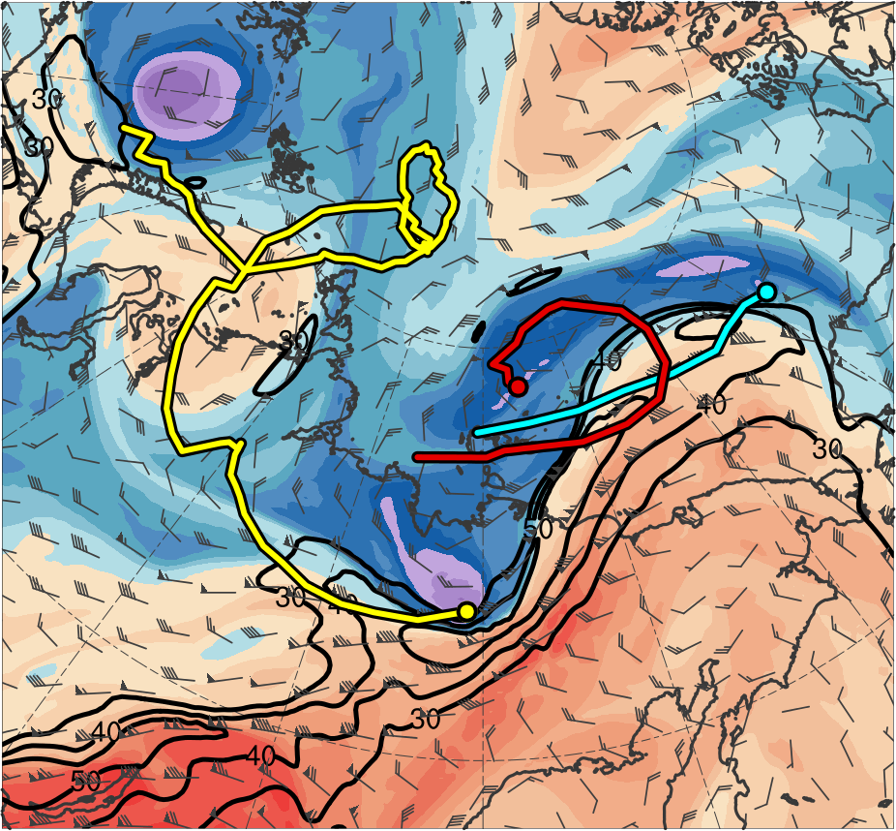
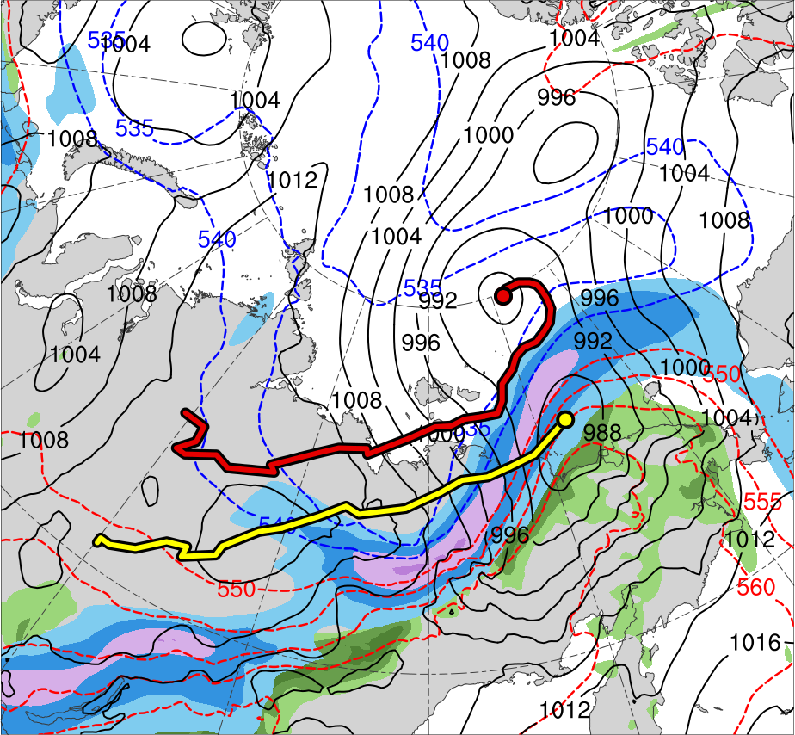
Synoptic Evolution
0000 UTC 5 Aug 2012
TPV 1
TPV 2
L1
TPV 3
AC12
(K)
252
258
264
270
276
282
288
294
300
306
312
318
324
330
336
342
348
354
360
366
372
378
(m s⁻¹ )
(mm)
30
40
50
60
70
80
90
100
25
30
35
40
45
50
55
Potential temperature (K, shaded), wind speed (black, every 10 m s⁻¹ starting at 30 m s⁻¹), and wind (m s⁻¹, flags and barbs) on 2-PVU surface
250-hPa wind speed (m s⁻¹, shaded),
1000–500-hPa thickness (dam, blue/red),
SLP (hPa, black), PW (mm, shaded)

Slide 22
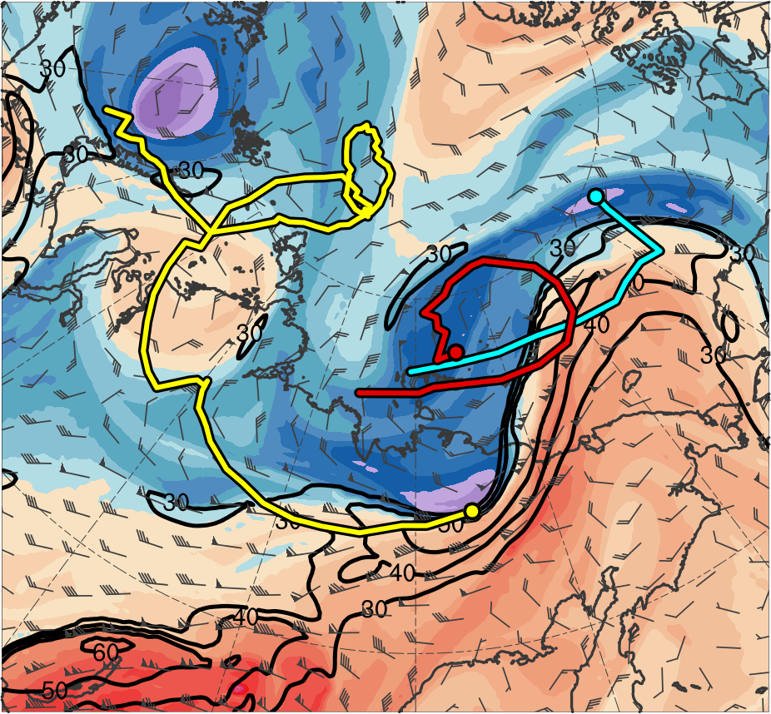
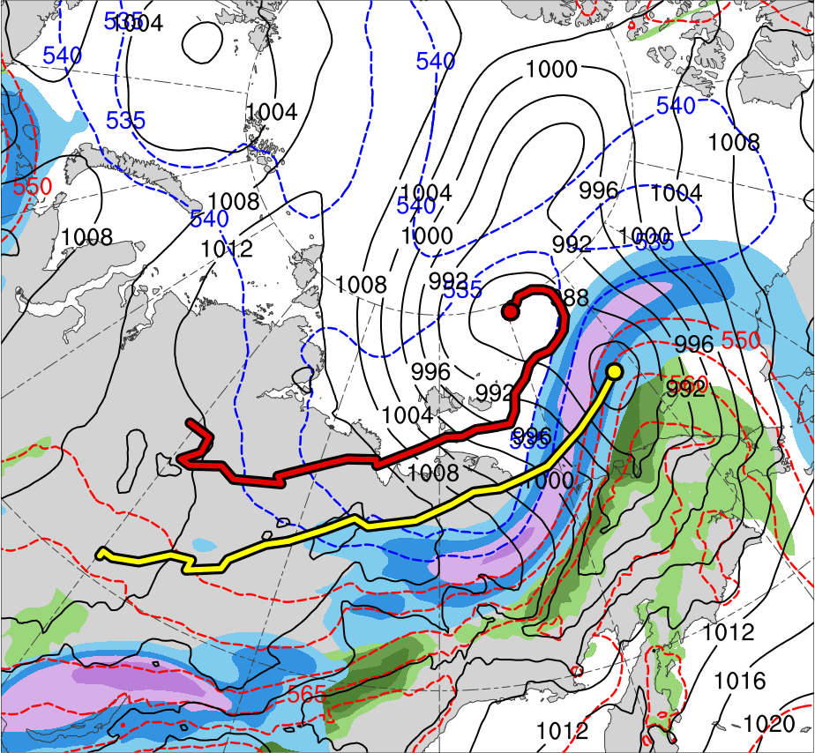
Synoptic Evolution
0600 UTC 5 Aug 2012
TPV 1
TPV 2
L1
TPV 3
AC12
(K)
252
258
264
270
276
282
288
294
300
306
312
318
324
330
336
342
348
354
360
366
372
378
(m s⁻¹ )
(mm)
30
40
50
60
70
80
90
100
25
30
35
40
45
50
55
Potential temperature (K, shaded), wind speed (black, every 10 m s⁻¹ starting at 30 m s⁻¹), and wind (m s⁻¹, flags and barbs) on 2-PVU surface
250-hPa wind speed (m s⁻¹, shaded),
1000–500-hPa thickness (dam, blue/red),
SLP (hPa, black), PW (mm, shaded)

Slide 23
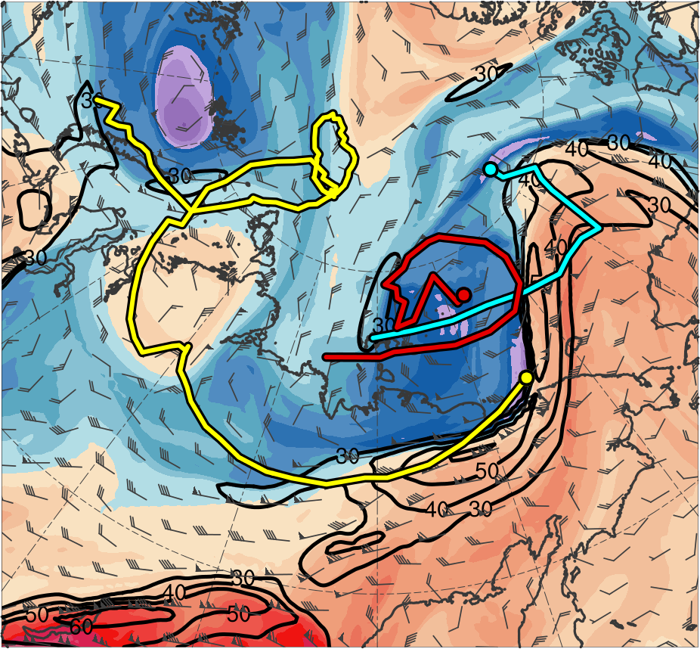
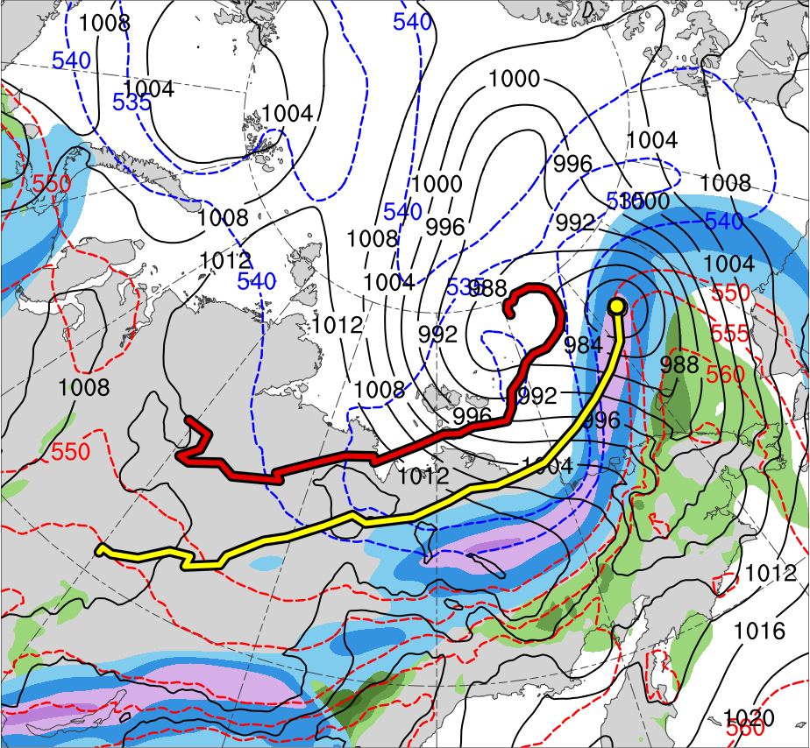
Synoptic Evolution
1200 UTC 5 Aug 2012
TPV 1
TPV 2
L1
TPV 3
AC12
(K)
252
258
264
270
276
282
288
294
300
306
312
318
324
330
336
342
348
354
360
366
372
378
(m s⁻¹ )
(mm)
30
40
50
60
70
80
90
100
25
30
35
40
45
50
55
Potential temperature (K, shaded), wind speed (black, every 10 m s⁻¹ starting at 30 m s⁻¹), and wind (m s⁻¹, flags and barbs) on 2-PVU surface
250-hPa wind speed (m s⁻¹, shaded),
1000–500-hPa thickness (dam, blue/red),
SLP (hPa, black), PW (mm, shaded)

Slide 24
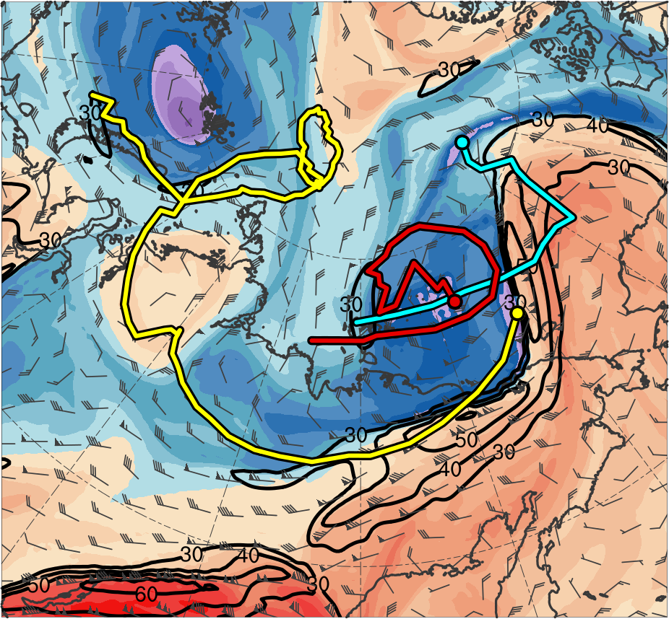
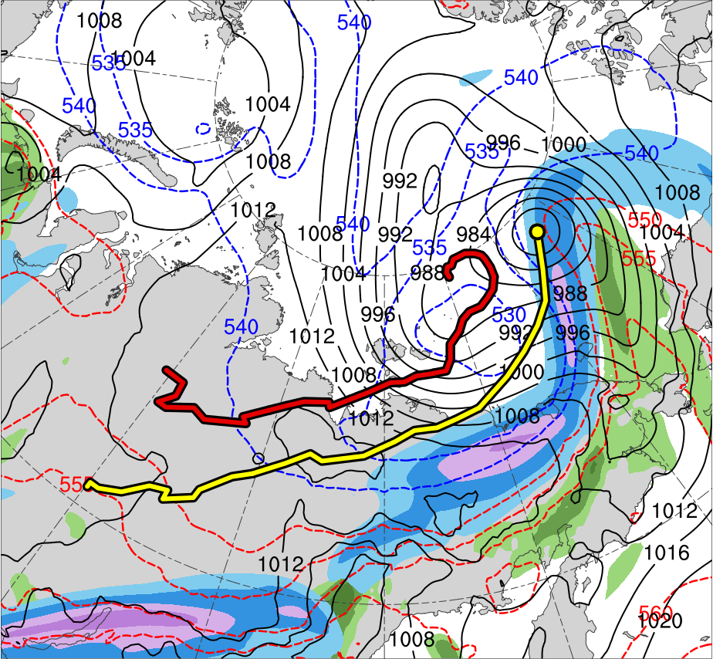
Synoptic Evolution
1800 UTC 5 Aug 2012
TPV 1
TPV 2
L1
TPV 3
AC12
(K)
252
258
264
270
276
282
288
294
300
306
312
318
324
330
336
342
348
354
360
366
372
378
(m s⁻¹ )
(mm)
30
40
50
60
70
80
90
100
25
30
35
40
45
50
55
Potential temperature (K, shaded), wind speed (black, every 10 m s⁻¹ starting at 30 m s⁻¹), and wind (m s⁻¹, flags and barbs) on 2-PVU surface
250-hPa wind speed (m s⁻¹, shaded),
1000–500-hPa thickness (dam, blue/red),
SLP (hPa, black), PW (mm, shaded)

Slide 25
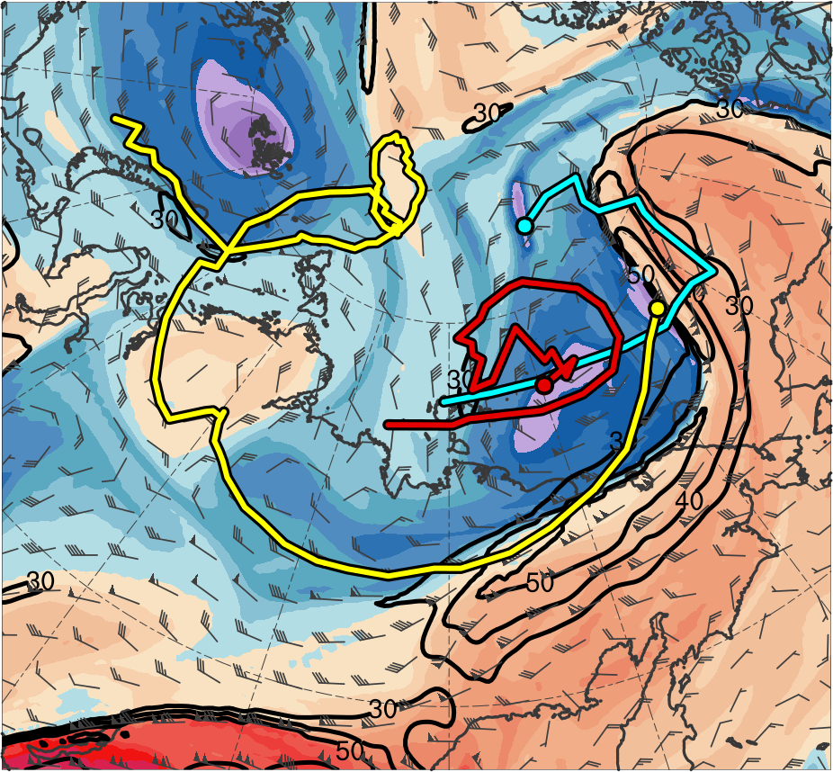
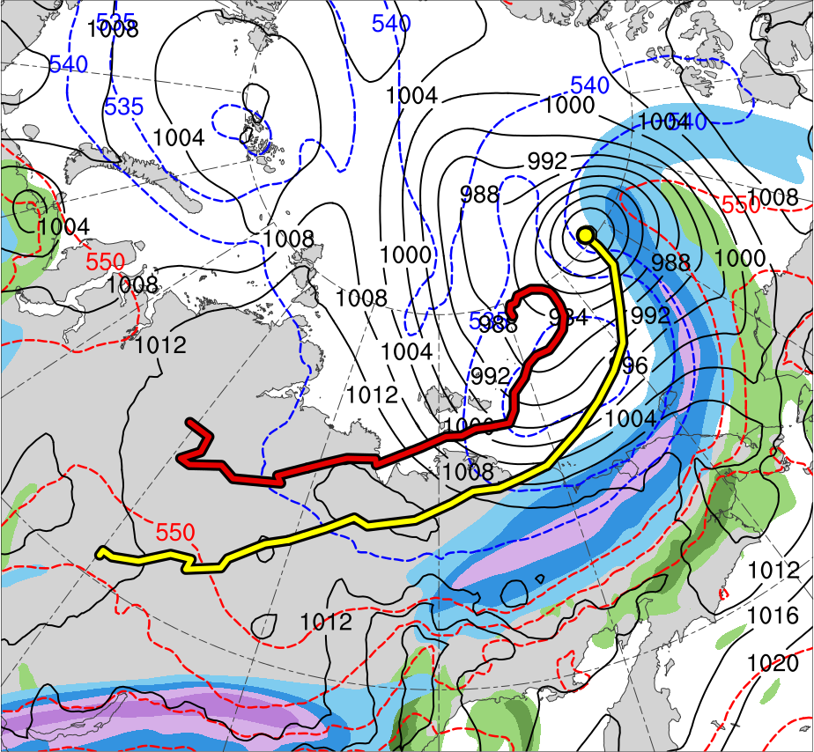
Synoptic Evolution
0000 UTC 6 Aug 2012
TPV 1
TPV 2
L1
TPV 3
AC12
(K)
252
258
264
270
276
282
288
294
300
306
312
318
324
330
336
342
348
354
360
366
372
378
(m s⁻¹ )
(mm)
30
40
50
60
70
80
90
100
25
30
35
40
45
50
55
Potential temperature (K, shaded), wind speed (black, every 10 m s⁻¹ starting at 30 m s⁻¹), and wind (m s⁻¹, flags and barbs) on 2-PVU surface
250-hPa wind speed (m s⁻¹, shaded),
1000–500-hPa thickness (dam, blue/red),
SLP (hPa, black), PW (mm, shaded)

Slide 26
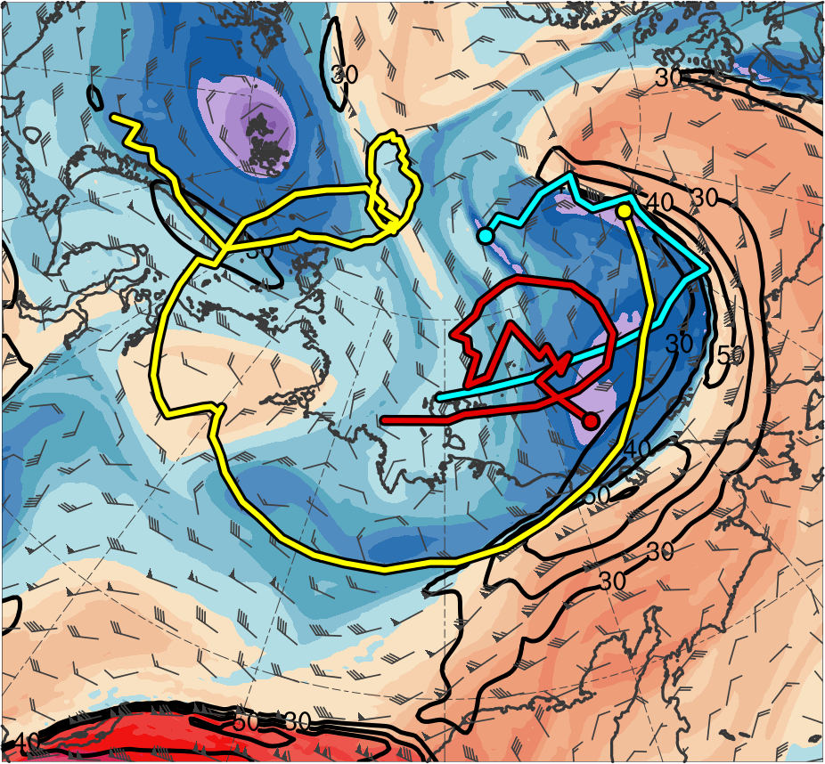
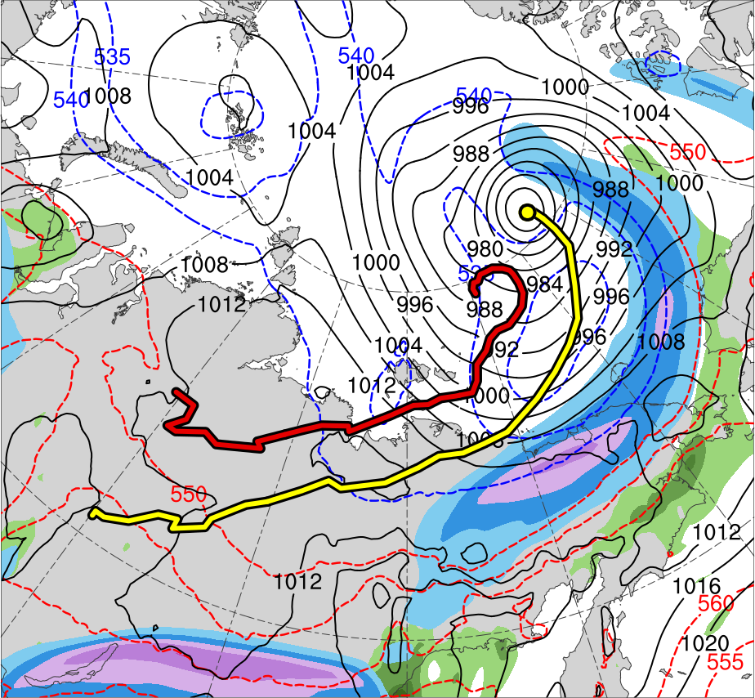
Synoptic Evolution
0600 UTC 6 Aug 2012
TPV 1
TPV 2
L1
TPV 3
AC12
(K)
252
258
264
270
276
282
288
294
300
306
312
318
324
330
336
342
348
354
360
366
372
378
(m s⁻¹ )
(mm)
30
40
50
60
70
80
90
100
25
30
35
40
45
50
55
Potential temperature (K, shaded), wind speed (black, every 10 m s⁻¹ starting at 30 m s⁻¹), and wind (m s⁻¹, flags and barbs) on 2-PVU surface
250-hPa wind speed (m s⁻¹, shaded),
1000–500-hPa thickness (dam, blue/red),
SLP (hPa, black), PW (mm, shaded)

Slide 27
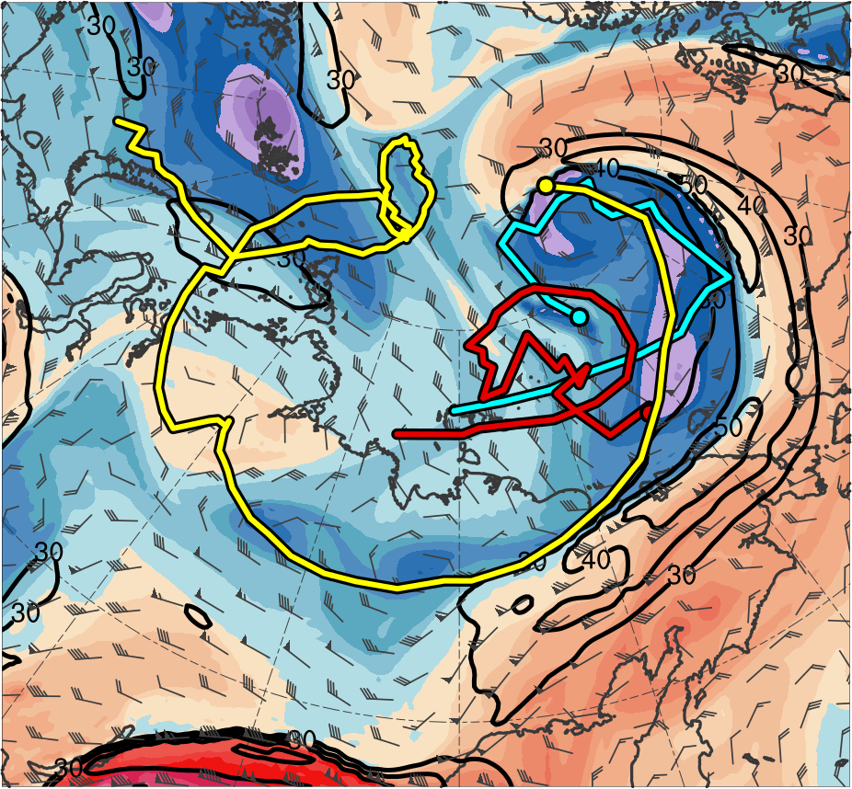
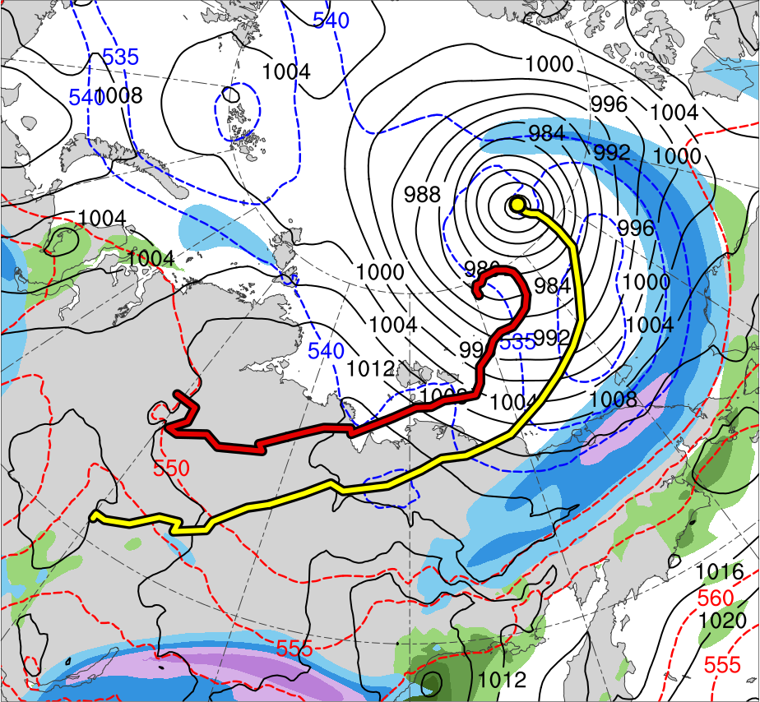
Synoptic Evolution
1200 UTC 6 Aug 2012
TPV 1
TPV 2
L1
TPV 3
AC12
(K)
252
258
264
270
276
282
288
294
300
306
312
318
324
330
336
342
348
354
360
366
372
378
(m s⁻¹ )
(mm)
30
40
50
60
70
80
90
100
25
30
35
40
45
50
55
Potential temperature (K, shaded), wind speed (black, every 10 m s⁻¹ starting at 30 m s⁻¹), and wind (m s⁻¹, flags and barbs) on 2-PVU surface
250-hPa wind speed (m s⁻¹, shaded),
1000–500-hPa thickness (dam, blue/red),
SLP (hPa, black), PW (mm, shaded)

Slide 28
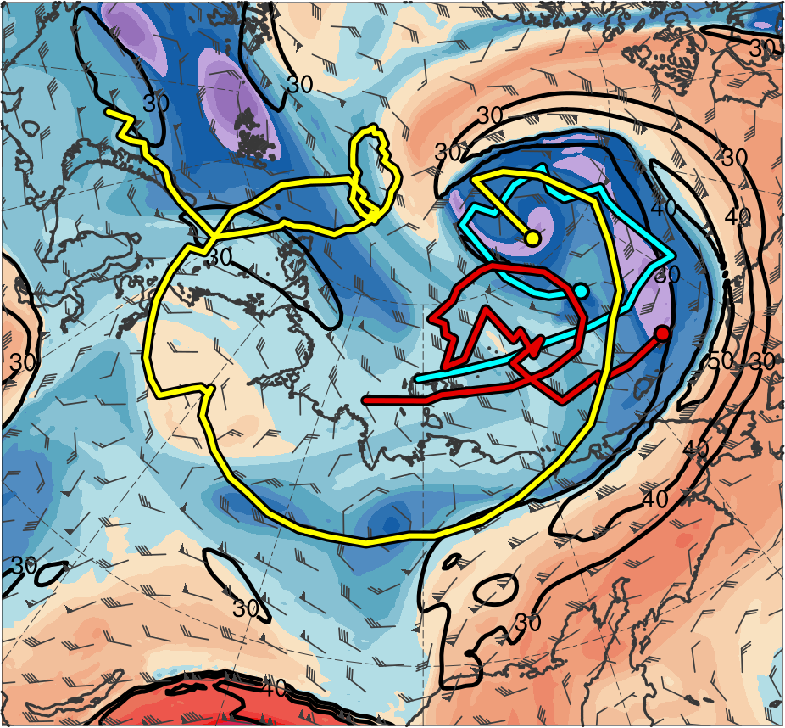
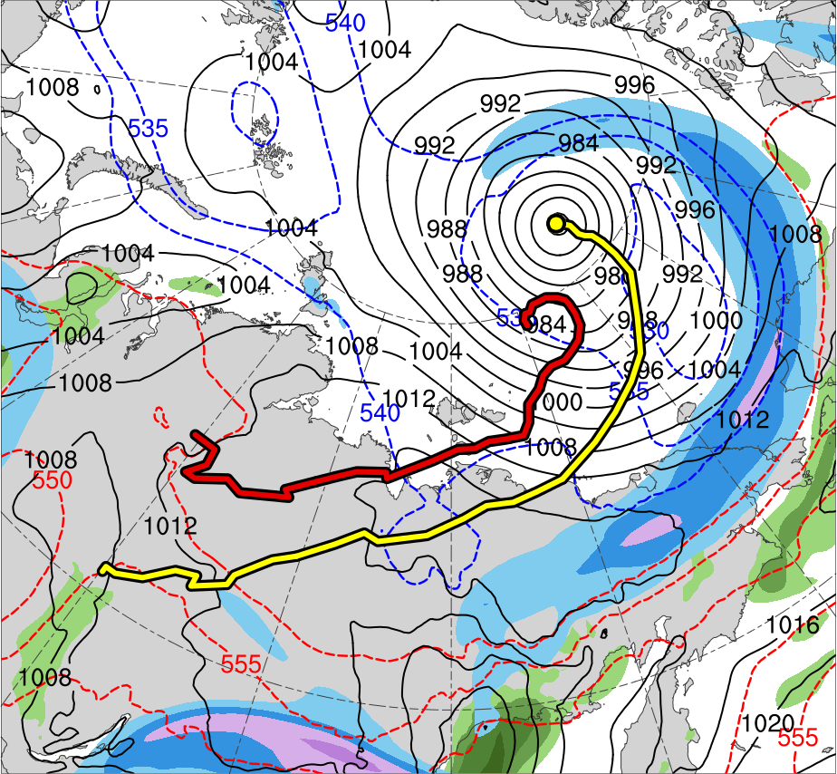
Synoptic Evolution
1800 UTC 6 Aug 2012
TPV 1
TPV 2
L1
TPV 3
AC12
(K)
252
258
264
270
276
282
288
294
300
306
312
318
324
330
336
342
348
354
360
366
372
378
(m s⁻¹ )
(mm)
30
40
50
60
70
80
90
100
25
30
35
40
45
50
55
Potential temperature (K, shaded), wind speed (black, every 10 m s⁻¹ starting at 30 m s⁻¹), and wind (m s⁻¹, flags and barbs) on 2-PVU surface
250-hPa wind speed (m s⁻¹, shaded),
1000–500-hPa thickness (dam, blue/red),
SLP (hPa, black), PW (mm, shaded)

Slide 29
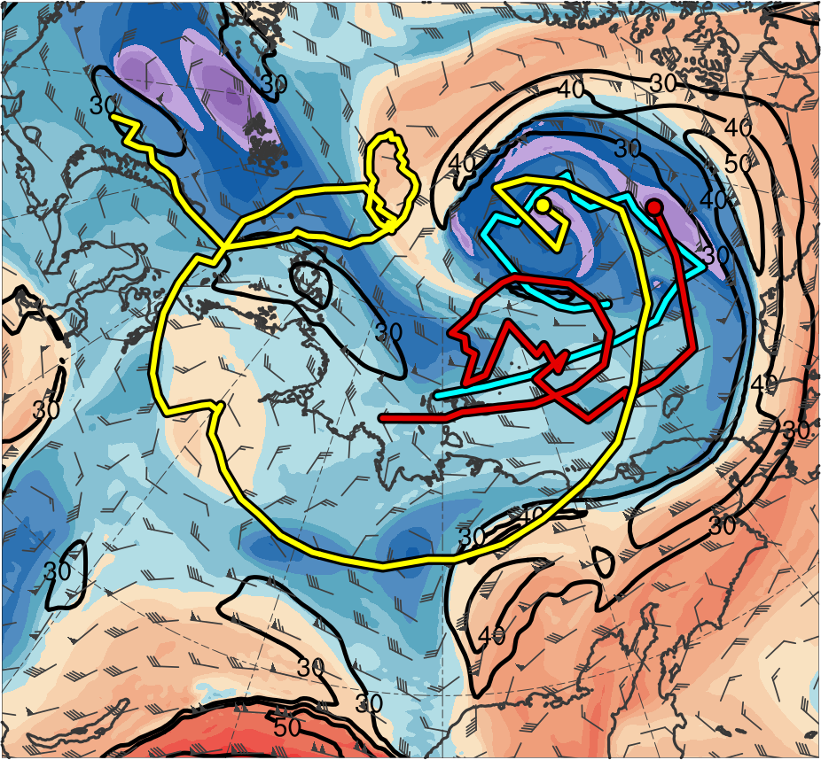
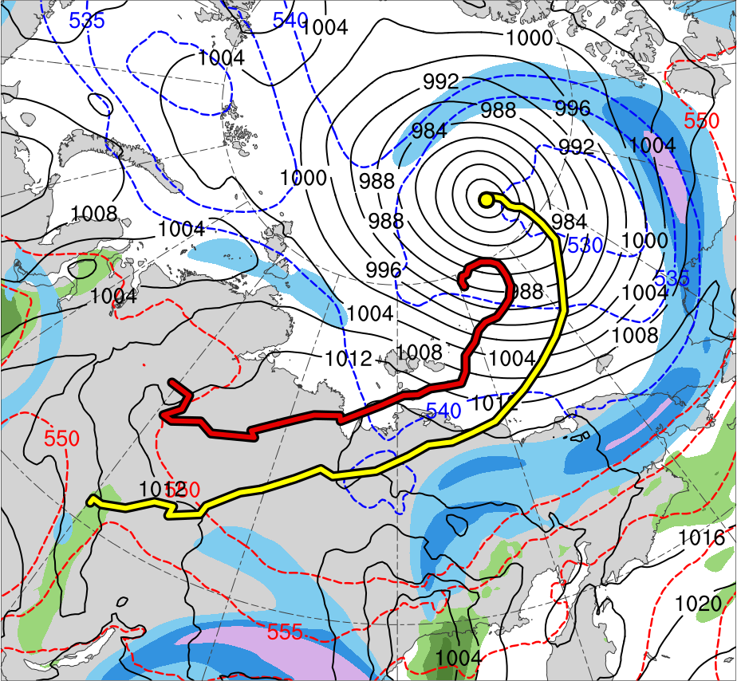
Synoptic Evolution
0000 UTC 7 Aug 2012
TPV 1
TPV 2
L1
TPV 3
AC12
(K)
252
258
264
270
276
282
288
294
300
306
312
318
324
330
336
342
348
354
360
366
372
378
(m s⁻¹ )
(mm)
30
40
50
60
70
80
90
100
25
30
35
40
45
50
55
Potential temperature (K, shaded), wind speed (black, every 10 m s⁻¹ starting at 30 m s⁻¹), and wind (m s⁻¹, flags and barbs) on 2-PVU surface
250-hPa wind speed (m s⁻¹, shaded),
1000–500-hPa thickness (dam, blue/red),
SLP (hPa, black), PW (mm, shaded)

Slide 30
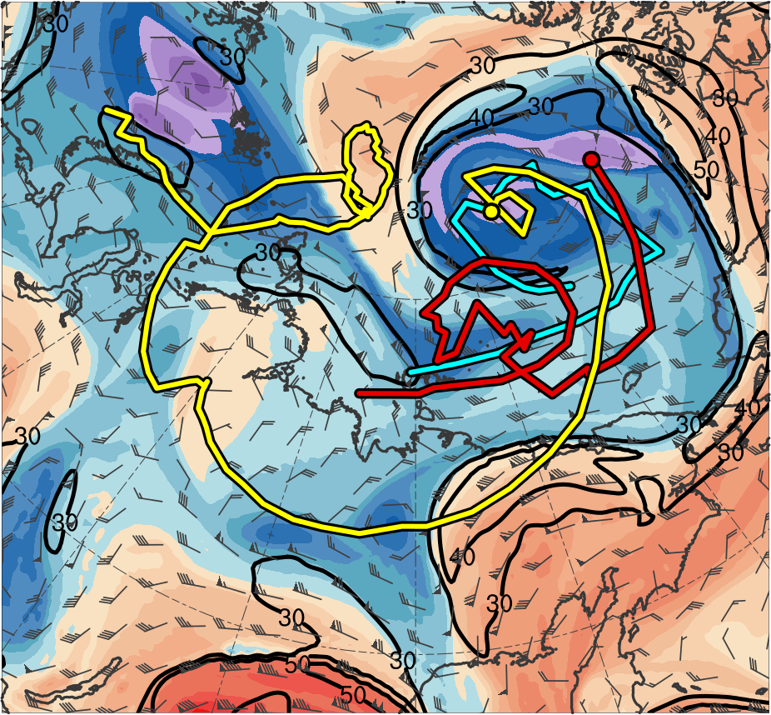
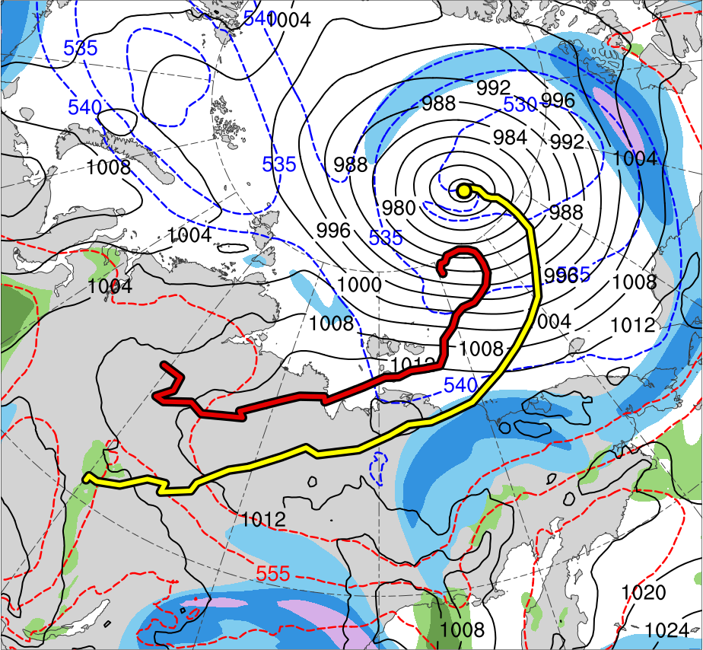
Synoptic Evolution
0600 UTC 7 Aug 2012
TPV 1
TPV 2
L1
TPV 3
AC12
(K)
252
258
264
270
276
282
288
294
300
306
312
318
324
330
336
342
348
354
360
366
372
378
(m s⁻¹ )
(mm)
30
40
50
60
70
80
90
100
25
30
35
40
45
50
55
Potential temperature (K, shaded), wind speed (black, every 10 m s⁻¹ starting at 30 m s⁻¹), and wind (m s⁻¹, flags and barbs) on 2-PVU surface
250-hPa wind speed (m s⁻¹, shaded),
1000–500-hPa thickness (dam, blue/red),
SLP (hPa, black), PW (mm, shaded)

Slide 31
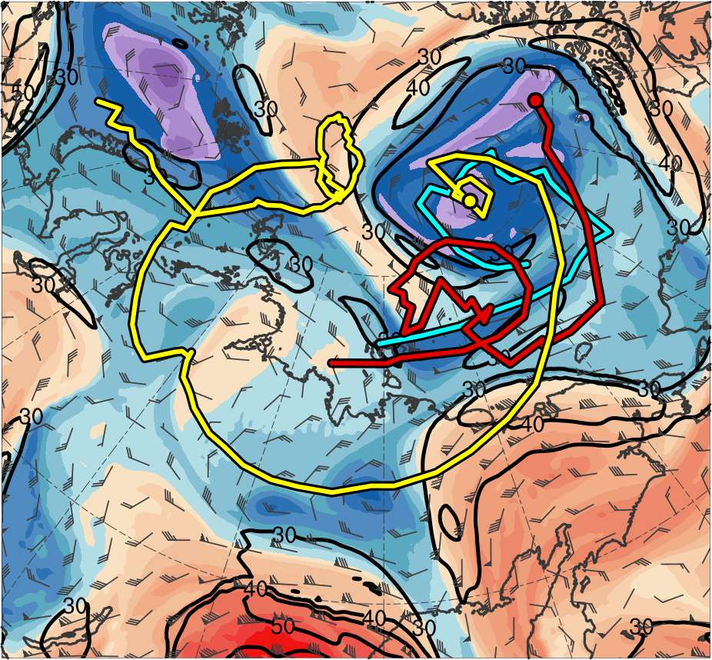
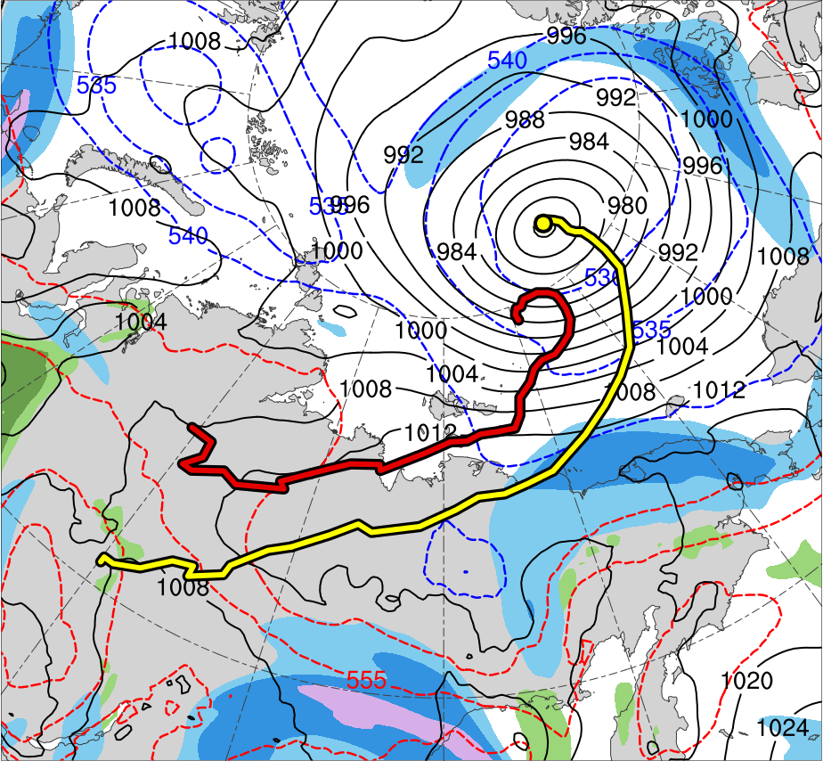
Synoptic Evolution
1200 UTC 7 Aug 2012
TPV 1
TPV 2
L1
TPV 3
AC12
(K)
252
258
264
270
276
282
288
294
300
306
312
318
324
330
336
342
348
354
360
366
372
378
(m s⁻¹ )
(mm)
30
40
50
60
70
80
90
100
25
30
35
40
45
50
55
Potential temperature (K, shaded), wind speed (black, every 10 m s⁻¹ starting at 30 m s⁻¹), and wind (m s⁻¹, flags and barbs) on 2-PVU surface
250-hPa wind speed (m s⁻¹, shaded),
1000–500-hPa thickness (dam, blue/red),
SLP (hPa, black), PW (mm, shaded)

Slide 32
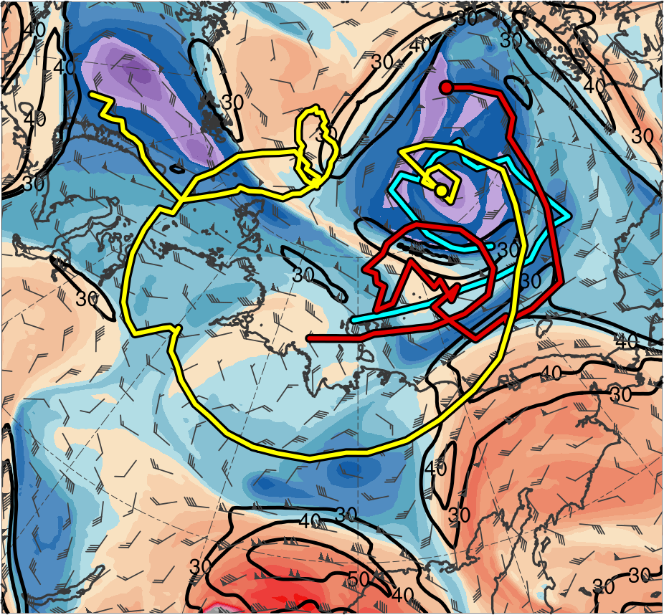
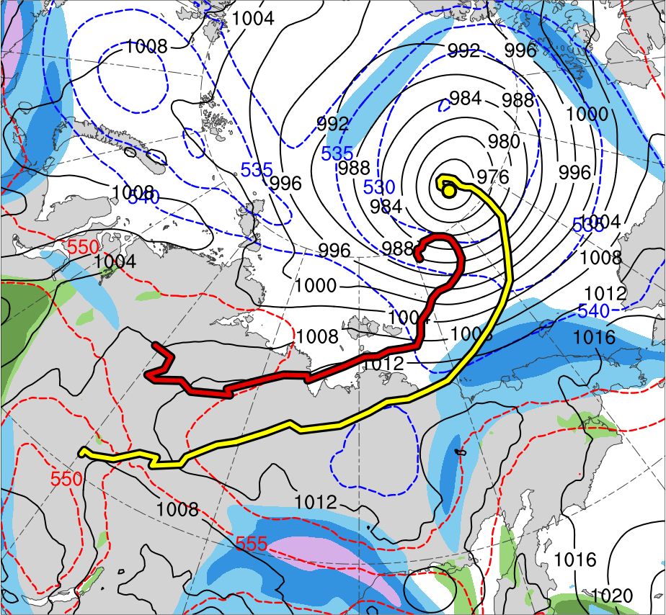
Synoptic Evolution
1800 UTC 7 Aug 2012
TPV 1
TPV 2
L1
TPV 3
AC12
(K)
252
258
264
270
276
282
288
294
300
306
312
318
324
330
336
342
348
354
360
366
372
378
(m s⁻¹ )
(mm)
30
40
50
60
70
80
90
100
25
30
35
40
45
50
55
Potential temperature (K, shaded), wind speed (black, every 10 m s⁻¹ starting at 30 m s⁻¹), and wind (m s⁻¹, flags and barbs) on 2-PVU surface
250-hPa wind speed (m s⁻¹, shaded),
1000–500-hPa thickness (dam, blue/red),
SLP (hPa, black), PW (mm, shaded)

Slide 33
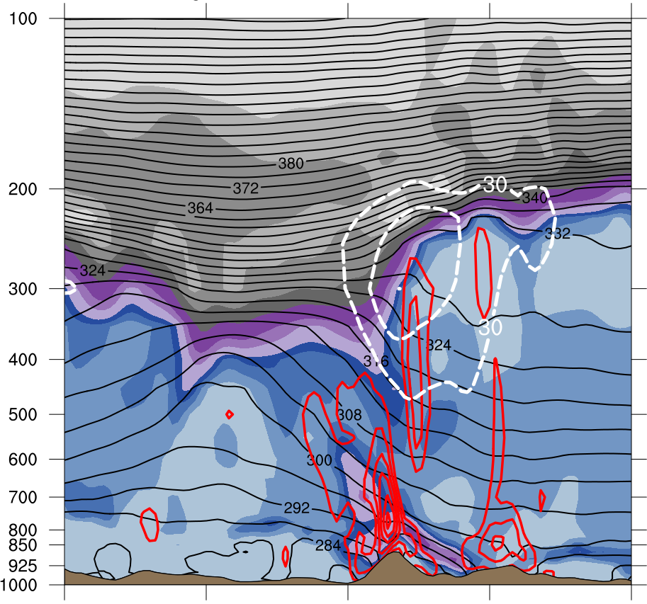
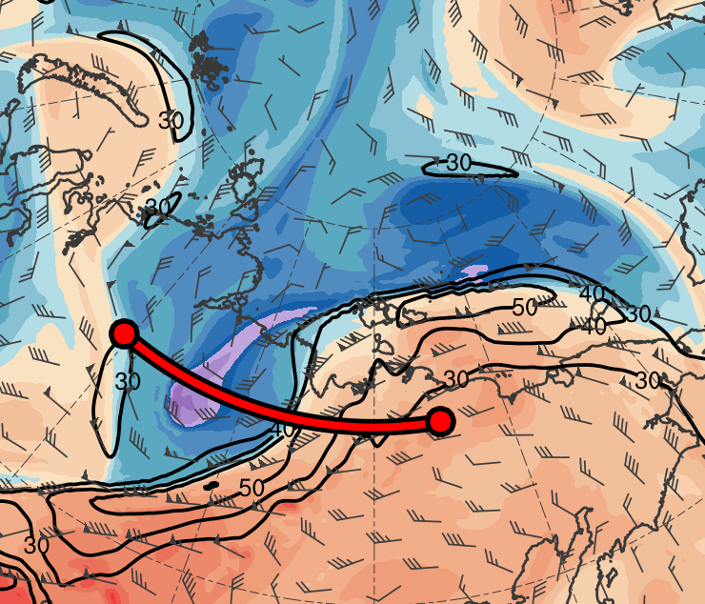
Cross Sections
0600 UTC 4 Aug 2012
(a)
(b)
378
372
100
12
366
90
10
360
80
A
354
70
8
348
60
A’
342
50
6
336
330
40
4
TPV 1
324
30
318
(m s⁻¹)
3
(c)
312
306
55
2
TPV 1
300
294
50
1.5
288
45
A
282
40
1
276
35
A’
270
AC12
264
30
0.5
258
AC12
25
252
(PVU)
A
69.3°N, 111.8°E
69.3°N, 124.5°E
69.3°N, 137.3°E
A’
(K)
(mm)
(a) PV (PVU, shaded), θ (K, black), ascent (red, every 3.0 × 10⁻³ hPa s⁻¹), and wind speed (dashed white, m s⁻¹); (b) DT (2-PVU surface) θ (K, shaded), wind speed (black, m s⁻¹), and wind (m s⁻¹, flags and barbs); (c) 250-hPa wind speed (m s⁻¹, shaded),1000–500-hPa thickness (dam, blue/red), SLP (hPa, black), PW (mm, shaded)

Slide 34
Cross Sections
0600 UTC 4 Aug 2012
(b)
B
(a)
378
372
100
12
TPV 3
366
90
10
TPV 2
360
80
354
70
8
348
60
342
50
6
336
B’
330
40
4
324
30
B
318
(m s⁻¹)
3
(c)
312
TPV 2
306
55
2
300
294
50
1.5
288
45
TPV 3
282
40
1
276
35
270
0.5
B’
264
30
AC12
258
25
252
(PVU)
B
81.8°N, 161.1°E
76.5°N, 161.1°E
71.3°N, 161.1°E
B’
(K)
(mm)
(a) PV (PVU, shaded), θ (K, black), ascent (red, every 3.0 × 10⁻³ hPa s⁻¹), and wind speed (dashed white, m s⁻¹); (b) DT (2-PVU surface) θ (K, shaded), wind speed (black, m s⁻¹), and wind (m s⁻¹, flags and barbs); (c) 250-hPa wind speed (m s⁻¹, shaded),1000–500-hPa thickness (dam, blue/red), SLP (hPa, black), PW (mm, shaded)

Slide 35
Cross Sections
0000 UTC 6 Aug 2012
(a)
(b)
C
378
372
100
12
366
90
10
360
80
354
70
8
348
60
TPV 1
342
50
6
336
330
40
4
C’
324
30
TPV 1
318
(c)
C
312
(m s⁻¹)
3
306
300
55
2
294
50
1.5
288
45
AC12
282
40
1
276
35
AC12
270
0.5
264
30
C’
258
25
252
(PVU)
C
81.8°N, 169.8°W
76.5°N, 169.8°W
71.3°N, 169.8°W
C’
(K)
(mm)
(a) PV (PVU, shaded), θ (K, black), ascent (red, every 3.0 × 10⁻³ hPa s⁻¹), and wind speed (dashed white, m s⁻¹); (b) DT (2-PVU surface) θ (K, shaded), wind speed (black, m s⁻¹), and wind (m s⁻¹, flags and barbs); (c) 250-hPa wind speed (m s⁻¹, shaded),1000–500-hPa thickness (dam, blue/red), SLP (hPa, black), PW (mm, shaded)

Slide 36
Reduction in Arctic Sea Ice
0000 UTC 5 Aug 2012
0000 UTC 5 Aug − 0000 UTC 2 Aug 2012
L1
AC12
(m s⁻¹ )
(%)
4
6
8
10
12
14
16
18
-60
-50
-40
-30
-20
-10
-5
5
10
20
30
40
50
60
SLP (hPa, black); 10-m wind speed (m s⁻¹, shaded) and wind (m s⁻¹, black barbs); and 20% contour of sea-ice concentration (thick blue)
Change in sea-ice concentration (shaded, %) since 0000 UTC 2 Aug 2012

Slide 37
Reduction in Arctic Sea Ice
0000 UTC 6 Aug 2012
0000 UTC 6 Aug − 0000 UTC 2 Aug 2012
L1
AC12
(m s⁻¹ )
(%)
4
6
8
10
12
14
16
18
-60
-50
-40
-30
-20
-10
-5
5
10
20
30
40
50
60
SLP (hPa, black); 10-m wind speed (m s⁻¹, shaded) and wind (m s⁻¹, black barbs); and 20% contour of sea-ice concentration (thick blue)
Change in sea-ice concentration (shaded, %) since 0000 UTC 2 Aug 2012

Slide 38
Reduction in Arctic Sea Ice
0000 UTC 7 Aug 2012
0000 UTC 7 Aug − 0000 UTC 2 Aug 2012
L1
AC12
(m s⁻¹ )
(%)
4
6
8
10
12
14
16
18
-60
-50
-40
-30
-20
-10
-5
5
10
20
30
40
50
60
SLP (hPa, black); 10-m wind speed (m s⁻¹, shaded) and wind (m s⁻¹, black barbs); and 20% contour of sea-ice concentration (thick blue)
Change in sea-ice concentration (shaded, %) since 0000 UTC 2 Aug 2012

Slide 39
Reduction in Arctic Sea Ice
0000 UTC 8 Aug 2012
0000 UTC 8 Aug − 0000 UTC 2 Aug 2012
L1
AC12
(m s⁻¹ )
(%)
4
6
8
10
12
14
16
18
-60
-50
-40
-30
-20
-10
-5
5
10
20
30
40
50
60
SLP (hPa, black); 10-m wind speed (m s⁻¹, shaded) and wind (m s⁻¹, black barbs); and 20% contour of sea-ice concentration (thick blue)
Change in sea-ice concentration (shaded, %) since 0000 UTC 2 Aug 2012

Slide 40
Reduction in Arctic Sea Ice
0000 UTC 9 Aug 2012
0000 UTC 9 Aug − 0000 UTC 2 Aug 2012
L1
AC12
(m s⁻¹ )
(%)
4
6
8
10
12
14
16
18
-60
-50
-40
-30
-20
-10
-5
5
10
20
30
40
50
60
SLP (hPa, black); 10-m wind speed (m s⁻¹, shaded) and wind (m s⁻¹, black barbs); and 20% contour of sea-ice concentration (thick blue)
Change in sea-ice concentration (shaded, %) since 0000 UTC 2 Aug 2012

Slide 41
Reduction in Arctic Sea Ice
0000 UTC 10 Aug 2012
0000 UTC 10 Aug − 0000 UTC 2 Aug 2012
L1
AC12
(m s⁻¹ )
(%)
4
6
8
10
12
14
16
18
-60
-50
-40
-30
-20
-10
-5
5
10
20
30
40
50
60
SLP (hPa, black); 10-m wind speed (m s⁻¹, shaded) and wind (m s⁻¹, black barbs); and 20% contour of sea-ice concentration (thick blue)
Change in sea-ice concentration (shaded, %) since 0000 UTC 2 Aug 2012

Slide 42
Reduction in Arctic Sea Ice
0000 UTC 11 Aug 2012
0000 UTC 11 Aug − 0000 UTC 2 Aug 2012
L1
AC12
(m s⁻¹ )
(%)
4
6
8
10
12
14
16
18
-60
-50
-40
-30
-20
-10
-5
5
10
20
30
40
50
60
SLP (hPa, black); 10-m wind speed (m s⁻¹, shaded) and wind (m s⁻¹, black barbs); and 20% contour of sea-ice concentration (thick blue)
Change in sea-ice concentration (shaded, %) since 0000 UTC 2 Aug 2012

Slide 43
Reduction in Arctic Sea Ice
0000 UTC 12 Aug 2012
0000 UTC 12 Aug − 0000 UTC 2 Aug 2012
L1
AC12
(m s⁻¹ )
(%)
4
6
8
10
12
14
16
18
-60
-50
-40
-30
-20
-10
-5
5
10
20
30
40
50
60
SLP (hPa, black); 10-m wind speed (m s⁻¹, shaded) and wind (m s⁻¹, black barbs); and 20% contour of sea-ice concentration (thick blue)
Change in sea-ice concentration (shaded, %) since 0000 UTC 2 Aug 2012

Slide 44
Reduction in Arctic Sea Ice
0000 UTC 13 Aug 2012
0000 UTC 13 Aug − 0000 UTC 2 Aug 2012
L1
AC12
(m s⁻¹ )
(%)
4
6
8
10
12
14
16
18
-60
-50
-40
-30
-20
-10
-5
5
10
20
30
40
50
60
SLP (hPa, black); 10-m wind speed (m s⁻¹, shaded) and wind (m s⁻¹, black barbs); and 20% contour of sea-ice concentration (thick blue)
Change in sea-ice concentration (shaded, %) since 0000 UTC 2 Aug 2012

Slide 45
Reduction in Arctic Sea Ice
0000 UTC 14 Aug 2012
0000 UTC 14 Aug − 0000 UTC 2 Aug 2012
L1
AC12
(m s⁻¹ )
(%)
4
6
8
10
12
14
16
18
-60
-50
-40
-30
-20
-10
-5
5
10
20
30
40
50
60
SLP (hPa, black); 10-m wind speed (m s⁻¹, shaded) and wind (m s⁻¹, black barbs); and 20% contour of sea-ice concentration (thick blue)
Change in sea-ice concentration (shaded, %) since 0000 UTC 2 Aug 2012

Slide 46
Conclusions
TPV 1 approaches and interacts with AC12 in a region of strong baroclinicity, likely supporting the development of AC12 via baroclinic processes
TPV–jet interactions involving TPV 1, TPV 2, and TPV 3 likely contribute to the formation of a dual-jet configuration and jet coupling over AC12
Presence of warm, moist air and relatively strong lower-tropospheric ascent in region of jet coupling likely contribute to formation of a potential vorticity (PV) tower associated with AC12

Slide 47
Conclusions
Interaction between TPV 1 and the PV tower associated with AC12 likely supports the intensification of AC12
L1 interacts and merges with AC12, which may further support the intensification of AC12
After attaining a minimum SLP of 962 hPa, AC12 moves slowly over Arctic, where its expansive surface wind field contributes to reductions in Arctic sea-ice extent

Slide 48
Questions?
Email: kbiernat@albany.edu
Interaction between TPV 1 and the PV tower associated with AC12 likely supports the intensification of AC12
L1 interacts and merges with AC12, which may further support the intensification of AC12
After attaining a minimum SLP of 962 hPa, AC12 moves slowly over Arctic, where its expansive surface wind field contributes to reductions in Arctic sea-ice extent
Acknowledgments
Special thanks to Nicholas Szapiro

