Slide 1
The New York City Metro Area Transportation Apocalypse Event of 15 November 2018
Lance F. Bosart, Kevin A. Biernat, and Tyler C. Leicht
Department of Atmospheric and Environmental Sciences
University at Albany – SUNY
Albany, NY 12222
44th Northeastern Storm Conference
Saturday 9 March 2019
Saratoga Springs, New York 12866
Support provided by: NSF AGS-1656406 and NOAA CSTAR NA16NWS4680005

Slide 2
Motivation
NYC Metro Transportation Apocalyse on Wednesday 15 November 2018:
Abrupt snow onset produced widespread travel gridlock
Model forecasts outperformed many human forecasters
Many automated forecasts produced automated nonsense
Many human forecasters suspended their powers of disbelief

Slide 3
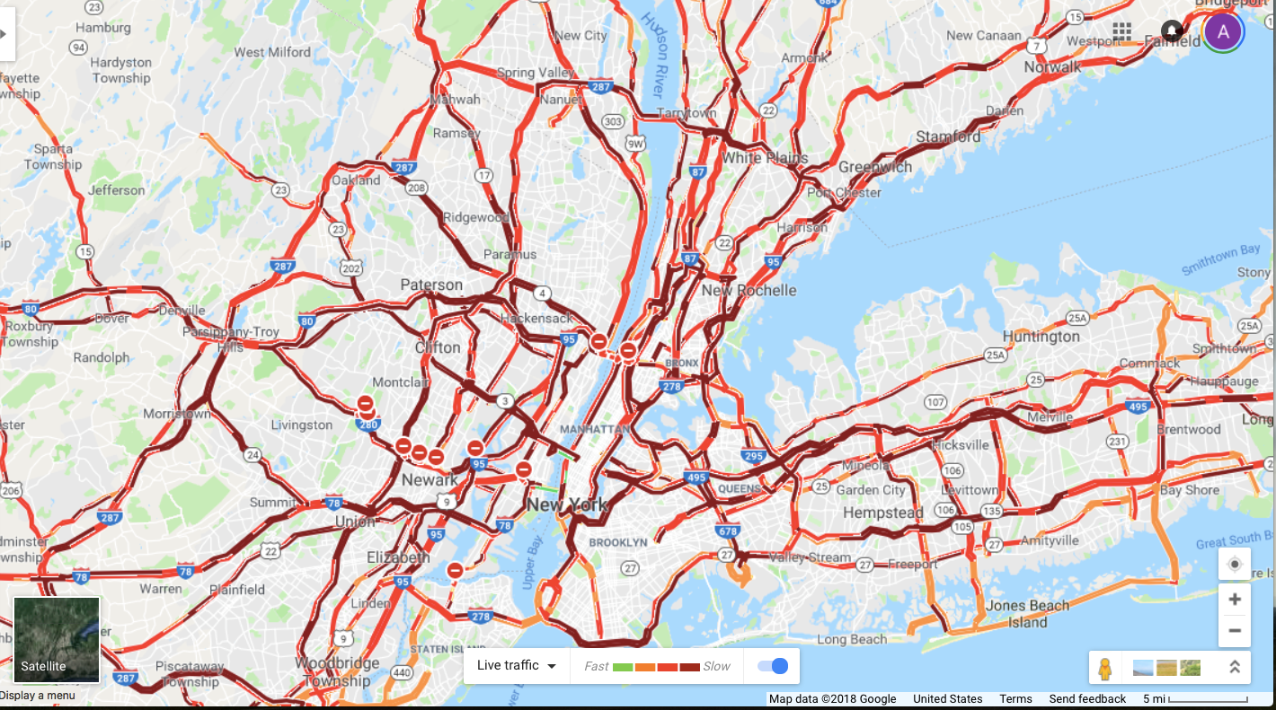
Motivation: Traffic Gridlock

Slide 4
Motivation: News Headlines
The New York Area Was Nearly Paralyzed by 6 Inches of Snow. What Went Wrong? (New York Times)
https://www.nytimes.com/2018/11/16/nyregion/snowstorm-total-delays-commute.html?action=click&module=Top Stories&pgtype=Homepage
New York Today: Snow Storm Causes Delays and Chaos for Trains, Buses, Schools (New York Times)
https://www.nytimes.com/2018/11/16/nyregion/newyorktoday/port-authority-nj-transit-snow-commute-nyc.html?rref=collection/sectioncollection/nyregion&action=click&contentCollection=nyregion&region=stream&module=stream_unit&version=latest&contentPlacement=7&pgtype=sectionfront
‘Not a Soul Taking Control’: How a Storm in the New York Area Upended the Night (New York Times)
https://www.nytimes.com/2018/11/16/nyregion/nyc-snowstorm-traffic-commute.html?rref=collection/sectioncollection/nyregion&action=click&contentCollection=nyregion&region=stream&module=stream_unit&version=latest&contentPlacement=1&pgtype=sectionfront
New York Today: Why Politicians Fear Snowstorms Even More Than You Do (New York Times)
https://www.nytimes.com/2018/11/19/nyregion/newyorktoday/new-york-today-politicians-storms.html?em_pos=large&emc=edit_ur_20181119&nl=new-york-today&nlid=54201803edit_ur_20181119&ref=headline&te=1

Slide 5
Official NWS Forecasts from 1153 UTC (left) and 1735 UTC (right) 15 Nov 2018

Slide 6
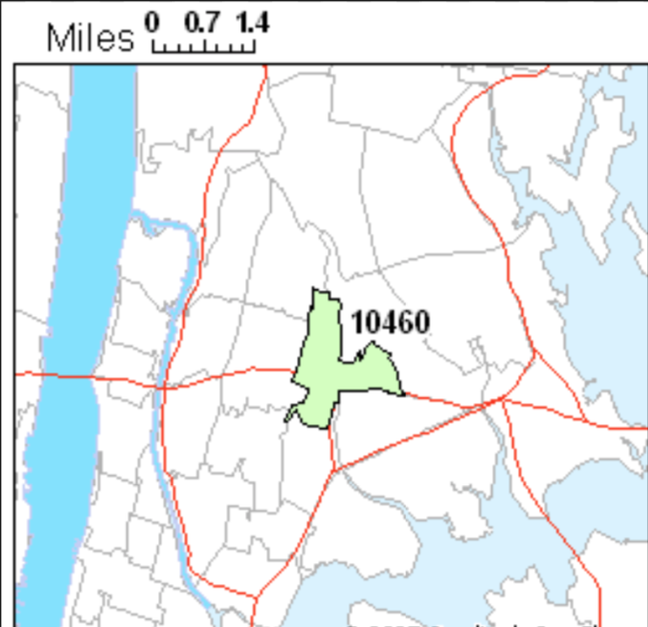
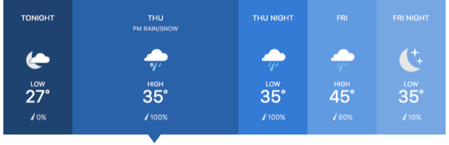
Snowfall Forecasts
Forecasts for the central Bronx, NYC for Thursday 15 Nov 2018
NWS Upton, NY:
Thursday: Snow and sleet before 4 pm, then freezing rain and sleet. High near 37. Wind chill values between 20 and 25. Northeast wind 7 to 10 mph, with gusts as high as 22 mph. Chance or precipitation is 90%. Little or no ice accumulation expected. New snow and ice accumulation of 1 to 2 inches possible.
The Weather Channel:
Cloudy skies early followed by a mixture of light rain and snow in the afternoon. Some sleet may mix in. High near 35F. Winds ENE at 10 to 20 mph. Chance of precipitation 100%. Snow accumulations less than one inch.

Slide 7
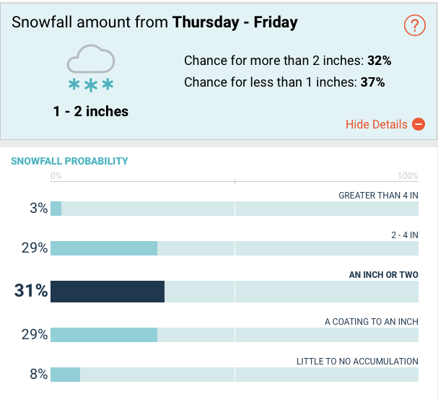
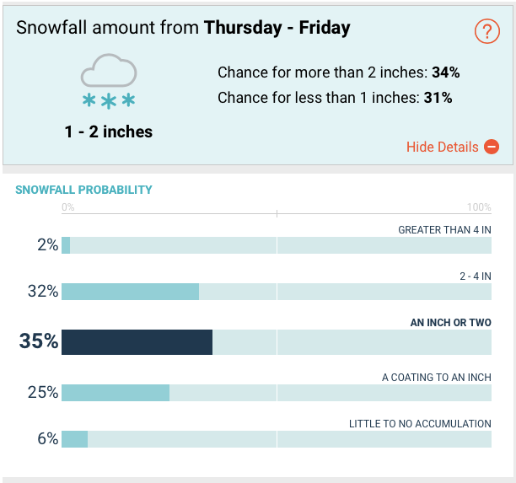
Accuweather.com probabilistic snowfall forecasts for the central Bronx, NYC for Thursday 15 Nov 2018
Snowfall Forecasts
Forecast as of 0400 UTC 15 Nov:
Forecast as of 1824 UTC 15 Nov:

Slide 8
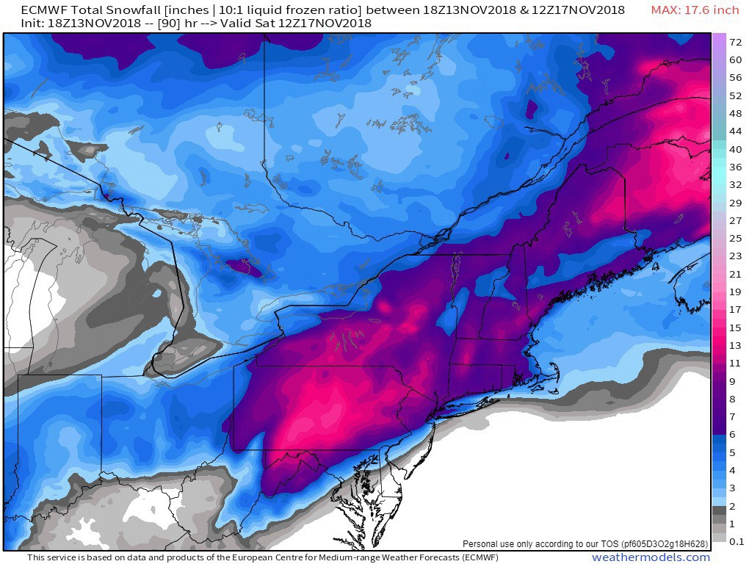
ECMWF Snowfall Forecast
ECMWF 90-h snowfall forecast Initialized 1800 UTC 13 Nov. Source: weathermodels.com

Slide 9
Radar
Source: Penn State Meteorology

Slide 10
KNYC METAR Obs
KNYC 152351Z AUTO 3/4SM -SN BR M02/M02 A3023 RMK AO2 SLP230 P0015 60079 T10171022 10022 21022 56035 FZRANO $ KNYC 152251Z AUTO 3/4SM -SN BR M02/M03 A3025 RMK AO2 SLP236 P0018 T10221028 FZRANO $ KNYC 152151Z AUTO 1/4SM +SN FZFG M02/M02 A3027 RMK AO2 PRESFR SLP244 P0025 T10171022 FZRANO $ KNYC 152051Z AUTO 1/4SM +SN FG 00/M01 A3033 RMK AO2 SLP265 P0015 60021 T00001006 55037 FZRANO $ KNYC 152037Z AUTO M1/4SM +SN FG 00/M01 A3033 RMK AO2 PRESRR P0010 T00001006 FZRANO $ KNYC 152015Z AUTO 1/4SM +SN FG VV004 01/M01 A3030 RMK AO2 P0004 T00061006 FZRANO $ KNYC 151951Z AUTO 1/4SM +SN FG VV005 01/M01 A3032 RMK AO2 SLP261 P0006 T00061006 FZRANO $ KNYC 151943Z AUTO 1/4SM +SN FG OVC005 01/M01 A3032 RMK AO2 P0005 T00061006 FZRANO $ KNYC 151924Z AUTO 1/4SM SN FG BKN004 OVC010 01/M01 A3035 RMK AO2 PRESFR P0002 T00061006 FZRANO $ KNYC 151917Z AUTO 1/4SM SN FG SCT006 OVC012 01/M01 A3036 RMK AO2 PRESFR P0001 T00061011 FZRANO $ KNYC 151910Z AUTO 1/4SM SN FG SCT009 BKN016 OVC024 01/M01 A3038 RMK AO2 PRESFR P0001 T00061011 FZRANO $ KNYC 151859Z AUTO 1/2SM SN OVC021 01/M02 A3040 RMK AO2 PRESFR P0000 T00111022 FZRANO $ KNYC 151851Z AUTO 1SM -SN BKN025 OVC032 02/M03 A3041 RMK AO2 SNB36 SLP290 P0000 T00171028 FZRANO $ KNYC 151844Z AUTO 2 1/2SM -SN BKN027 OVC034 02/M04 A3041 RMK AO2 SNB36 P0000 T00171039 FZRANO $ KNYC 151751Z AUTO 10SM OVC031 02/M05 A3044 RMK AO2 SLP301 T00171050 10017 21006 56027 FZRANO $

Slide 11
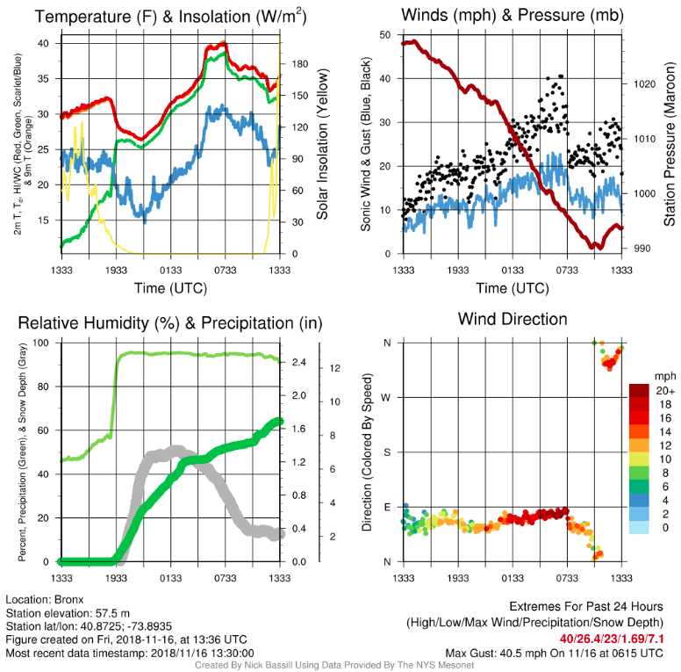
NYS Mesonet Obs at the Bronx
Image courtesy of Nick Bassill

Slide 12
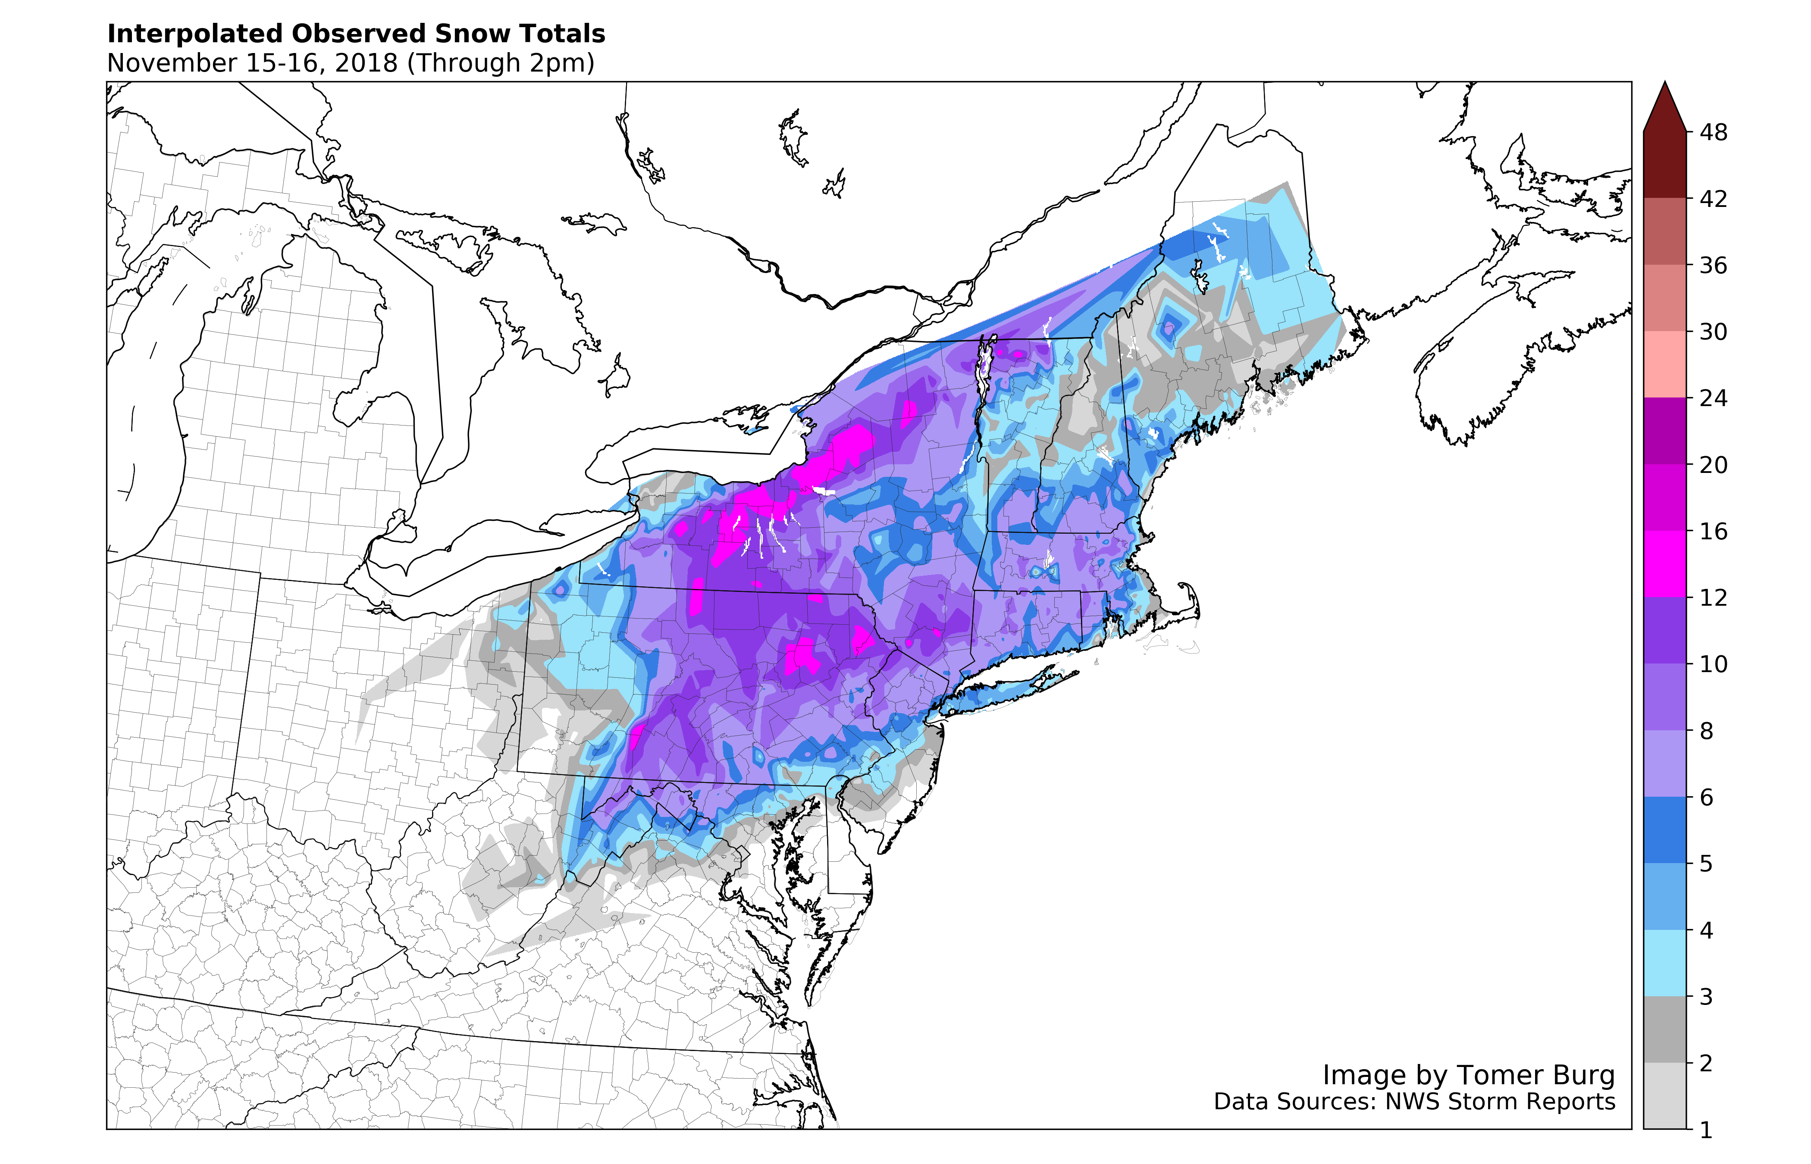
Observed Snowfall (inches) for 15–16 Nov 2018 (Tomer Burg)

Slide 13
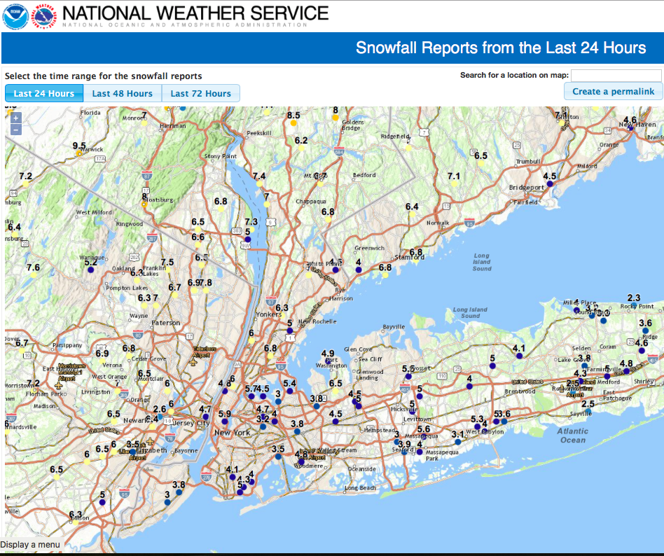
Snowfall Reports (NWS)

Slide 14
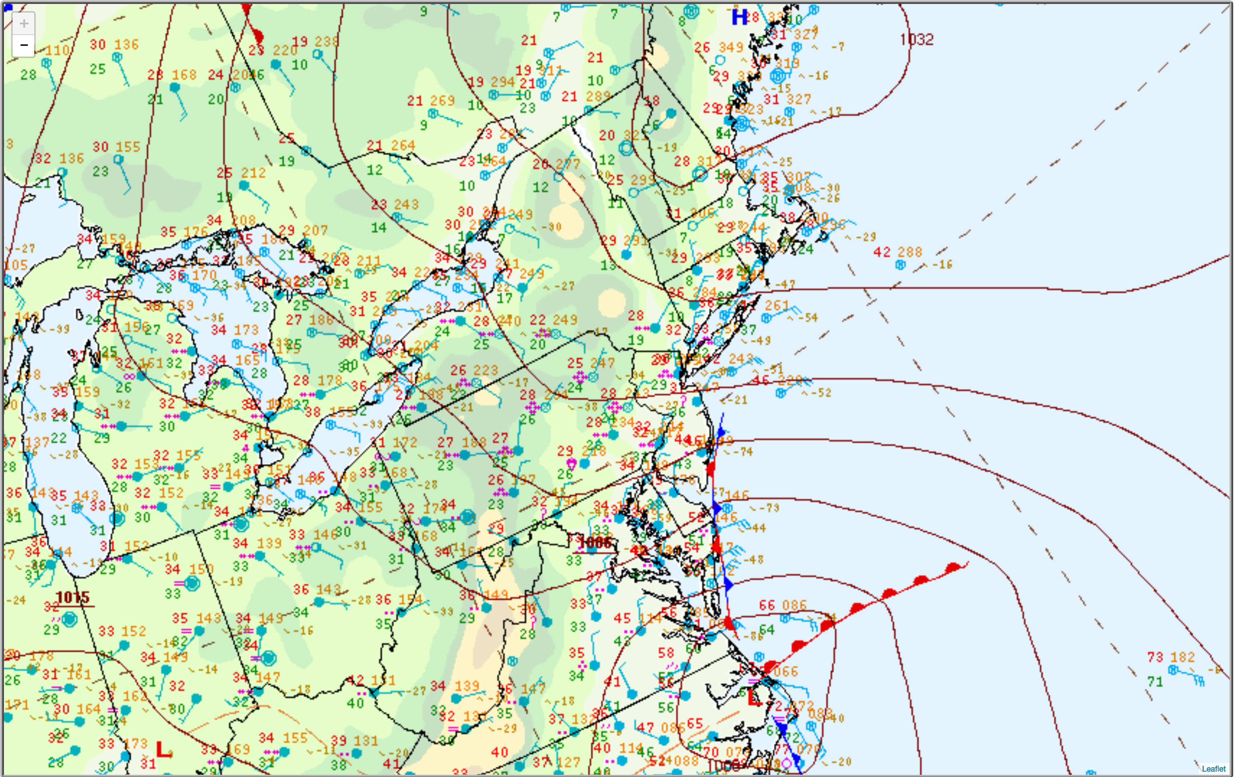
NCEP–WPC Surface Analysis: 2100 UTC 15 Nov 2018

Slide 15
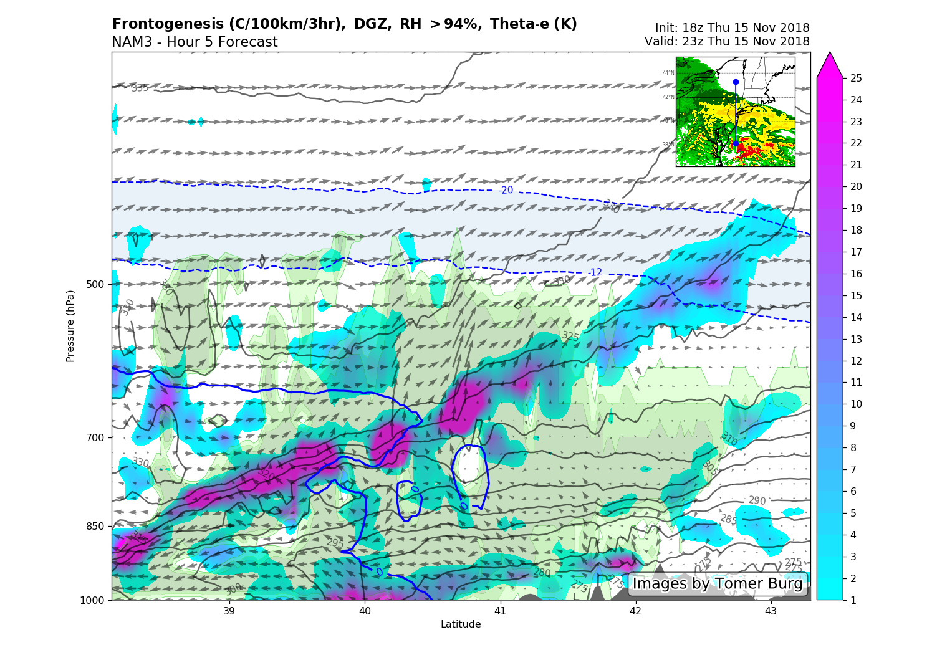
Frontogenesis valid 2300 UTC 15 Nov

Slide 16
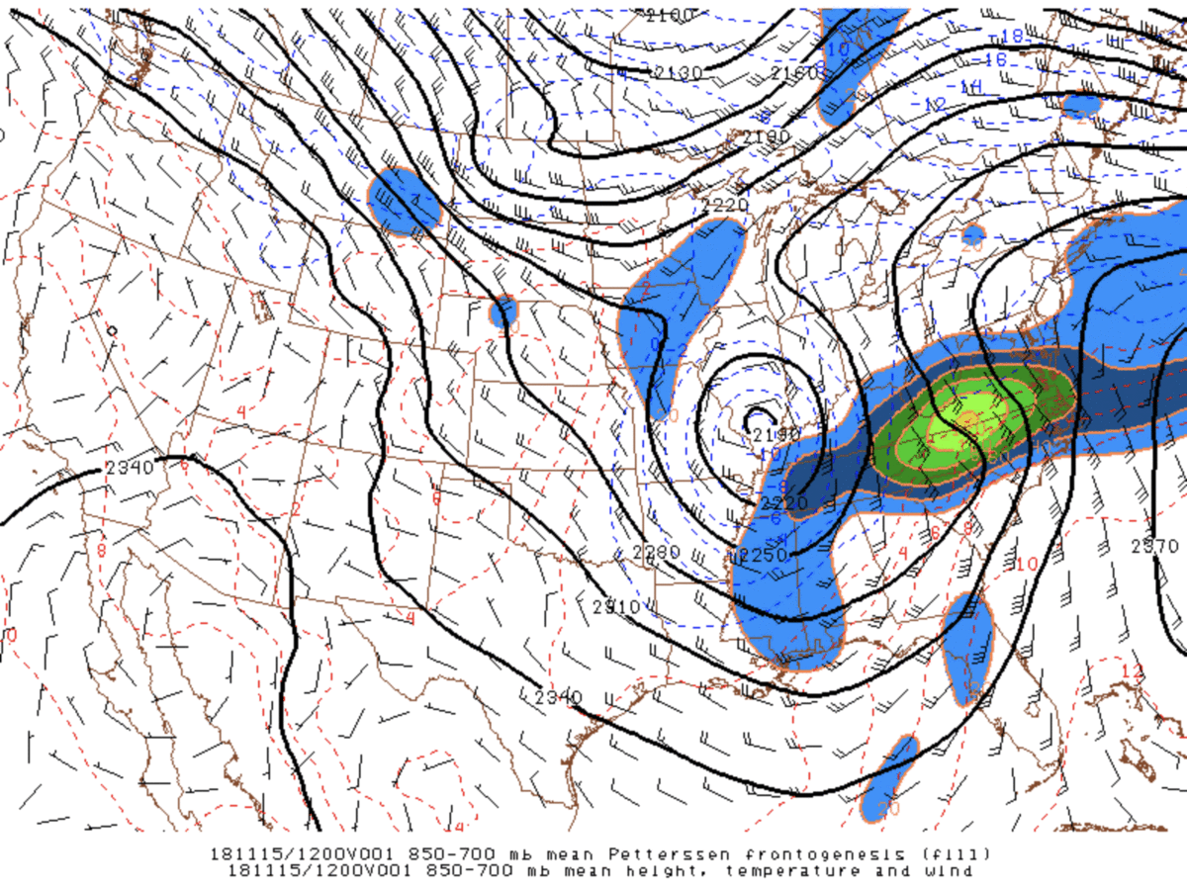
Frontogenesis
850–700-hPa frontogenesis [K (100 km)⁻¹ (3 h)⁻¹, shaded], height (m, black), temperature (°C, red/blue), and wind. Source: SPC.

Slide 17
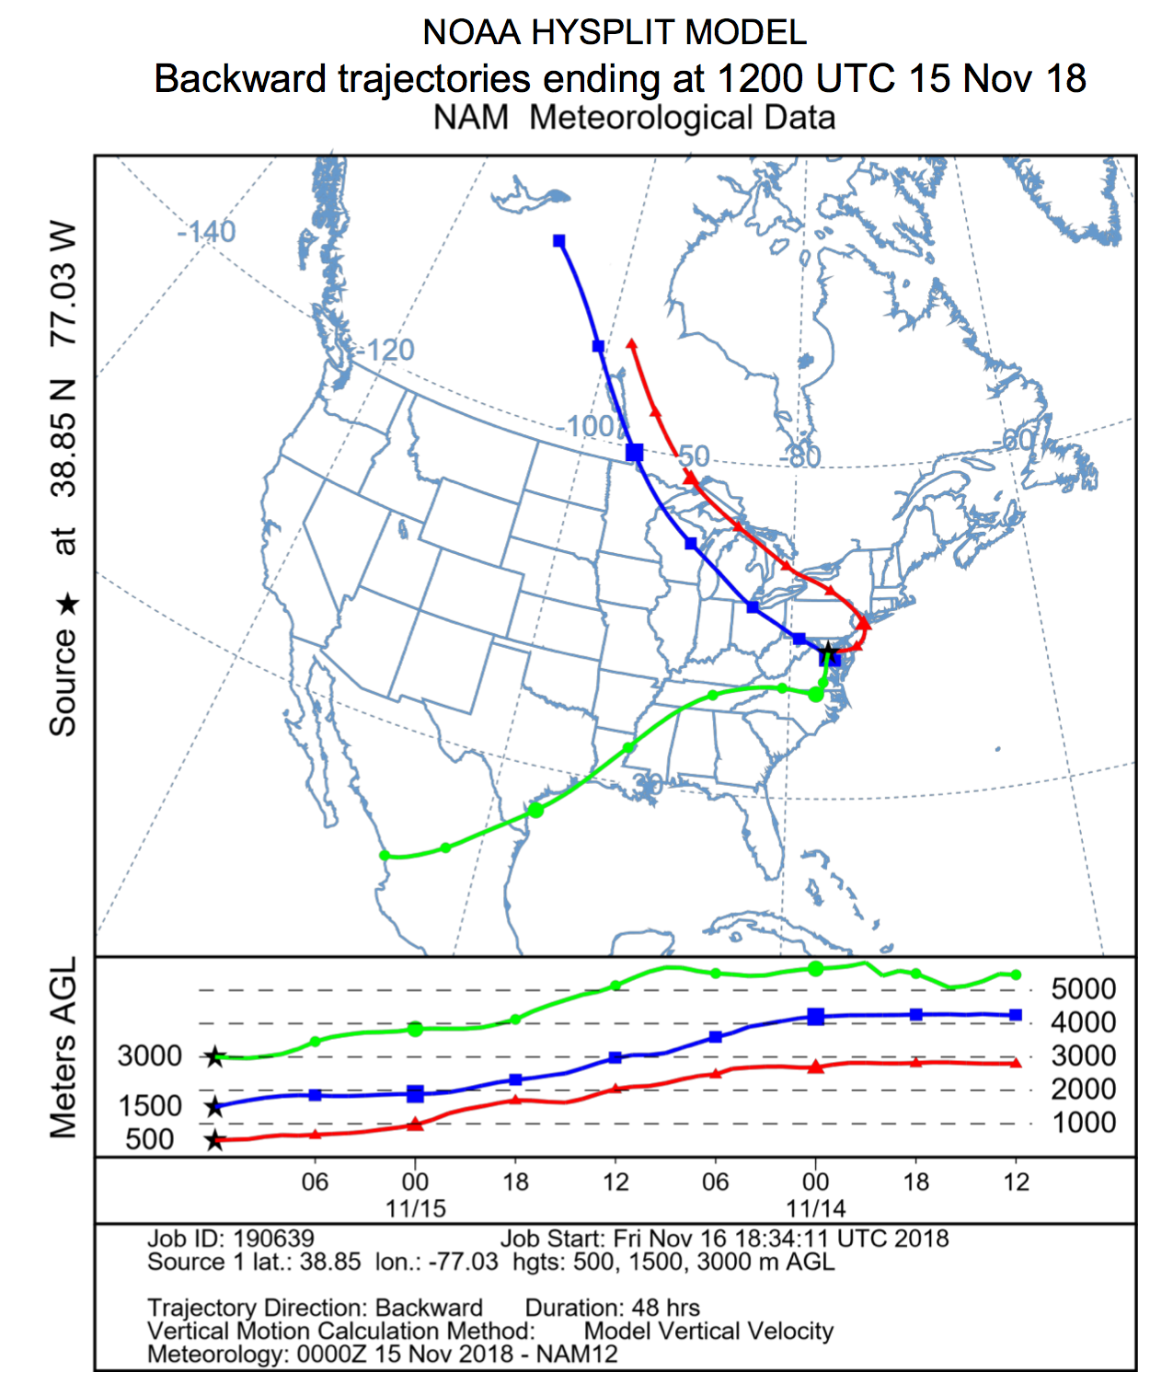
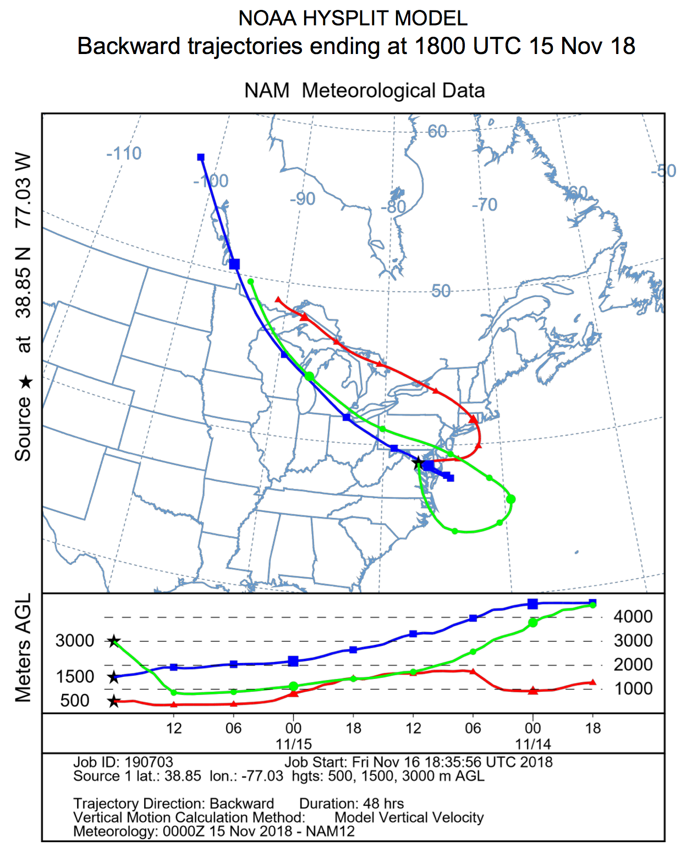
Backward Trajectories: KDCA
Ending 1200 UTC 15 Nov 2018
Ending 1800 UTC 15 Nov 2018

Slide 18
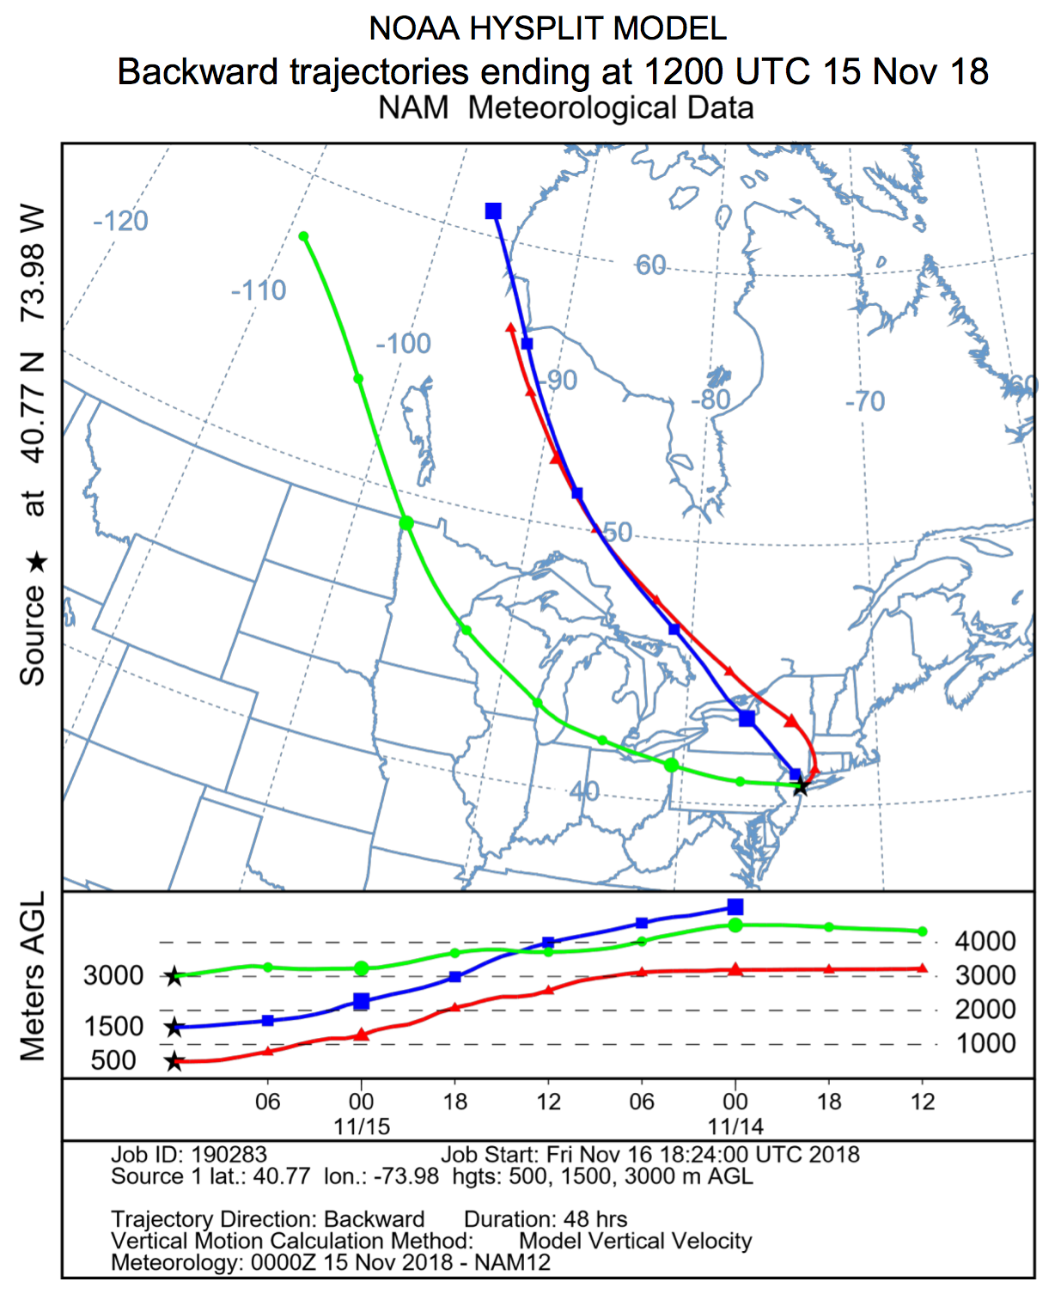
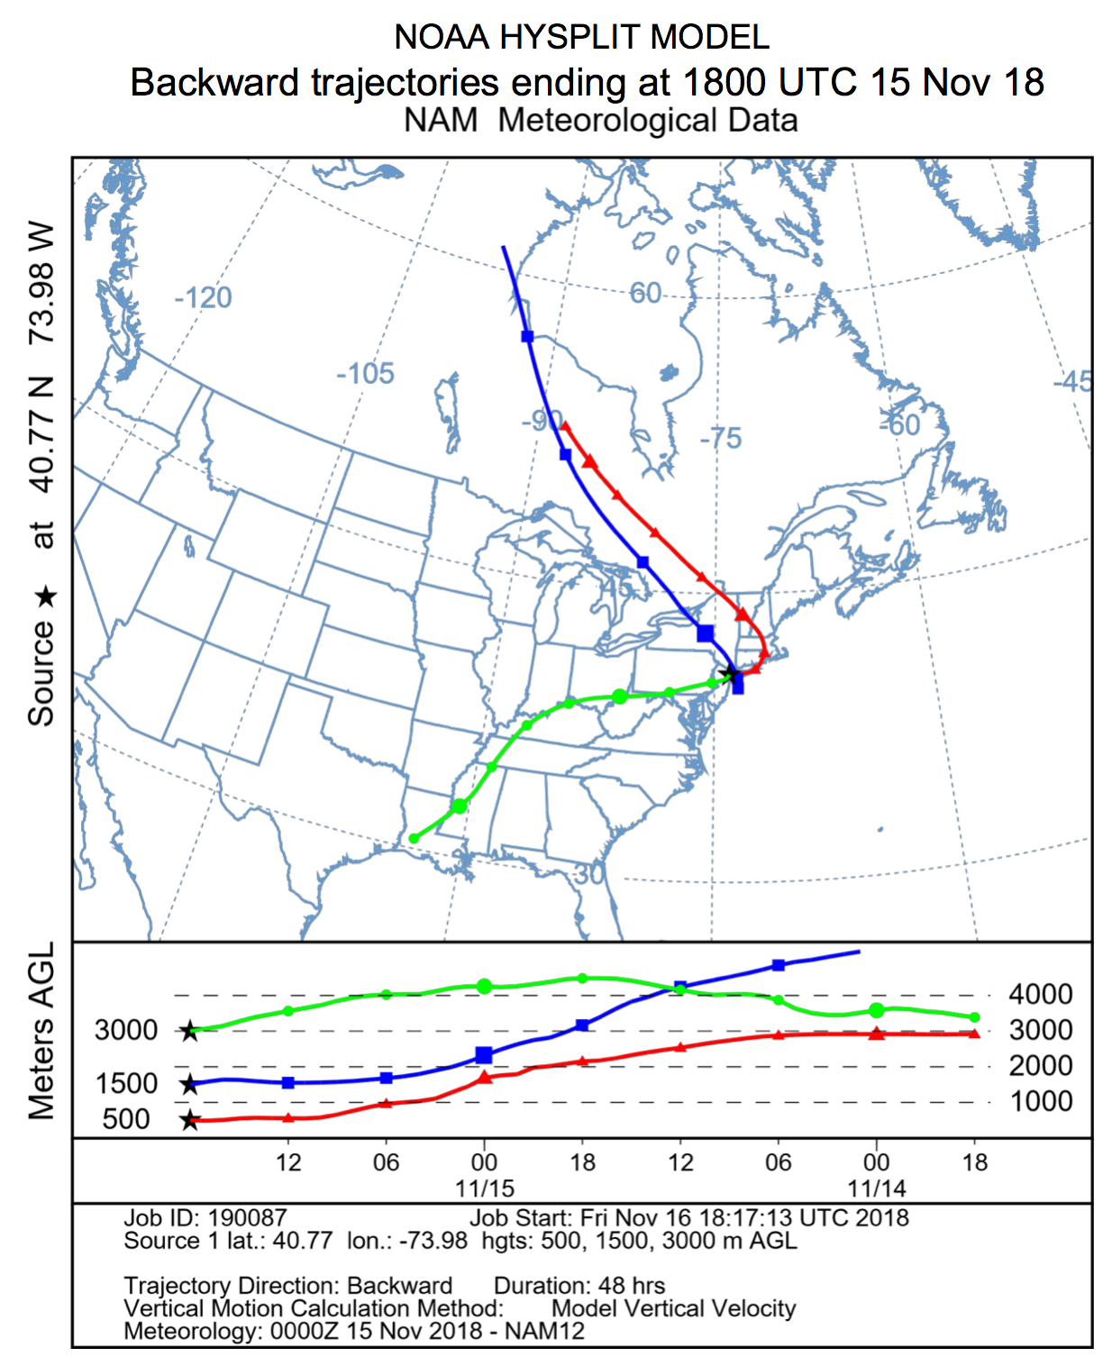
Backward Trajectories: KNYC
Ending 1200 UTC 15 Nov 2018
Ending 1800 UTC 15 Nov 2018

Slide 19
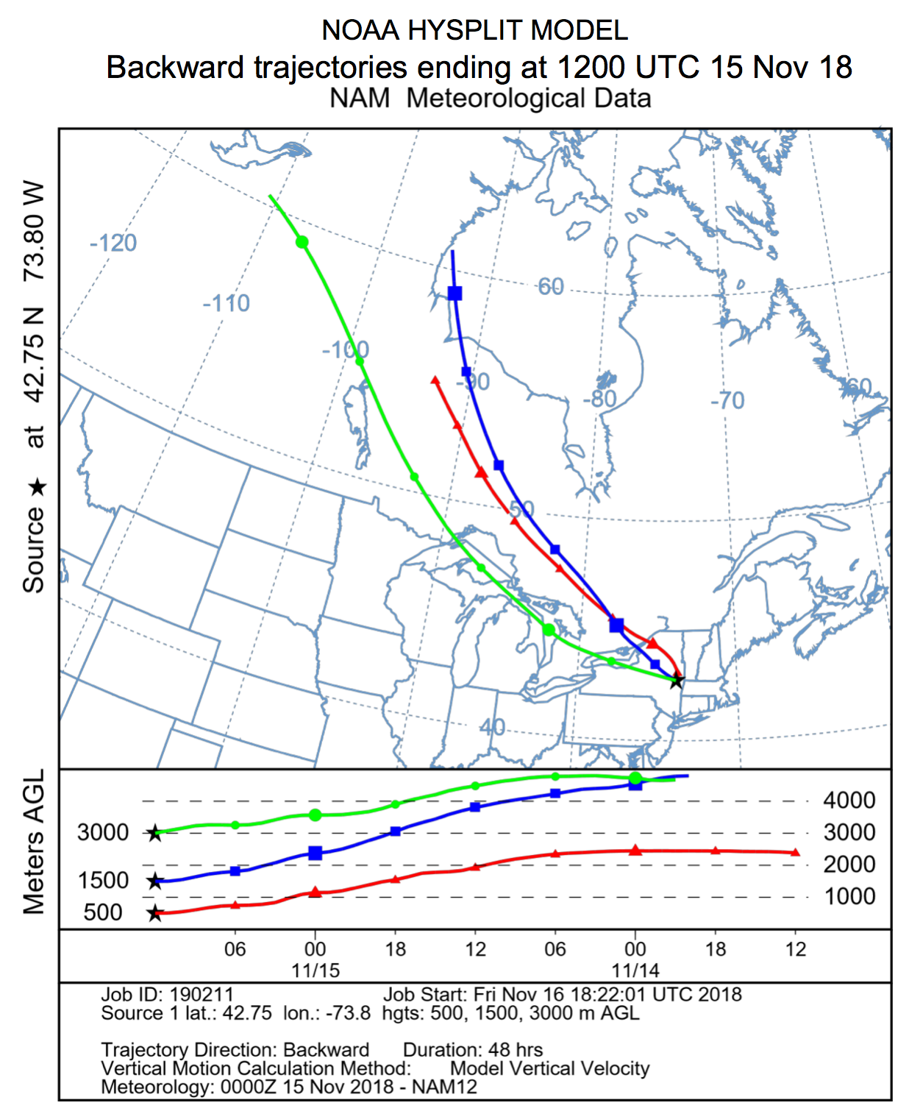
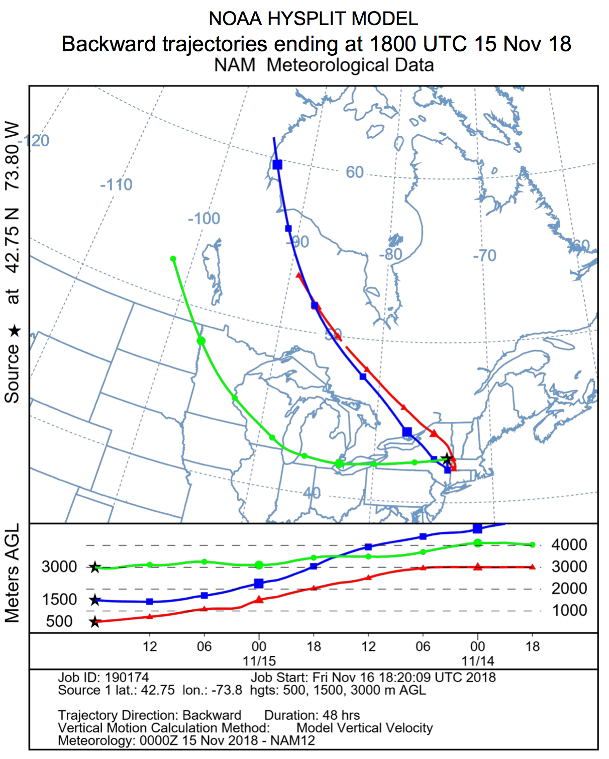
Backward Trajectories: KALB
Ending 1200 UTC 15 Nov 2018
Ending 1800 UTC 15 Nov 2018

Slide 20
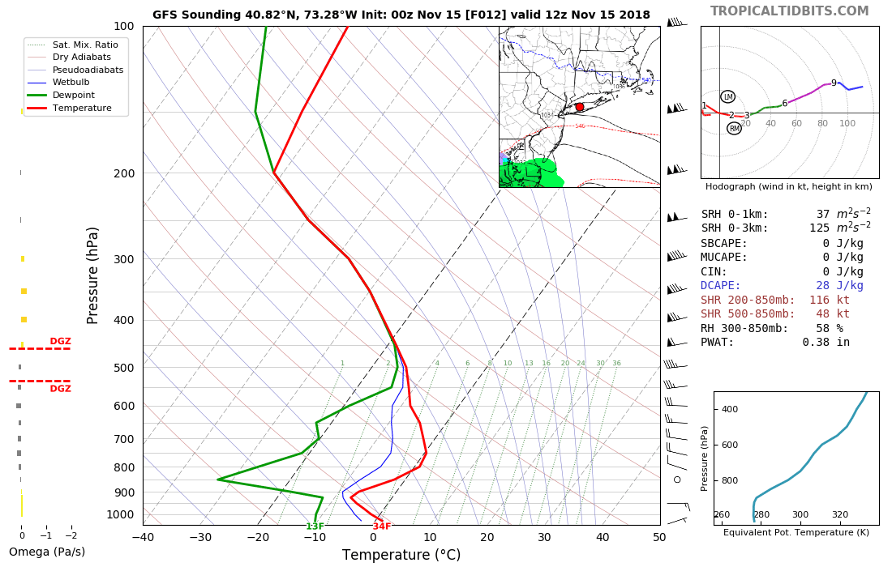
GFS Sounding: 12-h forecast for KOKX valid 1200 UTC 15 Nov
Source: tropicaltidbits.com

Slide 21
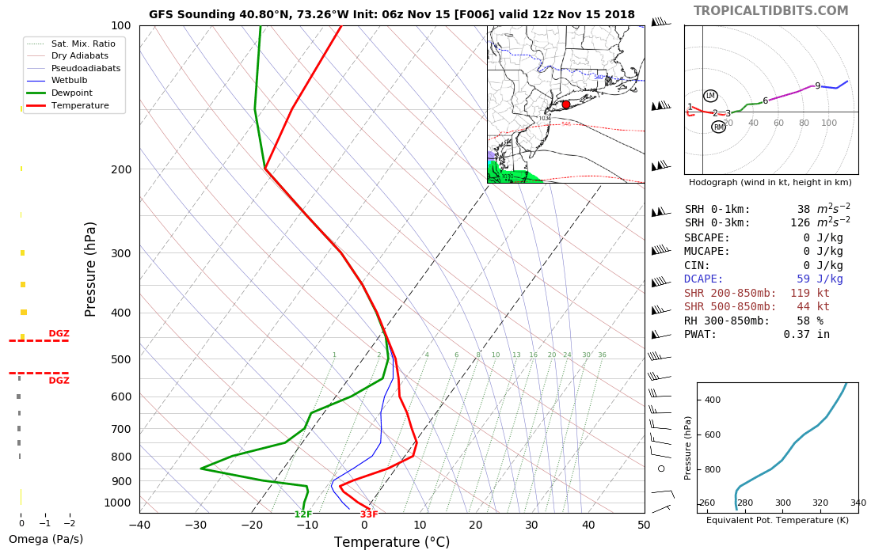
GFS Sounding: 6-h forecast for KOKX valid 1200 UTC 15 Nov
Source: tropicaltidbits.com

Slide 22
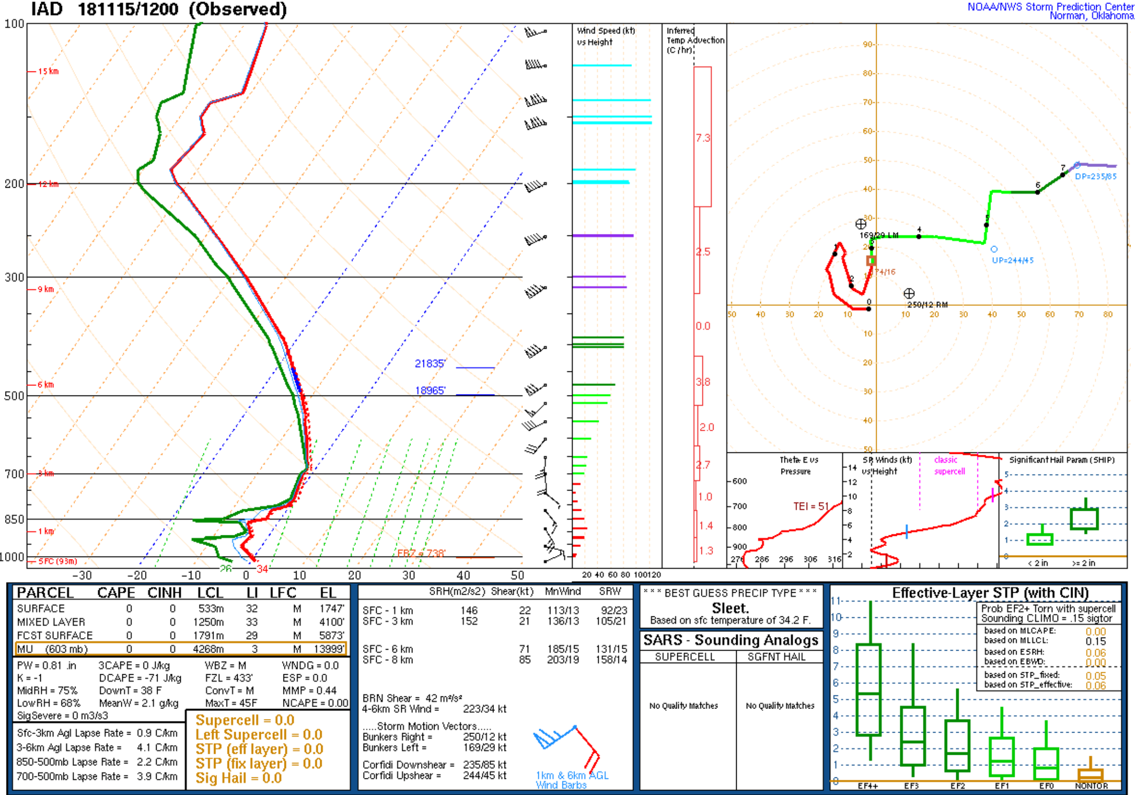
Soundings: KIAD (1200 UTC 15 Nov)
Source: SPC

Slide 23
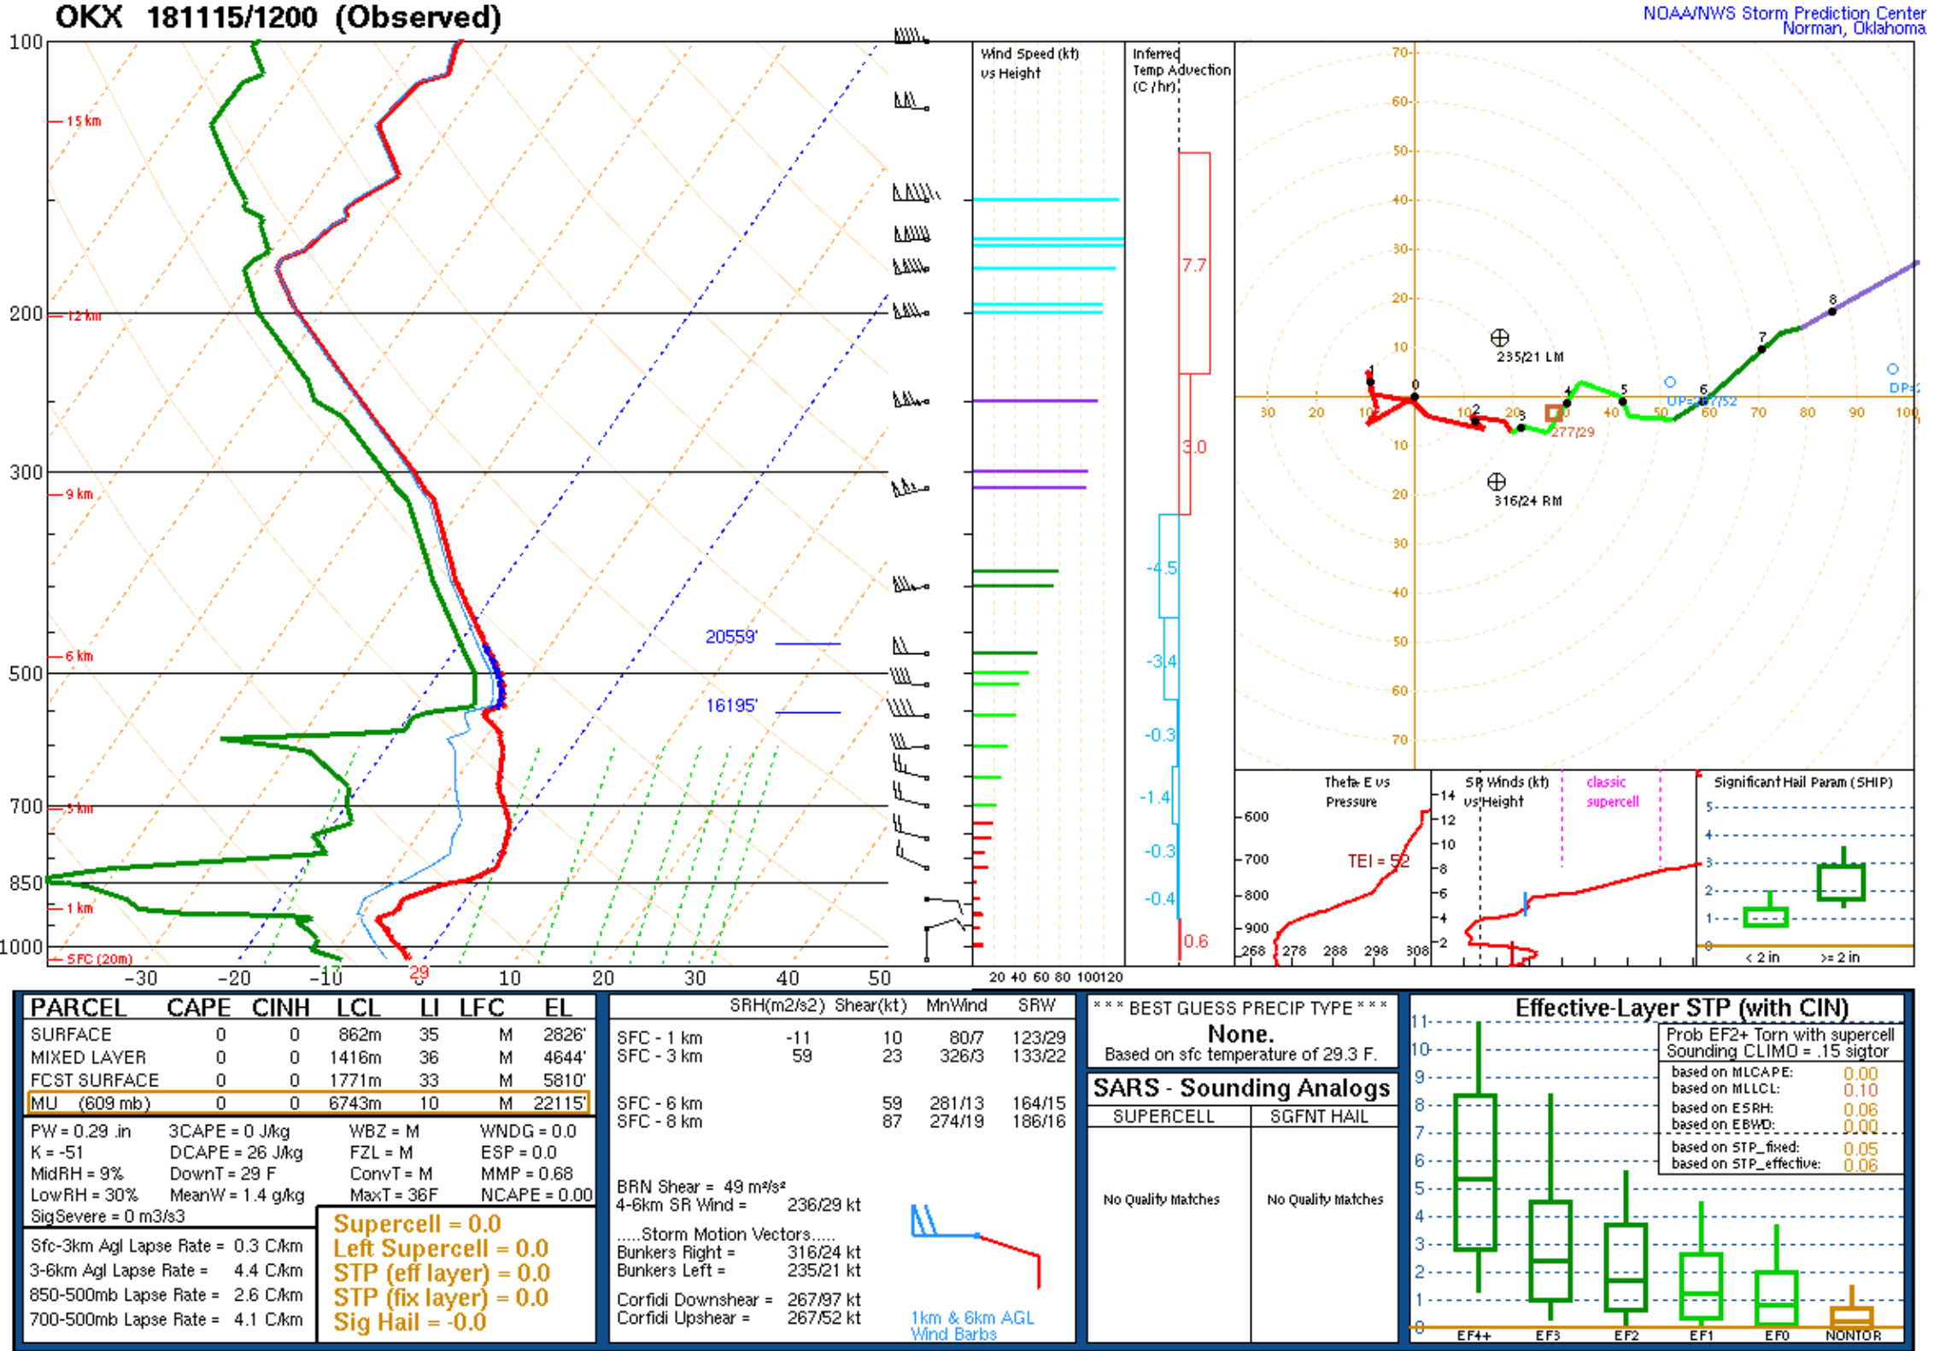
Soundings: KOKX (1200 UTC 15 Nov)
Source: SPC

Slide 24
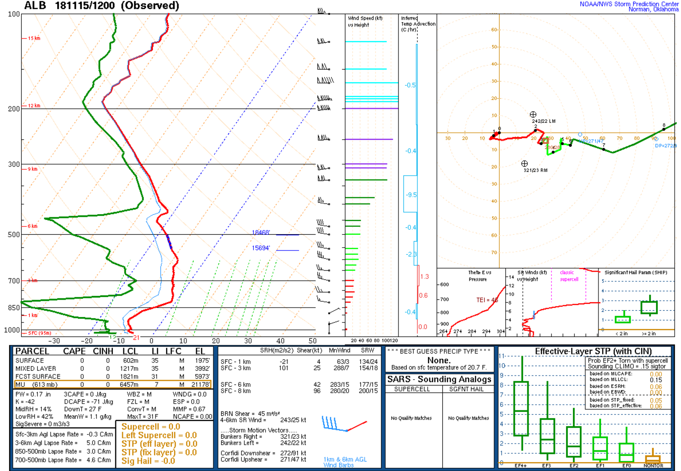
Soundings: KALB (1200 UTC 15 Nov)
Source: SPC

Slide 25
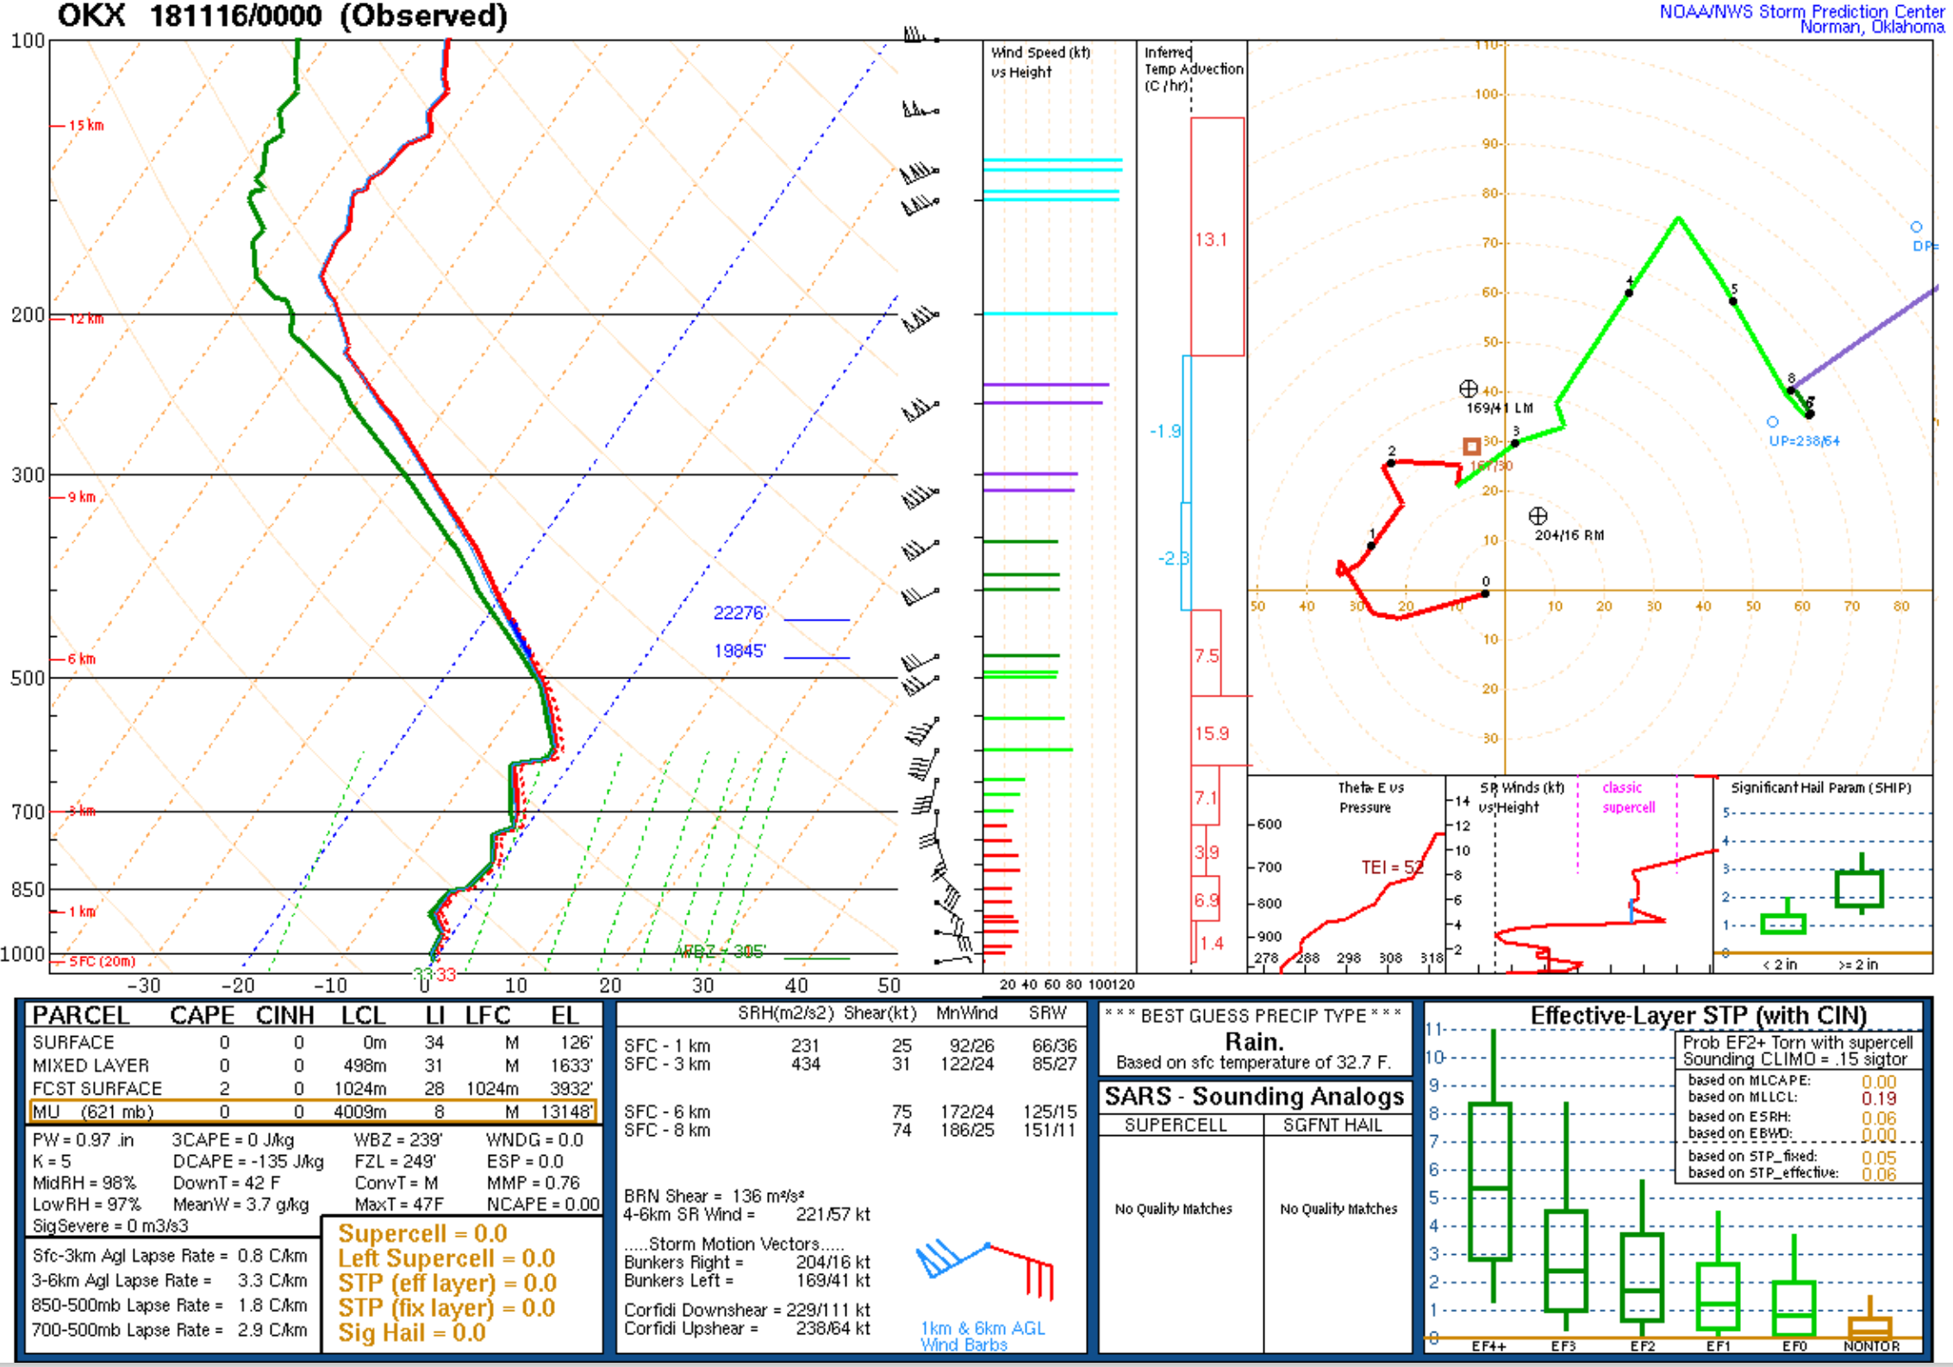
Soundings: KOKX (0000 UTC 16 Nov)
Source: SPC

Slide 26
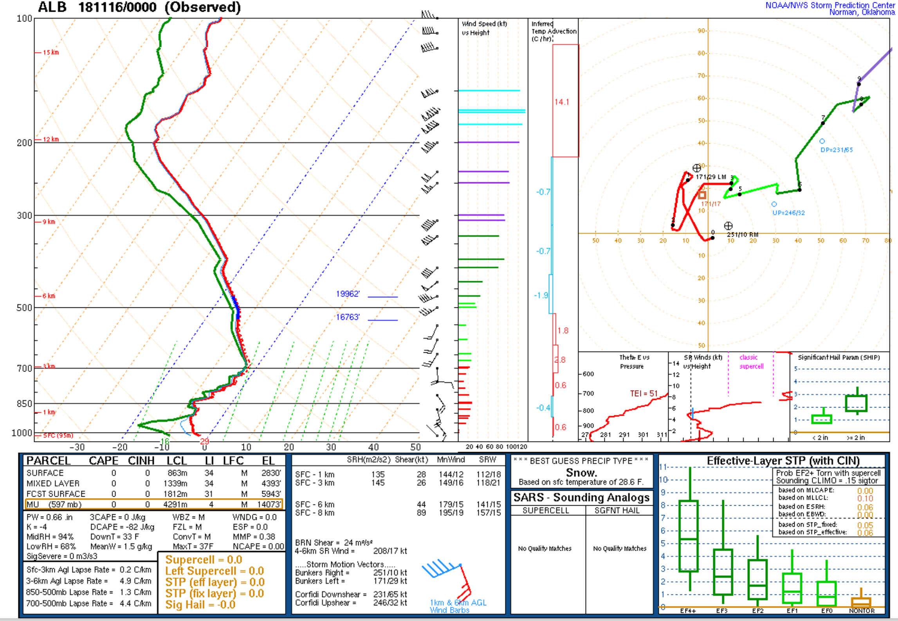
Soundings: KALB (0000 UTC 16 Nov)
Source: SPC

Slide 27
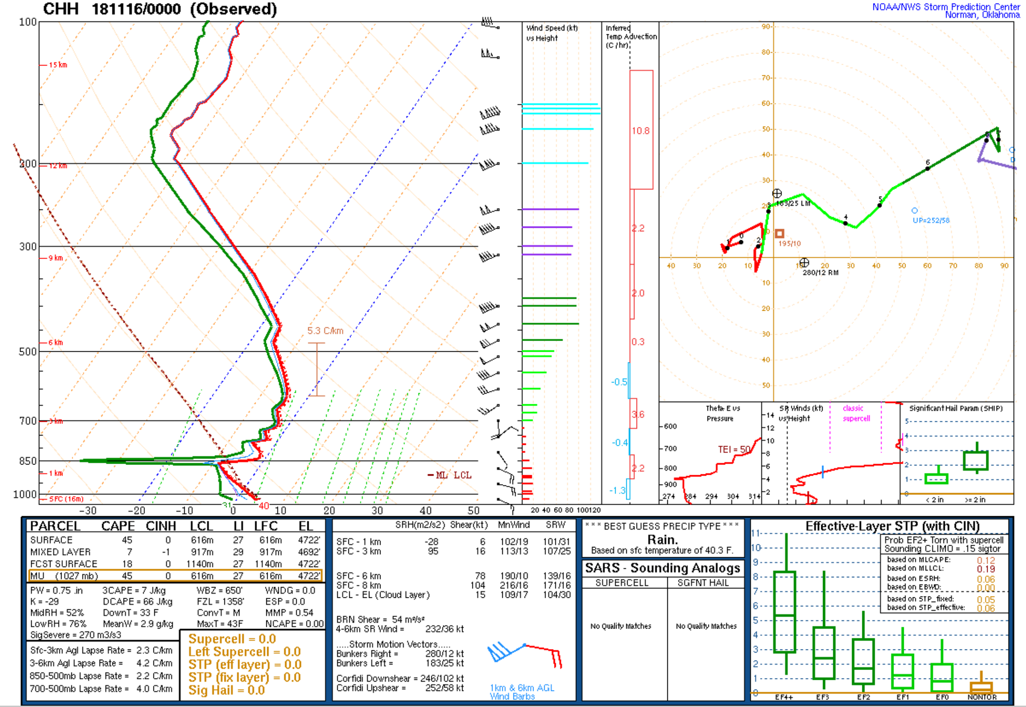
Soundings: KCHX (0000 UTC 16 Nov)
Source: SPC

Slide 28
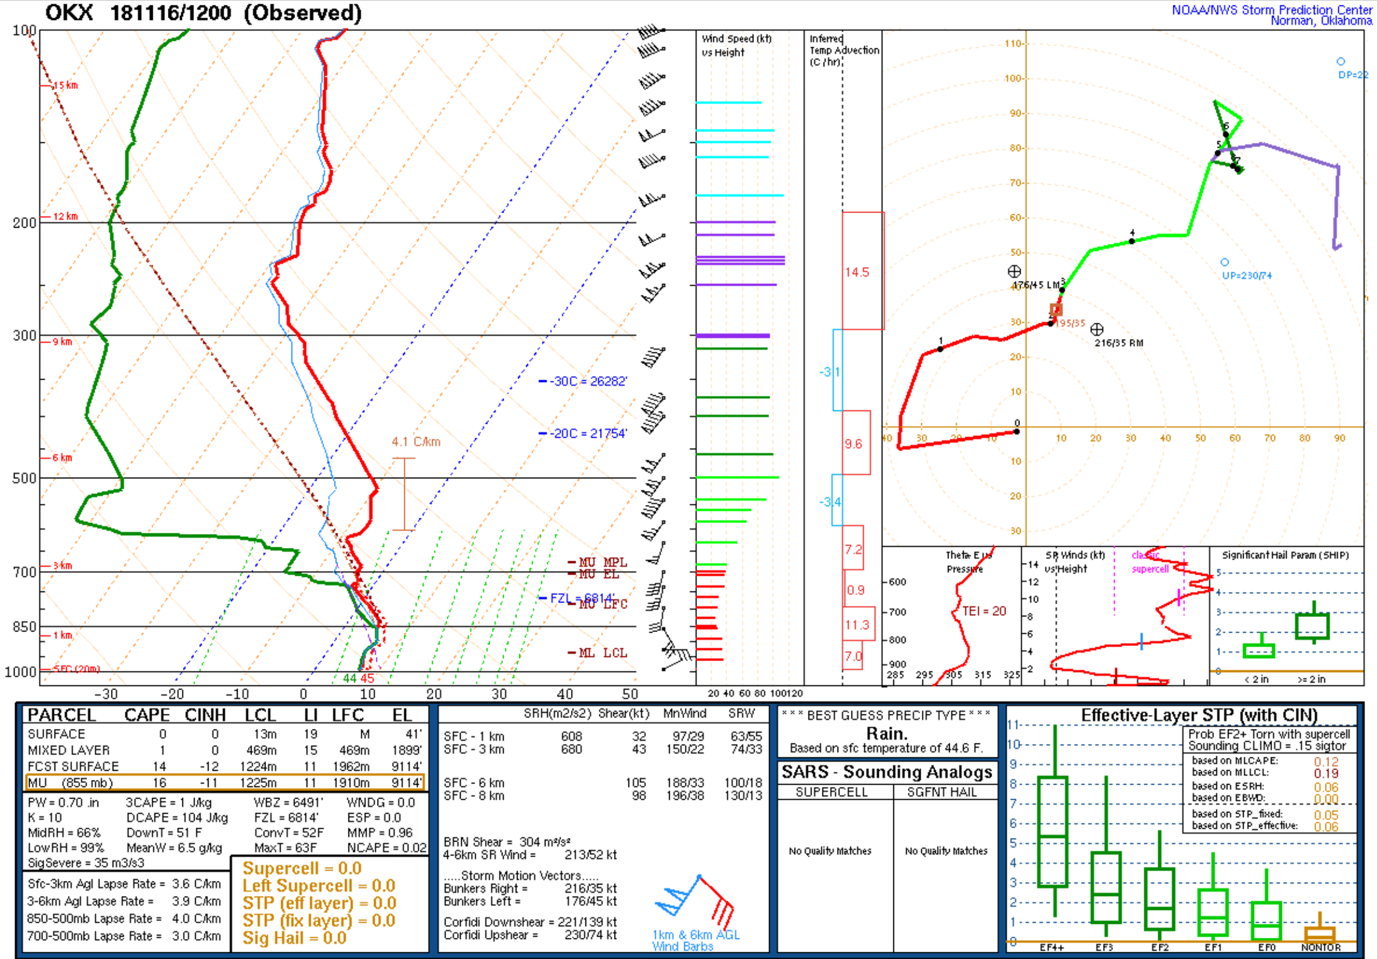
Soundings: KOKX (1200 UTC 16 Nov)
Source: SPC

Slide 29
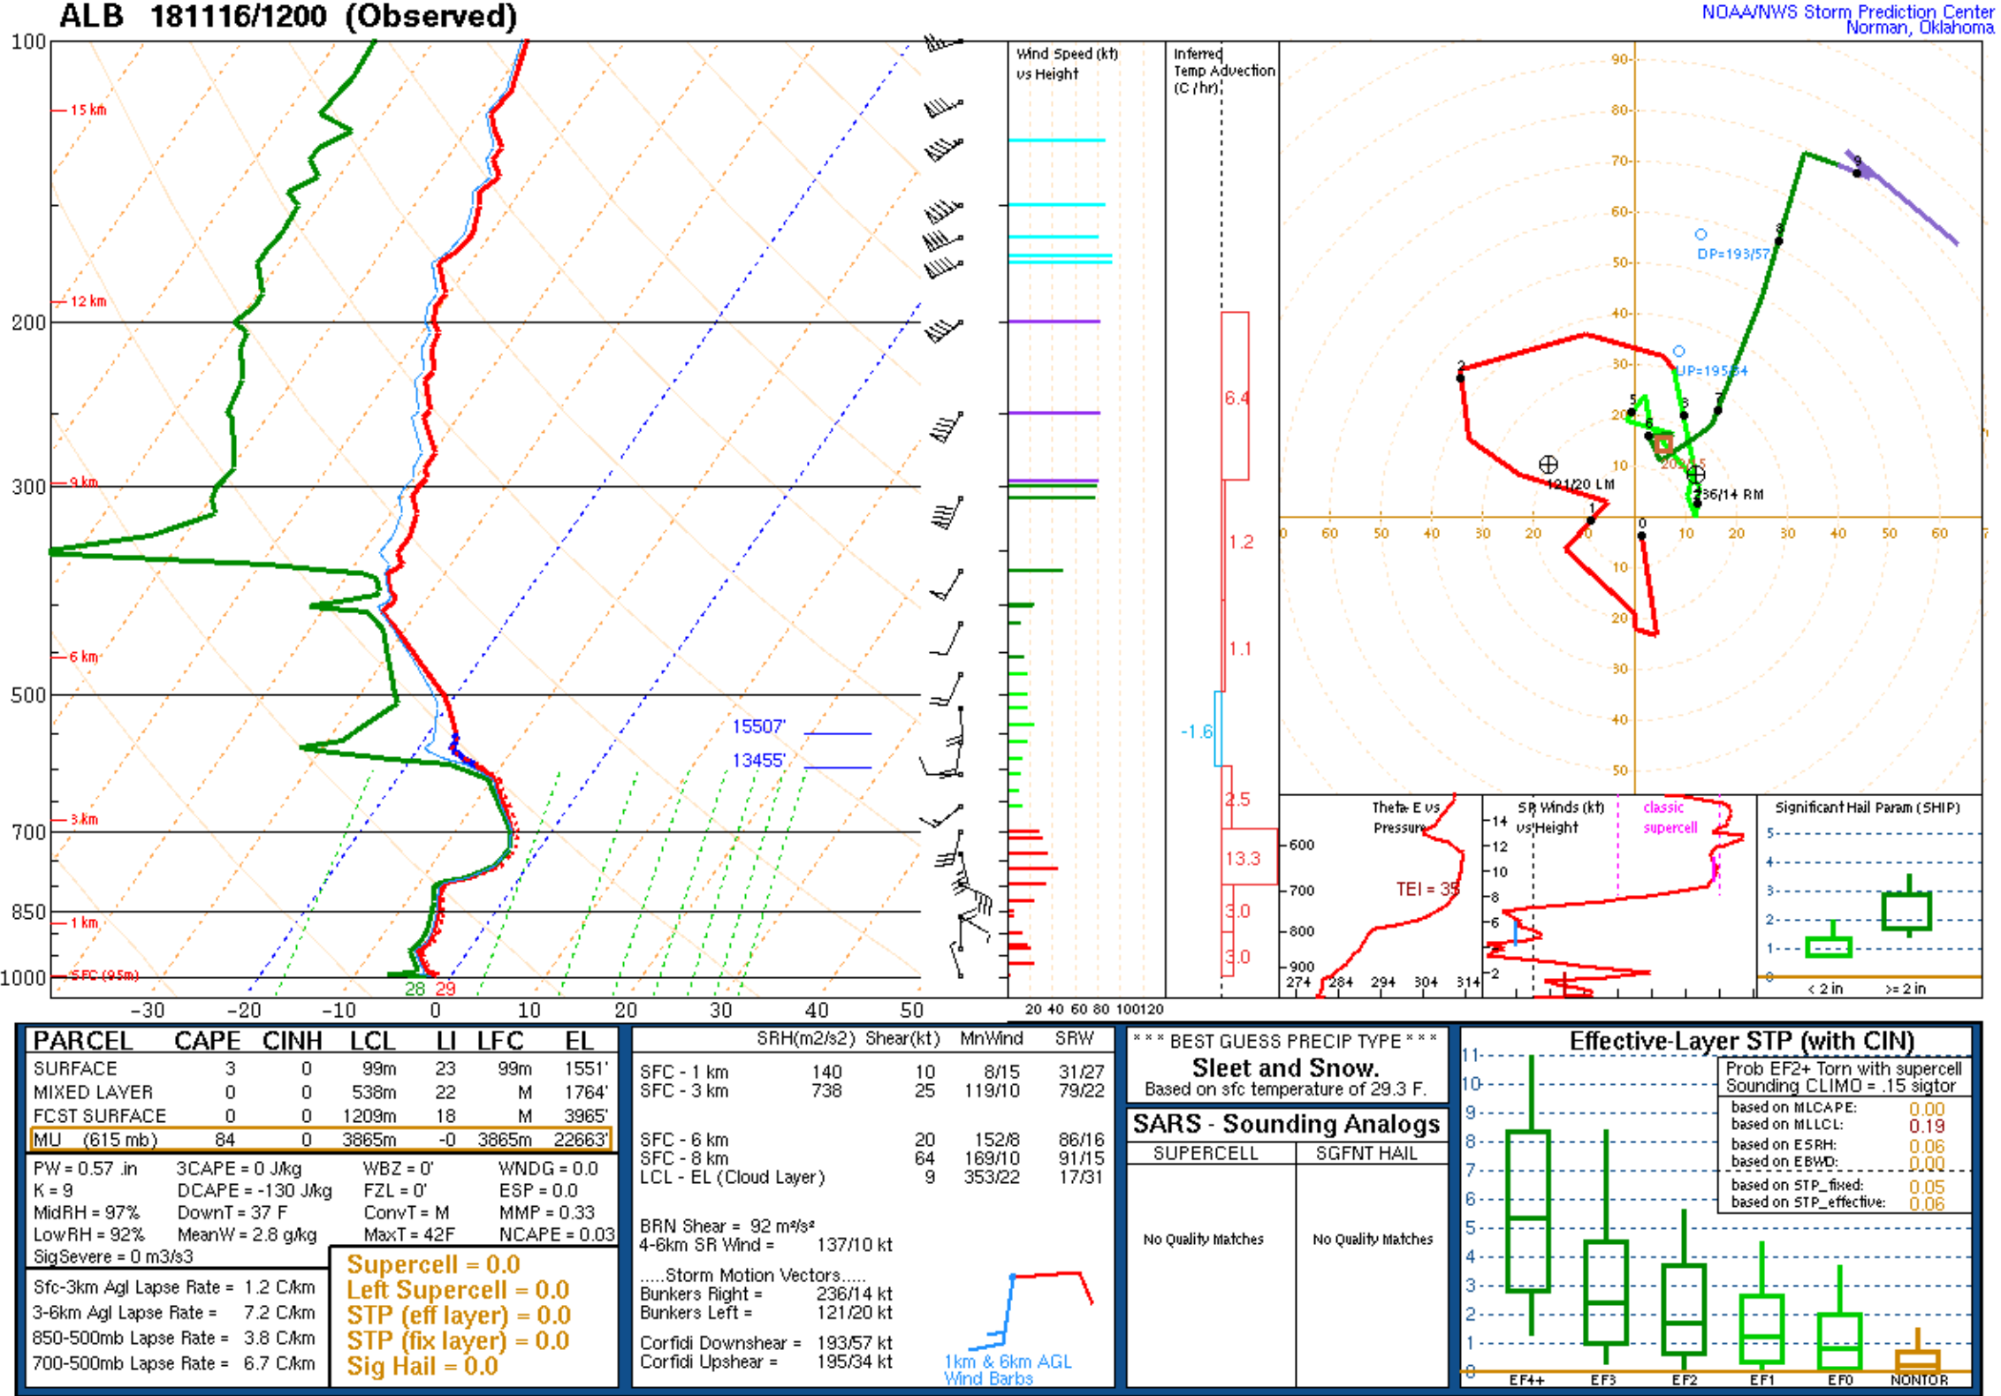
Soundings: KALB (1200 UTC 16 Nov)
Source: SPC

Slide 30
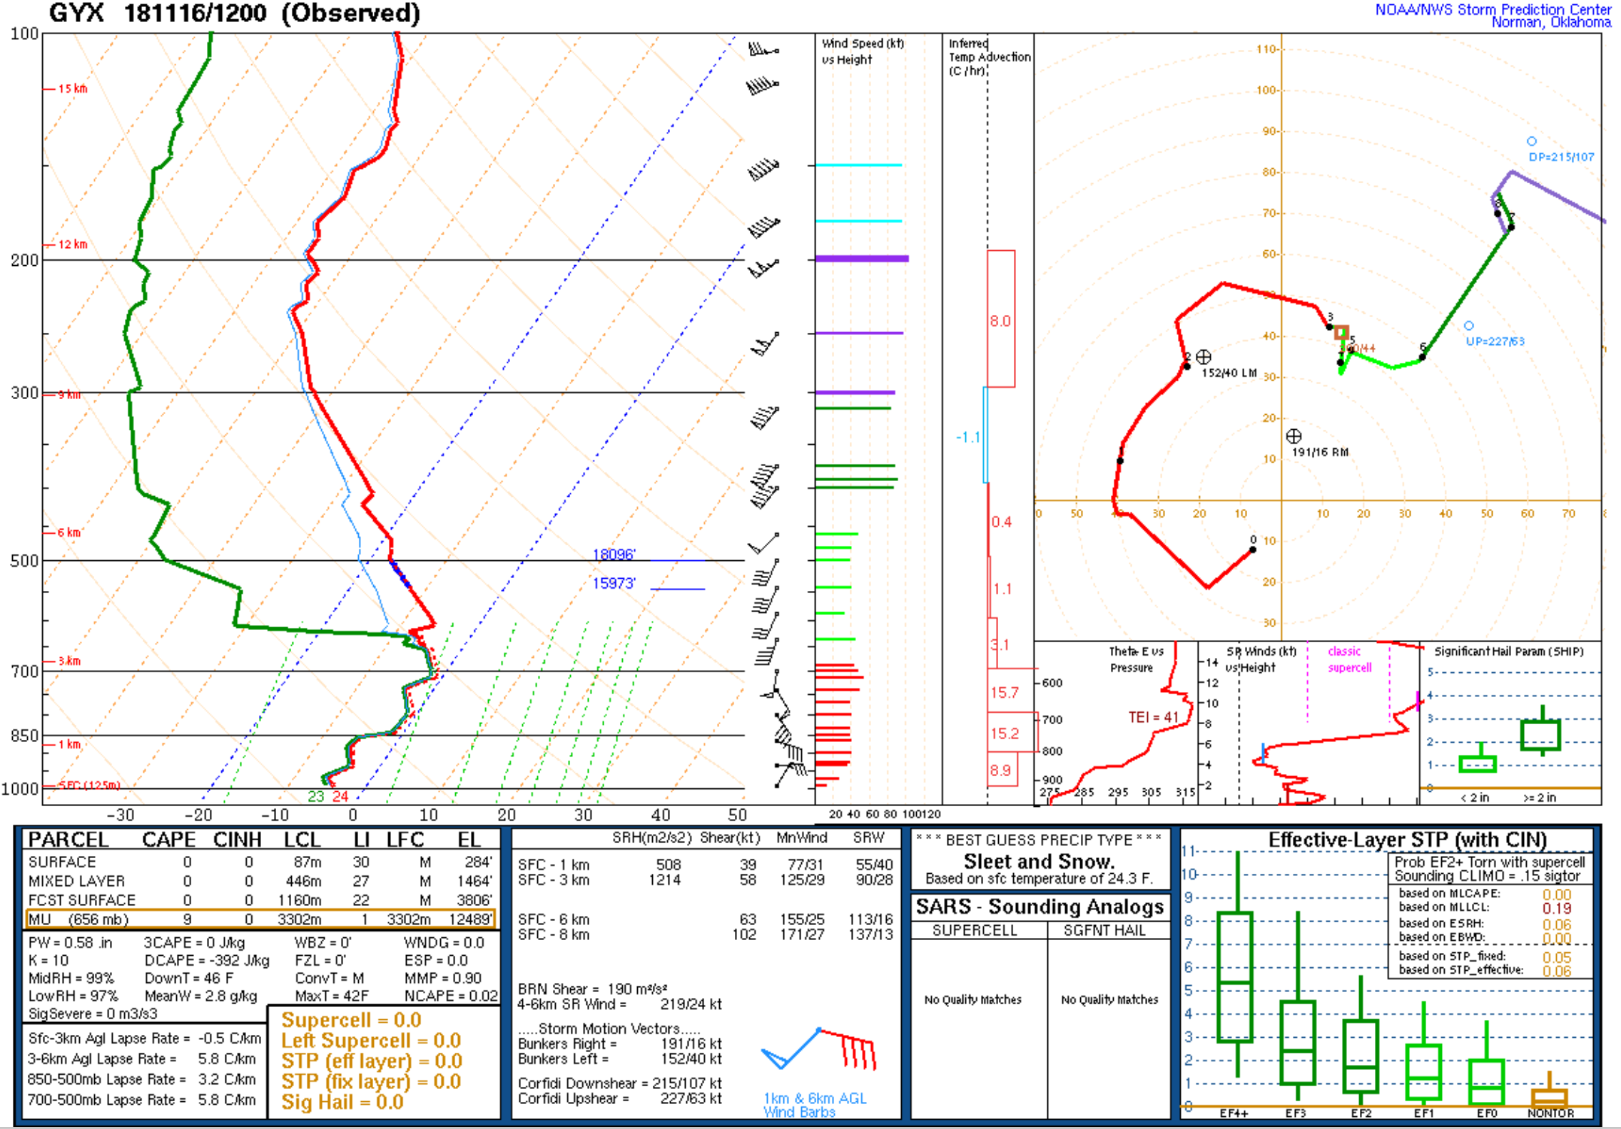
Soundings: KGYX (1200 UTC 16 Nov)
Source: SPC

Slide 31
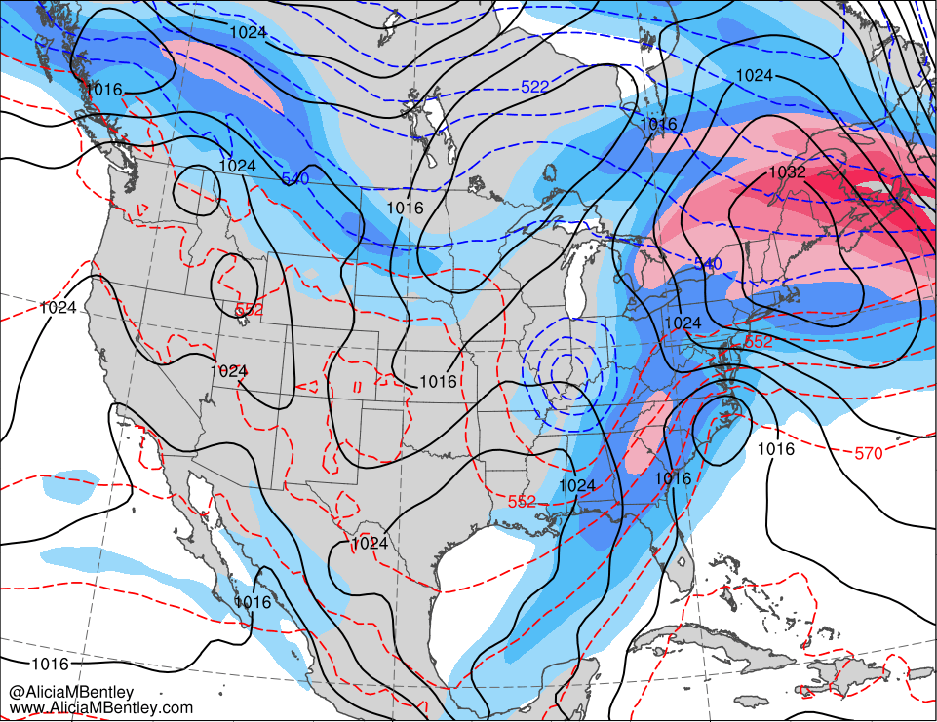
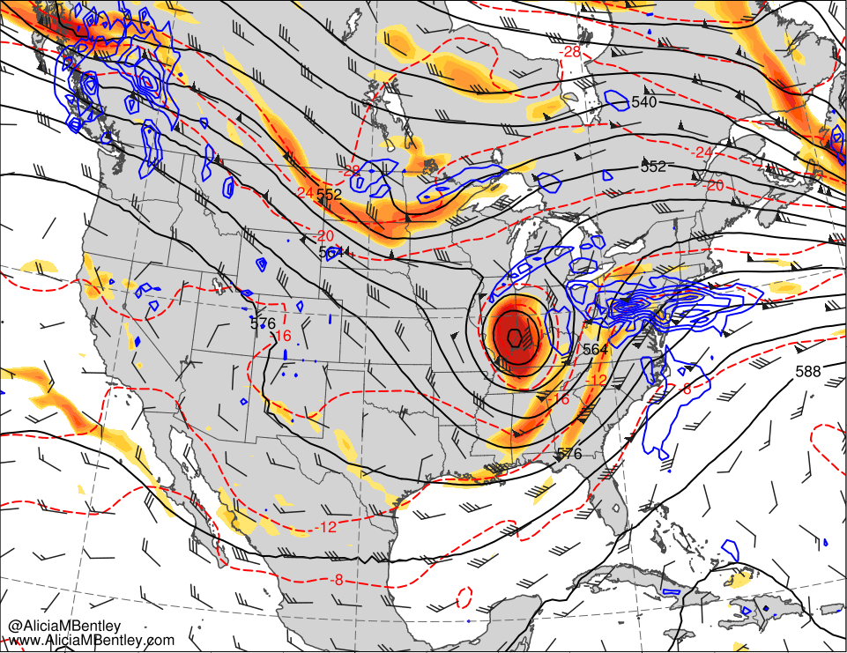
1800 UTC 15 Nov 2018
250-hPa wind speed (m s⁻¹, shaded), 1000–500-hPa thickness (dam, red/blue), and SLP (hPa, black)
500-hPa relative vorticity (10⁻⁵ s⁻¹, shaded), geopotential height (dam, black), ω (blue, every 5 × 10⁻³ hPa s⁻¹), and wind (kt, flags and barbs)

Slide 32
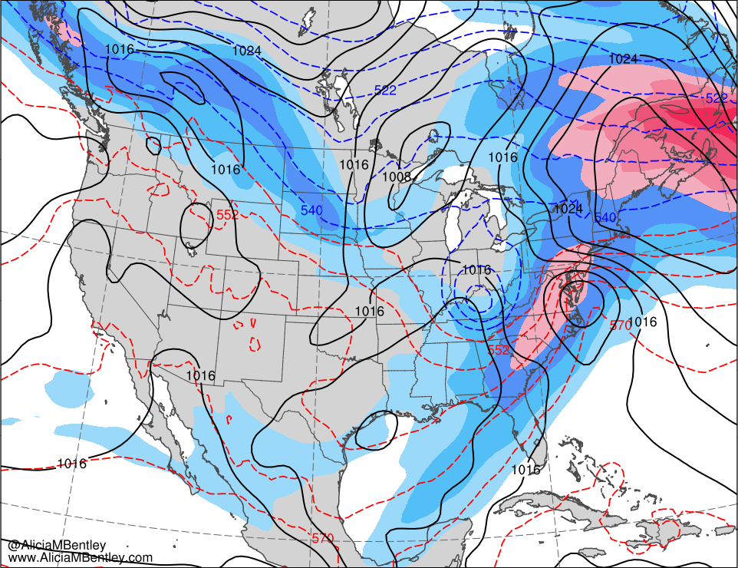
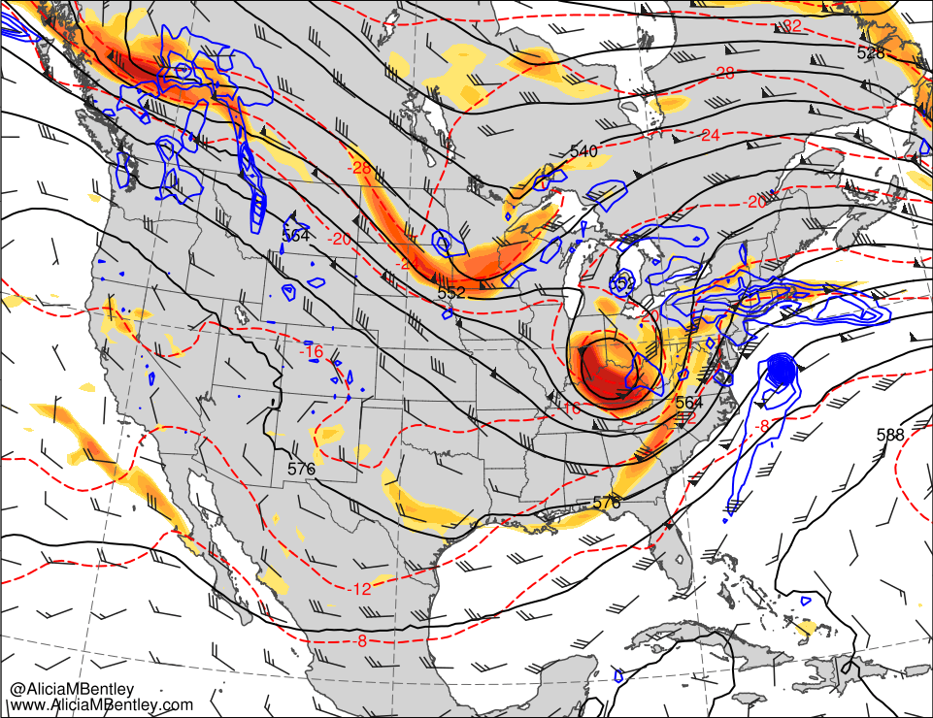
0000 UTC 16 Nov 2018
250-hPa wind speed (m s⁻¹, shaded), 1000–500-hPa thickness (dam, red/blue), and SLP (hPa, black)
500-hPa relative vorticity (10⁻⁵ s⁻¹, shaded), geopotential height (dam, black), ω (blue, every 5 × 10⁻³ hPa s⁻¹), and wind (kt, flags and barbs)

Slide 33
0600 UTC 16 Nov 2018
250-hPa wind speed (m s⁻¹, shaded), 1000–500-hPa thickness (dam, red/blue), and SLP (hPa, black)
500-hPa relative vorticity (10⁻⁵ s⁻¹, shaded), geopotential height (dam, black), ω (blue, every 5 × 10⁻³ hPa s⁻¹), and wind (kt, flags and barbs)

Slide 34
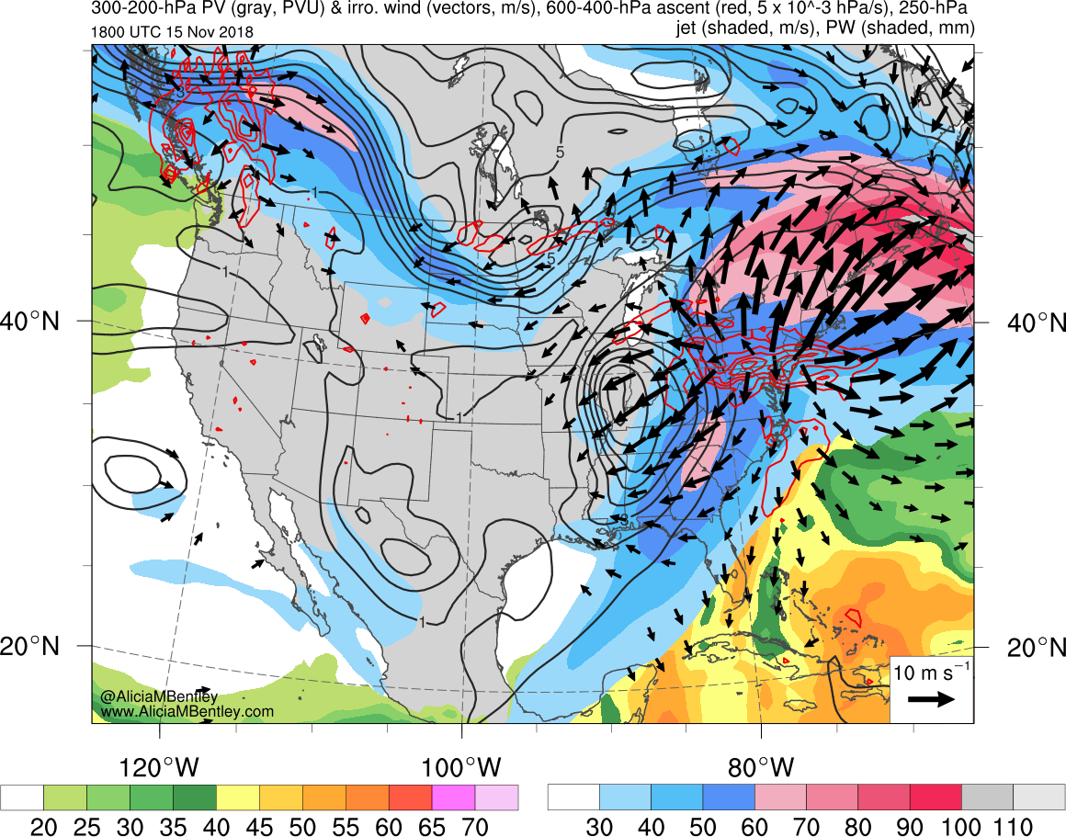
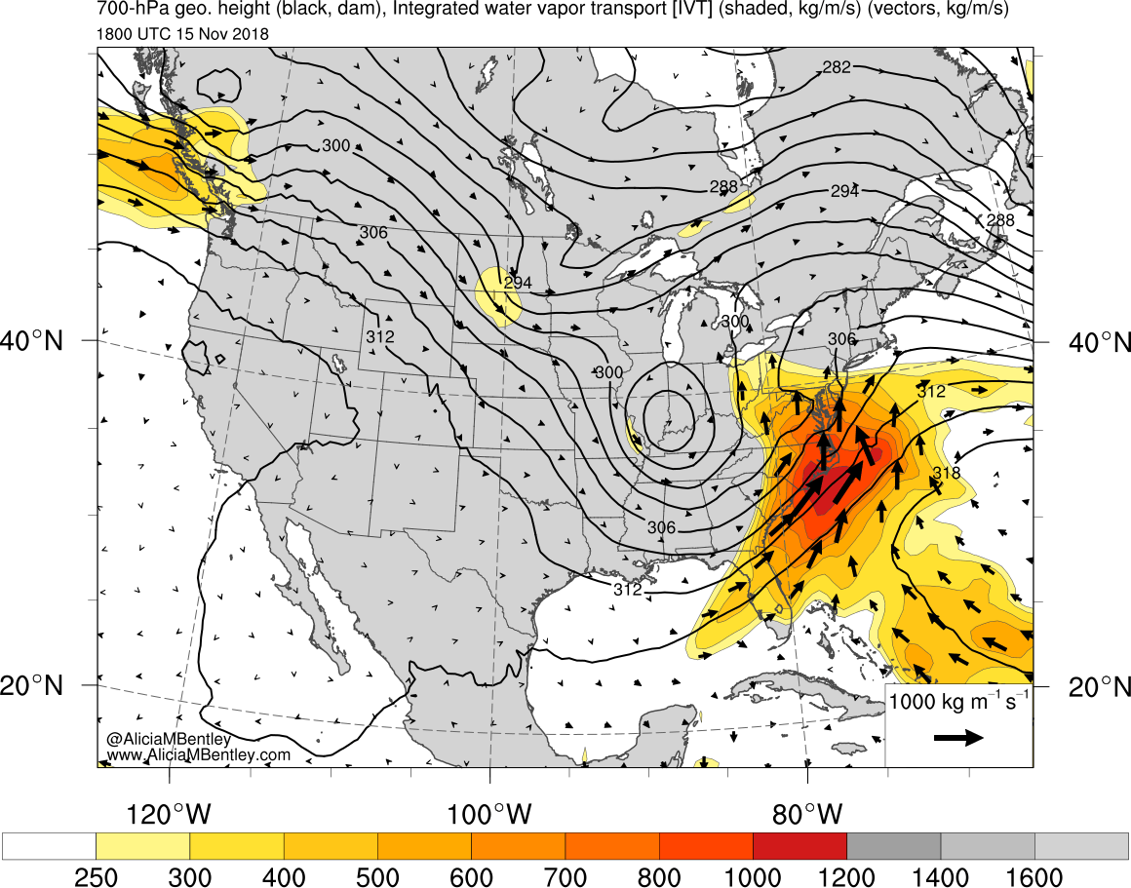
1800 UTC 15 Nov 2018
300–200-hPa PV (PVU, gray) and irrot. wind (m s⁻¹, vectors), 250-hPa wind speed (m s⁻¹, shaded), 600–400-hPa ω (red, every 5 × 10⁻³ hPa s⁻¹), and PW (mm, shaded)
IVT (kg m⁻¹ s⁻¹, shaded and vectors) and 700-hPa geopotential height (dam, black)

Slide 35
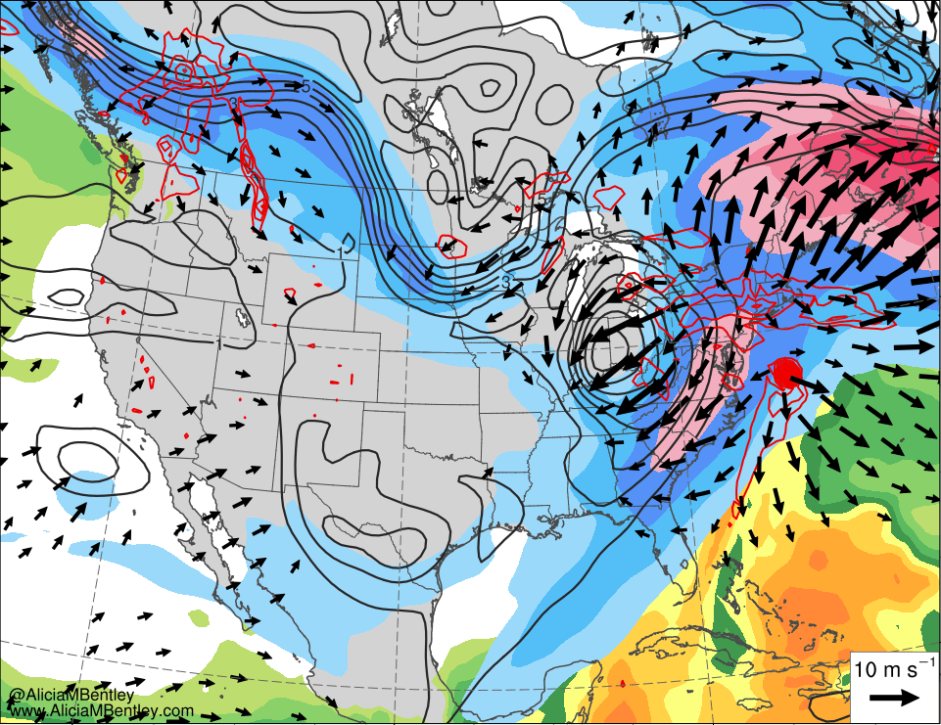
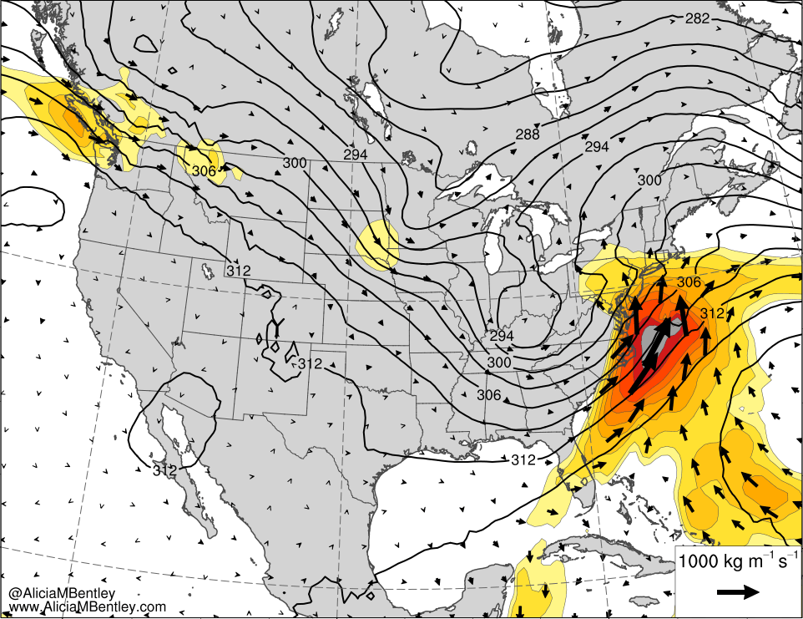
0000 UTC 16 Nov 2018
300–200-hPa PV (PVU, gray) and irrot. wind (m s⁻¹, vectors), 250-hPa wind speed (m s⁻¹, shaded), 600–400-hPa ω (red, every 5 × 10⁻³ hPa s⁻¹), and PW (mm, shaded)
IVT (kg m⁻¹ s⁻¹, shaded and vectors) and 700-hPa geopotential height (dam, black)

Slide 36
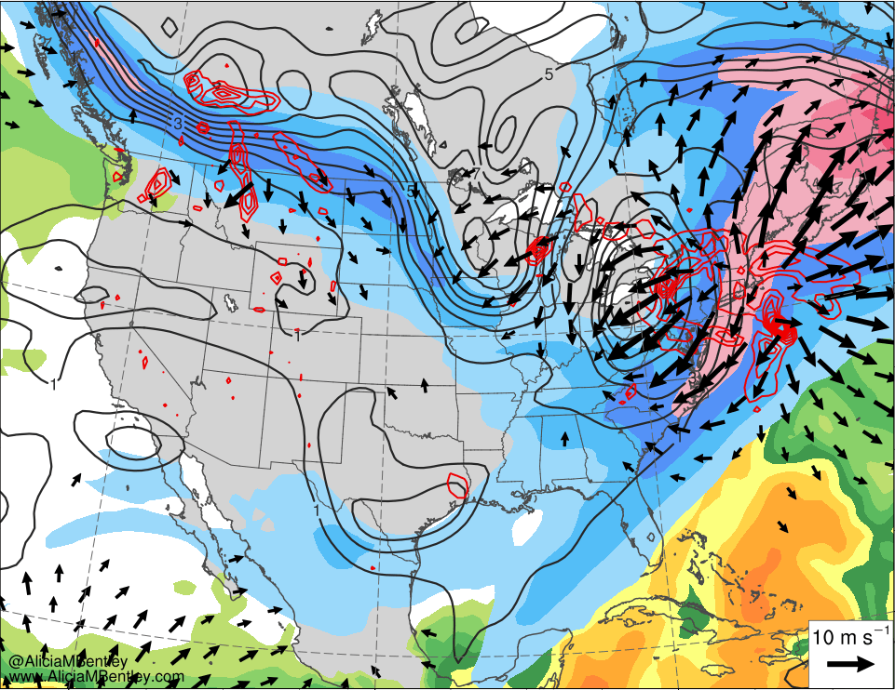
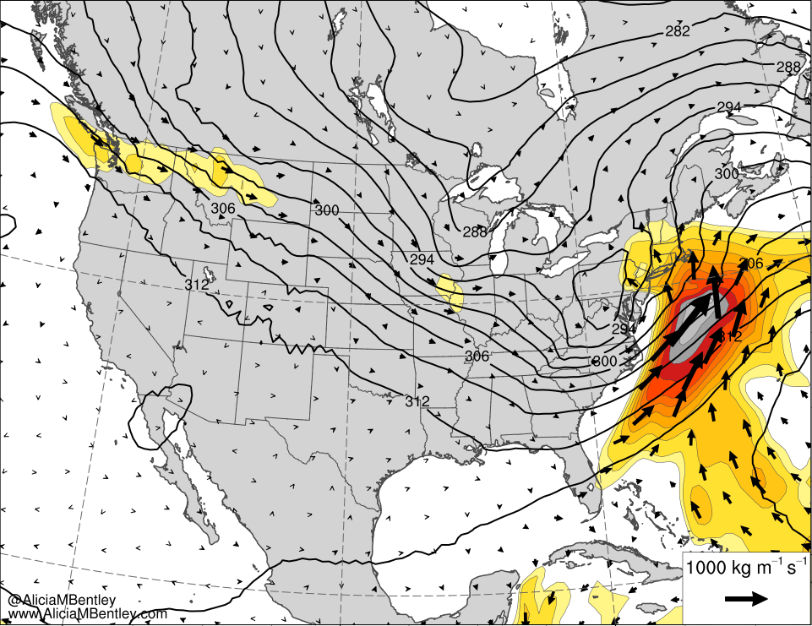
0600 UTC 16 Nov 2018
300–200-hPa PV (PVU, gray) and irrot. wind (m s⁻¹, vectors), 250-hPa wind speed (m s⁻¹, shaded), 600–400-hPa ω (red, every 5 × 10⁻³ hPa s⁻¹), and PW (mm, shaded)
IVT (kg m⁻¹ s⁻¹, shaded and vectors) and 700-hPa geopotential height (dam, black)

Slide 37
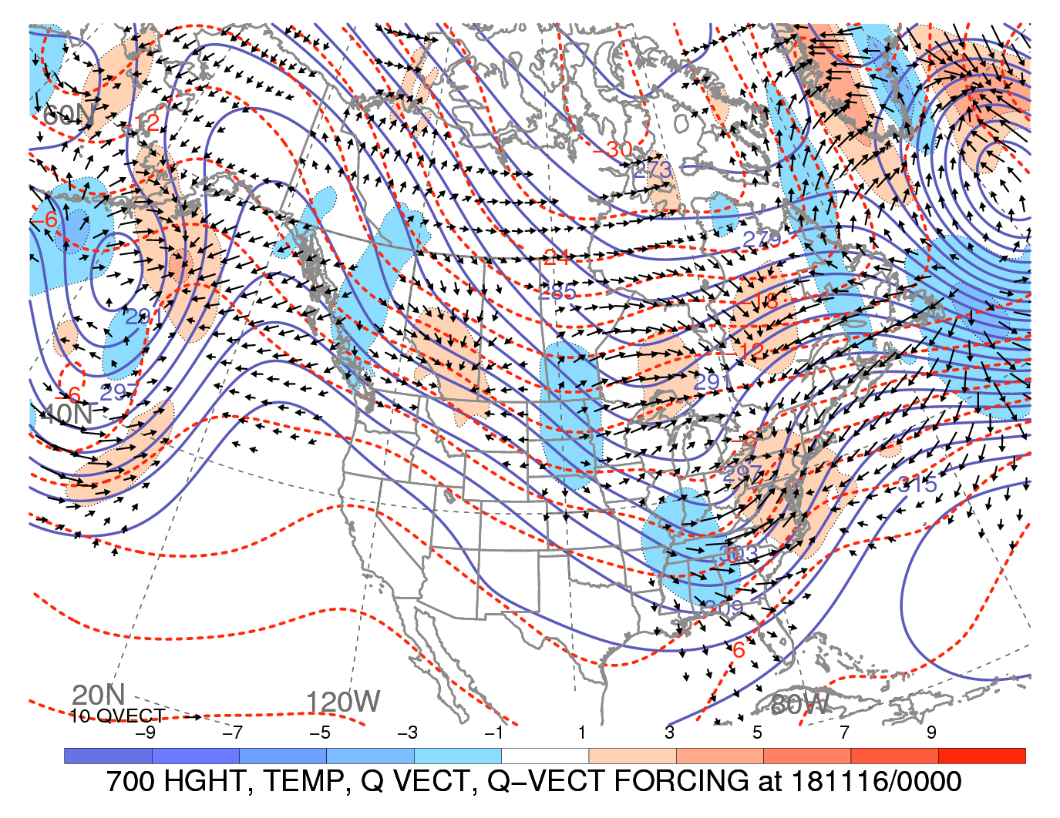
0000 UTC 16 Nov 2018

Slide 38
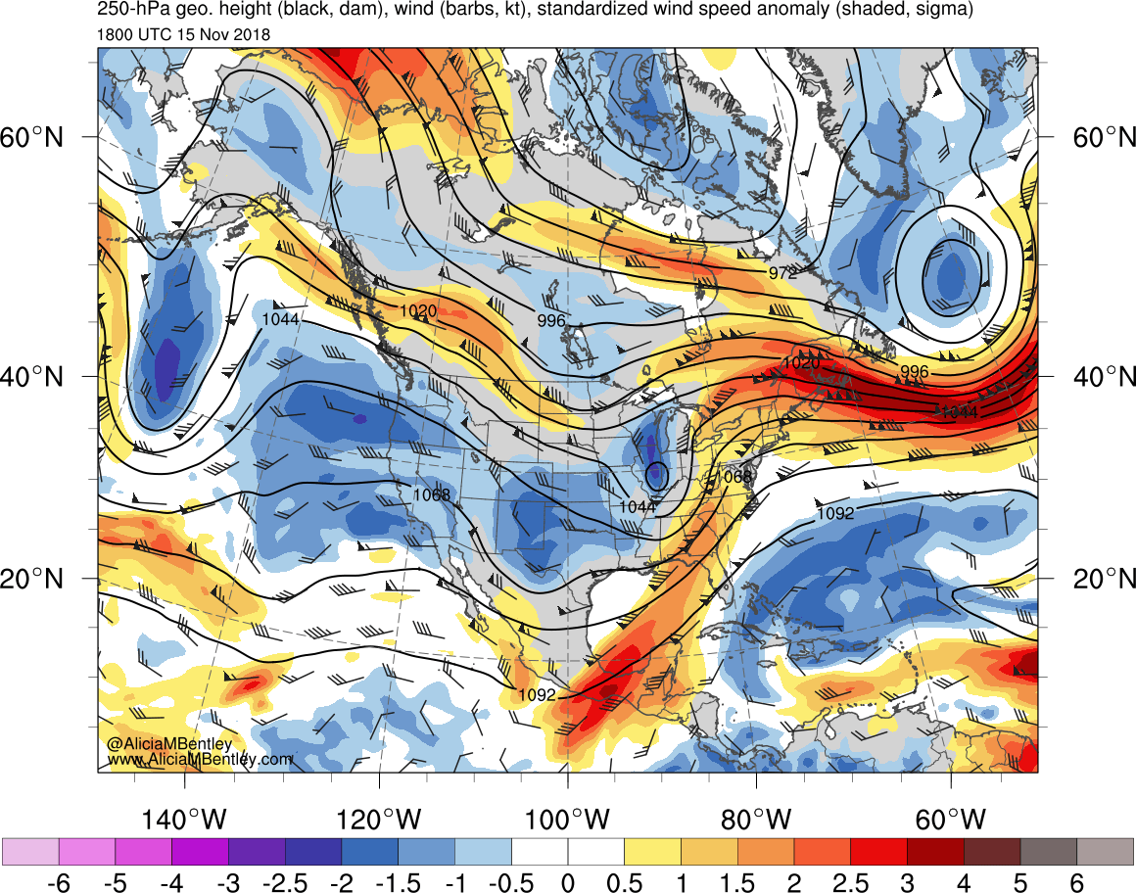
1800 UTC 15 Nov 2018
250-hPa geopotential height (dam, wind), wind (kt, flags and barbs), and standardized anomalies of wind speed (σ, shaded)

Slide 39
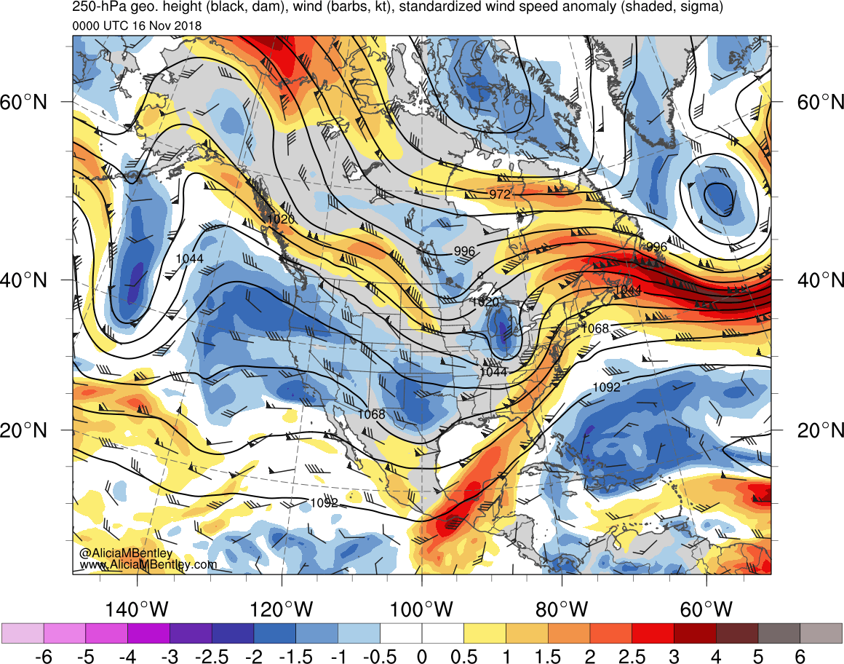
0000 UTC 16 Nov 2018
250-hPa geopotential height (dam, wind), wind (kt, flags and barbs), and standardized anomalies of wind speed (σ, shaded)

Slide 40
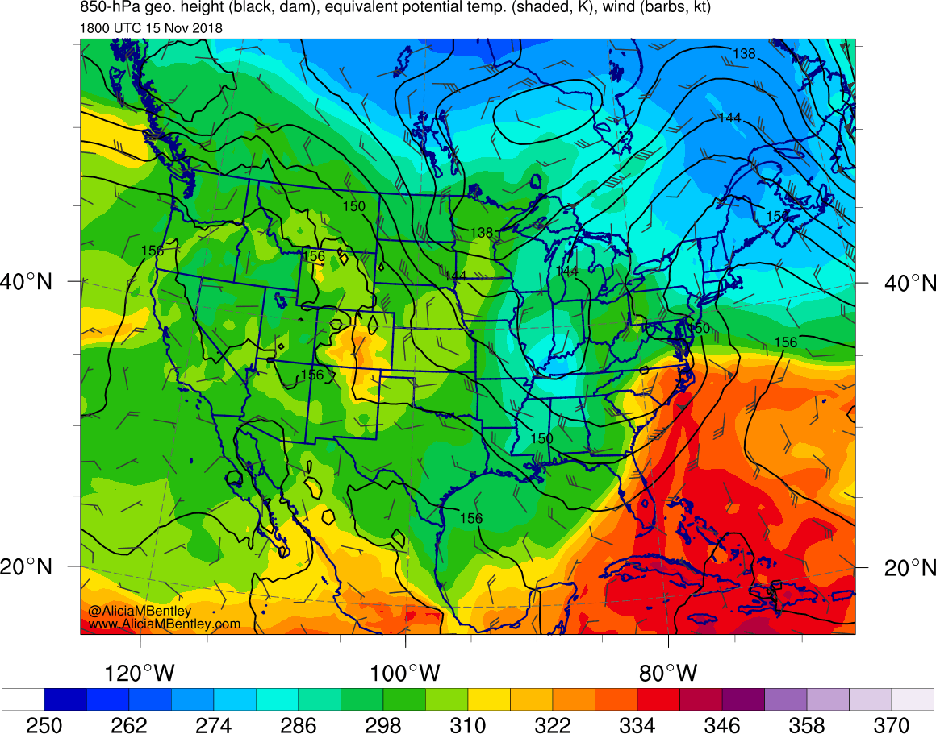
1800 UTC 15 Nov 2018
850-hPa theta-e (K, shading), geopotential height (dam, wind), and wind (kt, flags and barbs)

Slide 41
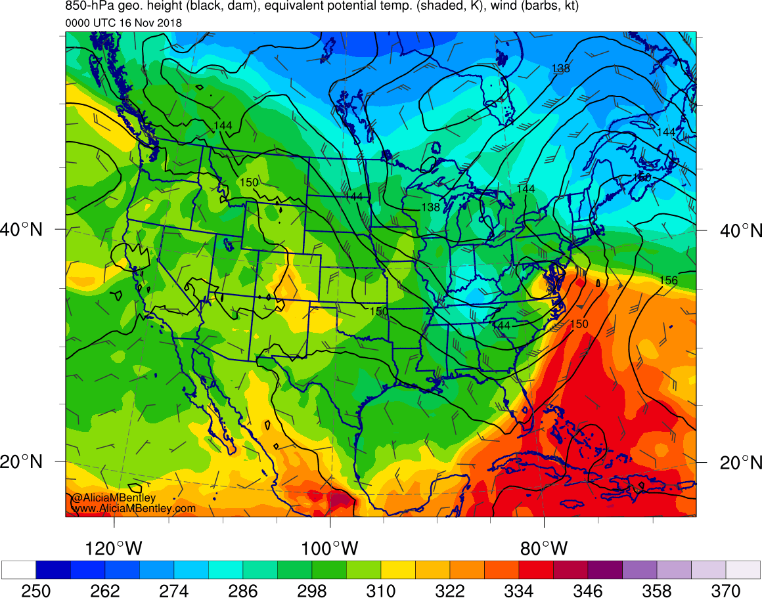
0000 UTC 16 Nov 2018
850-hPa theta-e (K, shading), geopotential height (dam, wind), and wind (kt, flags and barbs)

Slide 42
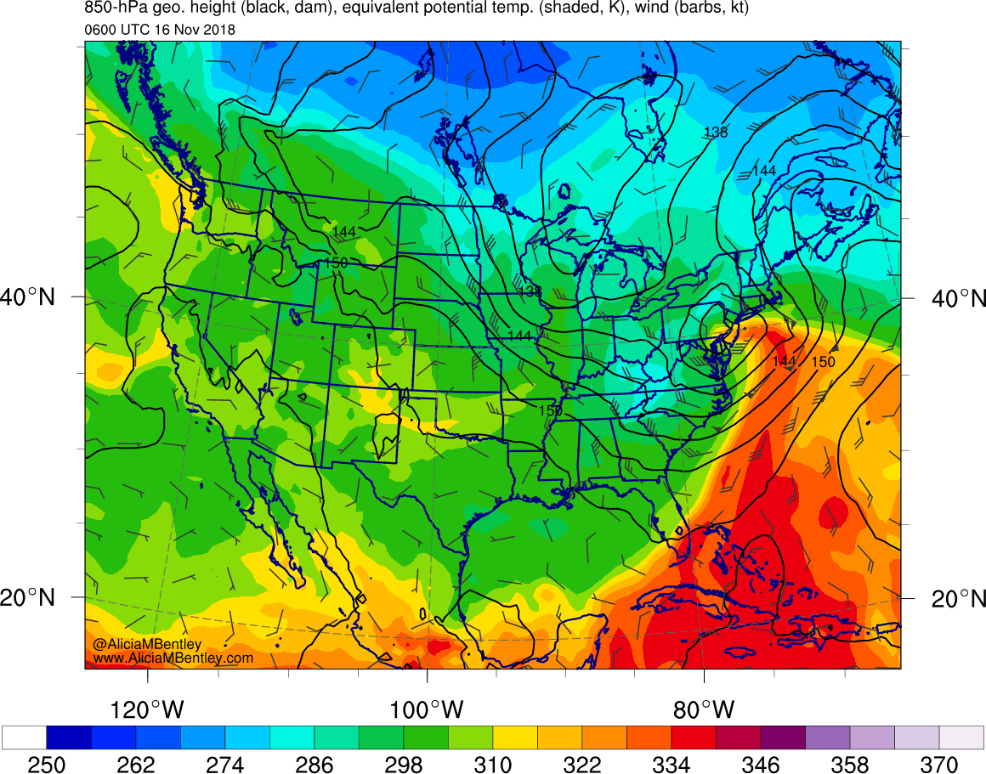
0600 UTC 16 Nov 2018
850-hPa theta-e (K, shading), geopotential height (dam, wind), and wind (kt, flags and barbs)

Slide 43
Outline
Observational overview
Antecedent NPJ regime (Andrew Winters)
A GEFS d(prog)/dt analysis

Slide 44
Analysis Overview

Slide 45
Observational Overview

Slide 46
Takeways: I

Slide 47
Conclusions: NYC Transportation Debacle Storm
Meow

Slide 48
Extra Slides

