Slide 1
Phenomenological and Predictability Studies of the Structure and Evolution of Arctic Cyclones, Polar Lows, and Tropopause Polar Vortices
Lance Bosart, Daniel Keyser, and Kevin Biernat
Department of Atmospheric and Environmental Sciences
University at Albany, State University of New York
Wednesday 30 May 2018
Research Supported by ONR Grant N00014-18-1-2200

Slide 2
Project Objective
This project addresses three research topics concerned with improving prediction of Arctic cyclones and related phenomena in support of the ONR DRI entitled “Overcoming the Barrier to Extended Range Prediction over the Arctic.”
This project is expected to contribute to advances in the understanding and prediction of tropopause polar vortices (TPVs), Arctic cyclones, and polar lows on synoptic-to-subseasonal time scales.

Slide 3
Project Objective
This project will be conducted by the PI (Lance Bosart), Co-PI (Dan Keyser), and two DAES graduate students (Kevin Biernat and Mansour Riachy) in collaboration with Steven Cavallo, Jim Doyle, Andrea Lang, and Ryan Torn, to leverage and benefit from their respective areas of expertise in addressing the project research topics.

Slide 4
Research Topics
The role of longitudinally localized incursions of warm, moist air from middle latitudes in disrupting the tropospheric polar vortex and in reconfiguring the large-scale baroclinicity over the Arctic.
The influence of reconfigurations of large-scale baroclinicity, high-latitude ridge amplification and blocking, sea ice and snow cover boundaries, and radiative processes on the genesis and evolution of TPVs, Arctic cyclones, and polar lows.

Slide 5
Research Topics
The dependence of predictability horizons of TPVs, Arctic cyclones, and polar lows on model uncertainty on synoptic-to-subseasonal time scales as determined through the synoptic evaluation of the forecast skill of deterministic and ensemble prediction systems.
Research topic #3 will be emphasized, and research topics #1 and #2 will establish the phenomenological basis for research topic #3.

Slide 6
Research Topics
Research topic #1 will be addressed by performing climatologies, composite analyses, and case studies of Arctic cyclones and the tropospheric polar vortex.
Research topic #2 will be addressed by performing case studies and associated composite analyses of interactions between TPVs, Arctic cyclones, and polar lows.
Research topic #3 will be addressed by performing predictability studies of TPVs, Arctic cyclones, and polar lows on synoptic-to-subseasonal time scales for episodes of compromised global model forecast skill.

Slide 7
Research Topics
In addressing the three research topics, we will
Use reanalysis datasets, in conjunction with deterministic and ensemble forecasts, produced by the Navy.
Use MPAS (Model for Prediction Across Scales) in predictive and ensemble modes to investigate multiscale interactions between TPVs, Arctic cyclones, and polar lows.
Participate in the field program, THINICE.

Slide 8
Research Topics
Participation in THINICE will consist of analysis and forecasting, as well as real-time monitoring, of evolving Arctic weather regimes and events applicable to the objectives and hypotheses to be addressed during selected intensive observing periods.

Slide 9
Research Topic #1
The role of longitudinally localized incursions of warm, moist air from middle latitudes in disrupting the tropospheric polar vortex and in reconfiguring the large-scale baroclinicity over the Arctic.

Slide 10
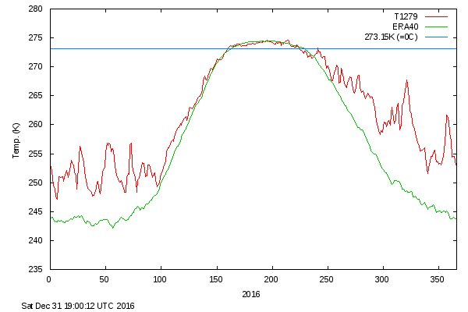
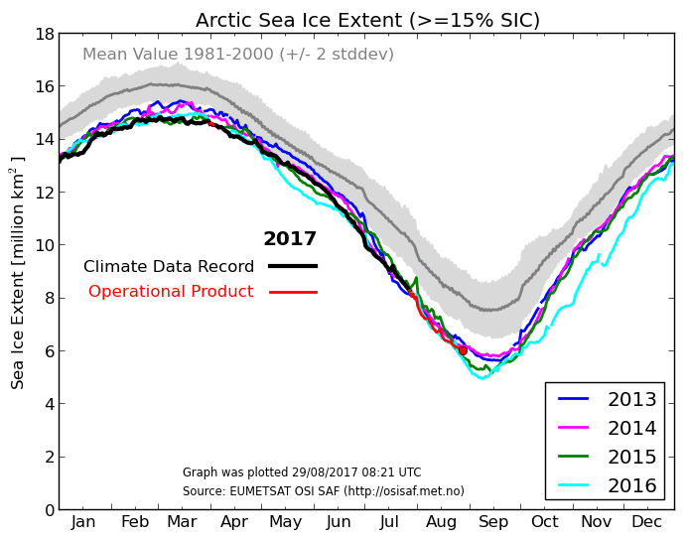
Fig. 1
(a)
(b)
Daily mean Arctic temperatures poleward of 80°N. In addition to the astounding autumnal and winter warmth overall, the large temperature spikes in late November and December are noteworthy.
Arctic sea ice extent for 2013–2016. Note the small sea ice extent retreat during the time of the 2016 winter solstice.
Source: Danish Meteorological Institute (http://ocean.dmi.dk/arctic/meant80n.uk.php)

Slide 11
Research Topic #2
The influence of reconfigurations of large-scale baroclinicity, high-latitude ridge amplification and blocking, sea ice and snow cover boundaries, and radiative processes on the genesis and evolution of TPVs, Arctic cyclones, and polar lows.

Slide 12
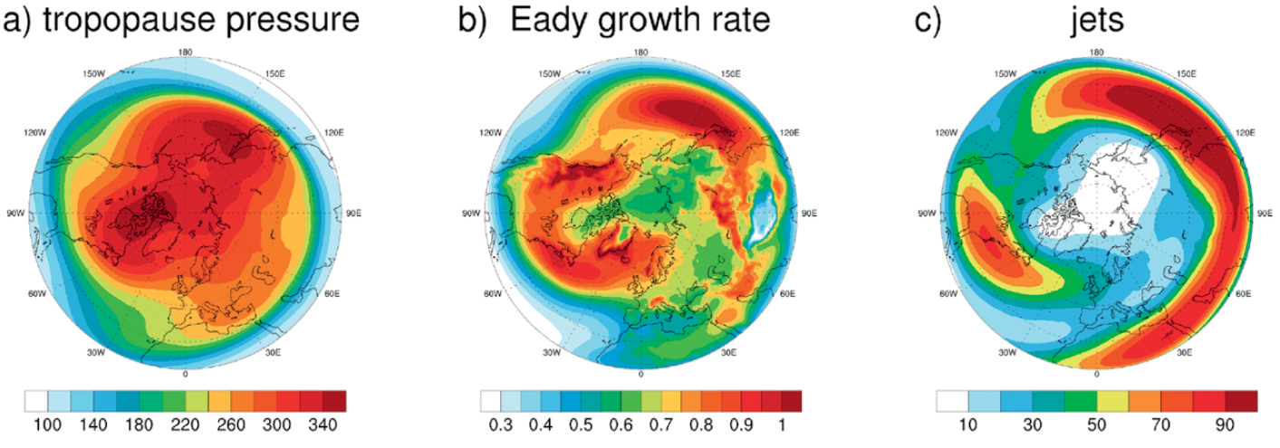
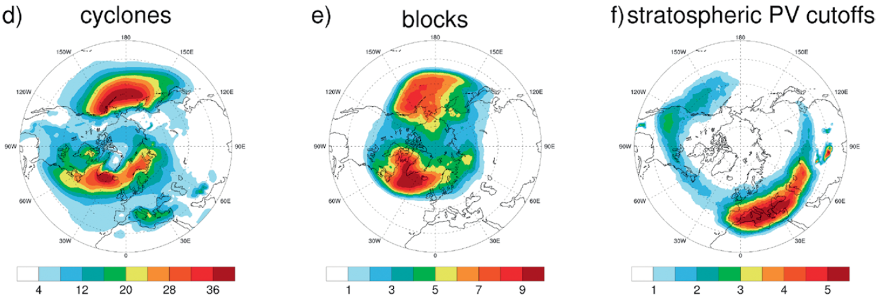
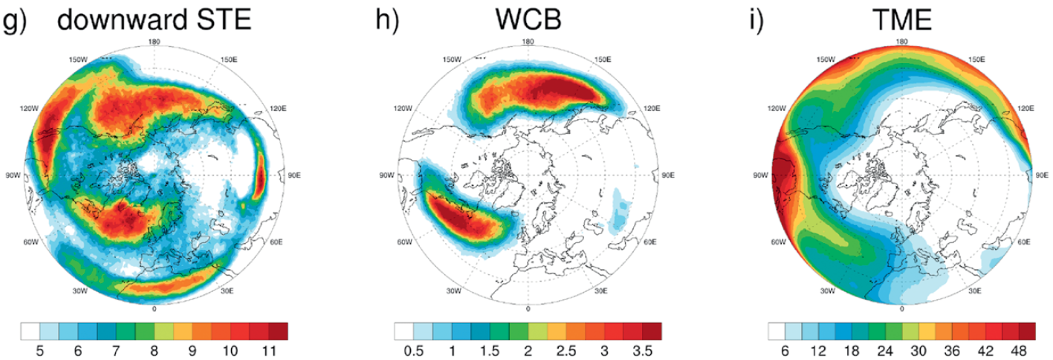
Fig. 5
(a) tropopause pressure (hPa)
(b) Eady growth rate (day⁻¹)
(c) 30 m s⁻¹ jet frequency (%)
(d) cyclone frequency (%)
(e) blocking frequency (%)
(f) frequency of stratospheric potential vorticity (PV) cutoffs on 310 K (%)
(g) frequency of downward stratosphere–troposphere exchange (STE) trajectories (%)
(h) frequency of warm conveyor belt (WCB) trajectories (%)
(f) frequency of tropical moisture export (TME) trajectories (%)
Climatological boreal winter fields in the Northern Hemisphere for 1979–2014 of quantities listed above. [Figure 1 and caption adapted from Sprenger et al. (2017).]

Slide 13
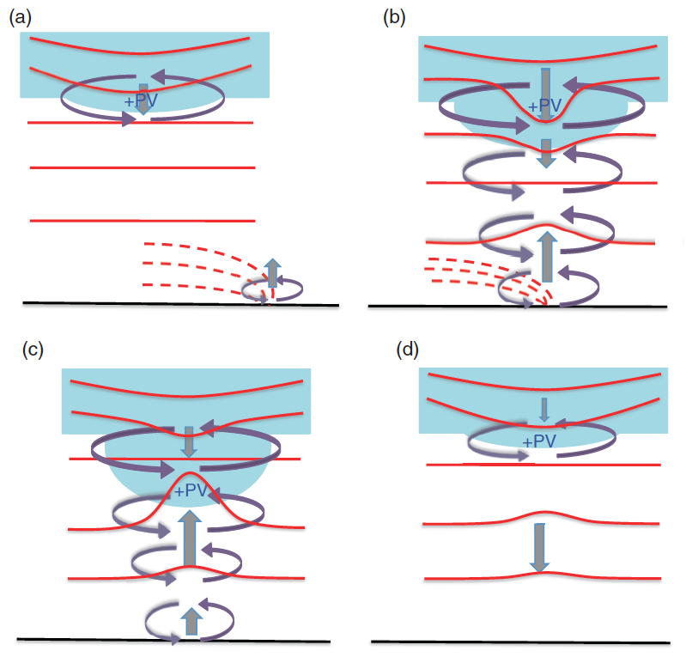
Fig. 7
Pre-generation
Development and intensification
stratospheric PV and the positive PV anomaly
isentropes from middle troposphere to lower stratosphere
isentropes associated with a surface and lower-tropospheric front
Mature and persistence
Decay and dissipation
vertical motions
horizontal circulations
Schematic summary illustrating dynamical and thermodynamic structures and processes during the development of an Arctic storm occurring during September 2010 over the Arctic Ocean. (a) Pre-generation phase; (b) development and intensification phase; (c) mature and persistence phase; and (d) decay and dissipation phase of the storm. [Figure 11 and caption adapted from Tao et al. (2017).]

Slide 14
Research Topic #3
The dependence of predictability horizons of TPVs, Arctic cyclones, and polar lows on model uncertainty on synoptic-to-subseasonal time scales as determined through the synoptic evaluation of the forecast skill of deterministic and ensemble prediction systems.

Slide 15
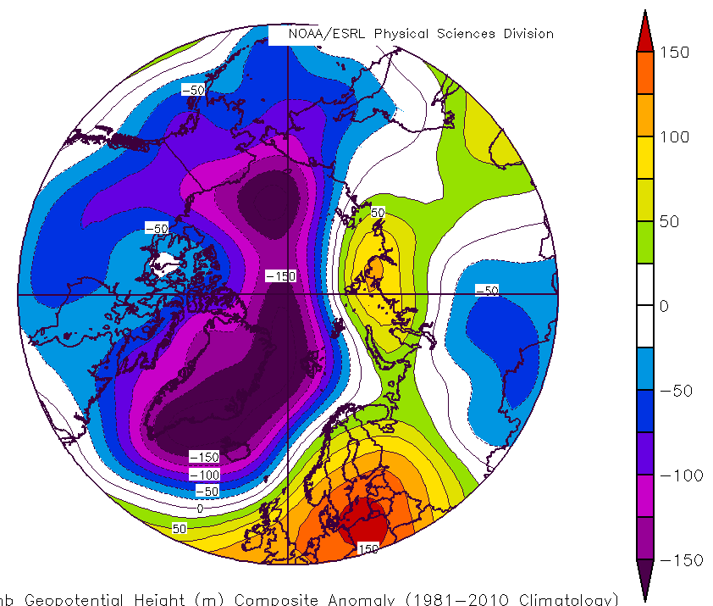
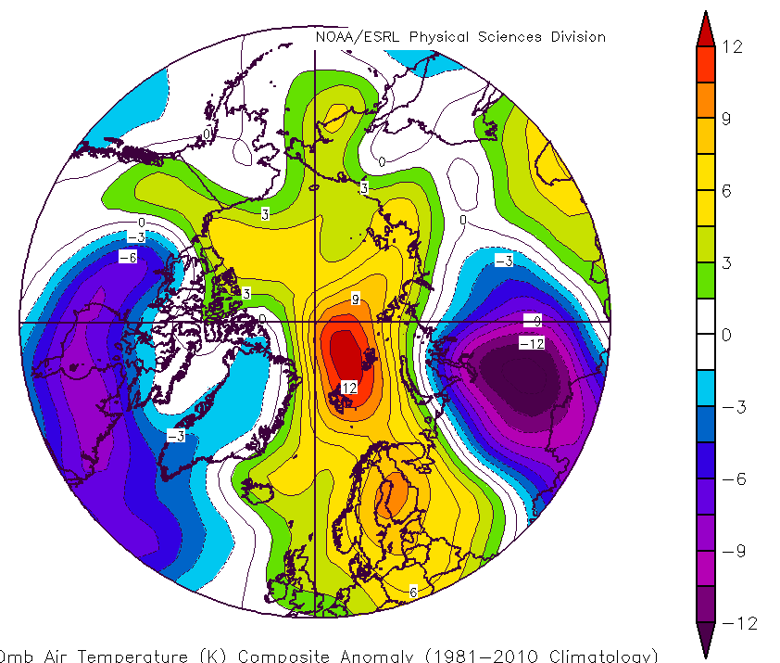
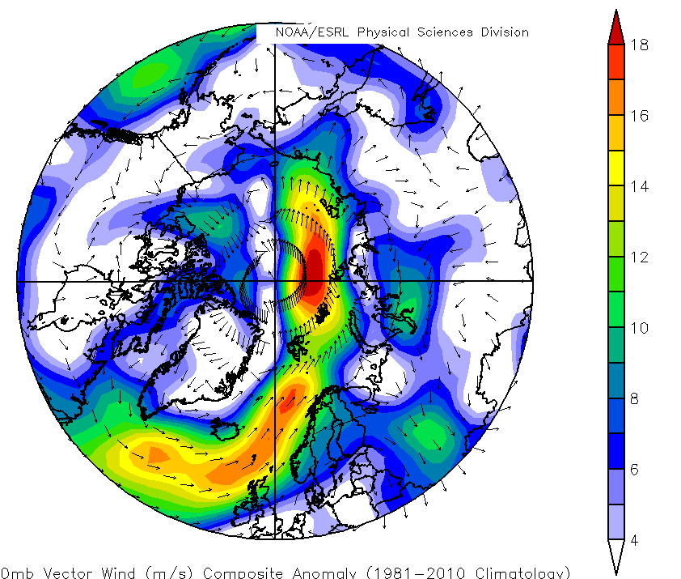
Fig. 10
(a) 850-hPa geopotential height anomaly (m)
(b) 850-hPa temperature anomaly (K)
(a) 850-hPa geopotential height anomaly (m), (b) 850-hPa temperature anomaly (K), and (c) 850-hPa vector wind anomaly (m s⁻¹) for 17–23 December 2016, from NCEP–NCAR Reanalysis.
(c) 850-hPa vector wind anomaly (m s⁻¹)

Slide 16
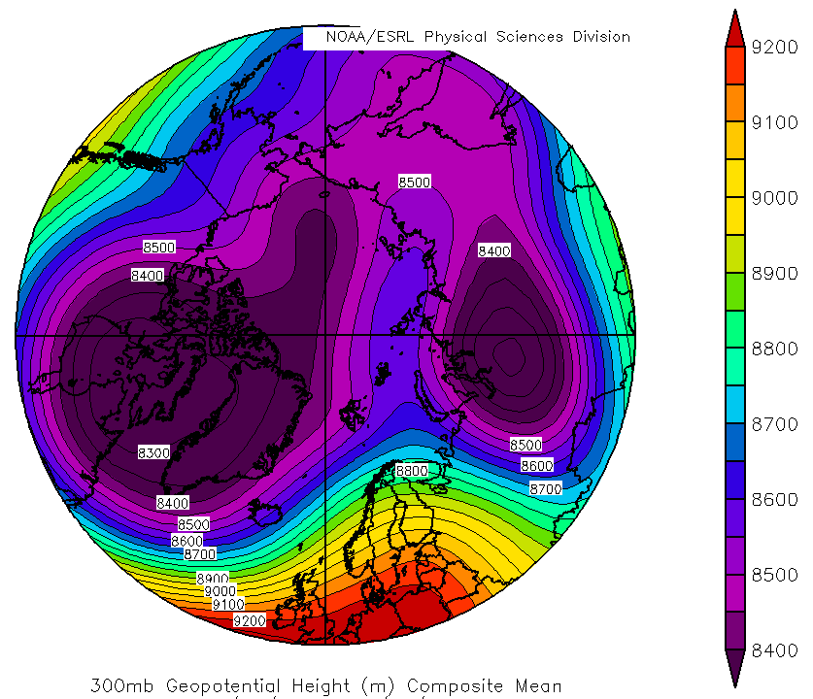
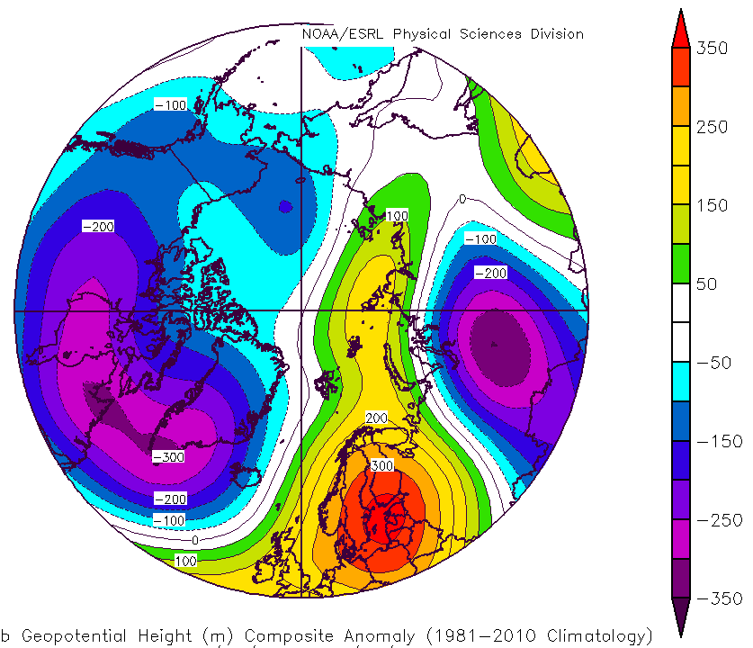
Fig. 11
(a) 300-hPa geopotential height (m)
(b) 300-hPa geopotential height anomaly (m)
(a) 300-hPa geopotential height (m) and (b) 300-hPa geopotential height anomaly (m) for 17–23 December 2016, from NCEP–NCAR Reanalysis.

Slide 17
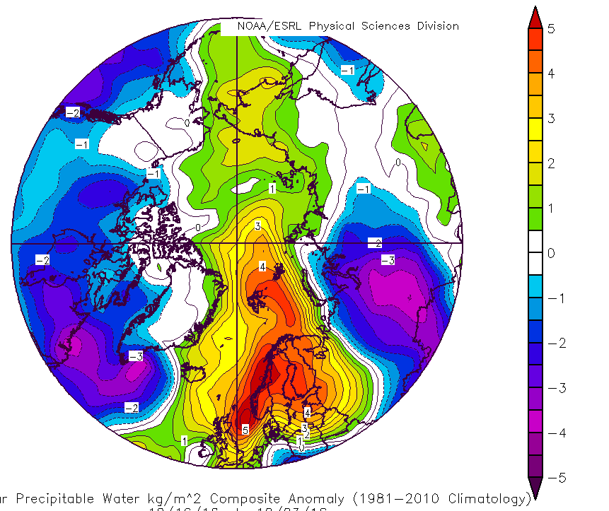
Fig. 12
Columnar precipitable water anomaly (mm)
Columnar precipitable water anomaly (mm) for 17–23 December 2016, from NCEP–NCAR Reanalysis

Slide 18
Research Topic #3
A Multiscale Analysis and Predictability Study of a Polar Low Linked to a TPV
The purpose of this study is to
Analyze the evolution of a polar low that is linked to a TPV.
Investigate factors influencing the predictability of the evolution of the polar low.

Slide 19
Research Topic #3
A Multiscale Analysis and Predictability Study of a Polar Low Linked to a TPV
A multiscale analysis is performed, using the ERA5, on a polar low that occurs during 10–11 February 2011 over the Barents Sea and that is linked to a TPV transported equatorward along a tropospheric-deep baroclinic zone.
The analysis shows that the TPV and a concomitant favorable thermodynamic environment likely play an important role in supporting the development and intensification of the polar low.

Slide 20
Research Topic #3
A Multiscale Analysis and Predictability Study of a Polar Low Linked to a TPV
The 51-member ECMWF Ensemble Prediction System (EPS) from TIGGE is utilized to evaluate forecast skill of the evolution of the polar low.
The ensemble members are separated in two groups: the most and least accurate members in terms of track and intensity errors of the polar low.

Slide 21
Research Topic #3
A Multiscale Analysis and Predictability Study of a Polar Low Linked to a TPV
Normalized composite differences between the two groups suggest that the TPV is located significantly farther northward and that the tropospheric-deep baroclinic zone is positioned significantly farther eastward in the most accurate group compared to the least accurate group.
The differences in position of the TPV and baroclinic zone between the two groups likely contribute to a significantly farther north and east, and more accurate, track of the polar low in the most accurate group (track over the Barents Sea) compared to the least accurate group (track predominately over Scandinavia).

Slide 22
Research Topic #3
A Multiscale Analysis and Predictability Study of a Polar Low Linked to a TPV
The more conducive thermodynamic environment for polar low development in the most accurate group compared to the least accurate group may contribute to the polar low being significantly stronger in the most accurate group compared to the least accurate group.

Slide 23
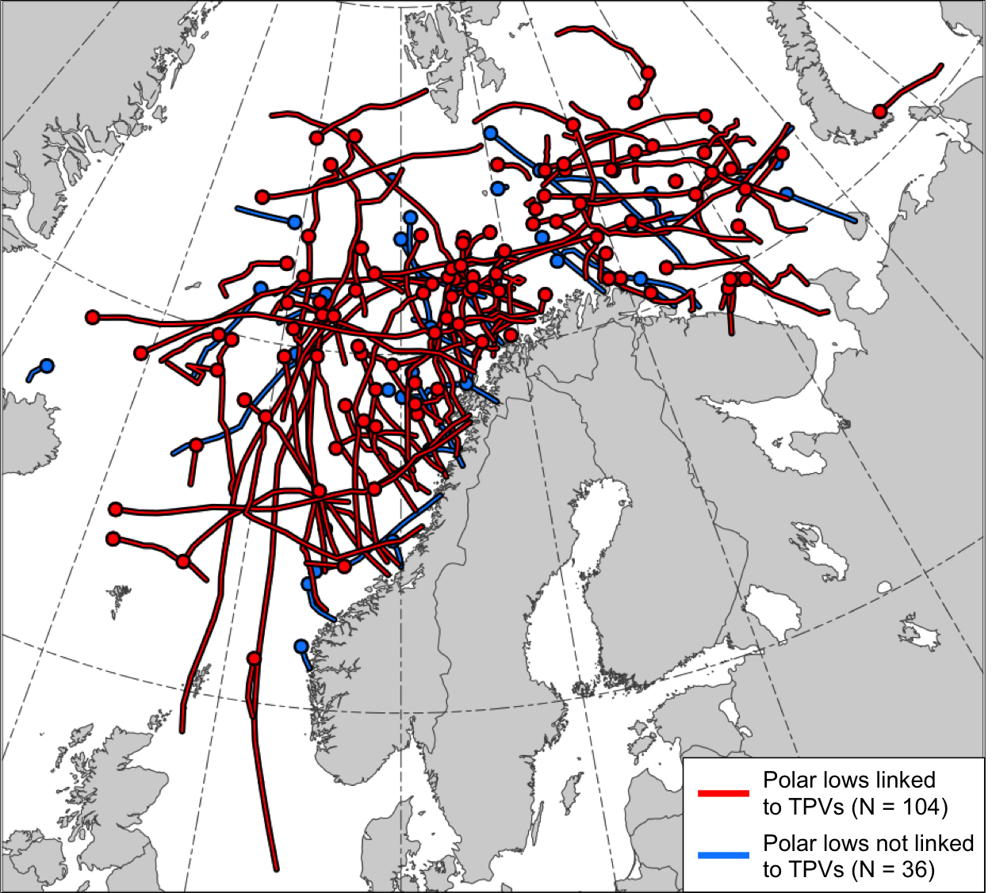
Fig. 1
Tracks of the polar lows in the STARS database. Tracks of polar lows that may be linked to TPVs (red) and tracks of polar lows that are not linked to TPVs (blue). Dots indicate the genesis locations of the polar lows.

Slide 24
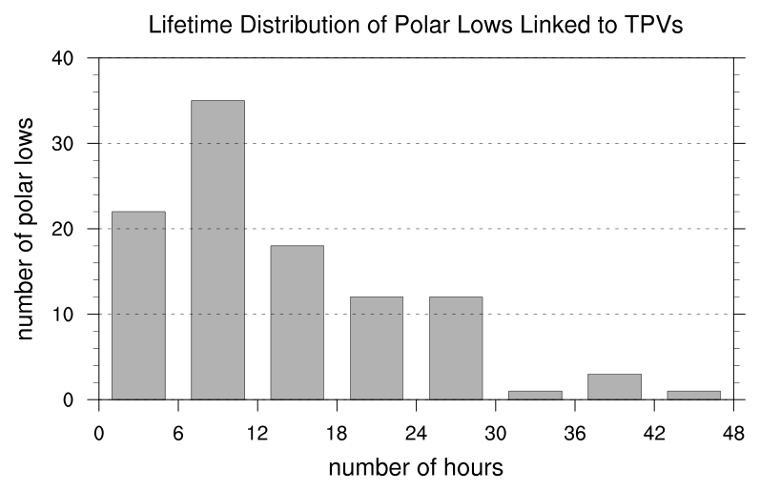
Fig. 2
N = 104
Mean: 12.9 h
Median: 9 h
Lifetime distribution of polar lows that may be linked to TPVs, with lifetime in number of hours.

Slide 25
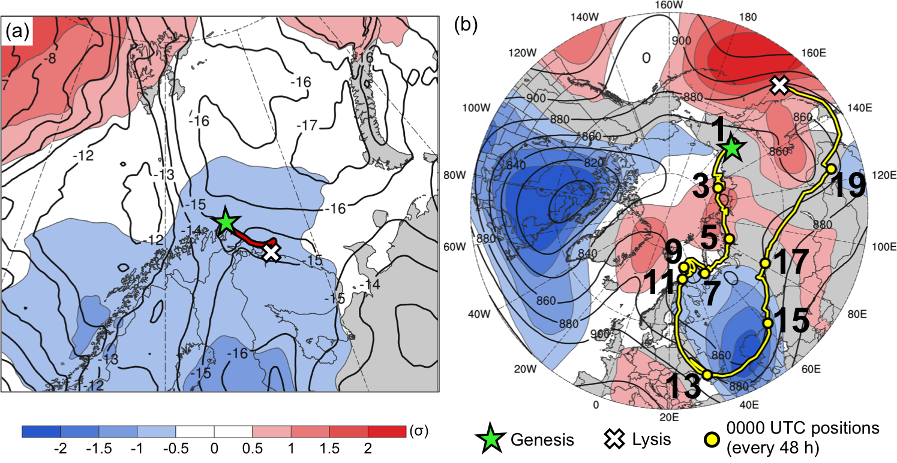
Fig. 3
Track of (a) polar low (red) and (b) TPV linked to the polar low (yellow). Also, the 10–11 February 2011 time-mean (a) 850-hPa temperature (K, black) and standardized anomaly of 850-hPa temperature (σ, shaded), and (b) 300-hPa geopotential height (dam) and standardized anomaly of 300-hPa geopotential height (σ, shaded).
Feature | Genesis | Lysis | Lifetime
TPV | 31 Jan | 20 Feb | 20 d
PL | 10 Feb | 11 Feb | 18 h

Slide 26
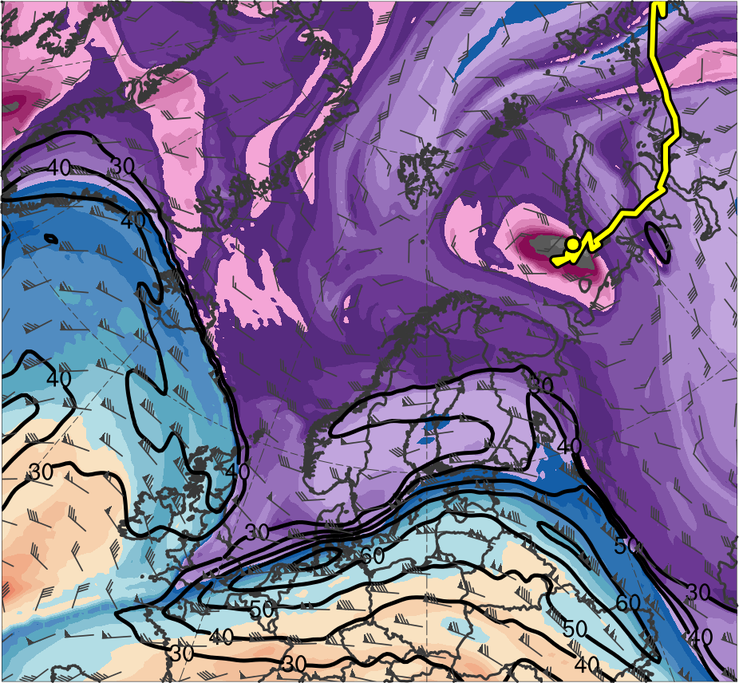
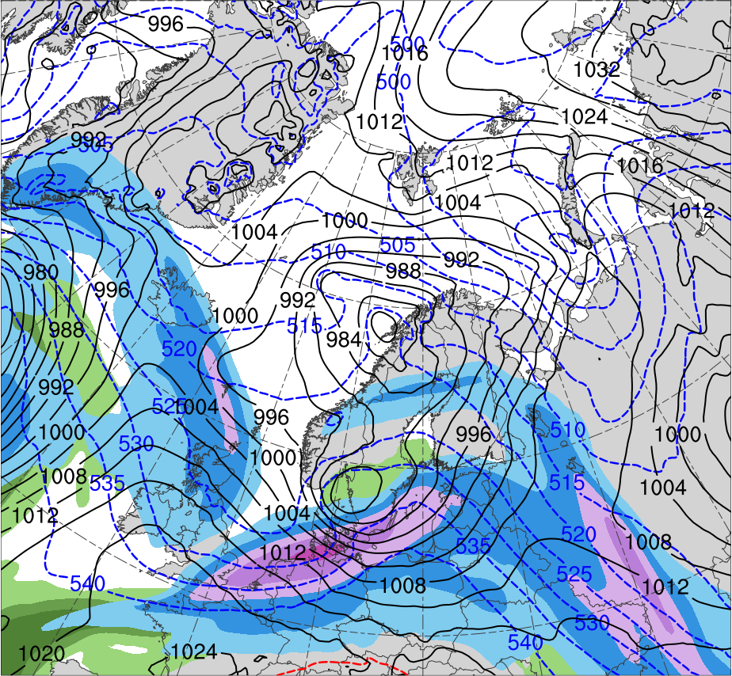
Fig. 4
0000 UTC 8 Feb 2011
R1
TPV
(K)
252
258
264
270
276
282
288
294
300
306
312
318
324
330
336
342
348
354
360
366
372
378
(m s⁻¹ )
(mm)
30
40
50
60
70
80
90
100
10
15
20
25
30
35
40
Potential temperature (K, shaded), wind speed (black, every 10 m s⁻¹ starting at 30 m s⁻¹), and wind (m s⁻¹, flags and barbs) on 2-PVU surface
300-hPa wind speed (m s⁻¹, shaded),
1000–500-hPa thickness (dam, blue/red),
SLP (hPa, black), PW (mm, shaded)

Slide 27
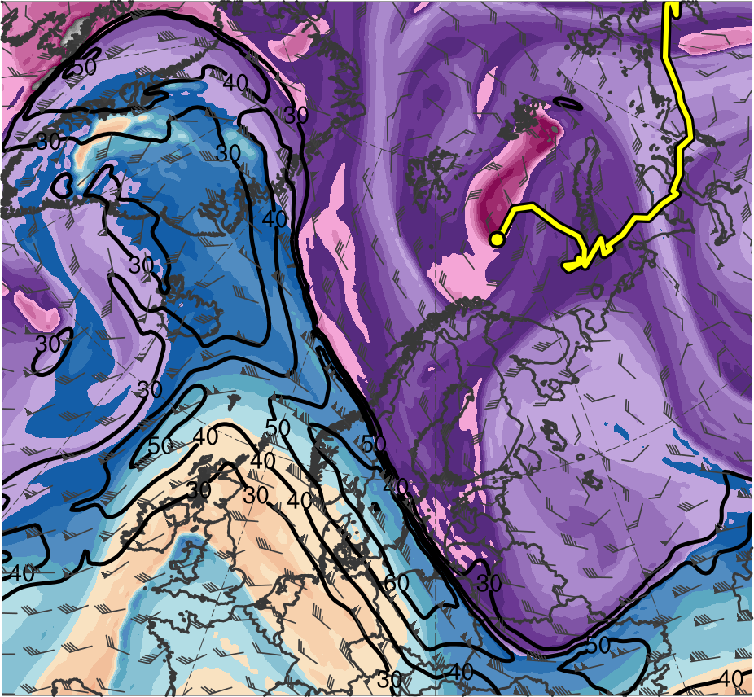
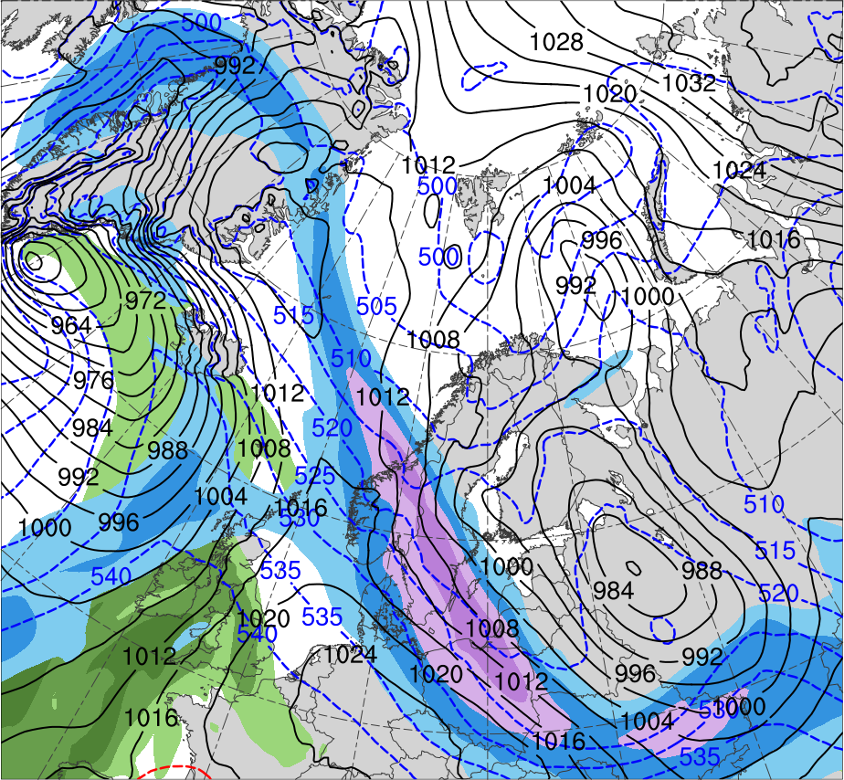
Fig. 4
0000 UTC 9 Feb 2011
R1
R2
TPV
(K)
252
258
264
270
276
282
288
294
300
306
312
318
324
330
336
342
348
354
360
366
372
378
(m s⁻¹ )
(mm)
30
40
50
60
70
80
90
100
10
15
20
25
30
35
40
Potential temperature (K, shaded), wind speed (black, every 10 m s⁻¹ starting at 30 m s⁻¹), and wind (m s⁻¹, flags and barbs) on 2-PVU surface
300-hPa wind speed (m s⁻¹, shaded),
1000–500-hPa thickness (dam, blue/red),
SLP (hPa, black), PW (mm, shaded)

Slide 28
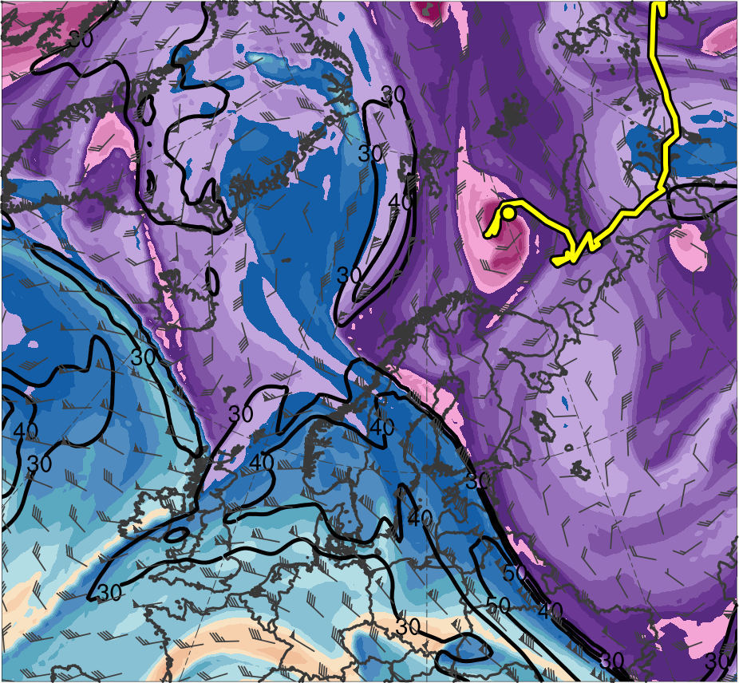
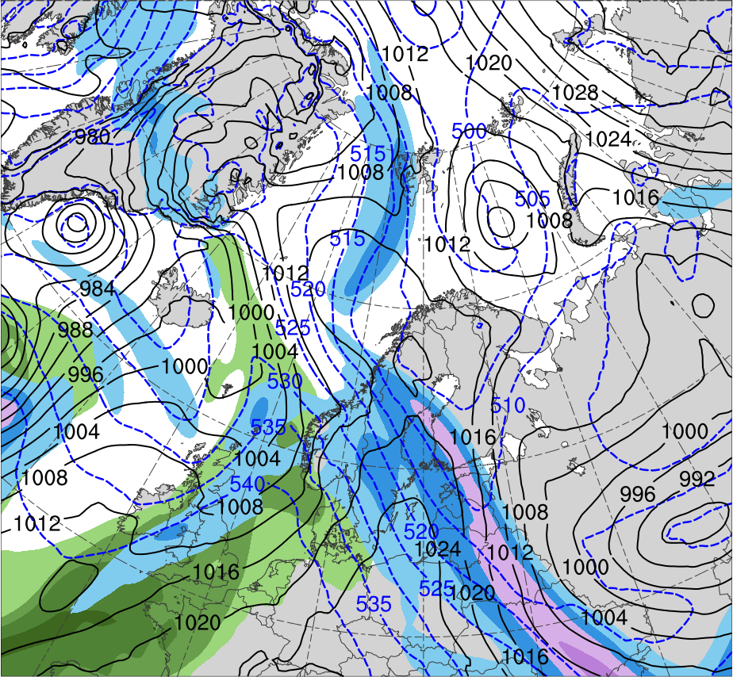
Fig. 4
0000 UTC 10 Feb 2011
R2
R1
TPV
(K)
252
258
264
270
276
282
288
294
300
306
312
318
324
330
336
342
348
354
360
366
372
378
(m s⁻¹ )
(mm)
30
40
50
60
70
80
90
100
10
15
20
25
30
35
40
Potential temperature (K, shaded), wind speed (black, every 10 m s⁻¹ starting at 30 m s⁻¹), and wind (m s⁻¹, flags and barbs) on 2-PVU surface
300-hPa wind speed (m s⁻¹, shaded),
1000–500-hPa thickness (dam, blue/red),
SLP (hPa, black), PW (mm, shaded)

Slide 29
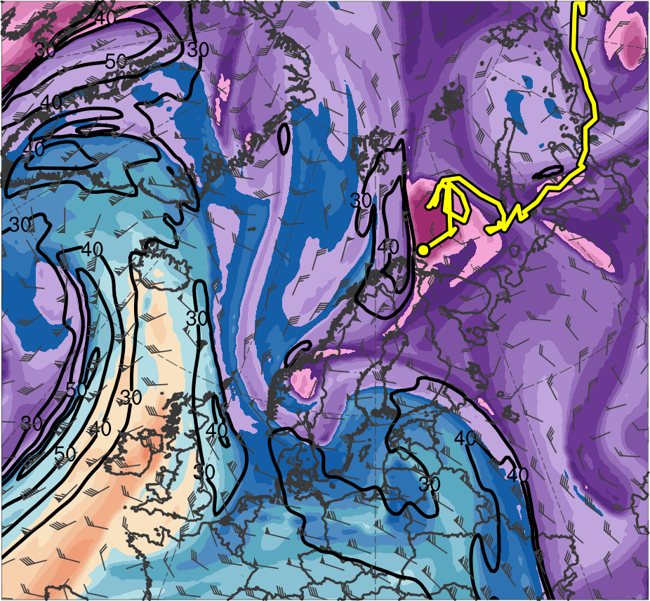
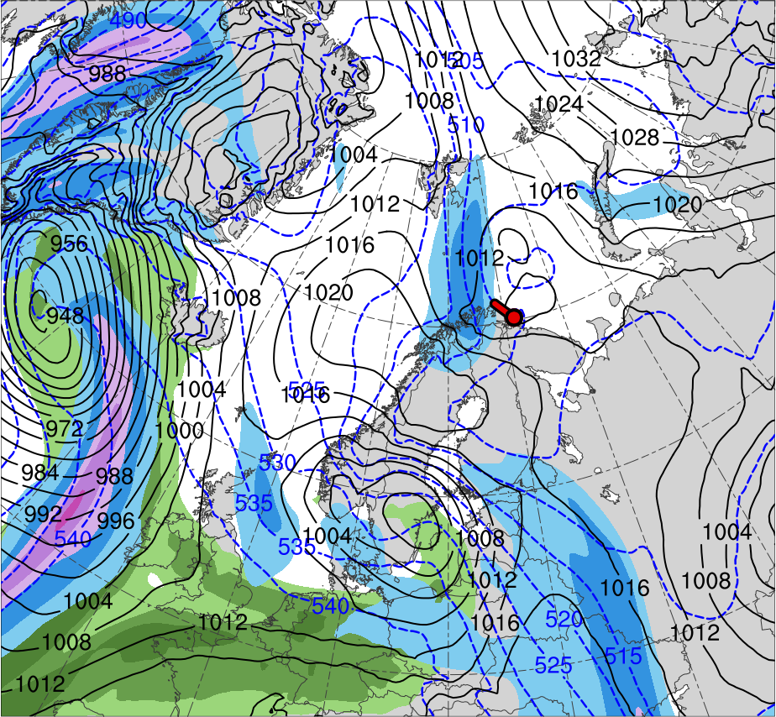
Fig. 4
0000 UTC 11 Feb 2011
R2
R1
TPV
PL
(K)
252
258
264
270
276
282
288
294
300
306
312
318
324
330
336
342
348
354
360
366
372
378
(m s⁻¹ )
(mm)
30
40
50
60
70
80
90
100
10
15
20
25
30
35
40
Potential temperature (K, shaded), wind speed (black, every 10 m s⁻¹ starting at 30 m s⁻¹), and wind (m s⁻¹, flags and barbs) on 2-PVU surface
300-hPa wind speed (m s⁻¹, shaded),
1000–500-hPa thickness (dam, blue/red),
SLP (hPa, black), PW (mm, shaded)

Slide 30
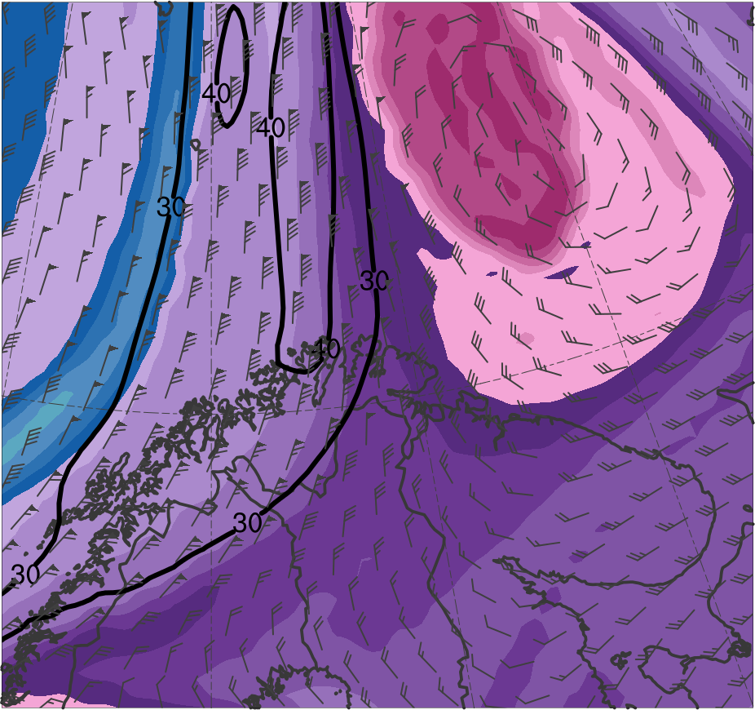
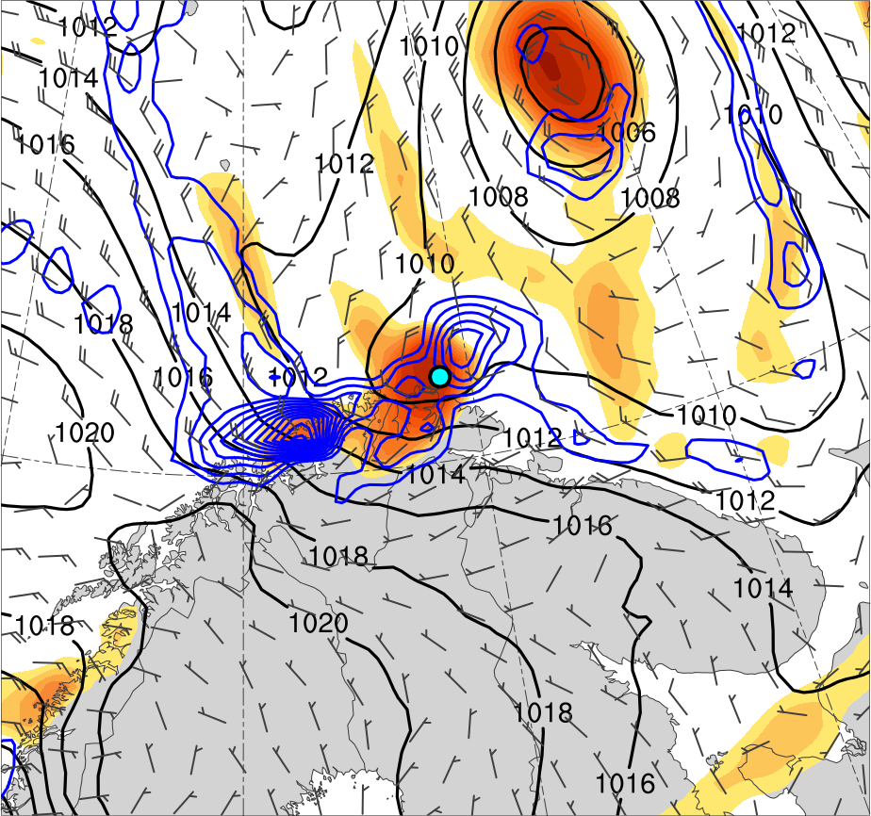
Fig. 5
1800 UTC 10 Feb 2011
PL
(K)
252
258
264
270
276
282
288
294
300
306
312
318
324
330
336
342
348
354
360
366
372
378
4
6
8
10
12
14
16
18
20
25
30
35
40
Potential temperature (K, shaded), wind speed (black, every 10 m s⁻¹ starting at 30 m s⁻¹), and wind (m s⁻¹, flags and barbs) on 2-PVU surface
850-hPa relative vorticity (10⁻⁵ s⁻¹, shaded),
850–600-hPa ascent (blue, every 2.5 × 10⁻³ hPa s⁻¹),
SLP (hPa, black), 10-m wind (m s⁻¹, barbs)

Slide 31
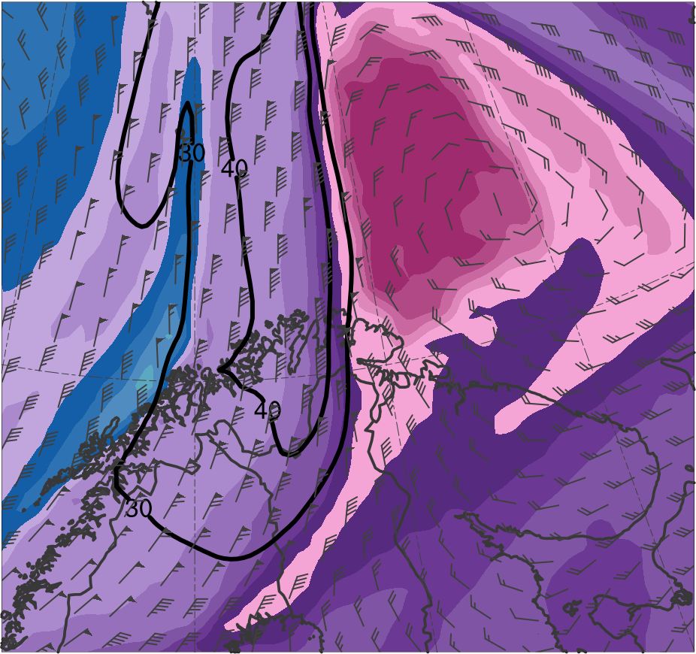
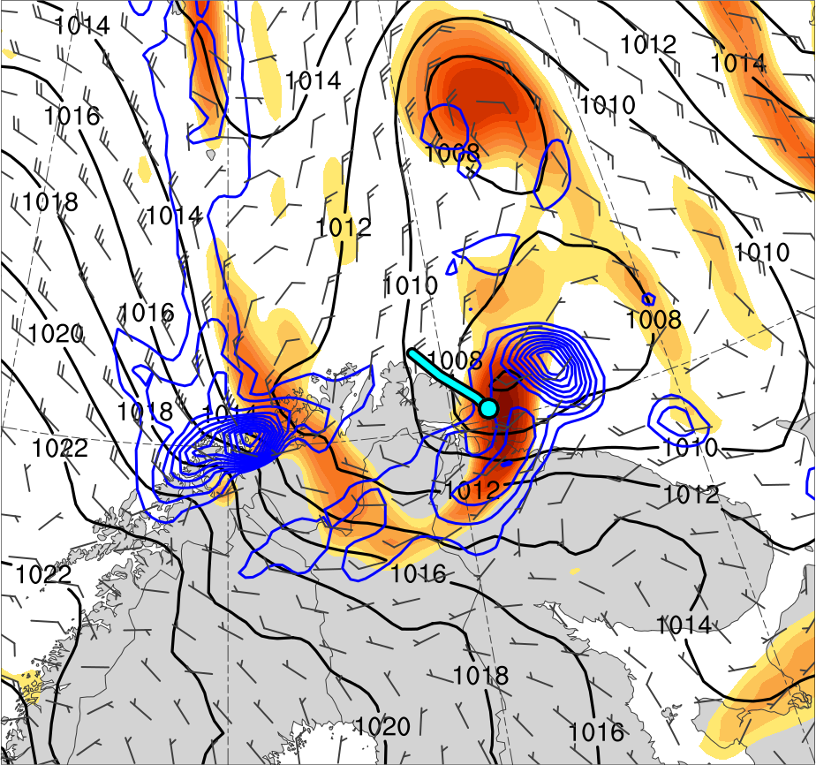
Fig. 5
0000 UTC 11 Feb 2011
PL
(K)
252
258
264
270
276
282
288
294
300
306
312
318
324
330
336
342
348
354
360
366
372
378
4
6
8
10
12
14
16
18
20
25
30
35
40
Potential temperature (K, shaded), wind speed (black, every 10 m s⁻¹ starting at 30 m s⁻¹), and wind (m s⁻¹, flags and barbs) on 2-PVU surface
850-hPa relative vorticity (10⁻⁵ s⁻¹, shaded),
850–600-hPa ascent (blue, every 2.5 × 10⁻³ hPa s⁻¹),
SLP (hPa, black), 10-m wind (m s⁻¹, barbs)

Slide 32
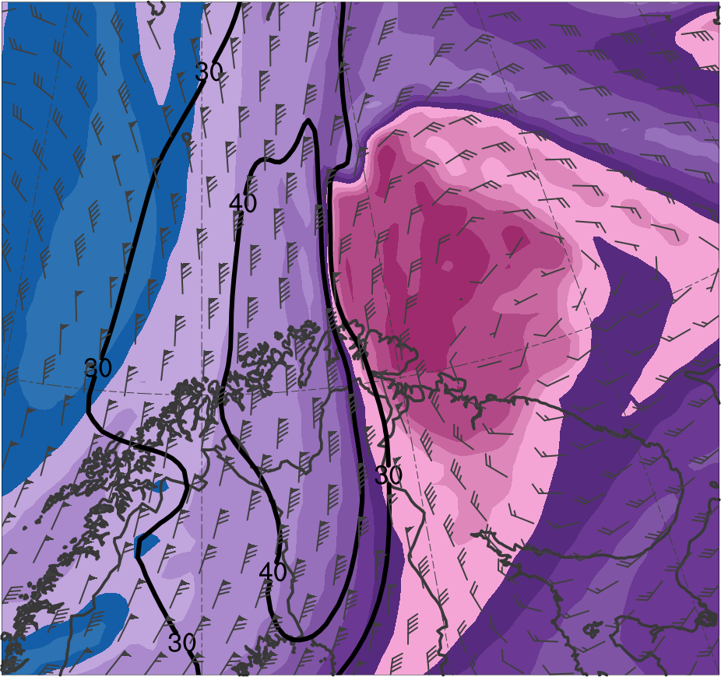
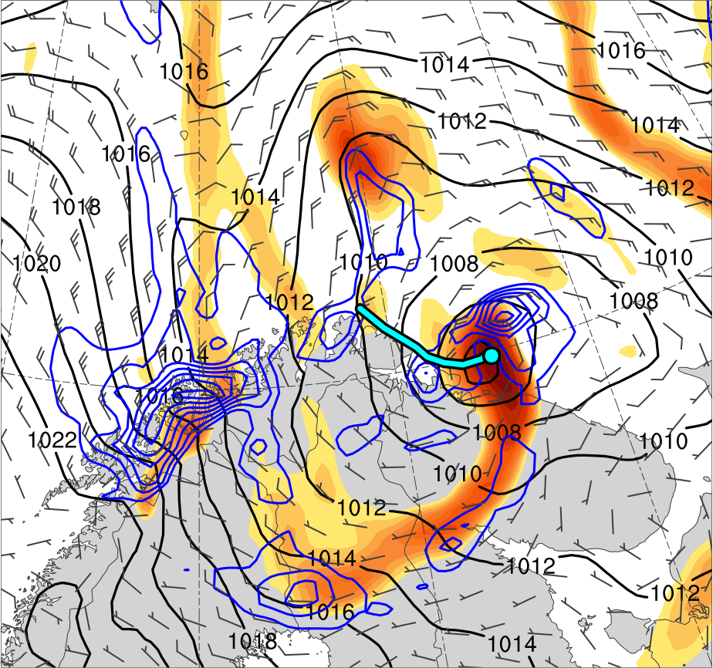
Fig. 5
0600 UTC 11 Feb 2011
PL
(K)
252
258
264
270
276
282
288
294
300
306
312
318
324
330
336
342
348
354
360
366
372
378
4
6
8
10
12
14
16
18
20
25
30
35
40
Potential temperature (K, shaded), wind speed (black, every 10 m s⁻¹ starting at 30 m s⁻¹), and wind (m s⁻¹, flags and barbs) on 2-PVU surface
850-hPa relative vorticity (10⁻⁵ s⁻¹, shaded),
850–600-hPa ascent (blue, every 2.5 × 10⁻³ hPa s⁻¹),
SLP (hPa, black), 10-m wind (m s⁻¹, barbs)

Slide 33
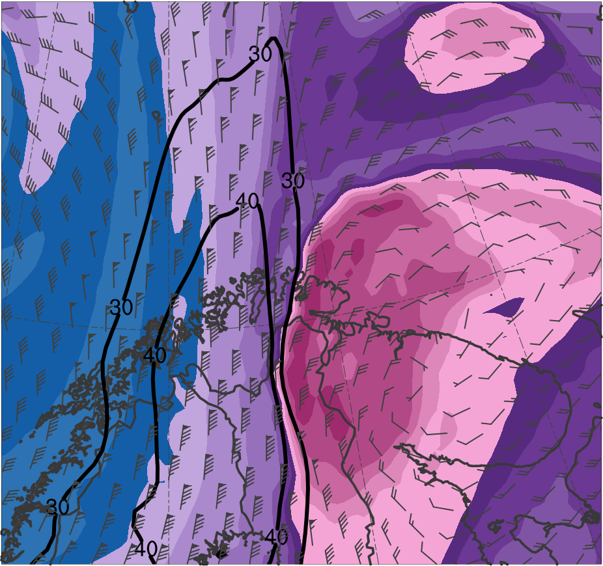
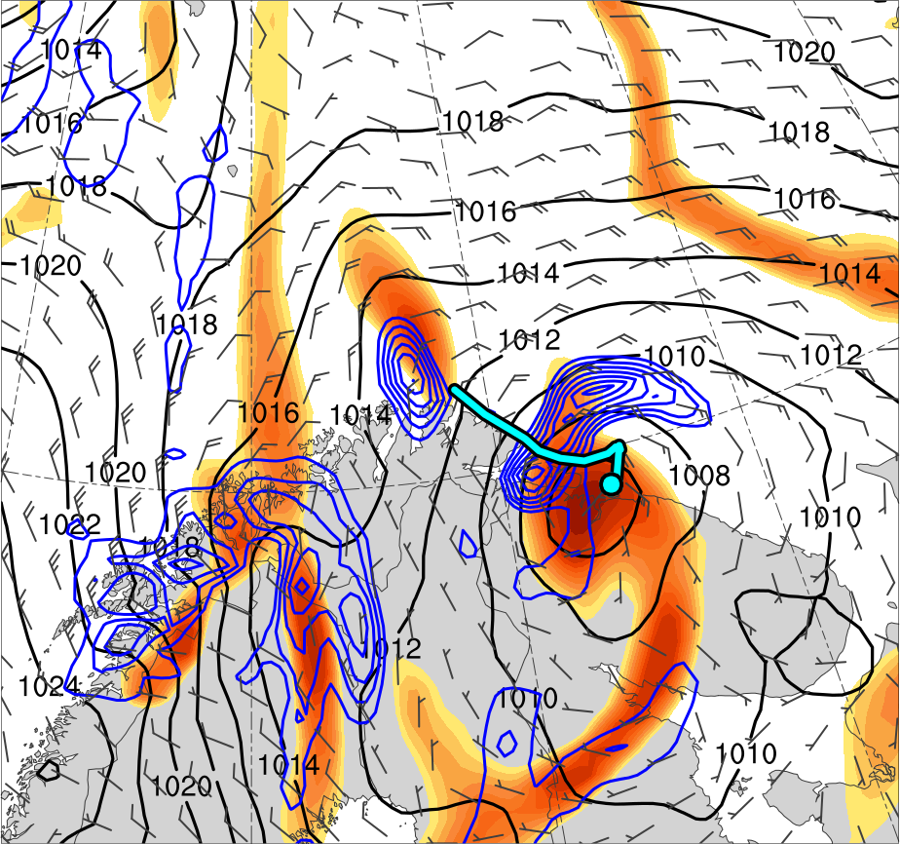
Fig. 5
1200 UTC 11 Feb 2011
PL
(K)
252
258
264
270
276
282
288
294
300
306
312
318
324
330
336
342
348
354
360
366
372
378
4
6
8
10
12
14
16
18
20
25
30
35
40
Potential temperature (K, shaded), wind speed (black, every 10 m s⁻¹ starting at 30 m s⁻¹), and wind (m s⁻¹, flags and barbs) on 2-PVU surface
850-hPa relative vorticity (10⁻⁵ s⁻¹, shaded),
850–600-hPa ascent (blue, every 2.5 × 10⁻³ hPa s⁻¹),
SLP (hPa, black), 10-m wind (m s⁻¹, barbs)

Slide 34
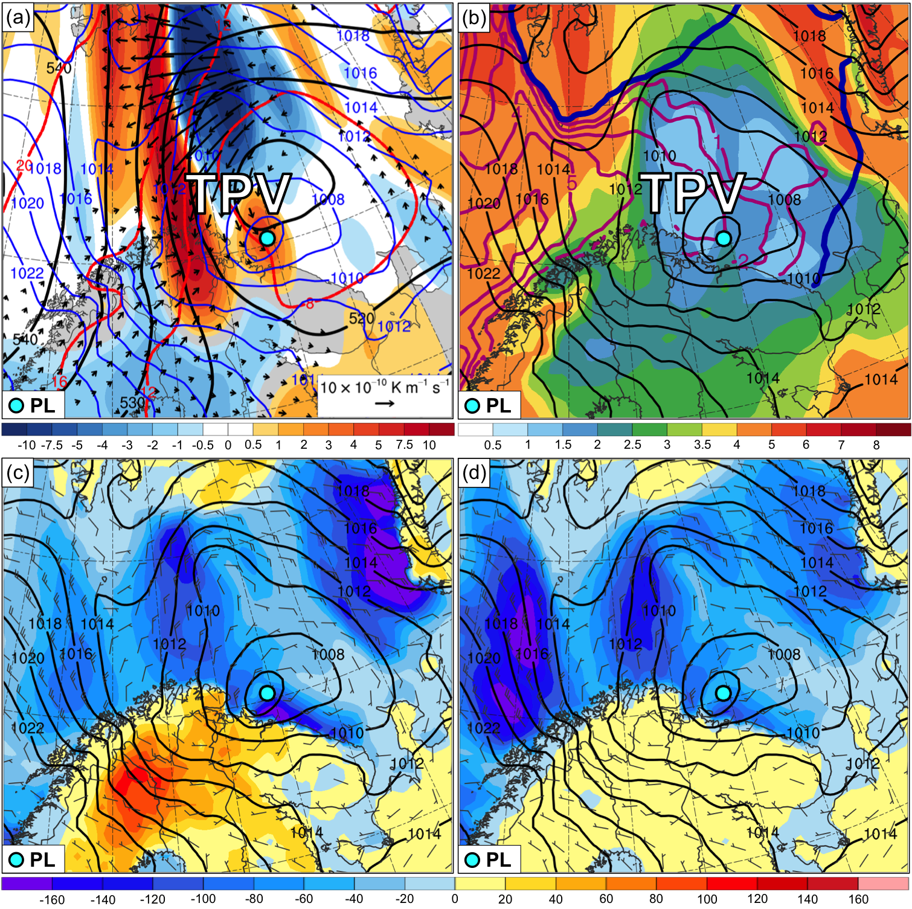
Fig. 6
0300 UTC 11 Feb 2011
(a) SLP (hPa, blue), and 600–400-hPa layer-averaged Q (K m⁻¹ s⁻¹, vectors), Q forcing for vertical motion (10⁻¹⁷ Pa⁻¹ s⁻³, shaded), geopotential height (dam, black), and potential temperature (°C, red)
(b) 900–600-hPa layer-averaged static stability [K (100 hPa)⁻¹, shaded], SLP (hPa, black), SST (°C, purple), and 20% contour of sea-ice concentration (thick blue)
(c) SLP (hPa, black), 10-m wind (m s⁻¹, barbs), and forecast sensible heat flux (W m⁻², shaded)
(d) SLP (hPa, black), 10-m wind (m s⁻¹, barbs), and forecast latent heat flux (W m⁻², shaded)

Slide 35
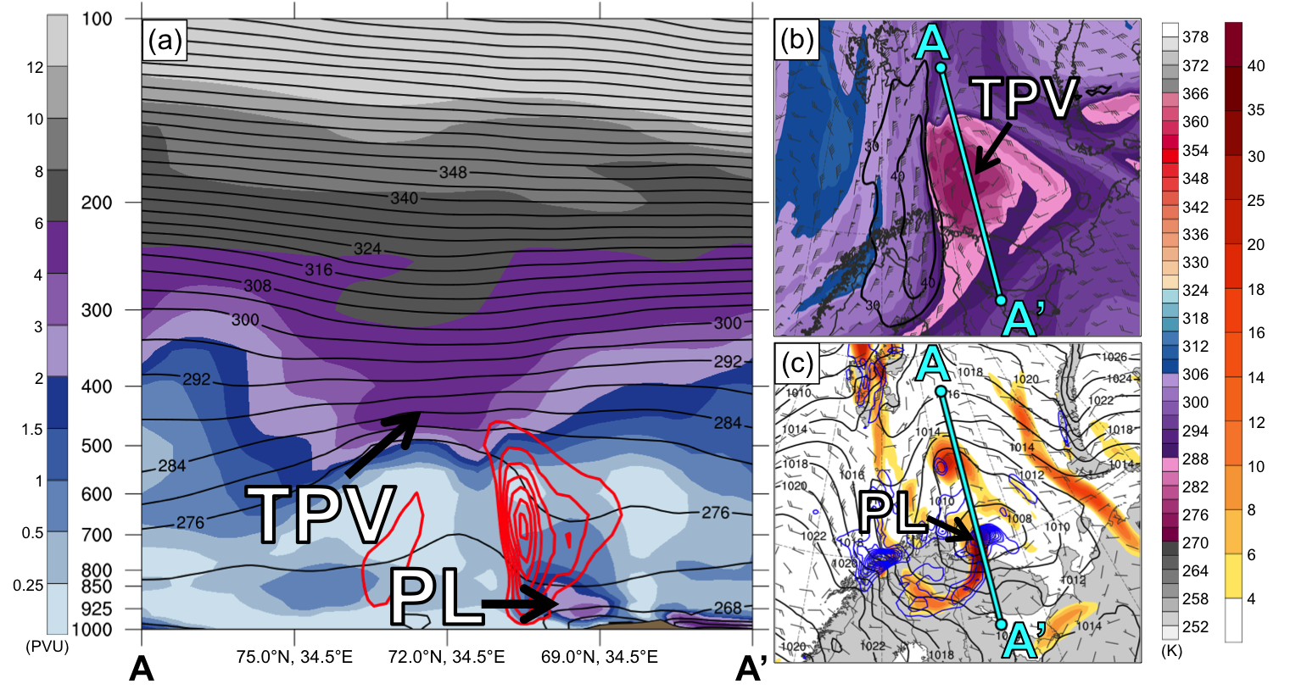
Fig. 7
0300 UTC 11 Feb 2011
(a) PV (PVU, shaded), θ (K, black), and ascent (red, every 2.5 × 10⁻³ hPa s⁻¹); (b) DT (2-PVU surface) θ (K, shaded), wind speed (black, m s⁻¹), and wind (m s⁻¹, flags and barbs); (c) 850-hPa relative vorticity (10⁻⁵ s⁻¹, shaded), 850–600-hPa ascent (blue, every 2.5 × 10⁻³ hPa s⁻¹), SLP (hPa, black), and 10-m wind (m s⁻¹, barbs)

Slide 36
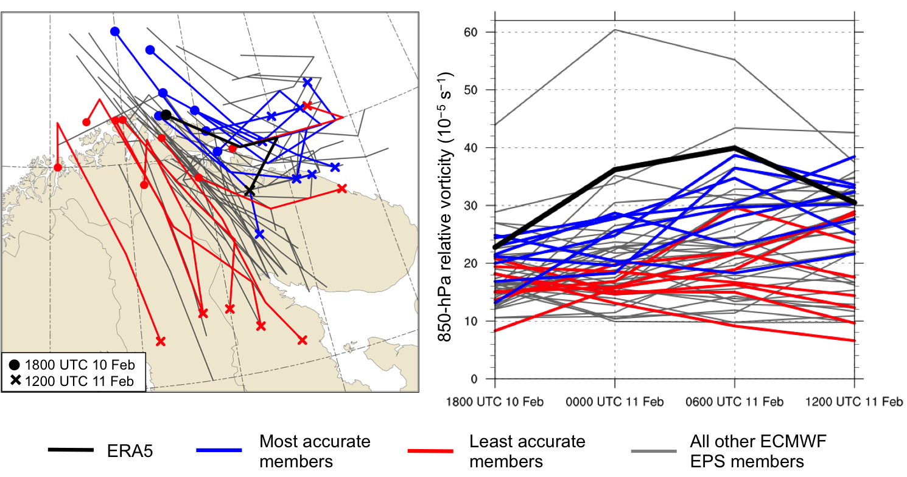
Fig. 8
(a) Track and (b) intensity of 850-hPa relative vorticity maximum (10⁻⁵ s⁻¹) associated with polar low, every 6 h during 1800 UTC 10–1200 UTC 11 February 2011 for ERA5 (black), most accurate members (blue), least accurate members (red), and all other ECMWF EPS members (gray)

Slide 37
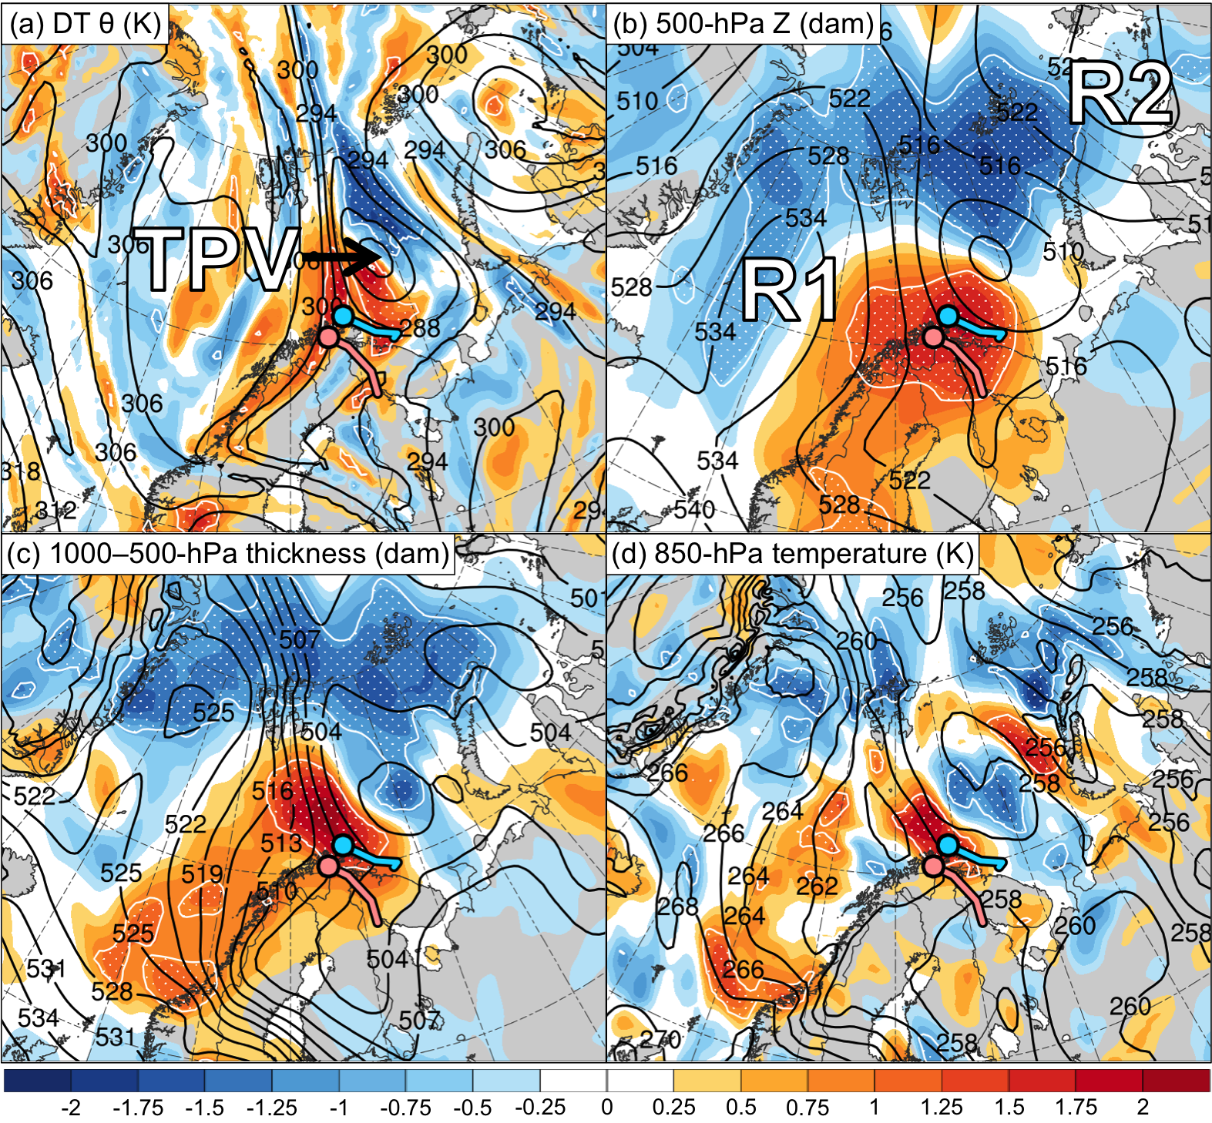
Fig. 9
1800 UTC 10 Feb 2011 (30 h)
Ensemble mean
shading: normalized composite differences (most accurate minus least accurate)
stippling: statistically significant differences between groups at 95% confidence level
Mean position of PL in most accurate group*
Mean position of PL in least accurate group*
*Corresponding line shows mean track of PL from 1800 UTC 10 to 1200 UTC 11 Feb 2011
Normalized composite difference between the most accurate and least accurate group (shading; units: standardized anomaly) and ensemble mean (black contours) of (a) DT (2-PVU surface) potential temperature (K), (b) 500-hPa geopotential height (dam), (c) 1000–500-hPa thickness (dam), and (d) 850-hPa temperature (K).

