Slide 1
Phenomenological and Predictability Studies of the Structure and Evolution of Arctic Cyclones, Polar Lows, and Tropopause Polar Vortices
Lance Bosart, Dan Keyser, Kevin Biernat, Mansour El Riachy, and Scott Feldman
Department of Atmospheric and Environmental Sciences
University at Albany, State University of New York
Tuesday 7 July 2020
ONR DRI Arctic Cyclone Workshop
Research Supported by ONR Grant N00014-18-1-2200

Slide 2
Project Objective
This project addresses three research topics concerned with improving the prediction of tropopause polar vortices (TPVs) and Arctic cyclones (ACs).
This project is expected to contribute to advances in the understanding and prediction of TPVs and ACs on synoptic-to-subseasonal time scales.
This project is being conducted by the PI (Lance Bosart), Co-PI (Dan Keyser), and three DAES graduate students (Kevin Biernat, Mansour El Riachy, and Scott Feldman).

Slide 3
Prospective Collaborations
The opportunity exists to collaborate with Steven Cavallo (TPVs and ACs), Jim Doyle (NWP), Andrea Lang (stratospheric dynamics), and Ryan Torn (predictability) in their indicated areas of expertise.

Slide 4
Research Topics
The role of longitudinally localized incursions of warm, moist air from middle latitudes in disrupting the tropospheric polar vortex and in reconfiguring the large-scale baroclinicity over the Arctic.
The influence of reconfigurations of large-scale baroclinicity, high-latitude ridge amplification and blocking, sea ice and snow cover boundaries, and radiative processes on the genesis and evolution of TPVs and ACs.

Slide 5
Research Topics
The dependence of predictability horizons of TPVs and ACs on model uncertainty on synoptic-to-subseasonal time scales as determined through the synoptic evaluation of the forecast skill of deterministic and ensemble prediction systems.

Slide 6
Comparing Arctic Cyclones between Periods of Low and High Forecast Skill of the Synoptic-Scale Flow over the Arctic during Summer
Kevin Biernat, Daniel Keyser, and Lance Bosart
Department of Atmospheric and Environmental Sciences
University at Albany, State University of New York
Tuesday 7 July 2020
ONR DRI Arctic Cyclone Workshop

Slide 7
Data and Methods
Constructed a 2007–2017 summer (JJA) climatology of ACs using cyclone tracks from 1° ERA-Interim cyclone climatology prepared by Sprenger et al. (2017).
Determined periods of low and high forecast skill of the synoptic-scale flow over the Arctic during summer based on day-5 forecasts of 500-hPa geopotential height over the Arctic in the GEFS reforecast dataset version 2.
Selected ACs that exist in the Arctic (> 70°N) within the low and high skill periods for further analysis.

Slide 8
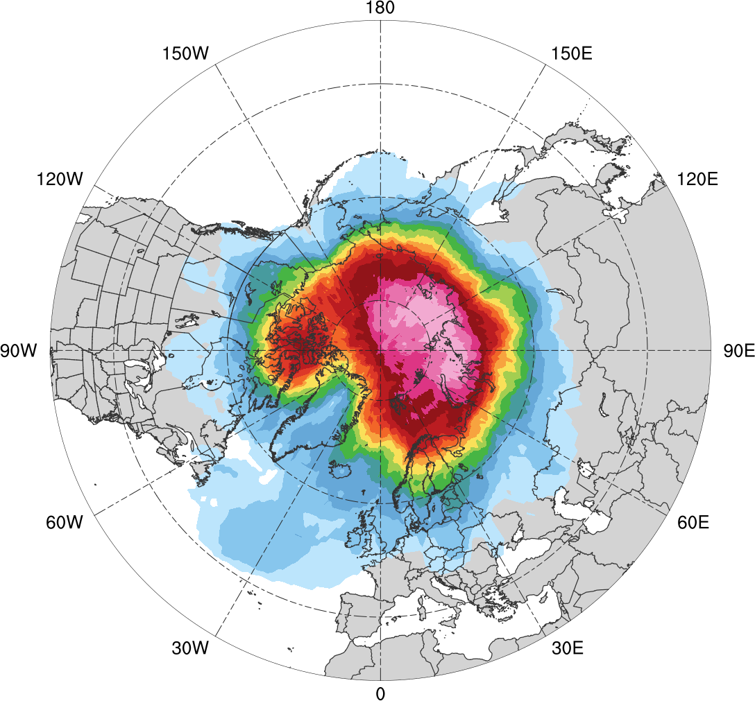
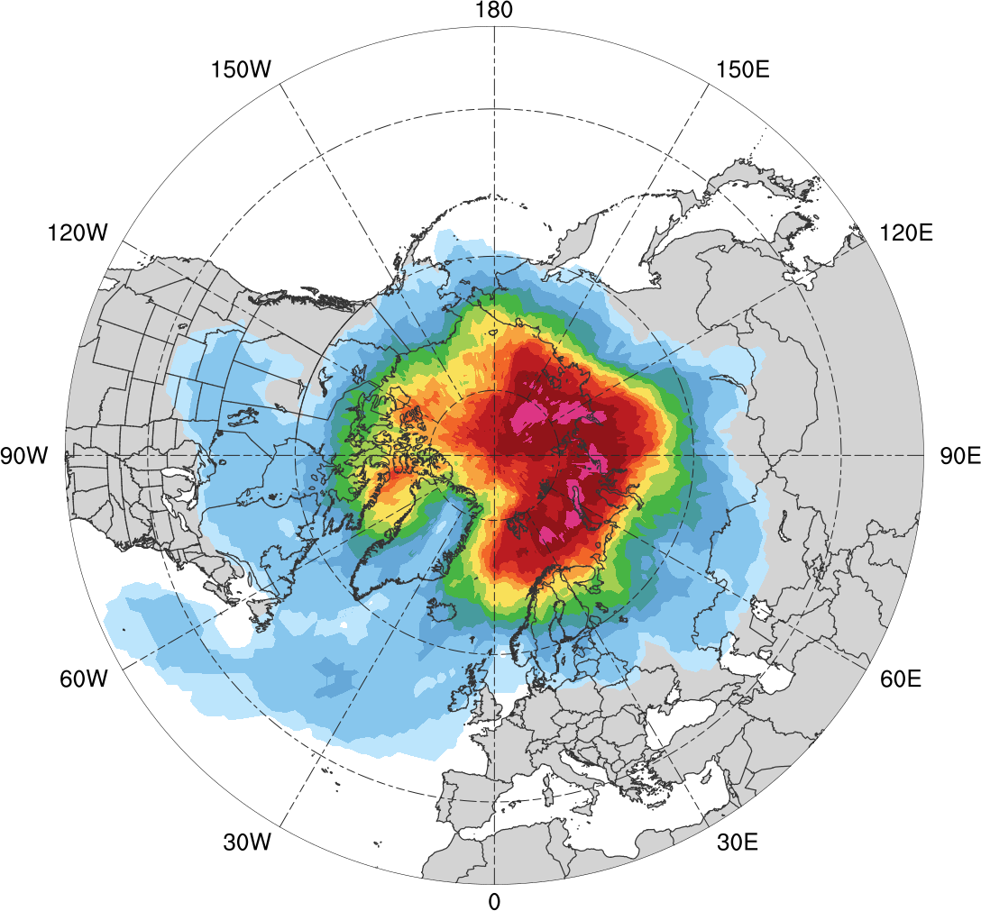
AC Track Frequency during Summer
Low skill (N = 307)
High skill (N = 216)
0.005
0.01
0.02
0.03
0.04
0.05
0.06
0.07
0.08
0.09
0.1
0.12
0.14
0.16
0.18
Total number of ACs within 500 km of a grid point, divided by number of days in period (number of ACs day⁻¹)

Slide 9
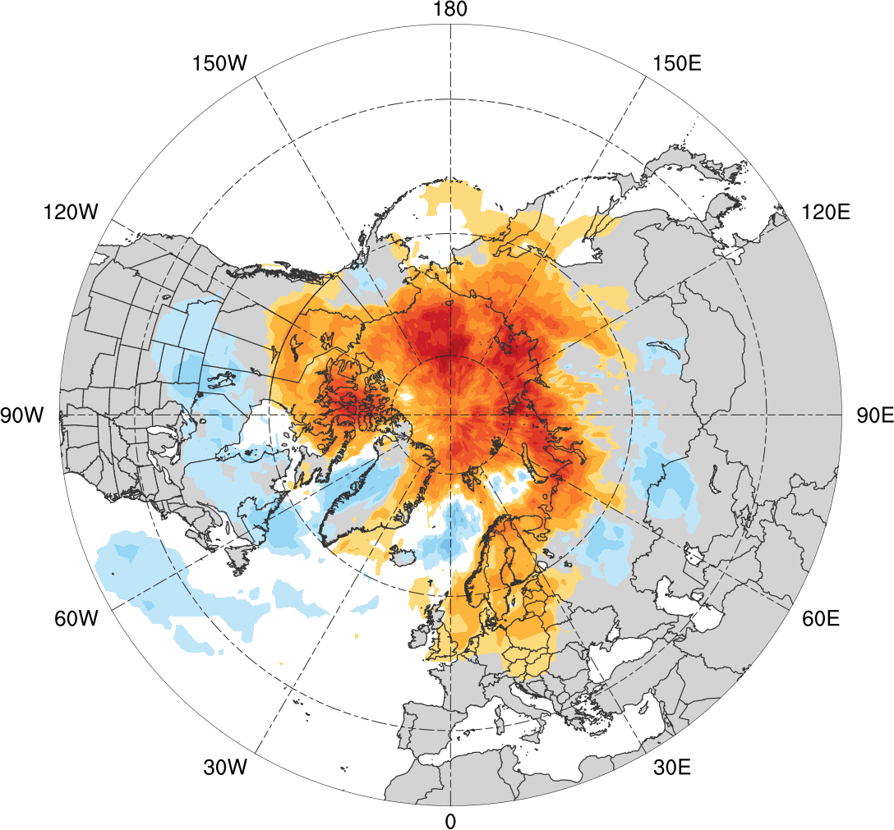
AC Track Frequency Difference during Summer
Low skill minus high skill
-0.07
-0.06
-0.05
-0.04
-0.03
-0.02
-0.01
-0.005
0
0.005
0.01
0.02
0.03
0.04
0.05
0.06
0.07
Difference in AC track frequency (number of ACs day⁻¹)

Slide 10
Data and Methods
Determined top 25% strongest ACs for low and high skill periods during summer in terms of lowest SLP of ACs when located in the Arctic during these periods.
Determined root mean square error (RMSE) of intensity and position of the ACs valid at time of aforementioned lowest SLP for forecasts in GEFS reforecast dataset v2.

Slide 11
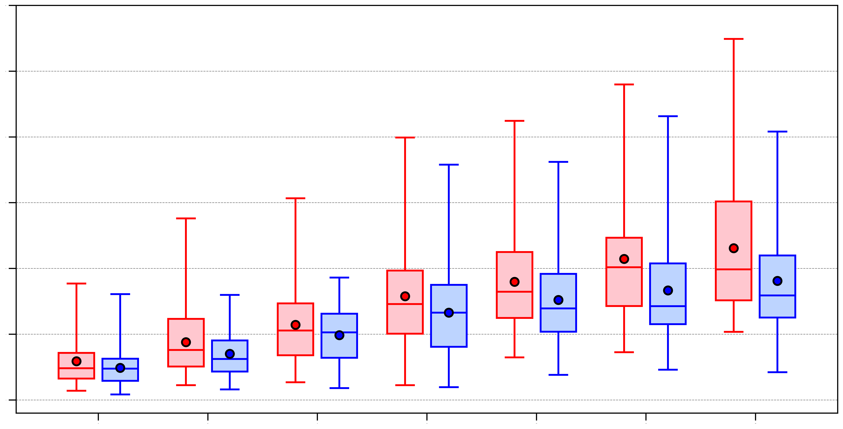
Intensity RMSE of Strongest ACs during Summer
30
Low skill
High skill
25
20
15
Intensity RMSE (hPa)
10
5
0
N=73
N=52
N=76
N=53
N=76
N=52
N=75
N=52
N=74
N=54
N=76
N=52
N=73
N=53
24
48
72
96
120
144
168
Forecast Lead Time (h)
max
75%
RMSE of minimum SLP (hPa) of ACs for forecasts valid at time of lowest SLP of the ACs when located in the Arctic during low and high skill periods
median
mean
25%
min

Slide 12
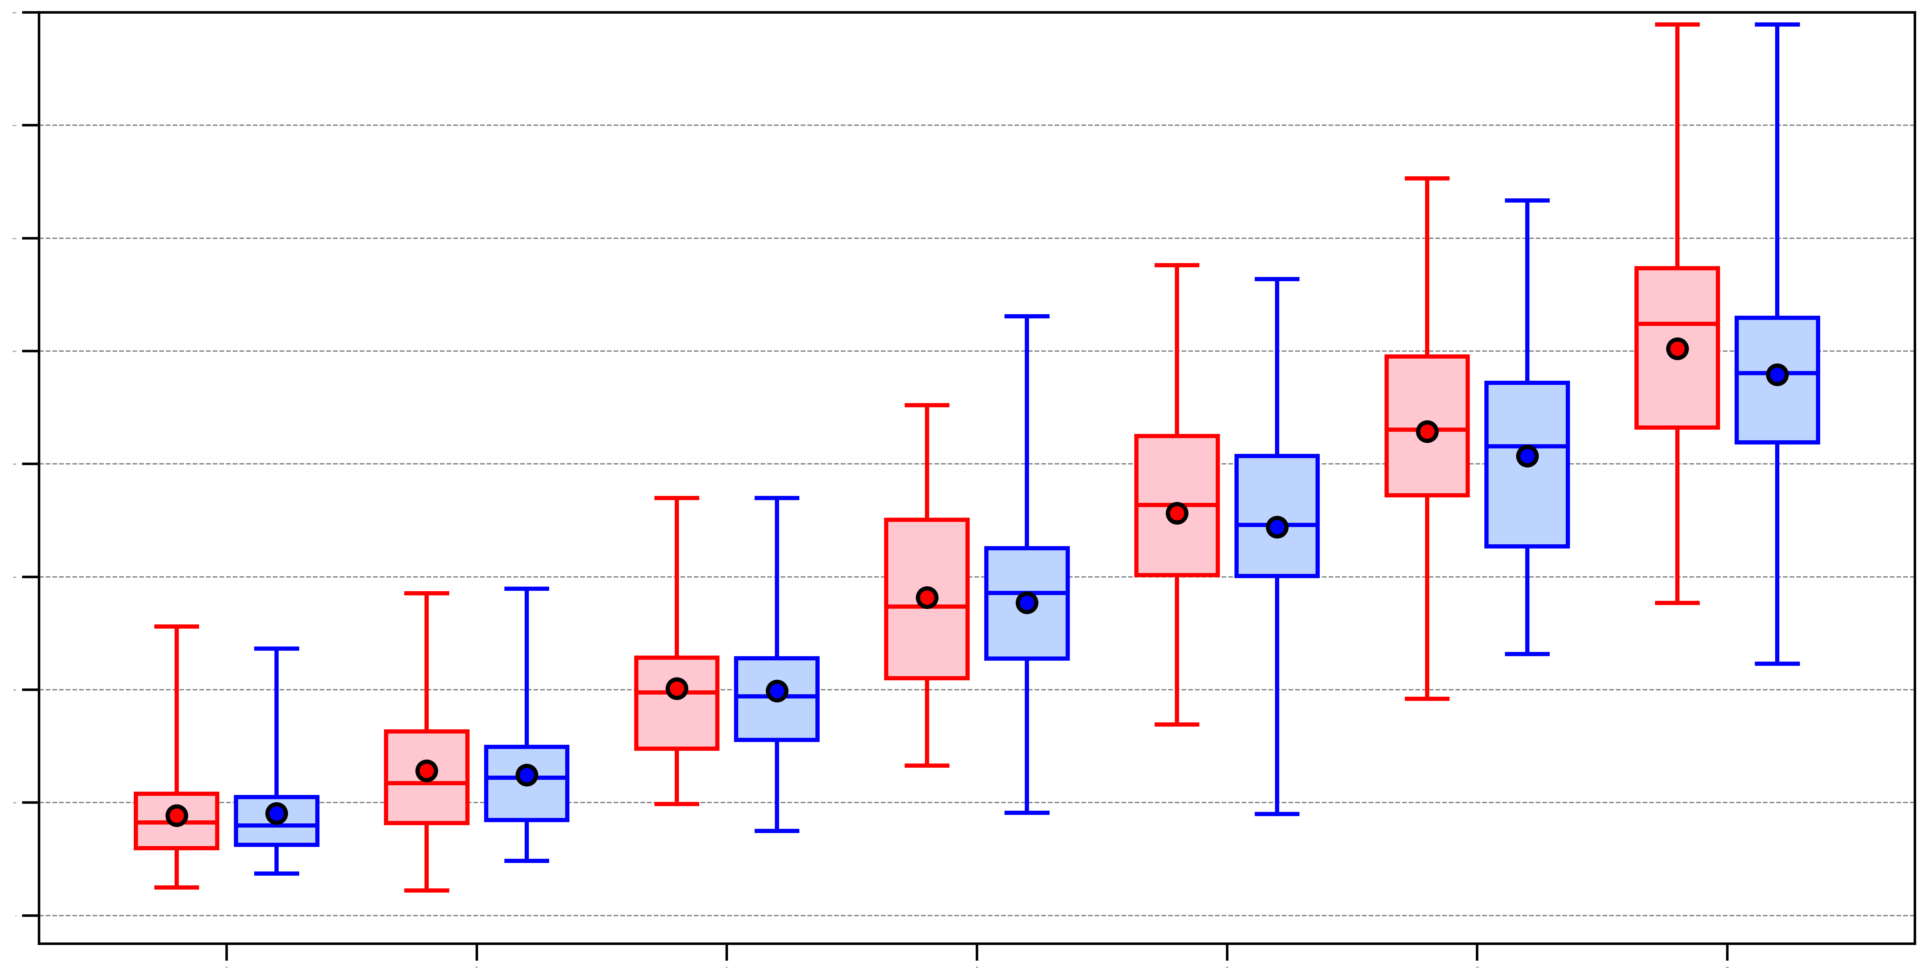
Position RMSE of Strongest ACs during Summer
1600
Low skill
High skill
1400
1200
1000
800
Position RMSE (km)
600
400
200
0
N=73
N=52
N=76
N=53
N=76
N=52
N=75
N=52
N=74
N=54
N=76
N=52
N=73
N=53
24
48
72
96
120
144
168
Forecast Lead Time (h)
max
75%
RMSE of position (km) of ACs for forecasts valid at time of lowest SLP of the ACs when located in the Arctic during low and high skill periods
median
mean
25%
min

Slide 13
Future Research
Determine how characteristics of ACs vary as a function of the forecast skill of the ACs.
Perform composite analyses using the ERA5 on selected categories of ACs.
Perform ensemble sensitivity analysis on several ACs from the selected categories using the ECMWF ensemble prediction system.

Slide 14
A Synoptic Analysis of the Late July–Early August 2019 Major Greenland Surface Ice-Melt Event
Scott Feldman, Lance Bosart, and Daniel Keyser
Department of Atmospheric and Environmental Sciences
University at Albany, State University of New York
Tuesday 7 July 2020
ONR DRI Arctic Cyclone Workshop

Slide 15
Background Information

Slide 17
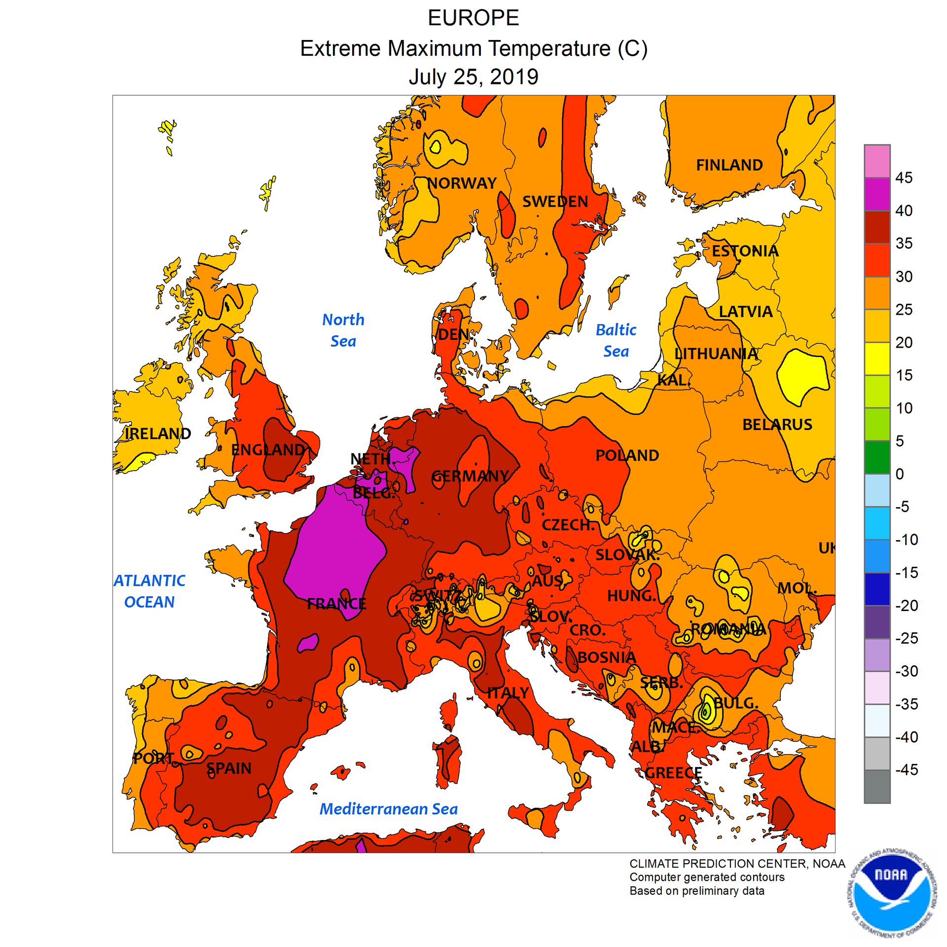
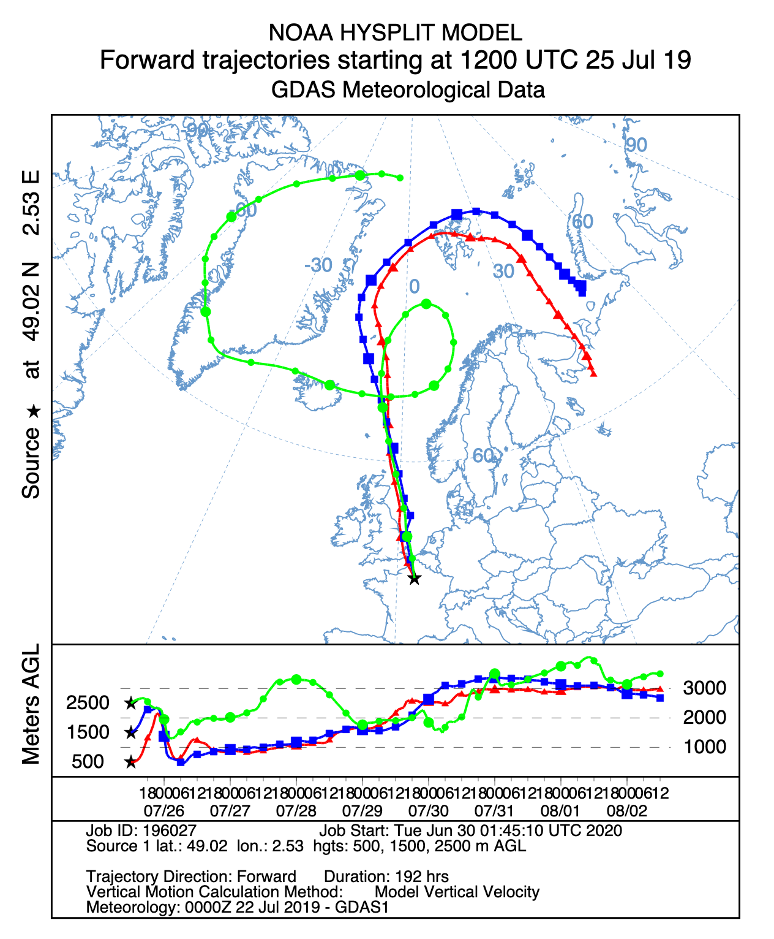
European Heat and Forward Trajectories
Paris
All-time European Heat Records on 25 July 2019
France: Paris (42.6 °C) [Previous: 40.4 °C]
Germany: Lingen (42.6 °C) [Previous: 40.3 °C] Luxembourg: Steinsel (40.8 °C ) [Previous: 40.5 °C] Netherlands: Gilze-Rijen (40.7 °C) [Previous: 38.6 °C] UK: Cambridge Univ. (38.7 °C) [Previous: 38.5 °C]

Slide 18
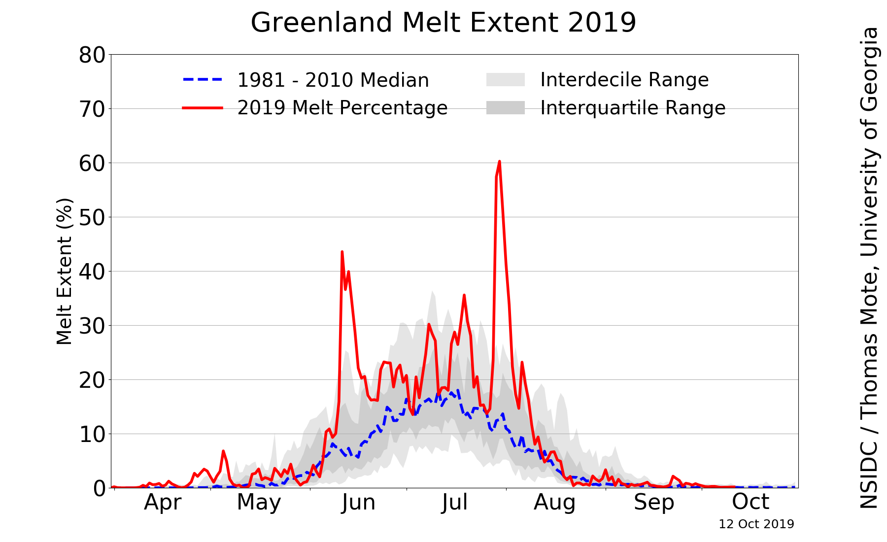
Motivation
Source: NSIDC/Thomas Mote, University of Georgia;
http://nsidc.org/greenland-today/

Slide 19
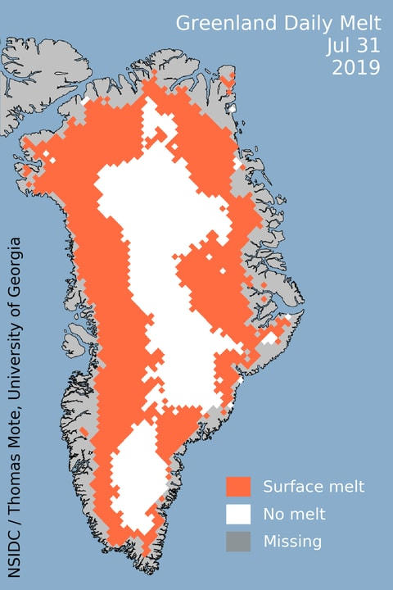
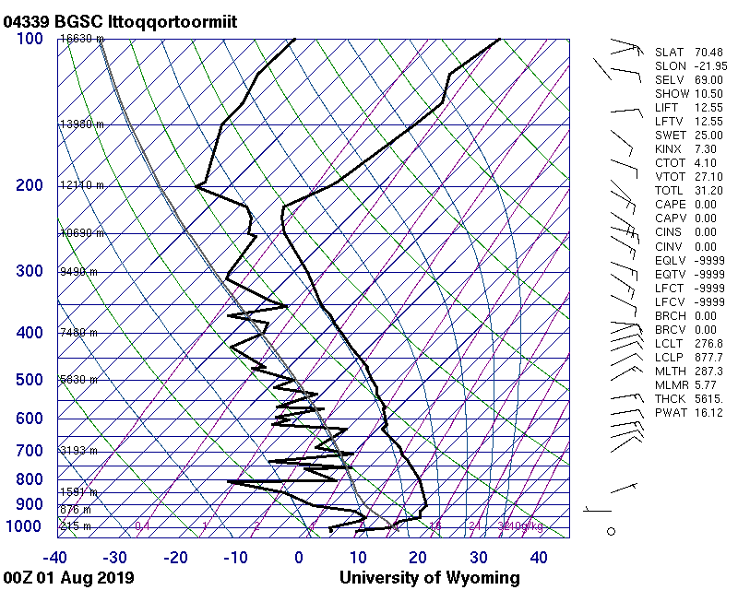
Motivation
Source: University of Wyoming
Notes:
850 mb temperatures as high as 12 degrees Celsius. Warm layer reaching the highest elevations of the ice sheet

Slide 20
Motivation
Investigate the antecedent evolution of the large-scale flow pattern that contributed to a record-breaking surface ice-melt event over Greenland during 31 July–1 August 2019

Slide 21
Data and Methods
Use the CFSR 0.5° gridded reanalyses (Saha et al. 2010) to illustrate and document the antecedent large-scale flow evolution that governed a record-breaking Greenland surface ice-melt event
Use the NOAA HYSPLIT trajectory model to investigate the origin of anomalously warm air that contributed to a record-breaking Greenland surface ice-melt event

Slide 22
Case Overview
Cyclonic flow over the Arctic Ocean on 22–24 July was replaced by anticyclonic flow with a strong ridge near the North Pole on 25–27 July
A deep trough over the eastern Atlantic on 24–27 July enabled a ridge over northwestern Africa to build poleward across western Europe to Scandinavia
A blocking anticyclone was established over Scandinavia as Saharan air reached western Europe and Scandinavia by 26–27 July
Modified Saharan air reached Greenland as the blocking Scandinavian anticyclone shifted westward during 31 July–1 August

Slide 23
Loop of 500-hPa heights and winds, and standardized height anomalies (sigma) for 0000 UTC 22 July to 2 August 2019

Slide 24
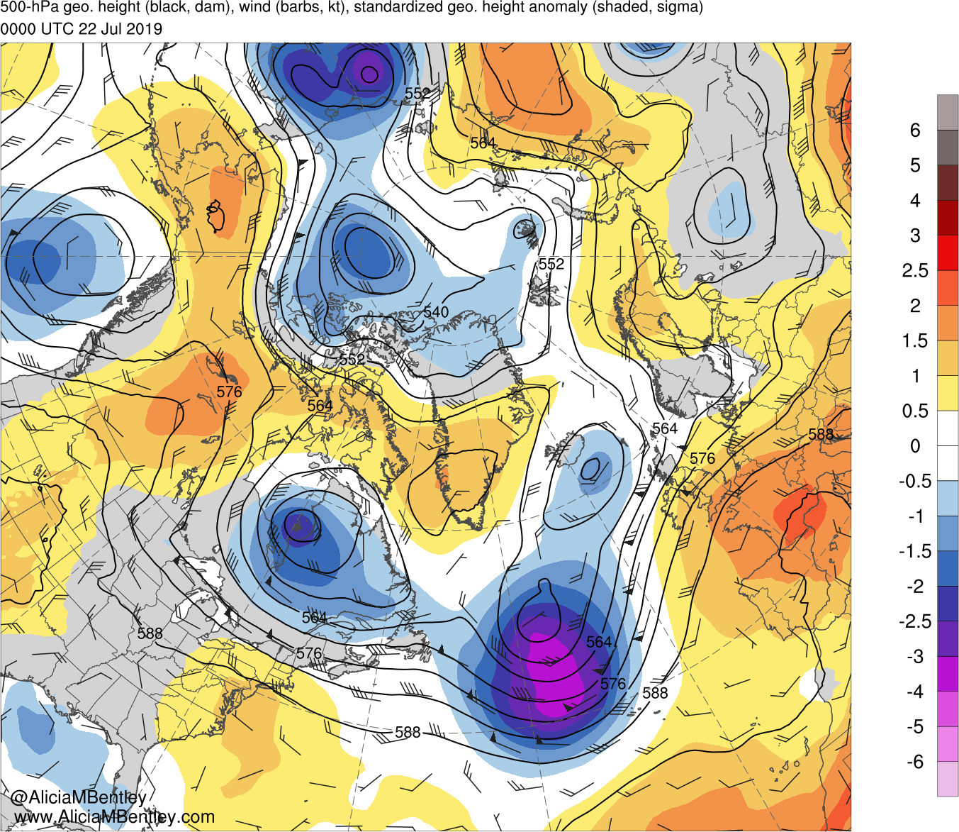
0000 UTC 22 July 2019

Slide 25
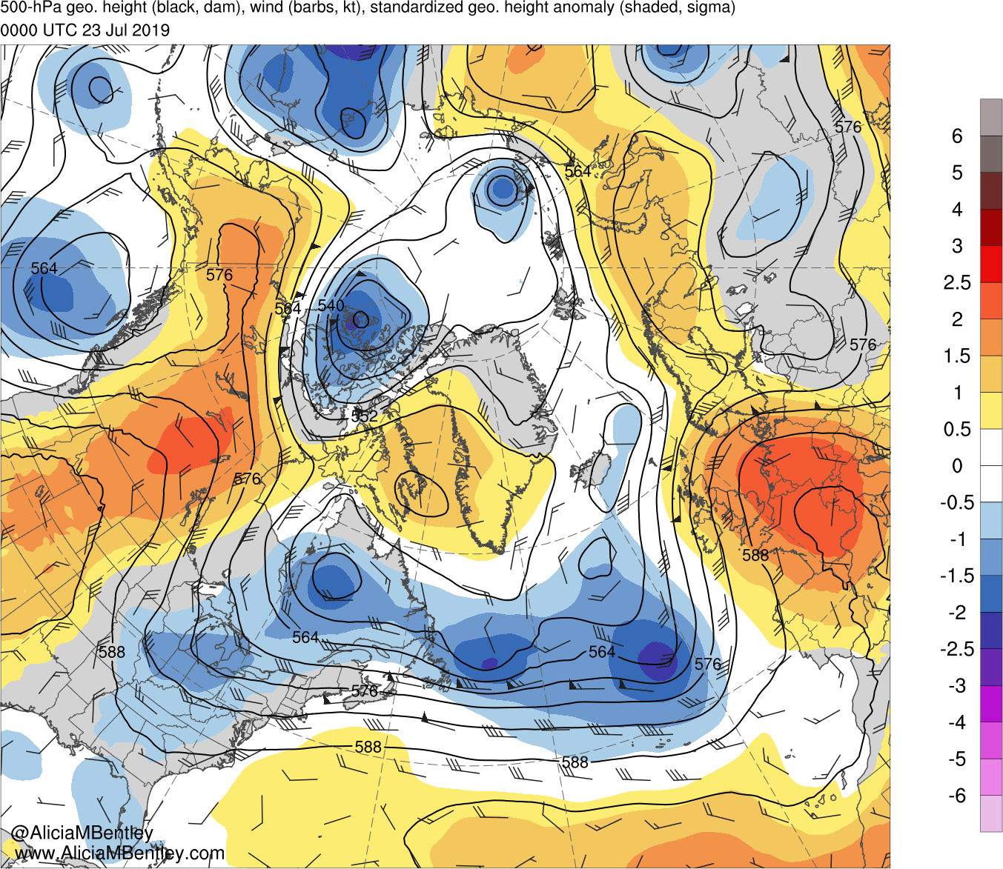
0000 UTC 23 July 2019

Slide 26
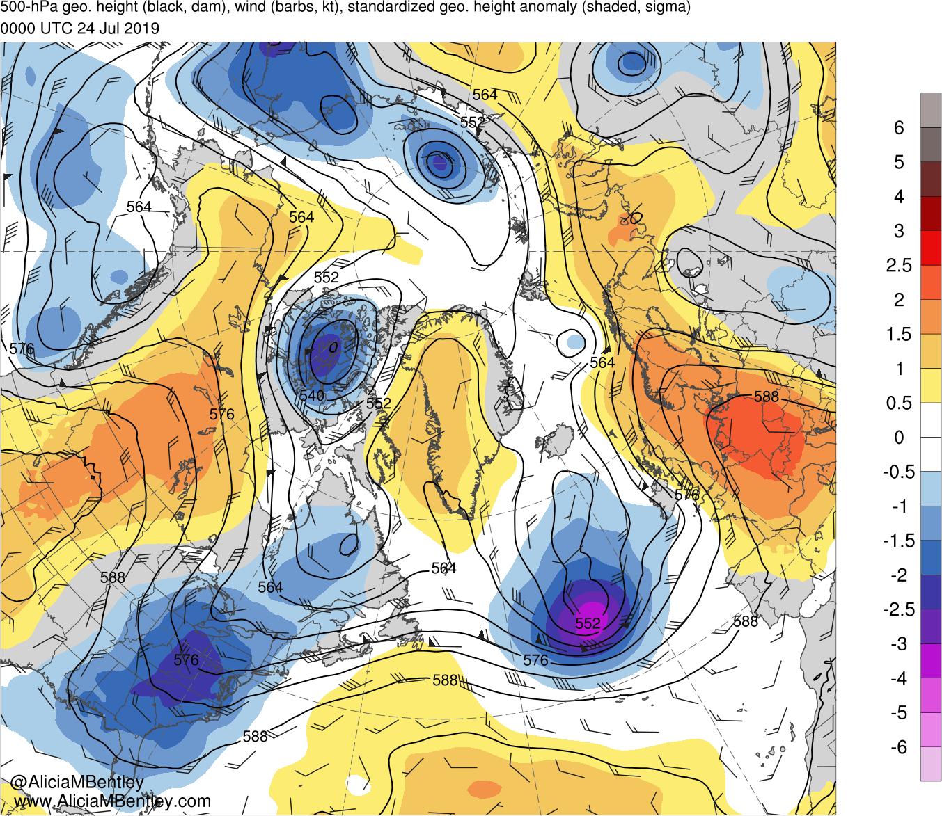
0000 UTC 24 July 2019

Slide 27
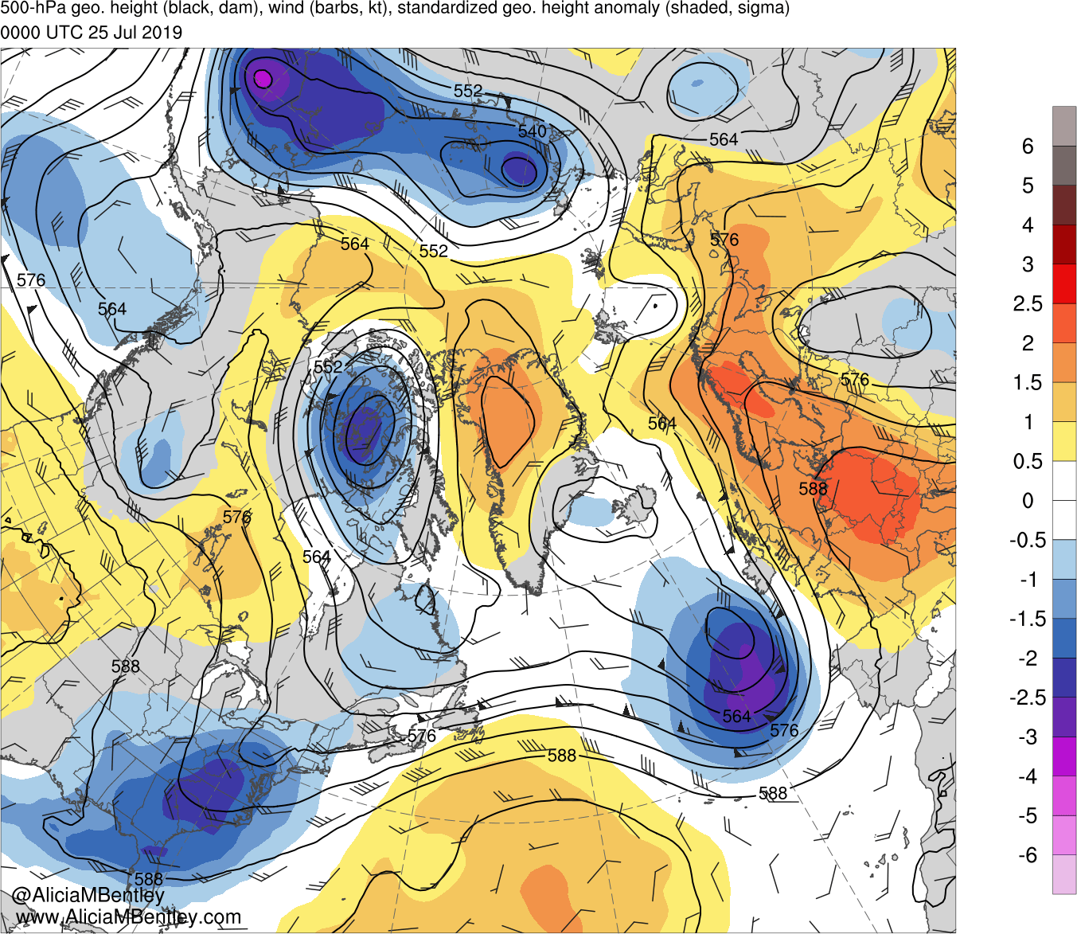
0000 UTC 25 July 2019

Slide 28
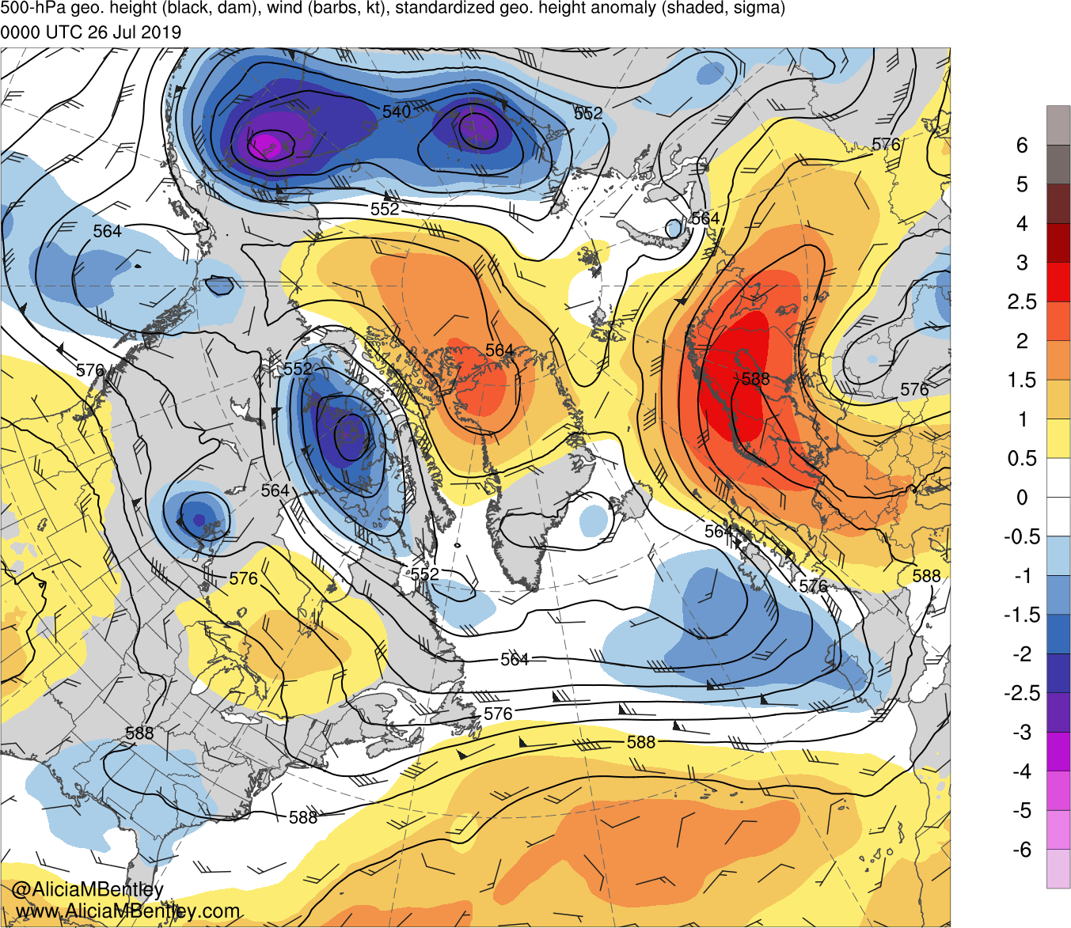
0000 UTC 26 July 2019

Slide 29
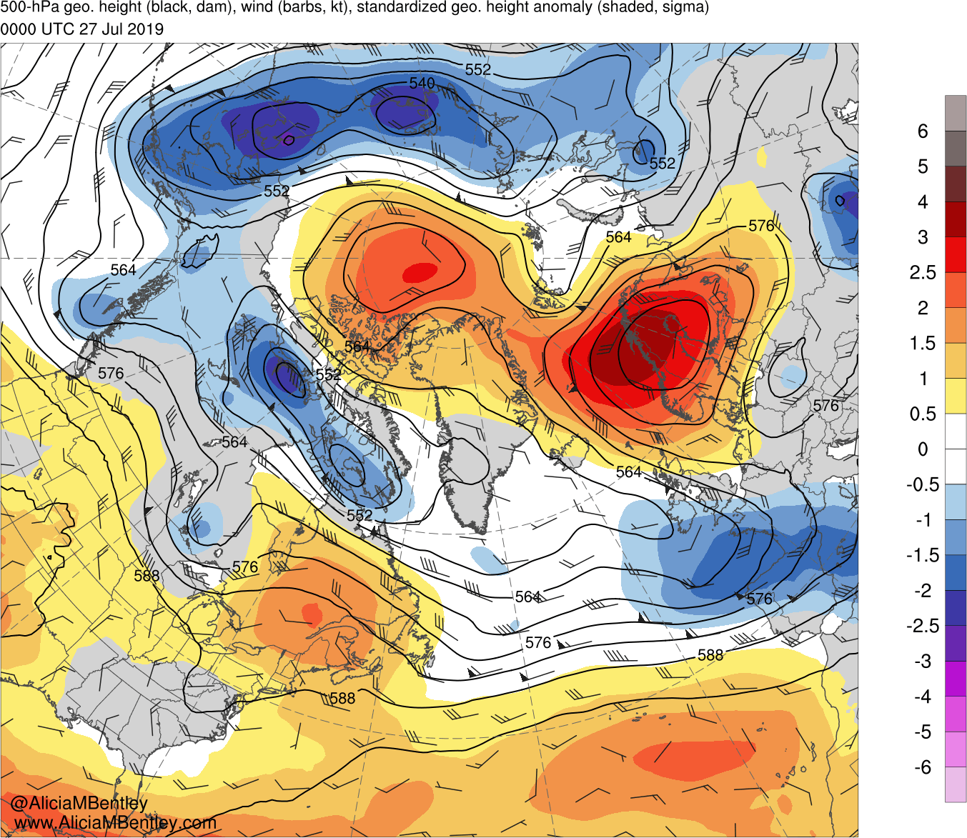
0000 UTC 27 July 2019

Slide 30
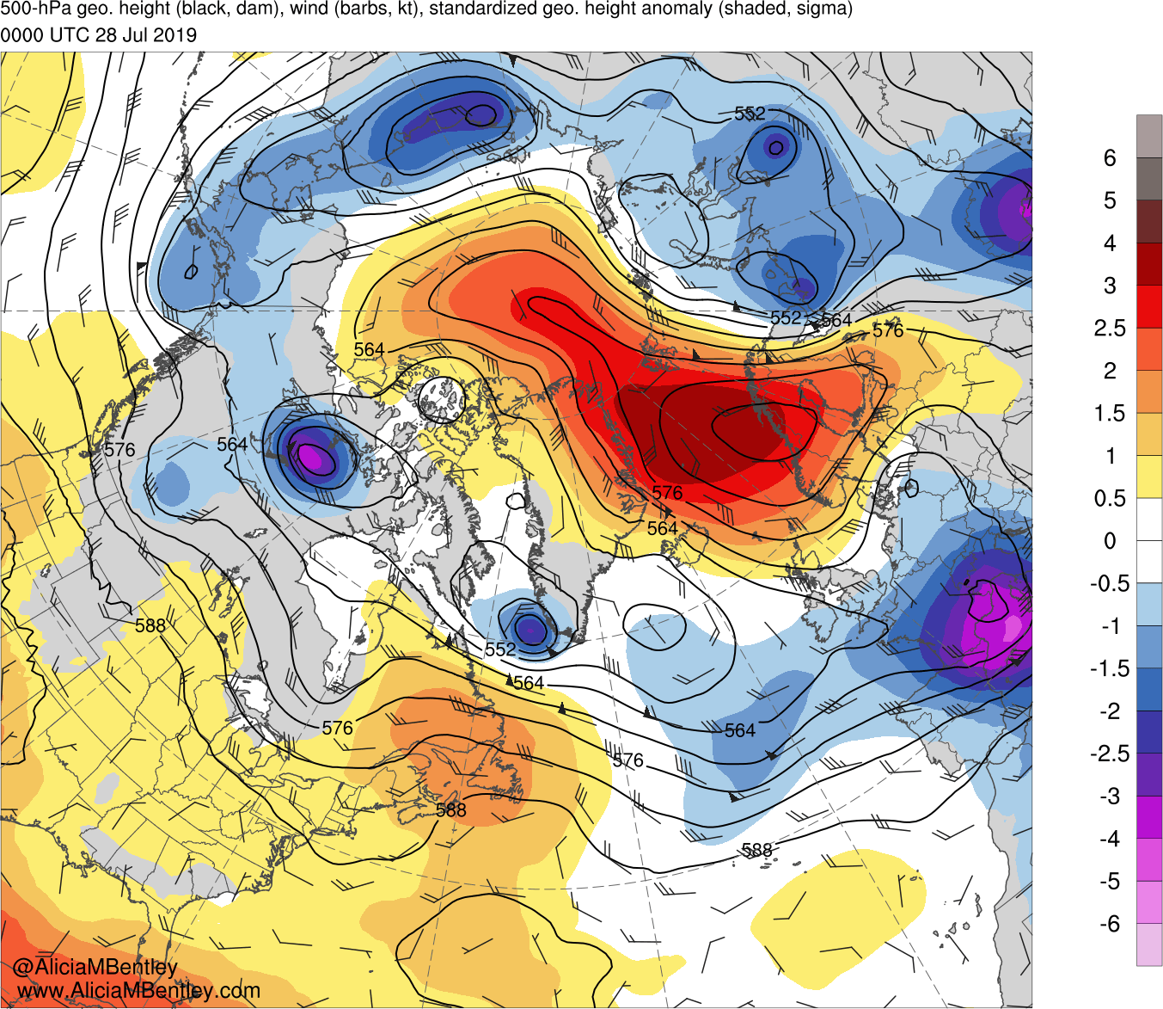
0000 UTC 28 July 2019

Slide 31
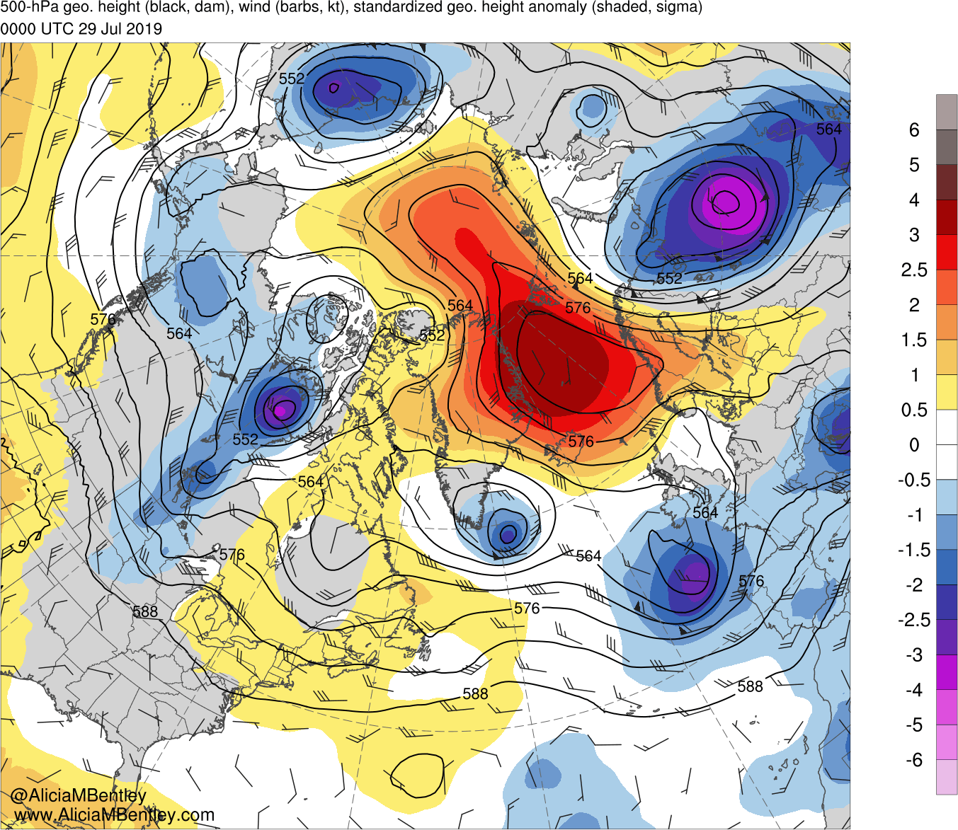
0000 UTC 29 July 2019

Slide 32
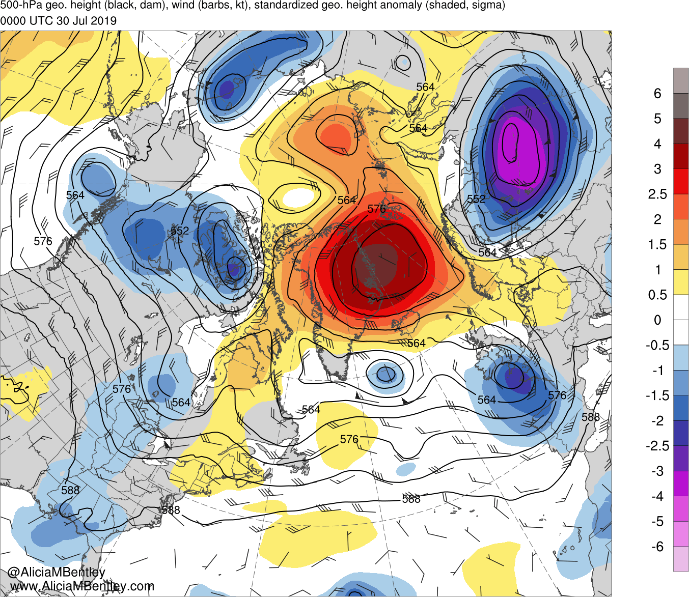
0000 UTC 30 July 2019

Slide 33
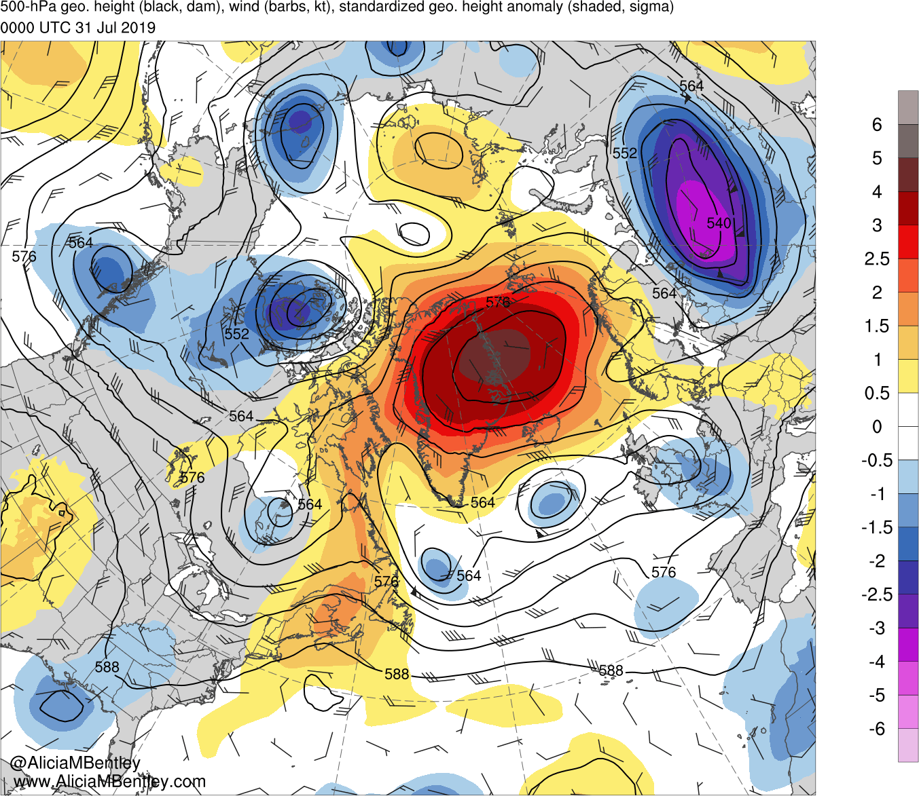
0000 UTC 31 July 2019

Slide 34
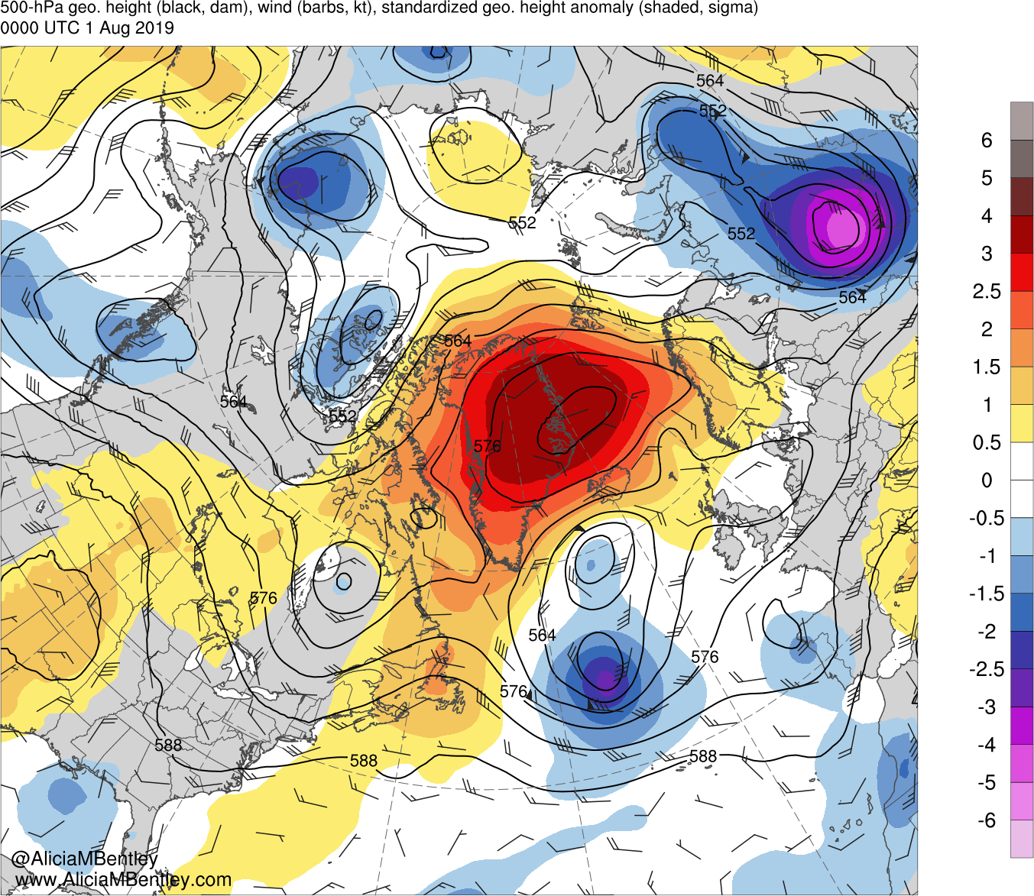
0000 UTC 1 August 2019

Slide 35
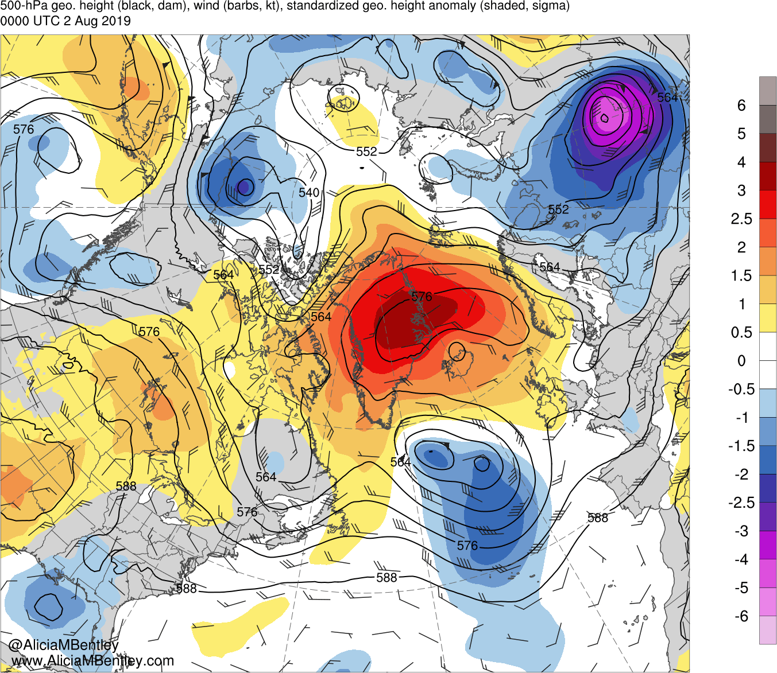
0000 UTC 2 August 2019

Slide 36
Loop of 850-hPa heights, temperatures, and winds, and standardized temperature anomalies (sigma) for 0000 UTC 22 July to 2 August 2019

Slide 37
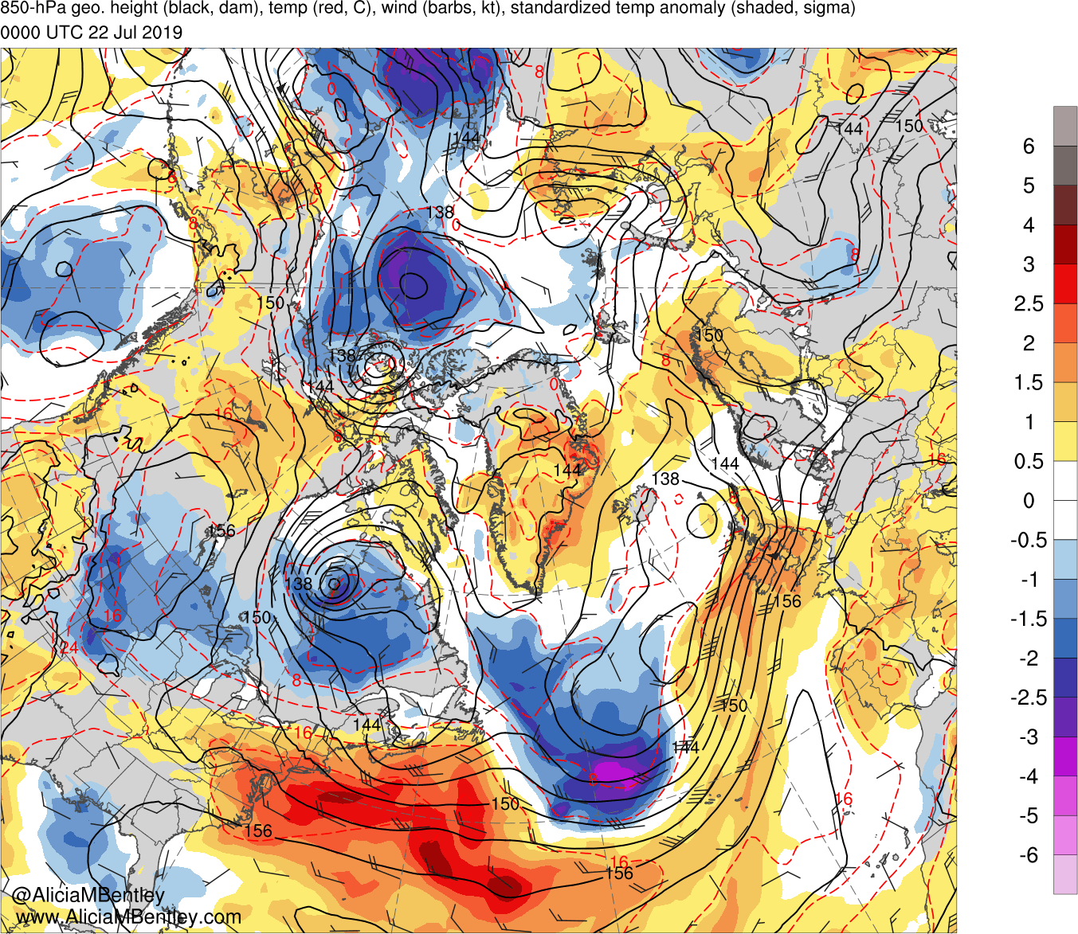
0000 UTC 22 July 2019

Slide 38
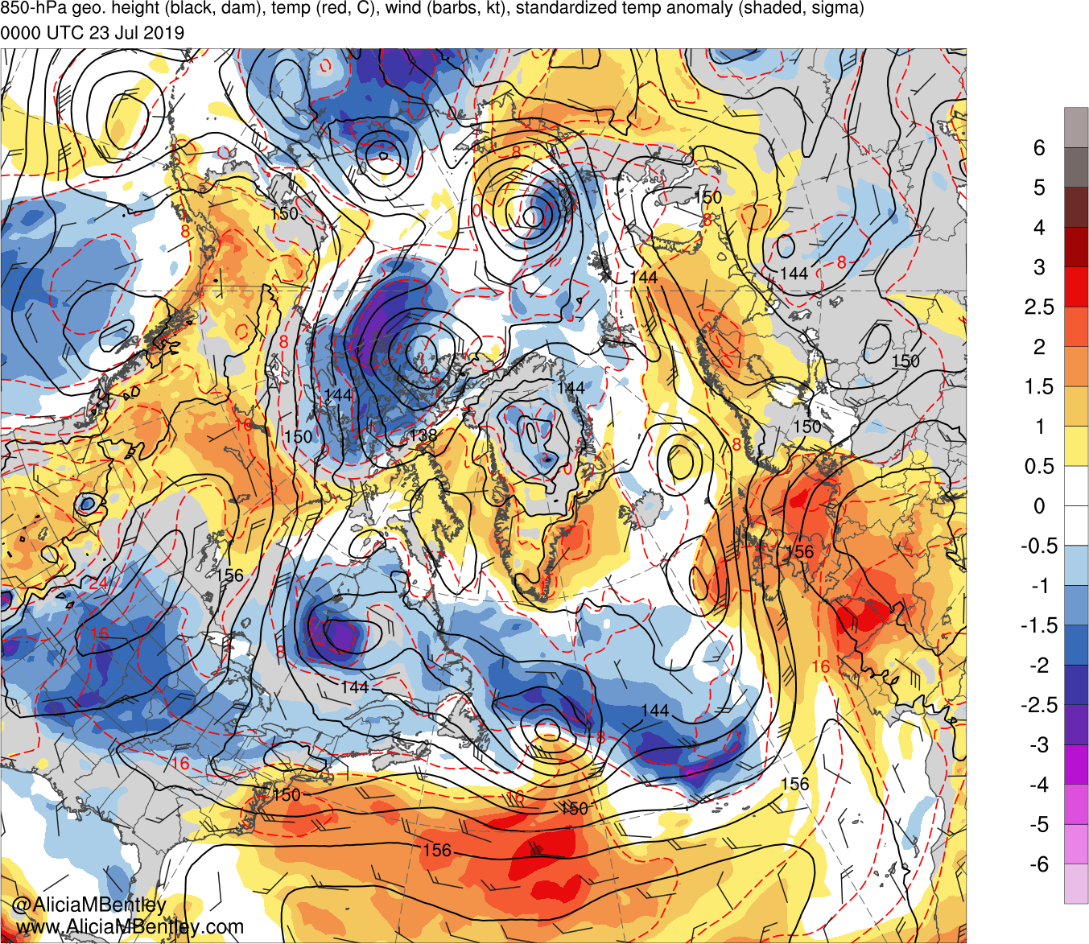
0000 UTC 23 July 2019

Slide 39
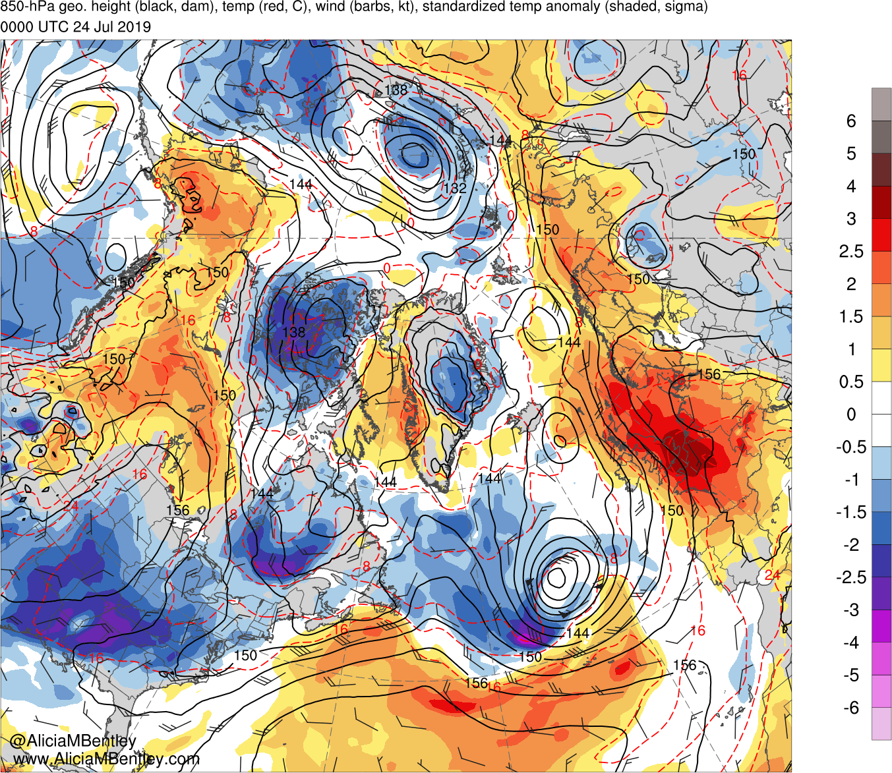
0000 UTC 24 July 2019

Slide 40
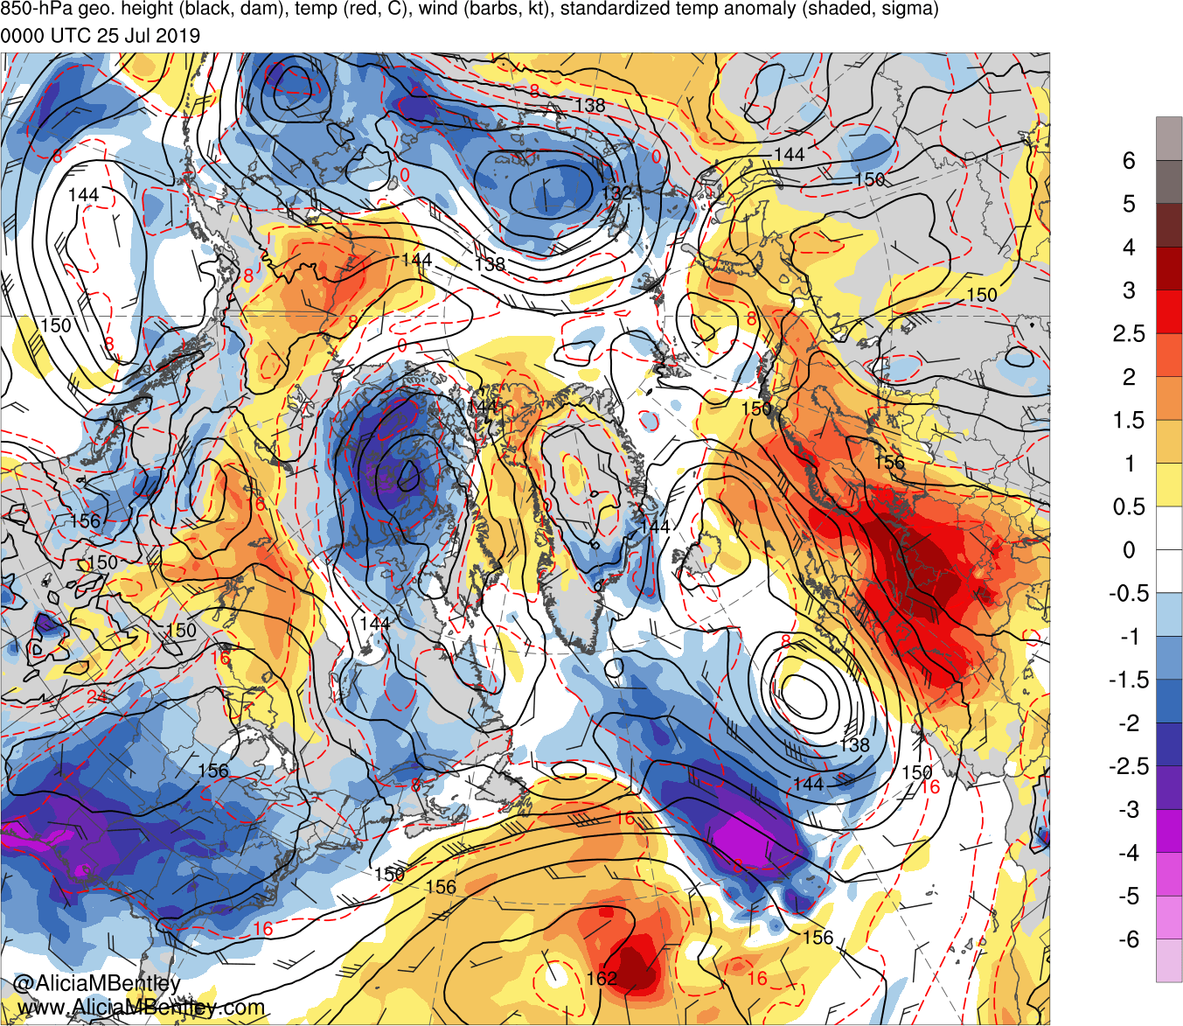
0000 UTC 25 July 2019

Slide 41
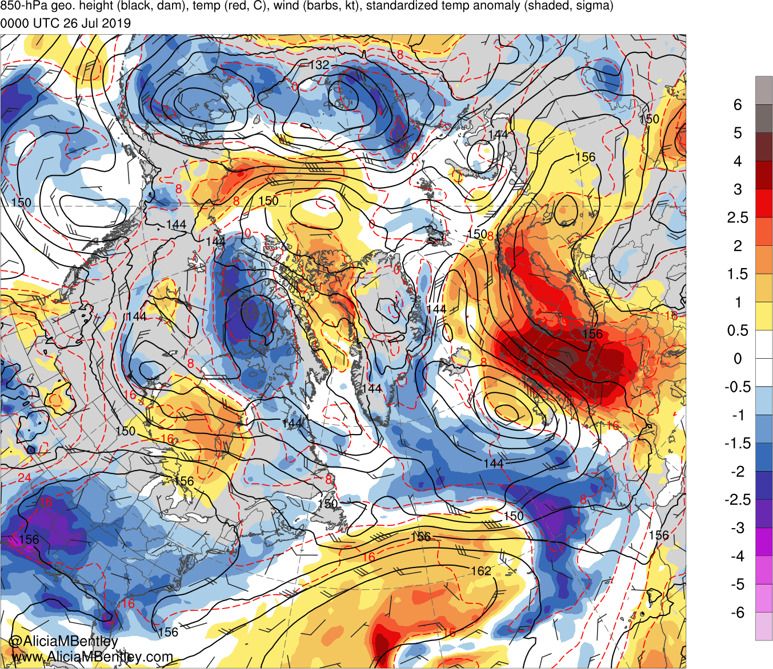
0000 UTC 26 July 2019

Slide 42
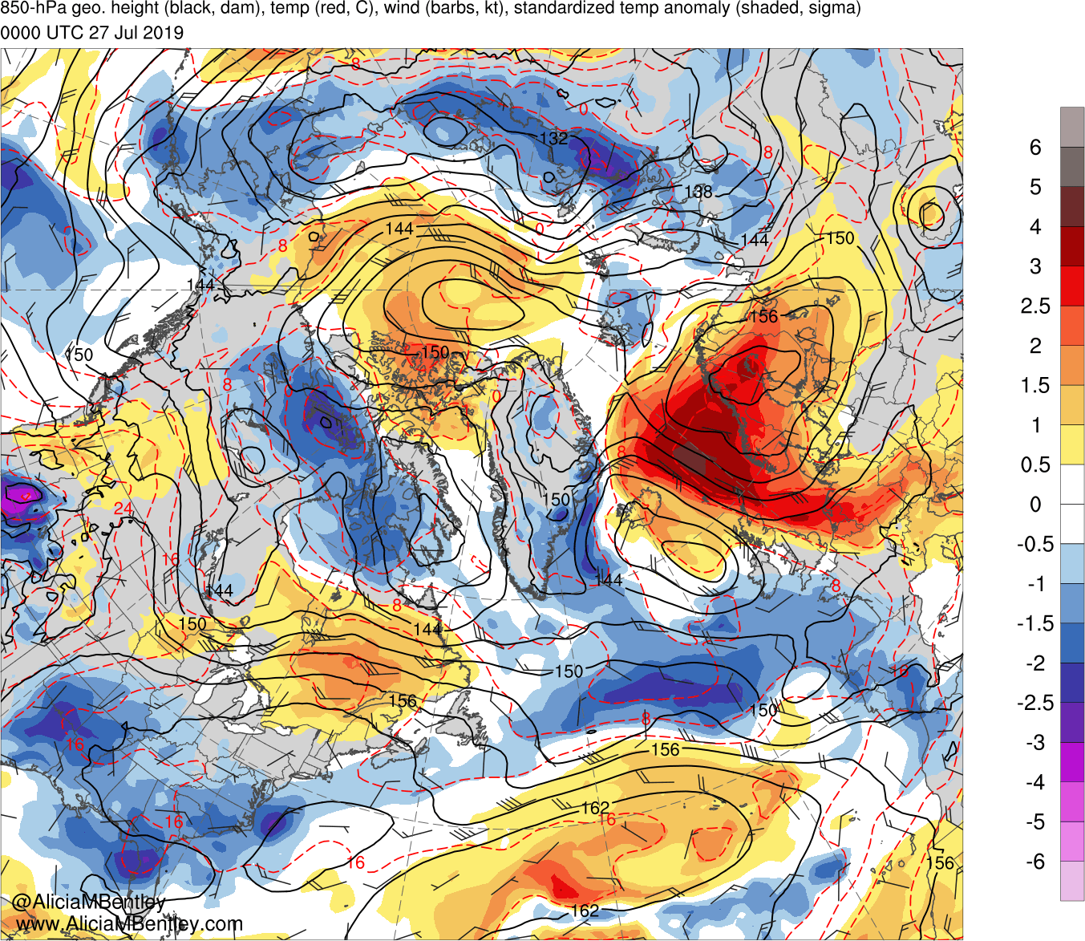
0000 UTC 27 July 2019

Slide 43
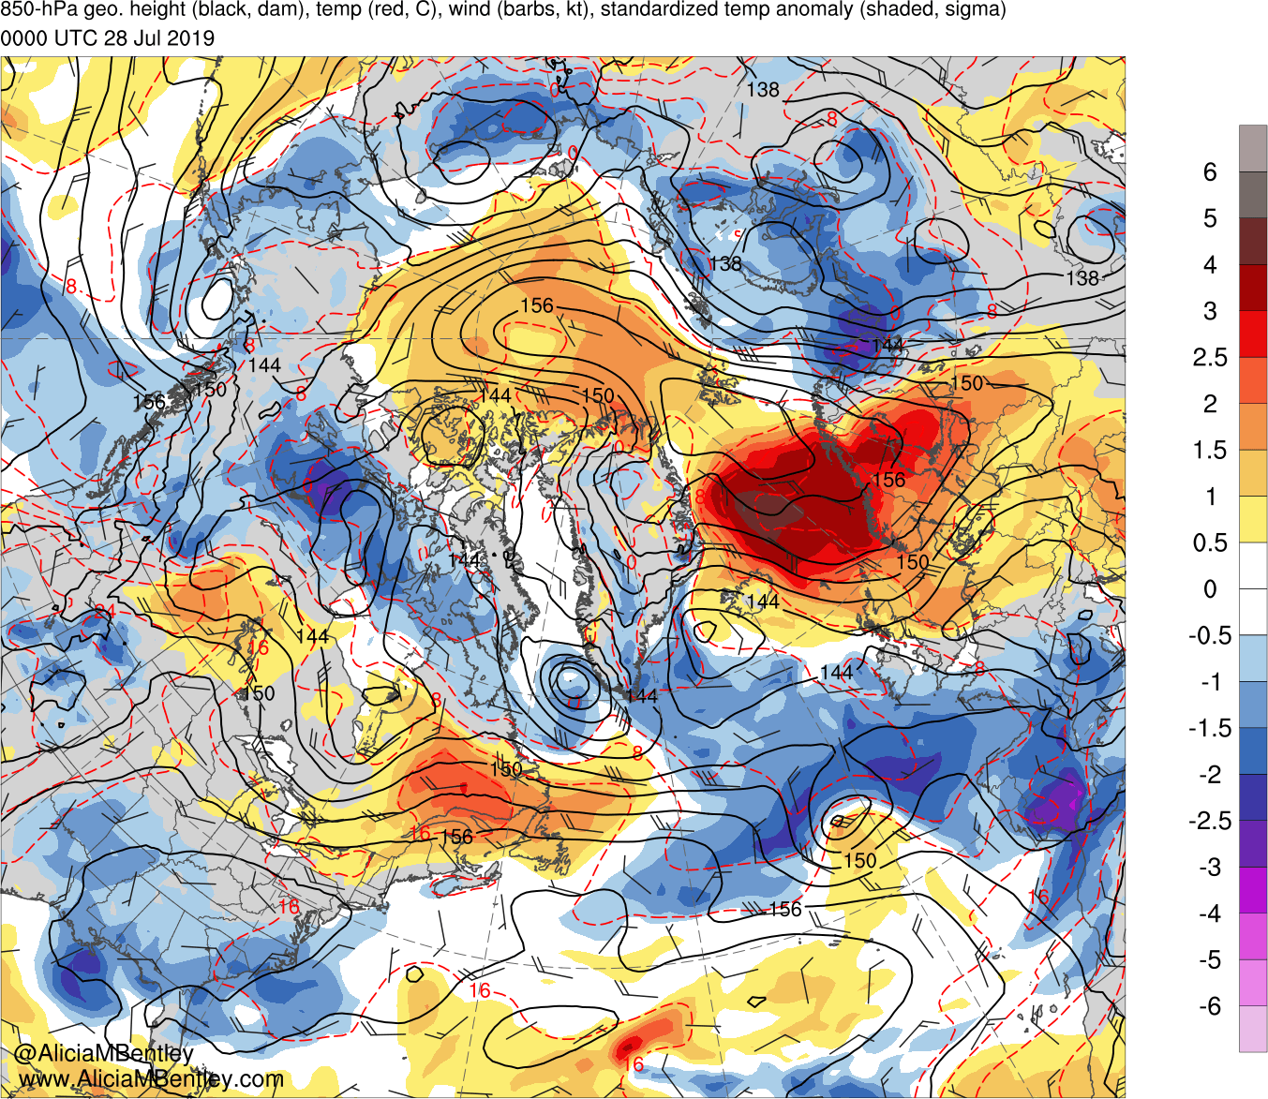
0000 UTC 28 July 2019

Slide 44
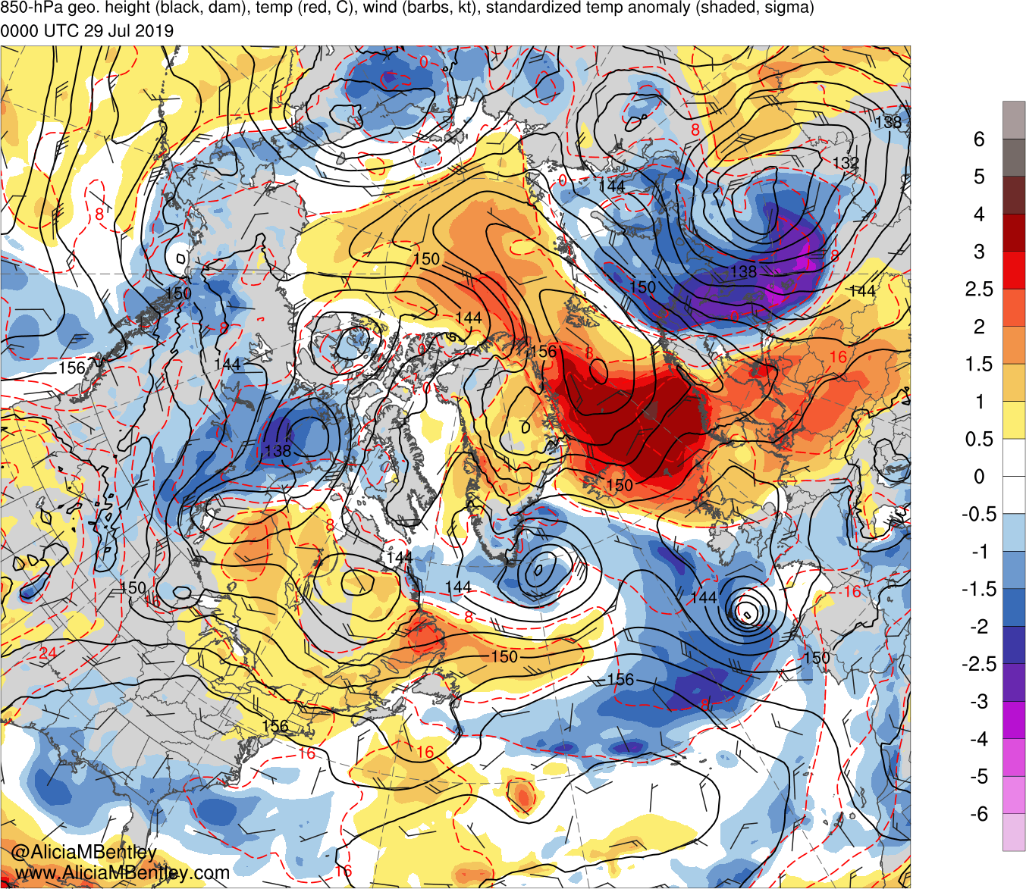
0000 UTC 29 July 2019

Slide 45
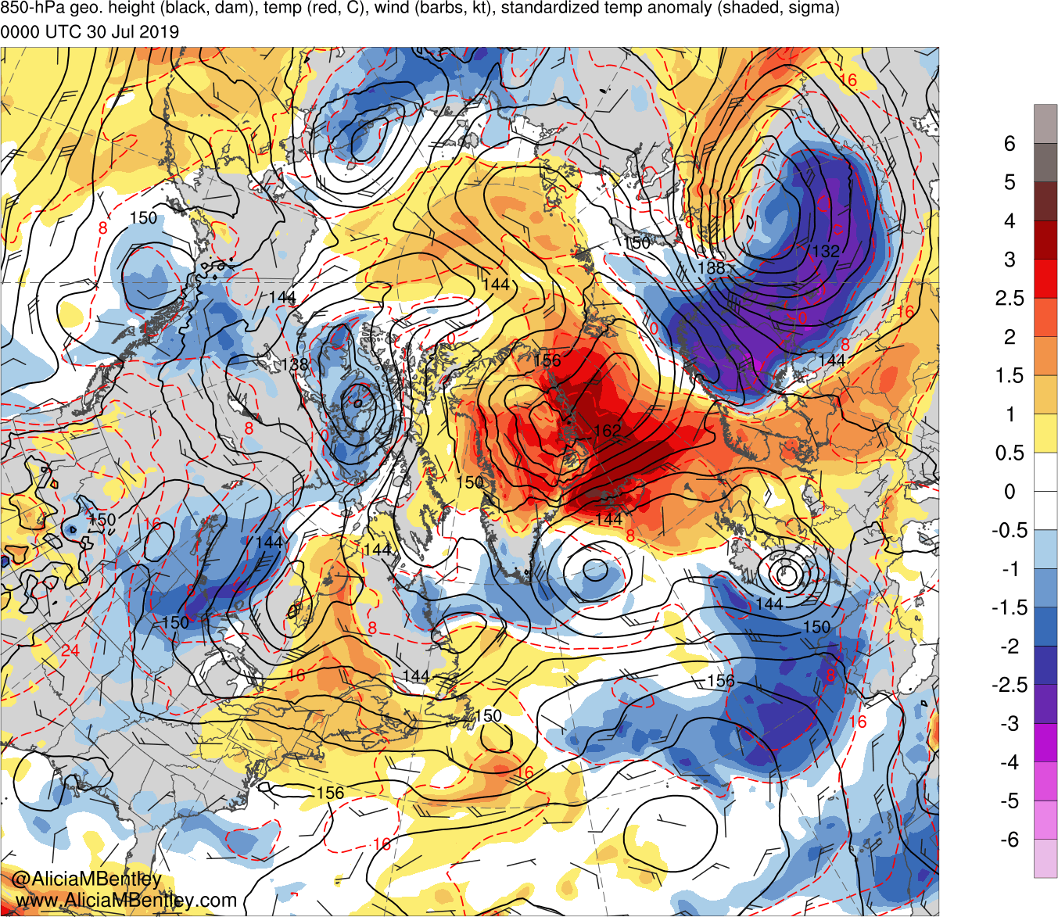
0000 UTC 30 July 2019

Slide 46
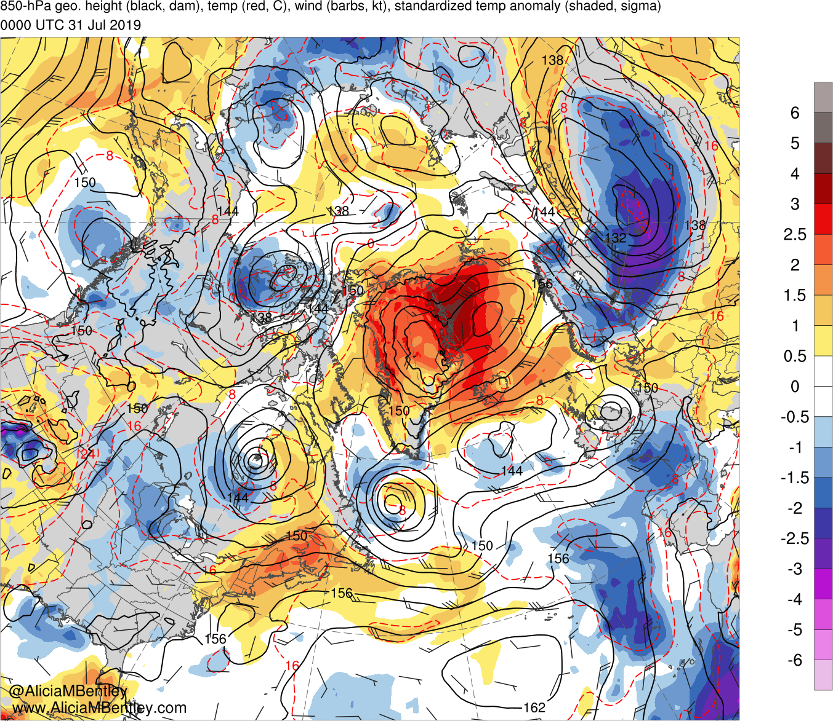
0000 UTC 31 July 2019

Slide 47
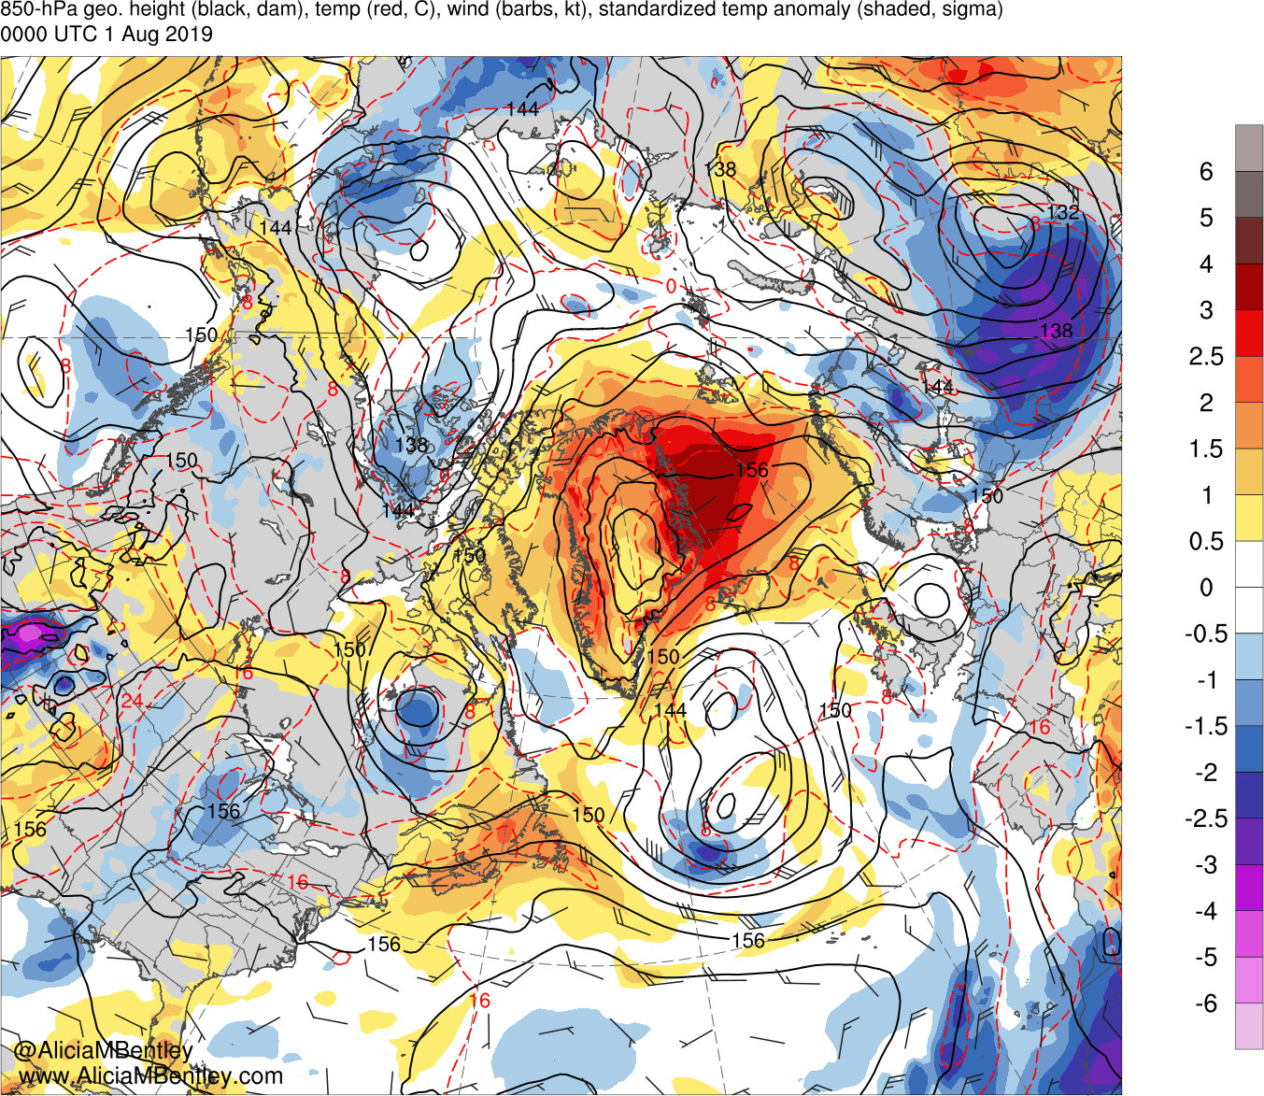
0000 UTC 1 August 2019

Slide 48
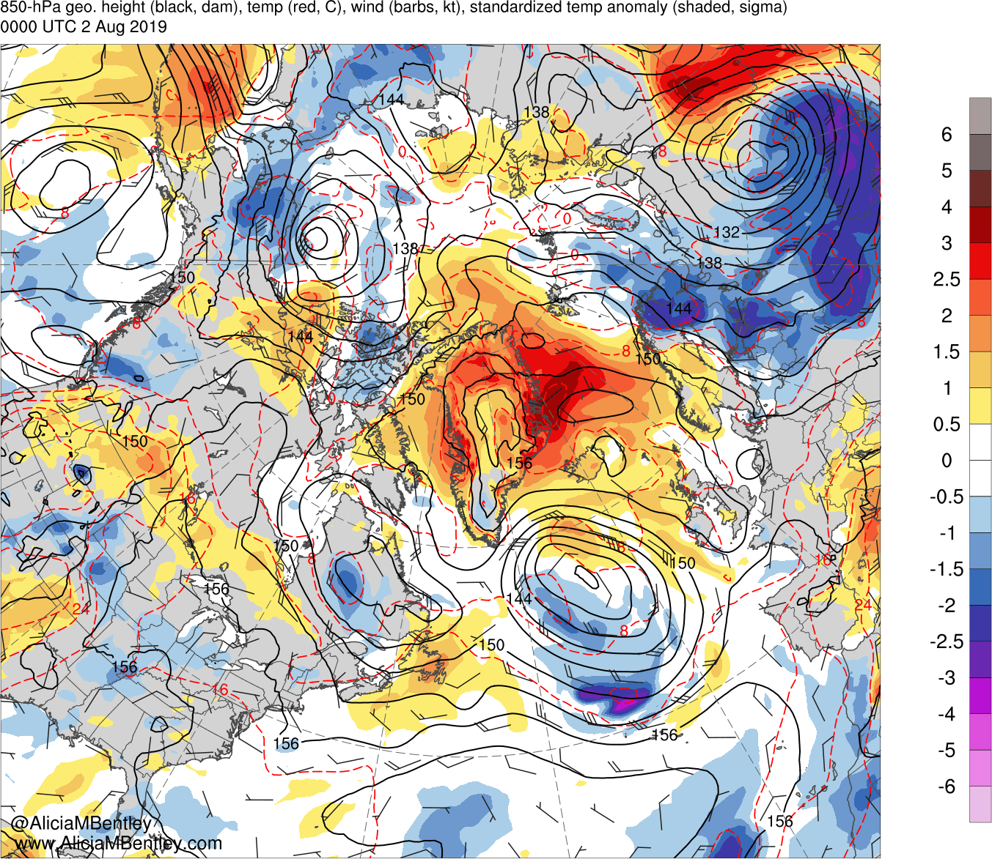
0000 UTC 2 August 2019

Slide 49
A Backward Trajectory Perspective and a Standardized Precipitable Water (PW) Analysis

Slide 50
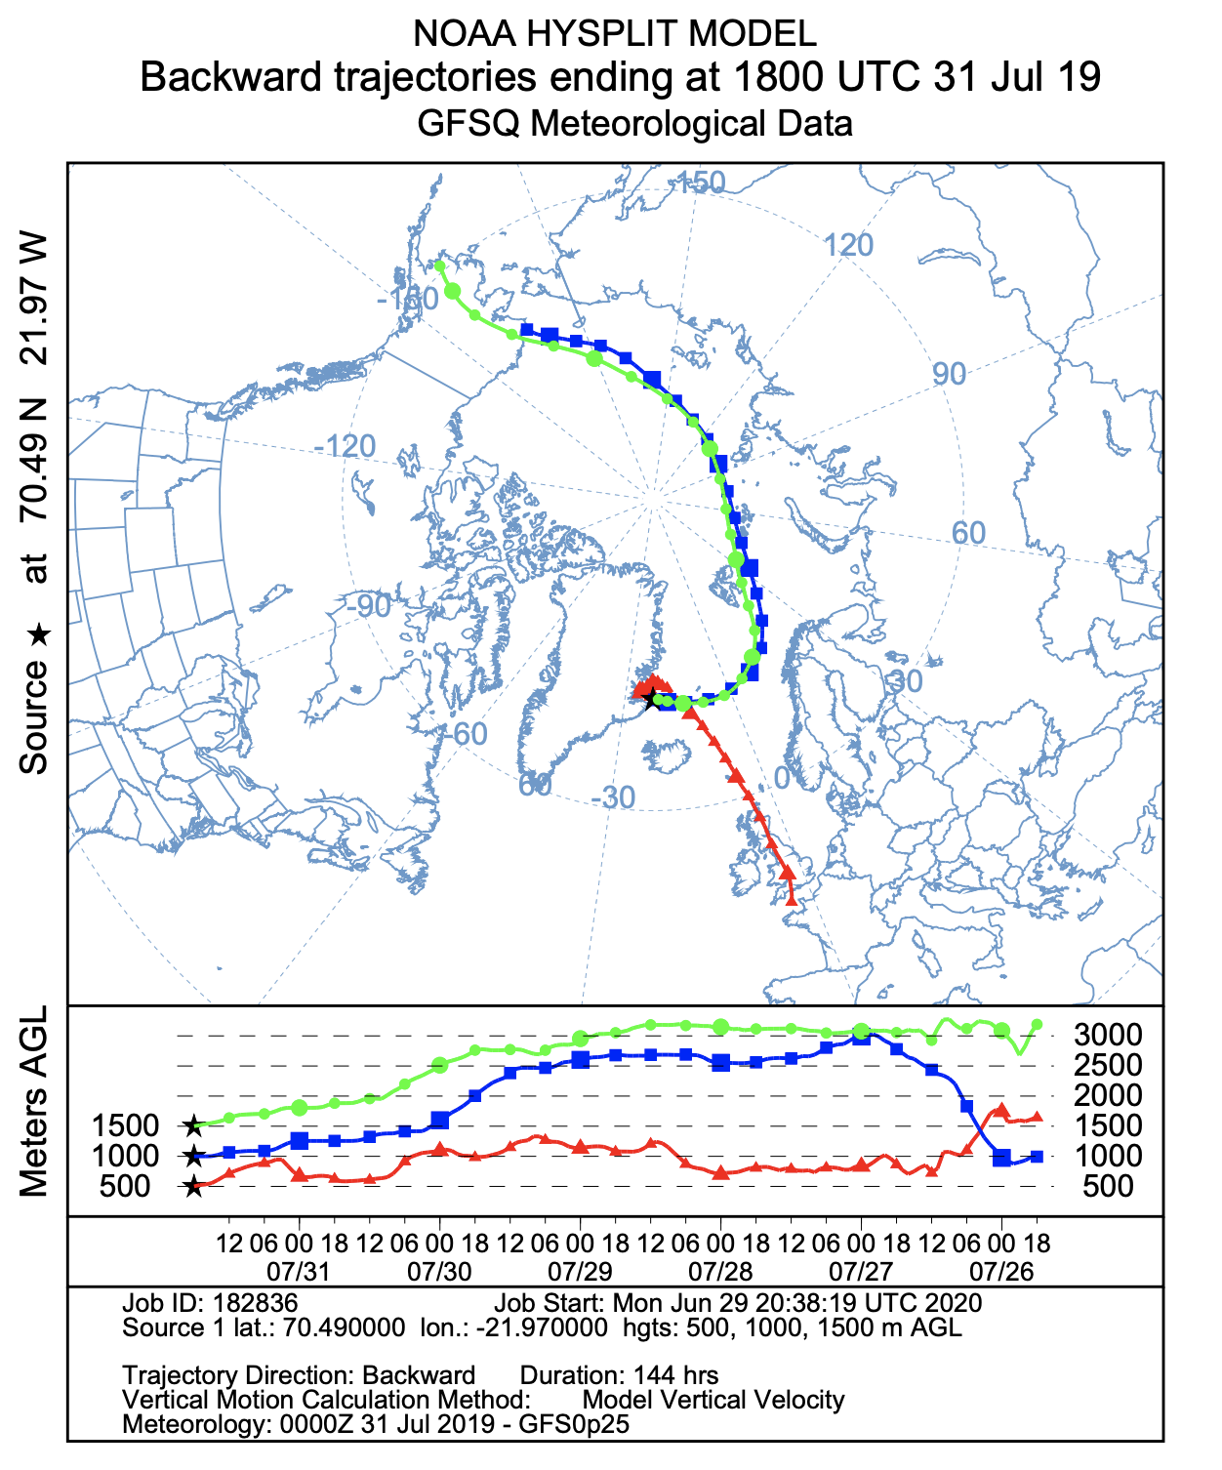
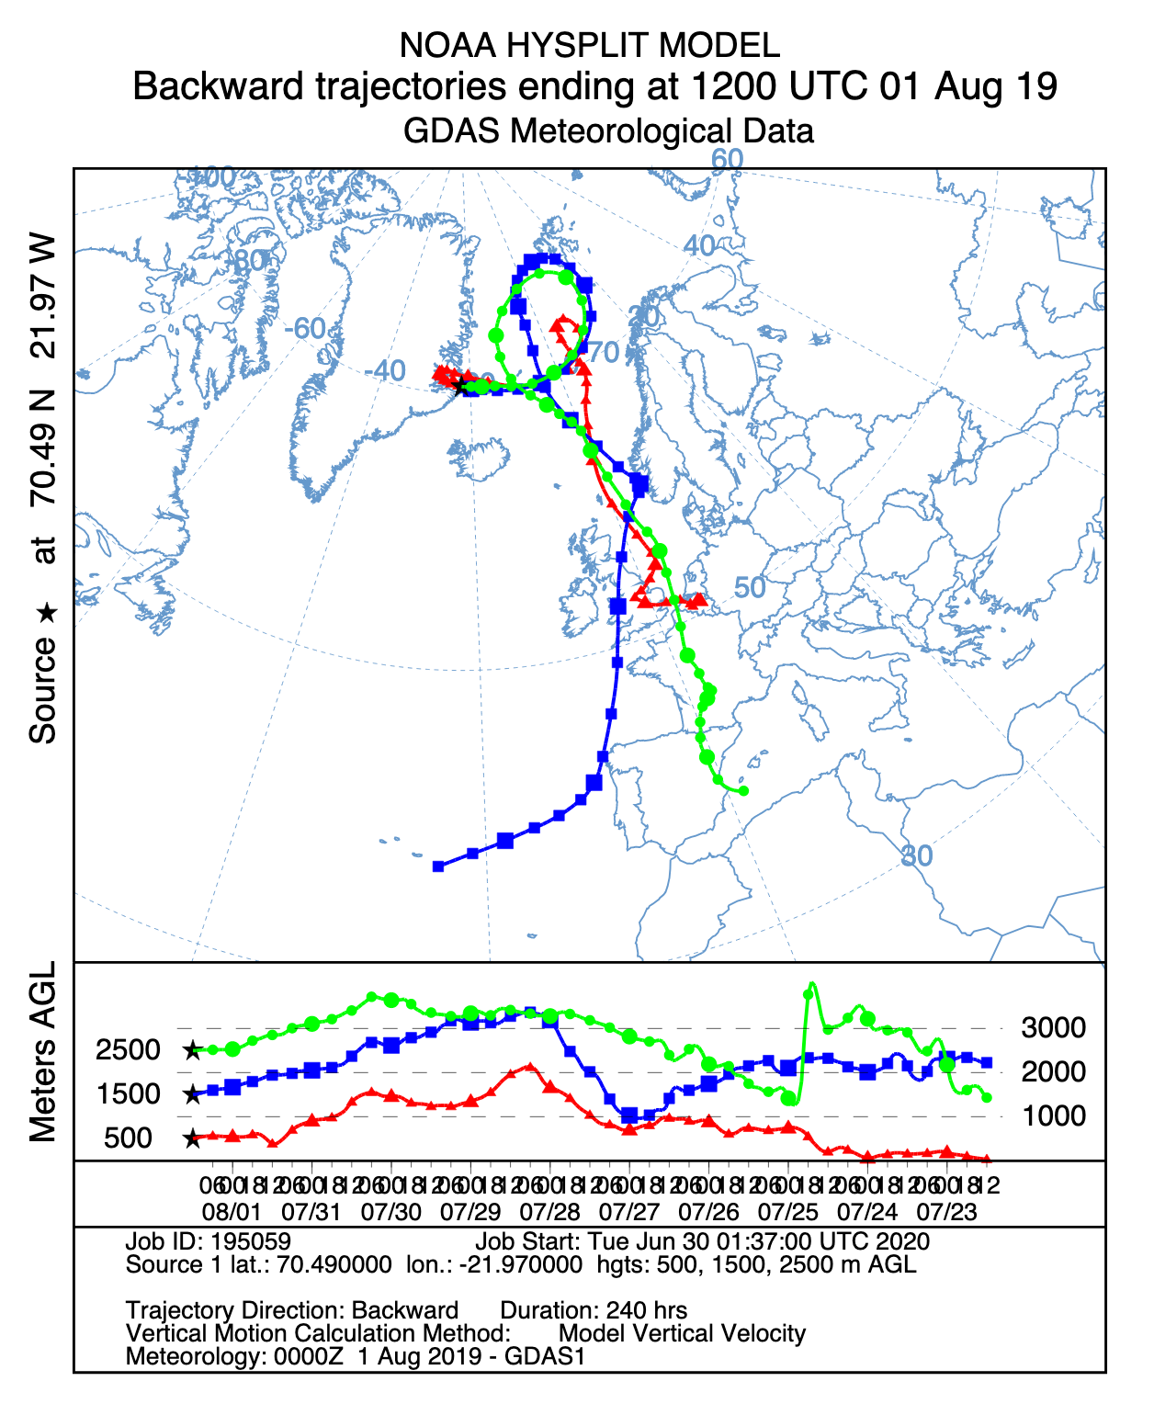
Greenland Backward Trajectories

Slide 51
700-hPa heights (dam), winds (kt), and PW std anom (shaded) for 1200 UTC 25 July (left) and 1200 UTC 29 July (right) 2019
−6
−5
−4
−3
−2.5
−2
−1.5
−1
−0.5
0
0.5
1
1.5
2
2.5
3
4
5
6
σ

Slide 52
Summary
Antecedent Arctic ridging north of Greenland in late July 2019 set the stage for deep easterly flow across Greenland
A progressive western North Atlantic trough enabled a northwestern Africa ridge to transition into a blocking Scandinavian anticyclone by late July
Record-breaking Saharan hot air (> 4 sigma at 850 hPa) overspread western Europe in conjunction with ridge building by 25 July
Modified Saharan hot air reached Greenland by late July as the blocking Scandinavian anticyclone built westward in deep easterly flow

Slide 53
The Role of Dynamical and Diabatic Processes in Arctic Cyclogenesis and Greenland Ice Melt
Scott Feldman, Daniel Keyser, and Lance Bosart
Department of Atmospheric and Environmental Sciences
University at Albany, State University of New York
Tuesday 7 July 2020
ONR DRI Arctic Cyclone Workshop

Slide 54
Science Goals:
Select representative cases of ACs tracking into and out of the Arctic and construct detailed synoptic-dynamic analyses of these representative cases
Determine the various types of synoptic flow regimes (e.g., cyclones and ridges) in the Arctic that contribute to Greenland ice melt
Examine predictability issues for the representative cases using available gridded reforecast datasets
Research Methodology:
Use self-organizing maps (SOMs) to create composites of the various synoptic flow regimes associated with Greenland ice melt
Select days during April–October 1979–2019 where the Greenland ice melt extent is in the upper 90th percentile compared to climatology
Use 500-hPa geopotential height from ERA5 reanalysis data at 1° resolution for input into the SOMs algorithm (Kohonen 1995, section 3.2)
Calculate the average 500-hPa geopotential height for each node identified from the SOMs analysis over a Greenland domain

Slide 55
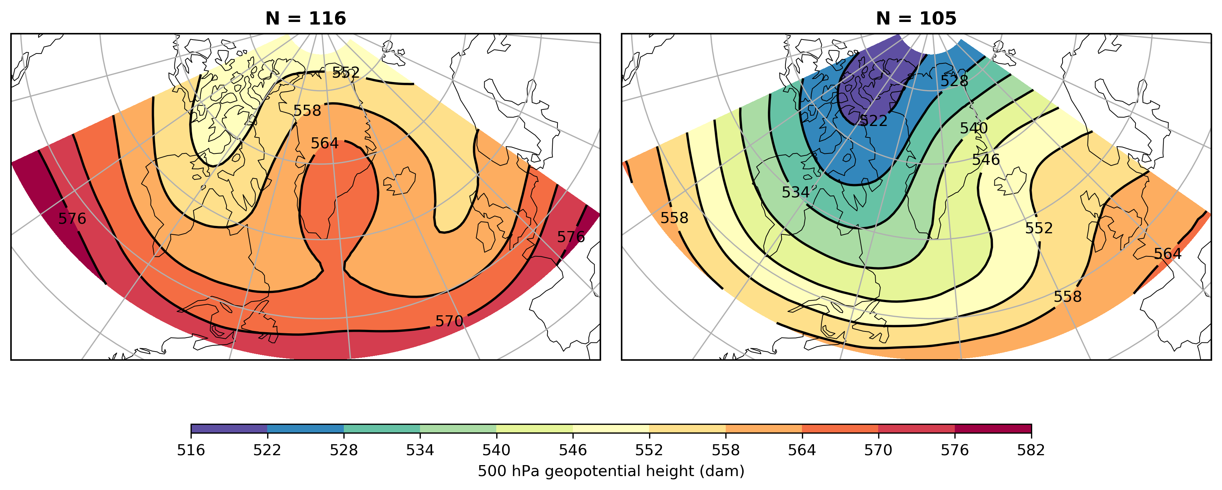
500-hPa Geopotential Height Composites
(a)
(b)
500-hPa geopotential height (dam) composites of days where the Greenland surface melt extent is in the upper 90th percentile compared to climatology
Panel (a) represents days with a strong ridge regime over Greenland and panel (b) represents days with a strong trough upstream of Greenland
Future Research: Select representative cases of various synoptic flow regimes that contribute to major Greenland ice melt events and construct detailed synoptic-dynamic analyses of these representative cases

Slide 56
Diagnosing High Sinuosity Regimes Associated with Greenland Ice Melt Events
Mansour El Riachy, Lance Bosart, and Daniel Keyser
Department of Atmospheric and Environmental Sciences
University at Albany, State University of New York
Tuesday 7 July 2020
ONR DRI Arctic Cyclone Workshop

Slide 57
Research Topic:
Sinuosity as a metric for quantifying of tropospheric polar vortex modification by ACs
The relationship between anomalous Greenland ice melt events and West of Greenland flow regimes
Science Goals:
Describe and assess the role of longitudinally localized incursions of warm, moist air from middle latitudes associated with ACs and flow regimes in the West of Greenland sector in producing modifications to the tropospheric polar vortex
Determine the relationship between highly amplified flow regimes and anomalous Greenland ice melt events
Research Methodology:
A sectorial sinuosity climatology is constructed and used to identify and describe flow regimes associated with Greenland ice melt events
Quasi-geostrophic (QG) geopotential height tendency forcing is used to diagnose the dynamics corresponding to highly amplified flow in the West of Greenland sector that is associated with Greenland ice melt events

Slide 58
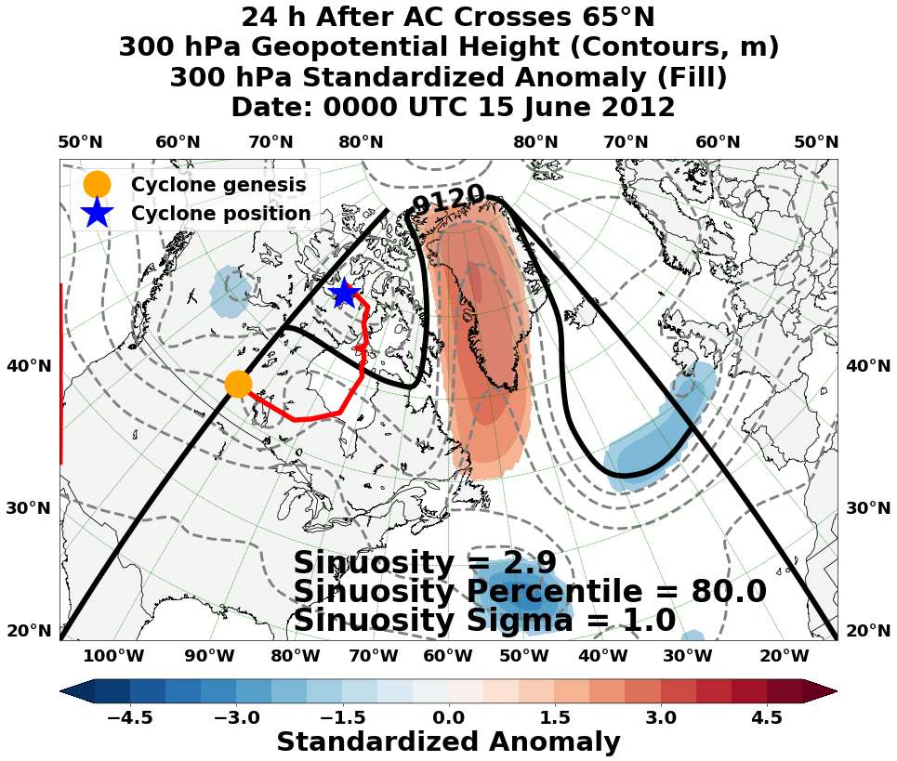
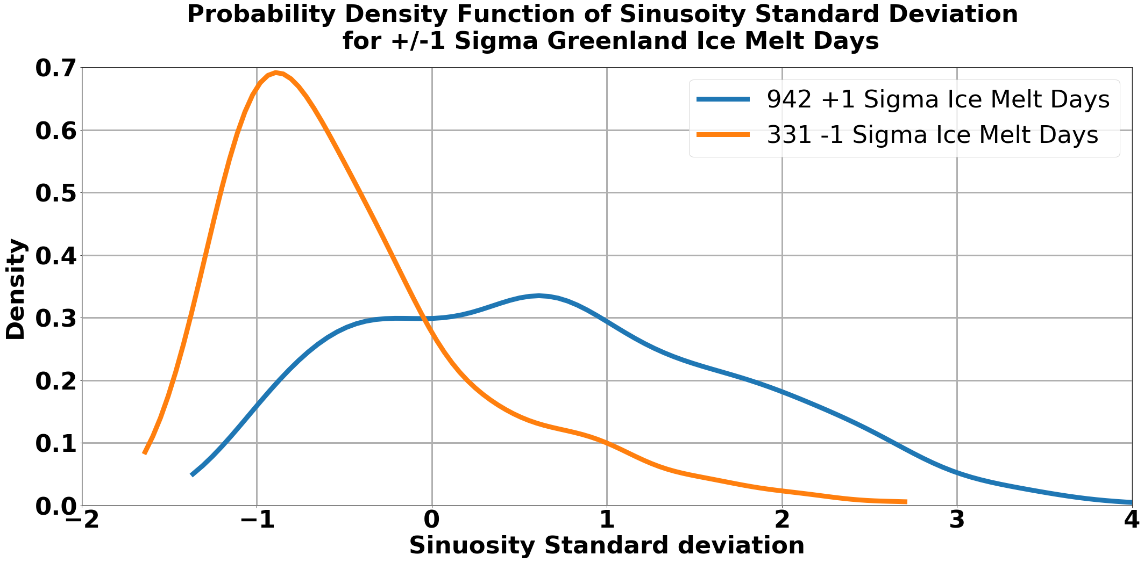
Future Research:
Diagnose QG height tendency forcing for selected Greenland ice melt events corresponding to highly amplified flow in the West of Greenland sector
Construct climatology of +1 sigma Greenland ice melt events that last 3 or more days
Determine characteristic synoptic patterns conducive to selected Greenland ice melt events and create associated composites

Slide 59
Opportunity for Field Campaign Collaboration
Hypothesis: The predictability of ACs is sensitive to the configuration of ice-covered–open-ocean boundaries as the melt season proceeds. This hypothesis rests on the idea that concave boundaries relative to the oncoming surface flow will be more effective in generating low-level cyclonic vorticity because the Laplacian of the diabatic heating term will favor low-level cyclonic vorticity growth due to vortex stretching.
Required Measurements: Ice–water boundary configuration, surface wind field, and surface sensible and latent heat fluxes.
Desired Measurements: Vertical profiles of temperature, moisture, and wind in the planetary boundary layer.

Slide 60
Refereed Publication
Biernat, K. A., L. F. Bosart, and D. Keyser, 2020: A climatological analysis of the linkages between tropopause polar vortices, cold pools, and cold air outbreaks over the central and eastern United States. Mon. Wea. Rev.,148, submitted in June 2020.

Slide 61
Conference Presentations
Biernat, K. A., D. Keyser, and L. F. Bosart, 2018: A Multiscale Analysis and Predictability Study of a Polar Low Linked to a Tropopause Polar Vortex. American Meteorological Society 29th Conference on Weather Analysis and Forecasting, Denver, CO, Tuesday 5 June 2018.
Keyser, D., K. A. Biernat, and L. F. Bosart, 2018: Linkages Between Tropopause Polar Vortices and the Great Arctic Cyclone of August 2012. American Meteorological Society 29th Conference on Weather Analysis and Forecasting, Denver, CO, Tuesday 5 June 2018.
Biernat, K., D. Keyser, L. F. Bosart, and S. M. Cavallo, 2018: A Predictability Study of a Polar Low Linked to a Tropopause Polar Vortex. Poster presentation, American Geophysical Union Fall 2018 Meeting, Washington, D.C., Friday 14 December 2018.
Bosart, L. F., K. Biernat, D. Keyser, and S. M. Cavallo, 2018: The Contributions of Tropopause Polar Vortices and Remnant Tropical Moisture from Tropical Storm Alberto to the Development of Two Intense Arctic Cyclones in June 2018. Poster presentation, American Geophysical Union Fall 2018 Meeting, Washington, D.C., Friday 14 December 2018.
Keyser, D., K. Biernat, L. F. Bosart, and S. M. Cavallo, 2018: Linkages Between Tropopause Polar Vortices and the Great Arctic Cyclone of August 2012. Poster presentation, American Geophysical Union Fall 2018 Meeting, Washington, D.C., Friday 14 December 2018.

Slide 62
Conference Presentations
Biernat, K. A., D. Keyser, L. F. Bosart, and S. M. Cavallo, 2019: A Predictability Study of a Polar Low Linked to a Tropopause Polar Vortex. 32nd Conference on Climate Variability and Change, 99th American Meteorological Society Annual Meeting, Phoenix, AZ, Tuesday 8 January 2019.
Bosart, L. F., K. A. Biernat, D. Keyser, and S. M. Cavallo, 2019: Lower-Latitude Linkages to Two Intense Arctic Cyclones in Early June 2018. 32nd Conference on Climate Variability and Change, 99th American Meteorological Society Annual Meeting, Phoenix, AZ, Tuesday 8 January 2019.
Keyser, D., K. A. Biernat, L. F. Bosart, and S. M. Cavallo, 2019: Linkages between Tropopause Polar Vortices and the Great Arctic Cyclone of August 2012. 32nd Conference on Climate Variability and Change, 99th American Meteorological Society Annual Meeting, Phoenix, AZ, Tuesday 8 January 2019.
Biernat, K. A., D. Keyser, and L. F. Bosart, 2019: A Case Study of Two Intense Arctic Cyclones in Early June 2018. 44th Annual Northeastern Storm Conference, Saratoga Springs, NY, Saturday 9 March 2019.
Biernat, K. A., L. F. Bosart, and D. Keyser, 2019: A Comparison of Arctic Cyclones between Periods of Low and High Forecast Skill of the Synoptic-scale Flow over the Arctic. American Meteorological Society 15th Conference on Polar Meteorology and Oceanography, Boulder, CO, Monday 20 May 2019.

Slide 63
Conference Presentations
Bosart, L. F., D. Keyser, and K. A. Biernat, 2019: Tropical Moisture Linkages to Intense Arctic Cyclones in June 2018. American Meteorological Society 15th Conference on Polar Meteorology and Oceanography, Boulder, CO, Monday 20 May 2019.
Keyser, D., K. A. Biernat, and L. F. Bosart, 2019: A Predictability Study of Two Intense Arctic Cyclones in Early June 2018. American Meteorological Society 15th Conference on Polar Meteorology and Oceanography, Boulder, CO, Monday 20 May 2019.
Biernat, K. A., D. Keyser, and L. F. Bosart, 2019: A Comparison of Arctic Cyclones between Periods of Low and High Forecast Skill of the Synoptic-Scale Flow over the Arctic. 19th Cyclone Workshop, Seeon, Bavaria, Germany, Wednesday 2 October 2019.
Biernat, K., L. F. Bosart, and D. Keyser, 2019: Diagnosing Factors Influencing the Forecast Skill of Two Intense Arctic Cyclones in Early June 2018. Poster presentation, American Geophysical Union Fall 2019 Meeting, San Francisco, CA, Thursday 12 December 2019.
Bosart, L. F., K. Biernat, and D. Keyser, 2019: Large-Scale Midlatitude–Polar Flow Interactions Leading to Rapid Surface Ice Melt over Greenland and Sea Ice Volume Loss over the Arctic Ocean in June 2019. American Geophysical Union Fall 2019 Meeting, San Francisco, CA, Thursday 12 December 2019.

Slide 64
Conference Presentations
El Riachy, M., L. F. Bosart, and D. Keyser, 2019: Sinuosity as a Metric for Quantifying Tropospheric Polar Vortex Modification Associated with Arctic Cyclones. American Geophysical Union Fall 2019 Meeting, San Francisco, CA, Thursday 12 December 2019.
Keyser, D., K. Biernat, and L. F. Bosart, 2019: Examining the Forecast Skill of the Synoptic-Scale Flow Associated with Arctic Cyclones. Poster presentation, American Geophysical Union Fall 2019 Meeting, San Francisco, CA, Thursday 12 December 2019.
Biernat, K. A., D. Keyser, and L. F. Bosart, 2020: Diagnosing Factors Influencing the Forecast Skill of Two Intense Arctic Cyclones in Early June 2018. Poster presentation, 33rd Conference on Climate Variability and Change, 100th American Meteorological Society Annual Meeting, Boston, MA, Tuesday 14 January 2020.
Bosart, L. F., K. A. Biernat, and D. Keyser, 2020: Large-Scale Midlatitude–Polar Flow Interactions Leading to Rapid Surface Ice Melt over Greenland and Sea Ice Volume Loss over the Arctic Ocean in June 2019. Poster presentation, 33rd Conference on Climate Variability and Change, 100th American Meteorological Society Annual Meeting, Boston, MA, Tuesday 14 January 2020.

Slide 65
Conference Presentations
El Riachy, M., D. Keyser, and L. F. Bosart, 2020: Sinuosity as a Metric for Quantifying Tropospheric Polar Vortex Modification Associated with Arctic Cyclones. Poster presentation, 33rd Conference on Climate Variability and Change, 100th American Meteorological Society Annual Meeting, Boston, MA, Tuesday 14 January 2020.
Keyser, D., K. A. Biernat, and L. F. Bosart, 2020: Examining the Forecast Skill of the Synoptic-Scale Flow Associated with Arctic Cyclones. 33rd Conference on Climate Variability and Change, 100th American Meteorological Society Annual Meeting, Boston, MA, Tuesday 14 January 2020.
El Riachy, M., L. F. Bosart, and D. Keyser, 2020: Sinuosity as a Metric for Quantifying Tropospheric Polar Vortex Modification Associated with Arctic Cyclones. 45th Annual Northeastern Storm Conference, Saratoga Springs, NY, Saturday 7 March 2020.
Feldman, S. W., L. F. Bosart, and D. Keyser, 2020: A Synoptic Analysis of the Late July–Early August 2019 Greenland Ice Melt Event. 45th Annual Northeastern Storm Conference, Saratoga Springs, NY, Sunday 8 March 2020.

