Slide 1
Intensity RMSE of ACs
ACs during climatology
Intensity RMSE (hPa)
16
ACs during low-skill periods
14
ACs during high-skill periods
12
95%
10
75%
Median
8
25%
5%
6
Statistically significant difference with respect to climatology at 95% confidence level
4
2
0
Statistically significant difference between ACs during low-skill periods and ACs during high-skill periods at 95% confidence level
1
2
3
4
5
6
7
Forecast lead time (days)

Slide 2
Position RMSE of ACs
ACs during climatology
Position RMSE (hPa)
1400
ACs during low-skill periods
1200
ACs during high-skill periods
1000
95%
75%
800
Median
25%
600
5%
400
200
0
1
2
3
4
5
6
7
Forecast lead time (days)

Slide 3
Motivation
The Arctic environment is rapidly changing in response to enhanced near-surface warming relative to the rest of the globe, referred to as Arctic amplification, and diminishing sea ice (e.g., Stroeve et al. 2007; Screen and Simmonds 2010).
As the Arctic environment rapidly changes, human activities, including shipping, tourism, and military operations, are increasing in the Arctic (e.g., Hall and Saarinen 2010; Melia et al. 2016, 2017; U.S. Department of the Navy 2021).
Accurate weather prediction over the Arctic is important given that these human activities can be impacted by weather conditions in the Arctic.
There has been a dearth of research concerning Arctic environmental conditions associated with periods of low and high forecast skill of the synoptic-scale flow over the Arctic, aside from a recent study by Yamagami and Matsueda (2021).

Slide 4
Motivation
Arctic cyclones (ACs) are synoptic-scale surface cyclones that may originate within the Arctic or move into the Arctic from lower latitudes (e.g., Serreze 1995; Zhang et al. 2004; Serreze and Barrett 2008; Crawford and Serreze 2016).
ACs occur most frequently during summer (e.g., Zhang et al. 2004; Serreze and Barrett 2008) and may play important roles in influencing Arctic environmental conditions and the forecast skill of the synoptic-scale flow over the Arctic (e.g., Yamagami and Matsueda 2021).
ACs may be associated with strong surface winds and high waves (e.g., Zhang et al. 2013; Thomson and Rogers 2014), may transport warm, moist air into the Arctic (e.g., Messori et al. 2018; Fearon et al. 2021), and may contribute to rapid sea ice loss and rapid sea ice movement (e.g., Asplin et al. 2012; Zhang et al. 2013; Stern et al. 2020 ;Peng et al. 2021).

Slide 5
Motivation
Previous studies that have examined features and processes influencing the evolution of ACs have primarily been conducted through case studies of selected ACs (e.g., Simmonds and Rudeva 2012; Tao et al. 2017a,b; Yamagami et al. 2017).
There have been a limited number of studies that have examined features and processes influencing the forecast skill of ACs (e.g., Tao et al. 2017b; Yamagami et al. 2018a; Johnson and Wang 2021).

Slide 6
Objectives
Examine characteristics of the Arctic environment and the frequency, characteristics, and forecast skill of ACs during periods of low and high forecast skill of the synoptic-scale flow over the Arctic, hereafter referred to as low-skill periods and high-skill periods, respectively.
Examine features and processes influencing the evolution of strong low-skill ACs and strong high-skill ACs during low-skill periods.
Examine features and processes influencing the forecast skill of a selected strong AC associated with low forecast skill during a low-skill period.

Slide 7
Hypotheses
The Arctic environment tends to be characterized by greater synoptic-scale flow amplitude, greater baroclinic growth rates, and greater latent heating during low-skill periods compared to high-skill periods.

Slide 8
Hypotheses
The Arctic environment tends to be characterized by greater synoptic-scale flow amplitude, greater baroclinic growth rates, and greater latent heating during low-skill periods compared to high-skill periods.
ACs occur more frequently across the Arctic, tend to be stronger, tend to be embedded in more favorable dynamic and thermodynamic environments for development and intensification, and tend to be characterized by lower forecast skill during low-skill periods compared to high-skill periods.

Slide 9
Hypotheses
The Arctic environment tends to be characterized by greater synoptic-scale flow amplitude, greater baroclinic growth rates, and greater latent heating during low-skill periods compared to high-skill periods.
ACs occur more frequently across the Arctic, tend to be stronger, tend to be embedded in more favorable dynamic and thermodynamic environments for development and intensification, and tend to be characterized by lower forecast skill during low-skill periods compared to high-skill periods.
Low-skill ACs during low-skill periods tend to be stronger and tend to be embedded in more favorable dynamic and thermodynamic environments for development and intensification compared to high-skill ACs during low-skill periods. Similarly, low-skill ACs during high-skill periods tend to be stronger and tend to be embedded in more favorable dynamic and thermodynamic environments for development and intensification compared to high-skill ACs during high-skill periods.

Slide 10
Hypotheses
TPVs, baroclinic zones, and WCBs, and TPV–AC interactions, baroclinic processes, and latent heating, influence the evolution of strong low-skill ACs during low-skill periods and strong high-skill ACs during low-skill periods, although these features and processes tend to be more robust for strong low-skill ACs during low-skill periods.

Slide 11
Hypotheses
TPVs, baroclinic zones, and WCBs, and TPV–AC interactions, baroclinic processes, and latent heating, influence the evolution of strong low-skill ACs during low-skill periods and strong high-skill ACs during low-skill periods, although these features and processes tend to be more robust for strong low-skill ACs during low-skill periods.
Forecast errors in TPVs, baroclinic zones, and WCBs, and forecast errors in TPV–AC interactions, baroclinic processes, and latent heating, contribute to forecast errors in strong low-skill ACs during low-skill periods.

Slide 12
Hypotheses
The Arctic environment tends to be characterized by greater synoptic-scale flow amplitude, greater baroclinic growth rates, and greater latent heating during low-skill periods compared to high-skill periods.

Slide 13
Hypotheses
ACs occur more frequently across the Arctic, tend to be stronger, tend to be embedded in more favorable dynamic and thermodynamic environments for development and intensification, and tend to be characterized by lower forecast skill during low-skill periods compared to high-skill periods.

Slide 14
Hypotheses
Low-skill ACs during low-skill periods tend to be stronger and tend to be embedded in more favorable dynamic and thermodynamic environments for development and intensification compared to high-skill ACs during low-skill periods. Similarly, low-skill ACs during high-skill periods tend to be stronger and tend to be embedded in more favorable dynamic and thermodynamic environments for development and intensification compared to high-skill ACs during high-skill periods.

Slide 15
Hypotheses
TPVs, baroclinic zones, and WCBs, and TPV–AC interactions, baroclinic processes, and latent heating, influence the evolution of strong low-skill ACs during low-skill periods and strong high-skill ACs during low-skill periods, although these features and processes tend to be more robust for strong low-skill ACs during low-skill periods.

Slide 16
Hypotheses
Forecast errors in TPVs, baroclinic zones, and WCBs, and forecast errors in TPV–AC interactions, baroclinic processes, and latent heating, contribute to forecast errors in strong low-skill ACs during low-skill periods.

Slide 17
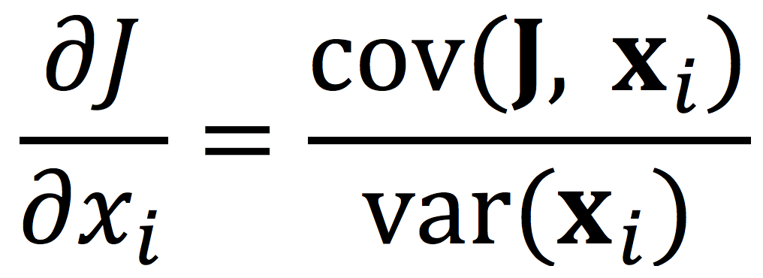
Ensemble-based sensitivity analysis (ESA)
Utilize ensemble-based sensitivity analysis (ESA) technique (e.g., Torn and Hakim 2008) to examine the sensitivity of the forecast skill of intensity and position of AC16 to selected dynamic and thermodynamic quantities at earlier forecast lead times.
Calculate the sensitivity of a forecast metric of interest J to a model state variable x_{i} at an earlier forecast lead time for an ensemble of size M via
J and x_{i} denote the 1 × M ensemble estimates of the forecast metric and ith model state variable, respectively, cov denotes the covariance, and var denotes the variance (e.g., Torn and Hakim 2008).

Slide 18
Ensemble-based sensitivity analysis (ESA)
Normalize the values of x_{i} by the ensemble standard deviation of x_{i} following Torn and Romine (2015), such that all sensitivities have units of the forecast metric per standard deviation of the model state variable.
Determine sensitivity to be statistically significant at the 95% confidence level by following the methodology of Torn and Hakim (2008).

Slide 19
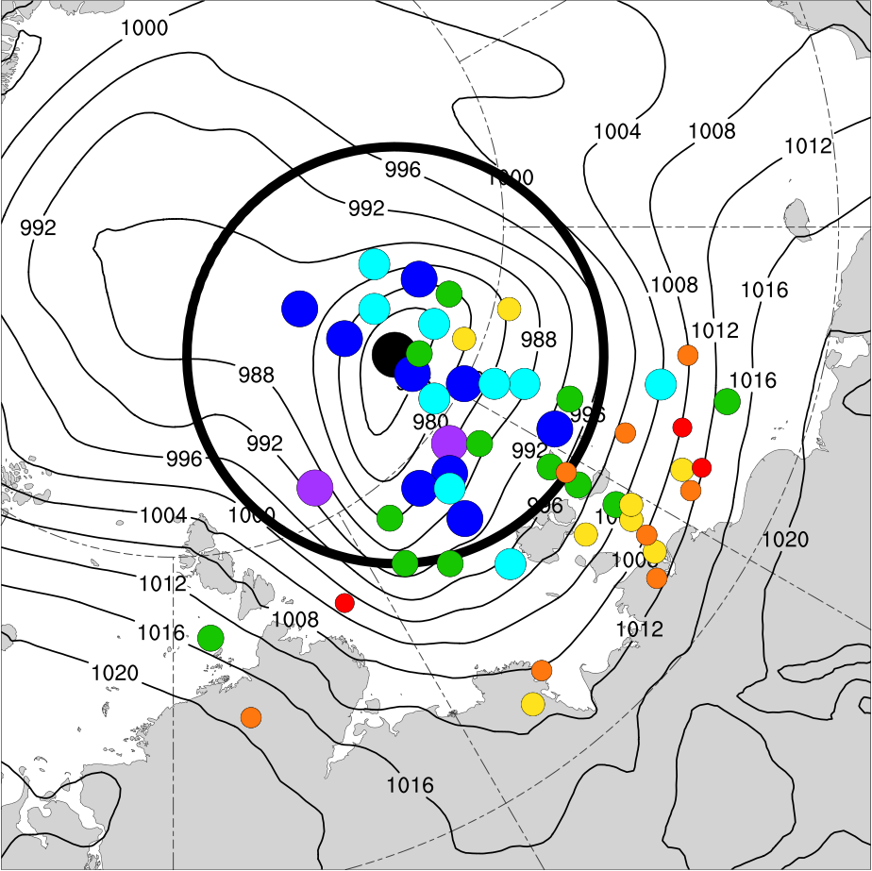
Data and Methods
0000 UTC 15 Aug (120 h)
ERA5 min SLP (972.8 hPa)
SLP within a 700-km radius circle surrounding the ERA5 position of AC16 at 0000 UTC 15 August (120 h) correlates relatively well with the intensity error and position error of AC16 at this time.
Use average SLP within the 700-km radius circle surrounding the ERA5 position of AC16 at 0000 UTC 15 August (120 h) as the forecast metric, which is hereafter referred to as J_{AC}.
Ensemble member min SLP (hPa):
< 970
970–975
975–980
980–985
985–990
990–995
≥ 995
700-km radius circle surrounding ERA5 location of the AC

Slide 20
Interpreting sensitivity values
All sensitivity values are multiplied by −1, such that a more accurate prediction of the intensity and position of AC16 at 0000 UTC 15 August (120 h) is associated with increasing the value of the model state variable at an earlier forecast lead time for positive sensitivity values and with decreasing the value of the model state variable at an earlier forecast lead time for negative sensitivity values.

Slide 21
Characteristics of the Arctic Environment and ACs
Calculate selected dynamic and thermodynamic quantities to characterize the Arctic environment and ACs using ERA-Interim dataset at 1° horizontal resolution.
The selected quantities are area-averaged over the Arctic (≥ 70°N) to characterize the Arctic environment.
The selected quantities are area-averaged within a 1000-km radius from the center of each AC to characterize the environment in the vicinity of each AC.
The most extreme value of the area-averaged quantities, and the lowest SLP, for each AC during a period of interest (i.e., climatology, low-skill periods, or high-skill periods) when located in the Arctic during the period of interest are determined.

Slide 22
Characteristics of the Arctic Environment and ACs
The selected quantities that are area-averaged are:
The absolute value of the standardized anomaly of 500-hPa v wind, hereafter referred to as σ_{v500}.
300-hPa wind speed.
850-hPa potential temperature (θ) gradient magnitude.
850–600-hPa Eady growth rate.
Positive values of 350–250-hPa divergence.
Negative values of 850–600-hPa vertical motions (ω).
1000–300-hPa integrated water vapor transport (IVT).
1000–300-hPa integrated moisture flux convergence (IMFC).

Slide 23
Literature review
Yamagami and Matsueda (2021) identify forecast busts over the Arctic based on anomaly correlation coefficient and root mean square error (RMSE) of day-6 forecasts of 500-hPa geopotential height over the Arctic for the control runs of five different ensemble prediction systems (EPSs) during 2008–2019.
They show that the largest proportion of forecast busts generally occurs during summer, the season during which ACs occur most frequently (e.g., Zhang et al. 2004; Serreze and Barrett 2008).
They examine Arctic weather patterns associated with forecast busts during summer at forecast initialization, and find that one of the most frequent patterns is referred to as the “Arctic Cyclone” pattern

Slide 24
Literature review
Composites for “Arctic cyclone” weather pattern during JJAS 1979–2019. Figure S2 adapted from Yamagami and Matsueda (2021).
Yamagami and Matsueda (2021) suggest that forecast busts over the Arctic during summer may be linked to forecast errors in synoptic-scale systems such as ACs.
Contours: 500-hPa geopotential
height anomalies
Contours: SLP anomalies
Shading: 850-hPa temperature
anomalies
Shading: 2-m temperature
anomalies

Slide 25
Literature review
Forecast errors propagating along upper-tropospheric waveguides (e.g., Langland et al. 2002; Hakim 2005) and forecast errors associated with features embedded within upper-tropospheric waveguides (e.g., troughs and ridges) (e.g., Sanders 1992; Davies and Didione 2013; Berman and Torn 2019) can contribute to forecast errors in the synoptic-scale flow over the middle latitudes.
Forecast errors related to baroclinic processes (e.g.,Tribbia and Baumhefner 2004; Davies and Didone 2013) and latent heating (e.g., Rodwell et al. 2013; Martínez-Alvarado et al. 2016; Grams et al. 2018) can contribute to forecast errors in the synoptic-scale flow over the middle latitudes.

Slide 26
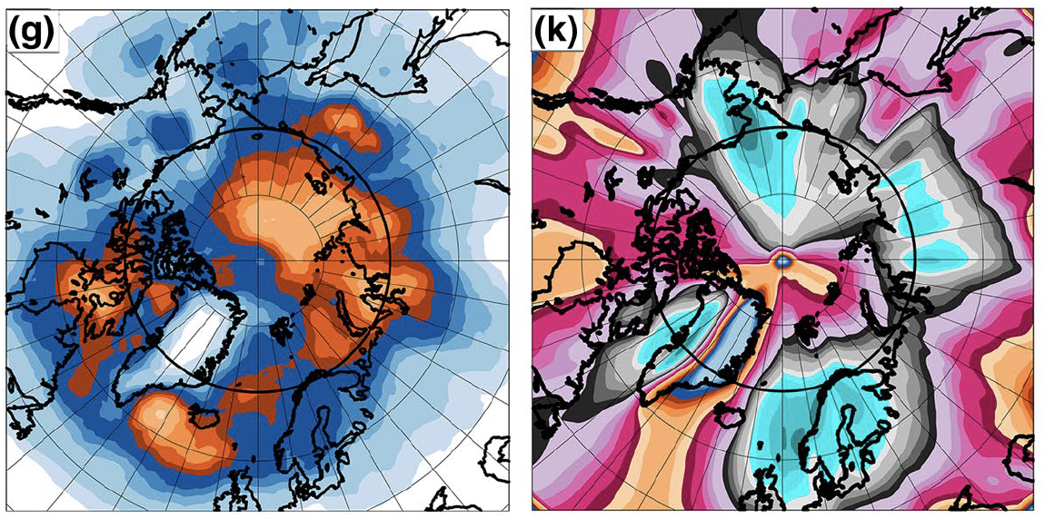
Literature review
Figure 1 adapted from Fearon et al. (2021). Panels shown correspond to June–August 1998–2017.
Fearon et al. (2021) identified moist intrusions based on 1000–300-hPa integrated water vapor transport (IVT).
They also identified ACs associated with moist intrusions extending from lower latitudes to poleward across 70°N.
(left) Cyclone-center grid cell counts per month for ACs associated with moist intrusions (top values of color bar)
(right) Moist intrusion grid cell counts per month (bottom values of color bar)

Slide 27
Literature review
Baroclinic processes have been shown to play an important role in the development and intensification of ACs (e.g., Simmonds and Rudeva 2012; Aizawa et al. 2014; Yamazaki et al. 2015; Tao et al. 2017a,b; Yamagami et al. 2017)

Slide 28
Literature review
Latent heating associated with the formation of clouds and precipitation has been shown to contribute to the development and intensification of midlatitude cyclones in numerous studies (e.g., Tracton 1973; Kuo and Reed 1988; Reed et al. 1988; Davis et al. 1993; Stoelinga1996; Wernli et al. 2002).
There has been a dearth of research that has examined the role of latent heating in the development and intensification of ACs.
ACs can be associated with intrusions of warm, moist air into the Arctic (e.g., Binder et al. 2017; Messori et al. 2018; Fearon et al. 2021), which may be related to atmospheric rivers (ARs) and warm conveyor belts (WCBs) of ACs.

Slide 29
Literature review
Yamagami et al. (2018a) find that accurate forecasts of AC12 only extend out to 2–3-day lead times relative to the time of peak intensity of AC12.
Yamagami et al. (2018b) state that the forecast skill of extraordinary ACs is lower than that of midlatitude cyclones in the Northern Hemisphere.
Capute and Torn (2021) show that ACs are less predictable in terms of position, and more predictable in terms of intensity, compared to midlatitude cyclones over the North Atlantic

Slide 30
Literature review
Forecast errors propagating along upper-tropospheric waveguides and forecast errors associated with features embedded within upper-tropospheric waveguides shown to contribute to forecast errors in midlatitude cyclones (e.g., Chang et al. 2013; Zheng et al. 2013; Lamberson et al. 2016).
The forecast errors related to baroclinic processes (e.g., Sanders 1986; Zhu and Thorpe 2006; Zheng et al. 2013) and latent heating (e.g., Zhang et al. 2003, 2007; Doyle et al. 2014, 2019) have been shown to contribute to forecast errors in midlatitude cyclones.

Slide 31
Literature review
The forecast skill of AC12 has been shown to be sensitive to the strength of TPVs (e.g., Tao et al. 2017b; Yamazaki et al. 2015), position of TPVs (e.g., Yamagami et al. 2018a) and to the strength of tropospheric baroclinicity (Tao et al. 2017b).
Johnson and Wang (2021) find that track and intensity errors of an AC during July 2018 are sensitive to the position and intensity of TPVs embedded within the Rossby wave, the amount of midtropospheric moisture located within the WCB of the AC, and the structure of the lower-tropospheric thermal field.

Slide 32
Literature review
Yamagami et al. (2019) and Capute and Torn (2021), who both show that ACs with lower forecast skill of intensity tend to be stronger.
Capute and Torn (2021) find that low-skill ACs are typically embedded in environments characterized by larger lower-to-midtropospheric Eady growth rates compared to high-skill ACs, when considering low-skill ACs and high-skill ACs determined based on forecast skill of intensity.
Capute and Torn (2021) find that there is no systematic difference in latent heating between low-skill ACs and high-skill ACs, when considering low-skill ACs and high-skill ACs determined based on forecast skill of intensity.

