Slide 1
A Comparison of Arctic Cyclones between Periods of Low and High Forecast Skill of the Synoptic-scale Flow over the Arctic
Kevin A. Biernat, Lance F. Bosart, and Daniel Keyser
Department of Atmospheric and Environmental Sciences
University at Albany, SUNY
Polar Prediction Workshop 2019
Wednesday 25 April 2019
Research Supported by ONR Grant N00014-18-1-2200

Slide 2
Motivation
Arctic cyclones (ACs) are synoptic-scale cyclones that may originate within the Arctic or move into the Arctic from lower latitudes (e.g., Crawford and Serreze 2016)
ACs may be associated with strong surface winds and poleward advection of warm, moist air, contributing to Arctic sea-ice loss (e.g., Zhang et al. 2013)
Heavy precipitation, strong surface winds, and large waves accompanying ACs may pose hazards to ships navigating through open passageways in the Arctic Ocean

Slide 3
Motivation
Yamagami et al. (2018a,b) show that forecast skill for strong Arctic cyclones can be low
Accurate forecasts of the Great Arctic Cyclone of August 2012 extend only out to 2–3 d lead time prior to peak intensity
Forecast skill of the synoptic-scale flow over the Arctic may be low at times relative to climatology
It is anticipated that low forecast skill of the synoptic-scale flow over the Arctic may be attributed in part to low forecast skill of ACs

Slide 4
Purpose
Investigate whether there are differences in the frequency, location, intensity, seasonality, and associated synoptic-scale flow patterns of ACs between periods of low and high forecast skill of the synoptic-scale flow over the Arctic

Slide 5
Data and Methods: Arctic Cyclone Identification
Create a 2007–2017 AC climatology
Obtain cyclone tracks from 1° ERA-Interim cyclone climatology prepared by Sprenger et al. (2017)
ACs are deemed cyclones that last ≥ 2 d and spend at least some portion of their lifetimes in the Arctic (>70°N)

Slide 6
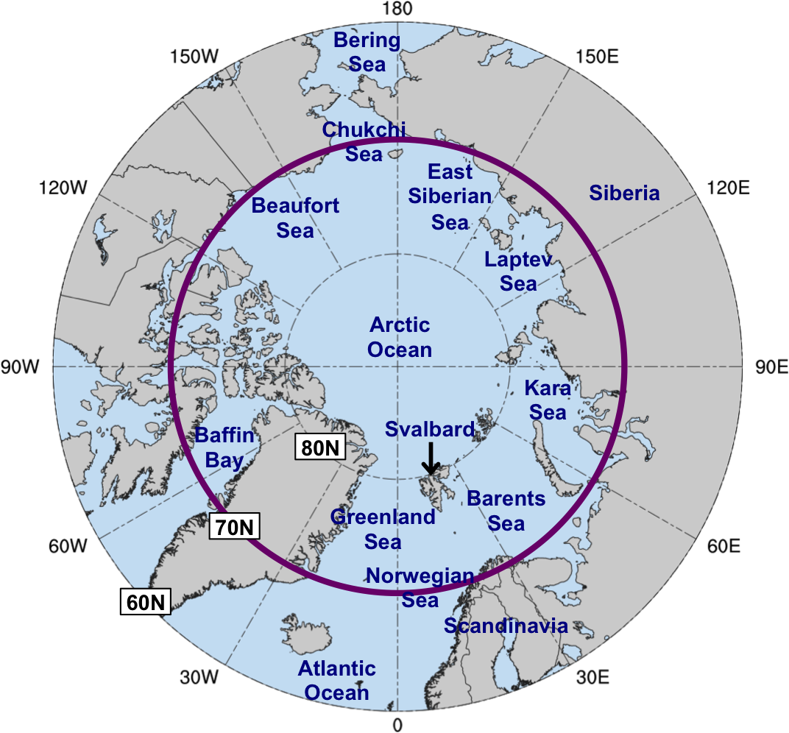
Data and Methods: Forecast Skill Evaluation
Calculate standardized anomaly of ensemble forecast spread of 500-hPa geopotential height (σ_{anom}) and determine area-weighted average of σ_{anom} over the Arctic (≥70°N)
Utilize forecasts initialized at 0000 UTC during 2007–2017 and valid at day 5 from:
11-member GEFS reforecast dataset v2 (Hamill et al. 2013)
51-member ECMWF Ensemble Prediction System (Buizza et al. 2007)

Slide 7
Data and Methods: Forecast Skill Evaluation
At each grid point (i), day of the year (d), and forecast lead time (f), σ_{anom} is calculated similarly following Torn (2017) as:
σ = raw ensemble spread
σ_{mean} = climatological mean ensemble spread
σ_{stdv} = climatological standard deviation of ensemble spread
σ_{mean} and σ_{stdv} are calculated for 1985–2017 period from the GEFS reforecast dataset v2

Slide 8
Data and Methods: Forecast Skill Evaluation
Forecast days valid at day 5 associated with the top and bottom 10% of the area-weighted average of σ_{anom} in both the GEFS and ECMWF EPS are referred to as low and high skill days, respectively
Time periods beginning five days prior to day 5 (i.e., day 0) through day 5 are referred to as low and high skill periods
ACs that exist in the Arctic (>70°N) at any time within the low and high skill periods are identified

Slide 9
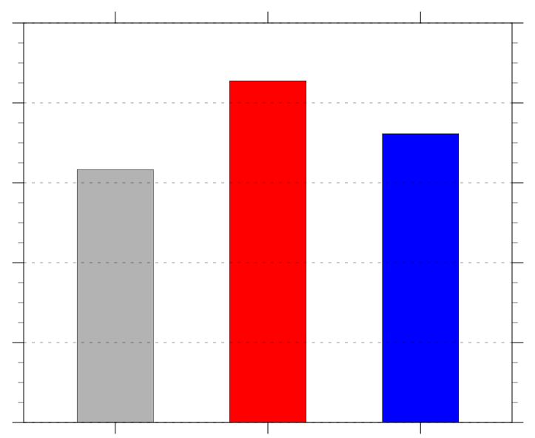
Number and Frequency of ACs
Frequency of ACs (number of ACs day⁻¹)
Period | Number of days in period | Number of ACs in period
Climo | 4018 | 2542
Low skill | 469 | 401
High skill | 477 | 345
1.0
0.8
0.6
0.4
0.2
0.0
climo
low
high
Frequency = number of ACs within period / number of days within period

Slide 10
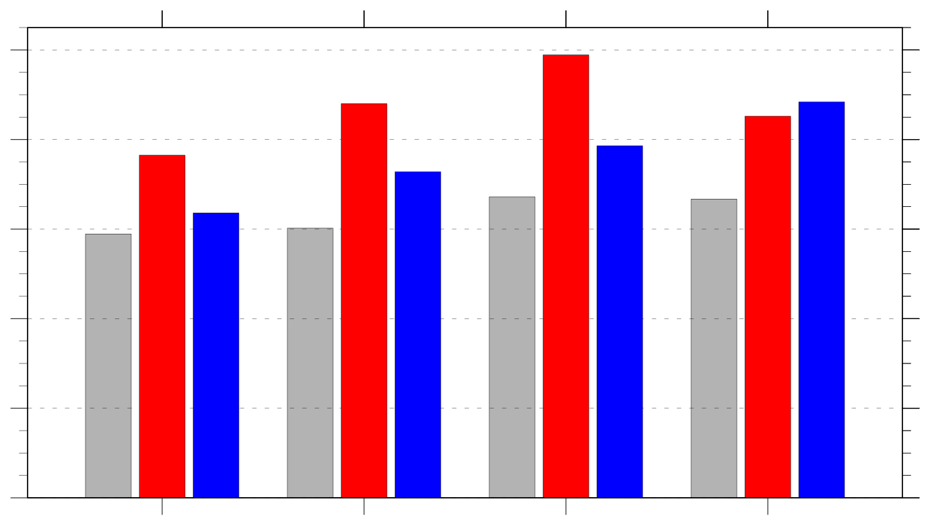
Frequency of ACs by Season
Frequency of ACs (number of ACs day⁻¹) by season
1.0
climo
low skill
high skill
0.8
0.6
0.4
0.2
0.0
DJF
MAM
JJA
SON
Frequency = number of ACs within period / number of days within period

Slide 11
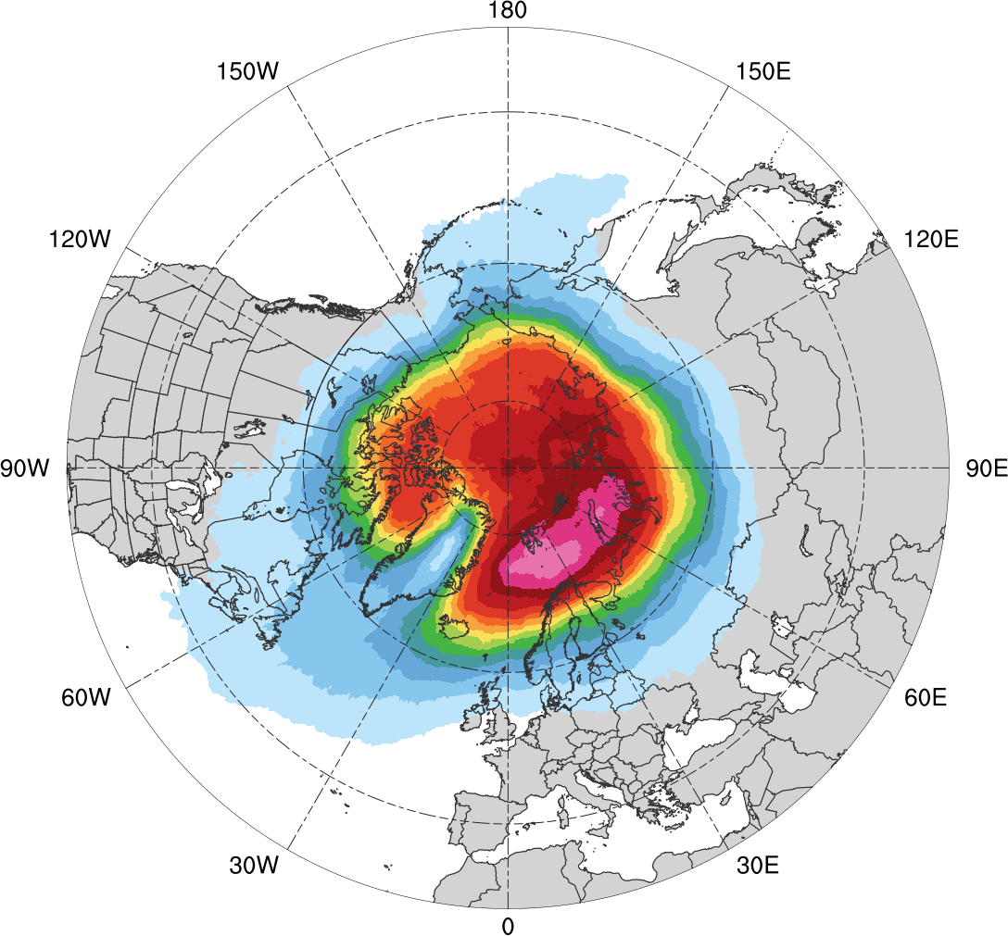
Normalized AC Track Density
Entire climatology (N = 2542)
0.05
0.1
0.15
0.2
0.25
0.3
0.35
0.4
0.45
0.5
0.6
0.7
0.8
0.9
Total number of ACs within 500 km of a grid point, normalized by maximum value

Slide 12
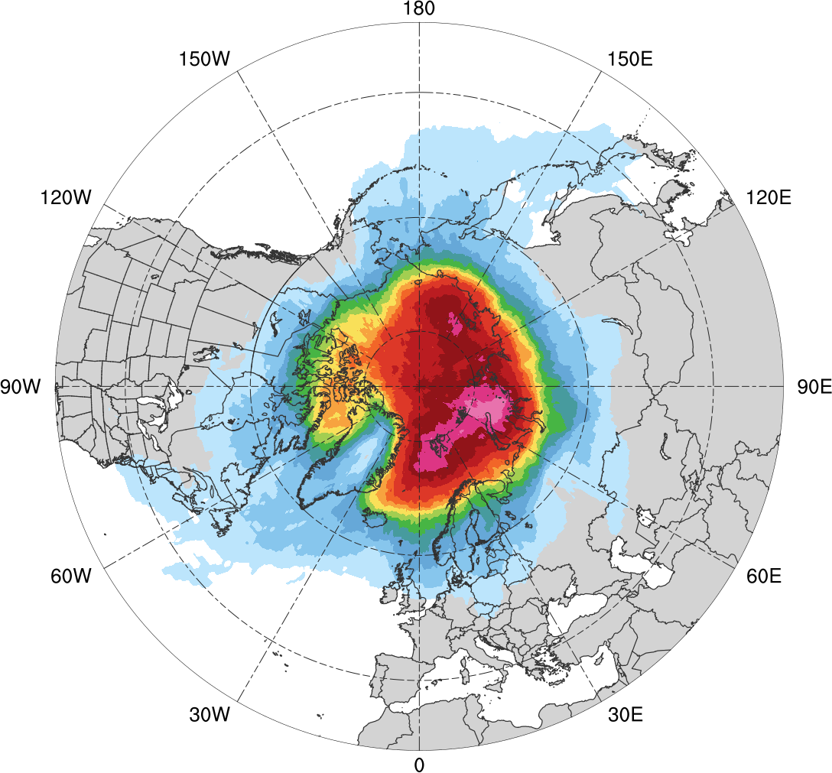
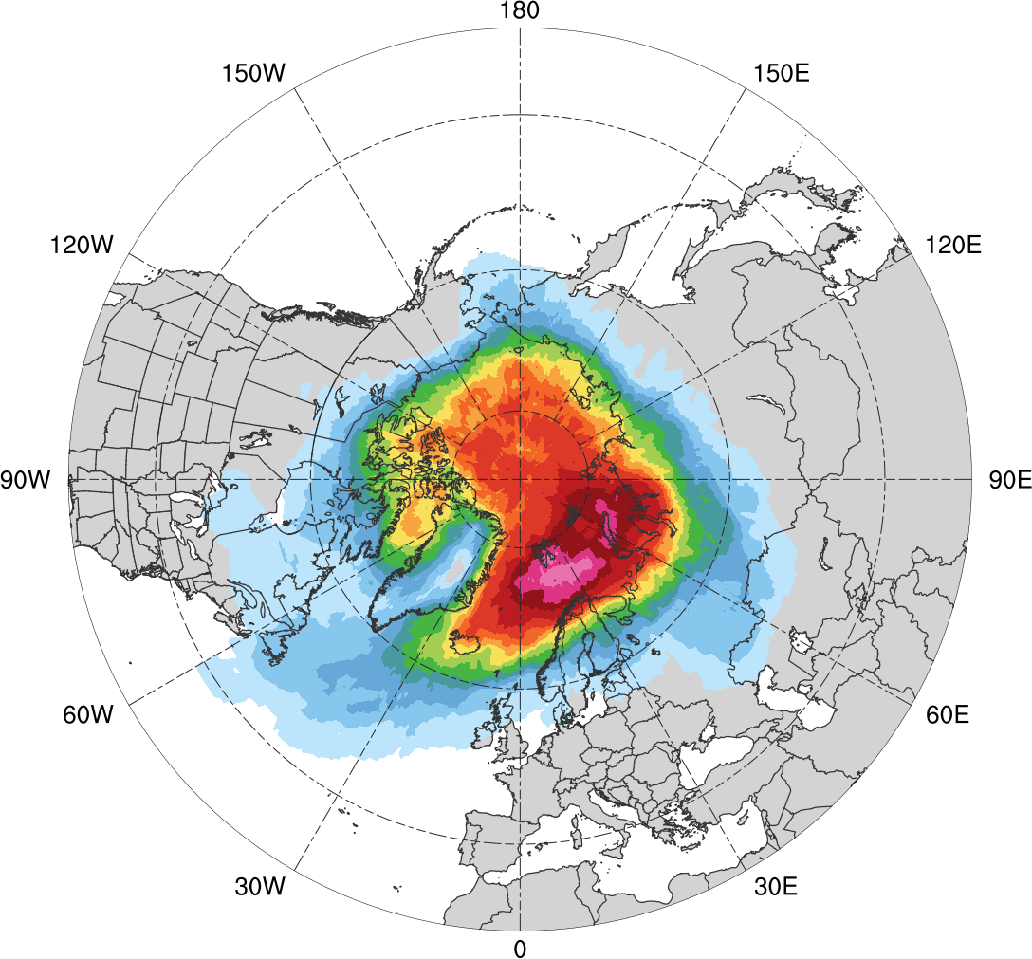
Normalized AC Track Density
Low skill (N = 401)
High skill (N = 345)
0.05
0.1
0.15
0.2
0.25
0.3
0.35
0.4
0.45
0.5
0.6
0.7
0.8
0.9
Total number of ACs within 500 km of a grid point, normalized by maximum value, for each period

Slide 13
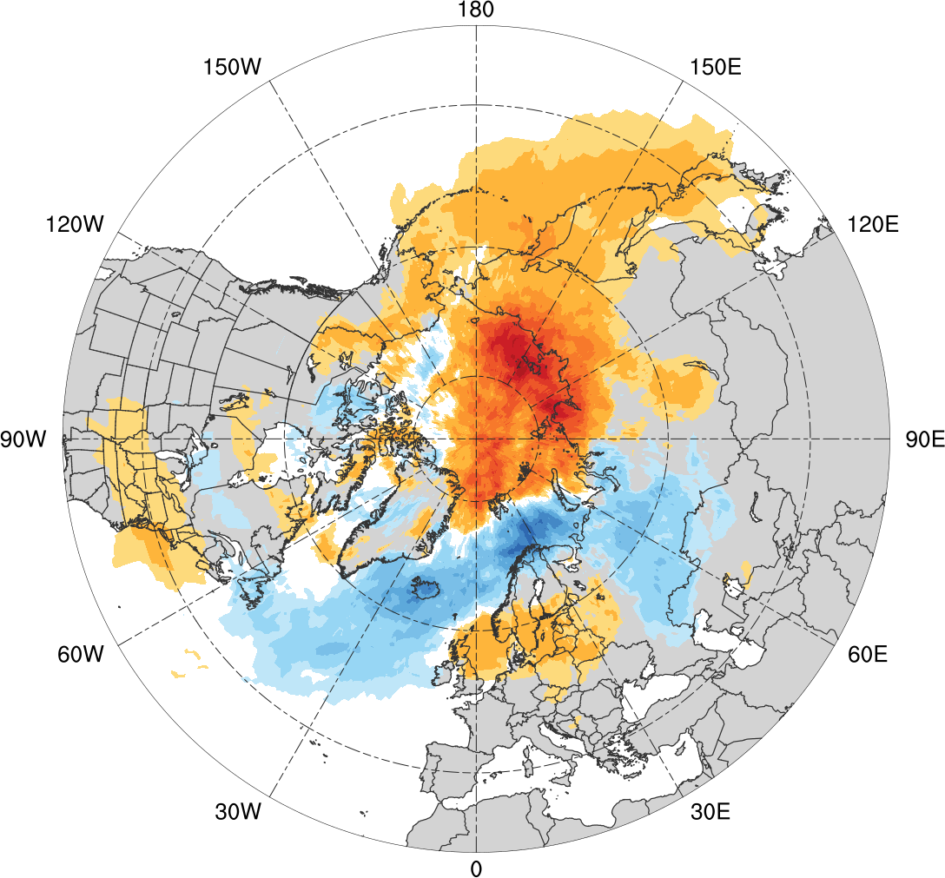
Normalized AC Track Density Differences
Low skill minus high skill
-0.35
-0.3
-0.25
-0.2
-0.15
-0.1
-0.05
-0.025
0
0.025
0.05
0.1
0.15
0.2
0.25
0.3
0.35
Difference in normalized AC track density

Slide 14
Preferred Longitudinal Corridors (DJF)
Distribution of longitude of Arctic cyclones at first time in Arctic (>70°N; % per longitudinal bin) during DJF
90°N
70°N
50°N
30°N
0°
30°E
60°E
90°E
120°E
150°E
180°
150°W
120°W
90°W
60°W
30°W
0°
0°
30°E
60°E
90°E
120°E
150°E
180°
150°W
120°W
90°W
60°W
30°W
0°
low (N=130)

Slide 15
Preferred Longitudinal Corridors (DJF)
Distribution of longitude of Arctic cyclones at first time in Arctic (>70°N; % per longitudinal bin) during DJF
90°N
70°N
50°N
30°N
0°
30°E
60°E
90°E
120°E
150°E
180°
150°W
120°W
90°W
60°W
30°W
0°
0°
30°E
60°E
90°E
120°E
150°E
180°
150°W
120°W
90°W
60°W
30°W
0°
low (N=130)
high (N=119)

Slide 16
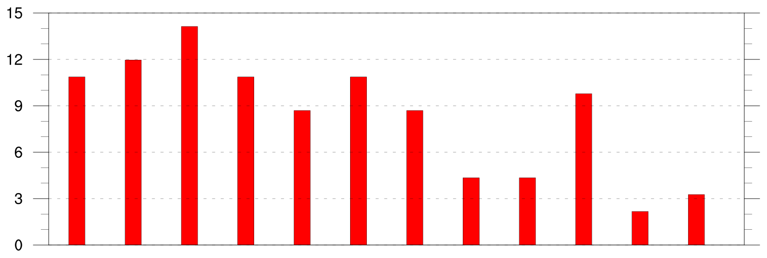
Preferred Longitudinal Corridors (JJA)
Distribution of longitude of Arctic cyclones at first time in Arctic (>70°N; % per longitudinal bin) during JJA
90°N
70°N
50°N
30°N
0°
30°E
60°E
90°E
120°E
150°E
180°
150°W
120°W
90°W
60°W
30°W
0°
0°
30°E
60°E
90°E
120°E
150°E
180°
150°W
120°W
90°W
60°W
30°W
0°
low (N=92)

Slide 17
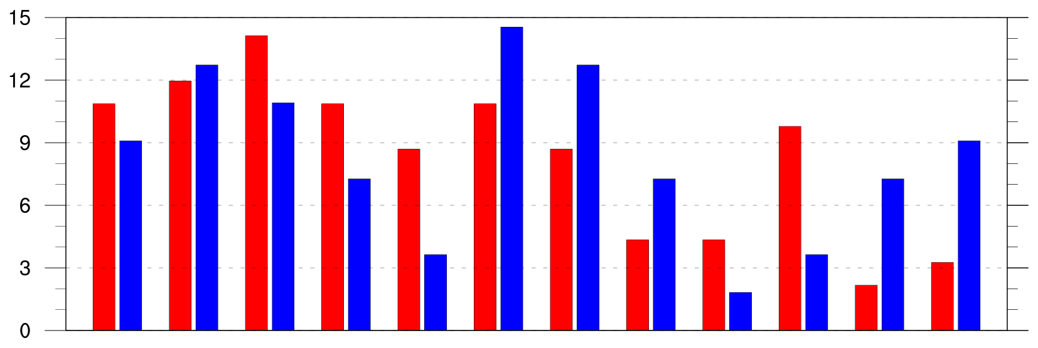
Preferred Longitudinal Corridors (JJA)
Distribution of longitude of Arctic cyclones at first time in Arctic (>70°N; % per longitudinal bin) during JJA
90°N
70°N
50°N
30°N
0°
30°E
60°E
90°E
120°E
150°E
180°
150°W
120°W
90°W
60°W
30°W
0°
0°
30°E
60°E
90°E
120°E
150°E
180°
150°W
120°W
90°W
60°W
30°W
0°
low (N=92)
high (N=55)

Slide 18
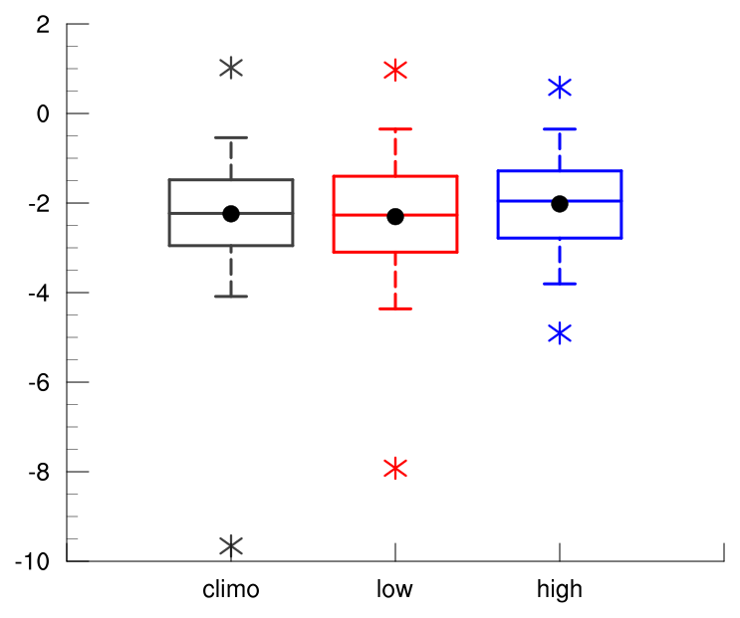
Intensity: Minimum Standardized Anomaly of SLP
Minimum standardized anomaly of SLP (σ) of ACs
2
min and max
0
mean
-2
95%
75%
median
-4
25%
5%
-6
Statistically significant differences in means
-8
-10
climo
(N=2542)
low
(N=401)
high
(N=345)

Slide 19
Intensity: Minimum Standardized Anomaly of SLP
Minimum standardized anomaly of SLP (σ) of ACs
2
min and max
0
mean
-2
95%
75%
median
-4
25%
5%
-6
Statistically significant differences in means
-8
-10
climo
(N=2542)
low
(N=401)
high
(N=345)

Slide 20
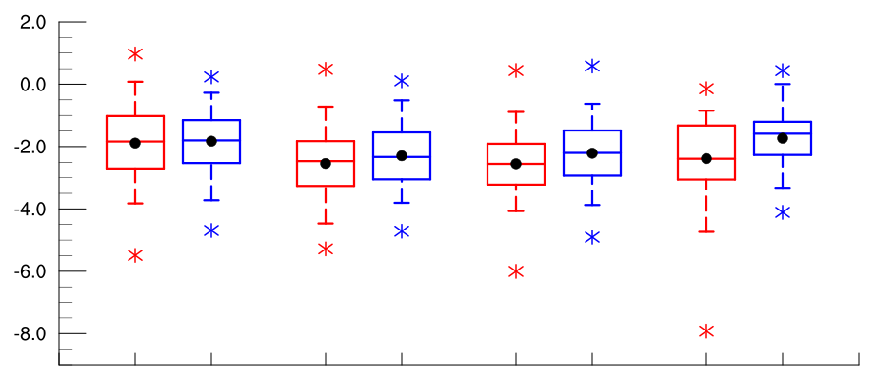
Intensity: Minimum Standardized Anomaly of SLP
Minimum standardized anomaly of SLP (σ) of ACs by season
2
0
-2
-4
-6
-8
low
(N =130)
high
(N=119)
low
(N=110)
high
(N=110)
low
(N=92)
high
(N=55)
low
(N=69)
high
(N=61)
DJF
MAM
JJA
SON
95%
75%
min and max
mean
median
Statistically significant differences in means
25%
5%

Slide 21
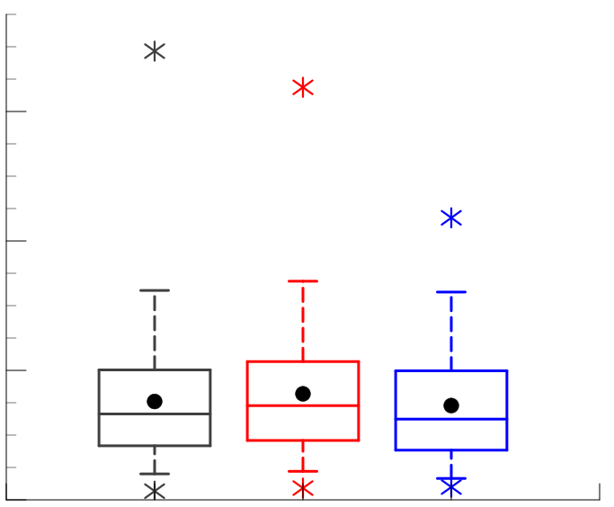
Intensity: Maximum SLP Depth
Maximum SLP depth (hPa) of ACs
min and max
60
mean
95%
75%
40
median
25%
5%
20
Statistically significant differences in means
0
climo
(N=2542)
low
(N=401)
high
(N=345)

Slide 22
Intensity: Maximum SLP Depth
Maximum SLP depth (hPa) of ACs
min and max
60
mean
95%
75%
40
median
25%
5%
20
Statistically significant differences in means
0
climo
(N=2542)
low
(N=401)
high
(N=345)

Slide 23
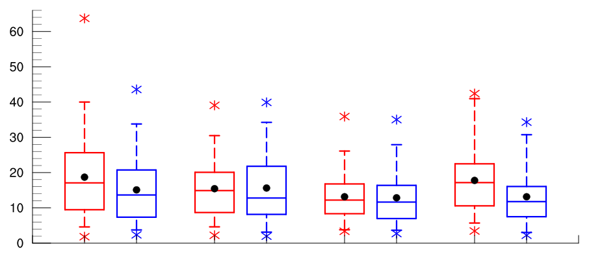
Intensity: Maximum SLP Depth
Maximum SLP depth (hPa) of ACs by season
60
50
40
30
20
10
0
low
(N =130)
high
(N=119)
low
(N=110)
high
(N=110)
low
(N=92)
high
(N=55)
low
(N=69)
high
(N=61)
DJF
MAM
JJA
SON
95%
75%
min and max
mean
median
Statistically significant differences in means
25%
5%

Slide 24
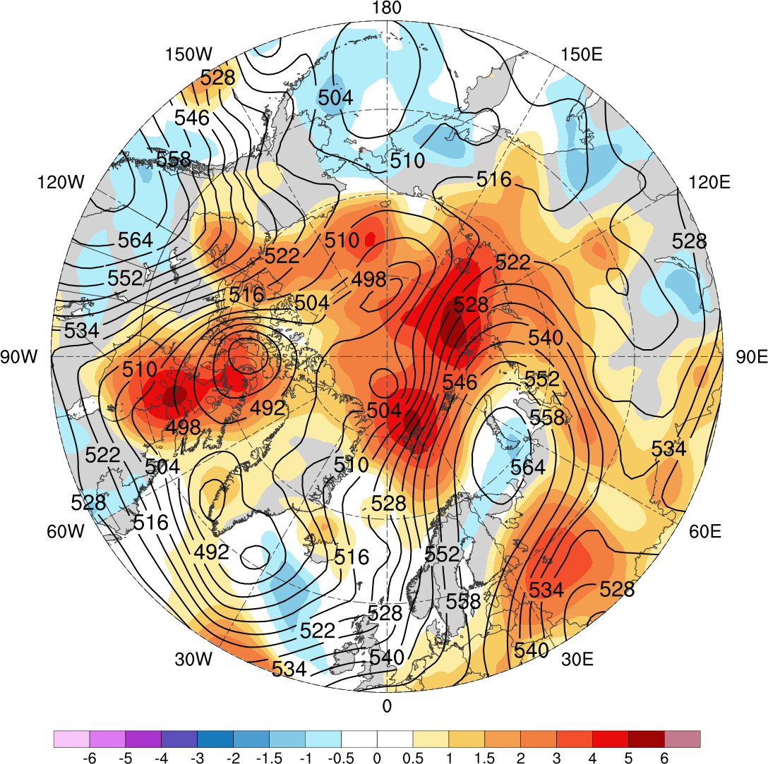
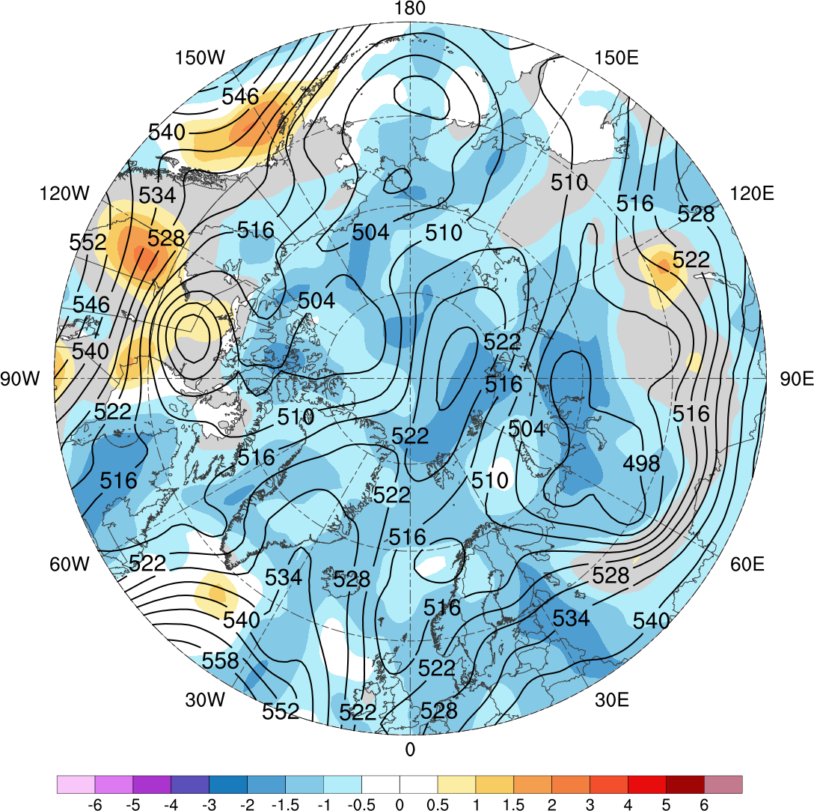
Low and High Skill Example
Low skill (valid 0000 UTC 1 Jan 2016)
High skill (valid 0000 UTC 6 Feb 2009)
-6
-5
-4
-3
-2
-1.5
-1
-0.5
0
0.5
1
1.5
2
3
4
5
6
Standardized anomaly of ensemble spread of day-5 forecasts of 500-hPa geopotential height (shading) from GEFS reforecast dataset v2; 500-hPa geopotential height (dam, black) from ERA-Interim

Slide 25
Flow Amplitude
Calculate absolute value of standardized anomaly of 500-hPa v-wind (hereafter σ_{v}) using ERA-interim
Calculate area-weighted average of σ_{v} over the Arctic (≥70°N) for low and high skill periods

Slide 26
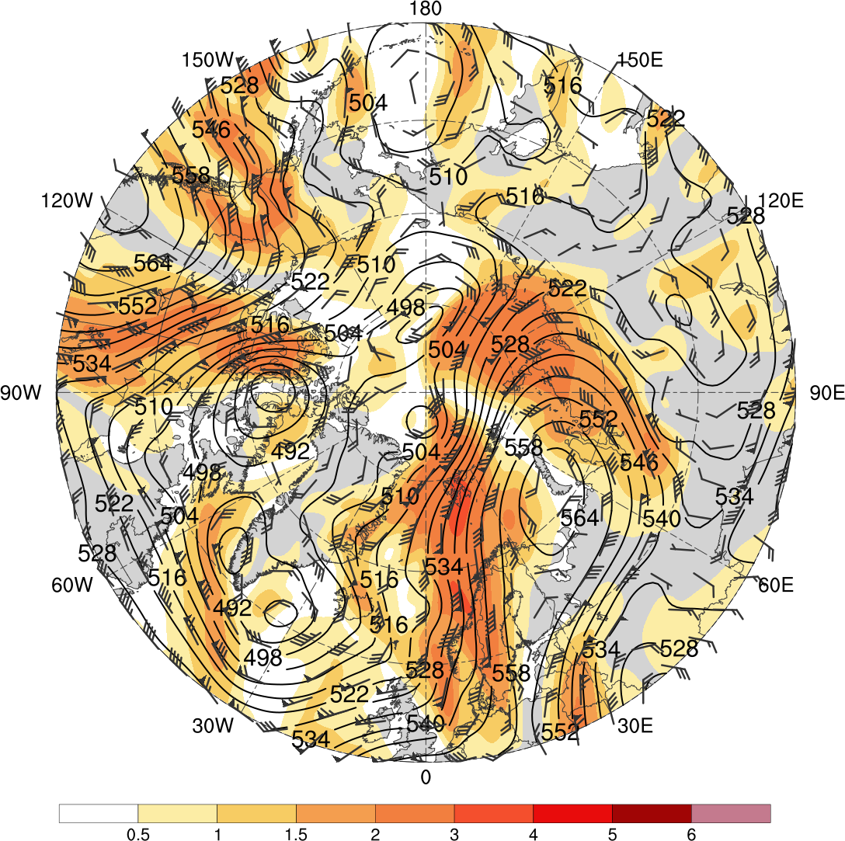
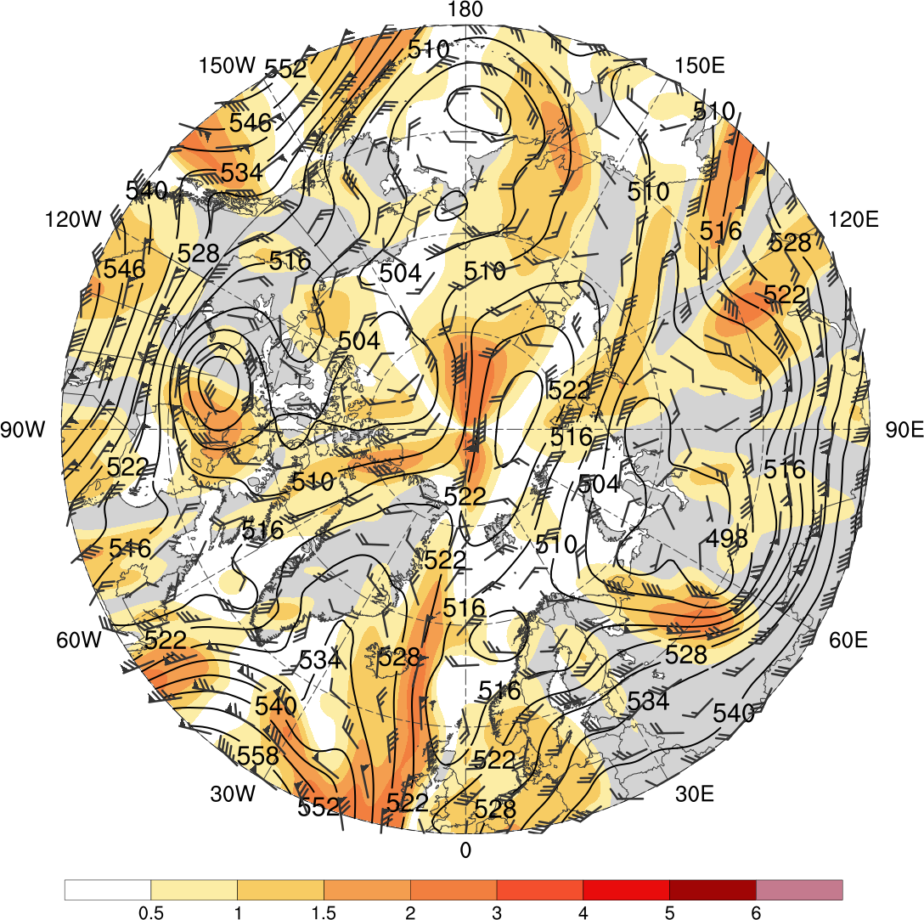
Flow Amplitude
Low skill
0000 UTC 1 Jan 2016
High skill
0000 UTC 6 Feb 2009
0.5
1
1.5
2
3
4
5
6
500-hPa geopotential height (dam), wind (flags and barbs, m s⁻¹), and σ_{v} (shading) from ERA-Interim

Slide 27
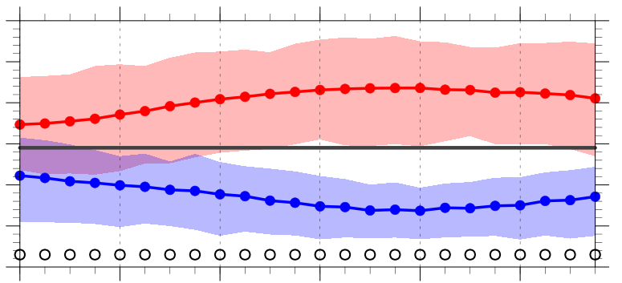
Flow Amplitude
Area-weighted average of σ_{v} over the Arctic (≥70°N)
1.1
1.0
0.9
0.8
0.7
0.6
0.5
-120
-96
-72
-48
-24
0
Hours relative to 0000 UTC of low and high skill days
1979–2017 climo mean
statistically significant difference between low/high skill mean and climo mean
statistically significant difference between low and high skill means
shading: interquartile range
low-skill mean
high-skill mean

Slide 28
Conclusions
Arctic cyclone frequency is higher for low skill periods compared to high skill periods
Arctic cyclone frequency is highest during JJA for low skill periods, and highest during SON for high skill periods
Arctic cyclone frequency is lowest during DJF for both low and high skill periods

Slide 29
Conclusions
Arctic cyclones during low skill periods more often occur over northern portions of central and eastern Eurasia and much of the adjacent Arctic Ocean compared to Arctic cyclones during high skill periods
Arctic cyclones during high skill periods more often occur over the northern North Atlantic and the adjacent Norwegian and Barents Seas compared to Arctic cyclones during low skill periods

Slide 30
Conclusions
Arctic cyclones tend to be stronger during low skill periods compared to high skill periods, especially during SON
The synoptic-scale flow over the Arctic tends to be significantly more amplified during low skill periods compared to high skill periods

Slide 31
Questions? Email: kbiernat@albany.edu
Arctic cyclones tend to be stronger during low skill periods compared to high skill periods, especially during SON
The synoptic-scale flow over the Arctic tends to be significantly more amplified during low skill periods compared to high skill periods

Slide 32
References
Buizza, R., J. R. Bidlot, N. Wedi, M. Fuentes, M. Hamrud, G. Holt, and F. Vitart,
2007: The new ECMWF VAREPS (Variable Resolution Ensemble Prediction
System). Quart. J. Roy. Meteor. Soc., 133, 681–695.
Crawford, A., and M. Serreze, 2016: Does the summer Arctic frontal zone
influence Arctic Ocean cyclone activity? J. Climate, 29, 4977–4993.
Hamill, T. M., G. T. Bates, J. S. Whitaker, D. R. Murray, M. Fiorino, T. J.
Galarneau Jr., Y. Zhu, and W. Lapenta, 2013: NOAA’s second-generation
global medium-range ensemble reforecast dataset. Bull. Amer. Meteor. Soc.,
94, 1553–1565.
Sprenger, M., and Coauthors, 2017: Global climatologies of Eulerian and
Lagrangian flow features based on ERA-Interim. Bull. Amer. Meteor. Soc.,
98, 1739–1748.
Torn, R. D., 2017: A comparison of the downstream predictability associated with
ET and baroclinic cyclones. Mon. Wea. Rev., 145, 4651–4672.
Yamagami, A., M. Matsueda, and H. L. Tanaka, 2018a: Predictability of the 2012
great Arctic cyclone on medium-range timescales. Polar Science, 15, 13–23.
——, ——, and ——, 2018b: Medium-range forecast skill for extraordinary Arctic
cyclones in summer of 2008–2016. Geophys. Res. Lett., 45, 4429– 4437.
Zhang, J., R. Lindsay, A. Schweiger, and M. Steele, 2013: The impact of an
intense summer cyclone on 2012 Arctic sea ice retreat. Geophys. Res. Lett.,
40, 720–726.

Slide 33
Extra Slides

Slide 34
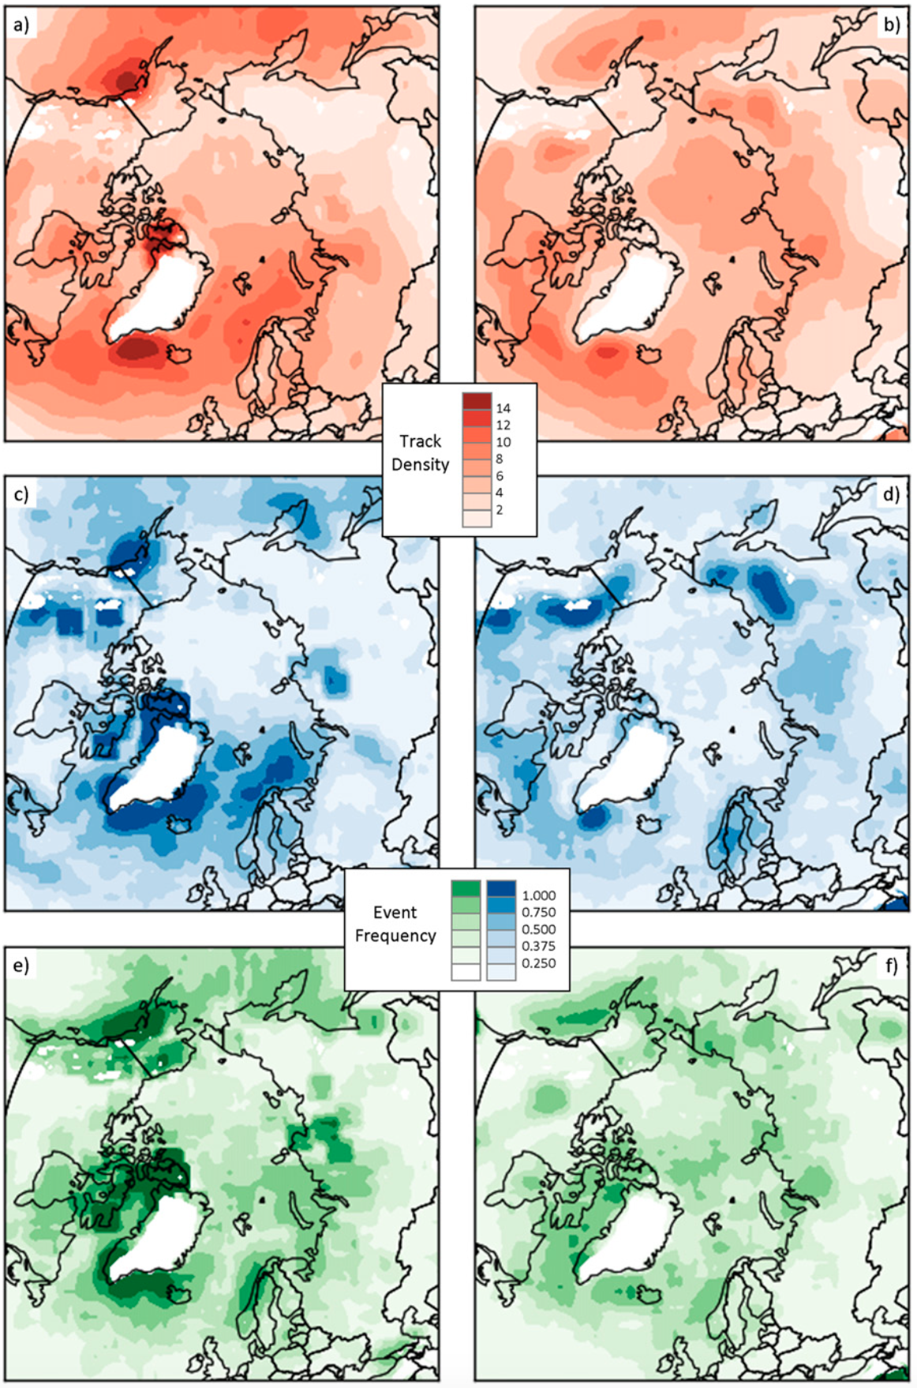
Background
Winter
Summer
Arctic cyclones may originate within and outside of Arctic
During winter, Arctic cyclones often originate from North Atlantic
During summer, Arctic cyclones often originate from Eurasia
Track Density
Genesis Frequency
Lysis Frequency
Figure 3 adapted from Crawford and Serreze (2016)

Slide 35
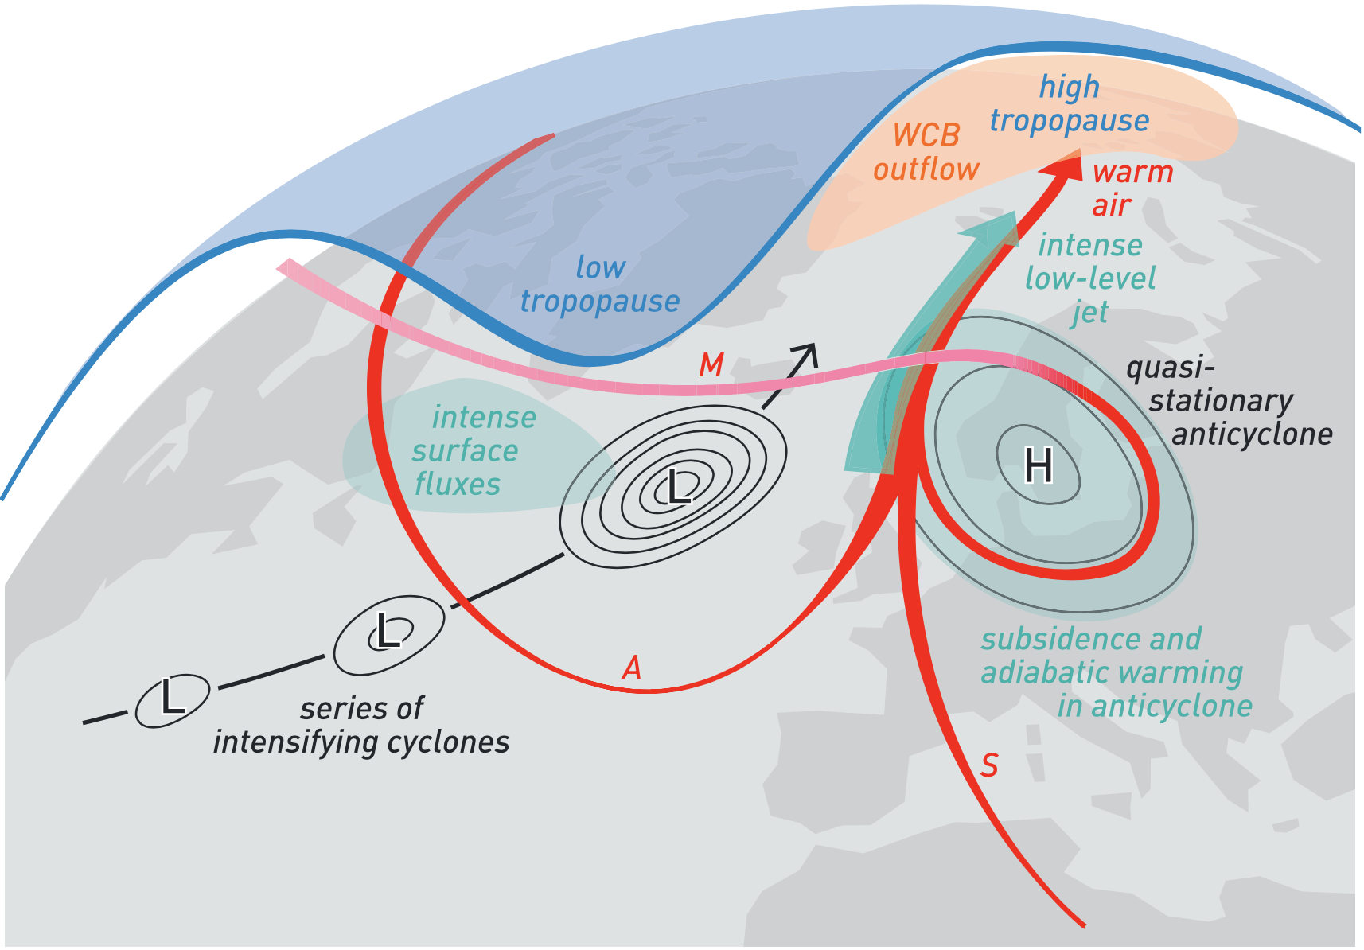
Background
Highly-amplified flow may enable cyclones and associated intrusions of warm, moist air to enter the Arctic
During late Dec 2015 and early Jan 2016, warm, moist air transported between series of cyclones and blocking anticyclone (Binder et al. 2017)
More than 30 cm of sea ice thinning in the Barents and Kara Seas occurred during this event
Kara
Sea
Barents Sea
L
H
L
L
Figure 4 adapted from Binder et al. (2017)

Slide 36
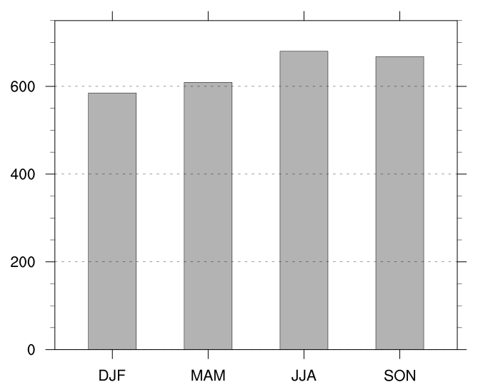
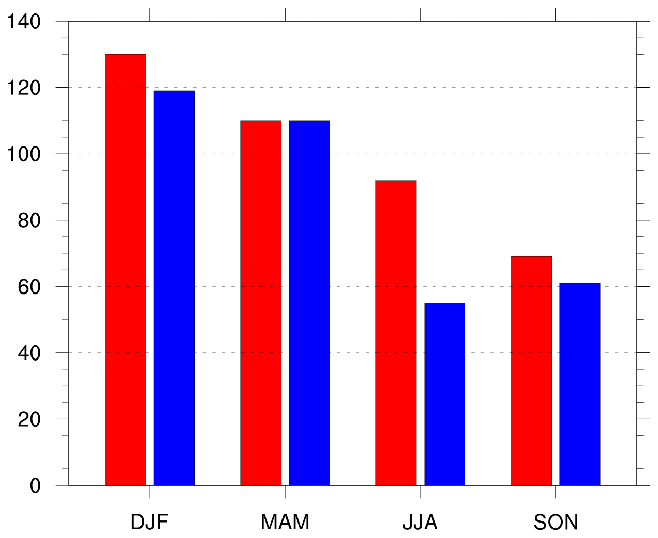
Number of Arctic Cyclones by Season
Number of Arctic cyclones in climatology by season
Number of Arctic cyclones in low and high skill periods by season
Low skill
High skill

Slide 37
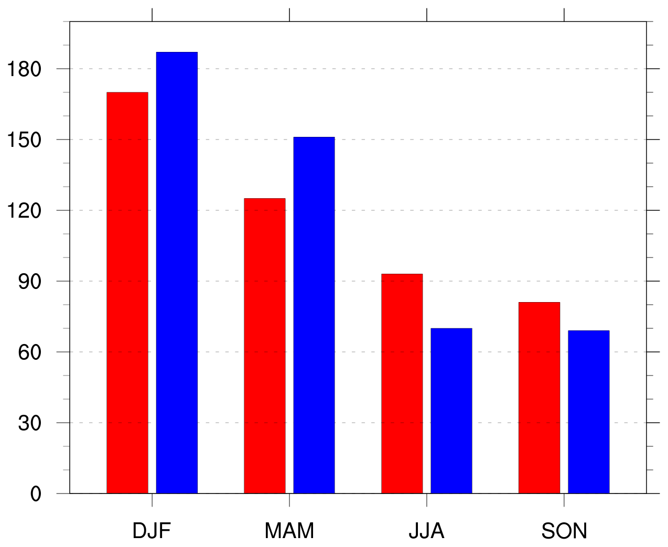
Number of Arctic Cyclones by Season
Number of days in low and high skill periods by season
Number of Arctic cyclones in low and high skill periods by season
Low skill
Low skill
High skill
High skill

Slide 38
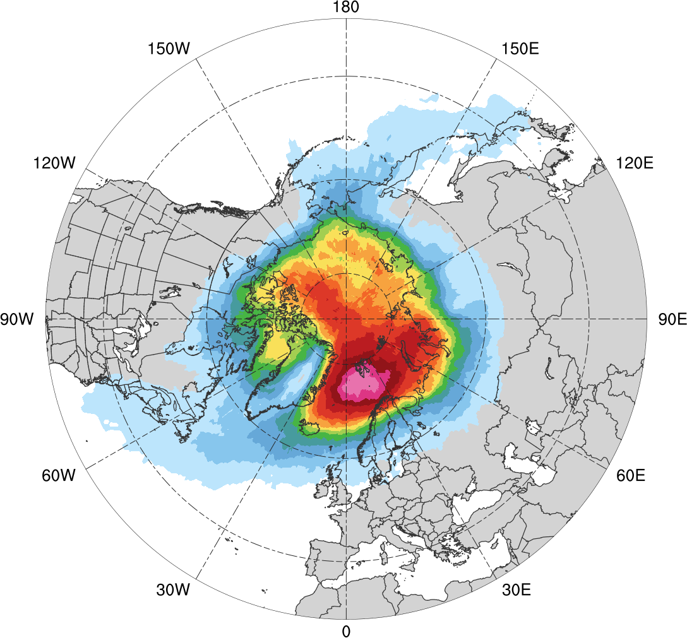
Normalized Track Density (DJF)
DJF climatology (N = 585)
0.05
0.1
0.15
0.2
0.25
0.3
0.35
0.4
0.45
0.5
0.6
0.7
0.8
0.9
Total number of Arctic cyclones during DJF within 500 km of a grid point, normalized by maximum value

Slide 39
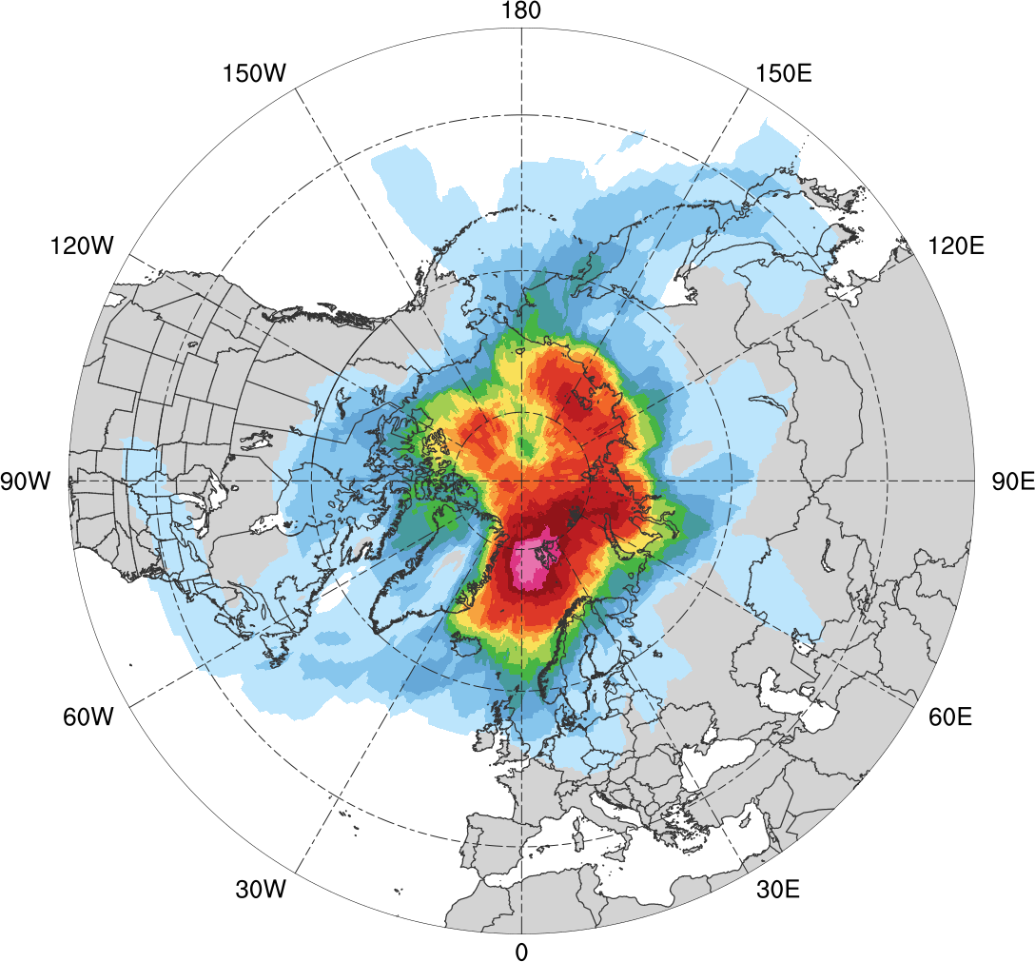
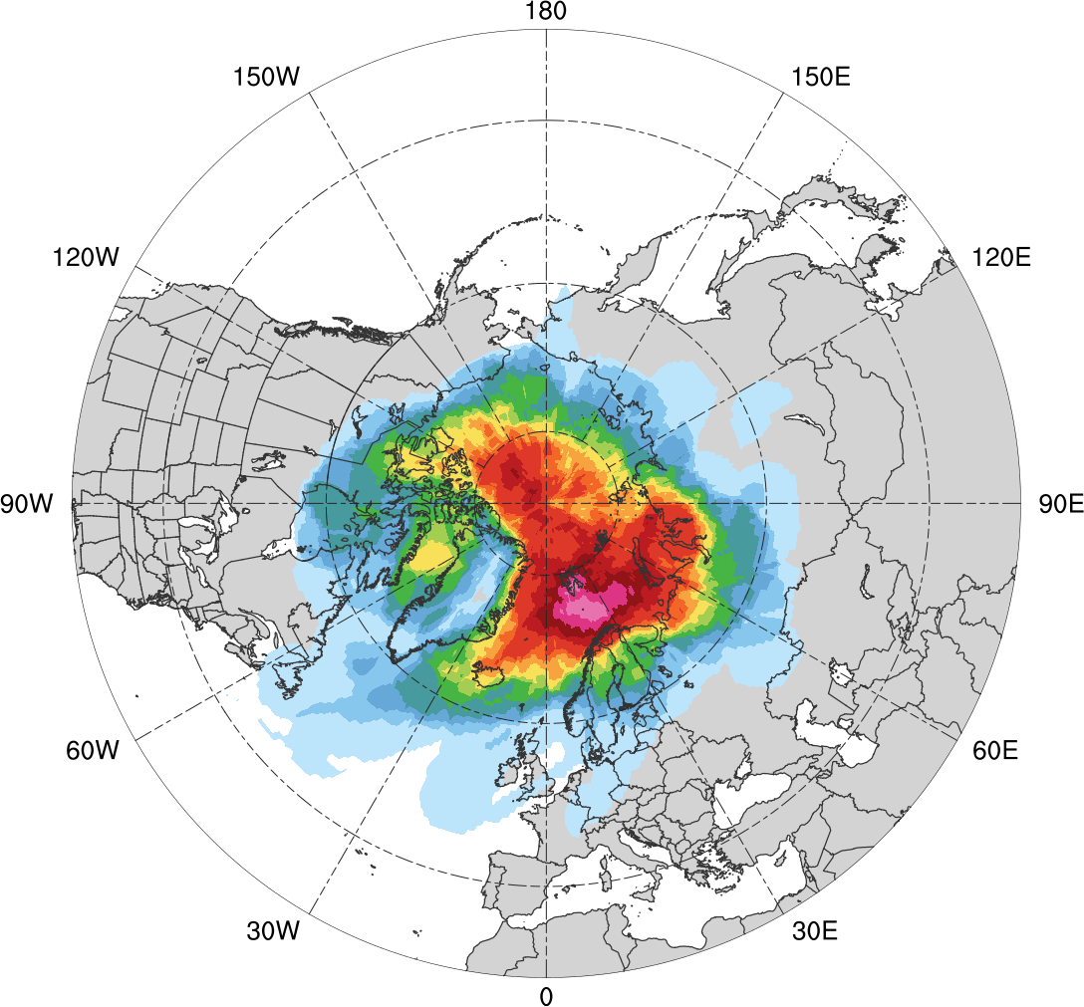
Normalized Track Density (DJF)
Low skill (N = 130)
High Skill (N = 119)
0.05
0.1
0.15
0.2
0.25
0.3
0.35
0.4
0.45
0.5
0.6
0.7
0.8
0.9
Total number of Arctic cyclones within 500 km of a grid point during DJF, normalized by maximum value, for each period

Slide 40
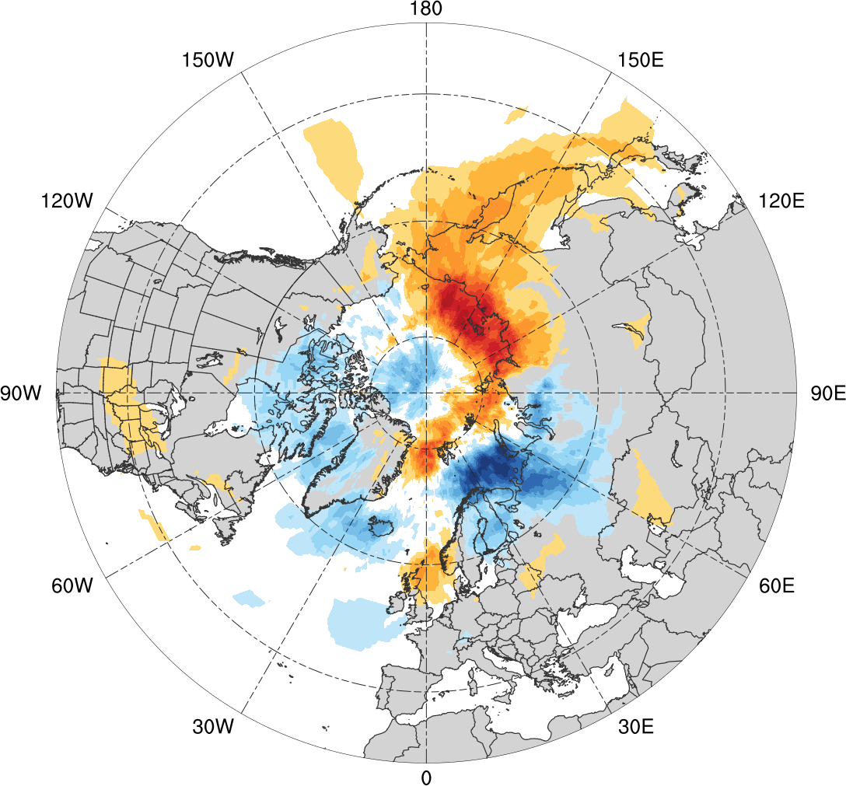
Normalized Track Density Differences (DJF)
Low skill minus high skill
-0.4
-0.35
-0.3
-0.25
-0.2
-0.15
-0.1
-0.05
0
0.05
0.1
0.15
0.2
0.25
0.3
0.35
0.4
Difference in normalized Arctic cyclone track density during DJF

Slide 41
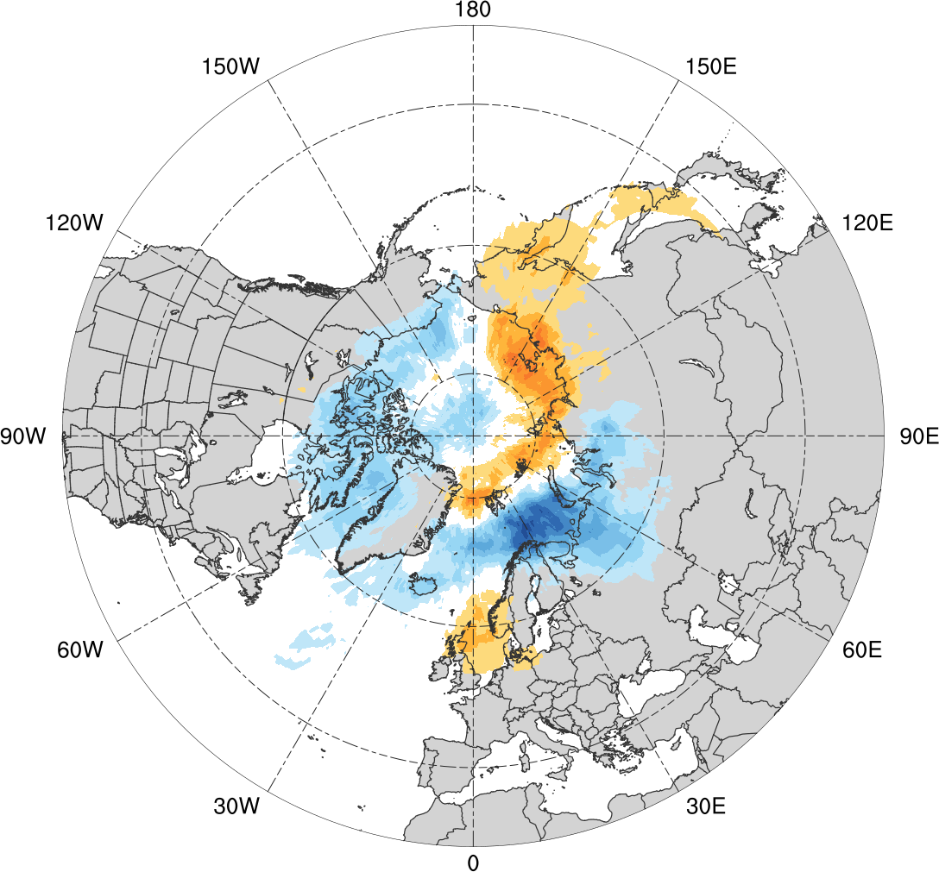
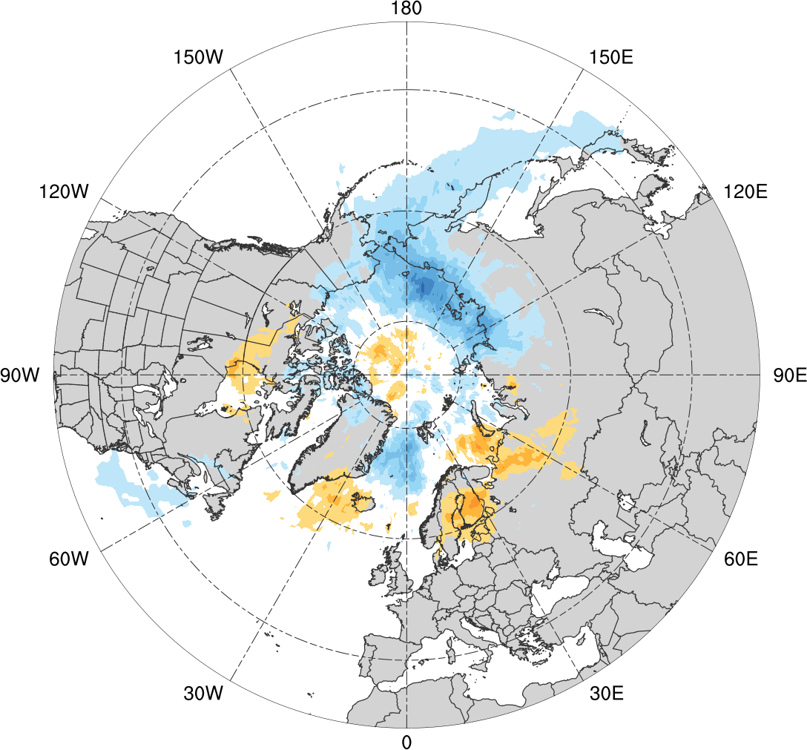
Normalized Track Density Differences (DJF)
Low skill minus climatology
High skill minus climatology
-0.4
-0.35
-0.3
-0.25
-0.2
-0.15
-0.1
-0.05
0
0.05
0.1
0.15
0.2
0.25
0.3
0.35
0.4
Difference in normalized Arctic cyclone track density during DJF

Slide 42
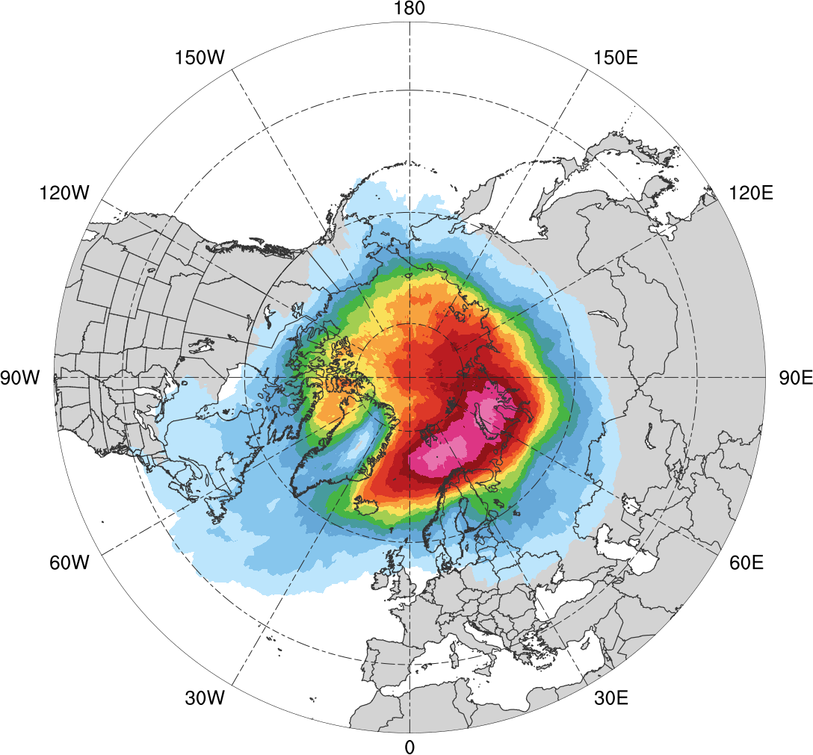
Normalized Track Density (MAM)
MAM climatology (N = 609)
0.05
0.1
0.15
0.2
0.25
0.3
0.35
0.4
0.45
0.5
0.6
0.7
0.8
0.9
Total number of Arctic cyclones during MAM within 500 km of a grid point, normalized by maximum value

Slide 43
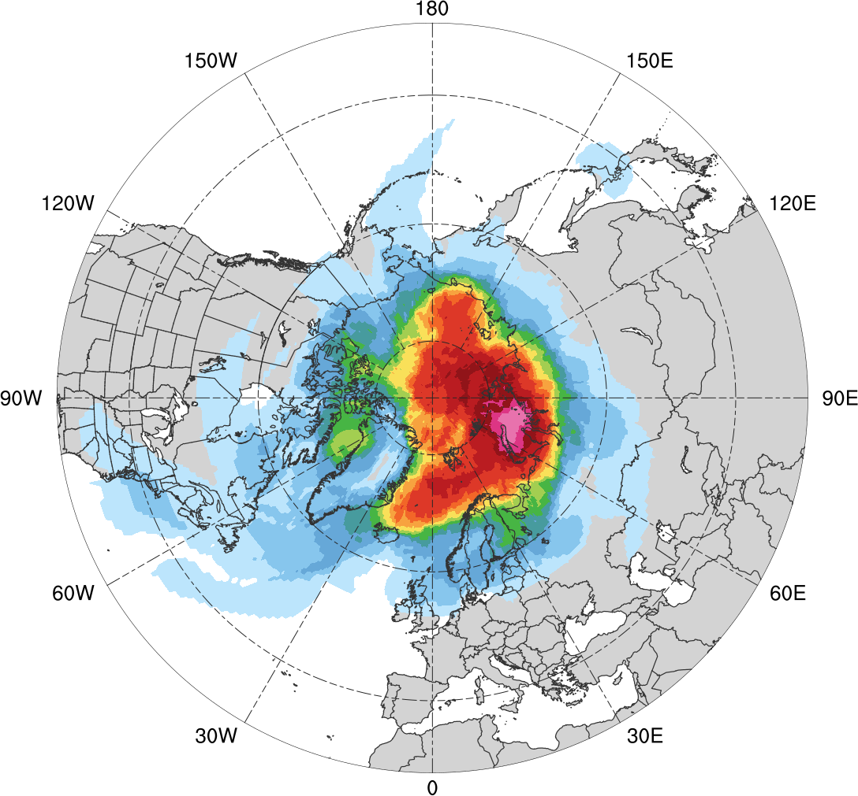
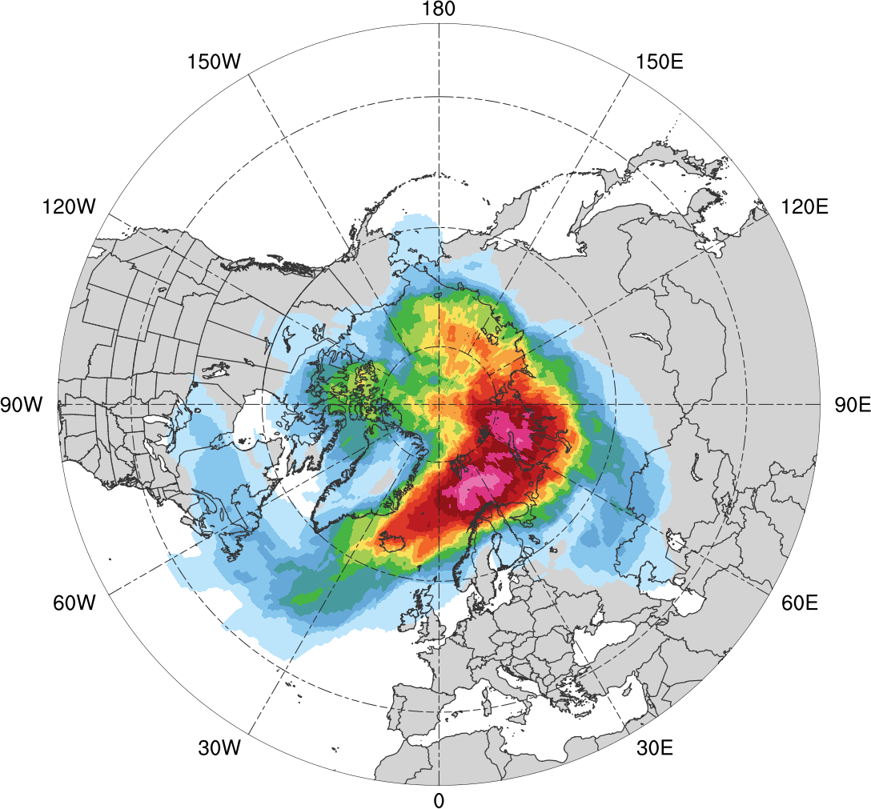
Normalized Track Density (MAM)
Low skill (N = 110)
High Skill (N = 110)
0.05
0.1
0.15
0.2
0.25
0.3
0.35
0.4
0.45
0.5
0.6
0.7
0.8
0.9
Total number of Arctic cyclones within 500 km of a grid point during MAM, normalized by maximum value, for each period

Slide 44
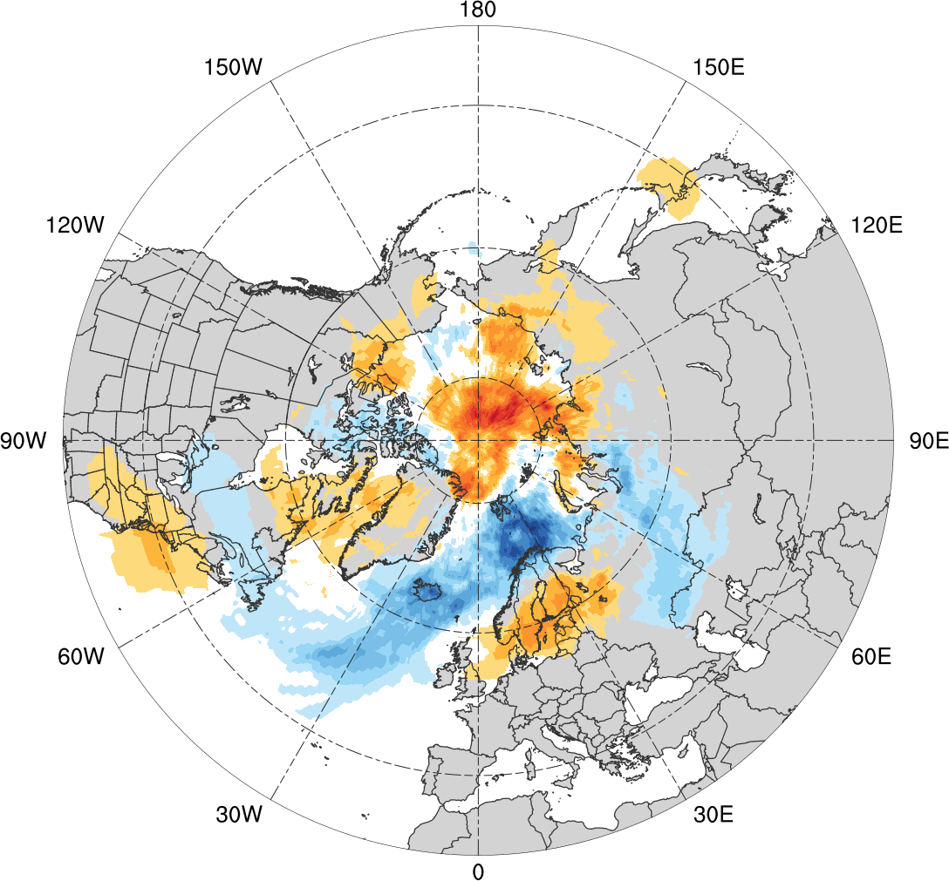
Normalized Track Density Differences (MAM)
Low skill minus high skill
-0.4
-0.35
-0.3
-0.25
-0.2
-0.15
-0.1
-0.05
0
0.05
0.1
0.15
0.2
0.25
0.3
0.35
0.4
Difference in normalized Arctic cyclone track density during MAM

Slide 45
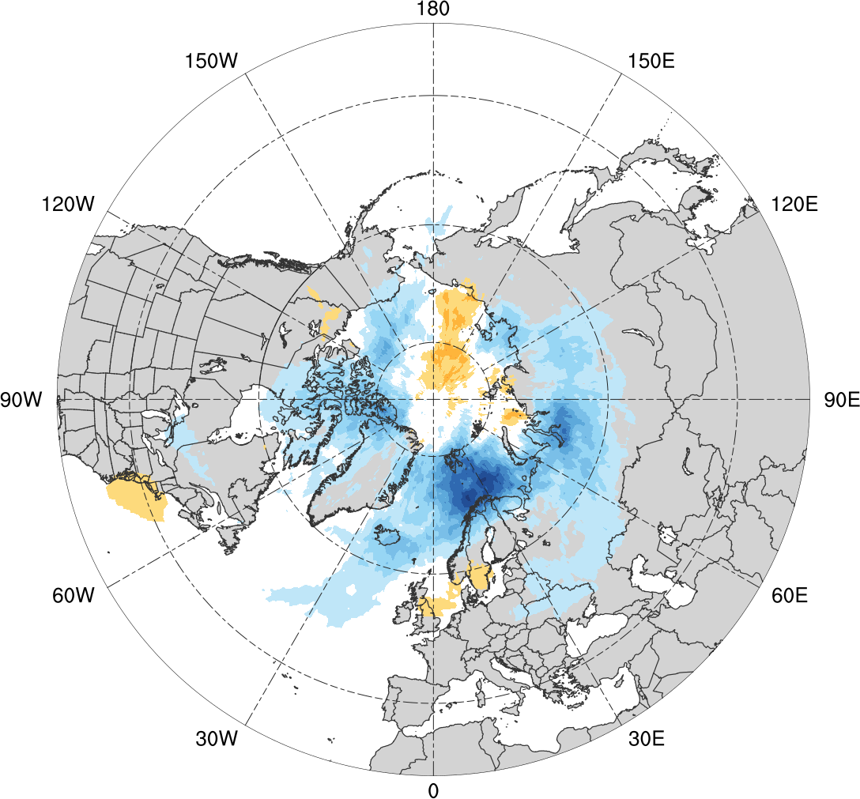
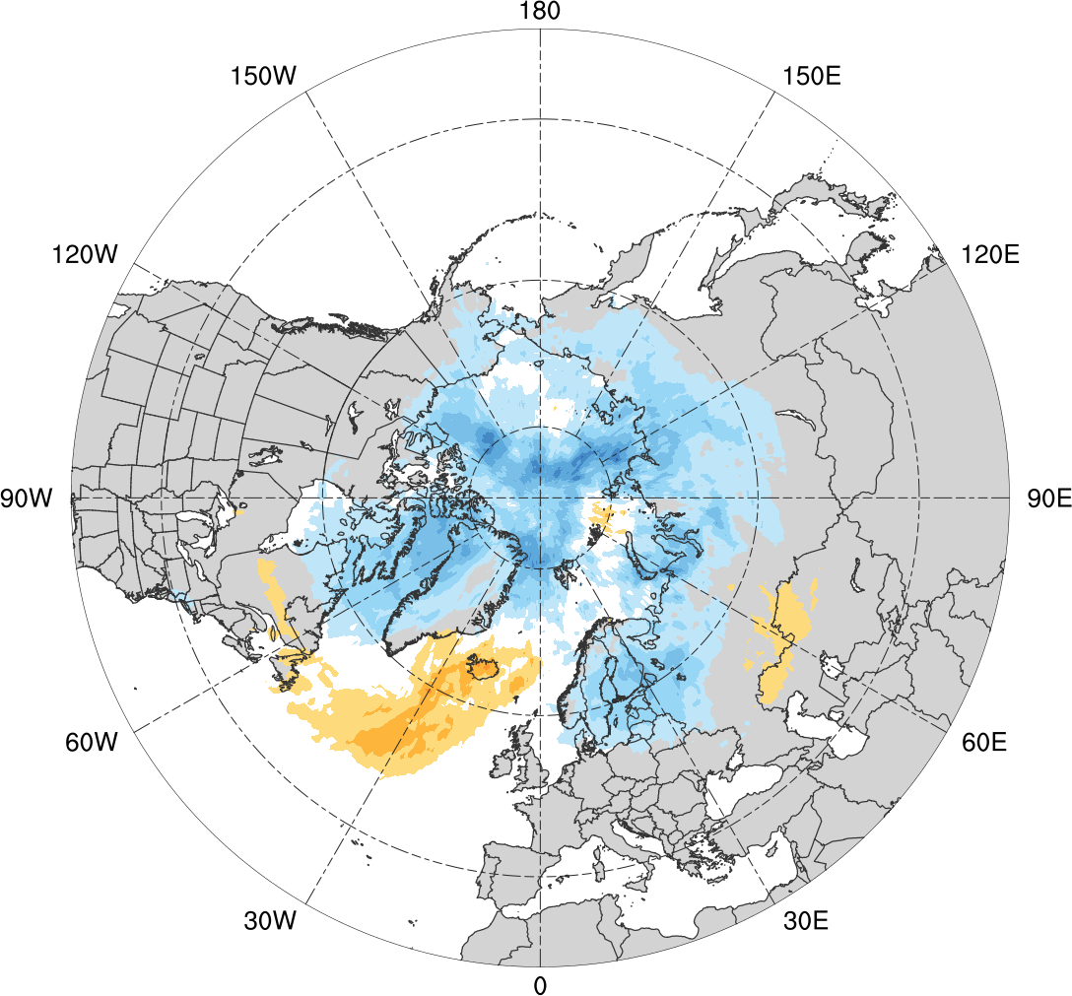
Normalized Track Density Differences (MAM)
Low skill minus climatology
High skill minus climatology
-0.4
-0.35
-0.3
-0.25
-0.2
-0.15
-0.1
-0.05
0
0.05
0.1
0.15
0.2
0.25
0.3
0.35
0.4
Difference in normalized Arctic cyclone track density during MAM

Slide 46
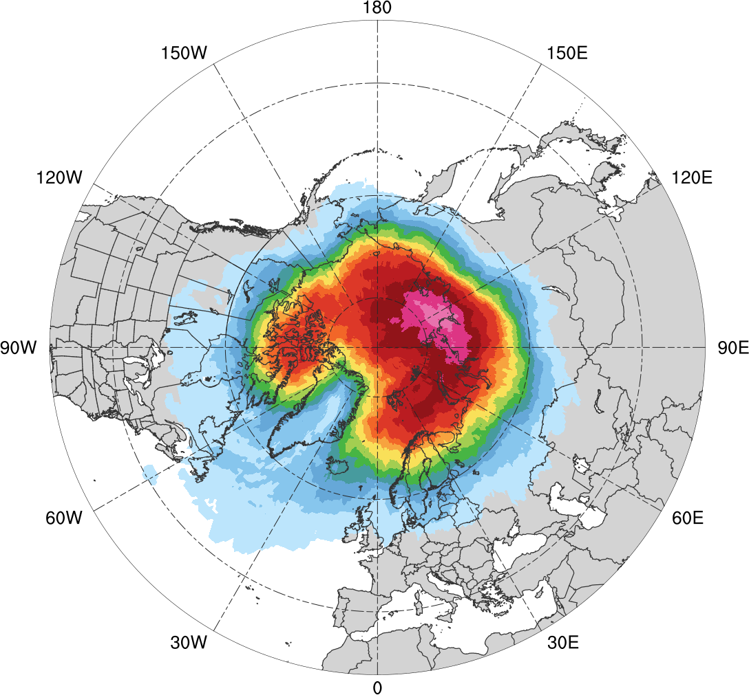
Normalized Track Density (JJA)
JJA climatology (N = 680)
0.05
0.1
0.15
0.2
0.25
0.3
0.35
0.4
0.45
0.5
0.6
0.7
0.8
0.9
Total number of Arctic cyclones during JJA within 500 km of a grid point, normalized by maximum value

Slide 47
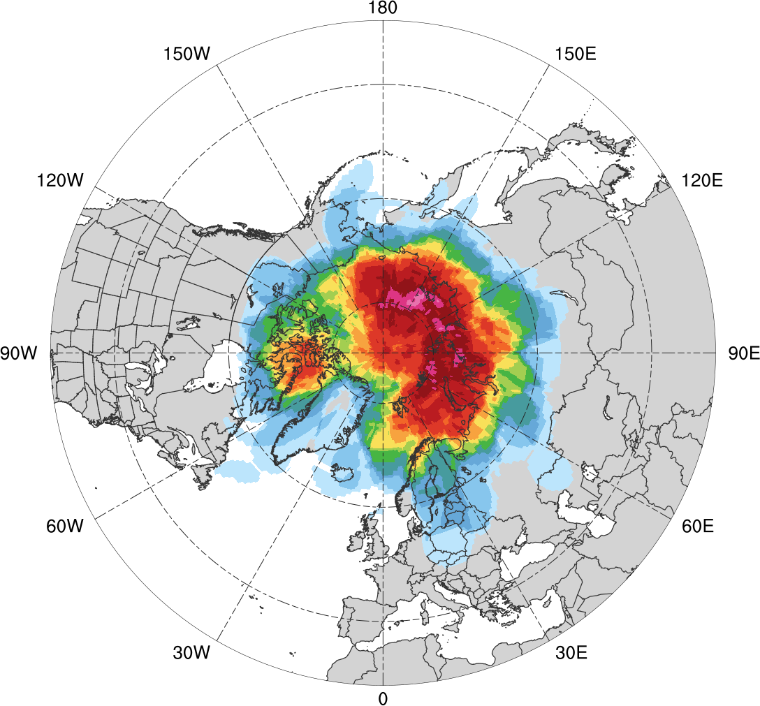
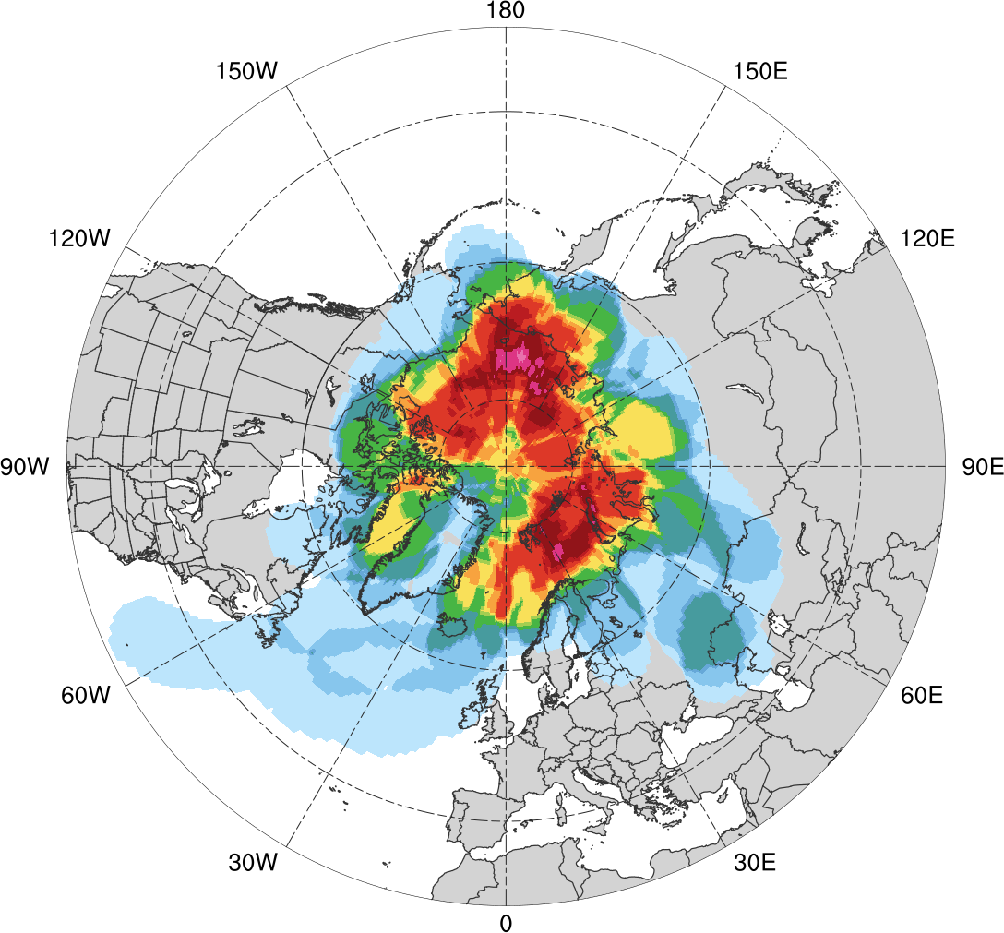
Normalized Track Density (JJA)
Low skill (N = 92)
High Skill (N = 52)
0.05
0.1
0.15
0.2
0.25
0.3
0.35
0.4
0.45
0.5
0.6
0.7
0.8
0.9
Total number of Arctic cyclones within 500 km of a grid point during JJA, normalized by maximum value, for each period

Slide 48
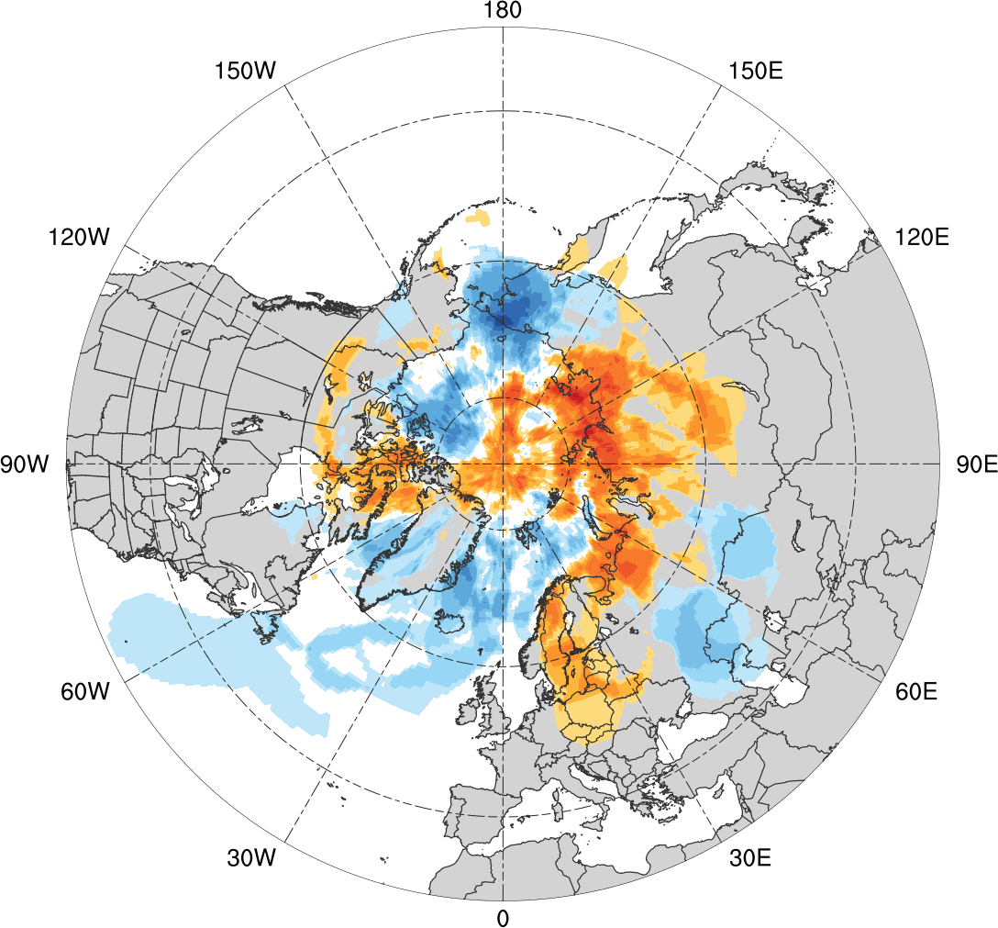
Normalized Track Density Differences (JJA)
Low skill minus high skill
-0.6
-0.5
-0.4
-0.3
-0.2
-0.15
-0.1
-0.05
0
0.05
0.1
0.15
0.2
0.3
0.4
0.5
0.6
Difference in normalized Arctic cyclone track density during JJA

Slide 49
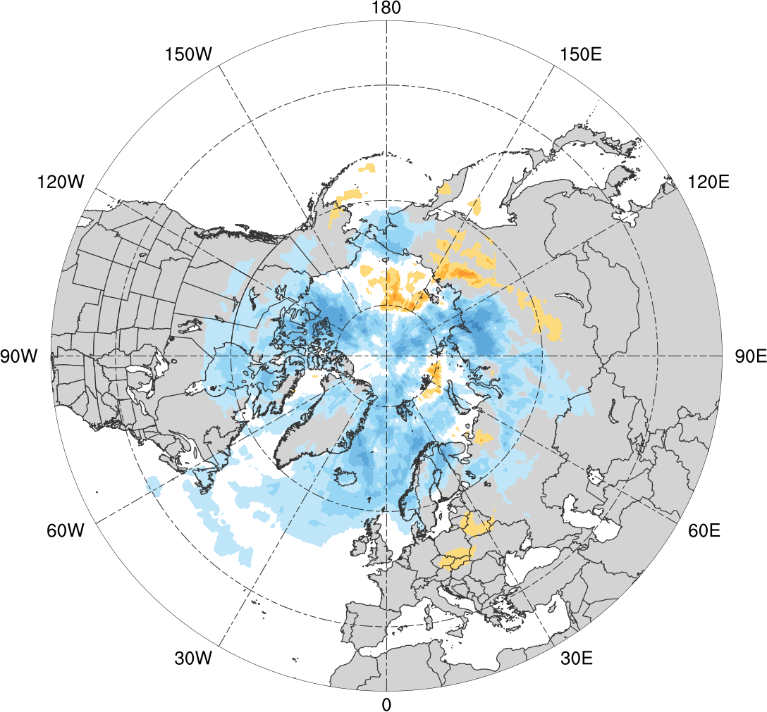
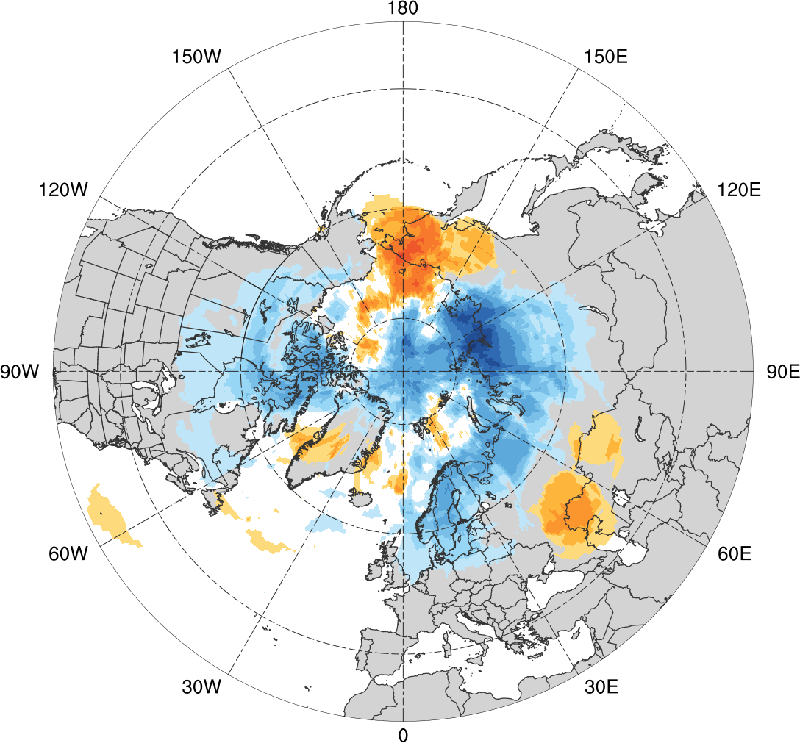
Normalized Track Density Differences (JJA)
Low skill minus climatology
High skill minus climatology
-0.6
-0.5
-0.4
-0.3
-0.2
-0.15
-0.1
-0.05
0
0.05
0.1
0.15
0.2
0.3
0.4
0.5
0.6
Difference in normalized Arctic cyclone track density during JJA

Slide 50
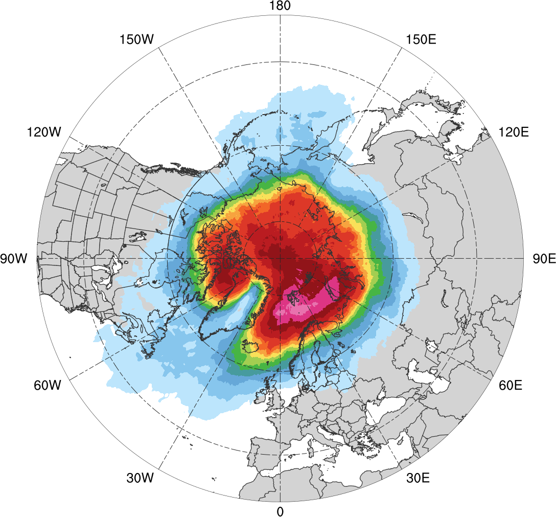
Normalized Track Density (SON)
SON climatology (N = 668)
0.05
0.1
0.15
0.2
0.25
0.3
0.35
0.4
0.45
0.5
0.6
0.7
0.8
0.9
Total number of Arctic cyclones during SON within 500 km of a grid point, normalized by maximum value

Slide 51
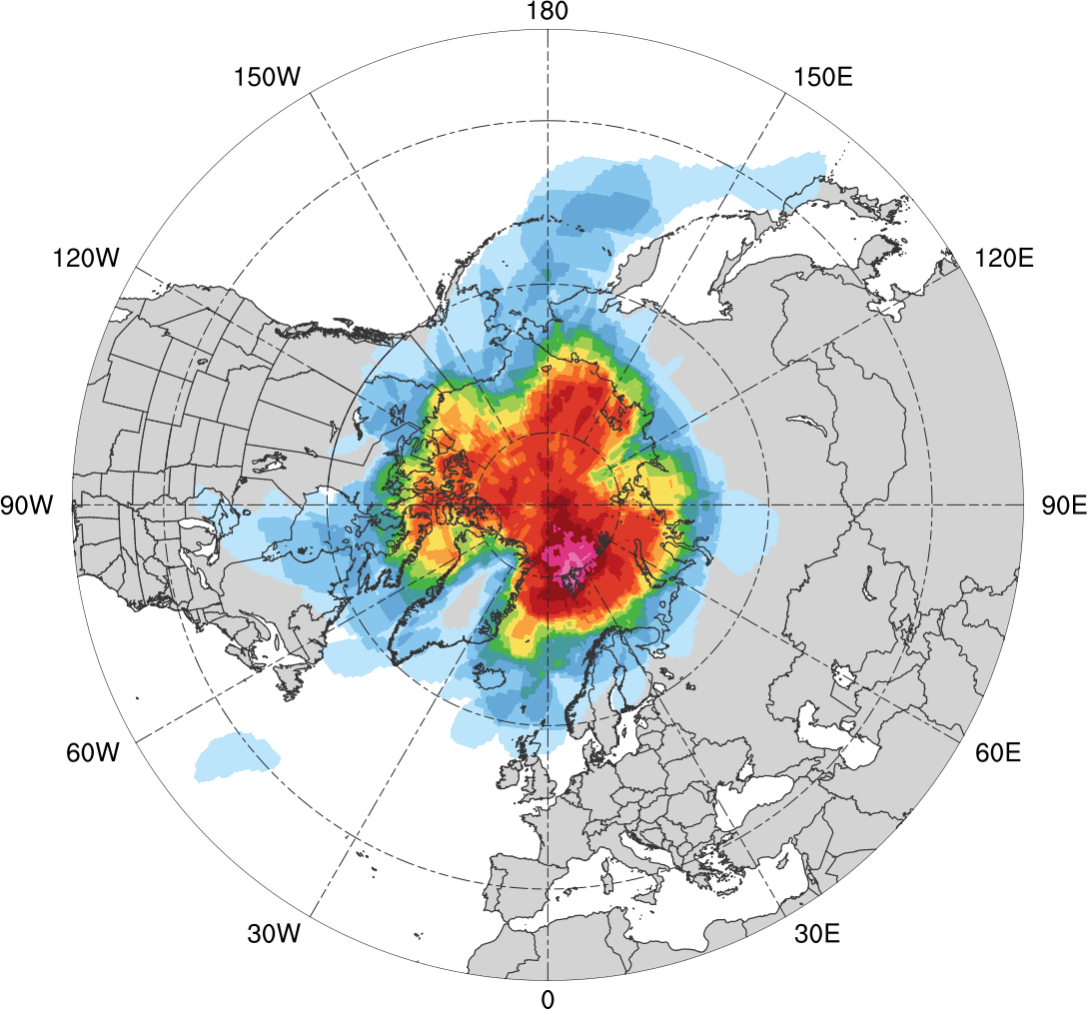
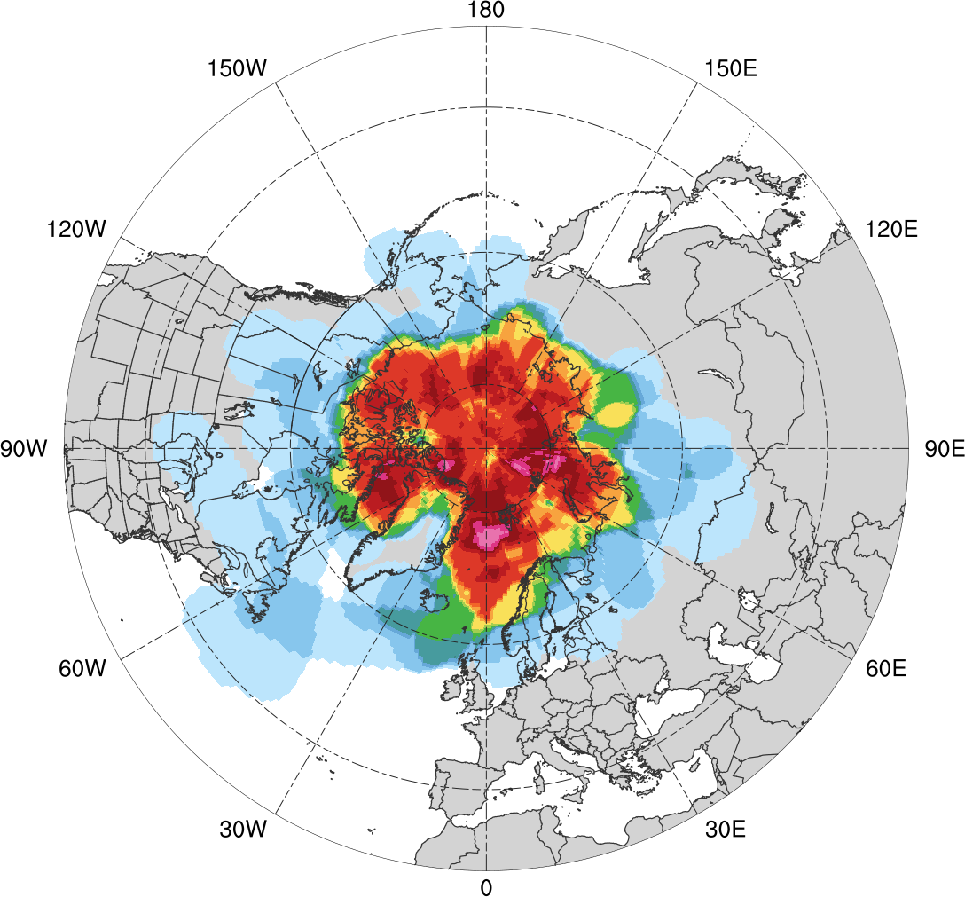
Normalized Track Density (SON)
Low skill (N = 69)
High Skill (N = 61)
0.05
0.1
0.15
0.2
0.25
0.3
0.35
0.4
0.45
0.5
0.6
0.7
0.8
0.9
Total number of Arctic cyclones within 500 km of a grid point during SON, normalized by maximum value, for each period

Slide 52
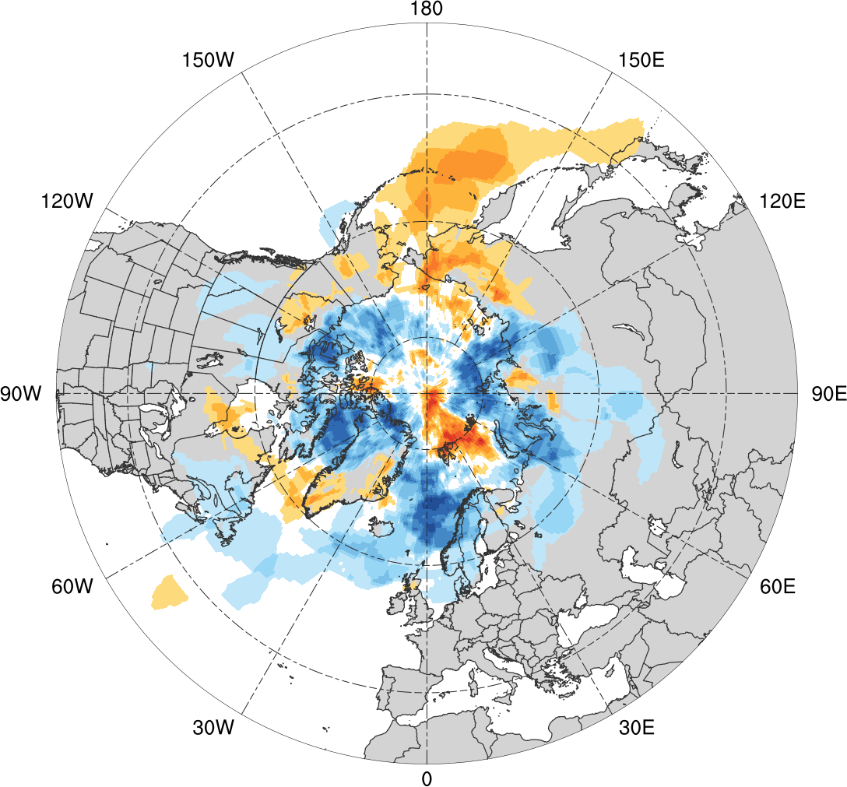
Normalized Track Density Differences (SON)
Low skill minus high skill
-0.5
-0.4
-0.3
-0.25
-0.2
-0.15
-0.1
-0.05
0
0.05
0.1
0.15
0.2
0.25
0.3
0.4
0.5
Difference in normalized Arctic cyclone track density during SON

Slide 53
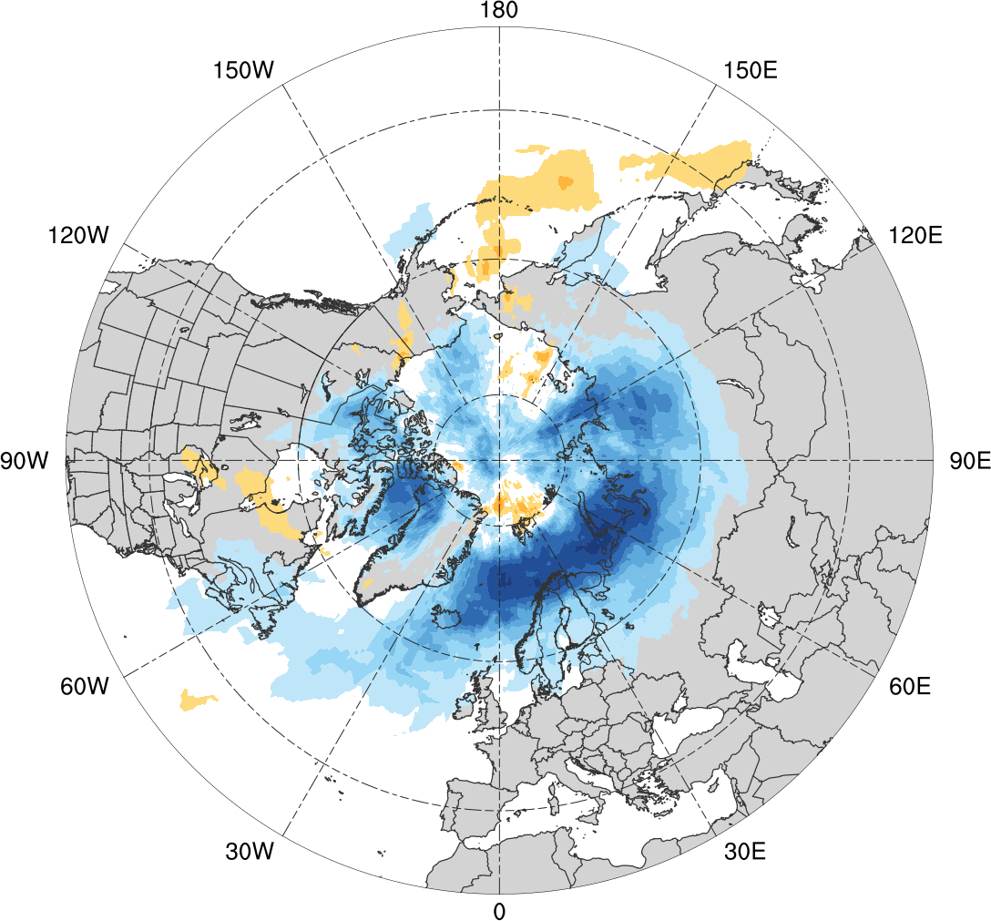
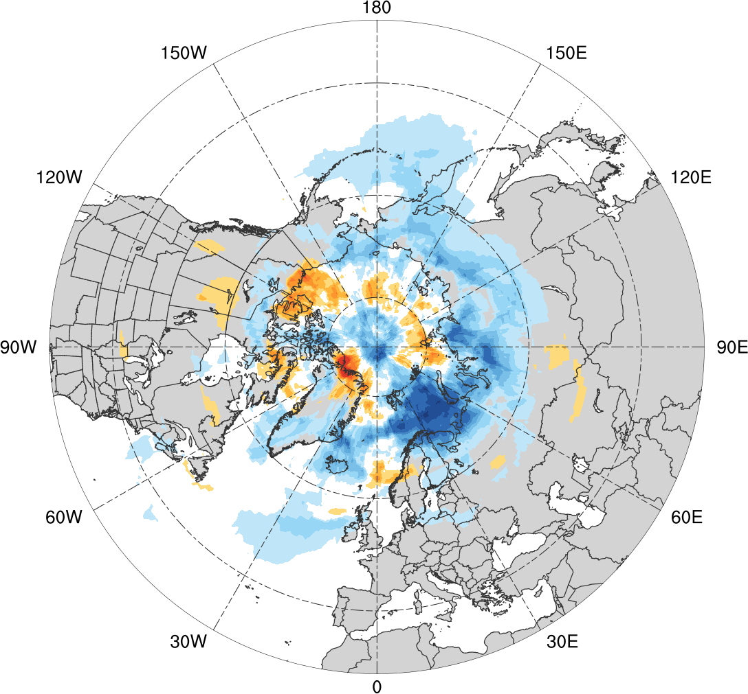
Normalized Track Density Differences (SON)
Low skill minus climatology
High skill minus climatology
-0.5
-0.4
-0.3
-0.25
-0.2
-0.15
-0.1
-0.05
0
0.05
0.1
0.15
0.2
0.25
0.3
0.4
0.5
Difference in normalized Arctic cyclone track density during SON

Slide 54
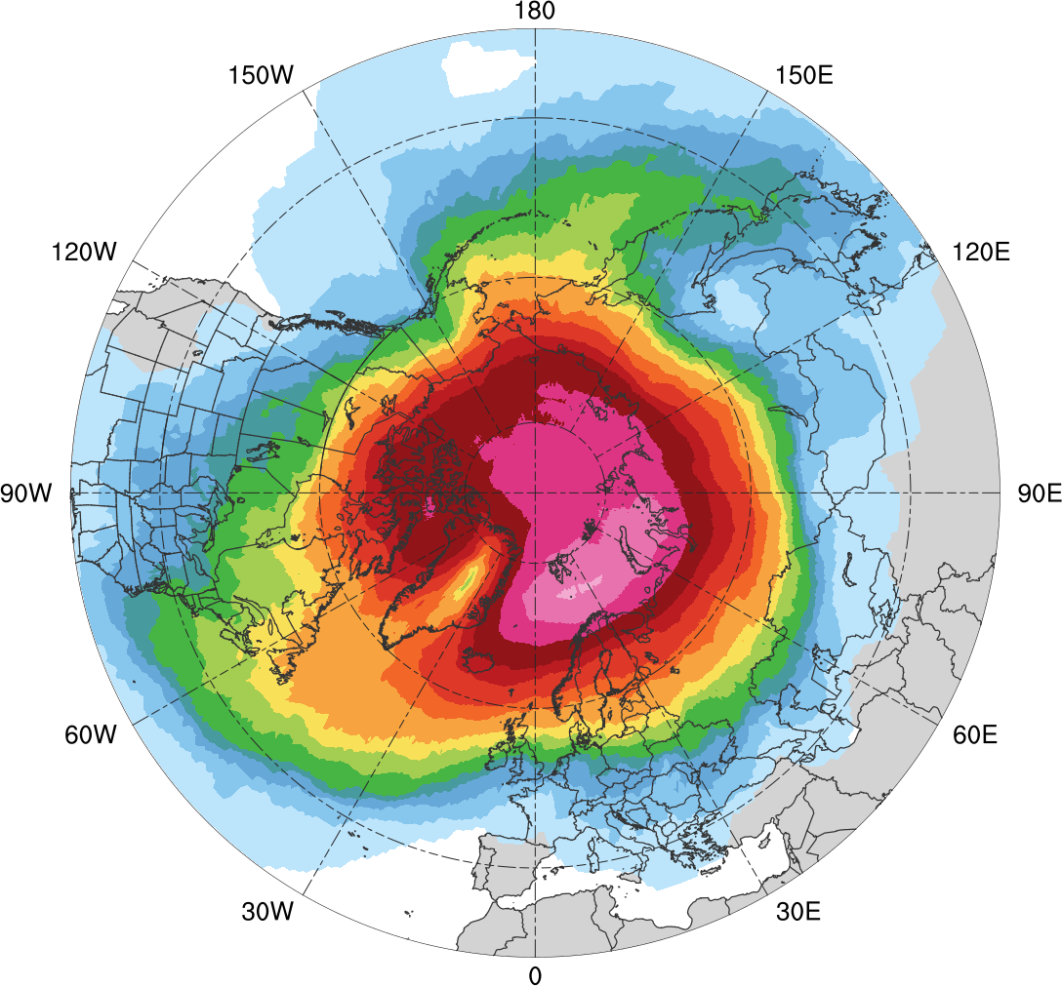
Track Density
Entire climatology (N = 2542)
1
5
10
15
20
30
40
50
75
100
150
200
300
400
500
Total number of Arctic cyclones within 500 km of a grid point

Slide 55
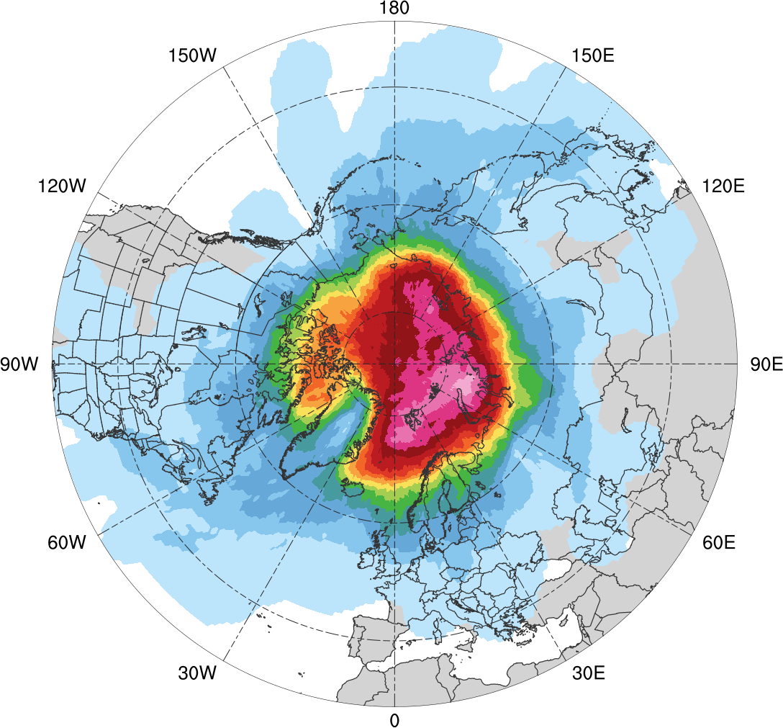
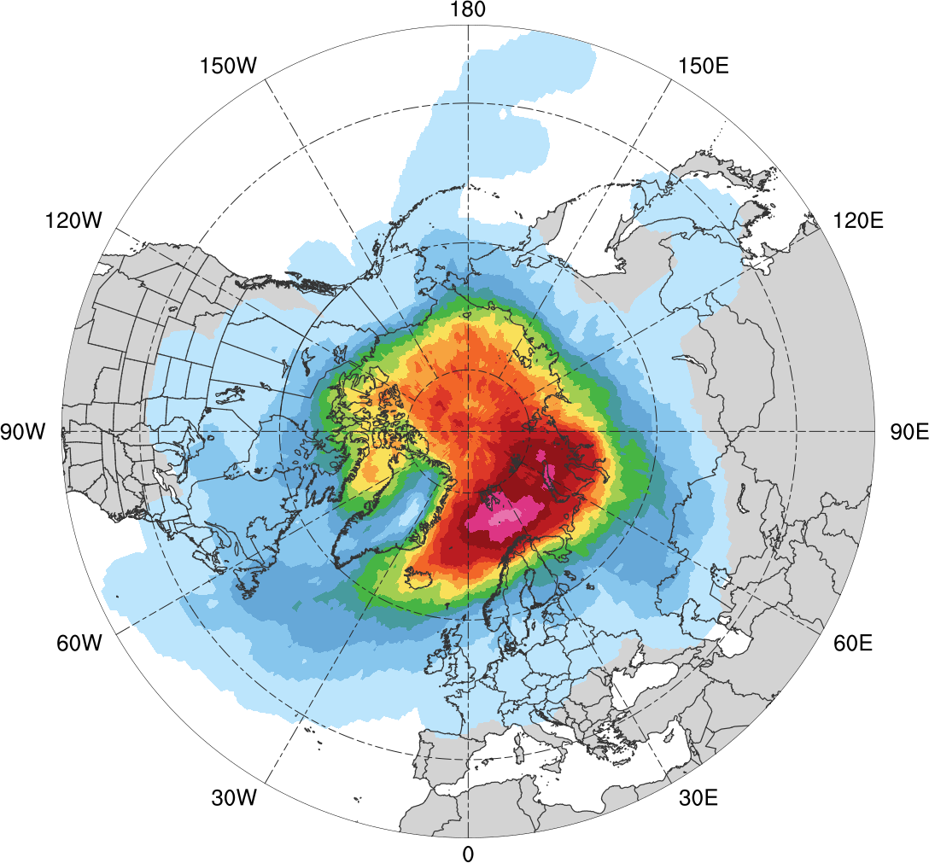
Track Density
Low skill (N = 401)
High Skill (N = 345)
1
5
10
15
20
25
30
35
40
45
50
60
70
80
90
Total number of Arctic cyclones within 500 km of a grid point

Slide 56
Preferred Longitudinal Corridors
Distribution of longitude of Arctic cyclones at first time in Arctic (>70°N; % per longitudinal bin)
90°N
70°N
50°N
30°N
0°
30°E
60°E
90°E
120°E
150°E
180°
150°W
120°W
90°W
60°W
30°W
0°
0°
30°E
60°E
90°E
120°E
150°E
180°
150°W
120°W
90°W
60°W
30°W
0°
climo (N=2542)
low (N=401)
high (N=345)

Slide 57
Results: Preferred Longitudinal Corridors (MAM)
Percentage of Arctic cyclones per longitude bin according to longitude of Arctic cyclones at first time in Arctic (>70°N) during MAM
90°N
70°N
50°N
30°N
0°
30°E
60°E
90°E
120°E
150°E
180°
150°W
120°W
90°W
60°W
30°W
0°
0°
30°E
60°E
90°E
120°E
150°E
180°
150°W
120°W
90°W
60°W
30°W
0°
climo (N=609)
low (N=110)
high (N=110)

Slide 58
Results: Preferred Longitudinal Corridors (SON)
Percentage of Arctic cyclones per longitude bin according to longitude of Arctic cyclones at first time in Arctic (>70°N) during SON
90°N
70°N
50°N
30°N
0°
30°E
60°E
90°E
120°E
150°E
180°
150°W
120°W
90°W
60°W
30°W
0°
0°
30°E
60°E
90°E
120°E
150°E
180°
150°W
120°W
90°W
60°W
30°W
0°
climo (N=668)
low (N=69)
high (N=61)

Slide 59
Genesis Latitude
Distribution of AC genesis latitude (% per latitude bin)
50
40
30
20
10
0
10°N
20°N
30°N
40°N
50°N
60°N
70°N
80°N
90°N
climo (N=2542)
low (N=401)
high (N=345)

Slide 60
Genesis Latitude (DJF)
Distribution of Arctic cyclone genesis latitude (% per latitude bin) during DJF
10°N
20°N
30°N
40°N
50°N
60°N
70°N
80°N
90°N
climo (N=585)
low (N=130)
high (N=119)

Slide 61
Genesis Latitude (MAM)
Genesis latitude of Arctic cyclones during MAM
10°N
20°N
30°N
40°N
50°N
60°N
70°N
80°N
90°N
climo (N=609)
low (N=110)
high (N=110)

Slide 62
Genesis Latitude (JJA)
Distribution of Arctic cyclone genesis latitude (% per latitude bin) during JJA
10°N
20°N
30°N
40°N
50°N
60°N
70°N
80°N
90°N
climo (N=680)
low (N=92)
high (N=55)

Slide 63
Genesis Latitude (SON)
Genesis latitude of Arctic cyclones during SON
10°N
20°N
30°N
40°N
50°N
60°N
70°N
80°N
90°N
climo (N=668)
low (N=69)
high (N=61)

Slide 64
Intensity: Minimum SLP
Minimum SLP (hPa) of Arctic cyclones
min and max
mean
95%
75%
median
25%
5%
climo
(N=2542)
low
(N=401)
high
(N=345)

Slide 65
Intensity: Minimum SLP
Minimum SLP (hPa) of Arctic cyclones by season
low
(N =130)
high
(N=119)
low
(N=110)
high
(N=110)
low
(N=92)
high
(N=55)
low
(N=69)
high
(N=61)
DJF
MAM
JJA
SON
95%
75%
min and max
mean
median
Statistically significant differences in means
25%
5%

