Slide 1
Extreme Weather Events Originating from Tropopause Polar Vortex Interactions with the North Atlantic Jet Stream
Kevin A. Biernat, Lance F. Bosart, and Daniel Keyser
Department of Atmospheric and Environmental Sciences
University at Albany, SUNY
AMS 27th Conference on Weather Analysis and Forecasting
1 July 2015
Research support provided by NSF Grant AGS-1355960
kbiernat@albany.edu

Slide 2
What are Tropopause Polar Vortices (TPVs)?
TPVs are defined as tropopause-based vortices of high-latitude origin and are material features (Cavallo and Hakim 2009)
A TPV is a particular type of coherent tropopause disturbance (CTD)
A CTD is defined as a tropopause-based material feature that is not necessarily of high-latitude origin and does not necessarily correspond to a vortex (Pyle et al. 2004)

Slide 3
What are Tropopause Polar Vortices (TPVs)?
TPV
TPV
(left) Dynamic tropopause (DT) wind speed (every 15 m s⁻¹ starting at 50 m s⁻¹, thick contours) and DT potential temperature (K, thin contours and shaded) on 1.5-PVU surface valid 0000 UTC 1 Dec 1991; (right) same as left except DT pressure (hPa, thin contours and shaded). Adapted from Fig. 11 in Pyle et al. (2004).
Notes:
Also a CTD but meets TPV criterion
Lower DT theta and higher DT pressure
Tropopause extends downward
Local minimum of DT theta, max in DT pressure, and relatively circular symmetric

Slide 4
Outline
Motivation
Objectives
Data and Methodology
Case Study: 18–19 November 2013 extreme flooding event over Sardinia, Italy
Conclusions

Slide 5
Motivation
TPVs may interact with midlatitude jet streams and act as precursors to intense midlatitude cyclogenesis events
Interactions between TPVs and North Atlantic jet stream (NAJ) may lead to development of extreme weather events (EWEs) between North America and Europe

Slide 6
Objectives
Diagnose processes that lead to the extraction of a TPV from high latitudes and the approach of the TPV toward the NAJ
Diagnose processes that result in interactions between the TPV and NAJ and that culminate in EWE development
Explore impact of large-scale flow configuration and embedded disturbances on TPV–NAJ interactions and EWE development

Slide 7
Data and Methodology
0.5° NCEP CFSR (Saha et al. 2010)
Manual TPV identification
Coherent vortex that exhibits a local minimum of DT θ (i.e., closed contours of DT θ)
Cavallo and Hakim (2009) require that a vortex spend at least 60% of its lifetime north of 65°N and last ≥ 2 days
“60% of lifetime north of 65°N” criterion is not imposed here; only require that vortex be of high-latitude origin and last ≥ 2 days

Slide 8
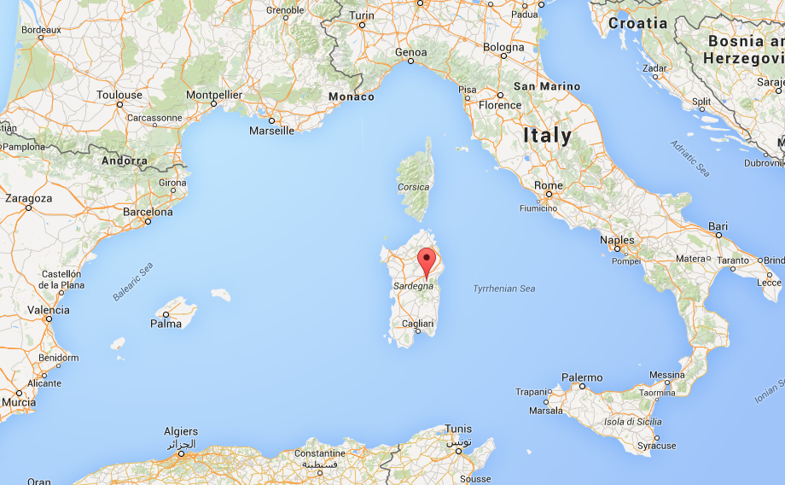
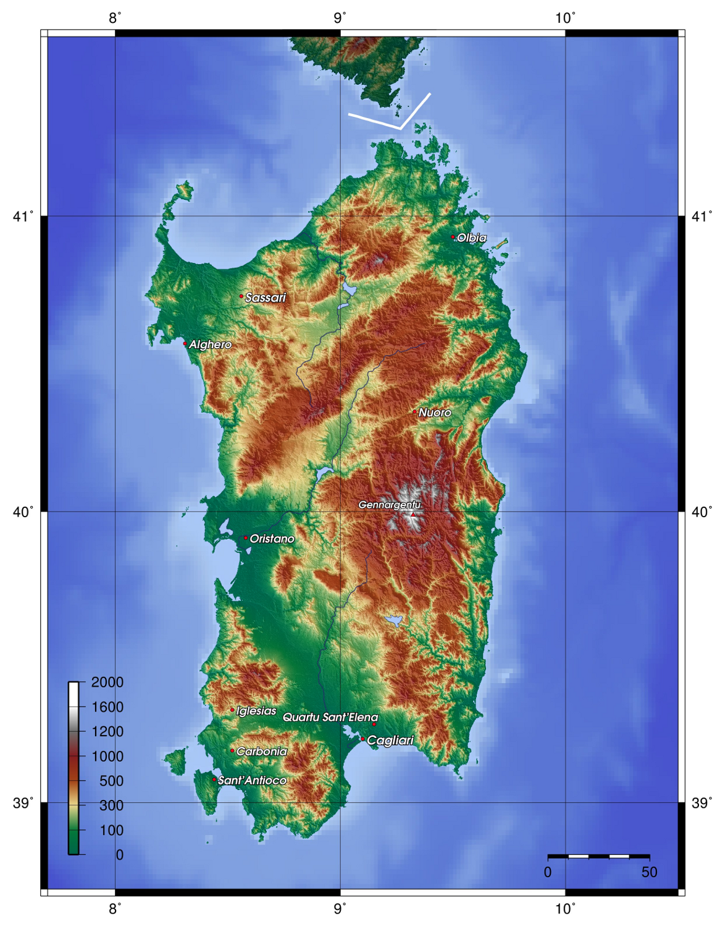
18–19 November 2013 Sardinia Flood Event
Slow-moving cutoff cyclone over Mediterranean leads to significant rainfall and flooding over portions of Sardinia
Up to 467 mm of rain reported
16 deaths (Munich RE, 2014)
Overall losses: ~780 million USD (Munich RE, 2014)
(Source: Google Maps)
(Source: http://it.wikipedia.org/wiki/Campidano)
Notes:
1–2 May 2010 Nashville Flood Event resulted in 26 fatalities and 2–3 billion USD in damages throughout Tennessee and Kentucky during 1–4 May (Moore et al. 2012)
May 2013 Central European Flood resulted in 22 billion USD in damages (costliest natural disaster in 2013)
Hurricane Sandy: 71.4 billion USD

Slide 9
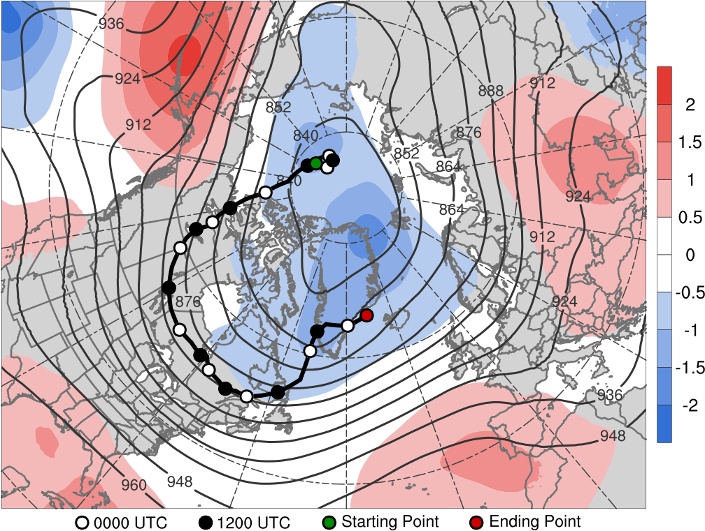
TPV Track: 1200 UTC 5 Nov – 0600 UTC 15 Nov 2013
80°E
140°W
7
60°E
8
6
9
120°W
10
80°N
40°E
15
11
60°N
14
20°E
100°W
12
13
40°N
80°W
60°W
40°W
20°W
0°
5–15 Nov 2013 time-mean 300-hPa geopotential height (dam, gray) and geopotential height anomaly (σ, shaded)

Slide 10
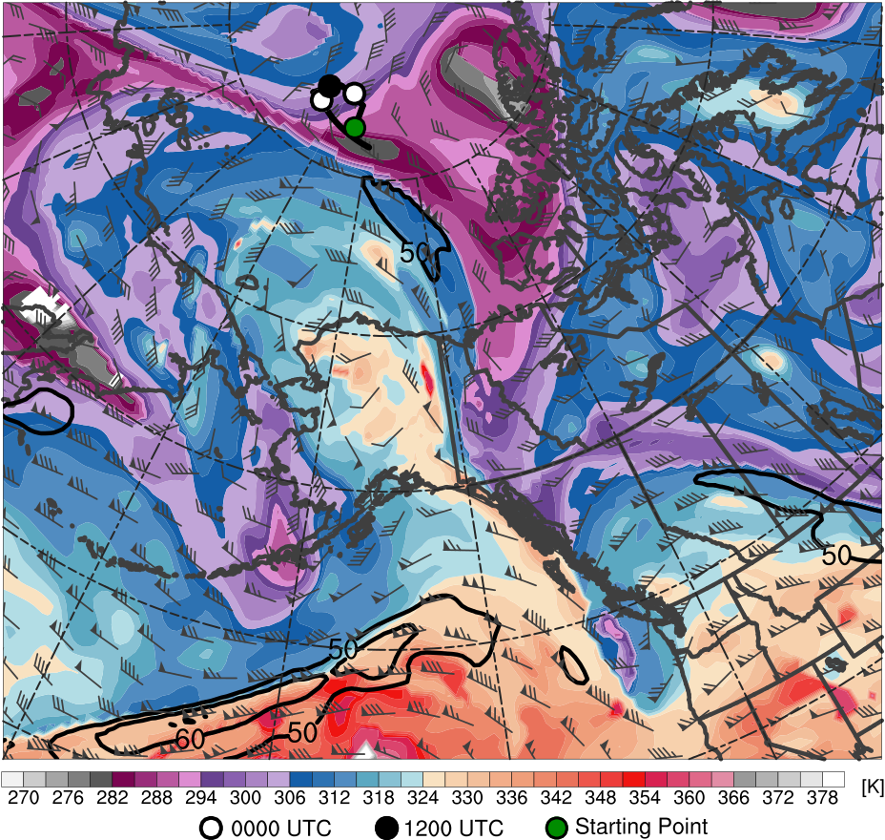
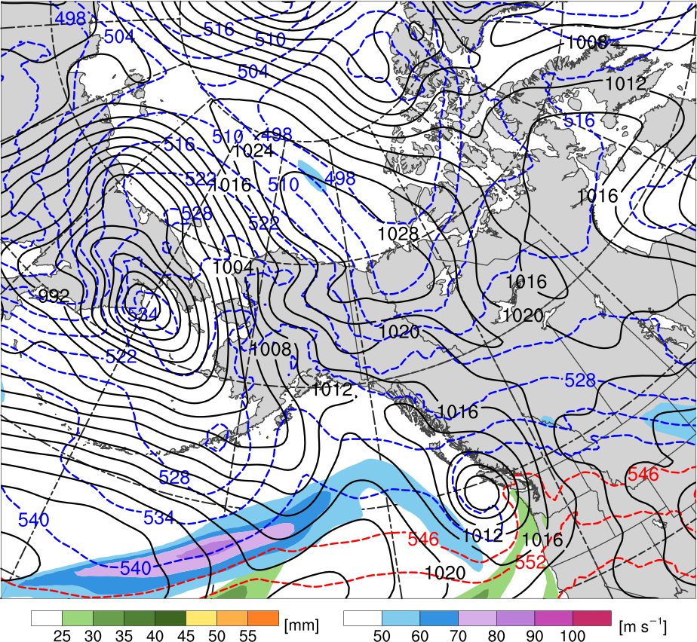
TPV Extraction
1200 UTC 7 Nov 2013
TPV
C
60°N
60°N
H
L₉₅₅
R1
50°N
50°N
40°N
40°N
180°
160°W
140°W
120°W
180°
160°W
140°W
120°W
Potential temperature (K, shaded), wind speed (black, every 10 m s⁻¹ starting at 50 m s⁻¹), and wind (m s⁻¹, barbs) on 2-PVU surface
250-hPa wind speed (m s⁻¹, shaded),
1000–500-hPa thickness (dam, blue/red),
MSLP (hPa, black), PW (mm, shaded)

Slide 11
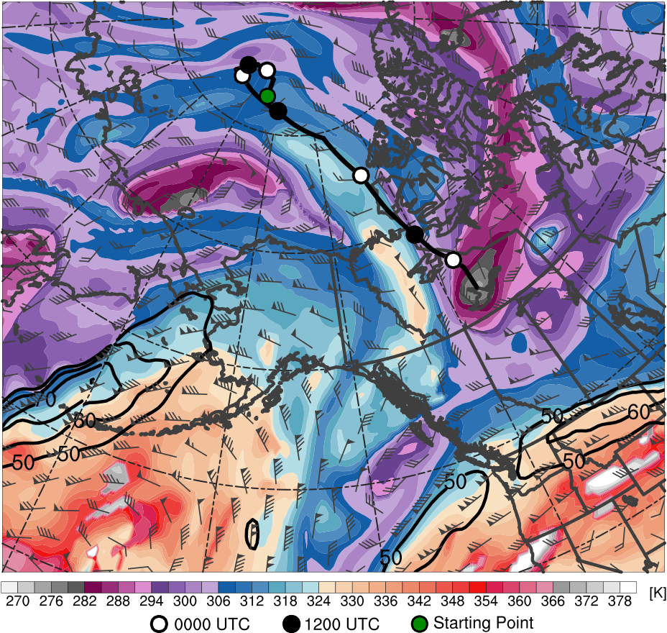
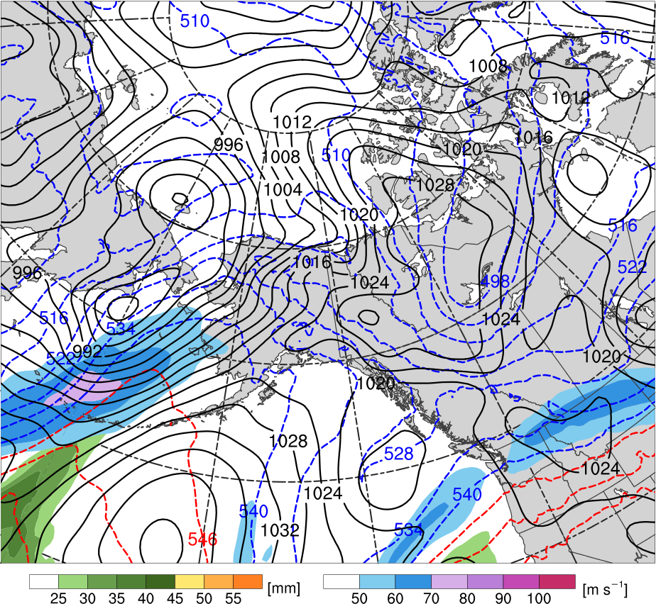
TPV Extraction
1200 UTC 9 Nov 2013
60°N
60°N
R1
C
TPV
H
50°N
50°N
R2
40°N
40°N
180°
160°W
140°W
120°W
180°
160°W
140°W
120°W
Potential temperature (K, shaded), wind speed (black, every 10 m s⁻¹ starting at 50 m s⁻¹), and wind (m s⁻¹, barbs) on 2-PVU surface
250-hPa wind speed (m s⁻¹, shaded),
1000–500-hPa thickness (dam, blue/red),
MSLP (hPa, black), PW (mm, shaded)

Slide 12
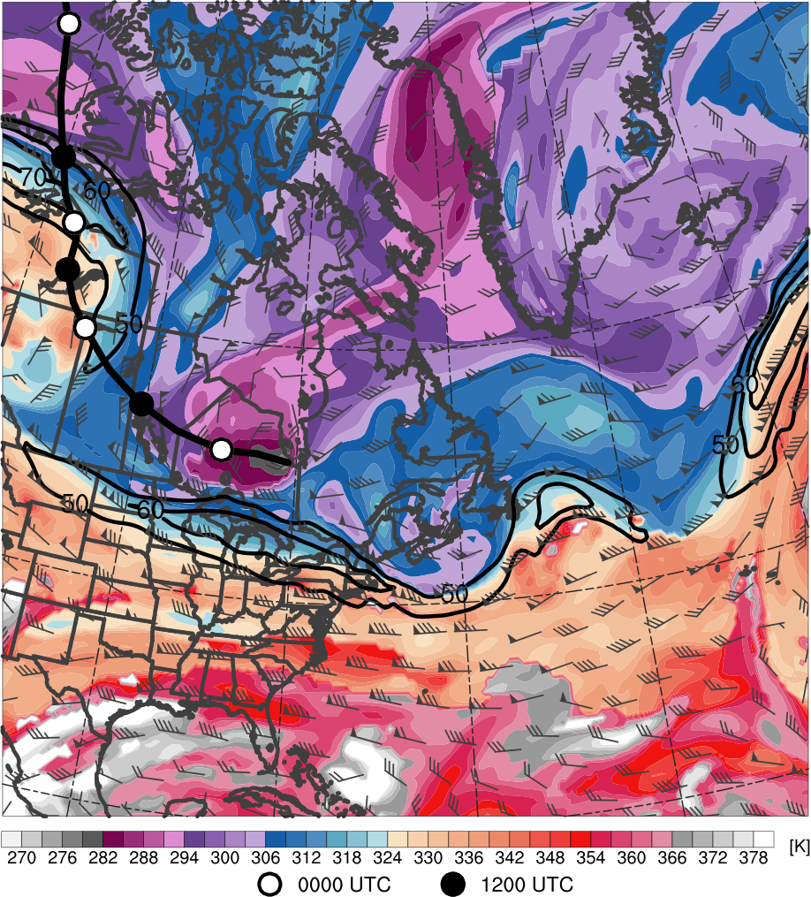
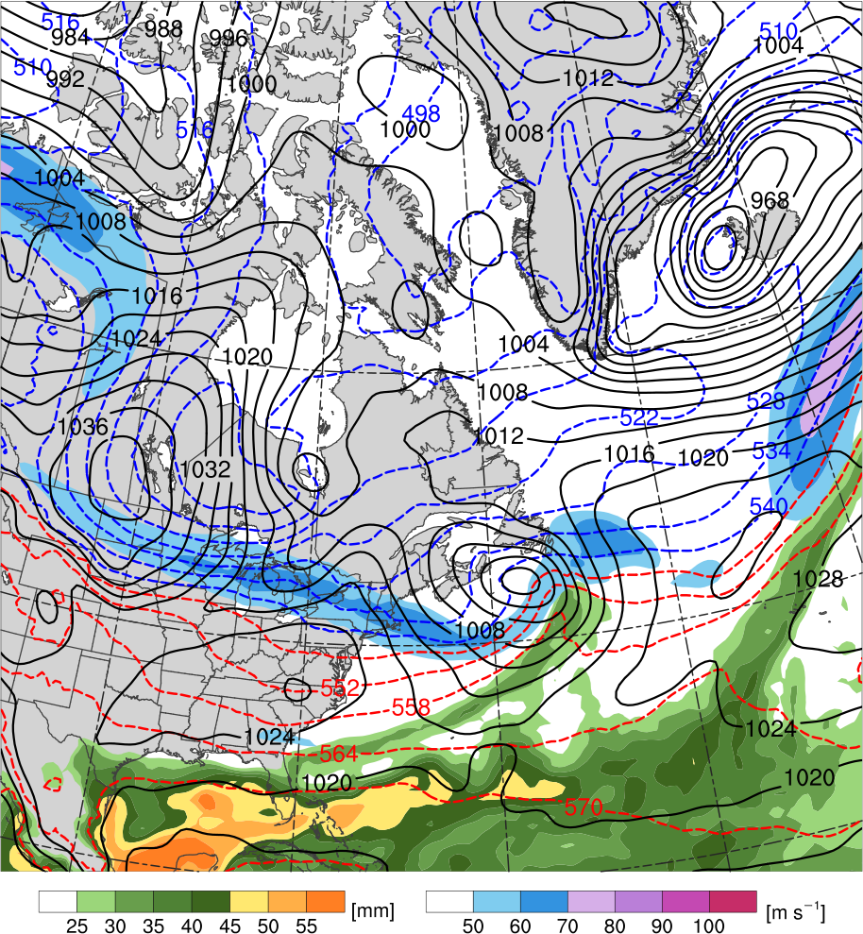
TPV–NAJ Interaction
1200 UTC 11 Nov 2013
R2
60°N
60°N
TPV
T1
L₁₀₀₂
H
C
T2
40°N
40°N
20°N
20°N
100°W
80°W
60°W
40°W
100°W
80°W
60°W
40°W
Potential temperature (K, shaded), wind speed (black, every 10 m s⁻¹ starting at 50 m s⁻¹), and wind (m s⁻¹, barbs) on 2-PVU surface
250-hPa wind speed (m s⁻¹, shaded),
1000–500-hPa thickness (dam, blue/red),
MSLP (hPa, black), PW (mm, shaded)

Slide 13
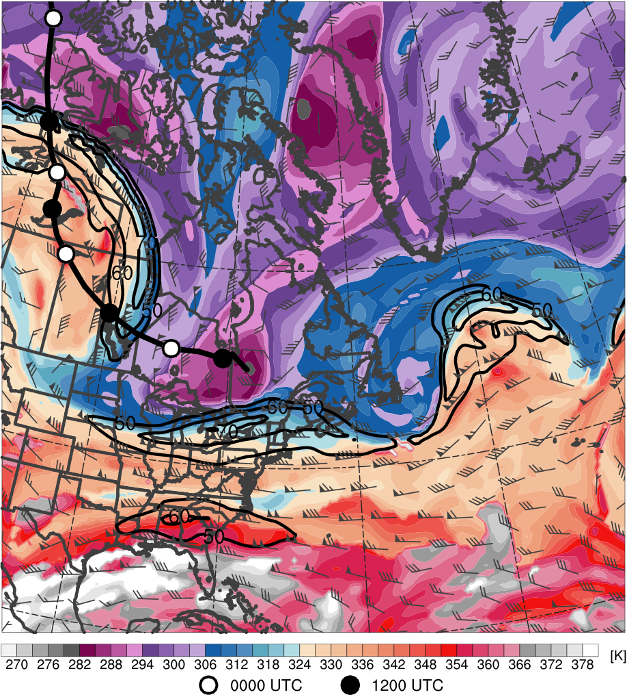
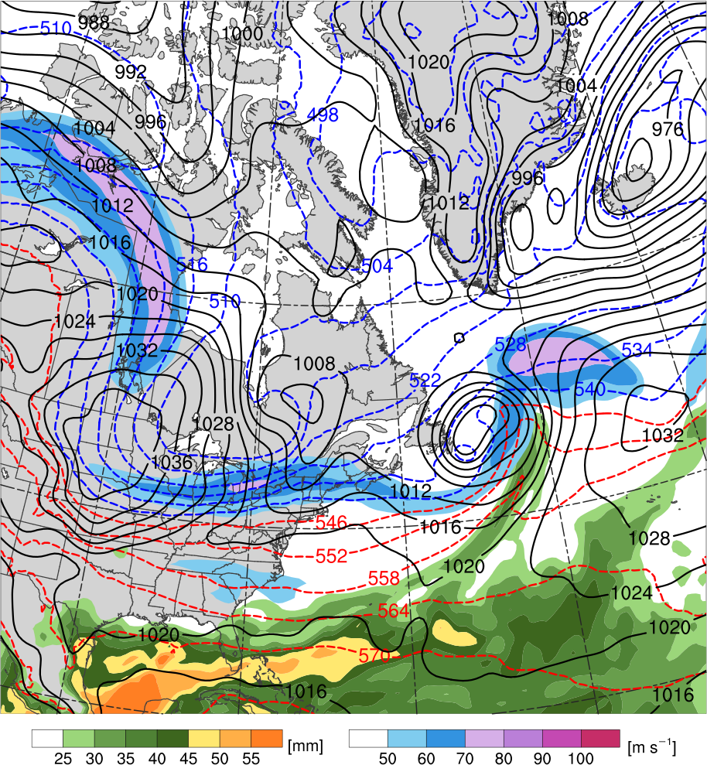
TPV–NAJ Interaction
0000 UTC 12 Nov 2013
R2
60°N
60°N
TPV
L₁₀₀₂
H
C
T1
T2
R3
40°N
40°N
20°N
20°N
100°W
80°W
60°W
40°W
100°W
80°W
60°W
40°W
Potential temperature (K, shaded), wind speed (black, every 10 m s⁻¹ starting at 50 m s⁻¹), and wind (m s⁻¹, barbs) on 2-PVU surface
250-hPa wind speed (m s⁻¹, shaded),
1000–500-hPa thickness (dam, blue/red),
MSLP (hPa, black), PW (mm, shaded)

Slide 14
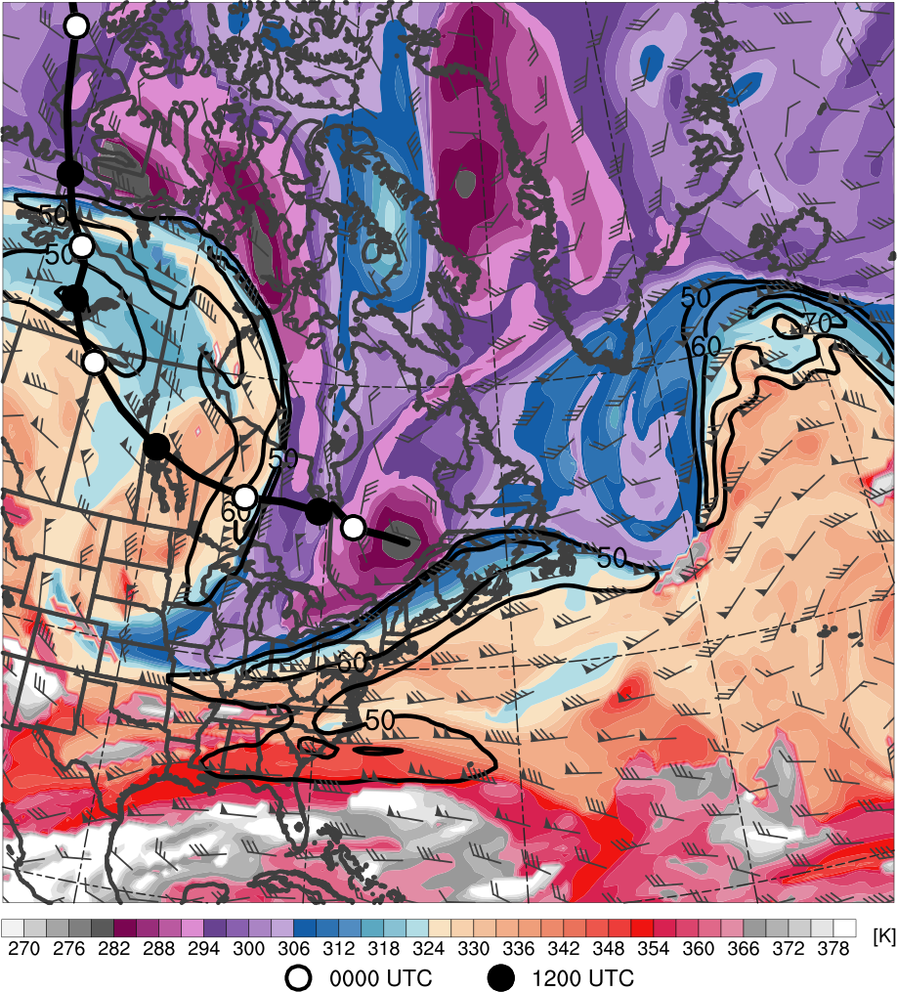
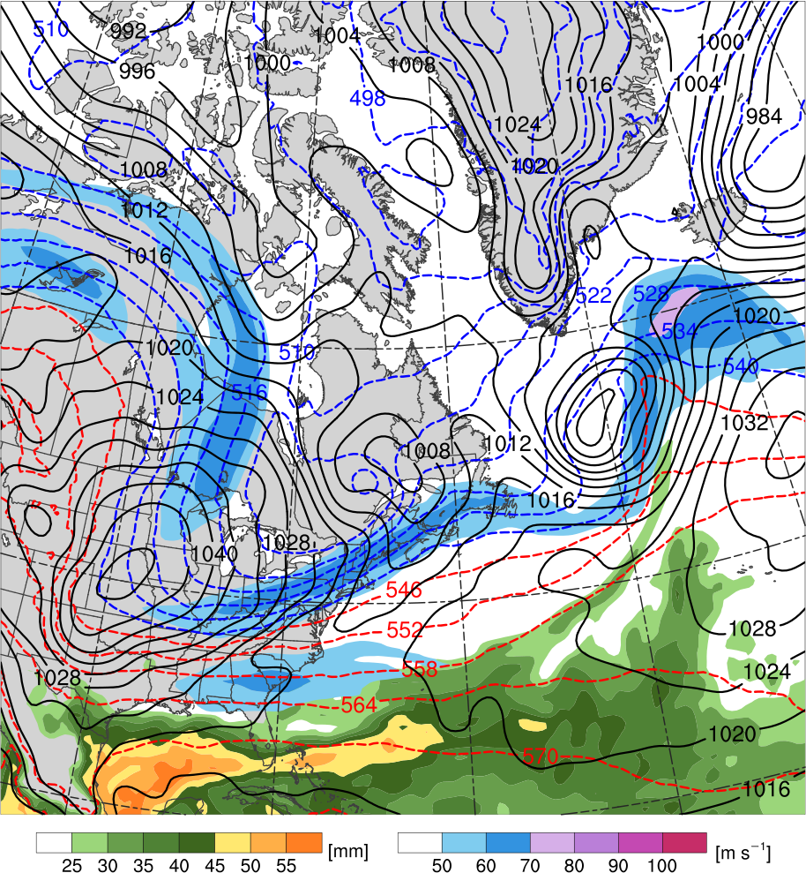
TPV–NAJ Interaction
1200 UTC 12 Nov 2013
60°N
60°N
R2
TPV
L₁₀₀₃
H
T2
C
T1
R3
40°N
H
H
40°N
20°N
20°N
100°W
80°W
60°W
40°W
100°W
80°W
60°W
40°W
Potential temperature (K, shaded), wind speed (black, every 10 m s⁻¹ starting at 50 m s⁻¹), and wind (m s⁻¹, barbs) on 2-PVU surface
250-hPa wind speed (m s⁻¹, shaded),
1000–500-hPa thickness (dam, blue/red),
MSLP (hPa, black), PW (mm, shaded)

Slide 15
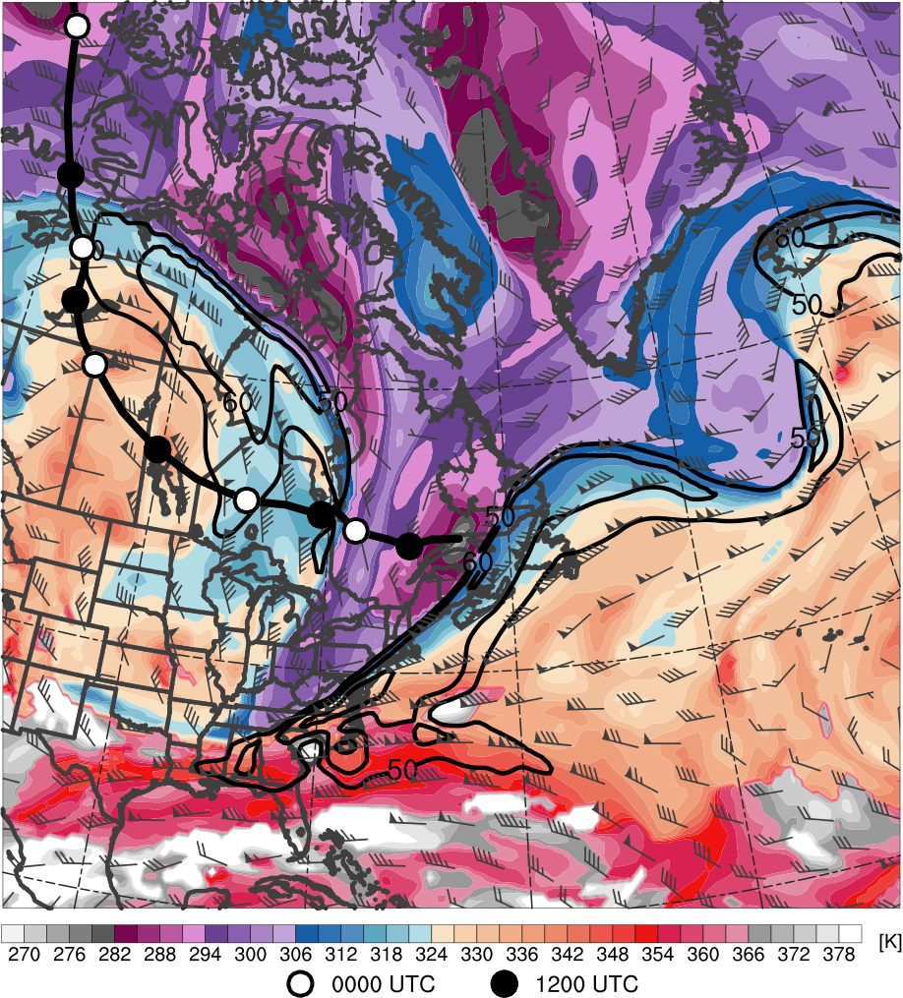
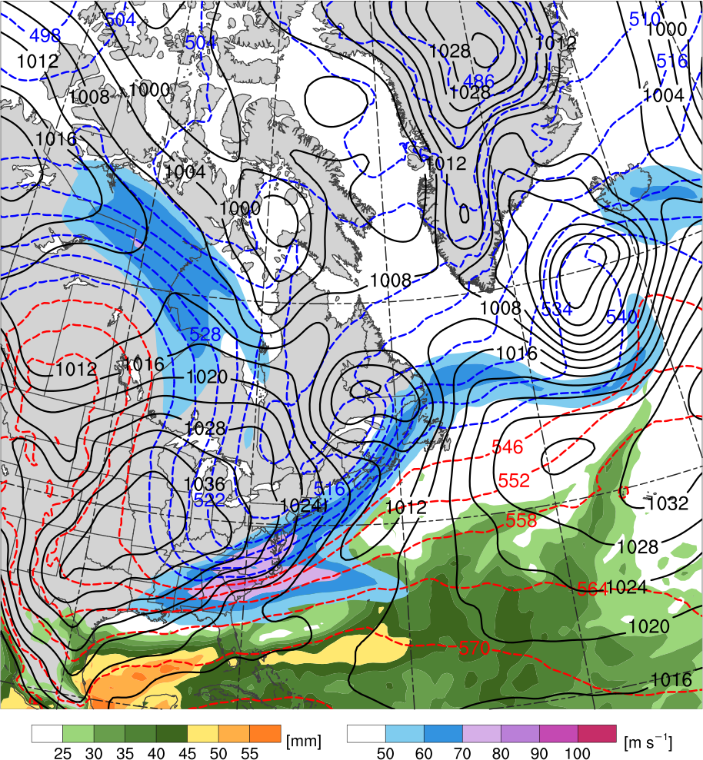
TPV–NAJ Interaction
0000 UTC 13 Nov 2013
60°N
60°N
TPV
T2
R2
L₉₉₉
R3
C
H
T1
40°N
H
40°N
20°N
20°N
100°W
80°W
60°W
40°W
100°W
80°W
60°W
40°W
Potential temperature (K, shaded), wind speed (black, every 10 m s⁻¹ starting at 50 m s⁻¹), and wind (m s⁻¹, barbs) on 2-PVU surface
250-hPa wind speed (m s⁻¹, shaded),
1000–500-hPa thickness (dam, blue/red),
MSLP (hPa, black), PW (mm, shaded)

Slide 16
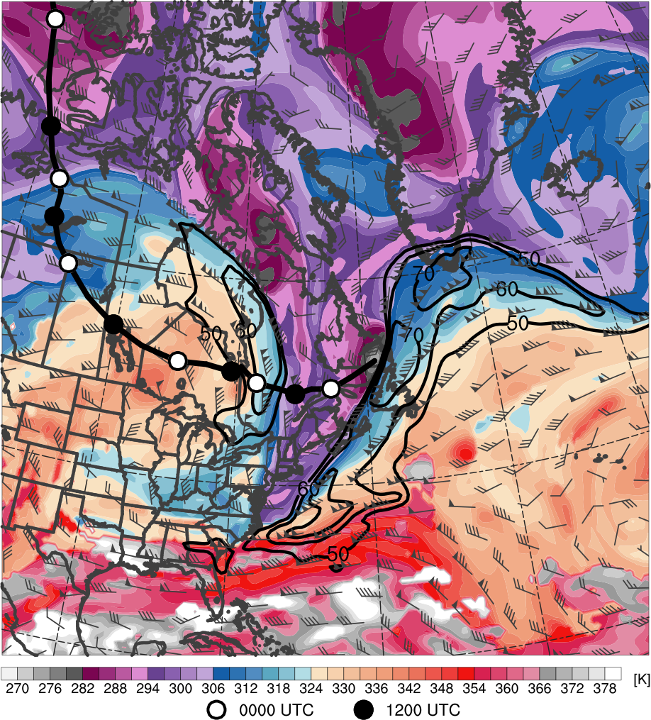
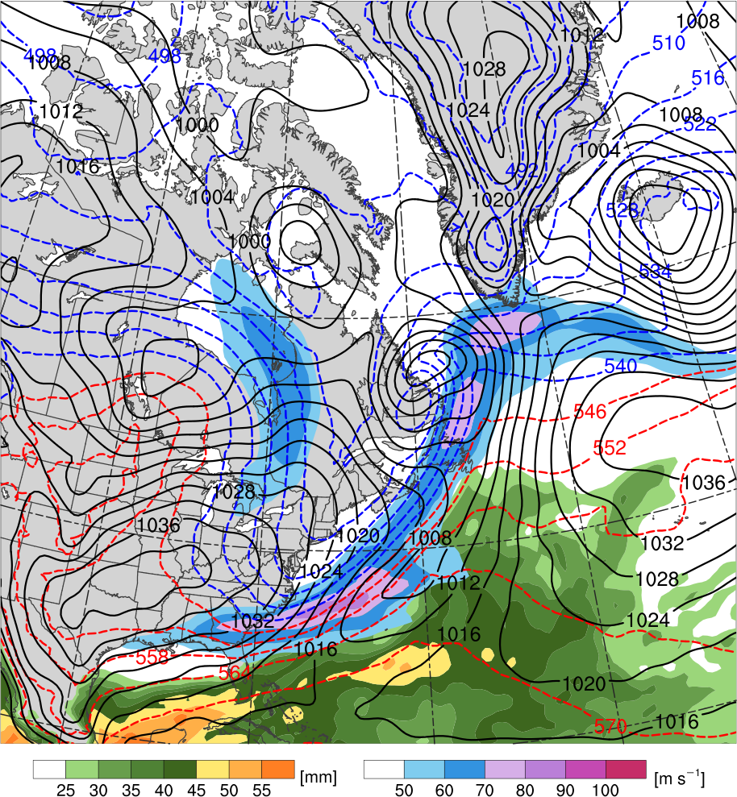
TPV–NAJ Interaction
1200 UTC 13 Nov 2013
60°N
60°N
TPV
T2
L₉₈₆
R3
C
H
R2
T1
40°N
40°N
H
20°N
20°N
100°W
80°W
60°W
40°W
100°W
80°W
60°W
40°W
Potential temperature (K, shaded), wind speed (black, every 10 m s⁻¹ starting at 50 m s⁻¹), and wind (m s⁻¹, barbs) on 2-PVU surface
250-hPa wind speed (m s⁻¹, shaded),
1000–500-hPa thickness (dam, blue/red),
MSLP (hPa, black), PW (mm, shaded)

Slide 17
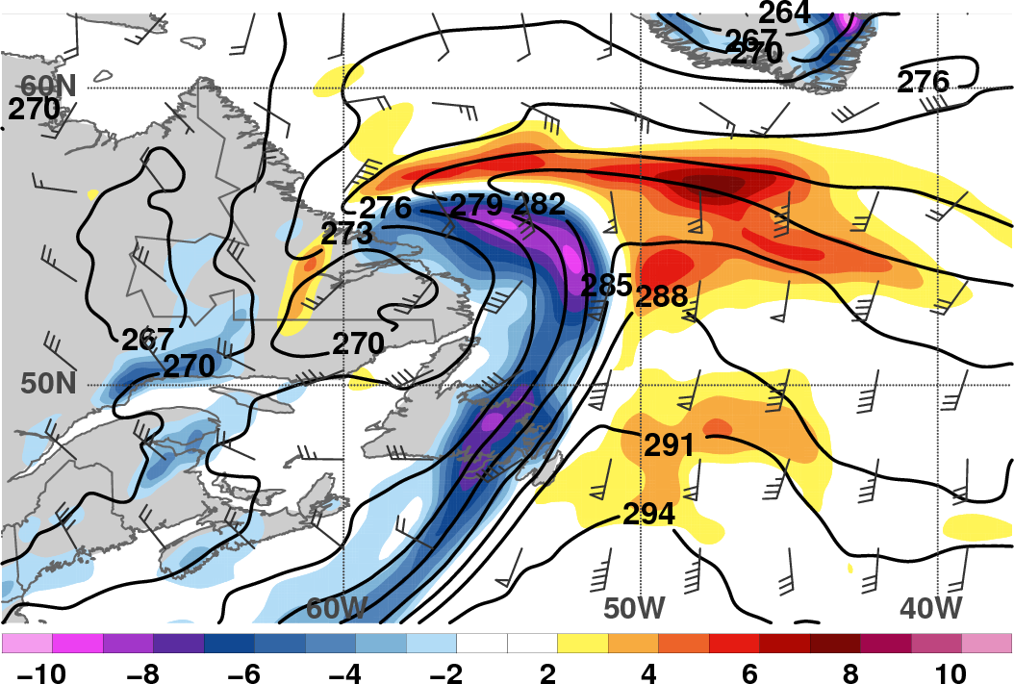
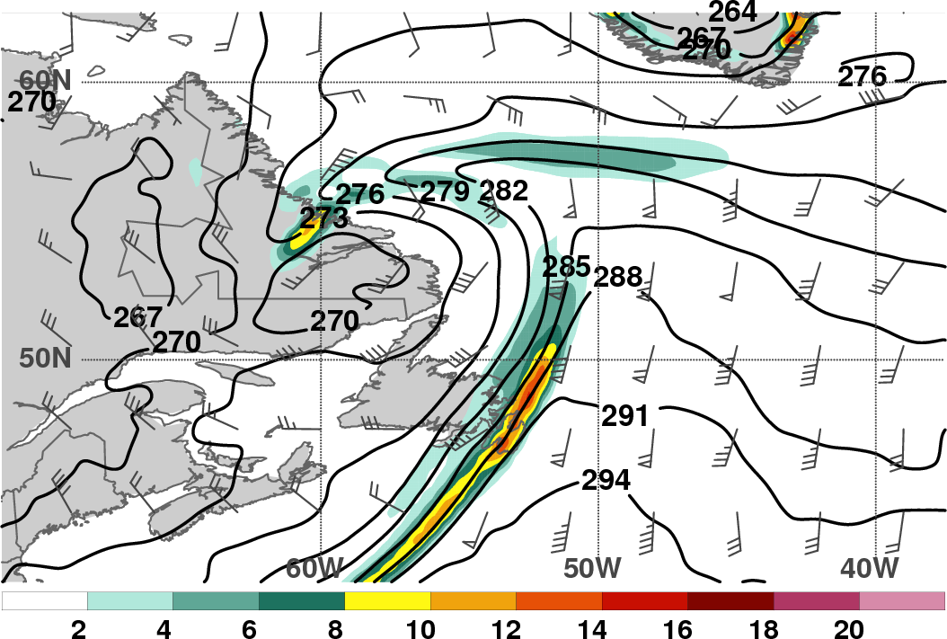
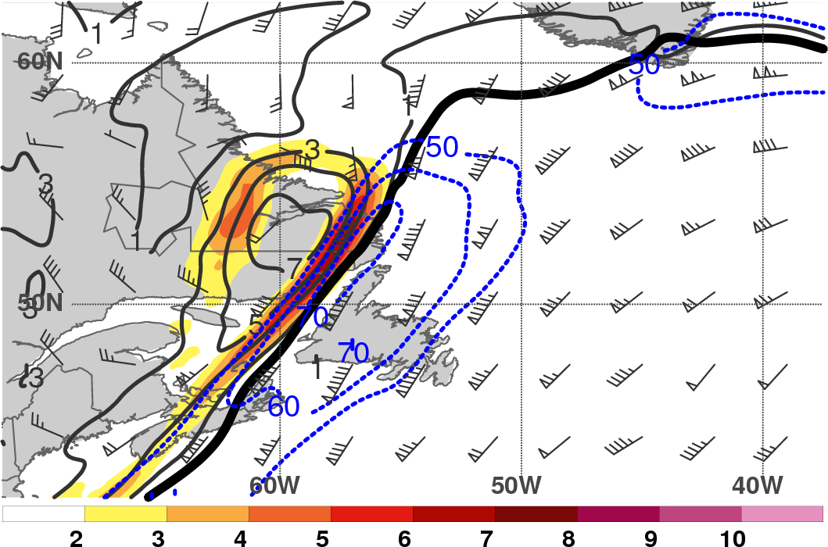
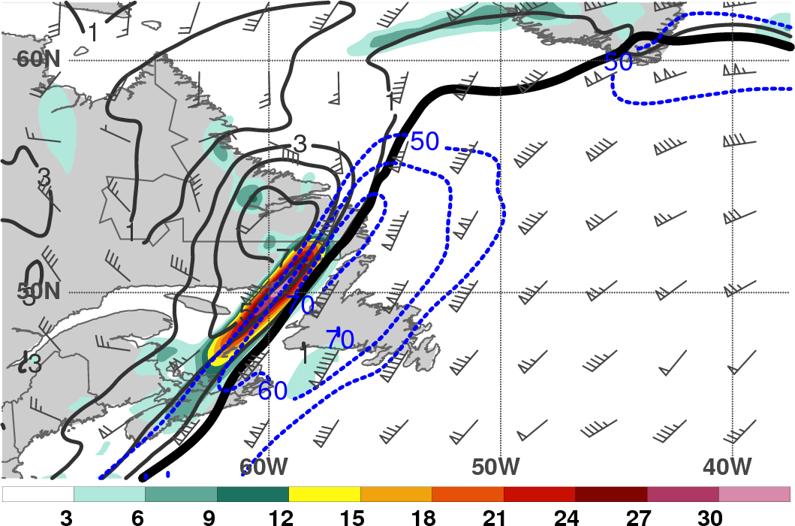
TPV–NAJ Interaction
1200 UTC 13 Nov 2013
L
L
925–850-hPa θ (K, black), θ advection [K (3 h)⁻¹, shaded],
and wind (m s⁻¹, barbs)
925–850-hPa θ (K, black), frontogenesis
[K (100 km) ⁻¹ (3 h)⁻¹, shaded], and wind (m s⁻¹, barbs)
TPV
309 K
θ on DT
TPV
309 K
θ on DT
450–350-hPa PV (PVU, gray), PV gradient magnitude [PVU (100 km)⁻¹, shaded], wind speed (m s⁻¹, blue)
450–350-hPa PV (PVU, gray), PV frontogenesis
[PVU (100 km)⁻¹ (day)⁻¹, shaded], wind speed (m s⁻¹, blue)

Slide 18
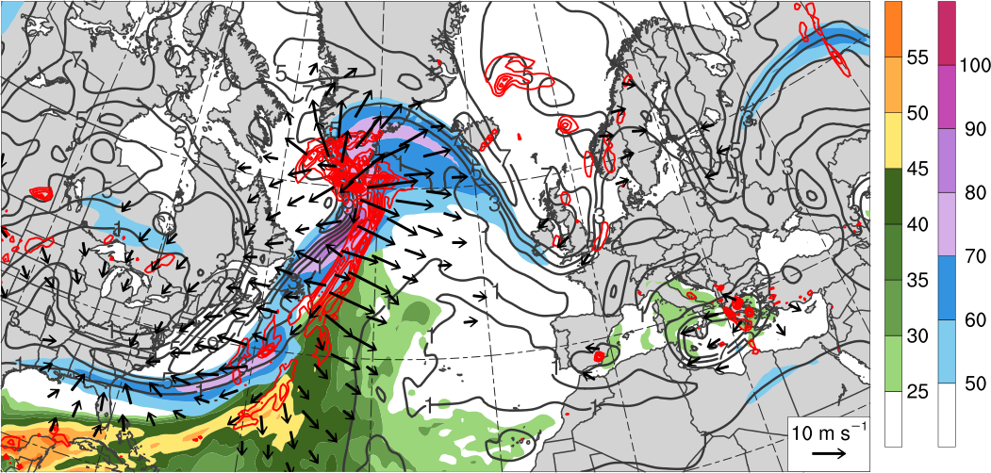
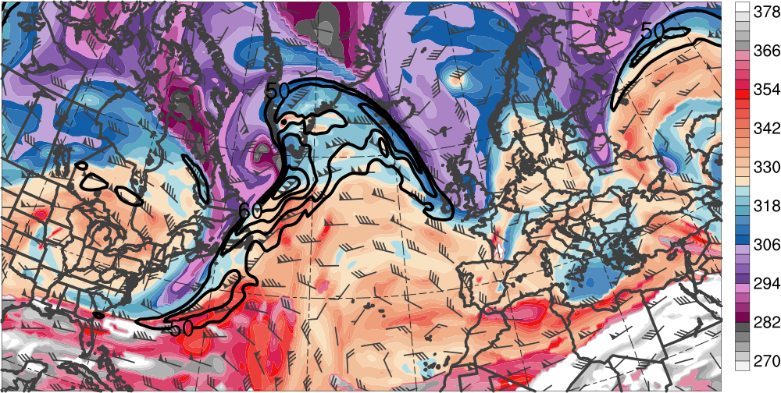
Downstream Development
0000 UTC 14 Nov 2013
300–200-hPa PV (PVU, gray)
and irrot. wind (m s⁻¹, vectors),
250-hPa wind speed (m s⁻¹),
600–400-hPa ascent
(every 0.5 × 10⁻³ hPa s⁻¹, red),
PW (mm)
60°N
L₉₆₆
H
40°N
L₁₀₀₀
20°N
80°W
60°W
40°W
20°W
0°
[mm]
[m s⁻¹]
DT θ (K, shaded),
wind speed (black, every 10 m s⁻¹ starting at 50 m s⁻¹), and wind (m s⁻¹, barbs) on 2-PVU surface
60°N
TPV
R3
T2
R2
40°N
T1
20°N
80°W
60°W
40°W
20°W
0°
20°E
[K]

Slide 19
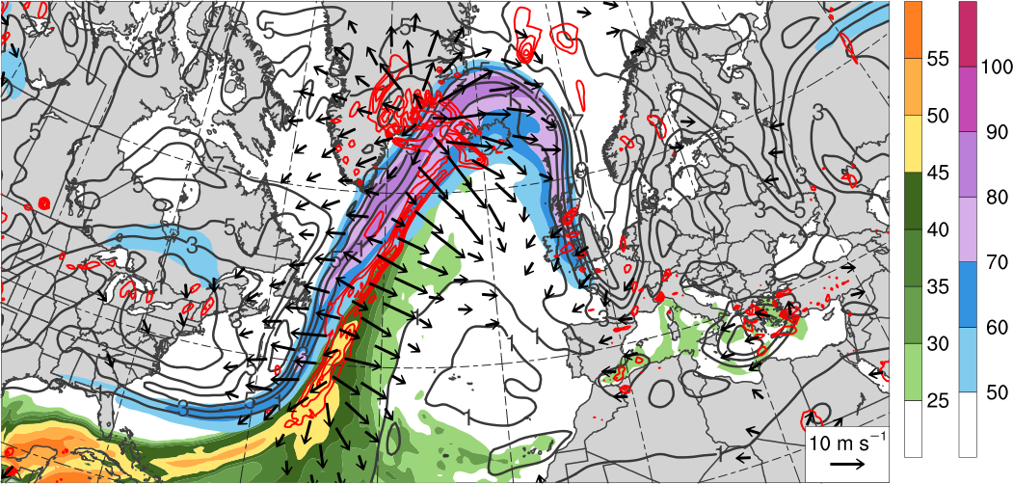
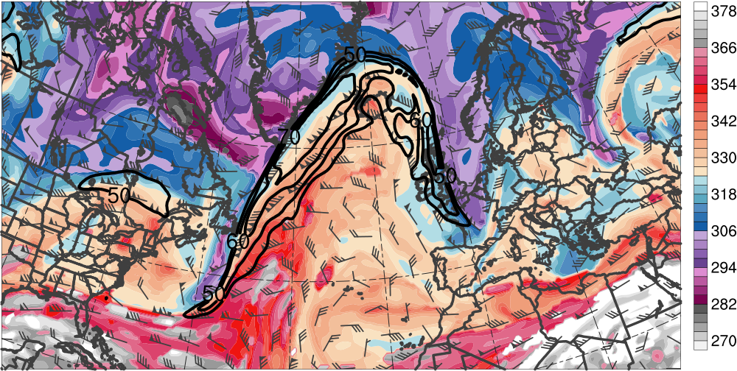
Downstream Development
1200 UTC 14 Nov 2013
300–200-hPa PV (PVU, gray)
and irrot. wind (m s⁻¹, vectors),
250-hPa wind speed (m s⁻¹),
600–400-hPa ascent
(every 0.5 × 10⁻³ hPa s⁻¹, red),
PW (mm)
60°N
L₉₇₅
L₉₇₁
L₉₉₉
H
40°N
20°N
80°W
60°W
40°W
20°W
0°
[mm]
[m s⁻¹]
DT θ (K, shaded),
wind speed (black, every 10 m s⁻¹ starting at 50 m s⁻¹), and wind (m s⁻¹, barbs) on 2-PVU surface
TPV
60°N
R3
T2
R2
40°N
T1
20°N
80°W
60°W
40°W
20°W
0°
20°E
[K]

Slide 20
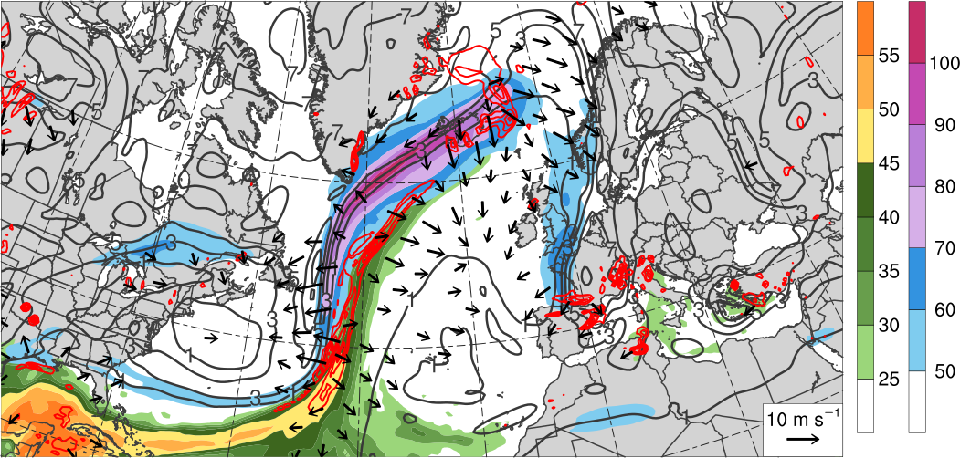
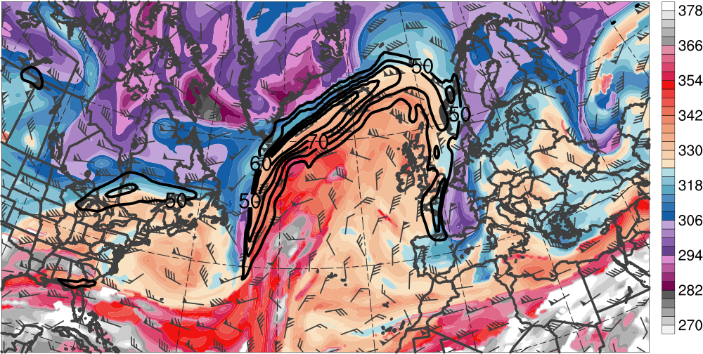
Downstream Development
0000 UTC 15 Nov 2013
300–200-hPa PV (PVU, gray)
and irrot. wind (m s⁻¹, vectors),
250-hPa wind speed (m s⁻¹),
600–400-hPa ascent
(every 0.5 × 10⁻³ hPa s⁻¹, red),
PW (mm)
L₉₇₆
60°N
L₉₉₆
H
40°N
20°N
80°W
60°W
40°W
20°W
0°
[mm]
[m s⁻¹]
DT θ (K, shaded),
wind speed (black, every 10 m s⁻¹ starting at 50 m s⁻¹), and wind (m s⁻¹, barbs) on 2-PVU surface
TPV
60°N
R3
T2
40°N
R2
T1
20°N
80°W
60°W
40°W
20°W
0°
20°E
[K]

Slide 21
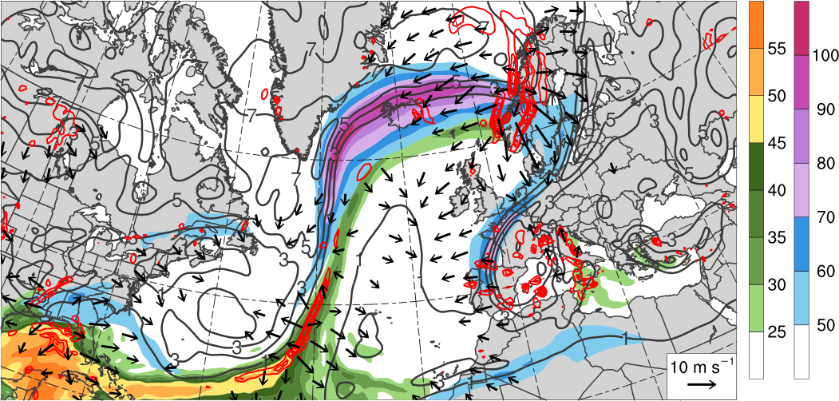
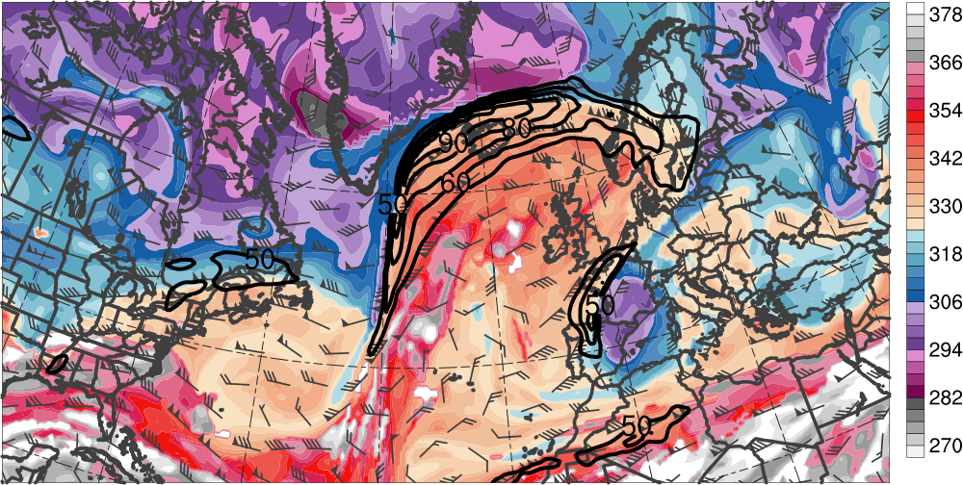
Downstream Development
1200 UTC 15 Nov 2013
L₉₅₈
300–200-hPa PV (PVU, gray)
and irrot. wind (m s⁻¹, vectors),
250-hPa wind speed (m s⁻¹),
600–400-hPa ascent
(every 0.5 × 10⁻³ hPa s⁻¹, red),
PW (mm)
60°N
L₉₉₄
H
40°N
20°N
80°W
60°W
40°W
20°W
0°
[mm]
[m s⁻¹]
DT θ (K, shaded),
wind speed (black, every 10 m s⁻¹ starting at 50 m s⁻¹), and wind (m s⁻¹, barbs) on 2-PVU surface
60°N
R3
T1
40°N
T2
R2
20°N
80°W
60°W
40°W
20°W
0°
20°E
[K]

Slide 22
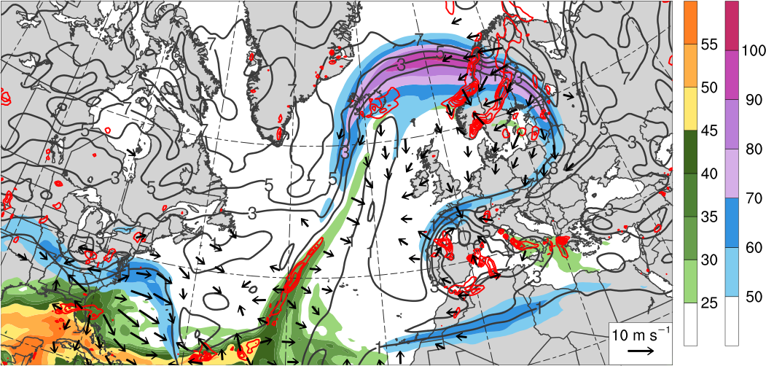
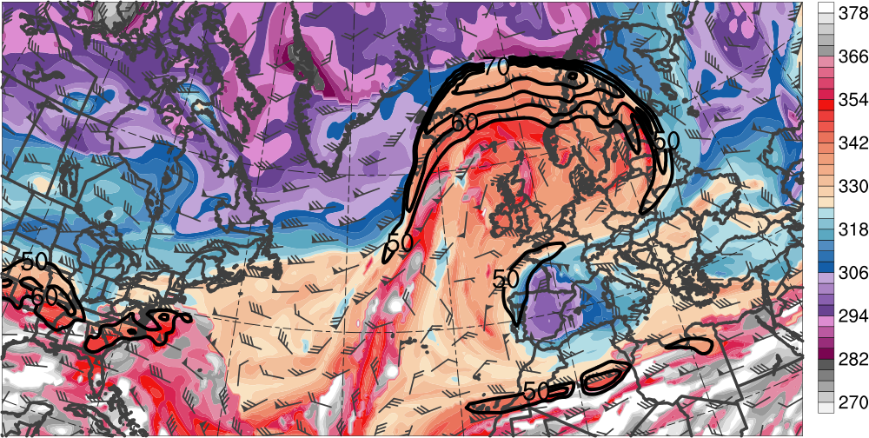
Downstream Development
0000 UTC 16 Nov 2013
300–200-hPa PV (PVU, gray)
and irrot. wind (m s⁻¹, vectors),
250-hPa wind speed (m s⁻¹),
600–400-hPa ascent
(every 0.5 × 10⁻³ hPa s⁻¹, red),
PW (mm)
60°N
L₉₈₇
H
40°N
20°N
80°W
60°W
40°W
20°W
0°
[mm]
[m s⁻¹]
DT θ (K, shaded),
wind speed (black, every 10 m s⁻¹ starting at 50 m s⁻¹), and wind (m s⁻¹, barbs) on 2-PVU surface
60°N
R3
40°N
T2
20°N
80°W
60°W
40°W
20°W
0°
20°E
[K]

Slide 23
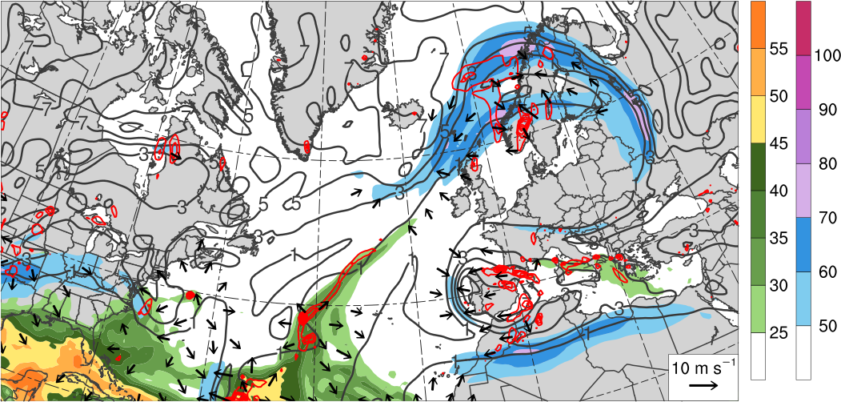
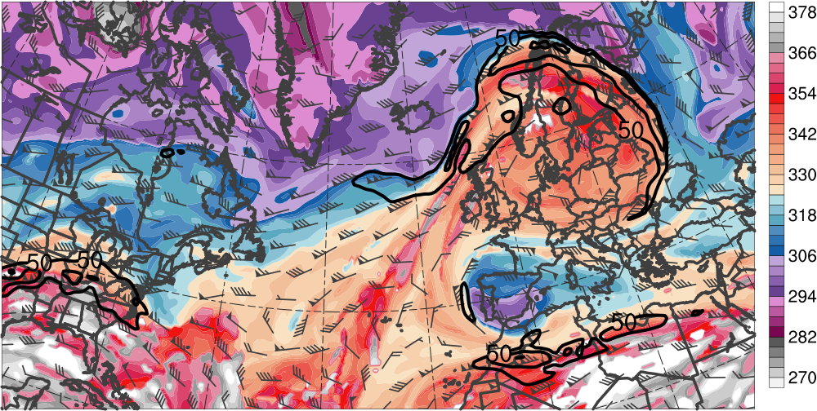
Downstream Development
1200 UTC 16 Nov 2013
300–200-hPa PV (PVU, gray)
and irrot. wind (m s⁻¹, vectors),
250-hPa wind speed (m s⁻¹),
600–400-hPa ascent
(every 0.5 × 10⁻³ hPa s⁻¹, red),
PW (mm)
L₉₇₄
60°N
40°N
H
20°N
80°W
60°W
40°W
20°W
0°
[mm]
[m s⁻¹]
DT θ (K, shaded),
wind speed (black, every 10 m s⁻¹ starting at 50 m s⁻¹), and wind (m s⁻¹, barbs) on 2-PVU surface
60°N
R3
40°N
T2
20°N
80°W
60°W
40°W
20°W
0°
20°E
[K]

Slide 24
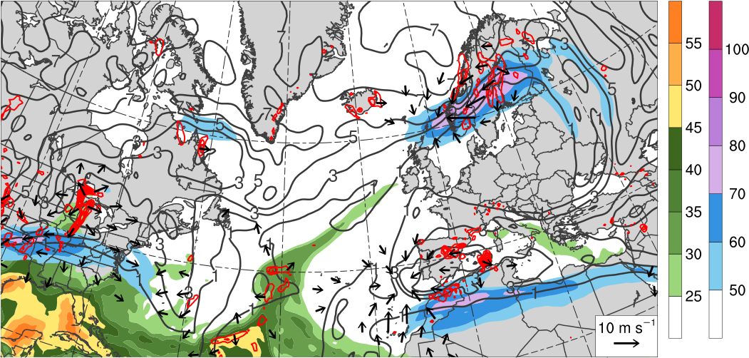
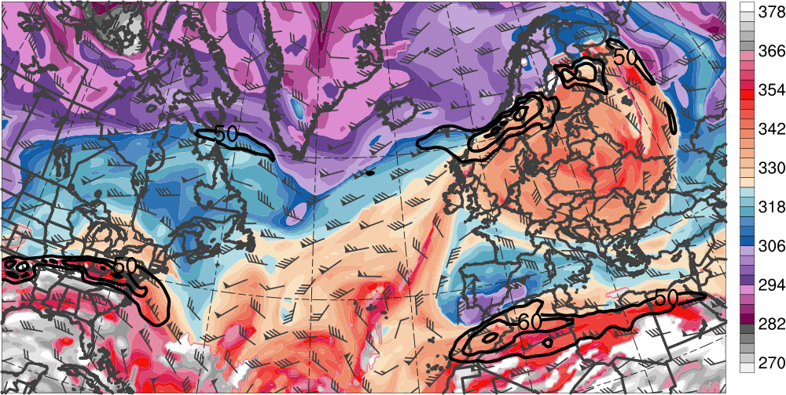
Downstream Development
0000 UTC 17 Nov 2013
300–200-hPa PV (PVU, gray)
and irrot. wind (m s⁻¹, vectors),
250-hPa wind speed (m s⁻¹),
600–400-hPa ascent
(every 0.5 × 10⁻³ hPa s⁻¹, red),
PW (mm)
L₉₆₉
60°N
40°N
H
20°N
80°W
60°W
40°W
20°W
0°
[mm]
[m s⁻¹]
DT θ (K, shaded),
wind speed (black, every 10 m s⁻¹ starting at 50 m s⁻¹), and wind (m s⁻¹, barbs) on 2-PVU surface
60°N
R3
40°N
T2
20°N
80°W
60°W
40°W
20°W
0°
20°E
[K]

Slide 25
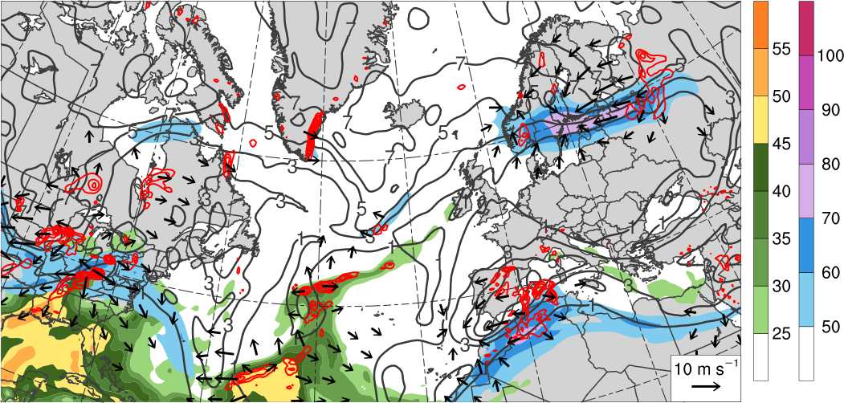
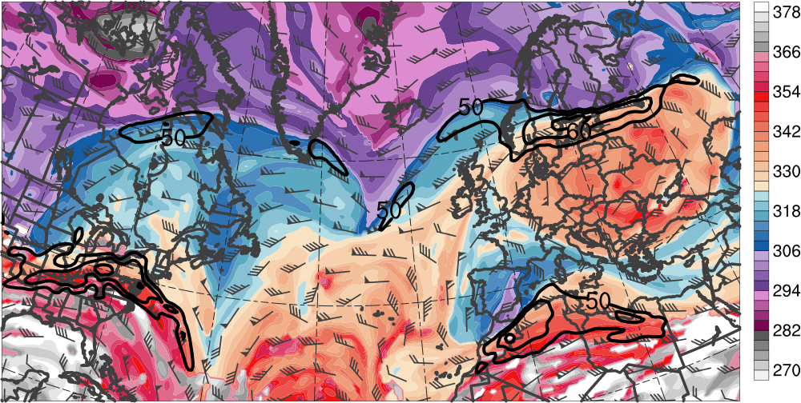
Downstream Development
1200 UTC 17 Nov 2013
300–200-hPa PV (PVU, gray)
and irrot. wind (m s⁻¹, vectors),
250-hPa wind speed (m s⁻¹),
600–400-hPa ascent
(every 0.5 × 10⁻³ hPa s⁻¹, red),
PW (mm)
L₉₇₁
60°N
40°N
H
20°N
80°W
60°W
40°W
20°W
0°
[mm]
[m s⁻¹]
DT θ (K, shaded),
wind speed (black, every 10 m s⁻¹ starting at 50 m s⁻¹), and wind (m s⁻¹, barbs) on 2-PVU surface
60°N
R3
40°N
T2
20°N
80°W
60°W
40°W
20°W
0°
20°E
[K]

Slide 26
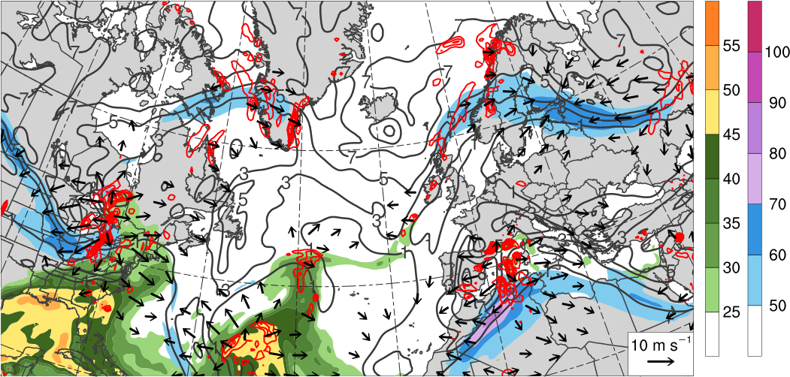
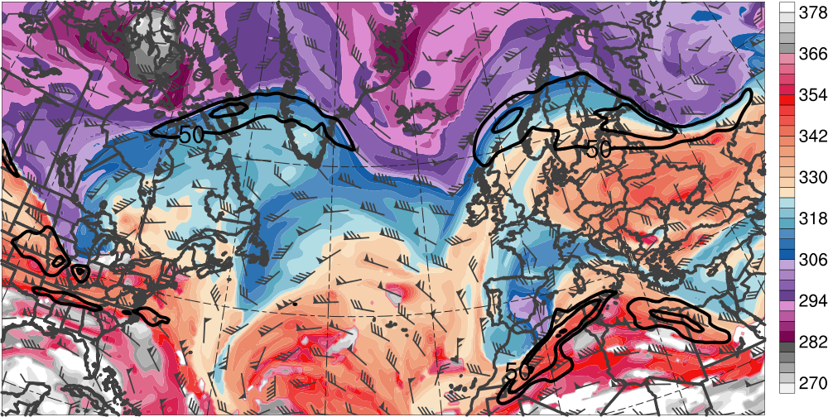
Downstream Development
0000 UTC 18 Nov 2013
300–200-hPa PV (PVU, gray)
and irrot. wind (m s⁻¹, vectors),
250-hPa wind speed (m s⁻¹),
600–400-hPa ascent
(every 0.5 × 10⁻³ hPa s⁻¹, red),
PW (mm)
L₉₇₅
60°N
L₁₀₀₅
40°N
H
20°N
80°W
60°W
40°W
20°W
0°
[mm]
[m s⁻¹]
DT θ (K, shaded),
wind speed (black, every 10 m s⁻¹ starting at 50 m s⁻¹), and wind (m s⁻¹, barbs) on 2-PVU surface
60°N
R3
40°N
T2
20°N
80°W
60°W
40°W
20°W
0°
20°E
[K]

Slide 27
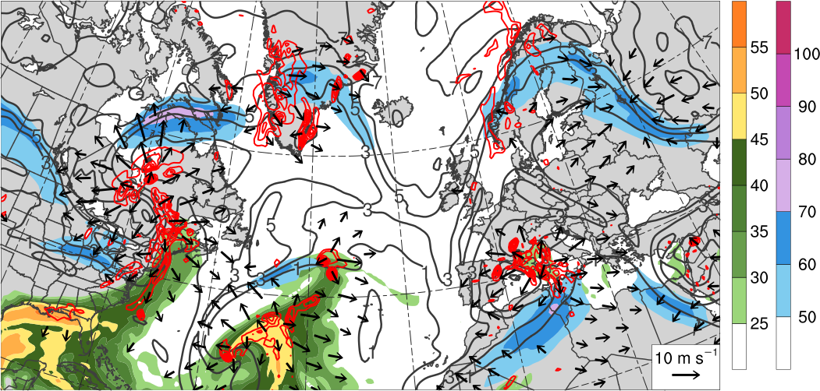
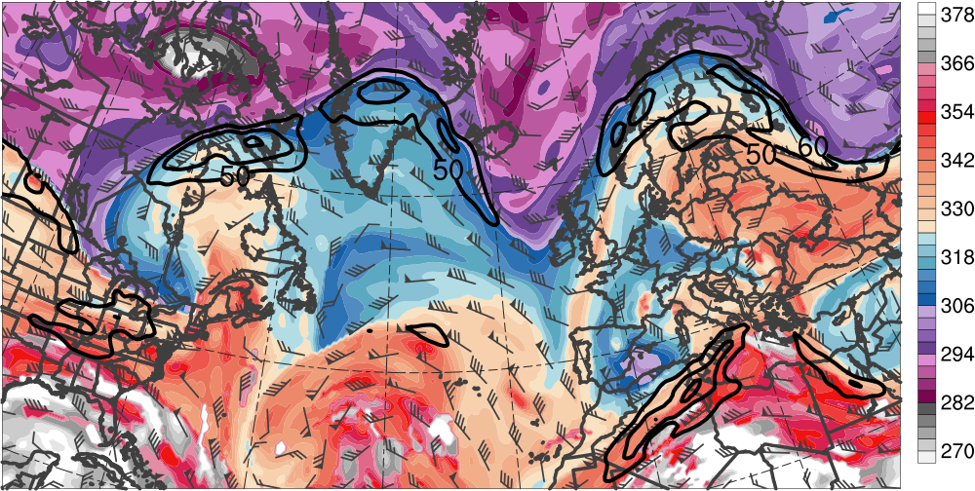
Downstream Development
1200 UTC 18 Nov 2013
300–200-hPa PV (PVU, gray)
and irrot. wind (m s⁻¹, vectors),
250-hPa wind speed (m s⁻¹),
600–400-hPa ascent
(every 0.5 × 10⁻³ hPa s⁻¹, red),
PW (mm)
L₉₇₅
60°N
40°N
L₉₉₉
H
20°N
80°W
60°W
40°W
20°W
0°
[mm]
[m s⁻¹]
DT θ (K, shaded),
wind speed (black, every 10 m s⁻¹ starting at 50 m s⁻¹), and wind (m s⁻¹, barbs) on 2-PVU surface
60°N
R3
40°N
T2
20°N
80°W
60°W
40°W
20°W
0°
20°E
[K]

Slide 28
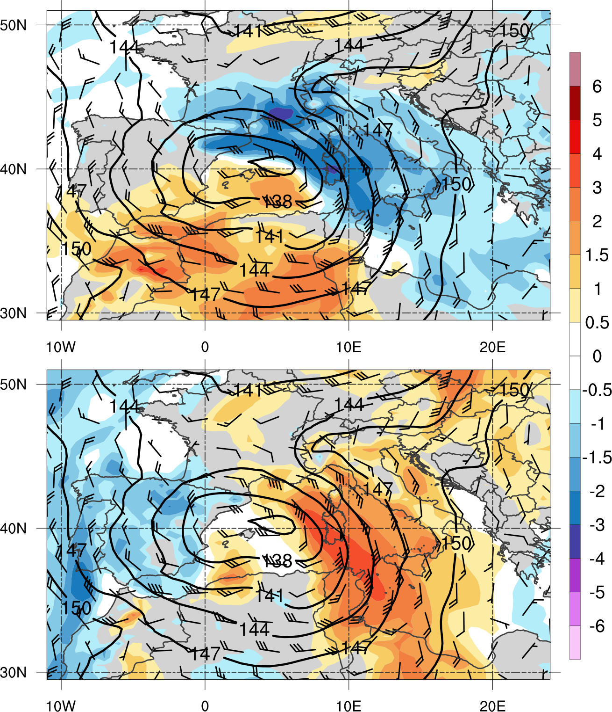
Flooding Event
1200 UTC 18 Nov 2013
850-hPa geopotential height (dam, black), wind (m s⁻¹, barbs), and standardized anomalies (σ, shaded) of u wind (top) and v wind (bottom)
Sardinia
(Source: http://it.wikipedia.org/wiki/Campidano)

Slide 29
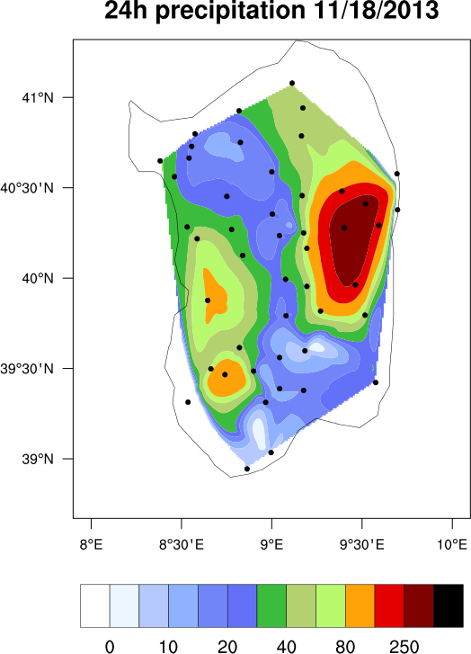
Flooding Event
1230 UTC 18 Nov 2013
Radar-derived rainfall rate (mm h⁻¹, color shading) and IR brightness temperature (gray shading) valid 1230 UTC 18 Nov 2013 (source: http://sop.hymex.org/)
24-h accumulated precipitation (mm, shaded) during 18 Nov 2013 (source: Julian Quinting)

Slide 30
Conclusions
Ridge amplification over North Pacific is critical to the extraction of TPV from high latitudes
TPV and associated cold surge increase baroclinicity associated with NAJ throughout the troposphere
Interaction between TPV and NAJ leads to explosive cyclogenesis in left-exit region of NAJ
Interaction between TPV, upstream trough, and downstream anticyclone induce significant ridge amplification over North Atlantic

Slide 31
Conclusions
NAJ intensifies to over 100 m s⁻¹ and ridge breaks anticyclonically over northern Europe
Downstream trough cuts off and retrogrades over southwestern Europe before interacting with subtropical jet over northern Africa
Slow-moving cutoff cyclone over Mediterranean leads to anomalously strong southeasterly upslope flow and heavy rainfall over Sardinia

