Slide 1
Linkages Between Tropopause Polar Vortices and the Great Arctic Cyclone of August 2012
Daniel Keyser, Kevin A. Biernat, and Lance F. Bosart
Department of Atmospheric and Environmental Sciences
University at Albany, SUNY
29th AMS Conference on Weather Analysis and Forecasting
Tuesday 5 June 2018
Research Supported by NSF Grant AGS-1355960 and ONR Grant N00014-18-1-2200

Slide 2
What are Tropopause Polar Vortices (TPVs)?
TPVs are defined as tropopause-based vortices of high-latitude origin and are material features (Pyle et al. 2004; Cavallo and Hakim 2009, 2010, 2012, 2013)
TPV
TPV
(left) Dynamic tropopause (DT) wind speed (every 15 m s⁻¹ starting at 50 m s⁻¹, thick contours) and DT potential temperature (K, thin contours and shading) on 1.5-PVU surface valid at 0000 UTC 1 Dec 1991; (right) same as left except DT pressure (hPa, thin contours and shading). Adapted from Fig. 11 in Pyle et al. (2004).

Slide 3
Motivation
TPVs may interact with and strengthen jet streams, and act as precursors to the development of intense Arctic cyclones (e.g., Simmonds and Rudeva 2012, 2014)
Arctic cyclones may be associated with strong surface winds and poleward advection of warm, moist air, contributing to reductions in Arctic sea-ice extent (e.g., Zhang et al. 2013)
Heavy precipitation, strong surface winds, and large waves due to Arctic cyclones may pose hazards to ships moving through open passageways in the Arctic Ocean

Slide 4
The Great Arctic Cyclone of August 2012 (AC12)
AC12 formed over Siberia on 2 August 2012 and tracked northeastward into the Arctic, reaching a minimum central sea level pressure (SLP) of 966.4 hPa at 1800 UTC 6 August in the CFSR (Simmonds and Rudeva 2012)
AC12 led to reductions in Arctic sea-ice extent during a time in which sea ice was thin and sea-ice volume was well below normal (Zhang et al. 2013)
Strong surface winds associated with AC12 helped to break up the thin sea ice (e.g., Parkinson and Comiso 2013)
Notes:
Minimum SLP of 962.3 hPa occurs at 1000 UTC 6 Aug 2012 in the ERA5

Slide 5
The Great Arctic Cyclone of August 2012 (AC12)
According to Zhang et al. (2013), sea-ice volume decreased twice as fast as normal during AC12 due to melting of the bottom and perimeter of ice floes
Simmonds and Rudeva (2012) and Yamazaki et al. (2015) found that a TPV played an important role in the life cycle of AC12

Slide 6
Outline
Identification and synoptic examination of three TPVs, a predecessor surface cyclone, and AC12
Impact of AC12 on Arctic sea-ice extent

Slide 7
Data and Methods
Data:
0.3° ERA5 (Hersbach and Dee 2016)
Utilized TPV tracking algorithm developed by Nicholas Szapiro and Steven Cavallo to identify and track TPVs of interest for AC12
Manually tracked the predecessor surface cyclone and AC12 by following the locations of minimum SLP
Link for Tracking Algorithm: https://github.com/nickszap/tpvTrack

Slide 8
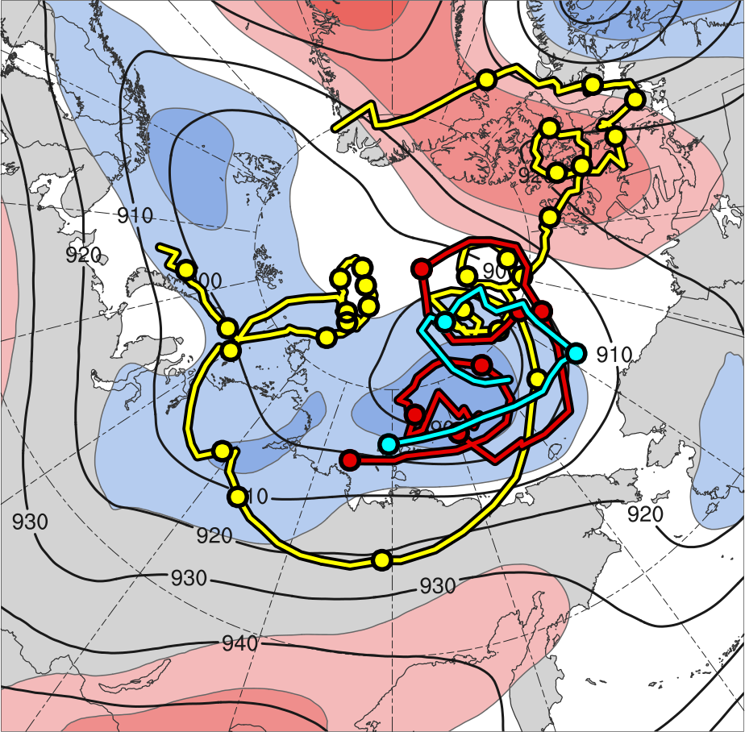
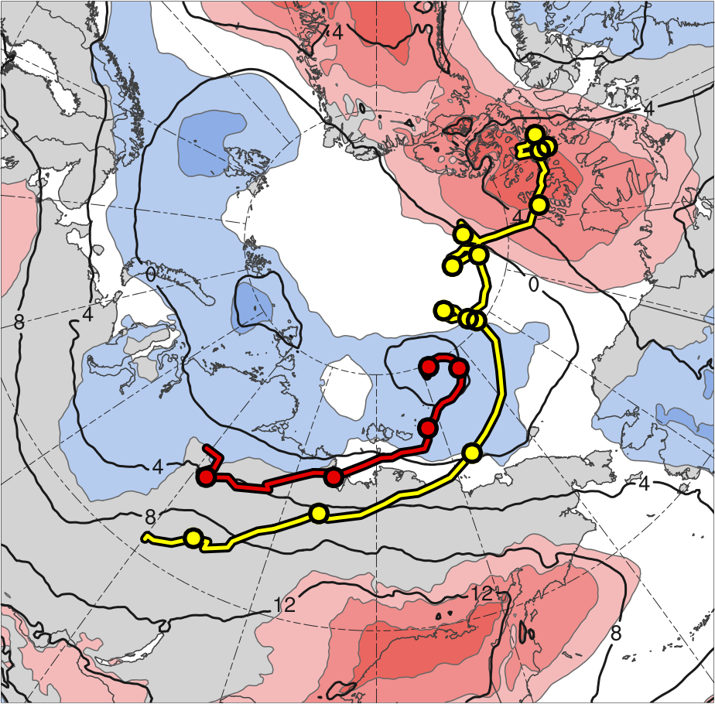
TPV and Surface Cyclone Tracks
TPV 1
L1
TPV 2
AC12
TPV 3
2
1.5
1
0.5
0
-0.5
-1
-1.5
-2
300 hPa
850 hPa
(σ)
Feature | Genesis | Lysis | Lifetime
TPV 1 | 23 July | 19 Aug | ~27 d
TPV 2 | 3 Aug | 9 Aug | 6 d
TPV 3 | 4 Aug | 6 Aug | ~3 d
L1 | 31 July | 5 Aug | ~5 d
AC12 | 2 Aug | 15 Aug | ~13 d
Genesis
Lysis
0000 UTC positions
1–7 Aug 2012 time-mean (left) 300-hPa geopotential height (dam, black) and standardized anomaly of 300-hPa geopotential height (σ, shaded); (right) 850-hPa temperature (°C, black) and standardized anomaly of 850-hPa temperature (σ, shaded)

Slide 9
TPV and Surface Cyclone Tracks
TPV 1 is the longest-lived of the three TPVs and corresponds to the TPV shown in previous studies to play an important role in the evolution of AC12
TPV 2 and TPV 3 are shorter-lived TPVs that play supporting roles in the evolution of AC12
L1 is the predecessor cyclone that merges with AC12
AC12 is the main cyclone of interest and has a lifetime of ~13 days
TPV 1 and AC12 track in a region of tropospheric-deep baroclinicity over Siberia

Slide 10
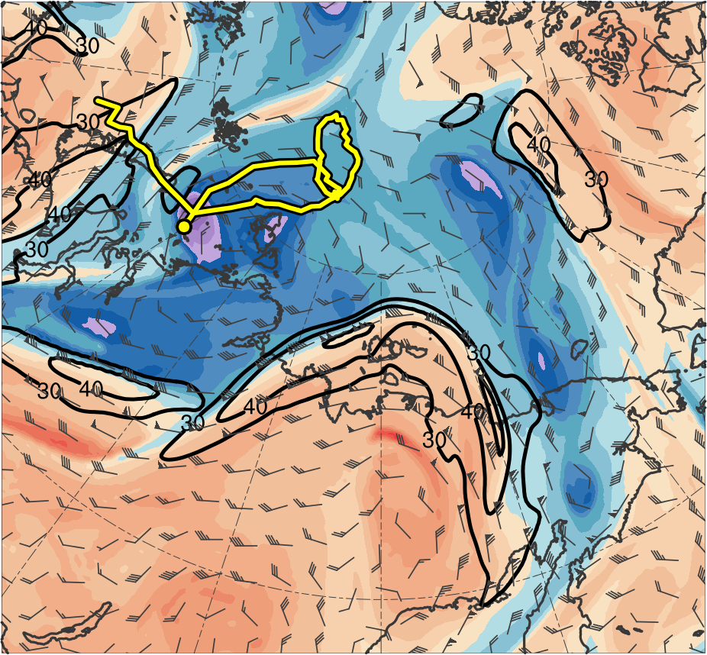
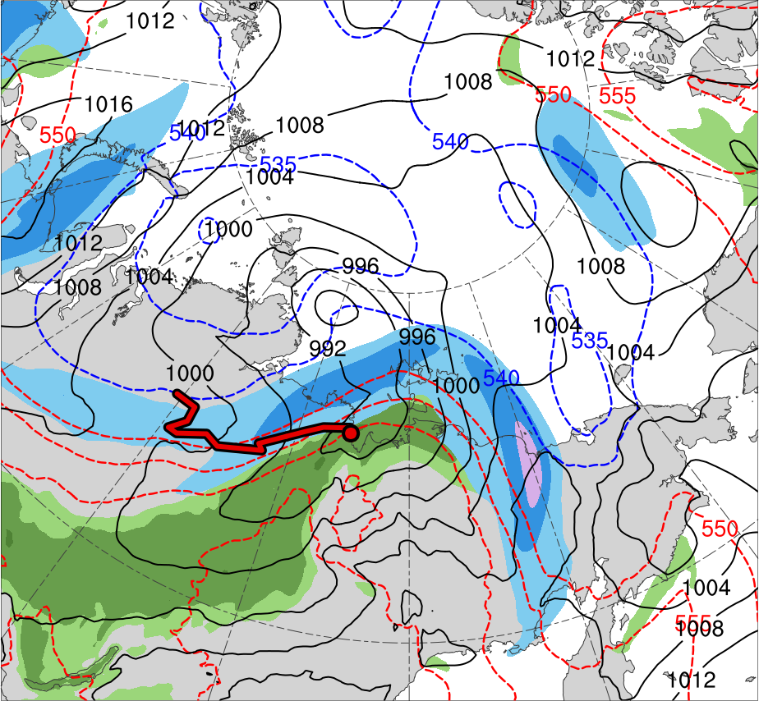
Synoptic Evolution
0000 UTC 2 Aug 2012
TPV 1
L1
(K)
252
258
264
270
276
282
288
294
300
306
312
318
324
330
336
342
348
354
360
366
372
378
(m s⁻¹ )
(mm)
30
40
50
60
70
80
90
100
25
30
35
40
45
50
55
Potential temperature (K, shaded), wind speed (black, every 10 m s⁻¹ starting at 30 m s⁻¹), and wind (m s⁻¹, flags and barbs) on 2-PVU surface
250-hPa wind speed (m s⁻¹, shaded),
1000–500-hPa thickness (dam, blue/red),
SLP (hPa, black), and PW (mm, shaded)
Notes:
Start day of TPV 1: 23 July 2012
Start day of L1: 31 July 2012

Slide 11
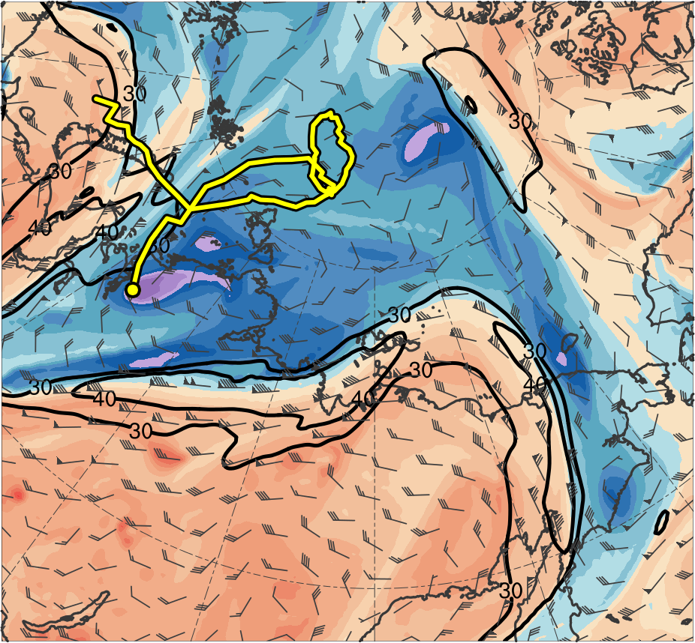
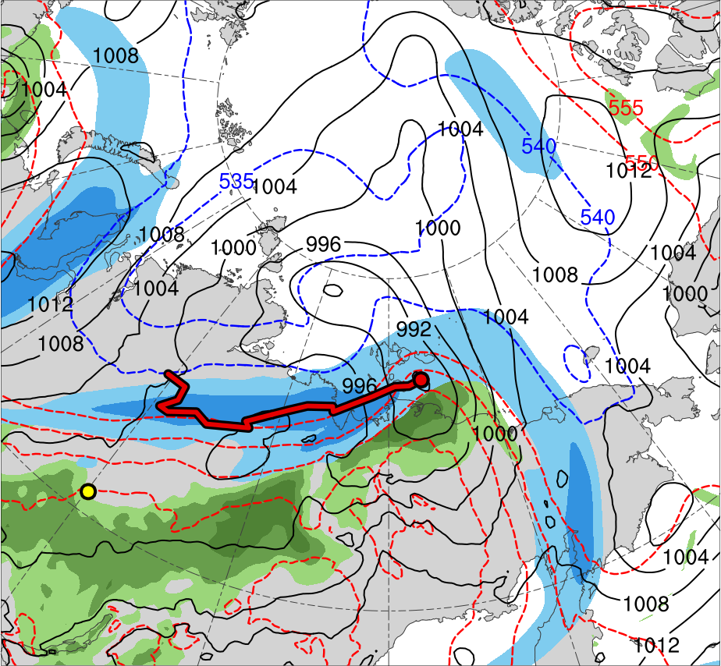
Synoptic Evolution
1200 UTC 2 Aug 2012
TPV 1
L1
AC12
(K)
252
258
264
270
276
282
288
294
300
306
312
318
324
330
336
342
348
354
360
366
372
378
(m s⁻¹ )
(mm)
30
40
50
60
70
80
90
100
25
30
35
40
45
50
55
Potential temperature (K, shaded), wind speed (black, every 10 m s⁻¹ starting at 30 m s⁻¹), and wind (m s⁻¹, flags and barbs) on 2-PVU surface
250-hPa wind speed (m s⁻¹, shaded),
1000–500-hPa thickness (dam, blue/red),
SLP (hPa, black), and PW (mm, shaded)
Notes:
Start day of AC12: 2 Aug 2012

Slide 12
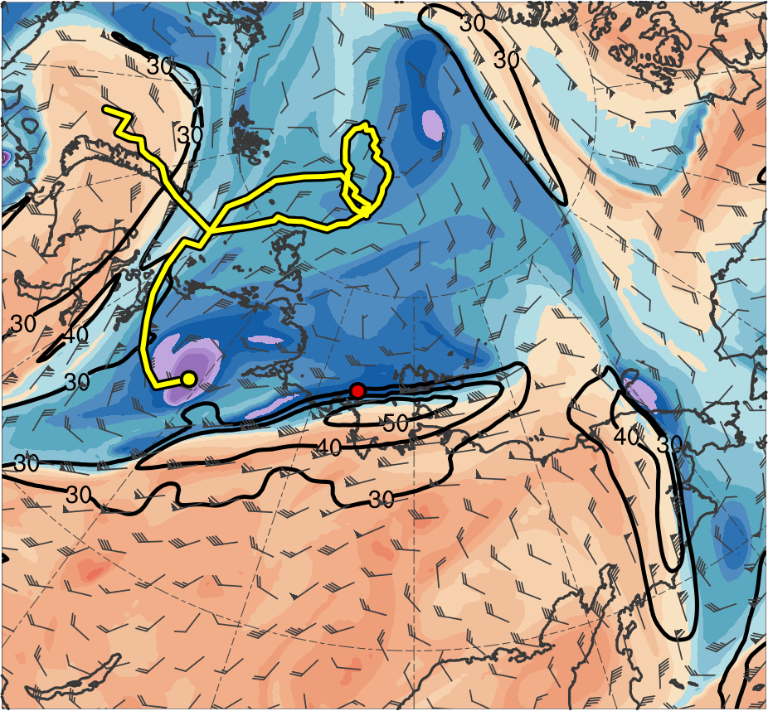
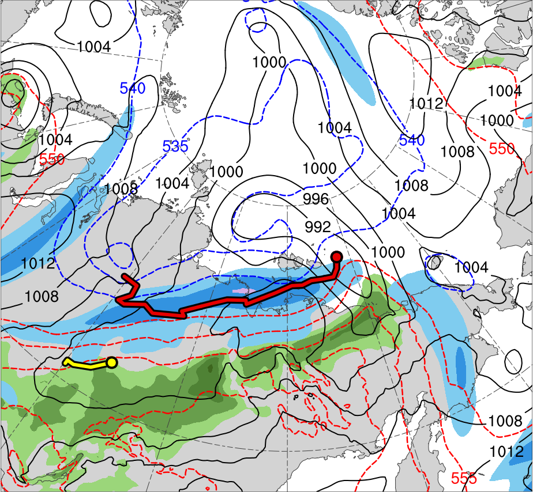
Synoptic Evolution
0000 UTC 3 Aug 2012
TPV 1
TPV 2
L1
AC12
(K)
252
258
264
270
276
282
288
294
300
306
312
318
324
330
336
342
348
354
360
366
372
378
(m s⁻¹ )
(mm)
30
40
50
60
70
80
90
100
25
30
35
40
45
50
55
Potential temperature (K, shaded), wind speed (black, every 10 m s⁻¹ starting at 30 m s⁻¹), and wind (m s⁻¹, flags and barbs) on 2-PVU surface
250-hPa wind speed (m s⁻¹, shaded),
1000–500-hPa thickness (dam, blue/red),
SLP (hPa, black), and PW (mm, shaded)
Notes:
Start day of TPV 2: 3 Aug 2012

Slide 13
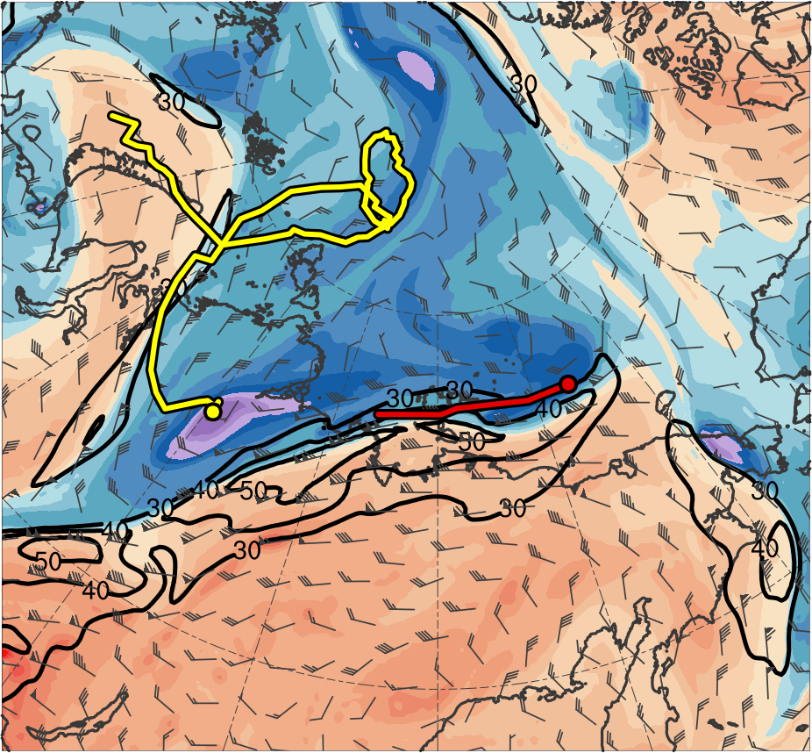
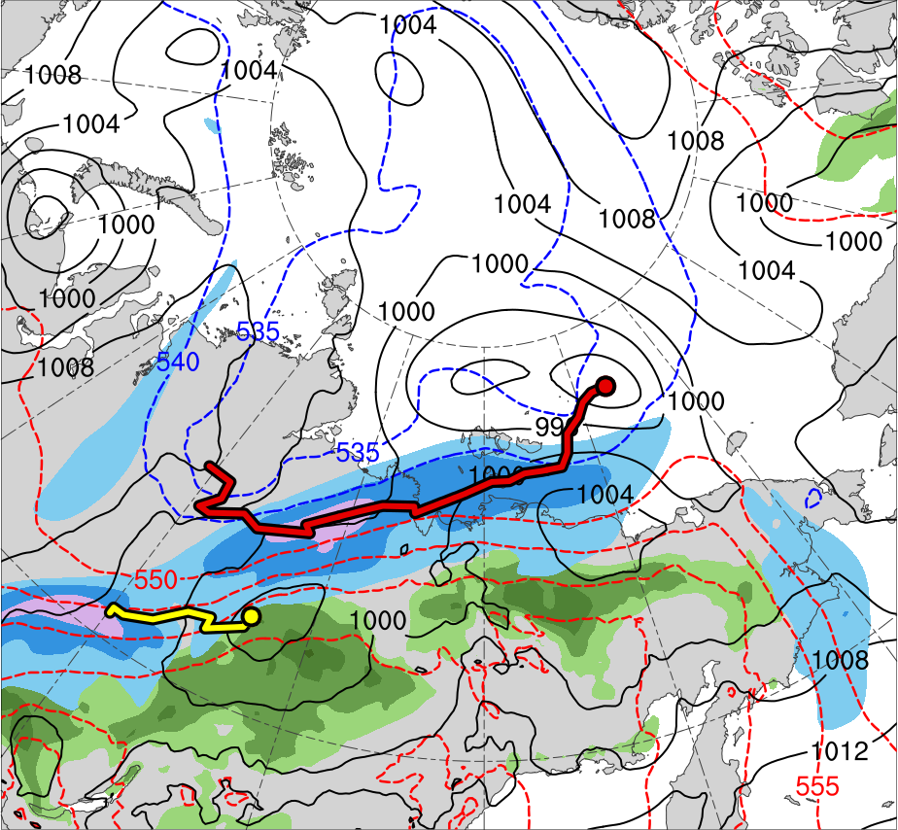
Synoptic Evolution
1200 UTC 3 Aug 2012
TPV 1
TPV 2
L1
AC12
(K)
252
258
264
270
276
282
288
294
300
306
312
318
324
330
336
342
348
354
360
366
372
378
(m s⁻¹ )
(mm)
30
40
50
60
70
80
90
100
25
30
35
40
45
50
55
Potential temperature (K, shaded), wind speed (black, every 10 m s⁻¹ starting at 30 m s⁻¹), and wind (m s⁻¹, flags and barbs) on 2-PVU surface
250-hPa wind speed (m s⁻¹, shaded),
1000–500-hPa thickness (dam, blue/red),
SLP (hPa, black), and PW (mm, shaded)

Slide 14
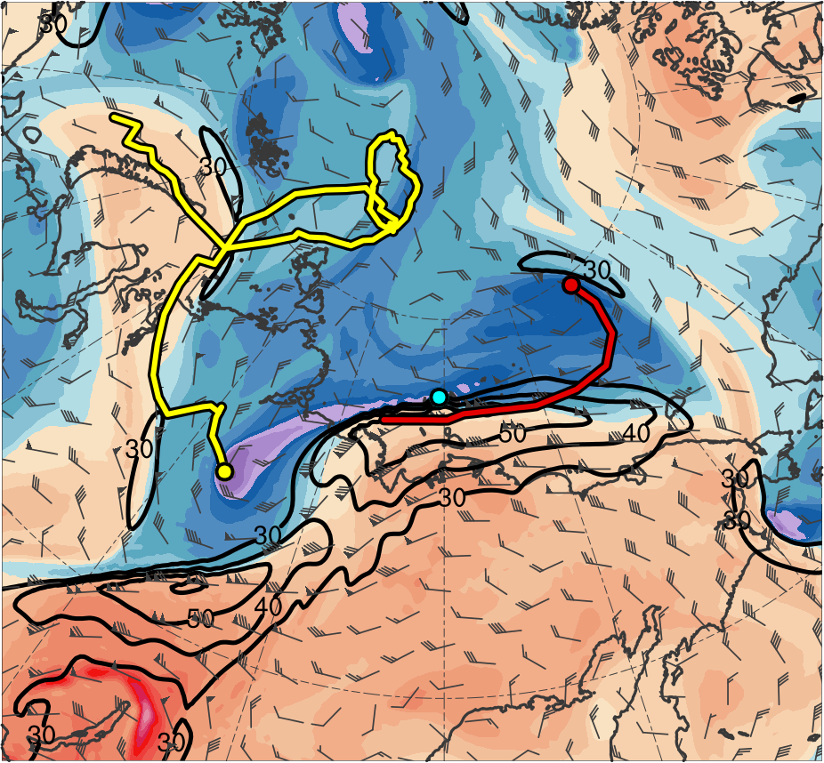
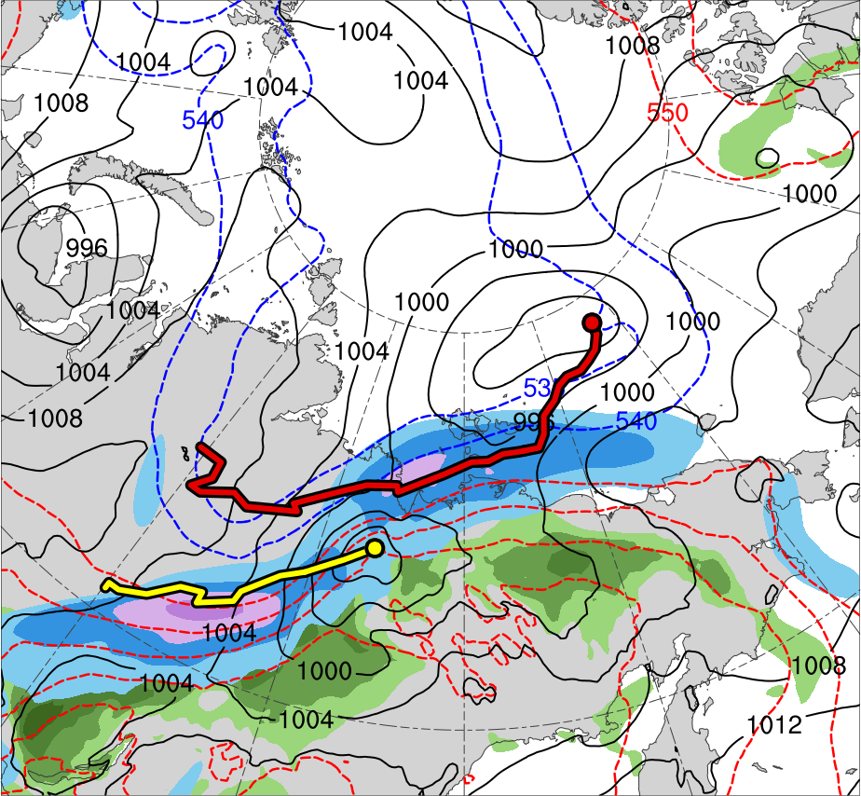
Synoptic Evolution
0000 UTC 4 Aug 2012
TPV 1
TPV 2
L1
TPV 3
AC12
(K)
252
258
264
270
276
282
288
294
300
306
312
318
324
330
336
342
348
354
360
366
372
378
(m s⁻¹ )
(mm)
30
40
50
60
70
80
90
100
25
30
35
40
45
50
55
Potential temperature (K, shaded), wind speed (black, every 10 m s⁻¹ starting at 30 m s⁻¹), and wind (m s⁻¹, flags and barbs) on 2-PVU surface
250-hPa wind speed (m s⁻¹, shaded),
1000–500-hPa thickness (dam, blue/red),
SLP (hPa, black), and PW (mm, shaded)
Notes:
Start Day of TPV 3: 4 Aug 2012

Slide 15
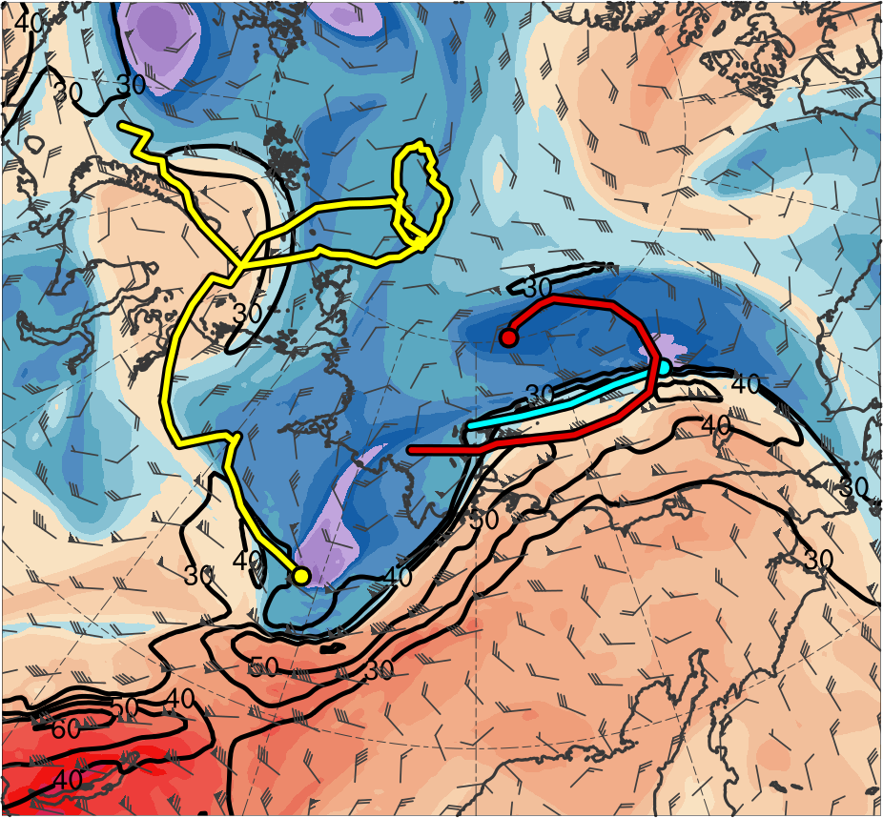
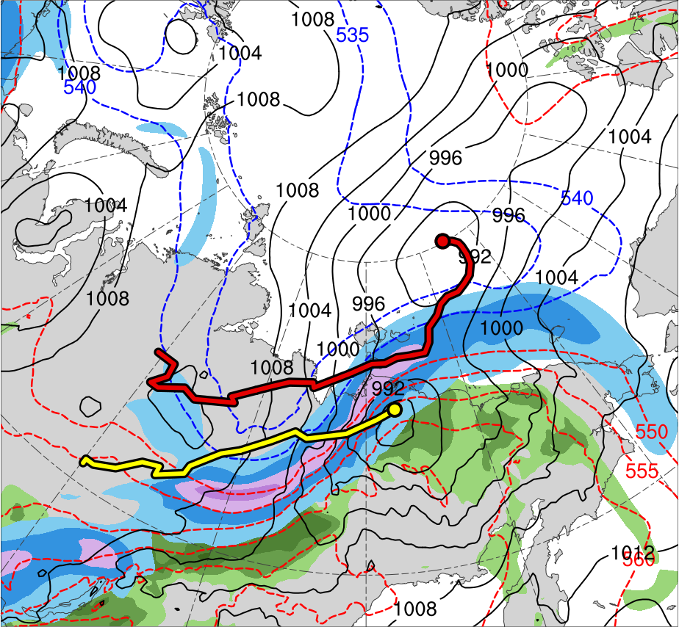
Synoptic Evolution
1200 UTC 4 Aug 2012
TPV 1
TPV 2
L1
TPV 3
AC12
(K)
252
258
264
270
276
282
288
294
300
306
312
318
324
330
336
342
348
354
360
366
372
378
(m s⁻¹ )
(mm)
30
40
50
60
70
80
90
100
25
30
35
40
45
50
55
Potential temperature (K, shaded), wind speed (black, every 10 m s⁻¹ starting at 30 m s⁻¹), and wind (m s⁻¹, flags and barbs) on 2-PVU surface
250-hPa wind speed (m s⁻¹, shaded),
1000–500-hPa thickness (dam, blue/red),
SLP (hPa, black), and PW (mm, shaded)

Slide 16
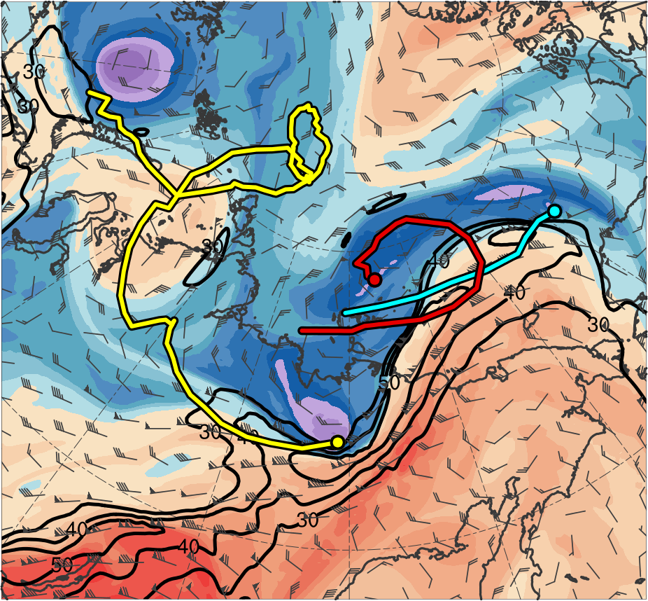
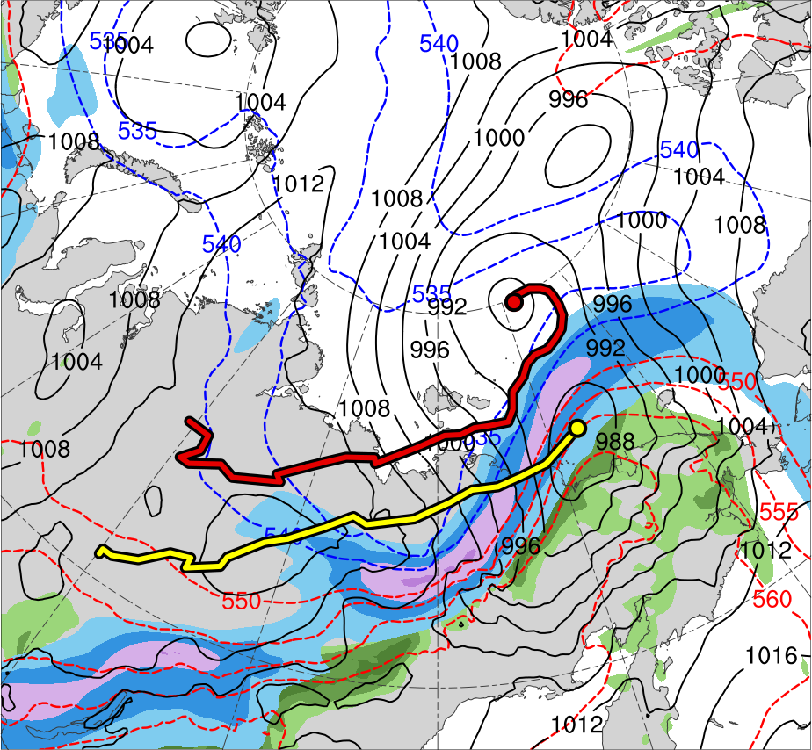
Synoptic Evolution
0000 UTC 5 Aug 2012
TPV 1
TPV 2
L1
TPV 3
AC12
(K)
252
258
264
270
276
282
288
294
300
306
312
318
324
330
336
342
348
354
360
366
372
378
(m s⁻¹ )
(mm)
30
40
50
60
70
80
90
100
25
30
35
40
45
50
55
Potential temperature (K, shaded), wind speed (black, every 10 m s⁻¹ starting at 30 m s⁻¹), and wind (m s⁻¹, flags and barbs) on 2-PVU surface
250-hPa wind speed (m s⁻¹, shaded),
1000–500-hPa thickness (dam, blue/red),
SLP (hPa, black), and PW (mm, shaded)

Slide 17
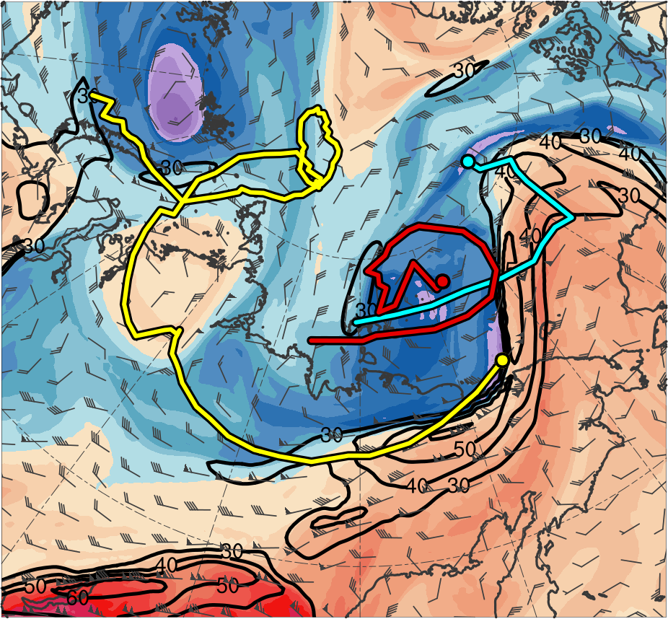
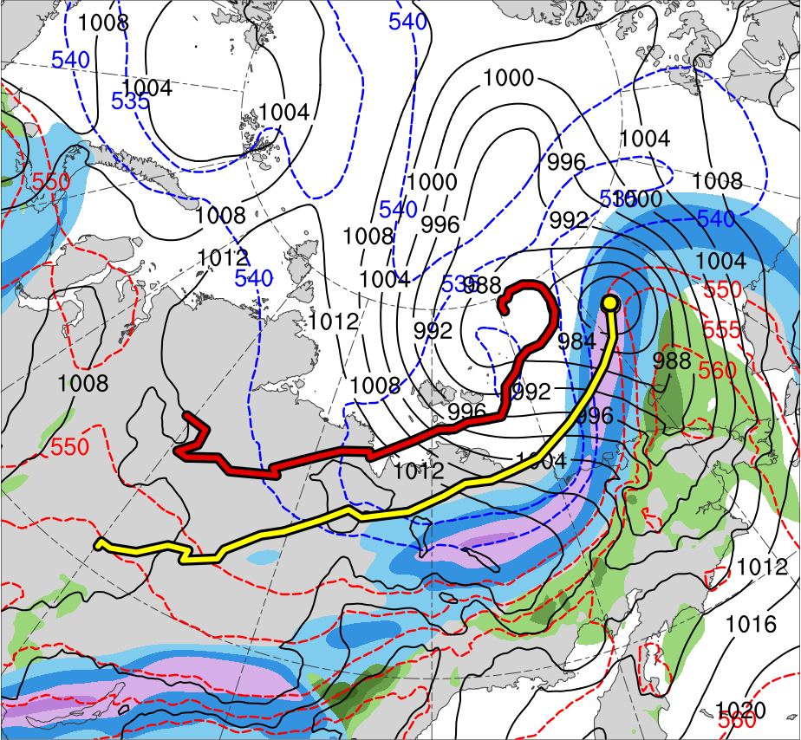
Synoptic Evolution
1200 UTC 5 Aug 2012
TPV 1
TPV 2
L1
TPV 3
AC12
(K)
252
258
264
270
276
282
288
294
300
306
312
318
324
330
336
342
348
354
360
366
372
378
(m s⁻¹ )
(mm)
30
40
50
60
70
80
90
100
25
30
35
40
45
50
55
Potential temperature (K, shaded), wind speed (black, every 10 m s⁻¹ starting at 30 m s⁻¹), and wind (m s⁻¹, flags and barbs) on 2-PVU surface
250-hPa wind speed (m s⁻¹, shaded),
1000–500-hPa thickness (dam, blue/red),
SLP (hPa, black), and PW (mm, shaded)
Notes:
End day of L1: 5 Aug 2012

Slide 18
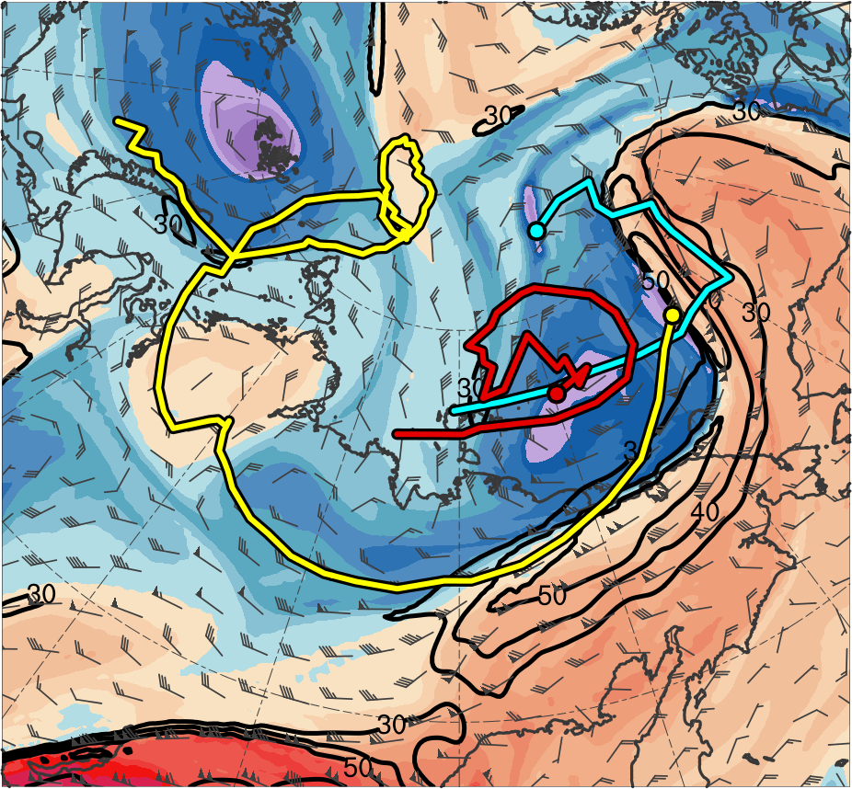
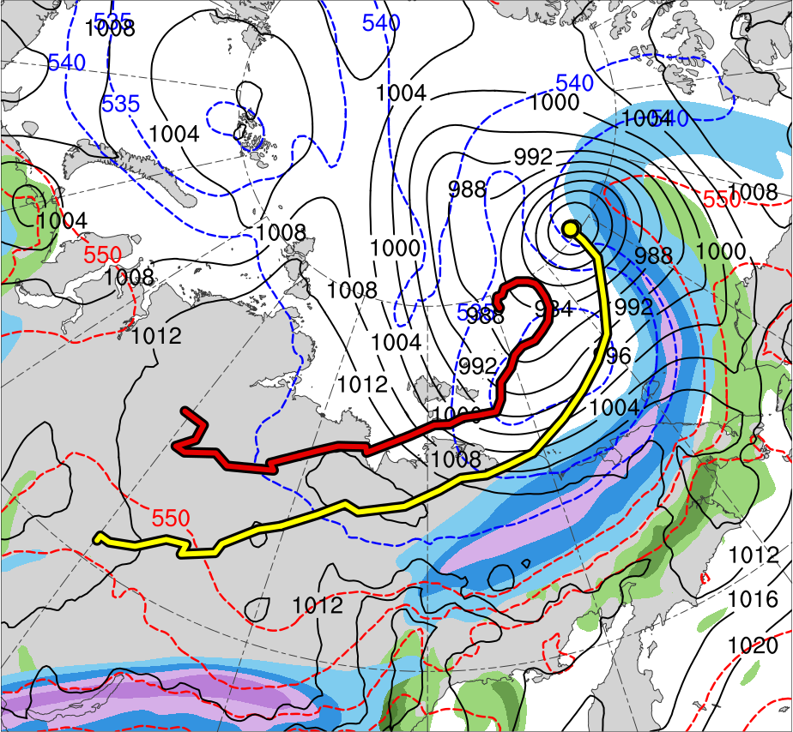
Synoptic Evolution
0000 UTC 6 Aug 2012
TPV 1
TPV 2
L1
TPV 3
AC12
(K)
252
258
264
270
276
282
288
294
300
306
312
318
324
330
336
342
348
354
360
366
372
378
(m s⁻¹ )
(mm)
30
40
50
60
70
80
90
100
25
30
35
40
45
50
55
Potential temperature (K, shaded), wind speed (black, every 10 m s⁻¹ starting at 30 m s⁻¹), and wind (m s⁻¹, flags and barbs) on 2-PVU surface
250-hPa wind speed (m s⁻¹, shaded),
1000–500-hPa thickness (dam, blue/red),
SLP (hPa, black), and PW (mm, shaded)

Slide 19
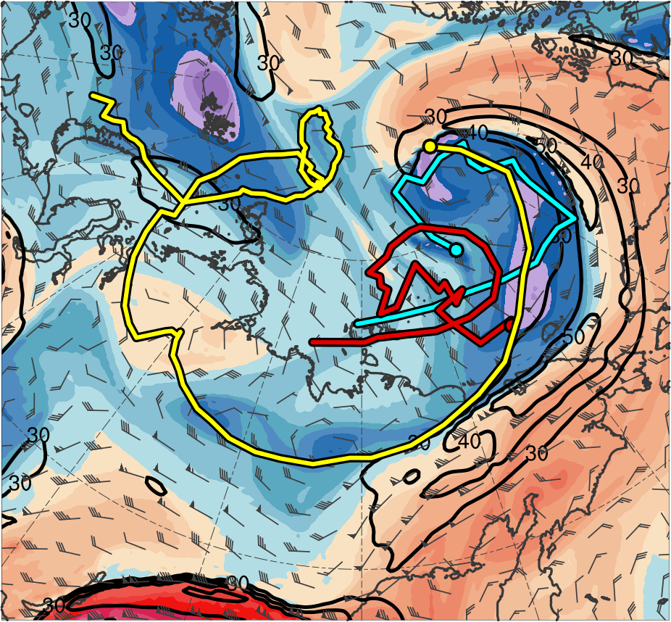
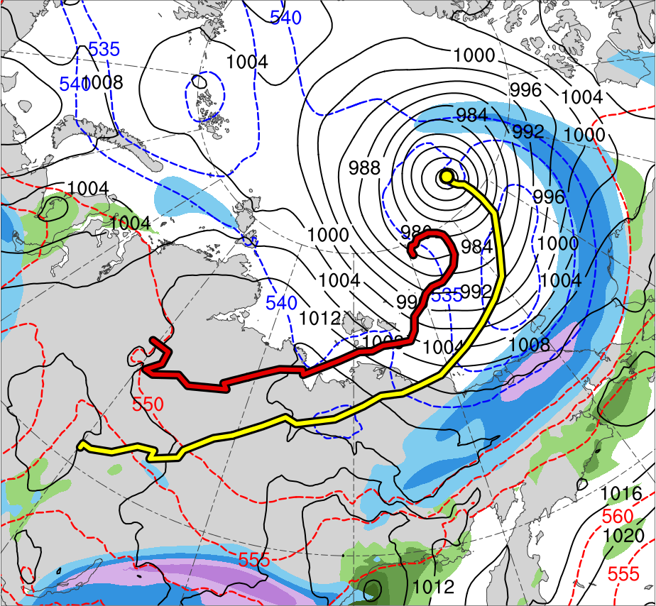
Synoptic Evolution
1200 UTC 6 Aug 2012
TPV 1
TPV 2
L1
TPV 3
AC12
(K)
252
258
264
270
276
282
288
294
300
306
312
318
324
330
336
342
348
354
360
366
372
378
(m s⁻¹ )
(mm)
30
40
50
60
70
80
90
100
25
30
35
40
45
50
55
Potential temperature (K, shaded), wind speed (black, every 10 m s⁻¹ starting at 30 m s⁻¹), and wind (m s⁻¹, flags and barbs) on 2-PVU surface
250-hPa wind speed (m s⁻¹, shaded),
1000–500-hPa thickness (dam, blue/red),
SLP (hPa, black), and PW (mm, shaded)

Slide 20
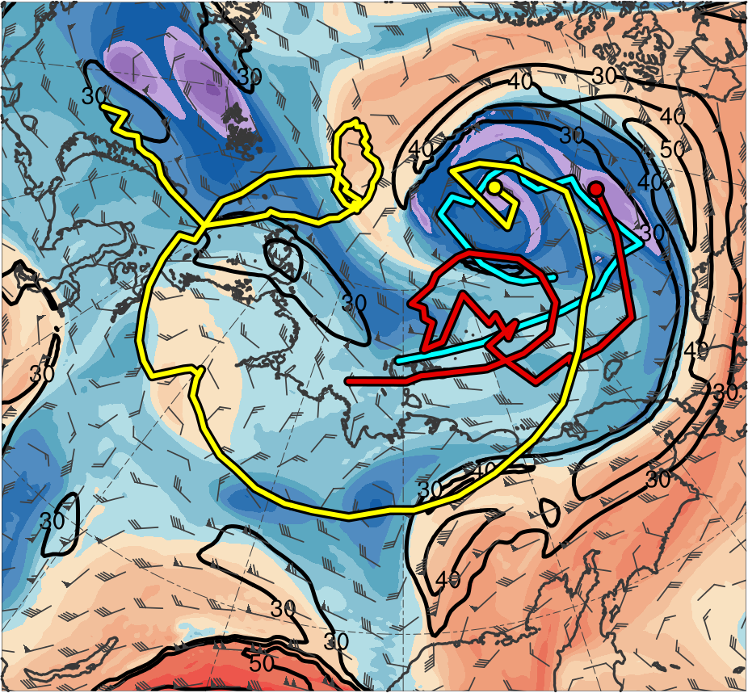
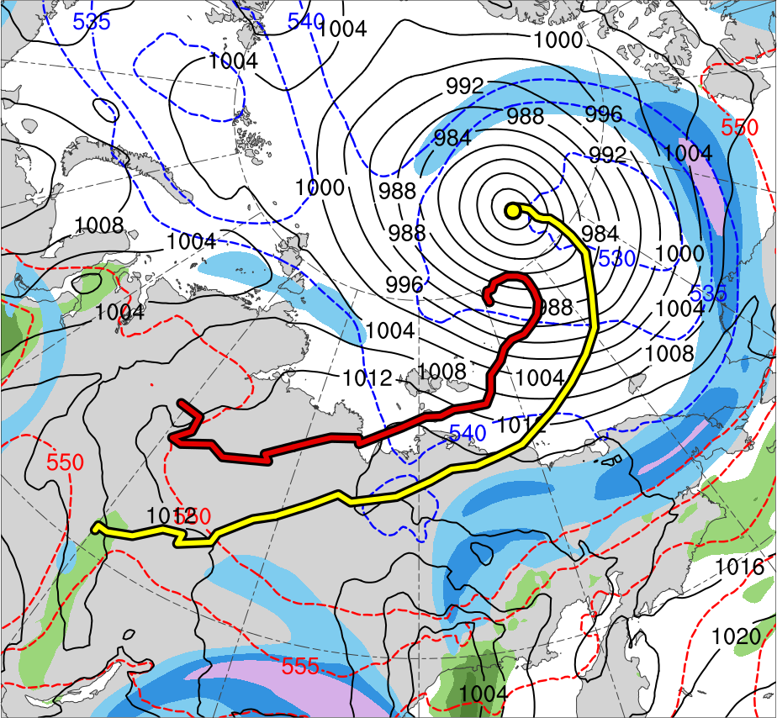
Synoptic Evolution
0000 UTC 7 Aug 2012
TPV 1
TPV 2
L1
TPV 3
AC12
(K)
252
258
264
270
276
282
288
294
300
306
312
318
324
330
336
342
348
354
360
366
372
378
(m s⁻¹ )
(mm)
30
40
50
60
70
80
90
100
25
30
35
40
45
50
55
Potential temperature (K, shaded), wind speed (black, every 10 m s⁻¹ starting at 30 m s⁻¹), and wind (m s⁻¹, flags and barbs) on 2-PVU surface
250-hPa wind speed (m s⁻¹, shaded),
1000–500-hPa thickness (dam, blue/red),
SLP (hPa, black), and PW (mm, shaded)
Notes:
End Day of TPV 3: 6 Aug

Slide 21
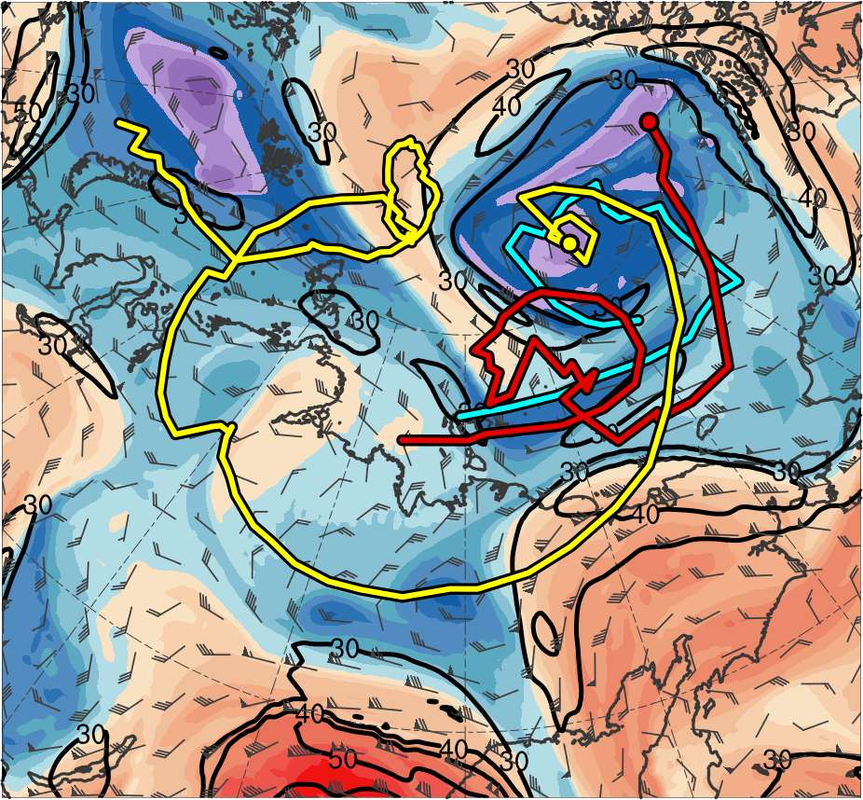
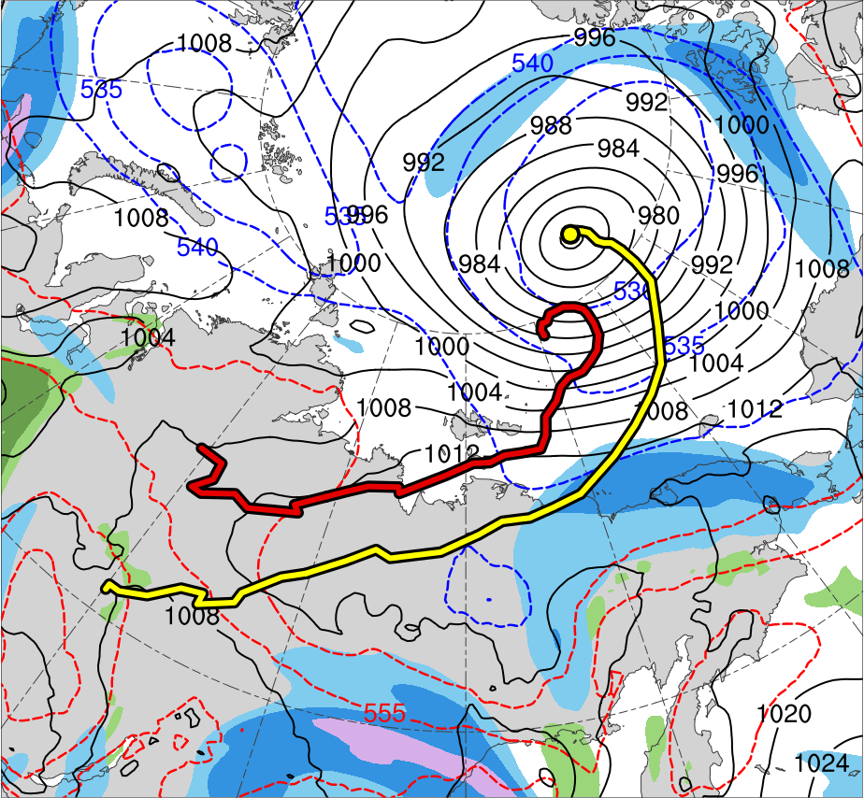
Synoptic Evolution
1200 UTC 7 Aug 2012
TPV 1
TPV 2
L1
TPV 3
AC12
(K)
252
258
264
270
276
282
288
294
300
306
312
318
324
330
336
342
348
354
360
366
372
378
(m s⁻¹ )
(mm)
30
40
50
60
70
80
90
100
25
30
35
40
45
50
55
Potential temperature (K, shaded), wind speed (black, every 10 m s⁻¹ starting at 30 m s⁻¹), and wind (m s⁻¹, flags and barbs) on 2-PVU surface
250-hPa wind speed (m s⁻¹, shaded),
1000–500-hPa thickness (dam, blue/red),
SLP (hPa, black), and PW (mm, shaded)

Slide 22
Synoptic Evolution
TPV 1 approaches and interacts with AC12 in a region of strong baroclinicity, likely supporting the development of AC12 through baroclinic processes
TPV 2 forms at 0000 UTC 3 Aug east of TPV 1, and TPV 3 forms at 0000 UTC 4 Aug by splitting off from TPV 1
TPV–jet interactions involving TPV 1, TPV 2, and TPV 3 likely contribute to the formation of a dual-jet configuration and jet coupling over AC12 during 3–4 Aug
Upper-level divergence associated with the jet coupling, as well as forcing for ascent associated with TPV 1, likely support the intensification of AC12

Slide 23
Synoptic Evolution
L1 interacts and merges with AC12 on 5 Aug, which may further support the intensification of AC12
AC12 becomes positioned in the left exit region of a jet streak located between TPV 1 and a downstream ridge by 0000 UTC 6 Aug and continues to intensify
AC12 attains peak intensity of 962.3 hPa at 1000 UTC 6 Aug in the ERA5 and becomes vertically aligned with TPV 1 by 1200 UTC 6 Aug
AC12 and TPV 1 then meander slowly in tandem over the Arctic, while AC12 slowly weakens

Slide 24
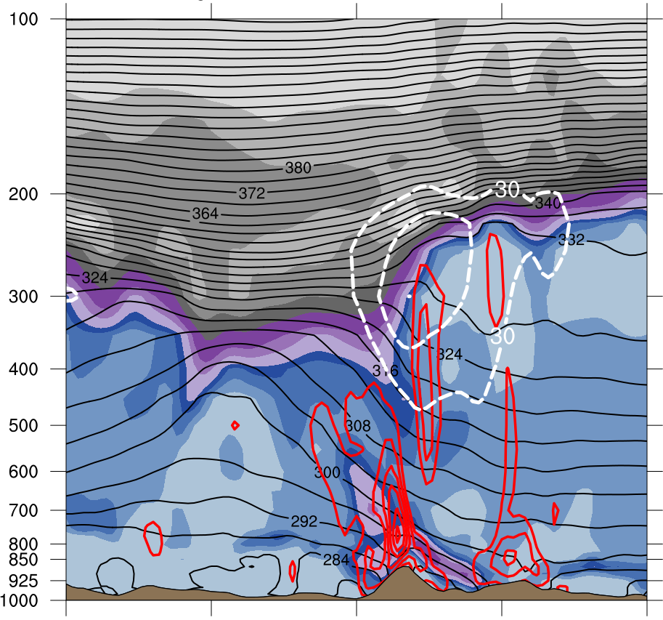
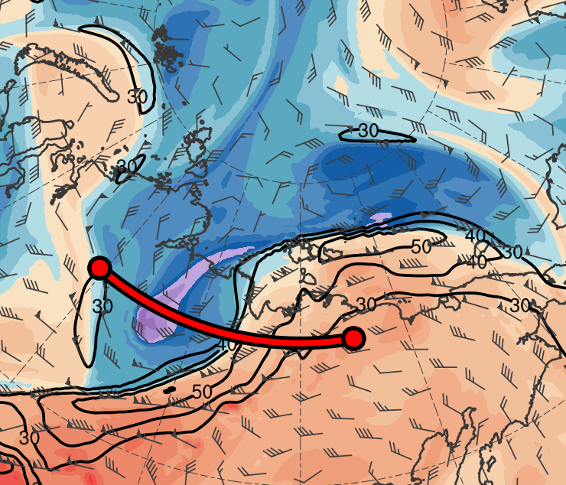
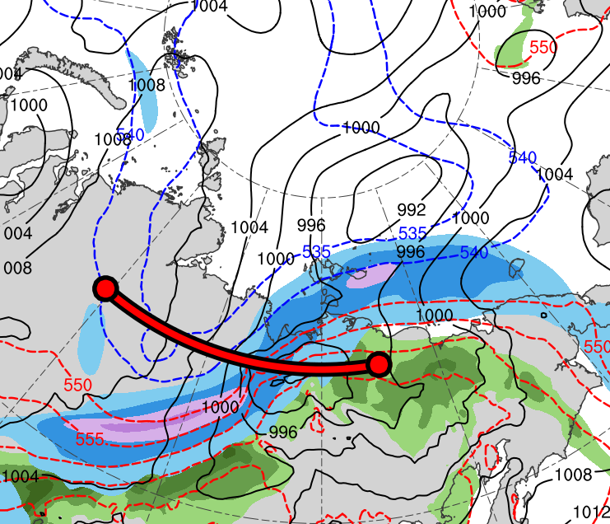
Cross Sections
0600 UTC 4 Aug 2012
(a)
(b)
378
372
100
12
TPV 3
366
90
10
TPV 2
360
80
A
354
70
8
348
60
A’
342
50
6
336
330
40
4
TPV 1
324
30
318
(m s⁻¹)
3
(c)
312
306
55
2
TPV 1
300
294
50
1.5
288
45
A
282
40
1
276
35
A’
270
AC12
264
30
0.5
258
AC12
25
252
(PVU)
A
69.3°N, 111.8°E
69.3°N, 124.5°E
69.3°N, 137.3°E
A’
(K)
(mm)
(a) PV (PVU, shaded), θ (K, black), ascent (red, every 3 × 10⁻³ hPa s⁻¹), and wind speed (dashed white, every 10 m s⁻¹ starting at 30 m s⁻¹ ); (b) DT (2-PVU surface) θ (K, shaded), wind speed (black, every 10 m s⁻¹ starting at 30 m s⁻¹ ), and wind (m s⁻¹, flags and barbs); (c) 250-hPa wind speed (m s⁻¹, shaded),1000–500-hPa thickness (dam, blue/red), SLP (hPa, black), and PW (mm, shaded)

Slide 25
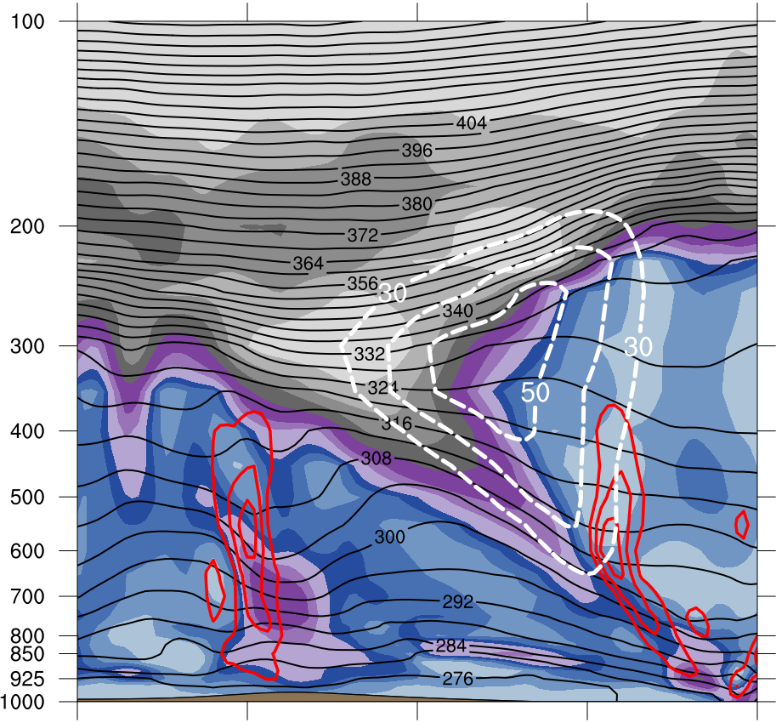
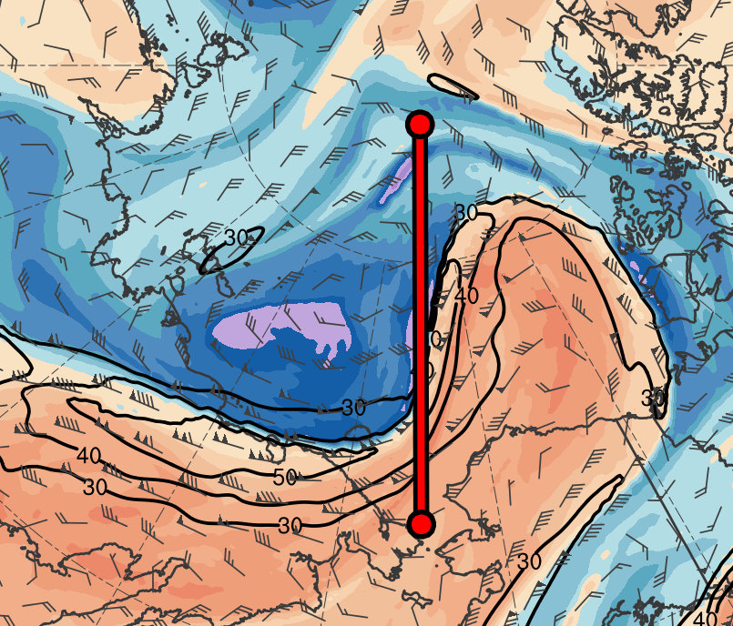
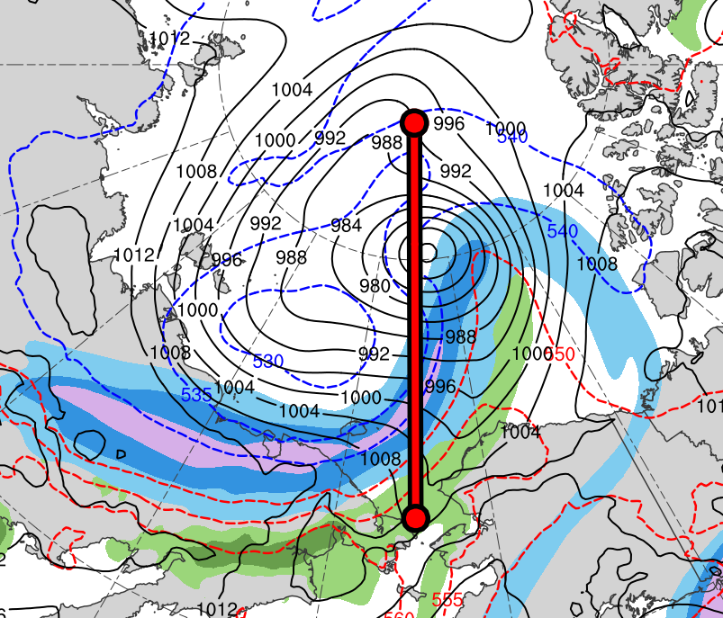
Cross Sections
0000 UTC 6 Aug 2012
(a)
(b)
B
378
372
100
12
366
90
10
360
80
354
70
8
348
60
TPV 1
342
50
6
336
330
40
4
B’
324
30
TPV 1
318
(c)
B
312
(m s⁻¹)
3
306
300
55
2
294
50
1.5
288
45
AC12
282
40
1
276
35
AC12
270
0.5
264
30
B’
258
25
252
(PVU)
B
81.8°N, 169.8°W
76.5°N, 169.8°W
71.3°N, 169.8°W
B’
(K)
(mm)
(a) PV (PVU, shaded), θ (K, black), ascent (red, every 3 × 10⁻³ hPa s⁻¹), and wind speed (dashed white, every 10 m s⁻¹ starting at 30 m s⁻¹ ); (b) DT (2-PVU surface) θ (K, shaded), wind speed (black, every 10 m s⁻¹ starting at 30 m s⁻¹ ), and wind (m s⁻¹, flags and barbs); (c) 250-hPa wind speed (m s⁻¹, shaded),1000–500-hPa thickness (dam, blue/red), SLP (hPa, black), and PW (mm, shaded)

Slide 26
Cross Sections
TPV–jet interactions involving TPV1, TPV 2, and TPV 3 likely contribute to the dual-jet configuration and jet coupling over AC12 at 0600 UTC 4 Aug
Jet coupling likely supports the relatively strong low-level ascent over and near AC12
Latent heating related to the low-level ascent in the presence of warm, moist air likely contributes to the formation of a potential vorticity (PV) tower associated with AC12

Slide 27
Cross Sections
By 0000 UTC 6 Aug, the depth of the PV tower associated with AC12 has increased
The increase in the depth of the PV tower likely is a manifestation of the contribution of latent heating to the intensification of AC12

Slide 28
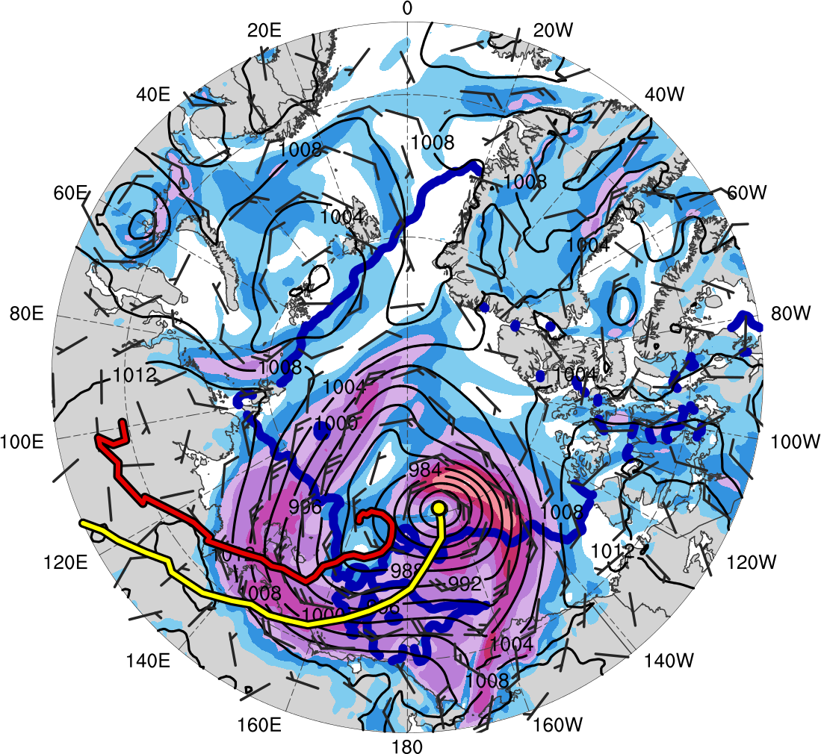
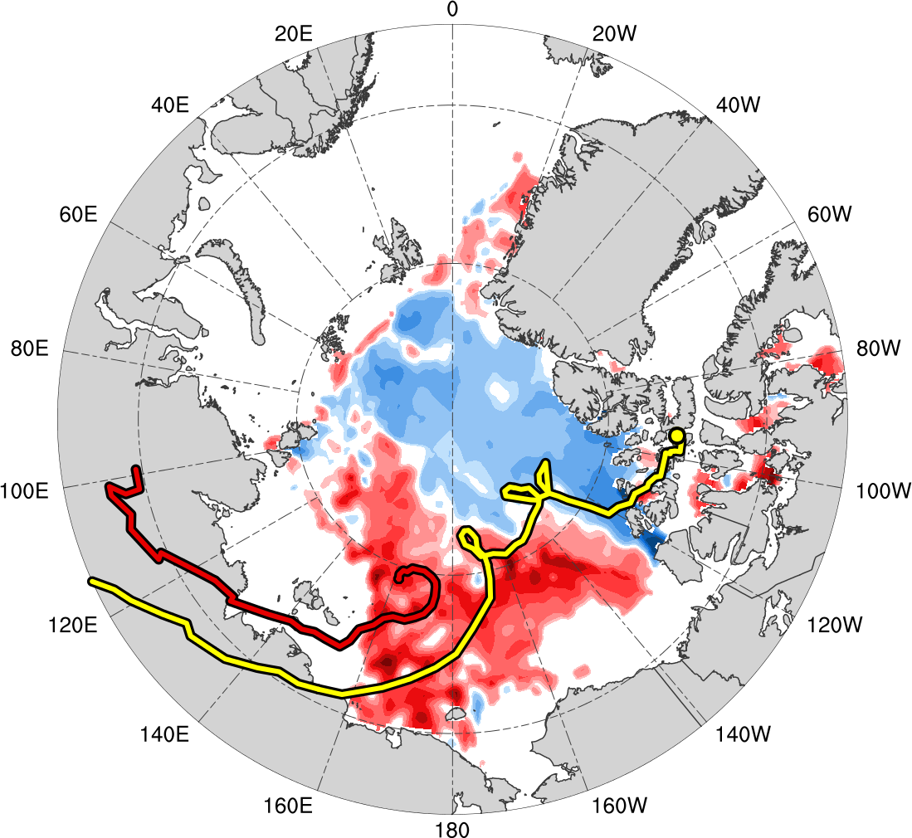
Reduction in Arctic Sea Ice
0000 UTC 6 Aug 2012
0000 UTC 14 Aug 2012
L1
AC12
(m s⁻¹ )
(%)
4
6
8
10
12
14
16
18
-60
-50
-40
-30
-20
-10
-5
5
10
20
30
40
50
60
SLP (hPa, black); 10-m wind speed (m s⁻¹, shaded) and wind (m s⁻¹, black barbs), and 20% contour of sea-ice concentration (thick blue)
Change in sea-ice concentration (%, shaded) during 0000 UTC 2–0000 UTC 14 Aug 2012
Notes:
Start Day of L1: 31 July 2012
End Day of L1: 5 Aug 2012
Start Day of AC12: 2 Aug 2012

Slide 29
Reduction in Arctic Sea Ice
AC12 is associated with an expansive field of relatively strong winds
The relatively strong southerly winds to the east of the center of AC12 are approximately perpendicular to the sea-ice edge, likely helping to move and break up the thin sea ice
AC12 meanders slowly over the Arctic, leading to a prolonged impact on the sea ice, as illustrated by the relatively large reduction in sea-ice concentration northeast of Siberia

Slide 30
Conclusions
TPV 1 approaches and interacts with AC12 in a region of strong baroclinicity, likely supporting the development of AC12 through baroclinic processes
TPV–jet interactions involving TPV 1, TPV 2, and TPV 3 likely contribute to the formation of a dual-jet configuration and jet coupling over AC12
Latent heating related to low-level ascent in the presence of warm, moist air in region of jet coupling likely contributes to the formation of the PV tower associated with AC12

Slide 31
Conclusions
The increase in the depth of the PV tower associated with AC12 likely is a manifestation of the contribution of latent heating to the intensification of AC12
L1 interacts and merges with AC12, which may further support the intensification of AC12
After attaining peak intensity, AC12 meanders slowly over the Arctic, where its expansive surface wind field contributes to reductions in Arctic sea-ice extent
Notes:
Peak intensity defined in terms of minimum SLP in ERA5

