Slide 1
Research Perspectives and Arctic Meteorology
Kevin A. Biernat
Department of Atmospheric and Environmental Sciences
University at Albany, SUNY
ATM 601 Lecture
23 October 2018

Slide 2
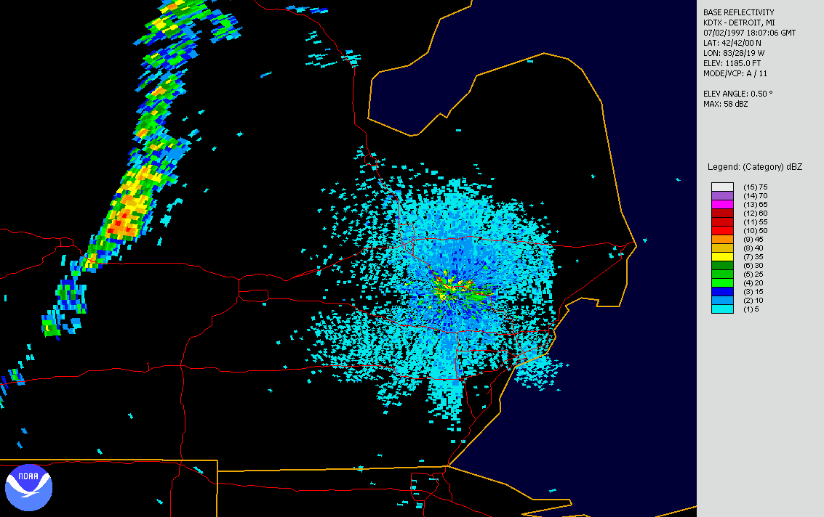
Severe Storms Spark Interest in Meteorology
2 July 1997 Tornado Outbreak
https://www.weather.gov/dtx/beechermet

Slide 3
Research Background
Undergrad work done at University of Detroit Mercy and Central Michigan University (CMU)
Undergrad Research:
Impact of elevated dry layers on wet microbursts (CMU)
Tornado climatology by synoptic and mesoscale storm parameter (NWS Huntsville, AL)

Slide 4
Research Background
Although did severe weather research in undergrad, my research interests were very broad and led me to SUNY Albany
Now enjoy researching Arctic meteorology in grad school
M.S. thesis: Linkages between tropopause polar vortices (TPVs) and the development of cold air outbreaks (CAOs) over central and eastern North America
Ph.D. research: Improving understanding and predictability of Arctic cyclones that are linked to TPVs

Slide 5
Research Background
How did I choose my M.S. research topic?
Motivation to study TPVs originated from a possible field campaign called DOWNSTREAM
Originally planned to study TPV interactions with the North Atlantic jet stream, but DOWNSTREAM did not happen
Work done in a class project for ATM 619 (Cyclone Workshop Seminar) provided proof of concept for my M.S. work on TPVs linked to CAOs

Slide 6
Research Background
Ph.D. research originated from an Office of Naval Research departmental research initiative entitled “Overcoming the Barrier to Extended-Range Prediction over the Arctic”
Supports several faculty and students here
Focuses on enhancing understanding of Arctic cyclones, their predictability, their relationship to TPVs, and their influence on coupled air-sea-ice-processes
Motivated by studies showing that Arctic cyclones can play an important role in Arctic sea-ice loss

Slide 7
Research Perspectives
When starting up a new research project, read up on the literature and look at what research is being presented at conferences
Ask basic questions
Case studies are a great starting point
Learn about features and processes that are important and connect back to what you learned from literature
Develop research methods from these cases
Spend some time looking at real-time examples of your research

Slide 8
Research Perspectives
Test your research from different angles
E.g., consider a variety of meteorological fields and diagnostics at different levels from Eulerian and Lagrangian perspectives with appropriate datasets
Consider different techniques (e.g., trajectories, clustering, machine learning, WRF modeling) and different plotting approaches (e.g., plan-views, cross-sections, hovmöllers)
Can follow the 4 C’s approach as applicable
Climatology, composites, case studies, and conceptual model

Slide 9
Research Perspectives
Leverage class projects and lectures to your benefit
Can turn class projects into conference presentations and portions of your thesis
Can use class projects to steer the direction of your thesis
Can use material in lectures for your thesis and future presentations

Slide 10
Research Perspectives
Don’t hesitate to seek help when needed
If you hit a brick wall on coding, ask others…often someone else has probably coded up what you need
Present research to fellow grad students (e.g., Cyclone Research Group)
Try not to go too long without updating your advisors
Reach out to other faculty

Slide 11
Research Perspectives
If possible, start tasks early on to give yourself enough time to meet deadlines because other tasks sometimes unexpectedly pop up
Try partitioning work day into different segments for different tasks

Slide 12
Research Perspectives
Take chances and put yourself out of your comfort zone
E.g., apply for summer workshops and study programs
Network!
Gain insight from experts in your area of research
Meet potential research collaborators and employers
Discover new research tools others may have available

Slide 13
Research Communication
Take opportunities to present and discuss research in front of others!
Present in class (e.g., lectures and class projects)
Present at research group meetings
Gain practice with both oral and poster presentations at conferences…both have their benefits
The more you practice, the more comfortable you will become, which will serve you well for presentations you may have to do as part of your career

Slide 14
Research Communication
In the process of research, you will end up with A LOT of data and figures
You cannot show all of it, so show your best work!
Tell a good story with a smaller number of figures and information
You are more likely to enjoy giving a presentation if you are not rushing against a time limit
Audience will more likely be able to follow along and provide useful feedback if you are not talking fast and not presenting too much information

Slide 15
Research Communication
Clear written communication is important, so always work on improving writing
It is easy to write a lot; editing down material is often the difficult part of writing
Tell the important points clearly and concisely (avoid unnecessary fluff)
When writing a thesis, plan thesis chapters as potential papers your would like to publish in order to make transition from thesis to published papers more seamless

Slide 16
What have I learned and what would I do differently?
Learned that it is okay if research does not go as initially planned (e.g., hypothesis is rejected) or research evolves unexpectedly
A plan is good, but be adaptable
A null result still tells you more information than you knew before
If methodology changes, don’t feel like you have wasted time, as the work you have already done is still of value
Spend less time trying to perfect certain methods, especially if the resulting changes are insignificant
There is only so much time to do everything

Slide 17
What have I learned and what would I do differently?
Multitask better
Network more
Work on a website
Work/life balance is important…make sure to take care of yourself!

Slide 18
Arctic Meteorology

Slide 19
CTDs and TPVs
Coherent tropopause disturbances (CTDs) are tropopause-based material features (e.g., Pyle et al. 2004)
Can be identified by closed contours of dynamic tropopause (DT) potential temperature, indicative of parcel trapping (e.g., Hakim 2000; Pyle et al. 2004)

Slide 20
CTDs and TPVs
Coherent tropopause disturbances (CTDs) are tropopause-based material features (e.g., Pyle et al. 2004)
Can be identified by closed contours of dynamic tropopause (DT) potential temperature, indicative of parcel trapping (e.g., Hakim 2000; Pyle et al. 2004)
Tropopause polar vortices (TPVs) are a subset of CTDs (e.g., Cavallo and Hakim 2009, 2010)
Typically have latitude restrictions [e.g., must spend at least 60% of lifetime poleward of 65°N for at least 2 days (e.g., Cavallo and Hakim 2010)]

Slide 21
CTDs and TPVs
DT potential temperature (K)
DT pressure (hPa)
TPV
TPV
(left) Dynamic tropopause (DT) wind speed (every 15 m s⁻¹ starting at 50 m s⁻¹, thick contours) and DT potential temperature (K, thin contours and shading) on 1.5-PVU surface valid at 0000 UTC 1 Dec 1991; (right) same as left except DT pressure (hPa, thin contours and shading). Adapted from Fig. 11 in Pyle et al. (2004).

Slide 22
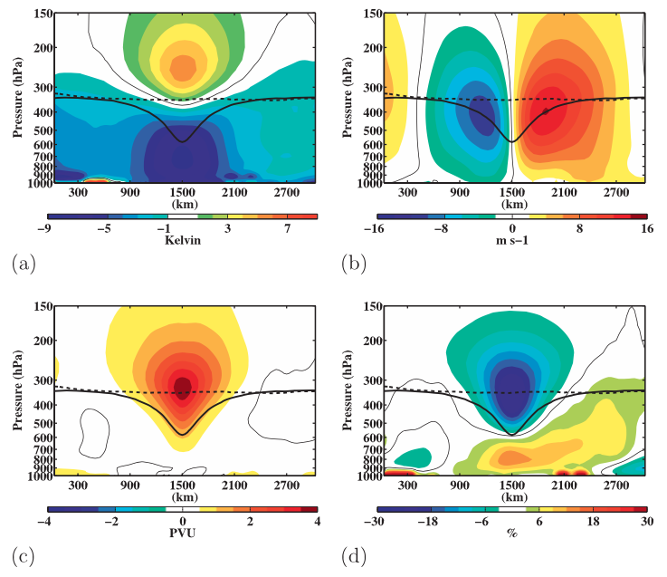
CTDs and TPVs
Temperature anomaly (K)
v-wind anomaly (m s⁻¹)
Ertel PV anomaly (PVU)
relative humidity anomaly (%)
Composite west-to-east cross-TPV section. Figure 9 adapted from Cavallo and Hakim (2010).

Slide 23
Importance of Radiative Cooling
Cavallo and Hakim (2010)
radiative heating rate
Radiative Heating
radiative heating rate anomaly
Schematic above adapted from Fig. 3 in Cavallo and Hakim (2009) and images to right adapted from Fig. 10 in Cavallo and Hakim (2010).

Slide 24
Importance of Radiative Cooling
Cavallo and Hakim (2010)
radiative heating rate
Radiative Heating
radiative heating rate anomaly
PV tendency from radiative heating
PV tendency due to radiation only
Schematic above adapted from Fig. 3 in Cavallo and Hakim (2009) and images to right adapted from Figs. 10 and 12 in Cavallo and Hakim (2010).

Slide 25
Importance of Radiative Cooling
Cavallo and Hakim (2010)
radiative heating rate
latent heating rate
Radiative Heating
Latent Heating
radiative heating rate anomaly
latent heating rate anomaly
PV tendency due to radiation only
Schematic above adapted from Fig. 3 in Cavallo and Hakim (2009) and images to right adapted from Figs. 10 and 12 in Cavallo and Hakim (2010).

Slide 26
Importance of Radiative Cooling
Cavallo and Hakim (2010)
radiative heating rate
latent heating rate
Radiative Heating
Latent Heating
radiative heating rate anomaly
latent heating rate anomaly
PV tendency from radiative heating
PV tendency from latent heating
PV tendency due to radiation only
PV tendency due to latent heating only
Schematic above adapted from Fig. 3 in Cavallo and Hakim (2009) and images to right adapted from Figs. 10 and 12 in Cavallo and Hakim (2010).

Slide 27
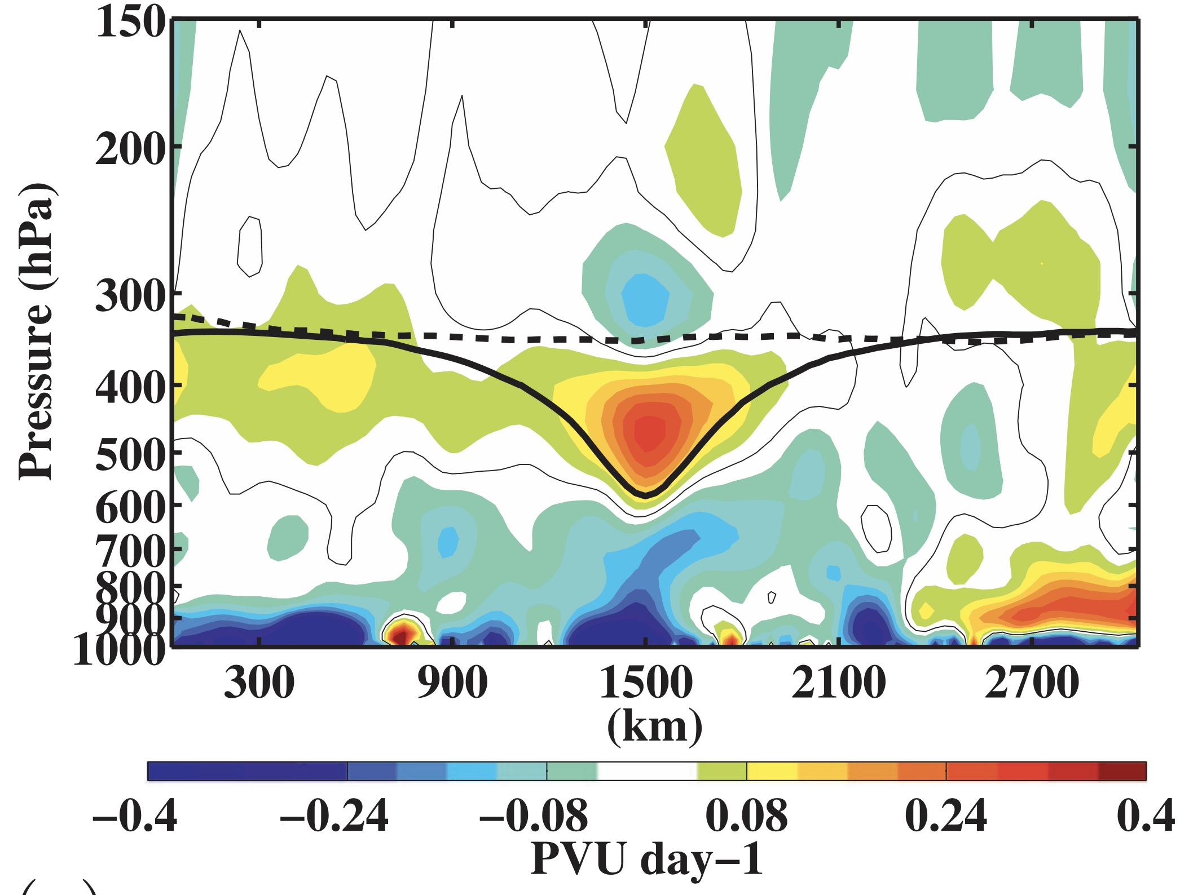
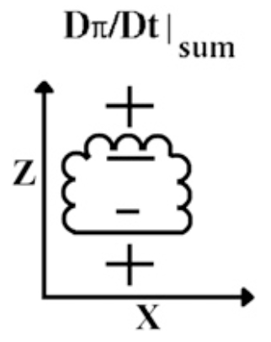
Importance of Radiative Cooling
Cavallo and Hakim (2010)
PV tendency due to all diabatic processes
Radiative Heating
Latent Heating
PV tendency from radiative heating
PV tendency from latent heating
Net PV tendency from radiative heating and latent heating
Schematic above adapted from Fig. 3 in Cavallo and Hakim (2009) and image to right adapted from Fig. 12 in Cavallo and Hakim (2010).

Slide 28
Location and Lifetime of TPVs
TPVs are prevalent features in the Arctic and may last from days to months (e.g., Hakim and Canavan 2005; Cavallo and Hakim 2012)
In the Arctic, longwave radiative cooling dominates latent heating
In the Arctic, TPVs tend to be isolated from horizontal shear associated with the jet stream

Slide 29
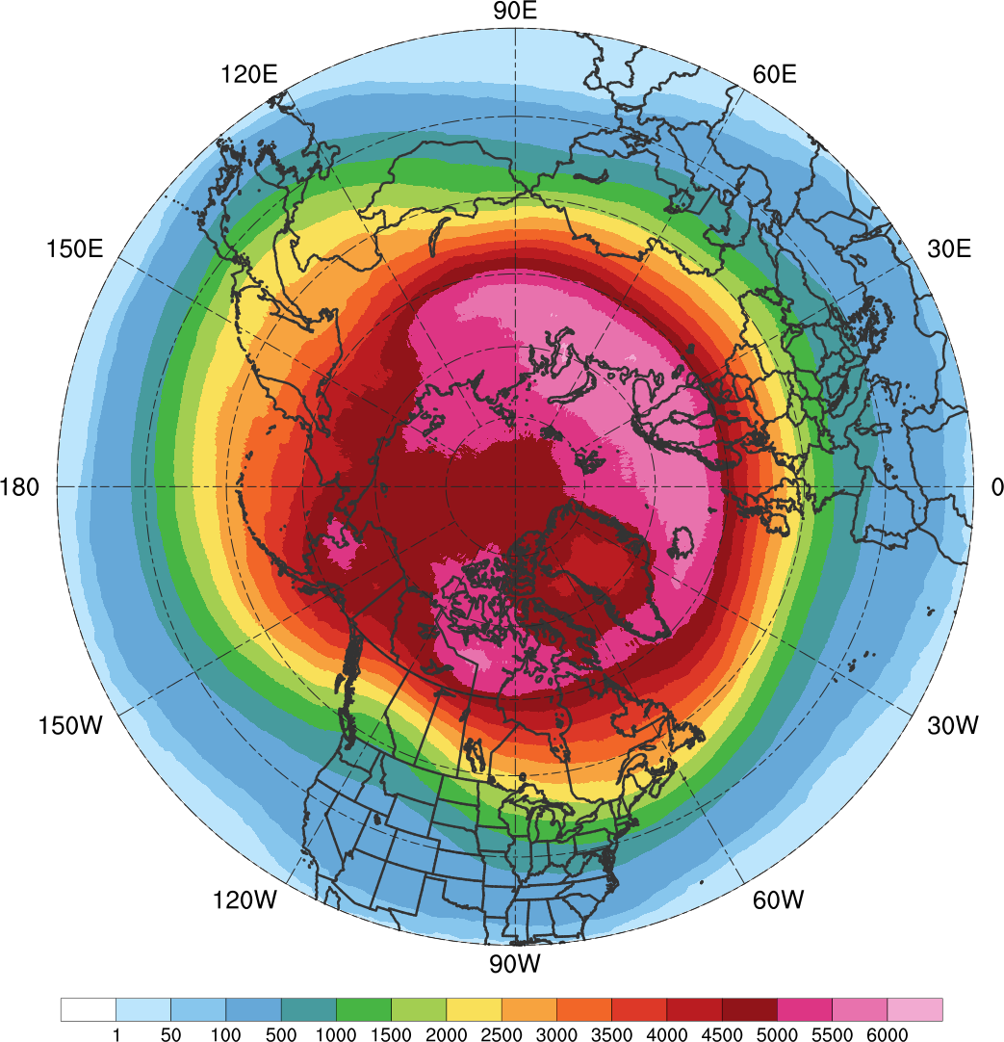
TPV Track Density
N = 58,563;
Avg. of ~1,583 per yr
6000
5500
5000
4500
4000
3500
3000
2500
2000
1500
1000
500
100
50
1
Total number of unique TPVs within 500 km of each grid point (using a 0.5° grid) for all TPVs during 1979–2015 in the ERA-Interim.

Slide 30
TPVs and Cyclogenesis
TPVs may act as precursors to surface cyclogenesis (e.g., Hoskins et al. 1985; section 6e)
v-wind anomaly (m s⁻¹)
Ertel PV anomaly (PVU)
Figure 9 adapted from Cavallo and Hakim (2010).

Slide 31
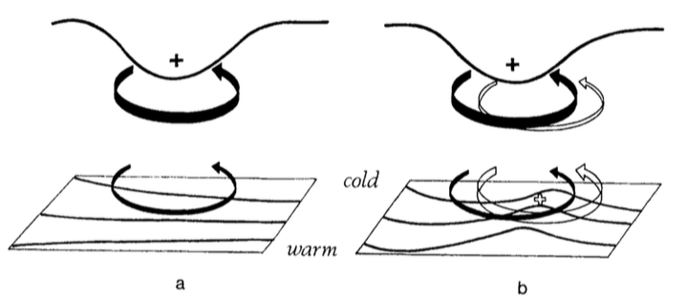
TPVs and Cyclogenesis
TPVs may act as precursors to surface cyclogenesis
TPV
DT
θ
t = t₀
Figure 21 adapted from Hoskins et al. (1985, section 6e).

Slide 32
TPVs and Cyclogenesis
TPVs may act as precursors to surface cyclogenesis
TPV
DT
WAA
θ
t = t₀
Figure 21 adapted from Hoskins et al. (1985, section 6e).

Slide 33
TPVs and Cyclogenesis
TPVs may act as precursors to surface cyclogenesis
TPV
TPV
DT
WAA
θ
Surface Cyclone
t = t₀
t = t₀ + Δt
Figure 21 adapted from Hoskins et al. (1985, section 6e).

Slide 34
TPVs and Cyclogenesis
TPVs may act as precursors to surface cyclogenesis
TPV
TPV
DT
“Phase Locking”
WAA
θ
Surface Cyclone
t = t₀
t = t₀ + Δt
Figure 21 adapted from Hoskins et al. (1985, section 6e).

Slide 35
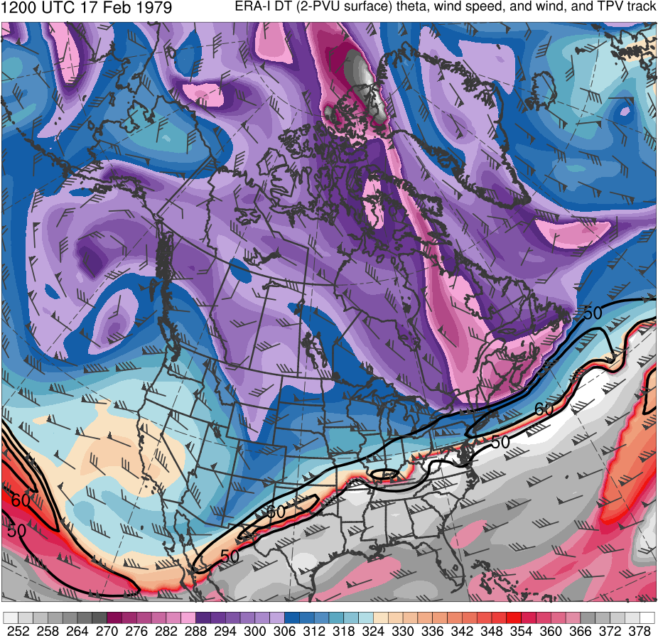
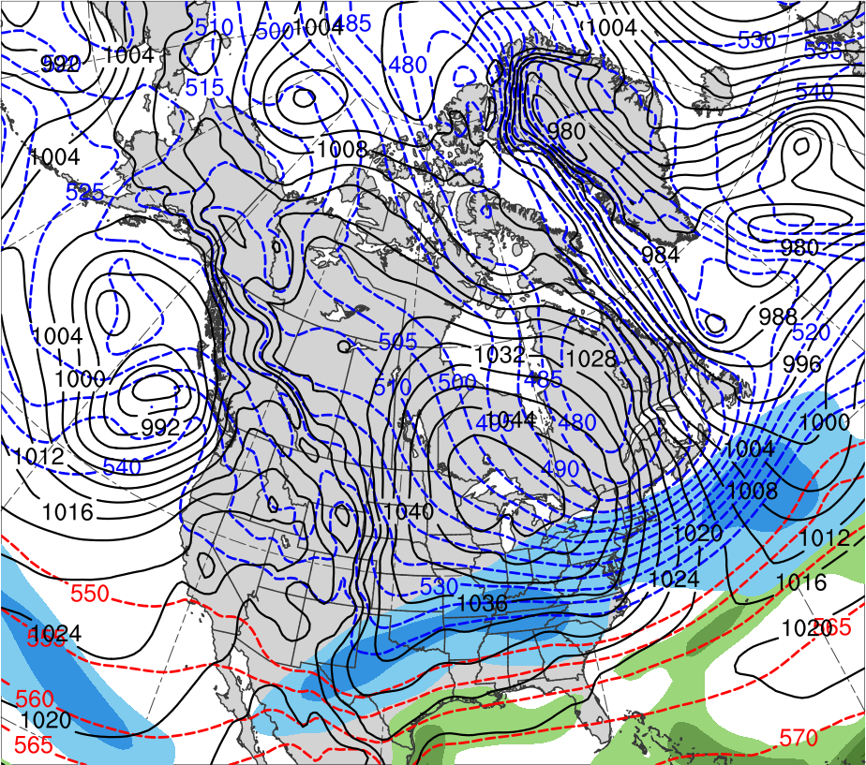
President’s Day Storm of 1979
1200 UTC 17 Feb 1979
Data Source: ERA-Interim
CTD
(K)
252
258
264
270
276
282
288
294
300
306
312
318
324
330
336
342
348
354
360
366
372
378
(mm)
(m s⁻¹ )
25
30
35
40
45
50
55
50
60
70
80
90
100
110
120
Potential temperature (K, shaded), wind speed (black, every 10 m s⁻¹ starting at 50 m s⁻¹), and wind (m s⁻¹, flags and barbs) on 2-PVU surface
250-hPa wind speed (m s⁻¹, shaded),
1000–500-hPa thickness (dam, blue/red),
SLP (hPa, black), PW (mm, shaded)

Slide 36
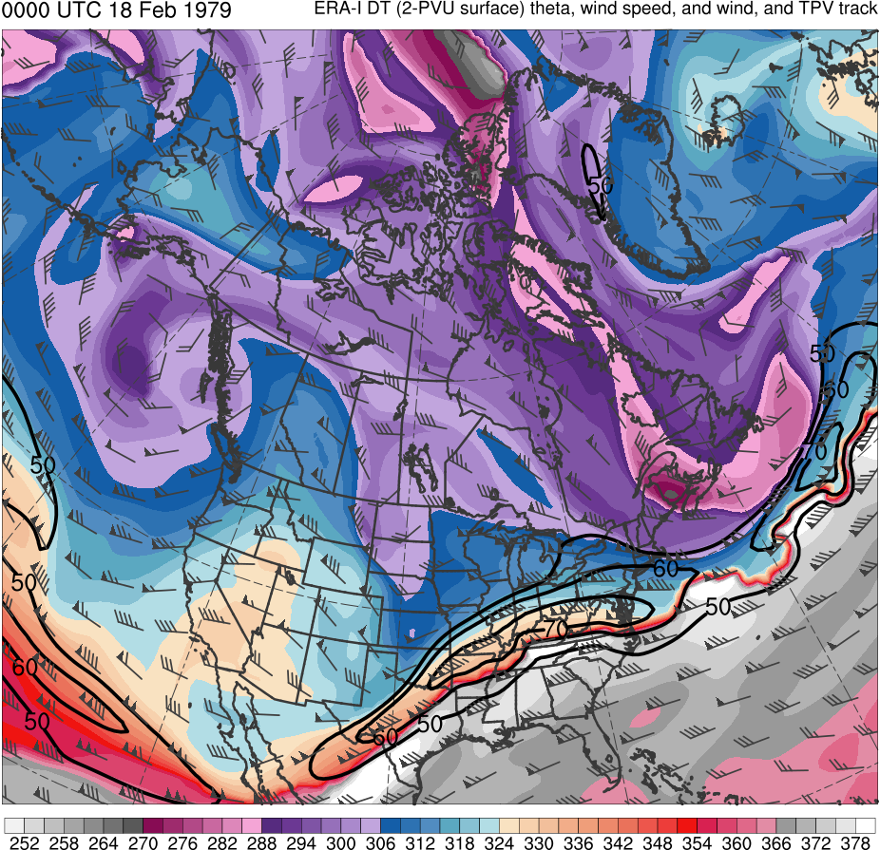
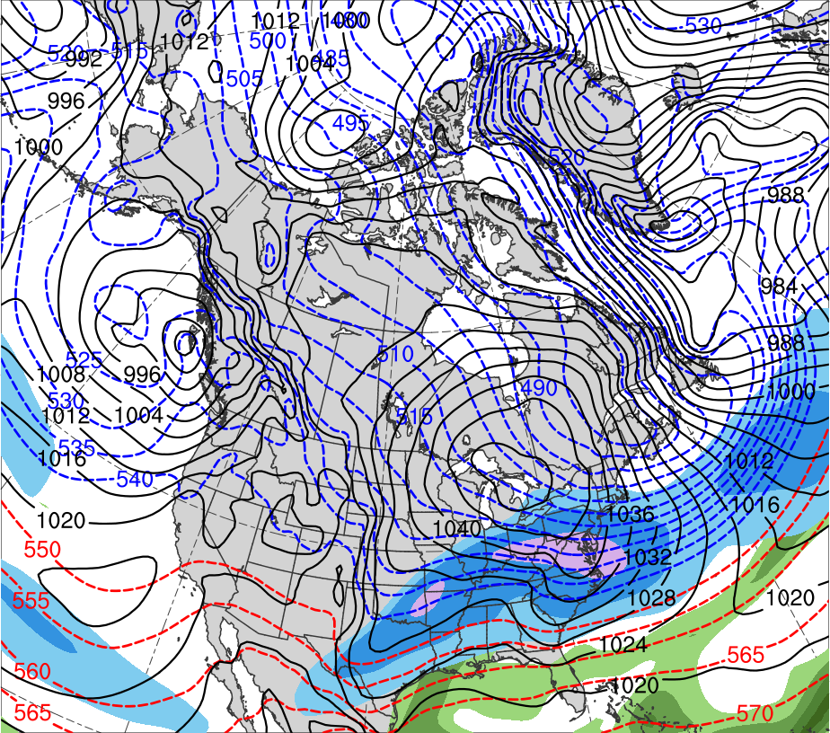
President’s Day Storm of 1979
0000 UTC 18 Feb 1979
Data Source: ERA-Interim
CTD
(K)
252
258
264
270
276
282
288
294
300
306
312
318
324
330
336
342
348
354
360
366
372
378
(mm)
(m s⁻¹ )
25
30
35
40
45
50
55
50
60
70
80
90
100
110
120
Potential temperature (K, shaded), wind speed (black, every 10 m s⁻¹ starting at 50 m s⁻¹), and wind (m s⁻¹, flags and barbs) on 2-PVU surface
250-hPa wind speed (m s⁻¹, shaded),
1000–500-hPa thickness (dam, blue/red),
SLP (hPa, black), PW (mm, shaded)

Slide 37
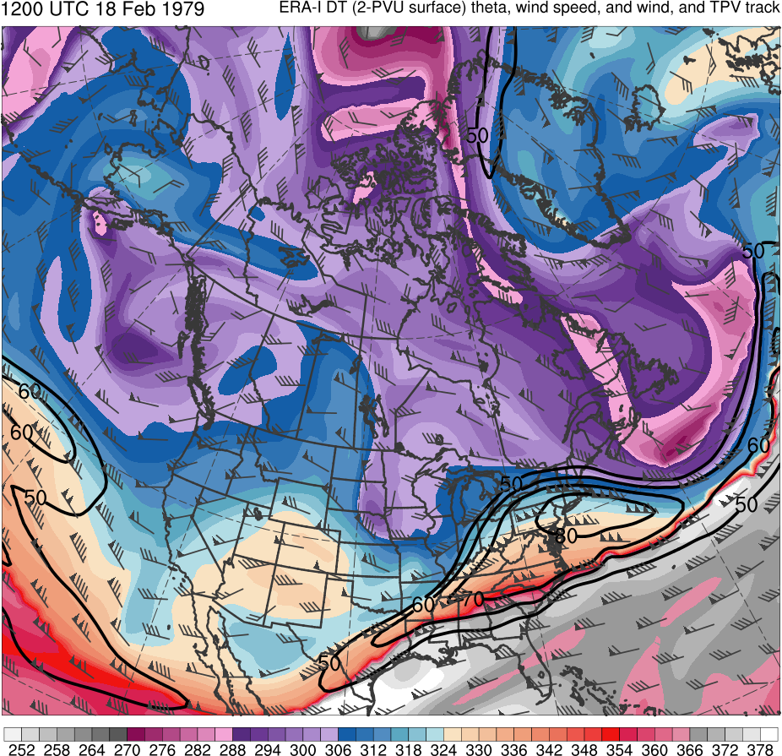
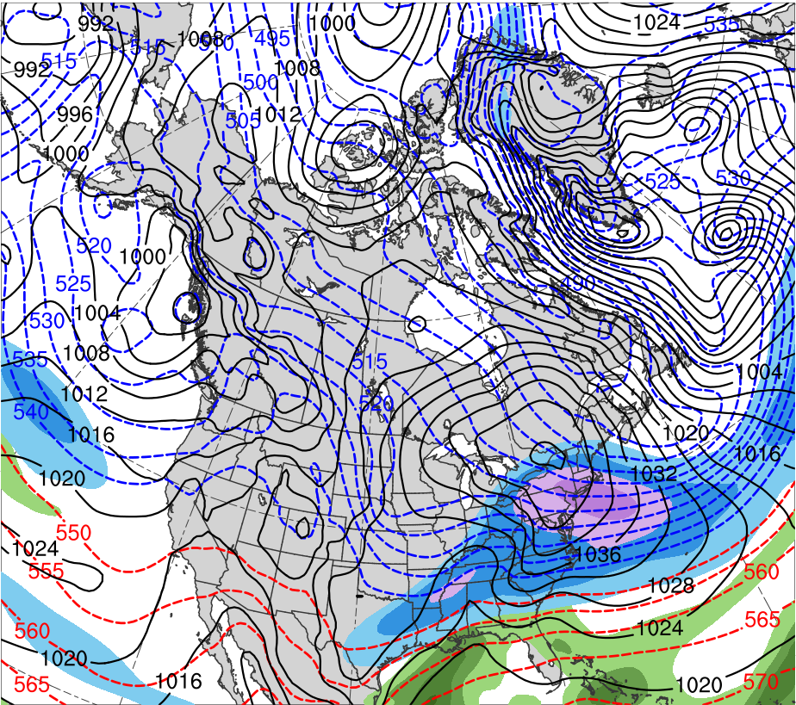
President’s Day Storm of 1979
1200 UTC 18 Feb 1979
Data Source: ERA-Interim
CTD
(K)
252
258
264
270
276
282
288
294
300
306
312
318
324
330
336
342
348
354
360
366
372
378
(mm)
(m s⁻¹ )
25
30
35
40
45
50
55
50
60
70
80
90
100
110
120
Potential temperature (K, shaded), wind speed (black, every 10 m s⁻¹ starting at 50 m s⁻¹), and wind (m s⁻¹, flags and barbs) on 2-PVU surface
250-hPa wind speed (m s⁻¹, shaded),
1000–500-hPa thickness (dam, blue/red),
SLP (hPa, black), PW (mm, shaded)

Slide 38
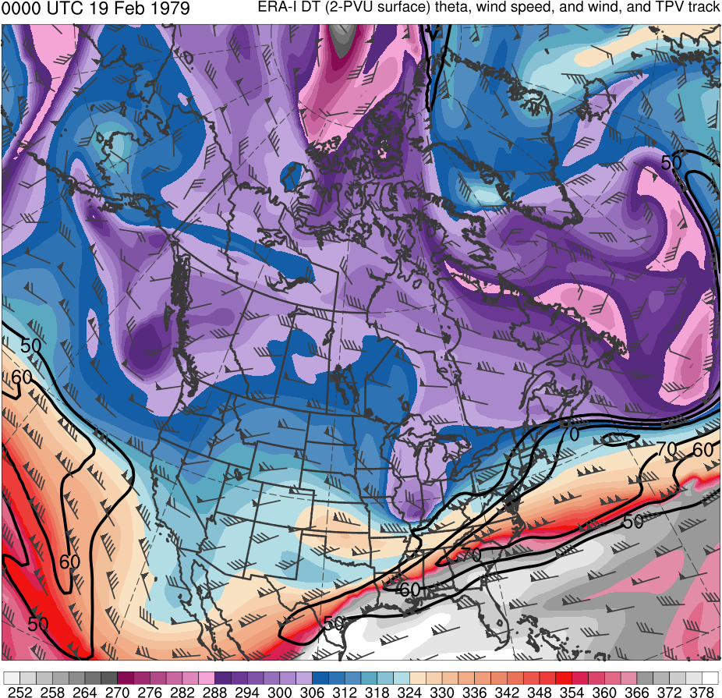
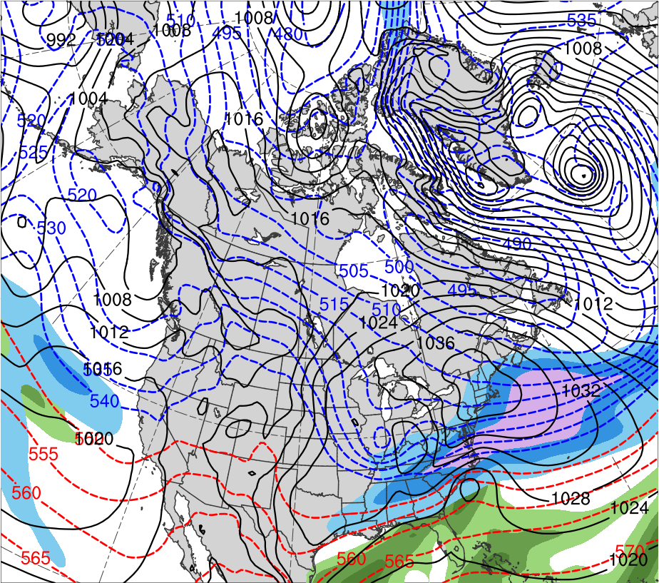
President’s Day Storm of 1979
0000 UTC 19 Feb 1979
Data Source: ERA-Interim
CTD
L
L
(K)
252
258
264
270
276
282
288
294
300
306
312
318
324
330
336
342
348
354
360
366
372
378
(mm)
(m s⁻¹ )
25
30
35
40
45
50
55
50
60
70
80
90
100
110
120
Potential temperature (K, shaded), wind speed (black, every 10 m s⁻¹ starting at 50 m s⁻¹), and wind (m s⁻¹, flags and barbs) on 2-PVU surface
250-hPa wind speed (m s⁻¹, shaded),
1000–500-hPa thickness (dam, blue/red),
SLP (hPa, black), PW (mm, shaded)

Slide 39
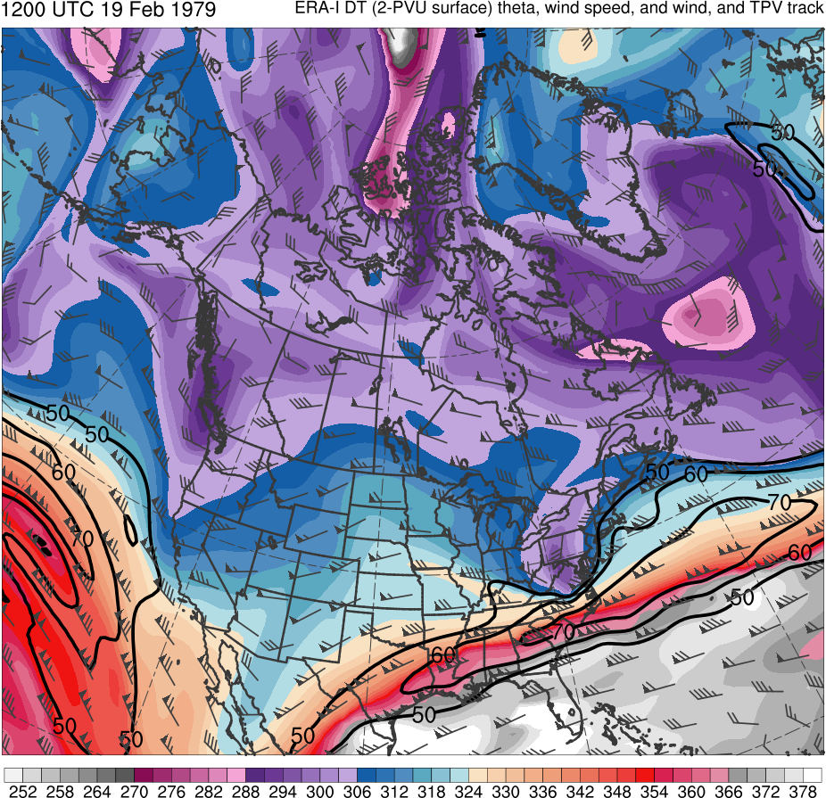
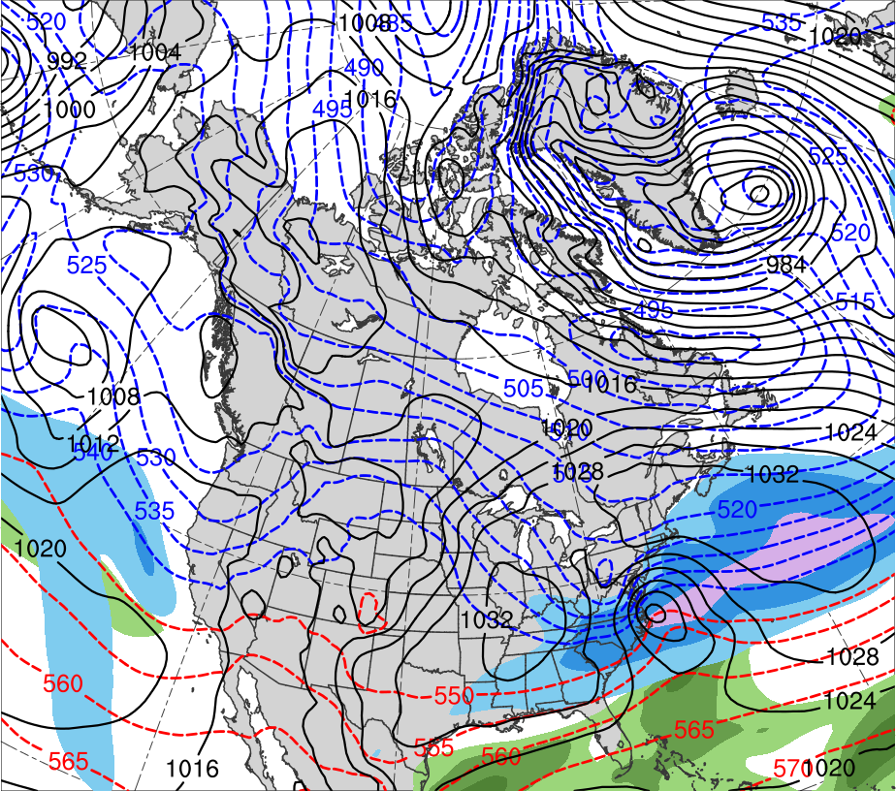
President’s Day Storm of 1979
1200 UTC 19 Feb 1979
Data Source: ERA-Interim
CTD
L
(K)
252
258
264
270
276
282
288
294
300
306
312
318
324
330
336
342
348
354
360
366
372
378
(mm)
(m s⁻¹ )
25
30
35
40
45
50
55
50
60
70
80
90
100
110
120
Potential temperature (K, shaded), wind speed (black, every 10 m s⁻¹ starting at 50 m s⁻¹), and wind (m s⁻¹, flags and barbs) on 2-PVU surface
250-hPa wind speed (m s⁻¹, shaded),
1000–500-hPa thickness (dam, blue/red),
SLP (hPa, black), PW (mm, shaded)

Slide 40
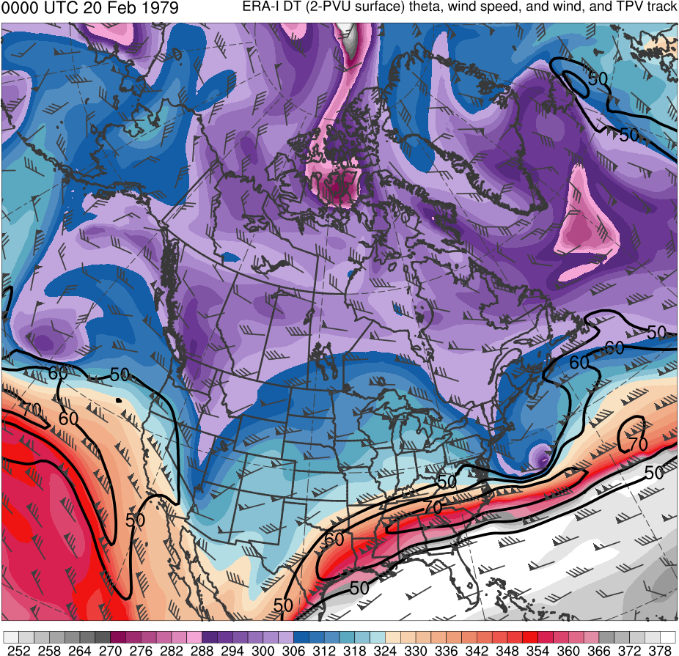
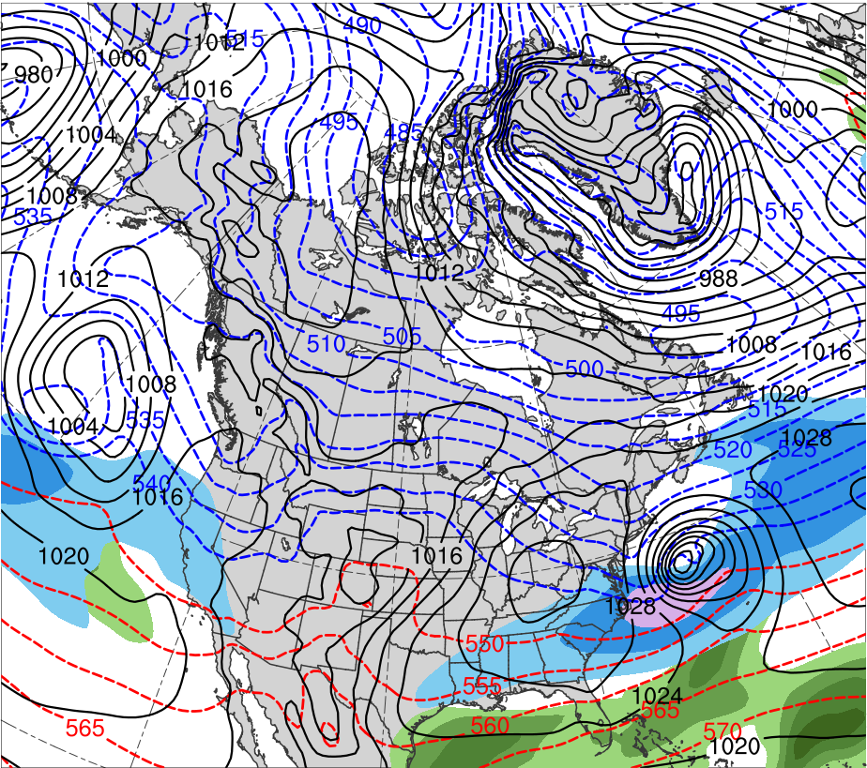
President’s Day Storm of 1979
0000 UTC 20 Feb 1979
Data Source: ERA-Interim
CTD
L
(K)
252
258
264
270
276
282
288
294
300
306
312
318
324
330
336
342
348
354
360
366
372
378
(mm)
(m s⁻¹ )
25
30
35
40
45
50
55
50
60
70
80
90
100
110
120
Potential temperature (K, shaded), wind speed (black, every 10 m s⁻¹ starting at 50 m s⁻¹), and wind (m s⁻¹, flags and barbs) on 2-PVU surface
250-hPa wind speed (m s⁻¹, shaded),
1000–500-hPa thickness (dam, blue/red),
SLP (hPa, black), PW (mm, shaded)

Slide 41
TPV–Jet Interactions
TPVs may interact with the jet stream and lead to the formation and intensification of jet streaks (e.g., Pyle et al. 2004)

Slide 42
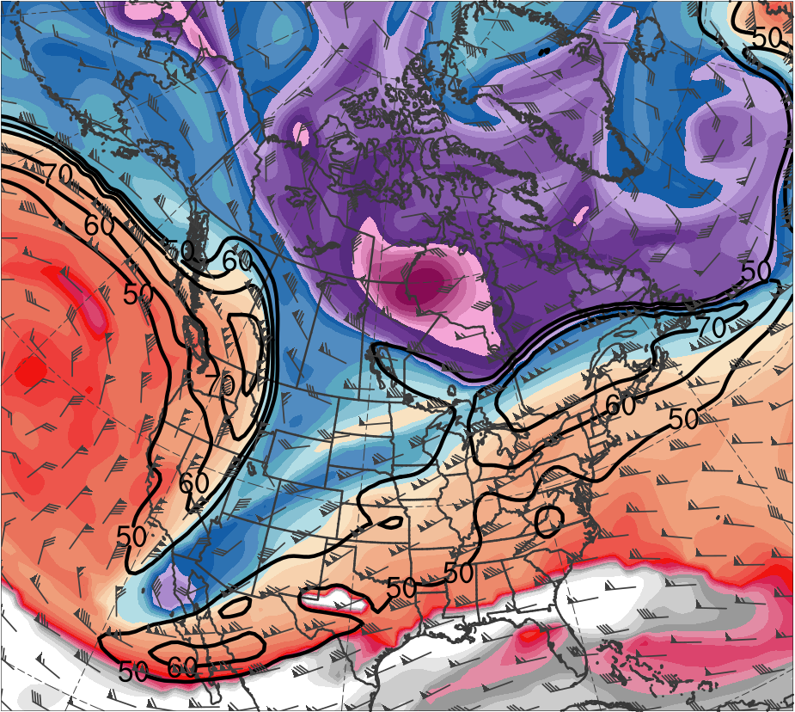
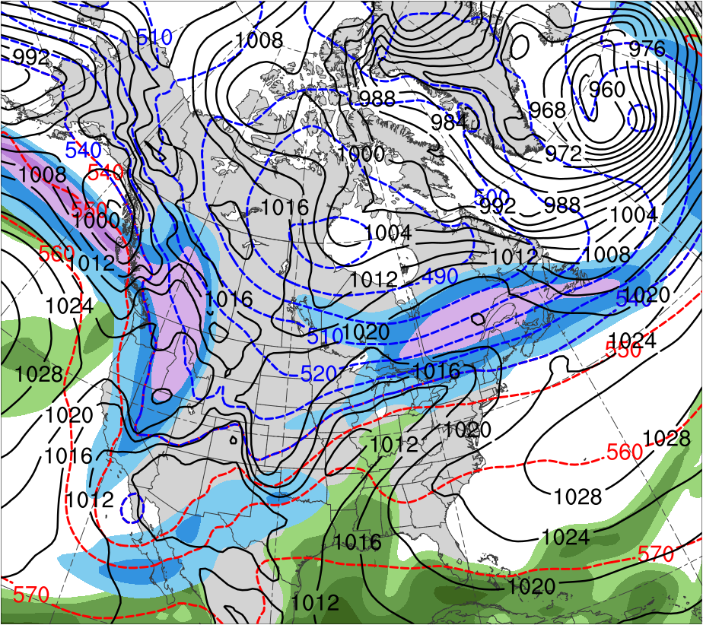
Dec 2013 “Uber Jet”
1200 UTC 20 Dec 2013
TPV
(K)
252
258
264
270
276
282
288
294
300
306
312
318
324
330
336
342
348
354
360
366
372
378
(m s⁻¹ )
(mm)
50
60
70
80
90
100
110
120
25
30
35
40
45
50
55
Potential temperature (K, shaded), wind speed (black, every 10 m s⁻¹ starting at 50 m s⁻¹), and wind (m s⁻¹, flags and barbs) on 2-PVU surface
250-hPa wind speed (m s⁻¹, shaded),
1000–500-hPa thickness (dam, blue/red),
SLP (hPa, black), PW (mm, shaded)

Slide 43
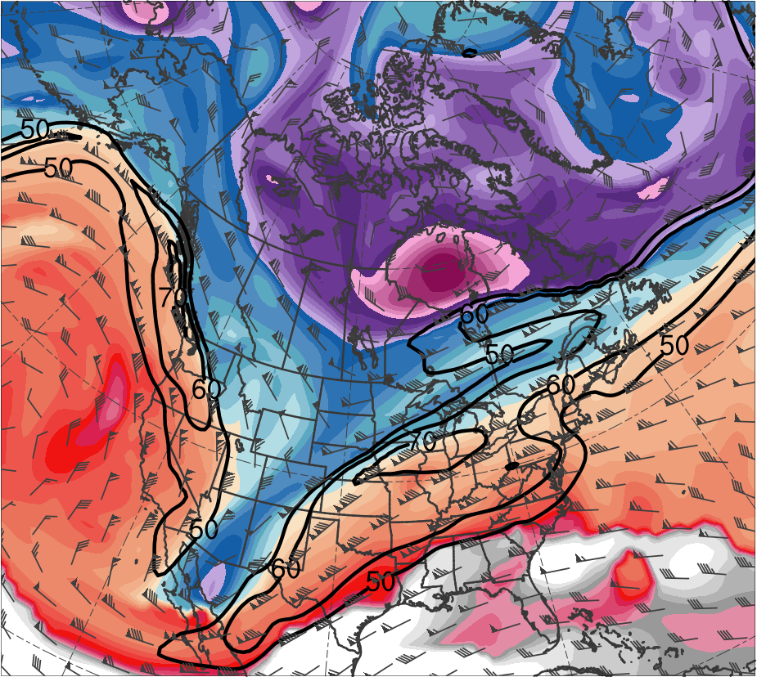
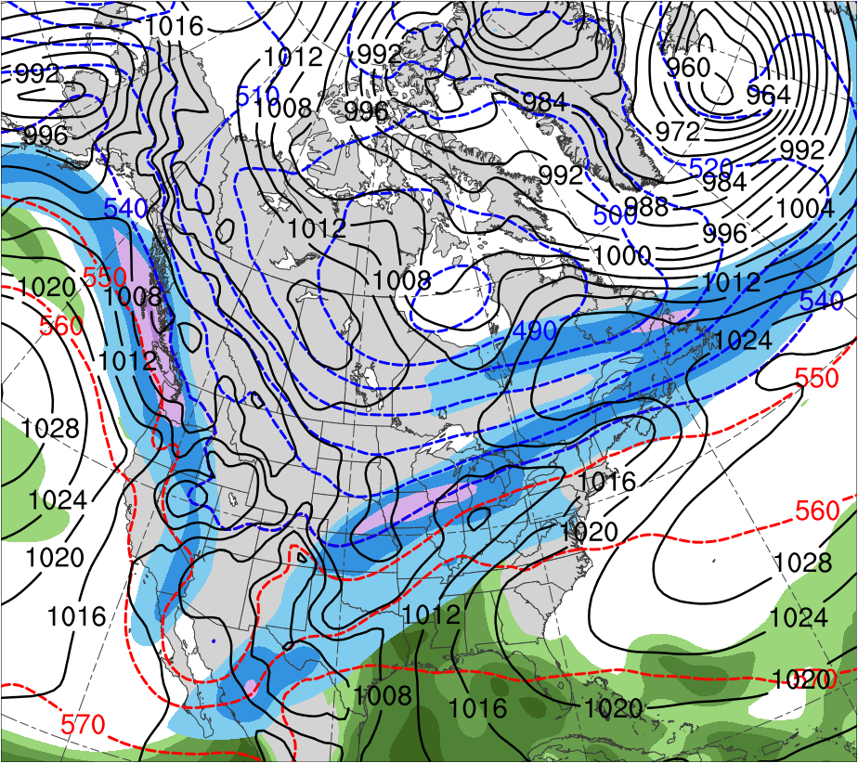
Dec 2013 “Uber Jet”
0000 UTC 21 Dec 2013
TPV
(K)
252
258
264
270
276
282
288
294
300
306
312
318
324
330
336
342
348
354
360
366
372
378
(m s⁻¹ )
(mm)
50
60
70
80
90
100
110
120
25
30
35
40
45
50
55
Potential temperature (K, shaded), wind speed (black, every 10 m s⁻¹ starting at 50 m s⁻¹), and wind (m s⁻¹, flags and barbs) on 2-PVU surface
250-hPa wind speed (m s⁻¹, shaded),
1000–500-hPa thickness (dam, blue/red),
SLP (hPa, black), PW (mm, shaded)

Slide 44
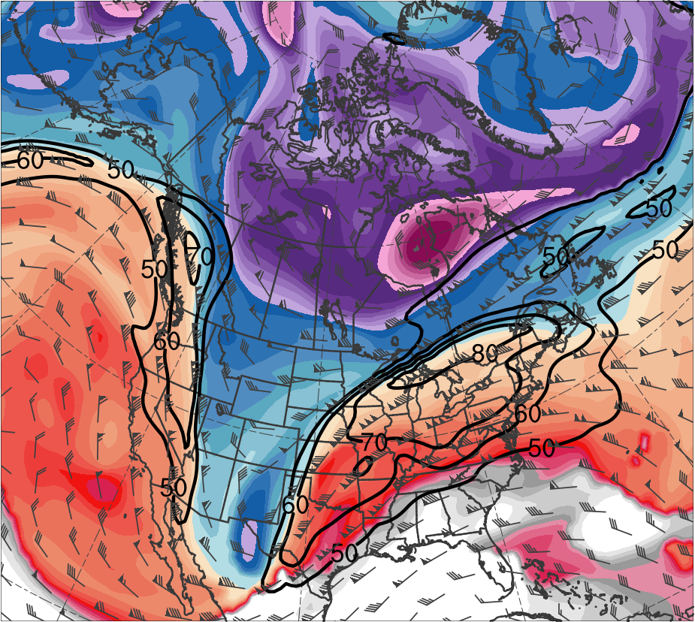
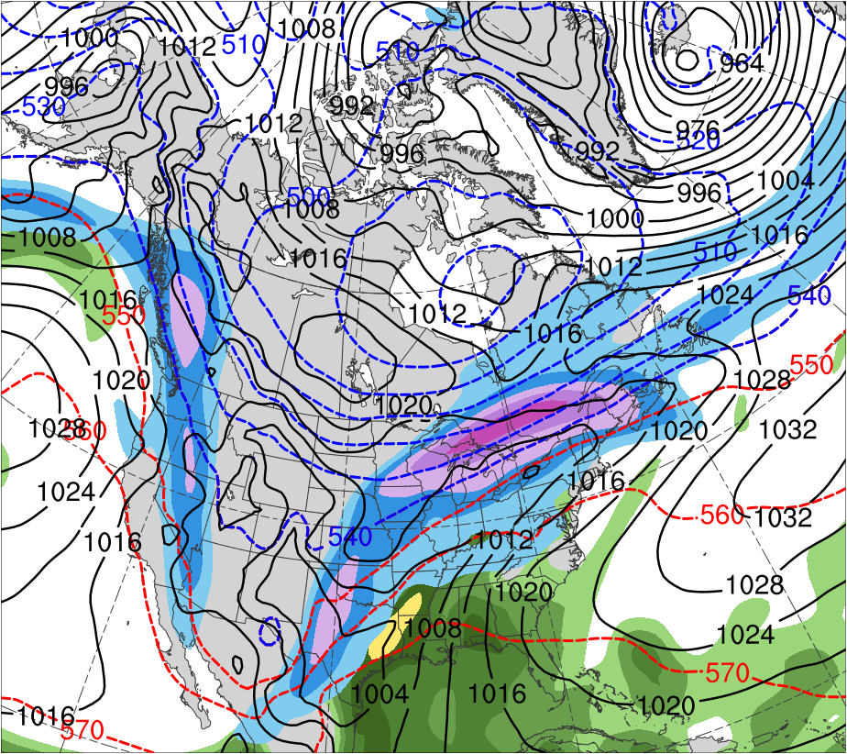
Dec 2013 “Uber Jet”
1200 UTC 21 Dec 2013
TPV
(K)
252
258
264
270
276
282
288
294
300
306
312
318
324
330
336
342
348
354
360
366
372
378
(m s⁻¹ )
(mm)
50
60
70
80
90
100
110
120
25
30
35
40
45
50
55
Potential temperature (K, shaded), wind speed (black, every 10 m s⁻¹ starting at 50 m s⁻¹), and wind (m s⁻¹, flags and barbs) on 2-PVU surface
250-hPa wind speed (m s⁻¹, shaded),
1000–500-hPa thickness (dam, blue/red),
SLP (hPa, black), PW (mm, shaded)

Slide 45
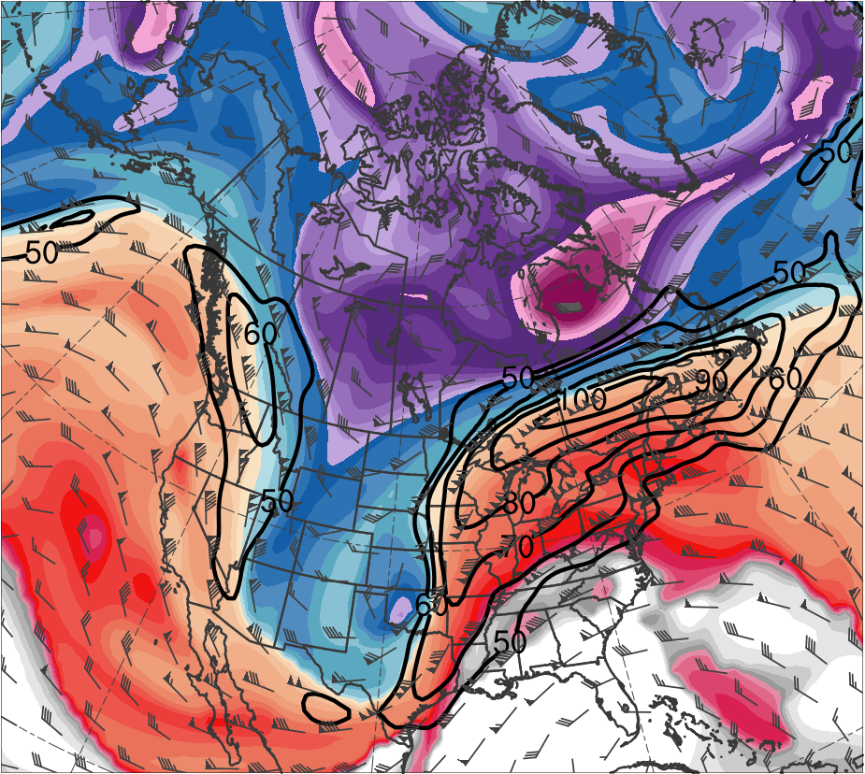
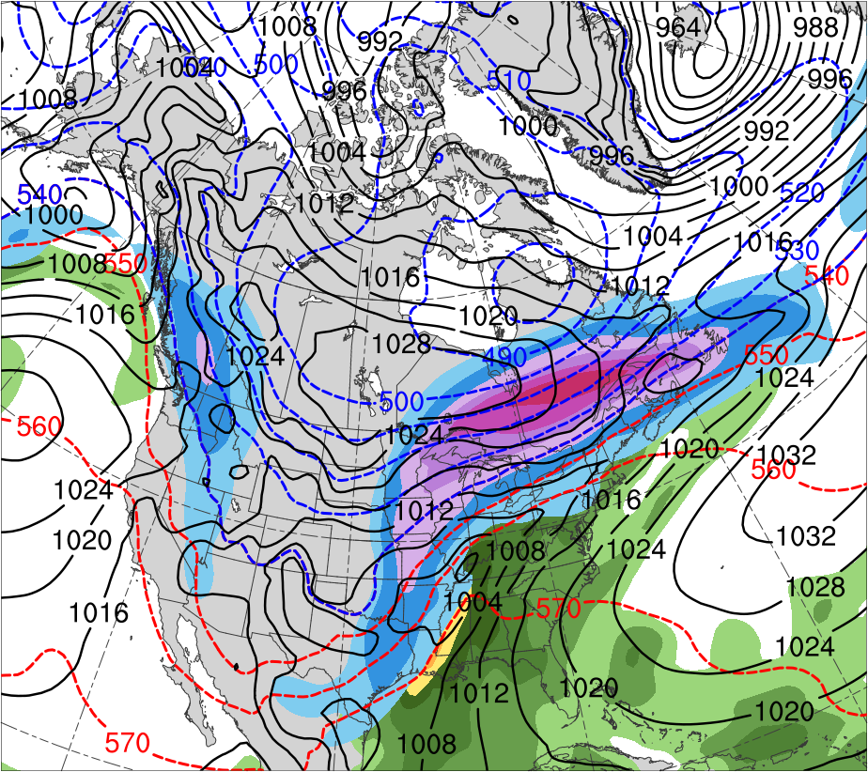
Dec 2013 “Uber Jet”
0000 UTC 22 Dec 2013
TPV
(K)
252
258
264
270
276
282
288
294
300
306
312
318
324
330
336
342
348
354
360
366
372
378
(m s⁻¹ )
(mm)
50
60
70
80
90
100
110
120
25
30
35
40
45
50
55
Potential temperature (K, shaded), wind speed (black, every 10 m s⁻¹ starting at 50 m s⁻¹), and wind (m s⁻¹, flags and barbs) on 2-PVU surface
250-hPa wind speed (m s⁻¹, shaded),
1000–500-hPa thickness (dam, blue/red),
SLP (hPa, black), PW (mm, shaded)

Slide 46
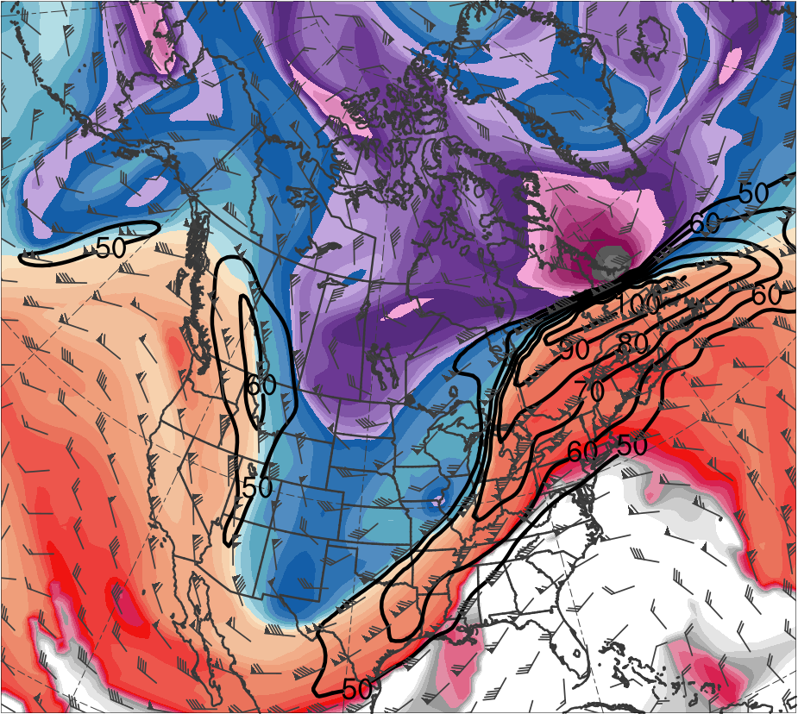
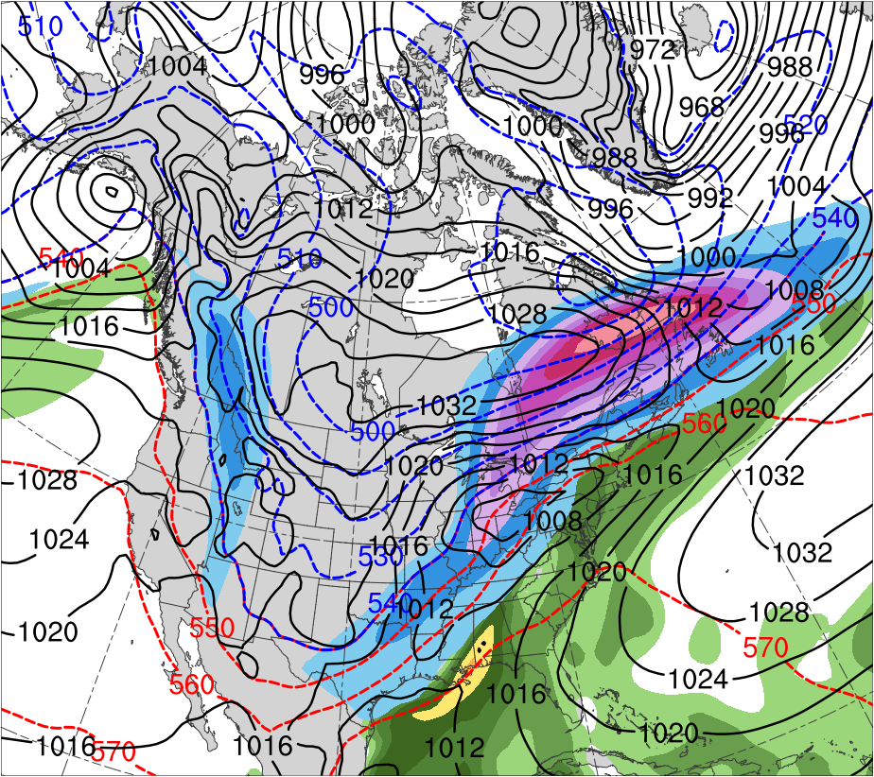
Dec 2013 “Uber Jet”
1200 UTC 22 Dec 2013
TPV
(K)
252
258
264
270
276
282
288
294
300
306
312
318
324
330
336
342
348
354
360
366
372
378
(m s⁻¹ )
(mm)
50
60
70
80
90
100
110
120
25
30
35
40
45
50
55
Potential temperature (K, shaded), wind speed (black, every 10 m s⁻¹ starting at 50 m s⁻¹), and wind (m s⁻¹, flags and barbs) on 2-PVU surface
250-hPa wind speed (m s⁻¹, shaded),
1000–500-hPa thickness (dam, blue/red),
SLP (hPa, black), PW (mm, shaded)

Slide 47
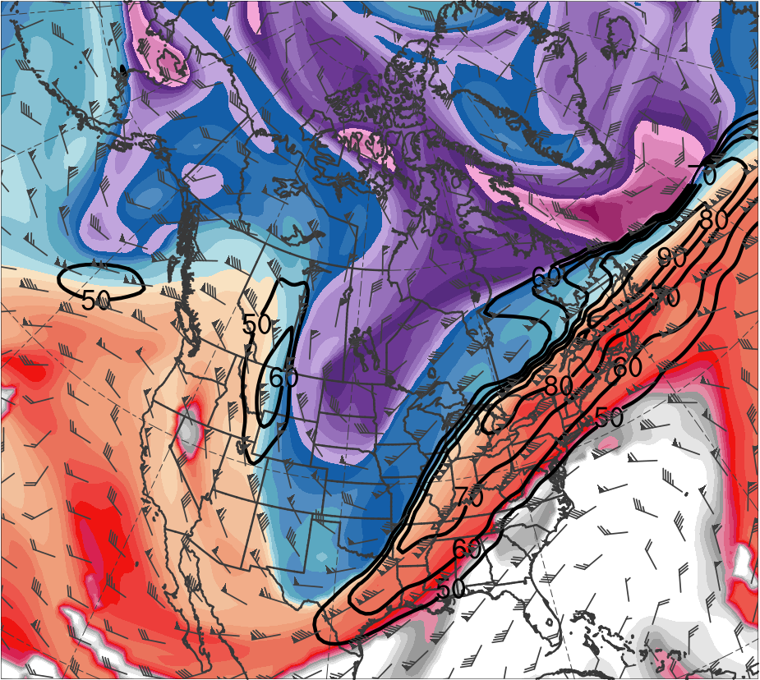
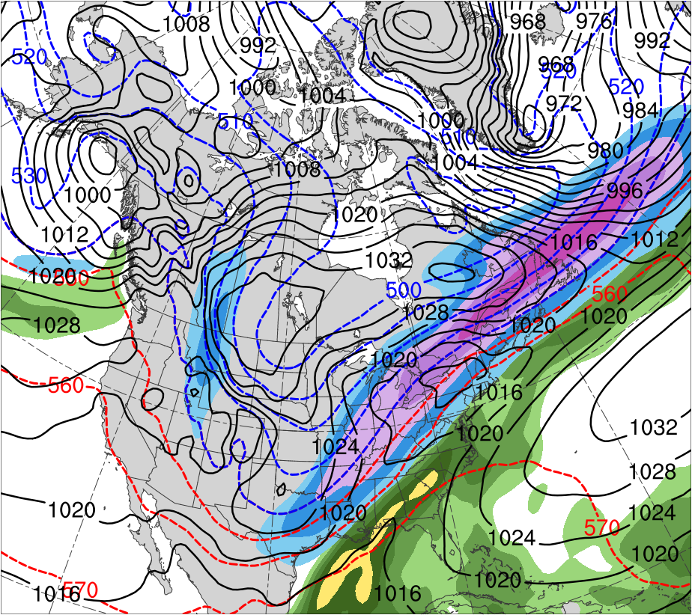
Dec 2013 “Uber Jet”
0000 UTC 23 Dec 2013
TPV
(K)
252
258
264
270
276
282
288
294
300
306
312
318
324
330
336
342
348
354
360
366
372
378
(m s⁻¹ )
(mm)
50
60
70
80
90
100
110
120
25
30
35
40
45
50
55
Potential temperature (K, shaded), wind speed (black, every 10 m s⁻¹ starting at 50 m s⁻¹), and wind (m s⁻¹, flags and barbs) on 2-PVU surface
250-hPa wind speed (m s⁻¹, shaded),
1000–500-hPa thickness (dam, blue/red),
SLP (hPa, black), PW (mm, shaded)

Slide 48
TPVs and CAOs
TPVs may be associated with CAOs (e.g., Shapiro et al. 1987; Biernat 2017)
Temperature anomaly (K)
Figure 9 adapted from Cavallo and Hakim (2010).

Slide 49
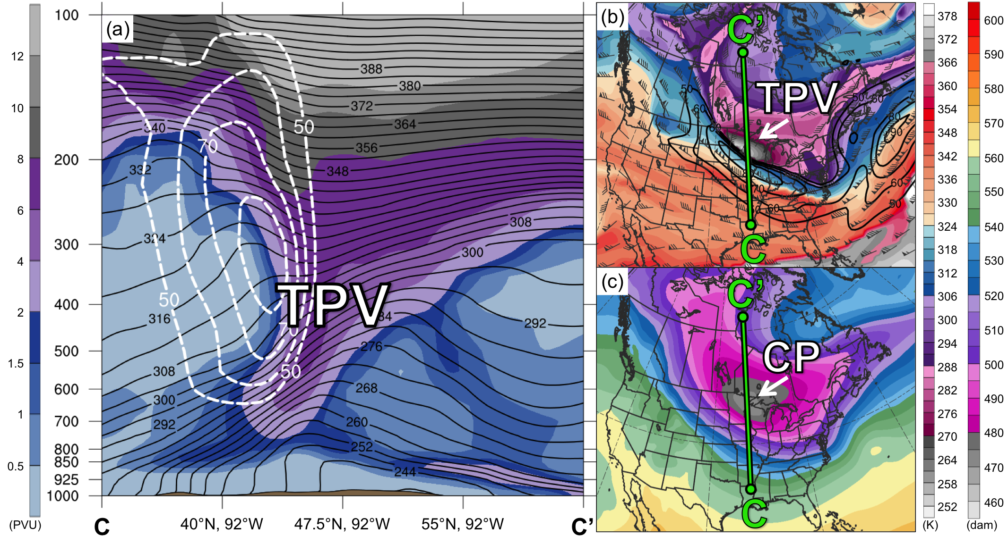
9–11 Jan 1982 CAO
0000 UTC 10 Jan 1982
PV (PVU, shaded), θ (K, black), and wind speed (dashed white, m s⁻¹);
(b) DT (2-PVU surface) θ (K, shaded), wind speed (black, m s⁻¹), and wind (m s⁻¹, flags and barbs);
(c) 1000–500-hPa thickness (dam, shaded); “CP” denotes cold pool

Slide 50
Polar Lows and Arctic Cyclones
Polar Lows
Arctic Cyclones
Mesoscale maritime cyclones of horizontal scales from 10s to 100s of km, often characterized by short lifetimes and rapid evolution (e.g., Smirnova et al. 2015)
Synoptic-scale cyclones, usually larger in size and longer lived than polar lows (e.g., Zhang et al. 2004)
Size and Duration

Slide 51
Polar Lows and Arctic Cyclones
Polar Lows
Arctic Cyclones
Mesoscale maritime cyclones of horizontal scales from 10s to 100s of km, often characterized by short lifetimes and rapid evolution (e.g., Smirnova et al. 2015)
Synoptic-scale cyclones, usually larger in size and longer lived than polar lows (e.g., Zhang et al. 2004)
Size and Duration
Often form within a cold air mass or along an Arctic front at the leading edge of a cold air mass moving over warmer sea surfaces in high latitudes (e.g., Rasmussen and Turner 2003)
Either form within the Arctic or move into the Arctic from lower latitudes (e.g., Zhang et al. 2004; Crawford and Serreze 2016)
Location

Slide 52
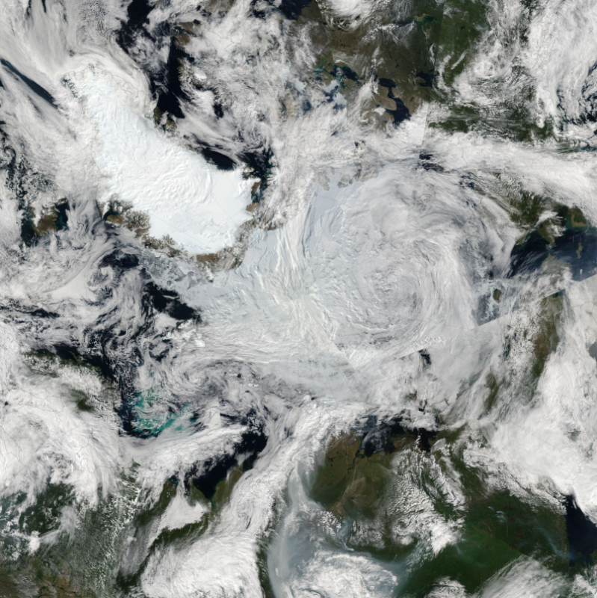
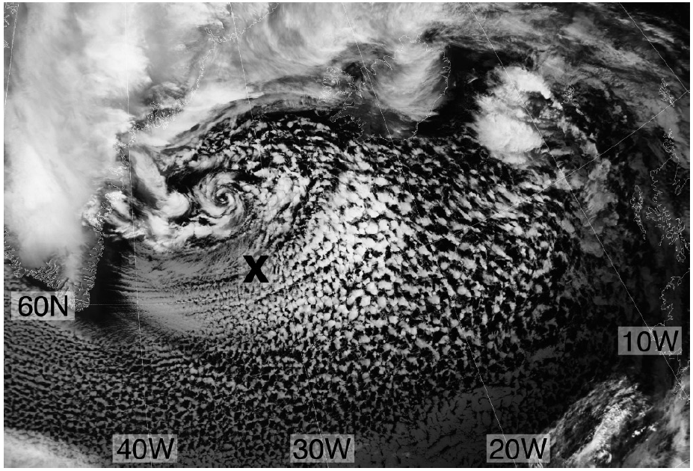
Polar Lows and Arctic Cyclones
Example Arctic Cyclone
Canada
Example Polar Low
Greenland
Greenland
Russia
Satellite image valid 1209 UTC 2 March 2009. Figure 2 adapted from Kolstad (2011).
Satellite image of the Great Arctic Cyclone of August 2012 from 7 August 2012. Obtained from: https://earthobservatory.nasa.gov/NaturalHazards/view.php?id=78812

Slide 53
Polar Lows and Arctic Cyclones
Strong surface winds, large waves, and heavy precipitation that may be associated with polar lows (e.g., Rasmussen and Turner 2003) and Arctic cyclones (e.g., Parkinson and Comiso 2013) may pose hazards to shipping, infrastructure, and coastal communities
Strong surface winds and poleward advection of warm, moist air associated with Arctic cyclones may contribute reductions in Arctic sea-ice extent (e.g., Zhang et al. 2013)
TPVs may play important roles in the development of polar lows (e.g., Bracegirdle and Gray 2009) and Arctic cyclones (e.g., Simmonds and Rudeva 2012)

Slide 54
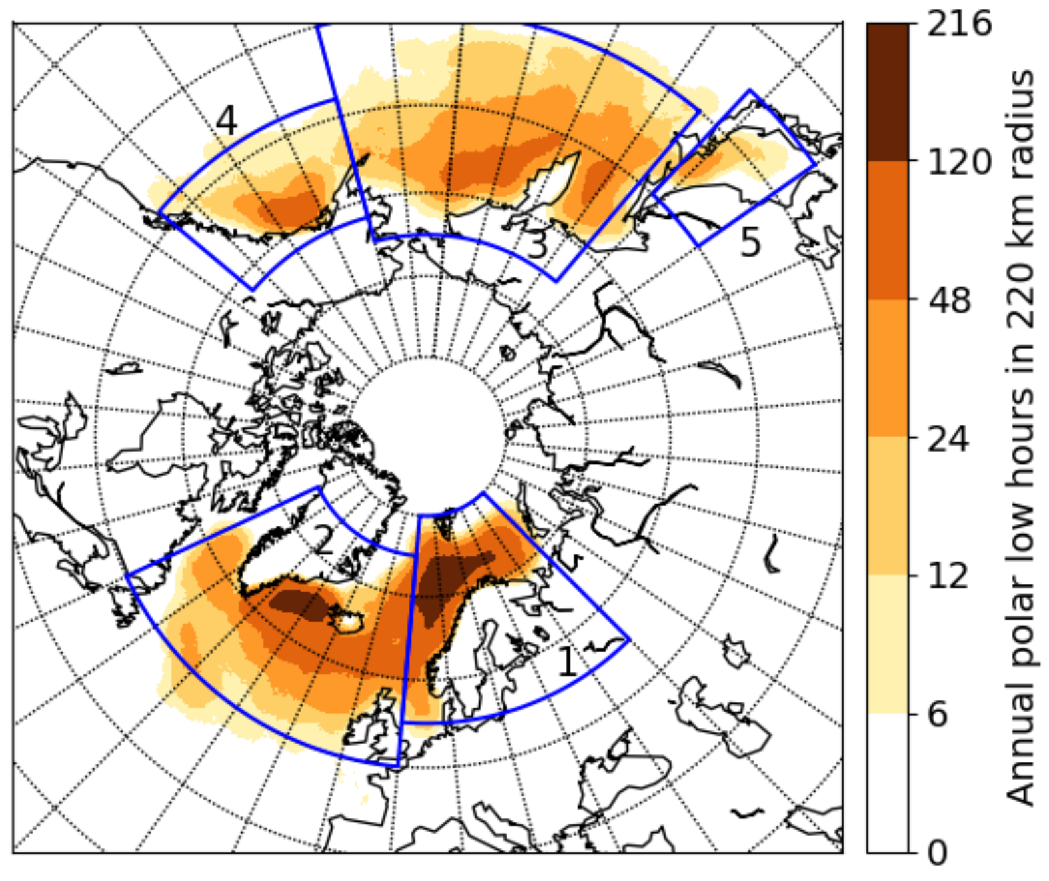
Polar Lows
Polar lows occur in all high-latitude marine basins
Spatial distribution of the average annual polar low hours for the Arctic System Reanalysis v1 during 2000–2012. Figure 5 adapted from Stoll et al. (2018).

Slide 55
Polar Lows
The Norwegian and Barents Seas is a favorable region for polar low development
Spatial distribution of the average annual polar low hours for the Arctic System Reanalysis v1 during 2000–2012. Figure 5 adapted from Stoll et al. (2018).

Slide 56
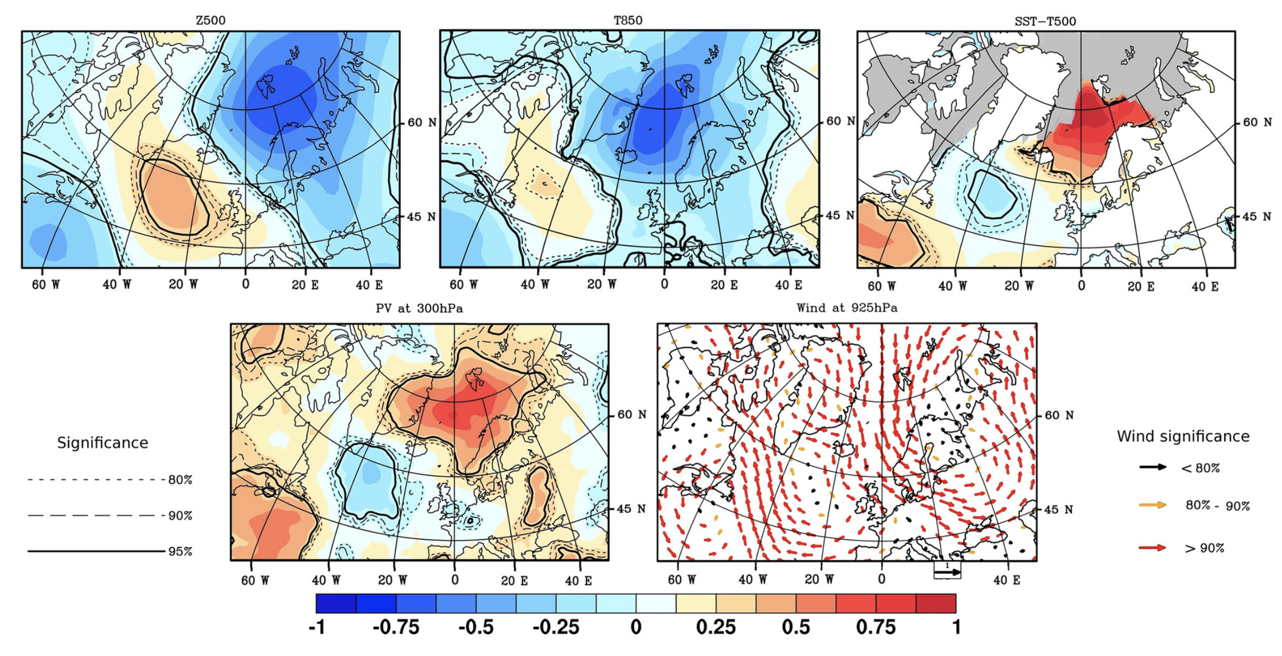
Polar Lows
(a) 500-hPa Geopotential Height
(b) 850-hPa Temperature
(c) SST−T500
(d) 300-hPa PV
(e) 925-hPa Wind
Maximum monthly sea-ice extent (1979–2007)
Significance
Wind Significance
80%
<80%
90%
80–90%
95%
>90%
Composite standardized anomalies for date of formation of 134 polar lows from Noer et al. (2011) occurring during the months of October–March during 1999–2011. Data source: ERA-Interim. Figure 2 adapted from Mallet et al. (2013).

Slide 57
Polar Lows
(a) 500-hPa Geopotential Height
(b) 850-hPa Temperature
(c) SST−T500
(d) 300-hPa PV
(e) 925-hPa Wind
Maximum monthly sea-ice extent (1979–2007)
Significance
Wind Significance
80%
<80%
90%
80–90%
95%
>90%
Composite standardized anomalies for date of formation of 134 polar lows from Noer et al. (2011) occurring during the months of October–March during 1999–2011. Data source: ERA-Interim. Figure 2 adapted from Mallet et al. (2013).

Slide 58
Polar Lows
CAOs occurring over relatively warm waters may provide favorable thermodynamic environment for polar low development (e.g., Emanuel and Rotunno 1989; Kolstad 2011)
CAOs in combination with strong surface winds may lead to large surface sensible and latent heat fluxes, which may lead to reductions in lower-tropospheric stability

Slide 59
Polar Lows
(a) 500-hPa Geopotential Height
(b) 850-hPa Temperature
(c) SST−T500
(d) 300-hPa PV
(e) 925-hPa Wind
Maximum monthly sea-ice extent (1979–2007)
Significance
Wind Significance
80%
<80%
90%
80–90%
95%
>90%
Composite standardized anomalies for date of formation of 134 polar lows from Noer et al. (2011) occurring during the months of October–March during 1999–2011. Data source: ERA-Interim. Figure 2 adapted from Mallet et al. (2013).

Slide 60
Polar Lows
Anomalous northerly flow from Arctic sea ice to the open waters of the Norwegian and Barents Sea may support strong low-level baroclinicity (e.g., Businger 1985)
Baroclinicity has been shown to be an important ingredient for polar low development (e.g., Harrold and Browning 1969; Reed 1979)
Baroclinic zones may be associated with relatively strong low-level cyclonic relative vorticity and convergence (e.g., Shapiro and Fedor 1989)

Slide 61
Polar Lows
(a) 500-hPa Geopotential Height
(b) 850-hPa Temperature
(c) SST−T500
(d) 300-hPa PV
(e) 925-hPa Wind
Maximum monthly sea-ice extent (1979–2007)
Significance
Wind Significance
80%
<80%
90%
80–90%
95%
>90%
Fig. 3. Composite standardized anomalies for date of formation of 134 polar lows from Noer et al. (2011) occurring during the months of October–March during 1999–2011. Data source: ERA-Interim. Figure 2 adapted from Mallet et al. (2013).

Slide 62
Polar Lows
Upper-level cyclonic PV anomalies, which may include TPVs associated with CAOs, may:
Provide upper-level forcing for ascent over polar lows (e.g., Bracegirdle and Gray 2009)
Become vertically coupled with polar lows (e.g., Føre et al. 2011; Sergeev et al. 2018)
Destabilize the lower troposphere (e.g., Mallet et al. 2013)

Slide 63
Polar Lows
Favorable ingredients for polar low development may support relatively strong upward vertical motions and stratiform and convective precipitation
Associated latent heat release may contribute to polar low development by, for example, leading to low-level PV production and intensification of the polar low (e.g. Montgomery and Farrell 1992)

Slide 64
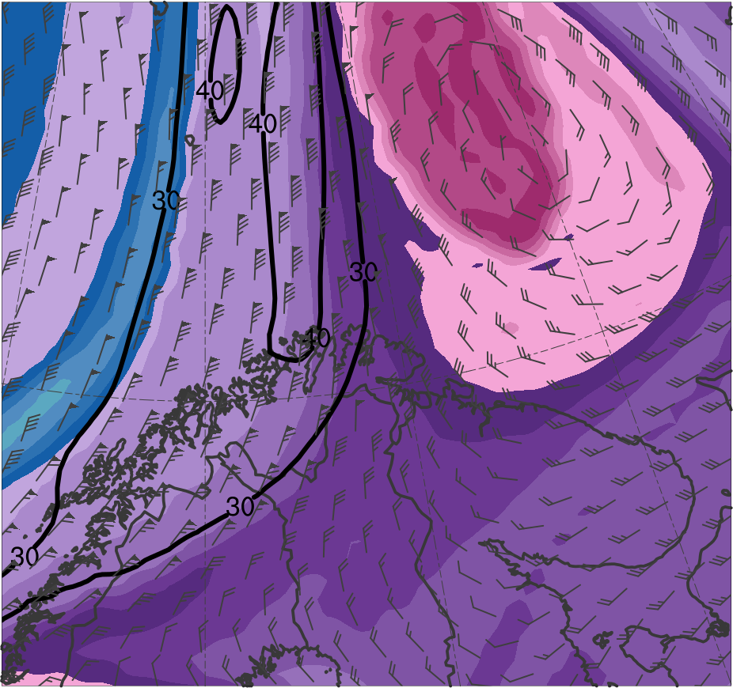
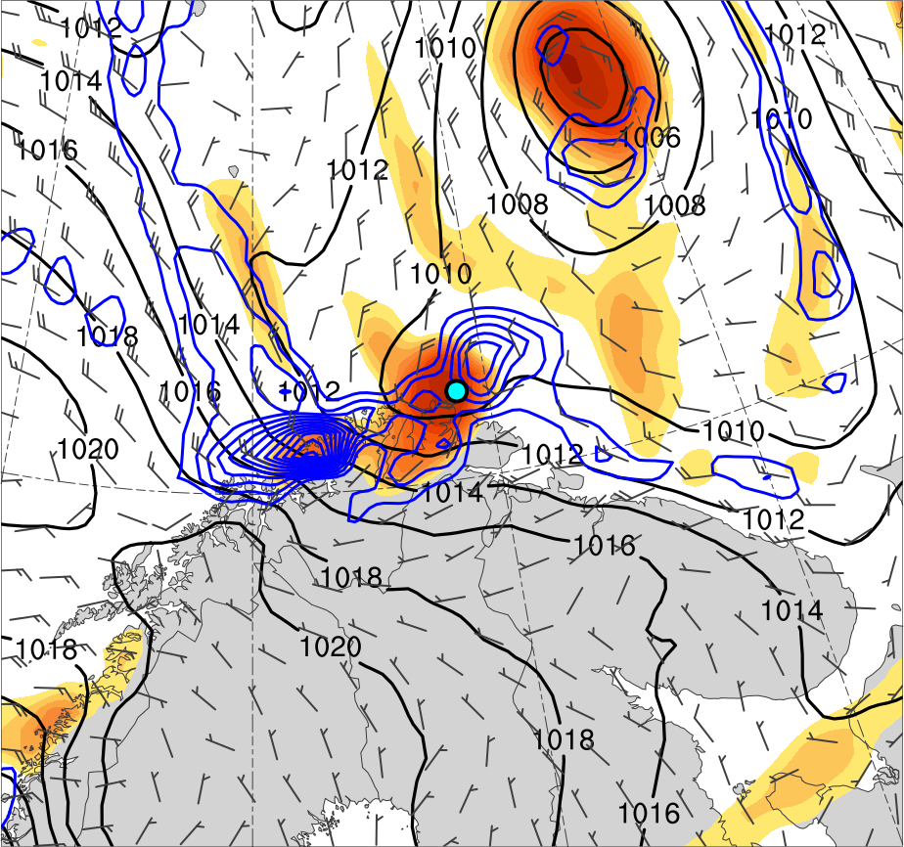
Polar Low Example
1800 UTC 10 Feb 2011
TPV
PL
(K)
252
258
264
270
276
282
288
294
300
306
312
318
324
330
336
342
348
354
360
366
372
378
4
6
8
10
12
14
16
18
20
25
30
35
40
Potential temperature (K, shaded), wind speed (black, every 10 m s⁻¹ starting at 30 m s⁻¹), and wind (m s⁻¹, flags and barbs) on 2-PVU surface
850-hPa relative vorticity (10⁻⁵ s⁻¹, shaded),
850–600-hPa ascent (blue, every 2.5 × 10⁻³ hPa s⁻¹),
SLP (hPa, black), and 10-m wind (m s⁻¹, barbs)

Slide 65
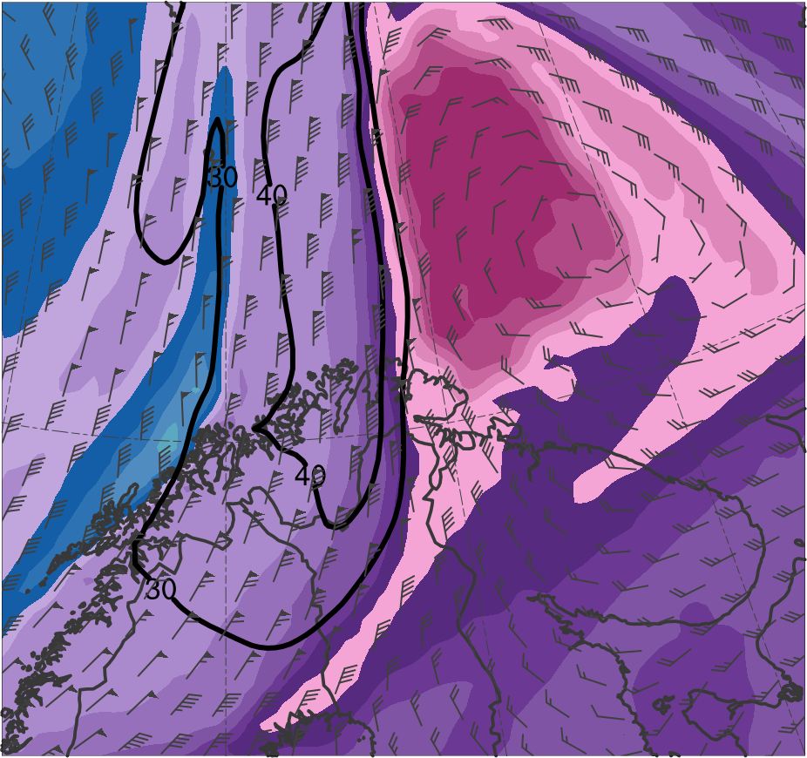
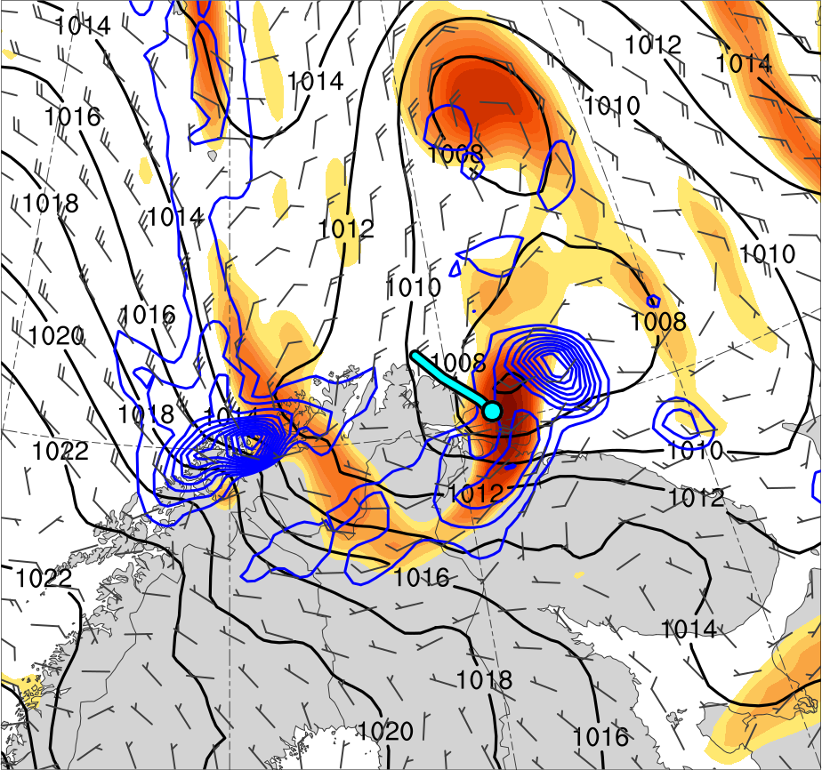
Polar Low Example
0000 UTC 11 Feb 2011
TPV
PL
(K)
252
258
264
270
276
282
288
294
300
306
312
318
324
330
336
342
348
354
360
366
372
378
4
6
8
10
12
14
16
18
20
25
30
35
40
Potential temperature (K, shaded), wind speed (black, every 10 m s⁻¹ starting at 30 m s⁻¹), and wind (m s⁻¹, flags and barbs) on 2-PVU surface
850-hPa relative vorticity (10⁻⁵ s⁻¹, shaded),
850–600-hPa ascent (blue, every 2.5 × 10⁻³ hPa s⁻¹),
SLP (hPa, black), and 10-m wind (m s⁻¹, barbs)

Slide 66
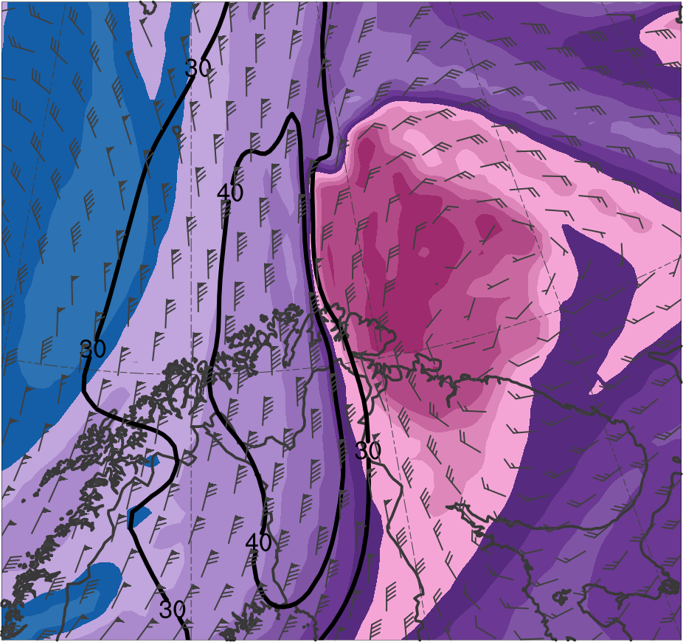
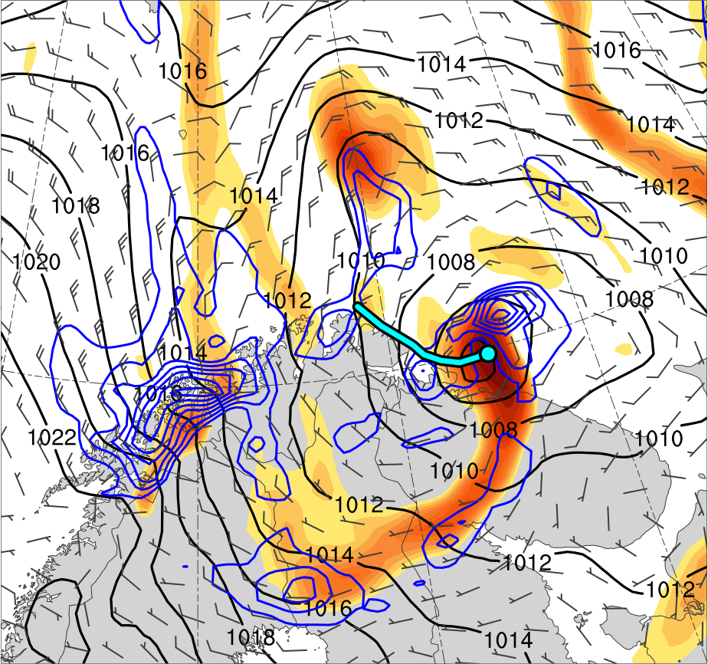
Polar Low Example
0600 UTC 11 Feb 2011
TPV
PL
(K)
252
258
264
270
276
282
288
294
300
306
312
318
324
330
336
342
348
354
360
366
372
378
4
6
8
10
12
14
16
18
20
25
30
35
40
Potential temperature (K, shaded), wind speed (black, every 10 m s⁻¹ starting at 30 m s⁻¹), and wind (m s⁻¹, flags and barbs) on 2-PVU surface
850-hPa relative vorticity (10⁻⁵ s⁻¹, shaded),
850–600-hPa ascent (blue, every 2.5 × 10⁻³ hPa s⁻¹),
SLP (hPa, black), and 10-m wind (m s⁻¹, barbs)

Slide 67
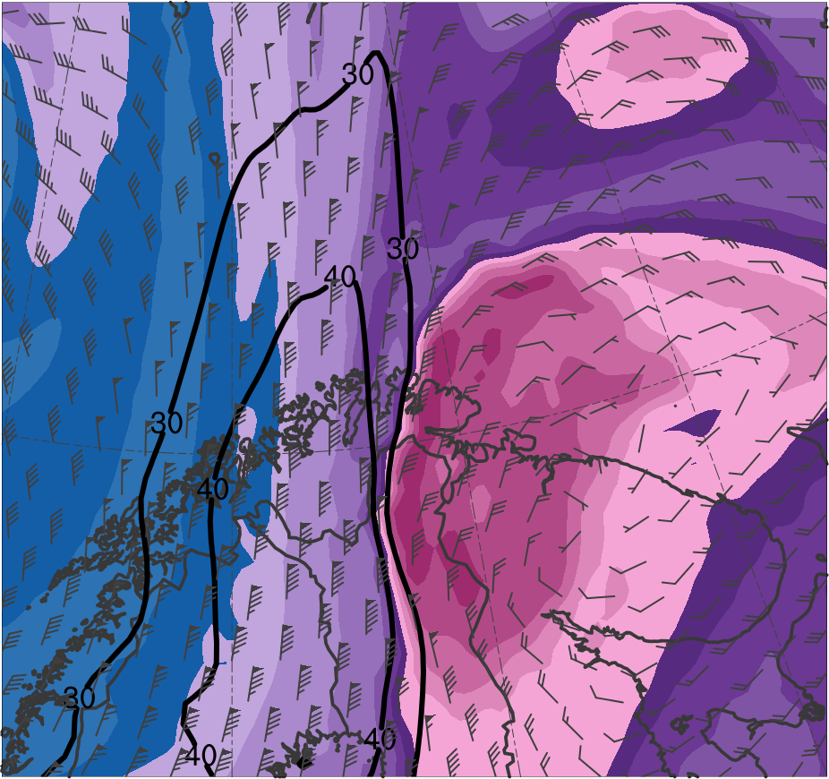
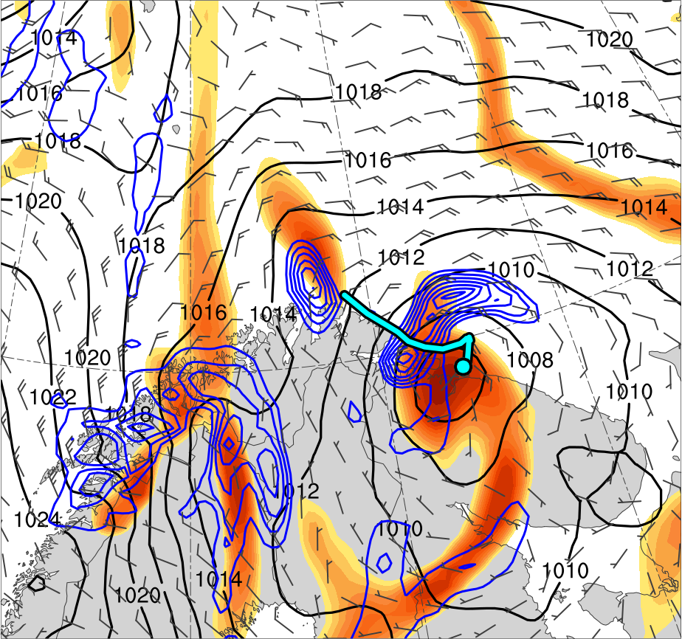
Polar Low Example
1200 UTC 11 Feb 2011
TPV
PL
(K)
252
258
264
270
276
282
288
294
300
306
312
318
324
330
336
342
348
354
360
366
372
378
4
6
8
10
12
14
16
18
20
25
30
35
40
Potential temperature (K, shaded), wind speed (black, every 10 m s⁻¹ starting at 30 m s⁻¹), and wind (m s⁻¹, flags and barbs) on 2-PVU surface
850-hPa relative vorticity (10⁻⁵ s⁻¹, shaded),
850–600-hPa ascent (blue, every 2.5 × 10⁻³ hPa s⁻¹),
SLP (hPa, black), and 10-m wind (m s⁻¹, barbs)

Slide 68
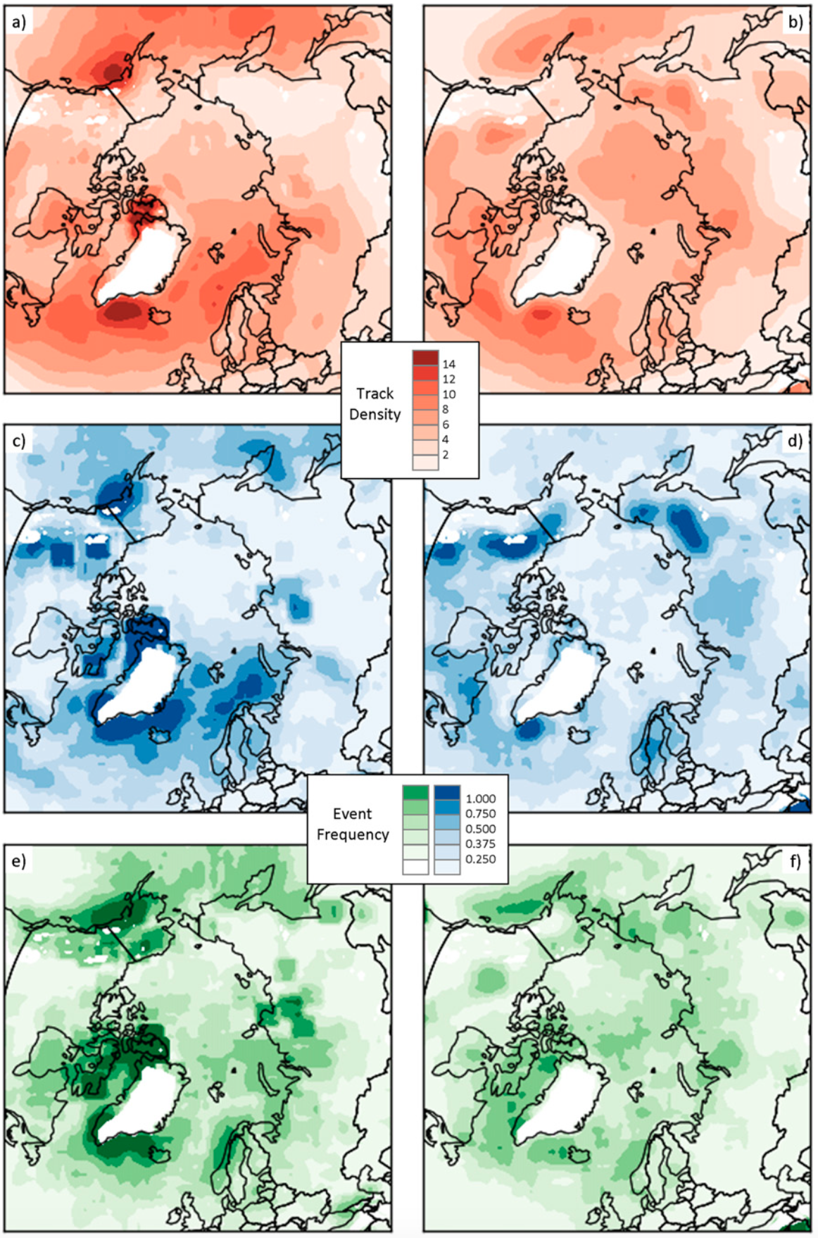
Arctic Cyclones
Winter
Summer
Arctic cyclones may originate within and outside of Arctic
~30–40% of Arctic cyclones originate within Arctic during both winter and summer
During winter, Arctic cyclones often originate from North Atlantic
During summer, Arctic cyclones often originate from Eurasia
Track Density
Genesis Frequency
Lysis Frequency
Figure 3 adapted from Crawford and Serreze (2016)

Slide 69
Arctic Cyclones
TPVs, baroclinic processes, and latent heating may play important roles in the evolution of Arctic cyclones
Strong Arctic cyclones (e.g., Simmonds and Rudeva 2014) and Arctic cyclones linked to extreme summer sea-ice loss events (e.g., Cavallo et al. 2017) have been shown to be frequently associated with TPVs
Simmonds and Rudeva (2012), Yamazaki et al. (2015), and Tao et al. (2017) illustrate that a TPV and baroclinic instability play an important role in the evolution of the Great Arctic Cyclone of August 2012 (AC12)

Slide 70
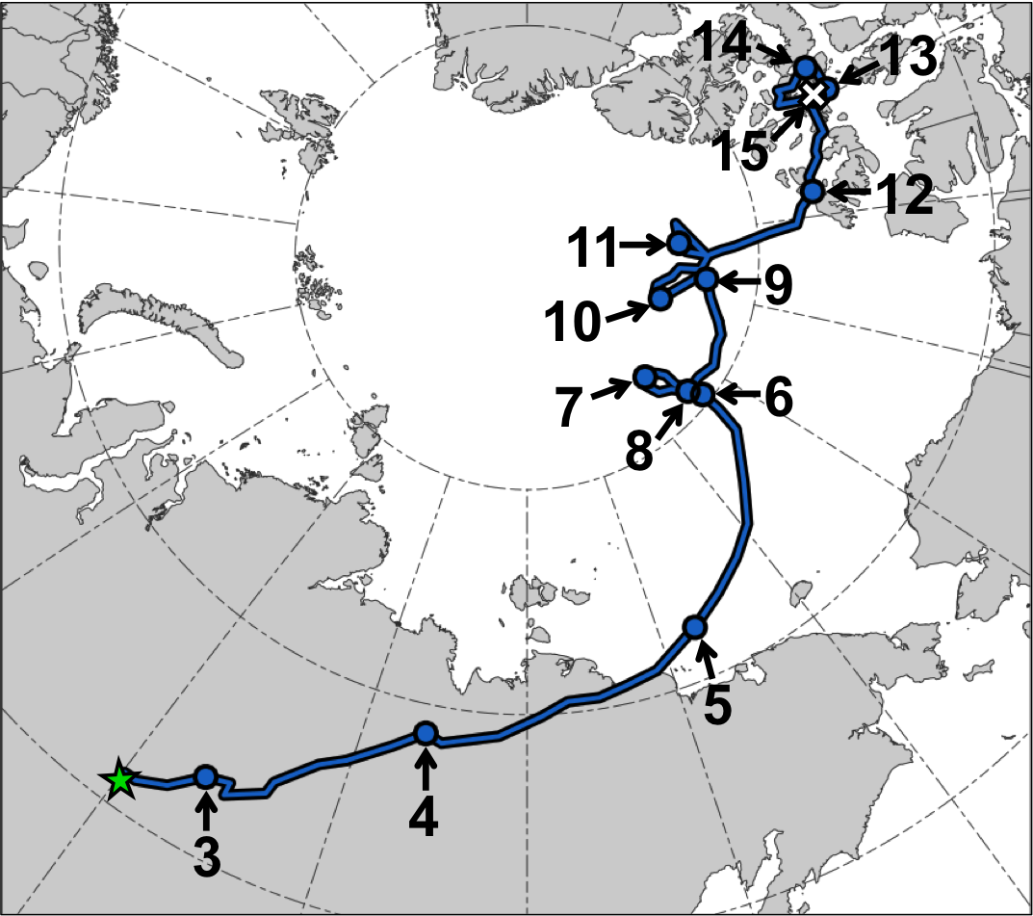
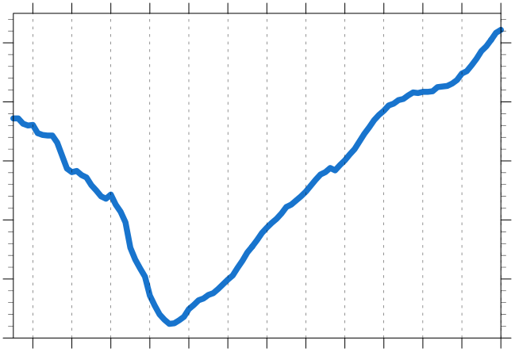
AC12
AC12 Track and Intensity
Minimum SLP (hPa) trace of AC12
1010
1000
990
980
970
960
3
4
5
6
7
8
9
10
11
12
13
14
15
Day in Aug 2012 (at 0000 UTC)
Genesis
Lysis
Manual tracking with ERA5 (0.3°; every 3 h)
1200 UTC 2–0000 UTC 15 Aug 2012

Slide 71
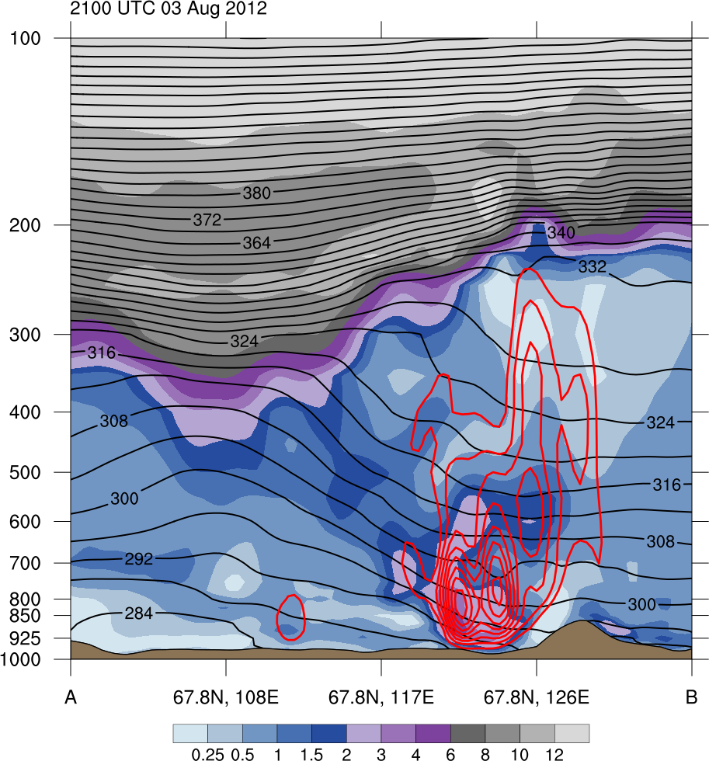
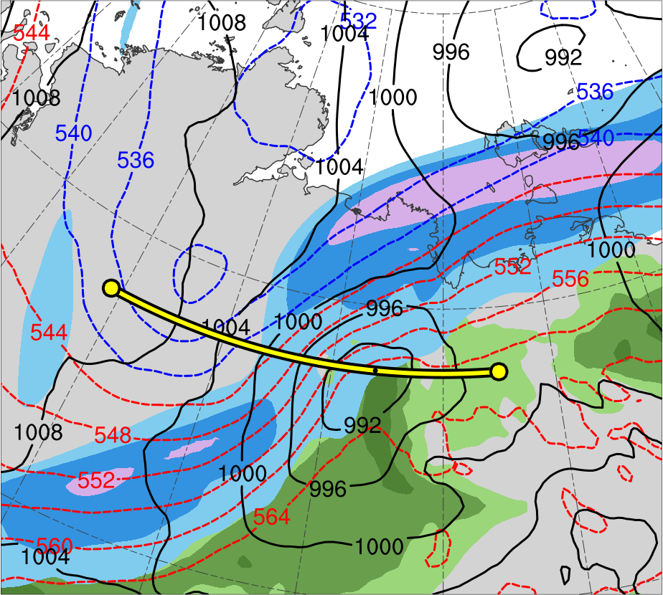
AC12
2100 UTC 3 Aug 2012
PV
(PVU)
(a)
(b)
12
10
A
8
A’
6
4
3
2
TPV
300-hPa wind speed (m s⁻¹)
1.5
30
40
50
60
70
80
90
100
PW (mm)
1
25
30
35
40
45
50
55
0.5
AC12
A
A’
Data Source: ERA5
(a) θ (K, black) and ascent (red, every 5 × 10⁻³ hPa s⁻¹);
(b) 1000–500-hPa thickness (dam, blue/red) and SLP (hPa, black)

Slide 72
AC12
Strong surface winds associated with AC12 helped to break up thin sea ice (e.g., Parkinson and Comiso 2013)
According to Zhang et al. (2013), sea-ice volume decreased twice as fast as normal during AC12 due to melting of the bottom and perimeter of ice floes

Slide 73
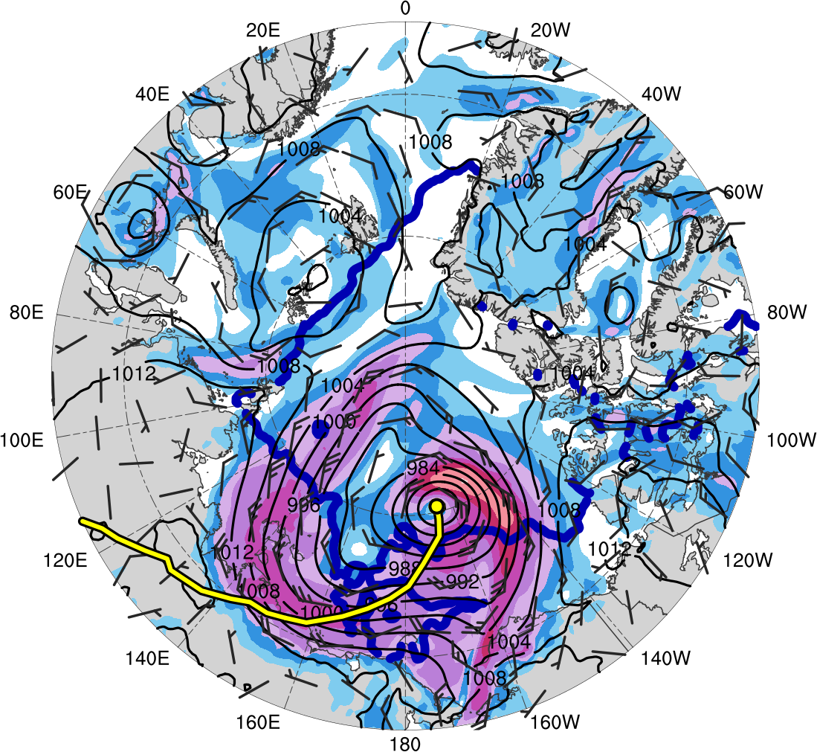
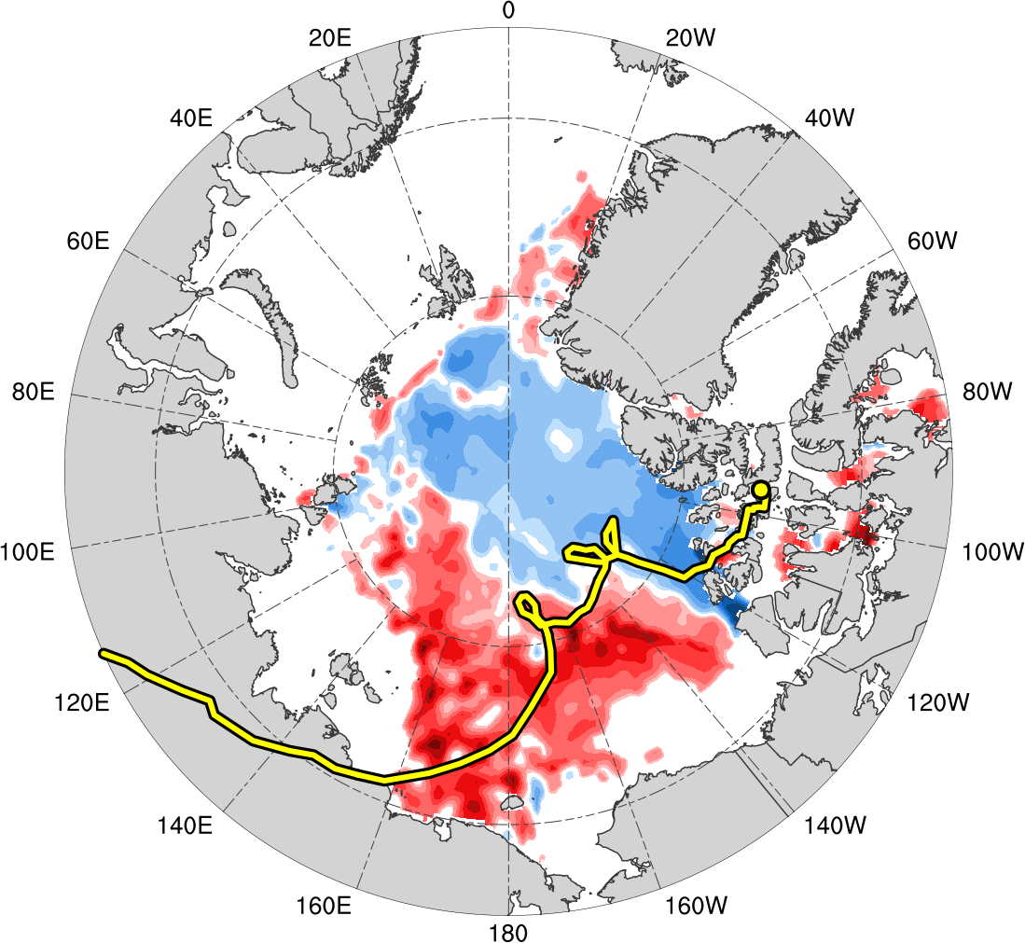
AC12
0000 UTC 6 Aug 2012
0000 UTC 14 Aug 2012
AC12
Data Source: ERA5
(m s⁻¹ )
(%)
4
6
8
10
12
14
16
18
-60
-50
-40
-30
-20
-10
-5
5
10
20
30
40
50
60
SLP (hPa, black); 10-m wind speed (m s⁻¹, shaded) and wind (m s⁻¹, black barbs), and 20% contour of sea-ice concentration (thick blue)
Change in sea-ice concentration (%, shaded) during 0000 UTC 2–0000 UTC 14 Aug 2012

