Slide 1
Linkages between Tropopause Polar Vortices and the Development of Extratropical Cyclones
Kevin A. Biernat
Department of Atmospheric and Environmental Sciences
University at Albany, SUNY
ATM 621: Structure and Dynamics of Extratropical Cyclones

Slide 2
Coherent Disturbances on the Dynamic Tropopause
Coherent tropopause disturbances (CTDs) are defined as a tropopause-based material features (Pyle et al. 2004)

Slide 3
Coherent Disturbances on the Dynamic Tropopause
Coherent tropopause disturbances (CTDs) are defined as a tropopause-based material features (Pyle et al. 2004)
Tropopause polar vortices (TPVs) are defined as tropopause-based vortices of high-latitude origin and are also material features (Cavallo and Hakim 2009, 2010)

Slide 4
Coherent Disturbances on the Dynamic Tropopause
Coherent tropopause disturbances (CTDs) are defined as a tropopause-based material features (Pyle et al. 2004)
Tropopause polar vortices (TPVs) are defined as tropopause-based vortices of high-latitude origin and are also material features (Cavallo and Hakim 2009, 2010)
Can be thought of as of a subset of CTDs
Typically have latitude restrictions [e.g., must spend at least 60% of lifetime poleward of 65°N for at least 2 days (Cavallo and Hakim 2010)]

Slide 5
Example of a TPV
Pyle et al. (2004)
TPV
TPV
(left) Dynamic tropopause (DT) wind speed (every 15 m s⁻¹ starting at 50 m s⁻¹, thick contours) and DT potential temperature (K, thin contours and shading) on 1.5-PVU surface valid 0000 UTC 1 Dec 1991; (right) same as left except DT pressure (hPa, thin contours and shading). Adapted from Fig. 11 in Pyle et al. (2004).

Slide 6
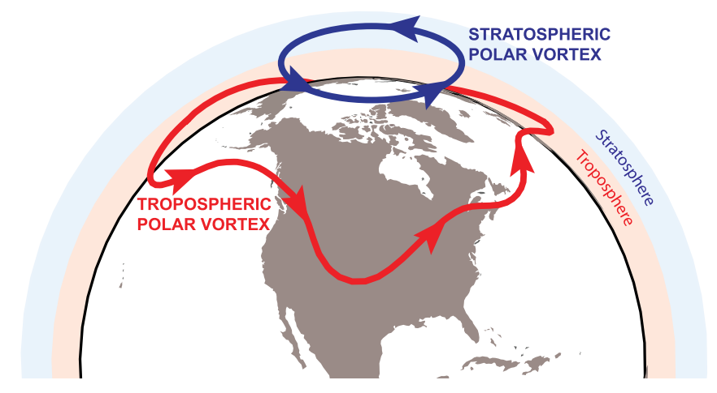
TPVs in Relation to the “Polar Vortex”
Waugh et al. (2017)
Schematic of stratospheric and tropospheric polar vortices. Adapted from Fig. 1 in Waugh et al. (2017)

Slide 7
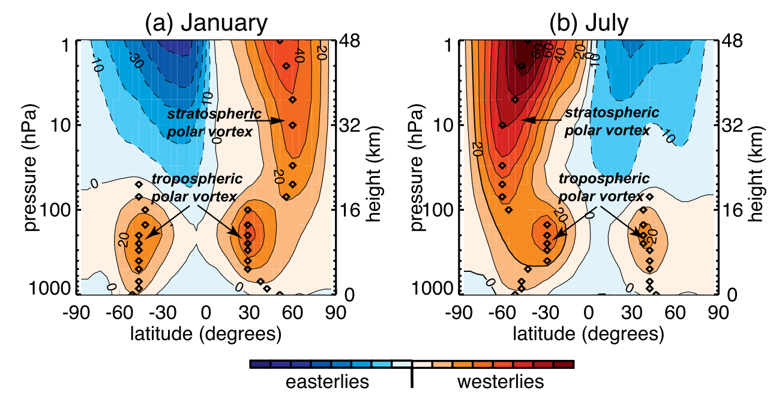
TPVs in Relation to the “Polar Vortex”
Waugh et al. (2017)
Climatological zonal-mean zonal wind for Jan and Jul. Diamonds mark hemispheric maximum of zonal wind at each pressure level and approximate edge of polar vortex for that hemisphere. Data source: National Oceanic and Atmospheric Administration (NOAA) and Climate Prediction Center (CPC) analyses. Adapted from Fig. 2 in Waugh et al. (2017).

Slide 8
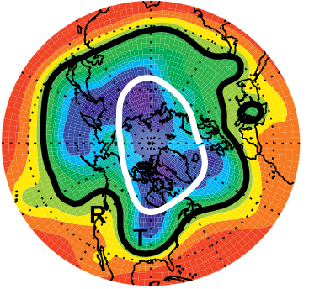
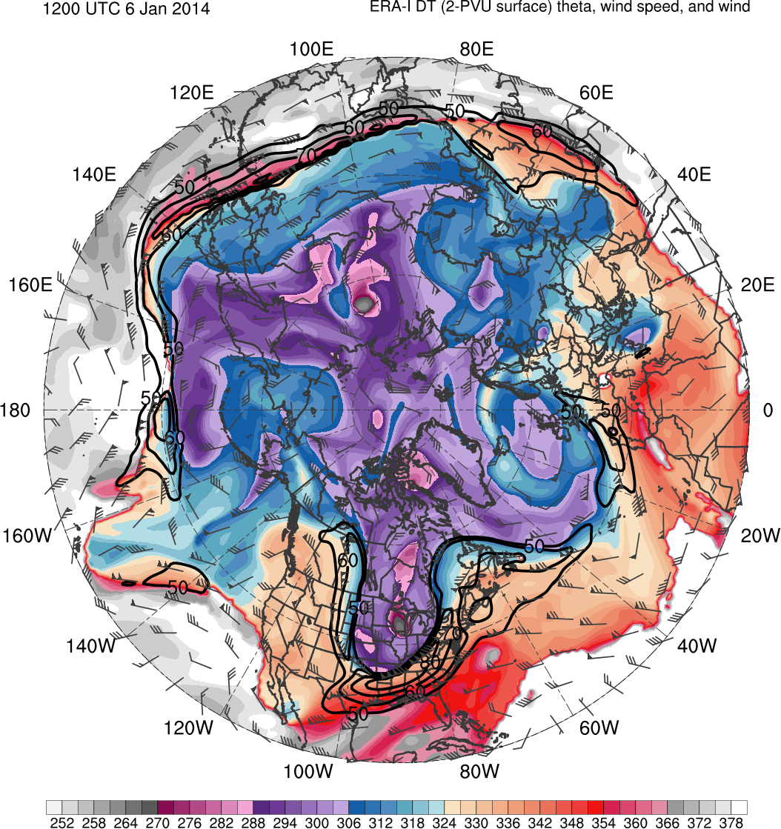
TPVs in Relation to the “Polar Vortex”
Waugh et al. (2017)
6 Jan 2014
1200 UTC 6 Jan 2014
TPV
8000
8240
8480
8720
8960
9200
9440
9680
252
261
270
279
288
297
306
315
324
333
342
351
360
369
378
300-hPa geopotential height (shaded, m) for 6 Jan 2014. Black edge marks tropospheric polar vortex edge at 300-hPa and white contours mark stratospheric vortex edge at 50 hPa. R and T represent locations of ridge and trough, respectively. Adapted from Fig. 4 in Waugh et al. (2017).
Potential temperature (K, shaded), wind speed (black, every 10 m s⁻¹ starting at 50 m s⁻¹), and wind (m s⁻¹, flags and barbs) on 2-PVU surface. Data source: ERA-Interim.

Slide 9
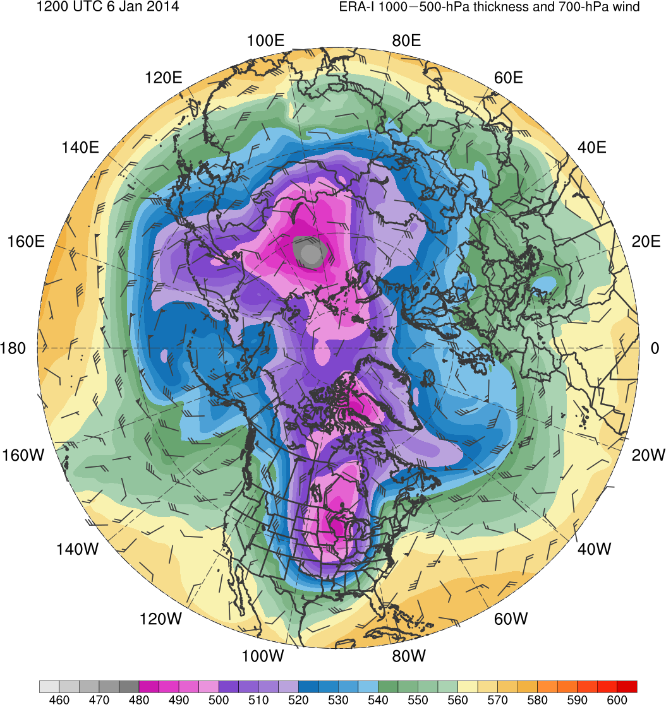
TPVs in Relation to the “Polar Vortex”
Waugh et al. (2017)
6 Jan 2014
1200 UTC 6 Jan 2014
CP
8000
8240
8480
8720
8960
9200
9440
9680
460
470
480
490
500
510
520
530
540
550
560
570
580
590
600
300-hPa geopotential height (shaded, m) for 6 Jan 2014. Black edge marks tropospheric polar vortex edge at 300-hPa and white contours mark stratospheric vortex edge at 50 hPa. R and T represent locations of ridge and trough, respectively. Adapted from Fig. 4 in Waugh et al. (2017).
1000–500-hPa thickness (dam, shaded) and 700-hPa wind (m s⁻¹, flags and barbs); CP denotes “cold pool”. Data source: ERA-Interim.

Slide 10
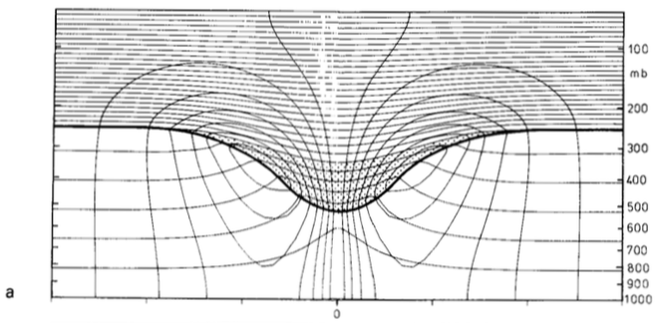
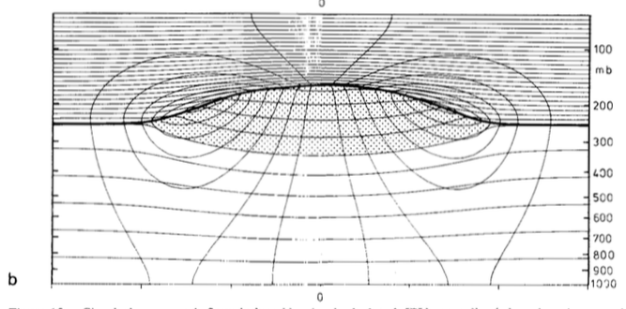
Tropopause-based PV Anomalies
Hoskins et al. (1985)
positive (cyclonic) PV anomaly
✕
Potential temperature (solid contours, every 5 K) and azimuthal wind (thin contours, every 3 m s⁻¹). Thick line is tropopause. Stippled regions represent the PV anomalies. Surface pressure anomaly is (top) −41 hPa and (bottom) +13 hPa and relative vorticity extrema (located at tropopause) are (top) 1.7 × f and (bottom) −0.6 × f where f = 10⁻⁴ s⁻¹ . Calculations done following method of Thorpe (1985). Adapted from Fig. 15 in Hoskins et al. (1985).
L
negative (anticyclonic) PV anomaly
✕
H

Slide 11
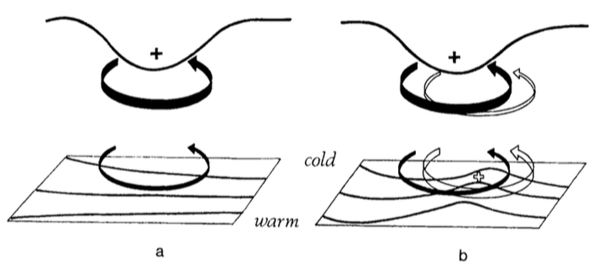
Cyclonic PV Anomalies and Cyclogenesis
Hoskins et al. (1985)
Cyclonic PV Anomaly
Trop.
θ
t = t₀
Notes:
Adapted from Fig. 21 in Hoskins et al. (1985).

Slide 12
Cyclonic PV Anomalies and Cyclogenesis
Hoskins et al. (1985)
Cyclonic PV Anomaly
Trop.
WAA
θ
t = t₀
Notes:
Adapted from Fig. 21 in Hoskins et al. (1985).

Slide 13
Cyclonic PV Anomalies and Cyclogenesis
Hoskins et al. (1985)
Cyclonic PV Anomaly
Trop.
WAA
θ
Cyclonic PV Anomaly
t = t₀
t = t₀ + Δt
Notes:
Adapted from Fig. 21 in Hoskins et al. (1985).

Slide 14
Cyclonic PV Anomalies and Cyclogenesis
Hoskins et al. (1985)
Cyclonic PV Anomaly
Positive PV Advection
Trop.
WAA
θ
Cyclonic PV Anomaly
t = t₀
t = t₀ + Δt
Notes:
Adapted from Fig. 21 in Hoskins et al. (1985).

Slide 15
Cyclonic PV Anomalies and Cyclogenesis
Hoskins et al. (1985)
Cyclonic PV Anomaly
Positive PV Advection
Trop.
WAA
“Phase Locking”
θ
Cyclonic PV Anomaly
t = t₀
t = t₀ + Δt
Notes:
Adapted from Fig. 21 in Hoskins et al. (1985).

Slide 16
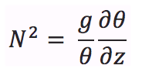
Cyclonic PV Anomalies and Cyclogenesis
Hoskins et al. (1985)
Including Moist Processes
H: Rossby penetration depth
f : Coriolis parameter
L: horizontal scale of flow
N: static stability
Positive PV Advection
Moist processes may modify amplification process
Ascent in region of reduced N beneath approaching upper-level PV anomaly
If enough moisture, condensation will lead to further reduction in N
This results in larger H
Positive feedback between PV anomalies will be enhanced
“Phase Locking”
θ
θ
Cyclonic PV Anomaly
t = t₀ + Δt
Notes:
Adapted from Fig. 21 in Hoskins et al. (1985).

Slide 17
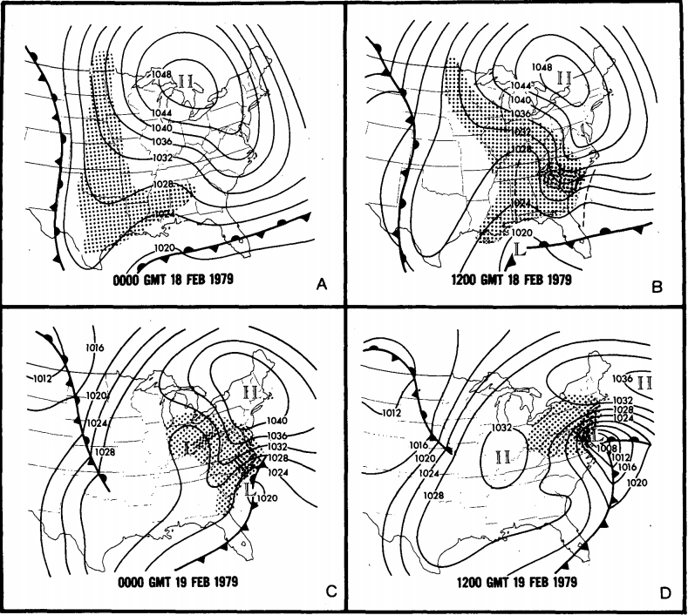
Presidents’ Day Storm of 1979
Uccellini et al. (1985)
Sea level pressure (mb) and surface frontal analyses for (a) 0000 GMT 18 Feb, (b) 1200 GMT 18 Feb, (c) 0000 GMT 19 Feb, and (d) 1200 GMT 19 Feb 1979. Shading represents precipitation; dark shading indicates moderate-to-heavy precipitation. Dashed line in (b) denote inverted and coastal troughs. Adapted from Fig. 1 in Uccellini et al. 1985.

Slide 18
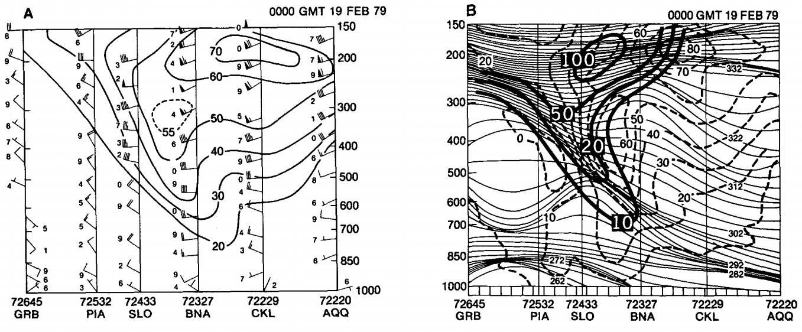
Presidents’ Day Storm of 1979
Uccellini et al. (1985)
(left) Isentropic analysis for 312 K surface for 0000 UTC 19 Feb 1979, including Montgomery streamfunction (solid, 100 = 3.100 × 10⁵ m² s⁻²), isotachs (dot dashed, m s⁻¹), and wind (barbs, m s⁻¹). Solid line represents transect of cross sections shown below. Adapted from Fig. 5 of Uccellini et al. 1985.
(bottom) Vertical cross sections for 0000 UTC 19 Feb 1979. (left) Total wind speed (solid, m s⁻¹). Wind barbs plotted with last digit of wind observation. (right) Isentropes (solid, K), geostrophic wind (dashed, m s⁻¹) and potential vorticity (heavy solid where 10 = 10 × 10⁻⁶ K mb⁻¹ s⁻¹). Adapted from Fig. 10 of Uccellini et al. 1985.

Slide 19
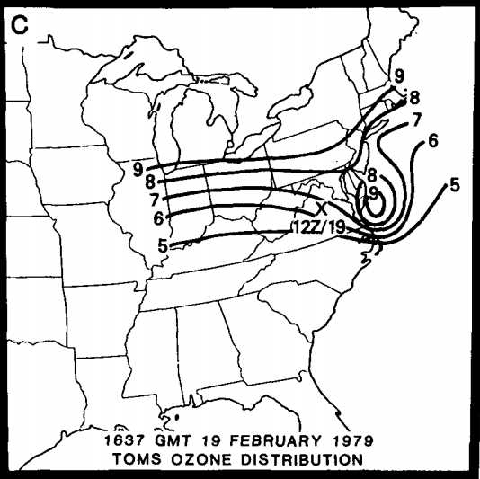
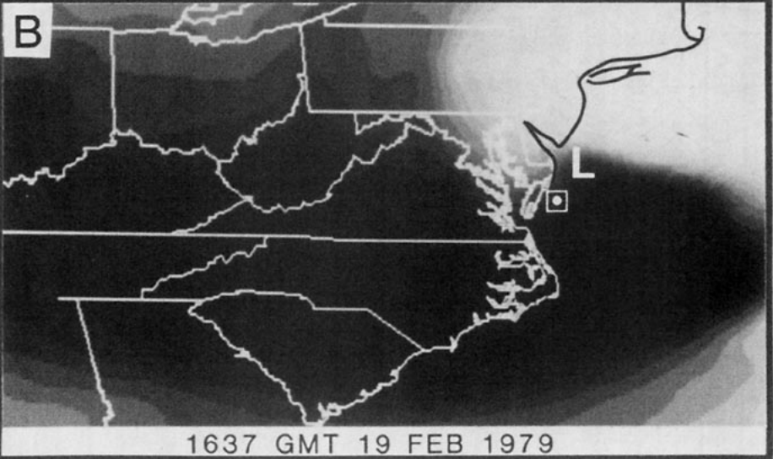
Presidents’ Day Storm of 1979
Uccellini et al. (1985)
(left) Water vapor infrared imagery from the Temperature-Humidity Infrared Radiometer (THIR) on Nimbus 7 for 1637 GMT 19 Feb 1979. For gray scale, 1.4 W m⁻² sr⁻¹ in driest air (darkest gray shade) south of cyclone, 1.2 W m⁻² sr⁻¹ in dry slot near L, and 0.3 W m⁻² sr⁻¹ in cloud regime north of cyclone center. Box indicates position of ozone maximum measured by the Total Ozone Mapping Spectrometer (TOMS). L indicates estimated position of surface low for 1500 GMT. Adapted from Fig. 4 in Uccellini et al. (1985).
(right) Total ozone distribution measured by the TOMS for 1637 GMT 19 Feb 1979. Analysis in Dobson units (1 DU = 10⁻³ atm-cm) where contour interval is as follows: 5 to 6 (325–339 DU); 6 to 7 (340–354 DU); 7 to 8 (355–369 DU); 8 to 9 (370–384 DU); 9 to 10 (385–400 DU). Location marked with “x” denotes position of maximum potential vorticity on 292 K surface at 1200 UTC 19 Feb 1979. Adapted from Fig. 11 in Uccellini et al. (1985)

Slide 20
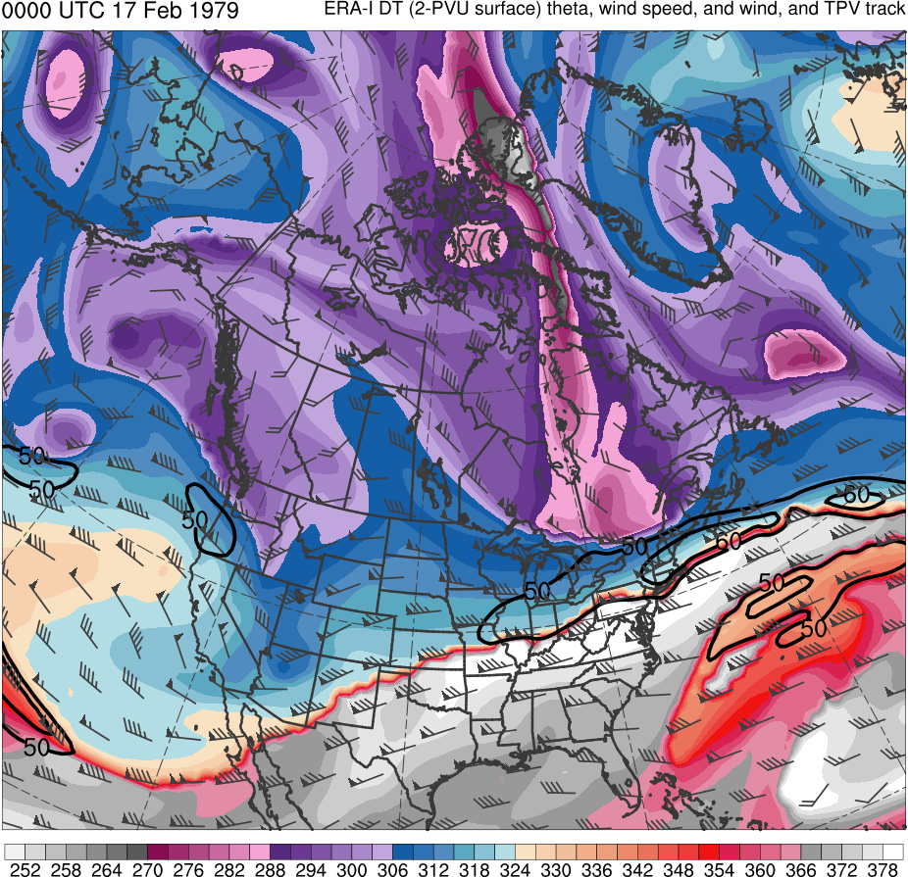
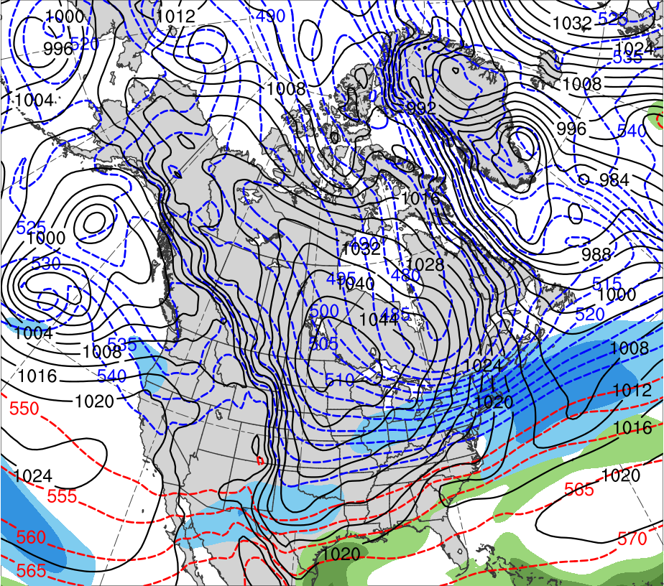
Presidents’ Day Storm of 1979
0000 UTC 17 Feb 1979
Data Source: ERA-Interim
(K)
252
258
264
270
276
282
288
294
300
306
312
318
324
330
336
342
348
354
360
366
372
378
(mm)
(m s⁻¹ )
25
30
35
40
45
50
55
50
60
70
80
90
100
110
120
Potential temperature (K, shaded), wind speed (black, every 10 m s⁻¹ starting at 50 m s⁻¹), and wind (m s⁻¹, flags and barbs) on 2-PVU surface
250-hPa wind speed (m s⁻¹, shaded),
1000–500-hPa thickness (dam, blue/red),
MSLP (hPa, black), PW (mm, shaded)

Slide 21
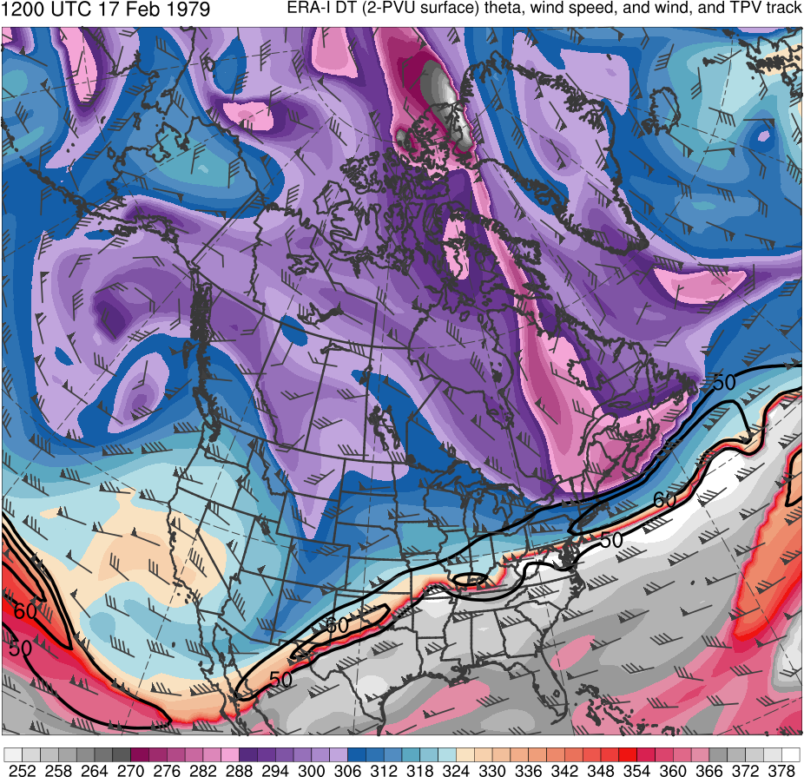
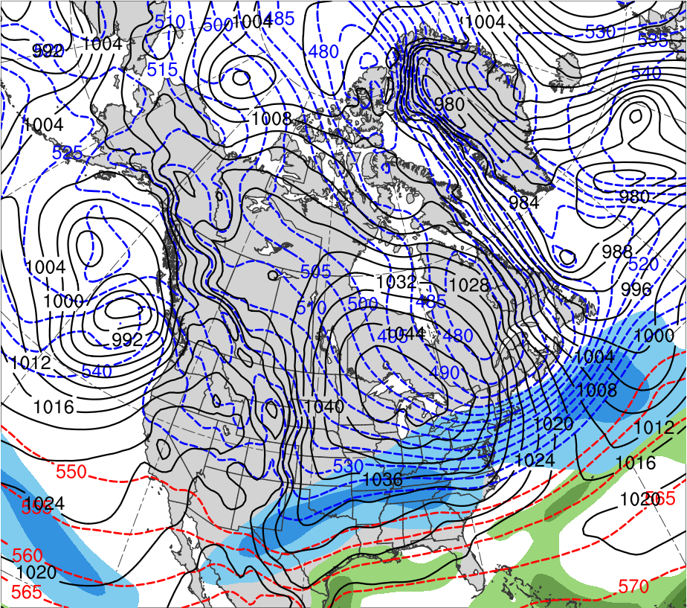
Presidents’ Day Storm of 1979
1200 UTC 17 Feb 1979
Data Source: ERA-Interim
CTD
(K)
252
258
264
270
276
282
288
294
300
306
312
318
324
330
336
342
348
354
360
366
372
378
(mm)
(m s⁻¹ )
25
30
35
40
45
50
55
50
60
70
80
90
100
110
120
Potential temperature (K, shaded), wind speed (black, every 10 m s⁻¹ starting at 50 m s⁻¹), and wind (m s⁻¹, flags and barbs) on 2-PVU surface
250-hPa wind speed (m s⁻¹, shaded),
1000–500-hPa thickness (dam, blue/red),
MSLP (hPa, black), PW (mm, shaded)

Slide 22
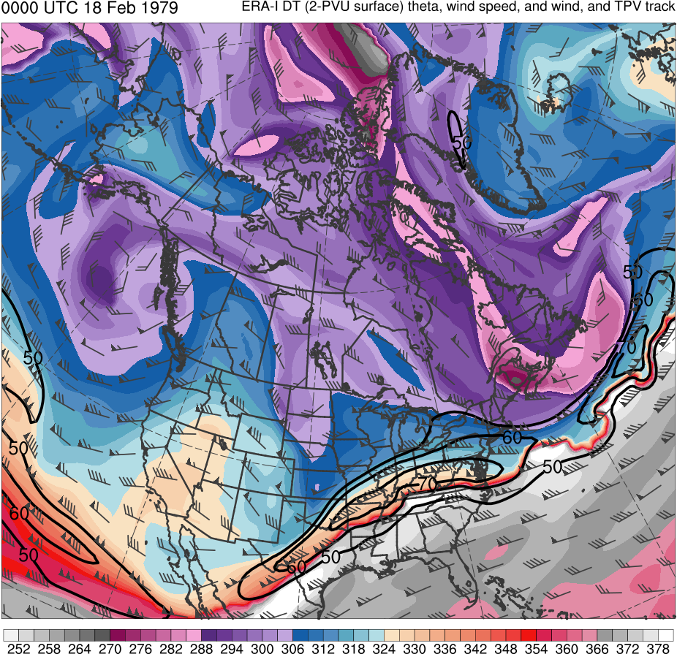
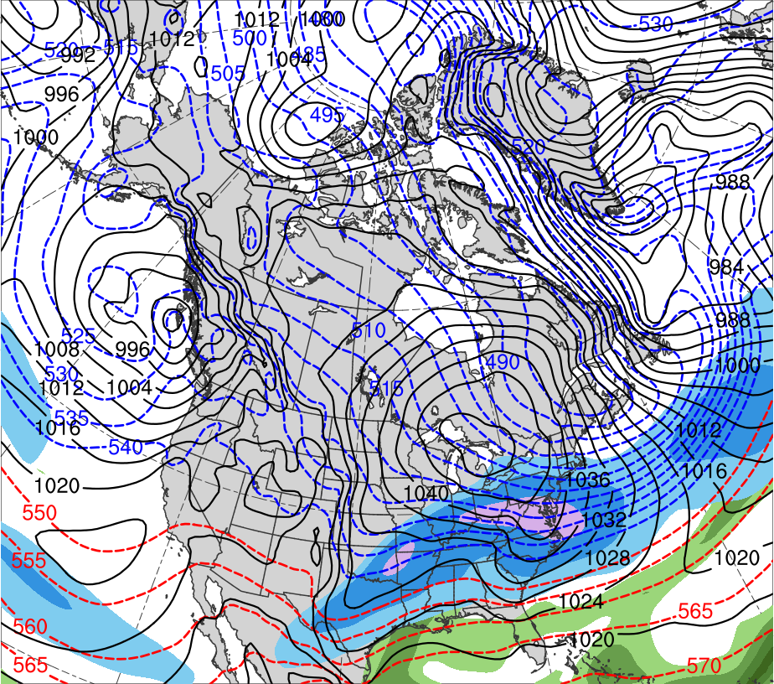
Presidents’ Day Storm of 1979
0000 UTC 18 Feb 1979
Data Source: ERA-Interim
CTD
(K)
252
258
264
270
276
282
288
294
300
306
312
318
324
330
336
342
348
354
360
366
372
378
(mm)
(m s⁻¹ )
25
30
35
40
45
50
55
50
60
70
80
90
100
110
120
Potential temperature (K, shaded), wind speed (black, every 10 m s⁻¹ starting at 50 m s⁻¹), and wind (m s⁻¹, flags and barbs) on 2-PVU surface
250-hPa wind speed (m s⁻¹, shaded),
1000–500-hPa thickness (dam, blue/red),
MSLP (hPa, black), PW (mm, shaded)

Slide 23
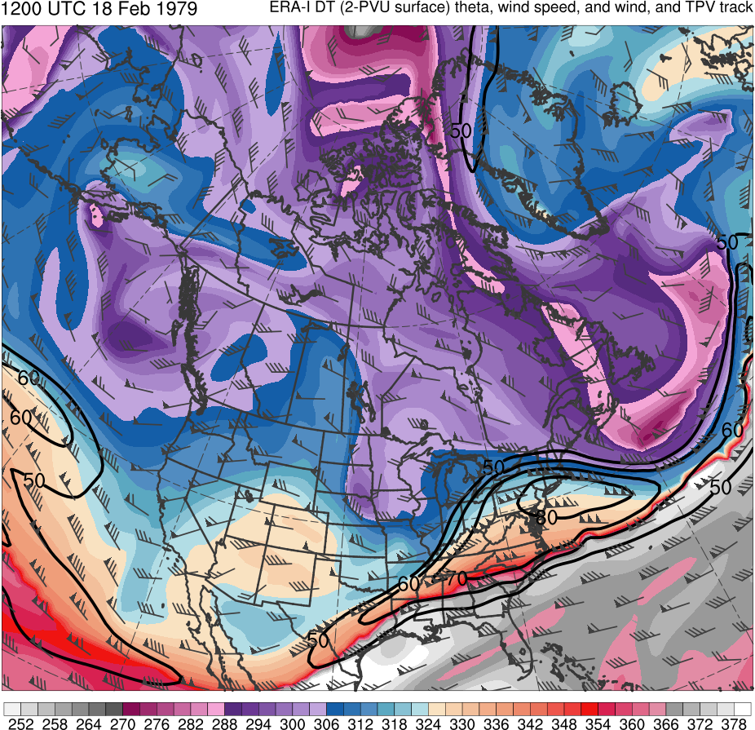
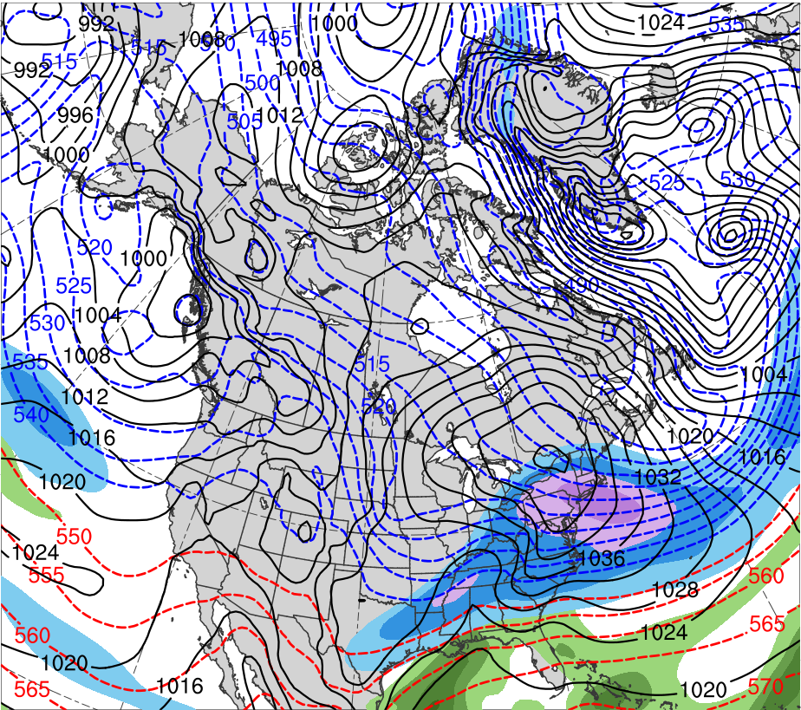
Presidents’ Day Storm of 1979
1200 UTC 18 Feb 1979
Data Source: ERA-Interim
CTD
(K)
252
258
264
270
276
282
288
294
300
306
312
318
324
330
336
342
348
354
360
366
372
378
(mm)
(m s⁻¹ )
25
30
35
40
45
50
55
50
60
70
80
90
100
110
120
Potential temperature (K, shaded), wind speed (black, every 10 m s⁻¹ starting at 50 m s⁻¹), and wind (m s⁻¹, flags and barbs) on 2-PVU surface
250-hPa wind speed (m s⁻¹, shaded),
1000–500-hPa thickness (dam, blue/red),
MSLP (hPa, black), PW (mm, shaded)

Slide 24
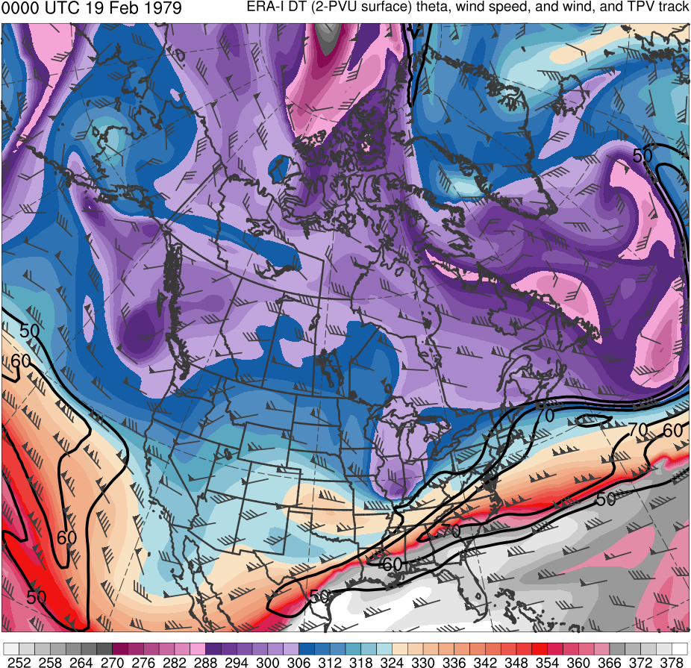
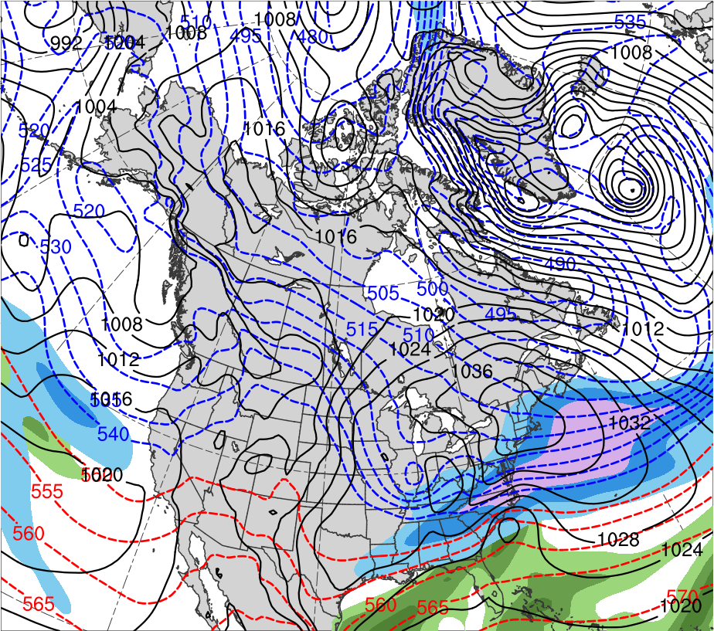
Presidents’ Day Storm of 1979
0000 UTC 19 Feb 1979
Data Source: ERA-Interim
CTD
L
L
(K)
252
258
264
270
276
282
288
294
300
306
312
318
324
330
336
342
348
354
360
366
372
378
(mm)
(m s⁻¹ )
25
30
35
40
45
50
55
50
60
70
80
90
100
110
120
Potential temperature (K, shaded), wind speed (black, every 10 m s⁻¹ starting at 50 m s⁻¹), and wind (m s⁻¹, flags and barbs) on 2-PVU surface
250-hPa wind speed (m s⁻¹, shaded),
1000–500-hPa thickness (dam, blue/red),
MSLP (hPa, black), PW (mm, shaded)

Slide 25
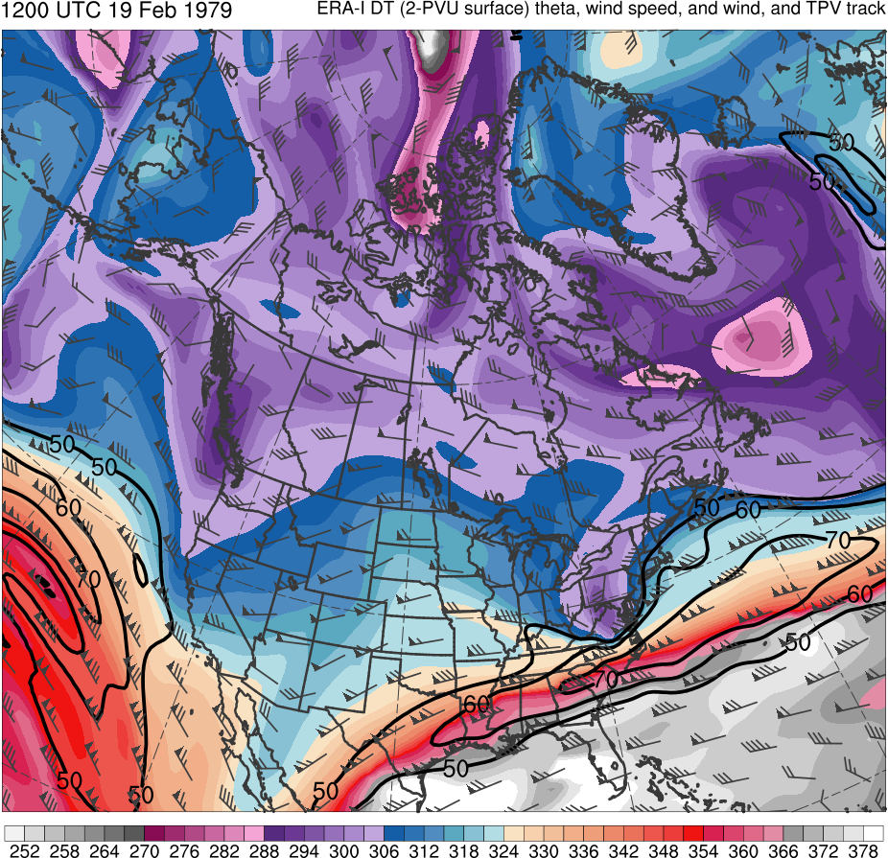
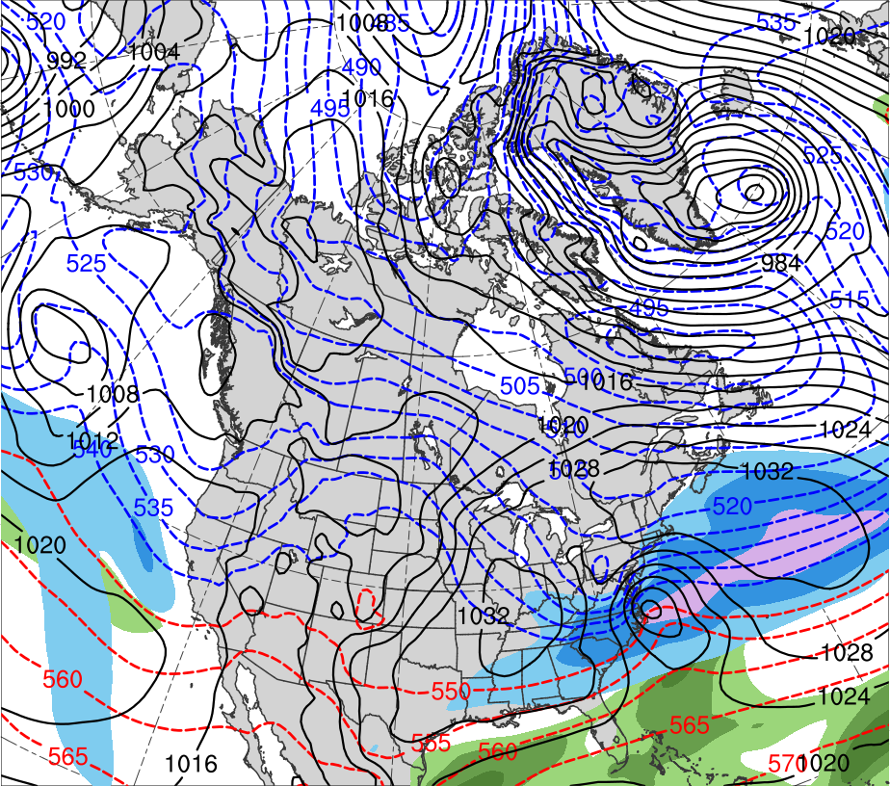
Presidents’ Day Storm of 1979
1200 UTC 19 Feb 1979
Data Source: ERA-Interim
CTD
L
(K)
252
258
264
270
276
282
288
294
300
306
312
318
324
330
336
342
348
354
360
366
372
378
(mm)
(m s⁻¹ )
25
30
35
40
45
50
55
50
60
70
80
90
100
110
120
Potential temperature (K, shaded), wind speed (black, every 10 m s⁻¹ starting at 50 m s⁻¹), and wind (m s⁻¹, flags and barbs) on 2-PVU surface
250-hPa wind speed (m s⁻¹, shaded),
1000–500-hPa thickness (dam, blue/red),
MSLP (hPa, black), PW (mm, shaded)

Slide 26
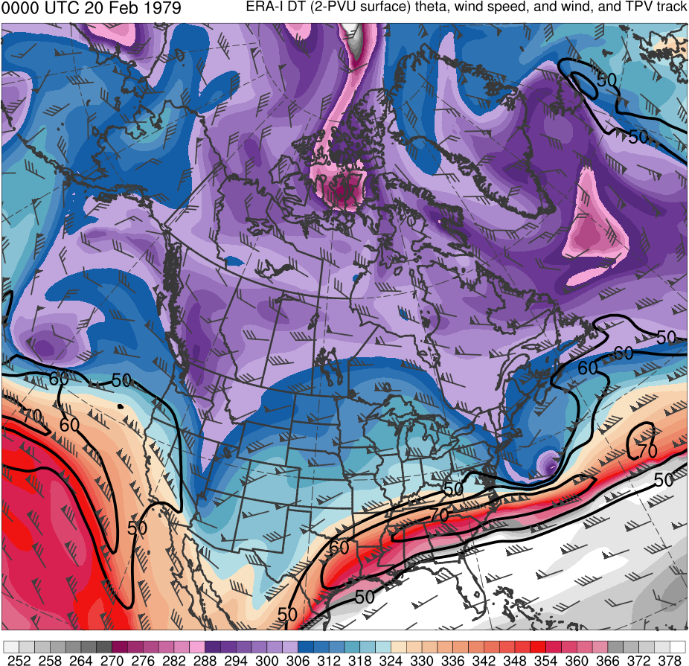
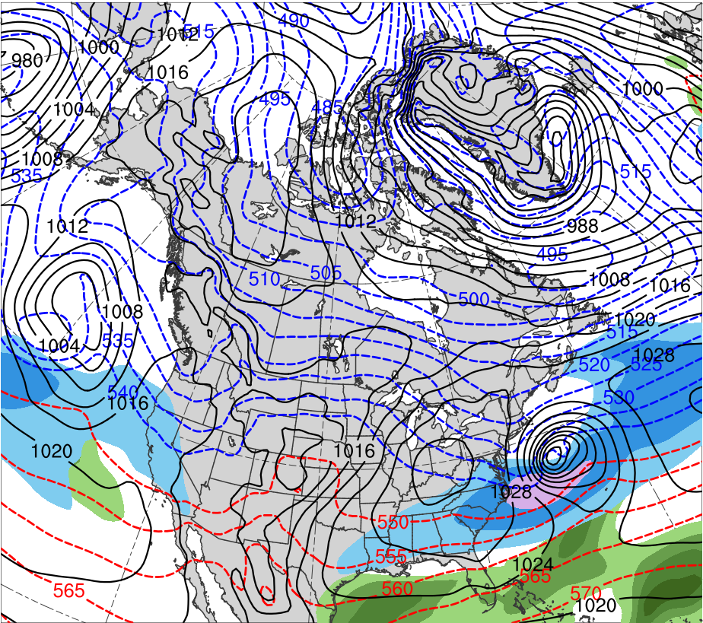
Presidents’ Day Storm of 1979
0000 UTC 20 Feb 1979
Data Source: ERA-Interim
CTD
L
(K)
252
258
264
270
276
282
288
294
300
306
312
318
324
330
336
342
348
354
360
366
372
378
(mm)
(m s⁻¹ )
25
30
35
40
45
50
55
50
60
70
80
90
100
110
120
Potential temperature (K, shaded), wind speed (black, every 10 m s⁻¹ starting at 50 m s⁻¹), and wind (m s⁻¹, flags and barbs) on 2-PVU surface
250-hPa wind speed (m s⁻¹, shaded),
1000–500-hPa thickness (dam, blue/red),
MSLP (hPa, black), PW (mm, shaded)

Slide 27
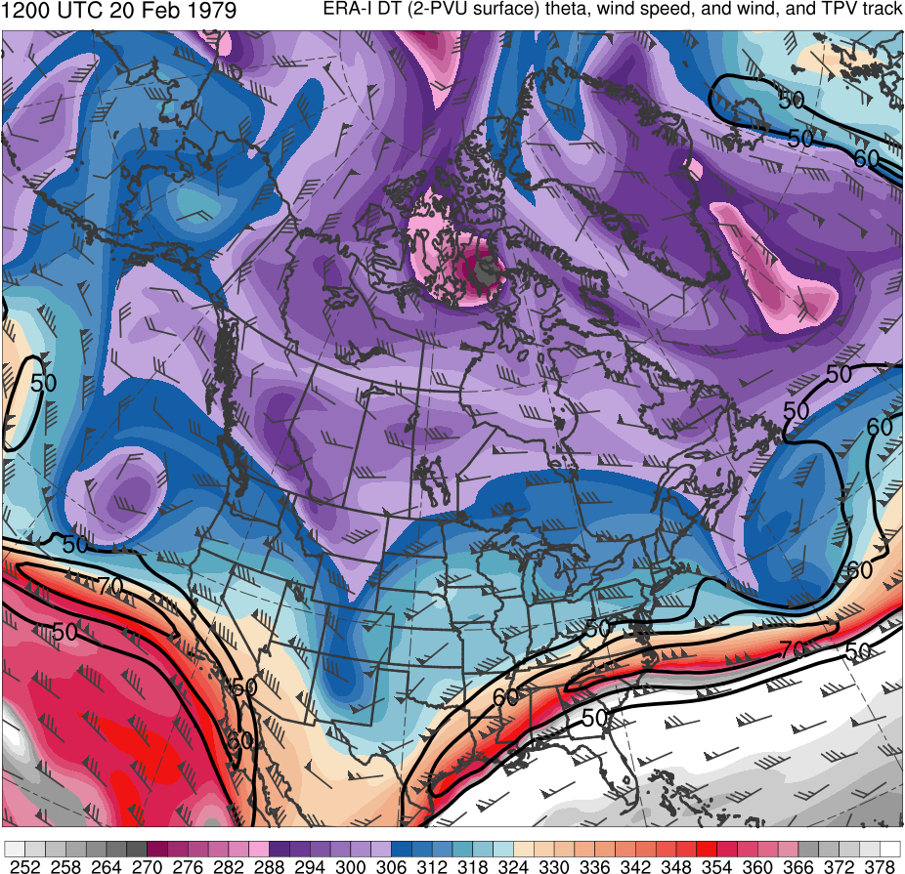
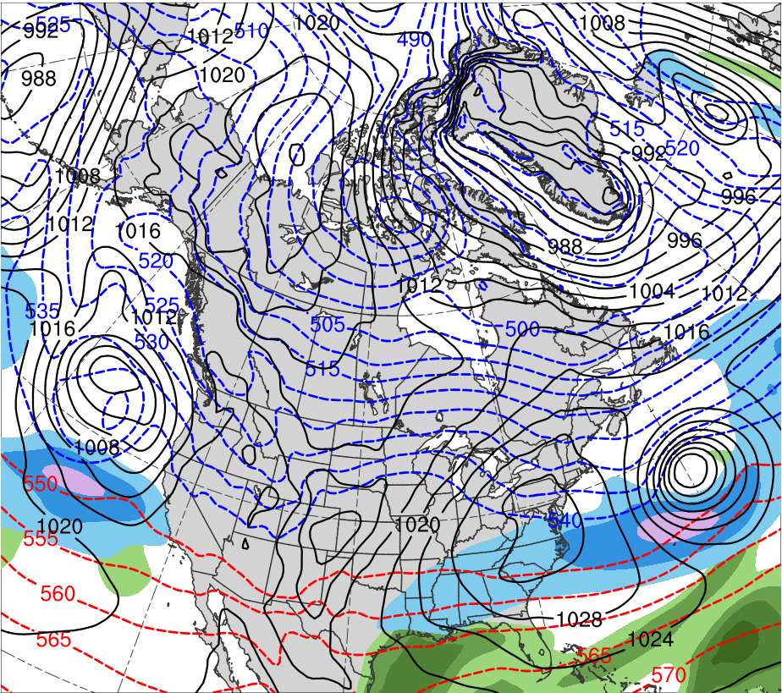
Presidents’ Day Storm of 1979
1200 UTC 20 Feb 1979
Data Source: ERA-Interim
CTD
L
(K)
252
258
264
270
276
282
288
294
300
306
312
318
324
330
336
342
348
354
360
366
372
378
(mm)
(m s⁻¹ )
25
30
35
40
45
50
55
50
60
70
80
90
100
110
120
Potential temperature (K, shaded), wind speed (black, every 10 m s⁻¹ starting at 50 m s⁻¹), and wind (m s⁻¹, flags and barbs) on 2-PVU surface
250-hPa wind speed (m s⁻¹, shaded),
1000–500-hPa thickness (dam, blue/red),
MSLP (hPa, black), PW (mm, shaded)

Slide 28
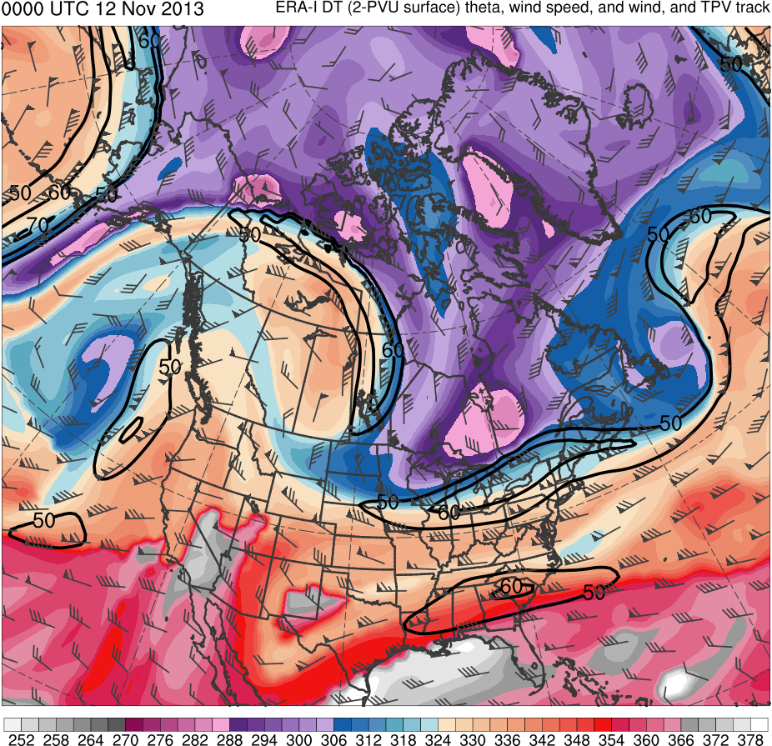
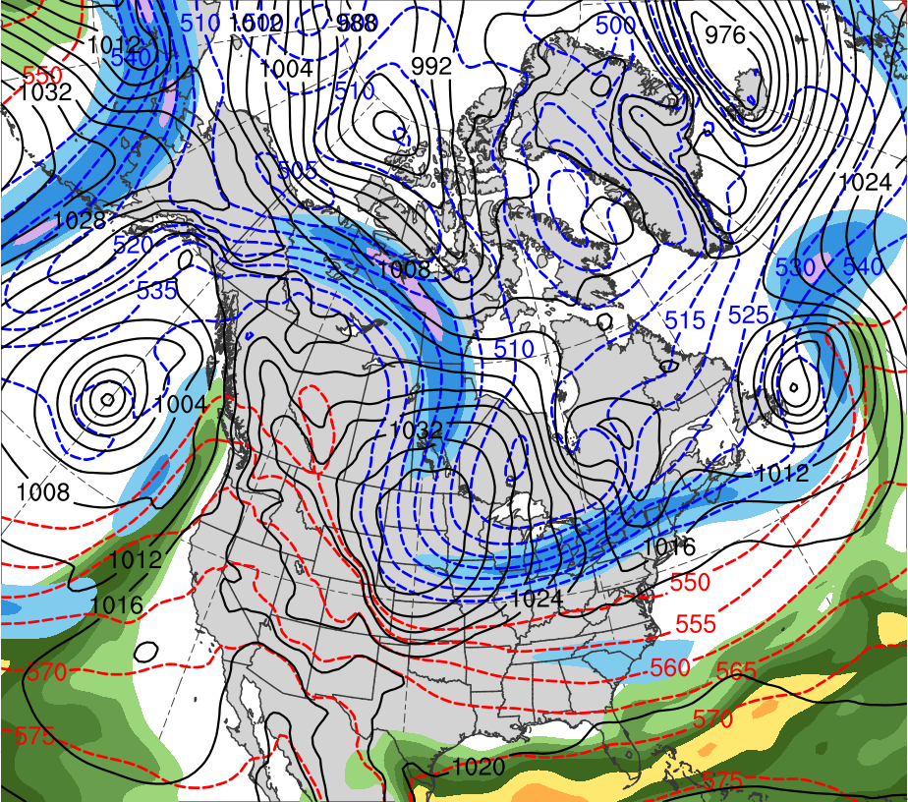
TPV-induced Cyclogenesis
0000 UTC 12 Nov 2013
Data Source: ERA-Interim
TPV
L
CP
(K)
252
258
264
270
276
282
288
294
300
306
312
318
324
330
336
342
348
354
360
366
372
378
(mm)
(m s⁻¹ )
25
30
35
40
45
50
55
50
60
70
80
90
100
110
120
Potential temperature (K, shaded), wind speed (black, every 10 m s⁻¹ starting at 50 m s⁻¹), and wind (m s⁻¹, flags and barbs) on 2-PVU surface
250-hPa wind speed (m s⁻¹, shaded),
1000–500-hPa thickness (dam, blue/red),
MSLP (hPa, black), PW (mm, shaded)

Slide 29
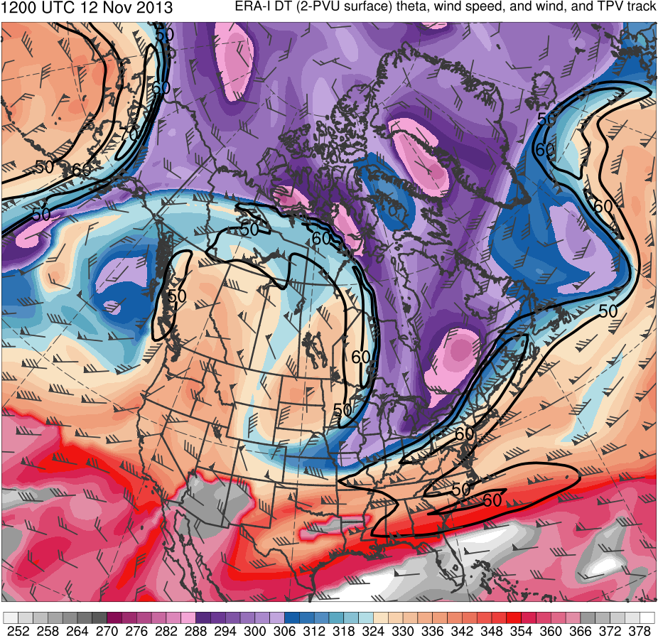
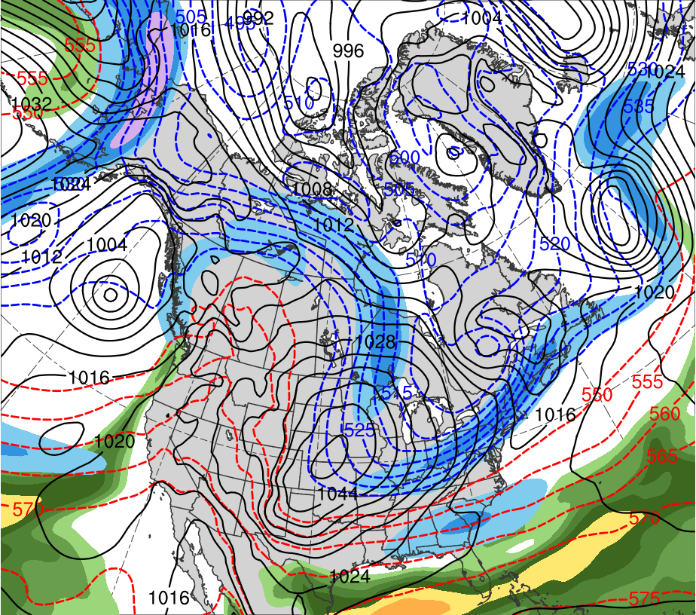
TPV-induced Cyclogenesis
1200 UTC 12 Nov 2013
Data Source: ERA-Interim
TPV
L
CP
(K)
252
258
264
270
276
282
288
294
300
306
312
318
324
330
336
342
348
354
360
366
372
378
(mm)
(m s⁻¹ )
25
30
35
40
45
50
55
50
60
70
80
90
100
110
120
Potential temperature (K, shaded), wind speed (black, every 10 m s⁻¹ starting at 50 m s⁻¹), and wind (m s⁻¹, flags and barbs) on 2-PVU surface
250-hPa wind speed (m s⁻¹, shaded),
1000–500-hPa thickness (dam, blue/red),
MSLP (hPa, black), PW (mm, shaded)

Slide 30
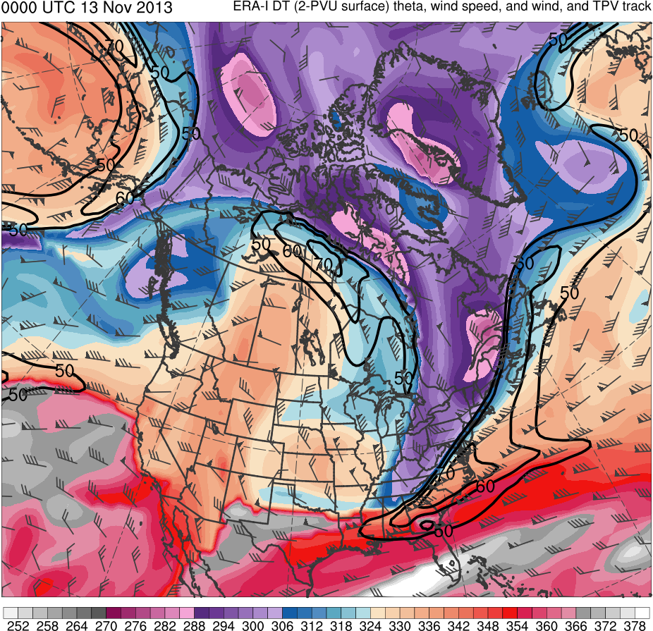
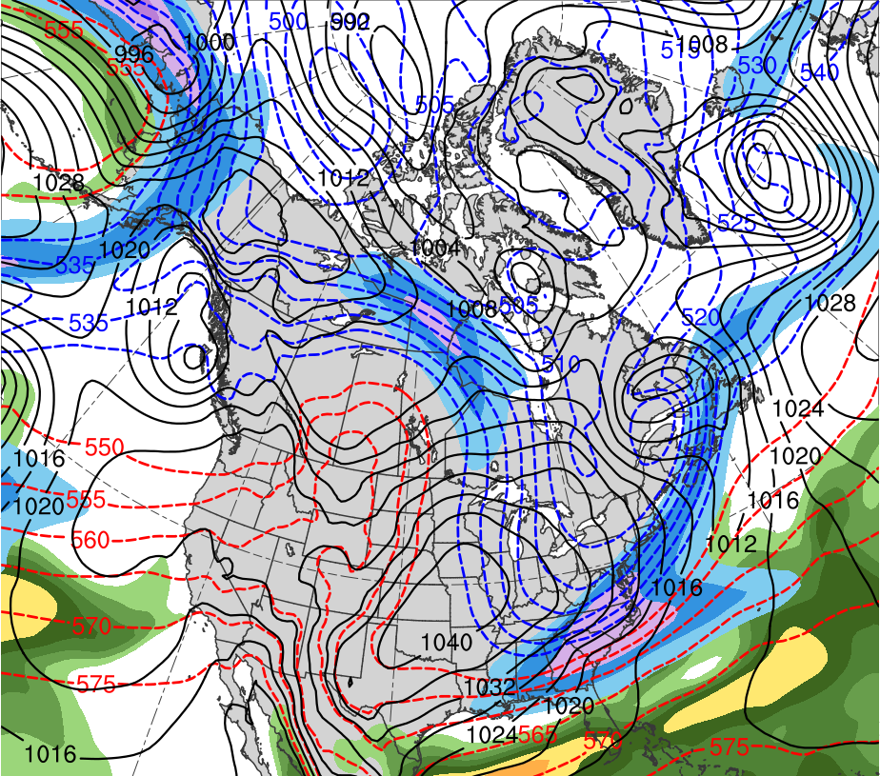
TPV-induced Cyclogenesis
0000 UTC 13 Nov 2013
Data Source: ERA-Interim
TPV
L
CP
(K)
252
258
264
270
276
282
288
294
300
306
312
318
324
330
336
342
348
354
360
366
372
378
(mm)
(m s⁻¹ )
25
30
35
40
45
50
55
50
60
70
80
90
100
110
120
Potential temperature (K, shaded), wind speed (black, every 10 m s⁻¹ starting at 50 m s⁻¹), and wind (m s⁻¹, flags and barbs) on 2-PVU surface
250-hPa wind speed (m s⁻¹, shaded),
1000–500-hPa thickness (dam, blue/red),
MSLP (hPa, black), PW (mm, shaded)

Slide 31
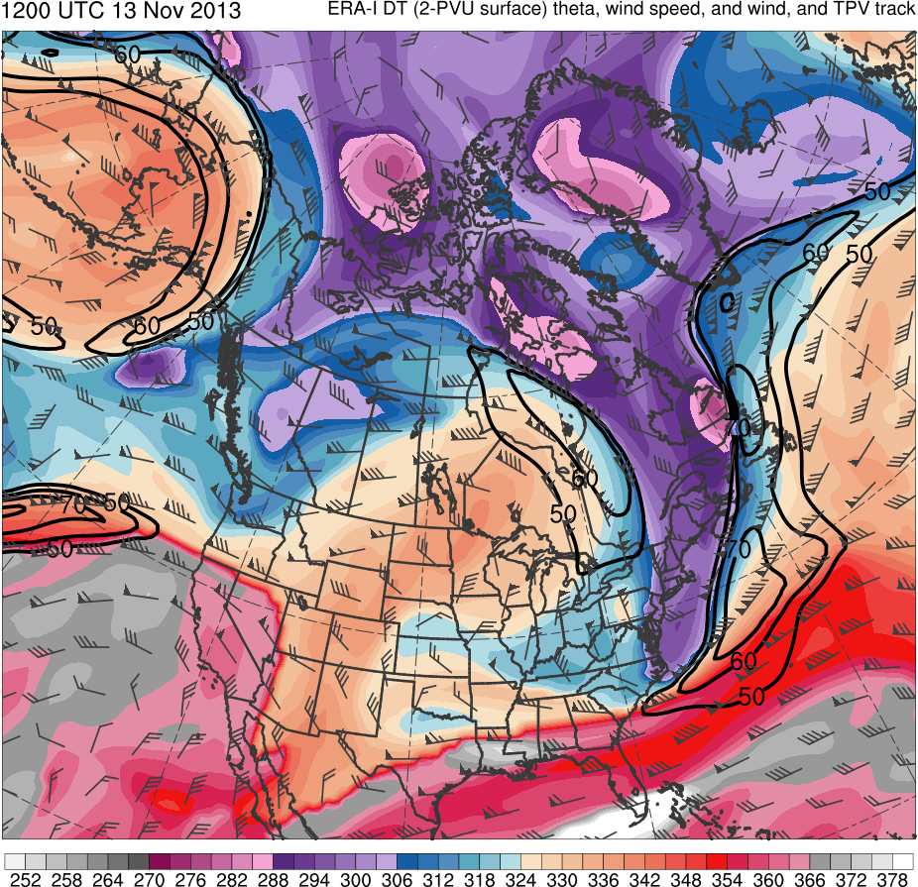
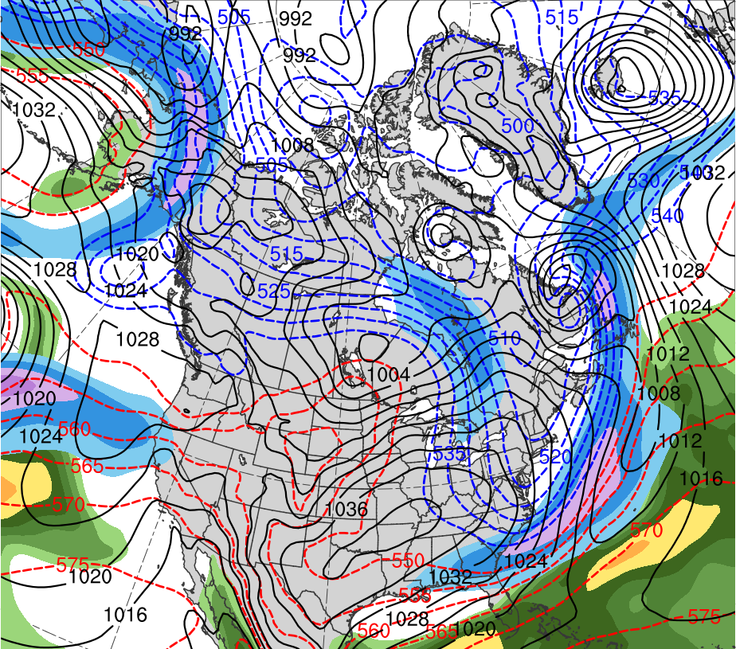
TPV-induced Cyclogenesis
1200 UTC 13 Nov 2013
Data Source: ERA-Interim
L
TPV
CP
(K)
252
258
264
270
276
282
288
294
300
306
312
318
324
330
336
342
348
354
360
366
372
378
(mm)
(m s⁻¹ )
25
30
35
40
45
50
55
50
60
70
80
90
100
110
120
Potential temperature (K, shaded), wind speed (black, every 10 m s⁻¹ starting at 50 m s⁻¹), and wind (m s⁻¹, flags and barbs) on 2-PVU surface
250-hPa wind speed (m s⁻¹, shaded),
1000–500-hPa thickness (dam, blue/red),
MSLP (hPa, black), PW (mm, shaded)

Slide 32
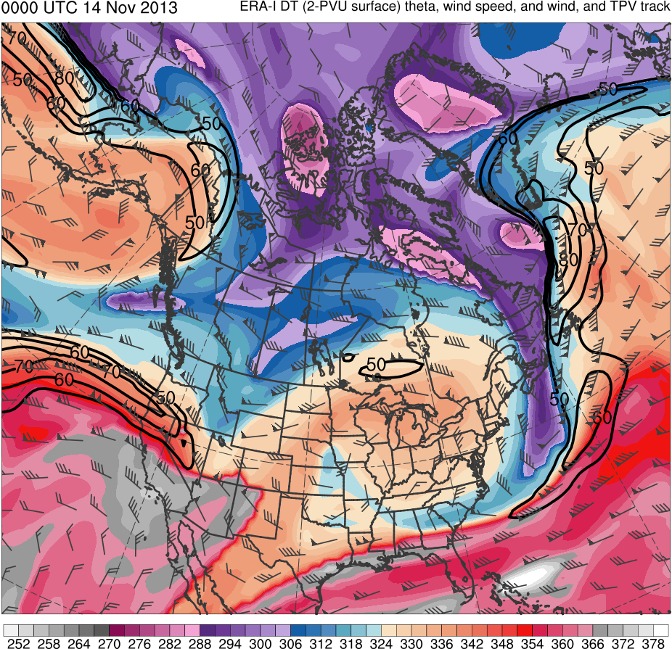
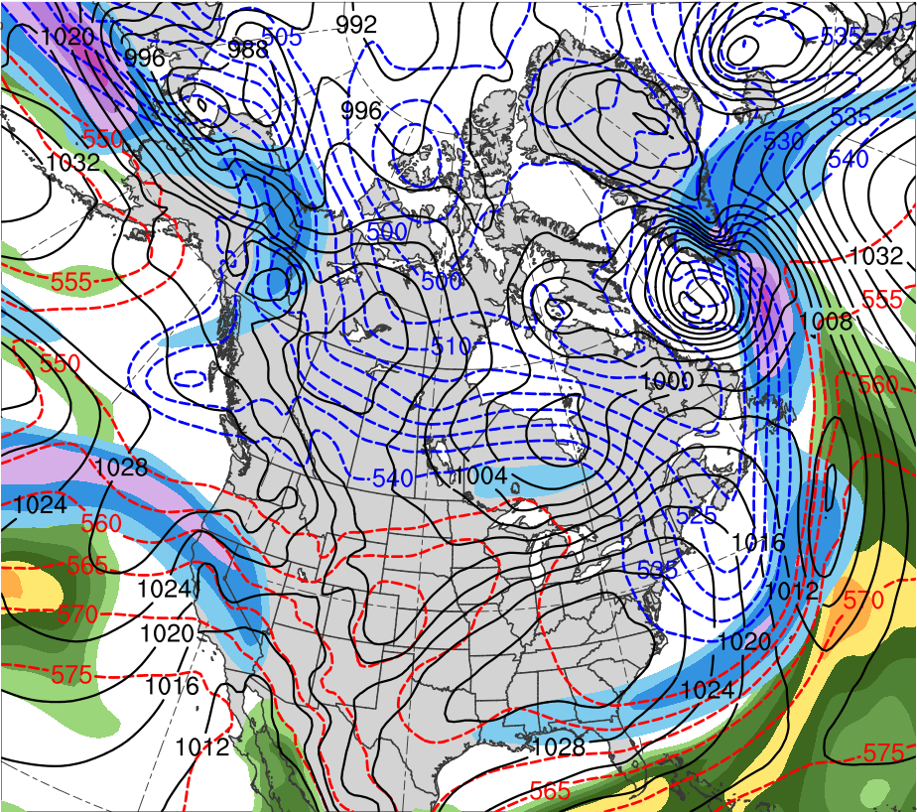
TPV-induced Cyclogenesis
0000 UTC 14 Nov 2013
Data Source: ERA-Interim
TPV
L
(K)
252
258
264
270
276
282
288
294
300
306
312
318
324
330
336
342
348
354
360
366
372
378
(mm)
(m s⁻¹ )
25
30
35
40
45
50
55
50
60
70
80
90
100
110
120
Potential temperature (K, shaded), wind speed (black, every 10 m s⁻¹ starting at 50 m s⁻¹), and wind (m s⁻¹, flags and barbs) on 2-PVU surface
250-hPa wind speed (m s⁻¹, shaded),
1000–500-hPa thickness (dam, blue/red),
MSLP (hPa, black), PW (mm, shaded)

Slide 33
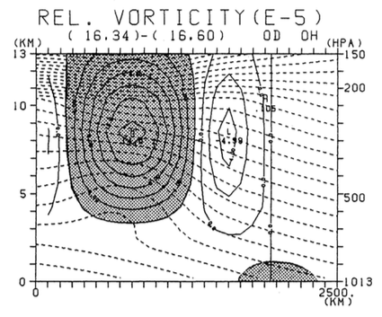
“Coupling Development”
Takayabu (1991)
Used simplified three-dimensional, β-plane channel, dry primitive equation model to simulate rapid cyclogenesis resulting from coupling of upper and lower tropospheric vortices
Used a simple baroclinic westerly jet as basic flow and superimposed finite amplitude upper vortex and lower vortex
Initial upper vortex associated with temperature anomaly of −9 K in upper-troposphere, while lower vortex associated with temperature anomaly of +4 K at surface
Initial upper vortex placed 1200 km north of basic state jet axis, while initial lower vortex is placed on jet axis, 1500 km east of upper vortex
Meridional–height cross section of initial disturbances with potential temperature (dashed contours, every 5 K) and relative vorticity (solid contours, every 2×10⁻⁵ s⁻¹). Relative vorticity values greater than 2×10⁻⁵ s⁻¹ are shaded for the upper vortex and relative vorticity values greater than 1×10⁻⁵ s⁻¹ are shaded for lower vortex (located 1500 km east of cross section). Adapted from Fig. 3 of Takayabu (1991).

Slide 34
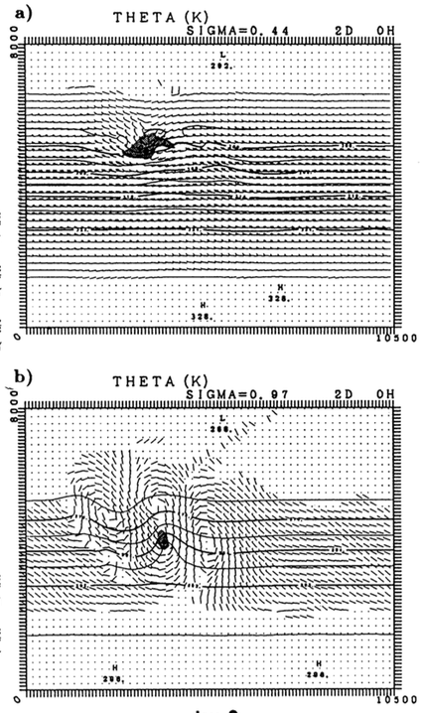
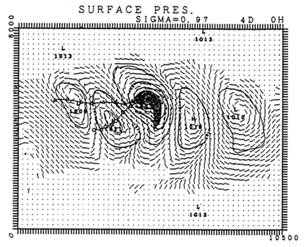
“Coupling Development”
Takayabu (1991)
σ = 0.44
σ = 0.97
Vortex track at σ = 0.44
L
J
Vortex track at σ = 0.97
σ = 0.97
Day 4
(left) Potential temperature (solid, contoured every 4 K), wind (flags and barbs), and relative vorticity greater than 4×10⁻⁵ s⁻¹ (shading) at (top) σ = 0.44 and (bottom) σ = 0.97. Adapted from Fig. 5 in Takayabu (1991).
(right) Surface pressure (solid, contoured every 4 hPa), winds (flags and barbs), and relative vorticity greater than 4×10⁻⁵ s⁻¹ (shading) at σ = 0.97. Adapted from Fig. 6 in Takayabu (1991).
Day 2

Slide 35
“Coupling Development”
Takayabu (1991)
Day 2
Day 2.5
“Coupling Development”
Zonal–height cross section at a latitude between upper and lower-level vortices (denoted by plus symbols). Potential temperature (thin dashed contours, every 5 K), relative vorticity (every 4 × 10⁻⁵ s⁻¹), motion along section (vectors). Thick solid line corresponding to tropopause represents 1.0 PVU surface and thick dotted line corresponding to low-level cyclonic PV anomaly represents 0.6 PVU surface.

Slide 36
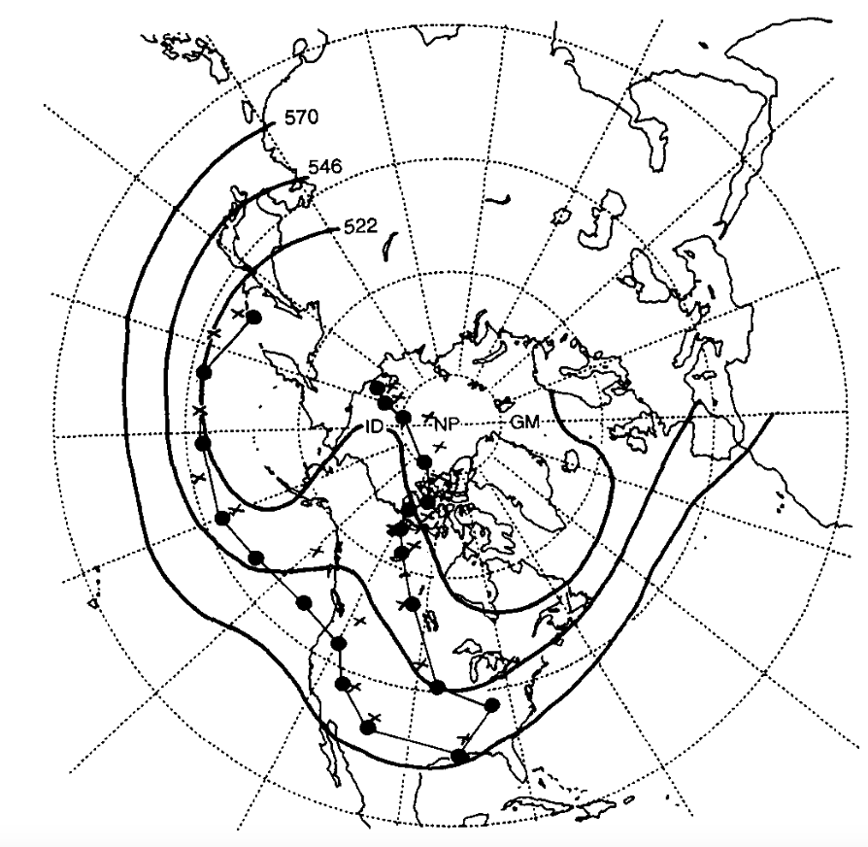
1978 Cleveland Superbomb
Hakim et al. (1995, 1996)
Midlatitude CTD
TPV
Position of QGPV maxima (colored dots) and 1000–500-hPa thickness minima (black crosses) every 24 h starting at 0000 UTC 17 January and ending 0000 UTC 27 January 1978; time-mean 500-hPa geopotential height field (black, contoured every 120 m) for 17–27 January 1978. Adapted from Fig. 3 in Hakim et al. (1995).
“Merged” CTD

Slide 37
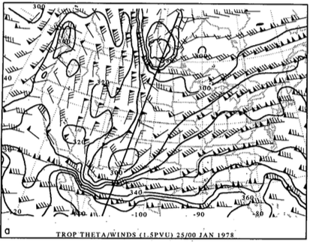
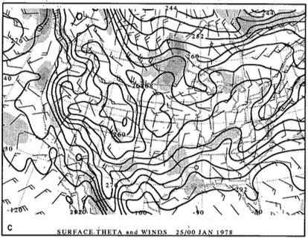
1978 Cleveland Superbomb
Hakim et al. (1995, 1996)
0000 UTC 25 January 1978
R
TPV
R
TPV
CTD 2
CTD 2
A
(a) Dynamic tropopause (DT; 1.5 PVU) potential temperature (black contours, every 10 K) and wind (flags and barbs, m s⁻¹); (b) DT pressure (black contours, every 50 hPa) and relative vorticity (shaded every 2×10⁻⁵ s⁻¹ for values greater than 4×10⁻⁵ s⁻¹ ); (c) surface potential temperature (black contours, every 4 K) and relative vorticity (shaded every 2×10⁻⁵ s⁻¹ for values greater than 2×10⁻⁵ s⁻¹). Adapted from Fig. 4 in Hakim et al. (1995).

Slide 38
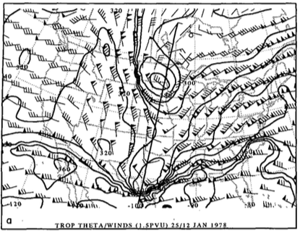
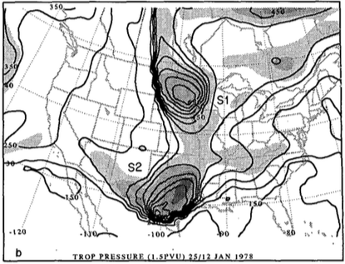
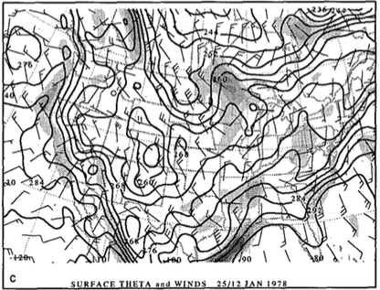
1978 Cleveland Superbomb
Hakim et al. (1995, 1996)
1200 UTC 25 January 1978
R
R
TPV
TPV
CTD 2
CTD 2
(a) Dynamic tropopause (DT; 1.5 PVU) potential temperature (black contours, every 10 K) and wind (flags and barbs, m s⁻¹); (b) DT pressure (black contours, every 50 hPa) and relative vorticity (shaded every 2×10⁻⁵ s⁻¹ for values greater than 4×10⁻⁵ s⁻¹ ); (c) surface potential temperature (black contours, every 4 K) and relative vorticity (shaded every 2×10⁻⁵ s⁻¹ for values greater than 2×10⁻⁵ s⁻¹). Adapted from Fig. 6 in Hakim et al. (1995).
A
L
998 hPa

Slide 39
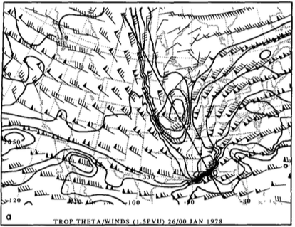
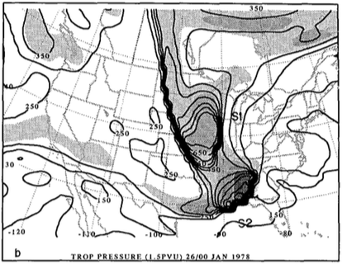
1978 Cleveland Superbomb
Hakim et al. (1995, 1996)
0000 UTC 26 January 1978
R
R
TPV
TPV
CTD 2
CTD 2
(a) Dynamic tropopause (DT; 1.5 PVU) potential temperature (black contours, every 10 K) and wind (flags and barbs, m s⁻¹); (b) DT pressure (black contours, every 50 hPa) and relative vorticity (shaded every 2×10⁻⁵ s⁻¹ for values greater than 4×10⁻⁵ s⁻¹ ); (c) surface potential temperature (black contours, every 4 K) and relative vorticity (shaded every 2×10⁻⁵ s⁻¹ for values greater than 2×10⁻⁵ s⁻¹). Adapted from Fig. 8 in Hakim et al. (1995).
A
L
982 hPa

Slide 40
1978 Cleveland Superbomb
Hakim et al. (1995, 1996)
1200 UTC 26 January 1978
CTD 2
CTD 2
R
R
TPV
TPV
(a) Dynamic tropopause (DT; 1.5 PVU) potential temperature (black contours, every 10 K) and wind (flags and barbs, m s⁻¹); (b) DT pressure (black contours, every 50 hPa) and relative vorticity (shaded every 2×10⁻⁵ s⁻¹ for values greater than 4×10⁻⁵ s⁻¹ ); (c) surface potential temperature (black contours, every 4 K) and relative vorticity (shaded every 2×10⁻⁵ s⁻¹ for values greater than 2×10⁻⁵ s⁻¹). Adapted from Fig. 9 in Hakim et al. (1995).
L
A
955 hPa

Slide 41
The Arctic Tropopause Fold and Arctic Jet
Shapiro et al. (1987)
0000 UTC 20 January 1985
378
372
366
360
354
348
342
336
“Polar Vortex”
TPV?
330
324
318
312
306
300
294
288
282
276
270
264
258
252
(K)
500-hPa geopotential height (black, every 6 dam) and −40°C isotherm (dashed contour); track of polar vortex from 0000 UTC 12 January to 0000 UTC 24 January 1985 (heavy black). Adapted from Fig. 5 in Shapiro et al. (1987).
Potential temperature (K, shaded), wind speed (black, every 10 m s⁻¹ starting at 50 m s⁻¹), and wind (m s⁻¹, barbs) on 2-PVU surface. Data source: ERA-Interim.

Slide 42
The Arctic Tropopause Fold and Arctic Jet
Shapiro et al. (1987)
0000 UTC 20 January 1985
600
590
580
570
560
550
“Polar Vortex”
Cold Pool
540
530
520
510
500
490
480
470
460
(dam)
500-hPa geopotential height (black, every 6 dam) and −40°C isotherm (dashed contour); track of polar vortex from 0000 UTC 12 January to 0000 UTC 24 January 1985 (heavy black). Adapted from Fig. 5 in Shapiro et al. (1987).
1000–500-hPa thickness (dam, shaded) and 700-hPa wind (m s⁻¹, flags and barbs). Data source: ERA-Interim.

Slide 43
The Arctic Tropopause Fold and Arctic Jet
Shapiro et al. (1987)
0000 UTC 20 January 1985
(upper left) 500-hPa geopotential height (dam, solid contours), temperature (°C, dashed contours), and wind (barbs and flags, m s⁻¹). (lower-left) Cross-section of potential temperature (K, thin solid), wind speed (m s⁻¹, heavy dashed contours), and wind (m s⁻¹, barbs and flags) between Sault Sainte Marie, MI and Longview, TX. Heavy solid line is tropopause (10⁻⁷ K s⁻¹ hPa⁻¹ isopleth of PV) and light dashed lines indicate tropospheric frontal and stable layer boundaries. (lower-right) “threefold” structure of tropopause where heavy line is PV discontinuity tropopause, shading is stratospheric air, and light dashed contours represent 40 m s⁻¹ isotach.
A
A’
Adapted from Fig. 7 in Shapiro et al. (1987)
PJ
STJ
AJ
PJ
AJ
A
A’
Adapted from Fig. 17 in Shapiro et al. (1987)
Adapted from Fig. 9 in Shapiro et al. (1987)

Slide 44
TPV Associated With Jan 1982 CAO
0000 UTC 10 Jan 1982
378
372
12
366
10
360
8
354
6
348
4
342
2
TPV
TPV
336
1.5
330
1
324
318
0.5
312
(PVU)
A
A’
B
B’
306
B’
(top left) Zonal and (top right) meridional cross sections of potential vorticity (PVU, shaded), wind speed (white, every 10 m s⁻¹ starting at 50 m s⁻¹), and potential temperature (K, black)
(bottom left) Potential temperature (K, shaded), wind speed (black, every 10 m s⁻¹ starting at 50 m s⁻¹), wind (m s⁻¹, flags and barbs) on 2-PVU surface, and cross section transect lines
300
294
60N
TPV
288
282
A
A’
276
40N
270
264
258
B
252
20N
Data Source: ERA-Interim
(K)
120W
90W
60W

Slide 45
TPV–Jet Interaction
Pyle et al. (2004)
CTD track from 0000 UTC 25 Nov to 1200 UTC 26 Nov 1991. Adapted from Fig. 9 in Pyle et al. 2004.
Time series of DT pressure maximum (hPa, triangles) and potential temperature minimum (K, circles) associated with CTD. Adapted from Fig. 9 in Pyle et al. 2004.

Slide 46
TPV–Jet Interaction
Pyle et al. (2004)
TPV/CTD–jet interactions may lead to formation or intensification of a jet streak
Gradient of DT potential temperature and pressure becomes locally enhanced as TPV/CTD closely approaches the waveguide/jet stream
0000 UTC 30 November 1991
J1
TPV
J1
TPV
(left) DT (1.5-PVU surface) wind speed (every 15 m s⁻¹ starting at 50 m s⁻¹, thick contours) and potential temperature (K, thin contours and shading); (right) same as left except DT pressure (hPa, thin contours and shading). Adapted from Fig. 10 in Pyle et al. (2004).

Slide 47
TPV–Jet Interaction
Pyle et al. (2004)
TPV/CTD–jet interactions may lead to formation or intensification of a jet streak
Gradient of DT potential temperature and pressure becomes locally enhanced as TPV/CTD closely approaches the waveguide/jet stream
0000 UTC 1 December 1991
J1
J1
TPV
TPV
J2
J2
(left) DT (1.5-PVU surface) wind speed (every 15 m s⁻¹ starting at 50 m s⁻¹, thick contours) and potential temperature (K, thin contours and shading); (right) same as left except DT pressure (hPa, thin contours and shading). Adapted from Fig. 11 in Pyle et al. (2004).

Slide 48
TPV–Jet Interaction
Pyle et al. (2004)
TPV/CTD–jet interactions may lead to formation or intensification of a jet streak
Gradient of DT potential temperature and pressure becomes locally enhanced as TPV/CTD closely approaches the waveguide/jet stream
1200 UTC 2 December 1991
TPV
TPV
J1
J1
J2
J2
(left) DT (1.5-PVU surface) wind speed (every 15 m s⁻¹ starting at 50 m s⁻¹, thick contours) and potential temperature (K, thin contours and shading); (right) same as left except DT pressure (hPa, thin contours and shading). Adapted from Fig. 12 in Pyle et al. (2004).

Slide 49
TPV–Jet Interaction
Pyle et al. (2004)
TPV/CTD–jet interactions may lead to formation or intensification of a jet streak
Gradient of DT potential temperature and pressure becomes locally enhanced as TPV/CTD closely approaches the waveguide/jet stream
0000 UTC 4 December 1991
TPV
TPV
J1
J1
J2
J2
(left) DT (1.5-PVU surface) wind speed (every 15 m s⁻¹ starting at 50 m s⁻¹, thick contours) and potential temperature (K, thin contours and shading); (right) same as left except DT pressure (hPa, thin contours and shading). Adapted from Fig. 13 in Pyle et al. (2004).

Slide 50
Climatology of Coherent Structures on Tropopause
Hakim (2000)
Weak: 0 < ζ ≤ 4 ×10⁻⁵ s⁻¹; N = 1635
Moderate: 4 ×10⁻⁵ s⁻¹ < ζ ≤ 8 ×10⁻⁵ s⁻¹ ; N = 1620
Strong: 8 ×10⁻⁵ s⁻¹ < ζ ≤ 12 ×10⁻⁵ s⁻¹; N = 1039
Extreme: 12 ×10⁻⁵ s⁻¹ < ζ ≤ 30 ×10⁻⁵ s⁻¹; N = 932
Mean 500-hPa total-wind relative vorticity (thick contours every 1×10⁻⁵ s⁻¹ in top and every 2×10⁻⁵ s⁻¹ in bottom) and total-wind speed (thing contours, every 4 m s⁻¹) for ERICA period of Dec 1988–Feb 1989. Data taken from ECMWF data assimilation system (1.125° × 1.125° interpolated to 1° × 1°). Adapted from Fig. 8 of Hakim (2000).

Slide 51
Climatology of Coherent Structures on Tropopause
Hakim (2000)
Weak: 0 < ζ ≤ 4 ×10⁻⁵ s⁻¹; N = 1635
Moderate: 4 ×10⁻⁵ s⁻¹ < ζ ≤ 8 ×10⁻⁵ s⁻¹ ; N = 1620
Strong: 8 ×10⁻⁵ s⁻¹ < ζ ≤ 12 ×10⁻⁵ s⁻¹; N = 1039
Extreme: 12 ×10⁻⁵ s⁻¹ < ζ ≤ 30 ×10⁻⁵ s⁻¹; N = 932
DT potential temperature (solid contours, every 5 K) and anomaly (thin lines every 4 K) for ERICA period of Dec 1988–Feb 1989. Data taken from ECMWF data assimilation system (1.125° × 1.125° interpolated to 1° × 1°). Adapted from Fig. 8 of Hakim (2000).

Slide 52
Climatology of Coherent Structures on Tropopause
Hakim (2000)
Cross sections of extreme vorticity maximum of (top) Relative vorticity (thick lines, every 2×10⁻⁵ s⁻¹) and vertical motion (thin lines, every 0.2×10⁻¹ Pa s⁻¹ and (bottom) EPV (thick lines, PVU) and potential temperature (thin lines, every 5 K). Cross sections are (left) zonal and (right) meridional. Adapted from Fig. 10 in Hakim (2000).

Slide 53
TPV Composite Structure
Cavallo and Hakim (2010)
Evaluated composite structure of TPVs from 2 August 2007 to 31 July 2009 for domain show in figure
Used Advanced Research Weather (ARW) version of Weather Research and Forecasting Model (WRF)
Horizontal grid spacing of 30 km × 30 km, 31 vertical levels, and time step of 120 s
Forecasts initialized with GFS analyses at 0000 UTC daily
Boundary conditions derived from GFS forecasts every 3 h
Only considered TPVs with minimum DT θ at least 2 standard deviations below domain mean
Area-weighted occurrence of intensifying TPVs (referring to location of greatest increase in TPV amplitude during a 24-h period along a unique vortex track) during 1948–99 (contours; contour interval every 50). Values equal to number of unique TPVs within a 5° latitude × 15° longitude box divided by cosine of latitude. Radiosonde stations denoted by “+” symbol. Adapted from Fig. 1 in Cavallo and Hakim (2010).

Slide 54
TPV Composite Structure
Cavallo and Hakim (2010)
temperature anomaly (K)
v-wind anomaly (m s⁻¹)
Ertel PV anomaly (PVU)
relative humidity anomaly (%)
Notes:
Adapted from Fig. 9 in Cavallo and Hakim (2010).

Slide 55
TPV Composite Structure
Cavallo and Hakim (2010)
Composite temperature, dewpoint temperature, and PV at TPV core (solid) and at a background grid point (dashed)
(left) TPV–background difference in temperature (solid) and relative humidity (dashed); (right) PV anomaly of TPV from background
Notes:
Adapted from Fig. 6 in Cavallo and Hakim (2010).

Slide 56
Video Clips for Paper Discussion
Paper: Uccellini et al. (1985)
Louis Uccellini and Lance Bosart gave a discussion of Presidents’ Day Storm in Lance Bosart’s ATM 409/509 class on 29 Nov 2016
Videos for discussion were created by Philippe Papin
Uccellini_Bosart_Presidents_Day_discussion_part1
Uccellini_Bosart_Presidents_Day_discussion_part2
21:52 – 26:00 (Part 1; 3D visualization of trop fold and impacts on community)
40:22–42:56 (Part 2; more on 3D visualization of trop fold and discussion of decrease in wavelength of trough/ridge and failure of QG)
7:03–10:33 (Part 2; Sawyer Eliassen circulation and discussion of model failure)

Slide 57
References
Cavallo, S. M., and G. J. Hakim, 2009: Potential Vorticity Diagnosis of a Tropopause Polar
Cyclone. Mon. Wea. Rev., 137, 1358–1371.
Cavallo, S. M., and G. J. Hakim, 2010: The composite structure of tropopause polar cyclones from
a mesoscale model. Mon. Wea. Rev., 138, 3840–3857.
Hakim, G. J., L. F. Bosart, and D. Keyser, 1995: The Ohio Valley wave-merger cyclogenesis
event of 25–26 January 1978. Part I: Multiscale case study. Mon. Wea. Rev., 123, 2663–
2692.
Hakim, G. J., D. Keyser, and L. F. Bosart, 1996: The Ohio Valley wave-merger cyclogenesis
event of 25–26 January 1978. Part II: Diagnosis using quasigeostrophic potential vorticity
inversion. Mon. Wea. Rev., 124, 2176–2205.
Hakim, G. J., 2000: Climatology of coherent structures on the extratropical tropopause. Mon.
Wea. Rev., 128, 385–406.
Hoskins, B. J., M. E. McIntyre, and A. W. Robertson, 1985: On the use and significance of
isentropic potential vorticity maps. Quart. J. Roy. Meteor. Soc., 111, 877–956.
Pyle, M. E., et al., 2004: A diagnostic study of jet streaks: Kinematic signatures and relationship
to coherent tropopause disturbances. Mon. Wea. Rev., 132, 297–319.
Shapiro, M. A., T. Hampel and A. J. Krueger, 1987: The Arctic tropopause fold. Mon. Wea.
Rev., 115, 444–454.
Takayabu, I., 1991: “Coupling development”: An efficient mechanism for the development of
extratropical cyclones. J. Meteor. Soc. Japan, 69, 609–628.
Uccellini, L. W., D. Keyser, K. F. Brill, and C. H. Walsh, 1985: The Presidents’ Day cyclone of 18–
19 February 1979: Influence of upstream trough amplification and associated tropopause
folding on rapid cyclogenesis. Mon. Wea. Rev., 113, 962–988.
Waugh, D. W., A. H. Sobel, and L. M. Polvani, 2017: What is the polar vortex and how does it
influence weather? Bull. Amer. Meteor. Soc., 98, 37–44.

